Slide 1
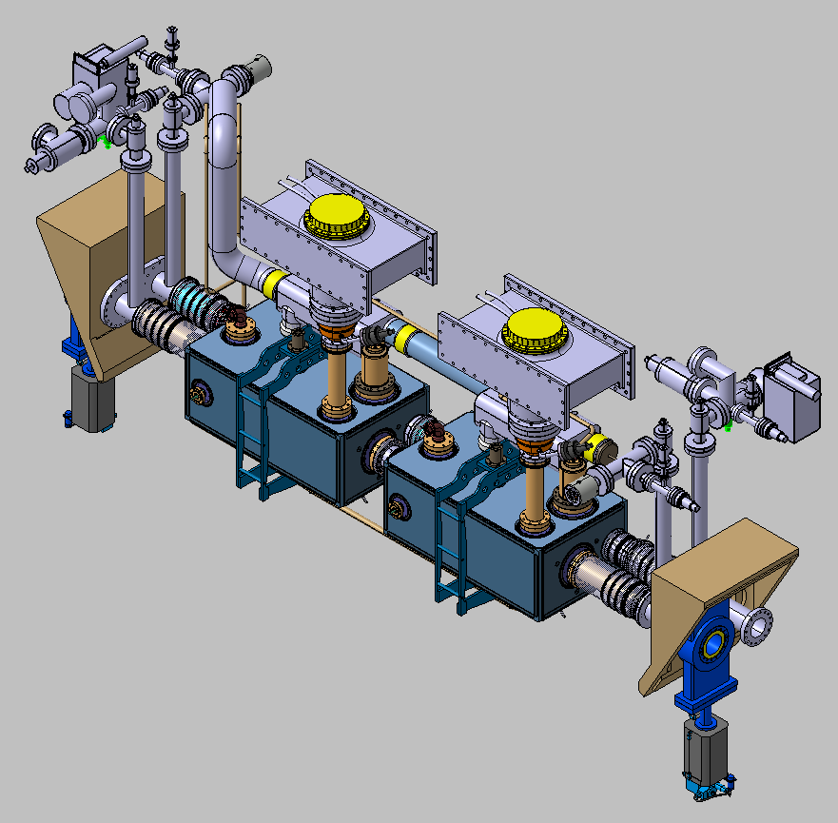





HL-LHC
Status on
RFD Cryomdule Development
Shrikant Pattalwar,
on behalf of Crab Cavity collaboration
7th HL-LHC meeting, 13-16 November, 2017, Madrid

Slide 2
Outline
UK ‘s Role in the project
Tasks and Status
Plans and Goals

Slide 3
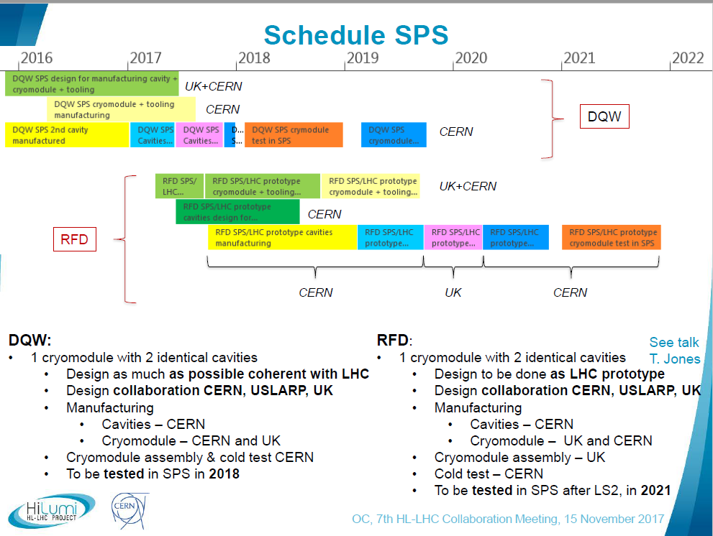

Slide 4
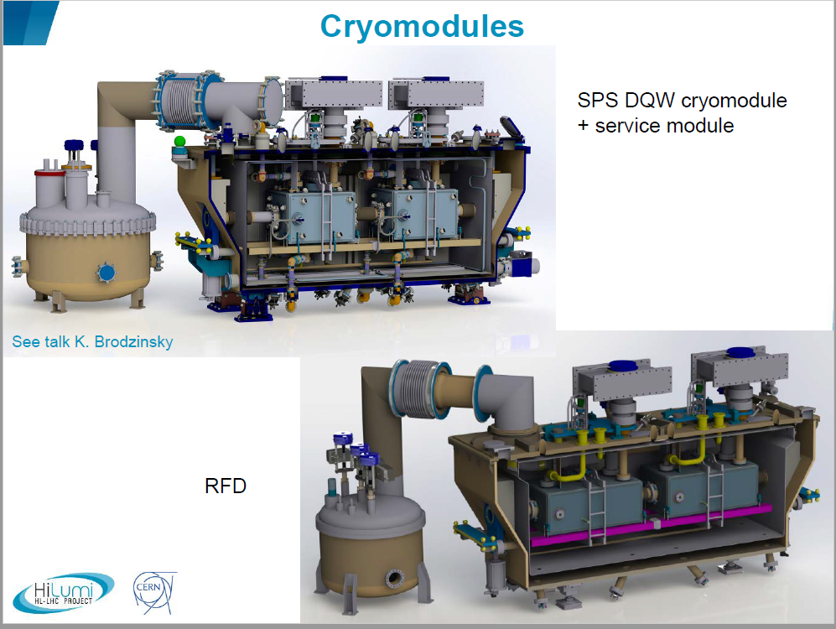

Slide 5
Additional Requirements
First draft of requirement was created in March 2017
DQW-CM will be used as a baseline reference
RFD-CM to be compatible with SPS and LHC
……..
Sector Valves
Vacuum Instrumentation to be a part of the Cryomodule
Two beam pipes, one with beam screen
………
5K – 20K cooling circuit for beam Screen cooling
PRVs to be moved from Service module to cryomdule
Specification for removable level probes
Vacuum barrier between service module and the cryomodule
……………..
RF requirements ( Couplers, tuners, etc…)
Lessons learnt from DQW-SPP-CM

Slide 6
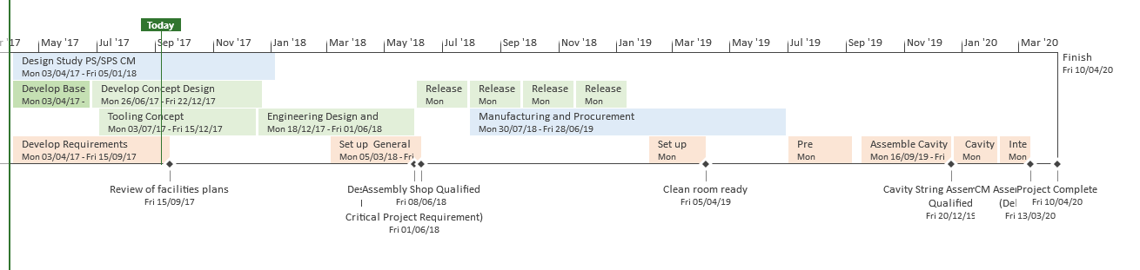
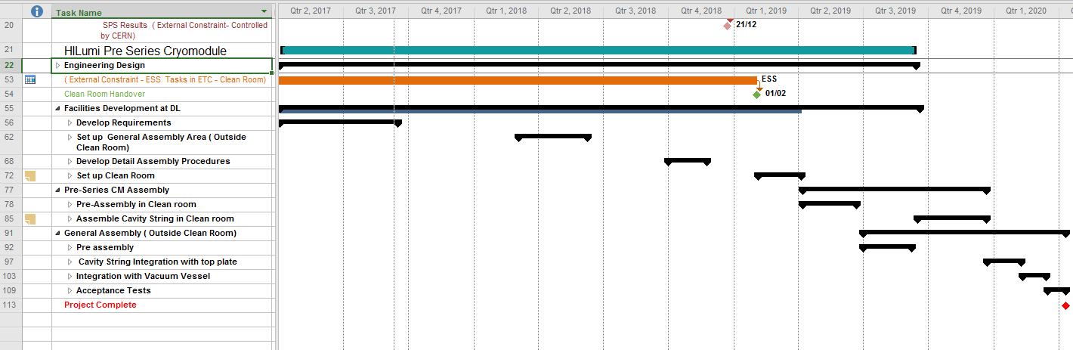
Project Plan
Plan, Targets and Milestone
Activities divided into 4 main Tasks
Release Drawings for Manufacturing
Y2
Y3
Y4
1
2
Design and manufacturing and testing of cavities, tuners, couplers etc. by CERN
3
4

Slide 7
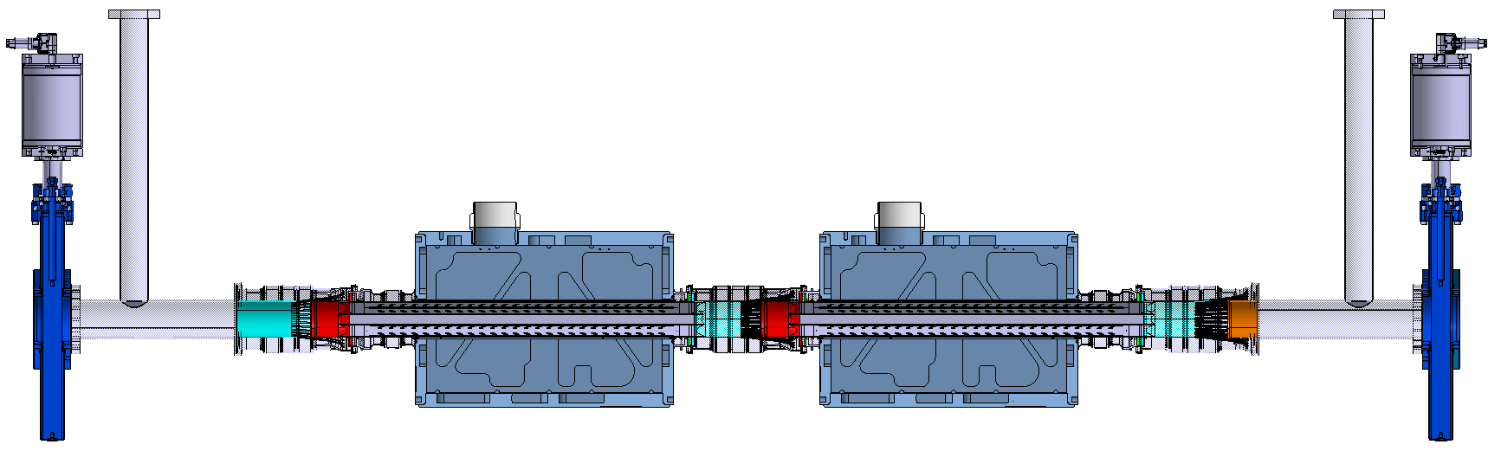
Cross section DQW Cryomodule
vacuum system in non-crab beamline
Crab beam line has the same configuration but without beam screen assembly. In consequence, its mechanical aperture is circular.
Cold warm transition
Cold warm transition
Beam screen
assembly
Beam screen
assembly
Vacuum
instrumentation
Plug-in
module
Cavities module
interconnection
Plug-in
module
Vacuum
instrumentation
Thermal shield
Cryomodule

Slide 8
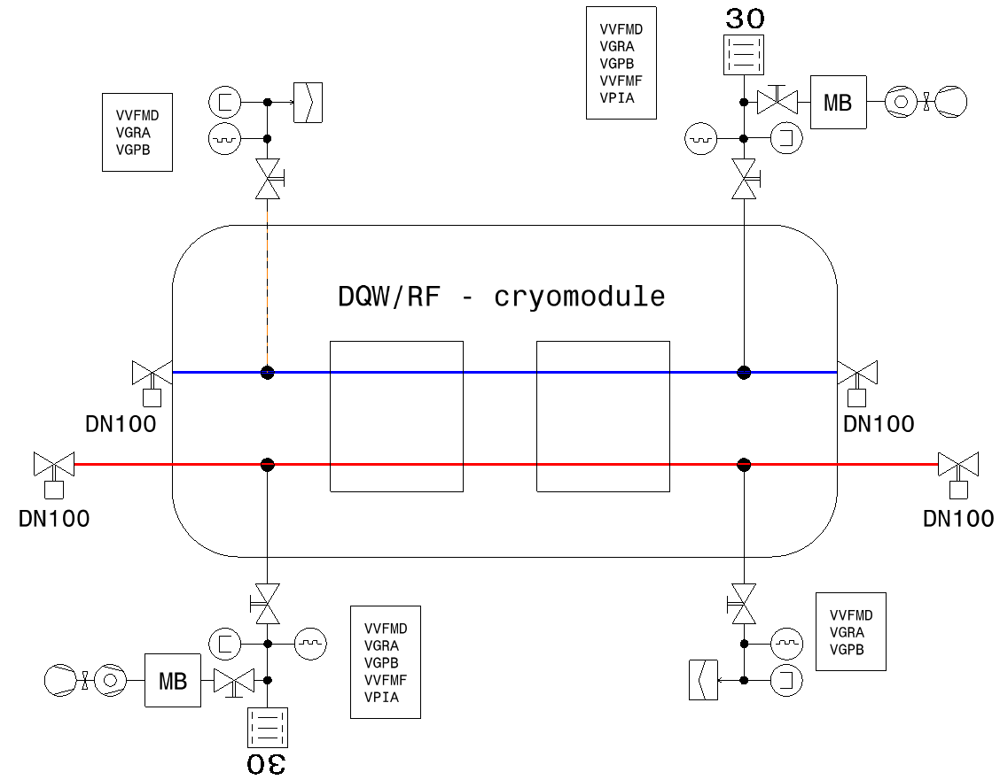
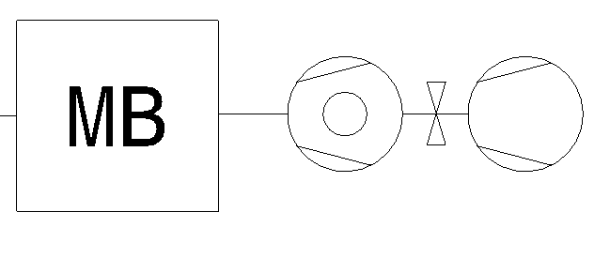
Vacuum requirement- Instrumentation Ports
The CC cryostat is equipped with 4 sector valves.
The 4 instrumentation ports are equipped with vacuum gauges and roughing valves for monitoring and maintenance of the cryomodule.
P. Santos Diaz
Blue: crabbed beam
Red: non-crabbed beam
Mobile pumping system

Slide 9
Vacuum requirement - Instrumentation Ports
The CC CM will be equipped with 2 sector valves on cavity beam pipe.
Other beam pipe ports will be flanged off and sector valves will be added later
CM will be equipped with Only 2 instrumentation ports ( inside) and the other 2 ports will move outside the CM after flange.
Blue: crabbed beam
Red: non-crabbed beam
Mobile pumping system

Slide 10
Cavity String (Preliminary Design)
Led by
Nik Templeton
Vacuum
Instrumentation to be moved here
Two Beam Pipes

Slide 11
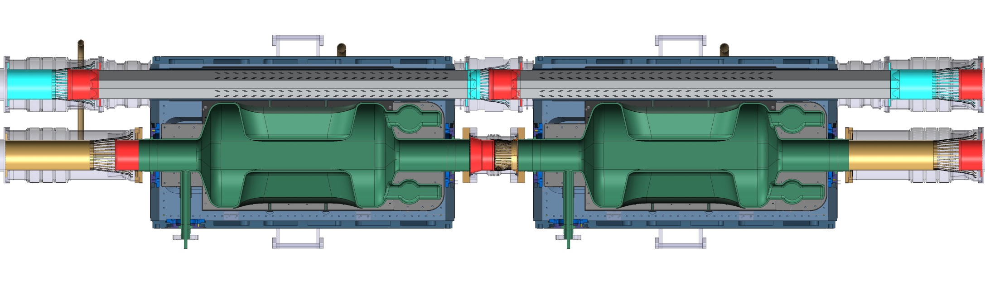
Cavity String length optimisation
Beam Screen
Stainless Steel - Cu & A-C coating
Plug-in Module
Beam Screen Interconnection
Sliding Beam Screen Connection
Cavity Warm Module (Shielded) Bellows
2653

Slide 12
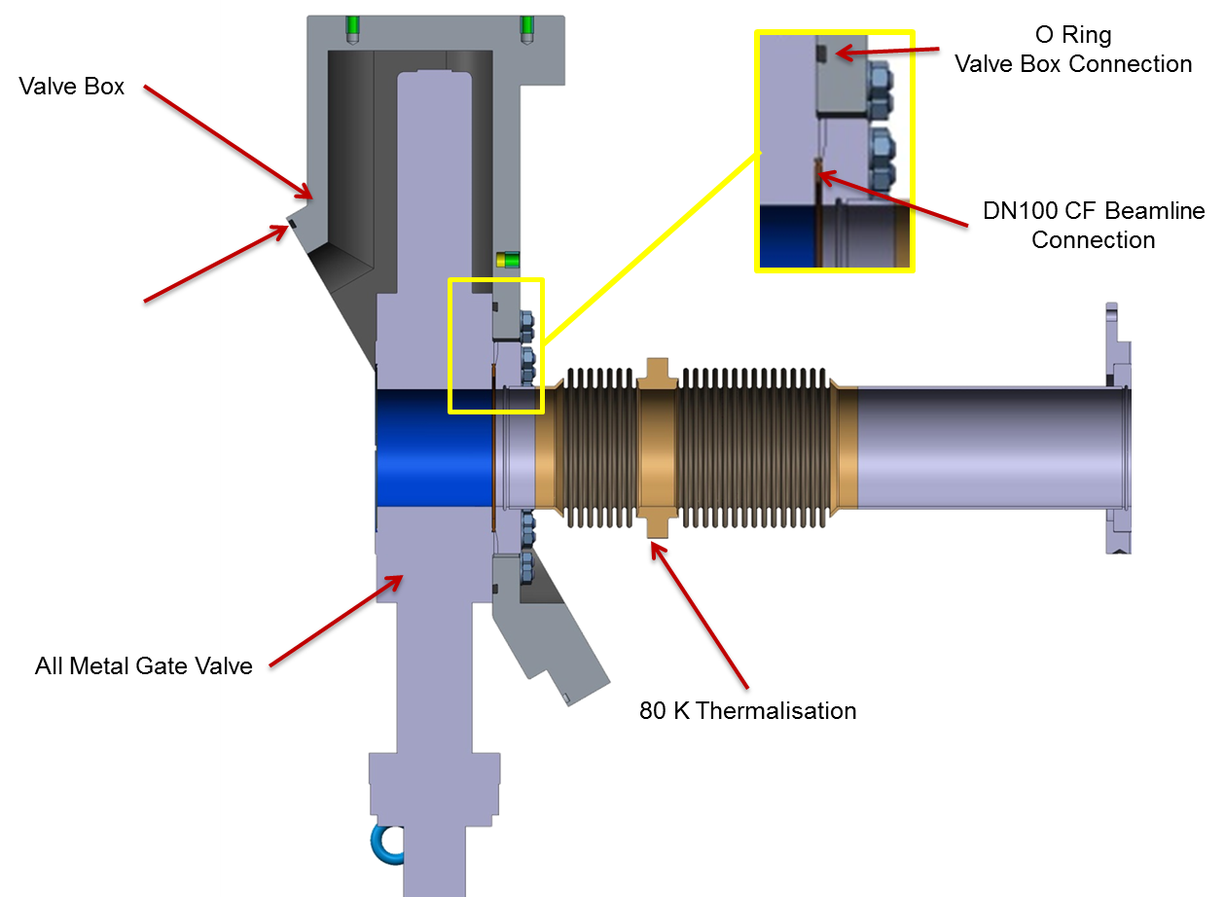
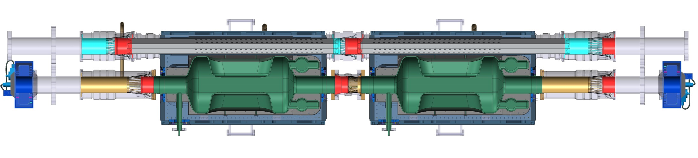
Cavity String length optimisation
Cold-Warm Transition
3334
Overall dimensions - to be optimised

Slide 13
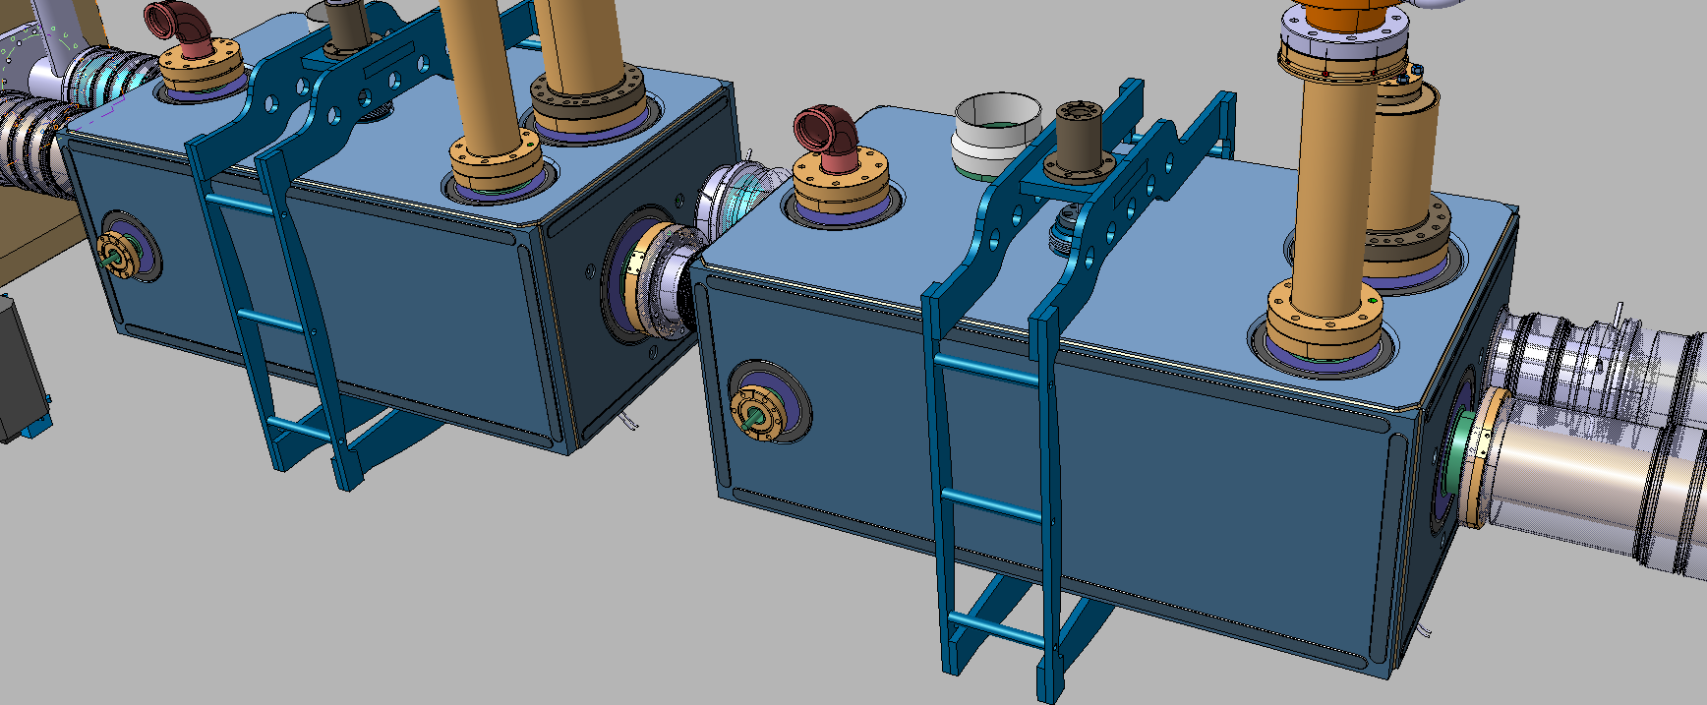
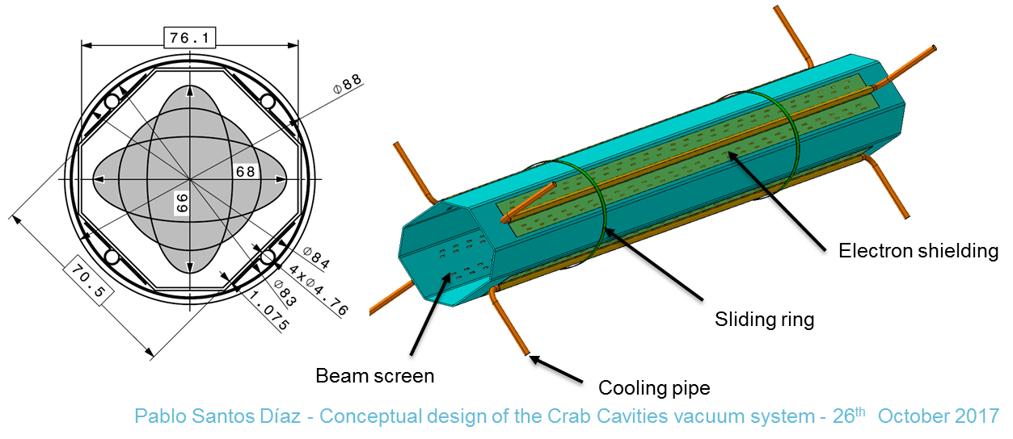
Active cooling for beam screen
Beam Screen Active Cooling

Slide 14
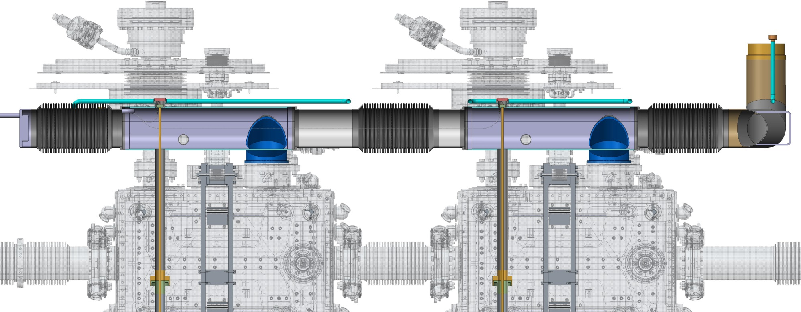
DQW-SPS HOM cooling
60
30
109
355
724
16 litres in reservoir
Nominal LHe Level: 724mm (1/2 Full)
Ensures 30mm above HOM Cooling

Slide 15
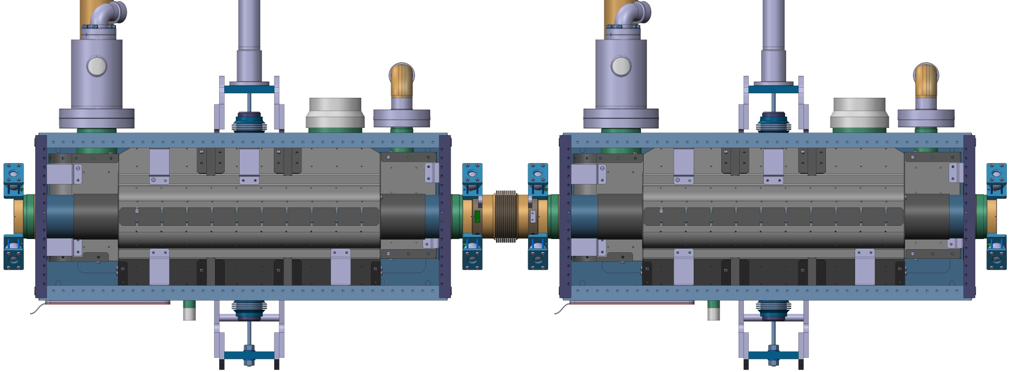
Parallel 2-Phase Line LHC (-1.24%) – Modified HOM Cooling
Alternative Option: Separate LHe Inlet & GHe Outlet lines for HOM cooling
~16 litres in reservoir
New HOM cryo-circuit ensures cooling

Slide 16
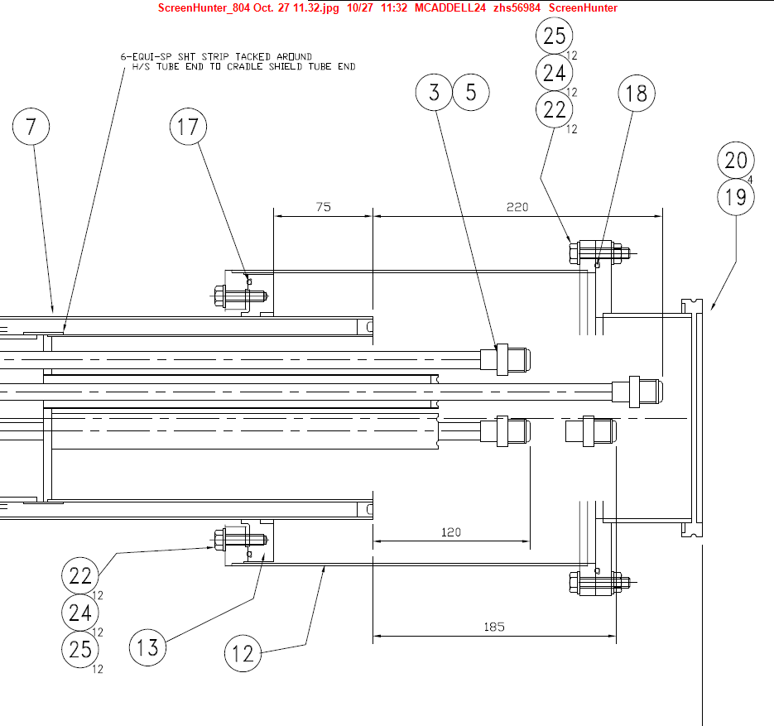
Vacuum barrier between
Cryo-Service Module and CM
Vacuum break
Thermal shield return gas used to thermalise vacuum break
Service module vacuum
Thermal shield Input gas
Cryomodule vacuum
5k in 10k out gas for intermediate HOM
Outer tubes provide long thermal path

Slide 17
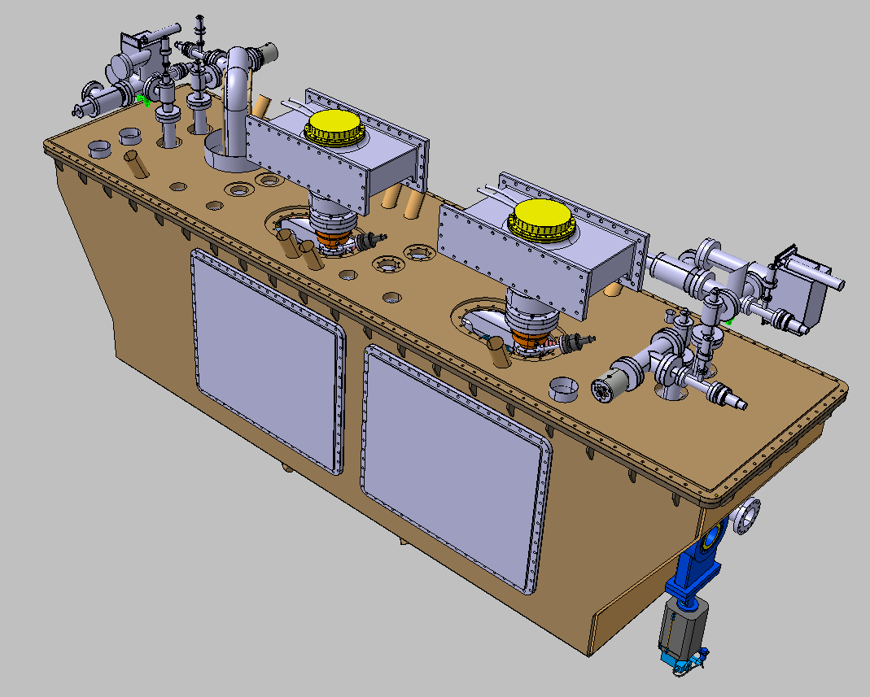
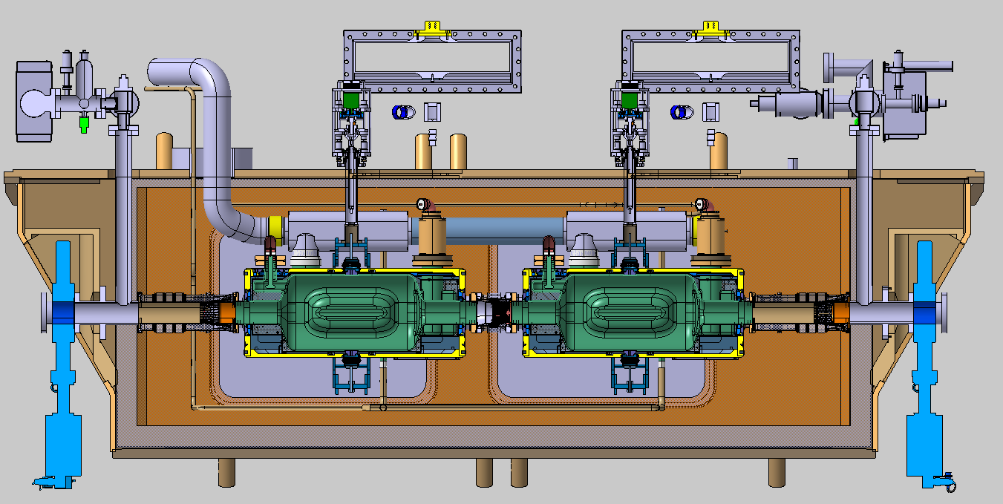
CM design (work in progress)
Nik Templeton

Slide 18
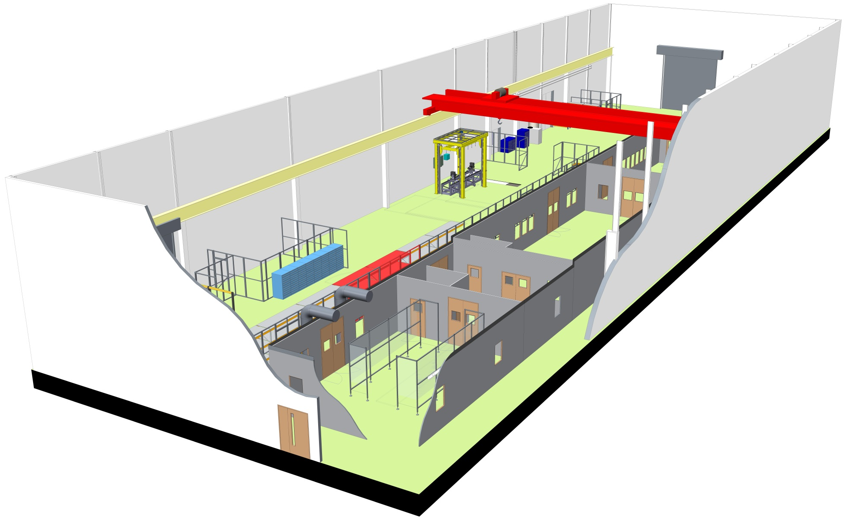
Engineering Technology Centre 3D Layout
Task 2 – Facility reconfiguration ( Ed Jordan)
CM Assembly
area
ISO – 4
Clean Room

Slide 19
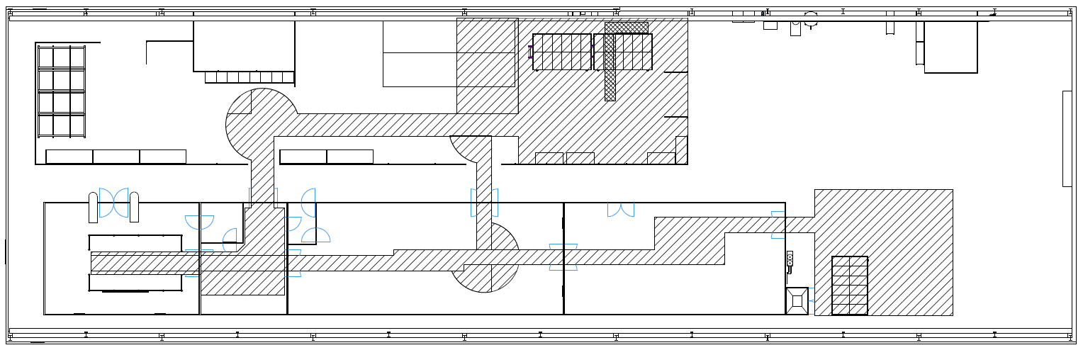
Cavity string travel route
Lifter Location
Cryomodule Integration (2019-20)
Jan-April Preparations
May-Dec Mock-up/ Qualify/Pre-assembly
Jan -March CM Integration
Large assembly area needed to store thermal shield, OVC, tooling etc.
Cleanroomm
Route B
Route A
Route C
Clean Room (2019)
Jan-April Preparations
May-Sept Mock-up/ Qualify
Oct-Dec String assembly

Slide 20
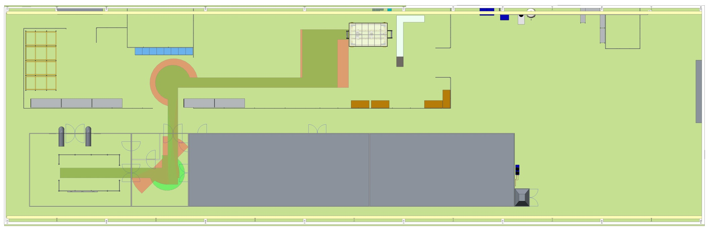
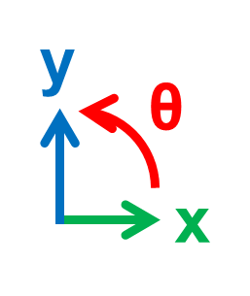
Cavity string travel route
Lifter Location 1
ASSEMBLY
ISO4
ISO5
Cleanroom
Path shown is to Lifter location 1 using route A – but considerations still apply to other routes and locations.

Slide 21
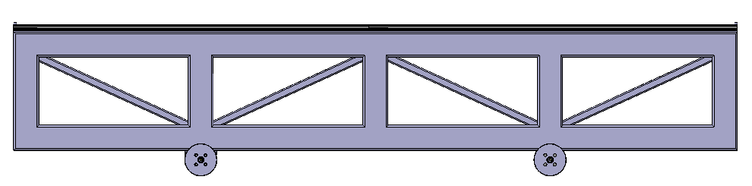
Cavity String Mobile (Trolley)
Cavity String Mobile 1
Cavity String Mobile 2
Assembly Interface required
4.6m
3.5m
1.1m + XX
Two Separate frames connected during clean room assembly – 1.1m frame detaches before transit.

Slide 22
Goals for 2018
Complete specification document - Feb 2018
Agree on the responsibilities for design, procurements and logistics - Feb 2018
Preliminary CM design (Internal design review) to facilitate procurement of long lead items - April 2018
Final CM design ( External design review) – June 2018
Launch development of assembly procedures and acceptance criteria - Jan 2018

Slide 23
Summary
Plans are in place to design and assemble RFD CM compatible with SPS and LHC.
Efforts will be shared between UK and CERN and CM will be assembled at STFC Daresbury Laboratory ( by March 2020)
At Daresbury the project activities are divided 4 tasks: ( technical lead by Tom Jones)
- CM design ( Nik Templeton)
- Facility Reconfiguration, tooling (Ed Jordan)
- Clean room assembly
- and final integration
Current focus is on developing preliminary design to meet the vacuum and Cryo requirements as well as on the design of the tooling
Goals have been set for 2018 and ……beyond

Slide 24
Thank you

Slide 25
Additional Slides

Slide 26
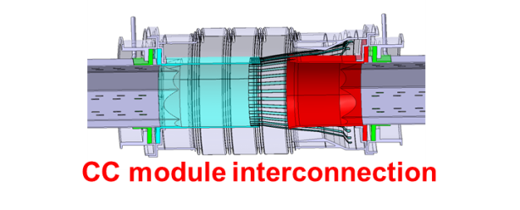
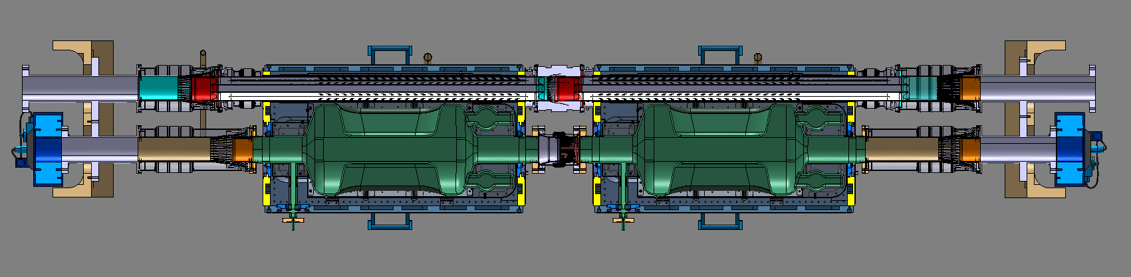
Cavity String - Sections

Slide 27
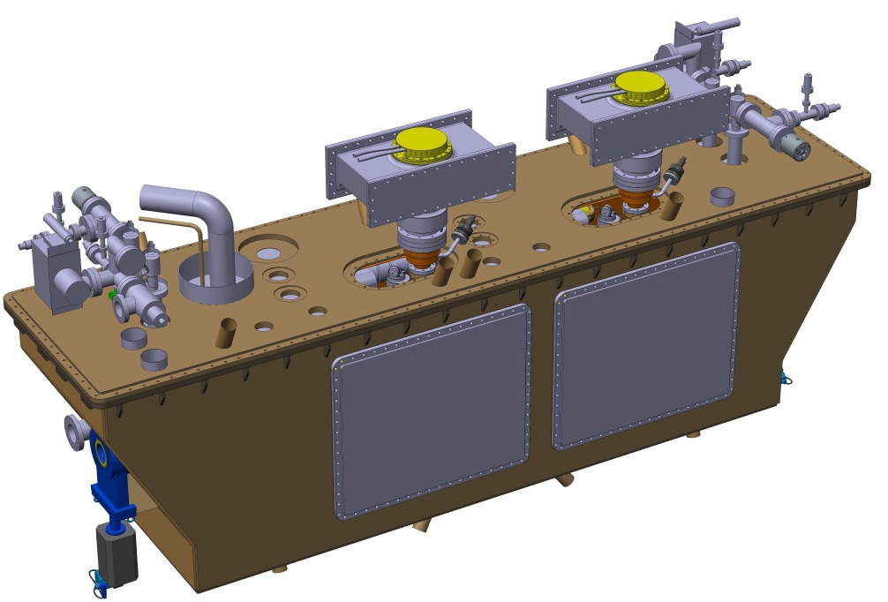
Cryomodule

Slide 28
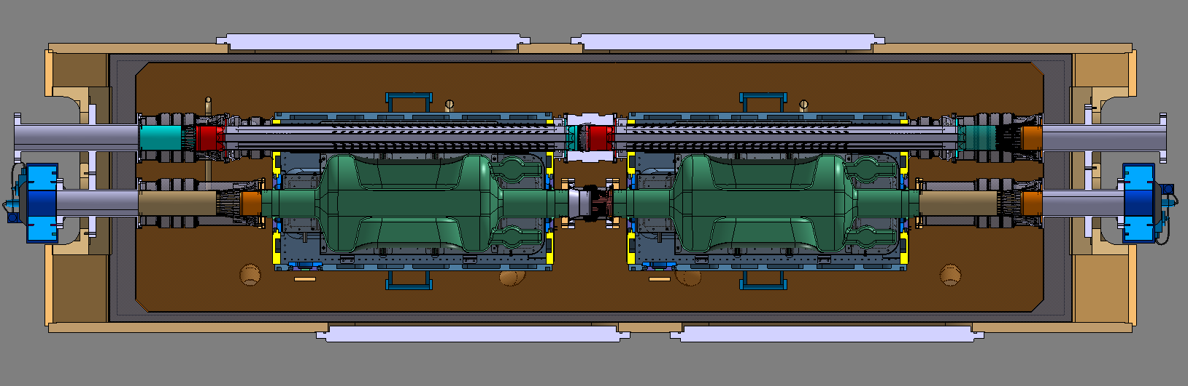

Slide 30
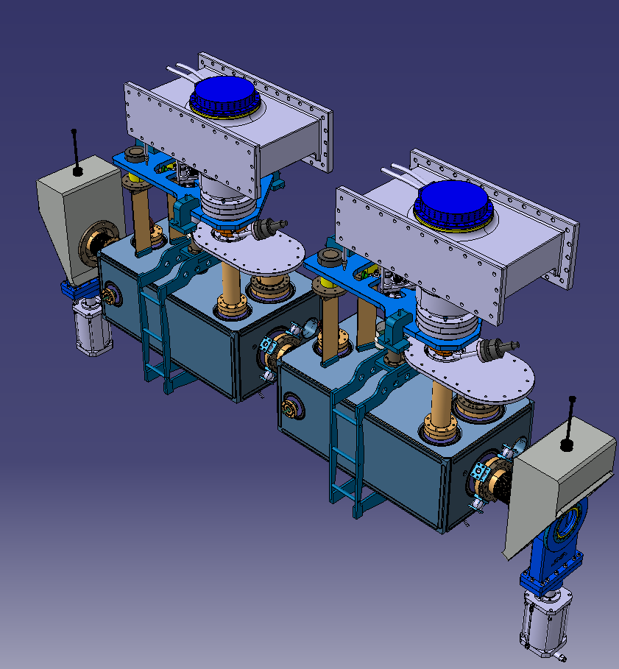

RFD LHC/SPS Prototype: Cavity String
Fixed:
FPC Distance - 1050 mm?
To Be Updated:
CWTs
Cryolines
Valves & Valve Box
Support & Alignment System
Top Plate Integration
New Conditions:
2nd Beamscreen
No BCAM
LHC Slope (1.24% ≈ 0.71°)
Internal Vacuum Instrumentation*
New Cryo Pressure Relief Valve
RFD SPS Concept Design

Slide 31
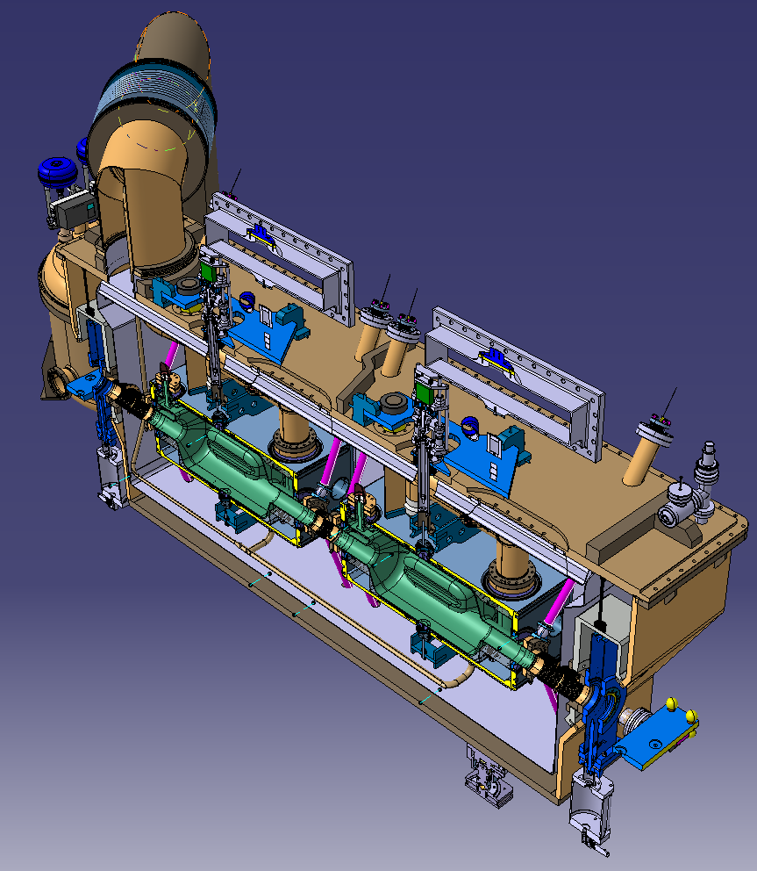
RFD LHC/SPS Prototype: Cryomodule
Fixed:
Trapezoidal / Top Loaded Configuration ?
To Be Updated:
Vacuum Vessel Design
Cryomodule Limits
Cryo-Service / Jumper
FSI
RF Lines
Thermal Shield & MLI
Warm Magnetic Shield
New Conditions:
No Gaskets / O Rings in LHC – Welded Vessel - No Windows
LHC Slope & Space Constraints
Split insulation vacuum
Level Gauge
RFD SPS Concept Design

Slide 32
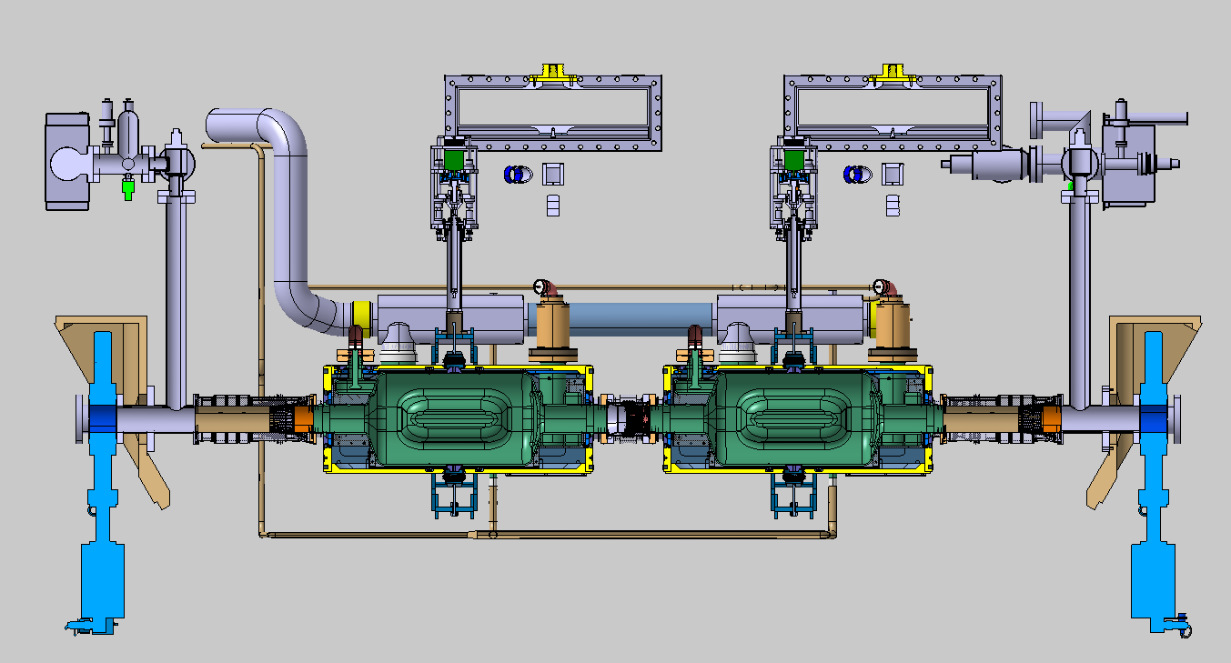
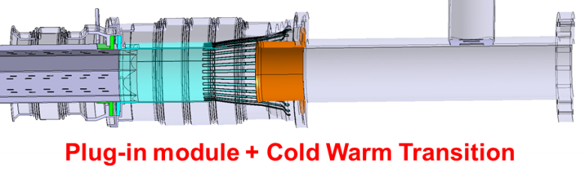

Slide 33
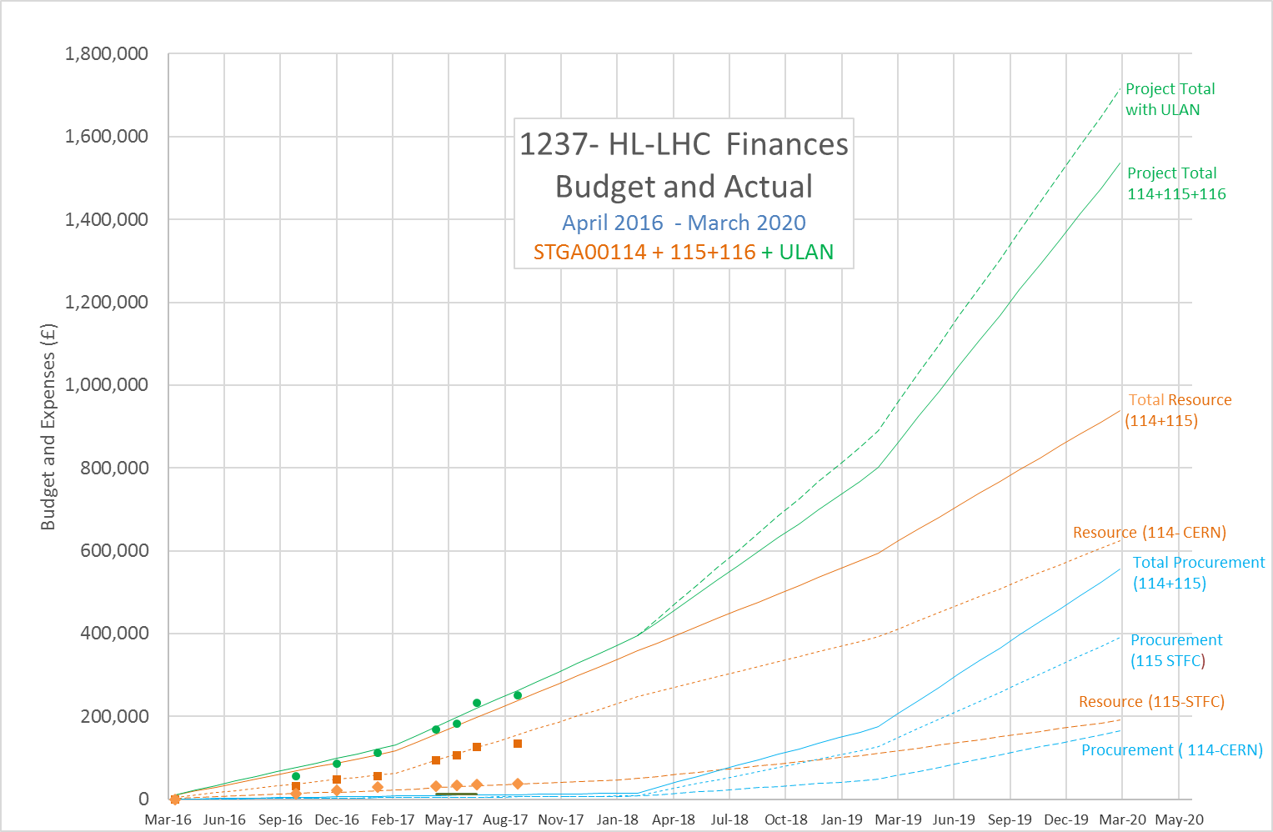
Progress To date - Finance
September 2017

Slide 34
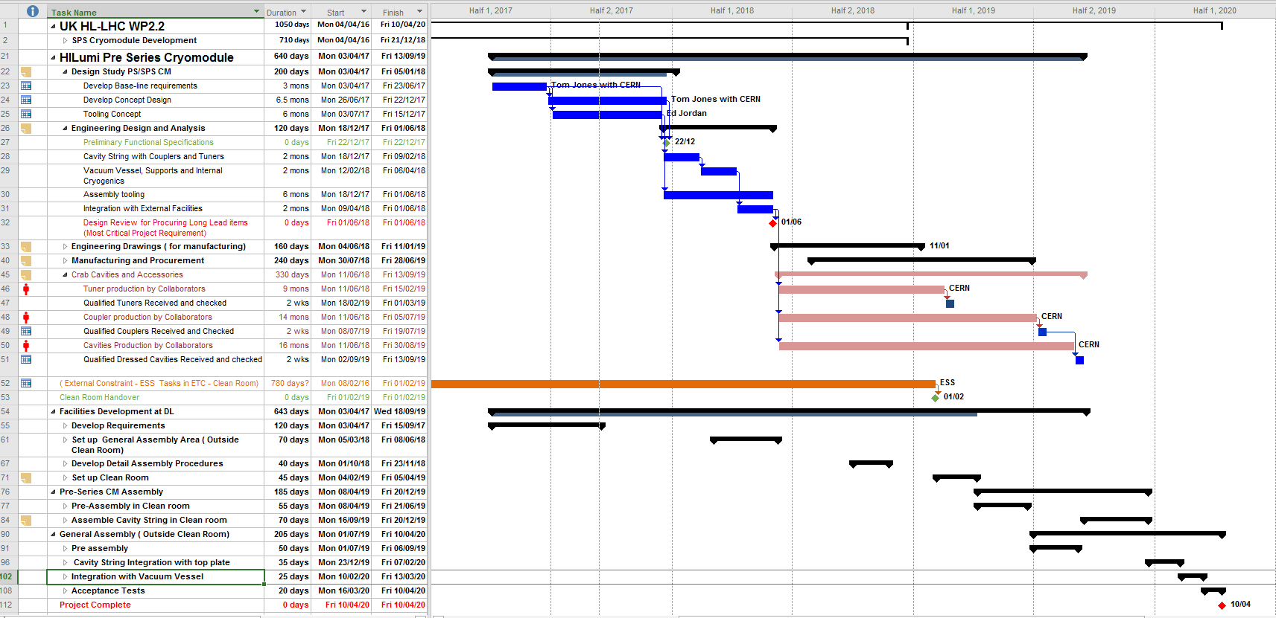

Slide 35
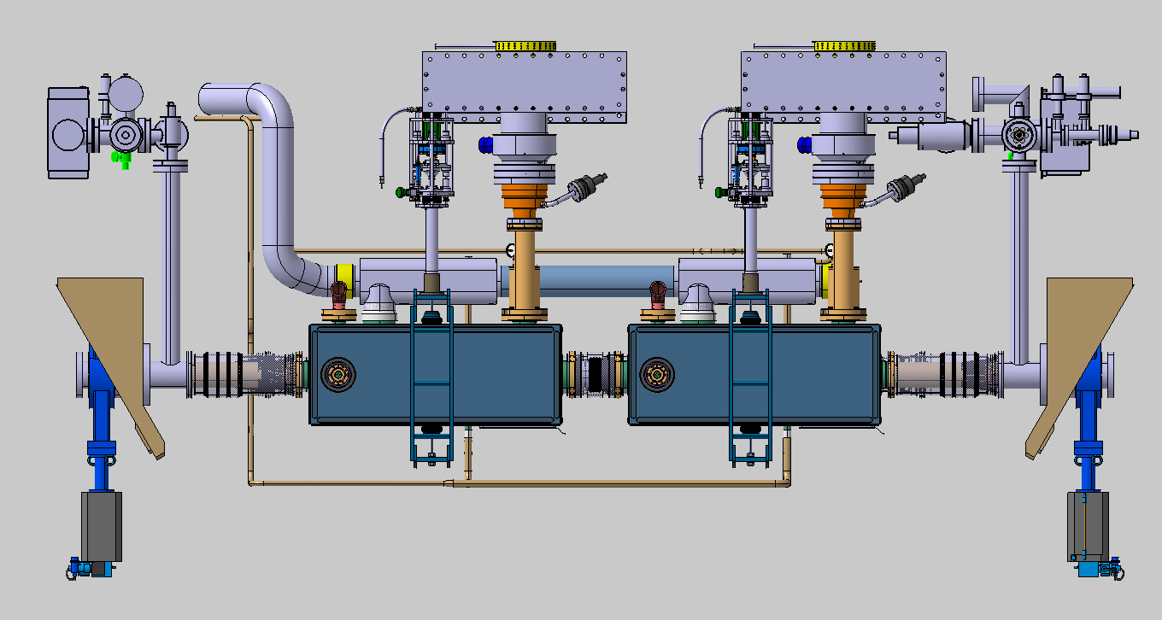
Vacuum Instrumentation

Slide 36
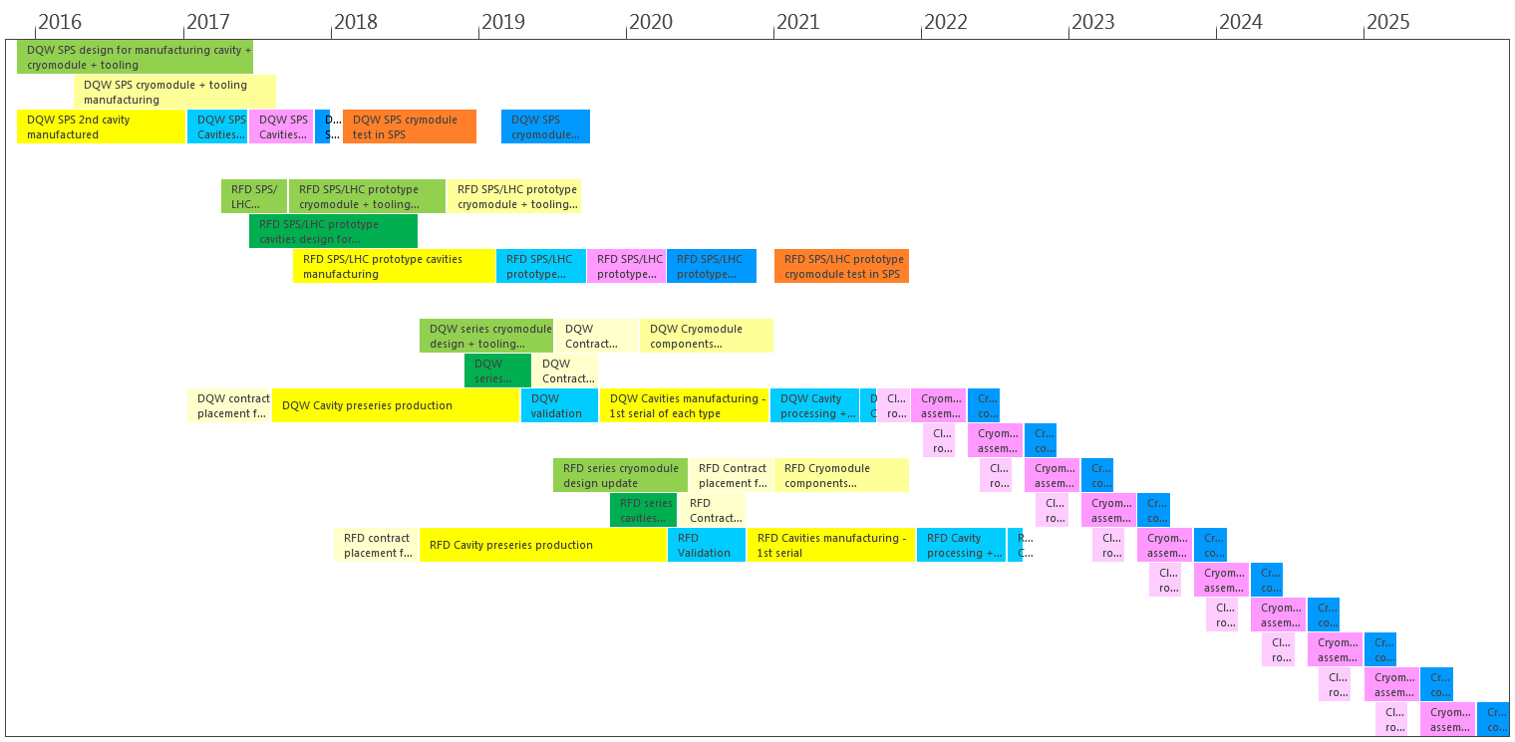
HL-LHC UK ( WP 2.2 Responsibilities)
LS2
Activities
Y1 Support CERN design and construction of SPS-CM1
Y2 to Y4 Design and deliver SPS⁺ CM2
STFC Deliverable
Support SPS-CM
Long Term Vision – to build and supply series cryomodule for HL-LHC
Courtesy: M. Garlaschè

Slide 37
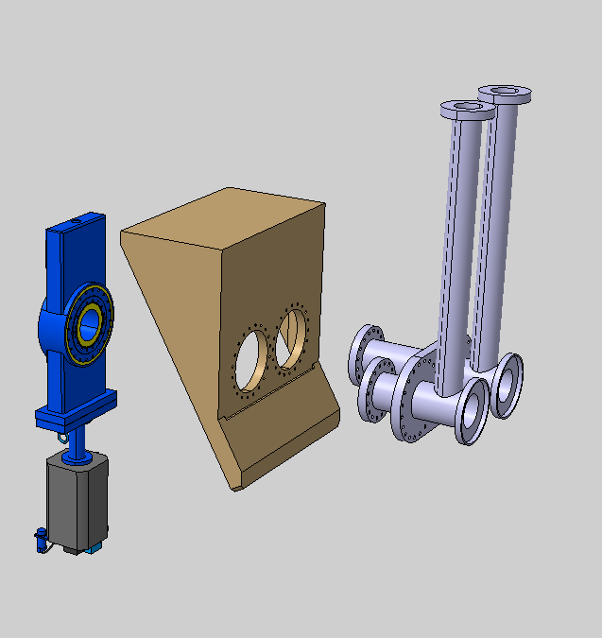
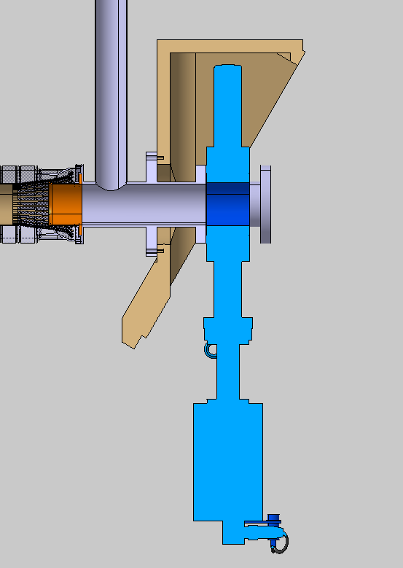
Vacuum Integration Proposal
DN63 Vacuum Instrumentation
Valve Box – Geometry TBD
DN100CF Beam Vac. Connection
All Metal Gate Valve
DN160CF Valve Box Connection
Welded OVC Interface (no O-Ring)

Slide 38
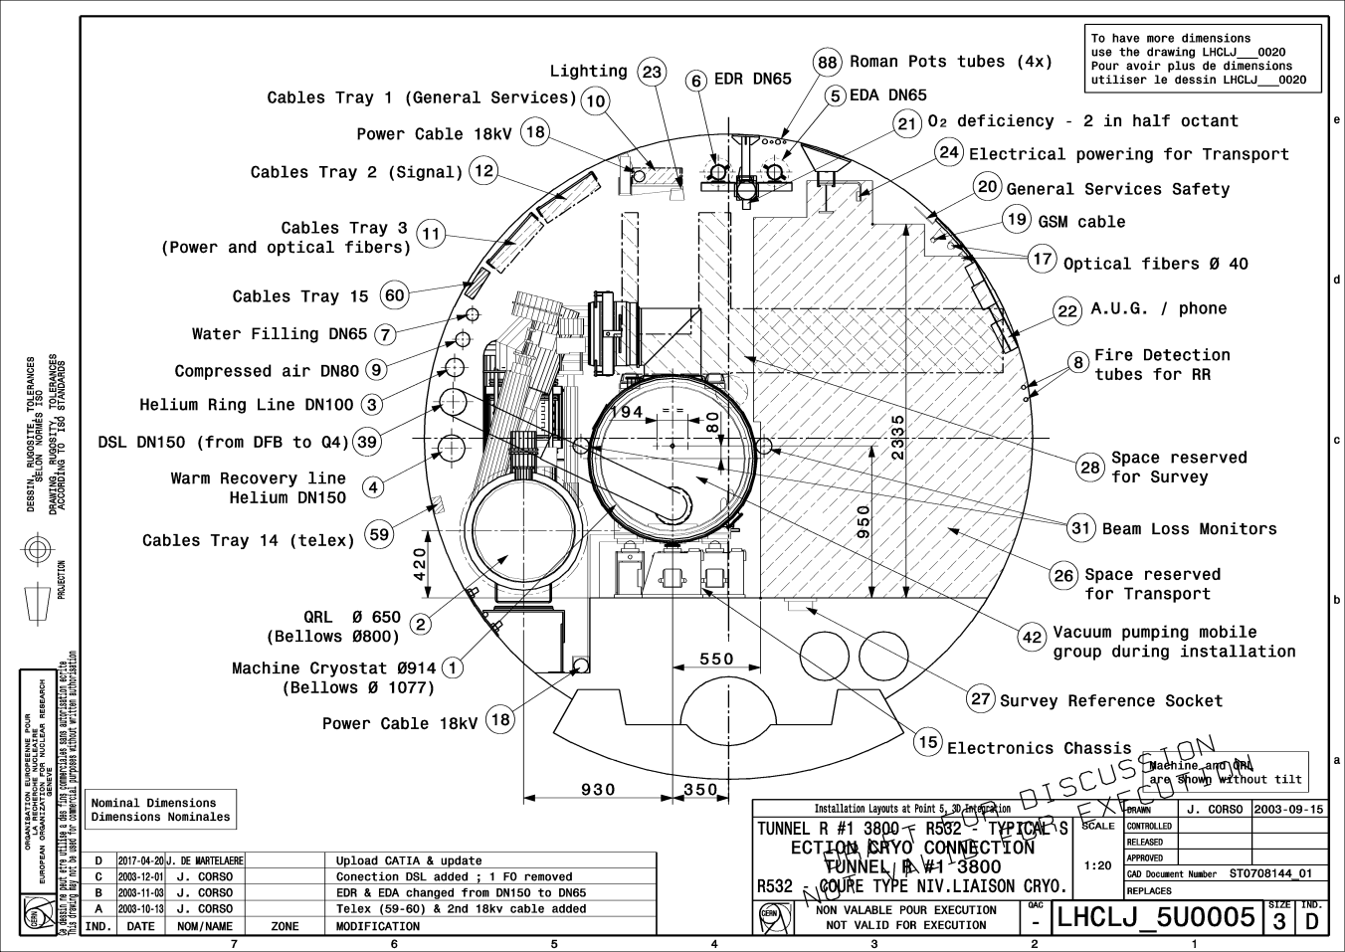
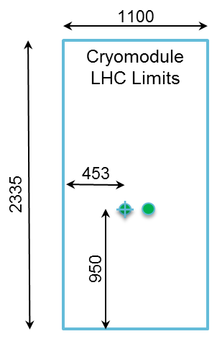
LHC Point 5
No Additional Constraints
Design for SPS
(+ 190 mm floor-beam height requires adjustment or additional frame)

