Slide 1


RFD Crab Cavity Contribution from the U.S.
Status, Needs and Plans
Leonardo Ristori – Crab Cavity L2 Manager, Fermilab
With input from: ANL, BNL, JLAB, ODU, SLAC
7th HL-LHC Collaboration Meeting – Madrid, Nov 13-16 2017

Slide 2
Outline
Scope and Deliverables
Schedule and deliveries to CERN
Upcoming Reviews in 2018
2018 Effort Distribution across the AUP teams
Cavity Design Issues and proposed solutions
Procurement of AUP Prototypes
RRR Niobium purchase and QC results

Slide 3
Scope and Deliverables
Dressed RFD Crab Cavity
  Assembly: Bare Cavity + Magnetic Shields + Helium Tank + RF Ancillaries
  Qualification at 2 K + Shipment to CERN
10 Dressed RFD Crab Cavities
  Qualified at FNAL (in VTS at 2K)
  Ready for integration in cryomodule (at CERN)
  (8) for tunnel installation (threshold KPP) – Need by: Summer-Fall 2023
  (2) additional at later time (objective KPP)

Slide 4
Scope and Deliverables
US-HiLumi-doc-39

Slide 5
Schedule
CY 2018-2019: RFD prototype cavities, dressed and tested (yellow)
CY 2020-2022: RFD production cavities, dressed and tested (blue)
  PO for Bare Cavities - March 2020
  PO for Helium Tanks - June 2021
  Qualification of dressed cavities - May-Dec 2022
  Deliveries to CERN - July-Dec 2022
Note: Niobium Procurement in FY2019 (next slide)

Slide 6
Reviews in 2018
CD-2/CD-3b Reviews (under US Responsibility):
  Specific Magnets:
    Design Criteria Apr ’18 Called by Project, external review Team
    Magnet FDR May ‘18 Called by Project, external review Team
    Cold Mass/CA PDR Jun ‘18 Called by Project, external review Team
  Specific Cavities
    FDR for Nb Material May ‘18 Called by Project, external review Team
    Sys. Int. Review Jun ‘18 Called by Project, external review Team
    PDR for Cavities Jun ‘18 Called by Project, external review Team
  Overall Reviews
    Director’s Review Aug-Sep ‘18 Called by FNAL Director
    DOE IPR Oct-Nov. ‘18 Called by DOE
    ESAAB Dec ‘18 or Jan ’19
CD-3 in FY20
  Full approval for CryoAssemblies and RFD Production
For production cavities we need approval for Niobium BEFORE CD-3. We will seek early approval at the time of CD-2

Slide 7
Final Design Review for Niobium – May 2018
Need to formalize agreement with CERN for LHC on:
  Material Tech. Specification (exists in EDMS, ok for LHC?)
  Material Thickness (functional DWG exists in EDMS, converge on revision for LHC)

Slide 8
Preliminary Design Review in June 2018
AUP Effort of next 6mo will feed into the Preliminary Design Report document.
  New RF design of cavity to address 760MHz HOM by SLAC
  New Mechanical design to satisfy functional requirements by Fermilab
  Broad set of warm RF measurements on LARP cavity to demonstrate understanding of tolerances, multipoles, and response to elastic + plastic tuning by ODU
  Construction of HOM dampers at JLab
  Rotational BCP at ANL
  Cold tests of cavity + HOM dampers at Fermilab
  And much more…........
First agreement on:
  Interfaces of dressed cavity (first draft of functional drawing would be sufficient)
  Acceptance Criteria for dressed cavity
  MIP, weld qualification, MTF strategy

Slide 9
FY18 Effort from other Labs
(SOWs being finalized)
BNL | ODU | SLAC
Interfaces in SM18, SPS and LHC | Warm measurements of electromagnetic and mechanical properties of the RFD cavity | Produce a RFD cavity design addressing the 760 MHz HOM issue
Lessons learned from DQW production | Elastic and plastic tuning sensitivity, including behavior of fundamental and higher-order modes | Calculate the full HOM impedance spectrum up to 2 GHz
Preliminary MIP for RFD pre-series production | Warm measurement of the electromagnetic properties of the HOM couplers | Design HOM coupler RF windows (feed through)
 | Oversee Design of dressed cavity (bare cavity, magnetic shields and helium tank) | Analyze cavity and coupler tolerance for engineering design;
Contribute the relevant sections of the Preliminary Design Report | Contribute the relevant sections of the Preliminary Design Report | Contribute the relevant sections of the Preliminary Design Report

Slide 10
Cavity Design – Open Issues
Shift of ~760MHz Higher Order Mode
  Solution presented by Zenghai Li (this collab. Meeting) also available at US-HiLumi-doc-722-v2
Concerns on soundness of tuner interface
  Solution presented by Mattia Parise
Ensure key functional parameters meet FRS with some margin
  Sensitivity to Lhe pressure variations
  Amplitude of detuning due to Lorenz forces
  Elastic tuning range at 2K
The good news:
  Same scheme of 4mm material thickness for the cavity
  The deflecting poles can be left untouched

Slide 11
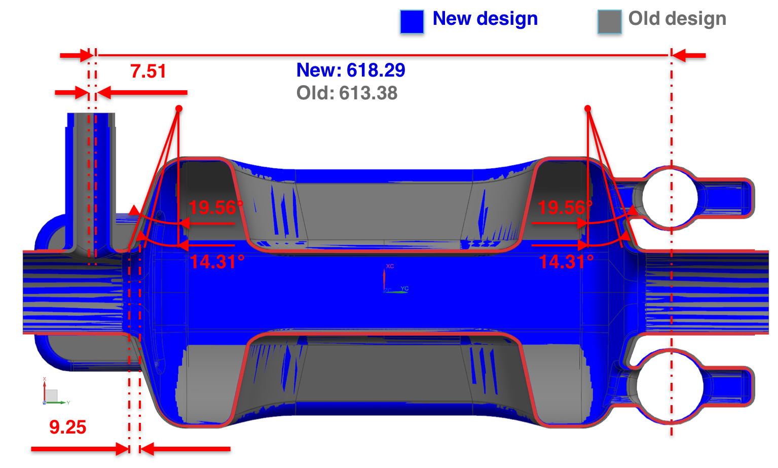
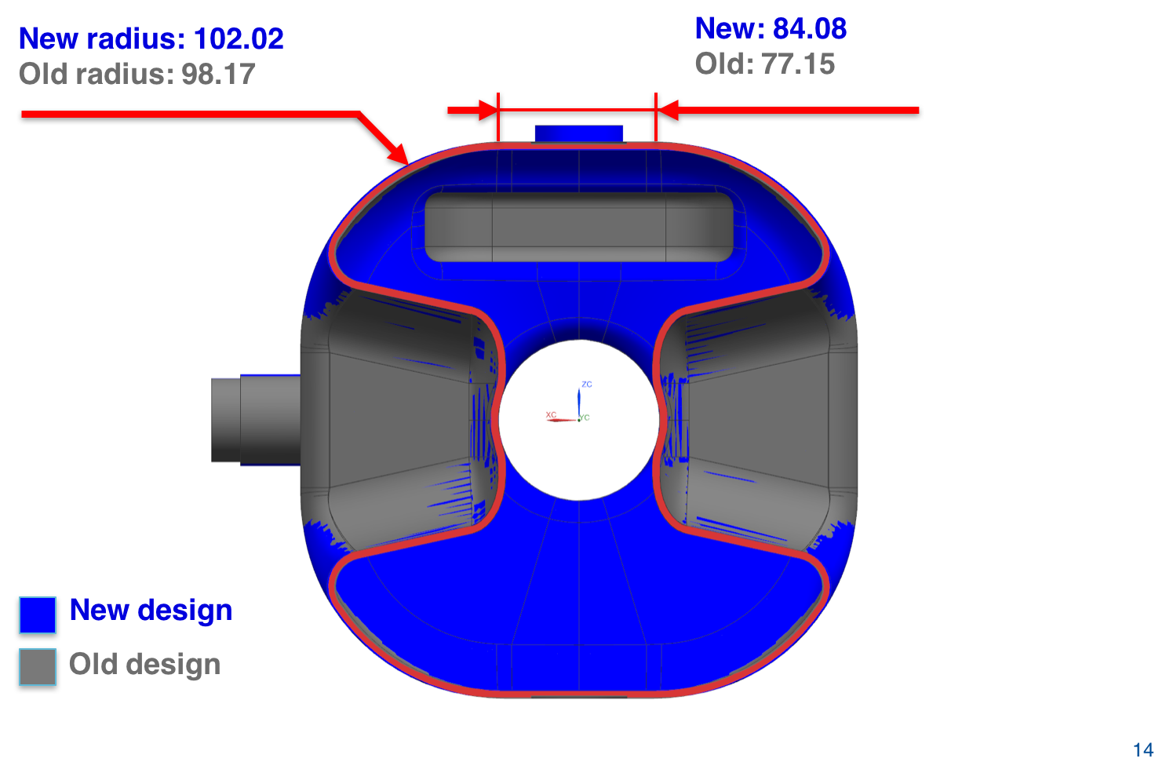
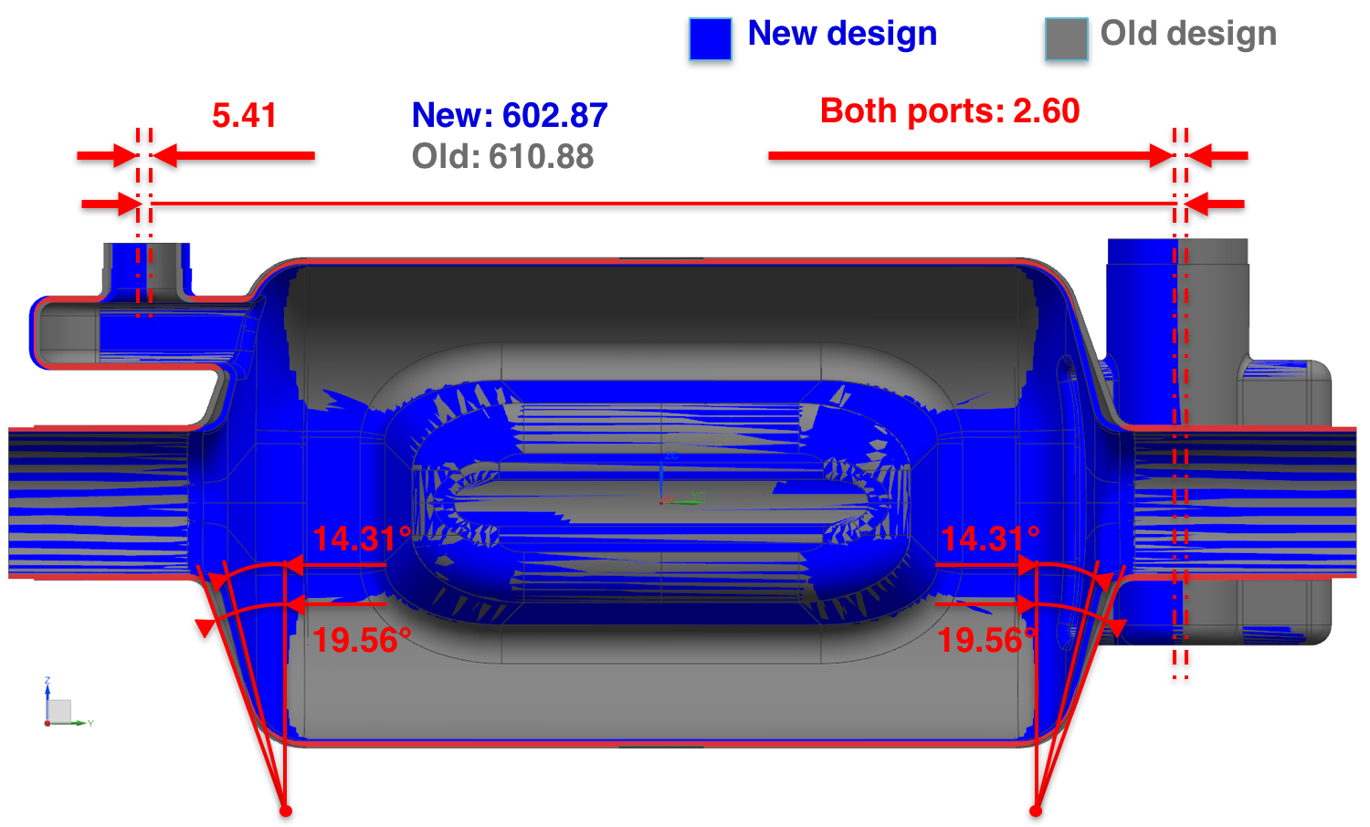
Lowering 760 MHz HOM

Slide 12
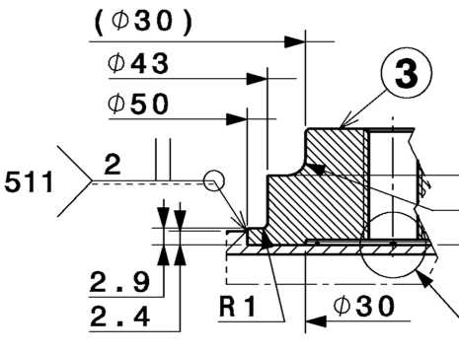
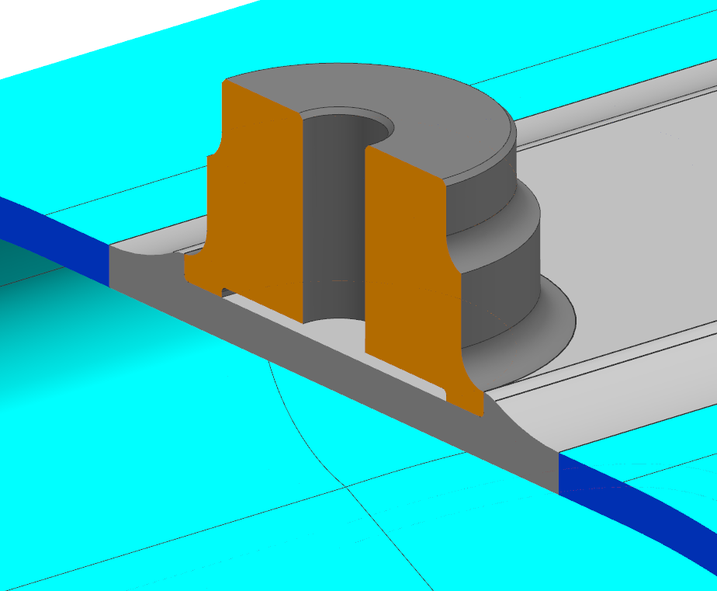
Updates on the tuner flange interface
Use of thicker material to distribute stresses and tuning forces.
Large radius (19 mm) reduces stress concentration
More material under the interface (original design was 1.6 mm)
Shape optimized to allow EBW from both sides for a 4mm thick weld
R = 19 mm
6.35 mm
4 mm

Slide 13
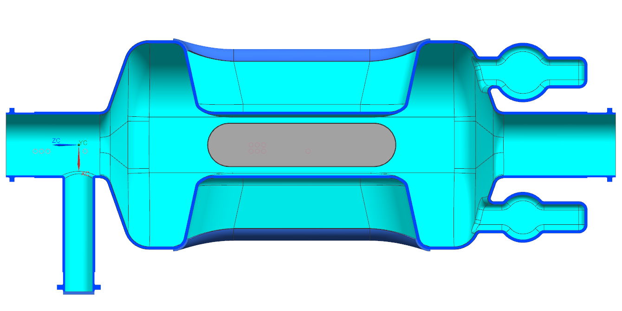
Proposed design of tuning interface
260 mm
8 mm

Slide 14
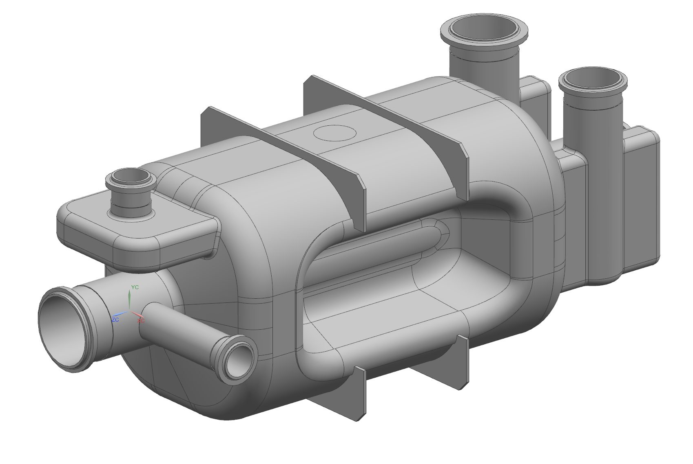
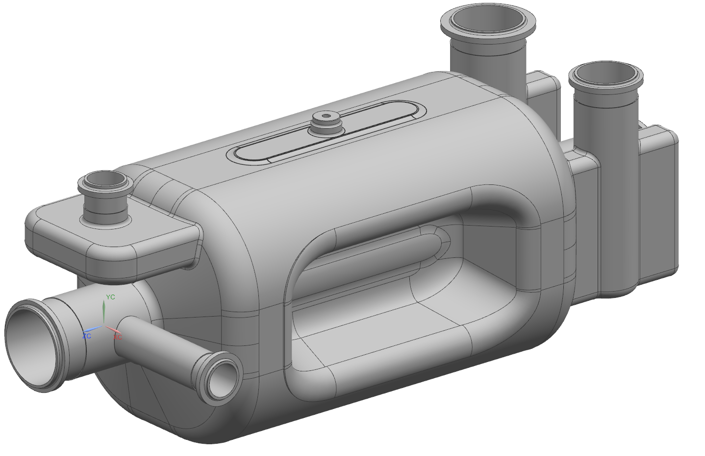
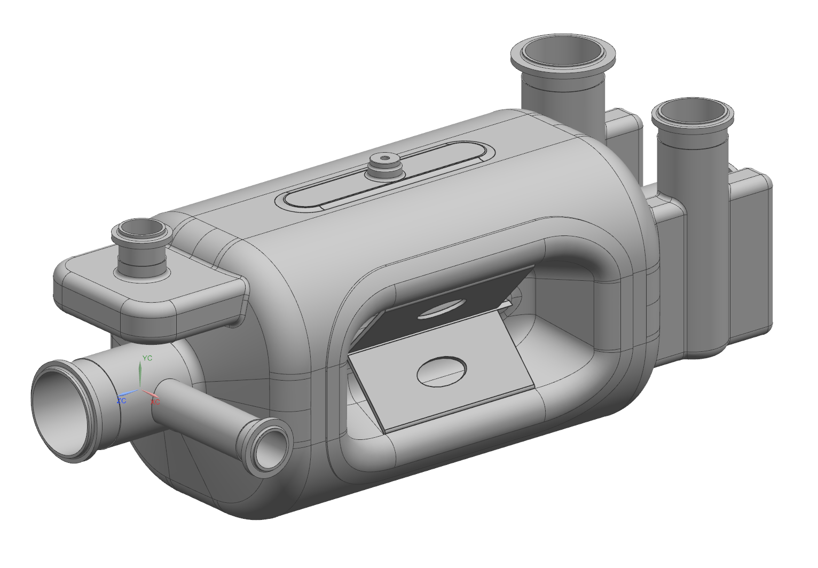
Evolution of Mechanical Design
1
2
3
GOAL: Guarantee satisfying functional specifications
1.8 bar pressure, df/dP, LFD
LARP prototype design
Removed Ribs + Racetrack
Racetrack and electric ribs + wider stiffeners at pole base

Slide 15
Linearized Stresses for 1.8bar – Free Tuner
Area | Pm [MPa] | Pm+Pb [MPa] | Allowable (Pm+Pb) [MPa]
1 | 8.4 | 46 | 75
2 | 30.4 | 56.7 | 75
Area | Pm [MPa] | Pm+Pb [MPa] | Allowable (Pm+Pb) [MPa]
1/2 | 9.8 | 67 | 75
Area | Pm [MPa] | Pm+Pb [MPa] | Allowable (Pm+Pb) [MPa]
1/2 | 10.2 | 68 | 75
3 | 28 | 56 | 75

Slide 16
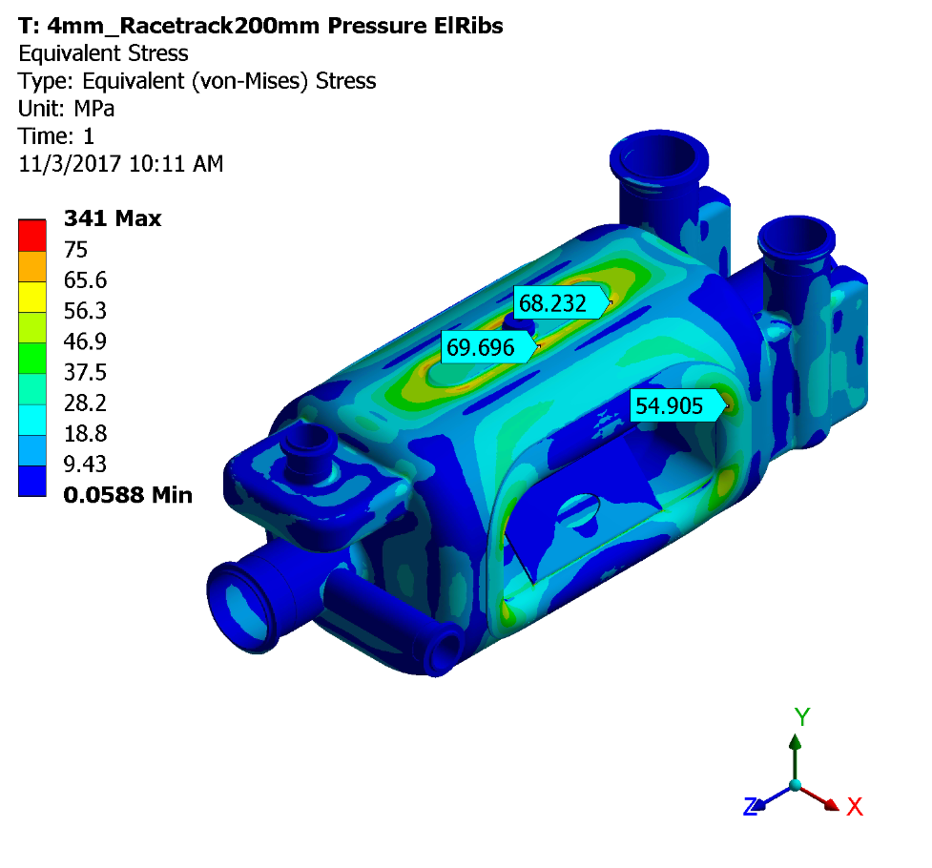
Racetrack + Electric ribs: Tuner flange free
2
1
3

Slide 17
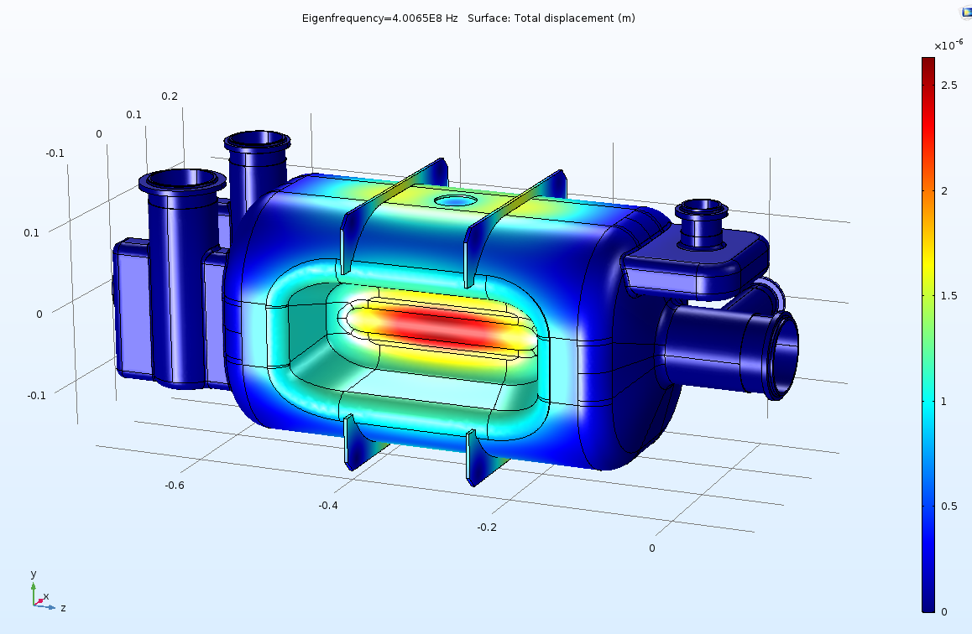
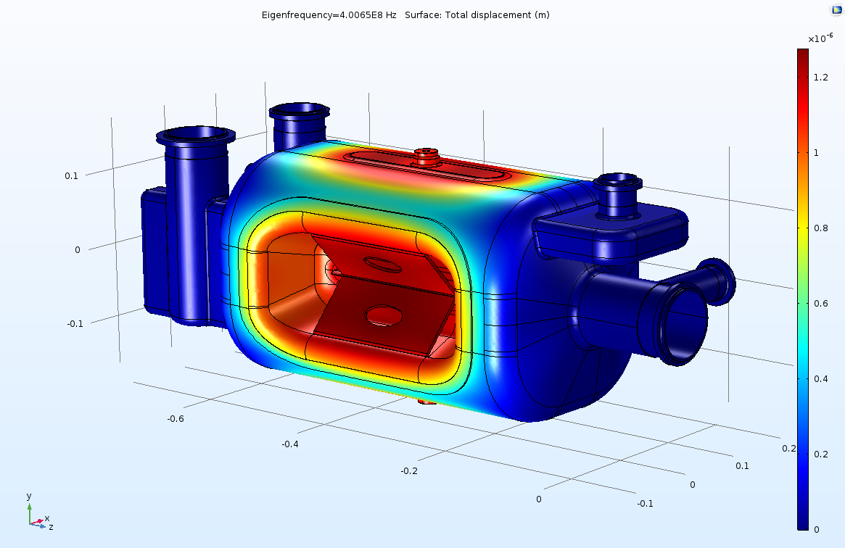
LFD study
Previous design
Updated design
Max displ.=2.5 microns
Max displ.=1.25 microns
Lorentz force Detuning WITH TUNER 6.8 kN/mm
Case | F0 @ 0 MV | F1 @3.4 MV | dF=F1-F0 [kHz] | LFD @ 3.4 MV [Hz/MV^2 ]
Updated Mechanical Design | 4.01E+08 | 4.01E+08 | -5.31E+00 | -4.47E+02
Previous Mechanical design | 4.01E+08 | 4.01E+08 | -7.17E+00 | -6.02E+02

Slide 18
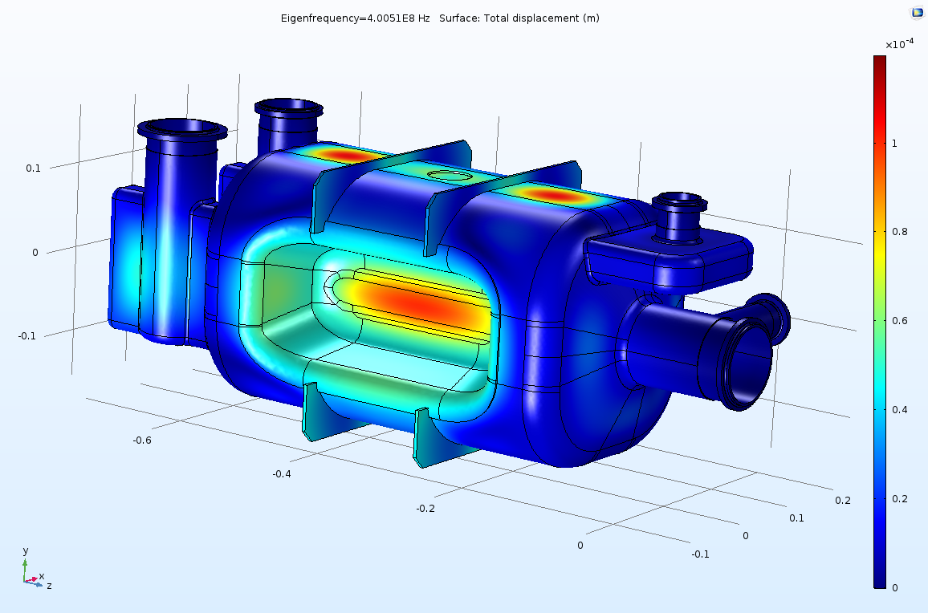
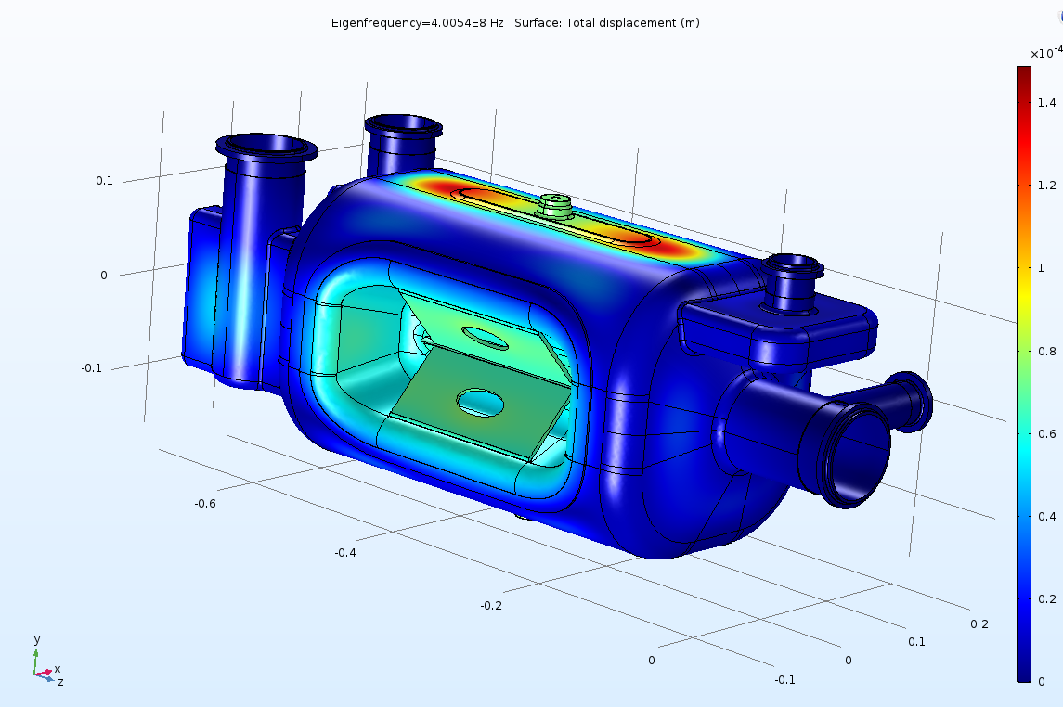
dF/dP study
Previous design
Updated design
Max displ.= 120 microns
Max displ.=150 microns
dF/dP WITH TUNER 6.8 kN/mm
Case | F0 @ 0 Bar | F1 @1 Bar | dF=F1-F0 [kHz] | dF/dP [Hz/mbar]
Updated Mechanical Design | 4.01E+08 | 4.01E+08 | -1.12E+02 | -1.12E+02
Previous Mechanical design | 4.01E+08 | 4.01E+08 | -1.47E+02 | -1.47E+02

Slide 19
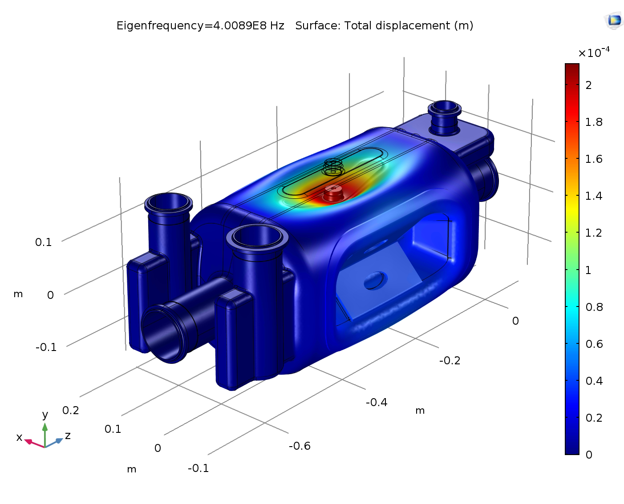
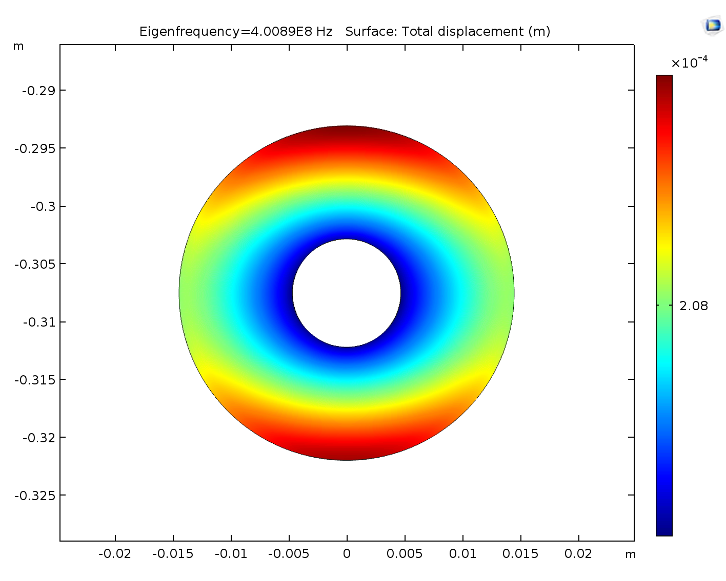




Frequency shift and displacement
Displacement of the
top flange along Y: $δ_{y}$
$$δ_{y}=0.208 mm$$
Force at each side applied along Y on each tuner flange:
$$F=1500 N$$
$$Δf =2.33∙ {10}^{2} kHz$$
Frequency shift due to tuning force:

Slide 20
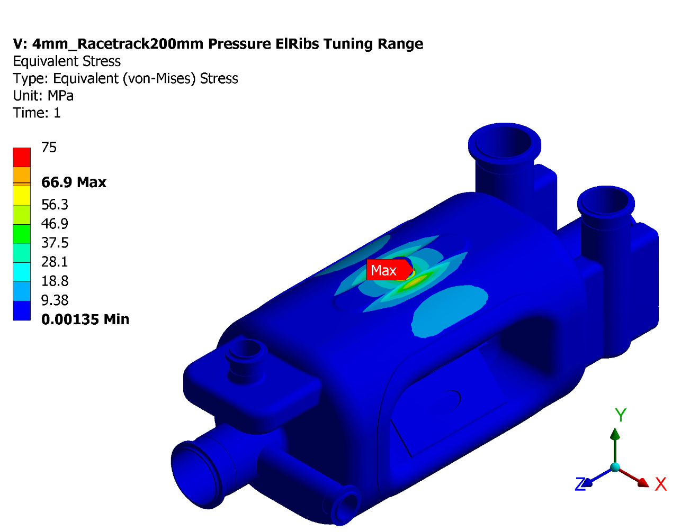
Peak stress
1
Area | Pm [MPa] | Pm+Pb [MPa] | Allowable (Pm+Pb) [MPa]
1 | 9.8 | 40.7 | 75

Slide 21
Procurement of AUP Prototypes
Main goal of prototypes is to lead the path for production in 2020-2021
Procurement will be set up as 2 + option of 12 units to ensure continuity at the same supplier
Bare cavity and Helium Tanks not necessarily at same supplier
Heavy Oversight of AUP representatives
Award will be based on ”best value” to include a technical score
Material provided to cavity supplier:
  RRR niobium sheets
  Nb-Ti discs
  Nb-SST brazed joints
Minimum set of documents necessary for launching prototypes:
  Functional drawing of bare cavity (exists for LARP cavity, exists for CERN DQW call for tender)
  Engineering specification (exists from CERN DQW call for tender)
  Example of MIP (exists for CERN DQW)

Slide 22
Challenges of Prototype Fabrication
Interactions AUP-Industry and AUP-CERN to compile all necessary QA/QC documentation
Qualification of all weld joints according to CERN requirements
Definition of best plan for Radiographic inspection of welds in Industry
  Likely to be outsourced to independent body
  Favorable to minimize number of setups and shipments
  Possible to explore digital imaging, allowing inspection of multiple welds with same setup

Slide 23
RRR Nb for AUP Prototypes
Received RRR Nb for 2x RFD prototypes
  3.15mm Sheets
  6.35mm Sheets
  Rods
  Tubes
  (+ NbTi Discs)
Visual & Dimensional Inspections, Including water-soak completed and documented: OK
Ultrasonic Inspection for sheets completed: OK
  do we need UT on rods/tubes?
Traceability is given highest importance
First opportunity to use CERN MTF system

Slide 24
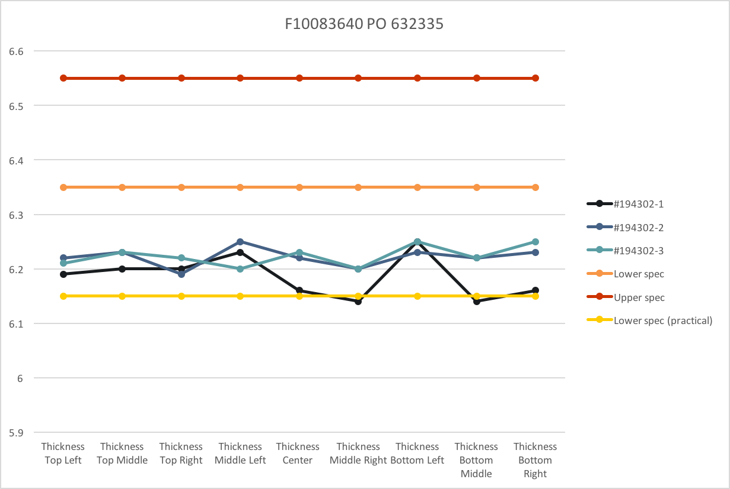
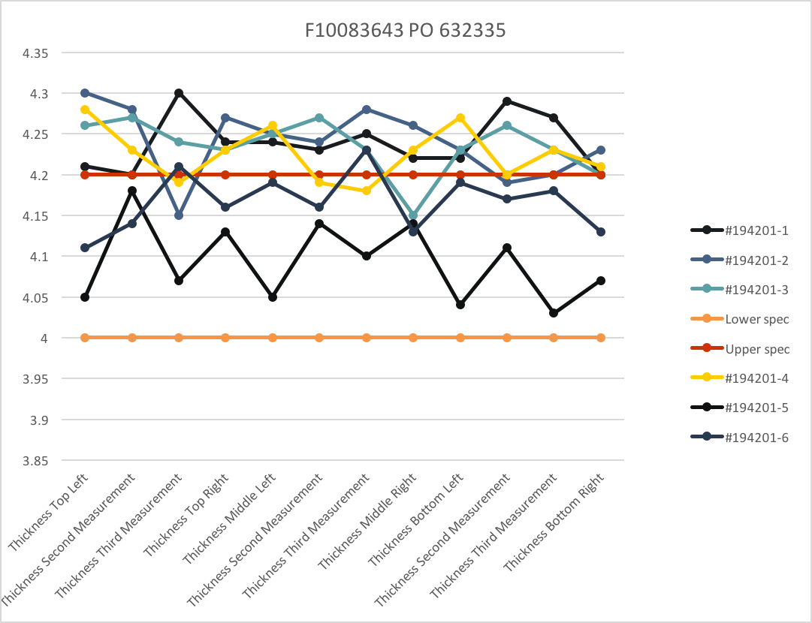
RRR Nb Sheets Inspections (in progress)

Slide 25
Summary
Final Design Review for Nb procurement is May 2018
  Need agreement on Niobium documents
Preliminary Design Review for Dressed Cavity is June 2018
  Need “first-pass” agreement on interfaces, functional drawing, acceptance criteria (including MIP, weld qualification,..)
RF Design of RFD modified, need agreement
New Mechanical Design proposed, need to evaluate best strategy, considering impact on CERN fast-track in-house plan
Niobium inspections are first opportunity for using CERN MTF system, let’s start
Procurement of 2x RFD Prototypes imminent by AUP. Need to converge on functional drawing of bare cavity

Slide 26
Additional Slides

Slide 27

Fabrication and Qualification Flow Plan
Large procurements in industry
Processing/Testing in laboratories
Centralized management at Fermilab (Issue PO’s, Perform QC)
Raw Material Procurement
(Industry)
Braze Joints
Procurement
(ANL)
Bare Cavity Procurement
(Industry)
Bare Cavities
Process + Test
(ANL+FNAL)
RF Ancillaries Procurement
(JLab)
Magnetic Shields Procurement
(Industry)
Helium Vessel Welding
(Industry)
Dressed Cavities Process + Test
(ANL+FNAL)
Shipment to CERN

Slide 28
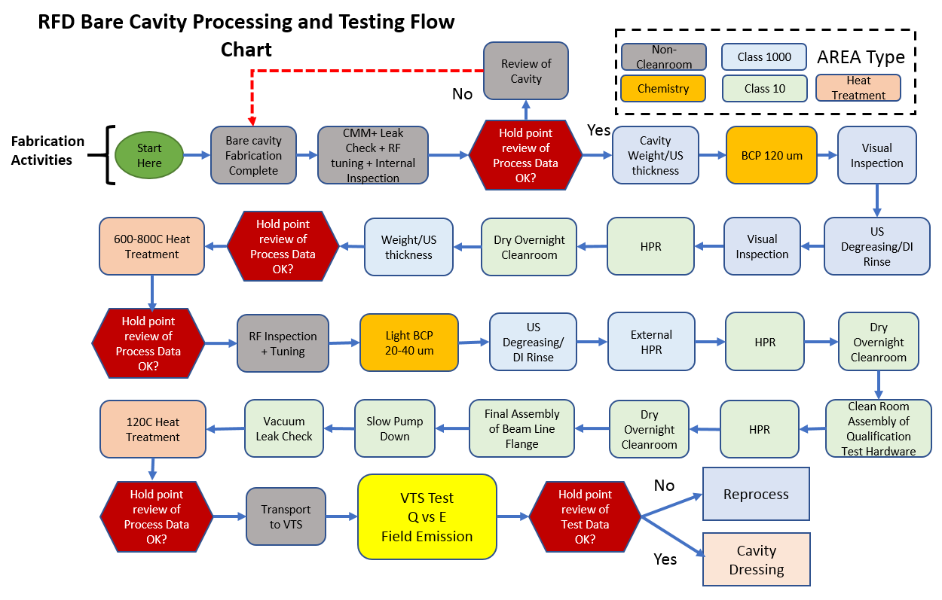
Processing & Testing Plan (2)
Charge 2.a
US-HiLumi-doc-164
600C Heat Treatment
Shipment to CERN
For Dressed Cavity: Only second half of operations

Slide 29
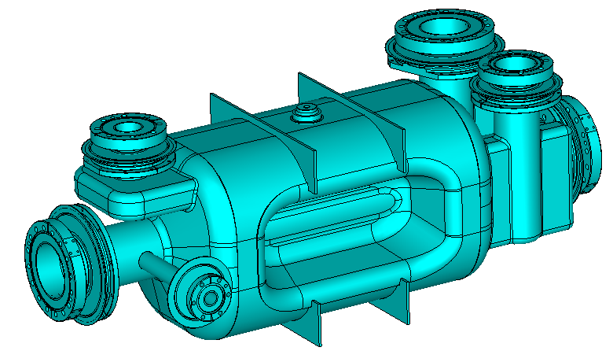
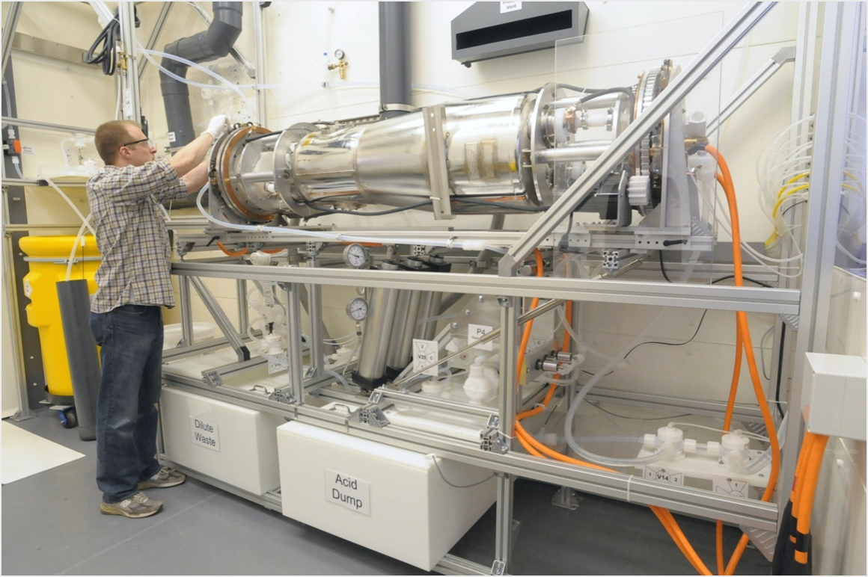
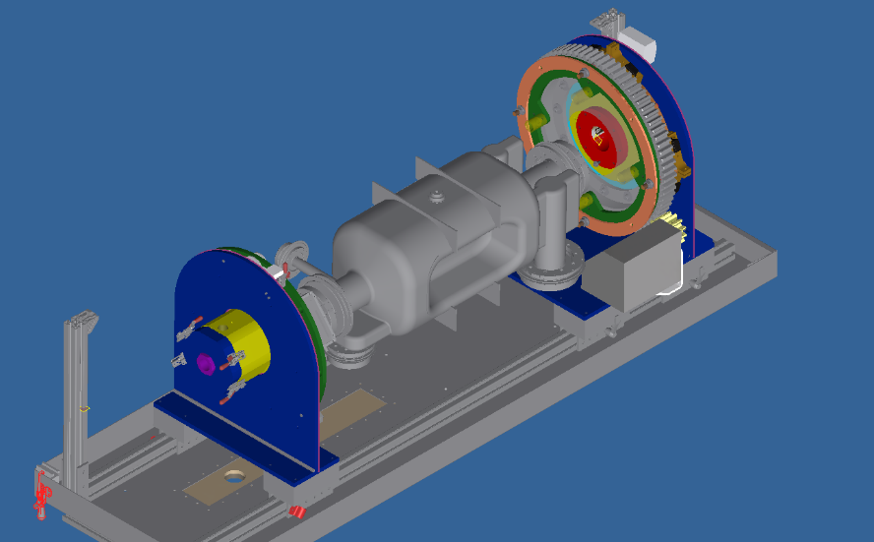
Cavity Processing
Charge 2.a
BCP Processing in horizontal orientation with rotation and possibly also tilting
  Allows more uniform removal
  Better acid circulation and drainage
ANL rotational processing tool

