Slide 1
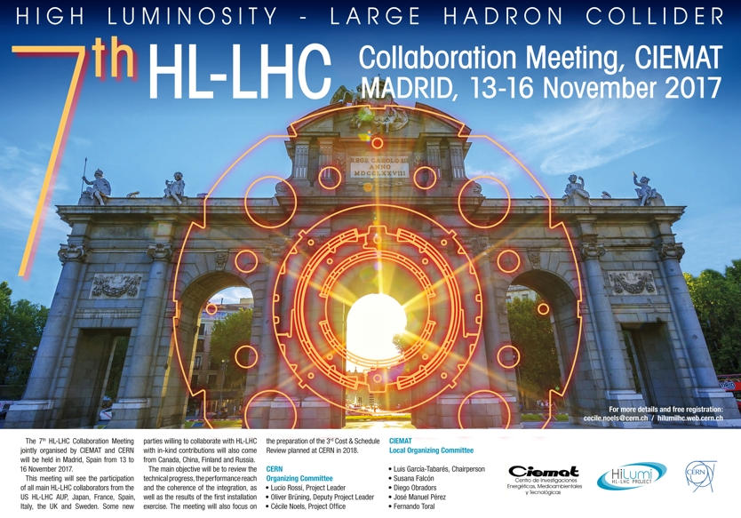

HL-LHC - Residual Dose Rate Estimations in the LSS1 and LSS5 (from TAXS up to Q7)
+ A Preliminary collective dose estimation exercise for ALARA optimization
C. Adorisio
7th HL_LHC Collaboration Meeting – CIEMAT, 13-16 November 2017

Slide 2
Outline
Rules and regulations
  Limitation
  Optimization/ALARA
Optimization during design
  Methodology
  Design options
Residual dose rate outlook
  LHC/HL-LHC operation scenario considered
  FLUKA geometry
  Residual dose rate estimations
    Ultimate scenario – LS4
    LSS1 vs. LSS5
    HL-LHC vs LHC (LS4 vs. LS3)
    LS4 vs. LS6
    Nominal vs. Ultimate
RP assessment for the new underground areas in P1 and P5
Example: preliminary dose estimations for the alignment measurement
Summary and Conclusions
A reminder

Slide 3
Rules and regulations a reminder

Slide 4
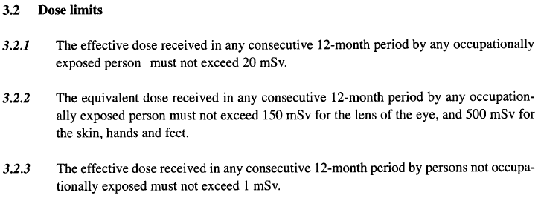
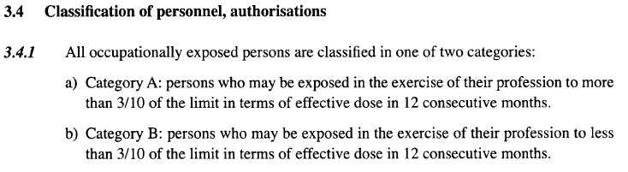
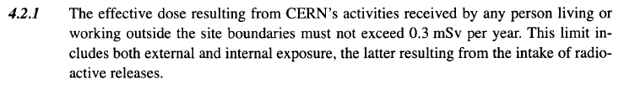
Safety Code F
Limitation
Design and operation !
Radiation Workers
Category A: 20 mSv/y
Category B: 6 mSv/y
Not occupationally exposed workers
1 mSv/y
Environment
0.3 mSv/y

Slide 5
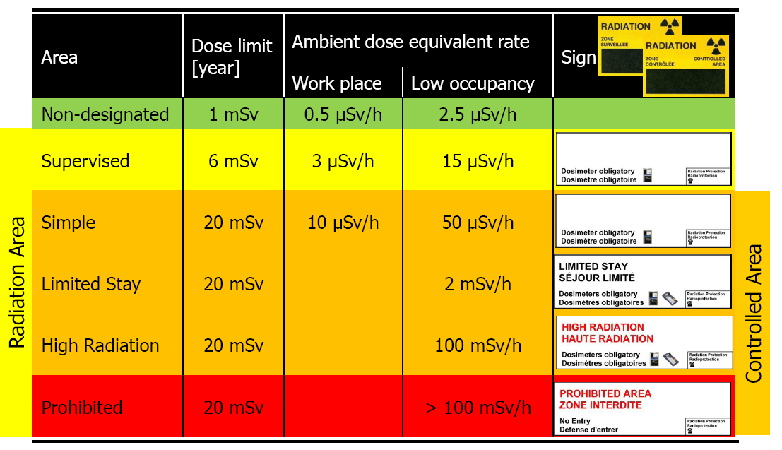
Safety Code F
Limitation
Total number of working hours per year: 2000 hours
(example: Supervised Area 3 µSv/h × 2000 h = 6 mSv)
Low-occupancy: < 20% of working time

Slide 6
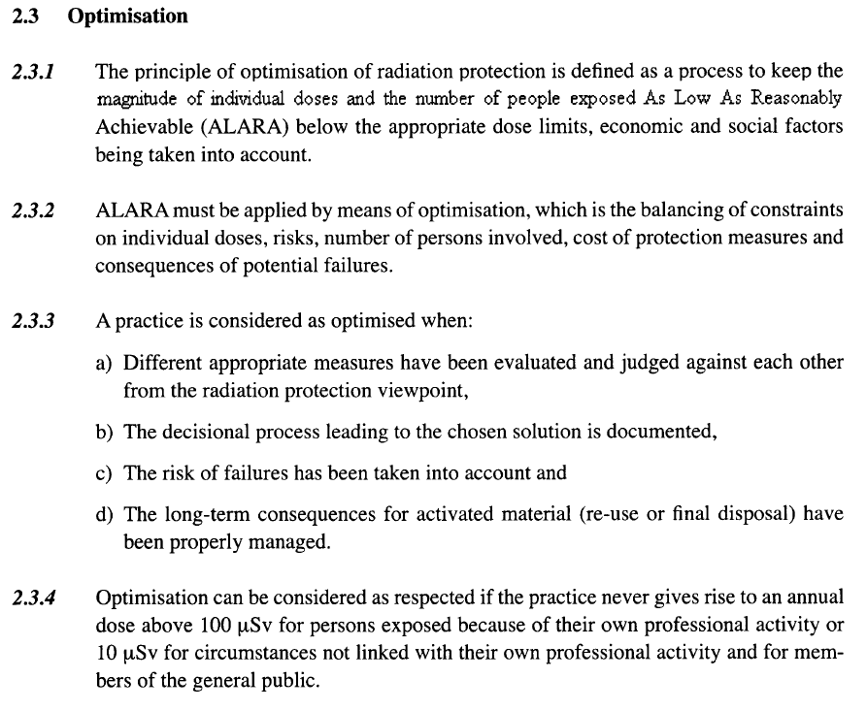
Safety Code F
Optimization (ALARA)
Design and operation !
Optimization by balancing:
individual doses
number of persons exposed
risk
costs
consequences of potential failures
Workers on CERN site
100/10 µSv/yr
Outside of CERN (environment)
10 µSv/yr

Slide 7
Safety Code F
Limitation / Optimization
6/20 mSv/yr 1 mSv/yr 300 μSv/yr
Radiation Workers
Other workers
Population outside CERN
On CERN site
On CERN site
On CERN site
Limits
Optimization / ALARA to be demonstrated
Optimization Thresholds
100 μSv/yr 10 μSv/yr 10 μSv/yr
Optimized (by definition)

Slide 8
Optimization during operation
ALARA procedure
CERN dose objectives
Operational Periods
Long Shutdowns
3 mSv/yr
ALARA categories for individual interventions
Primary criteria
Individual Dose
Collective Dose
Secondary criteria
Ambient dose equivalent rate
Airborne activity
Surface contamination
Level I
Level II
Level III
100 μSv
1 mSv
500 μSv
5 mSv
50 μSv/h
2 mSv/h
5 CA
200 CA
10 CS
100 CS
100 μSv / intervention
Detailed work-and-dose planning
ALARA committee

Slide 9
Optimization during design

Slide 10
Intervention doses
Methodology
1. Calculation of residual dose rate maps
→ for cooling times typical for interventions on the respective component
→ based on nominal operational parameters
→ definition of geometry and materials as detailed as needed (and available)
2. Calculation of individual and collective intervention doses
→ based on as realistic as possible work scenarios, including locations, duration, number of persons involved,..
→ identification of cooling times below which work will be impossible
design criterion:
2 mSv/intervention/yr
→ communication of results and constraints to equipment groups
3. Revision of design and/or work scenario
→ start with work steps that give highest individual or collective doses
→ consider optimization measures (distance, tooling, material choices, etc.)
→ identify if remote handling is possible
New design?
Step 1
Start of iteration
Revised working scenario?
Step 2

Slide 11
Optimization during design
Design options
Material choice
Avoid materials for which no radioactive waste elimination pathway exists (e.g., highly flammable metallic activated waste)
Optimized handling
Provisions for fast installation/ maintenance/ repair, in particular, around beam loss areas (e.g., plugin systems, quick-connect flanges, remote survey, remote bake-out)
Limitation of installed material
Install only components that are absolutely necessary, in particular in beam loss areas
Reduction of radioactive waste
Radiation resistant
Foresee easy dismantling of components
Easy access to components that need manual intervention or complex manipulation
Low activation properties to reduce residual doses and minimize radioactive waste (optimization with ActiWiz code, Web-site: https://actiwiz.web.cern.ch)

Slide 12
Residual dose rate outlook

Slide 13
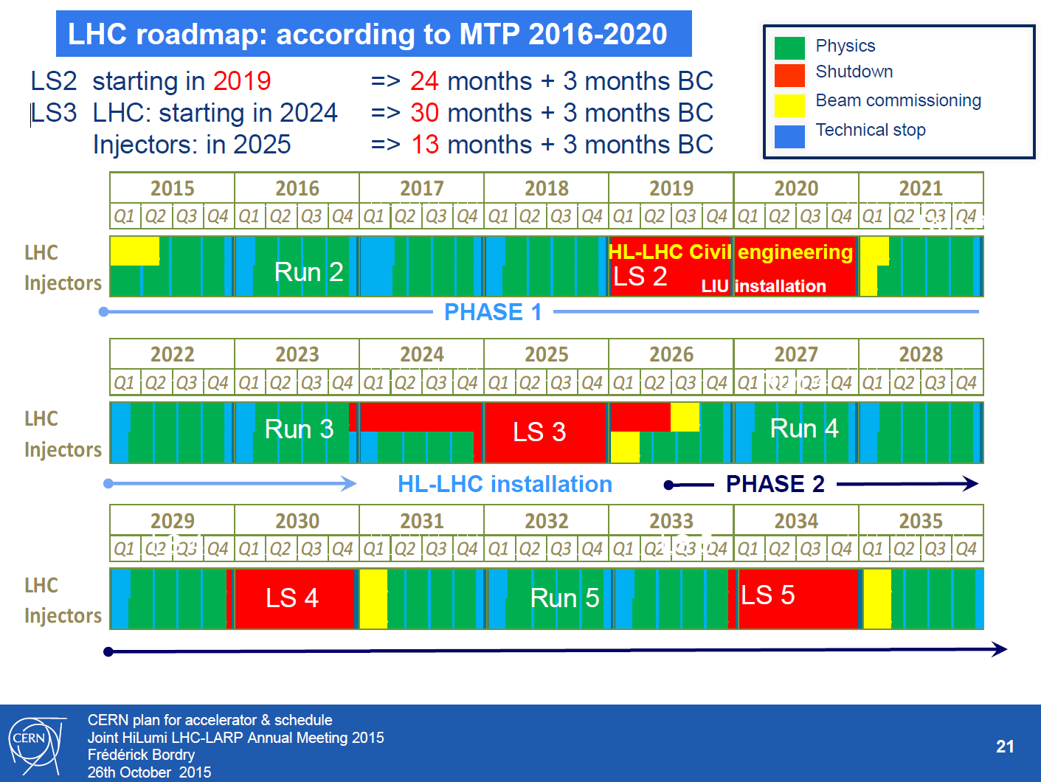
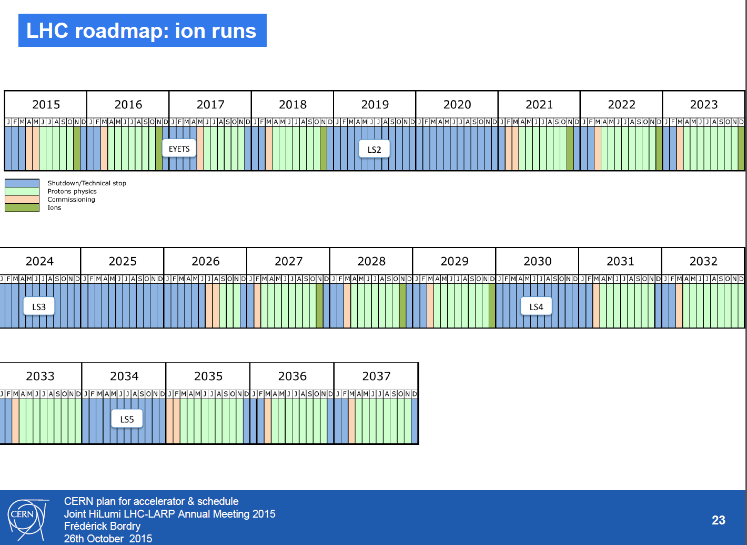
LHC/HL-LHC Operational Scenarios
 | Year of (HL-)LHC Operation | Peak / levelled luminosity [cm⁻²s⁻¹] |  | Integrated luminosity [fb⁻¹]
 | ≤2012 | 0.8E+34 |  | 30
LS1
 | 2015 | 6.30E+33 |  | 4
 | 2016 | 1.40E+34 |  | 40
 | 2017 | 1.60E+34 |  | 50
 | 2018 | 1.60E+34 |  | 50
LS2 | (2 years)
 | 2021 | 2.0E+34 |  | 60
 | 2022 | 2.0E+34 |  | 60
 | 2023 | 2.0E+34 |  | 60
LS3 | (3 years) | Nominal | Ultimate | Nominal | Ultimate
 | 2027 | 5.0E+34 | 7.5E+34 | 250 | 300
 | 2028 | 5.0E+34 | 7.5E+34 | 250 | 300
 | 2029 | 5.0E+34 | 7.5E+34 | 250 | 300
LS4 | (1 year)
 | 2031 | 5.0E+34 | 7.5E+34 | 250 | 300
 | 2032 | 5.0E+34 | 7.5E+34 | 250 | 300
 | 2033 | 5.0E+34 | 7.5E+34 | 250 | 300
LS5 | (1 year)
 | 2035 | 5.0E+34 | 7.5E+34 | 250 | 300
 | 2036 | 5.0E+34 | 7.5E+34 | 250 | 300
 | 2037 | 5.0E+34 | 7.5E+34 | 250 | 300
LS6
past
~TOT 350 fb⁻¹
HL-LHC
3 blocks of 3 consecutive years of operation + 1 year Long Shutdown each
  Nominal: 5.0x10³⁴ – 250 fb⁻¹/y
  Ultimate: 7.5x10³⁴ – 300 fb⁻¹/y
TOT ~2600 fb⁻¹
TOT ~3050 fb⁻¹

Slide 14
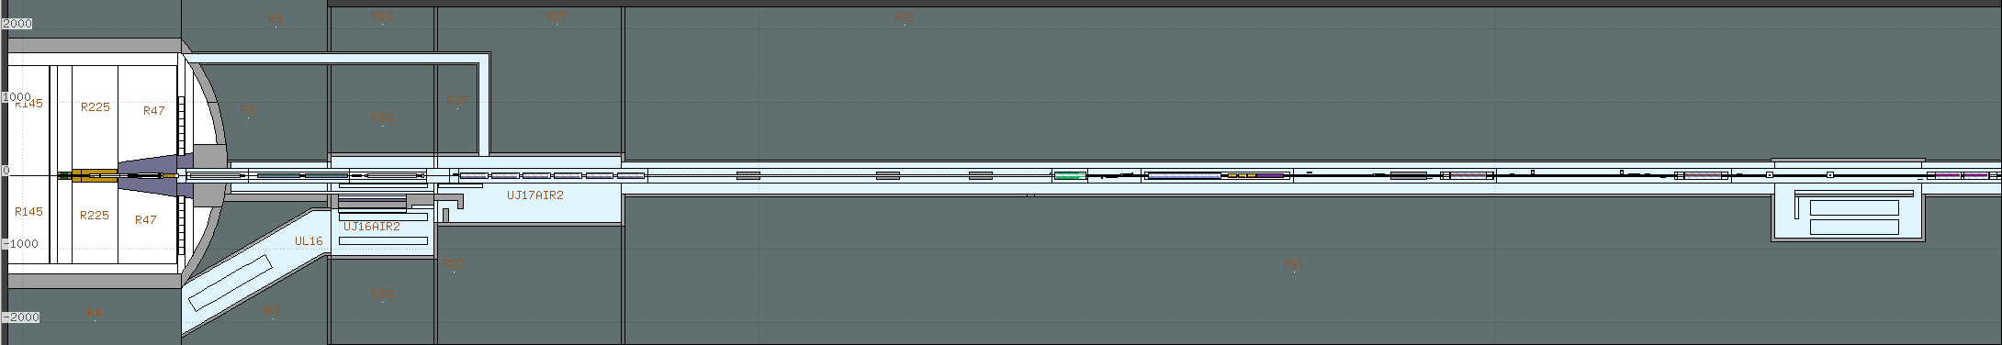
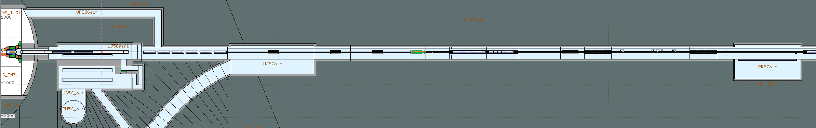
LHC – Simulation geometry
Long Straight Sections in the two interaction regions, IR1 and IR5:
Actual machine layout
Real collimators settings
Thanks to the FLUKA Team
LHC IR1 LSS
LHC IR5 LSS

Slide 15
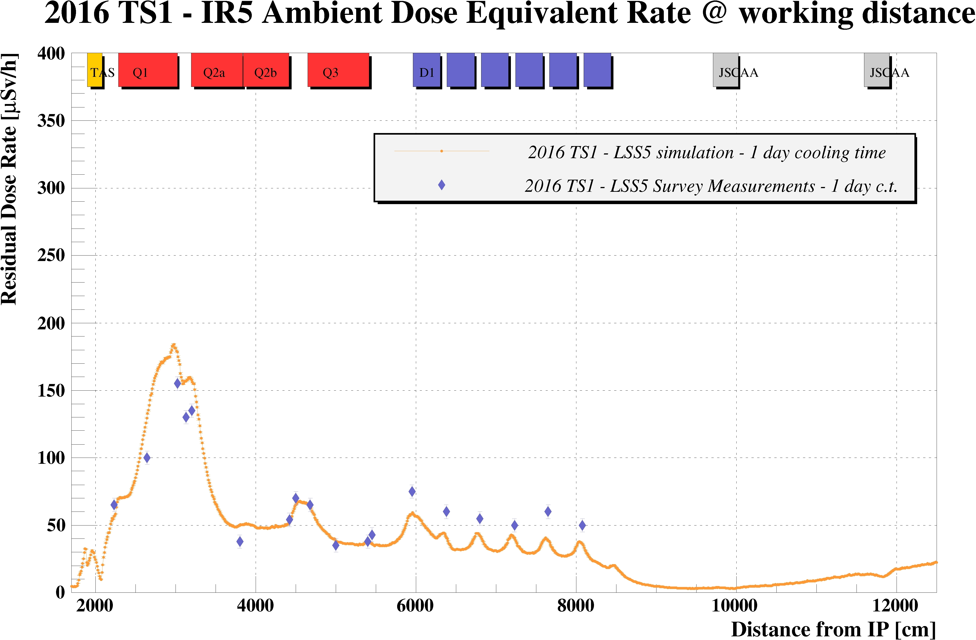
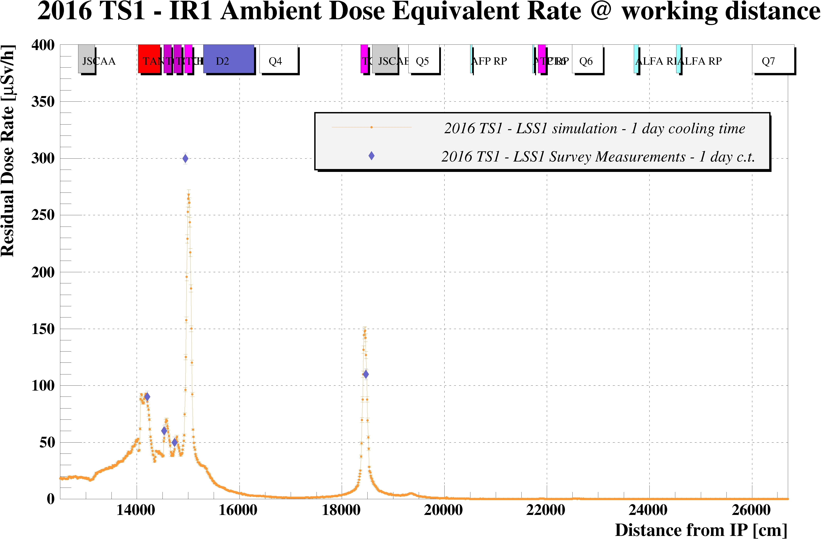
LHC – Simulation/measurement comparison
During the year, simulations are performed in order to prepare the Work and Dose Planning (WDP) in advance for each Technical Stop (TS)
Radiation measurement, which performed at the beginning of TS, in order to classify the area and prepare WDP for interventions, used to benchmark the simulation

Slide 16
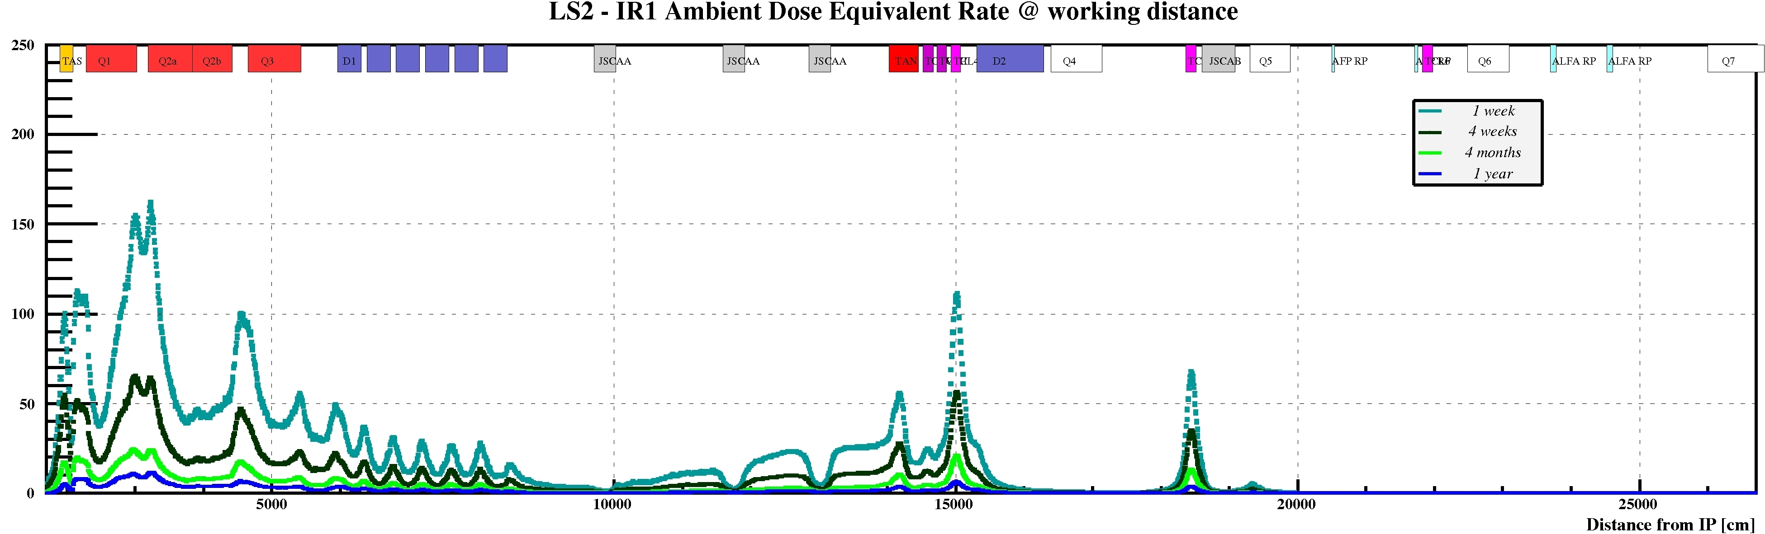

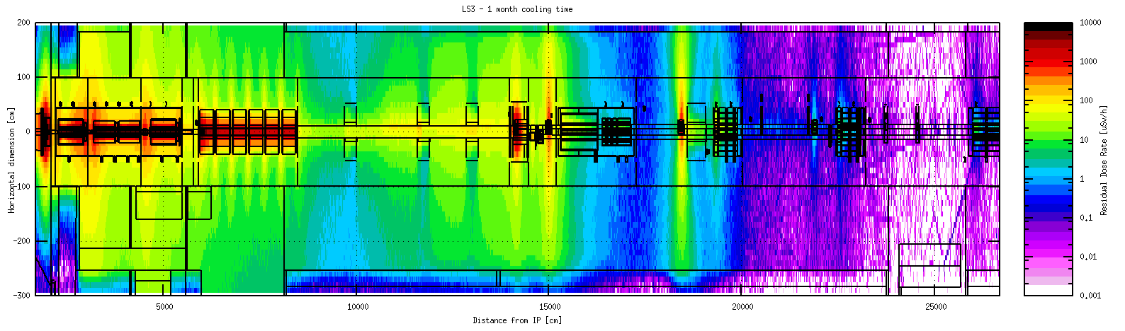
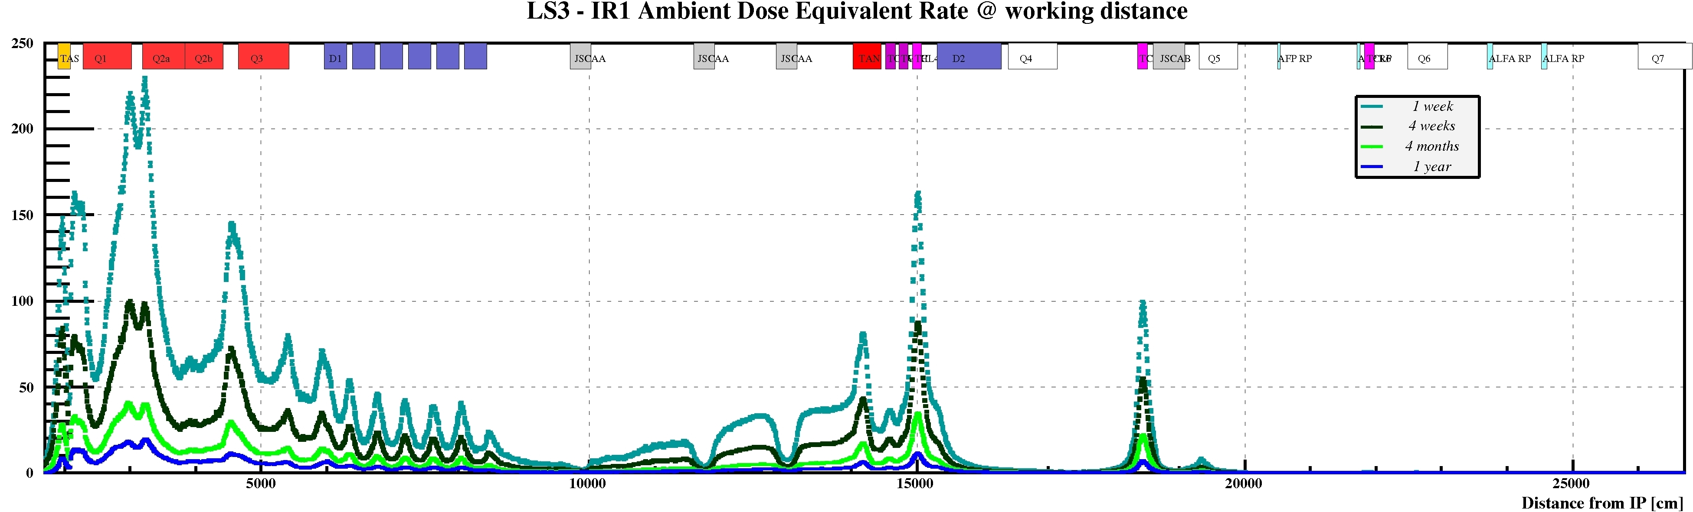
LHC - Residual Dose Rate estimation
LS3 – IR1 Ambient dose equivalent rate – 1 month cooling time
~ 40÷50% more
Residual dose rate estimations are available for LS2 and LS3 periods and can be used for the individual/collective dose evaluation for the consolidation/dismantling works

Slide 17
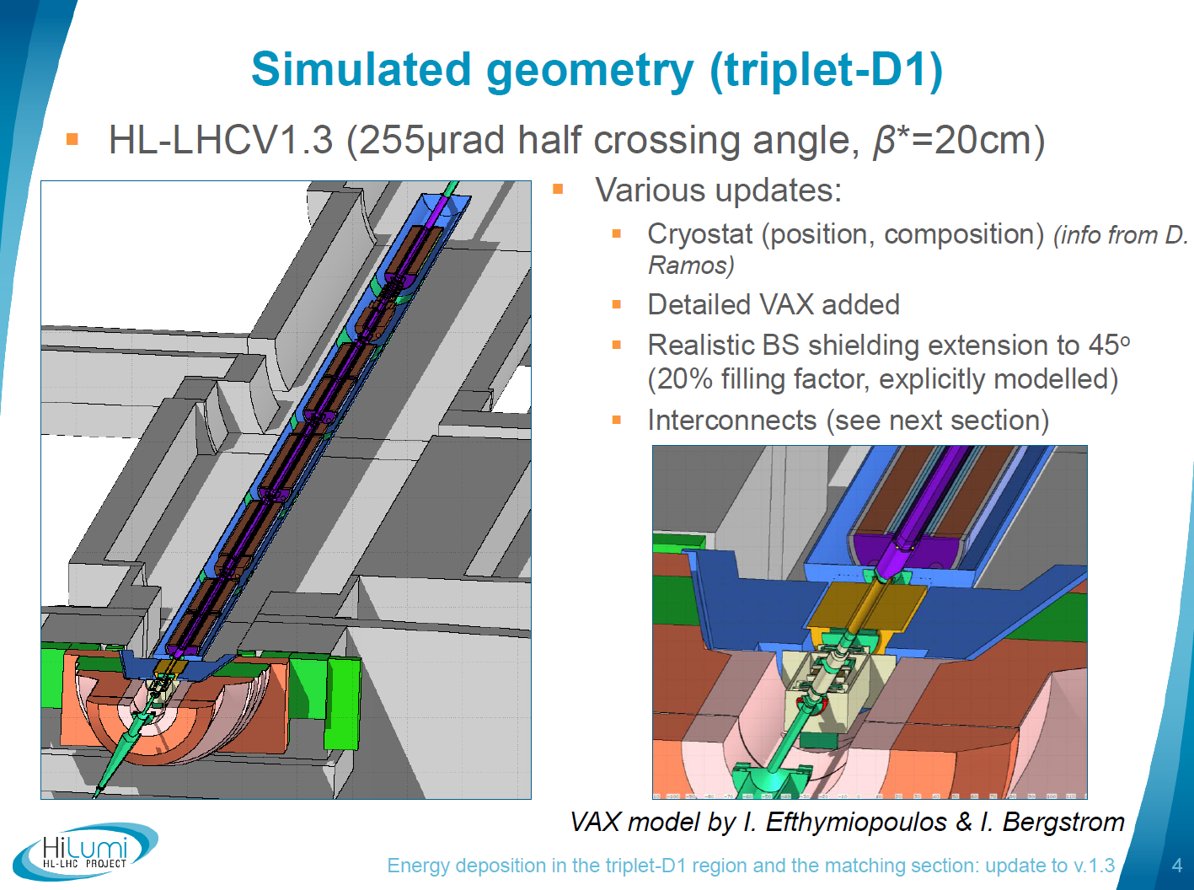
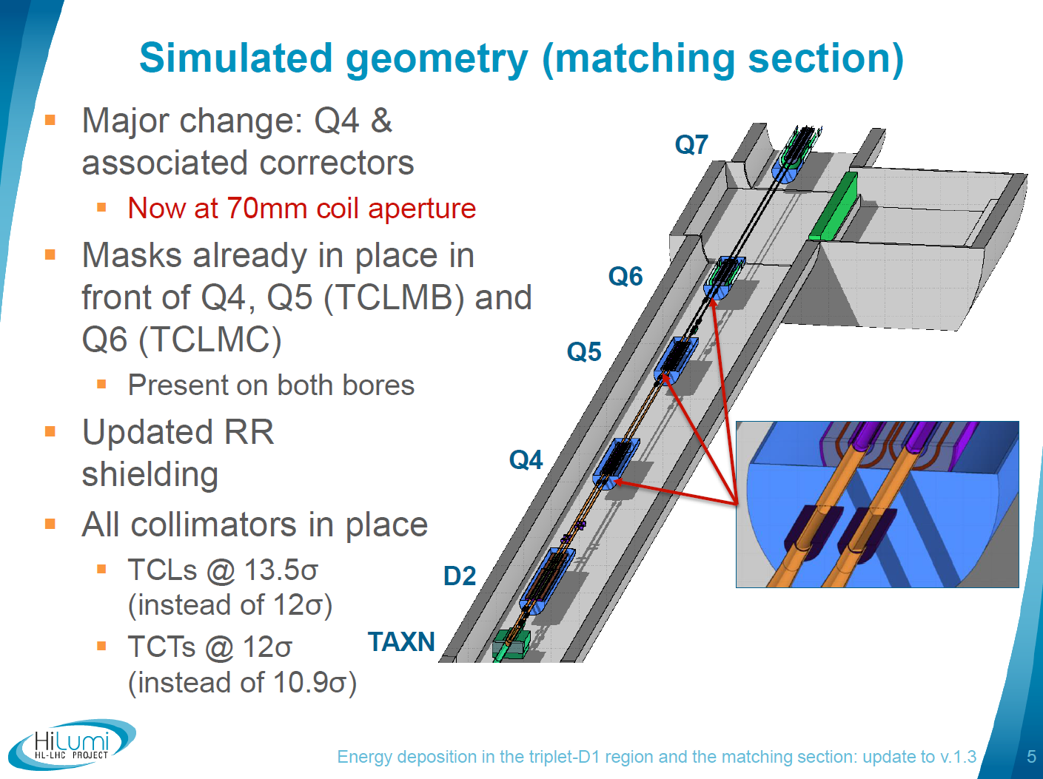
HL-LHC FLUKA Model
Same geometry model developed by the FLUKA team for the energy deposition studies as presented by Andrea Tsinganis @ 6th HL-LHC Collaboration Meeting in Paris

Slide 18
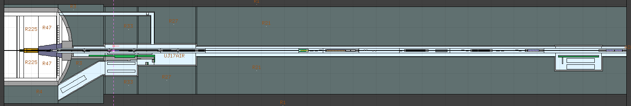
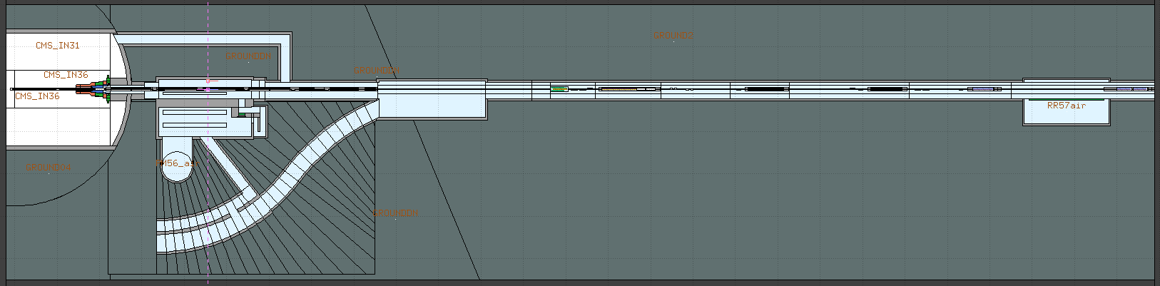
HL-LHC FLUKA Geometry
HL-LHC IR1 v1.3
HL-LHC IR5 v1.3
Thanks to the FLUKA Team

Slide 19
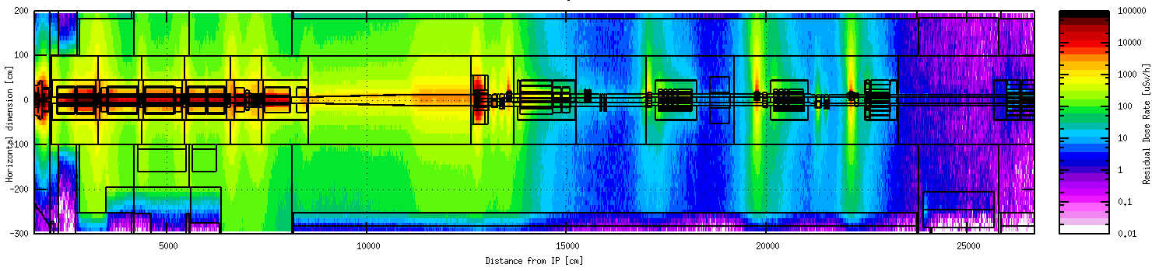
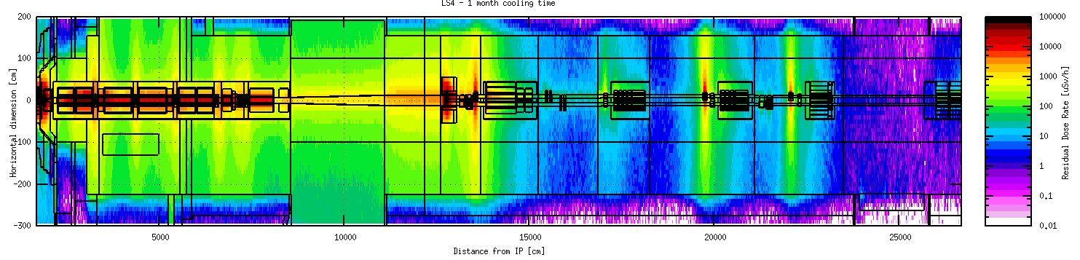
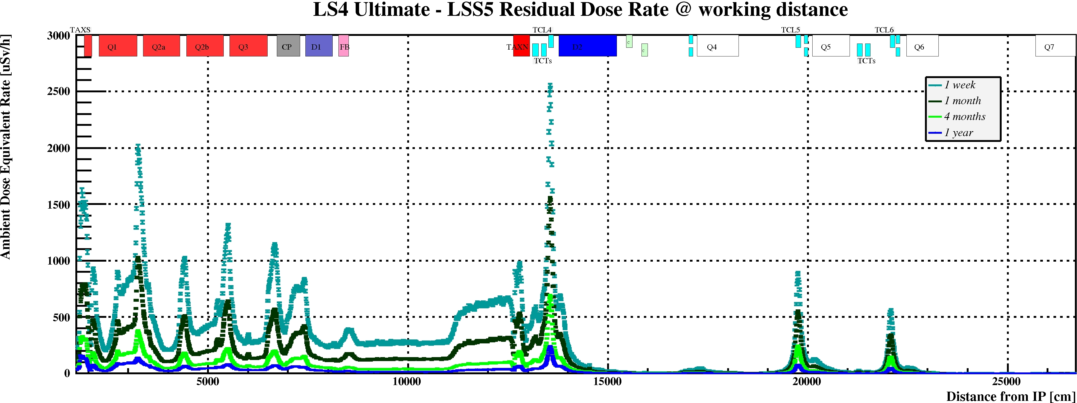
HL-LHC – Residual Dose Rate estimation
HL-LHC LSS1 – LS4 1 month cooling time
The optics and the collimator settings are the same for IR1 and IR5.
Only difference is crossing angle plane.
HL-LHC LSS5 – LS4 1 month cooling time

Slide 20
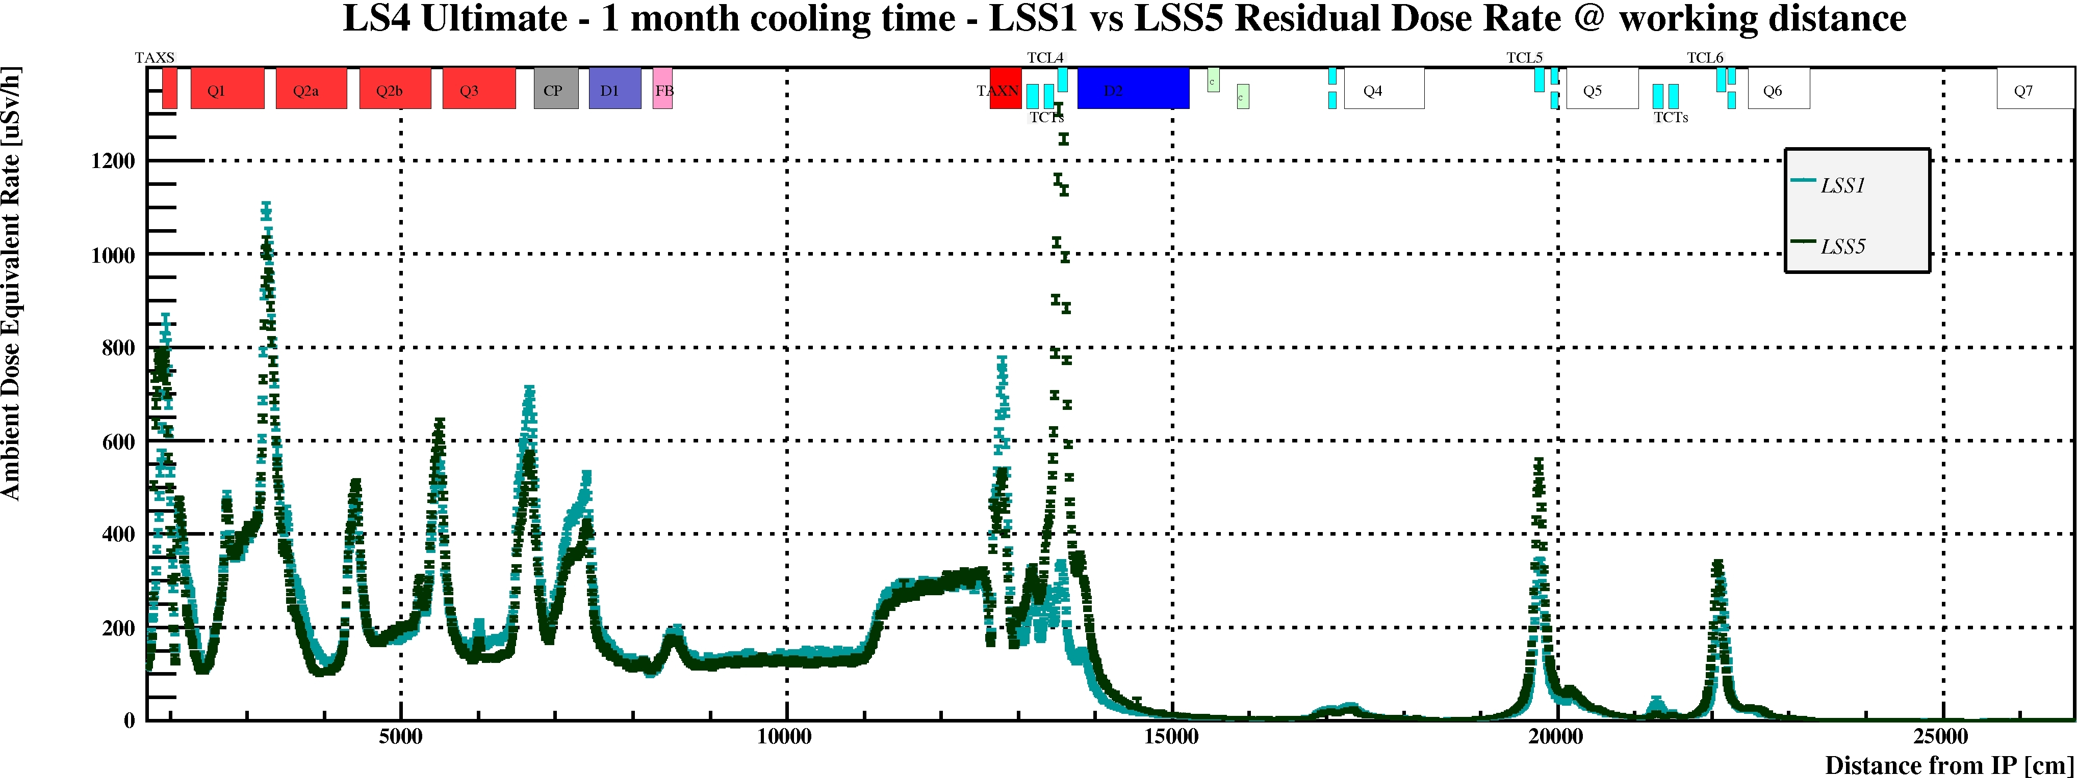
LSS1 vs LSS5
The optics and the collimator settings are the same for IR1 and IR5.
Only difference is crossing angle plane.

Slide 21
LHC vs HL-LHC – Residual Dose Rate estimation
Inner triplet area - comparing the highest peaks:
LS4_{Ult} vs LS3
Higher of a factor ~8

Slide 22
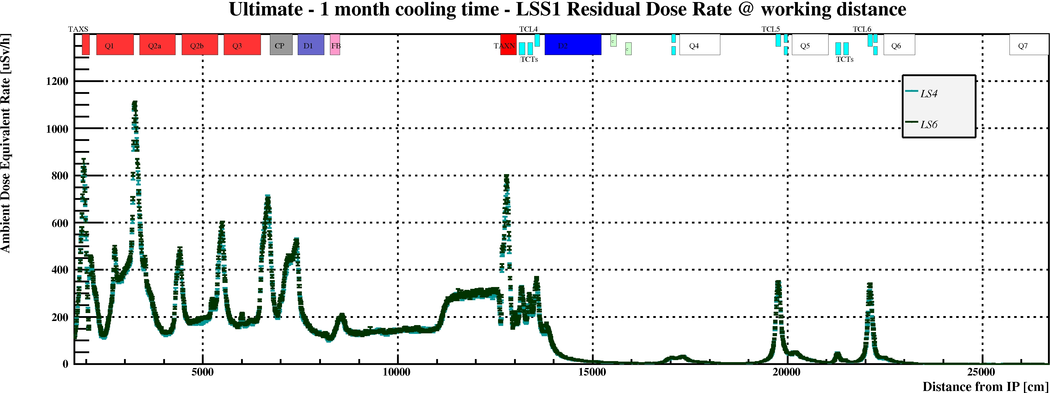
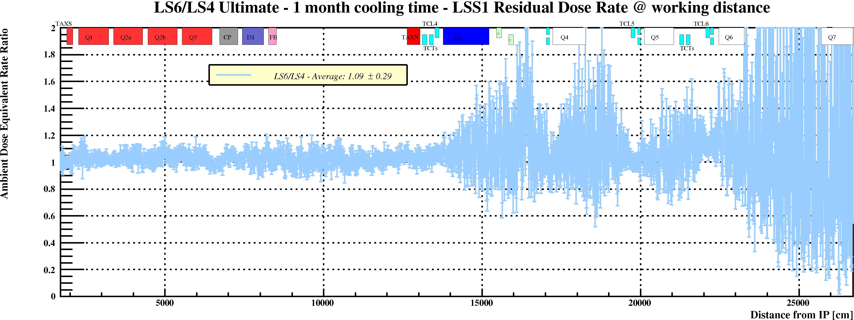
LS4 vs LS6
Cooling time | LS6/LS4
1 hour | 1.02
1 day | 1.03
1 week | 1.06
1 month | 1.09
4 months | 1.18
1 year | 1.29

Slide 23
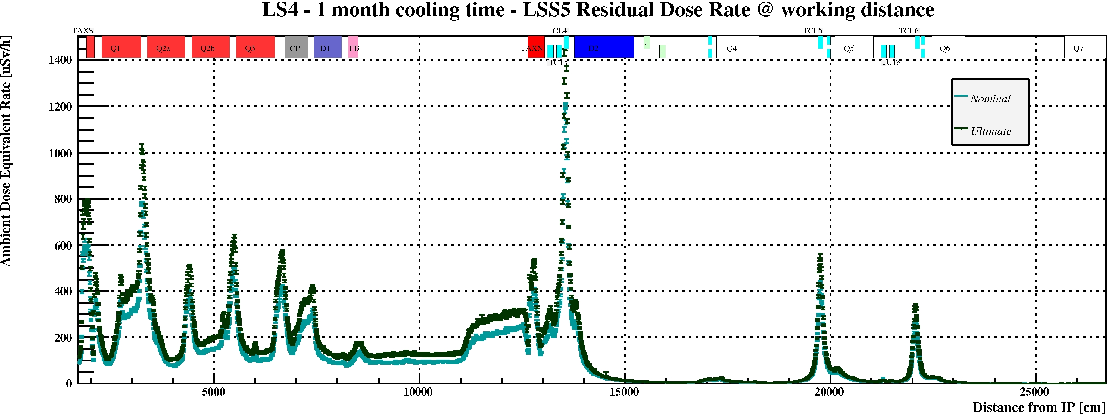
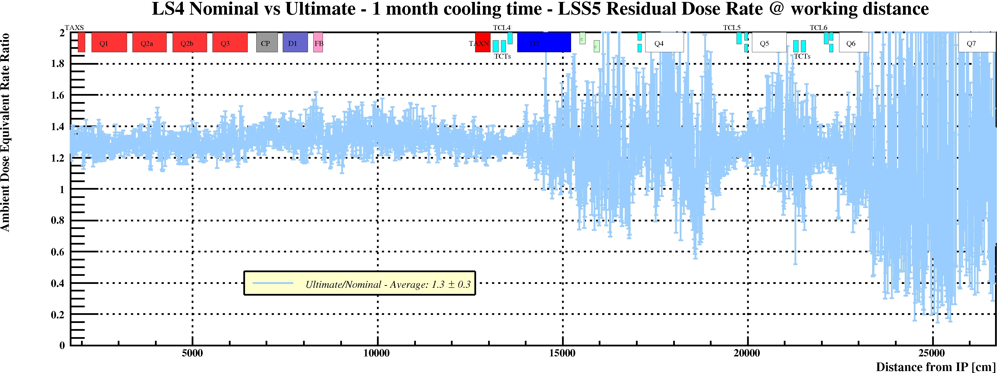
Nominal vs Ultimate
Cooling time | Ultimate/ Nominal
1 hour | 1.50
1 day | 1.46
1 week | 1.35
1 month | 1.30
4 months | 1.24
1 year | 1.23

Slide 24
Example: A Preliminary collective dose estimation for ALARA optimization

Slide 25
Example - alignment
First estimation done considering the actual procedure (elements from D1 up to cell 6)
vertical measurements, 2 workers, 10 minutes next to each element, ~2 hours work
measurements have to be done asap the machine stops
alignment, if needed, can be done at longer cooling time
Very high individual and collective doses even at long cooling time
For example:
measurement (1 week cooling time)
+
alignment (all elements (!), 4 months cooling time)
Collective dose: ~1.6 man.mSv
 |  |  |  |  |  | 2 hours (μSv)
aisle | - | 50 | 25 | 10 | 5 | 100 | 50 | 20 | 10
Collective Dose (man.μSv) |  | 1333 | 753 | 311 | 122

Slide 26
Example - alignment
Alignment group solution (*):
Permanent remote monitoring system for the equipment up to Q5
Motorized jacks for the main components (D1, TAXN, D2, crab cavities, Q4, Q5)
Fast adjustment system made of plug-in motors to perform remote alignment (estimated time to plug it in and out: 2 minutes)
Access for measurement and alignment needed only on cell 6 elements (TCL6, mask and Q6), as it is done today
 |  | LSS5 (one side only)
 |  | 10 minutes (uSv) |  | 2 minutes (uSv)
 | distance from IP (cm) | 1 week | 1 month | 4 month | 1 year
D1 | 7442 | 0.0 | 0.0 | 0.0 | 0.0
 | 8450 | 0.0 | 0.0 | 0.0 | 0.0
TAXN | 12626 | 0.0 | 0.0 | 0.0 | 0.0
 | 13047 | 0.0 | 0.0 | 0.0 | 0.0
TCL4 | 13511 | 0.0 | 0.0 | 23.3 | 8.3
D2 | 13779 | 0.0 | 0.0 | 0.0 | 0.0
 | 15224 | 0.0 | 0.0 | 0.0 | 0.0
crabs | 15600-15900 | 0.0 | 0.0 | 0.0 | 0.0
Q4 mask | 17075 | 0.0 | 0.0 | 0.3 | 0.2
Q4 | 17230 | 0.0 | 0.0 | 0.0 | 0.0
 | 18262 | 0.0 | 0.0 | 0.0 | 0.0
TCL5 | 19705 | 0.0 | 0.0 | 7.2 | 2.3
Q5 mask | 19959 | 0.0 | 0.0 | 1.0 | 0.5
Q5 | 20115 | 0.0 | 0.0 | 0.0 | 0.0
 | 21027 | 0.0 | 0.0 | 0.0 | 0.0
TCL6 | 22062 | 85.0 | 51.7 | 23.3 | 8.3
Q6 mask | 22256 | 11.7 | 6.7 | 3.3 | 1.7
Q6 | 22472 | 8.3 | 5.0 | 1.7 | 0.8
 | 23265 | 1.7 | 0.8 | 0.8 | 0.8
 |  | 107 | 64 | 61 | 23
aisle | - | 50 | 25 | 10 | 5
 | Collective Dose (man.μSv) | 157 | 89 | 71 | 28
For example:
measurement (1 week cooling time)
+
alignment (all elements (!), 4 months cooling time)
Collective dose: 228 man.μSv
(*) See presentation given by Helene at WP15 meetings:
07.04.2017
13.10.2017

Slide 27
Example – alignment
Lesson learnt
The estimation is done considering the first LS in the HL era (ultimate scenario)
Nominal scenario: ~ 30% less
LS6 vs LS4:
  up to 30% more for long cooling times
  few % more for short cooling times
Secondary elements measurement and alignment not taken into account in this example (e.g. vacuum equipment, BPMs…)
Same procedure as in the LHC nowadays
Optimized procedure for HL-LHC
For example:
measurement (1 week cooling time)
+
alignment (all elements (!), 4 months cooling time)
Collective dose: ~1.6 man.mSv
For example:
measurement (1 week cooling time)
+
alignment (all elements (!), 4 months cooling time)
Collective dose: 228 man.μSv

Slide 28
HL-LHC New Underground galleries

Slide 29
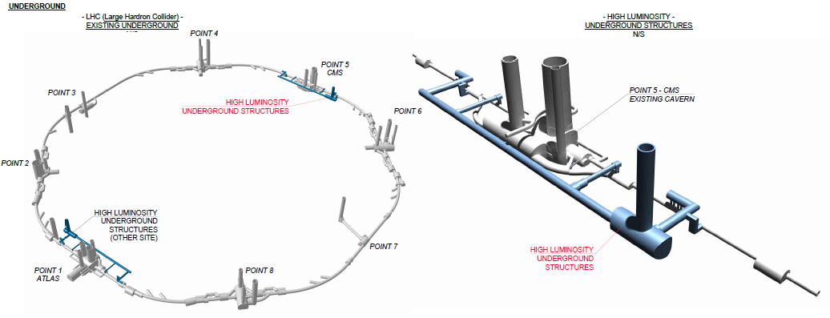
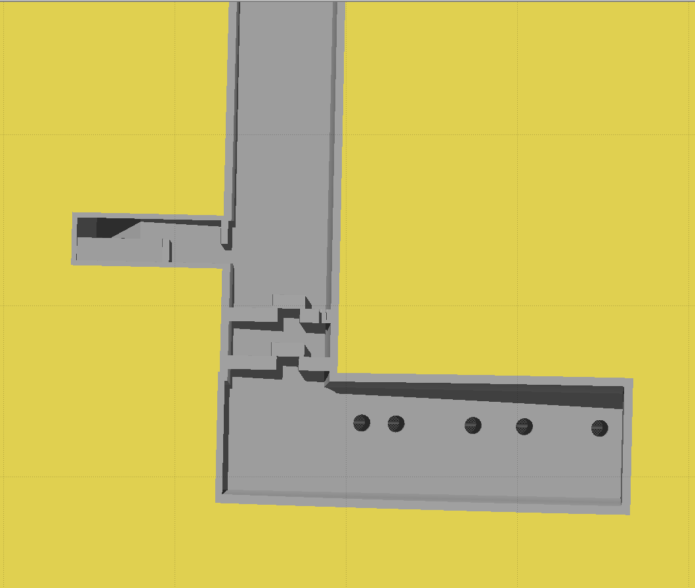
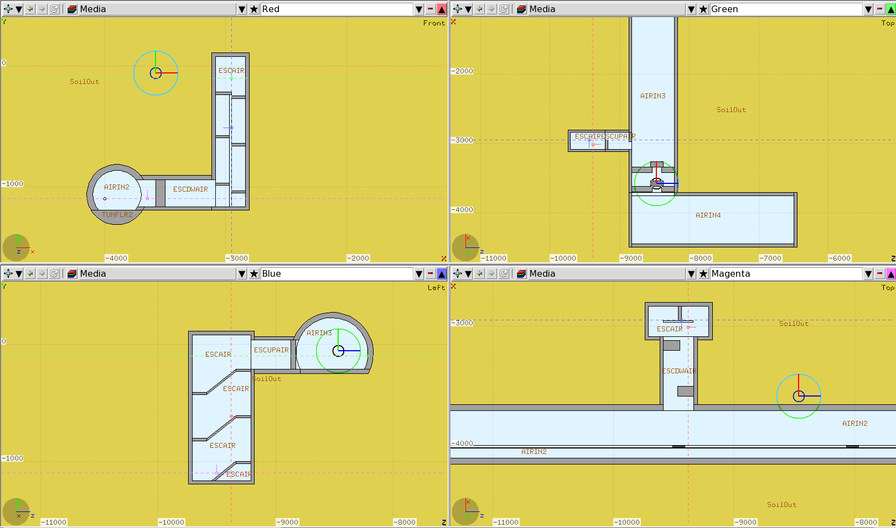
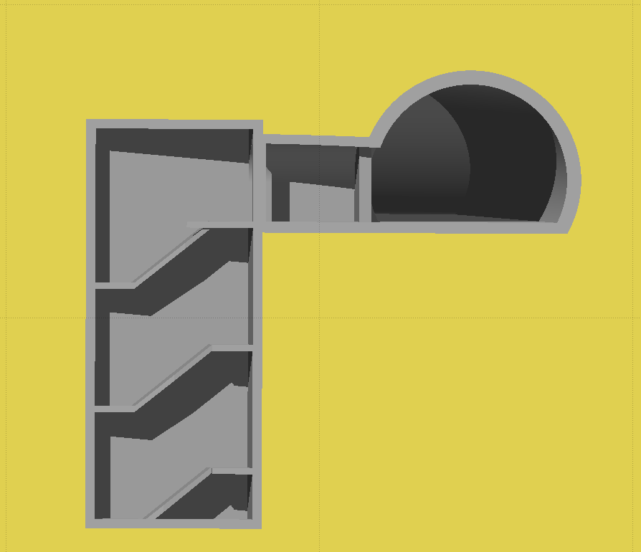
HL-LHC new underground galleries
New underground galleries will be excavated to put new services in Point 1 and Point 5
RP assessment:
  Shielding requirements to access the new underground during operation
  Excavation spoils activation
Emergency escape
Emergency escape
LHC
Emergency escape
Emergency escape
LHC

Slide 30
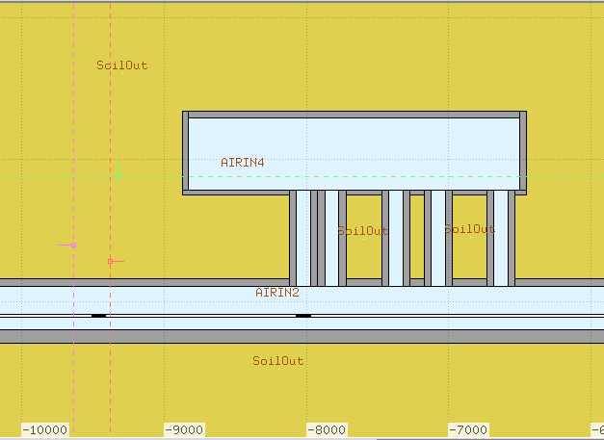
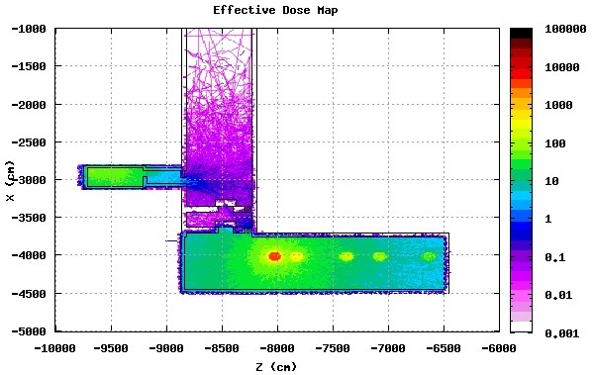
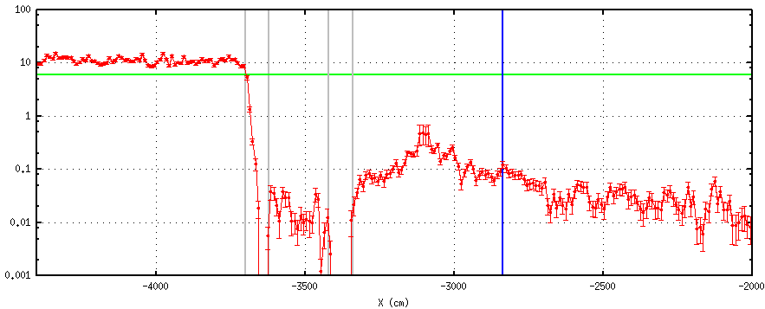
HL-LHC new underground galleries
Shielding
Accidental scenario
Full beam loss
just in front of the nearest connection
1 m x 10 cm x 10 cm tungsten target
Beam parameters considered:
2808 bunches
2.2·10¹¹ ppb
Supervised Radiation Area:
< 6 mSv
Escape path
One tungsten block
(100cm x 10cm x 10cm)
in front of the nearest connection
6 mSv
Effective Dose (mSv)
Effective Dose (mSv)

Slide 31
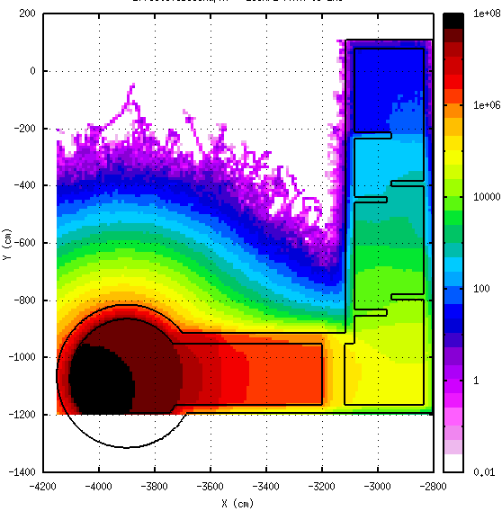
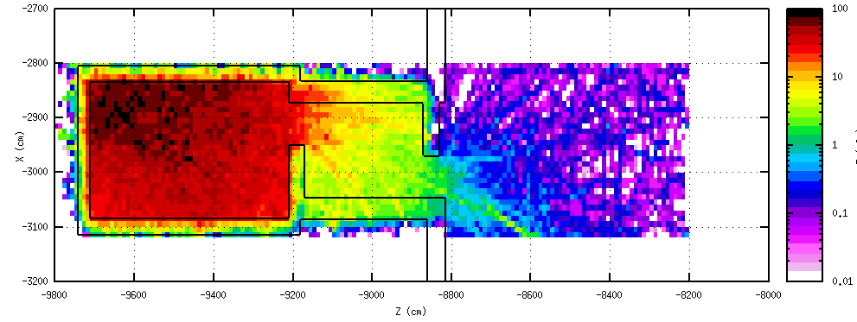
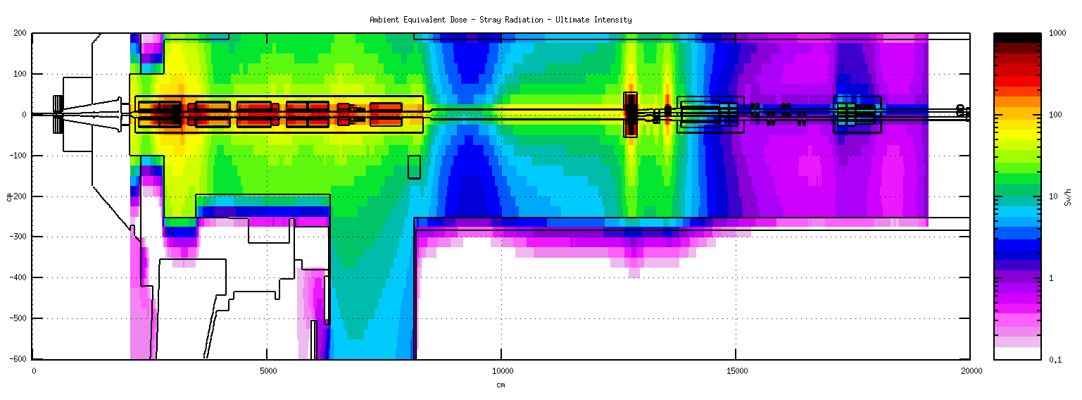
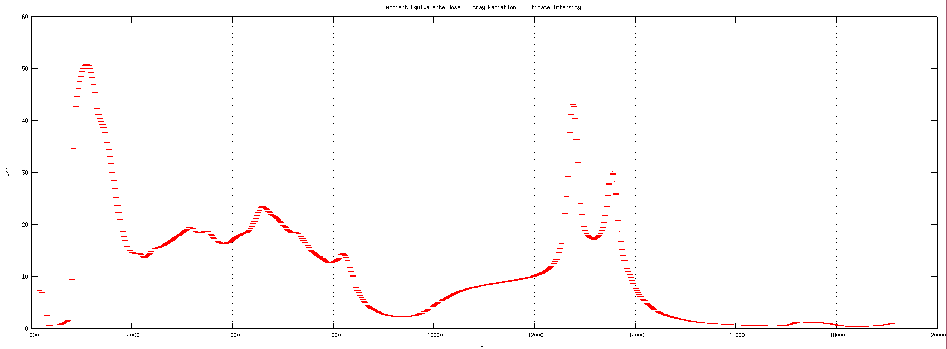
HL-LHC new underground galleries
Shielding
The attenuation provided by the shielding walls and the concrete stairs in the UPR escape path is evaluated by the accidental case
Normal proton operation
Ultimate scenario
Levelled luminosity 7.5·10³⁴ cm⁻²s⁻¹
Supervised Radiation Area:
< 3 μSv/h
< 15 μSv/h
Effective Dose (mSv)
Effective Dose (mSv)
~10⁻⁸
HL-LHC Run at Ultimate intensity
Ambient Dose Equivalent– Stray radiation – Ultimate intensity
60
Max dose rate next to the tunnel wall is 50 Sv/h
⇒ In the underground gallery (UAs) closest accessible point 0.5 μSh/h
50
40
Ambient Dose Equivalent Rate (Sv/h)
Ambient Dose Equivalent Rate (Sv/h)
30
20
10
0

Slide 32
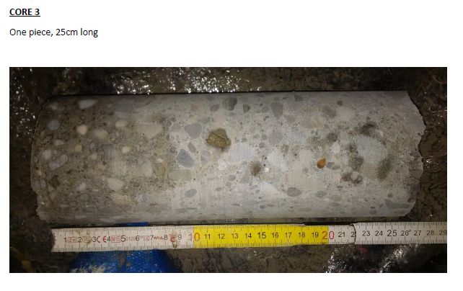
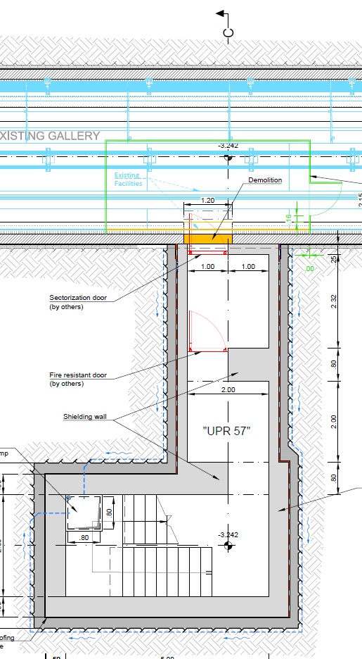

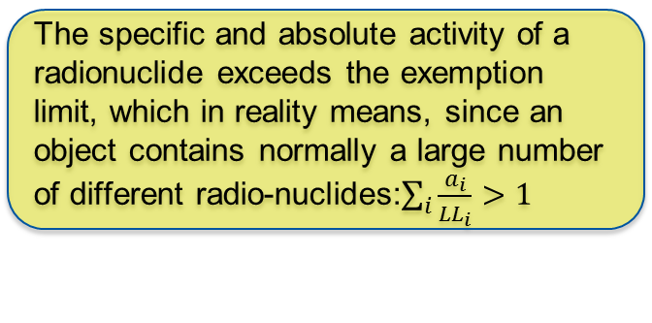
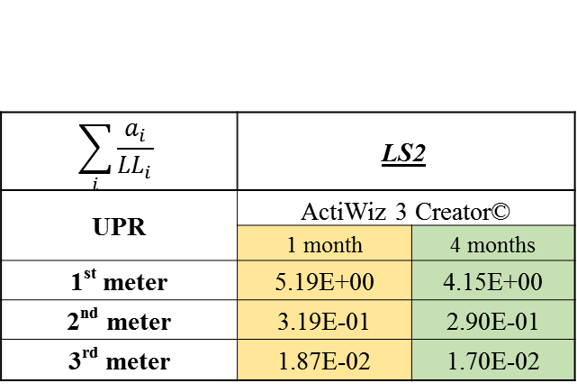
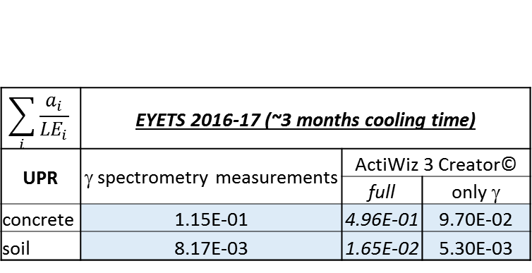
HL-LHC new underground galleries
Spoil activation
Is it radioactive?
The specific and absolute activity of a radionuclide exceeds the exemption limit, which in reality means, since an object contains normally a large number of different radio-nuclides:$\sum_{i}{\frac{a_{i}}{{LL}_{i}}}>1$
During 2016 EYETS some concrete wall and rock samples were taken and analysed
$$\sum_{i}{\frac{a_{i}}{{LE}_{i}}}$$ | EYETS 2016-17 (~3 months cooling time)
UPR | γ spectrometry measurements | ActiWiz 3 Creator©
 |  | full | only γ
concrete | 1.15E-01 | 4.96E-01 | 9.70E-02
soil | 8.17E-03 | 1.65E-02 | 5.30E-03
$$\sum_{i}{\frac{a_{i}}{{LL}_{i}}}$$ | LS2
UPR | ActiWiz 3 Creator©
 | 1 month | 4 months
1st meter | 5.19E+00 | 4.15E+00
2nd meter | 3.19E-01 | 2.90E-01
3rd meter | 1.87E-02 | 1.70E-02
Ca-45 is a pure β emitter: cannot be seen with γ-spec
Ca-45 | 68%
Na-22 | 28%
S-35 | 2%
Ca-45 | 80%
Na-22 | 7%
Zn-65 | 3%
Fe-55 | 3%
S-35 | 1%
Mn-54 | 1%

Slide 33
it is time to summarize and conclude…

Slide 34
Summary and Conclusions
Simulation are performed using a very long and detailed geometry which reproduce the real accelerator environment in great detail
Fruitful collaboration with the FLUKA team
  the use of the same geometry models they developed
  the consistency with the energy deposition study
Radio nuclide inventory and activity estimation are done using Fluka and the Actiwiz 3 Creator© code
The simulation results are continuously benchmarked with the radiation measurements performed in the LHC machine

Slide 35
Summary and Conclusions
In the HL-LHC era, the residual radiation levels will be higher and there will be more areas with high residual radiation compared to the actual LHC machine
It is important, in the design phase, to take this into account and do all the possible optimization in order to reduce the individual and collective dose for the interventions in these areas
Design optimization could also minimize the machine downtime
Residual dose rate estimations are available for LSS1, LSS5, LSS8 and for the experimental caverns, for all the Long Shutdowns
LSS7 residual dose rate estimations are under preparation

Slide 36
Thank you!

Slide 37
Radiological quantities
Beam operation periods
  dose equivalent to personnel by stray radiation in accessible areas
  activation of water and air and their release into the environment as well as the resulting annual dose to the reference groups of the population
  dose equivalent to personnel and environment in case of abnormal operation or accidents
Beam-OFF periods
  induced radioactivity in accelerator components and related residual dose equivalent rate
  individual and collective doses to personnel during interventions in radiation areas
Decommissioning
  waste minimization
  radionuclide inventory for waste disposal

Slide 38
Residual Dose Rate Maps
HL-LHC LSS1 – LS4 1 month cooling time
HL-LHC LSS5 – LS4 1 month cooling time

Slide 39
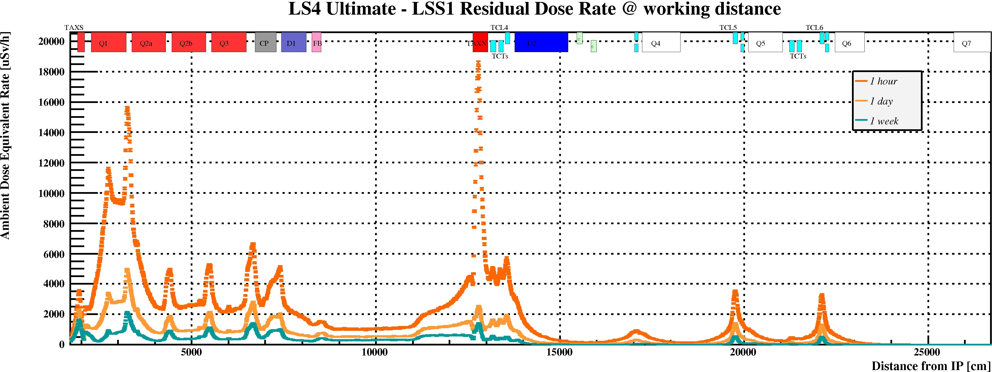
Residual Dose Rate Profiles

Slide 40
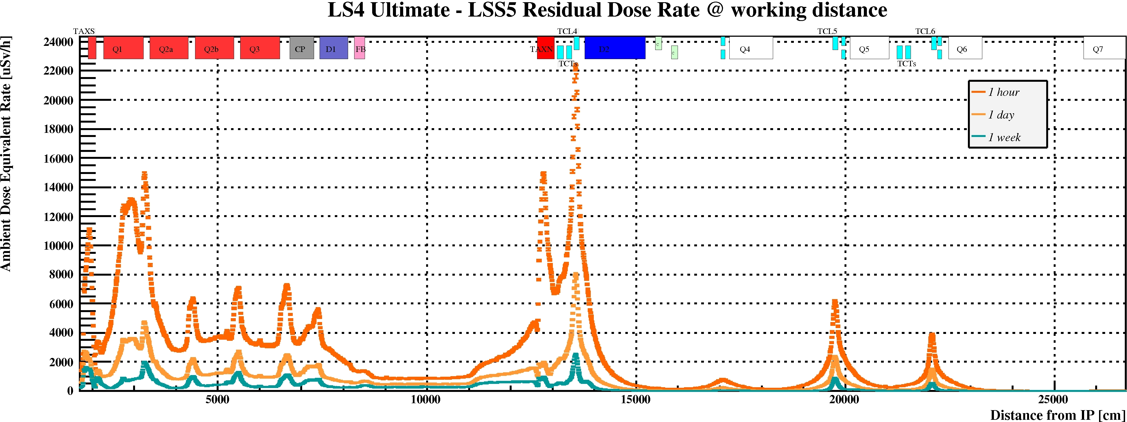
Residual Dose Rate Profiles

Slide 41
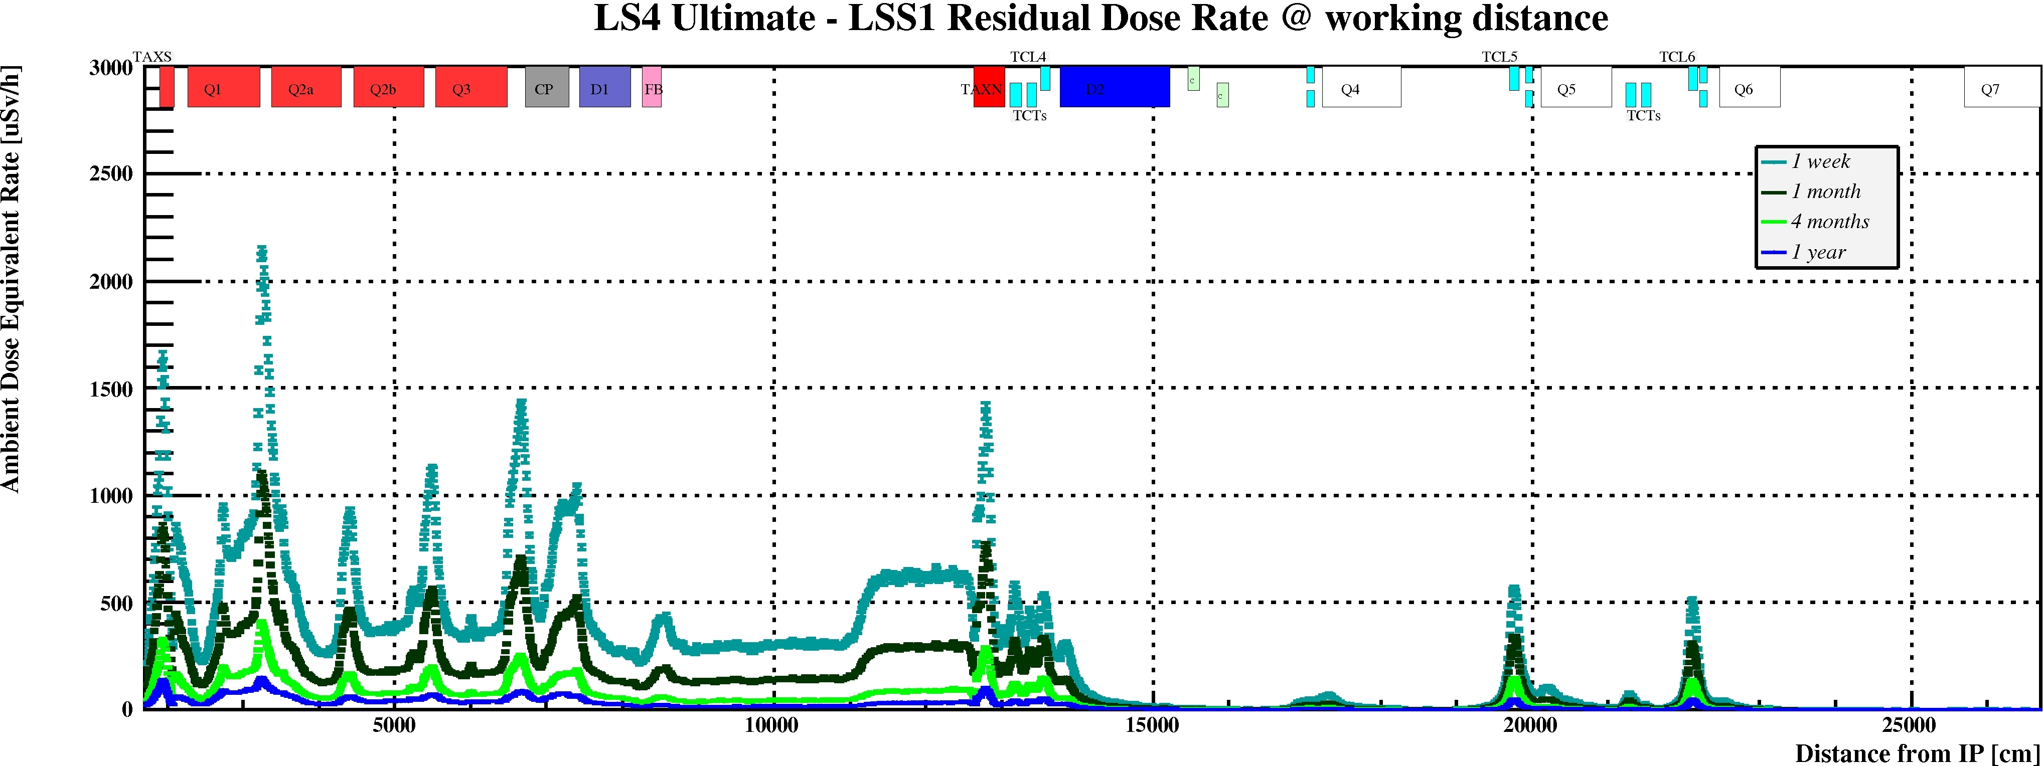
Residual Dose Rate Profiles

Slide 42
Residual Dose Rate Profiles

