Slide 1
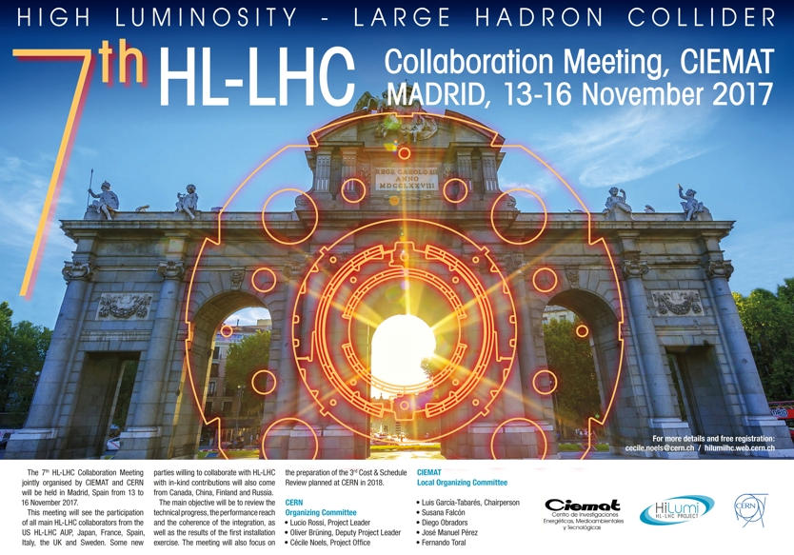
Radiation Protection Guideline for
Cobalt content in Stainless Steel
C. Adorisio
7th HL-LHC Collaboration Meeting
CIEMAT, 13-16 November 2017

Slide 2

Why we have to care about material composition
For materials being implemented in an accelerator environment the questions of its activation and therefore its induced radiological hazard have to be taken into account
Maintenance
Disposal
Transport
Decommissioning

Slide 3
When do we declare a material as radioactive?
The contamination of its surface exceeds the CS-limit
The actual dose rate after background subtraction exceeds 0.1 μSv/h @ 10 cm distance
The specific and absolute activity of a radio-nuclide exceeds the exemption limit LL, which in reality means, since an object contains normally a large number of different radio-nuclides:$\sum_{i}{\frac{a_{i}}{{LL}_{i}}}>1$
The specific and absolute activity of a radio-nuclide exceeds the exemption limit LL, which in reality means, since an object contains normally a large number of different radio-nuclides:∑_𝑖▒𝑎_𝑖/〖𝐿𝐿〗_𝑖 >1
OR
OR

Slide 4
Why we have to care about Cobalt
large thermal neutron cross-section to Co-60
Co-60 has a long half-life, ~5.27 years
the SWISS legislation (ORaP), which defines the limits for clearance at CERN, will become more restrictive in 2018
The limit for Co-60 will be lower by a factor 10:
Present LE [Bq/g] 1 Future LL [Bq/g] 0.1

Slide 5
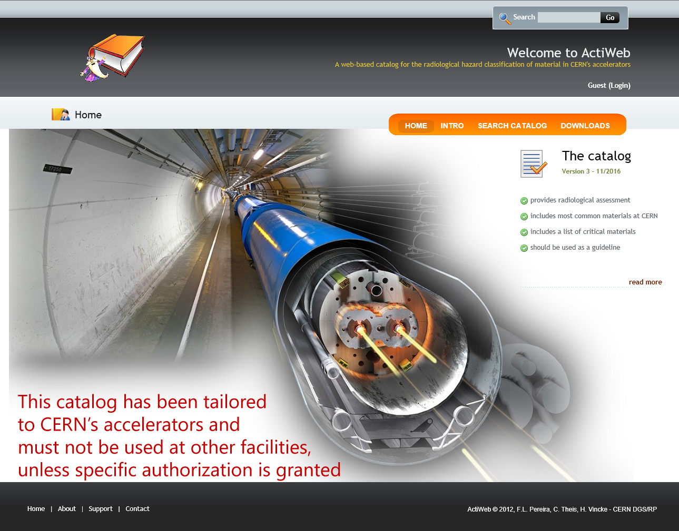
ActiWiz catalog
http://rpactiweb.cern.ch/actiweb/critical_materials.html
Notes:
This catalogue provides radiological guidelines via hazard values allowing for choosing materials in terms of their activation-triggered radiological consequences. The hazard factors are provided in quantities that allow to linearly compare the radiological consequences caused by the implementation of various materials in the given radiation environment (i.e.: a two times higher hazard factor of material “A” compared to material “B” results in double the radiological consequence of material “A” when being compared to material “B”). They consider both the operational (dose to personnel) and the radioactive waste (specific activity) aspects.

Slide 6
Radiological hazard vs Co content in Stainless Steel (316LN grade)
Stainless Steel 316LN grade composition:
(density 8 g/cm³)
Irradiation: 9 years of HL-LHC operation
  3 blocks of 3 consecutive years of operation + 1 year Long Shutdown
Cooling times:
  Operational hazard: 6 months
  Waste Clearance: 20 years
element | wt %
CARBON | 0.03
CHROMIUM | 17.3
COBALT | 0.1 / 0.15 / 0.2 / 0.3
IRON | 63.9
MANGANESE | 2
MOLYBDENUM | 2.5
NICKEL | 13
NITROGEN | 0.17
PHOSPHORUS | 0.0225
SILICON | 1
SULFUR | 0.0075
Cobalt comes as impurity, linked to the Nickel

Slide 7
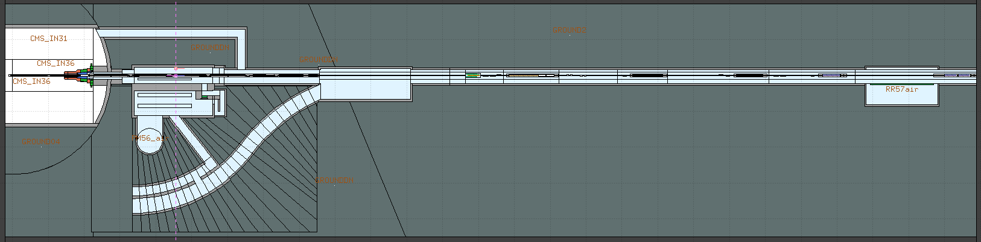
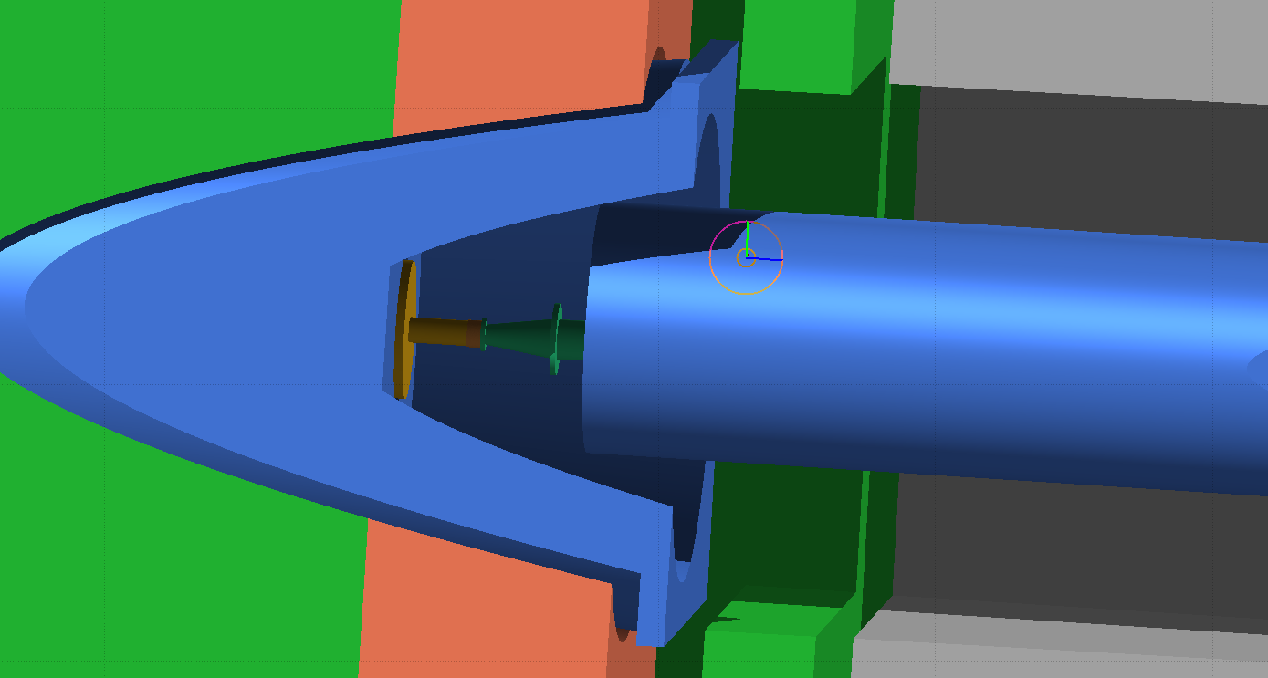
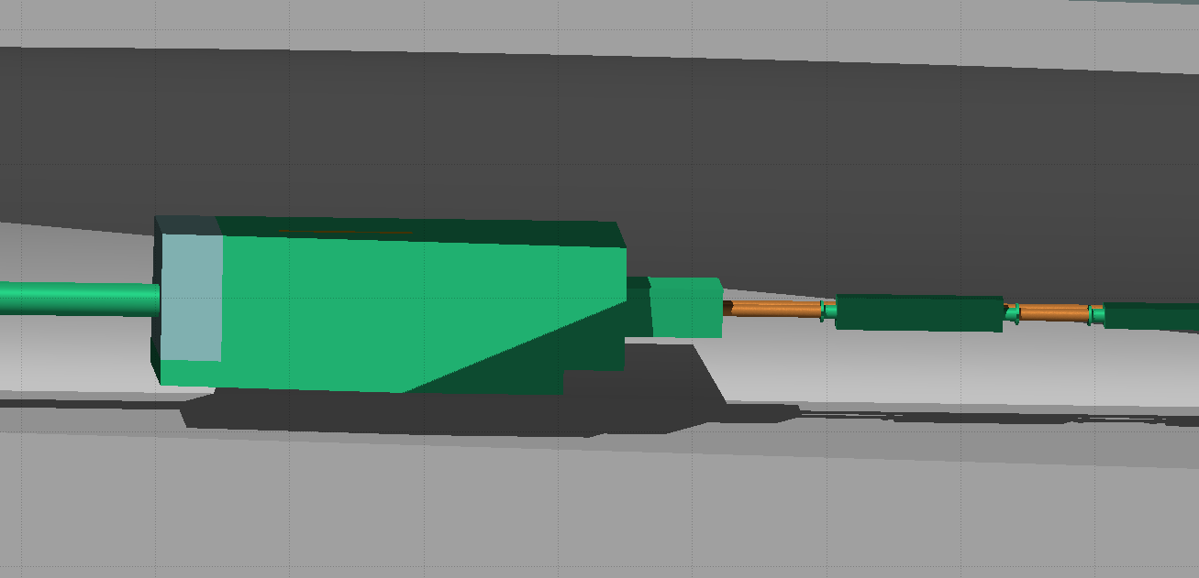
Considered positions
HL-LHV IR5 v1.3
Q1
TAXS
TAXN
TCL4
cell 4

Slide 8
TAXS front – next to beam pipe
For example, considering a SS 316LN plate:
1 week cooling time
Co content | H*(10) @1m | Co-60
wt% | uSv/h | contribution
0.1 | 260 | 13%
0.15 | 271 | 14%
0.2 | 283 | 17%
0.3 | 306 | 23%
1 month cooling time
Cobalt content | H*(10) @1m | Co-60
wt% | uSv/h | contribution
0.1 | 157 | 15%
0.15 | 168 | 21%
0.2 | 180 | 26%
0.3 | 203 | 34%
6 months cooling time
Cobalt content | H*(10) @1m | Co-60
wt% | uSv/h | contribution
0.1 | 65 | 35%
0.15 | 76 | 44%
0.2 | 86 | 51%
0.3 | 108 | 61%
1 year cooling time
Cobalt content | H*(10) @1m | Co-60
wt% | uSv/h | contribution
0.1 | 42 | 51%
0.15 | 52 | 60%
0.2 | 62 | 67%
0.3 | 82 | 75%
1 m
H*(10)
NOTA BENE:
The H*(10) absolute number refers to the unique contribution of the SS plate,
they are not representative of the radiation environment in the LHC tunnel
r= 47 cm
Q1
TAXS
h= 1 cm

Slide 9
TAXS front – next to beam pipe
Ambient dose equivalent rate ratio
x/0.1 | 1 w | 1 m | 6 m | 1 y
0.15 | 1.04 | 1.07 | 1.17 | 1.24
0.2 | 1.09 | 1.15 | 1.33 | 1.49
0.3 | 1.18 | 1.29 | 1.66 | 1.96
Q1
TAXS
Activity/LL ratio
x/0.1 | 1 w | 1 m | 6 m | 1 y
0.15 | 1.06 | 1.07 | 1.10 | 1.14
0.2 | 1.13 | 1.14 | 1.21 | 1.29
0.3 | 1.25 | 1.28 | 1.42 | 1.57

Slide 10
Q1 – next to the cryostat
For example, considering a SS 316LN plate:
1 week cooling time
Co content | H*(10) @1m | Co-60
wt% | uSv/h | contribution
0.1 | 62 | 47%
0.15 | 76 | 57%
0.2 | 90 | 63%
0.3 | 119 | 72%
1 month cooling time
Cobalt content | H*(10) @1m | Co-60
wt% | uSv/h | contribution
0.1 | 48 | 60%
0.15 | 62 | 69%
0.2 | 76 | 75%
0.3 | 105 | 81%
6 months cooling time
Cobalt content | H*(10) @1m | Co-60
wt% | uSv/h | contribution
0.1 | 32 | 85%
0.15 | 45 | 89%
0.2 | 59 | 92%
0.3 | 85 | 94%
1 year cooling time
Cobalt content | H*(10) @1m | Co-60
wt% | uSv/h | contribution
0.1 | 28 | 92%
0.15 | 40 | 94%
0.2 | 53 | 96%
0.3 | 78 | 97%
1 m
H*(10)
NOTA BENE:
The H*(10) absolute number refers to the unique contribution of the SS plate,
they are not representative of the radiation environment in the LHC tunnel
r= 47 cm
Q1
h= 1 cm
TAXS

Slide 11
Q1 – next to the cryostat
Ambient dose equivalent rate ratio
x/0.1 | 1 w | 1 m | 6 m | 1 y
0.15 | 1.24 | 1.30 | 1.42 | 1.46
0.2 | 1.46 | 1.59 | 1.84 | 1.91
0.3 | 1.92 | 2.19 | 2.69 | 2.82
Q1
TAXS
Activity/LL ratio
x/0.1 | 1 w | 1 m | 6 m | 1 y
0.15 | 1.13 | 1.32 | 1.37 | 1.41
0.2 | 1.25 | 1.64 | 1.75 | 1.81
0.3 | 1.51 | 2.28 | 2.49 | 2.63

Slide 12
Cell 4 – next to TCL4 collimator
For example, considering a SS 316LN plate:
1 week cooling time
Co content | H*(10) @1m | Co-60
wt% | uSv/h | contribution
0.1 | 46 | 19%
0.15 | 50 | 25%
0.2 | 55 | 31%
0.3 | 63 | 40%
1 month cooling time
Cobalt content | H*(10) @1m | Co-60
wt% | uSv/h | contribution
0.1 | 31 | 28%
0.15 | 35 | 37%
0.2 | 39 | 43%
0.3 | 47 | 53%
6 months cooling time
Cobalt content | H*(10) @1m | Co-60
wt% | uSv/h | contribution
0.1 | 15 | 55%
0.15 | 19 | 64%
0.2 | 23 | 71%
0.3 | 30 | 78%
1 year cooling time
Cobalt content | H*(10) @1m | Co-60
wt% | uSv/h | contribution
0.1 | 11 | 70%
0.15 | 14 | 78%
0.2 | 18 | 83%
0.3 | 25 | 88%
1 m
H*(10)
NOTA BENE:
The H*(10) absolute number refers to the unique contribution of the SS plate,
they are not representative of the radiation environment in the LHC tunnel
r= 47 cm
TCL4
h= 1 cm
TAXN
cell 4

Slide 13
Cell 4 – next to TCL4 collimator
Ambient dose equivalent rate ratio
x/0.1 | 1 w | 1 m | 6 m | 1 y
0.15 | 1.09 | 1.14 | 1.27 | 1.34
0.2 | 1.18 | 1.27 | 1.54 | 1.68
0.3 | 1.36 | 1.55 | 2.07 | 2.37
TCL4
TAXN
cell 4
Activity/LL ratio
x/0.1 | 1 w | 1 m | 6 m | 1 y
0.15 | 1.13 | 1.14 | 1.19 | 1.24
0.2 | 1.25 | 1.28 | 1.39 | 1.48
0.3 | 1.51 | 1.56 | 1.76 | 1.96

Slide 14
Contribution from Co to H*(10) vs Co content in Stainless Steel (316LN grade) - summary

Slide 15
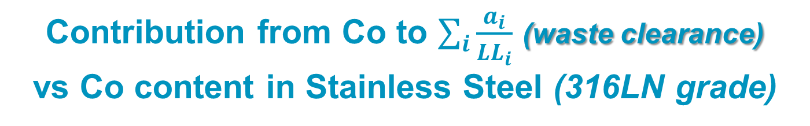
Contribution from Co to $\sum_{i}{\frac{a_{i}}{{LL}_{i}}}$ (waste clearance) vs Co content in Stainless Steel (316LN grade)

Slide 16
Summary
Cobalt content, even in a small fraction as impurity, is very relevant for radiation risk
It is important to keep the Cobalt content as low as reasonably possible – ALARA
Some experiences at CERN show that having SS with a max Cobalt content of 0.1wt% is feasible
Anywhere there is the choice, go for max 0.1wt% (or at least for the lowest possible Co content)

Slide 17
Thank you!

Slide 18
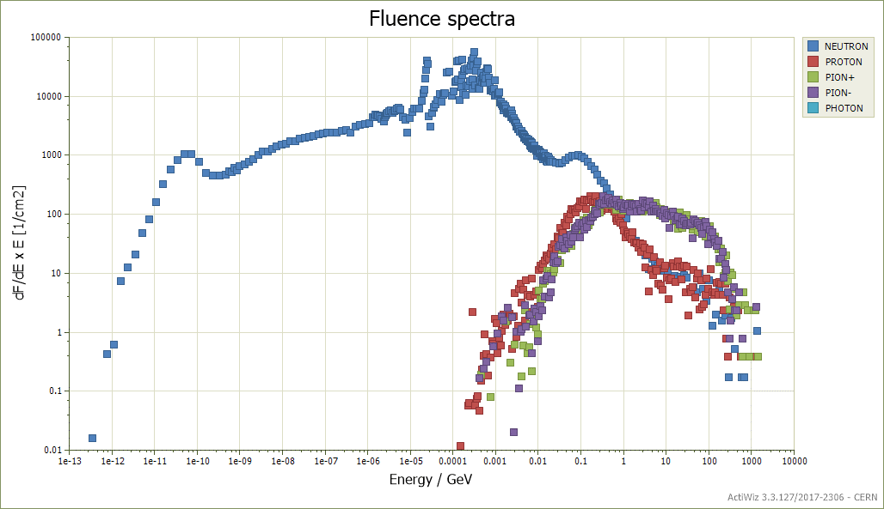
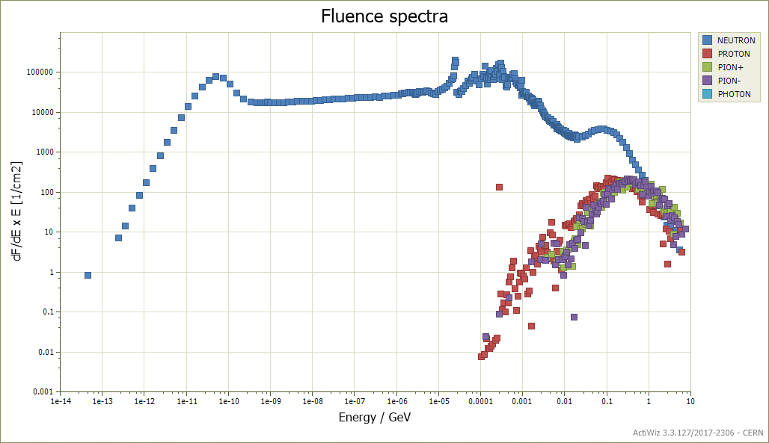
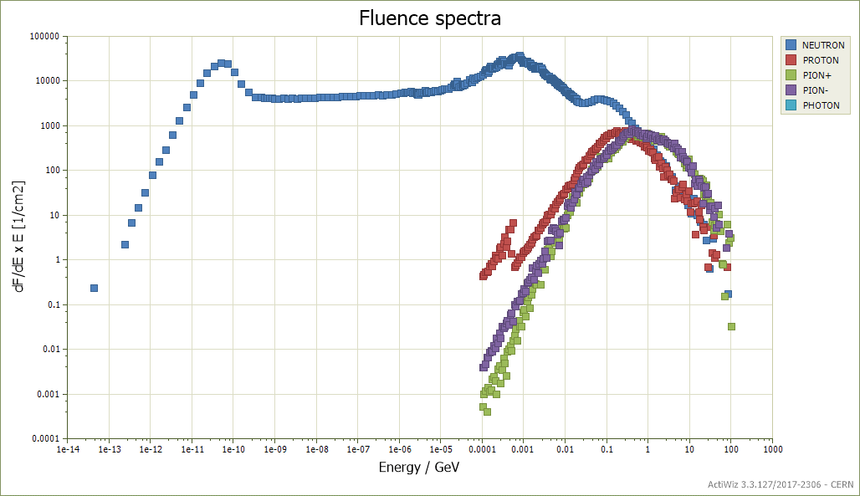
FLUKA fluence spectra
TAXS front – next to beam pipe
Q1 – next to the cryostat
Cell 4 – next to TCL4 collimator

Slide 19
TAXS front – next to beam pipe
6 months cooling time
Alloy Element | Contribution to H*(10) @ 1m | Weight fraction
IRON | 35.66% | 63.90%
COBALT | 33.59% | 0.10%
NICKEL | 24.29% | 13%
MANGANESE | 2.62% | 2%
MOLYBDENUM | 1.84% | 2.50%
CHROMIUM | 1.72% | 17.30%
SILICON | 0.26% | 1%
PHOSPHORUS: | <0.01% | 0.02%
SULFUR | <0.01% | 0.01%
NITROGEN | <0.01% | 0.17%
CARBON | <0.01% | 0.03%
Radionuclide | Contribution to H*(10) @ 1m
Mn-54 | 36%
Co-60 | 35%
Co-58 | 10%
Co-56 | 10%
Sc-46 | 3%
Co-57 | 2%
Alloy Element | Contribution to H*(10) @ 1m | Weight fraction
COBALT | 50.29% | 0.20%
IRON | 26.69% | 63.90%
NICKEL | 18.18% | 13%
MANGANESE | 1.96% | 2%
MOLYBDENUM | 1.38% | 2.50%
CHROMIUM | 1.29% | 17.20%
SILICON | 0.19% | 1.00%
PHOSPHORUS: | <0.01% | 0.02%
SULFUR | <0.01% | 0.01%
NITROGEN | <0.01% | 0.17%
CARBON | <0.01% | 0.03%
Radionuclide | Contribution to H*(10) @ 1m
Co-60 | 51%
Mn-54 | 27%
Co-58 | 8%
Co-56 | 7%
Sc-46 | 2%
Co-57 | 2%
Alloy Element | Contribution to H*(10) @ 1m | Weight fraction
COBALT | 60.28% | 0.30%
IRON | 21.33% | 63.80%
NICKEL | 14.53% | 13%
MANGANESE | 1.57% | 2%
MOLYBDENUM: | 1.10% | 2.50%
CHROMIUM | 1.03% | 17.20%
SILICON | 0.16% | 1.00%
PHOSPHORUS: | <0.01% | 0.02%
SULFUR | <0.01% | 0.01%
NITROGEN | <0.01% | 0.17%
CARBON | <0.01% | 0.03%
Radionuclide | Contribution to H*(10) @ 1m
Co-60 | 61%
Mn-54 | 21%
Co-58 | 6%
Co-56 | 6%
Sc-46 | 2%
Co-57 | 1%
ActiWiz3 Creator, V 1.1
Q1
TAXS

Slide 20
Radiological hazard vs Co content in Stainless Steel (316LN grade) - summary
TAXS front – next to beam pipe
6 months cooling time
Q1
TAXS

Slide 21
Q1 – next to the cryostat
6 months cooling time
Alloy Element | Contribution to H*(10) @ 1m | Weight fraction
COBALT | 84.63% | 0.10%
IRON | 8.60% | 63.90%
NICKEL | 5.28% | 13%
MANGANESE | 0.57% | 2%
CHROMIUM | 0.57% | 17.30%
MOLYBDENUM: | 0.31% | 2.50%
SILICON | 0.04% | 1%
PHOSPHORUS: | 0.01% | 0.02%
SULFUR | 0.01% | 0.01%
NITROGEN | 0.01% | 0.17%
CARBON | 0.01% | 0.03%
Radionuclide | Contribution to H*(10) @ 1m
Co-60 | 85%
Mn-54 | 8%
Co-58 | 2%
Co-56 | 2%
Alloy Element | Contribution to H*(10) @ 1m | Weight fraction
COBALT | 91.67% | 0.20%
IRON | 4.66% | 63.90%
NICKEL | 2.86% | 13%
MANGANESE | 0.31% | 2%
CHROMIUM | 0.31% | 17.20%
MOLYBDENUM: | 0.17% | 2.50%
SILICON | 0.02% | 1.00%
PHOSPHORUS: | 0.01% | 0.02%
SULFUR | 0.01% | 0.01%
NITROGEN | 0.01% | 0.17%
CARBON | 0.01% | 0.03%
Radionuclide | Contribution to H*(10) @ 1m
Co-60 | 92%
Mn-54 | 4%
Co-58 | 1%
Co-56 | 1%
Alloy Element | Contribution to H*(10) @ 1m | Weight fraction
COBALT | 94.29% | 0.30%
IRON | 3.19% | 63.80%
NICKEL | 1.96% | 13%
MANGANESE | 0.21% | 2%
CHROMIUM | 0.21% | 17.20%
MOLYBDENUM: | 0.12% | 2.50%
SILICON | 0.02% | 1.00%
PHOSPHORUS: | 0.01% | 0.02%
SULFUR | 0.01% | 0.01%
NITROGEN | 0.01% | 0.17%
CARBON | 0.01% | 0.03%
Radionuclide | Contribution to H*(10) @ 1m
Co-60 | 94%
Mn-54 | 3%
ActiWiz3 Creator, V 1.1
Q1
TAXS

Slide 22
Radiological hazard vs Co content in Stainless Steel (316LN grade) - summary
Q1 – next to the cryostat
6 months cooling time
Q1
TAXS

Slide 23
Cell 4 – next to TCL4 collimator
6 months cooling time
Alloy Element | Contribution to H*(10) @ 1m | Weight fraction
COBALT | 53.78% | 0.10%
IRON | 24.34% | 63.90%
NICKEL | 17.51% | 13%
MANGANESE | 1.87% | 2%
CHROMIUM | 1.19% | 17.30%
MOLYBDENUM: | 1.15% | 2.50%
SILICON | 0.16% | 1%
PHOSPHORUS: | 0.01% | 0.02%
SULFUR | 0.01% | 0.01%
NITROGEN | 0.01% | 0.17%
CARBON | 0.01% | 0.03%
Radionuclide | Contribution to H*(10) @ 1m
Co-60 | 55%
Mn-54 | 24%
Co-58 | 8%
Co-56 | 6%
Sc-46 | 2%
Co-57 | 2%
Alloy Element | Contribution to H*(10) @ 1m | Weight fraction
COBALT | 69.94% | 0.20%
IRON | 15.83% | 63.90%
NICKEL | 11.39% | 13%
MANGANESE | 1.22% | 2%
CHROMIUM | 0.77% | 17.20%
MOLYBDENUM: | 0.75% | 2.50%
SILICON | 0.10% | 1.00%
PHOSPHORUS: | 0.01% | 0.02%
SULFUR | 0.01% | 0.01%
NITROGEN | 0.01% | 0.17%
CARBON | 0.01% | 0.03%
Radionuclide | Contribution to H*(10) @ 1m
Co-60 | 71%
Mn-54 | 16%
Co-58 | 5%
Co-56 | 4%
Sc-46 | 1%
Co-57 | 1%
Alloy Element | Contribution to H*(10) @ 1m | Weight fraction
COBALT | 77.73% | 0.30%
IRON | 11.73% | 63.80%
NICKEL | 8.44% | 13%
MANGANESE | 0.90% | 2%
CHROMIUM | 0.57% | 17.20%
MOLYBDENUM: | 0.55% | 2.50%
SILICON | 0.08% | 1.00%
PHOSPHORUS: | 0.01% | 0.02%
SULFUR | 0.01% | 0.01%
NITROGEN | 0.01% | 0.17%
CARBON | 0.01% | 0.03%
Radionuclide | Contribution to H*(10) @ 1m
Co-60 | 78%
Mn-54 | 12%
Co-58 | 4%
Co-56 | 3%
ActiWiz3 Creator, V 1.1
TCL4
TAXN
cell 4

Slide 24
Cell 4 – next to TCL4 collimator
6 months cooling time
Radiological hazard vs Co content in Stainless Steel (316LN grade) - summary
TCL4
TAXN
cell 4

Slide 25
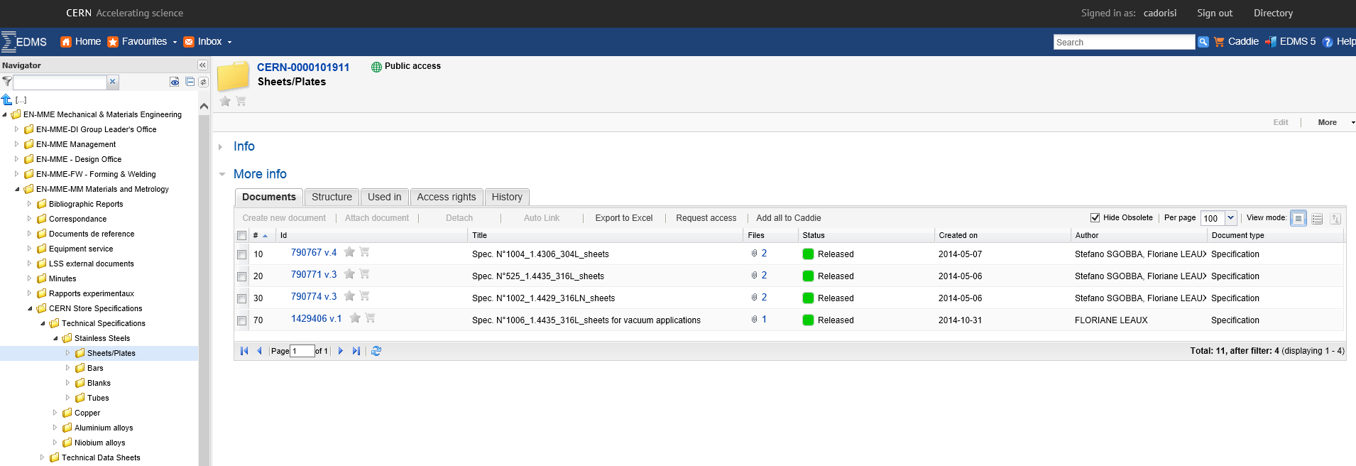
What already exists
Specification EN-MME:
https://edms.cern.ch/ui/#!master/navigator/project?P:1442625205:1540260177:subDocs
According to EN-MME experience:
No difficulties in procuring SS with max Cobalt content of 0.1 wt%
No extra cost, no extra time

Slide 26
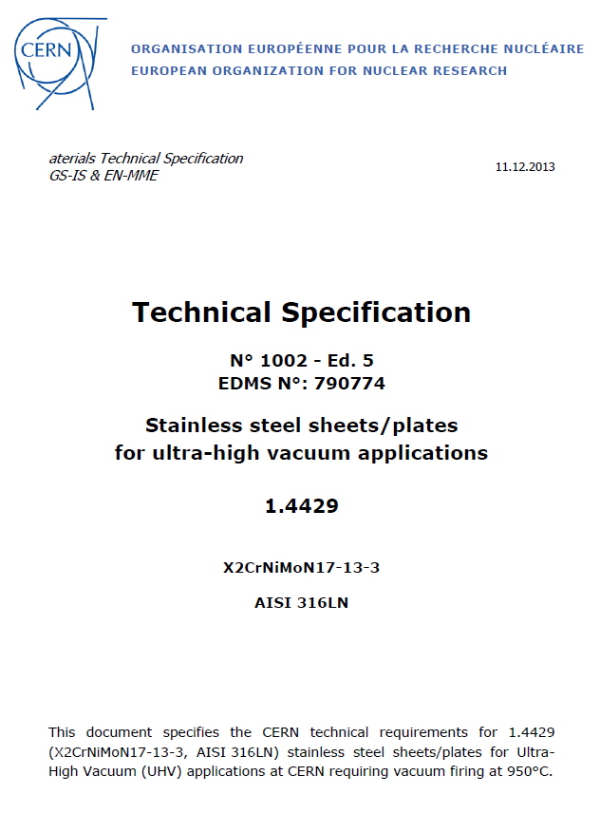
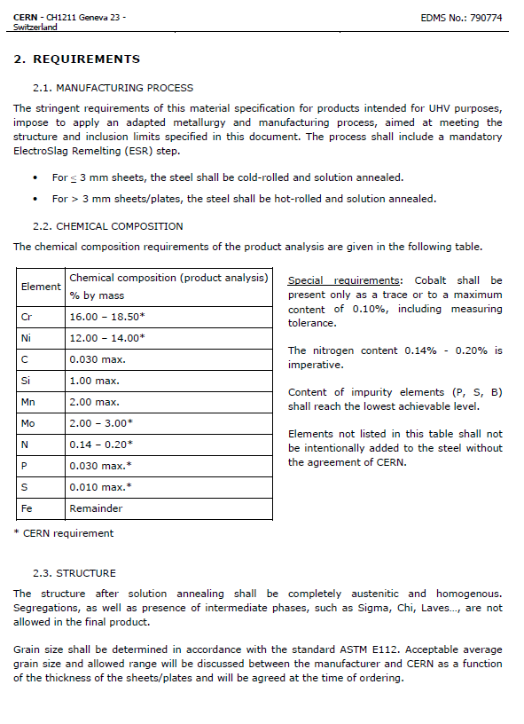
An example

Slide 27
Highly critical materials for accelerator environments
Highly critical elements due to their high radiological risk
Critical materials in terms of handling and waste disposal
ANTIMONY
IRIDIUM
TANTALUM
CADMIUM
LITHIUM
TERBIUM
CESIUM
SCANDIUM
THORIUM
COBALT
SILVER
URANIUM
EUROPIUM
STRONTIUM-90
XENON
GOLD
Besides the pure radiological risk there are also restrictions for some materials caused by difficulties in terms of their disposal as radioactive waste. Materials concerned can be grouped as follows:
Materials with restrictions in acceptance criteria at the final waste repositories:
Lead (higher than 0.1 % weight contribution in any material)
Mercury (higher than 0.1 % weight contribution in any material)
All chemically toxic materials (not always the storage for decay of the radiological risk is possible/advisable; therefore a limitation of their use is required). Examples are:
Beryllium
Nickel
Boron
Chromium
Arsenic
Antimony
Selenium
Cadmium
Asbestos

