Slide 1

Conformity approach for Pressure Equipment for the High Luminosity LHC Project
Thomas Otto, TE Department, CERN
Simon Marsh and Carlos Arregui, CERN HSE Unit
HL-LHC Collaboration Meeting, Madrid, 13. – 16. 11. 2017

Slide 2
CERN Mechanical Safety Rules
In accordance with its intergovernmental status, CERN establishes and updates Safety Rules to implement its Safety Policy
Mechanical Safety Regulation SR-M (2015) and associated General Safety Instructions
  Define the minimum safety requirements related to the life cycle of pressure equipment
  Valid for all new equipment and equipment brought onto the CERN site from elsewhere
  Aligned, as far as possible, to existing standards

Slide 3
CERN Mechanical Safety Rules
Design, manufacture and procurement
  Primarily based on European Directives for pressure equipment and transportable pressure equipment
  Use of harmonised European standards (EN and IEC)
    Use of other technical standards is subject to approval by HSE Unit
  CE marking
  Declaration of conformity
  Factory acceptance tests, where applicable
  Instruction manual

Slide 4
CERN Safety Rules for Pressure Equipment
Baseline approach
  Design, manufacturing and testing as per EN harmonised standards
  Compliance with Pressure Equipment Directive (PED) 2014/68/EU
  CE marking
Exceptional Approach
  Equipment that does not readily fit into the context of European harmonised standards (e.g. due to equipment type, materials, area of application, geographical origin, etc.)
  Classification as equipment with “major Safety implications”(mSi), at the discretion of the HSE Unit, who defines the Safety requirements
  HSE Unit performs the conformity assessment, for all equipment categories (substitutes itself for the notified body)

Slide 5
Pressure Equipment Directive (PED)
Conformity assessment
  Conformity assessment modules: the higher the category, the more demanding the requirements (increase of supervision from Notified body over the whole fabrication process).
Notified bodies
  Organisations appointed by EU states to assess conformity of a product to the ESRs before being put in the market.
  Categories II-IV require conformity to be assessed by external independent Notified bodies.
CE marking
  Affixed to equipment by the manufacturer.
  Statement that the equipment meets requirements of all relevant Directives – Declaration of conformity.
  Permitted only after Notified body attests full conformity to the Directive(s), when the Notified body involvement is required.

Slide 6
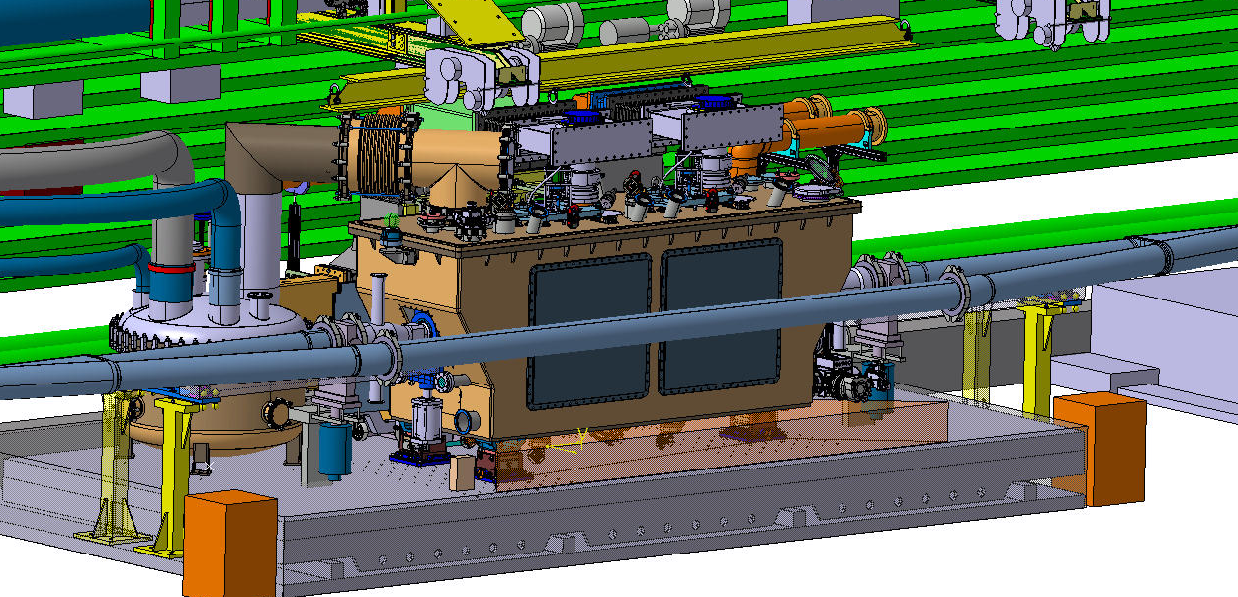
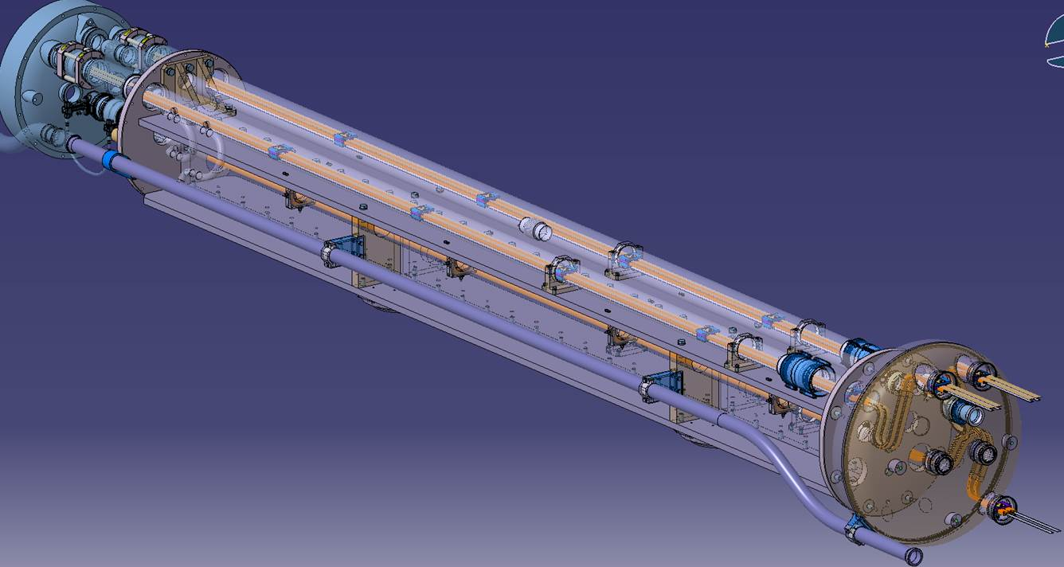
Application of CERN Mechanical Safety Rules – High Luminosity LHC Project
WP 4: crab cavity cryostat
WP 11: 11T Dipole
WP 3: Inner triplet magnets

Slide 7
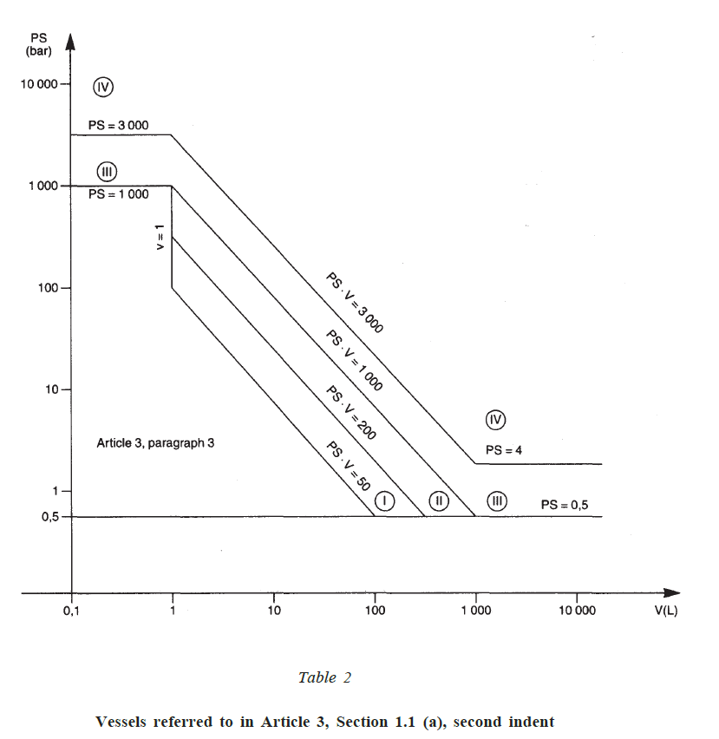
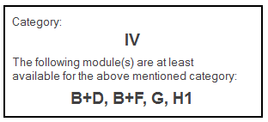
11T dipole cold mass
Annex II Table 2
PS = 20 bar
V = 183 L
PS * V = 3630 bar L > 3000 bar L
Article 4, Paragraph 3
WP 3: same criteria (PED Cat. IV) apply
WP 4: Niobium not officially qualified for mechanical properties at liquid Helium temperature

Slide 8
Conformity assessment by HSE
Requirements for HSE Safety clearance:
  Full compliance with the applicable Essential Safety Requirements (ESRs) in the PED
  Use of harmonised European standards wherever applicable (presumption of conformity) for design, manufacturing and testing, e.g.
    EN 13445 – Unfired pressure vessels;
    EN 13458 – Cryogenic vessels – static vacuum-insulated vessels;
    EN 10028 – Flat products made of steels for pressure purposes;
    …
  Other (inter)national standards may be used provided compliance with the ESRs is fully demonstrated
  Eventual non-compliances to be assessed individually. The Project shall propose compensatory measures to ensure a commensurate level of Safety
  Assessment of conformity to the ESRs is carried out by the HSE Unit acting as an ‘independent’ party

Slide 9
Conformity assessment by HSE
Design examination
  HSE Unit will validate the design of the equipment prior to the commencement of fabrication
  Manufacturer must produce technical documentation as to enable an assessment of the conformity of the equipment with the ESRs
Production quality assurance
  HSE Unit and Project to agree on the Inspection and Test Plan, including Safety-relevant Hold Points
  Manufacturer to provide quality records for the manufacturing part of the QA system, such as inspection reports and test data, qualifications of personnel concerned, etc.
  Documentation to ensure full traceability of components and processes

Slide 10
Conformity assessment by HSE
Provided Safety requirements are met and Safety clearance is achieved, CE marking is not compulsory as per the Safety Rules
HSE acts as de facto Notified body
  Involvement of external Notified body not required
Safety accessories (e.g. relief valves, rupture discs) have to be, however, fully compliant with the Pressure Equipment Directive and harmonised standards

Slide 11
Current status
Project has made a formal request to follow the ‘Exceptions to the baseline approach’ for 21 superconducting magnet and connection cryostat variants (concerning 191 pieces of equipment, including spares)
WP 3, WP 11 and HSE Unit work out the Inspection and Test Plan
Currently following same approach for the Crab Cavity prototype test facility, so expectation is that this will be requested for the series production

Slide 12
Thank you for your attention

Slide 13
Spare Slides

Slide 14
Pressure Equipment Directive (PED) 2014/68/EU – Annex I
Essential Safety Requirements - pressure equipment must be:
And they qualitatively cover:
As to ensure its safety when
Designed
Manufactured
Verified
Equipped and installed (if applicable)
Put into service as per manufacturer’s instructions
Other foreseeable conditions (including potential misuse)
Design
Calculation/experimental method
Provisions for safe handling/operation
Manufacturing
WPS and welding personnel to be approved by NoBo or recognised third party
NDT
Materials
Appropriate properties
Covered by EN, EAM or PMA
Adequate strength
Appropriate Safety factors
Safety accessories against overpressure
Operating instructions
Compulsory declaration from material supplier affirming compliance with a specification.
Traceability of material from receipt of material through final testing
Final proof test (normally hydrostatic, other tests allowed with additional measures, such as NDT)

