Slide 1


Simulation studies for the electron dynamics in the HL-LHC Hollow Electron Lens
BINP
A.M. Barnyakov, A.E. Levichev, M.V. Maltseva, D.A. Nikiforov (Budker Institute of Nuclear Physics)
With contributions from A.Rossi (CERN), G. Stancari (FNAL) and A. Pikin (BNL)

Slide 2
Context
HEL design
Electron gun simulation
Possible instabilities of the hollow e-beam
Virtual cathode
Asymmetry of the vacuum chamber
Drift velocities
Diocotron instability
Conclusion and feedback
Problems of the beam dynamics simulation
BINP

Slide 3
Hollow Electron Lens
Electron gun 3-5Ax10-15kV
Modulator
Collector
Main SC solenoid 4-6 T
Gun solenoid 0.2-3T
Bending SC solenoids ~3T
6.4 – 6.5 m
BINP

Slide 4
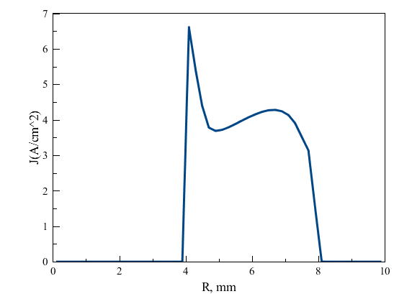
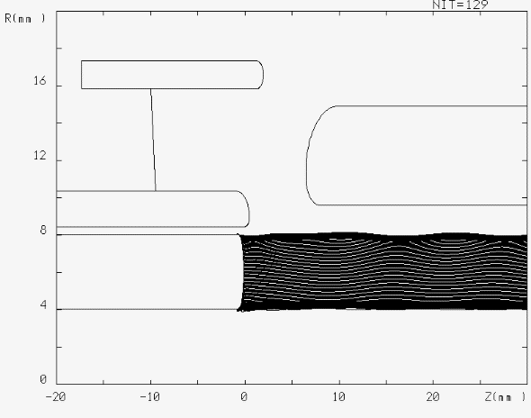
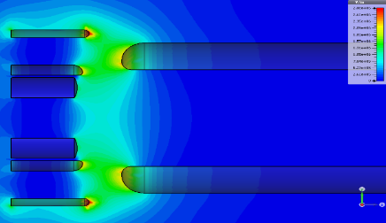
Gun simulations
Transverse profile on the distance of 30 mm from the cathode (5.9 A, 9.8 kV)
Renormalized Fermilab’s gun with curve cathode
Code: UltraSAM
Applied voltage | 10 kV | 12 kV
Extracted current | 5.9 A | 6.7 A
Mag. field on the cathode | 0.18 T | 0.18 T
BINP
Notes:
Warp simulation NAPA
Take

Slide 5
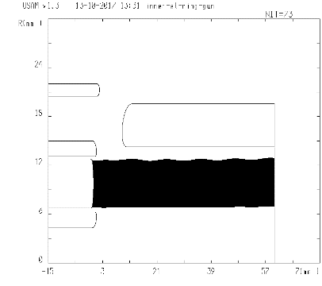
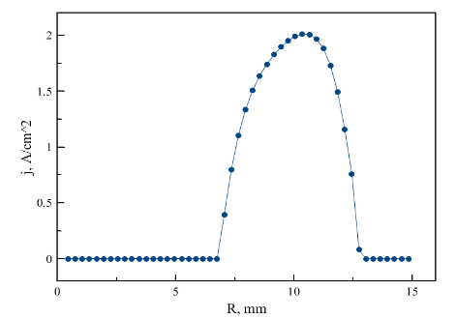
Proposal to change gun emission profile
If deemed necessary to have a smoother emission profile, it is proposed to add an inner electron to the FNAL gun design
BINP

Slide 6
Possible beam instabilities
There are many different instabilities for high current, non-relativistic beam. In general, most of them are investigated in physics of plasma, but not in physics of accelerators.
In our case, we have unique situation, when the beam parameters do not correspond in full to plasma or accelerators. On the one hand, the beam energy is too low and characteristics times are too large for the accelerators, but on the other hand, the beam size is too low and beam charge is too high for the plasma. Thus, the description and prediction of the beam instabilities are very difficult. We can indicate only the “critical points”, which can lead to the beam instabilities:
1. Sagging potential of the beam
2. Asymmetry of the vacuum chamber
3. Drift velocities
BINP

Slide 7
Sagging potential of the beam.
Pipe perveance
For non-relativistic beams the total energy consists of the kinetic and potential energy, but not only kinetic, E=U+K
The oscillations between two kinds of energies can occur, U↔K
There is maximum beam current with fixed kinetic energy, which can be transported through the vacuum pipe. It is determined by pipe perveance P_{p}
Analytical estimation for P_{p}
(cylindrical capacitor,
assuming round e-beam)
BINP
Notes:
Estimation of Perveance assuming round beam

Slide 8
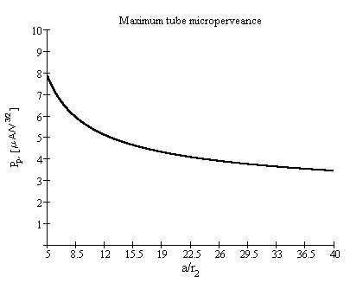
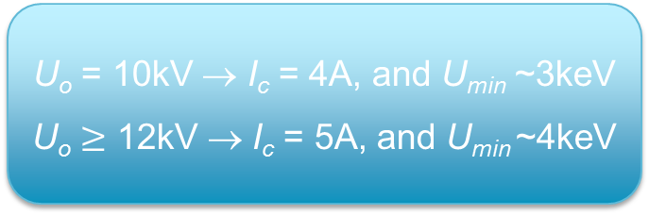
… and critical electron current
I_{c}=P_{p}U_{o}^{3/2}
Maximum current trough a pipe
for a given accelerating potential U_{o}
For I~I_{c}, the minimum beam
energy in the pipe will be ~U_{o}/3
U_{o} = 10kV
r_{p}/r_{b} =22.2 (40/1.8mm)
I_{c} = 4A
BINP
Notes:
Estimation of Perveance assuming round beam

Slide 9
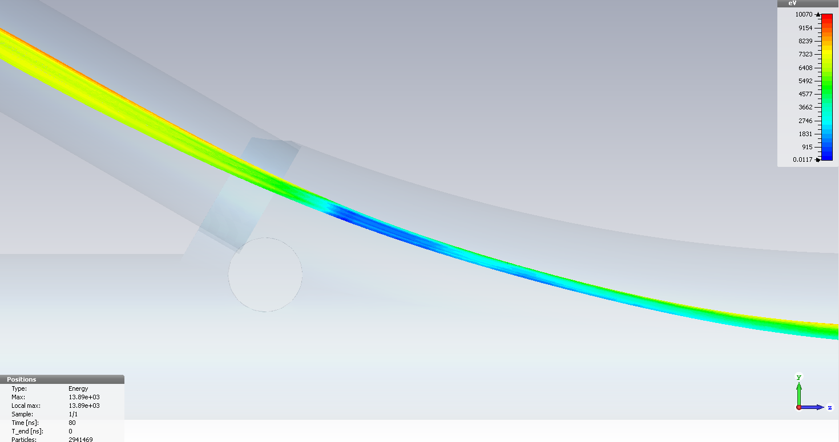
Effect of compression and virtual cathode: 10 kV accelerating voltage and 5A current
Code: CST
BINP

Slide 10
Regime near the ‘virtual cathode’
The regime of the virtual cathode (or near virtual cathode) is characterized by different phenomena such as
  Radio frequency radiation (like in VIRCATOR – VIRtual CAthode oscillaTOR),
  Distortion of the beam shape,
  Particle losses,
  Other instabilities (for example, diocotron)
  We should therefore work as far as possible from the critical regime.
In stable regime, the beam energy decrease is smaller and depends non-linearly on the beam radius.
BINP

Slide 11
Asymmetry of the vacuum chamber
Sagging potential of the beam depends on the distance between the beam and vacuum chamber
The asymmetric vacuum chamber leads to asymmetric beam potential and, therefore, to different velocities of the particles.
BINP

Slide 12

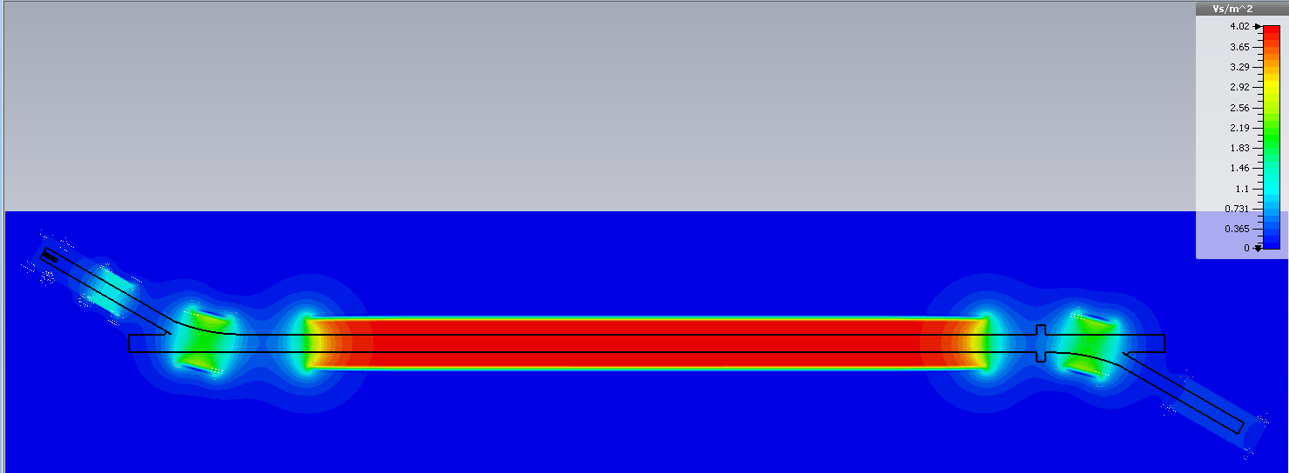
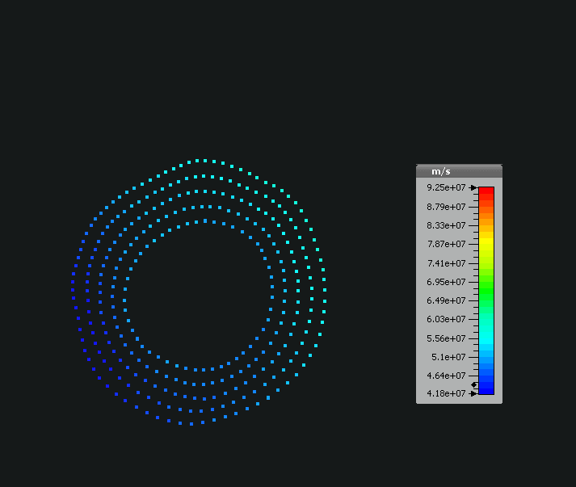
Changing beam potential after the bend
Maximum beam potential is about 12 kV
Minimum beam potential is about 5 kV
2 T
4 T
The beam potential has angular irregularity due to asymmetrical vacuum chamber of the bend
Gun potential is 12 kV, beam current is 5 A
BINP

Slide 13
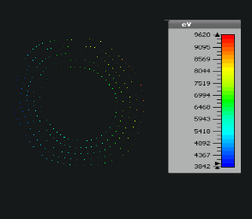
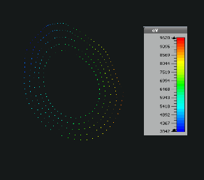
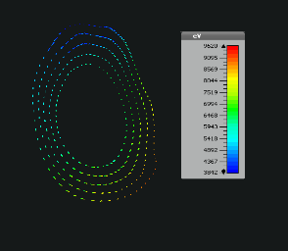
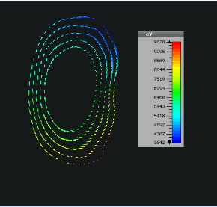
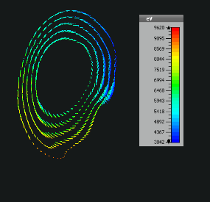
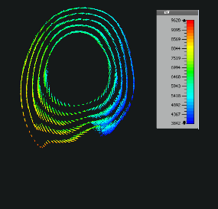
Beam misalignments
(beam is off-centered by 1.5 mm)
2 T
4 T
BINP
Gun potential is 10 kV, beam current is 4 A

Slide 14
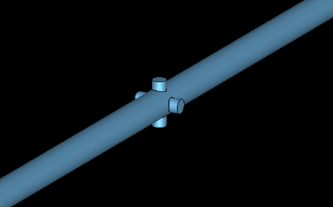
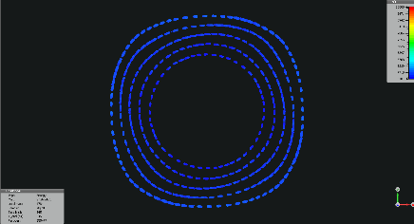
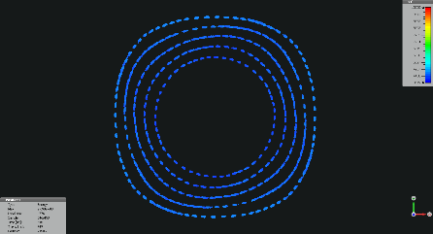
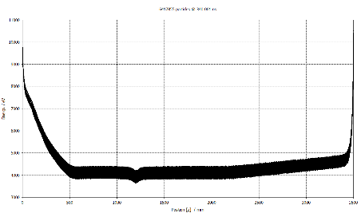
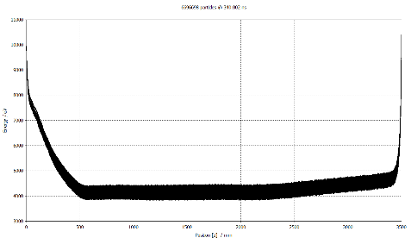
Beam potential along the HEL with ports for diagnostics
Cross section of the beam in fixed point with crossed vac. chamber
Cross section of the beam in fixed point without crossed vac. chamber
Additional ports for diagnostics do not seem to influence beam dynamics
Beam energy with crossed vac. chamber
Beam energy without crossed vac. chamber
Magnetic field of 6 T, initial energy is 10 kV, beam current is 4 A
BINP

Slide 15
Asymmetric vacuum chamber leads to
Asymmetric beam potential
Different particles longitudinal velocities
Non-laminar particle motion
Different Larmor precession
Different transverse velocities
and other
BINP

Slide 16
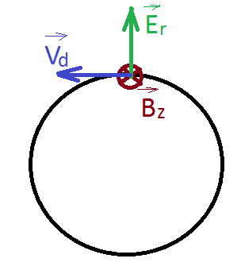
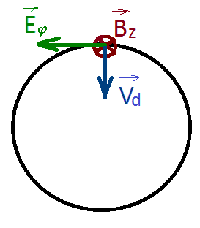
Effect of drift velocity
Drift velocity derives from the ExB (e-beam electric field is
significant for large e-currents)
Radial electric field of the beam and external longitudinal magnetic field provide the angular drift velocity
Angular drift velocity provides the angular rotation, which depends on the drift velocity and potential of the particle. It can lead to non-uniform current density
If there is angular component of the electric field, the radial drift velocity can arise and, therefore, the beam size can be changed
BINP
16
Notes:
16

Slide 17
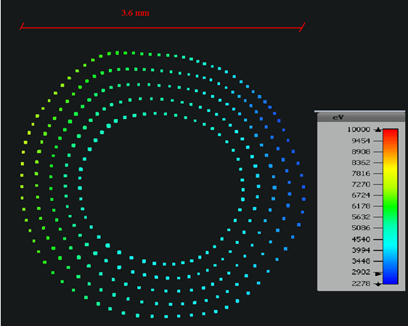
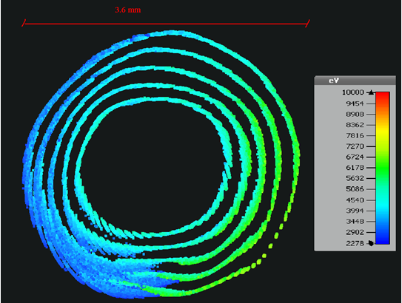
Beam instabilities due to drift velocities and asymmetric vacuum chamber
The beam profiles close to the beginning of the main solenoid with field of 4 T (beam current is 4 A, initial beam potential is 10 kV)
The beam profiles close to the end of the main solenoid with field of 4 T (beam current is 4 A, initial beam potential is 10 kV)
BINP

Slide 18

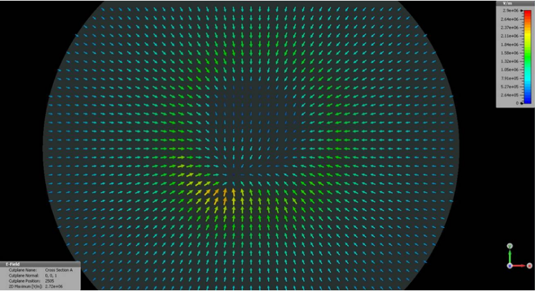
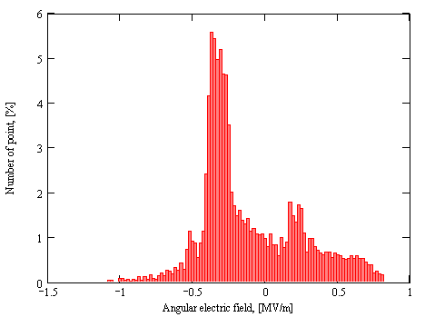
Beam instabilities due to drift velocities and asymmetric vacuum chamber
Main solenoid with field of 4 T, beam current is 4 A, initial beam potential is 10 kV
According to non-uniform distribution of the beam potential and drift velocities, the transverse current density becomes irregular, the electric field with angular component in the beam center is appeared. As a result, the beam size can be changed and additional instabilities can arise.
BINP

Slide 19
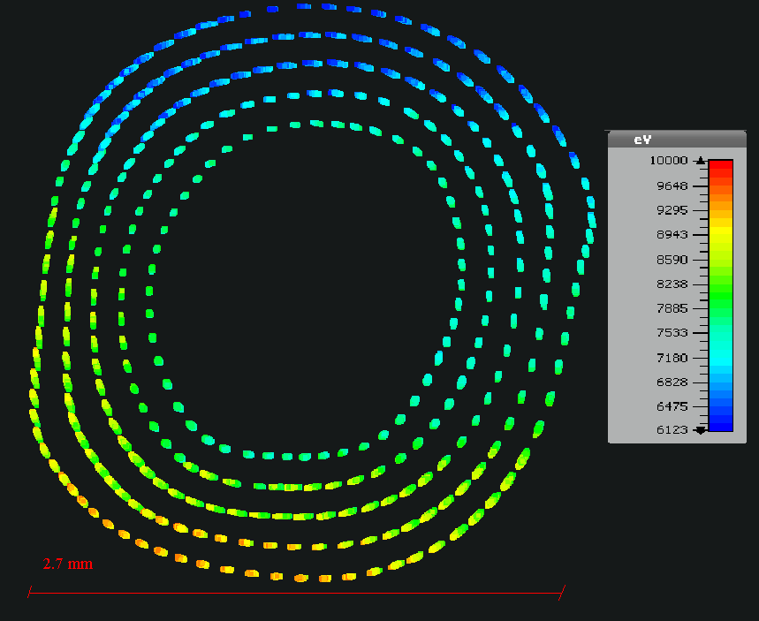
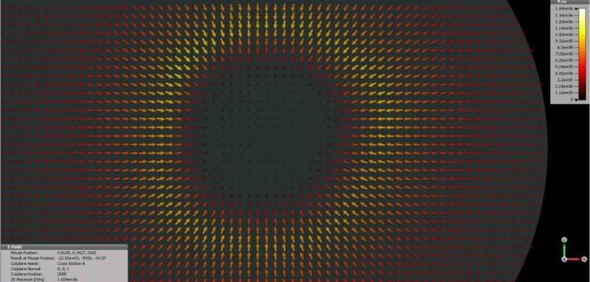
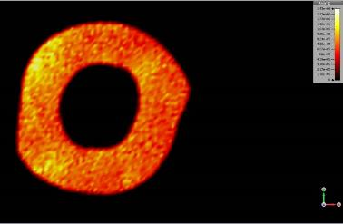
Beam instabilities due to drift velocities and asymmetric vacuum chamber
Main solenoid with field of 6 T, beam current is 4 A, initial beam potential is 12 kV
Beam current density
BINP

Slide 20
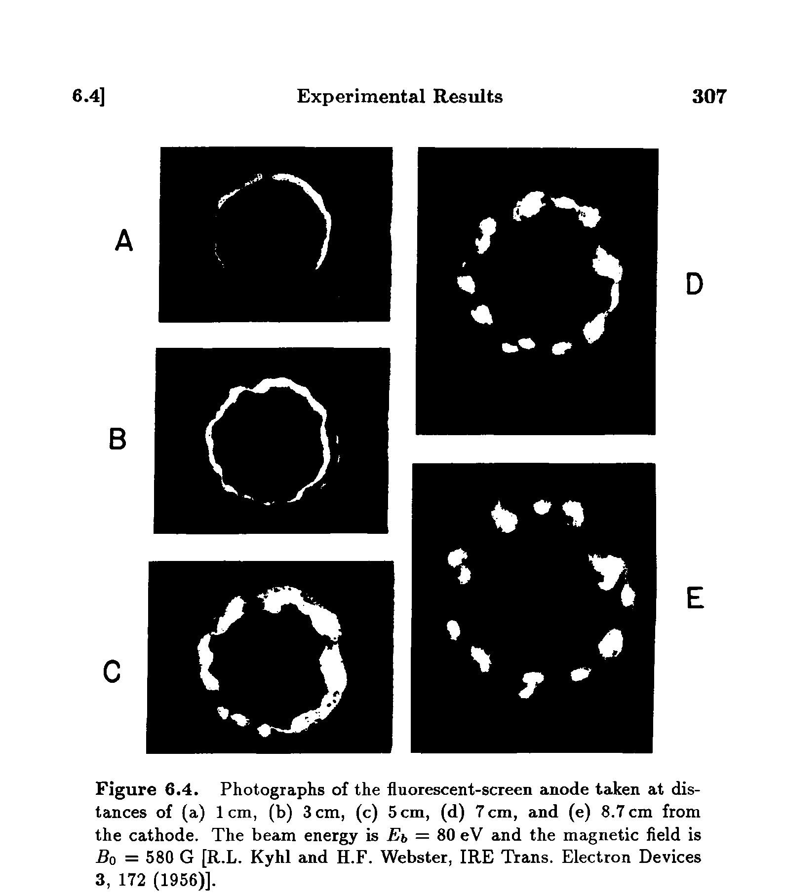
Diocotron instability
Diocotron instability is one of the frequent instabilities for non-neutral plasma and especially with hollow profile. It is a result of the interaction between plasma frequency, Larmor frequency and frequency provided by drift velocities.
Criterion and increment of the diocotron instability depends on the dimension of the e-beam and vacuum pipe, the density of the charge and external magnetic field.
Diocotron instability is characterized by azimuthal modes of the beam density.
BINP
R. Davidson.Physics of Nonneutral Plasmas. 1990

Slide 21
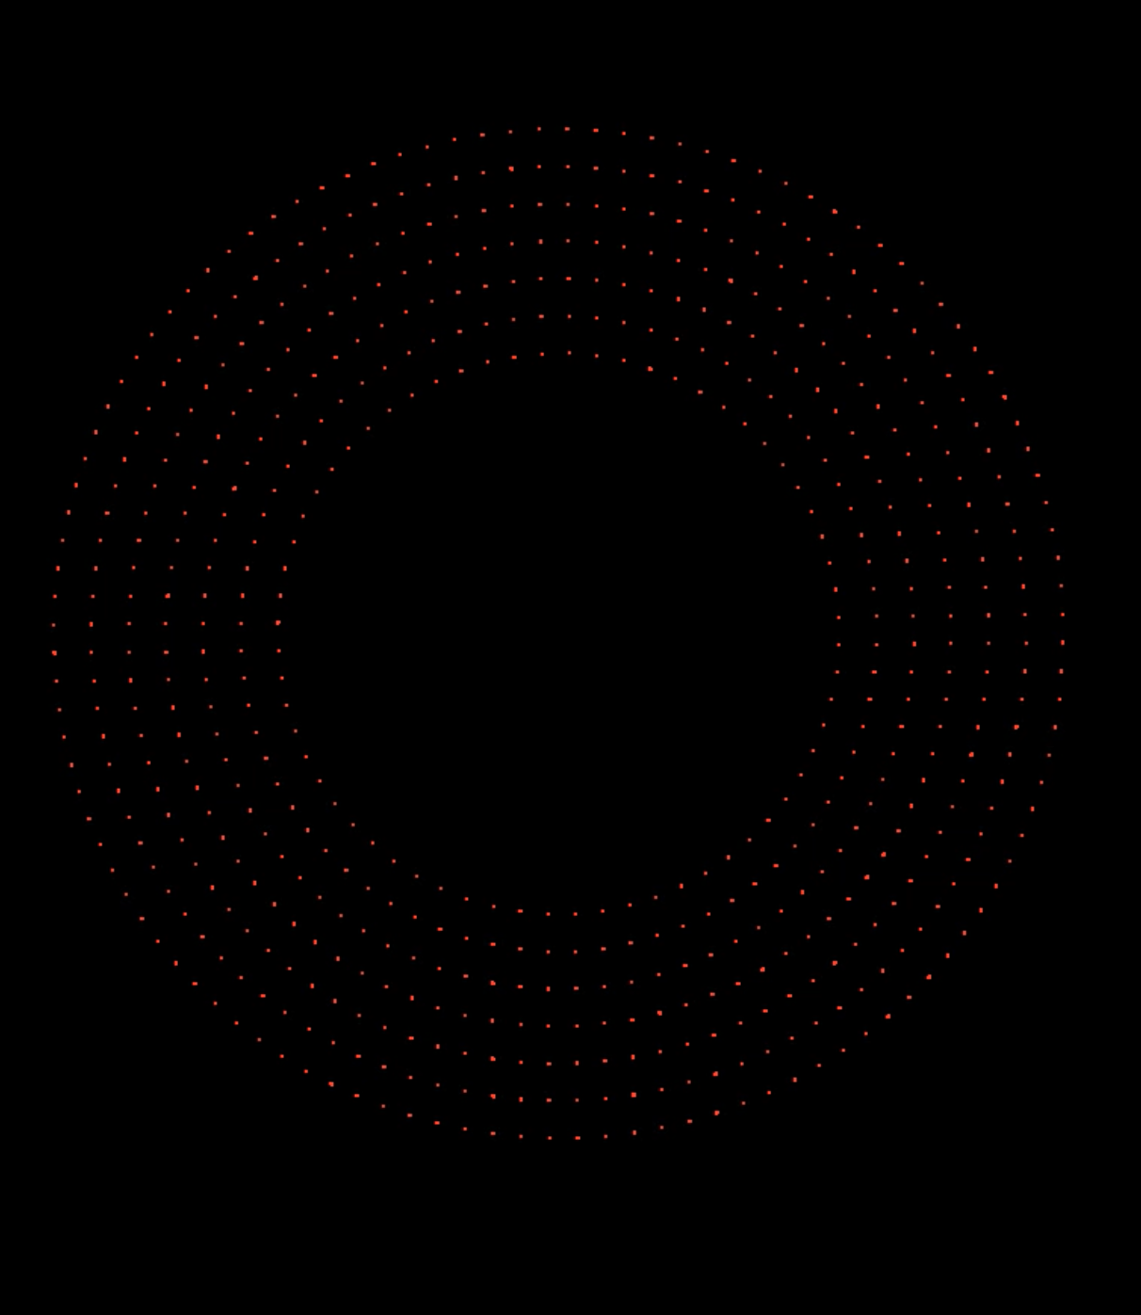

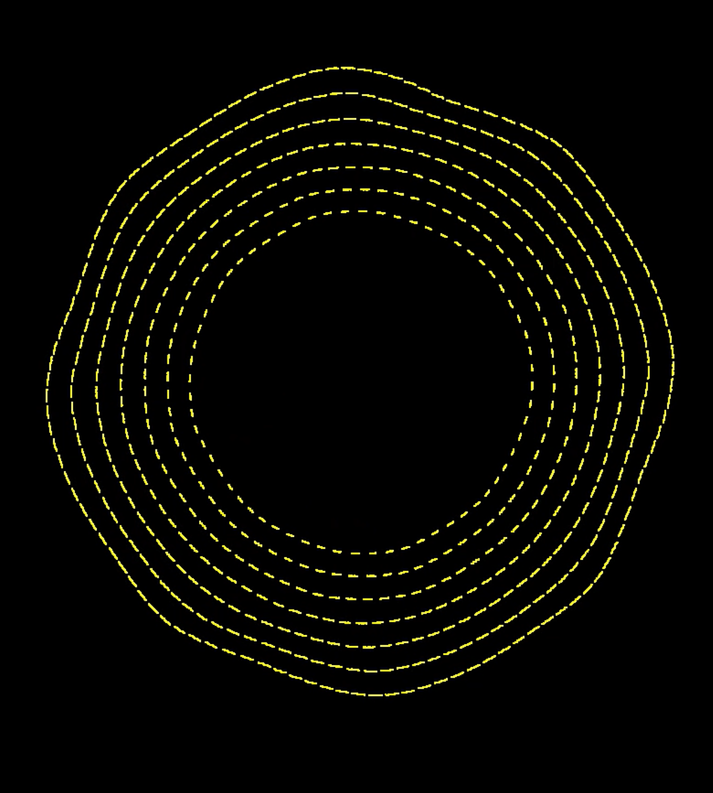
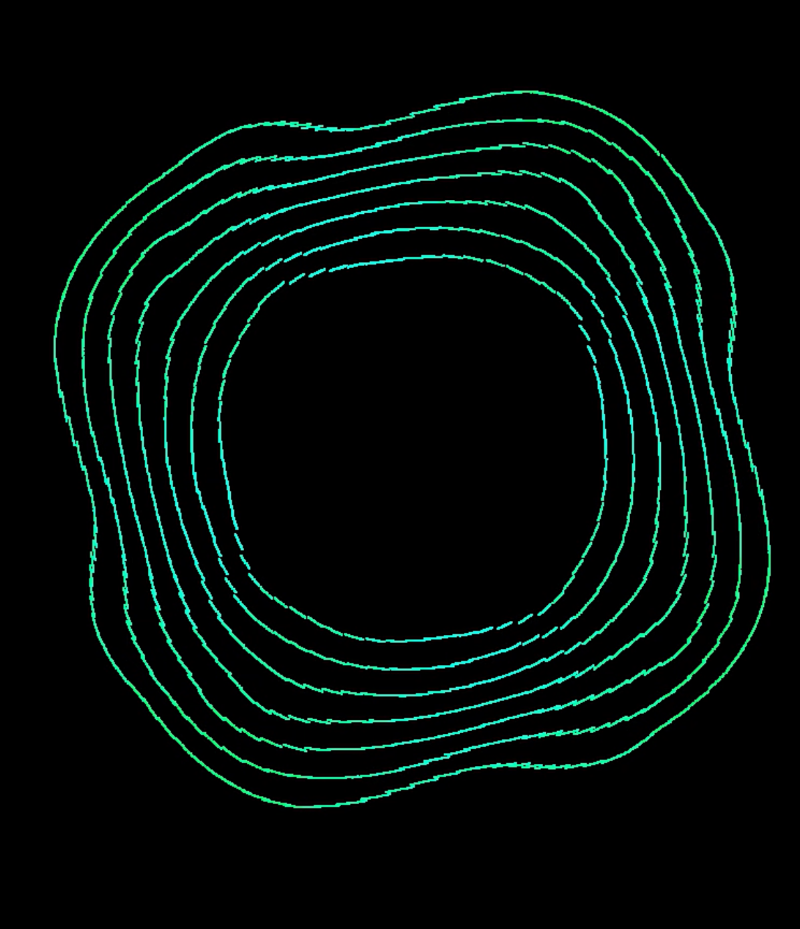
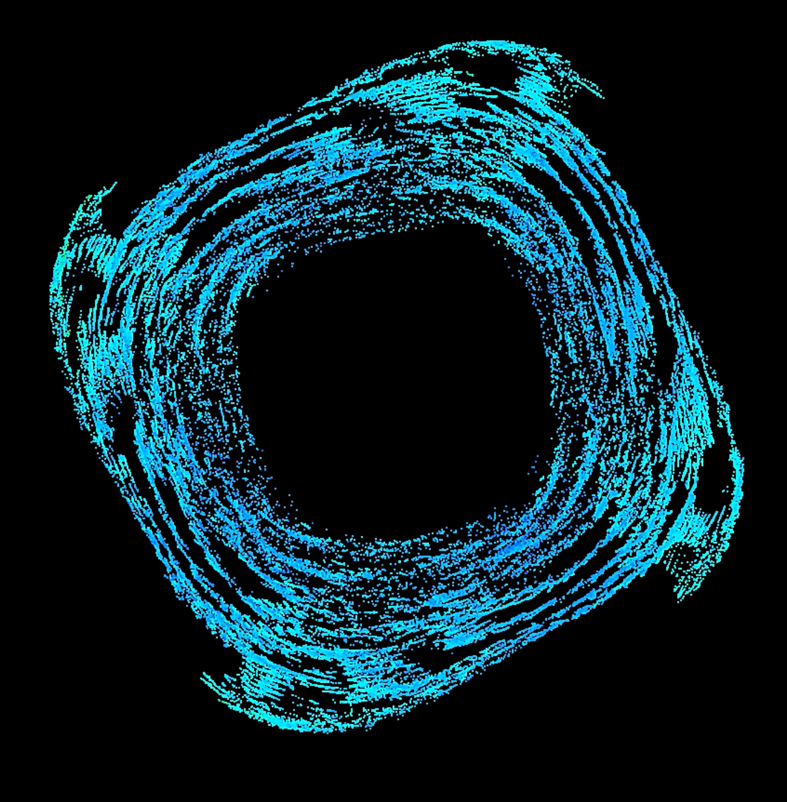
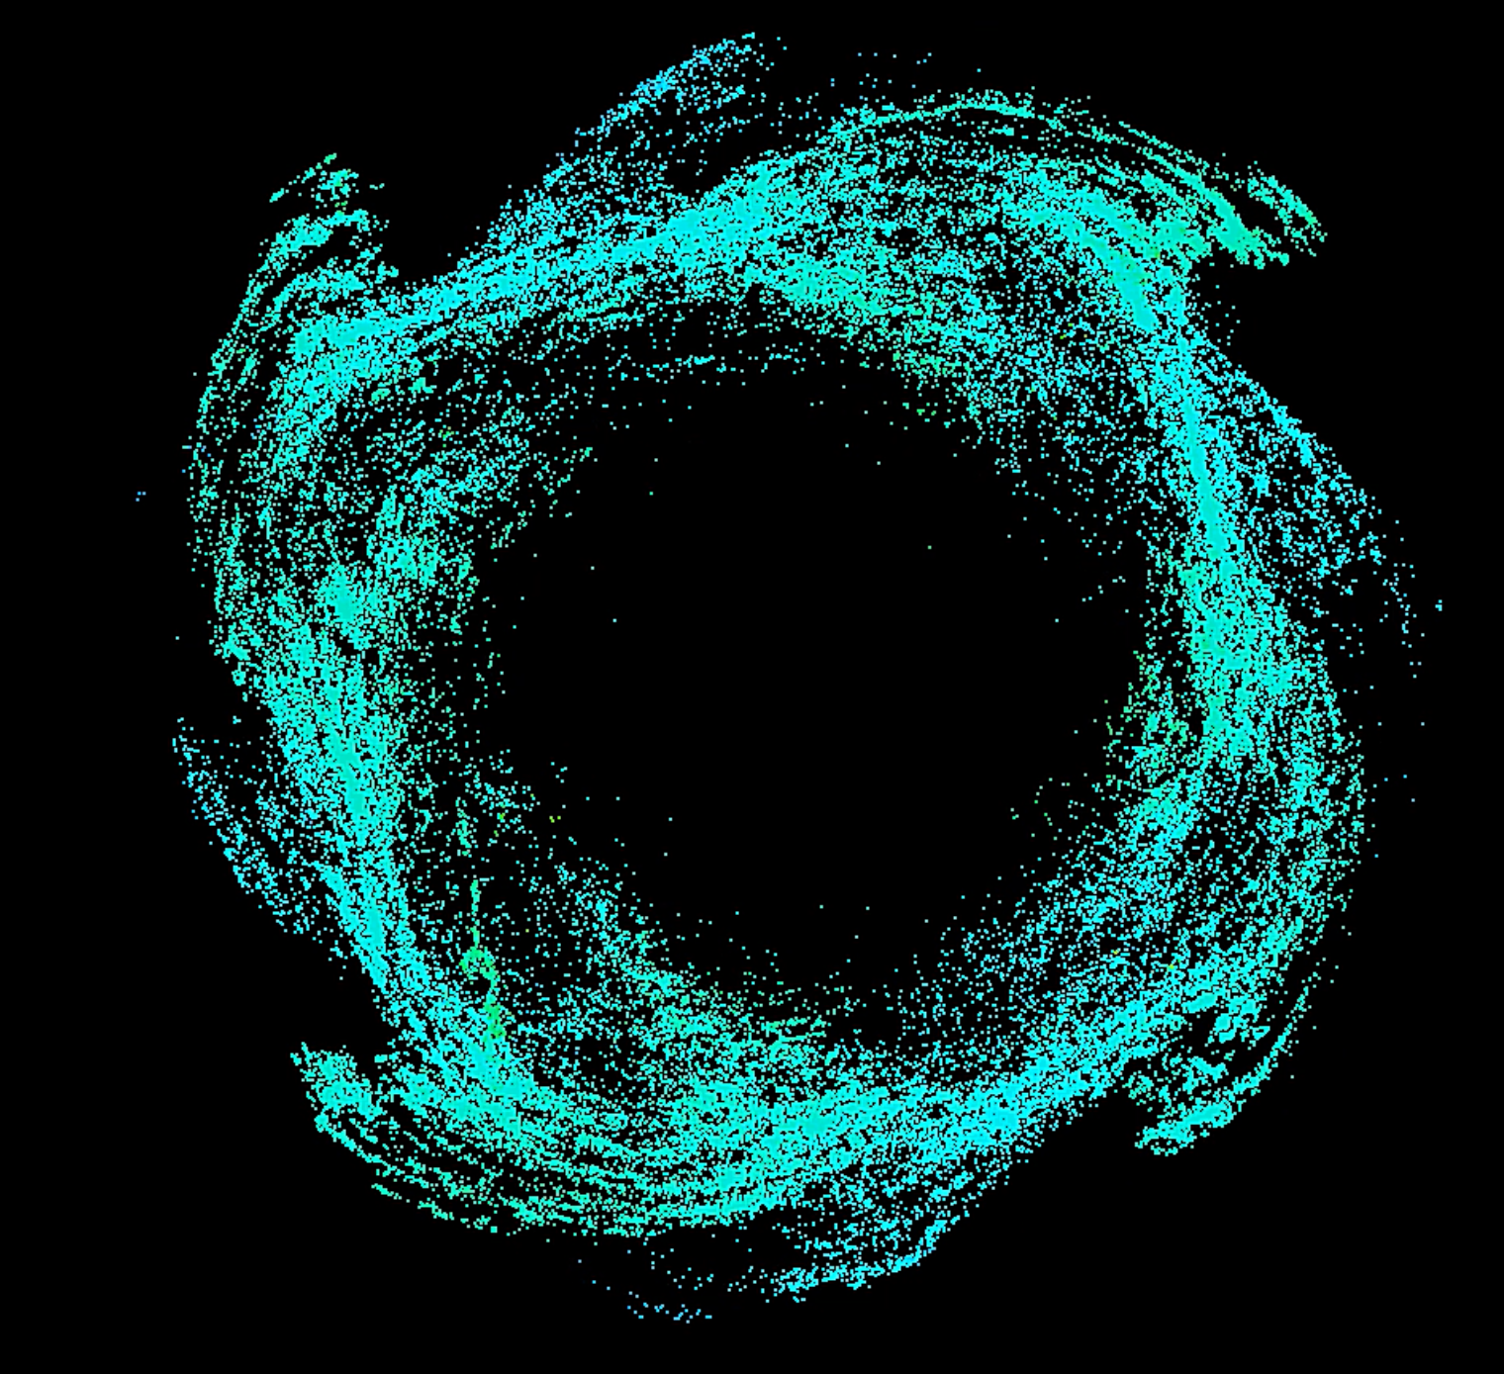
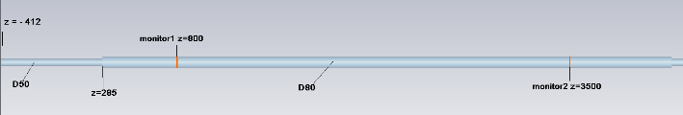
Diocotron instability
I<1 A
U~10 kV
I~2.5 A
U~8 kV
I~3.5 A
U~4 kV
I>4 A
U~? kV
I>4 A
U~? kV
I>4 A
U~? kV
BINP

Slide 22
Main conclusions and feedback to design
With 5A e-current it is necessary to increase the accelerating (anode) voltage to ≥ 12 kV
Working close to the critical beam perveance (4 A, 10 kV) may lead to instabilities or limit operational range
Beam misalignment or asymmetric vacuum chamber provide different azimuthal potential and can deform beam shape
Drift velocities can lead to irregular particle distribution, field inside the beam and many beam instabilities
Larger external magnetic field, larger initial beam potential or smaller beam current can compensate drift velocities
In order to have the stable beam, the beam current has to be reduced and beam potential with external fields should be increased. The operating regime should be chosen far from critical pipe perveance
BINP

Slide 23
Main problems of the simulation
Typical beam size is about 1 mm, therefore the size of the cell should be less than 1 mm. Taking into account the total length of the HEL, the number of the cells is too large
Even if we find the computer resource, which allows us to calculate the total design of HEL with necessary grid, the numerical errors can prevent to obtain a good results
It is necessary to simulate the total duration of the e-beam, because, many instabilities have the time of increment (for example, diocotron instability). Typical time of the simulation of 1 us is about 12 hours, the total duration of the beam is 80 us
Computer resource should be withmargin, because, when the resource is not enough the process can be terminated and the results will be lost
What can we do to improve the simulations?
Division of the task into elements
Use the theory for the more clear understanding of the physics
Comparison of the simulations with theory
Use the test stand and comparison of the measurements with simulation**
** The test stand can be simplified and to consist of different parts, for example, e-gun, e-gun with long solenoid, e-gun with the bend etc. Also, in our opinion, the parameters can be differed from the real stand, but they should satisfy the investigated phenomenon.
BINP

Slide 24
Thank you for your attention
BINP

