Slide 1


Update on HL-LHC Availability Estimates
Apollonio, J. Uythoven, TE-MPE
Many thanks to the AFT team
HL-LHC Annual Meeting, 13 – 16 November 2017, Madrid

Slide 2
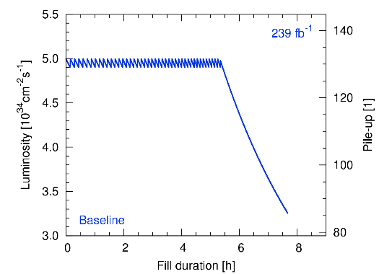
Reminder: Integrated Luminosity for HL-LHC
L. E. Medina Medrano, R. Tomas Garcia
Target: 3000 fb⁻¹ over HL-LHC lifetime
  250 fb⁻¹ per year
  160 days of p-p physics
  1.56 fb⁻¹ per day
Levelling: 5*10³⁴ [cm⁻²s⁻¹]
Simple calculation:
12 h HL-LHC fill produces ~ 1.5 fb⁻¹
Requirement for HL-LHC physics efficiency is ~ 50 %
The physics efficiency depends on the achieved machine availability
HL Annual Meeting Madrid 15 Nov 2017 Jan Uythoven

Slide 3
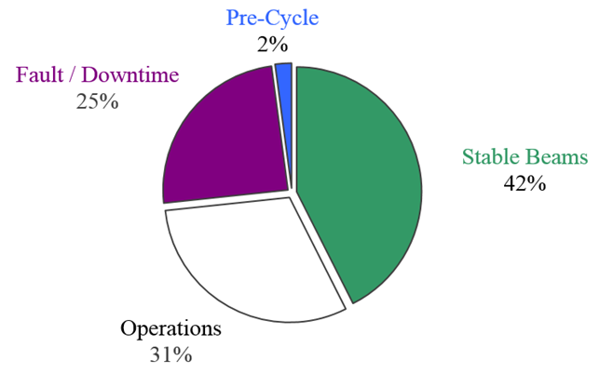
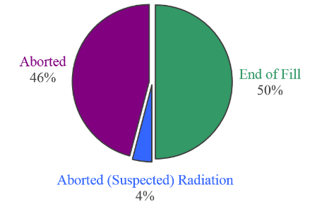
2017 Statistics (TS1-TS2)
621 h in Stable Beams
98 fills to Stable Beams
2017 performance limited by recurring dumps due to beam losses in 16L2, otherwise very good machine availability and smooth operation
HL Annual Meeting Madrid 15 Nov 2017 Jan Uythoven

Slide 4
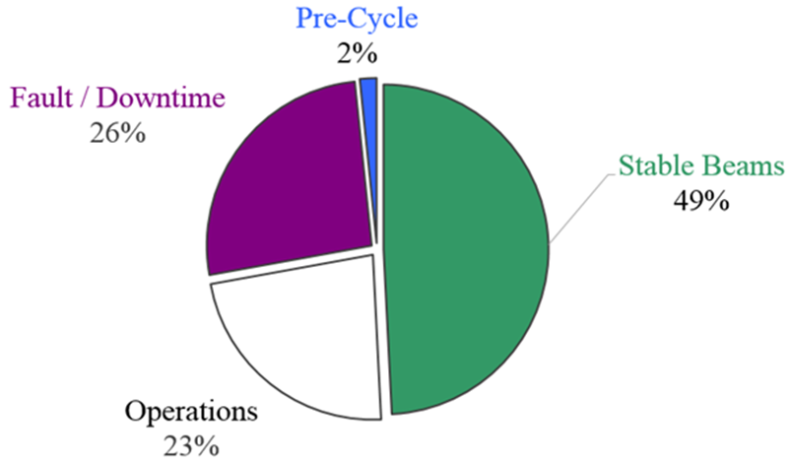
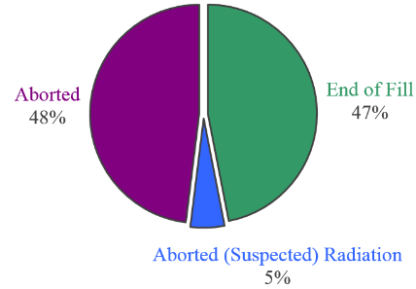
2016 Statistics (reference year)
1840 h in Stable Beams
175 fills to Stable Beams
vs. 31 % 2017 up to TS2
2016 is chosen as a reference for the reproducibility of operating conditions
HL Annual Meeting Madrid 15 Nov 2017 Jan Uythoven

Slide 5
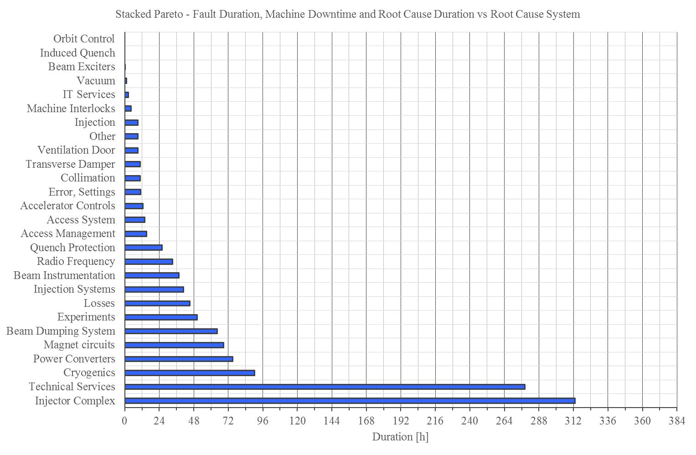
2016 Downtime Distribution
LHC availability in 2016 mainly limited by:
Isolated, long stops (transformer Pt8, LBDS erratics, POPS)
Electrical perturbations
Availability of the injector complex
Will be even more important for HL-LHC due to shorter fills
[h]
HL Annual Meeting Madrid 15 Nov 2017 Jan Uythoven

Slide 6
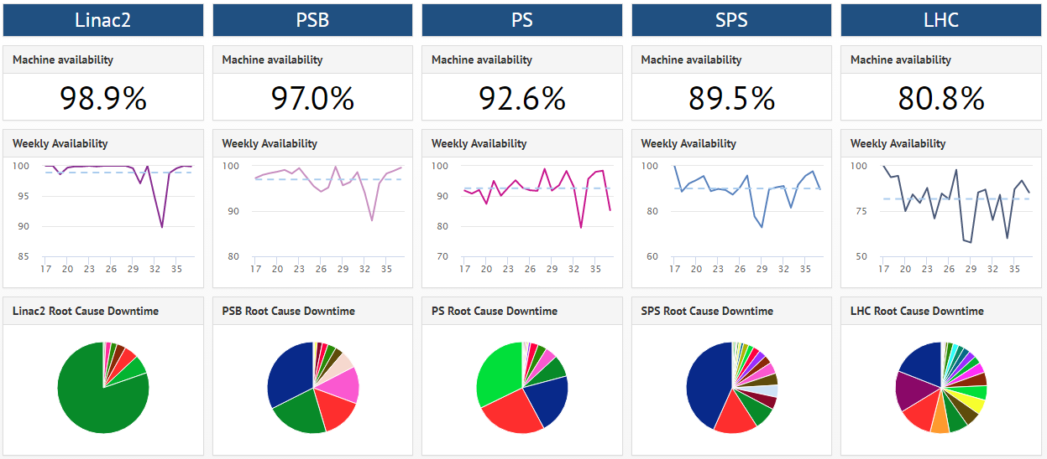
2017 Performance of the Injector Complex (May – Sep)
Accelerator Fault Tracker in use from the beginning of 2017 in all injectors
Linac2
CV
SPS
PS
RF
PSB
RF
PC
PC
HL Annual Meeting Madrid 15 Nov 2017 Jan Uythoven

Slide 7
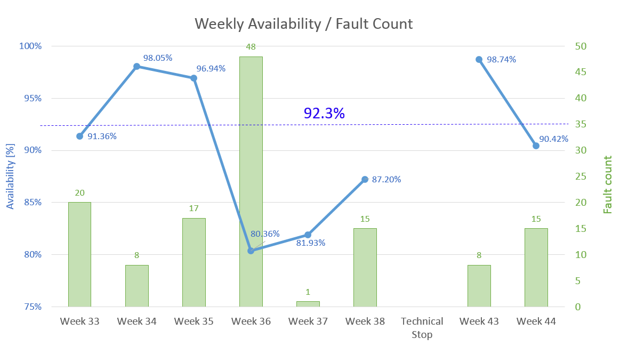
First Results from Linac4 Reliability Run
Period: 14/08/2017 – 06/11/2017
Last time updated: 08/11/2017
O. Rey Orozco
11 systems out of 18 (61 %) operated without faults
Achieving high Linac4 availability will be crucial for HL-LHC goals!
Official target availability is 95 %
*
* only 1 day of operation that week, planned intervention

Slide 8
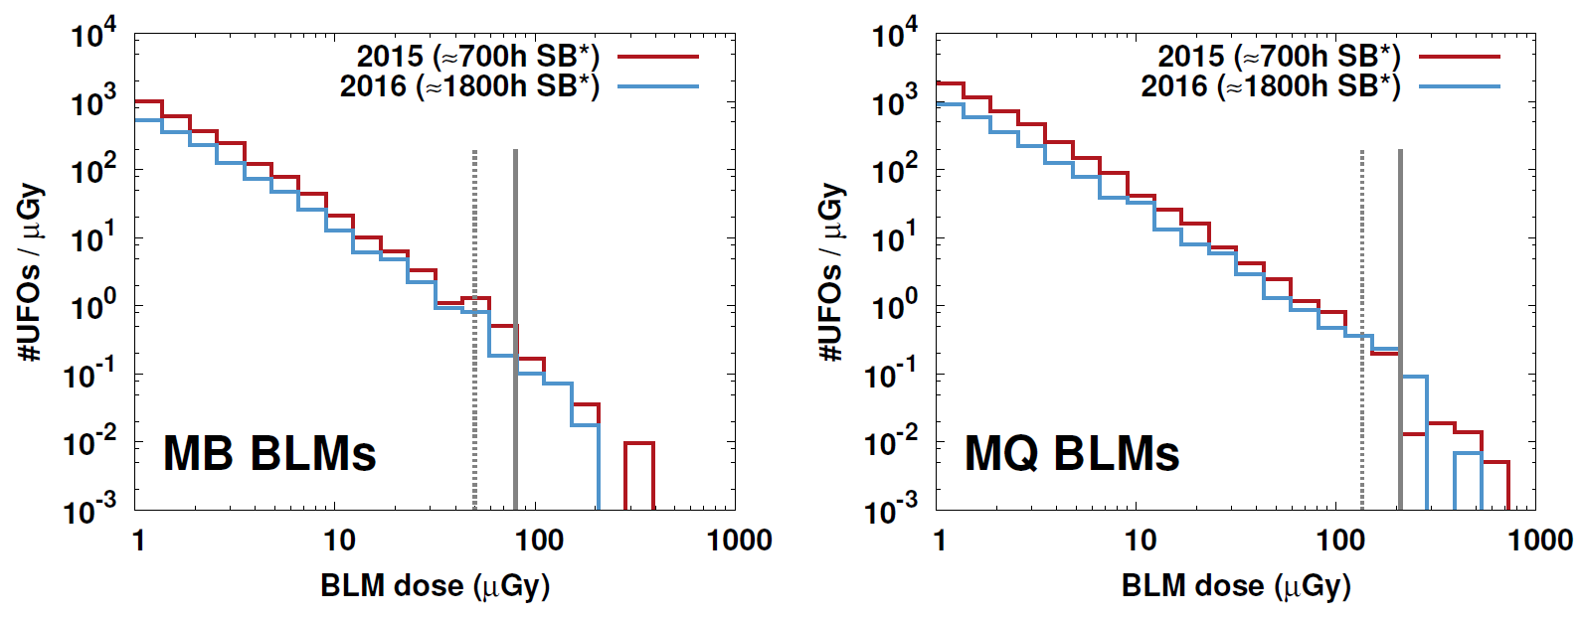
UFOs at 7 TeV
UFO’s measured by UFO buster in 2016/2017 and their losses
A. Lechner
* Including intensity ramp-up
* Including intensity ramp-up
Quench 7.0 TeV
Conditioning 2016 → 2017
Quench 6.5 TeV
For a given UFO rate, # of UFOs which have potential to induce a quench increases by a factor of 2-4 when moving to 7 TeV
The strong dependence of the UFO rate on the machine conditioning status implies that the impact of UFOs on operation at 7 TeV can be critical after a long shutdown
HL Annual Meeting Madrid 15 Nov 2017 Jan Uythoven

Slide 9
Extrapolation to HL-LHC
Operation at 7 TeV + higher beam brightness:
  UFOs:
    UFO rate: release mechanism not understood, scaling with intensity unknown
    Lower magnet quench levels (30 %) → Potentially 3x more quenches due to UFOs
    Impact of R2E: target 0.1 SEUs dumps / fb-1 (order of 25-30 per year)
  Possibly increased failure rate of LBDS due to running at higher voltage (consolidation in LS2 foreseen)
New systems:
  Quench behaviour of Nb₃Sn magnets, reliability of HTS links
  Reliability of crab cavities (failure rate, failure modes and effects)
  Hollow e-lens, if installed
  New cryogenic configuration (Pt. 1-5, 4)
HL Annual Meeting Madrid 15 Nov 2017 Jan Uythoven

Slide 10

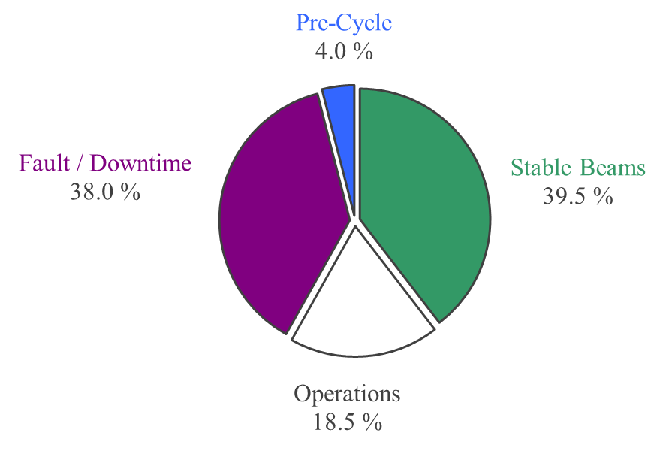
Impact of 7 TeV Operation on Availability
Proton Run 2016
Projection HL (160 days)
Assumptions (conservative):
  2016-like fault distributions (26 % downtime)
  2016-like operation efficiency
  + 4 MKD erratics (2 per beam) ~ 8 days downtime
  + 6 MKB erratics ~ 2 days
  + 10 flat-top quenches ~ 4 days
  + 10 UFO-induced quenches ~ 3 days
  + 4 cold compressor failures ~ 2 days
  + 100 % precycles
14 % Availability
9.5 % Stable Beams
HL Annual Meeting Madrid 15 Nov 2017 Jan Uythoven

Slide 11
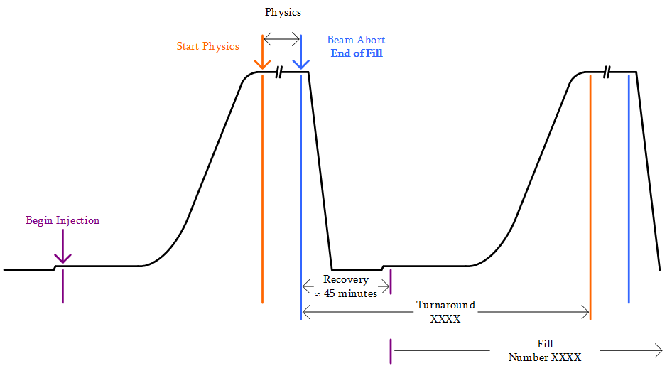
Turnaround Time
HL Annual Meeting Madrid 15 Nov 2017 Jan Uythoven

Slide 12
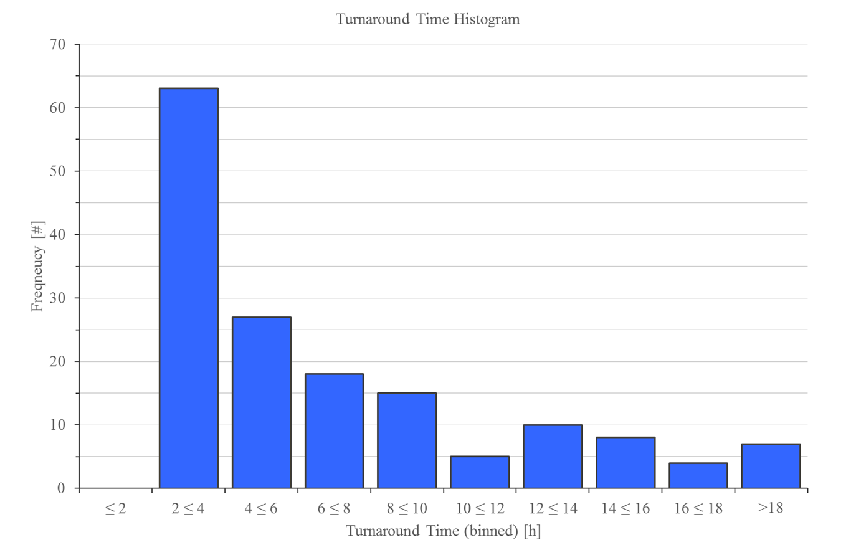
Turnaround Distribution 2016
‘Nominal’
cycle
  Difficult to predict evolution of turnaround
  Shorter due to 144 or 288 b / injection
  Potentially longer due to increasing number of pre-cycles due to failures
Short fault / Injection Tuning /
1 precycle
Long / Multiple faults, 1 or more precycles
Very long faults, measurements, loss maps, planned accesses
HL Annual Meeting Madrid 15 Nov 2017 Jan Uythoven

Slide 13
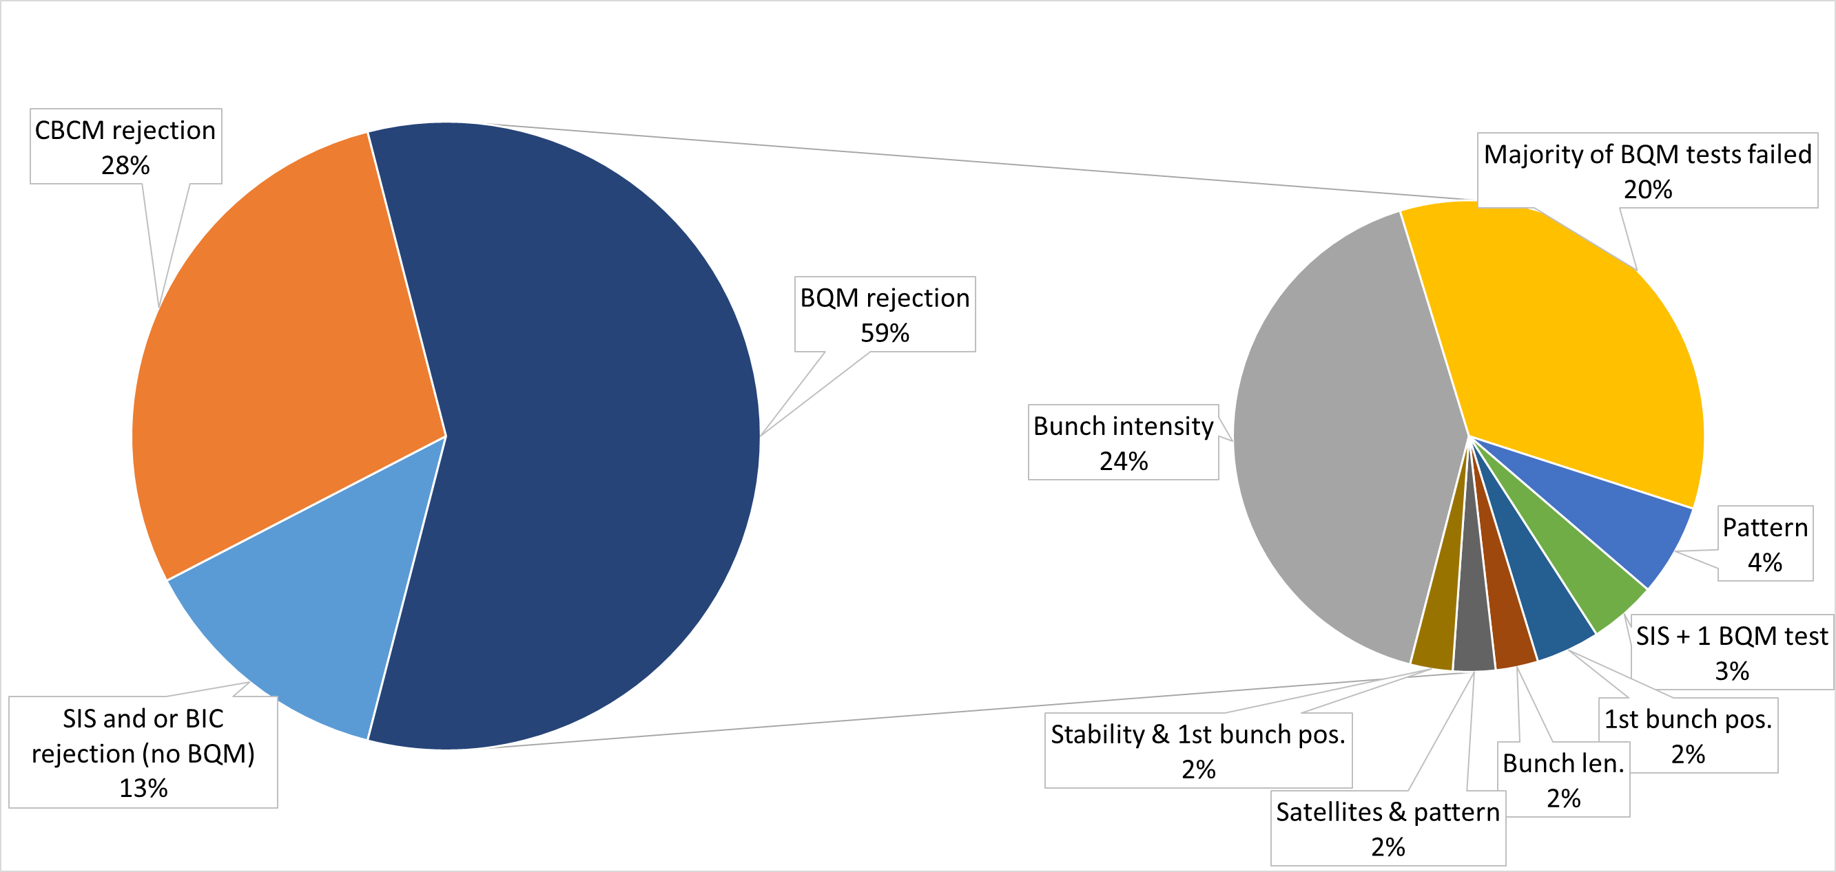
Analysis of Injection Performance
Variability in cycle duration is driven by the injection phase → injectors’ performance + injection process
  Efficiency of the injection process → tool under development in OP to promptly identify and register the reason of rejected injections (20 % in 2017)
  Extrapolation for HL-LHC beams to be carried out
A. Niemi
HL Annual Meeting Madrid 15 Nov 2017 Jan Uythoven

Slide 14
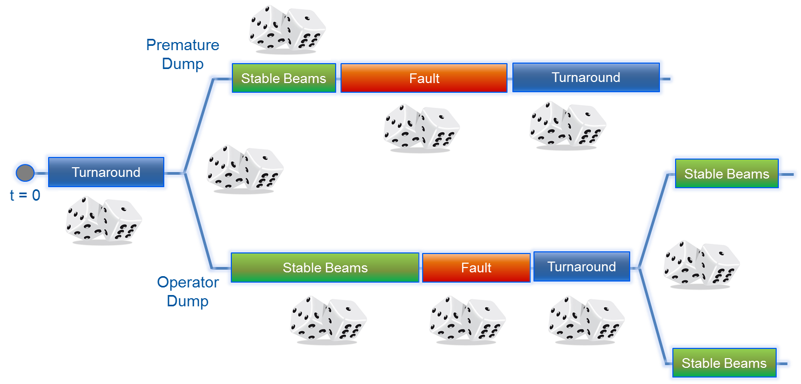
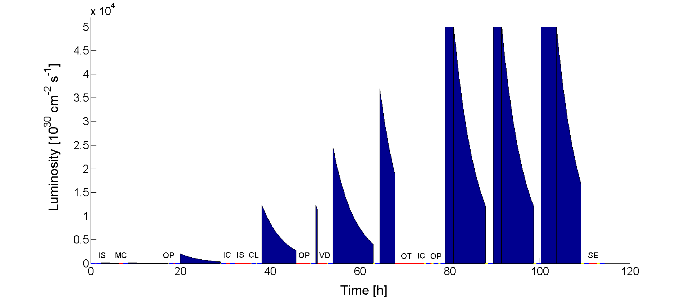
HL-LHC Luminosity Predictions
Using the Monte Carlo model to describe integrated luminosity production as a function of LHC availability
Ramp-up
HL Annual Meeting Madrid 15 Nov 2017 Jan Uythoven

Slide 15
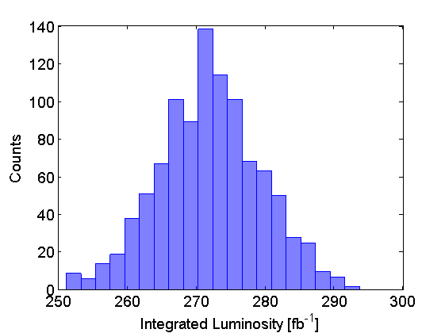
HL-LHC Availability and Luminosity Predictions – based on 2016 figures
Assumptions (from WP2):
Lumi Levelling Time: ~5 h
Lumi Lifetime (exp) after levelling: ~5 h
2016 fault and turnaround distributions
Model Output (160 days operation):
Availability: 74.6 %
Stable Beams Efficiency: 44.6 %
Integrated Luminosity: 272 fb⁻¹
For the same equipment availability, the stable beams efficiency is lower for HL-LHC → higher sensitivity to turnaround time and injectors’ performance
HL Annual Meeting Madrid 15 Nov 2017 Jan Uythoven

Slide 16
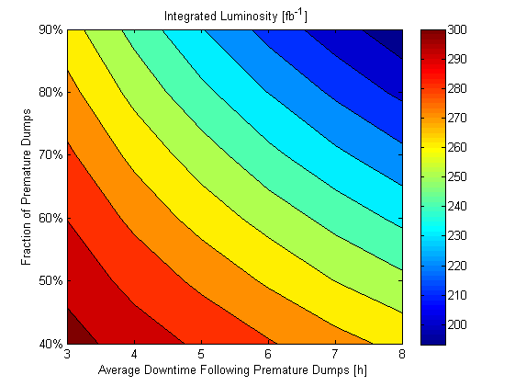
Sensitivity Analysis
New systems
?
Impact of 7 TeV Operation (pessimistic)
Ultimate HL Target
2016 Availability Figures
HL Annual Meeting Madrid 15 Nov 2017 Jan Uythoven

Slide 17
Conclusions
The HL-LHC target luminosity can be reached with the good machine availability as seen in the last years (2016, 2017)
  Detailed model predicts 272 fb⁻¹ / year
Significant lumi reduction can occur because of
  Operation at higher energy and higher beam intensities
  Specifically UFO’s can become an issue
  New equipment without known availability numbers
  End-of-life of not consolidated equipment
  Modelled numbers down to 210 fb⁻¹ / year
How to obtain HL target or even Ultimate HL-target of 300 fb-1?
  Reliable design, testing and reliability runs of critical equipment, as being done for LINAC4
  Optimise where you can gain:
    Measure to improve: AFT → start to use Expert Data
    Turnaround time and injection performance
  Experience & time

Slide 18
Thanks a lot for your attention!

