Slide 1

Q1-Q2-Q3 cryo-assemblies: status and plan
D. Ramos, H. Prin, M. Moretti, C. Eymin, A. Temporal,
V. Parma, F. Micolon, Y. Leclercq, M. Struik, G. Barlow
7th HL-LHC Collaboration Meeting, 13-16 November 2017

Slide 2
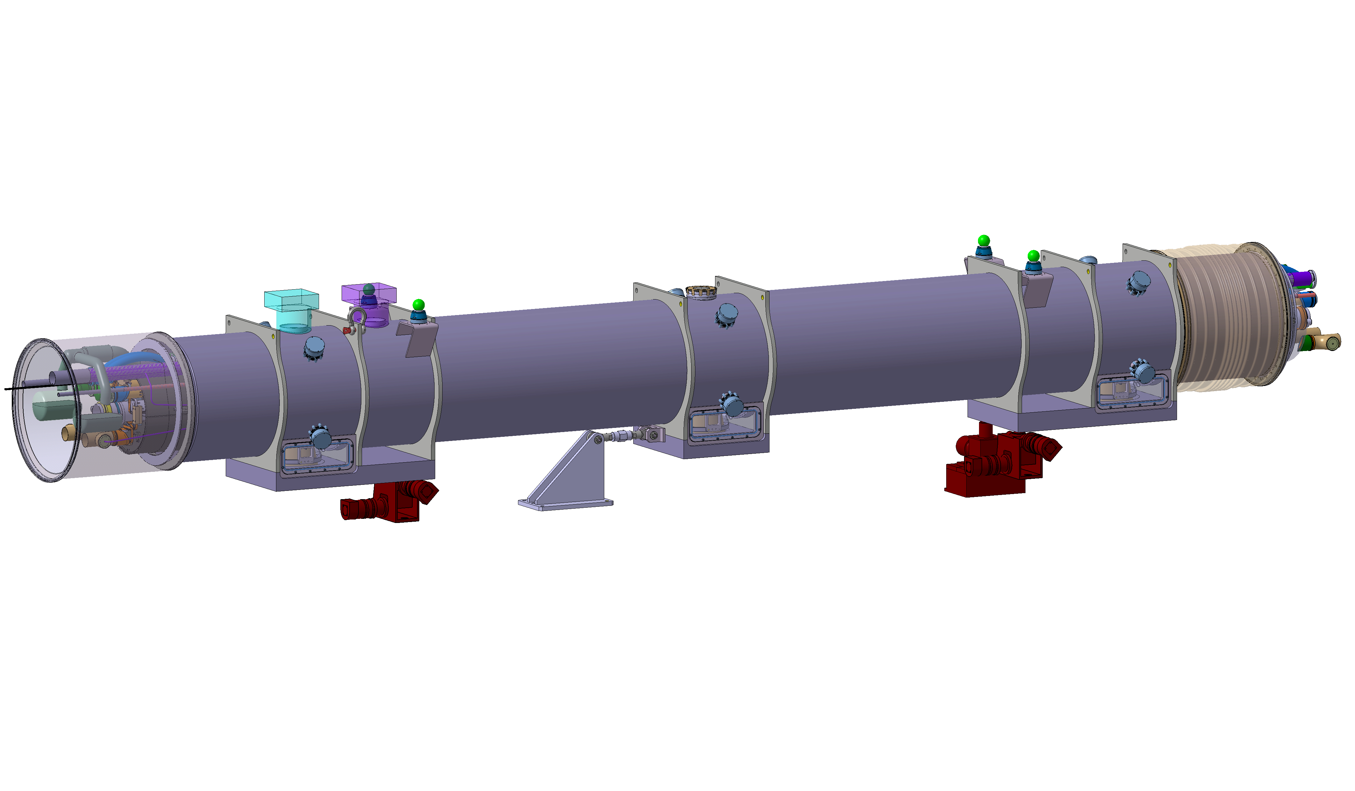
Cryostat design status (ex. Q2 IR1 Right)
One feedthrough for cold mass instrumentation and one feedthrough for CLIQ leads
Pressure relief valve for insulation vacuum (to discussed)
Interconnect sliding sleeve opens towards the IP
Survey targets
Service module always on the IP side (phase separator, pumping manifold, BPM feedthroughs)
Lifting points
Cold mass position monitoring (FSI)
Cold mass, termal shield and cryo-piping with central fixed point
Cold mass rests on 3 support posts
Phase separator can be connected to its magnet or the neighbouring magnet depending on tunnel slope
Tie-rod as longitudinal anchor (performs both in compression and tension). Required in Q1 but optional in Q2 Q3.
Cryo-assembly isostatically supported on 3 jacks

Slide 3
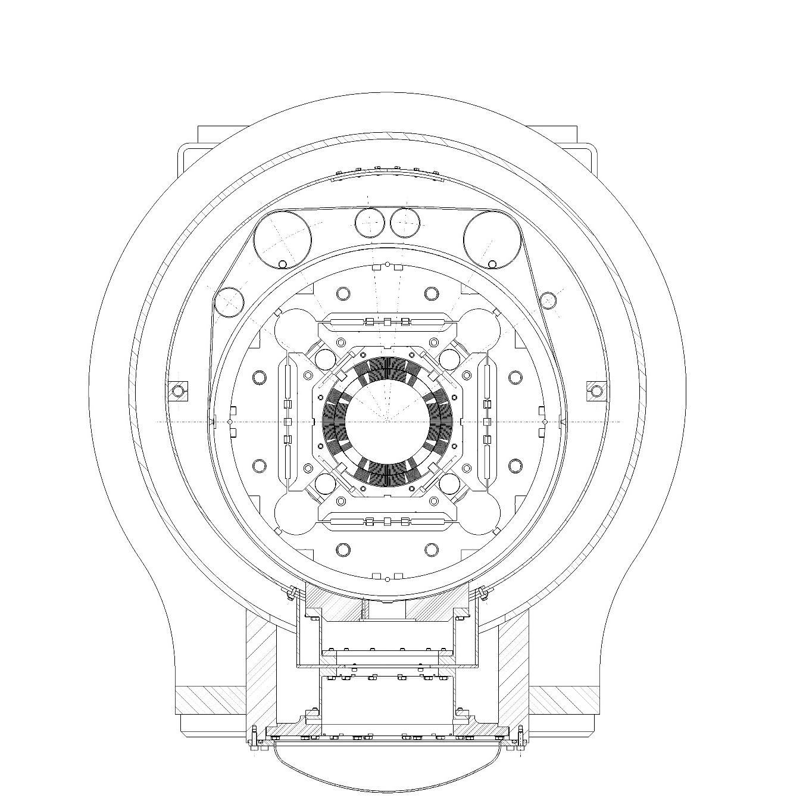
Piping nomenclature
XB1
N1&N2
XB2
N1 & N2 Auxilary lines for Trim and Correctors Busbars
M Aperture for the cold mass busbars
MN Busbars Interconnection line
X1 & X2 Heat exchanger tubes
y1 & y2 Helium inlets
V Beam line
L1 & L2 Conduction path for HeII (2x75cm²)
IFS Instrumentation feethroughs capillary
CLIQ CLIQ feedthroughs cuurent leads
XB1 XB2 Pumping lines
CY1 CY2 1.9 K inlet
LD Cooldown and quench line
E_{H}E’_{H} Thermal shield and beamscreen inlet
E’_{H}1 E’_{H}2 Thermal shield cooling
M
CY1
CLIQ
IFS
CY2
LD
MN
E_{H}E’_{H}
X1
X2
Y1
Y2
V
E’_{H}2
E’_{H}1
L1
L2

Slide 4
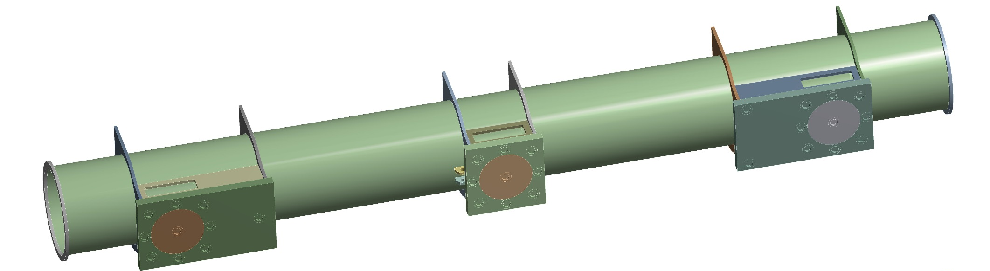
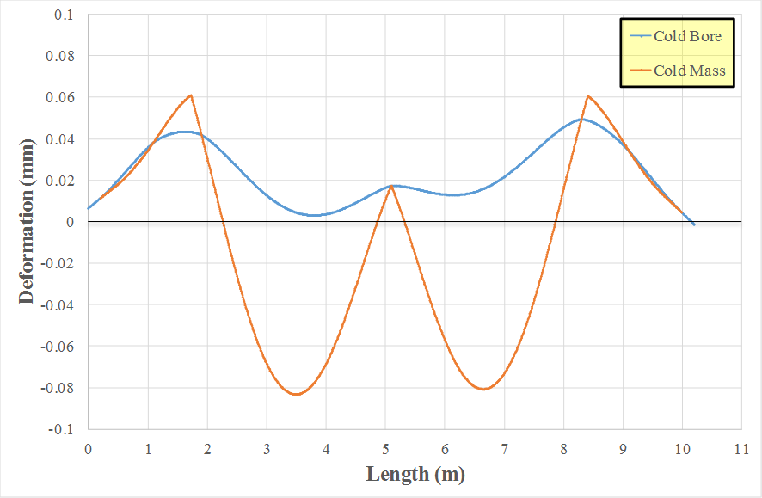
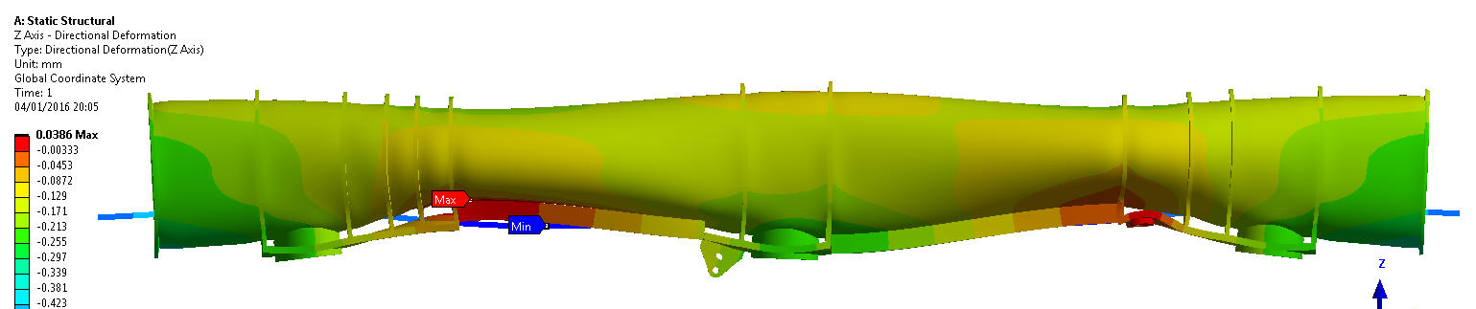
Cryostat supports and vacuum vessel design
free
L’’=2.47 m
L’=2.51 m
free
free
Q2
Cryostat interface meeting 29/8/2017: decision to implement isostatic support (3 jacks instead of 4) https://indico.cern.ch/event/661726/
Small difference in length between Q1/3 and Q2: same interfaces to simplify assembly tooling
Optimisation of jack locations for minimum cold mass deformation presented at WGA#3 18/10/2017 https://indico.cern.ch/event/666376/
  Goal: Interface between cold mass and vacuum vessel deform evenly
  Total displacement of cold mass interfaces ~130 micron
  Contribution of vacuum vessel deformation to cold bore misalignmment: < 60 micron
Q1/3

Slide 5
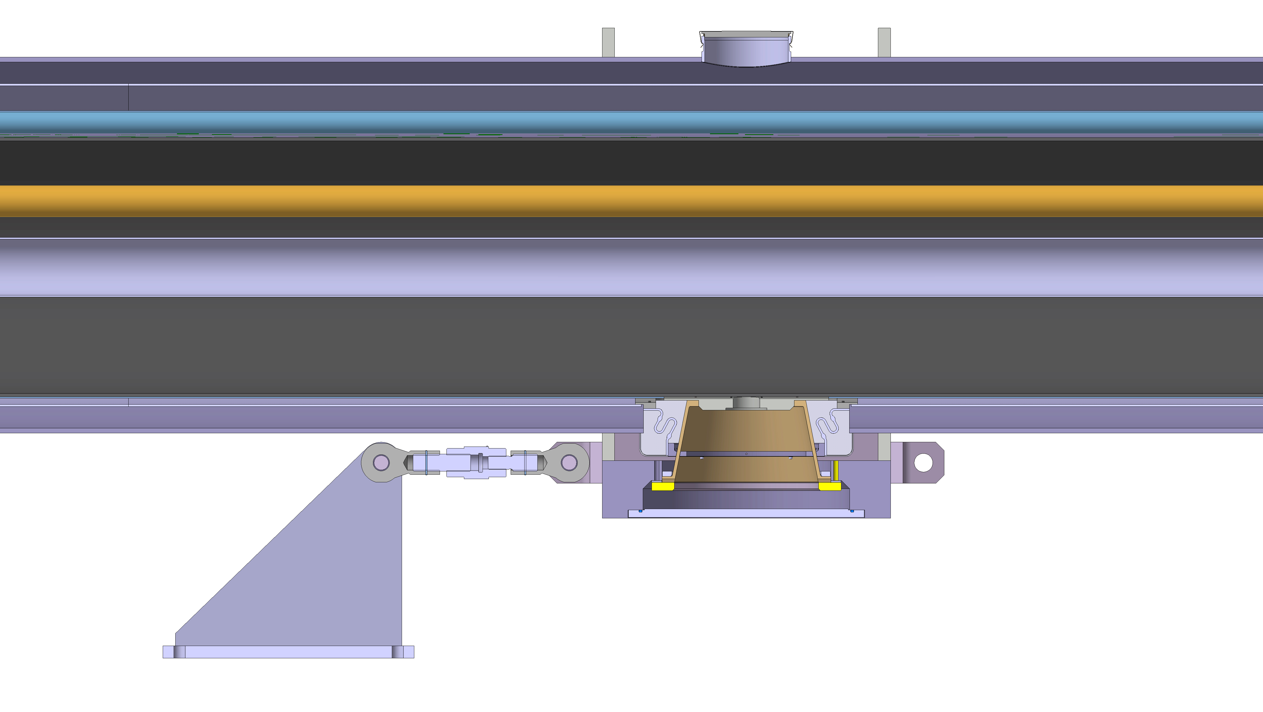
Longitudinal anchor for Q1
Can be placed on either side of the central support post
Designed to work in compression or tension
Functional specification https://edms.cern.ch/document/1856323/0.1
  13 tonne on either direction
  Adjustment range +/-10 mm
  Resolution +/- 0.1 mm with differential screw
  No adjustment under vacuum load
  Not remotely operated
Validation test planned in 2018 using LHC spare triplet cryo-assemblies

Slide 6
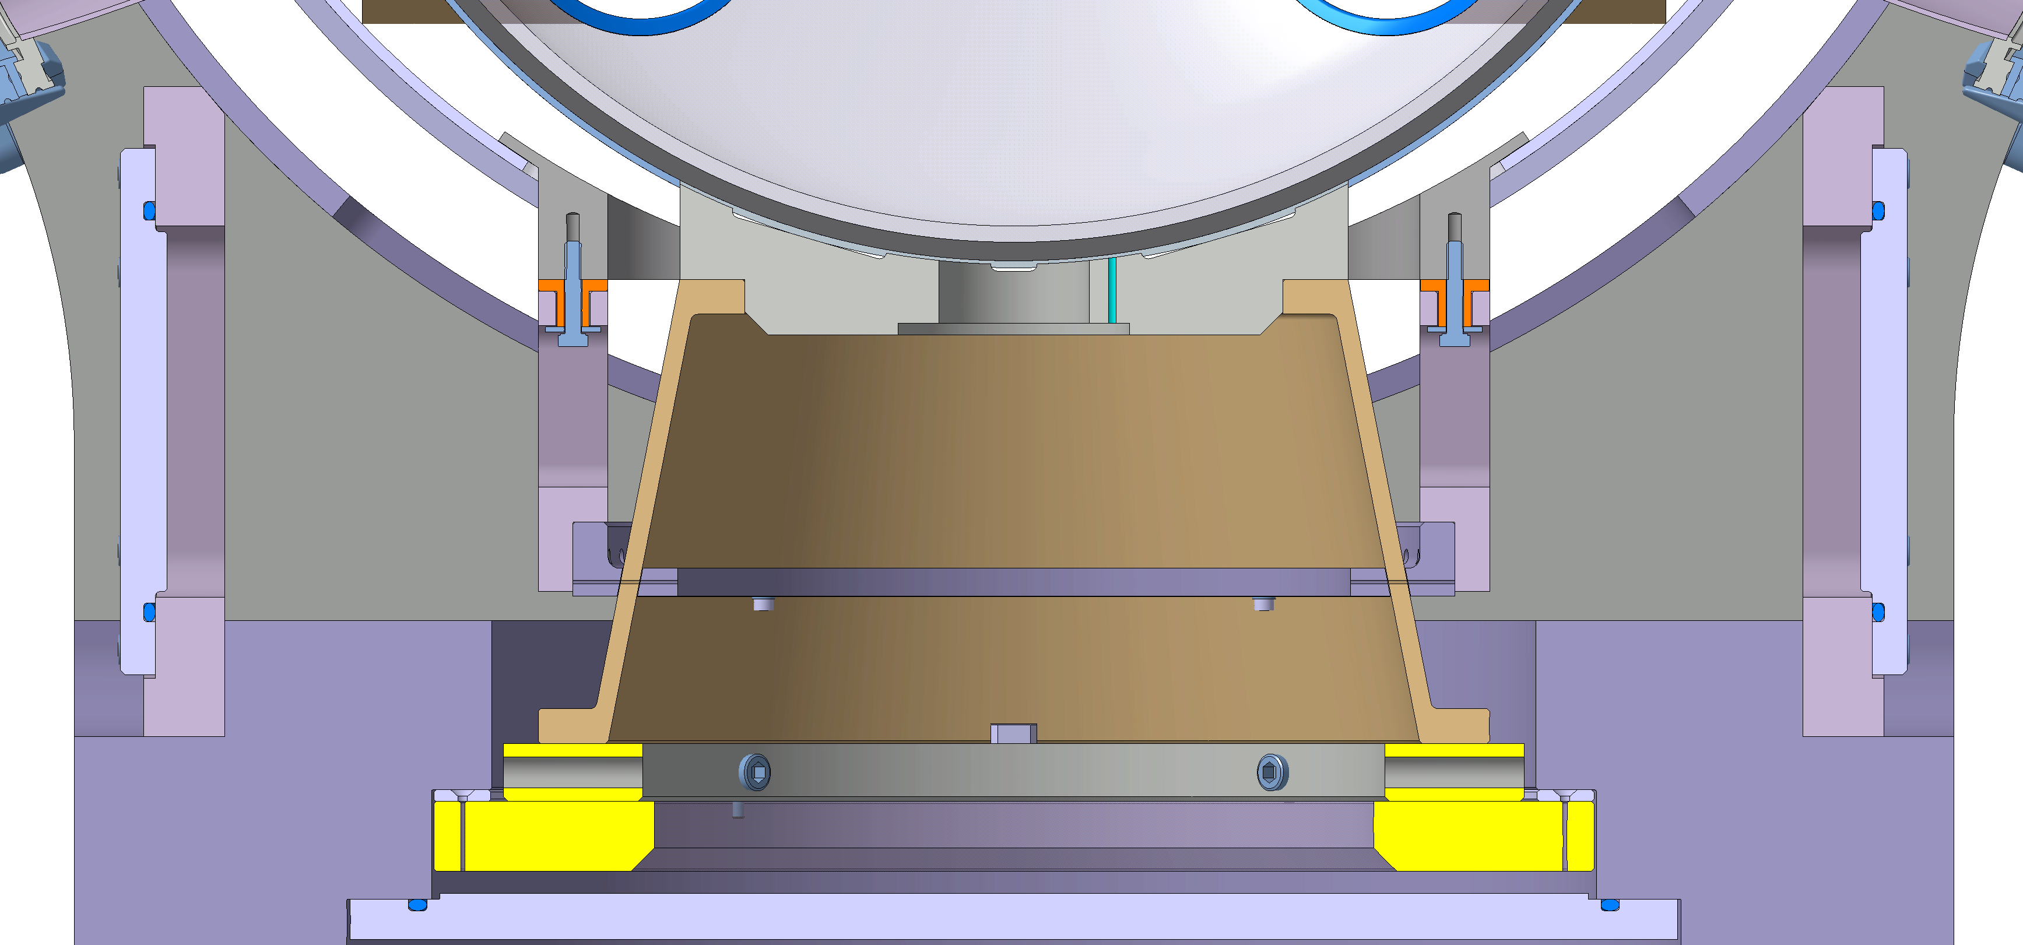
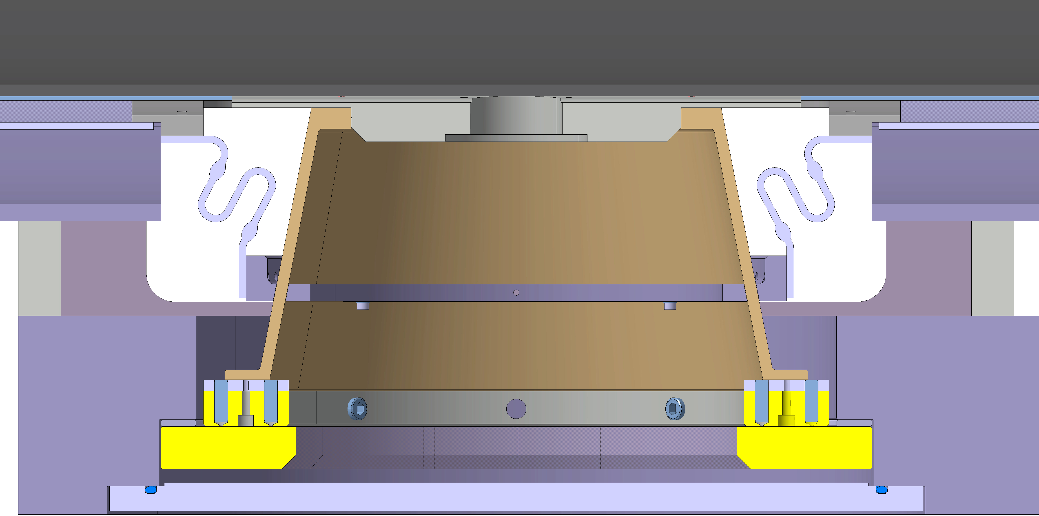
Sliding support post
Sliding termal shield guides
Conical GFRE post (2x stiffness wrt LHC)
Heat intercept and termal shield support (no heat loads to support the termal shield)
Sliding surface
Bolted on top to cold mass
Thermalisation straps
Straightness NC mitigation in horizontal plane
Guiding key and slot
Shims for out of straigtness NC mitigation on vertical plane
Vacuum vessel cover

Slide 7
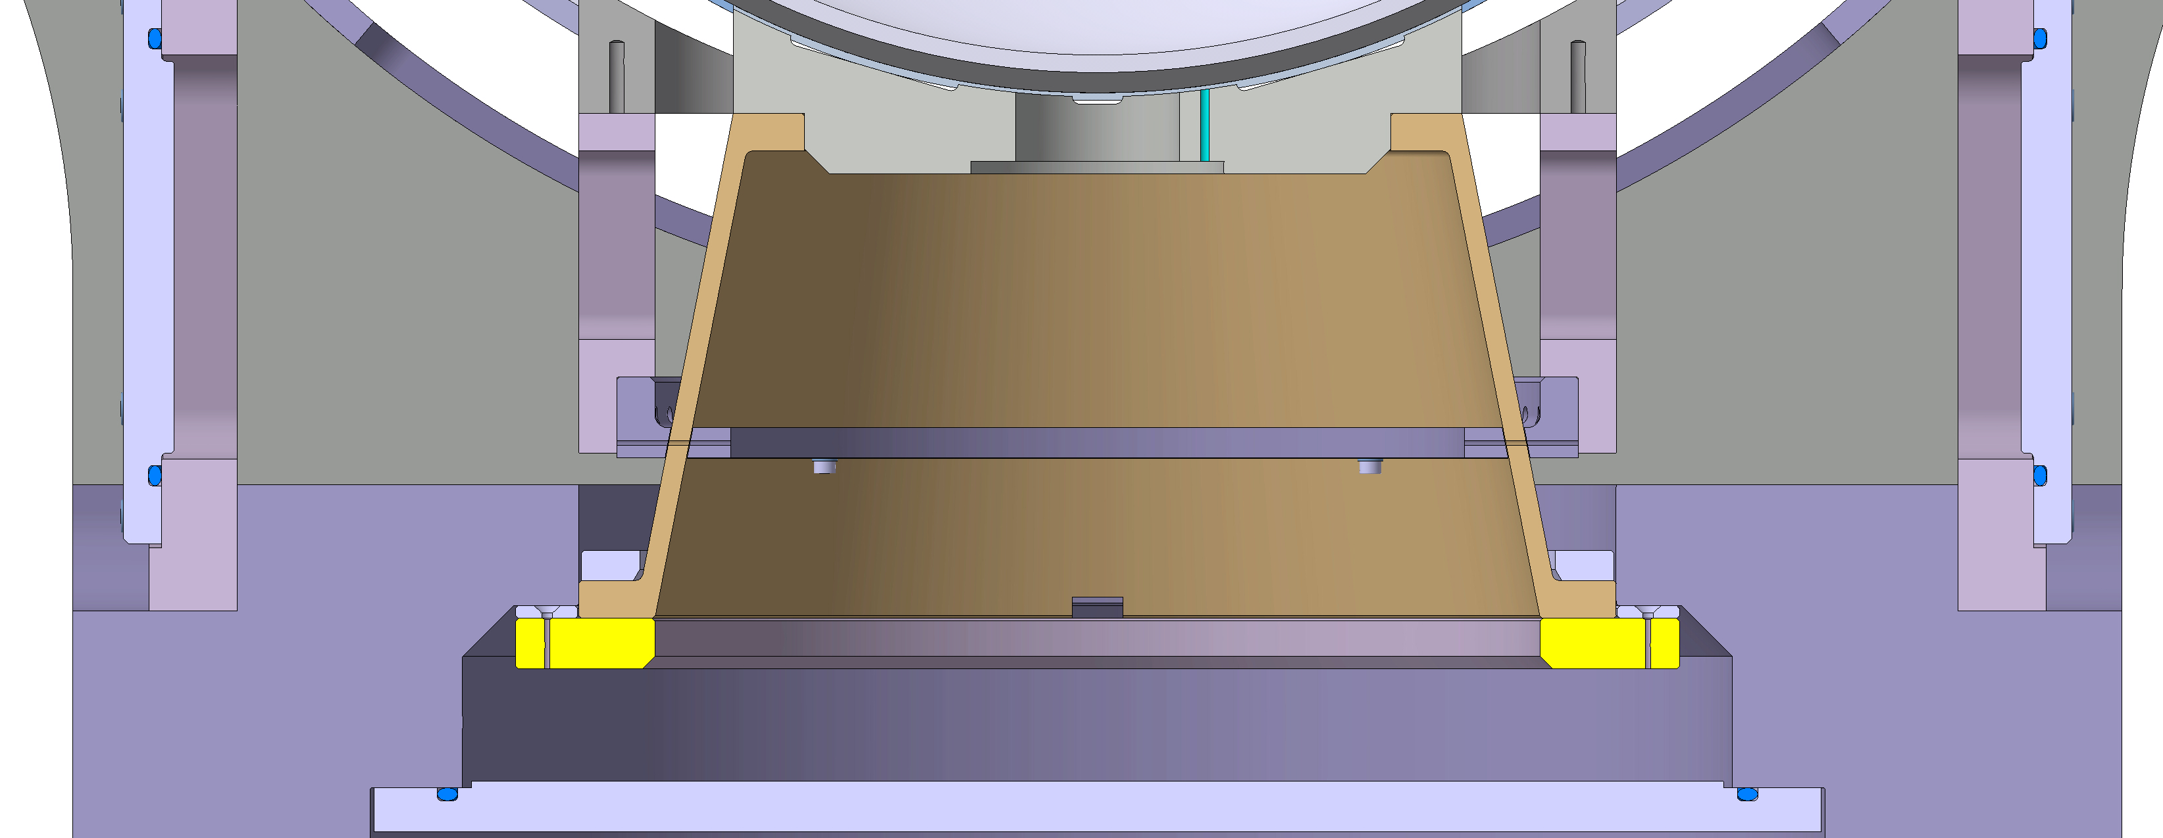
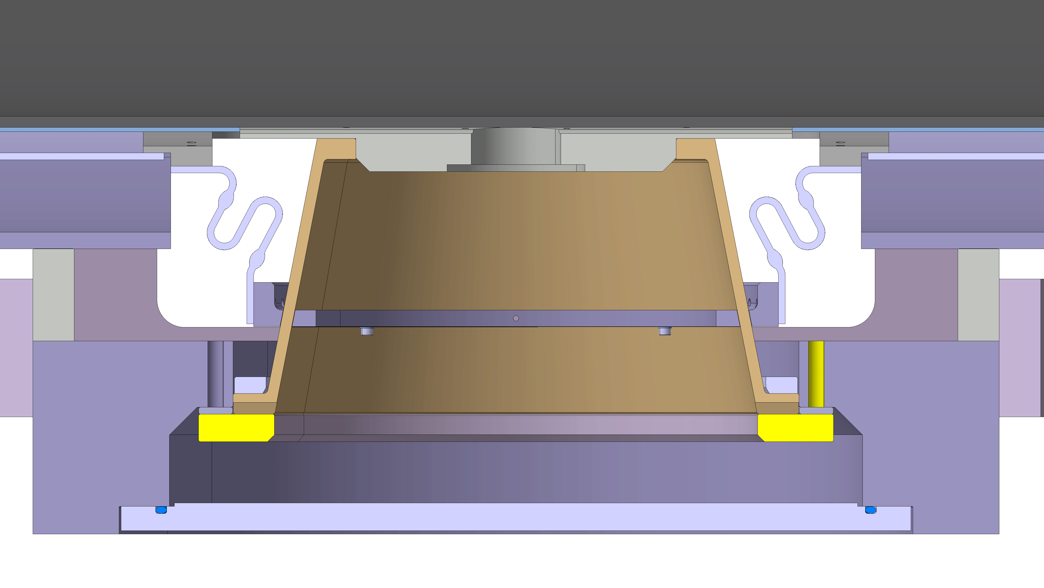
Fixed support post
Conical GFRE post (2x stiffness wrt LHC)
Heat intercept and termal shield support (no heat loads to support the termal shield)
Access door in vacuum vessel for assembly
Thermalisation straps
Bolted on top and bottom
Shims for out of straigtness NC mitigation on vertical plane
Vacuum vessel cover

Slide 8
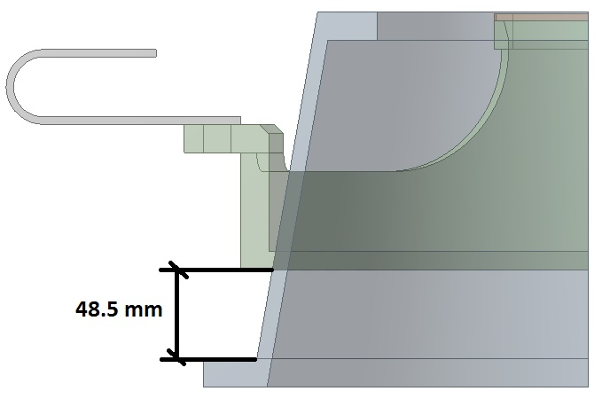
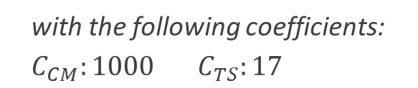

Heat intercept location
  Optimum location: 48.5 mm Minimum exergetic cost: 1132 W
  Heat loads for 8 mm thickness (very preliminary):
  0.23 W at 1.9 K level
  3.3 W on 60-80 K level
$W=W_{CM}C_{CM}$+${ W}_{TS}C_{TS}$
  with the following coefficients:
  $$C_{CM}:1000 C_{TS}:17$$

Slide 9
Preliminary specifications
Design loads functional spec under approval https://edms.cern.ch/document/1868420/0.1
  LC1, room temperature, 205 kN compression, 135 kN transverse
  LC2, cold, 142 kN compression, 125 kN transverse
Glass fibre – epoxy composite
Layup and autoclave (preferred by potential suppliers)
Fibre volume fraction: 40-50%, max 2% dispersion
Maximum void content: 1%
Dispersion on support post stiffness: +/- 5%
Residual deformation after load testing: 2%
Tests done by manufacturer
  Material property testing as input for mechanical calculations
  Load testing 100%
  Ultrasound testing 20% (option for 100%)
Done by CERN
  Thermal contraction tests at the EN-MME lab
  Radiation hardness on samples (100 kGy)
  Thermal performance evaluation by CERN

Slide 10
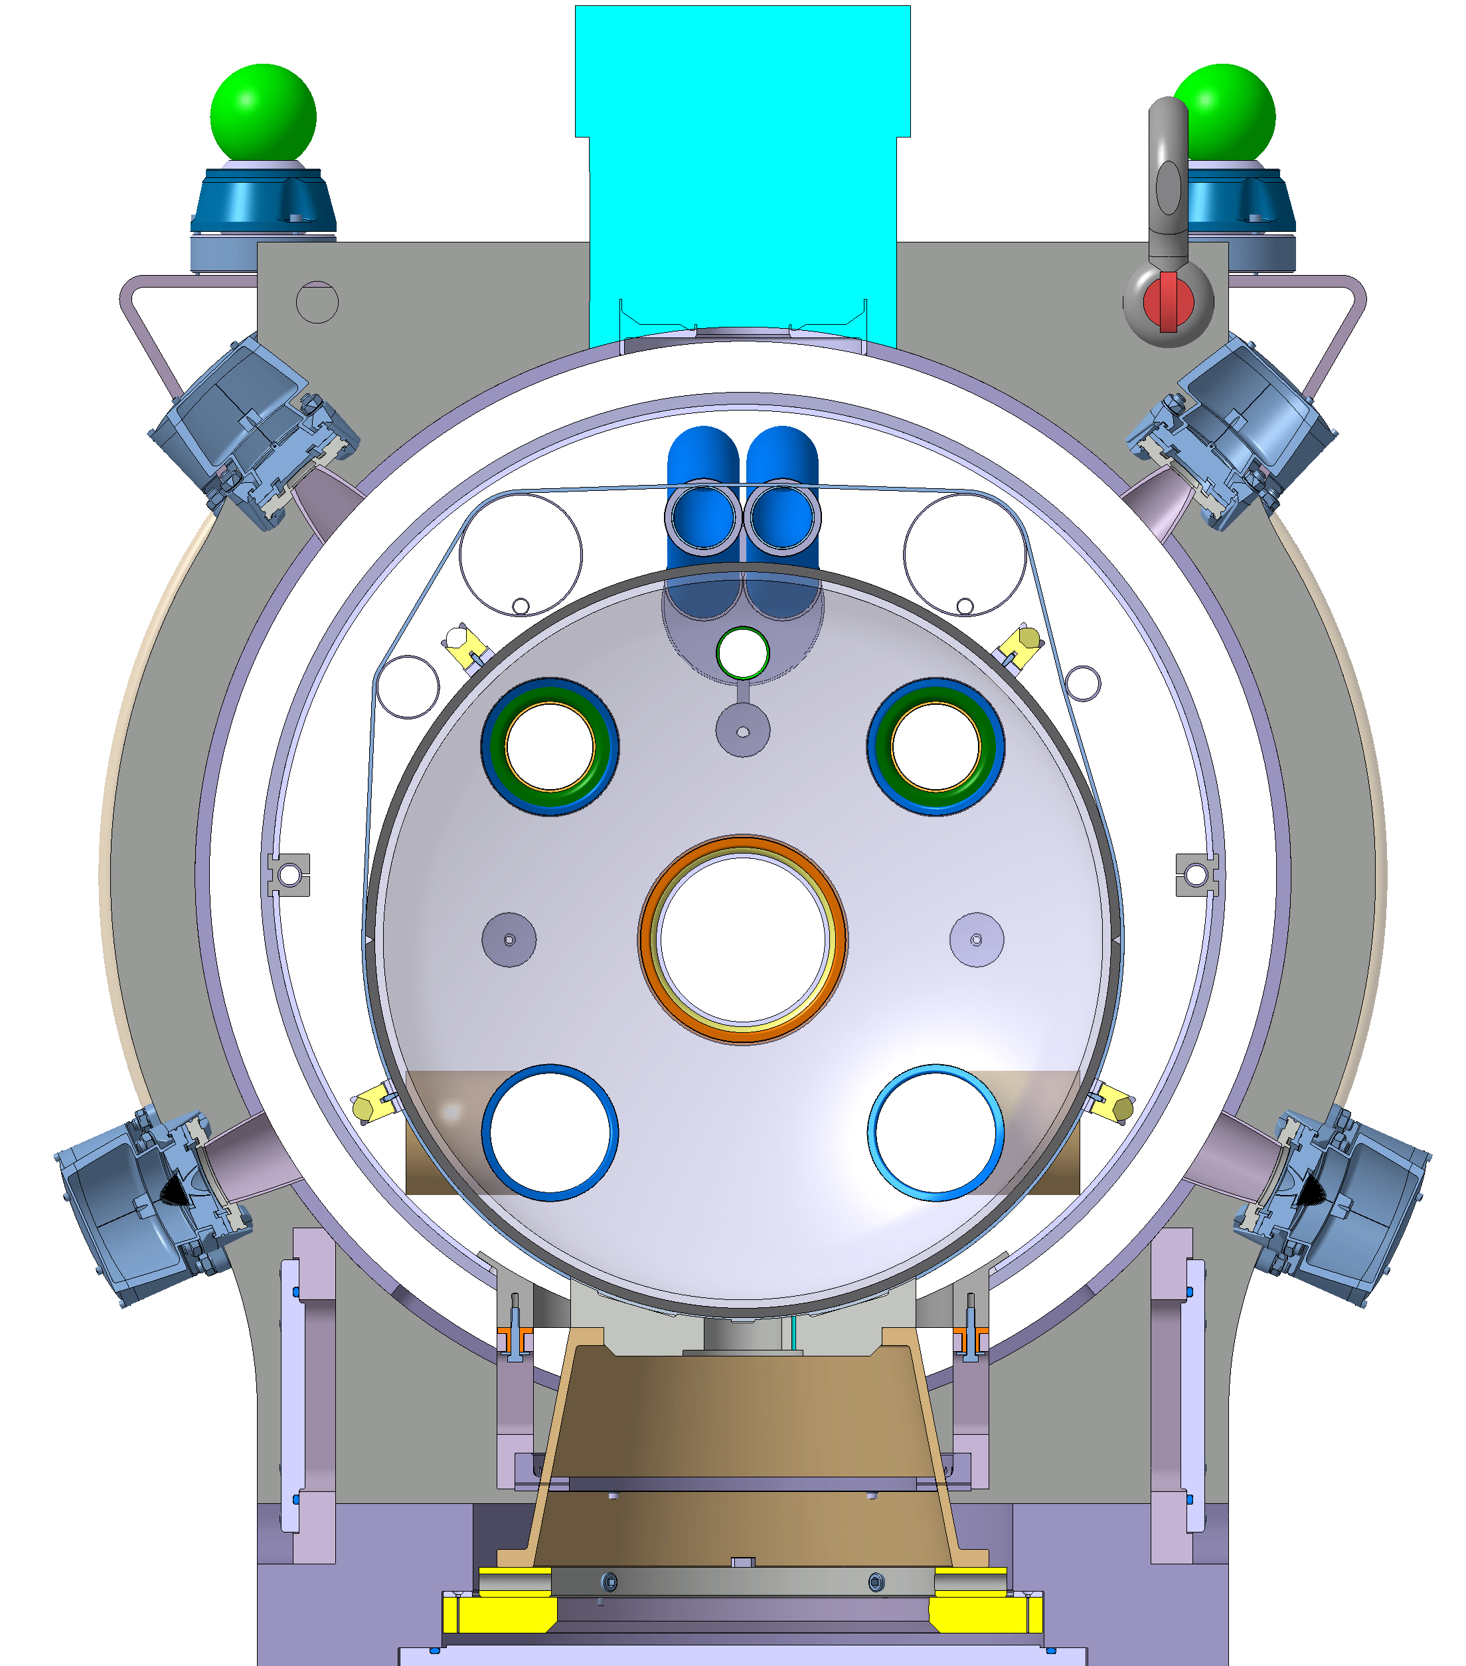
Integration of CM position monitoring (FSI)
Mateusz Sosin
Frequency scanning interferometry, absolute postitioning
3 x 4 targets aligned with cold mass support posts
Circumferential location agreed Nov 2017
At sliding supports, mounted with an angle of 10 deg wrt vertical plane to allow measurement of longitudinal movement
Thermals shield interfaces for minimum heat load to be specified
Interference with transport to be addressed

Slide 11
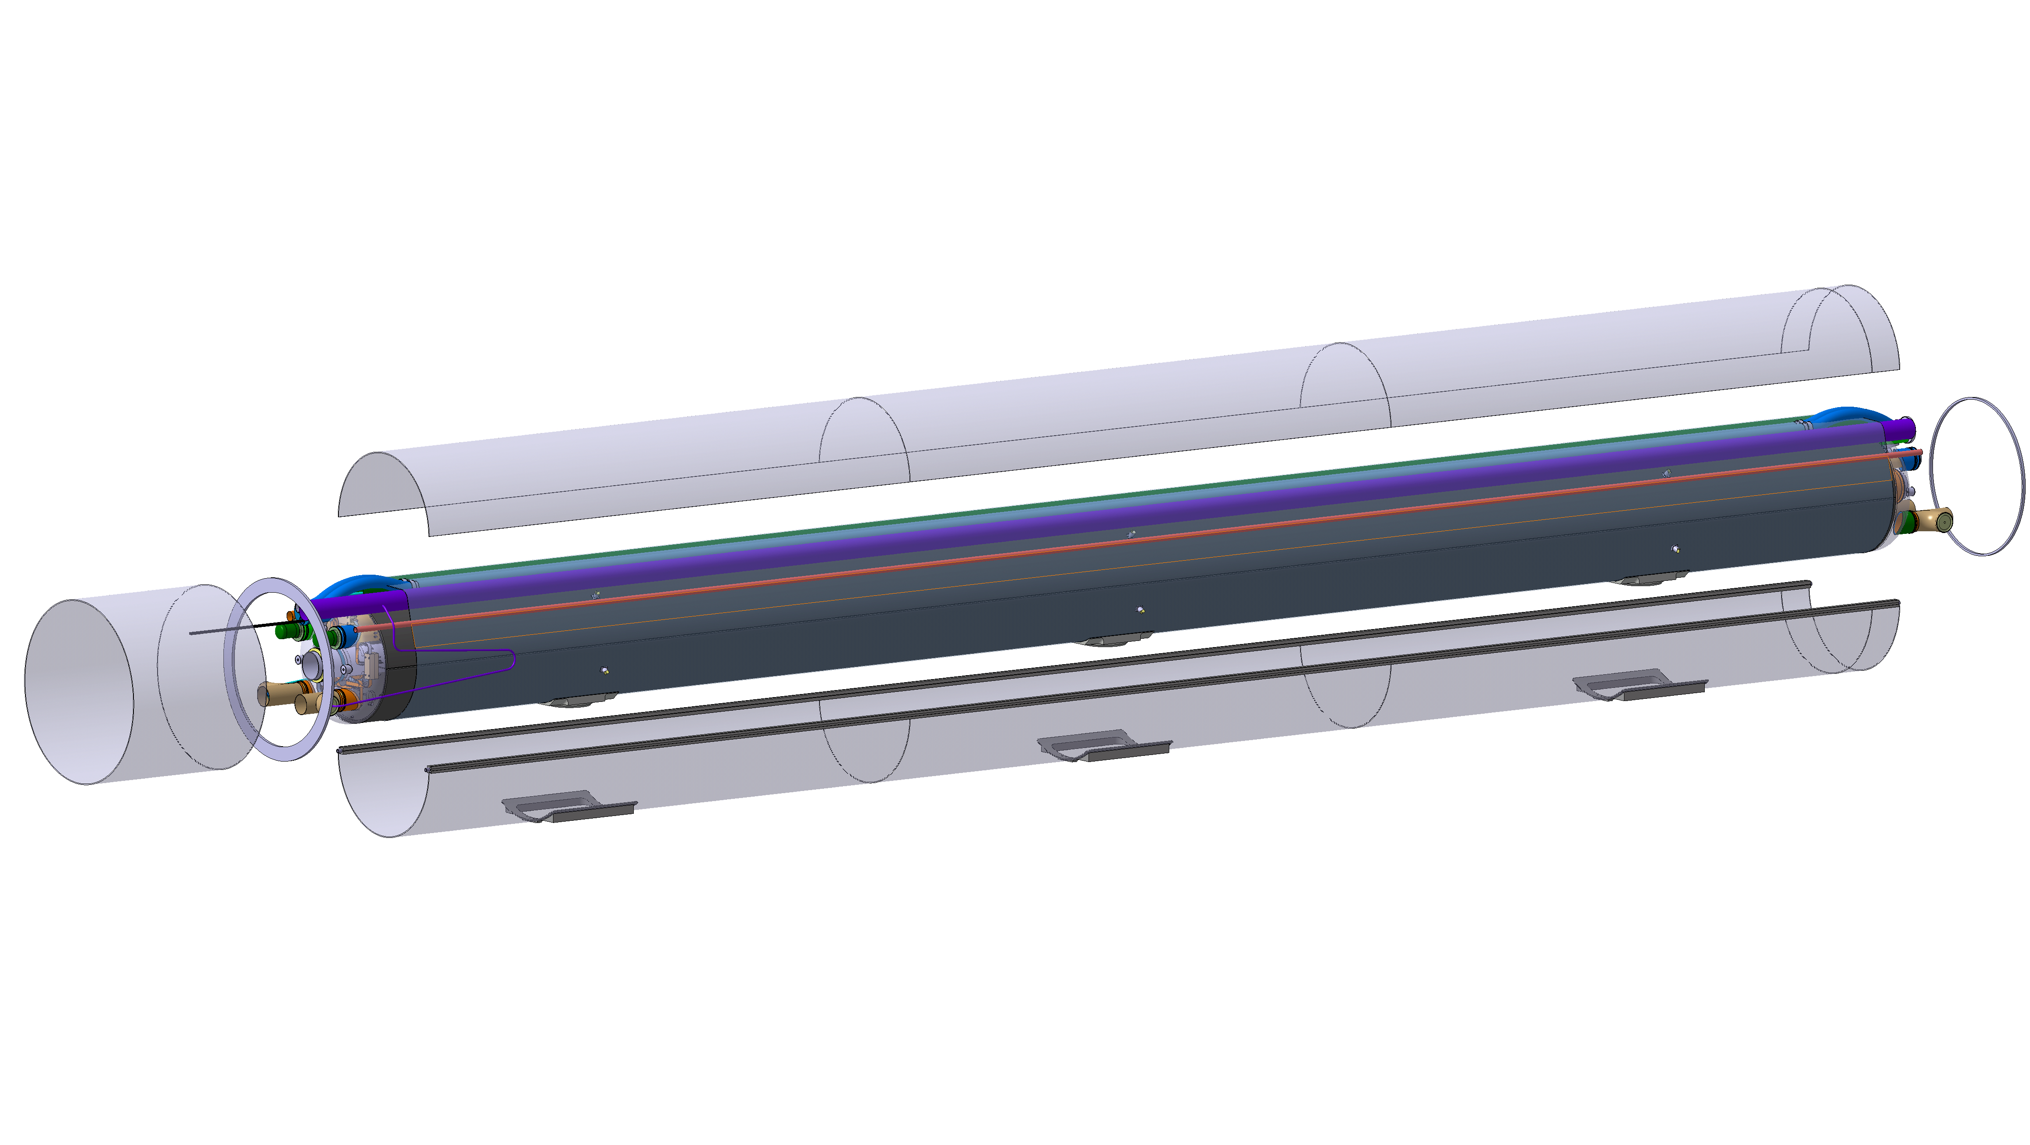
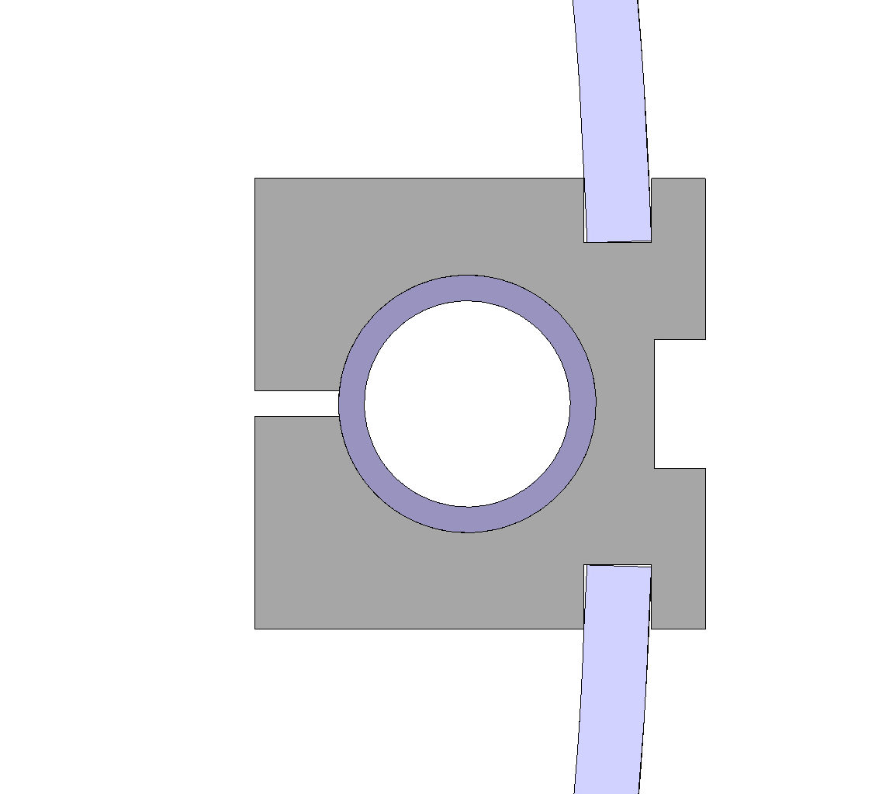
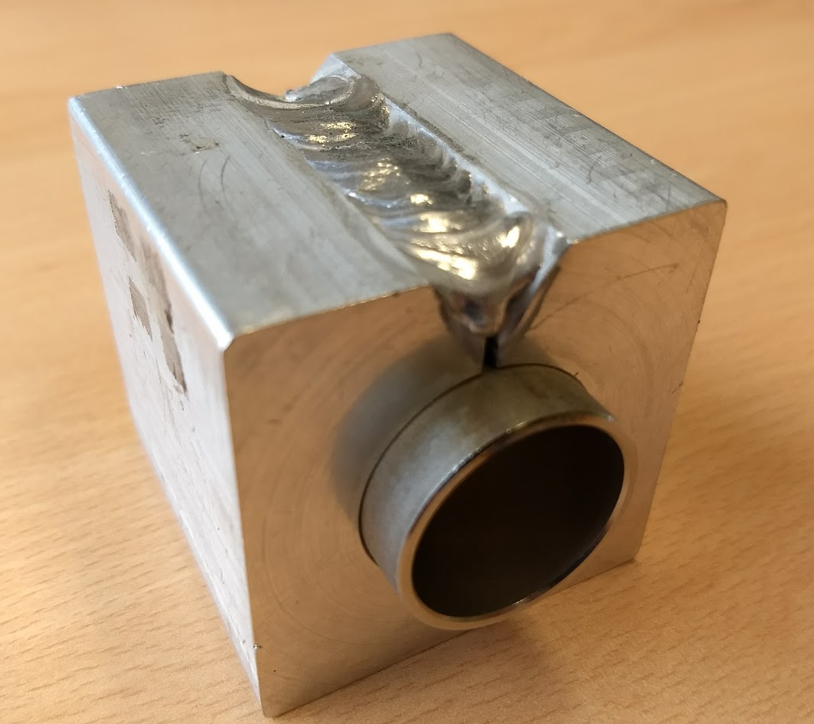
Thermal shield
5 mm thick aluminium 1050 shell with continuous longitudinal cooling on both sides
Symmetrical cooling prevents “banana effects” during thermal transients
The cylinder is split horizontally in two halves that are welded once the cold mass is in place
Machined saddles at the interfaces with support posts
Two options for the cooling pipes
  Stainless steel tube press fitted inside aluminium bar: negligeable tooling investment / more labor / inferior thermal efficiency
  Extruded aluminium tube: investment on extrusion tooling / better for series / delicate aluminium welds / aluminium to stainless steel transitions
Welds on the outside

Slide 12
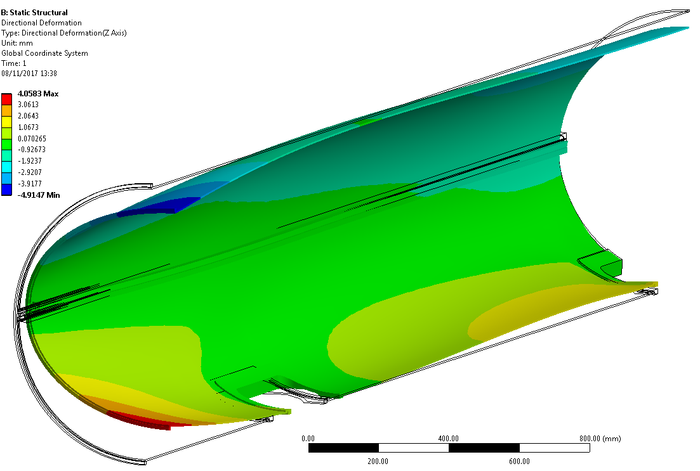
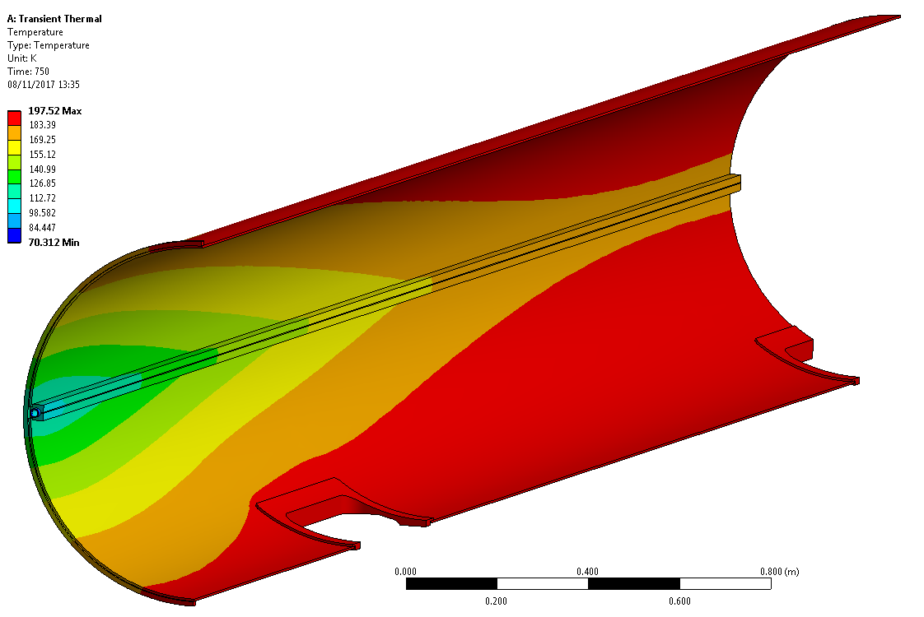
Thermal shield deformations
Thermo-mechanical calculations on going (cryostat interface meeting 7/11/2017 https://indico.cern.ch/event/677105/)
  Mass flow 7.5 g/s
  Radiation through MLI 1.5 W/m^2
  Support post in-leak ~5 W @ 70 K per support (conservative)
  First radiation cooled to 200 K (by radiation exchange with the 80K cooled cold mass).
  Then gaseous helium is run in the cooling lines to further cool down the screen to 60-80K.
  Maximum ovalisation during transients of 4 mm

Slide 13
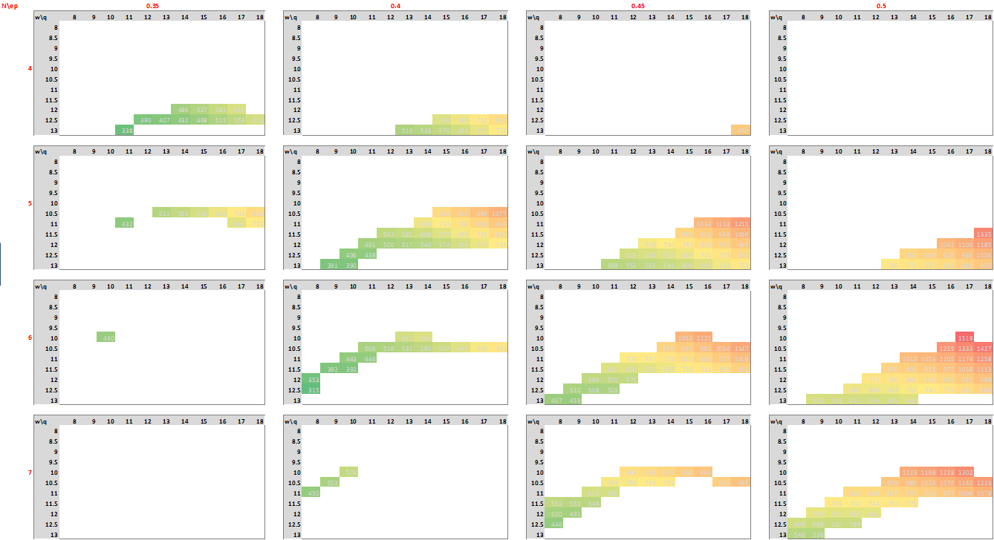
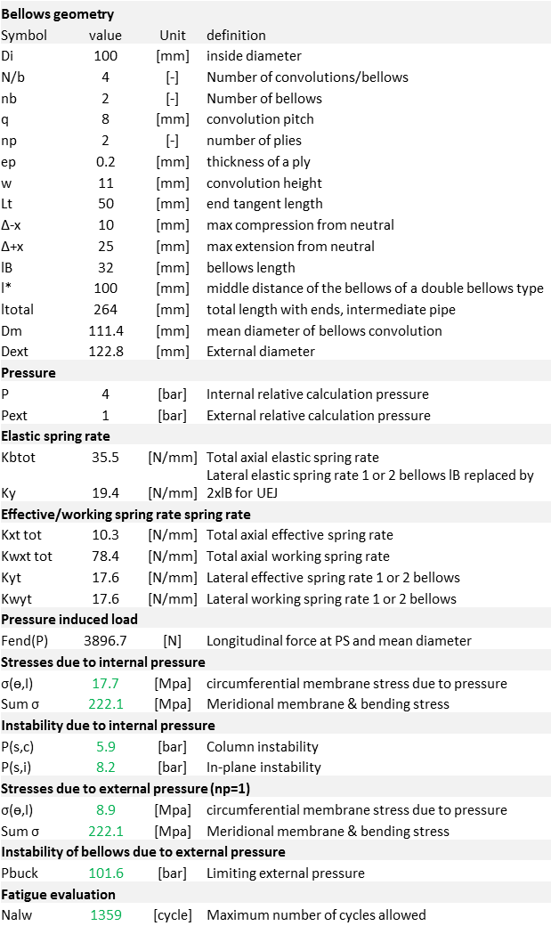
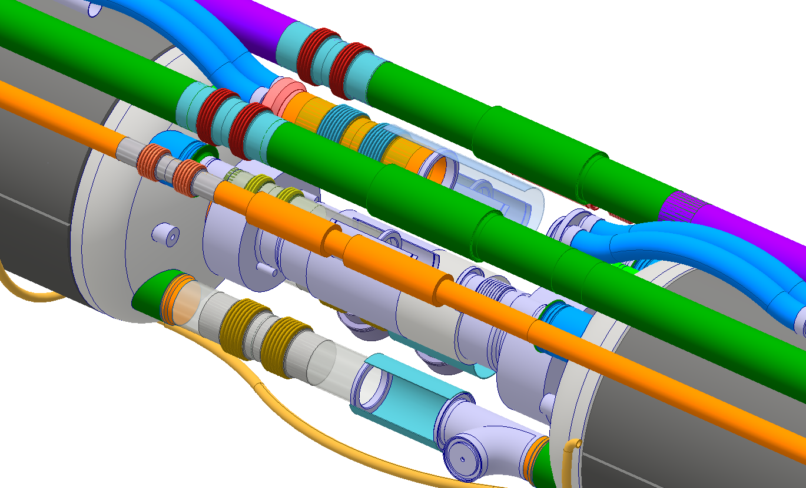
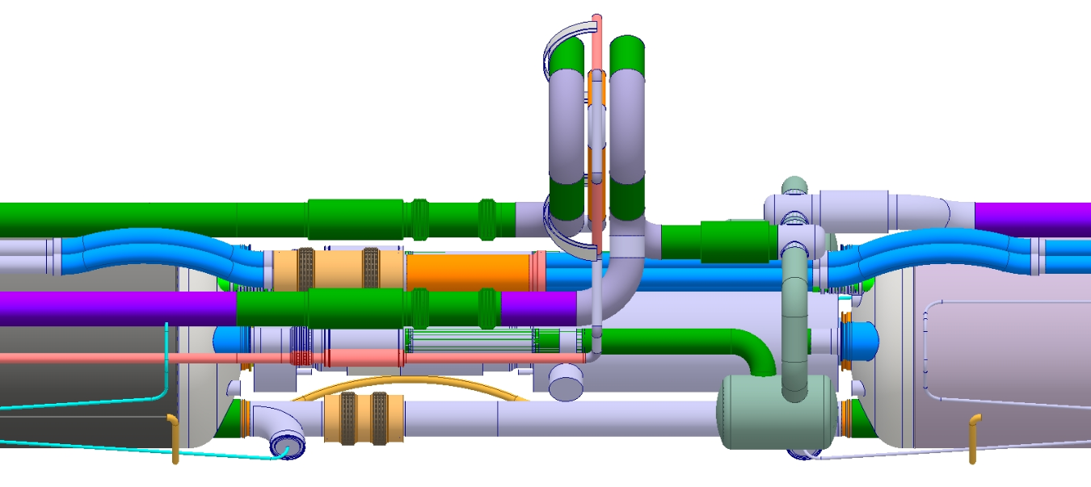
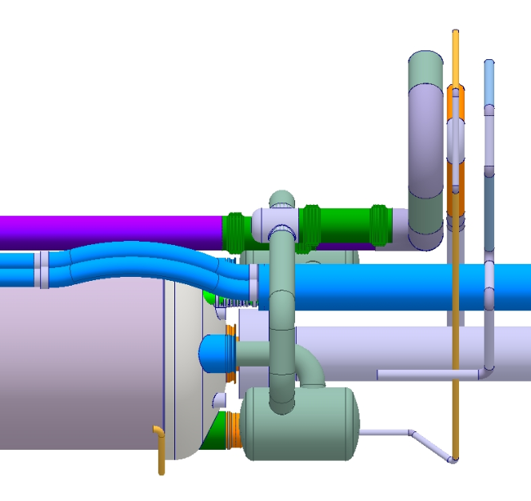
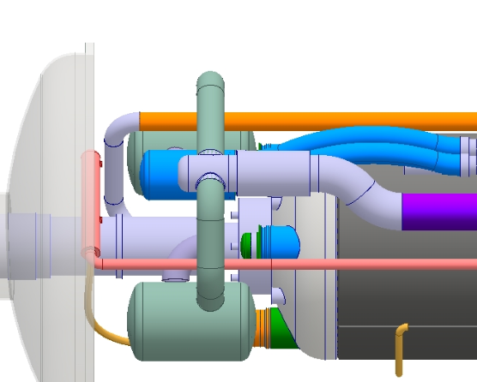
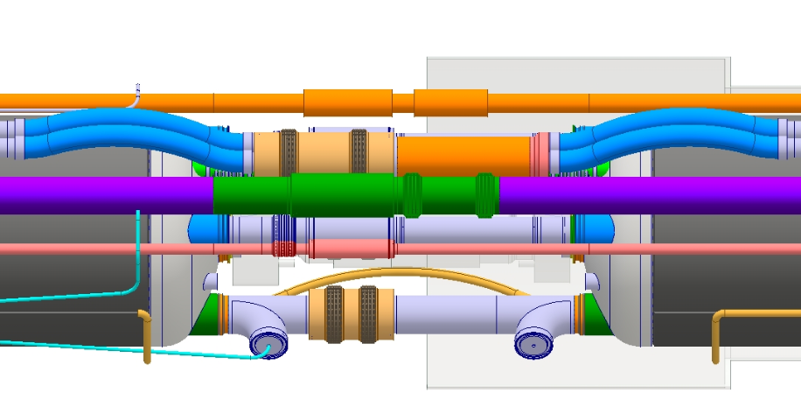
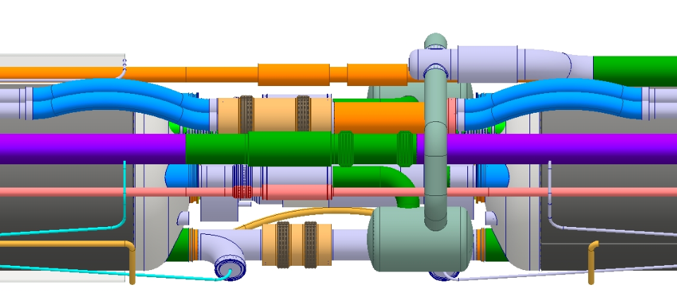
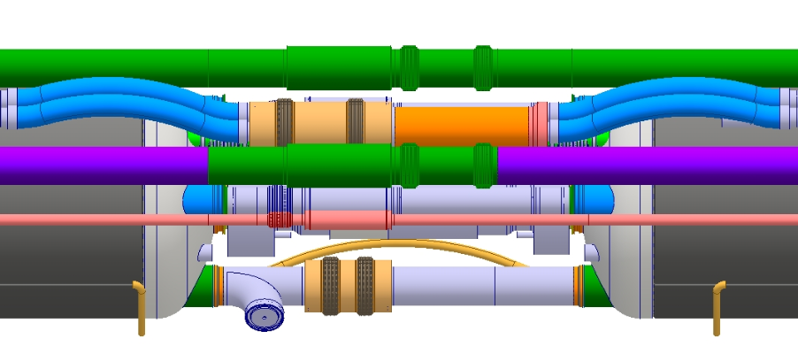
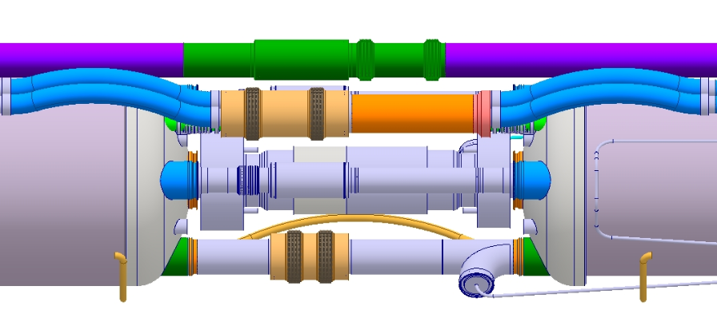
Expansion joints
Software interface for bellows design optimisation
Universal expantion joints for minimum impact on alignment
Specifications:
  Design pressure (PS) : from 4 to 25 bar internal relative pressure
  Axial cyclic movements up to 46mm (500 cycles)
  Temperature range : [1.9 K ; 300 K]
  Nominal diameters : from Ø10 to Ø110 mm
Quantity:
  up to 100 bellows and flexibles per side
Design optimisation:
  Minimise outer diameter for integration purposes
  Minimise axial and lateral spring rates
  Minimise number of plies
  Minimise the number of different bellows
Bellows project progress status:
  Dedicated pre-design software developed based on European Pressure Directive (EN13445 & EN14917+A1).
  Most used bellows are pre-designed and loads evaluated
    Axial rigidity up to 250 N/mm per universal expansion joint
  Exceptional cases under study: End of Q1, Interconnection equipped with jumper, interface with DFX
Flex DN50
DN100LP + Flex DN16LP
DN71LP + Flex DN12LP
DN110HP
DN26HP
DN50HP
DN100HP
Flex DN16HP
01
Q1
12a
Q2a
2a2b
Q2b
2b3
Q3
3cp
CP
cpd1
D1
d1df
DFX
MQXFA
MQXFA
11.0
MCBFB
MQXFB
11.0
MQXFB
MCBFB
11.0
MQXFA
MQXFA
6.1
2.4
MCBFA
7.2
MBXF
5.1
5.1
4.9
4.9
4.9
4.9
5.1
5.1
1.5
4.7
1.5
4.7

Slide 14
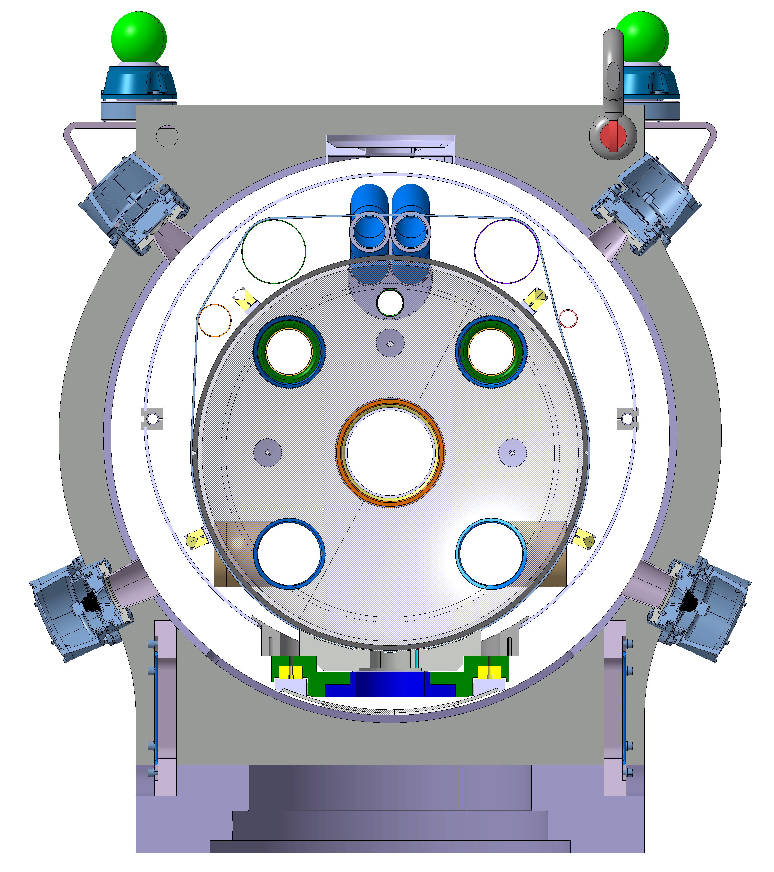
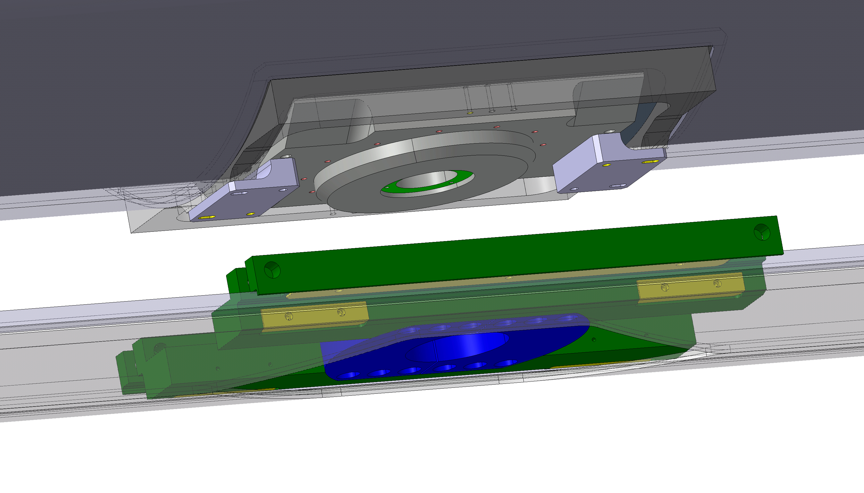
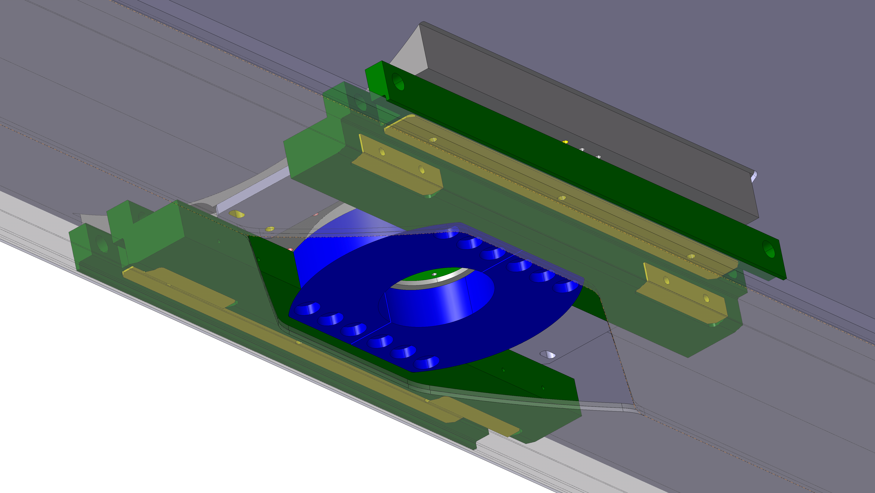
Assembly tooling: sledge on rails
Cold mass offset at -27 mm during insertion (nominal is 54 mm), up to -23 mm to remove sledges and then rails
Temporary support for termal shield
Sledge
Rail

Slide 15
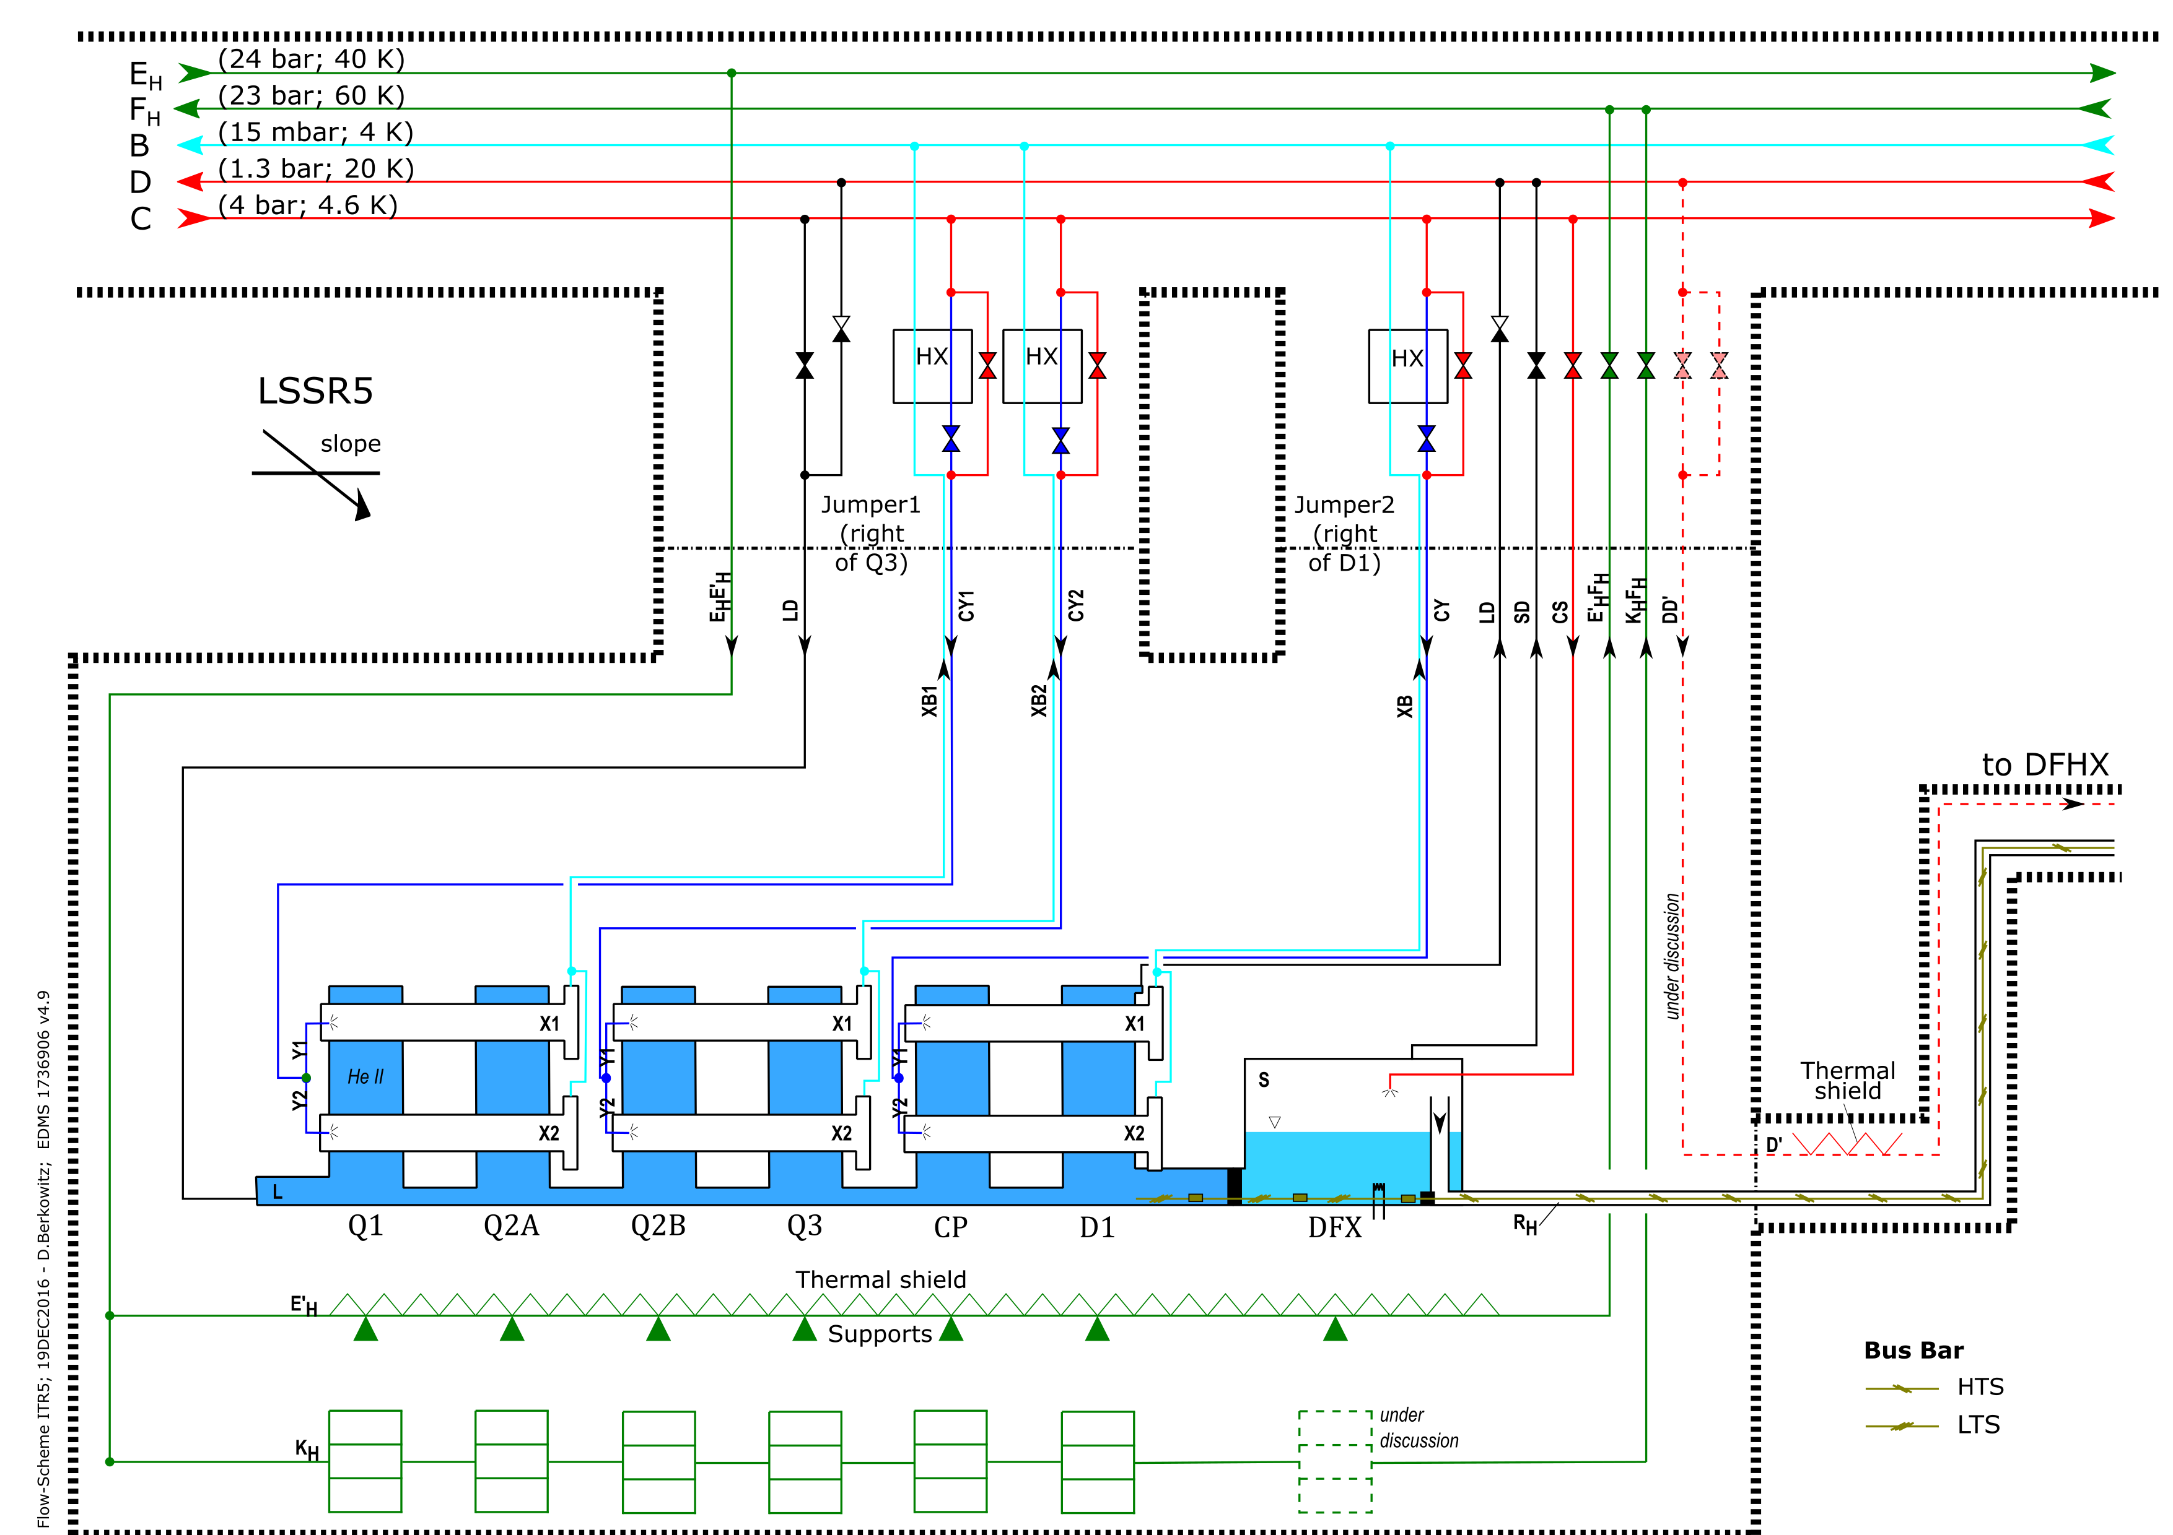
Pipe sizing and pressure drop
Edms 1573115
Edms 1710017

Slide 16
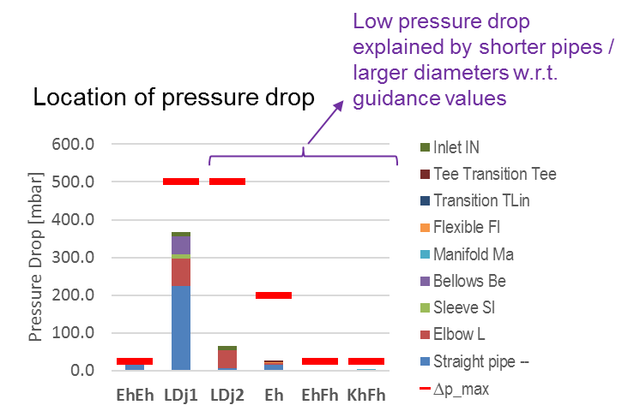
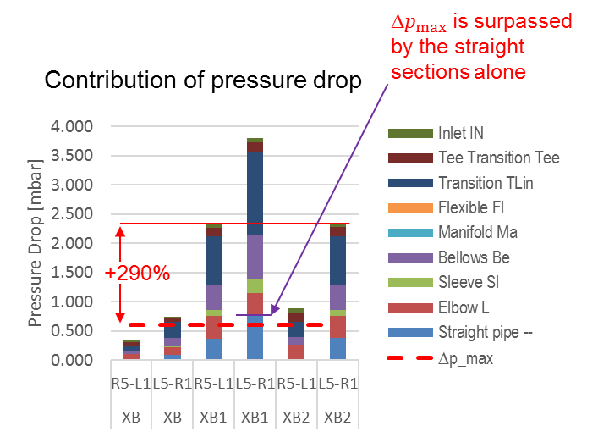
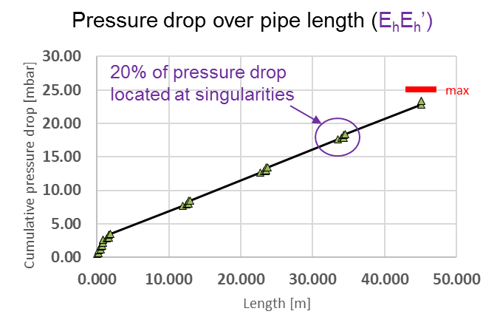
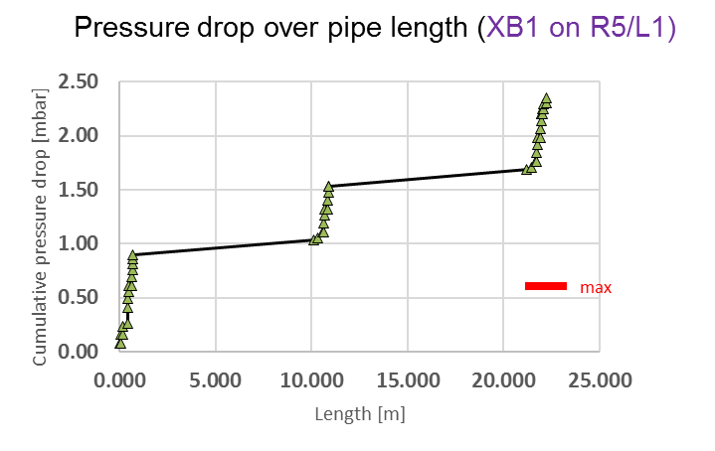
Pressure drop
Based on preliminary design Edms 1855744
Daniel Berkowitz Zamora
https://indico.cern.ch/event/677105/
High/medium pressure lines
Pumping lines
Recent data. Discussions on-going.

Slide 17
Design and procurement road map
Component | Who | Design | Procurement/Assembly
Cold mass | LMF | End covers depend on interconnect detailed design Interfaces for survey FSI | Delivered with N-lines Welded plates for cryo lines (tbd)
Vacuum vessel | CMI | First design by end of year Opening for support post Jack interfaces Deformations under load Baseline for instrumentation and CLIQ feedthroughs Minimise welded reinforcements for stability over time Interfaces for survey FSI | Single contract for all WP3 vacuum vessels (excl. D1). Q10 as option. Cylinder + service module with adjusted diameter DR Jul 2017 (price estimation as C&SR) MS before end 2017 IT spring 2018 FC June 2018, Order Jul 2018 First units Q2 & Q1 Mar 2019 Delivery over 3 years (tbd)
Support posts | CMI | First design by end of year Review assembly procedure Increase diameter as much as possible for stiffness Thermalisation design Assembly tooling pre-design | Single contract for all WP3 vacuum vessels incl. D1 (must be the same in a continuous cryostat) As critical as vacuum vessels MS dispatch Nov 2017 IT dispatch Feb 2018 Finance committee June 2018 Order placed July 2018 Pre-series Mar 2018
Thermalizations for support posts | CMI | Idem Must be very compact | Schedule OK if design done Q1 2017
Thermal shields | CMI | First design by end of year Thermalization and accessibility during assembly Split vertically or horizontally Temporary support during cryostating Cold mass alignment targets: approve heat loads | Aluminium extrusions Tender Q1 2018 Aluminium to stainless steel transitions Tender Q1 2018 Plates and machining Wwith support from MME (tbd) Welding/assembly in SMI2 Bottom trays and transitions for Q4 and Q10: qty in stock to be checked.
MLI |  | Blankets designed by contractor | Not much to gain with scale effect. Several orders according to needs
Cryo piping and phase separators | CMI | Cross check pressure drop with TE-CRG Detailed design of phase separator manifold Design of liquid boiling solution, active or passive (with TE-CRG) Level gauges (tbc) Validate jumper design | Solution to ensure cooling at 1.9 K to be discussed Procurement strategy will depend on design Assembled after cold test: Will be not shipped to the US.

Slide 18
Design and procurement road map (cont.)
Component | Who’s in charge | Design | Procurement/Assembly
Expansion joints and hoses | CMI | Pre-design and functional specification on going Design by contractor LHC specifications on materials are not interesting to contractors: we must revise them | Better in a single contract or we risk not being attactive to industry Conceptual specification Design by the supplier Fatigue testing of pre-series Series production Heat exchanger bellows + N Line hoses shipped to US, others welded at CERN? (tbd)
CLIQ and instrumentation feedthroughs |  | Local feedthroughs: Can be cold tested with the magnet Simpler test bench Less connections if magnet must be removed Local feedthroughs agreed for Instrumentation and CLIQ
Current leads 35 A trim |  | 35 A leads after Q1 as they must go through cold diode
16x120 A correctors 2x200 A correctors |  | Pre-study on-going. Not baseline yet
Beam screens / BPM / Plug-in module / CWT | VSC | There is very little room for welding and cutting between beamscreen and cold mass lines: to be discussed at the level of HL-LHC integration BPM cables and feedtrhoughs to be routed
Interconnects |  | Welding and cutting tools to be designed Mockups | Vacuum vessels sleeves ordered as single contract (needed for the string) Thermal shields and MLI to have shorter lead times Procurement of welding and cutting tools must be addressed as soon as the first design is done
Jacks |  | Will we need to design new jacks or can we use existing ones? Longitudinal adjustment range under discussion. Strategy to be discussed with SU
Cryostating bench for SMI2 |  | Will replace existing MS bench. Compatible with all WP3 cryostats + LHC MS SSS and long connection cryostats Design by contractor according to CERN functional spec. | 1 tooling for CERN+ 1 tooling for US IT dispatch Nov 2017 Order placed: Feb 2018 + 12 months: Tool 1 installed and commissioned at CERN Feb. 2019 + 14 months: Tool 2 installed and commissioned at FNAL Apr. 2019

Slide 19
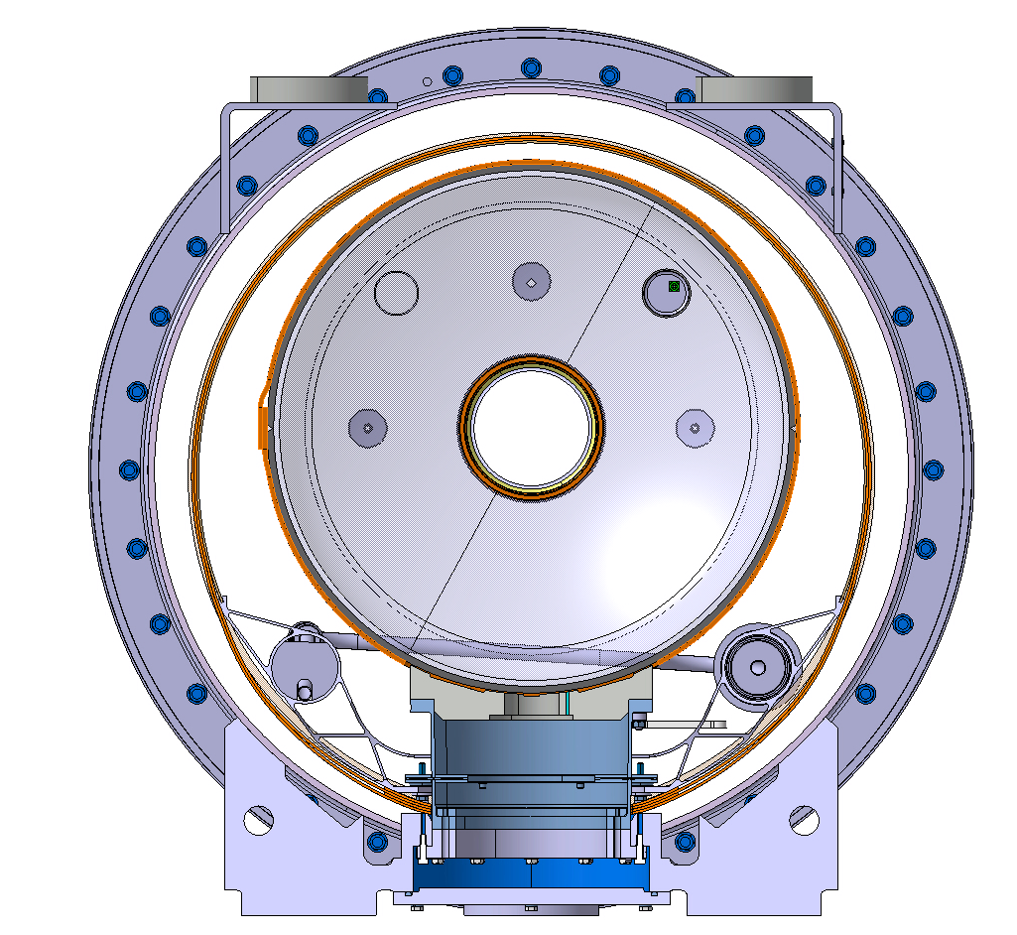
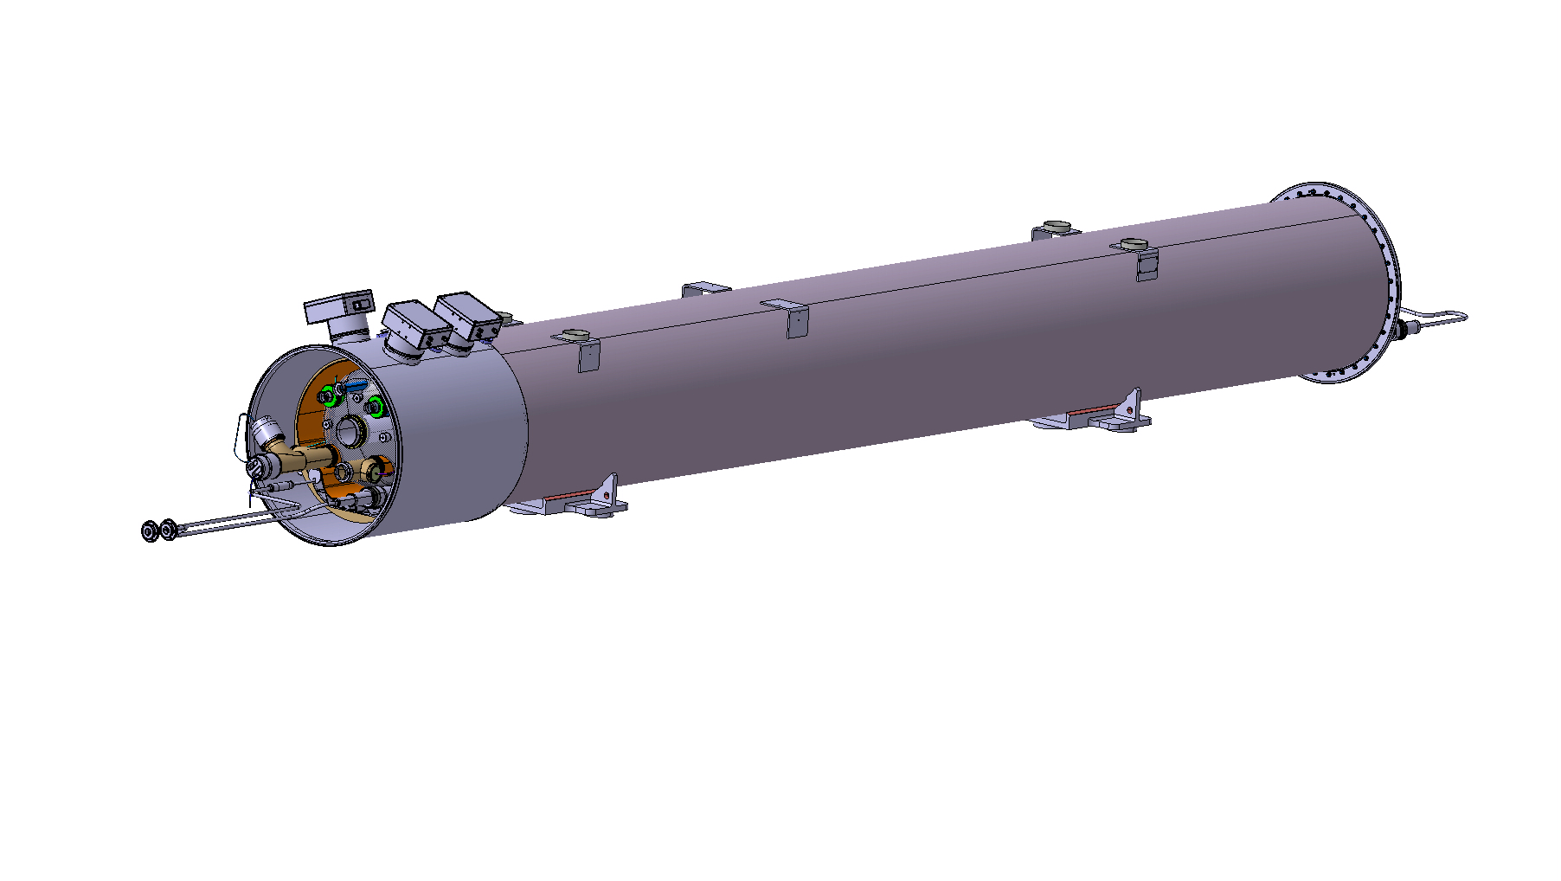
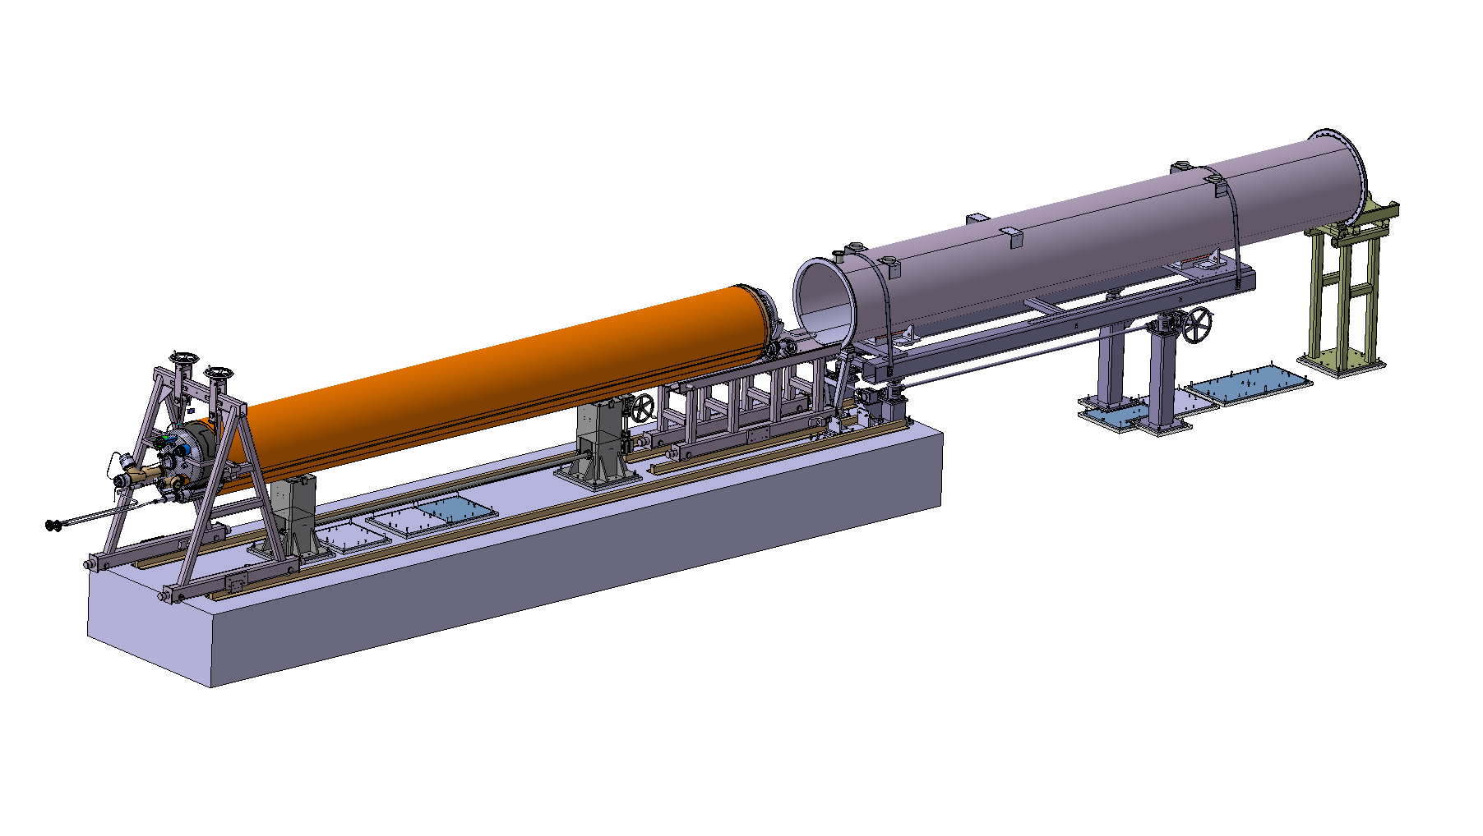
Test cryostat for MQXF proto
Using LHC spare vacuum vessel
  Dedicated service module for feedthroughs to be welded and cut off after the test
New support posts required (shorter):
  Collaboration with EP department for production in lay-up and autoclave.
  Machined from G10 tube was studied: not ideal for transverse loads.
  Alternative: machined from stainless steel (higher heat loads)
Modifications to the cryostating tooling
The vessel is too thin to support the cold mass weight: Reinforcement plates inside vacuum vessel
Definition of feedthroughs required to finish the design

Slide 20
Thank you!

