Slide 1

Structural Design Criteria Discussion
E Anderssen, LBNL
FNAL, BNL, LBNL
Design criteria meeting 2017-10-28

Slide 2
Outline
What exists that we can simply refer to
Where and why would we deviate
Should include references to standards
Address use of ‘Brittle’ materials
Recommendations from the Review Committee to the Project Team:
1) Create & Approve (Structural & Electrical) Design Criteria, including criteria for brittle materials, prior to CD-2/CD-3b.
2) Secure external review of these criteria prior to or during CD-2/CD-3b.

Slide 3
Design Criteria used by other projects
Structural
System
Superconducting Circuit
MagLab Cryostat
Resistive Magnet
Plumbing
Lifting and Turning
Human Occupied Structures
Criterion
FIRE (NSTX)
ASME B&PVC Sec. VIII, div. 2
MagLab RES/MAG
ASME B31 (Pressure Piping)
ASME B30.20 (BTH)
ANSI/AISC 360 (SSSB)
Usually documented in critical lift notes—defined by institute, but specify
Electrical
Superconducting Circuit
Power
ITER
National Electric Code

Slide 4
Comparison of example design criteria docs
ITER Structural Design Criteria
NSTX Design Criteria
Exists, is well written, copies or refers to large sections of existing standards
Good balance in definition of limits and loads—we would need to define independently
Perhaps too much emphasis on welded structures which are adequately covered in B&PVC
Treatment of Linear Elastic Fracture Mechanics (LEFM) but with an emphasis on fatigue not fracture
Some good values and points—should steal where appropriate (appropriate where appropriate)
~60 pages, + appendices
Simpler formulation, similar in tone to what we should probably produce
Tends to be more rule based than analysis based—we generally always have FEA results so should identify what we would ‘only hand calculate’
Does not include significant treatment of LEFM, uses S-N curves and cumulative damage for Fatigue…
Does have some good section ideas, e.g. defining allowables for differing kinds of materials e.g. insulators etc.
~28 pages, + appendices

Slide 5
Boiler & Pressure Vessel Code and
Pressure Equipment Directive
Generally rely on high margins against yield
Provide conservative material properties to use and define/document source of properties
Rely generally on tough, typically weldable alloys (alternate materials have limited treatments, e.g. composites)
References are outside of code for brittle or flawed structures, e.g cracks
Do not usually cover material common in our structures, e.g. 7000 Al, Iron, low-carbon steel

Slide 6
Excerpts from BPVC VIII Division 2
Alternative Rules
BPVC references Fitness for Service standards for fracture
3.11.2.8 Establishment of the MDMT Using a Fracture Mechanics Methodology.
(a) In lieu of the procedures in 3.11.2.1 through 3.11.2.7, the MDMT may be established using a fracture mechanics
approach. The fracture mechanics procedures shall be in accordance with API 579-1/ASME FFS, Part 9, Level 2 or Level3.
(b) The assessment used to determine the MDMT shall include a systematic evaluation of all factors that control the susceptibility to brittle fracture, e.g., stresses from the applied loadings including thermal stresses, flaw size, fracture toughness of the base metal and welded joints, heat treatment, and the loading rate.
(c) The reference flaw size used in the fracture mechanics evaluation shall be a surface flaw with a depth of a = min [t/4, 25mm] and a length of 2c = 6a where t is the thickness of the plate containing the reference flaw.
If approved by the user, an alternative reference flaw size may be used based on the weld joint geometry and the NDE
that will be used and demonstrated for qualification of the vessel (see Part 7).
(d) The material fracture toughness shall be established using the exemption curve for the material (see Notes to
Figures 3.7 and 3.8) and MPC Charpy impact energy correlation described in API 579-1/ASME FFS-1, Appendix F,
F.4. If approved by the user, an alternative material fracture toughness may be used based on fracture toughness test results.
(e) The MDMT established using a fracture mechanics approach shall not be colder than that given in 3.11.2.3(e).
Part 3 of BPVC_VIII-2 is on material properties
Part 4 is design by Rule
Part 5 is the Design by Analysis requirements (what we do)
Nominally Division 2 is for vessels between 3,000-10,000psi
That’s not us, but gives clearest guidance on how to approach calculations conservatively
Provides some guidance on inspection as well
Does not explicitly discuss Fracture
Excellent ref for Plastic Collapse
MDMT: Min Design Metal Temp: for elevated temp performance– Level 2 or Level 3 described later.
5.11 FRACTURE MECHANICS EVALUATIONS
Fracture mechanics evaluations performed to determine the MDMT in accordance with 3.11.2.8 shall be in accordance with API/ASME FFS-1. Residual stresses resulting from welding shall be considered along with primary and secondary stresses in all fracture mechanics calculations.

Slide 7
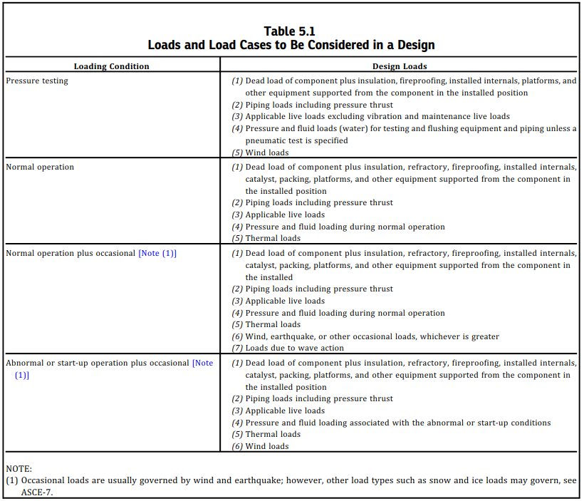
More from BPVC VIII Div 2
DEFINE LOAD CASES and DEFINITIONS
This is something we do already, but haven’t documented well

Slide 8
Fitness for Service
Devised by energy sector to assess damaged equipment (also considers defects from mfg)
  Aimed at extending life or allowing use
  Similar discipline to Damage Tolerant Design used in aerospace—assumes ‘flaws’ are present in structure
Based on inspection and evaluation of flaws
  Graded approach, from ‘hand calculations’ to FEA, simple LEFM to EPFM—in order of complexity
  Each grade uses more of the ‘strength criteria’ of the material or structure—allowing higher usable loads
  Each grade decreases conservatism
It is up to us to establish the thresholds between each of the steps of the graded approach
  This is where our design criteria document is useful and important…

Slide 9
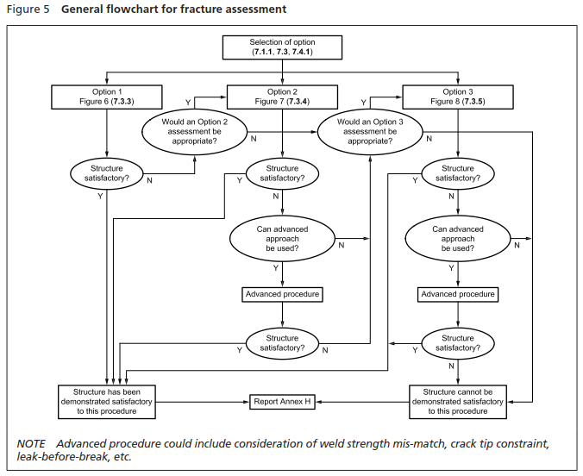
Excerpt BS 7910:2013+A1:2015
Decreasing margin
Less
Expert
More
Expert
Always ends in a report
More complete Material properties

Slide 10
Graded Approach can start simple
Options 1 can be as simple as FoS > 4 Done
Move to option 2 if simple change can’t meet criteria specified in option 1
Move to next level if say FoS < 2, require more analysis, maybe relavent material test data, etc
LEFM is just one of the later levels
  It should be stated that some auxiliary checks should be defined e.g. if X material property is lower than some threshold, Level X analysis is required (skipping lower levels)
  Ratio of Yield to Ultimate, ductility below some threshold, K_{Ic} etc.
This is why some replication of the various standards is useful in a design criteria document so that its distilled and more accessible to engineers on the project(s)
None of the divisions of the standards is less than 700pages long, and not always easy to access.
  Either excerpt or point directly at relevant section of accessible documents…

Slide 11
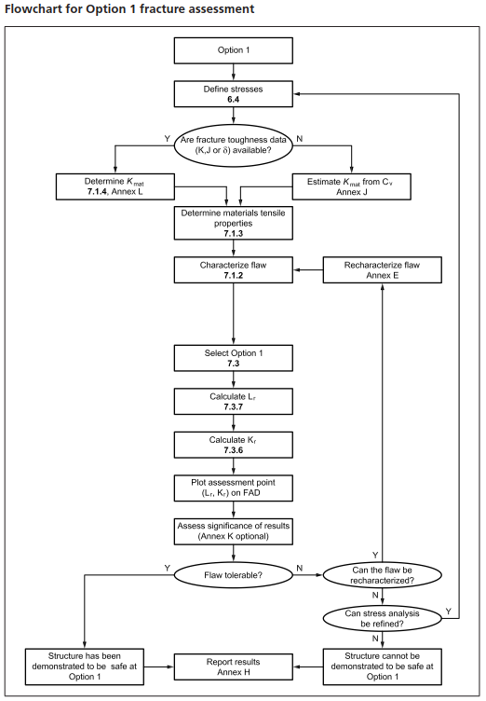
Flow Chart for flawed structure assessment
FEA results
All Options have the same Flow Chart, become more complicated for higher levels
‘Options’ defined from FFS-1
Material
Properties
The LEFM calculation is aimed at assessing a load point on a Failure Assessment Diagram (FAD)
The Option 1 FAD depends on only K_{Ic} and Yield (at temp)
Option 2 FAD requires also plastic flow data--full stress-strain data at relevant temps (try to avoid)
Option 3 FAD is based fully on experimentally failed samples of relevant temp, geometry and residual stress (we shall avoid)
LEFM
Calculation
Mitigate
Report
Move to Option 2

Slide 12
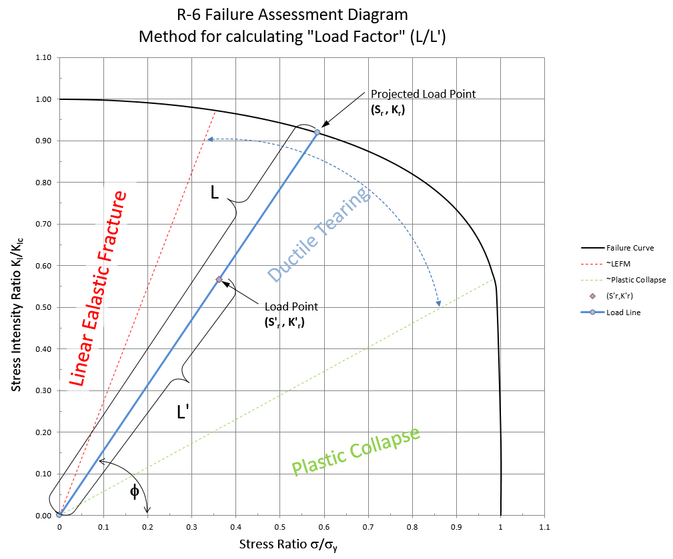
Option 1 (section 3 of FFS-1) uses LEFM
Failure Assessment Diagram
R6 is a useful method to assess complex failure envelopes
Predicts well LEFM and Plastic Collapse on one figure
If under curve on FAD, safe, if outside mitigation is required
Can set Limits on Load Factors, e.g. 1.1-1.5 are suggested for different load severities in the ITER SDC
Here the FAD is normalized to K_{Ic} and Sy, for materials with significant strain hardening significant margin above Sy is available
I propose we do not use that, but do take advantage of higher Sy at cryo temperature
SU-1005-6694 is a decent summary of the method outlined in R6 and BS7910 which is a ref for FFS-1

Slide 13
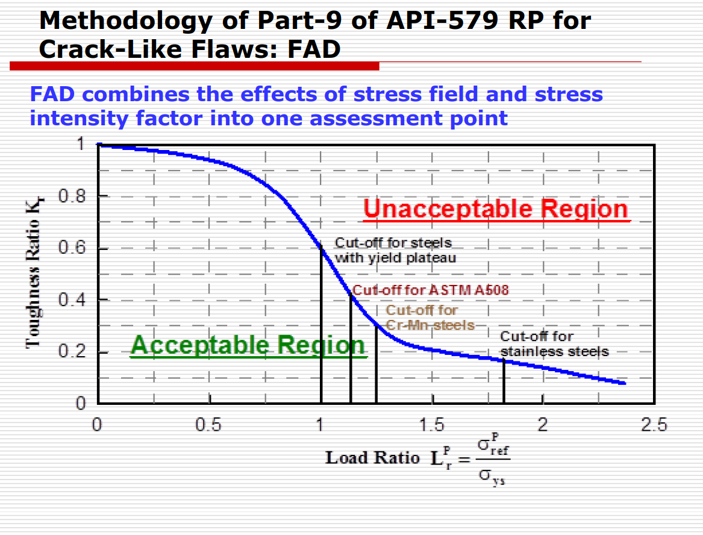
Section 9 is fully Elasto-Plastic Fracture
Significant residual strength lies beyond Sy = 1…
Part-9 FAD (Option 3) extends to higher plastic collapse values
Curves as aggressive as this are only used with actual data to define the envelopes—methods presented in BS7910/FFS-1
Option 2 is more benign but propose that we stay conservative and design well within the Option 1 FAD
Can better flesh this out, but may help to read the previously mentioned engineering note on the shell.
Figure from talk on API 579-1/ASME FFS-1
Mohammad M. Megahed
Mohammad S. Attia
Faculty of Engineering – Cairo University – Egypt

Slide 14
How we propose to move forward
Leverage existing codes where appropriate
  ITER, FFS, NSTX, etc
Develop a “simple” document specific to MQXF that…
  provides custom guidance for our application
  leverages/duplicates as much as possible from existing codes
  provides a graded approach for straightforward guidance to design & analysis
  Is kept short and focused on our application
Check our analysis of each major element of the MQXF magnet wrt the draft code
Review the draft code within LARP
Convene external reviewers
Make modifications as necessary prior to CD2 and/or CD3b

Slide 15
A draft timeline for the development and implementation of the design criteria document
Develop skeleton of the draft Design Criteria | ~November 10th, 2017
Flesh out the graded criteria and associated analysis techniques | ~December 1st, 2017
Check analysis of all critical components wrt design criteria | Dec. 20th, 2017
Finalize draft document | January 12th, 2018
Review draft document within LARP | January 19th, 2018
Convene external review of document | February/March 2018
Address feedback from external review | March/April 2018
Dates are aggressive, but reasonable

Slide 16
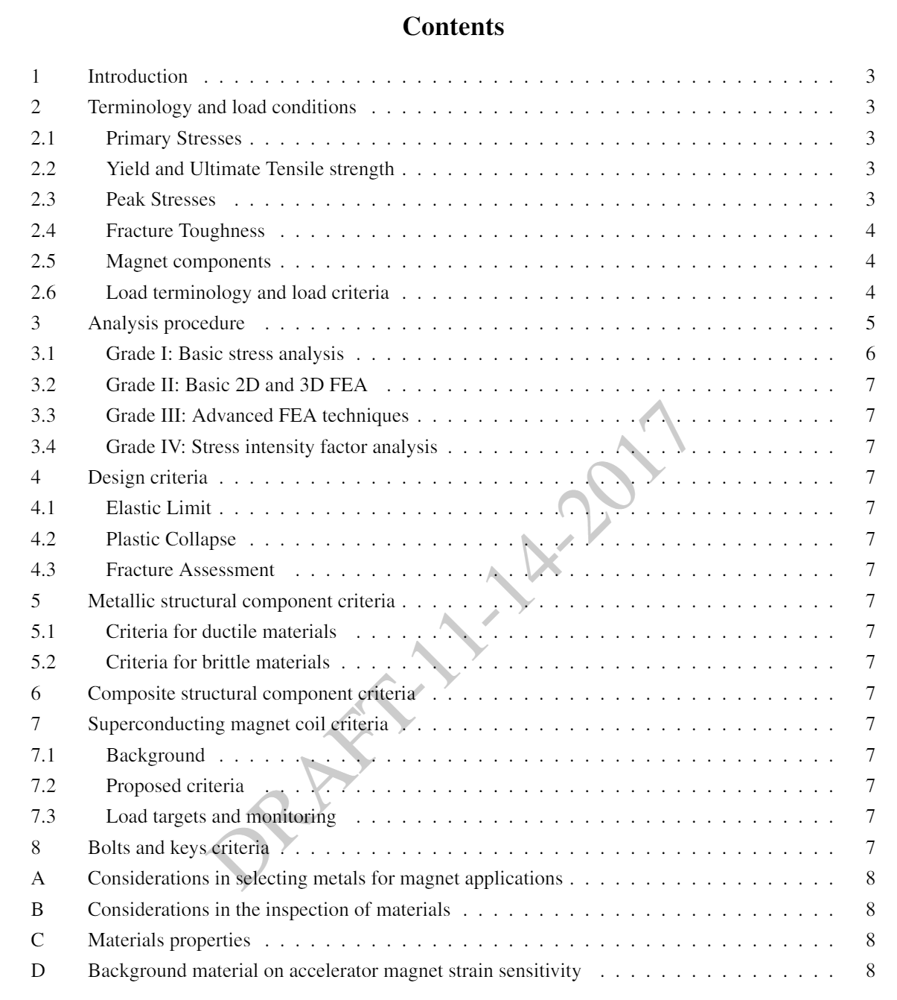
Draft Document exists—beginning to write
Document outline prepared and beginning to flesh out sections that can be appropriated from other design criteria documents, codes, etc.

Slide 17
Conclusion
Fitness for Services methodology seems a well structured approach to build design criteria
The R6 FAD is a method that should allow us to adequately assess ‘brittle’ materials for use in magnet structures
Should extend to other ‘brittle’ materials such as insulators, coils, G11, etc
  Need to investigate further failure criteria in composites (Mil HDBK 17)
Should re-write SU-1005-6694 to be more consistent with FFS-1 (also need to get K_{Ic} data for shell at cold)

