Slide 1
Update on hollow e-lens: resonant excitation MD
Miriam Fitterer, G. Stancari, A. Valishev (Fermilab), R. Bruce, A. Gorzawski, S. Papadopoulou, G. Papotti, D. Pellegrini, S. Redaelli, B. Salvachua, G. Valentino, D. Valuch, J. F. Wagner (CERN)
7th HL-LHC Collaboration Meeting, 16th November 2017
Many thanks to: G. Apollinari, D. Perini, A. Rossi, L. Valerio, all MD participants and operations!

Slide 2
Outline
Effects on the beam core
Simulations
LHC MDs on effects on the beam core in case of pulsed e-lens operation (resonant excitation, random)
Conclusion and Outlook

Slide 3
Effects on the beam core

Slide 4
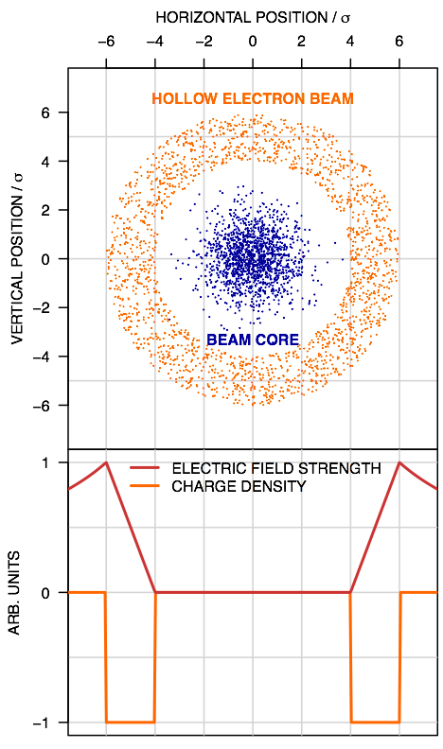
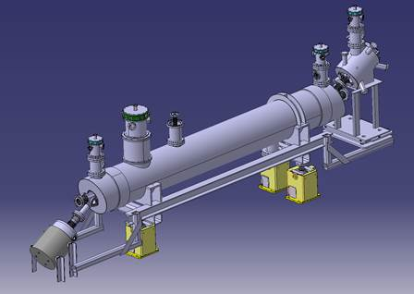
Principle of hollow e-lens
proton beam (p-beam) traveling inside a hollow electron beam (e-beam)
hollow profile of e-beam => p-beam core (ideally) not affected
halo particles kicked to higher amplitudes by electromagnetic field of e-beam => cleaning of halo particles
G. Stancari
D. Perini
Gun + Solenoid
magnetically confined, low-energy e-beam
tunable transverse kicks of approx. 0.3 µrad
e-beam
superconducting
solenoid
p-beam
Correctors
Collector

Slide 5
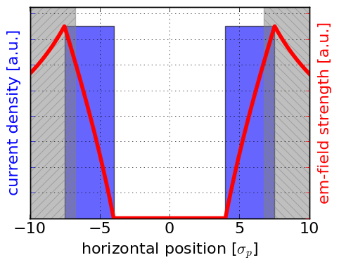
Effects of HEL on beam core
for a perfect profile, the field at the beam core is zero => no effect on p-beam
residual field at p-beam core from e-lens bends and profile imperfections
DC operation: residual fields are negligible
pulsed operation increases diffusion in tails (fast depletion if needed):
Collimator
Collimator
  random mode: uniform modulation of current
  resonant mode: pulse e-lens every n^{th} turn -> drives n^{th} order resonances
noise is induced on the p-beam (not negligible)
approximate kick to first order by dipole kick, then we can use the ADT in the LHC for experimental studies and to define tolerances

Slide 6
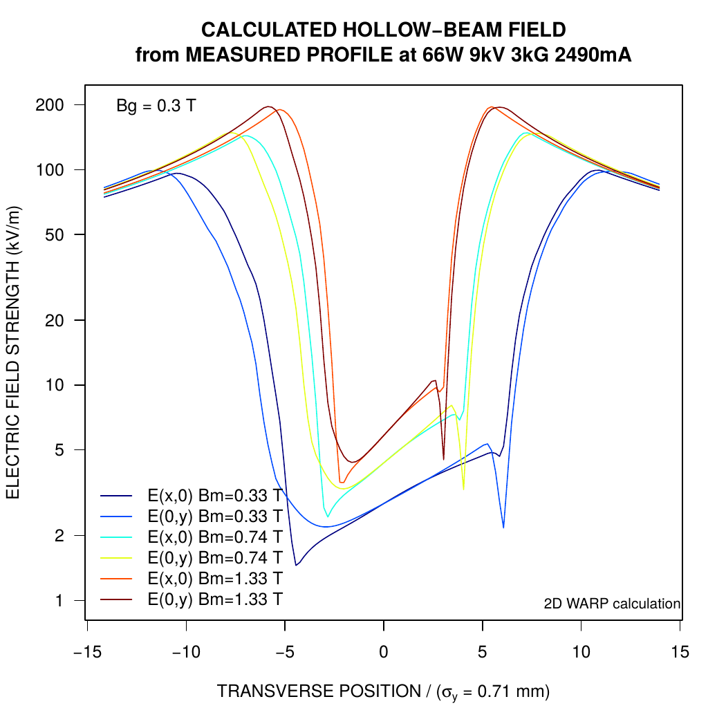
Effects of HEL on beam core
Estimates for HL-LHC e-lens design parameters [3]:
E_{p-beam}=7 TeV, E_{e-beam} = 10 keV, I_{e-beam} = 5 A, L_{e-lens} = 3 m, B_{main solenoid} = 5 T
Noise due to uncompensated kicks from e-lens bends [4]:
estimate based on derivation of symplectic map for e-lens bends [5], scale to design parameters, assume 10% fluctuation between entrance/exit kick
Noise due to profile imperfections [4]:
scaled from measured profile, kick increases linearly with main solenoid field
G. Stancari
[3] G. Stancari, V. Previtali, A. Valishev, R. Bruce, S. Redaelli, A. Rossi, B. S. Ferrando, Conceptual design of hollow electron lenses for beam halo control in the Large Hadron Collider, FERMILAB-TM-2572-APC, CERN-ACC-2014-0248
  [4] M. Fitterer, G. Stancari, A. Valishev, Effect of pulsed hollow electron-lens operation on the proton beam core in LHC, FERMILAB-TM-2635-AD
[5] G. Stancari, Calculation of the Transverse Kicks Generated by the Bends of a Hollow Electron Lens, FERMILAB-FN-0972-APC

Slide 7
Simulations

Slide 8
Simulations
FMA to understand which resonances are excited => most effective pulsing pattern
tracking of Gaussian beam distribution to obtain estimate for:
  losses
  emittance growth
  change in shape of beam distribution
simulation code: Lifetrac

Slide 9
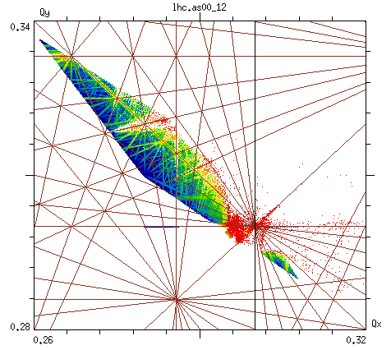
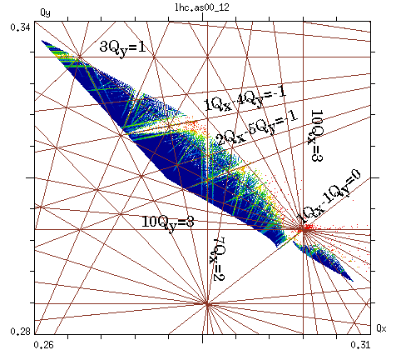
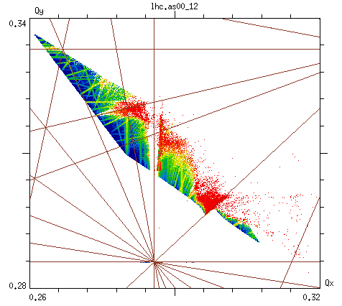
Sensitivity to 7th and 10th order resonance (2016)
10Q_{x}
7th turn pulsing H+V
10Q_{y}
10th turn pulsing H+V
no excitation, no errors
7Q_{x}
efficiency of pulsing patterns can be understood with FMA

Slide 10
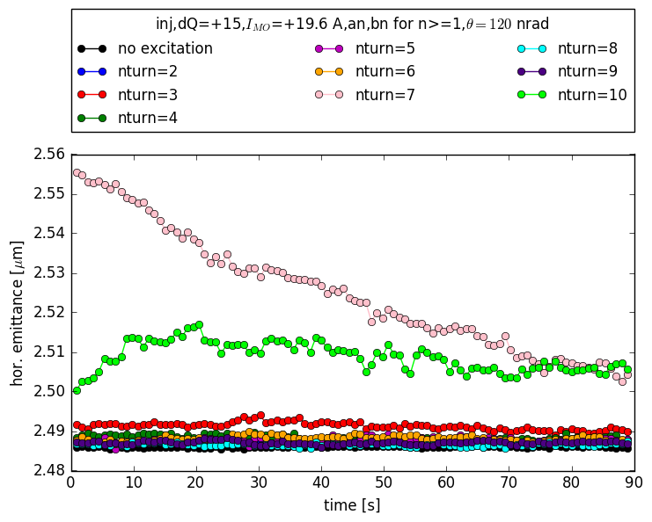
Simulation of losses and emittances (first try)
simulations are non-trivial as they enter deeply into the non-linear dynamics.
simulations and experimental results of losses and emittance growth do not agree well (see :
  emittance decrease or constant emittance instead of increase
  losses are underestimated
experiments can be used to benchmark simulations
2016 parameters

Slide 11
Improvement of simulations (in progress)
remove orbit error as not modeled in the same way in SixTrack and Lifetrac => no decrease of emittance any more
emittance varies between 2.5 and 3.5 μm => simulate min/max emittance
add random noise ⬄ interplay between resonant excitation and random noise
  estimate of random noise: A_{noise} = 8.0e-5 (from BB noise MD @ 6.5 TeV, X. Buffat)
  scale with beam rigidity to injection : A_{noise} = 1.2e-3
  apply kick at ADT:

Slide 12
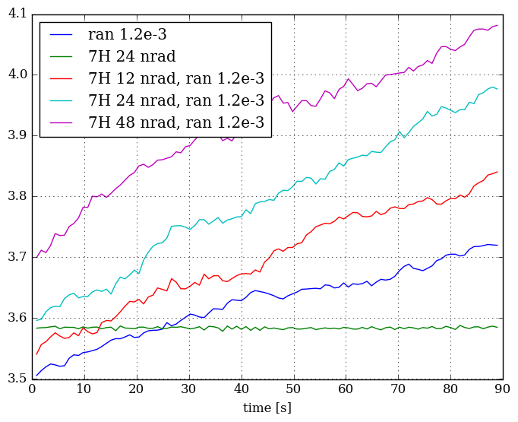
Example: 7th turn H, hor. emittance
continuous emittance growth on top of initial change of distribution

Slide 13
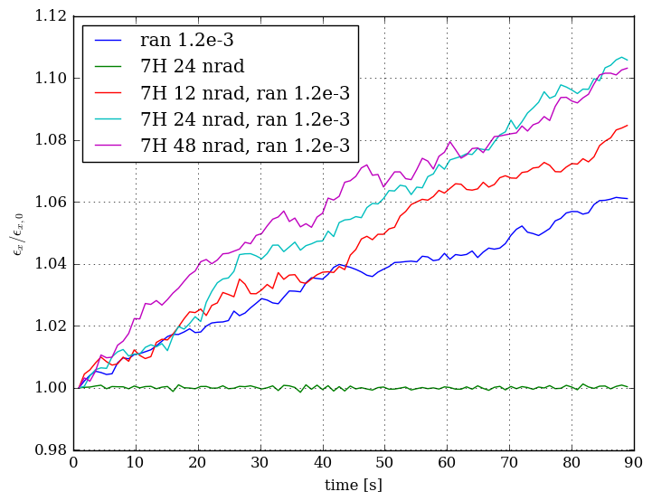
Example: 7th turn H, hor. emittance
resonant excitation amplitude dependent emittance growth

Slide 14
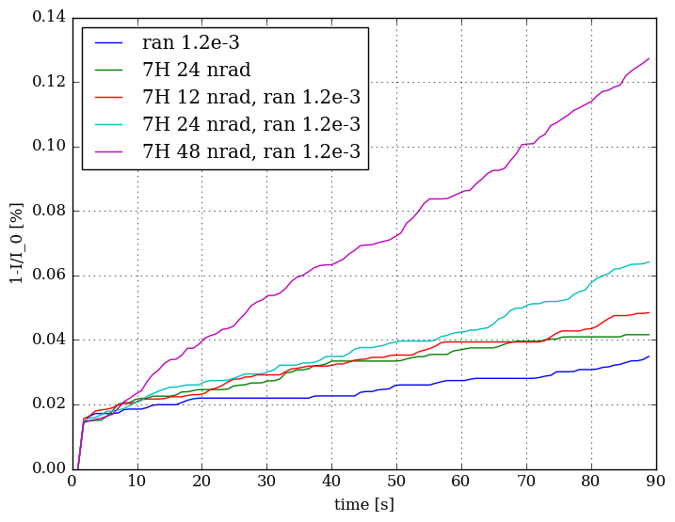
Example: 7th turn H, relative losses
resonant excitation amplitude dependent losses

Slide 15
Challenges of precise predictions from simulations
we need the full non-linear model of the machine (tracking is CPU intensive)
random noise level in LHC not known at injection
large parameter space to scan (emittance, excitation amplitude + plane, noise level, error seeds)
rather large uncertainties on input (emittance, beam distribution, excitatition amplitude, small number of error seeds)
extrapolation to larger time scales (we only simulate 90 s of the machine)
saver+faster to determine tolerances experimentally and use simulations for better understanding

Slide 16
resonant excitation MDs
2016 + 2017

Slide 17
Experiments at the LHC (resonant excitation MDs)
in total 2 experiments (one in 2016 + one in 2017)
Excitation:
  e-lens field approximated by dipole kick
  dipole kick is applied with ADT with either resonant or random pulsing pattern, one pattern per fill
  2016: patterns 7th H, 10th V turn pusling
  2017: patterns 7th, 8th turn pulsing, random

Slide 18
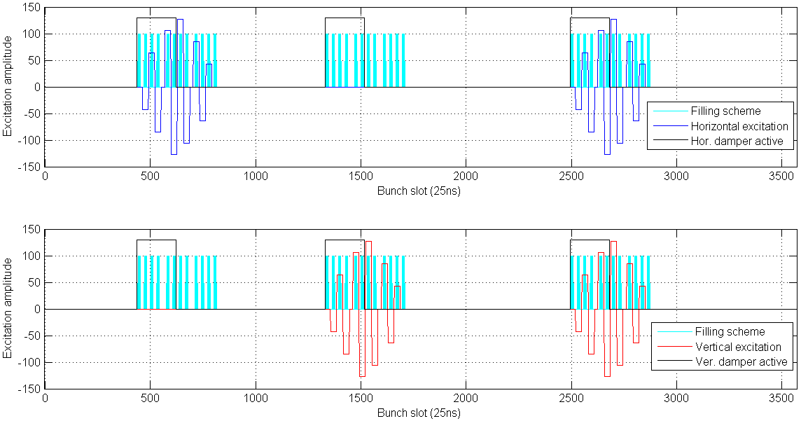
Example filling scheme 2017
we have to test: pattern + plane + effect of transverse damper
D. Valuch

Slide 19
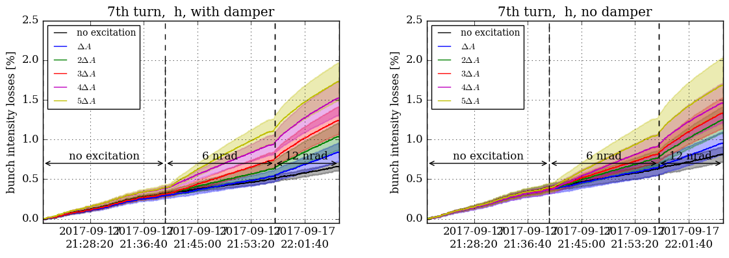
Example FBCT losses 2017 – 7th
excitation amplitude dependent losses
no reduction of losses by transverse damper

Slide 20
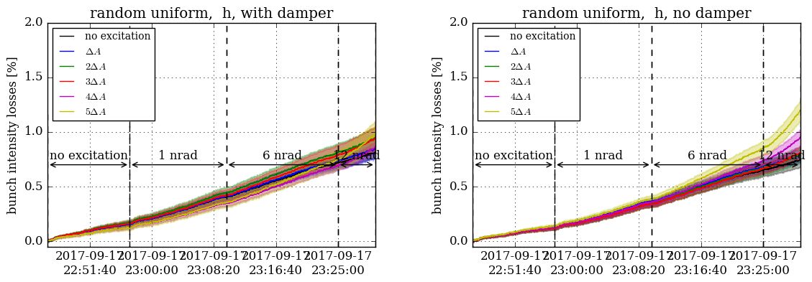
Example FBCT losses 2017 – random
excitation amplitude dependent losses
reduction of losses by transverse damper

Slide 21
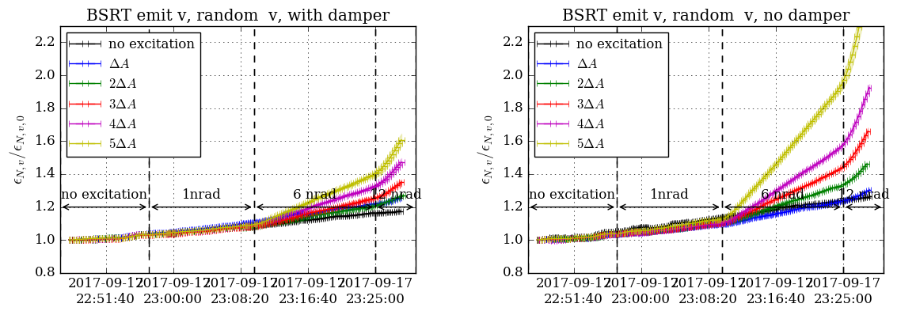
Example BSRT emittance 2017 – random
excitation amplitude dependent losses
constant amplitude dependent growth rate of emittance
reduction of emittance growth by transverse damper

Slide 22
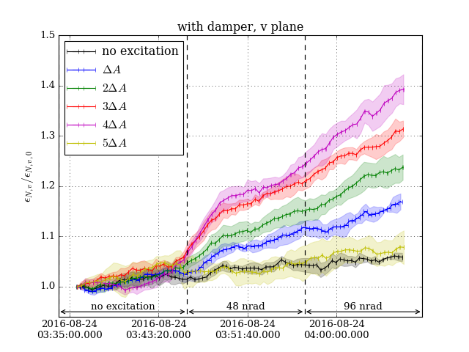
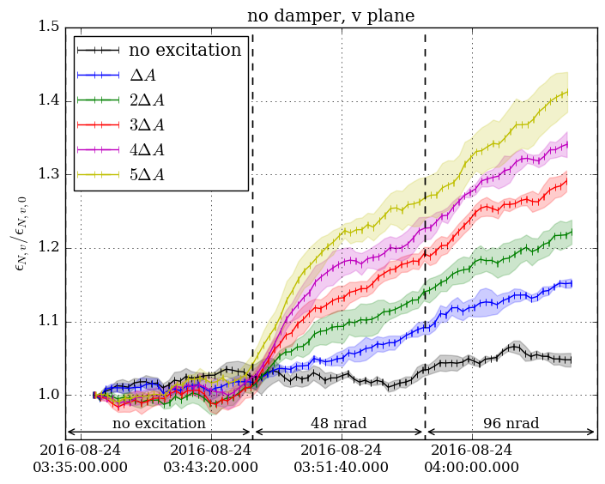
Example BSRT emittance 2016 – 10th
fast increase
fast increase
new equilibrium?
new equilibrium?
excitation amplitude dependent emittance growth
strong increase followed by constant growth (adjustment of beam distribution to new equilibrium state?)
no reduction of emittance growth by transverse damper

Slide 23
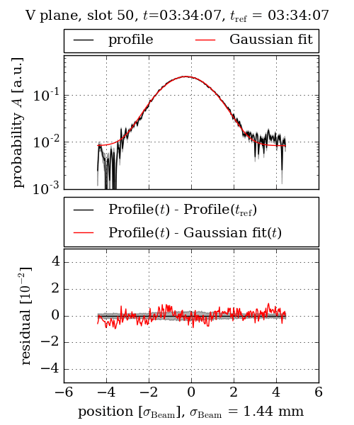
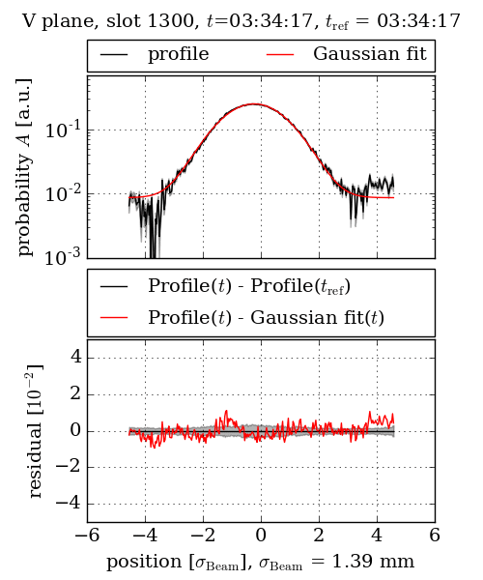
Example BSRT profiles 2016 – 10th
no excitation
10th turn V

Slide 24
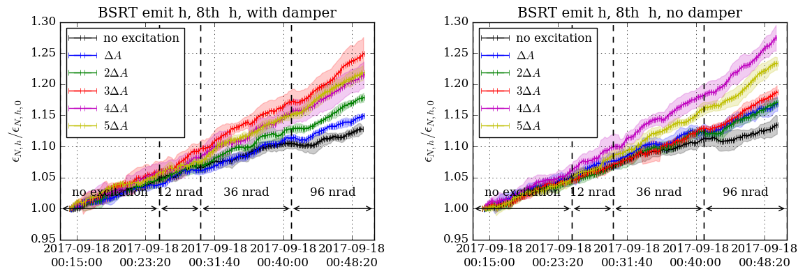
8th turn BSRT emittance (2017)
effect on beam only for much higher amplitudes
96 nrad = maximum amplitude without saturation

Slide 25
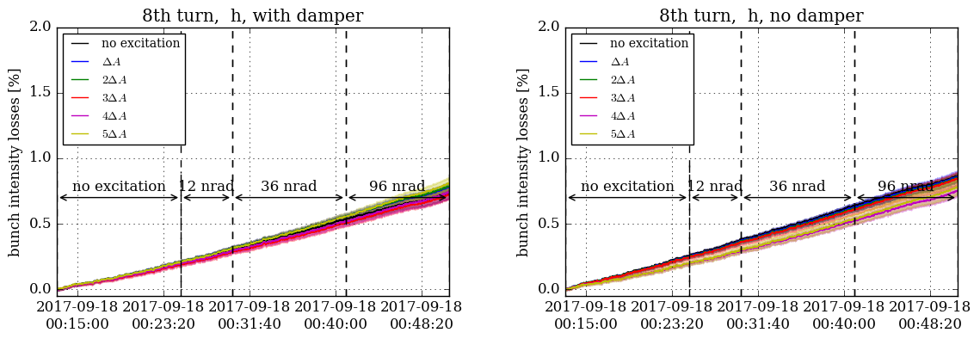
8th turn FBCT losses (2017)
no effect on losses even for maximum amplitude of 96 nrad

Slide 26
Summary of experiments in 2016 and 2017
7th turn pulsing (6 and 12 nrad):
  high losses
  small emittance growth
10th turn pulsing (48 and 96 nrad):
  small losses
  large emittance growth
8th turn pulsing (12, 36 and 96 nrad):
  no losses
  small emittance growth
random (1, 6 and 12 nrad):
  small losses
  strong emittance growth
no reduction of losses/emittance growth if transverse damper active
reduction of losses/emittance growth if transverse damper active

Slide 27
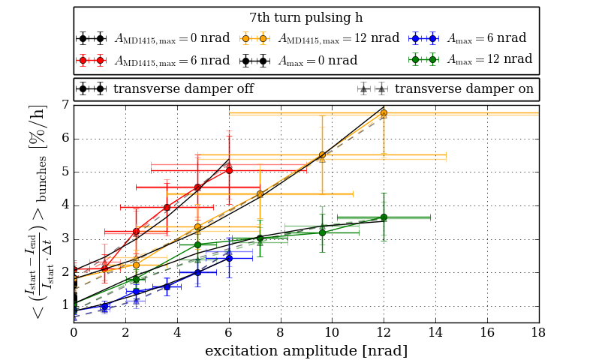
Scaling FBCT losses 7th (2016+2017)
different tune in 2016 than in 2017
similar results in both MDs

Slide 28
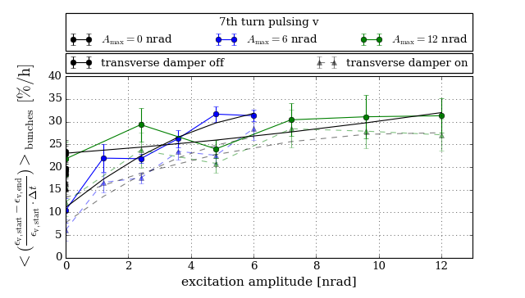
Scaling BSRT losses 7th (2016+2017)
small emittance growth
emittance growth in V for pulsing in V (and H+V) (different tune)
no horizontal emittance growth

Slide 29
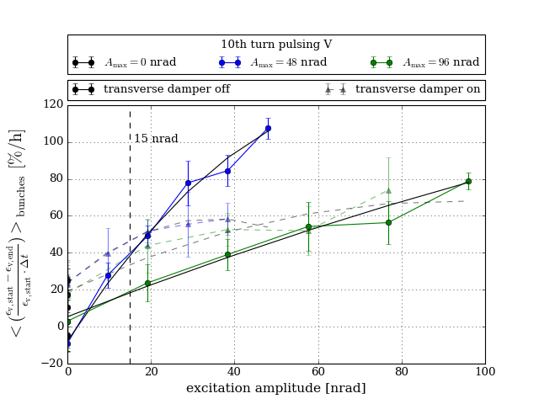
Scaling BSRT emittance 10th 2016
strong emittance growth in the plane of excitation

Slide 30
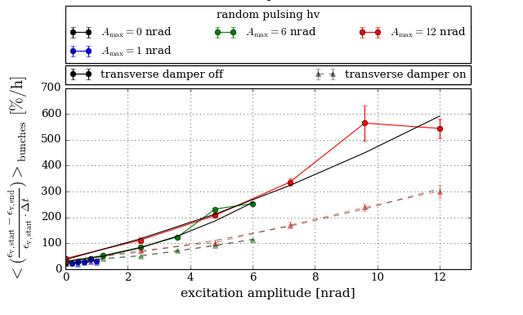
Scaling BSRT emittance random (2017)
very strong emittance growth
strong effect of the transverse damper

Slide 31
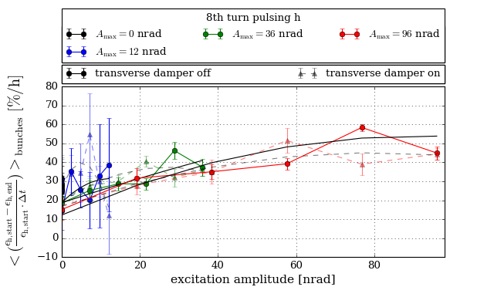
Scaling BSRT emittance 8th (2017)
noisy
small emittance growth visible

Slide 32
Summary
effects of e-lens on beam core are negligible in DC operation
the e-lens does work in DC mode
for the optional pulsed operation (nth turn + random) mode, the e-lens induces noise
effects on beam core not negligible for current estimate of 15 nrad dipole field
experiments in 2016 and 2017 to determine tolerances on residual e-lens field in core region
relative effectiveness of pulsing patterns can be predicted in simulations and understood with FMA
quantitative simulation of losses and emittance non trivial
better to determine tolerances experimentally and use simulations for better understanding

Slide 33
Summary
all pulsing patterns for which an effect is predicted in simulations show high losses and/or high emittance growth for 15 nrad
improve the residual e-lens field in the core region (better e-gun)
find a pulsing patterns that effects the halo, but not the core (dependent on machine + beam configuration)
effect of transverse damper:
  nth turn pulsing: no effect
  random: reduction of emittance growth and losses
in all experiments we only excited for max. 15 min during injection
this is ”a good case scenario”
for more precise values we would need to measure also at collision energy and for a longer time

Slide 34
Questions?

