Slide 1


Preliminary results from HiRadMat “Multimat” experiment
F. Carra
C. Accettura, A. Bertarelli, E. Berthomé, L. Bianchi, C. Fichera, T. Furness, G. Gobbi, P. Grosclaude, J. Guardia, M. Guinchard, M. Pasquali, E. Rigutto, O. Sacristán and many more …
7th HL-LHC Collaboration meeting
CIEMAT, Madrid
November 15th, 2017

Slide 2
Objectives
Assess/validate materials for HL-LHC
Offer a single, flexible platform to test specimens of a large palette of materials (including coatings, anisotropic materials, foams, AM etc.) used in Collimators (and other Beam Intercepting Devices) under high brightness beams (as close as possible to HL-LHC and LIU/BCMS)
Dedicated target stations to assess behaviour of components (sensors, electronic devices, beam diagnostics, etc.) in close vicinity of high intensity beams
Acquire online material dynamic responses and derive / extend constitutive models (to be reused in simulating full scale devices) without reaching extensive material degradation (with the possible exception of coatings)
Benchmark complex numerical simulations with little known constitutive equations
Allow rapid specimens disassembling in view of Post Irradiation Examination completing material characterization

Slide 3
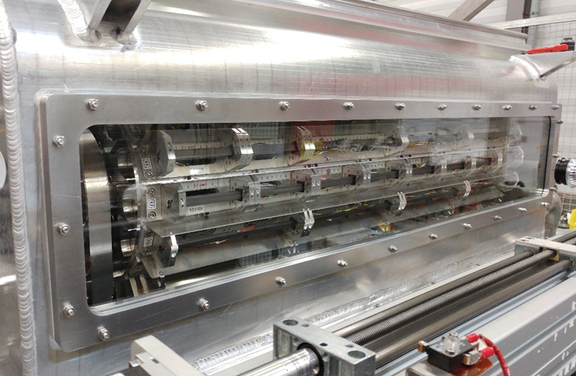
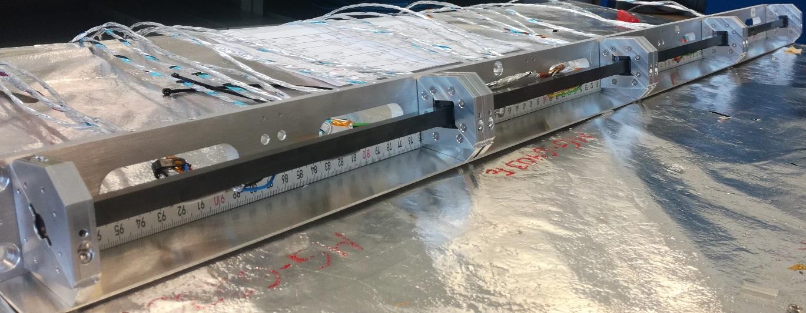
Configuration
Al vessel hosting 16 target stations on a rotatable barrel. Each target station equipped with several specimens of 18 materials
Vessel cooled by forced Ar inert gas
Comprehensive Acquisition system based on Strain Gauges, Temperature probes, LDV, Rad-hard Camera
Specimens of simple geometry (slender bars, length 120 or 248 mm) to generate simple wave signals, relatively easy to acquire and benchmark. Some low-Z samples coated (Mo, Cu, TiN)
Simply supported bars, axially free to expand
Mainly square cross section (8×8 to 12×11.5 mm²) to disentangle anisotropy and simplify PIE

Slide 4
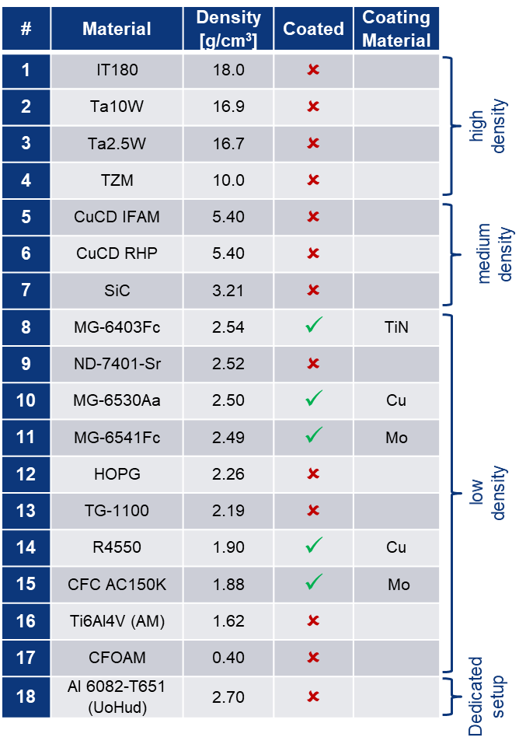
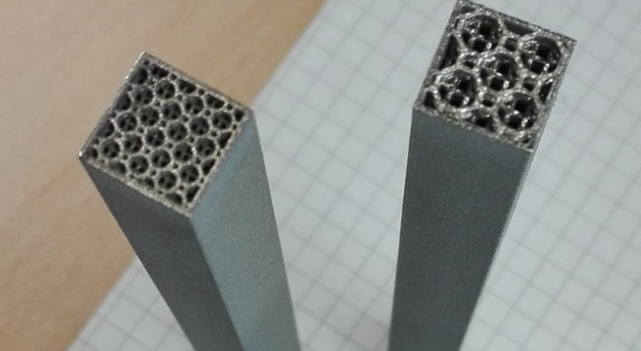
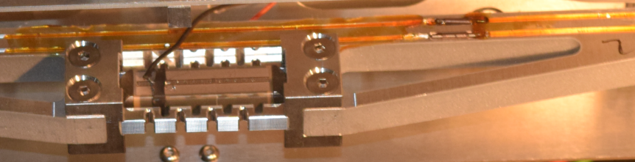
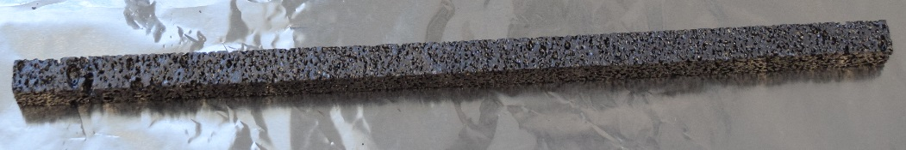
Specimens
18 materials/grades to be tested.
4 grades of MoGr from 2 manufacturers (BB and Nanoker)
3 coatings, Cu, Mo (CERN) and TiN (DTI)
Different combination of surface and thermal treatments (48h firing, CO₂ blasting, US cleaning);
2 grades of CuCD from 2 suppliers (RHP and IFAM)
Novel carbon-based materials as HOPG (Highly-Ordered Pyrolitic Graphite) and Titanium-Graphite (TG-1100)
Additively Manufactured Titanium samples (Ti6Al4V);
Actively controlled (via piezoelectric transducers) Al samples (UoH)

Slide 5
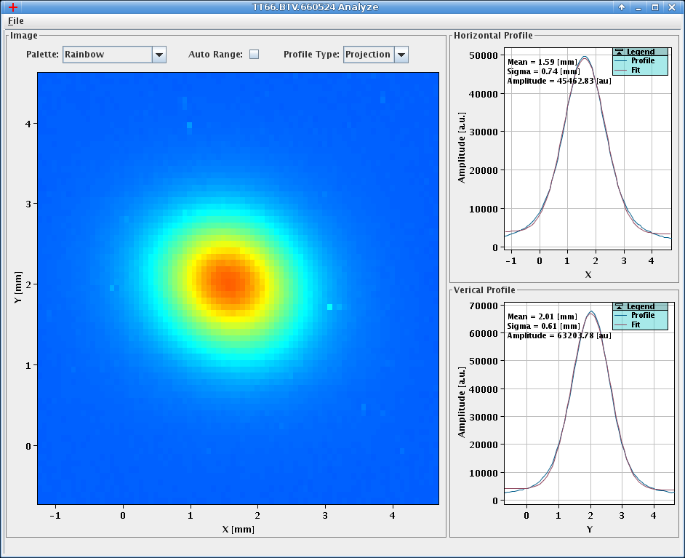
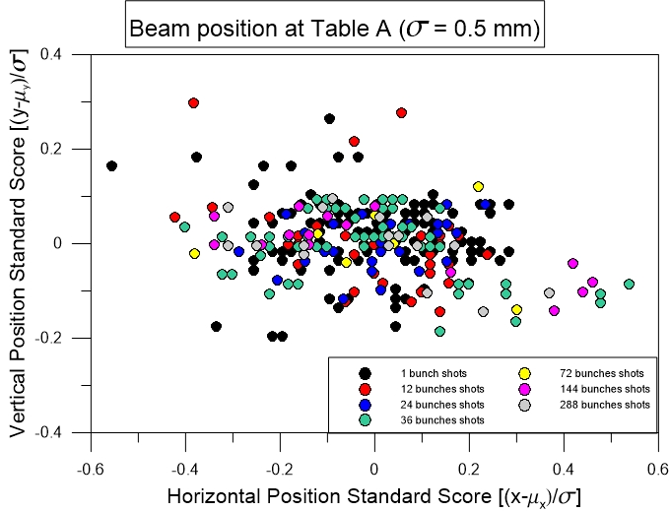
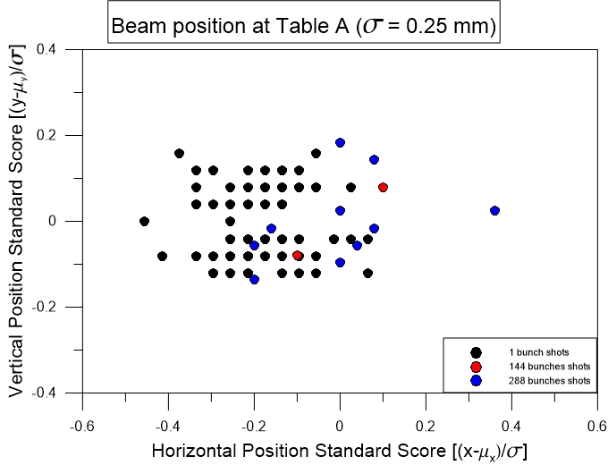
Experimental run
Installed 2 October
Experimental runs from 3 October to 17 October
478 pulses (including BBA and parking position). 2.25x10¹⁵ POT
Intensity ranging from 1 b to 288 b, typically 1.3x10¹¹ p/b
Beam rms size (nominal): 0.25×0.25, 0.5×0.5, 2×2 mm²
Good beam stability and repeatability, particularly important for grazing impacts

Slide 6
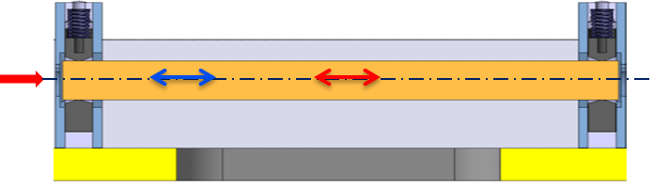
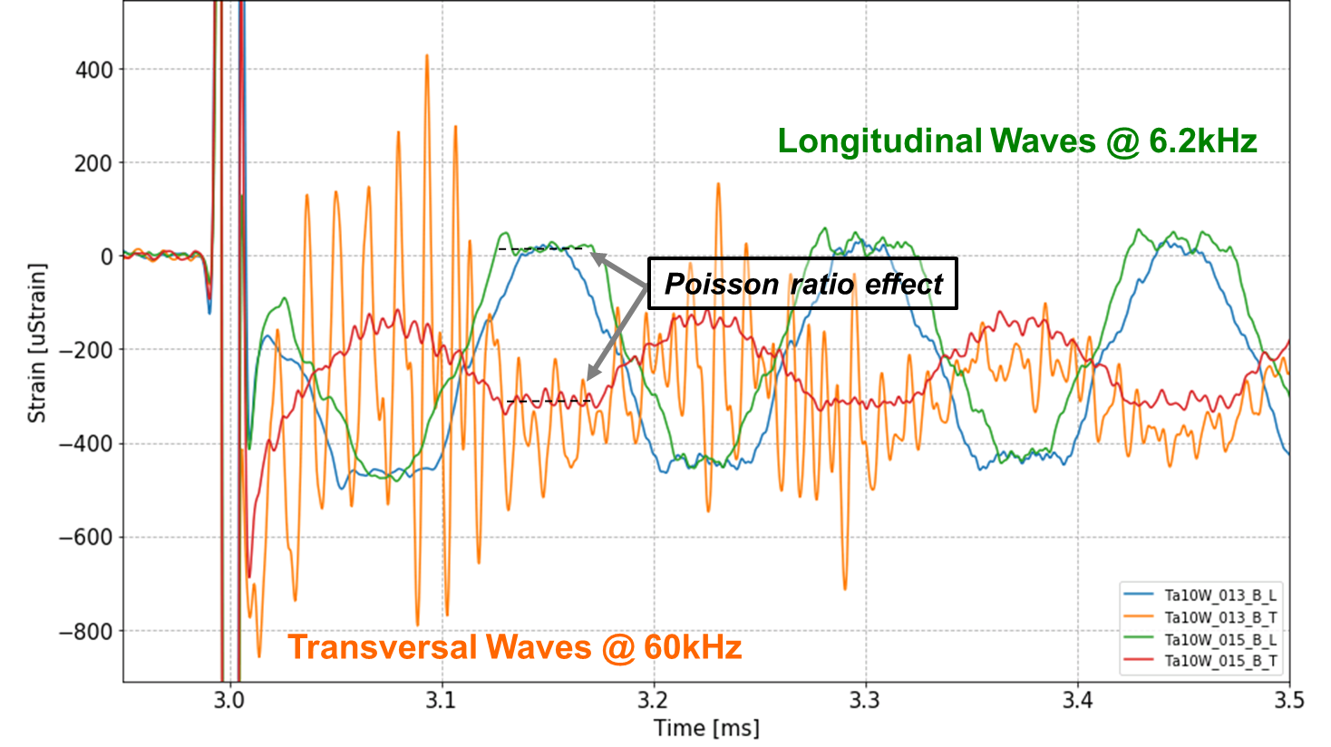
Results – Centred impacts
Response of Ta10W (1b 1.49e11)

Slide 7
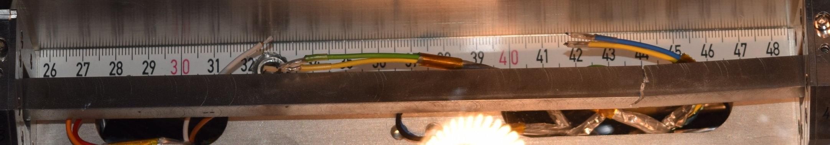
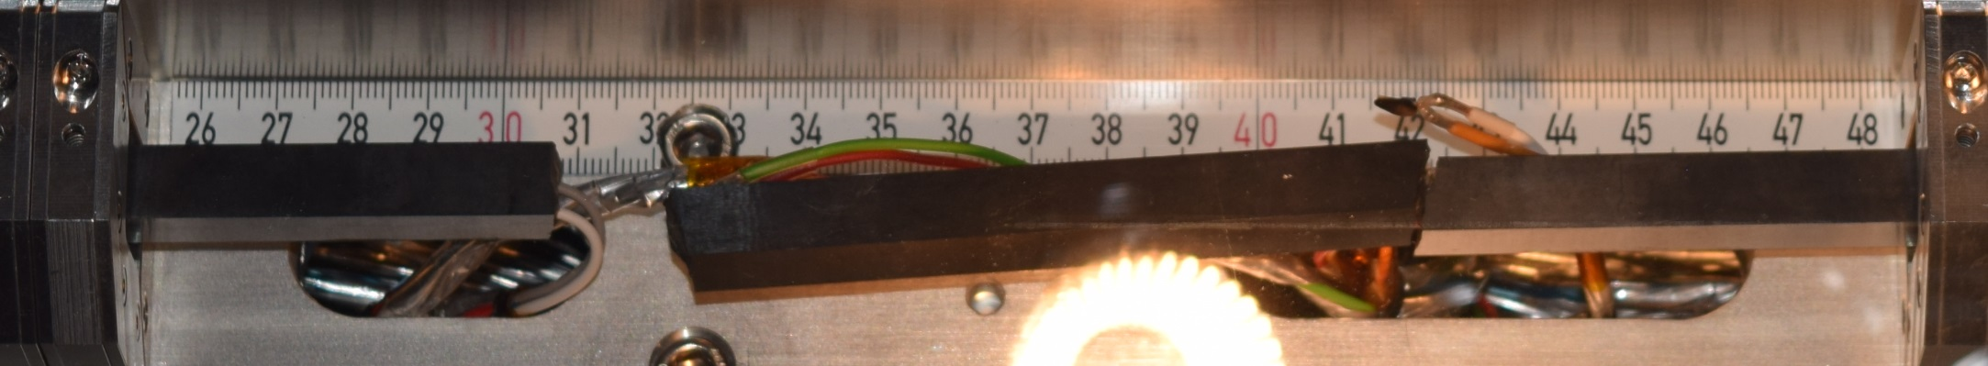
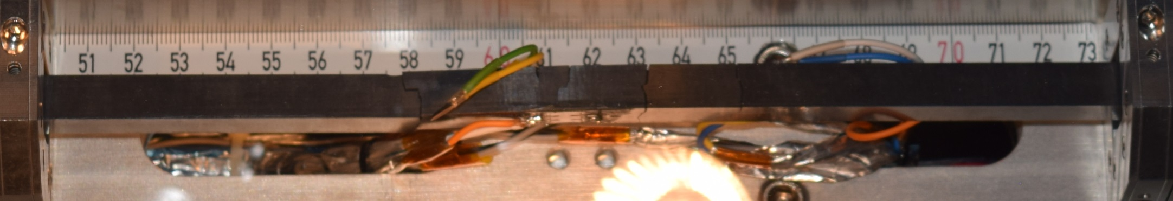
Results – Centred impacts
TZM sample n. 2 – 12 b
SiC sample n. 2 – 36 b
SiC sample n. 3 – 36 b

Slide 8
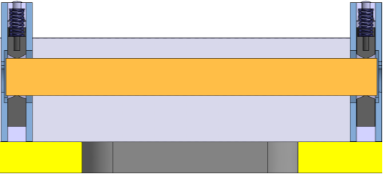
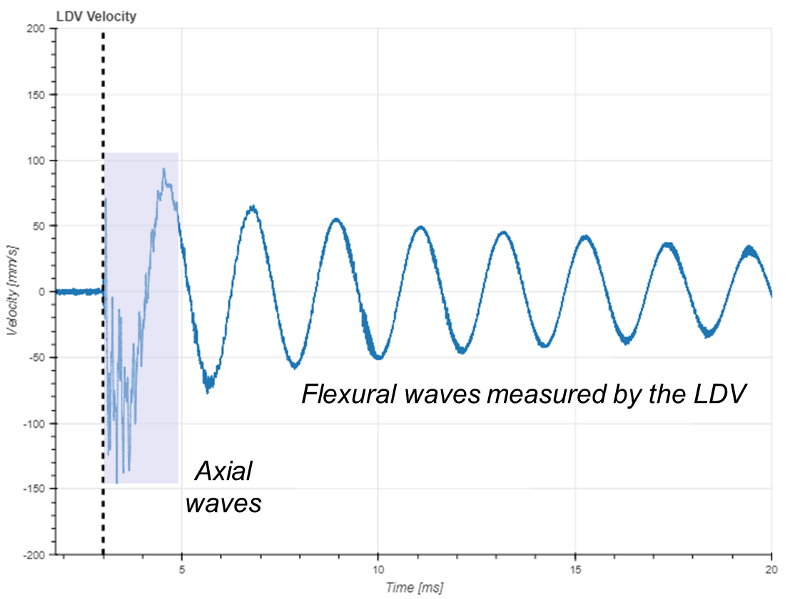
Results – Offset impacts

Slide 9
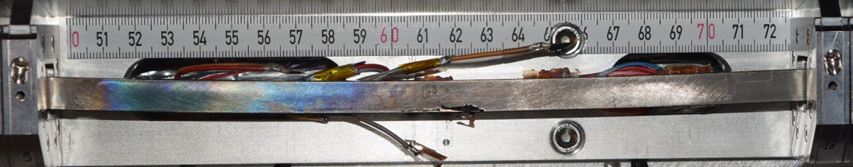
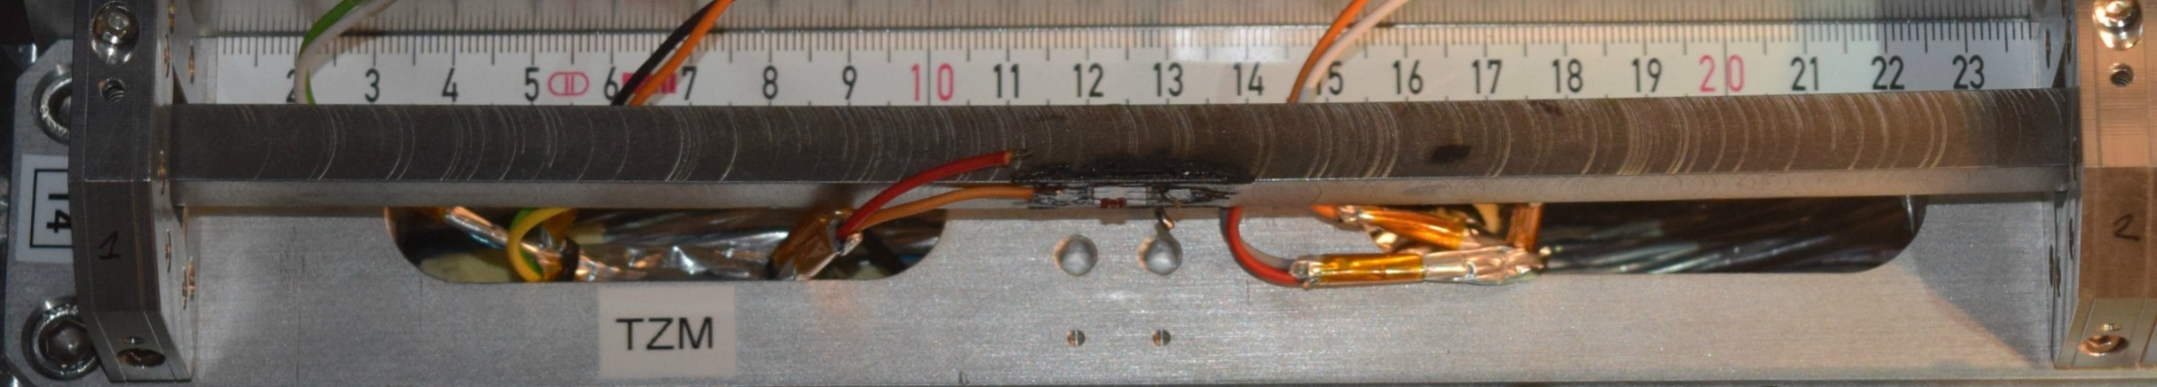
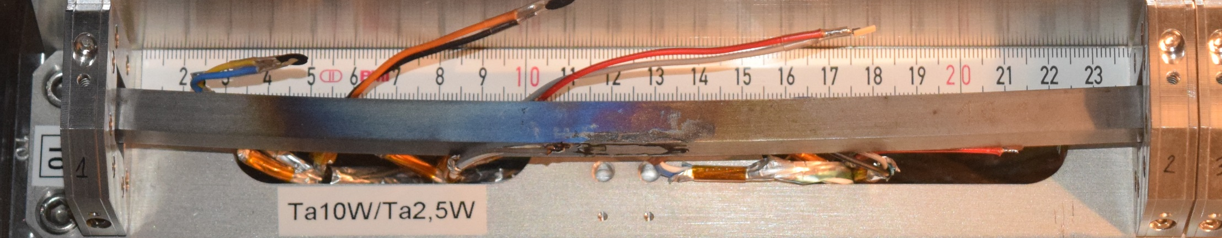
Results – Offset impacts
IT180 after 24 b, 2 mm offset
TZM after 36 b, 2 mm offset
Ta10W after 24 b, 2 mm offset

Slide 10
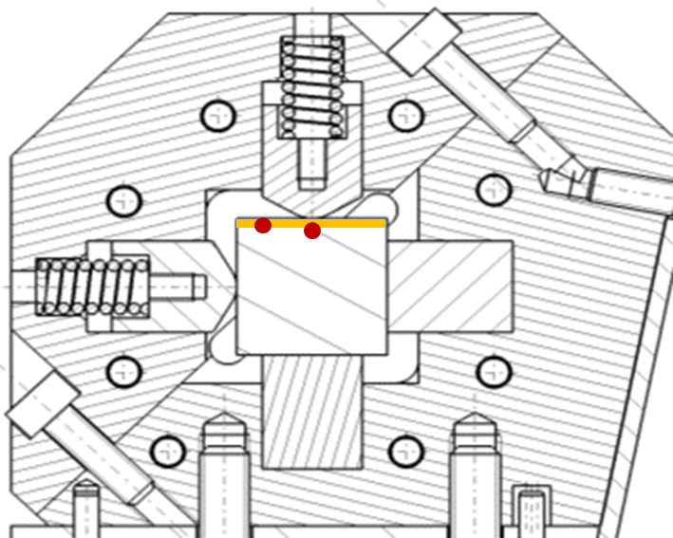
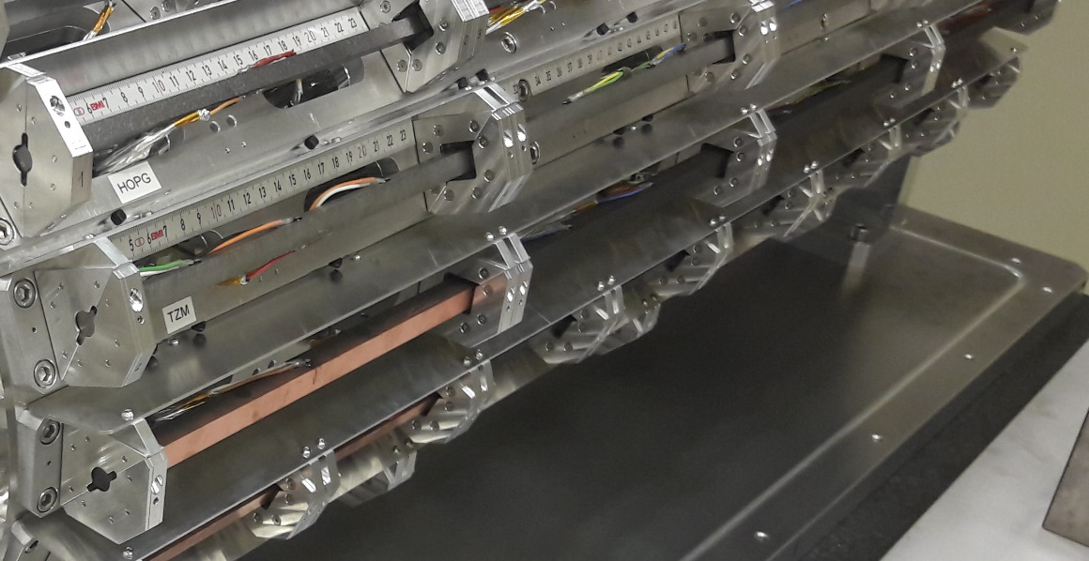
Results – Grazing impacts
Goal: assess coating strength (Cu, Mo, TiN) and surface damage.
Coating on first specimens for a total coated length of ¼ m
Smallest available beam size (0.25×0.25 mm²) at max bunch intensity (1.4e11 p/b) to mimic or exceed HL-LHC energy density
Impacts at 144 (on Cu) and 288 b (all) at different spots
2 impact parameters: 150 µm and 500 µm
Target alignment by BTV combined with Beam-based alignment

Slide 11
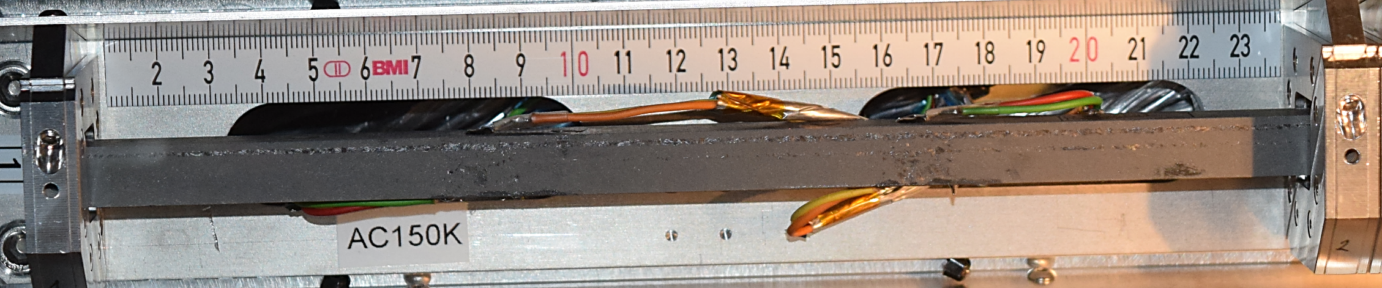
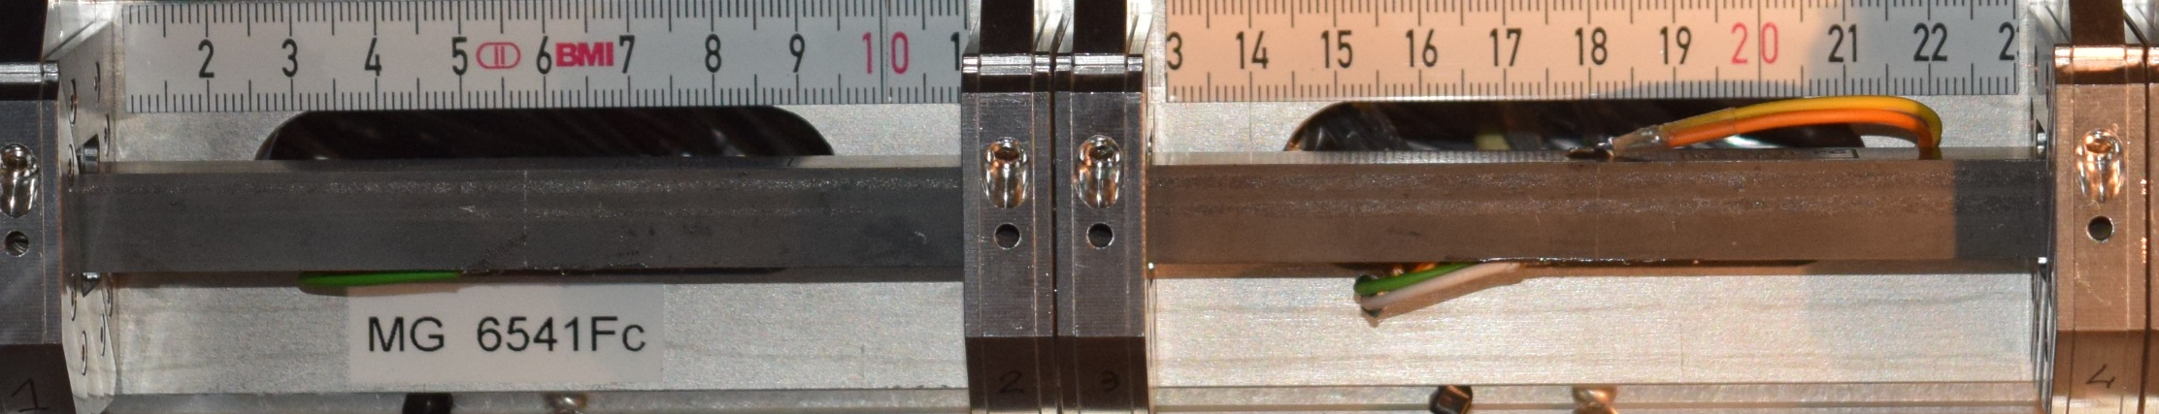
Results – Grazing impacts, Mo coatings
288 b, σ 0.25 mm, impact 150 µm
288 b, σ 0.25 mm, impact 500 µm
CFC (AC150K) with
8 µm Mo coating – CO₂ blasting
288 b, σ 0.25 mm, impact 150 µm
288 b, σ 0.25 mm, impact 500 µm
MoGr (MG6541Fc) with 8 µm Mo Coating – US cleaning

Slide 12
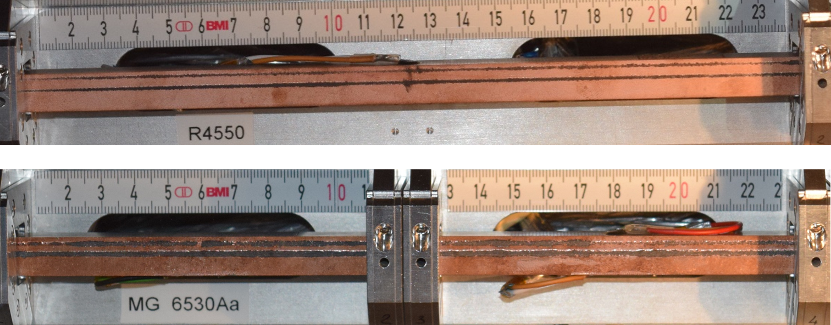
Results – Grazing impacts, Cu coatings
144 b, σ 0.25 mm, impact 150 µm
288 b, σ 0.25 mm, impact 500 µm
Graphite (R4550) with
2 µm Cu + 0.5 µm Ti coating – CO₂ blasting
144 b, σ 0.25 mm, impact 150 µm
288 b, σ 0.25 mm, impact 500 µm
MoGr (MG6530Aa) with
2 µm Cu + 0.5 µm Ti coating – US cleaning

Slide 13
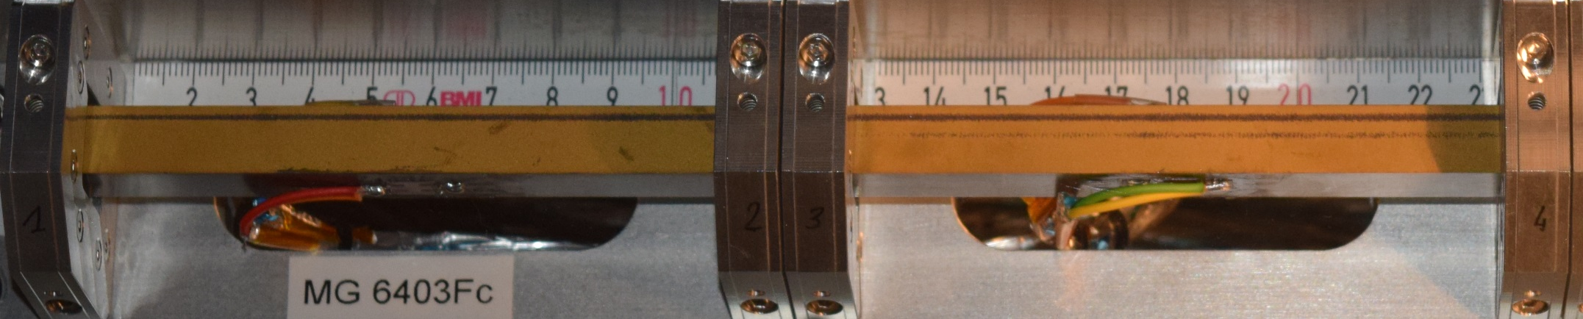
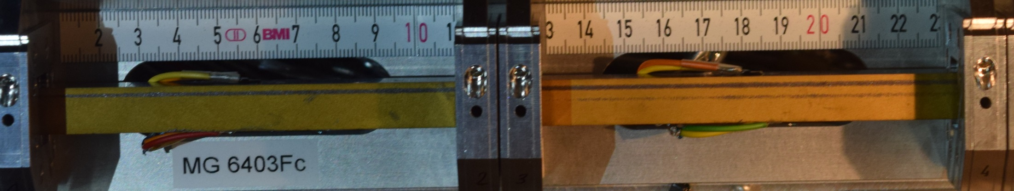
Results – Grazing impacts, TiN coatings
MoGr (MG6403Fc) with
5 µm TiN coating – US cleaning
288 b, σ 0.25 mm, impact 150 µm
288 b, σ 0.25 mm, impact 500 µm

Slide 14
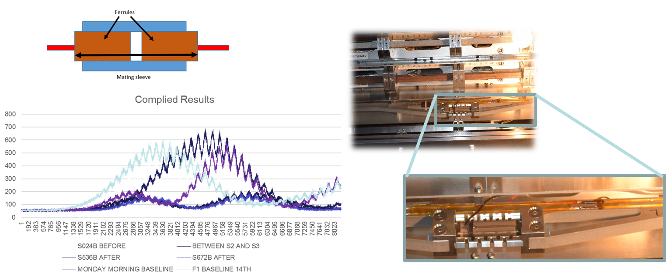
Results – MACS (UoH)
Multimat Adaptive Collimator System (MACS)
Fibres survived with same returned light intensity as started
Piezo actuators still operational – observed by increased noise in signal response
Noisy results on flexural response: UoH working on new algorithm to cope with low intensity data.
Termination cavity issue solved as future fibres will be fusion spliced.

Slide 15
Summary
MultiMat experiment was successfully concluded in October 2017 totalling ~2.3e15 POT
Good stability and repeatability of delivered pulses
All carbon-based materials (C Foam, CFC, Isotropic Graphite, HOPG, MoGr, TiGr) survived impacts at maximum available intensities, in all conditions
Unexpected failure was only achieved in SiC. A TZM sample failed possibly because of fabrication defect
Plastic permanent deflections induced in high-Z materials
Surface damage was induced on coatings: larger in Cu coatings (lower melting point), smaller in Mo and TiN. Damaged stripes ~ 1÷3 mm wide
A number of unknown materials properties can be derived: dynamic constants, damping, viscoelastic parameters, dynamic strength … lots of work ahead!
MACS still operational after high intensity impact: low signal to noise ratio makes assessment of flexural response difficult. System to be improved in next demonstrator

Slide 16
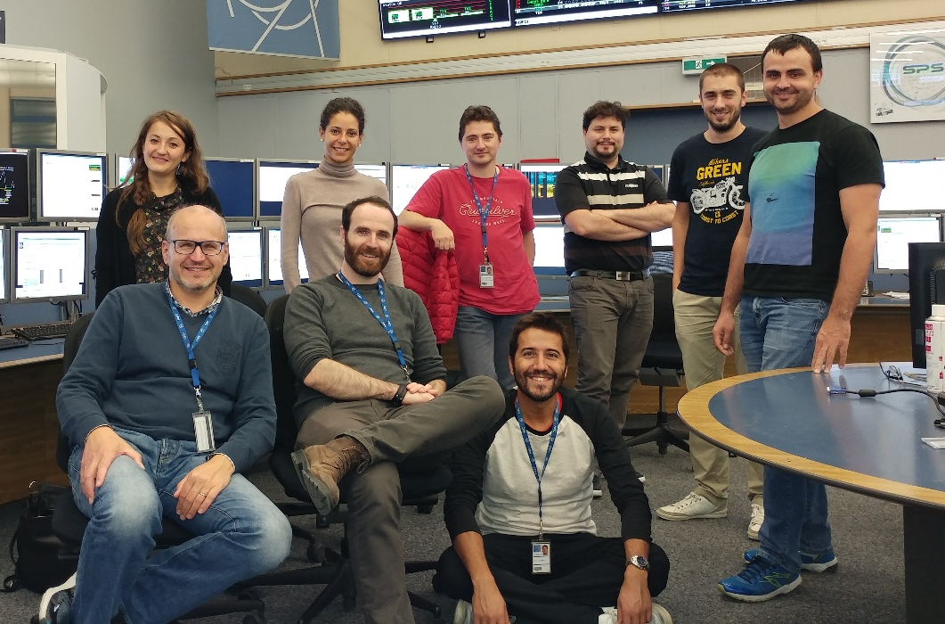
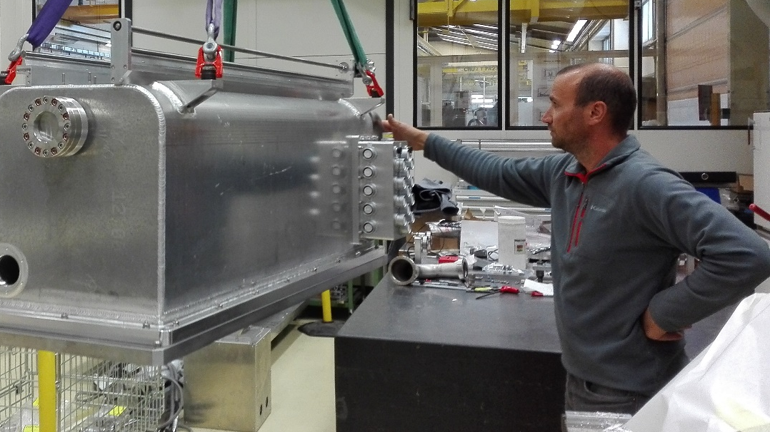
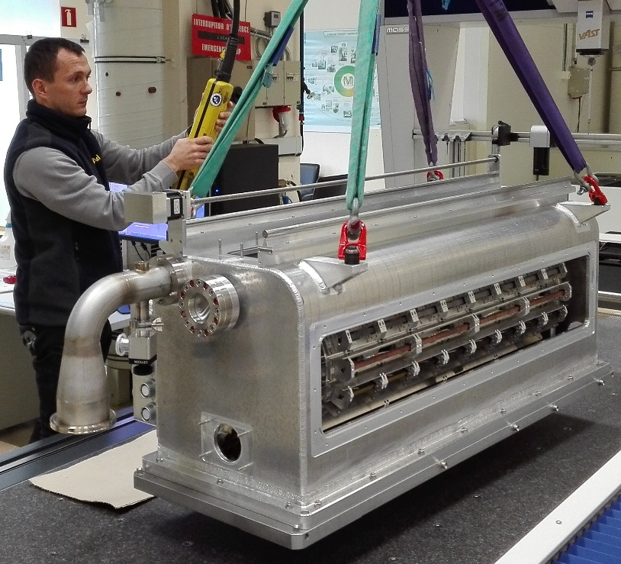
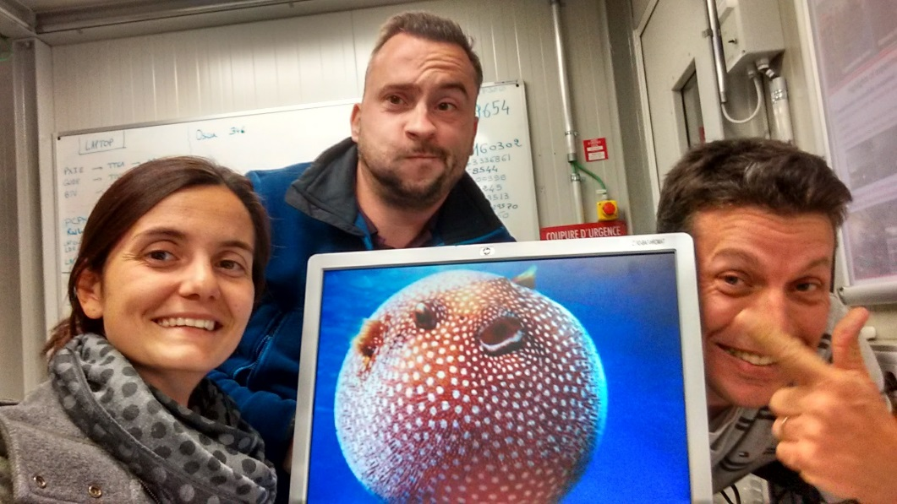
Thanks for the attention!

