Slide 1
Recommendation from impedance
B. Salvant
on behalf of BE-ABP/HSC section and impedance WG

Slide 2
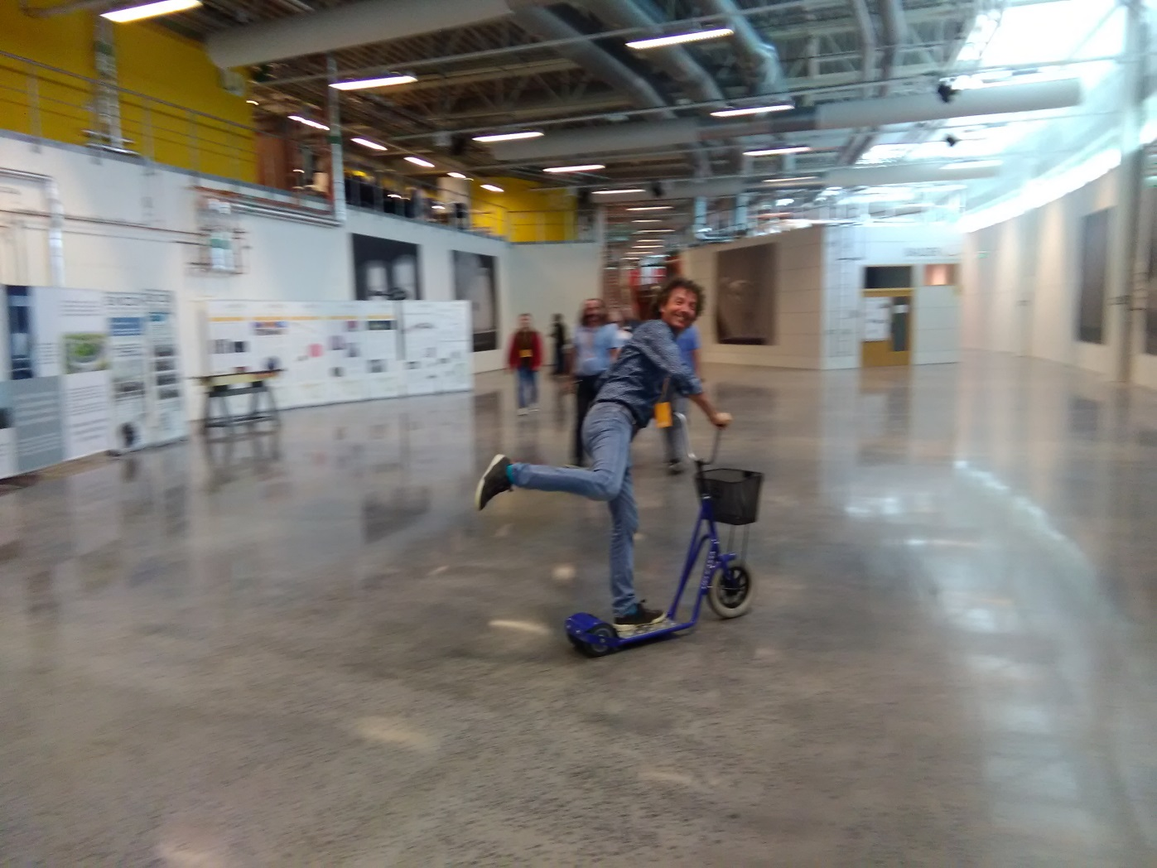
With the help of Vincent Baglin

Slide 3

Summary of guidelines
(extracted from vacuum CAS 2017)
The impact of the in-vacuum elements on the beam strongly depends on bunch length
To reduce resistive wall impedance
  higher conductivity ($Z\sim \sqrt{σ}$)
  higher radius (Z ~ 1/b or 1/b³)
  lower length (Z~L)
  use coating with good conductor
  Thickness of bad conducting material on good conducting material has a much stronger impact on impedance than the conductivity of the coating
Bellows:
  no power loss if perfect conducting and no resonance excited
  Z linear with number of convolution and convolution depth
  Z linear with 1/b or 1/b³ if convolution is much smaller than radius b
Cavities:
  higher cavity radius → lower frequency
  Cavity length should avoid the order of magnitude of the radius if possible
  Tapering helps reducing the impedance
  Shielding with fingers or beam screen is very efficient, but beware of non conformities
  Use funneling for fingers

Slide 4
Main topics
Triplet bellows → already agreed at WP2 and TCC for deformable bellow
VAX area → more unshielded bellows
Specification for 2.5 mm transverse displacement in the LSS → need for deformable RF bridge?
5th axis abandoned? → good news for some bellows!
Baseline: amorphous carbon coating on triplets, corrector package, D1, D2 and Q4 (and maybe TAXS?) → already dealt with
Is LESS an option? The impact there could be large due to the low conductivity (up to a factor 16 less compared to cold copper) and the large thickness (1 micron)
More iterations needed

Slide 5
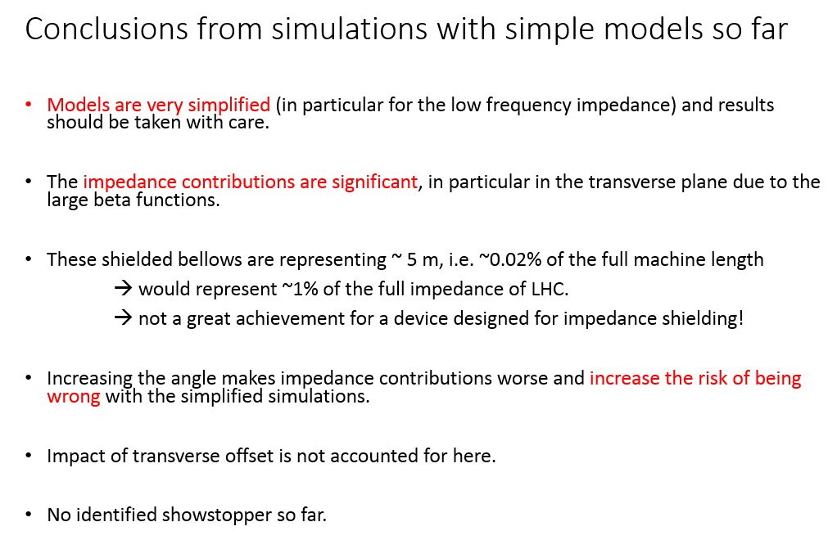
Triplet bellows
Recommended for approval at TCC on Sept 2016

Slide 6
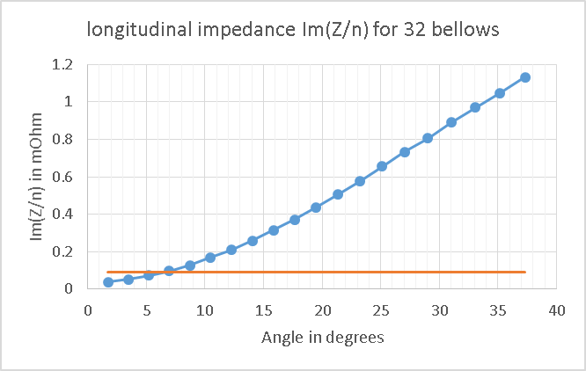
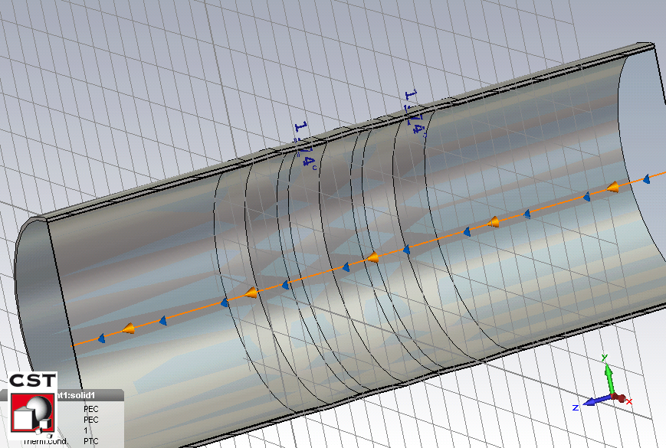
Longitudinal low frequency impedance
Simplified model without fingers
15º
1% of full HL-LHC impedance
New with 15 degrees
Old
Assuming 32 shieldings with 65 mm radius
Large contribution compared to current shielding type (estimated a factor 3.5 increase)
Would amount to 0.3% of total impedance
Going to 30 degrees for all shieldings would reach 1% of full HL-LHC impedance

Slide 7
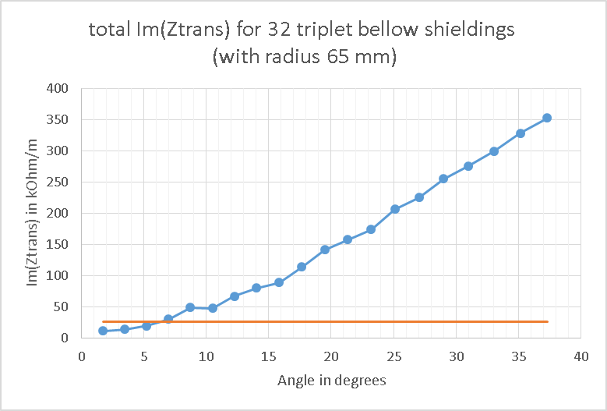
Transverse low frequency impedance
Simplified model without fingers
15º
1% of full HL-LHC impedance
New with 15 degrees
old
Assuming 32 shieldings with 65 mm radius at 12 km beta function
Large contribution compared to current shielding type (estimated a factor 3.5 increase)
Would amount to 0.5% of the total LHC impedance
Increase to 30 degrees reaches 1.5 % of the full HL-LHC impedance
Risk to increase beyond 15 degrees, in fact we already said it should be reduced.

Slide 8
Main topics
Triplet bellows → already agreed at WP2 and TCC for deformable bellow
VAX area → more unshielded bellows
Specification for 2.5 mm transverse displacement in the LSS → need for deformable RF bridge?
5th axis abandoned? → good news for some bellows!
Baseline: amorphous carbon coating on triplets, corrector package, D1, D2 and Q4 (and maybe TAXS?) → already dealt with
Is LESS an option? The impact there could be large due to the low conductivity (up to a factor 16 less compared to cold copper) and the large thickness (1 micron)
More iterations needed

Slide 9
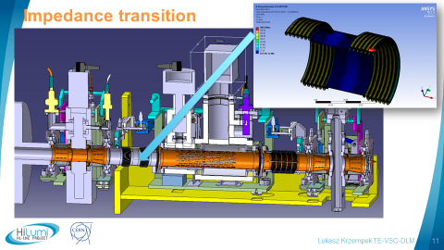
VAX area
Unshielded bellows requested
12 bellows in total (3 per IP per side)
Why step in radius?
Is that “only” for standard valve?

Slide 10
Impedance cost of bellows (formula of K. Ng)
Expensive in terms of impedance
Management should decide

Slide 11
Main topics
Triplet bellows → already agreed at WP2 and TCC for deformable bellow
VAX area → more unshielded bellows
Specification for 2.5 mm transverse displacement in the LSS → need for deformable RF bridge?
5th axis abandoned? → good news for some bellows!
Baseline: amorphous carbon coating on triplets, corrector package, D1, D2 and Q4 (and maybe TAXS?) → already dealt with
Is LESS an option? The impact there could be large due to the low conductivity (up to a factor 16 less compared to cold copper) and the large thickness (1 micron)
More iterations needed

Slide 12
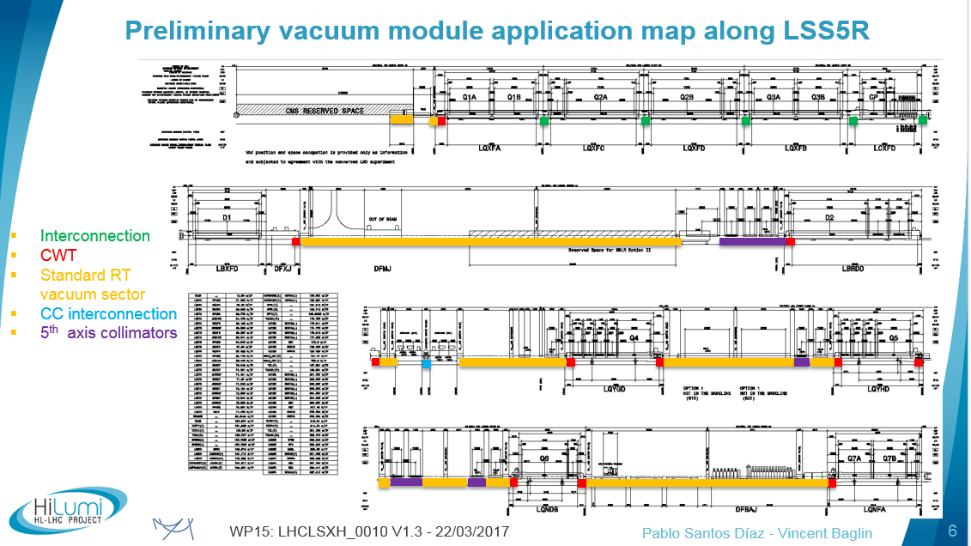
Different transitions
→ 11 additional bellows with deformable fingers

Slide 13
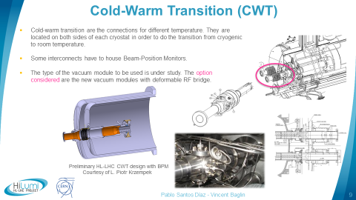
Deformable fingers everywhere???
Avoid cavity!

Slide 14
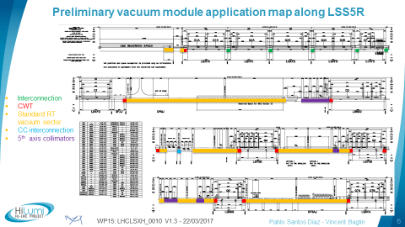
Different transitions
11 additional bellows with deformable fingers per IP per side?
Is expected to be very expensive in terms of impedance if the angle can not be kept flat

Slide 15
Main topics
Triplet bellows → already agreed at WP2 and TCC for deformable bellow
VAX area → more unshielded bellows
Specification for 2.5 mm transverse displacement in the LSS → need for deformable RF bridge?
5th axis abandoned? → good news for some bellows!
Baseline: amorphous carbon coating on triplets, corrector package, D1, D2 and Q4 (and maybe TAXS?) → already dealt with
Is LESS an option? The impact there could be large due to the low conductivity (up to a factor 16 less compared to cold copper) and the large thickness (1 micron)
More iterations needed

Slide 16
Carbon coating
Carbon coating: 500 nm
IT, CP, D1, D2 and Q4. Also maybe on TAXS
Same copper thickness as LHC.

Slide 17
Update on new triplet beam screen impedance
B. Salvant, N. Wang, C. Zannini
14th December 2015
Acknowledgments:
N. Biancacci, R. de Maria, E. Métral, N. Mounet, N. Kos
Agenda:
Impact of coating on the new triplet beam screen
Impact of coating on the current beam screen
Impact of various weld scenarios of weld of new triplets

Slide 18
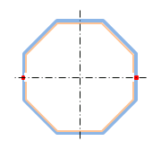
Resistive wall impedance of the new beam screens
With Coating
  5 layers structure
    1st layer (aC)
    2nd layer (Ti)
    3rd layer (Cu)
    4th layer (StSt)
    5th layer (Vacuum)
Without Coating
  3 layers structure
    1st layer (Cu)
    2nd layer (StSt)
    3rd layer (Vacuum)
Material | σ_{el} [S/m] | ε_{r} | Thickness [µm]
aC coating | 400 | 5.4 | 0.5
Titanium coating | 4*10⁵ | 1 | 0.1
Copper | 10⁹ | 1 | 50
Stainless steel | 1.35 10⁶ | 1 | 1000
Vacuum | 0 | 1 | Infinity
Updated
Thanks to
Nicolo Biancacci’s
measurements

Slide 19
Geometries of the Hi-Lumi IR1 and IR5 beam screens (triplet)
Magnet | Cold bore ID (mm) | Beam screen ID between flats (mm) | Beam screen length (m)
Q1 | 139 | 99.7/99.7 | 11
Q2a | 139 | 119.7/111.7 | 10.2
Q2b | 139 | 119.7/111.7 | 10.2
Q3 | 139 | 119.7/111.7 | 11
CP | 139 | 119.7/111.7 | 7.3
D1 | 139 | 119.7/111.7 | 8.3
DFXJ | 139 | 119.7/111.7 | 3.7
D2 | 95 | 87/78 | 13.5
Q4 | 80.8 | 73.8/63.8 | 9.5
Info from N. Kos

Slide 20
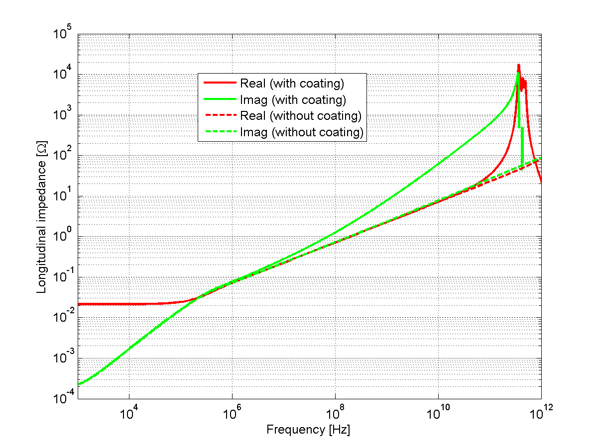
Longitudinal impedance of beam screen in triplets (IR1&IR5)
(2D calculation with ImpedanceWake 2D – N. Mounet)
Significant impact of coating on imaginary part
Longitudinal effective impedance of the beam screen multiplied by 3 because of the coating.
Still expected to be in the background of the total LHC impedance (~90 mOhm)

Slide 21
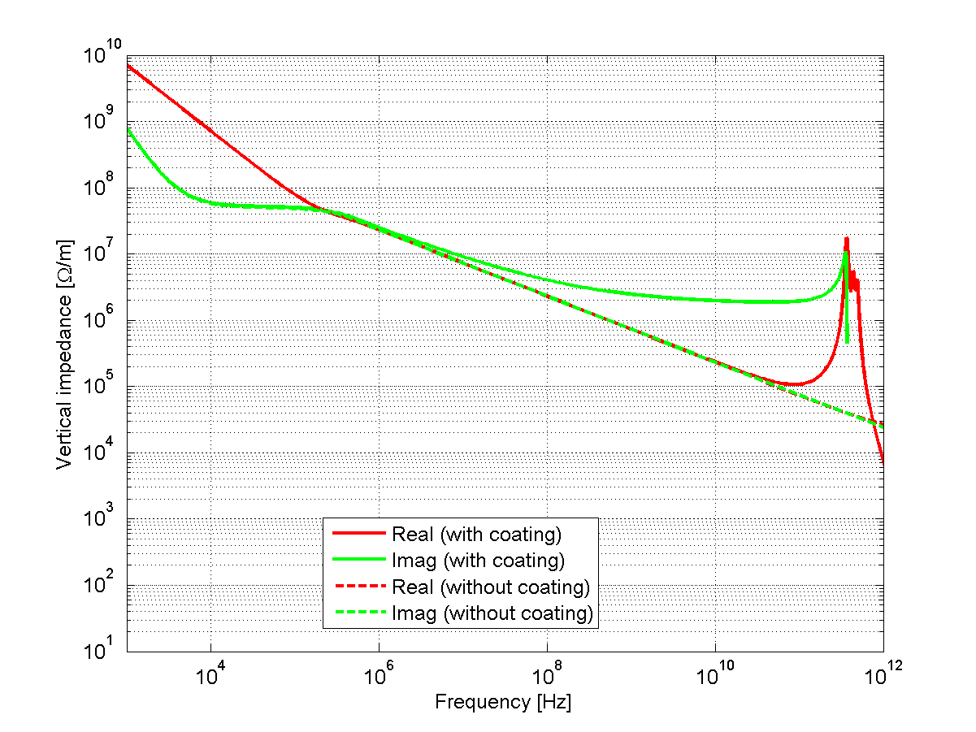
Transverse impedance of beam screen in triplets (IR1&IR5)
(2D calculation with ImpedanceWake 2D – N. Mounet)
For lattice version V1.2 beta*=15cm/15cm
Significant impact of coating on imaginary part
Vertical effective impedance of the beam screen increased by 70% because of the coating.
Still expected to be in the background of the total LHC impedance (~20 MOhm/m)

Slide 22
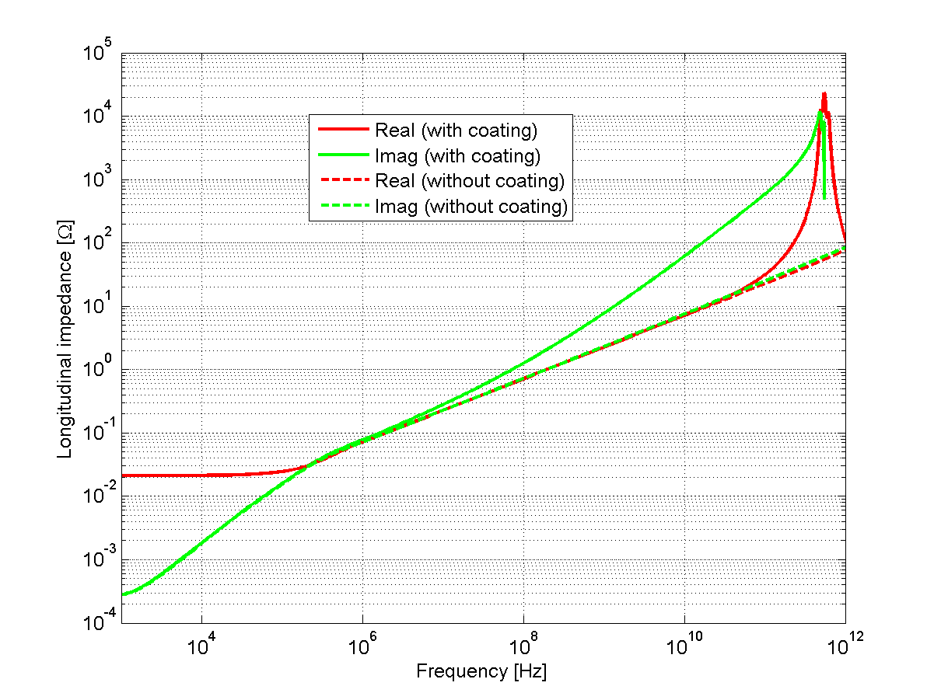
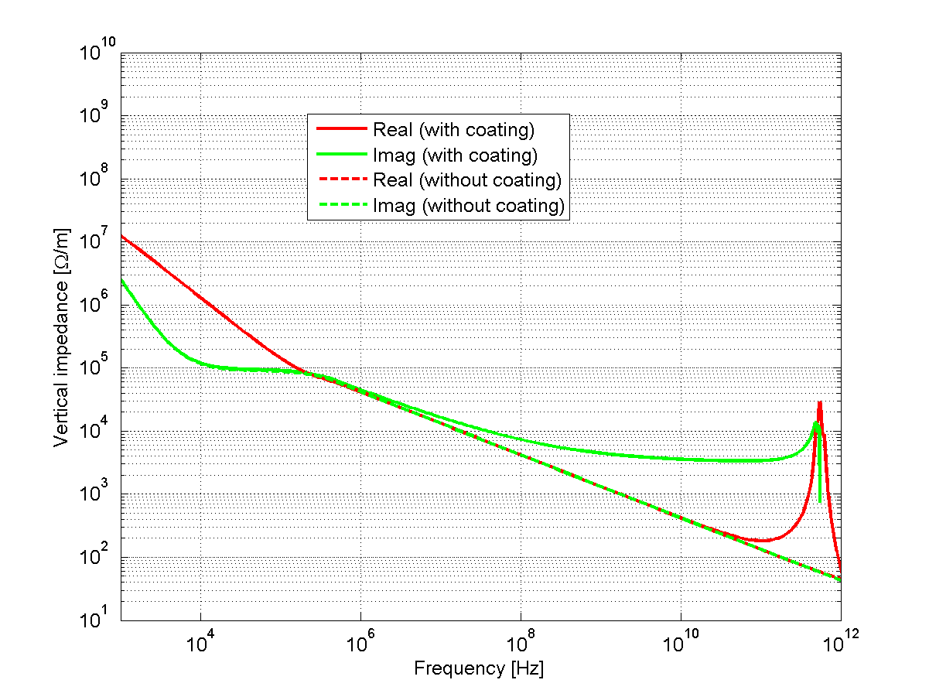
Impact of coating on the current beam screen (IR2 and IR8)
Info from N. Kos
For lattice version V1.2 beta*=15cm/15cm
Magnet | Beam screen ID (mm) | Beam screen length (m) | Average betax (m) | Average betay (m)
Q1 | 40.4/50.0 | 7.9 | 181 | 132
Q2+Q3 | 50.4/60.0 | 23.9 | 300 | 340
CP+D1 | 61.0/70.6 | 2.7+10.9 | 328 | 309
Significant impact of coating on imaginary part
Longitudinal effective impedance comparable with the impedance of the new beam screen.
Transverse effective impedance is about 1/8 of the new beam screen impedance.

Slide 23
Impact of coating on the current beam screen (IR2 and IR8)
Info from N. Kos
For lattice version V1.2 beta*=15cm/15cm
Magnet | Beamscreen ID (mm) | Length (m) | Betax_ave (m) | Betay_ave (m)
Q1 | 40.4/50.0 | 7.9 | 181 | 132
Q2+Q3 | 50.4/60.0 | 23.9 | 300 | 340
CP+D1 | 61.0/70.6 | 2.7+10.9 | 328 | 309
D2 | 56.2/65.8 | 10.7 | 170 | 160
Q4 | 50.4/60.6 | 12.1 | 146 | 151
Q5 (2L & 8R) | 50.4/60.0 | 12.1 | 93 | 132
Q5 (2R & 8L) | 37.6/47.2 | 11.8 | 112 | 121
Q6 | 37.6/47.2 | 10.9 | 146 | 108
Longitudinal effective impedance comparable with the impedance of the new beam screen.
Transverse effective impedance is about 1/10 of the new beam screen impedance.

Slide 24
Conclusion for coating
Small impact expected on impedance of coating the new beam screens or the whole LLS for IR1 and IR5.
Same level of longitudinal impedance contribution by coating the current beam screen in IR2 and IR8. The transverse impedance contribution is much lower than the new beam screen impedance.
 | IP1/IP5 |  | IR2/IR8
Element | Δ (ZL/n) [Ohm] | Δ Zy [kOhm/m] | Δ (ZL/n) [Ohm] | Δ Zy [kOhm/m]
Triplets | 6.0E-5 | 24.3 | 6.0E-5 | 3.1
LSS | 8.4E-5 | 27.7 | 1.3E-4 | 5.3

Slide 25
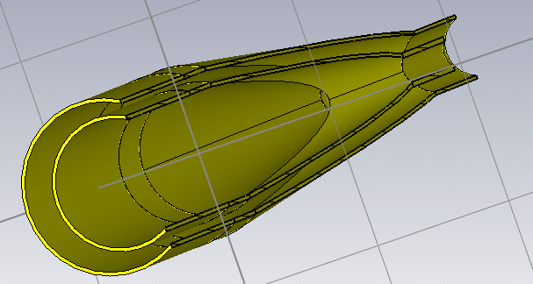
New Y chamber
Old
New
Larger diameters → lower frequency for modes but also lower resistive wall

Slide 26
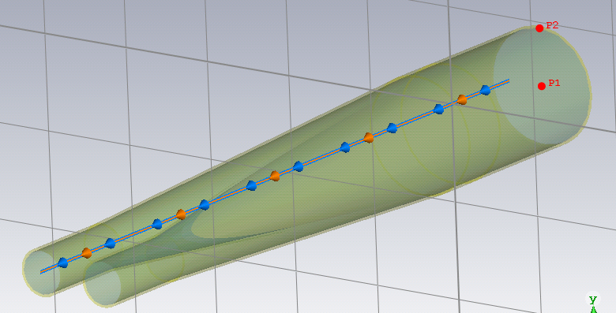
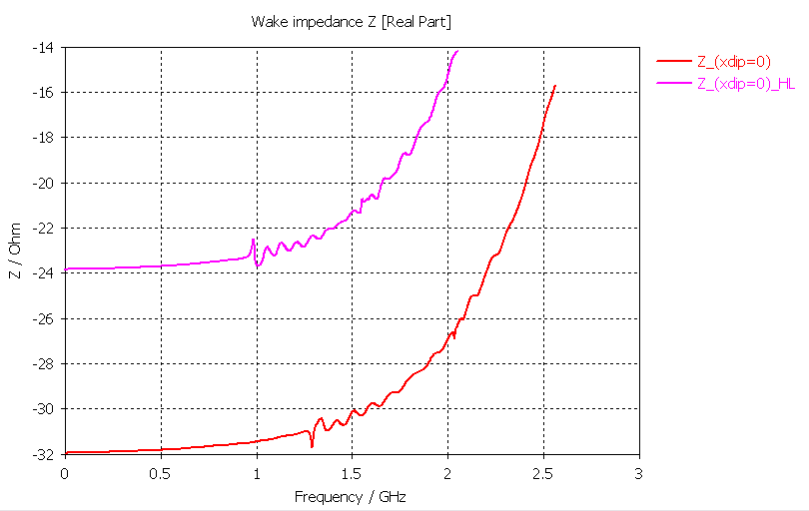
Lower frequencies and lower impact due to taper IN (and of course taper OUT – not shown).
No visible significant mode.

Slide 27
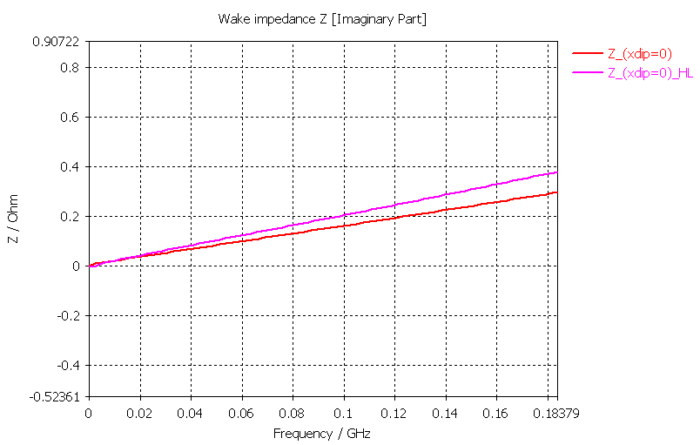
Im(Zeff_long/n) slightly higher (0.03 instead of 0.02 mOhm) → still negligible

Slide 28
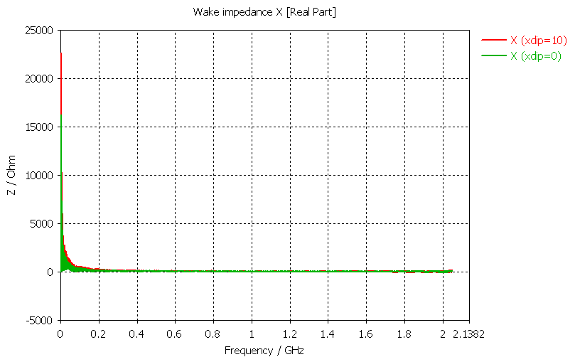

Slide 29
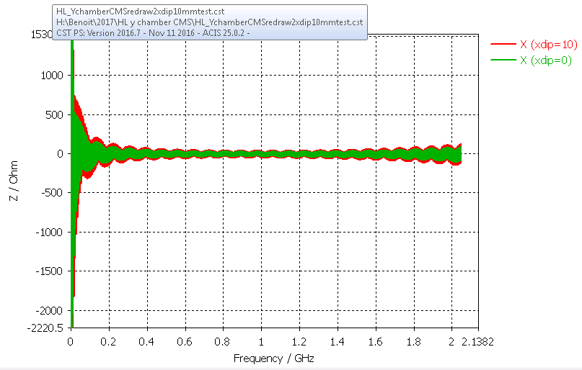

Slide 30
Conclusions
Geometry of the Y chamber already well optimized
No significant mode or effective contribution

Slide 31
Conclusions and next steps
Significant amount of additional bellows without shielding and with deformable fingers, in addition to what was already approved
→ large cost expected in terms of impedance
→ need to know what is the operational angle of these fingers if significant transverse offsets are needed.
More iterations are needed with all the information provided by Vincent

Slide 33
Compare between different Optics (IR1, IR5 new beam screens)
Element | Max betax/betay [m/m] | Z_{T,eff1} without aC coating [kOhm/m] | Z_{T, eff2} with aC coating [kOhm/m] | Z_{T,eff2}-Z_{T,eff1} [kOhm/m]
Collision Round | 21758/21721 | 35.7 | 60.0 | 24.3
Collision Flat | 43154/43281 | 45.5 | 76.4 | 30.9
Presqueeze optics | 6776/6780 | 11.4 | 19.2 | 7.8
VDM optics 30m | 618/599 | 0.6 | 1.0 | 0.4

Slide 34
Effect from coating all LSS (IR1, IR5)
For lattice version V1.2 beta*=15cm/15cm
Element | Length [m] | Z_{l,eff1} without aC coating [Ohm] | Z_{l, eff2} with aC coating [Ohm] | Z_{l,eff2}-Z_{l,eff1} [Ohm]
Triplets | -- | 3.6E-5 | 9.6E-5 | 6.0E-5
Q5 | 8.5 | 6.8E-6 | 1.8E-5 | 1.1E-5
Q6 | 7.1 | 7.6E-6 | 2.0E-5 | 1.3E-5
LSS | -- | 5.1E-5 | 13.5E-5 | 8.4E-5
Element | Length [m] | Beam screen ID between flats (mm) | betay_ave [m] | Z_{T,eff1} without aC coating [kOhm/m] | Z_{T, eff2} with aC coating [kOhm/m] | Z_{T,eff2}-Z_{T,eff1} [kOhm/m]
Triplets | -- | -- | -- | 35.7 | 60.0 | 24.3
Q5 | 8.5 | 50.4/60 | 900 | 2.8 | 4.7 | 1.9
Q6 | 7.1 | 37.6/47.2 | 345 | 2.2 | 3.7 | 1.5
LSS | -- | -- | -- | 40.7 | 68.4 | 27.7
Longitudinal/transverse impedance of beam screen increased by 40%/14%
Still expected to be in the background of the total LHC impedance.

