Slide 1


Summary of heat load estimates
G. Iadarola and G. Skripka
Thanks to: G. Arduini, P. Dijkstal, R. De Maria, L. Mether, E. Metral, G. Rumolo
HLLHC-WP2 Meeting, 29 June 2017

Slide 2
Outline
Introduction and some reminders on previous results
Heat load estimates for the Inner Triplets
  IR1 and IR5
  IR2 and IR8
Progress status on arc heat loads
Simulations for the TAXS absorber

Slide 3
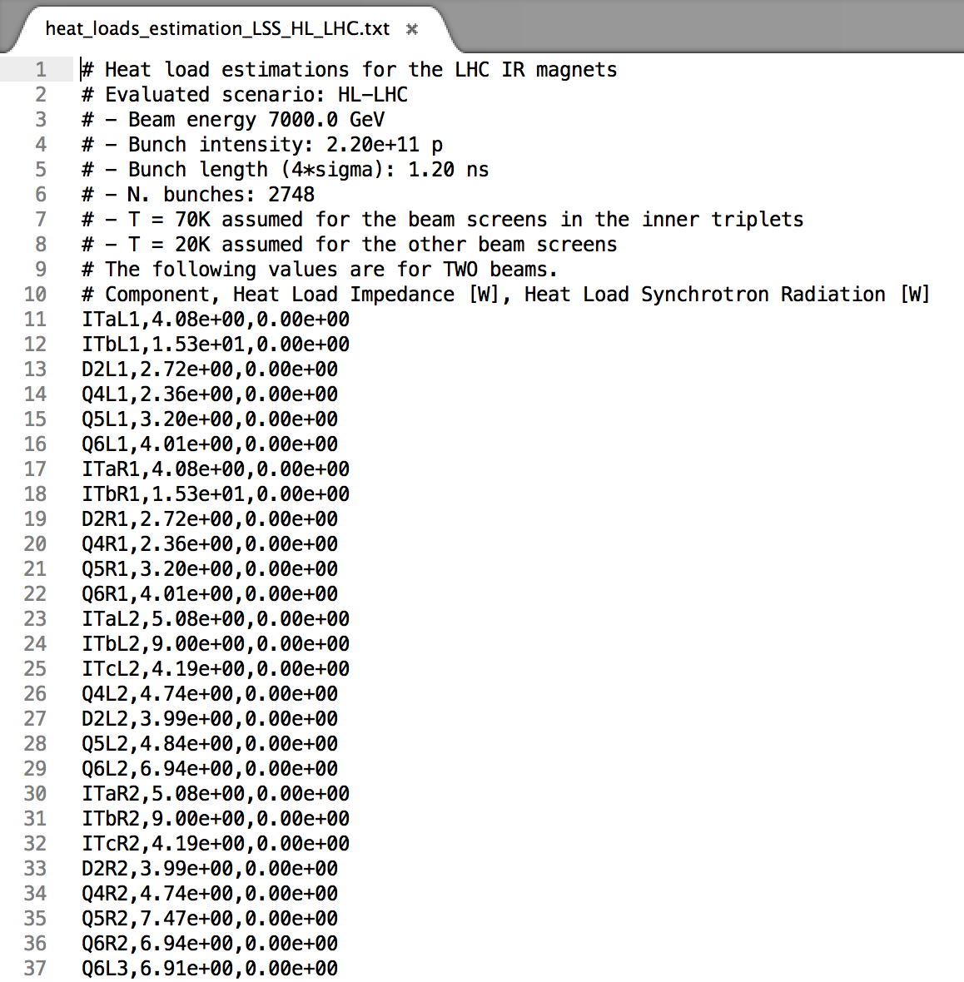
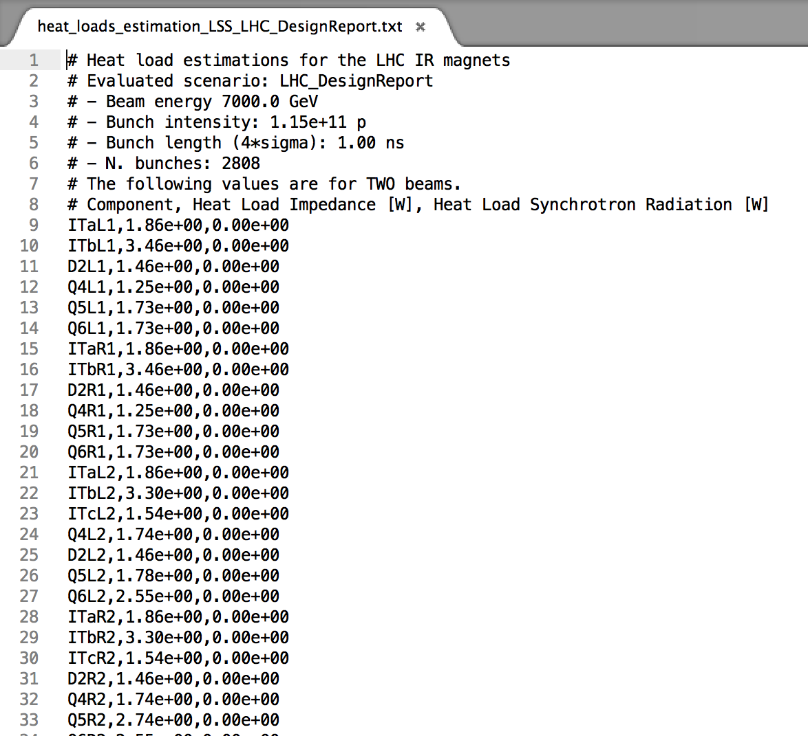
Introduction
In 2017 we continued exchanging estimates on beam induced heat loads with WP9
  HeatLoadCalculator tool used regularly to evaluate impedance and synchrotron radiation contribution
  Agreed on conventions and file format
  Heat loads are provided per cryostat, separating the different sources
  For the arcs we provide the loads over the total length (first to last bend, including dispersion suppressors)
LHC
Design Report
HL-LHC

Slide 4
Introduction
In 2017 we continued exchanging estimates on beam induced heat loads with WP9
  HeatLoadCalculator tool used regularly to evaluate impedance and synchrotron radiation contribution
  Agreed on conventions and file format
  Heat loads are provided per cryostat, separating the different sources
  For the arcs we provide the loads over the total length (first to last bend, including dispersion suppressors)
Strategy proposed by WP9
  In a first iteration only estimates on impedance and synchrotron radiation are required. These are combined with other heat load sources to compute the remaining capacity available for e-cloud loads
  On the WP2 side we prepare e-cloud estimates for the full machine for comparison with the available margins

Slide 5
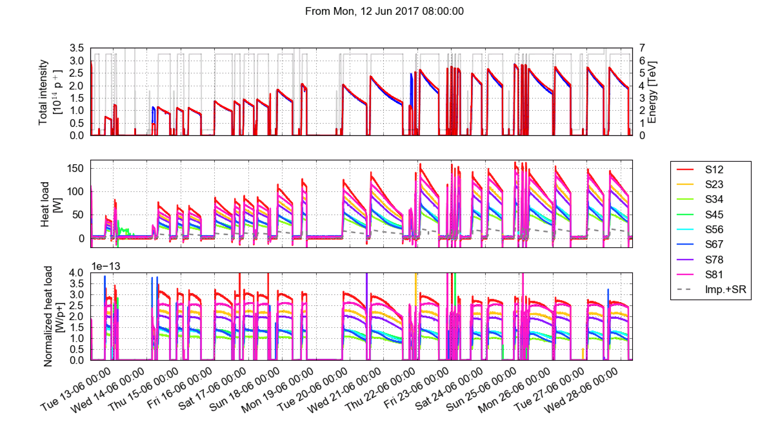
Introduction
Presently a large difference beam induced heat load is observed on the beam screen the arcs, with some of them using a large fraction of the available capacity
The source of this extra heat load (presently unknown) needs to be identified and suppressed in order to reach the target HL-LHC performance

Slide 6
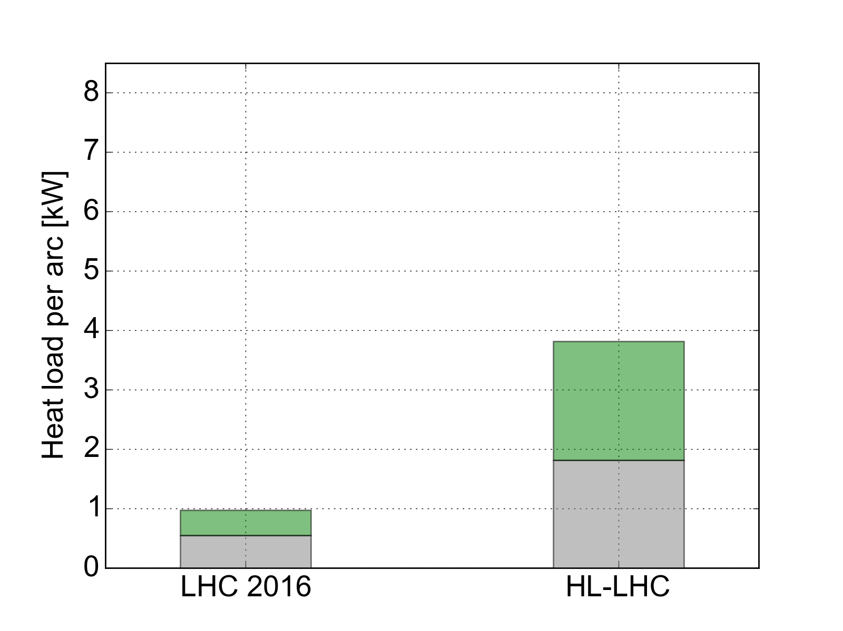
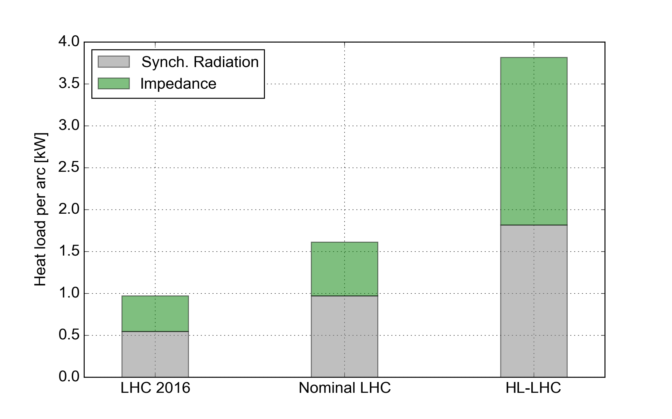
Introduction
The situation for HL-LHC will be more critical as other heat load sources will be larger
Maximum allowed by cryogenics
Margin
~7 kW
Margin
~4 kW
e-cloud load
in 2016
~5.5 kW
(S12 and S81)
2200b
1.1e11 p/bunch
6.5 TeV
2748b
2.2e11 p/bunch
7 TeV

Slide 7
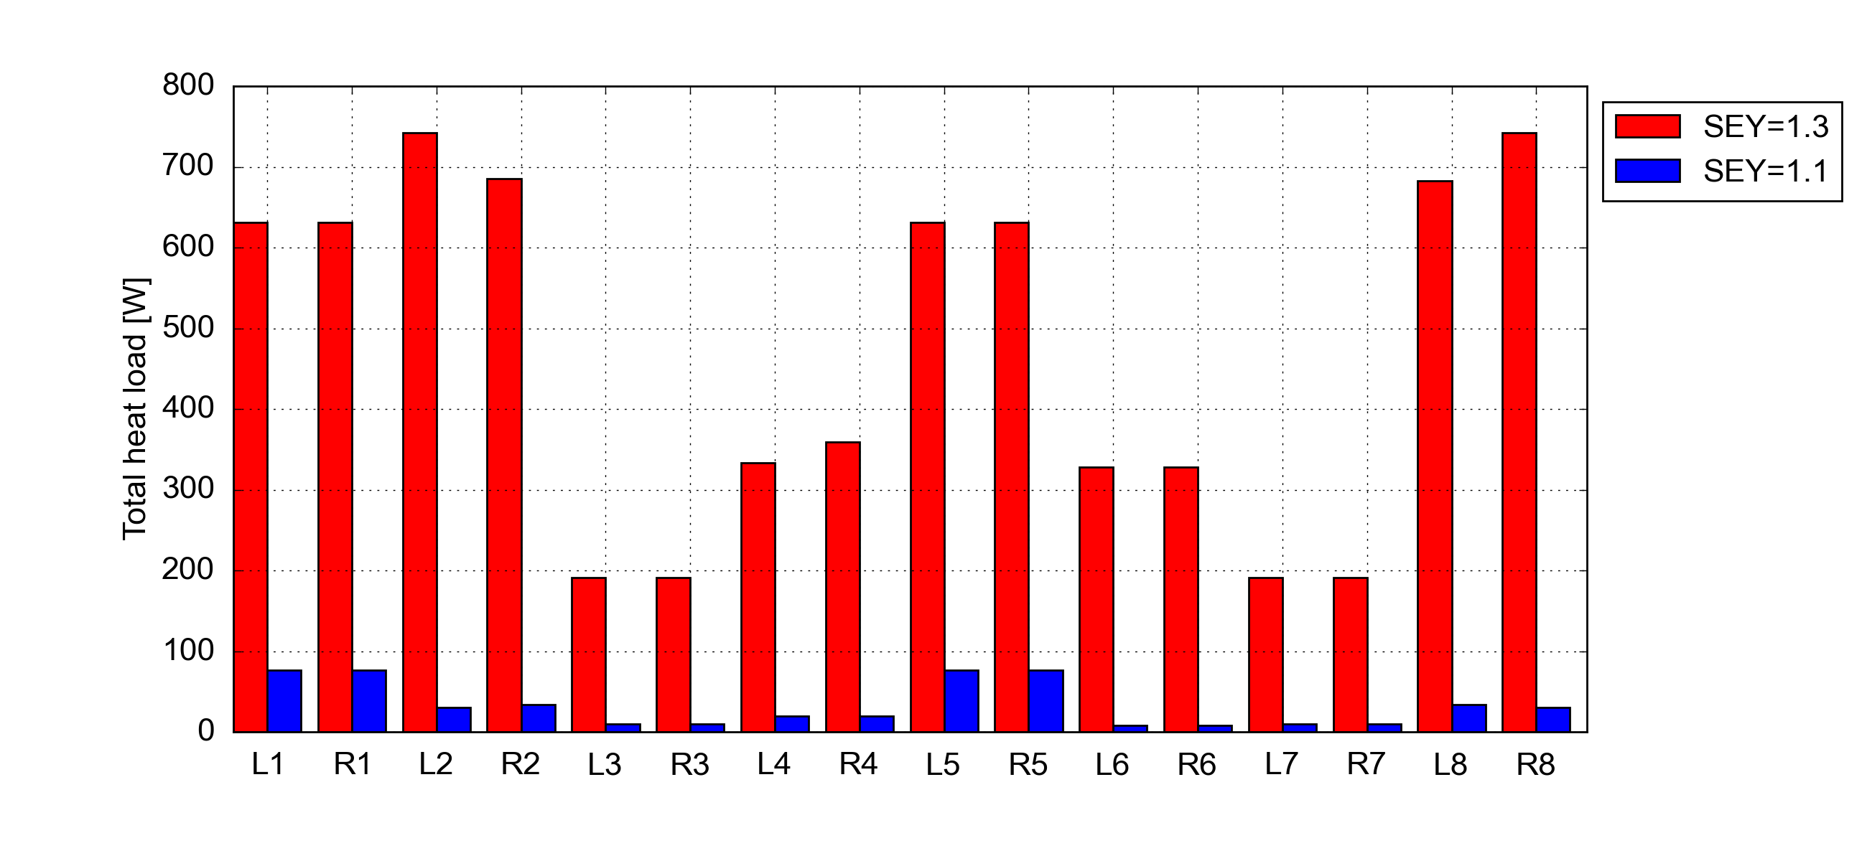
Twin bore magnets in the IRs
Detailed heat load estimations have been made for twin-bore magnets all IRs. Results have been published in https://cds.cern.ch/record/2217217?ln=en
Only experimental IRs have a significant impact
In particular S78 and S23 are the most critical as they are cooled by less powerful cryoplants (ex-LEP)
Additional margin for these arcs can be gained by coating the beams screens in the adjacent matching sections (i.e. L8 and R2)
For more info: S. Claudet and G. Iadarola @ 6th HL-LHC Collaboration Meeting, Paris

Slide 8
Outline
Introduction and some reminders on previous results
Heat load estimates for the Inner Triplets
  IR1 and IR5
  IR2 and IR8
Progress status on arc heat loads
Simulations for the TAXS absorber

Slide 9
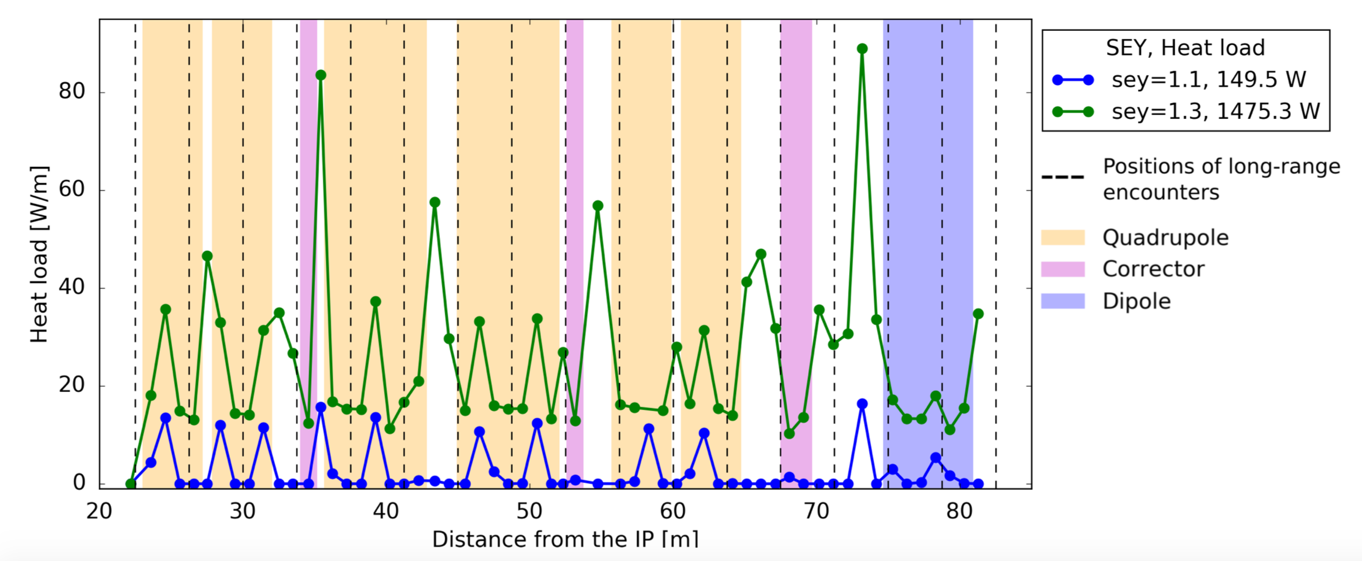
HL-LHC inner triplets: IR1 and IR5
Simulated the entire cryogenic length
Relevant magnetic field map is used for main dipoles and quadrupoles and for dipole correctors. Other sections (e.g. multipole correctors) are simulated as drifts
Conclusion: we rely on the presence of a low SEY coating to keep heat loads on cryogenics at reasonable values
  SEYmax < 1.1 assumed for the coatings

Slide 10
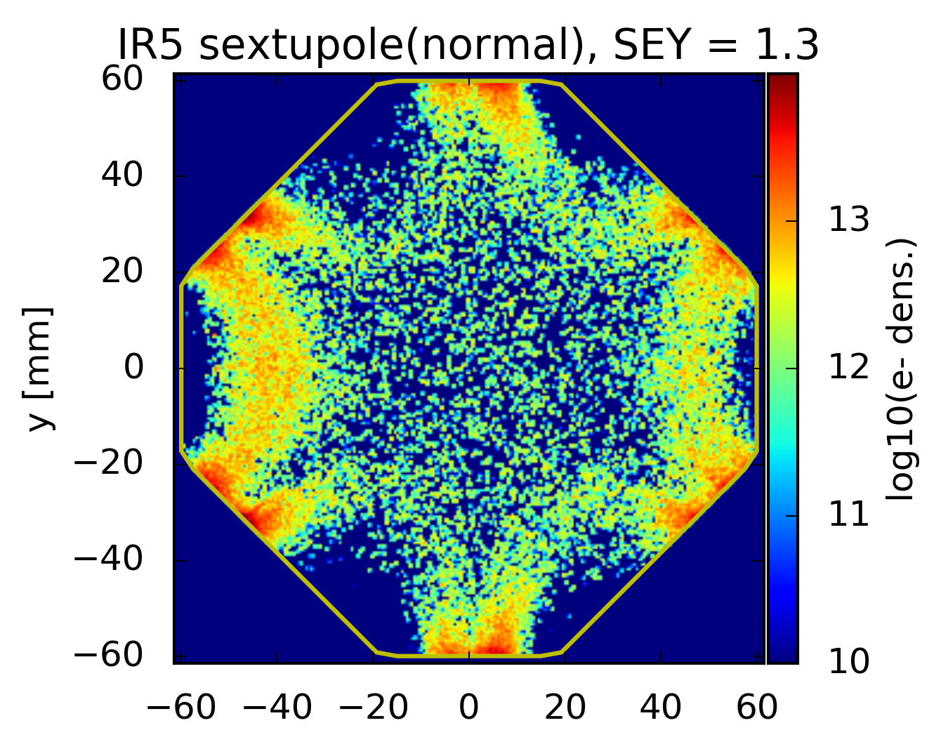
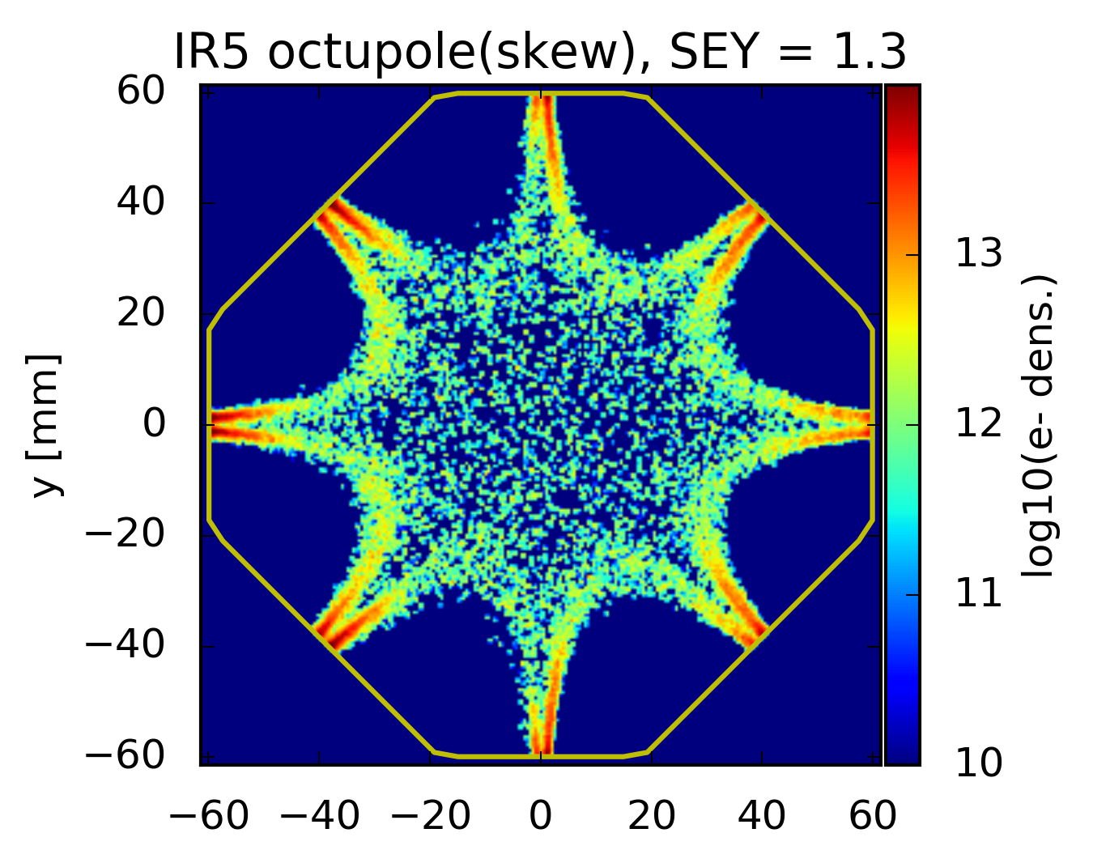
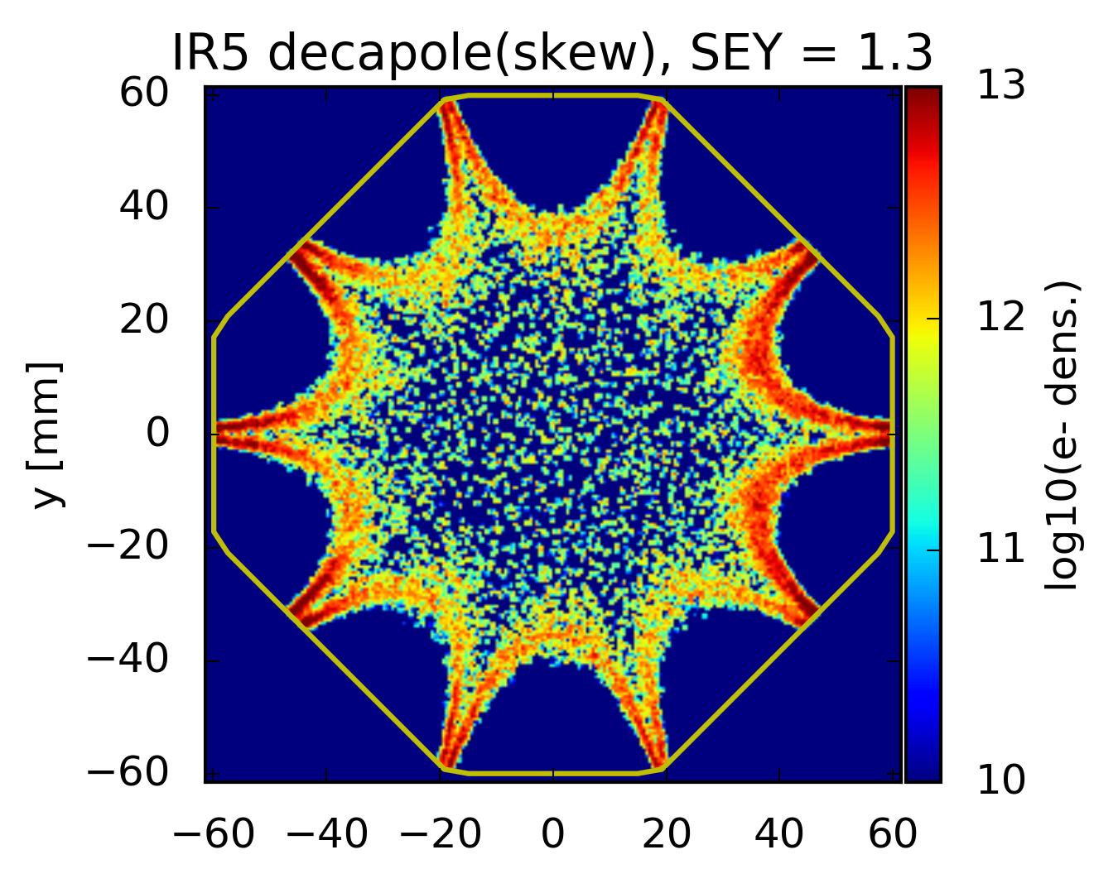
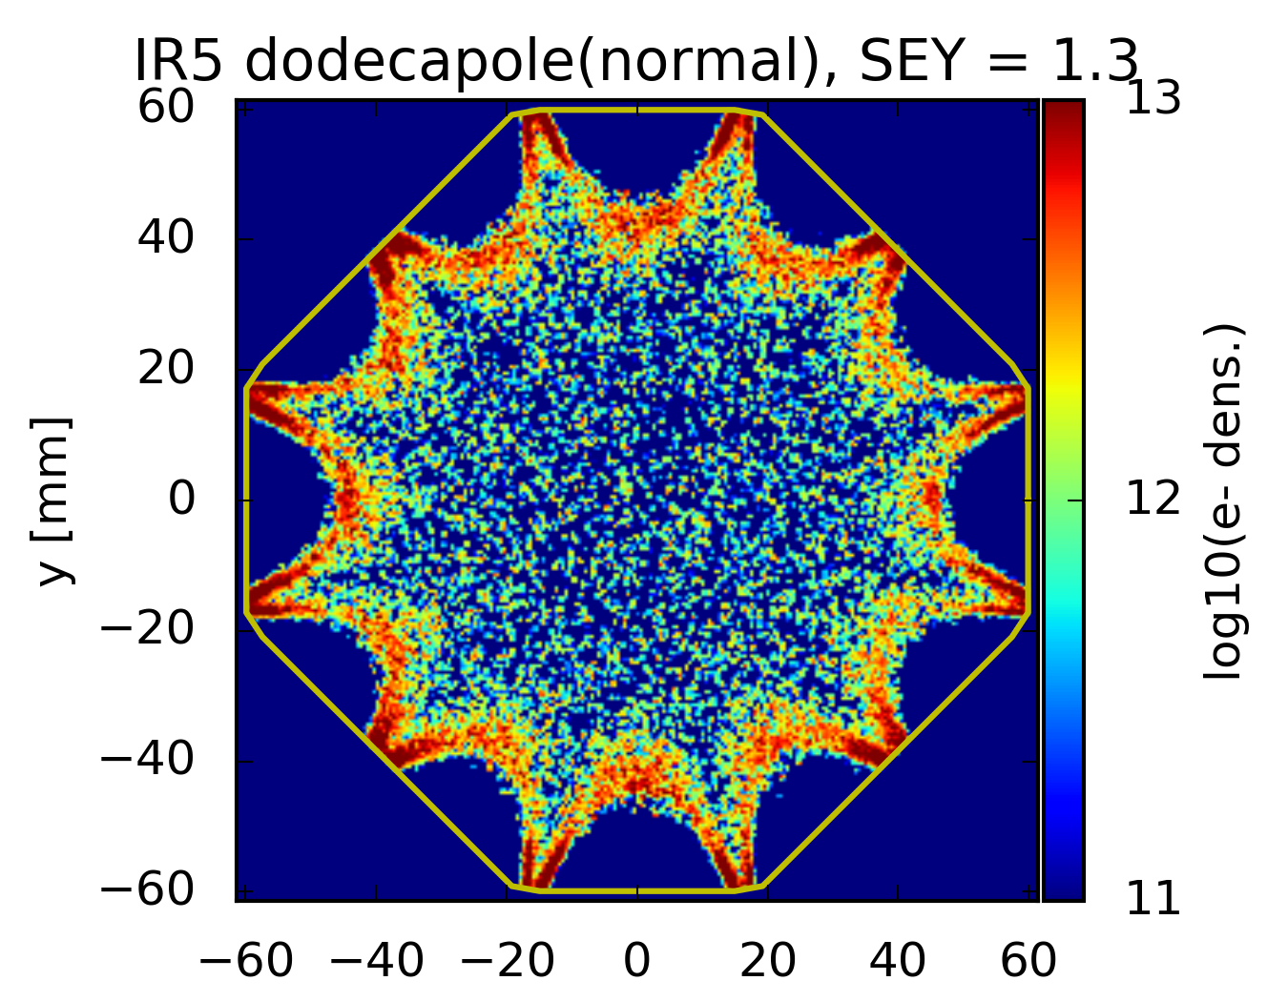
HL-LHC inner triplets: IR1 and IR5
The corrector package is presently being simulated and will be added soon to the heat load estimates:
Simulated the entire cryogenic length
Relevant magnetic field map is used for main dipoles and quadrupoles and for dipole correctors. Other sections (e.g. multipole correctors) are simulated as drifts
Conclusion: we rely on the presence of a low SEY coating to keep heat loads on cryogenics at reasonable values
  SEYmax < 1.1 assumed for the coatings

Slide 11
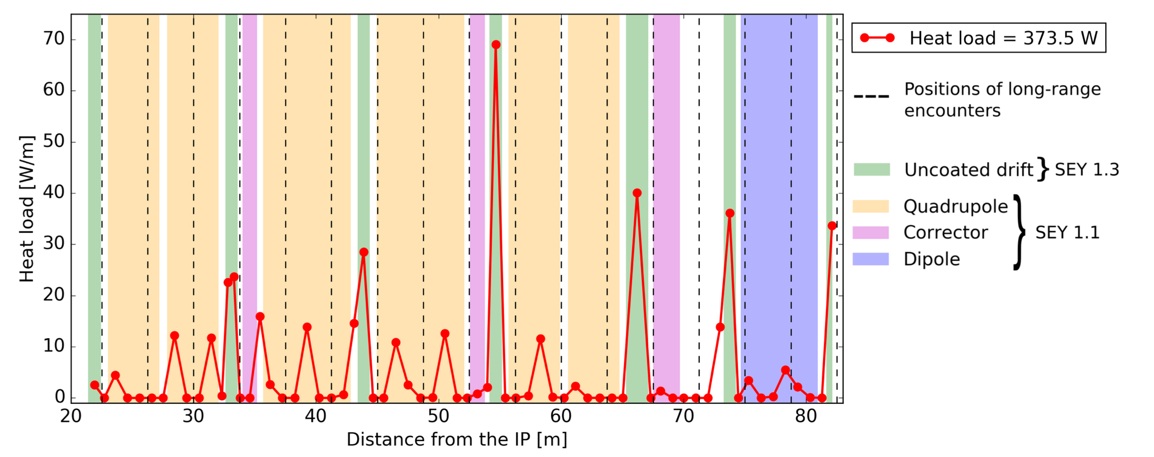
HL-LHC inner triplets: IR1 and IR5
To asses the impact of having short uncoated sections (bellows, BPMs) we simulated the case in which all sections outside the cold masses have SEY_{max} = 1.3
The heat load increases by ~220 W with respect to the fully coated case
Moreover, impact on beam quality and stability needs to be assessed as the effect on the beam is amplified by the large beta functions
Strategy proposed to WP12 (vacuum):
  Total length of non-coated parts should be minimised (as much as possible)
  Once the the “SEY profile” along the IR is defined, we will perform detailed simulations to confirm that no problem is expected

Slide 12
HL-LHC inner triplets: IR1 and IR5
To asses the impact of having short uncoated sections (bellows, BPMs) we simulated the case in which all sections outside the cold masses have SEY_{max} = 1.3
The heat load increases by ~220 W with respect to the fully coated case
Moreover, impact on beam quality and stability needs to be assessed as the effect on the beam is amplified by the large beta functions
Strategy proposed to WP12 (vacuum):
  Total length of non-coated parts should be minimised (as much as possible)
  Once the the “SEY profile” along the IR is defined, we will perform detailed simulations to confirm that no problem is expected
Improved evaluation for the non-coated parts w.r.t. last presentation at WP2 meeting (27.03)
  Removed DFX from uncoated drifts
  Changed integration method (more realistic now)

Slide 13
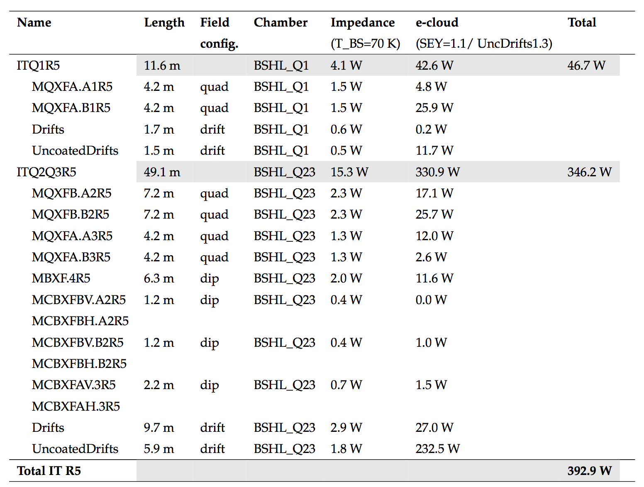
HL-LHC inner triplets: summary table
A document has been drafted including detailed tables for the beam induced heat loads in the different components
Impedance heating is included assuming that beam screens are operated at 70 K

Slide 14
HL-LHC inner triplets: summary table
A document has been drafted including detailed tables for the beam induced heat loads in the different components
Impedance heating is included assuming that beam screens are operated at 70 K
Not exactly innocent… can this heat load be handled by the cryogenic system?
If not, no panic ☺ → the estimate is based on rather conservative assumptions:
  We can re-simulate using a more realistic “SEY vs s” profile to be provided by the vacuum team (see next slide…), guessing a gain of ~70W, to be verified
  A feedback from Tuesday’s meeting with the vacuum team is that SEY_{max}=1.1 is quite pessimistic → if needed we can tighten a bit this specification

Slide 15
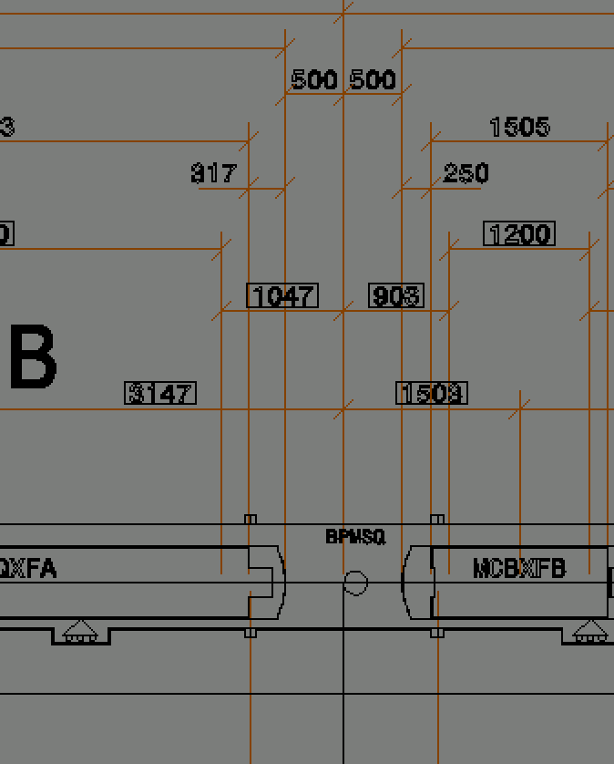
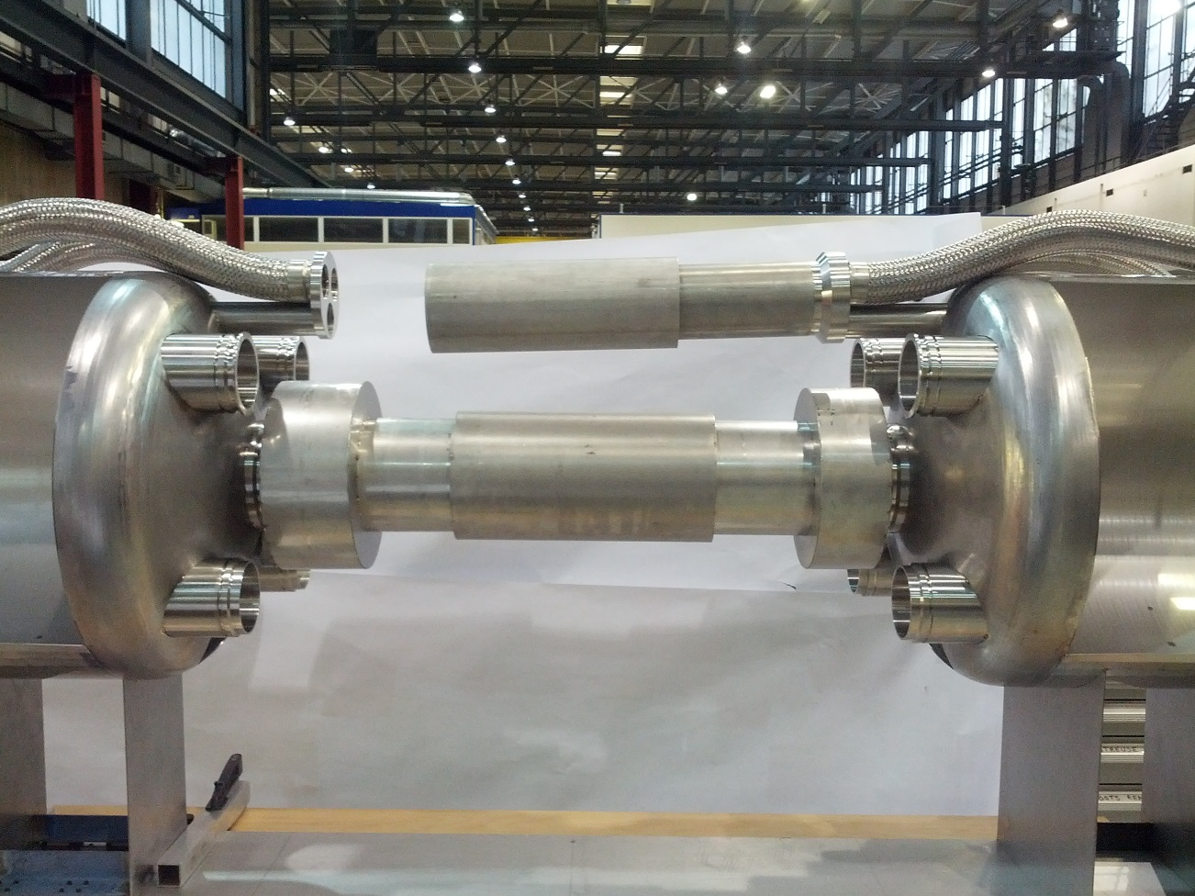
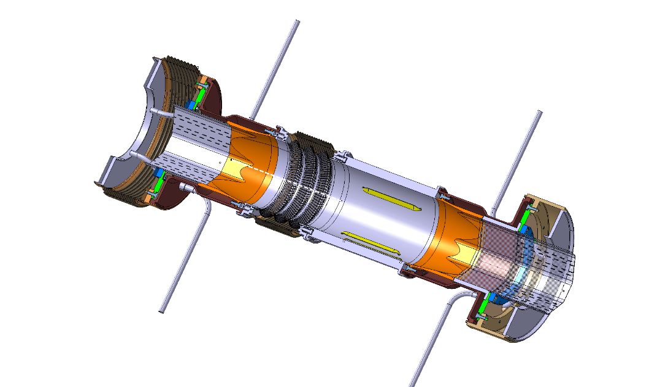
HL-LHC inner triplets: assumptions on the interconnections
Simulation assumption
Preliminary design
~50 cm
1 m

Slide 16
Outline
Introduction and some reminders on previous results
Heat load estimates for the Inner Triplets
  IR1 and IR5
  IR2 and IR8
Progress status on arc heat loads
Simulations for the TAXS absorber

Slide 17
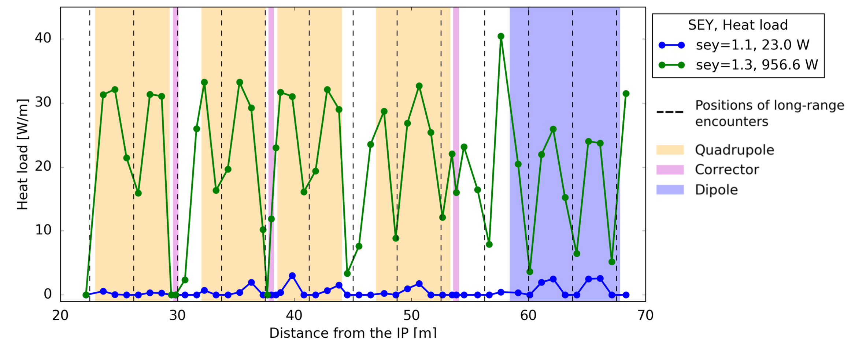
HL-LHC inner triplets: IR2 and IR8
Similar conclusions as for Inner Triplets in IR1 and IR5
We rely on the presence of a low SEY coating to keep heat load on cryogenics at reasonable values (here the treatment will have to be performed in situ)
  SEYmax < 1.1 assumed in the estimates provided to WP9 (cryogenics)

Slide 18
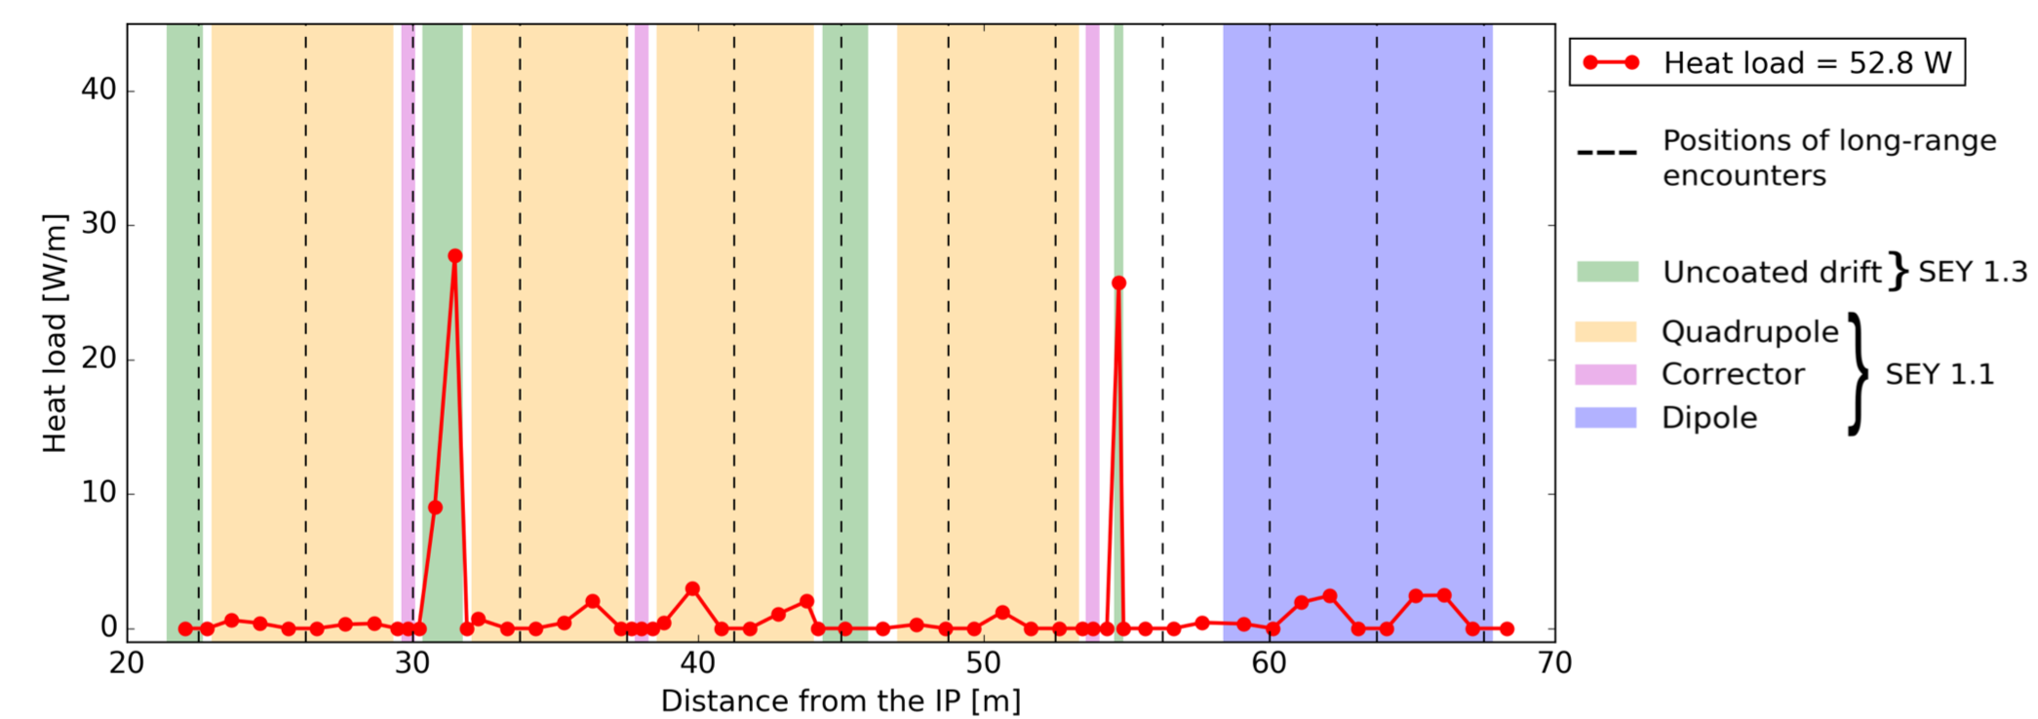
HL-LHC inner triplets: IR2 and IR8
Similar conclusions as for Inner Triplets in IR1 and IR5
We rely on the presence of a low SEY coating to keep heat load on cryogenics to reasonable values (here the treatment will have to be performed in situ)
  SEYmax < 1.1 assumed in the estimates provided to WP9 (cryogenics)
Impact of having non coated drifts has been evaluated also for these devices
  Less critical

Slide 19
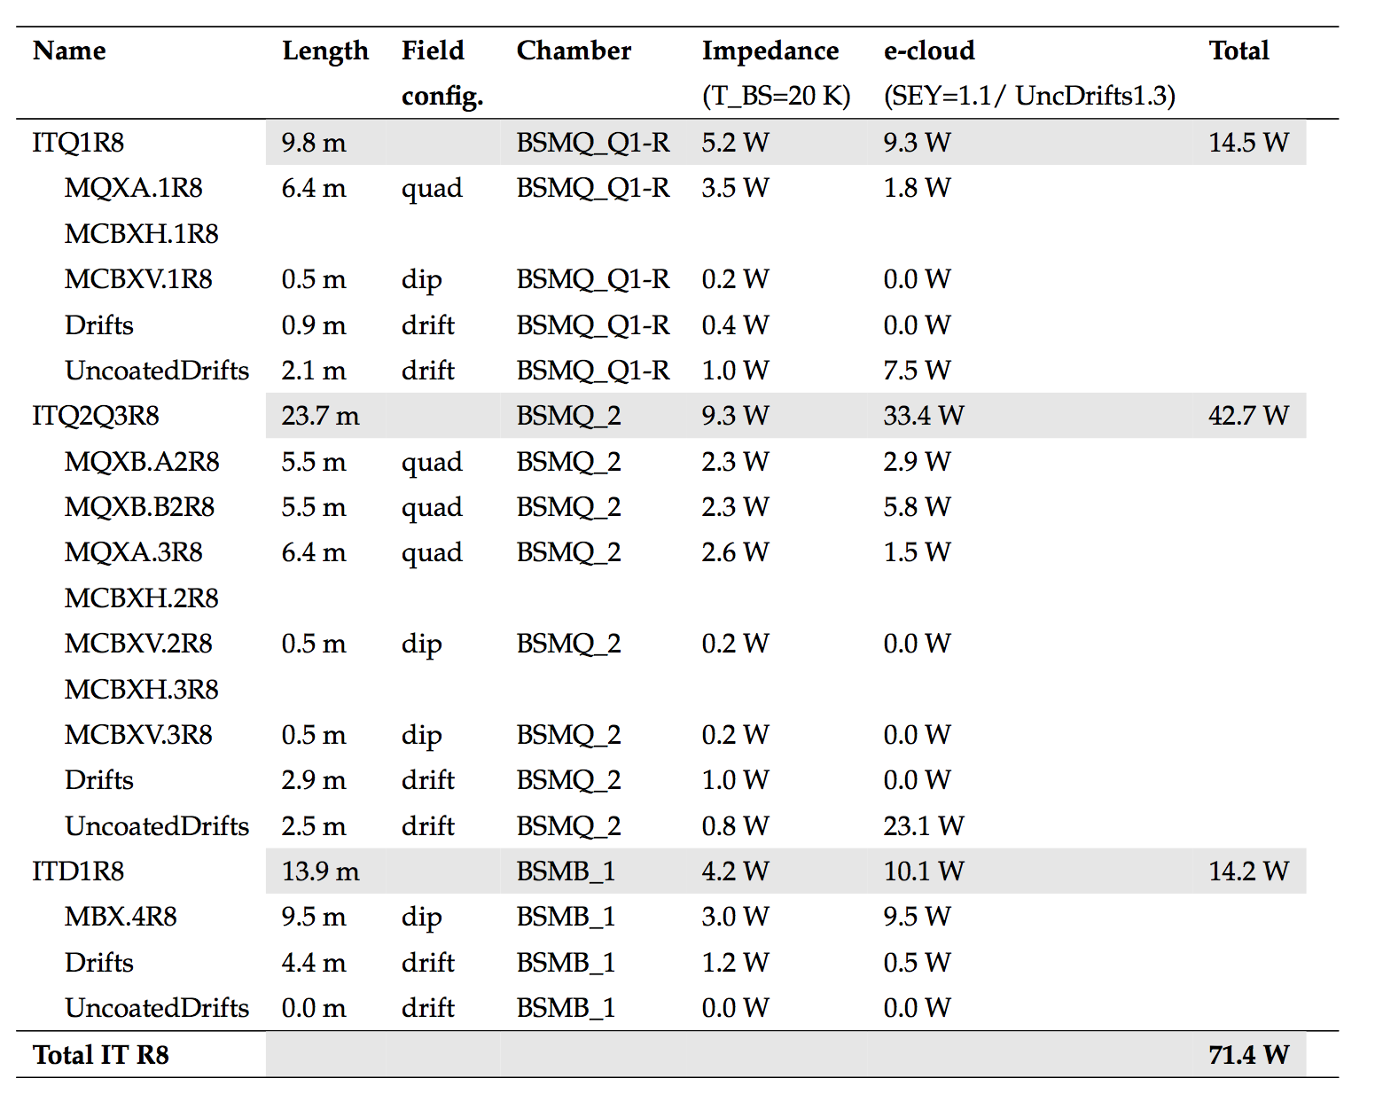
Inner triplets in IR2 and IR8: summary table
A document has been drafted including detailed tables for the beam induced heat loads in the different components (simulations of the high order correctors are ongoing)
Impedance heating is included assuming that beam screens are operated at 20 K
Inner triplets
in IR2&8:

Slide 20
Outline
Introduction and some reminders on previous results
Heat load estimates for the Inner Triplets
  IR1 and IR5
  IR2 and IR8
Progress status on arc heat loads
Simulations for the TAXS absorber

Slide 21
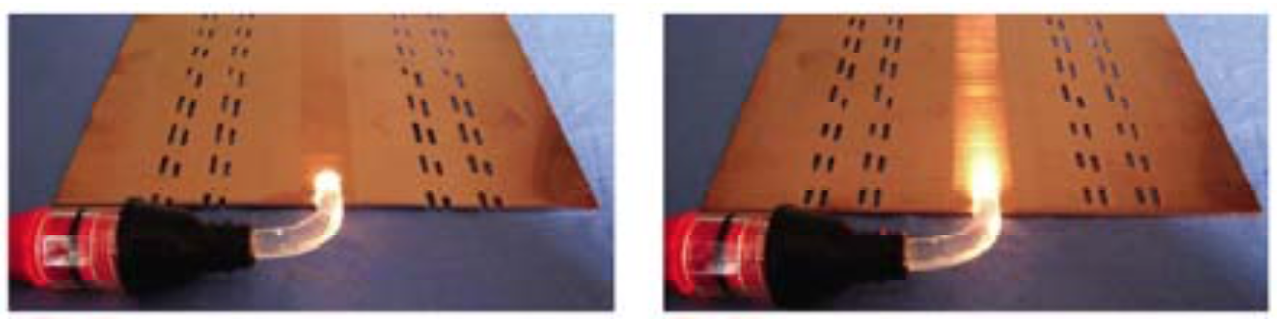
Arc heat loads: progress status
  Performed literature review to identify the best available knowledge on photoelectron yield for the LHC beam screens (correctly handling the effect of the saw-tooth)
  Defined the correct “recipe” to model the effect of photoelectrons from synchrotron radiation.
  Drafted a document and prepared a python tool to:
  Evaluate the photon spectrum for an arbitrary energy
  Compute the number of “direct” and reflected photoelectrons
  Translate the information into the input parameters required by PyECLOUD
Correct orientation
Inverted orientation
Work done together with P. Dijkstal, L. Mether and G. Rumolo

Slide 22
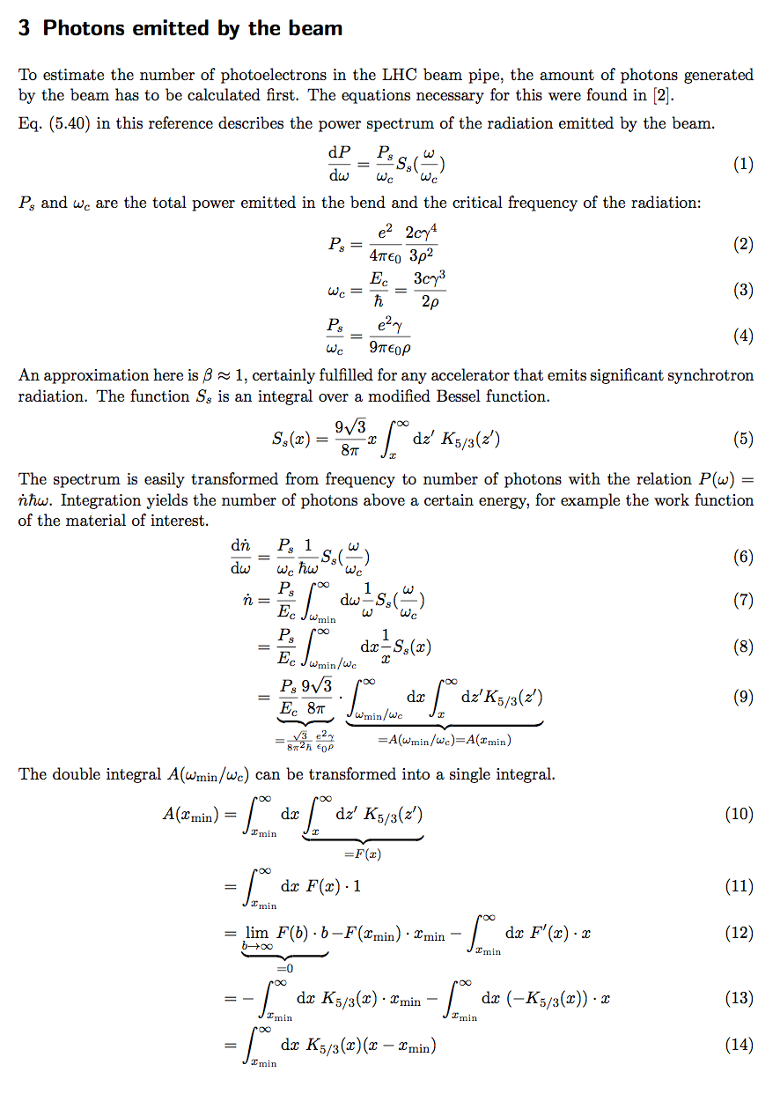
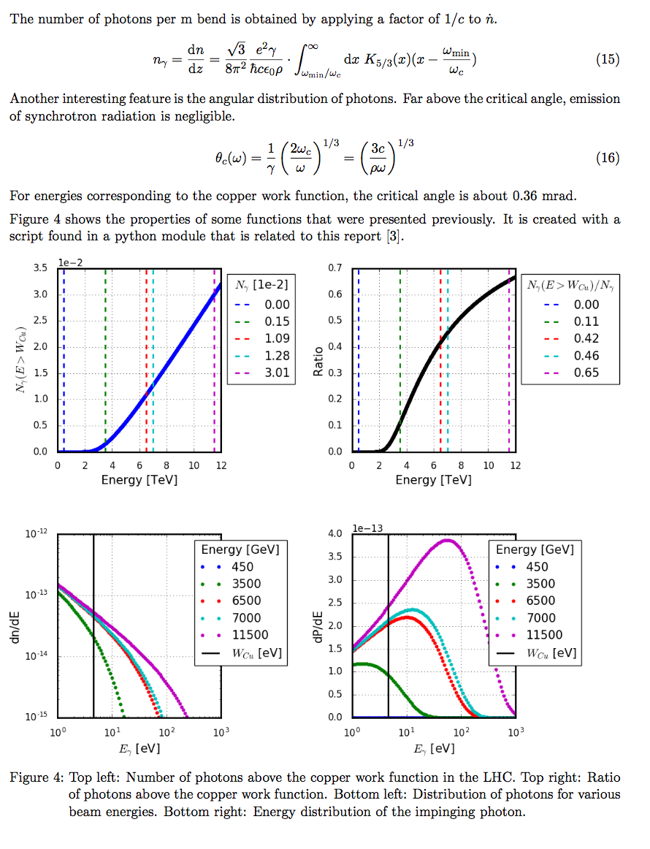
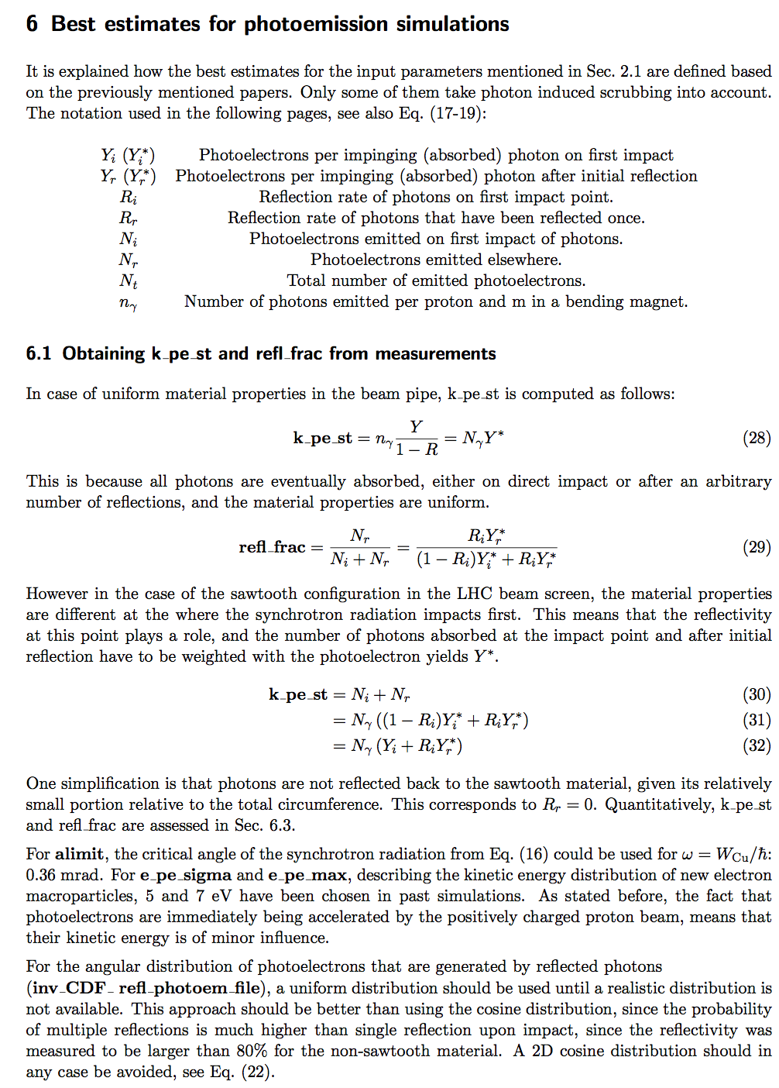
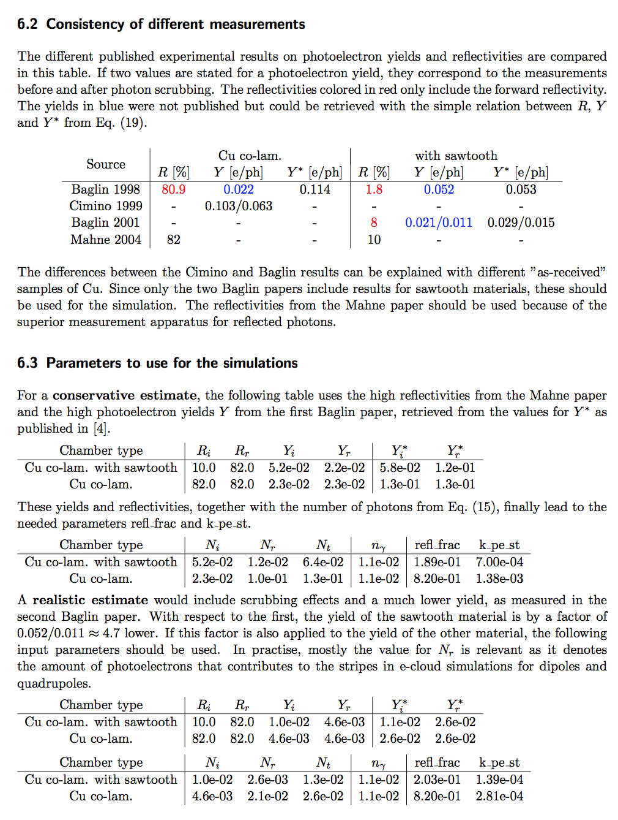
Arc heat loads: work in progress
  Performed literature review to identify the best available knowledge on photoelectron yield for the LHC beam screens (correctly handling the effect of the saw-tooth)
  Defined the correct “recipe” to model the effect of photoelectrons from synchrotron radiation.
  Drafted a document and prepared a python tool to:
  Evaluate the photon spectrum for an arbitrary energy
  Compute the number of “direct” and reflected photoelectrons
  Translate the information into the input parameters required by PyECLOUD
Correct orientation
Inverted orientation
Work done together with P. Dijkstal, L. Mether and G. Rumolo

Slide 23
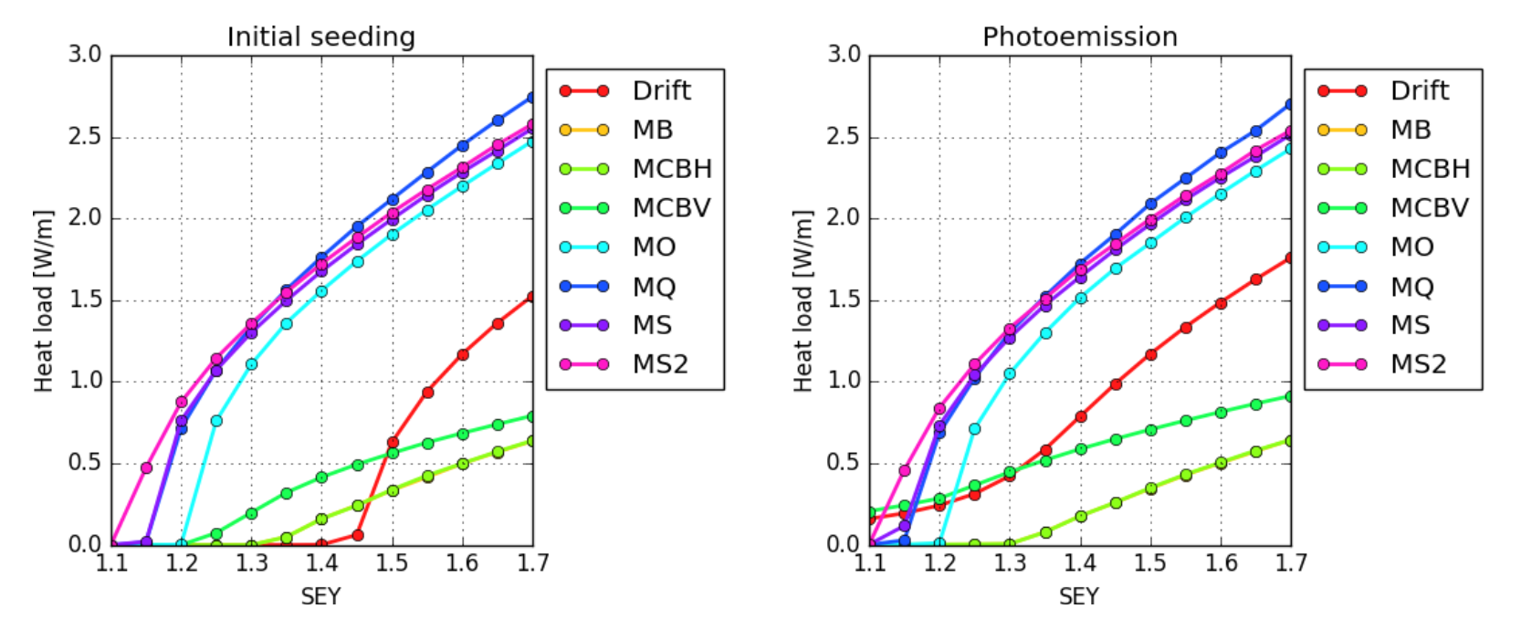
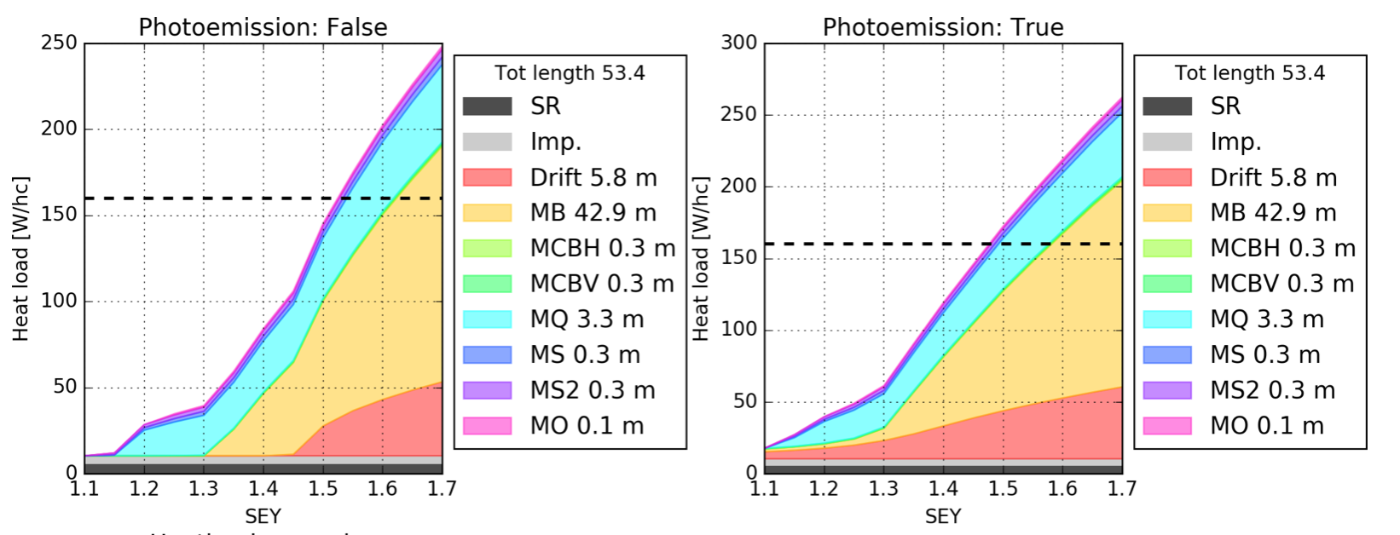
Arc heat loads: work in progress
  Simulating all components. Preliminary results for present LHC beam parameters:

Slide 24
Arc heat loads: work in progress
  Simulating all components. Preliminary results for present LHC beam parameters:
  Soon the model will be “frozen” we will investigate the dependence on intensity

Slide 25
Outline
Introduction and some reminders on previous results
Heat load estimates for the Inner Triplets
  IR1 and IR5
  IR2 and IR8
Progress status on arc heat loads
Simulations for the TAXS absorber

Slide 26
TAXS absorber
Electron cloud build-up simulations have been performed for the TAXS absorber
Two beam device → multipacting depends on the distance w.r.t. the long range encounters
Length = 1.8 m, circular chambers, diameter = 60 mm

Slide 27
TAXS absorber
Electron cloud build-up simulations have been performed for the TAXS absorber
Two beam device → multipacting depends on the distance w.r.t. the long range encounters
Multipacting thresholds are above SEY_{max} = 1.2
NEG coating not possible there, a-C coating under investigation
Length = 1.8 m, circular chambers, diameter = 60 mm

Slide 28
Summary and conclusion
“WP2-WP9 interface” for exchanging data on heat load estimates has been defined(conventions, requirements)
Evaluations for twin bore magnets performed in 2016. Main outcomes:
  Experimental IR are the most critical
  IR1 and IR5 will be equipped with dedicated cryoplants
  Load IR2 and IR8 will affect the neighboring arcs → Low SEY coating of the matching sections is desirable
Heat loads in the Inner Triplets have been estimated IR1&5 and for IR2&8
  We rely on low SEY surface treatments (SEY_{max}<1.1) to have reasonable heat loads on cryogenics
  A first analysis of the impact of having un-coated drift sections outside the cold masses has been performed
Work for the definition of a detailed e-cloud model of the arc half-cell is almost complete→ soon to be applied to HL-LHC beam
TAXS simulations are available to be folded in heat load and vacuum estimated

Slide 29
Thanks for your attention

