Slide 1


In-medium heavy quarkonium from lattice NRQCD
Alexander Rothkopf
Faculty of Science and Technology
Department of Mathematics and Physics
University of Stavanger
In collaboration with S. Kim (Sejong-U.) and P. Petreczky (BNL)
References:
S.Kim, P. Petreczky, A.R., arXiv:1808:XXXXX
XIIIth Quark Confinement and the Hadron Spectrum Conference 2018 – 05/08 – Maynooth, Ireland

Slide 2
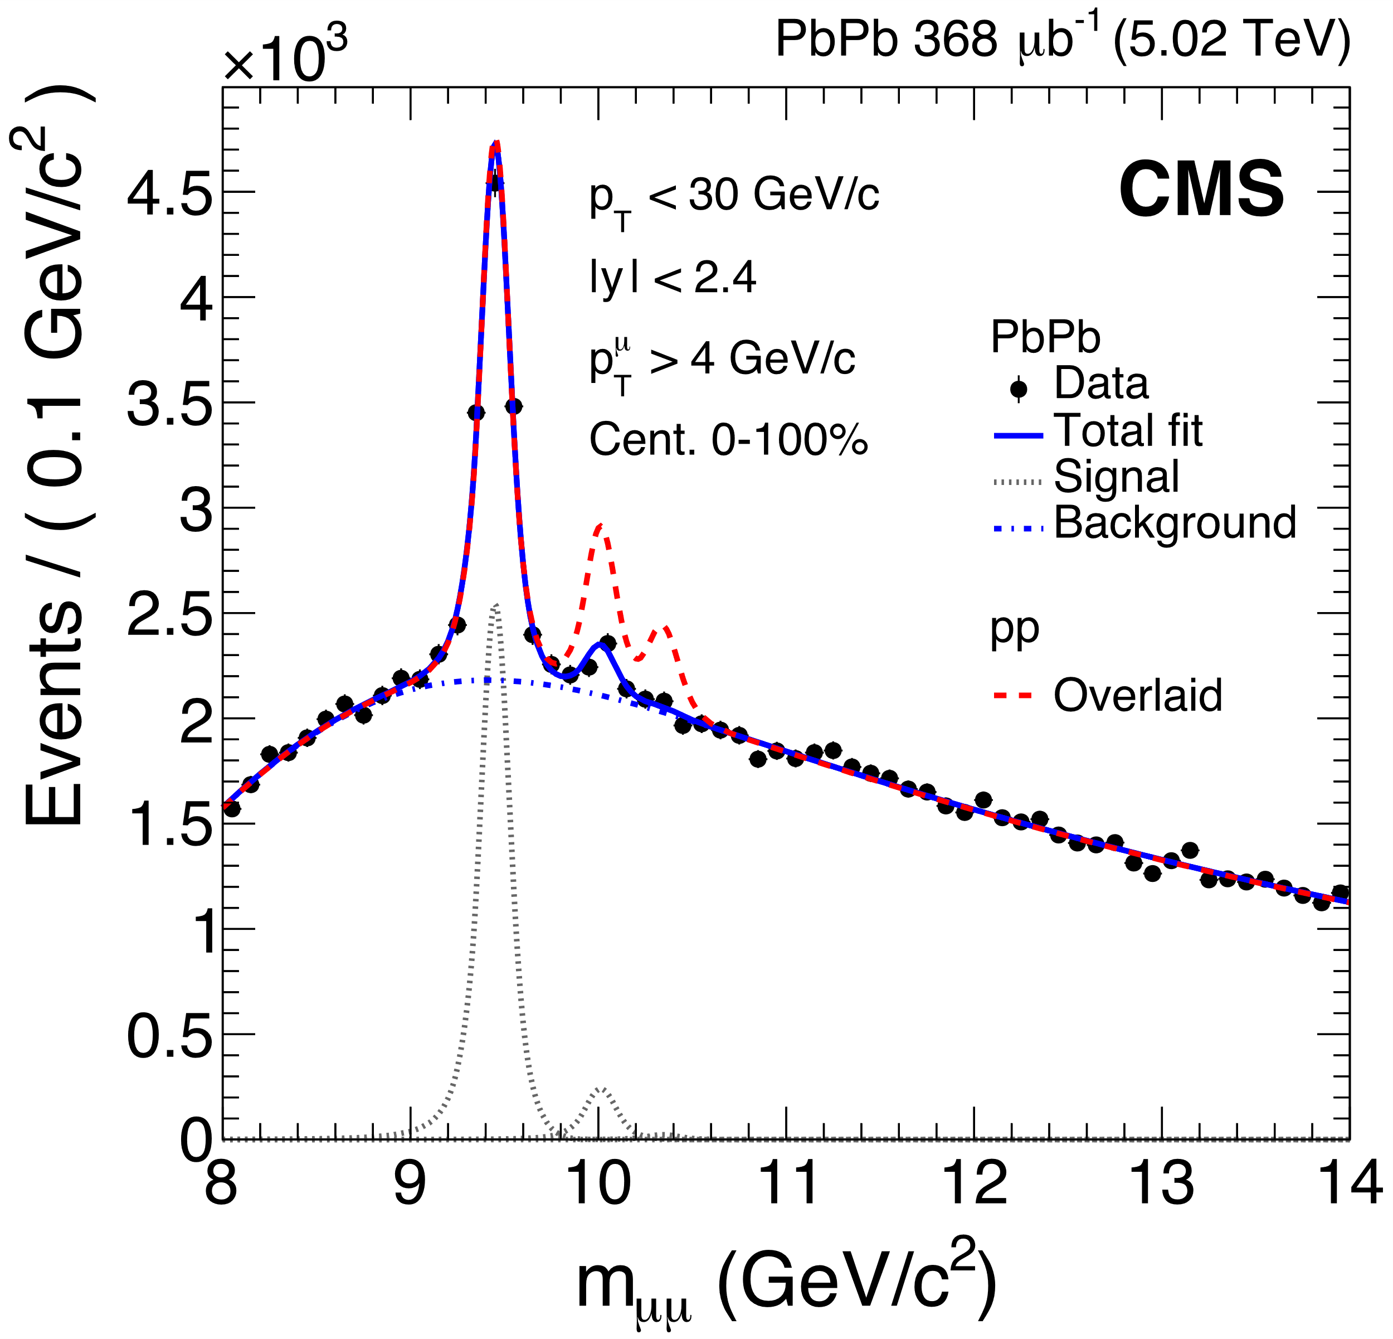
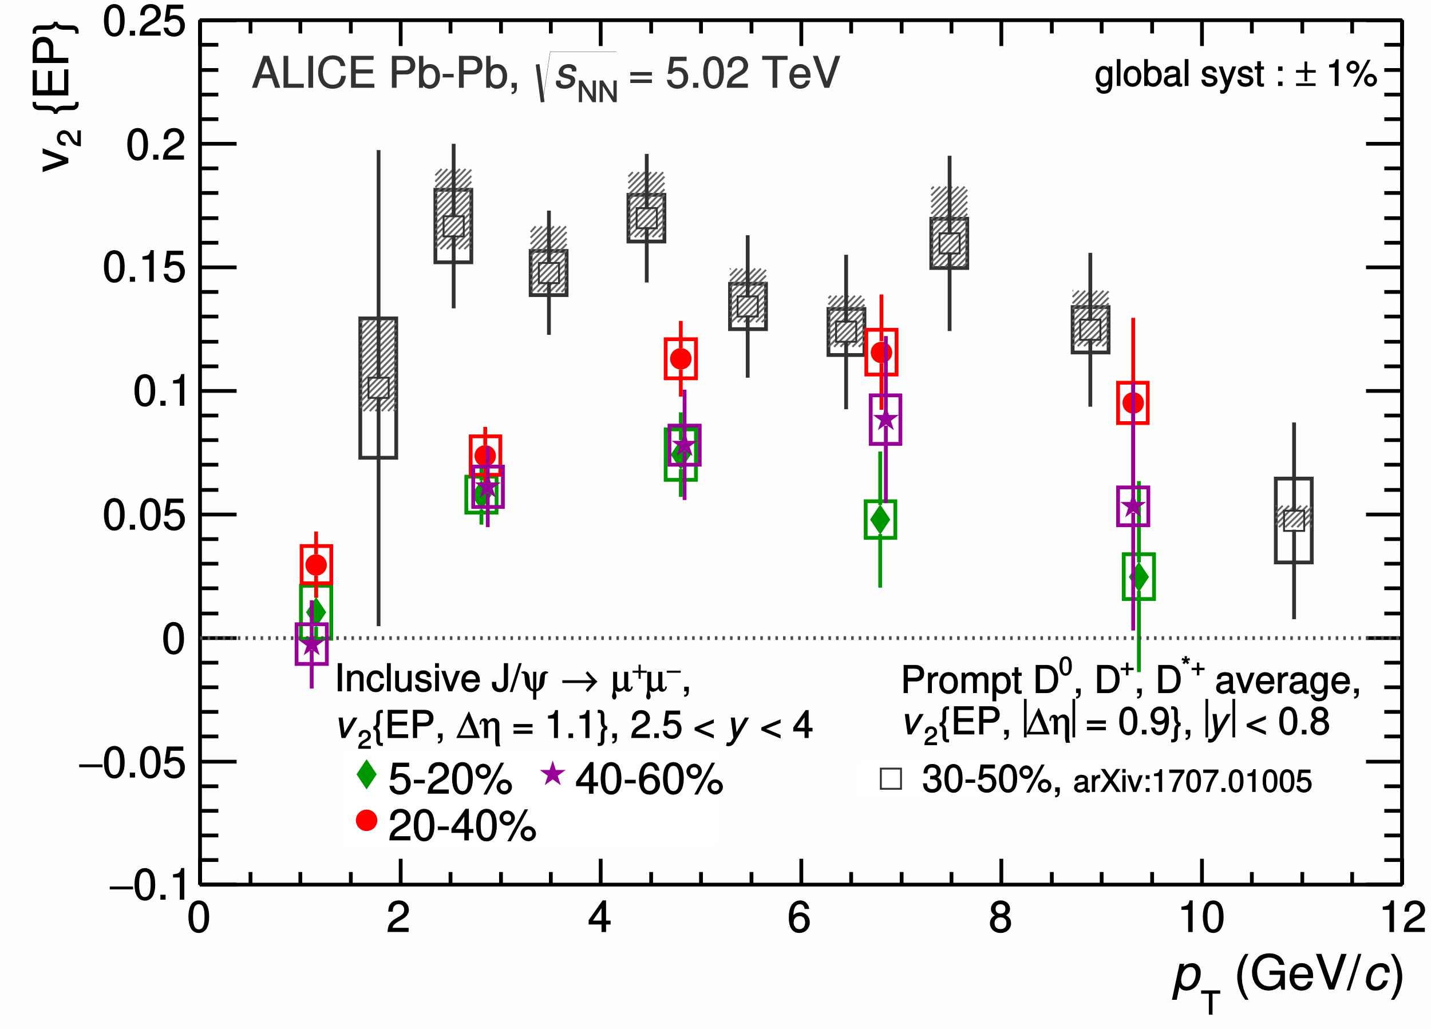
Motivation: Quarkonium in HIC
Heavy quarkonium: Precision probes of the QGP
[CMS collaboration] PRL120 (2018) 142301
[ALICE collaboration] PRL119 (2017) 242301
Bottomonium: a non-equilibrium
probe of the full QGP evolution
Charmonium: a partially equilibrated
probe, sensitive to the late stages
In experiment only T=0 states measured, medium effects at hadronization
Idealized setting: properties of quarkonium in a static medium?

Slide 3
Outline
Numerical Setup (Lattice NRQCD)
Preparatory studies at T=0
In-medium properties of heavy quarkonium
Outlook and Conclusion

Slide 4
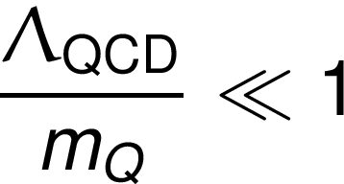
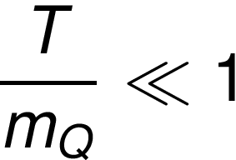
Lattice NRQCD
Exploit separation of scales to treat heavy quarks non-relativistically
QQ in NRQCD effective theory
u
d
s
am_{Q} << 1
am_{Q} ~1
Q
Q
g
N_{τ}a=1/T
Q
g
d
s
N_{τ}a=1/T
Q
u
Full Lattice QCD simulation incl. QQ
(still too costly)
Lattice QCD simulation without QQ
Lattice Non-Relativistic QCD (NRQCD) well established at T=0, applicable at T>0
no modeling, systematic expansion of QCD action in 1/m_{Q}a, includes v≠0 contributions
Thacker, Lepage Phys.Rev. D43 (1991) 196-208
our implementation uses O(v⁴), i.e. O(1/(m_{Q}a)³) and leading order Wilson coefficients
Realistic & high statistics simulations of the QCD medium by HotQCD
HotQCD PRD85 (2012) 054503, PRD90 (2014) 094503
m_{π}=161MeV
T=0 N_{τ}=32-64
T>0 N_{τ} =12
T= [ 140 – 407 ] MeV m_{b}a= [ 2.759 – 1.559 ] Lepage n_{b}=4
T= [ 140 – 251 ] MeV m_{c}a= [ 0.757 – 0.427 ] Lepage n_{c}=8
Use adaptive time discretization for NRQCD stability via Lepage parameter
Notes:
\frac{\Lambda_{\rm QCD}}{m_Q}\ll 1
\frac{T}{m_Q}\ll 1

Slide 5
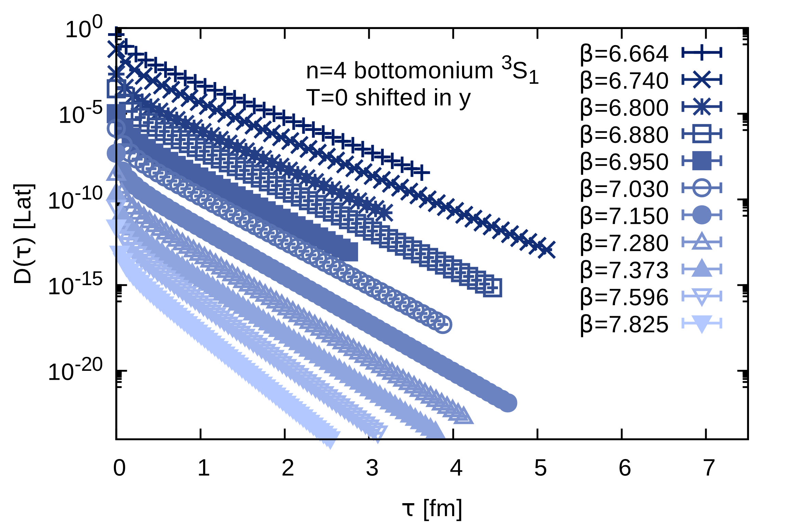
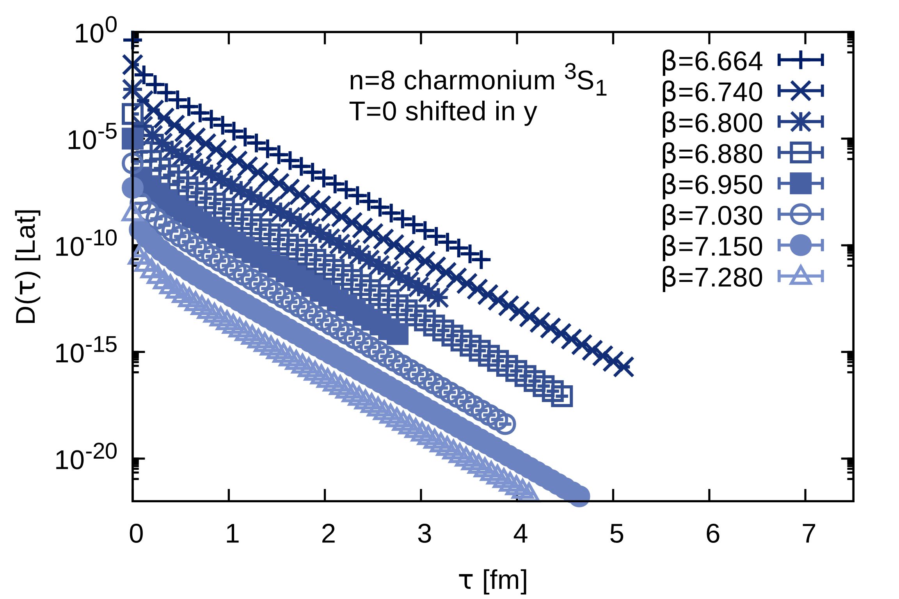
NRQCD Euclidean correlators
meas
τ
N_{bb}(T=0)=400
N_{bb}(T>0)=1-4x10³
Q
meas
Q
Q
σ^{i}
Euclidean time
QCD
medium
σ^{i}
meas
N_{cc}(T=0)=200
N_{cc}(T>0)=400
Q
Q
Q
meas
Non-rel. propagator of
a single heavy quark G
QQ propagator
projected to a certain channel
„correlator of QQ wavefct.
D_{J/ψ}(τ) ≙ <ψ_{J/ψ} (τ)ψ†_{J/ψ} (0)> “
Davies, Thacker Phys.Rev. D45 (1992)
Brambilla et. al. Rev.Mod.Phys. 77 (2005) 1423
Notes:
Significantly increased statistics compared to aour previous study

Slide 6
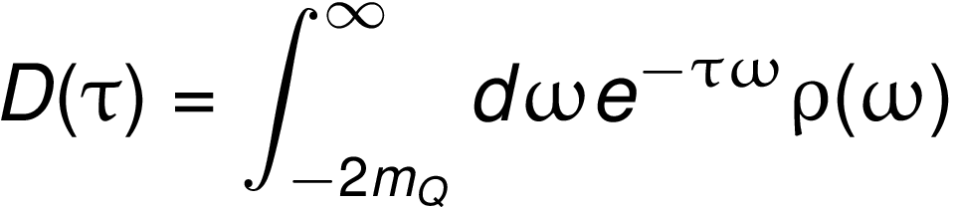
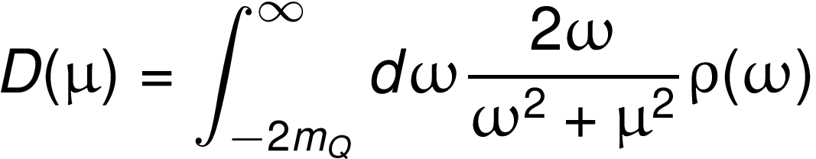
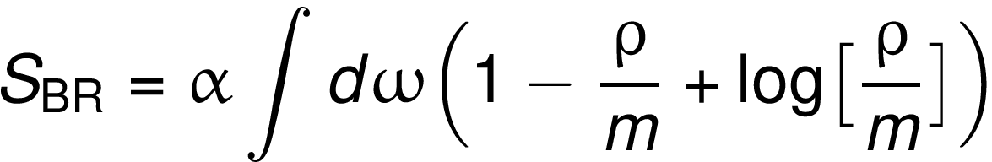
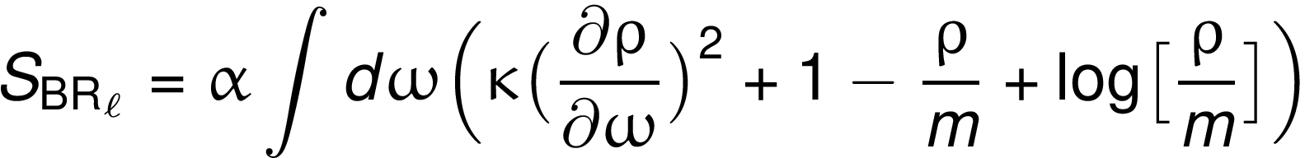
Bayesian spectral reconstruciton
In NRQCD: data D and spectral function ρ are related via Laplace transform
Fourier
Improvement: incorporate both Euclidean and imaginary frequency data in unfolding
Ill-posed problem: naïve χ² fit of spectrum leads to degenerate solutions
Bayes: regulate χ² fit (likelihood L) with prior information (regulator S)
Standard BR method (BR)
Low ringing BR method (BR_{l})
Resolves narrow peaked structures
with high accuracy
Introduces penalty on arc length of
reconstruction (dL/dw)²=1+(dρ/dw)²
Y. Burnier, A.R. PRL 111 (2013) 182003
c.f. C. Fsicher et.al. PRD98 (2018) 014009
Ringing in broad structures if recon-
structed from small # of datapoints
Efficiently removes ringing but may
lead to overestimated peak widths
„high gain – high noise“
„low gain – low noise“
Notes:
D(\tau)=\int_{-2m_Q}^\infty d\omega e^{-\tau\omega}\rho(\omega)
D(\mu)=\int_{-2m_Q}^\infty d\omega \frac{2\omega}{\omega^2+\mu^2}\rho(\omega)
S_{\rm BR}=\alpha\int d\omega\Big(1-\frac{\rho}{m}+{\rm log}\big[ \frac{\rho}{m}\big]\Big)
S_{\rm BR_\ell}=\alpha\int d\omega\Big(\big(\frac{\partial\rho}{\partial \omega}\big)^2+1-\frac{\rho}{m}+{\rm log}\big[ \frac{\rho}{m}\big]\Big)

Slide 7
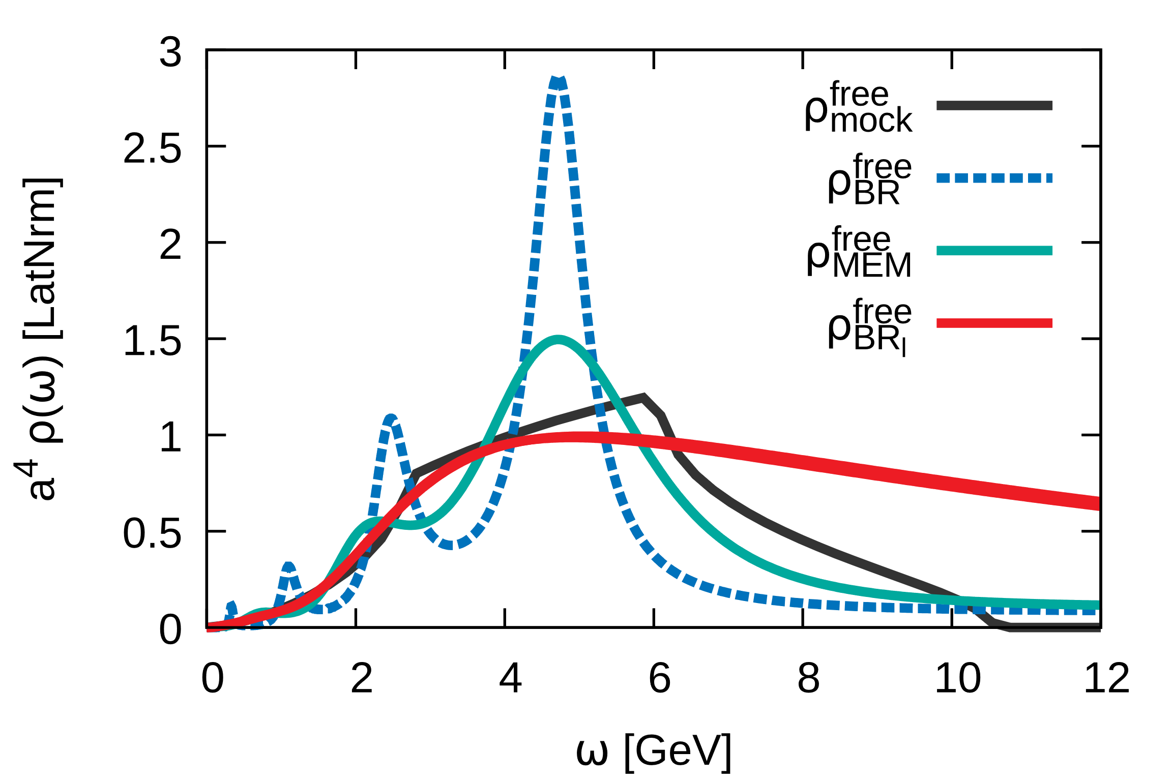
Calibrating the smooth BR method
from analytic mock data
ma=2.76
Hyperparameter κ needs to be self consistently selected
Use prior knowledge: free spectral functions known analytically
In reconstruction from N_{τ}=12 data: κ=1 successfully suppresses ringing
Use smooth BR to verify peak existence, standard BR for peak position etc.

Slide 8
Outline
Numerical Setup (Lattice NRQCD)
Preparatory studies at T=0
In-medium properties of heavy quarkonium
Outlook and Conclusion

Slide 9
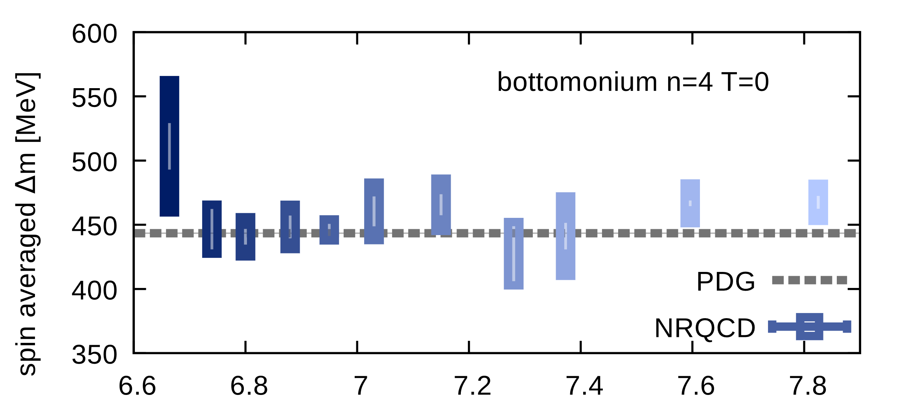
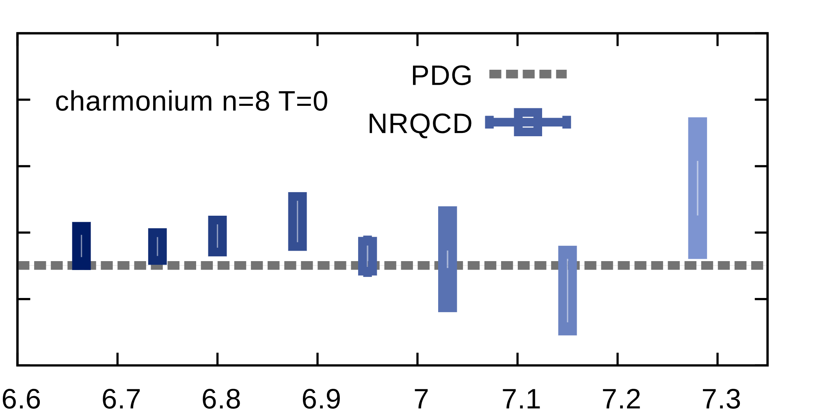
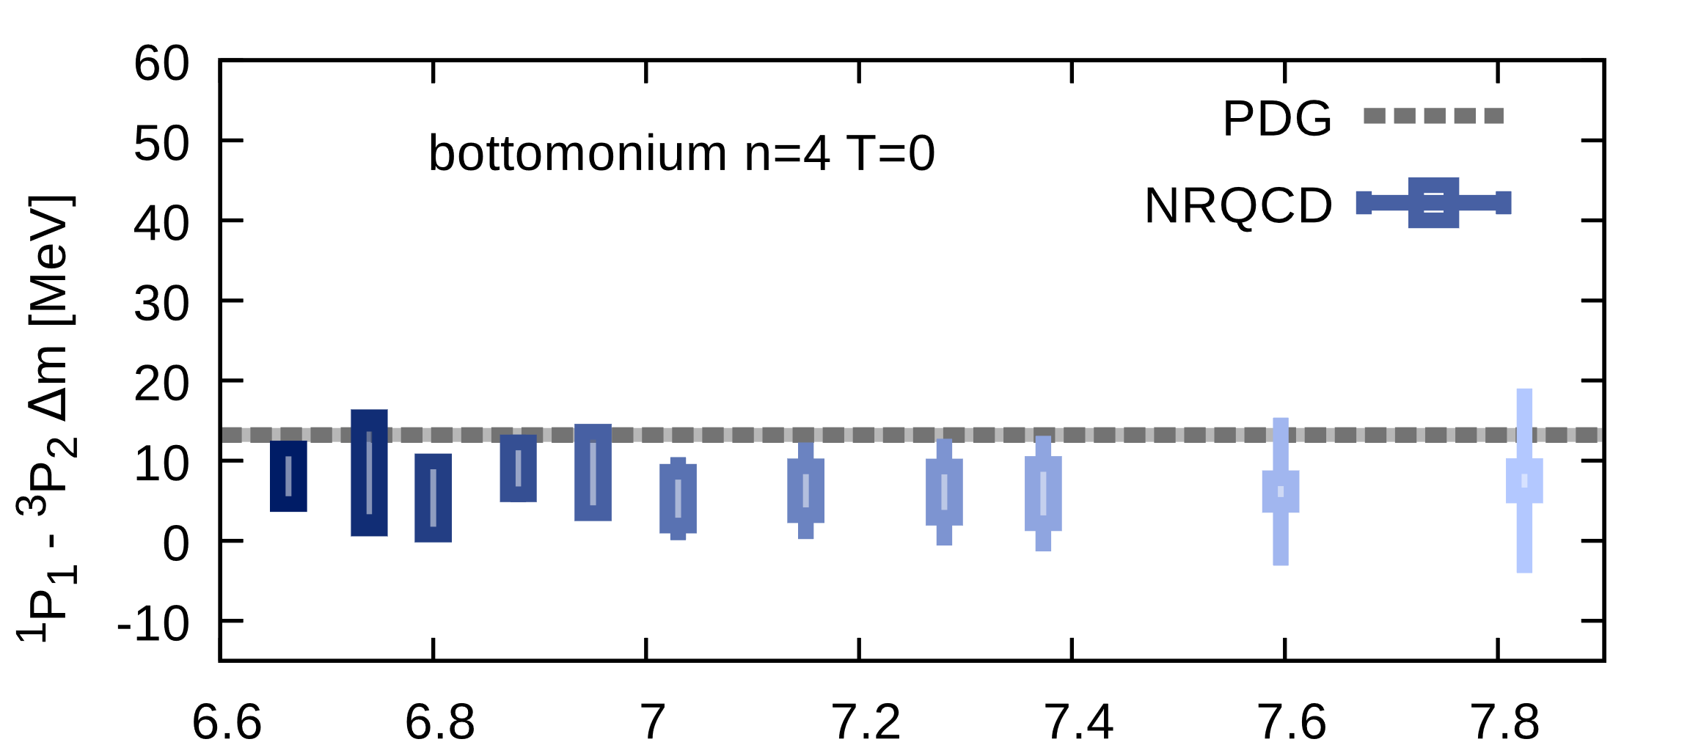
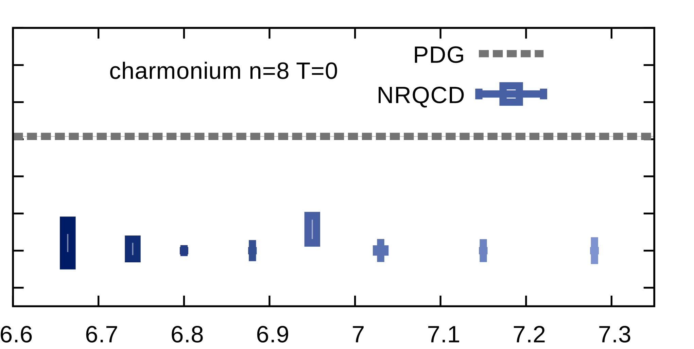
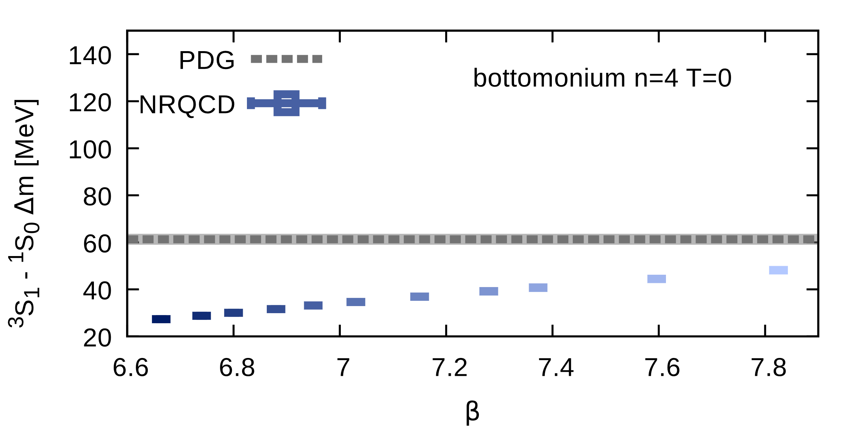
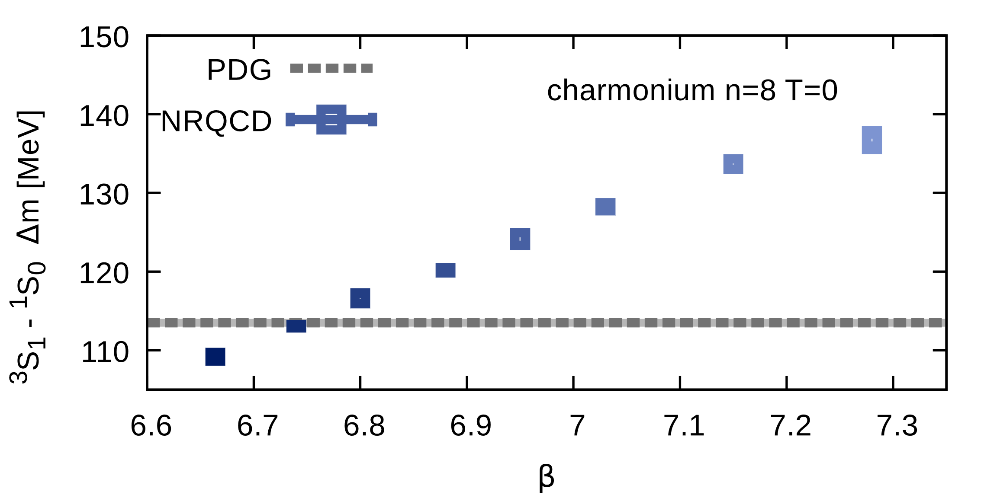
Mass splittings at T=0
With T>0 spectra goal, no T=0 specific NRQCD improvements: Accuracy?
Spin weighted difference
between S- and P-wave
(c.f. potential model:
dep. only on central pot.)
✓
✓
P-wave ¹P₁ ³P₂ splitting
(c.f. potential model:
spin-orbit coupling)
😐
✓
😐
S-wave splitting
(c.f. potential model: HFS)
😐
Max 35MeV deviation. (HFS:
NRQCD O(v⁶) and O(α_{S}v⁴) )
Reasonable agreement but no competition with high-prec. T=0 NRQCD

Slide 10
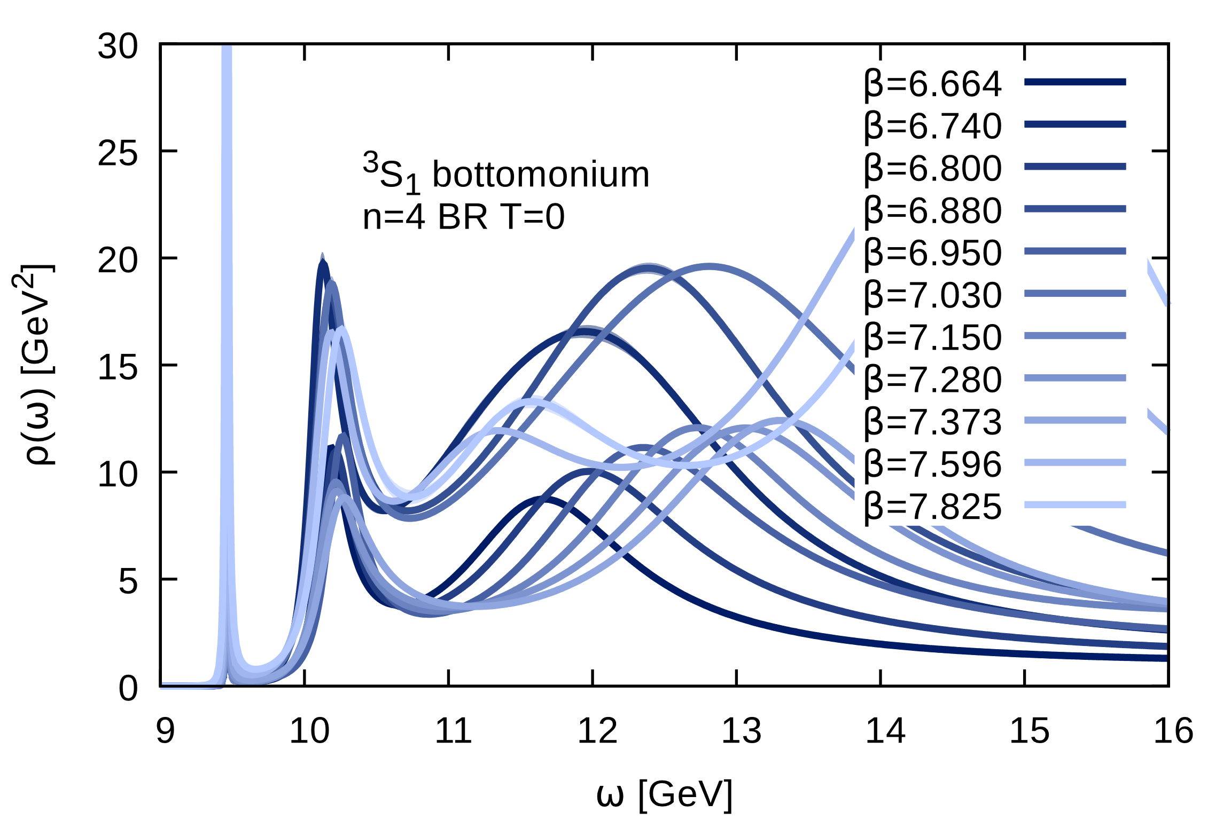
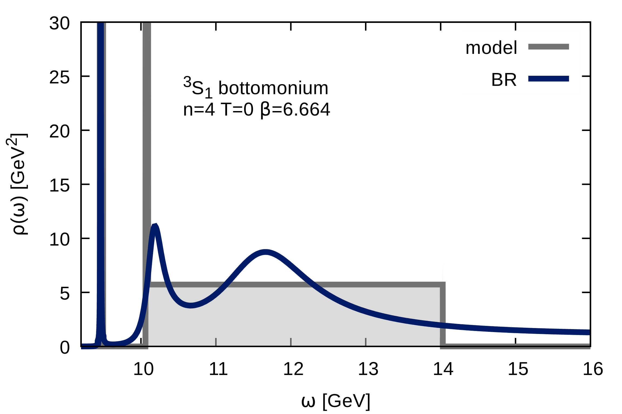
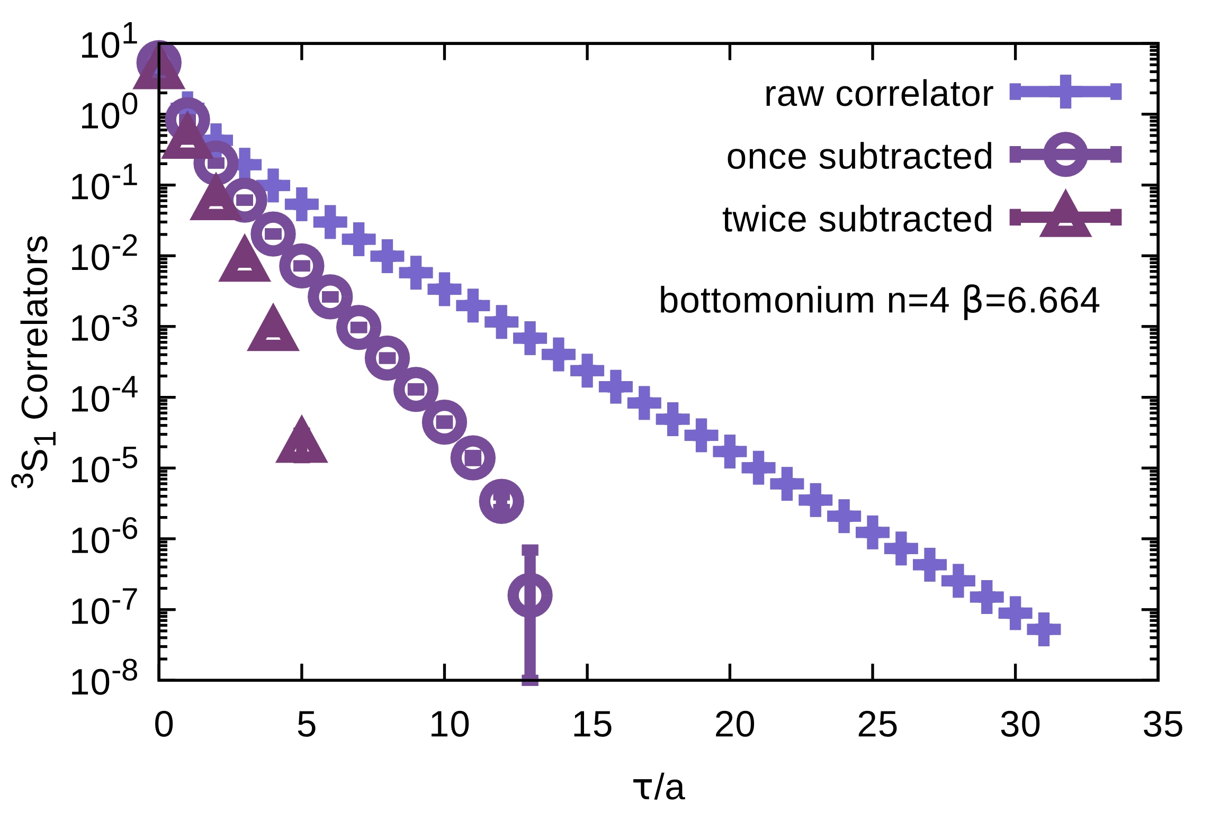
Information content at T=0
With a hypothetically perfect extraction,
how much can we learn from the data?
Offer alternative interpretation of correlator:
two peaks and a box. Fits correlator χ²/N_{τ} ≈1
After subtracting two peaks, only small
# of relevant points remain.
Notes:
M_{\rm ^sX_J}^{\rm exp} = E^{\rm sim}_{\rm ^sX_J} + 2 (Z_{M_q} M_q - E_0)

Slide 11
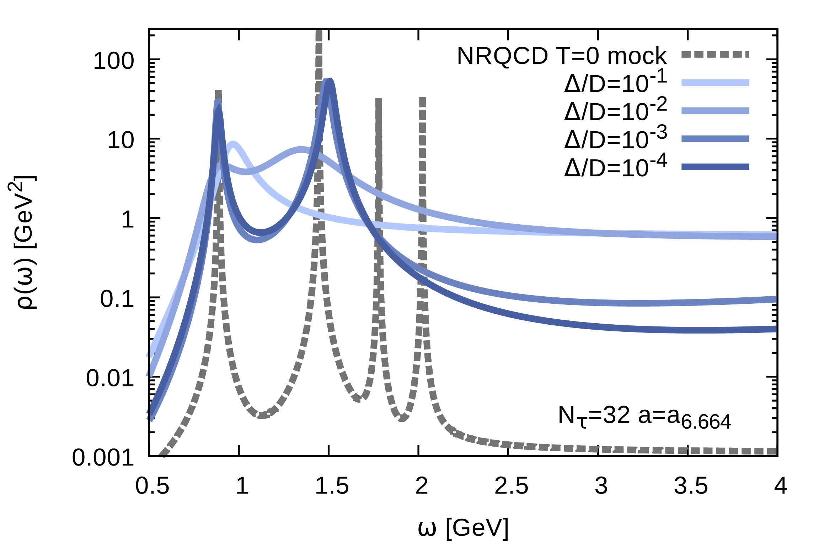
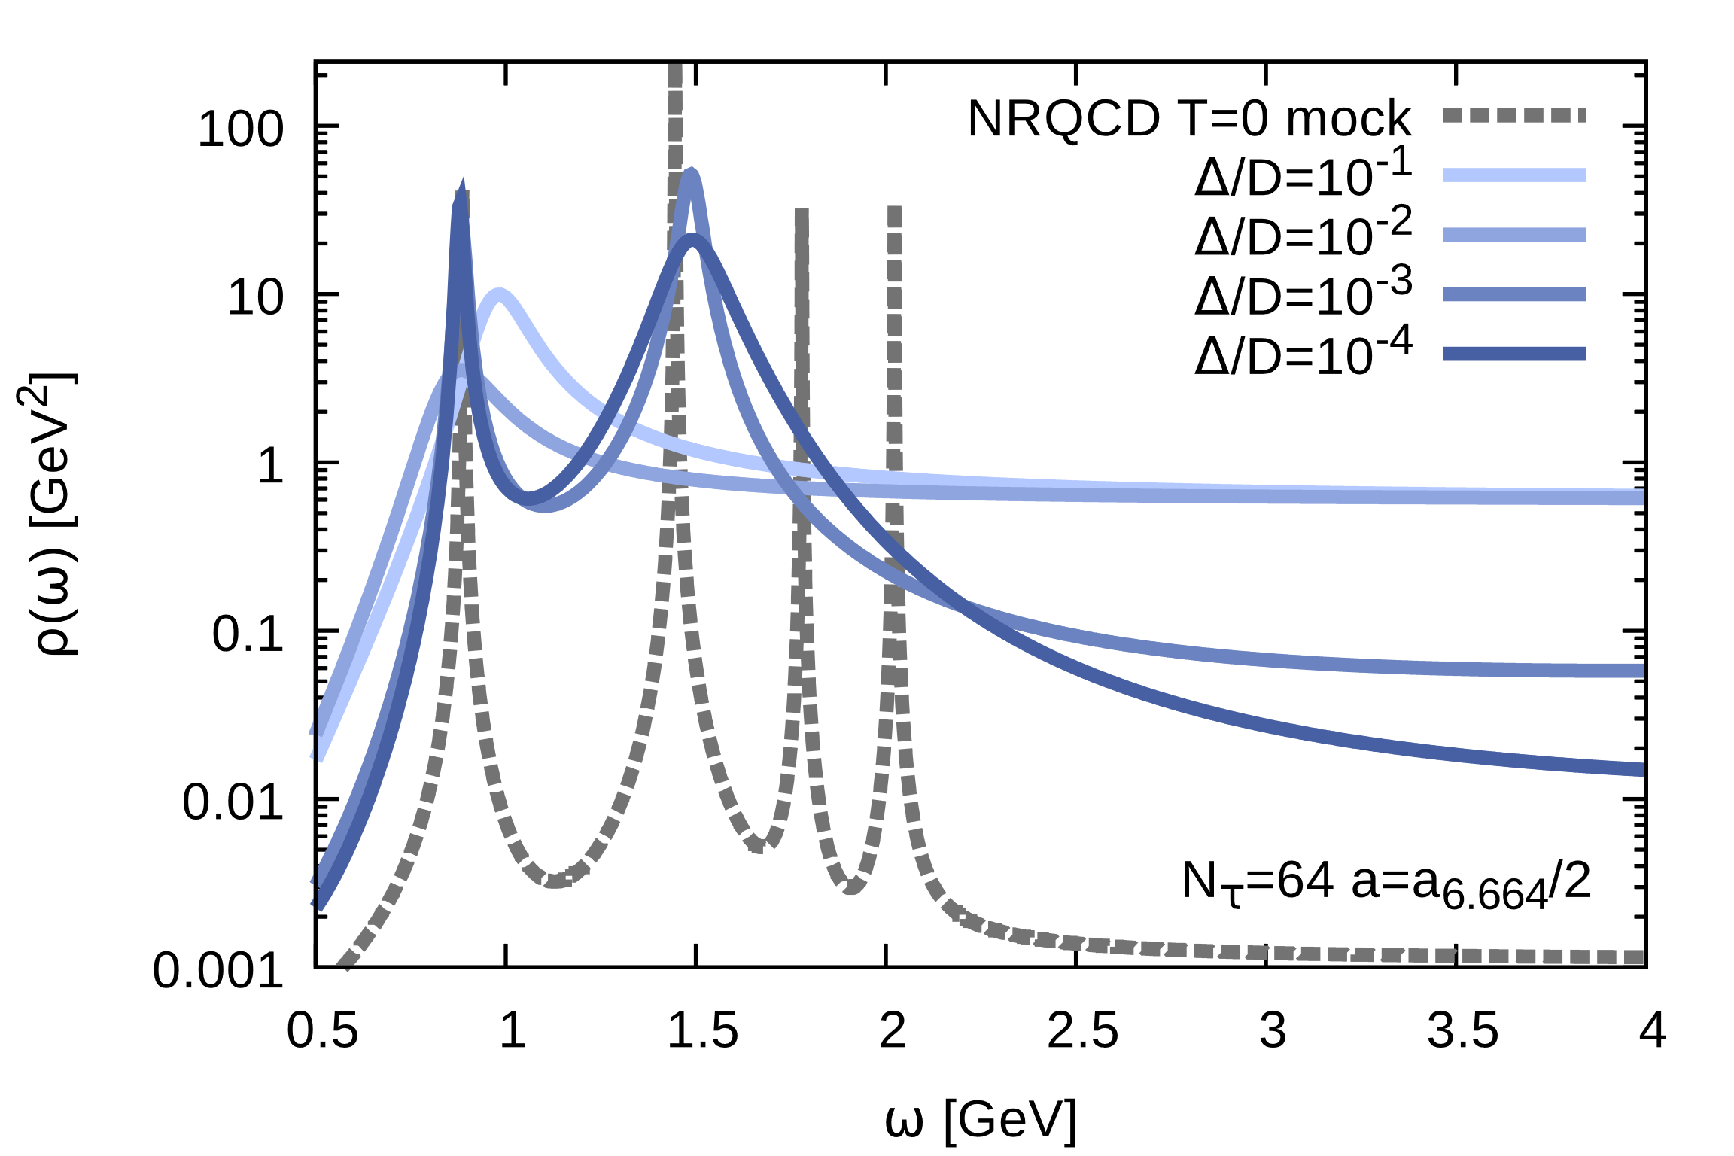
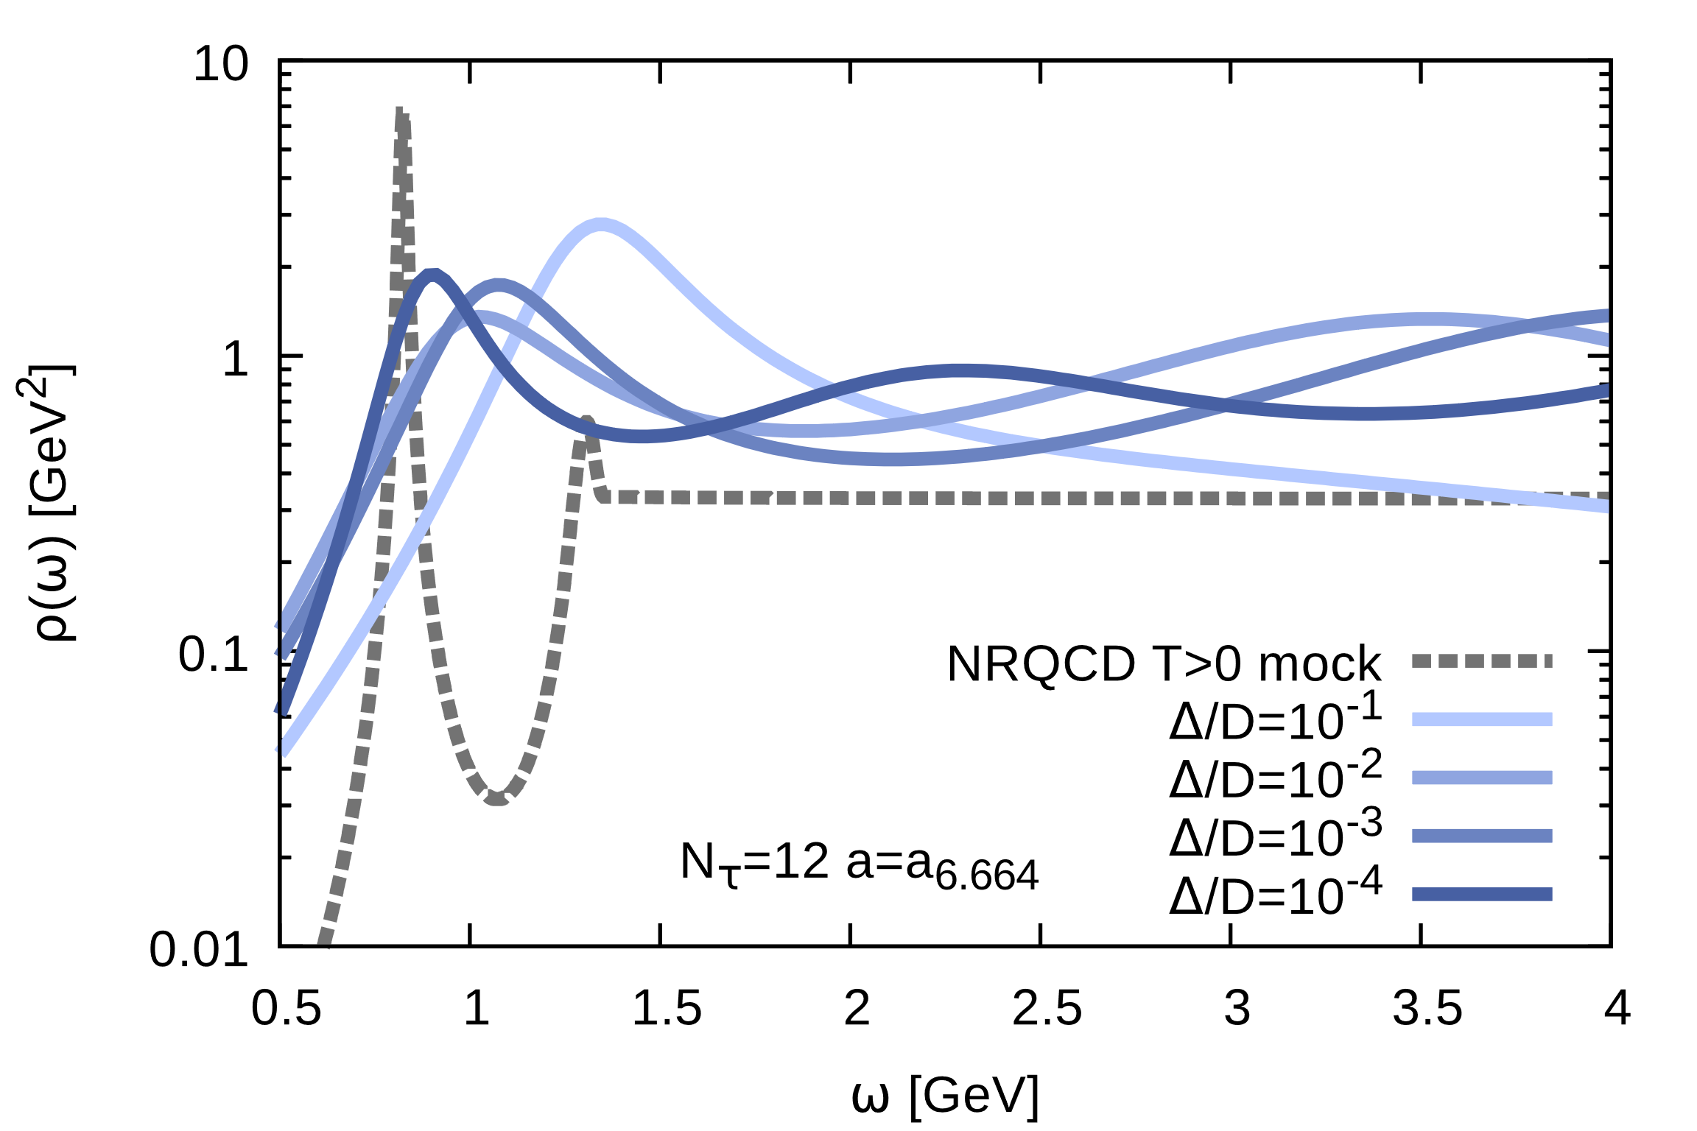
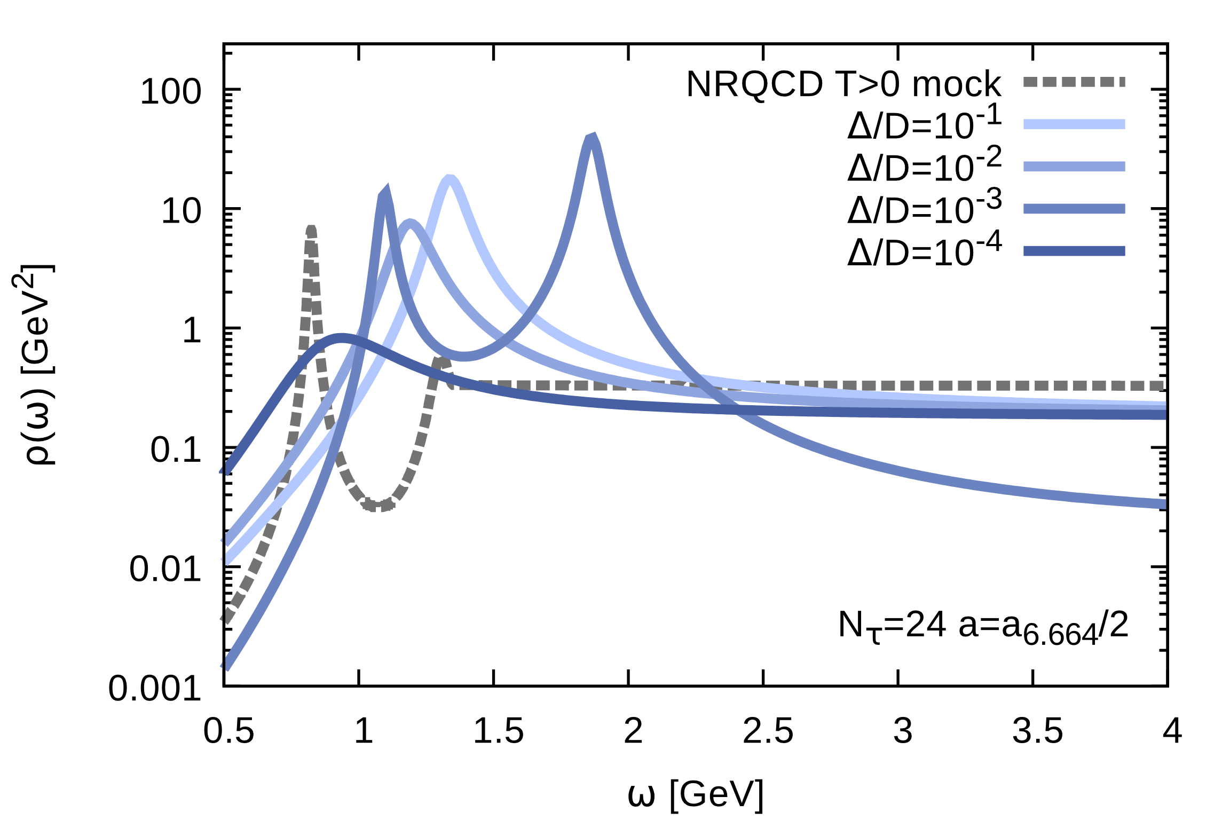
How to improve reconstructions?
Mock Test
N_{τ}=32
N_{τ}=64
Towards the continuum: no significant improvement of bound state reconstruction
Mock Test
N_{τ}=12
N_{τ}=24
With e.g. anisotropic lattices, the continuum will be better under control
Progress needs new ideas: e.g. full QCD multilevel algorithm.

Slide 12
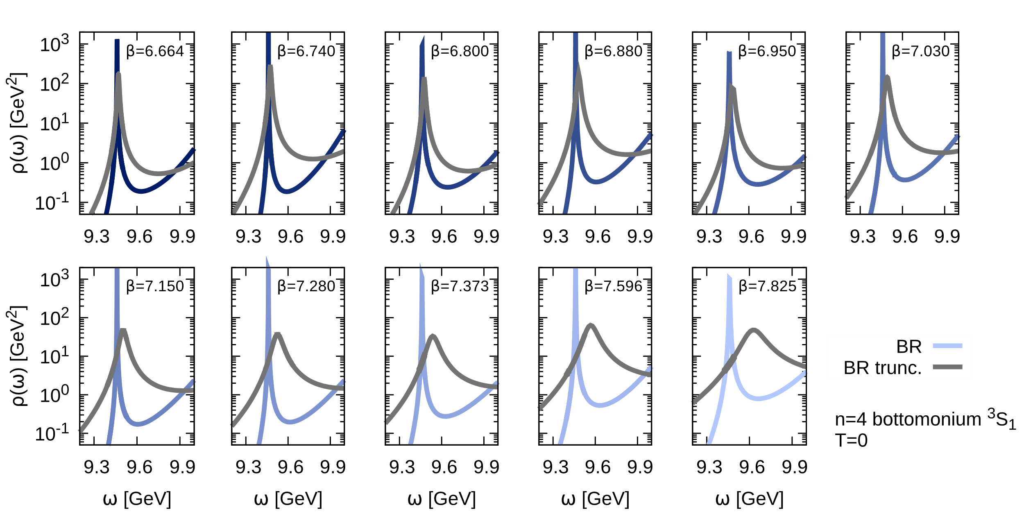
Towards finite temperature
“High-gain” BR method resolves T=0 ground state very well from N_{τ}=48-64 points
How does accuracy suffer from limited Euclidean extent at T>0 (N_{τ}=12) ?
Systematic shift of peaks to higher frequencies, as well as broadening.
needs to be accounted for when analyzing T>0 spectra

Slide 13
Outline
Numerical Setup (Lattice NRQCD)
Preparatory studies at T=0
In-medium properties of heavy quarkonium
Outlook and Conclusion

Slide 14
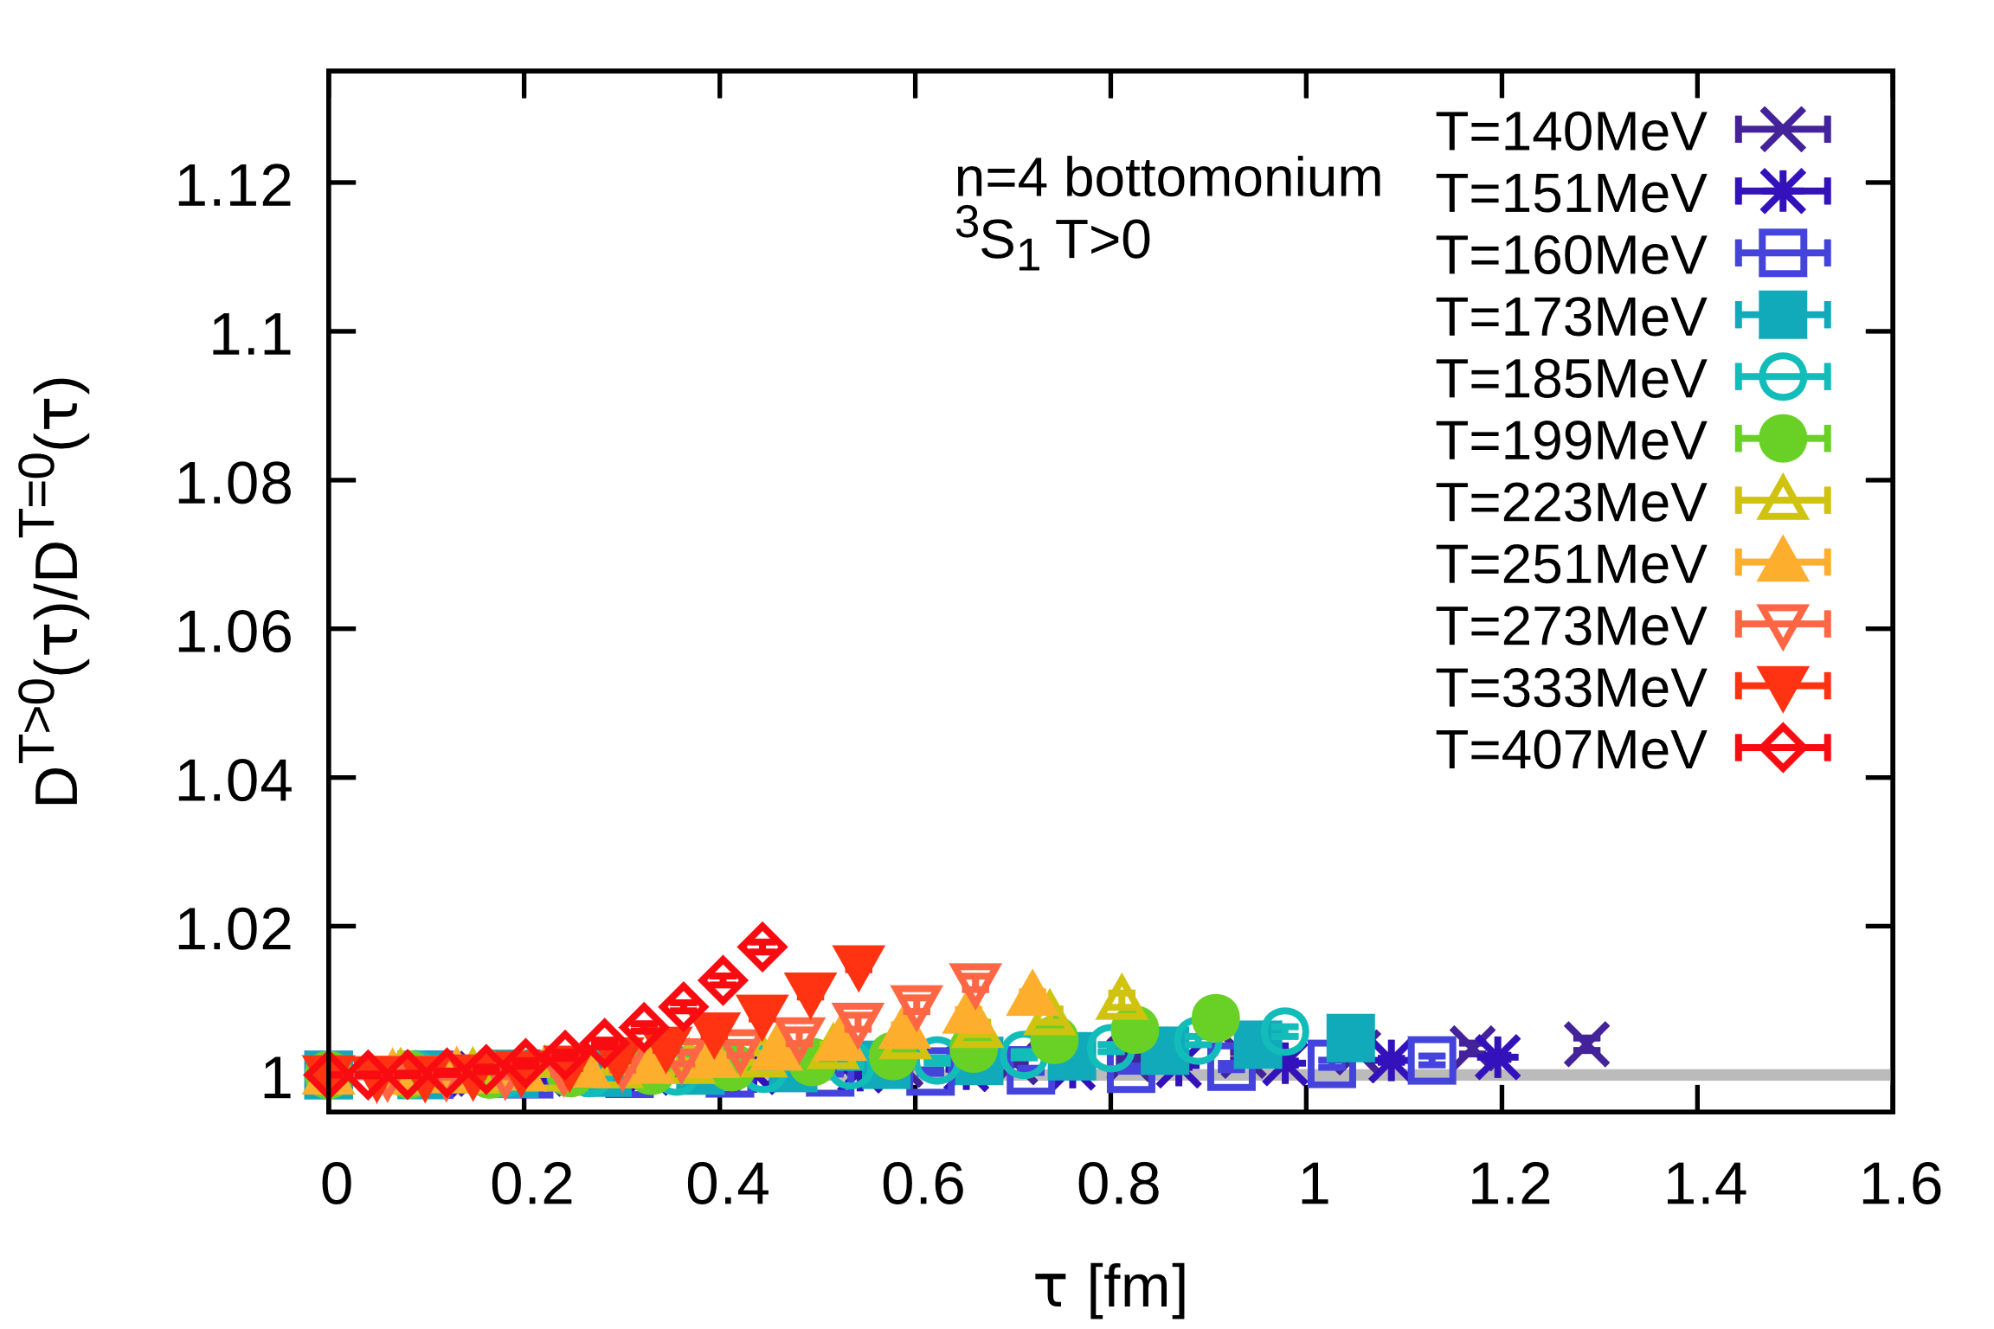
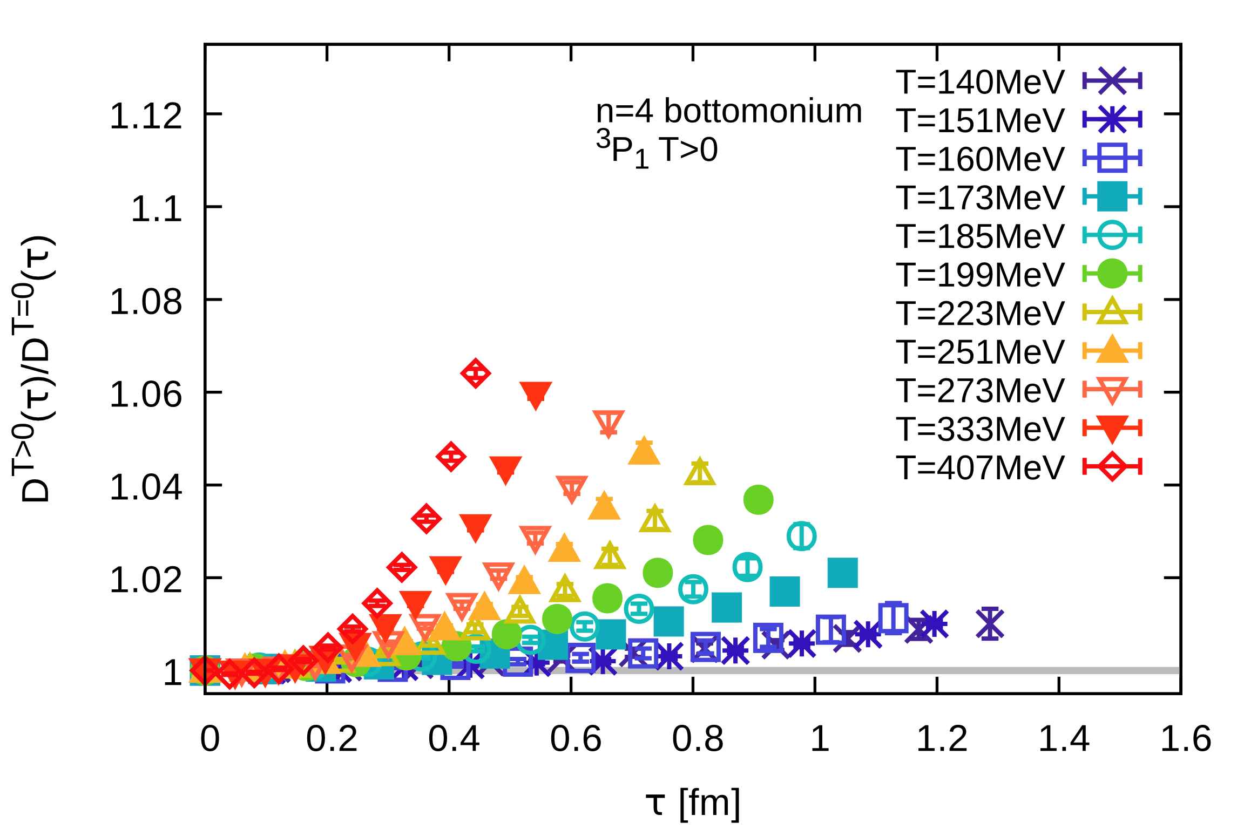
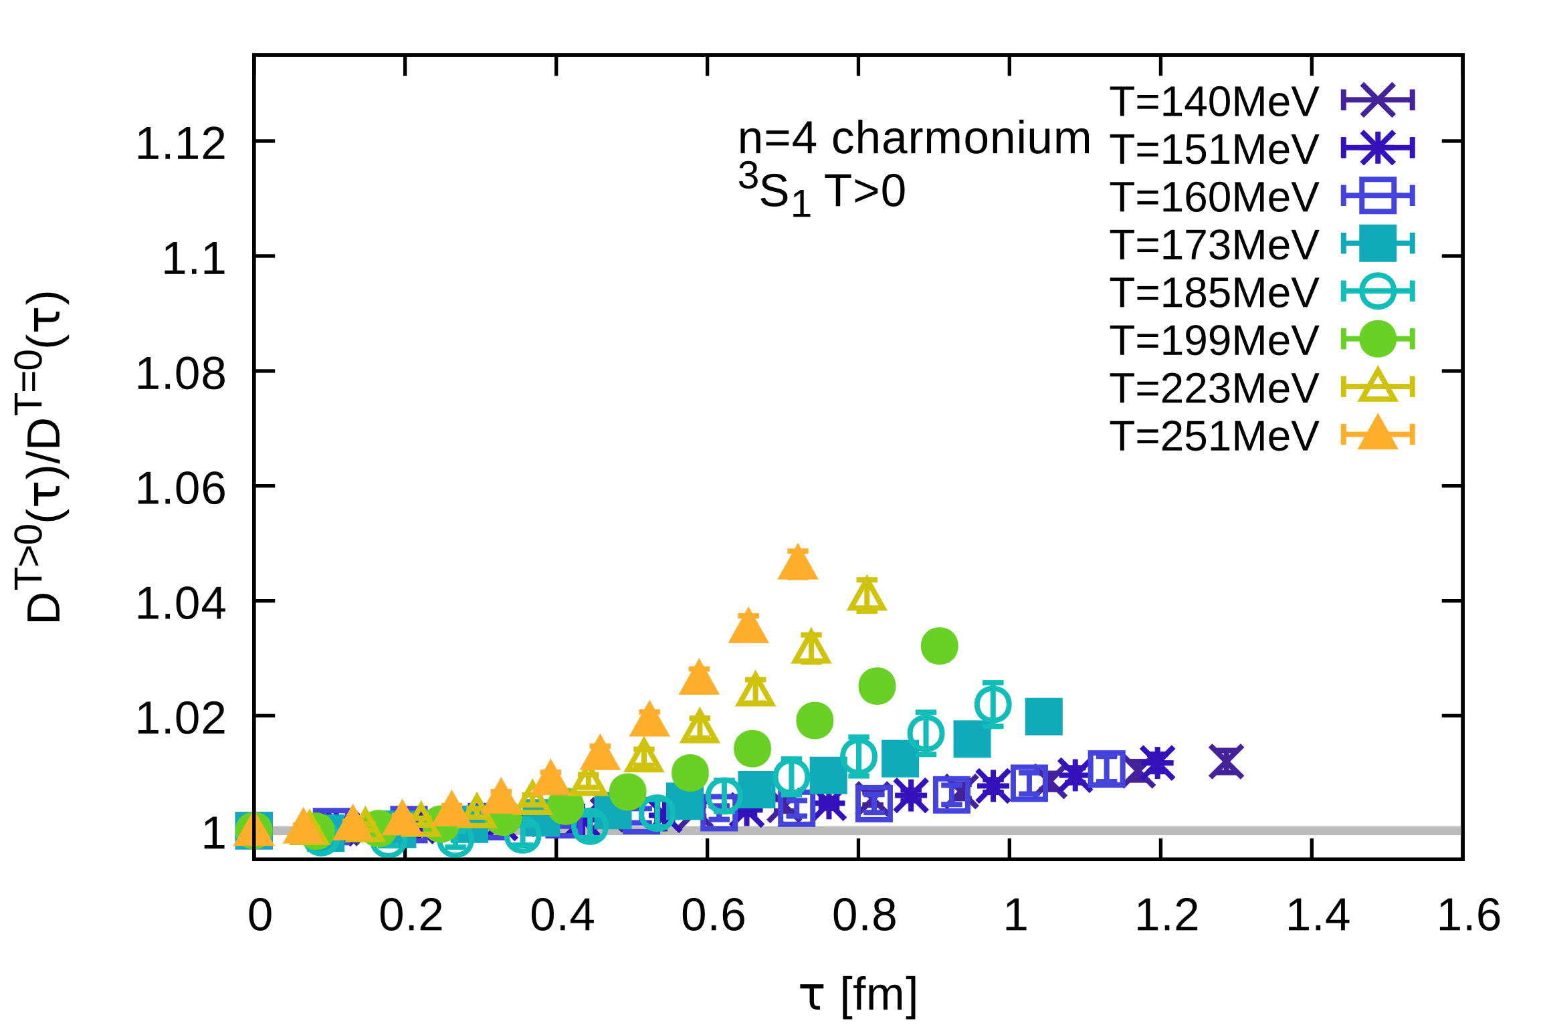
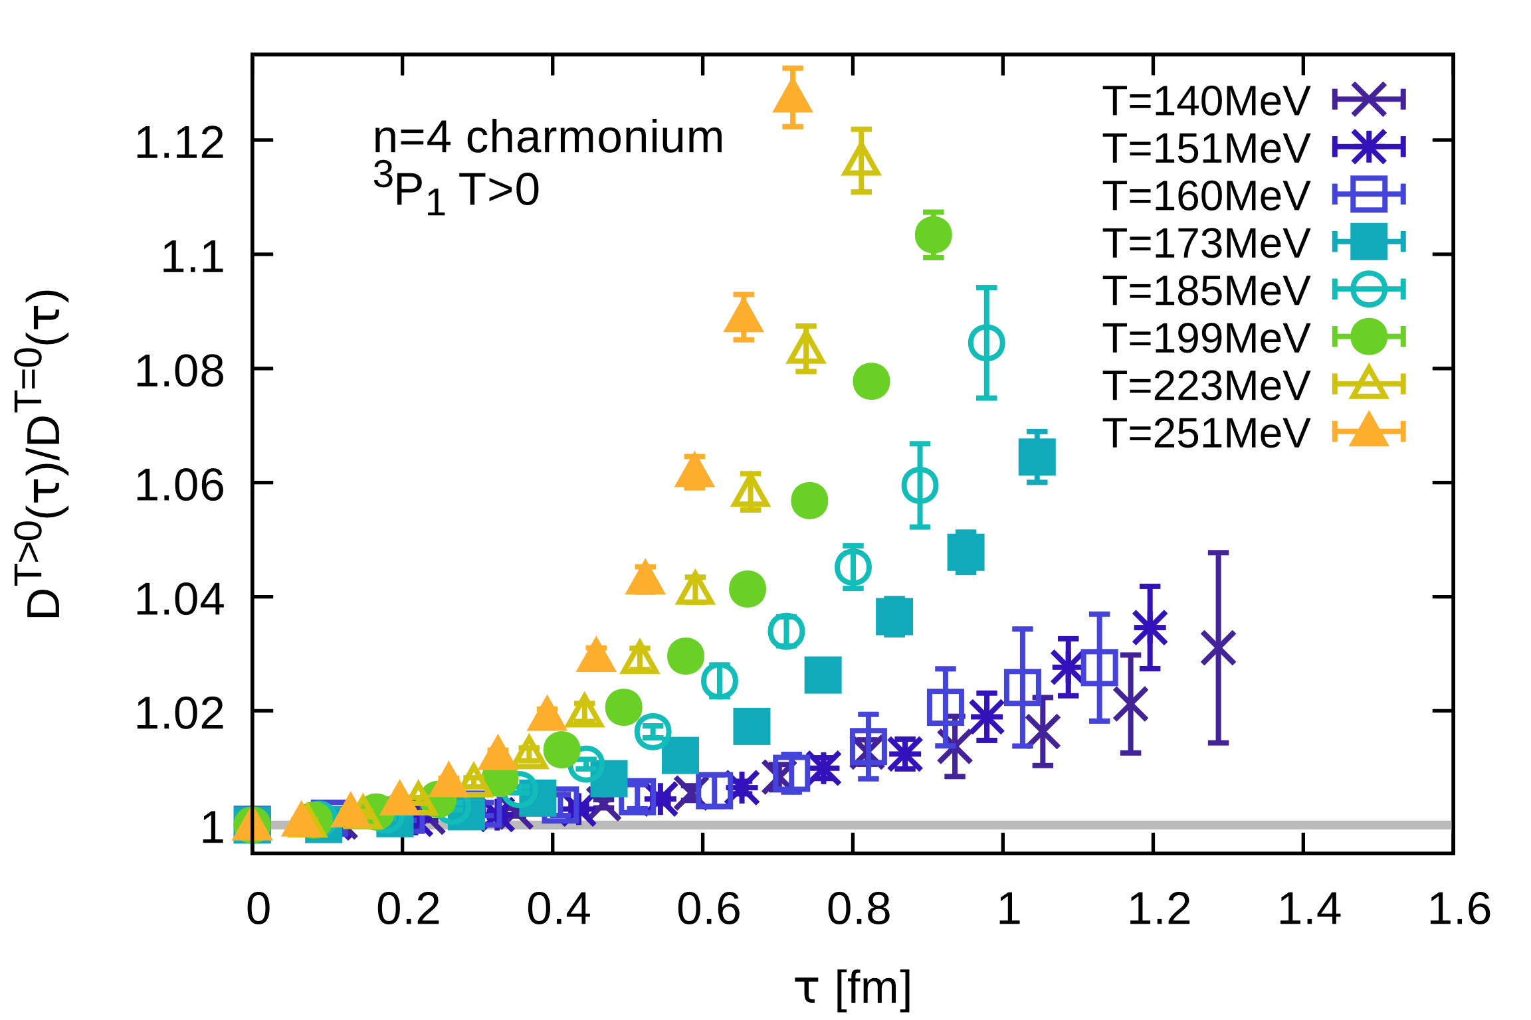
Correlator ratios
E_{bind} (T=0)~1.1GeV
E_{bind} (T=0)~640MeV
ϒ(1S)
6.5%@
407MeV
5%@
251MeV
1.75%@407MeV
χ_{b}(1P)
E_{bind} (T=0)~200MeV
J/ψ(1S)
Significant upward bent
in the QGP phase
5%@251MeV
13%@
251MeV
χ_{c}(1P)
Already in hadronic phase
deviations from unity
In-medium modification hierarchically ordered with vacuum binding energy

Slide 15
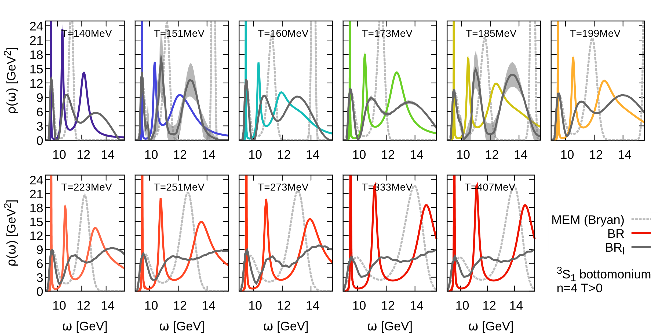
Bottomonium S-wave melting at T>0
Naïve definition of melting temperatures: disappearance of peak structures
ω[GeV]
ω[GeV]
ω[GeV]
Three methods: BR (colored), smooth BR (gray solid) & MEM (gray dashed)
All three methods show GS peak remnant at T=407 MeV

Slide 16
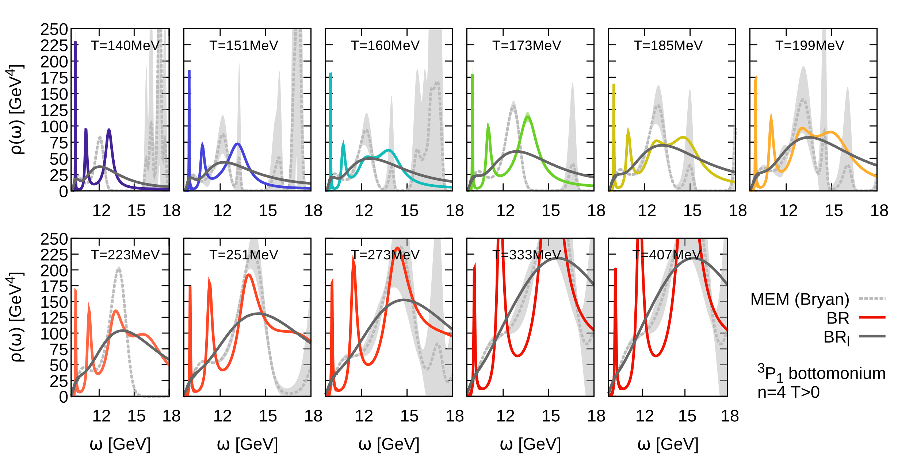
Bottomonium P-wave melting at T>0
ω[GeV]
ω[GeV]
ω[GeV]
Three methods: BR (colored), smooth BR (gray solid) & MEM (gray dashed)
At T=199MeV: all methods show remnant structure (threshold enhancement?)
For 199<T<233MeV: only original BR shows peak (amplitude higher than next structure)
For T>233MeV: lowest peak in original BR smaller than next, most likely ringing

Slide 17
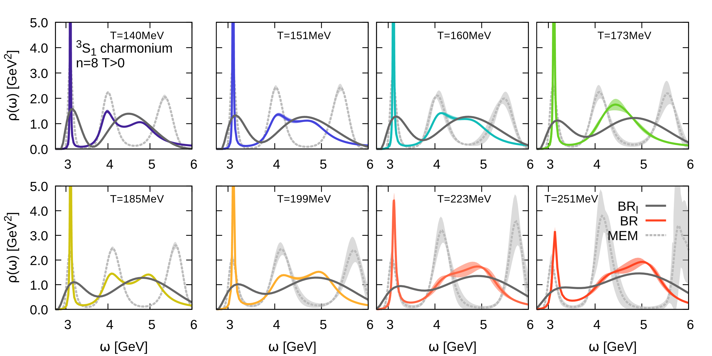
Charmonium S-wave melting at T>0
ω[GeV]
ω[GeV]
ω[GeV]
Three methods: BR (colored), smooth BR (gray solid) & MEM (gray dashed)
MEM and BR find peak at T=251MeV, smooth BR washed out at T>200MeV

Slide 18
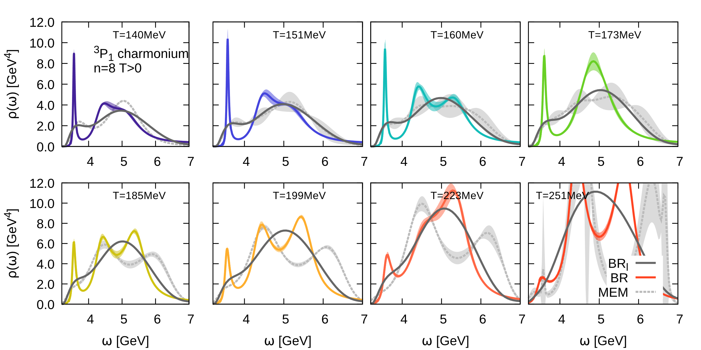
Charmonium P-wave melting at T>0
ω[GeV]
ω[GeV]
ω[GeV]
Three methods: BR (colored), smooth BR (gray solid) & MEM (gray dashed)
At T<185MeV: all methods show remnant structure (threshold enhancement?)
For T=185MeV: only original BR shows peak (amplitude higher than next structure)
For T>185MeV: lowest peak in original BR smaller than next, most likely ringing

Slide 19
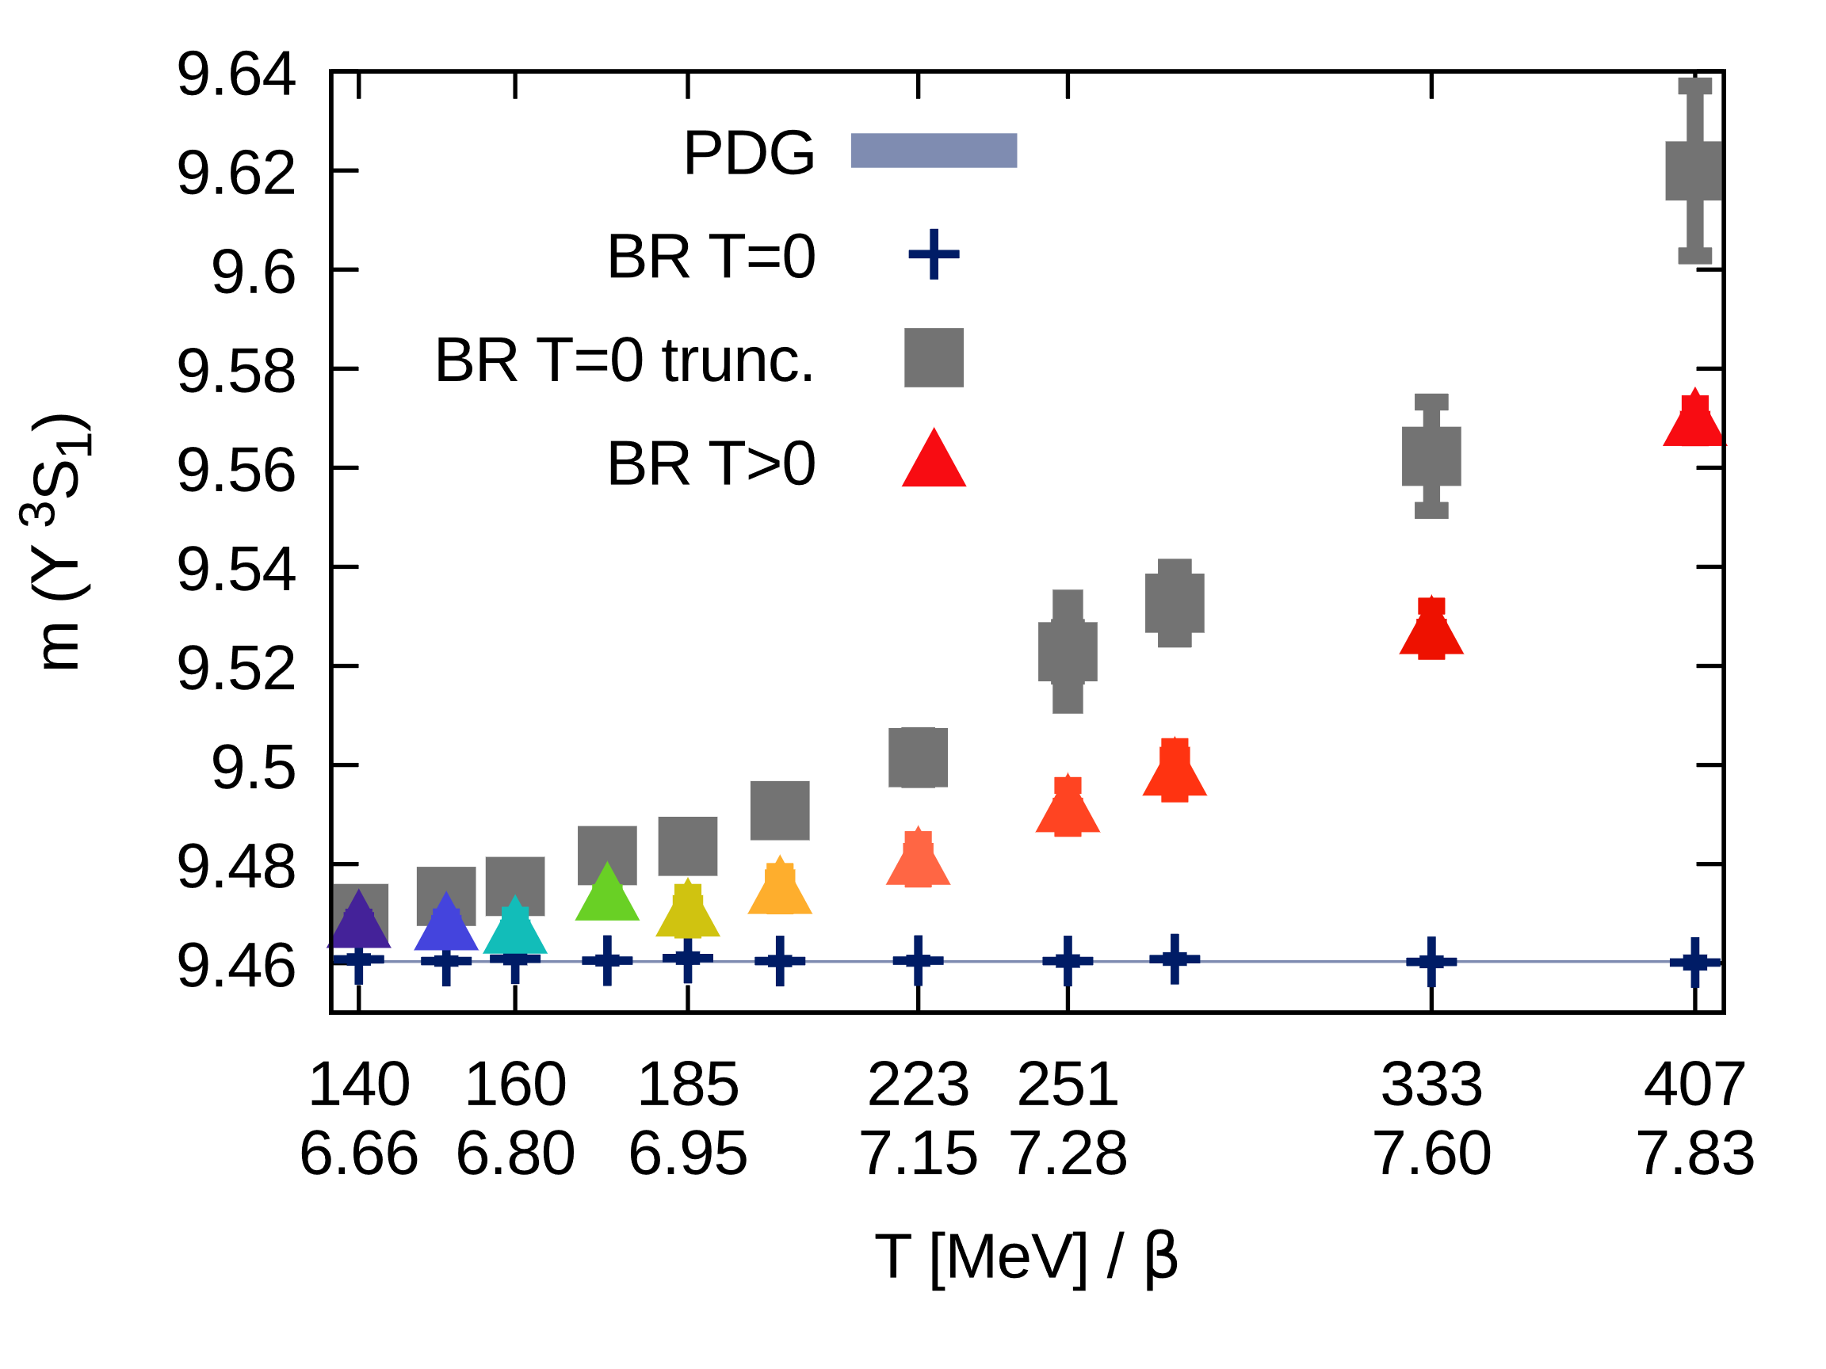
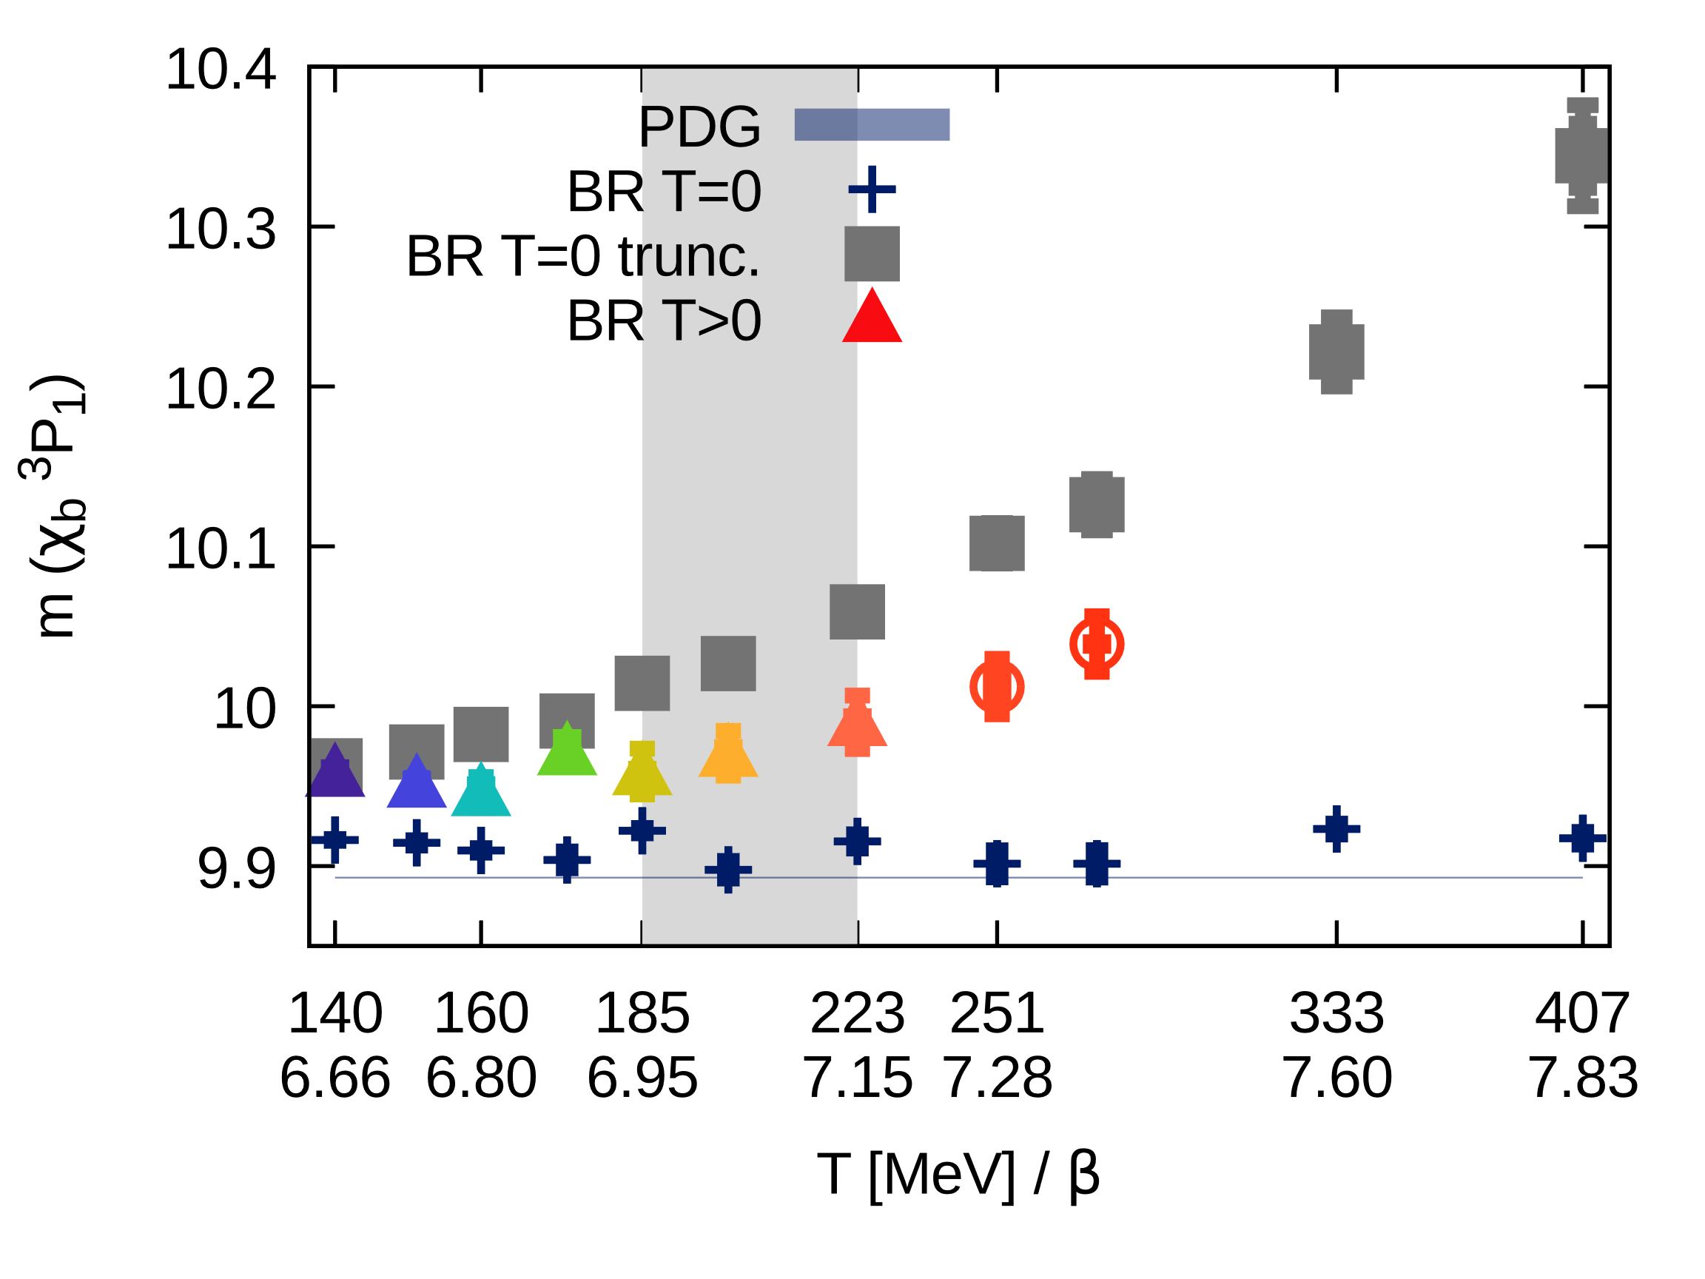
In-medium mass shifts
Need to establish correct baseline to compare in-medium masses to
Region of
melting
Truncated T=0 reconstruction shows artificial shift to higher frequencies (gray sq.)
In-medium shifts at T=140MeV very close to truncated results (no in-medium mod.)
At higher temperatures masses lie clearly below the baseline
(compatible with non-perturbative potential based computations (pNRQCD))

Slide 20
Conclusion
Lattice NRQCD accurate & precise tool for the study of T>0 quarkonium
Technical progress underlying this study:
Significantly increased statistics, larger T regime, inclusion of charm quarks
Novel smooth BR method, successful in combating ringing artifacts
Updated and new results:
Verified hierarchical T>0 modification of correlators according to vacuum E_{bind}
Revised melting temperatures through additional smooth BR analysis
First quantitative determination of in-­medium shifts to lower masses
Need for genuine improved methods to push analysis forward
Go raibh maith agat as do aird - Thank you for your attention

Slide 21
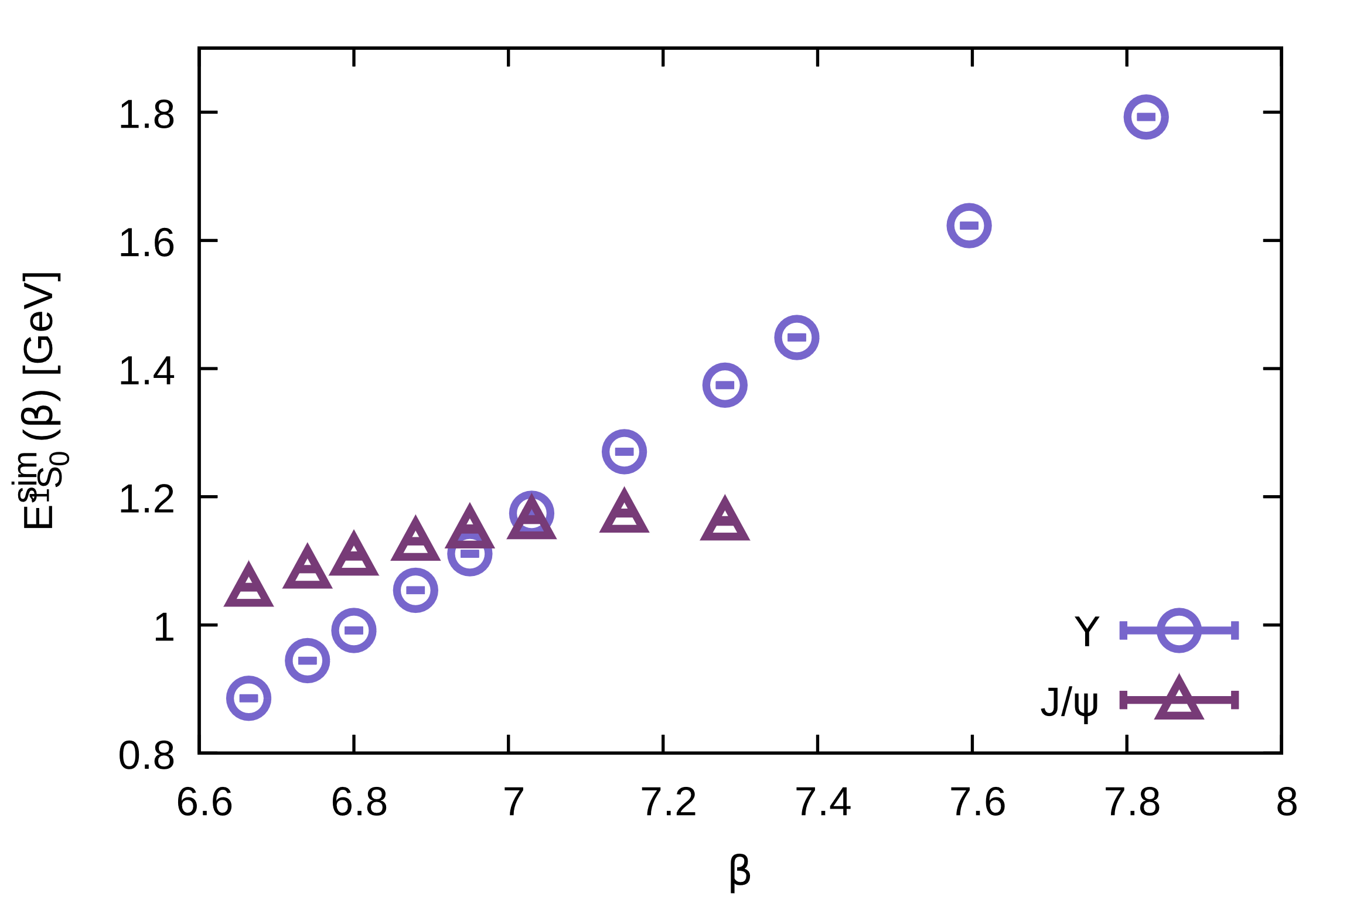
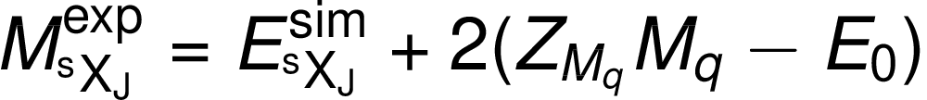
Energy calibration
In NRQCD energy needs extra calibration (shift by 2m_{q}):
Use PDG value for
S-wave ground state
Notes:
M_{\rm ^sX_J}^{\rm exp} = E^{\rm sim}_{\rm ^sX_J} + 2 (Z_{M_q} M_q - E_0)

Slide 22
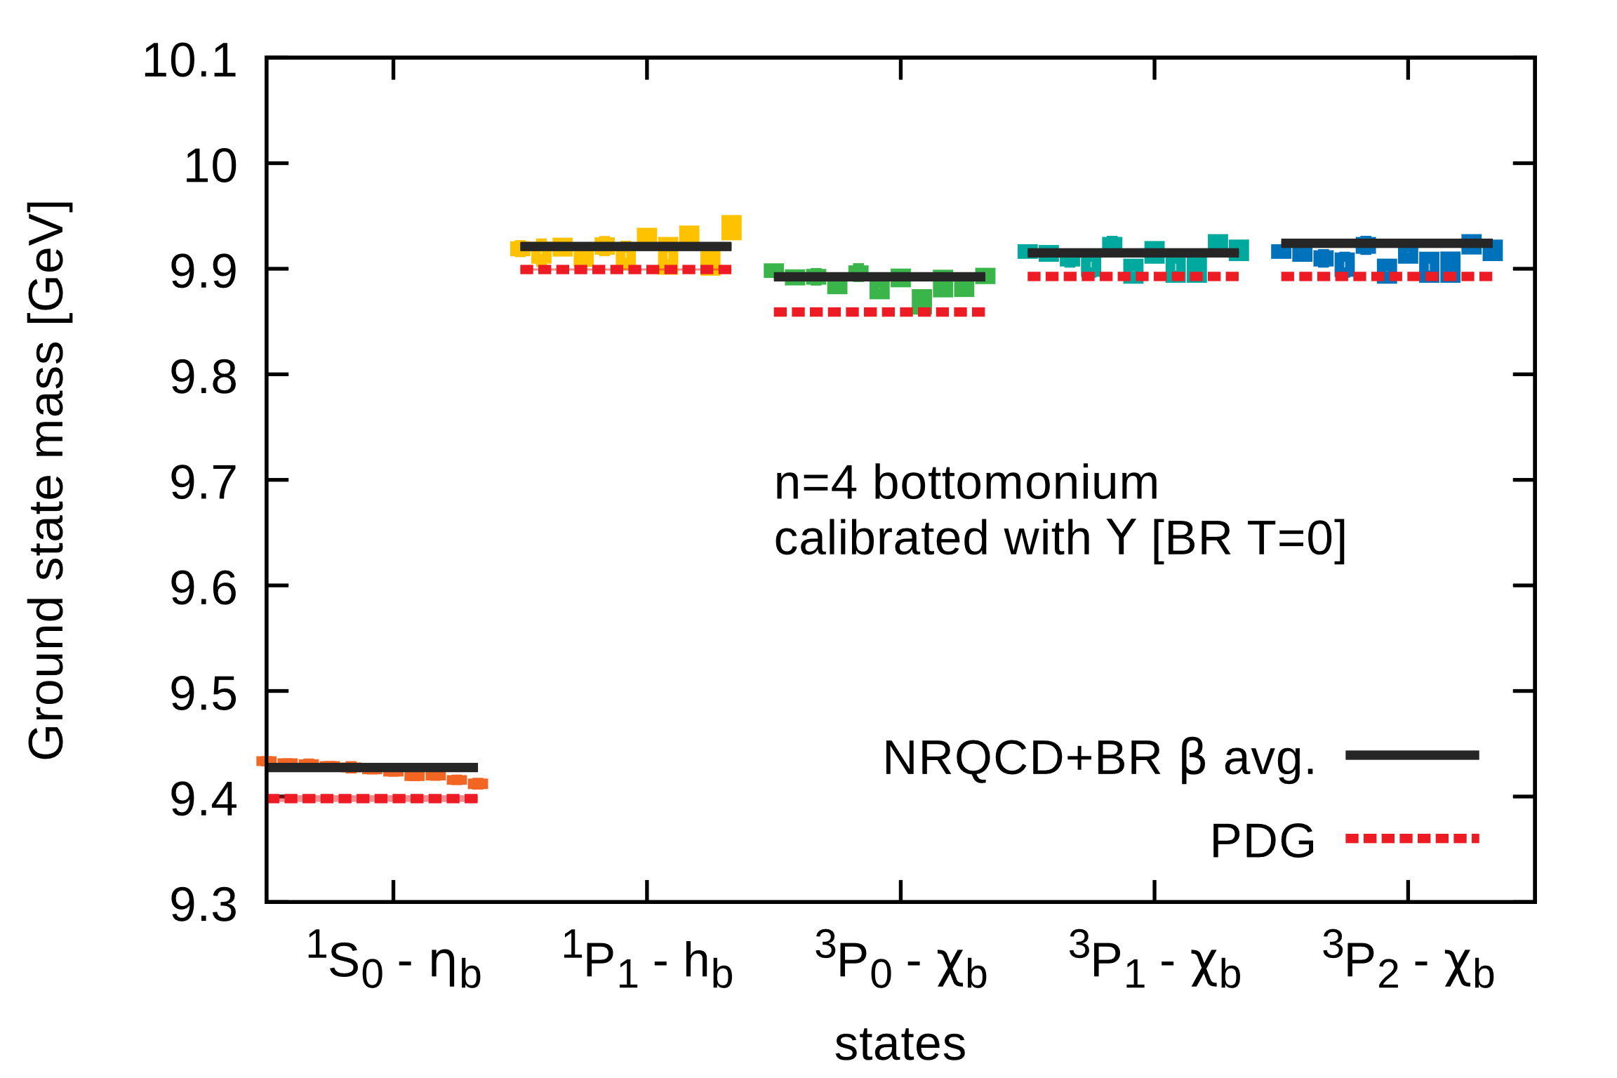
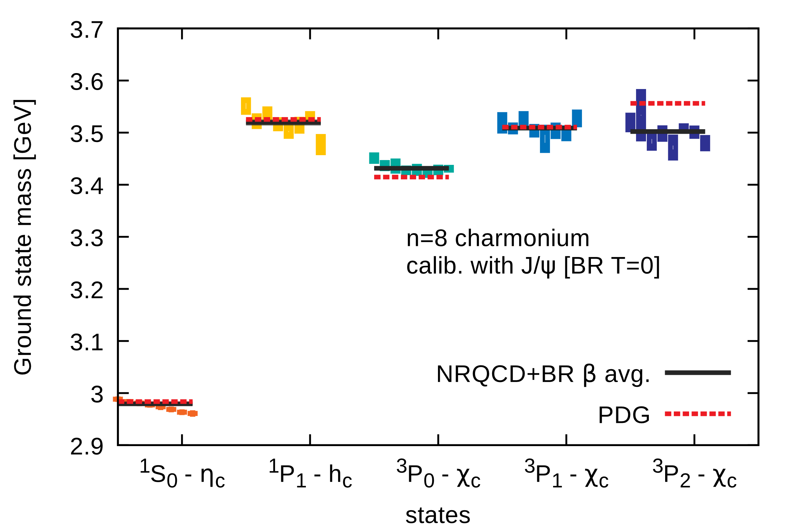
T=0 spectral reconstructions
Reconstruction parameters:
N_{ω}=2000 frequency bins, ωa=[-5,20]
N_{ω}=600 bin high res. interval around GS peak
m(ω)=const. statistical errors from 10-bin jackknife
systematic errors from variation of default model
varying reconstructed peak heights since N_{τ} different
GS peak position agree among effective mass fit and BR reconstruction

Slide 23
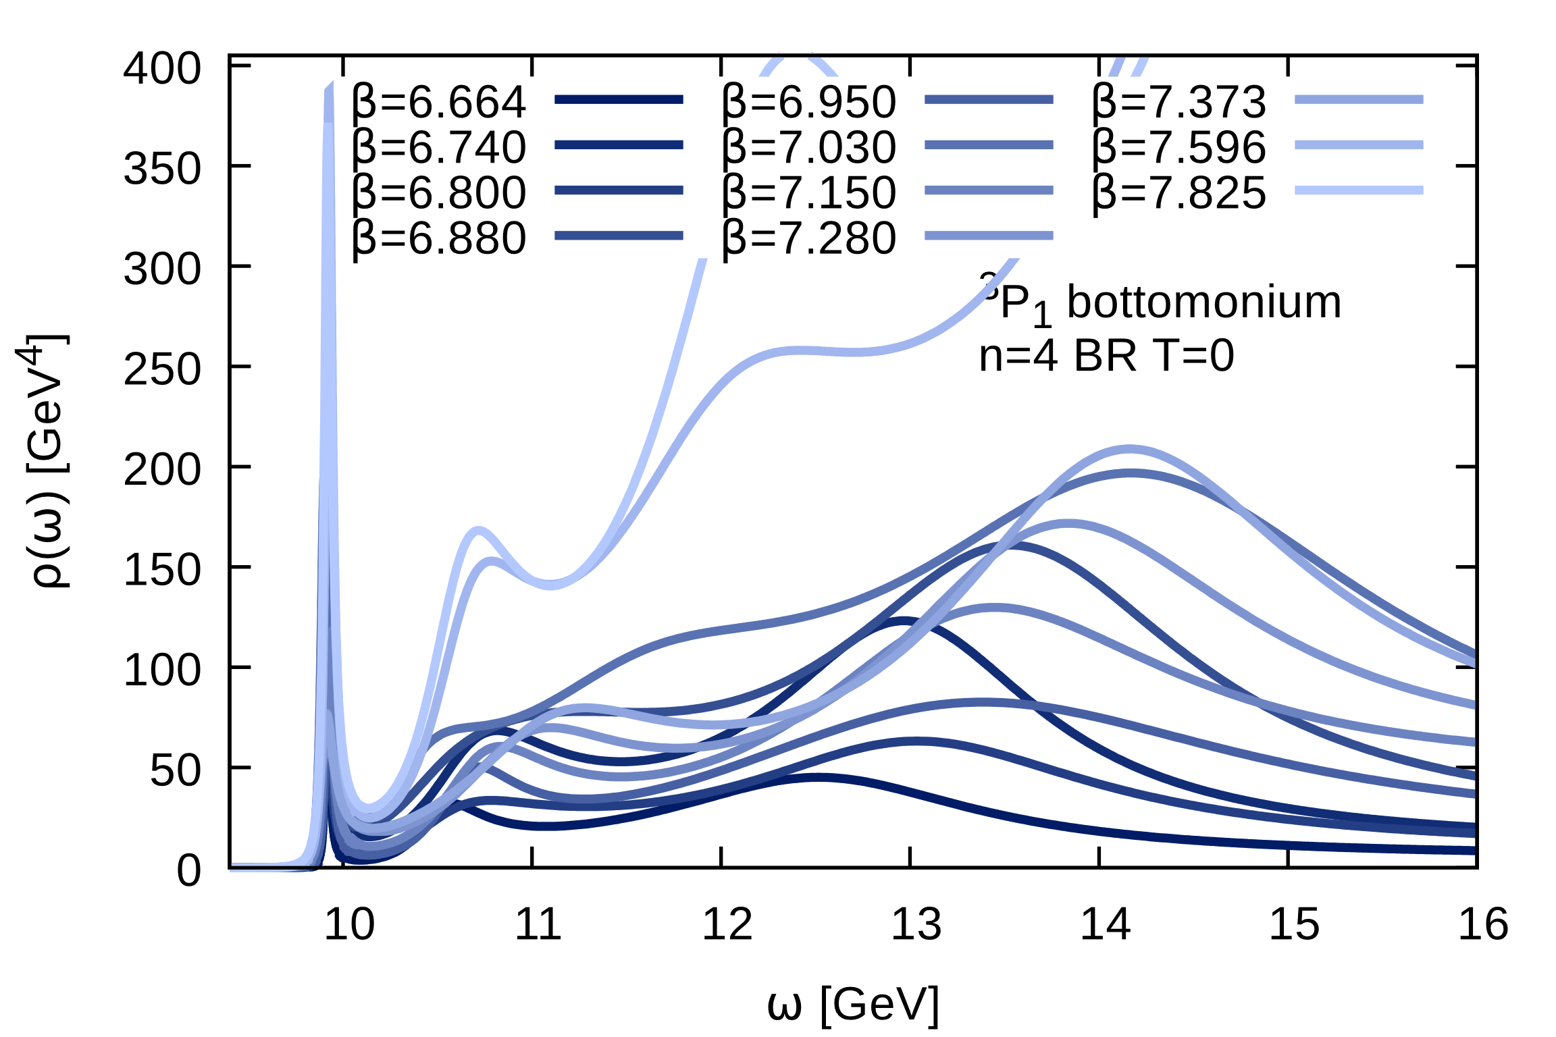
T=0 spectral reconstructions
Reconstruction parameters:
N_{ω}=2000 frequency bins, ωa=[-5,20]
N_{ω}=600 bin high res. interval around GS peak
m(ω)=const. statistical errors from 10-bin jackknife
systematic errors from variation of default model
Combined Euclidean and imaginary frequency data: less ringing at large ω
GS peak position agree among effective mass fit and BR reconstruction

Slide 24
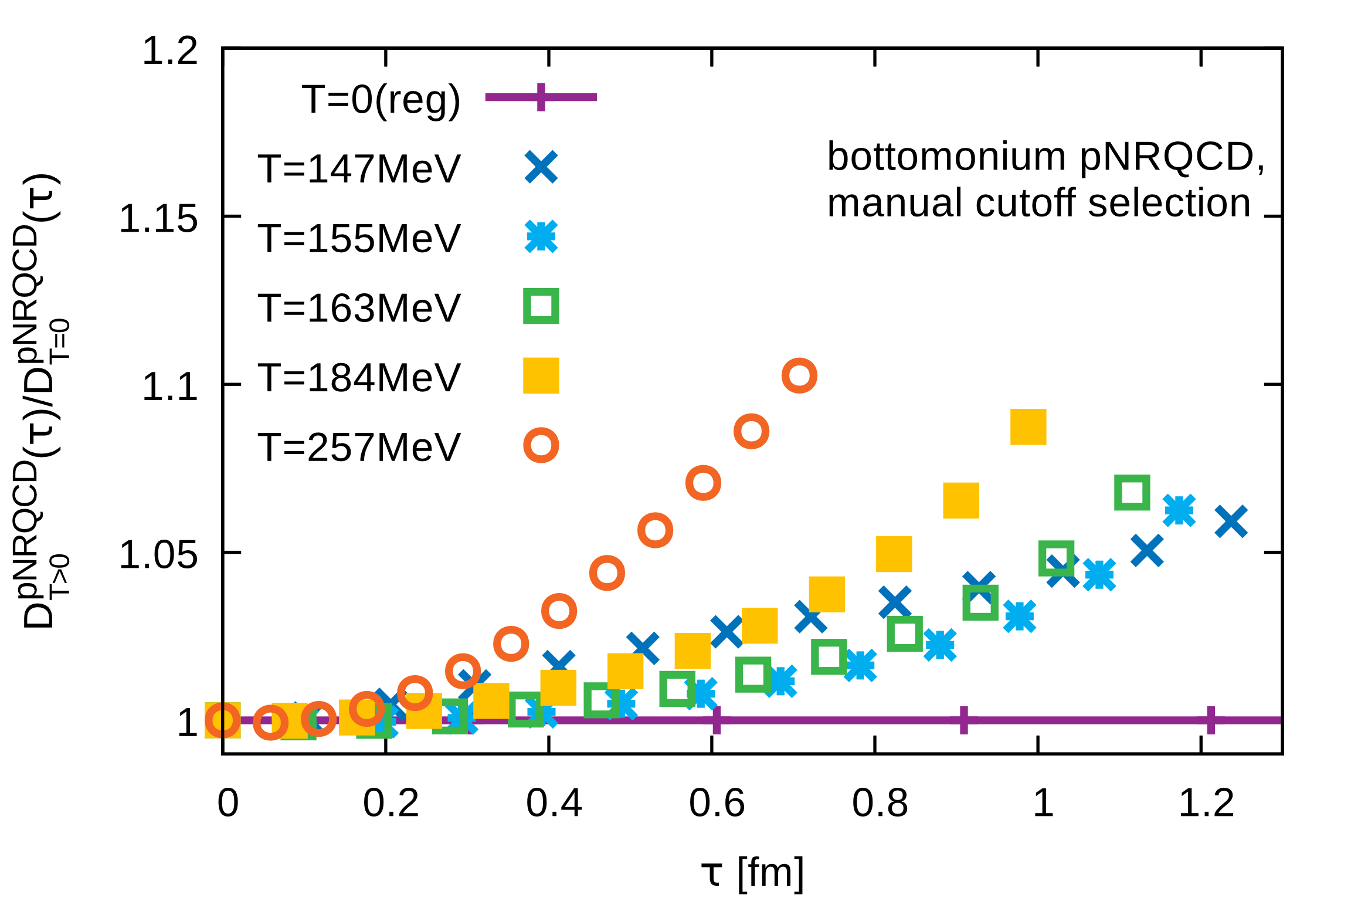
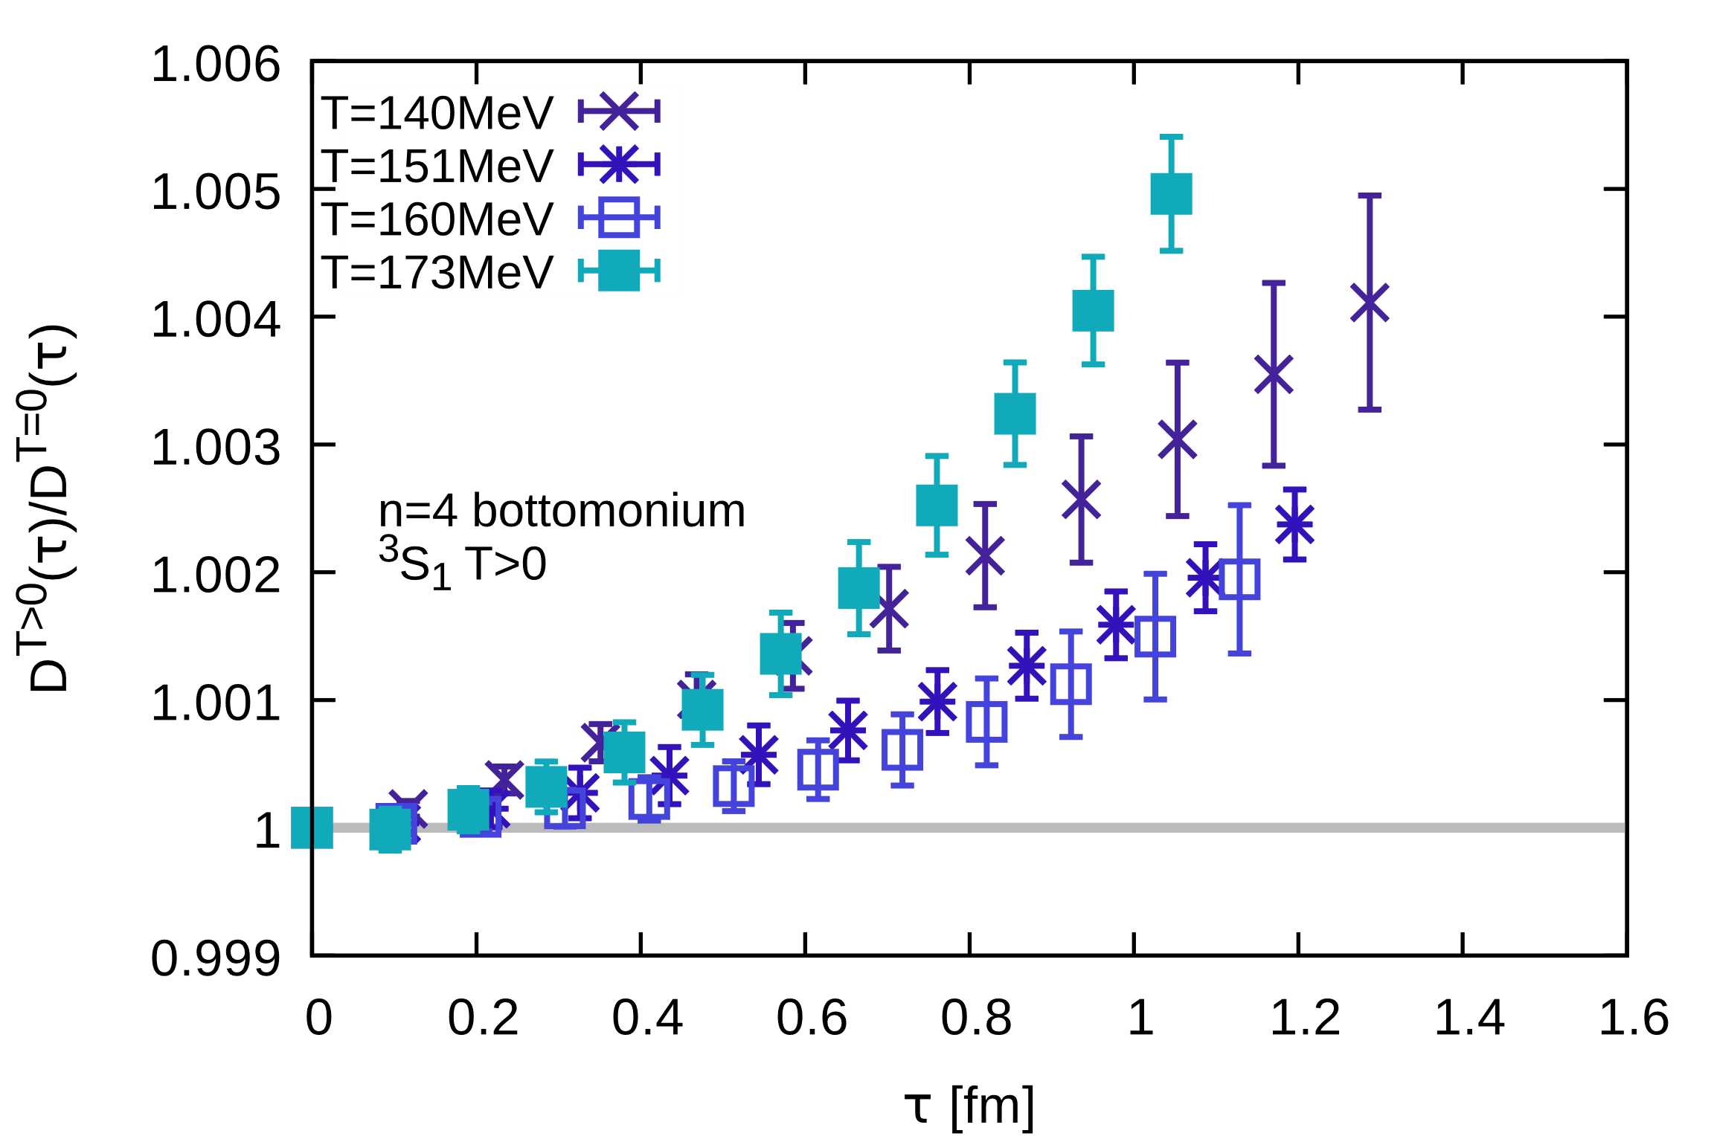
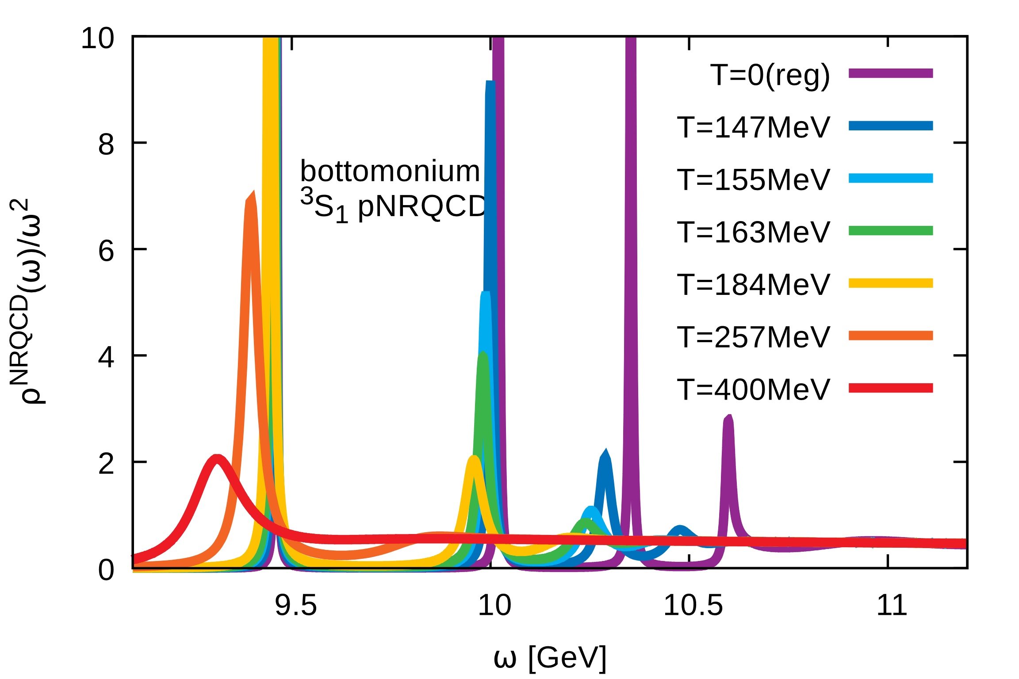
Interpreting the ratios
Behavior in ratios qualitatively reproduced by potential based computation
Lattice QCD potential based computation
Strong upward bend: ground state moves
to smaller mass
Lattice NRQCD
Non-monotonicity only in the Bottomonium
S-wave: destabilization of excited states

Slide 25
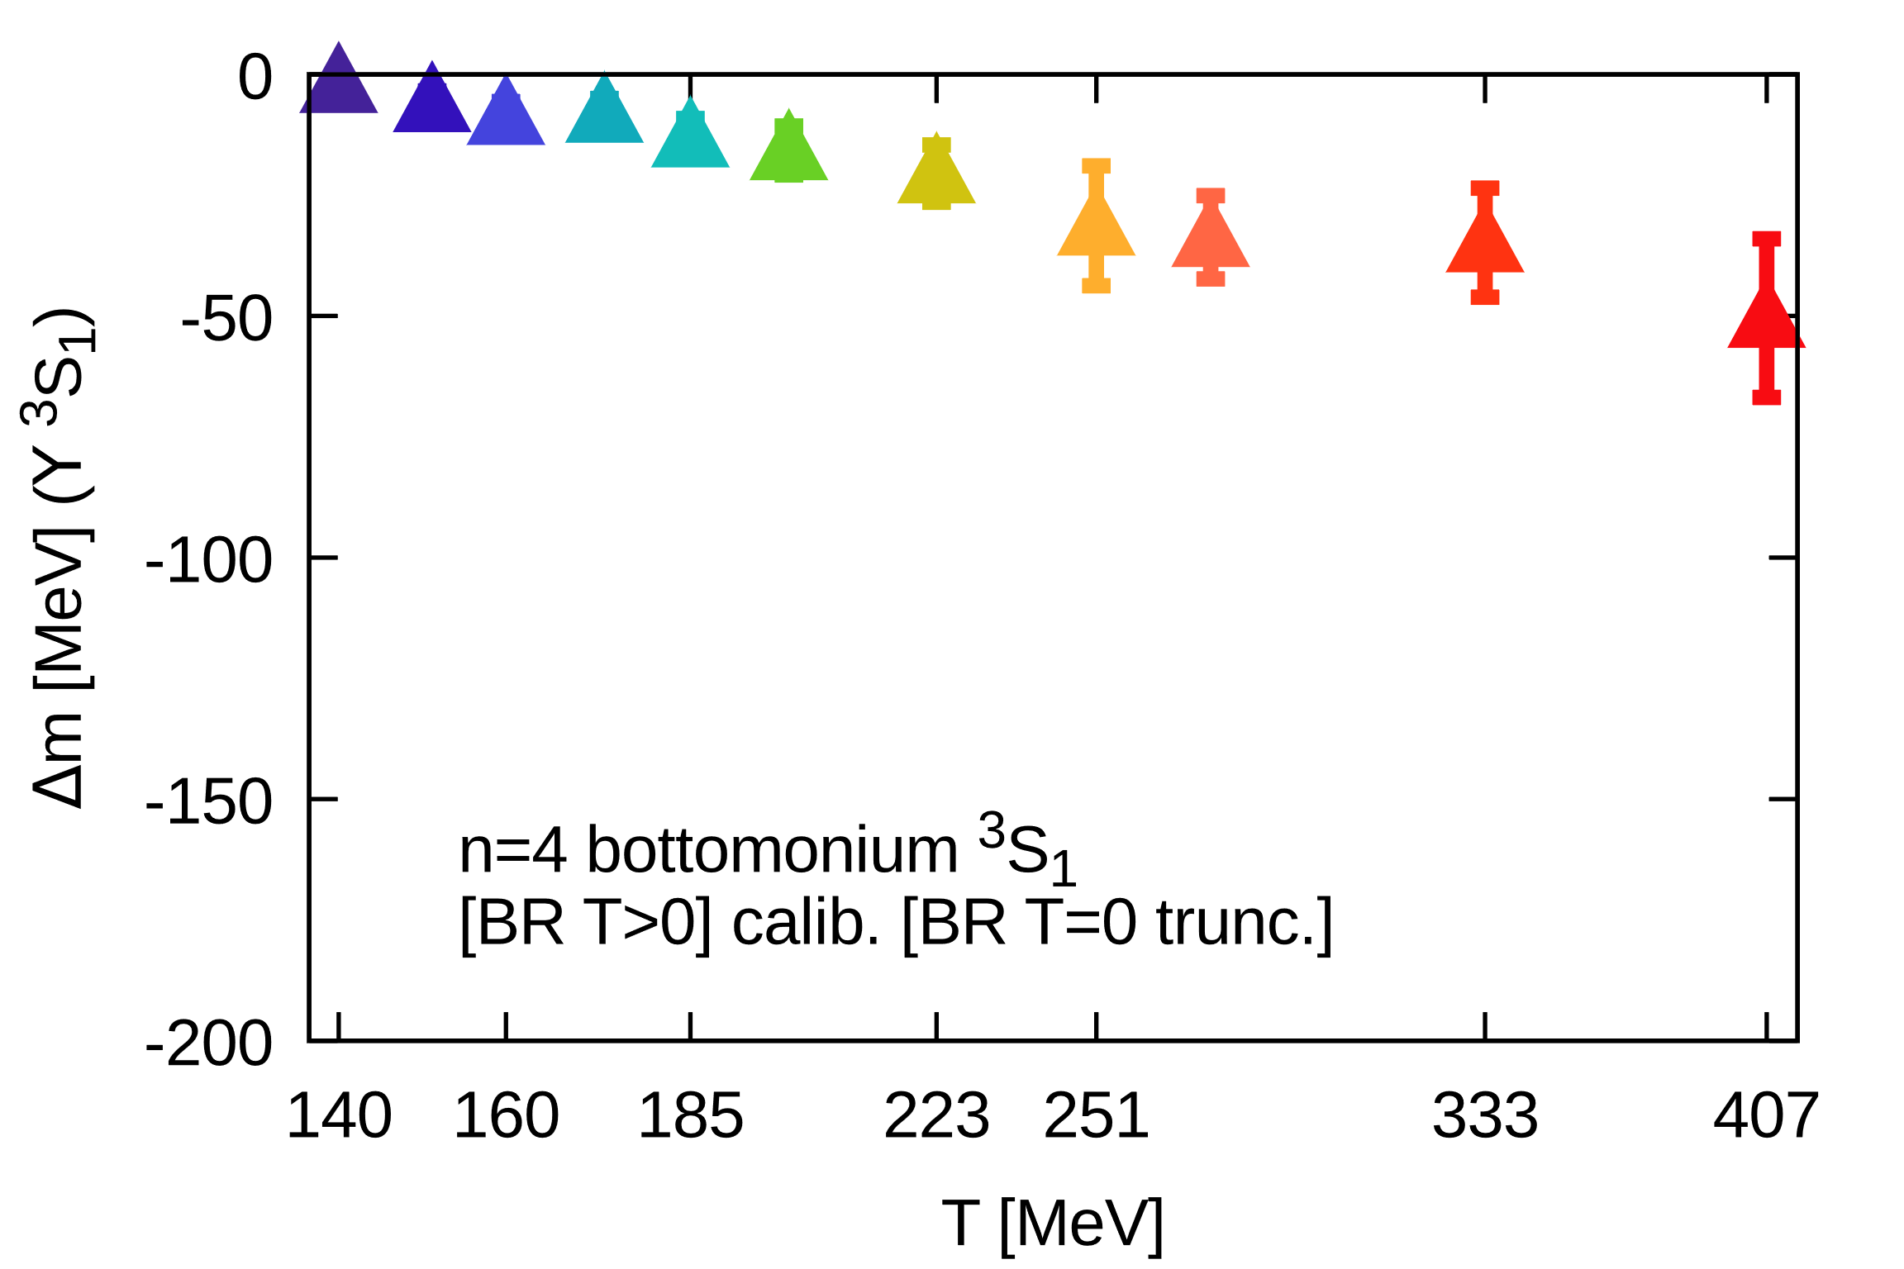
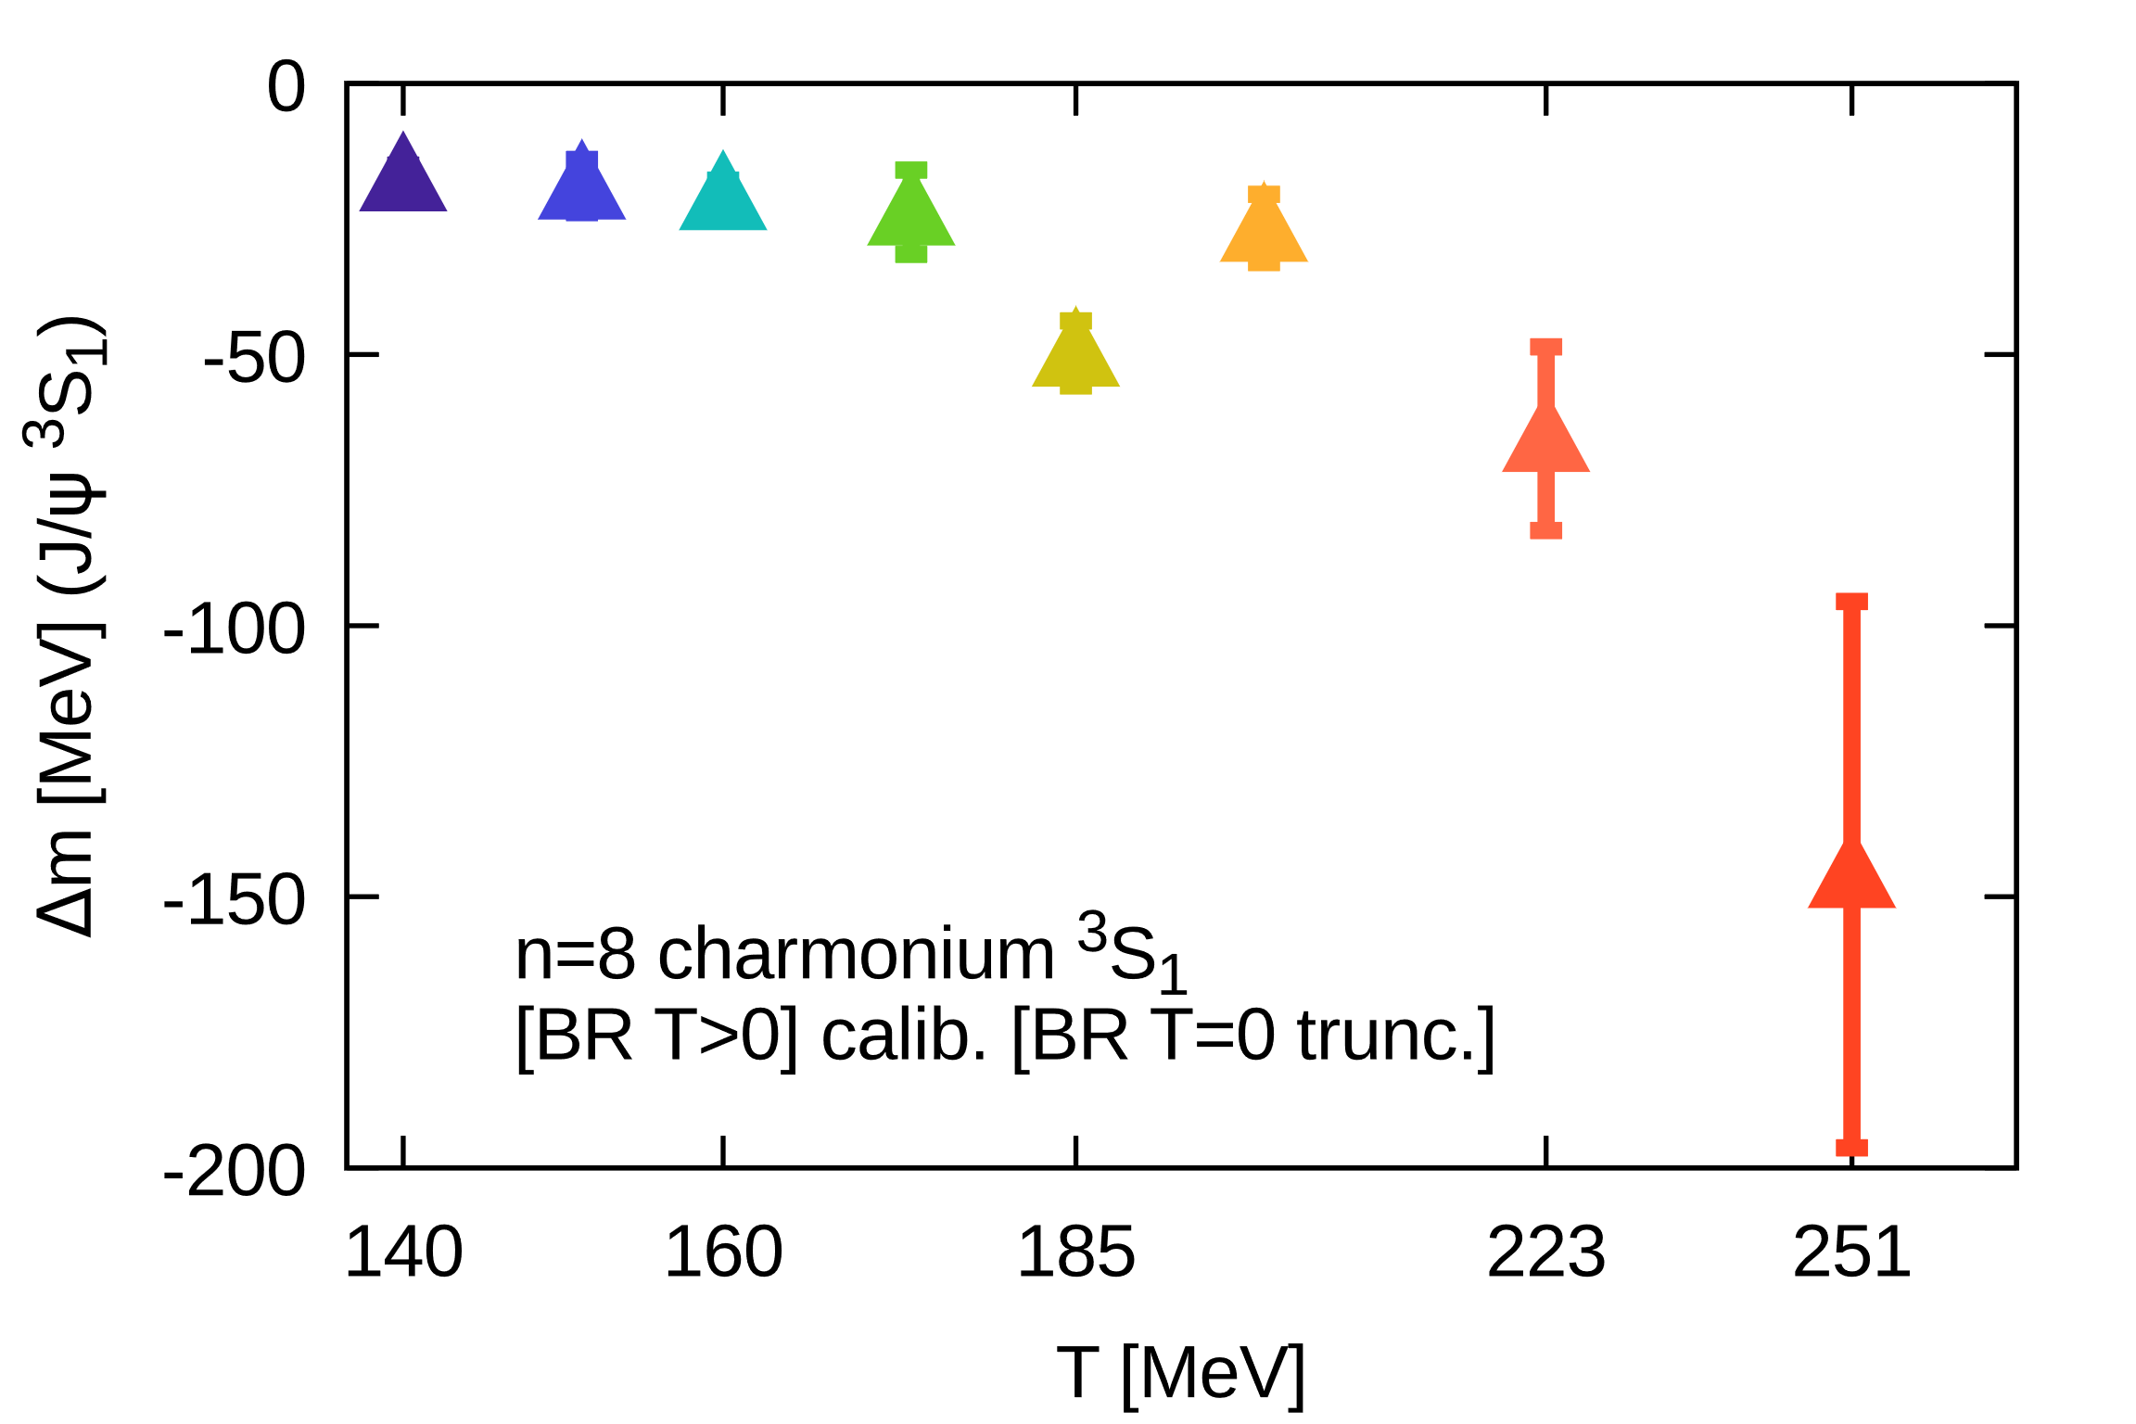
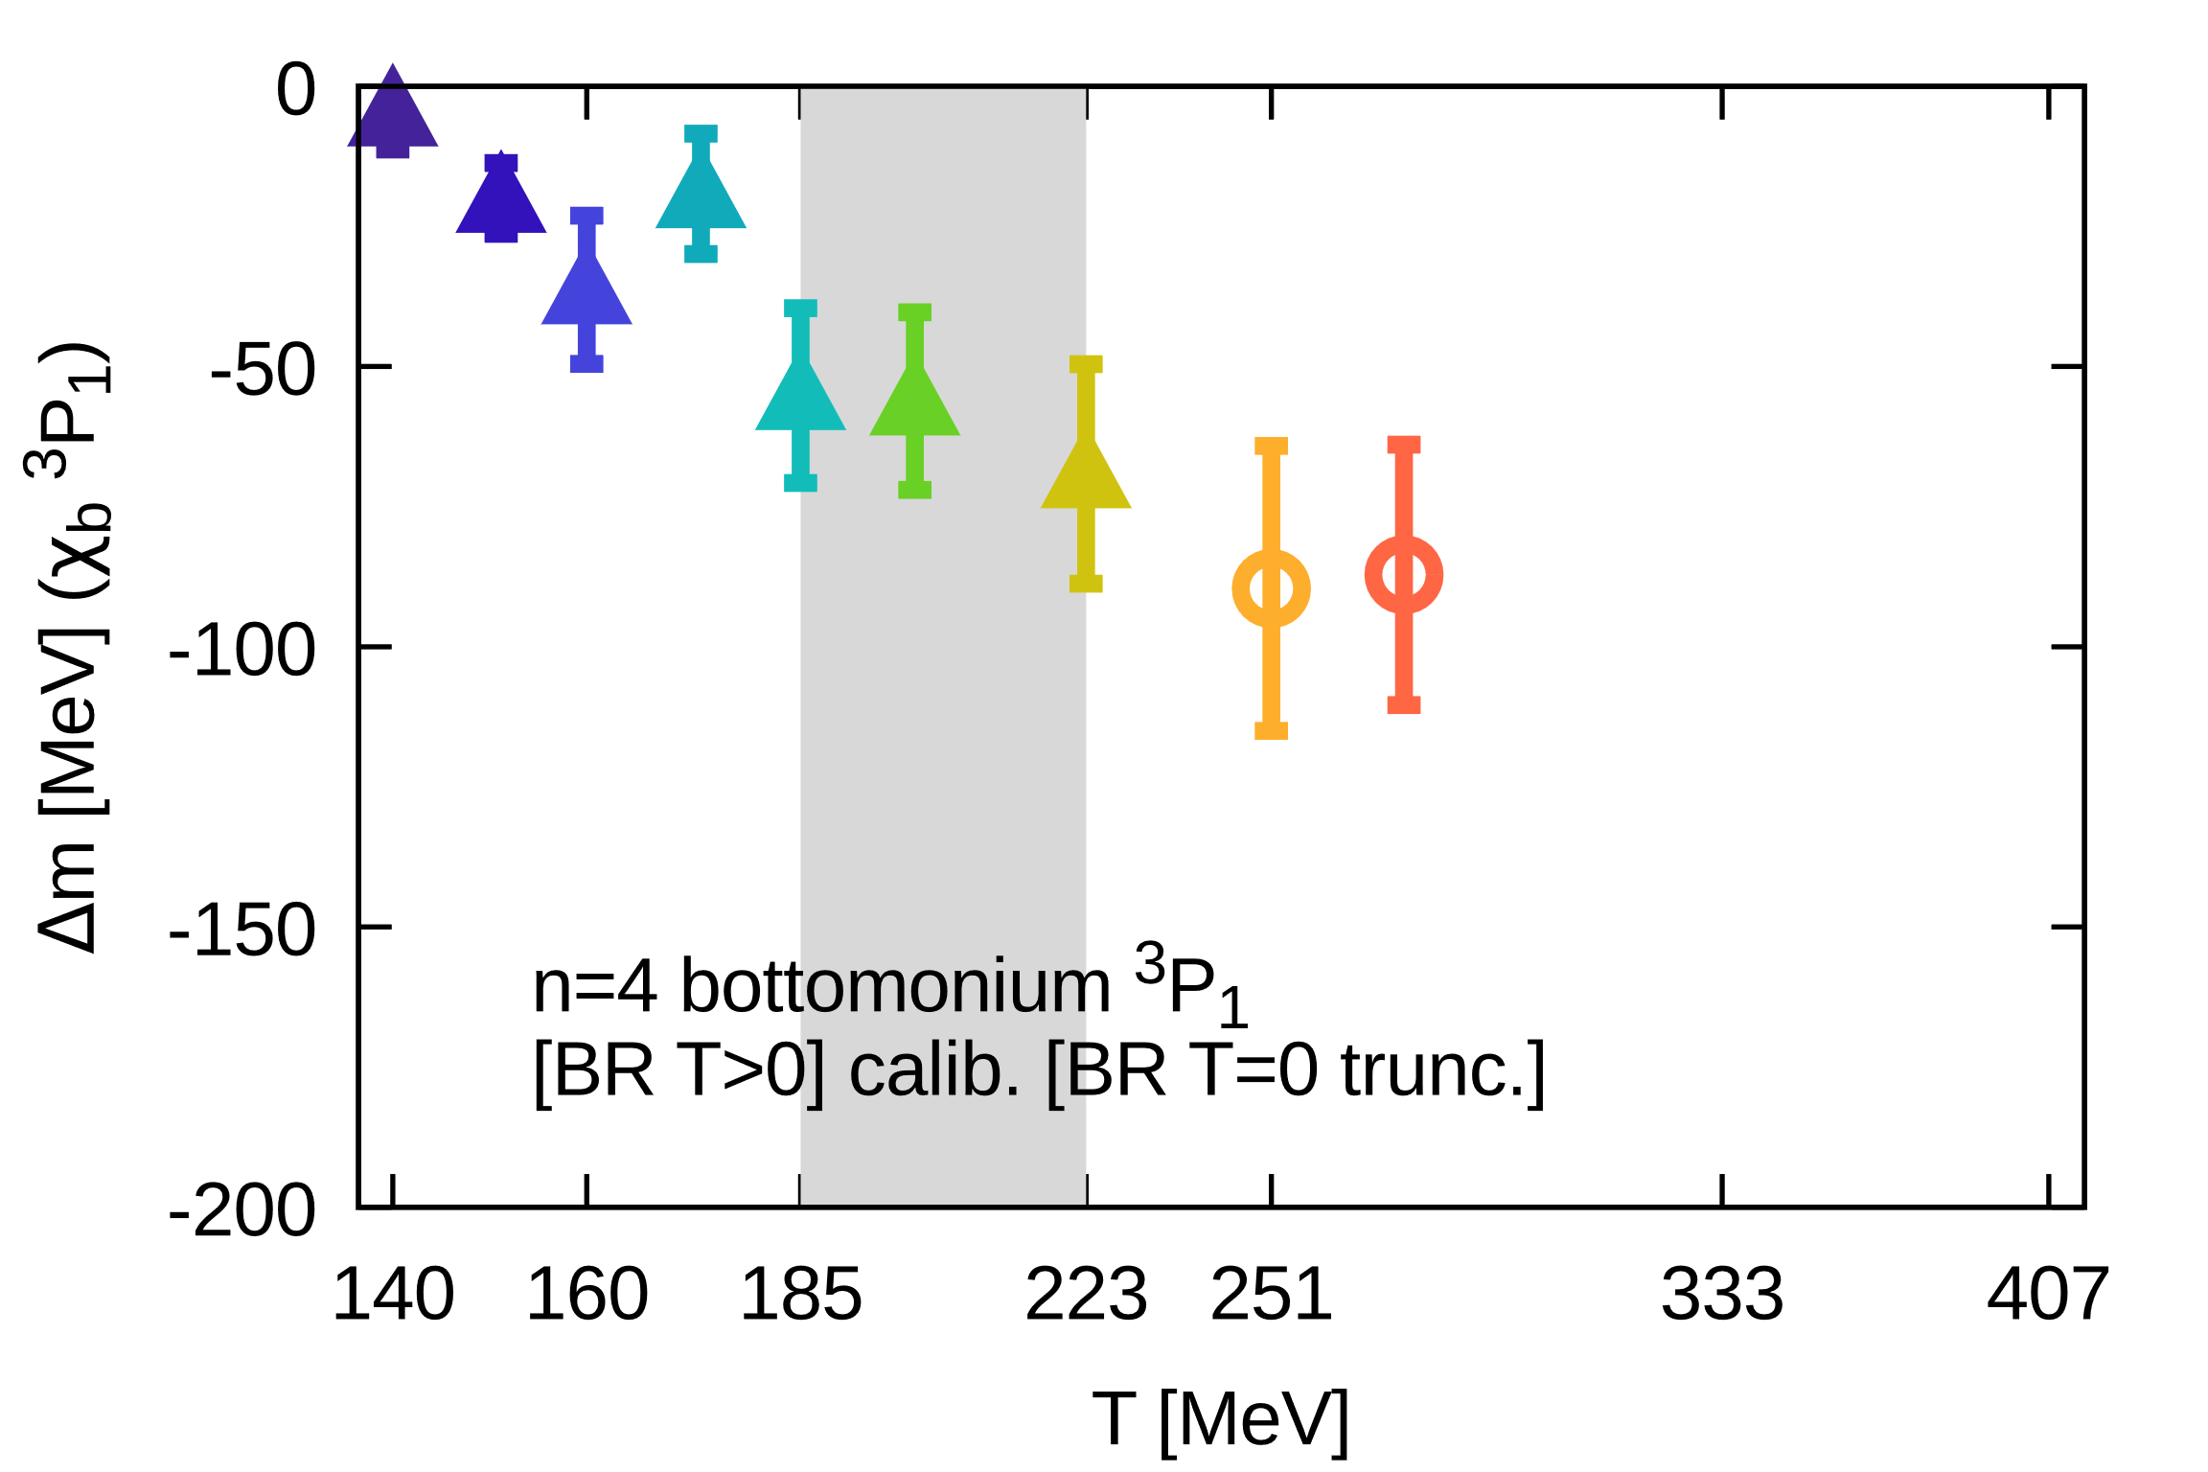
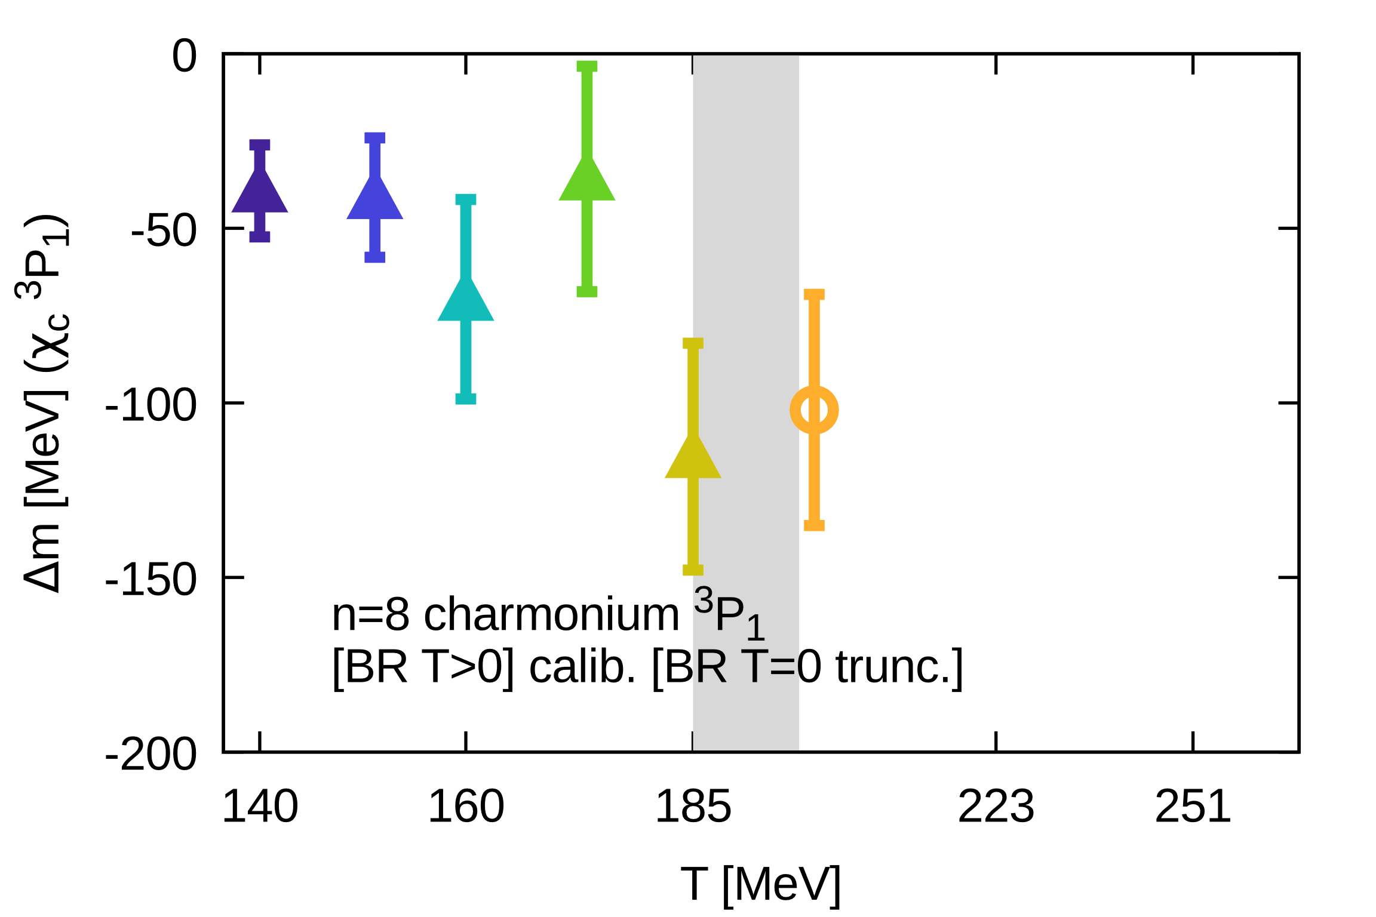
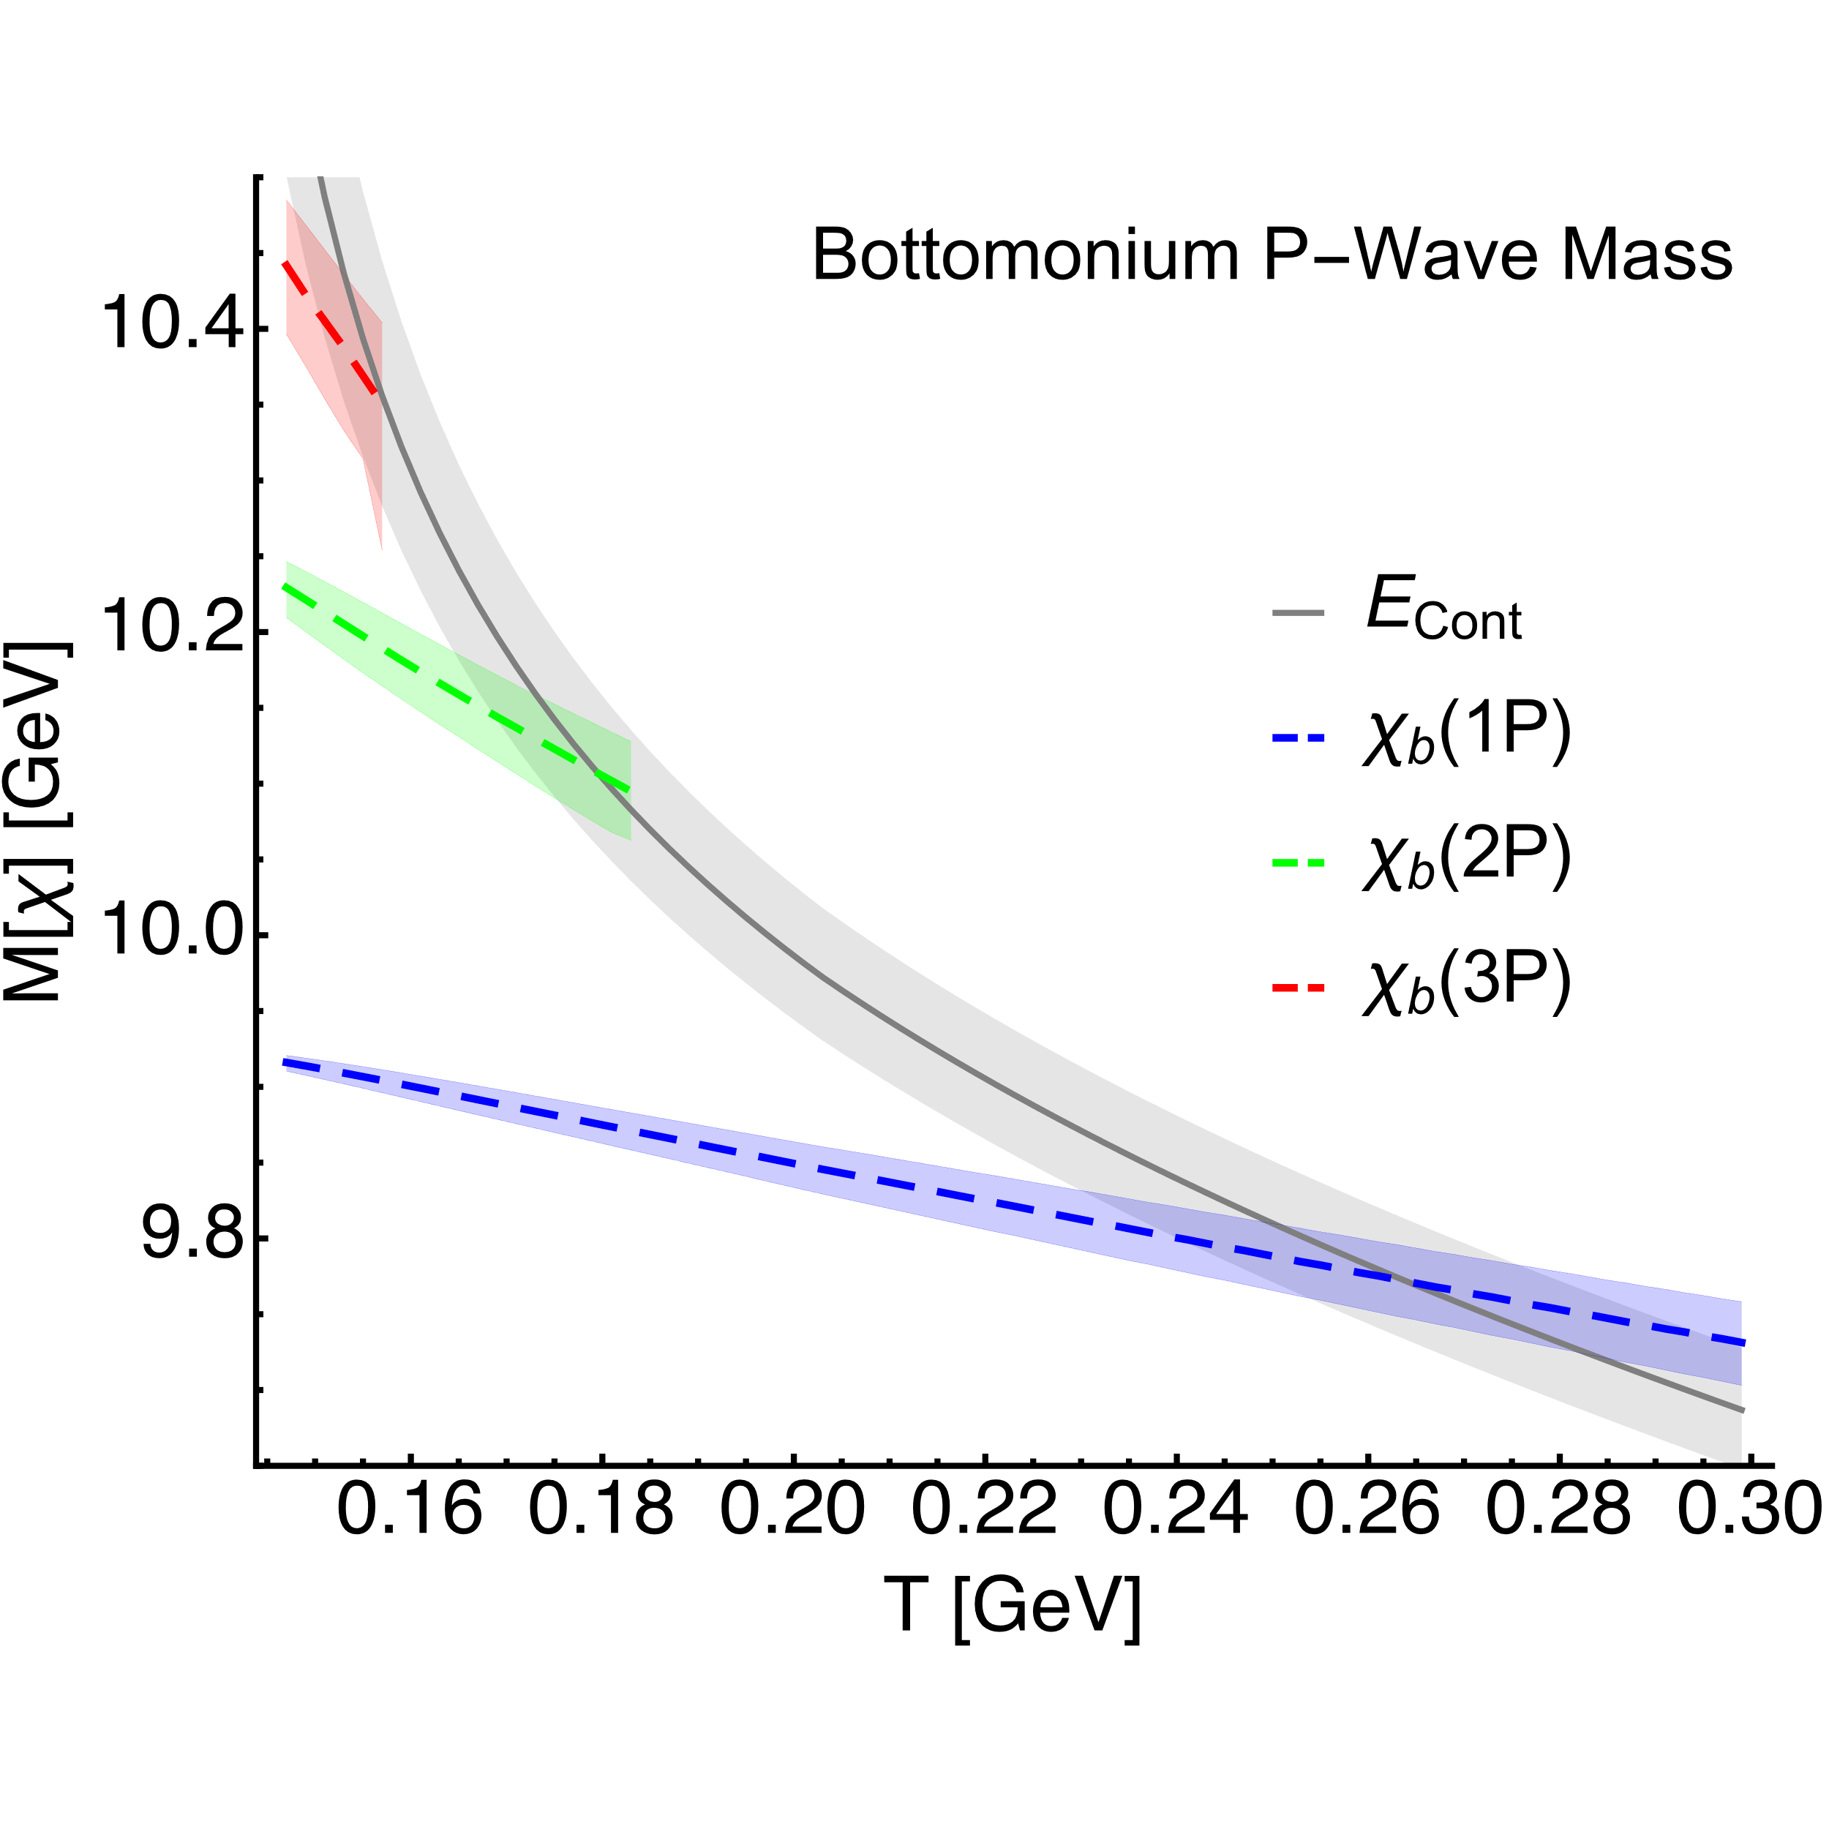
In-medium mass shifts II
Our direct lattice NRQCD result for T>0 mass shifts
Lattice QCD potential based computation
Negative mass shifts in qualitative agreement with potential based computation
(i.e. with a non-perturbative implementation of the EFT pNRQCD)

