Slide 1
Quarkonium Cross Sections, Polarizations and Spectroscopy in pp Collisions with CMS
Quark Confinement and the Hadron Spectrum XIII
Maynooth, August 5 2018
Tommaso Dorigo, INFN-Padova
for the CMS Collaboration

Slide 2
Contents
The experimental apparatus
  CMS
  Triggering for quarkonium
Basic notions about quarkonium production
Charmonium and bottomonium measurements
  J/ψ, ψ(2S) and ϒ(nS) mass, yields, cross section and ratios
Spectroscopy of χ_{c} and χ_{b} states
  and first result on χ_{b1,2}(3P) mass splitting
Upsilon pair production
Conclusions

Slide 3
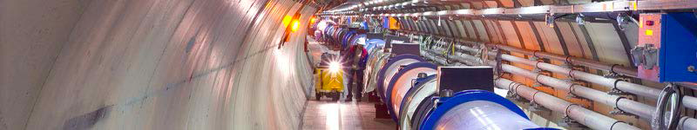
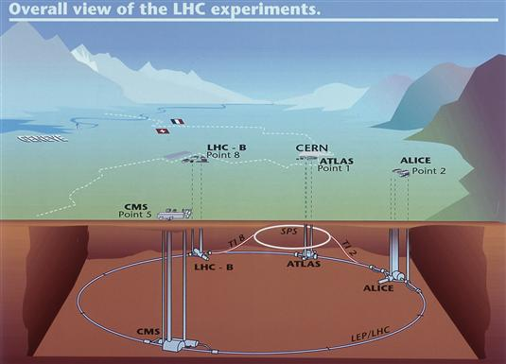
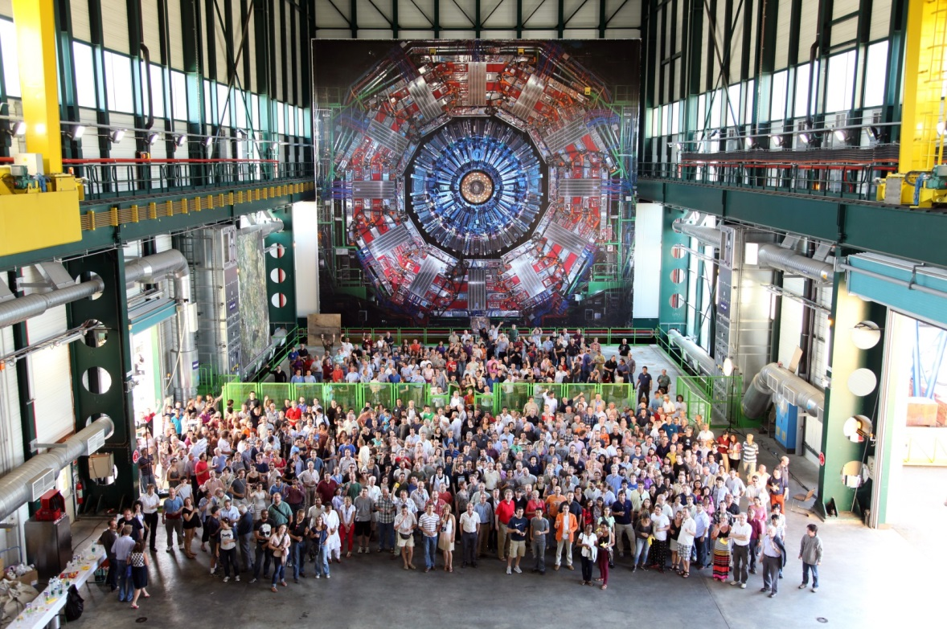
Experimental Facilities
LHC
Large Hadron Collider
CMS Collaboration
CMS: 5200 members: 1900 physicists, 1800 students, 950 engineers/technicians from 193 institutions, 43 countries
Notes:
The Large Hadron Collider at CERN is the highest energy accelerator in the world and is one of the largest and truly global scientific projects ever
4 interaction points, 2 housing two general purpose detectors, designed to search for the Higgs Boson: ATLAS and CMS
The Large Hadron Collider is a 27 km long pp collider ring housed in a tunnel about 100 m underground near Geneva.

Slide 4
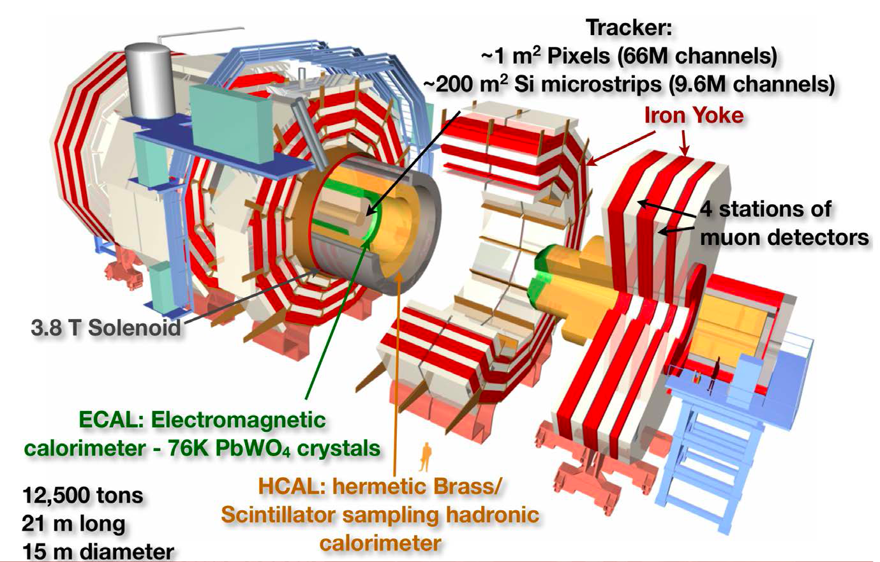
CMS After LS1
DAQ and HLT:
New computers
Improved Trigger
New beampipe
4th Muon Station (CSC & RPC)
New detectors for Luminosity
HCAL - New photosensors
Notes:
Classical collider general purpose detector. Highlighted you see the present configuration with the upgrade implemented during LS1.
Taking data, RUN2, at 13 Tev since 2015-6-7-8 Expect an extensive upgrade efforts during next few years of LS2 2019-2020
Detector upgrades: •Presently Phase I upgrade continuing well, some installations scheduled for next EYETS .
•Phase II upgrade for HL-LHC is being crystalized. Extensive R&D efforts during next few years. → Technical Design Reports for upgrade of various subsystems during 2017.
Main challenge: mitigate the effects of radiation on the performance of the Tracker
Addressed by equipping it to operate at low temperatures (down to -20°C). Cooling plant and cooling distribution were modified to prevent condensation.
Planning ahead: Central beampipe was replaced by a narrower one in preparation for the installation in 2016-‘17 of a new Pixel Tracker that will better measure the momenta and points of origin of charged particles.
Better muon system: A fourth measuring station was added to each muon endcap, in order to maintain discrimination between low-momentum muons and background as the LHC beam intensities increase. This was complemented by two 125-ton shielding at each end of detector, reducing neutron backgrounds.
Better luminosity measurement: A luminosity-measuring device, the Pixel Luminosity Telescope, was installed on either side of the collision point around the beam-pipe.
Other improvements: Photo-detectors in the hadron calorimeter were replaced by better-performing designs, moving the muon readout to more accessible locations for maintenance; a first stage of a new hardware triggering system was installed.
The software and computing systems underwent a significant overhaul during the shutdown to reduce the time needed to produce analysis datasets.

Slide 5
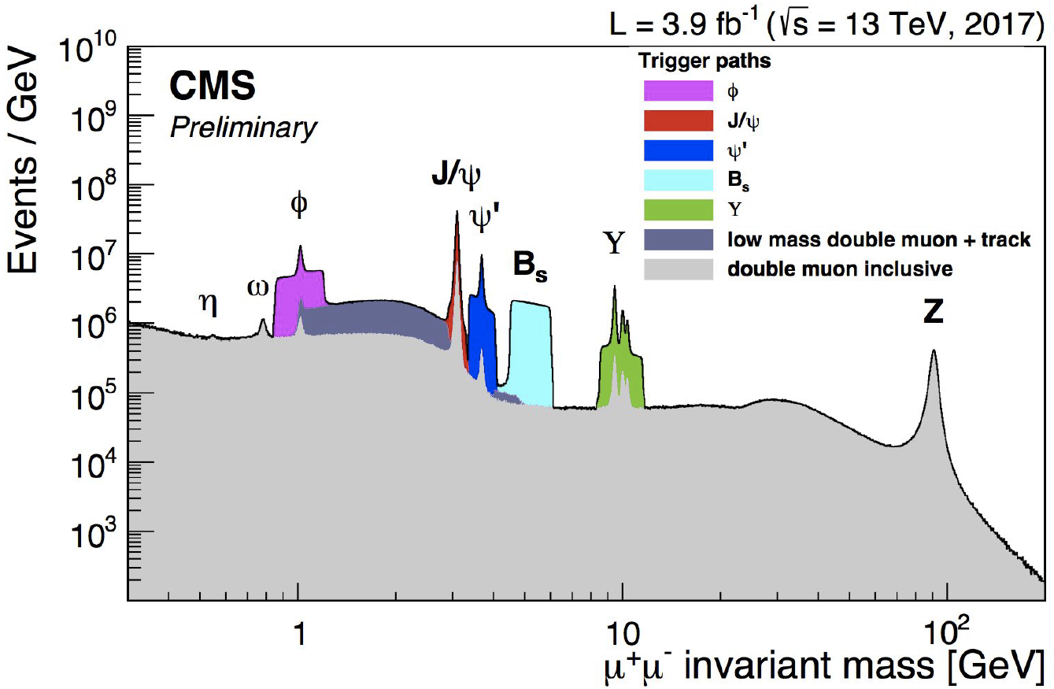
Di-Muon Resonances @ 13 TeV
CMS-DP-2017-029
Quarkonium events are effectively collected through dimuon triggers
https://cds.cern.ch/record/2276459/files/DP2017_029.pdf
Notes:
CMS experiment has an excellent dimuon mass resolution. Not surprising since Muon is our second name.
Plot of the whole vector resonance spectrum as a function of the mu-mu invariant mass. NB Log scale on both axis!
Quarkonium is reconstructed through dimuon triggers and dimuon final states. LHC exp show good performance to detect different signals.
ATLAS and CMS and LHCb complement each other in measuring heavy flavor HF properties at LHC; While LHCb is a dedicated HF experiment,
specific topic/channels where ATLAS and CMS can be competitive must be accurately selected, already at trigger level.
A dimuon mass resolution of 18-40 MeV (depending on rapidity), a secondary vertex resolution of 25 μm, and high muon detection and identification capabilities made this possible. Over 15 onia-related publications.
At LHC measurements at high p_T and wider rapidity ranges, high production rates and large integrated luminosity, higher CM energy, excellent detectors acceptance and performance.
1% of the mass 40 pb⁻¹ ; μ⁺μ⁻ widths: J/Ψ 31 MeV/c² ; ϒ 67 MeV/c²
1)Flavour production; 2)Spectroscopy and particle properties; 3) rare beauty decays

Slide 6
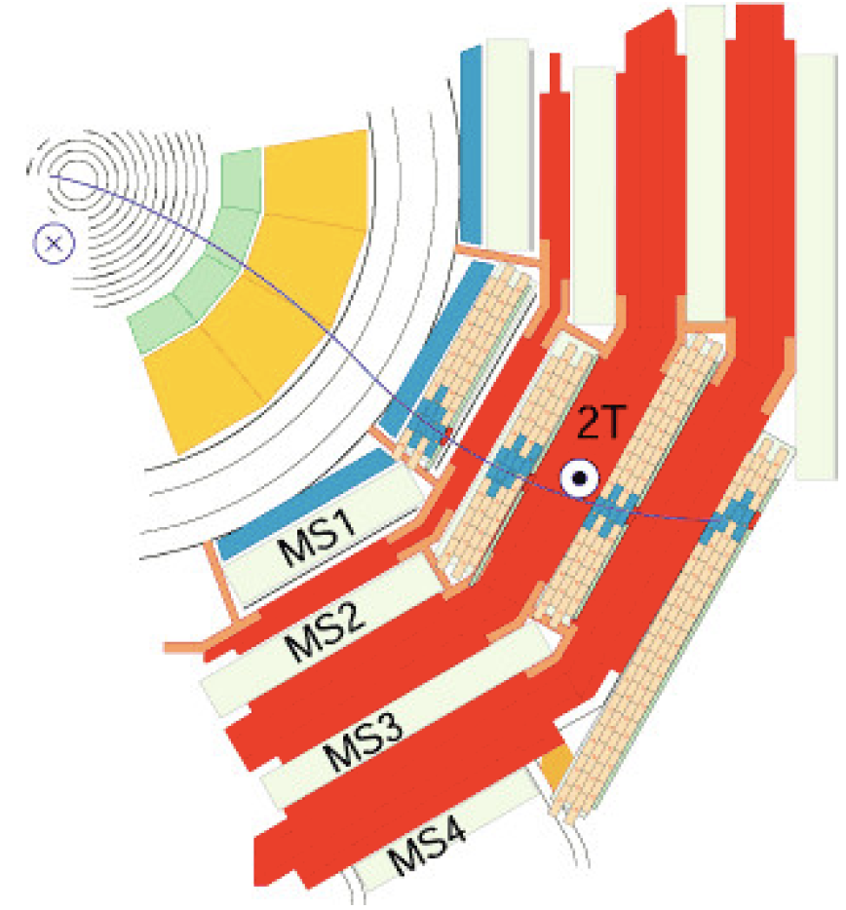
Muon Trigger and Reconstruction
Three different muon detectors (RPC, CSC, DT) dedicated to muon trigger and reconstruction
4 muon stations
Stand-alone reconstruction capability by muon detectors
Rapidity coverage: |η|<2.4
Tracker-Muon match:
  inside-out: more efficient at low p_{T}
  outside-in: more efficient at high p_{T}
The trigger has a limited bandwidth. Over time triggers are tightened to balance higher rate from increasing luminosity → affecting quarkonia
High p_{T} – get them all
Low p_{T} threshold single muon trigger
Low p_{T} dimuon trigger must be kept at reasonable rate
J/ψ, ϒ, B_{S}(μμ) dedicated triggers
JINST 7 (2012) P10002
Mis-identification probability < 1%
Transverse momentum resolution: 1 ÷ 6% for p_{T} < 100 GeV
Notes:
1) 3 diff… High luminosity, Limited bandwidth → Di-muon triggers possibly plus other tracks.
Specific topic/channels where ATLAS and CMS can be competitive must be accurately selected, already at trigger level.
Specific triggers developed for different analyses. Sophisticated triggers are applied to select signal and reduce data rate. Trigger is flexible, this is the secret!.
Cuts on: transverse momentum; (pseudo)rapidity; vertex 2nd and displacement; di-muon mass & pointing angles
At LHC measurements at high p_T and wider rapidity ranges, high production rates and large integrated luminosity, higher CM energy, excellent detectors acceptance and performance.
L1: hardware (fast, rate 100 kHz)
HLT: software (full track reconstruction, rate 1 kHz)
Triggers are challenging in ATLAS/CMS, need specialized and full SW based trigger capabilities.
B triggers: Seeded by high p_T muon, p_T > 4/6 GeV, additional muon p_T > 2.5/4 GeV
Efficient and inclusive, moderate threshold
No lifetime cuts or pre-scales in trigger

Slide 7
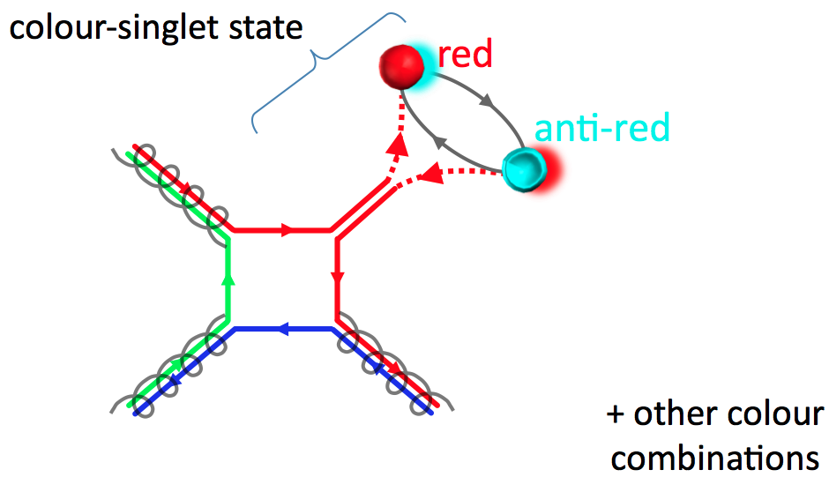
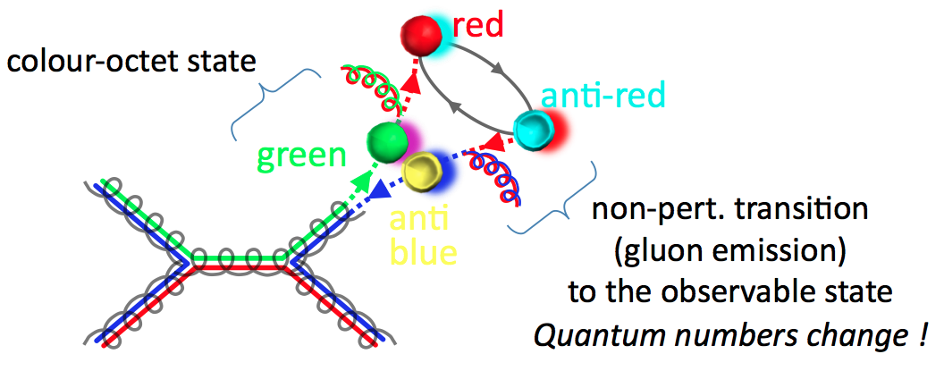
Why Quarkonium?
Quarkonium is a simple state: a flavorless meson whose constituents are a quark and its own antiquark, in an often narrow bound state.
The simplest production model for quarkonia requires a qq state produced as color-singlet in the LO Feynman diagram: Color Singlet Model (CS)
Order-of-magnitude rate disagreements in CDF measurements proved that CS is insufficient. qq pairs can be produced in any color, subsequently color is removed with soft gluon radiation: Color Octet Model (CO).
Dynamics are p_{T} dependent → LHC energy scale offers new avenues of investigation and extension of tests of phenomenological models
By Pietro Faccioli
By Pietro Faccioli
Notes:
Although quantum chromodynamics (QCD) is well established as the theory of the strong interaction, a complete understanding of the (nonperturbative) processes that lead to the binding of quarks and gluons into hadrons is still lacking
Quarkonia are probes of hadron formation, but production is not yet totally understood.
Long history of disagreement between Theory and Experimental results.
Some popular models in the market are: *Color singlet model (CSM), - Color octet mechanism (COM /NRQCD) *Color evaporation model (CEM) *K_T factorization…. color singlet model, produced as a color neutral object; NRQCD, produced as color octet → gluon emission to reach color singlet state .
More data is needed. LHC provides luminosity, higher energy scale → extended Xsection and p_{T} reach At LHC measurements at high p_T and wider rapidity ranges, high production rates and large integrated luminosity, higher CM energy, excellent detectors acceptance and performance.
Most models are for direct production only but experiments cannot separate all, at all, or all the time the direct production….
A combination of COM and CSM seems to describe the p_T spectrum and xsection measured at Tevatron. However a satisfactory description of polarization remains elusive. Complex system, requires careful investigation of many nuanced effects.
**Ideal Testing ground for QCD calculations at the perturbative (short distance process ) and non-perturbative boundary (long distance process).
**Ideal Testing ground for QCD described by NRQCD: process *Color octet and color singlet B mesons, searches….
**Other production models include CE **Role of double parton scattering (DPS)
Other observable (double charm production…) have been proposed to solve the puzzle.
LHC-With its high lumi the production xsection and possibly polariz of states as Chi_c and Chi_b might become available at LHC.
With yields at LHC one can explore new observables, detailed effects ….Experiment at LHC have excellent dimuon mass resolution which allow to study P-wave quarkonium states through radiative decays.
Also excellent test of pQCD and nonpQCD, +tune of MC generators at new energies, HF background to many searches, calibration and understanding of the detector.
At LHC measurements at high p_T and wider rapidity ranges, high production rates and large integrated luminosity, higher CM energy, excellent detectors acceptance and performance.
Motivations to study HF physics at CMS Probe the underlying QCD processes: measure production cross section , measure quarkonia polarization, look for new and exotic states.
Quarkonium Polarization is sensitive to the production mechanism.
No theory has simultaneously explained experimental measurements of both production xsection and polarization. More data is needed.
Quarkonia are probes of hadron formation, but production is not yet totally understood. Long history of disagreement between Theory and Experimental results
Historically physicist tried to understand the quarkonium production mechanism and polarization. Even after decades of theoretical and experimental research → No theory has simultaneously explained experimental measurements of both production xsection and polarization.

Slide 8
    Quarkonium Production: Theoretical Framework
Quarkonia production occurs through:
Prompt production is used to understand how quarks combine into a bound state.
NRQCD is an effective field theory that treats heavy quarkonia (cc, bb) as non-rela-tivistic systems. It predicts the existence of intermediate CO states in nature, that sub-sequently evolve into physical color-singlet quarkonia by non–perturbative emissions
Inclusive quarkonium production can be factorized in two distinct phases:
  Production of qq in the regime of perturbative QCD.
Short-distance coefficients (SDCs). Calculated by perturbative QCD (expansions in α_{S} ).
  2) Formation of a bound state, non-perturbative QCD sector.
Long-distance matrix elements (LDMEs). Relative relevance given by ν = v/c <<1 (scaling rules). Determined from fits to experimental data
Theoretical predictions are organized as double expansions in α_{S} and ν. Truncation of ν-expansion for S-wave states in NRQCD includes 4 terms: 1 CS term and 3 CO terms
Prompt production: direct QCD process or feed-down from higher quarkonium states
Non-prompt production: from decays of long-lived b-hadrons (for charmonia only)
Notes:
Two distinct charmonium production mechanisms at LHC: Charmonium states are produced by two mechanisms with comparable contributions:
Prompt: direct production in the pp interaction or through feed-down from decays of heavier states or feed-down from heavier quarkonium states , no long pseudo-proper-time tail – Theory: non-relativistic QCD, NRQCD [pQCD c cbar production, soft evolution into quarkonium (data derived)]
NonPrompt: produced in decays of b-hadrons, long pseudo-proper-time tail , fitted to produce fractions, can be separated experimentally due to the “long” lifetime of b-hadron - Theory: Fixed Order Next-to-Leading Loga-rithm , FONLL [perturbative b-bbar production, data driven fragmentation and b-hadron decay model. A fragmentation function for the transition to the final state. Includes long-distance effects, taken as universal.
Today one of the most accredited theories is NRQCD*, an effective theory that factorizes the production mechanism into a perturbative (Short Distance Coefficients) and nonperturbative (Long Distance Matrix Elements). The“missing” contribution is thought to derive from qqbar pairs created in a color-octet state, that “evolve” into a color-singlet physical state by soft gluon radiation.
LDMEs, thought to be universal, have to be extracted from data, although expected to obey scaling rules. For the 3S1 states, the relevant ones are 3S1[1], 1S0[8], 3S1[8], 3PJ[8]. The extraction of the LDMEs is a crucial point and can lead to puzzling results.
Around 35% of prompt J/ψ comes from feed-down, prompt ψ(2S) almost all produced directly
Test NRQCD and factorization Well established framework: NRQCD ~ factorizes short-distance (SDCs, perturbative calculations) and universal long-distance (LDMEs, from fits to data) contributions.

Slide 9
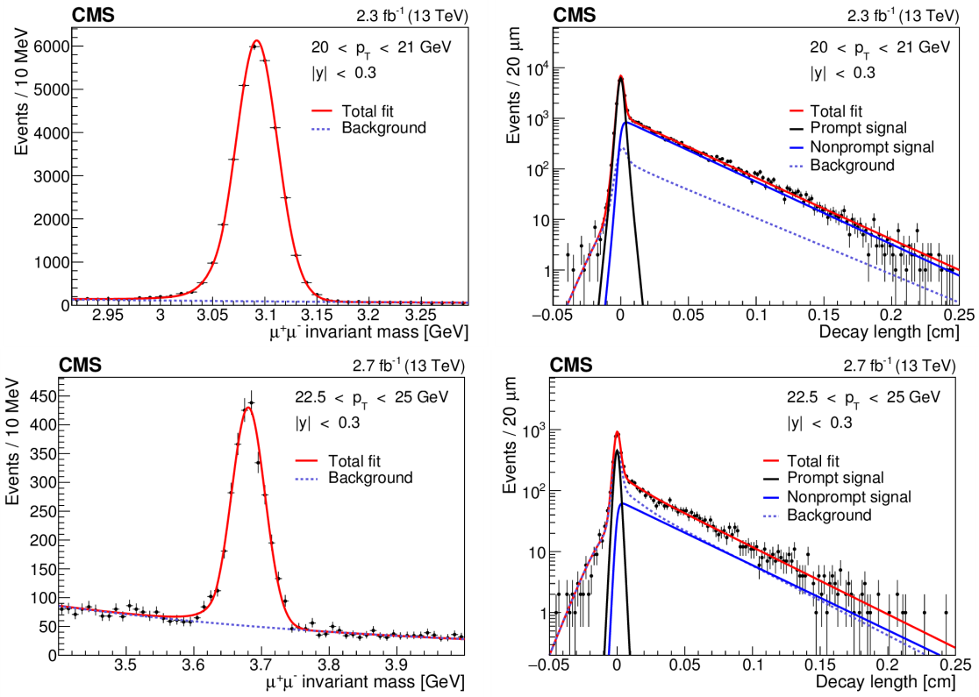
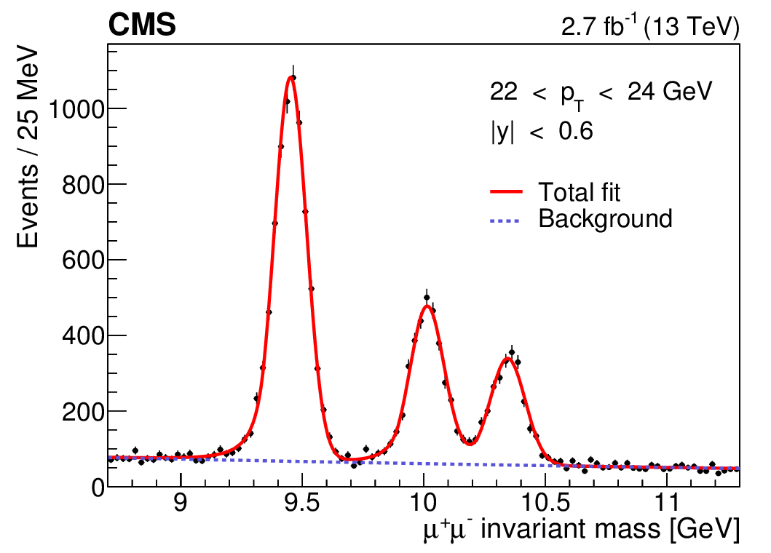
Double-Differential Yields @13 TeV
13 TeV analysis uses same technique of earlier measurements to extend the p_{T} reach and test the validity domain of NRQCD and scaling with energy.
Yields extracted from UML fit to mass and lifetime (for charmonium only, to subtract non-prompt bgr), in p_{T} and |y|
For the mass, PDF used are: J/ψ (Crystal Ball+Gaussian), ψ(2S) (Crystal Ball), ϒ(1S,2S,3S) (Crystal Ball); background: exponential function.
Mass resolution for Y
states 60-90 MeV,
depending on |y|
Floating for Y(1S), scaled
for (2S,3S) states;
for charmonium 30-50 MeV
NEW
PLB 780 (2018) 251
J/ψ
ϒ(1S,2S,3S)
ψ(2S)
CMS-DP-2017-029
Notes:
FIG.L Projections on the dimuon invariant mass (left) and pseudo-proper-decay-length (right) axes, for the J/ψ (top) and ψ(2S) (bottom) events in the kinematic bins given in the plots. The right panels show dimuons of invariant mass within +-3σ_CB of the pole masses. The curves, identified in the legends, represent the result of the fits de-scribed in the text. The vertical bars on the data points show the statistical uncertainties.
Fig.R Results of the fits to the dimuon invariant mass distribution The solid line is the result of the full fit. The short-dashed line is the background contribution.
The mass signal is modeled using Crystal Ball functions. The backround PDF is an exponential function. The masses and widths of the Y(nS) are constrained one another.
No lifetime cuts or pre-scales in trigger. The yields are obtained using an unbinned Maximum Likelihood Fit to the dimuon invariant mass spectrum.
Prompt produced in primary vertex or from feed down. Non prompt J/psi and psi(2S) from B hadrons.
The mass signal is modeled by a CB plusgaussian function (CB only for the 2S). The background is exponential.
The ct signal is the sum of a delta (P) and decay (NP) function, convolved with a gaussian resolution function.
The ct background also has P and NP components

Slide 10
The Double-Differential Cross Section
The cross section has been calculated in bins of rapidity y and transverse momentum p_{T}
S-wave Quarkonium states:
J/ψ, ψ(2S), ϒ(1S, 2S, 3S)
Number of the prompt signal events: Likelihood fit to m_{μμ} spectra (and ctau) in 2D bin
d² σ^{qq} N^{qq}(p_{T},y) 1
BR(qq μ⁺μ⁻) × = ×
dp_{T}dy L ΔyΔp_{T} < ε(p_{T},y)A(p_{T},y)>
Branching fraction
to two muons
integrated Luminosity
width of the bins
Efficiency
Acceptance
N^{gen}_{kin}(p_{T},y)
A=
N^{gen}(p_{T},y)
Acceptance from
MC simulation
ε_{μμ}(p_{T},y) = ε(p_{T1},η₁) ε(p_{T2},η₂) ρ(p_{T},y) ε²_{tk}
di-muon
reconstruction efficiency
single muon tag&probe efficiency
di-muon correlation
tracking efficiency
Notes:
Double differential cross section calculated in bins of rapidity y and transverse momentum p_{T}
ΔpT, Δy: width of the transverse momentum and rapidity bin
• N(pT,y): yield of prompt J/ψ, ψ(2S) or Υ(nS) candidates from unbinned maximum likelihood
fit to dimuon invariant mass spectrum.
• 𝓛 : integrated luminosity
• 𝓐: geometrical acceptance, from simulation
• 𝛆 : efficiency, from data and simulation
• <> average over (rapidity, tranverse momentum) bin

Slide 11
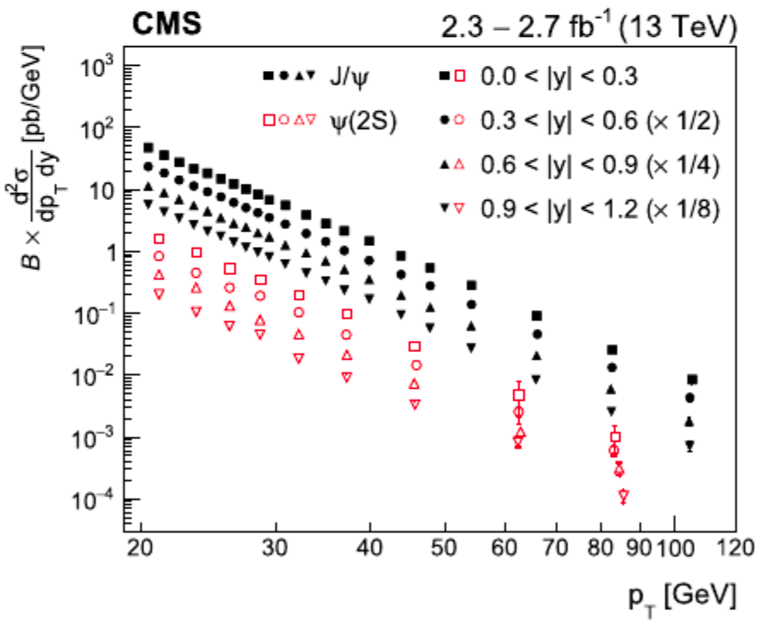
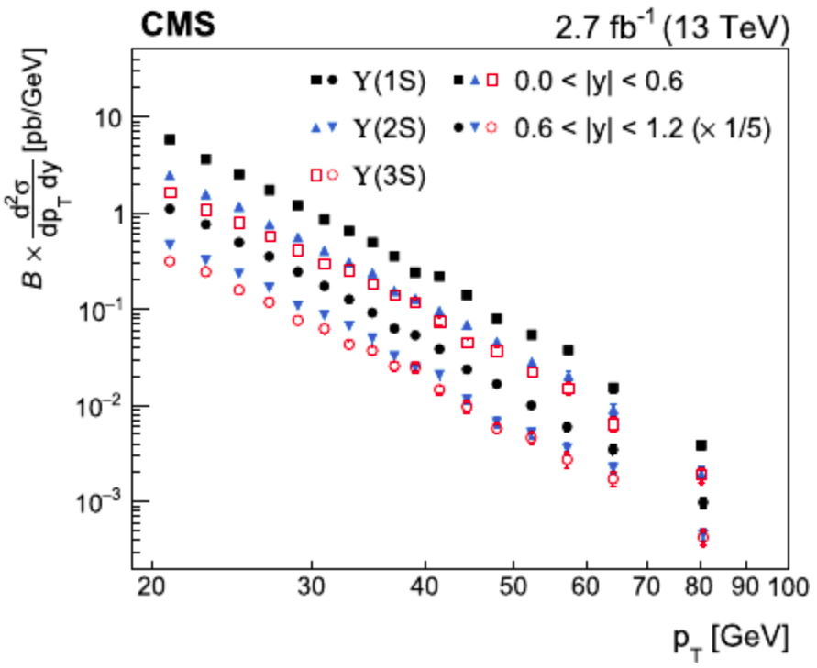
Prompt production @13 TeV
NEW
  Double differential cross section:
Charmonium S-wave states production
Bottomonium S-wave states production
PLB 780 (2018) 251
Shapes are consistent across the rapidity |y| region → can integrate over y.
For integrated y we assign the tot. syst. uncertainty from the most forward bin.
Notes:
FIG The product of the measured double-differential cross sections and dimuon branching fractions for prompt J/ψ and ψ(2S) (left) and the ϒ(nS) (right) mesons as a function of p_T, in four and two rapidity regions, respectively, assuming unpolarized dimuon decays. For presentation purposes, the individual points the measurements are scaled by the factors given in the legends. The inner ve? bars on the data points represent the statistical uncertainty, while the outer show the statistical and systematic uncertainties, not including the 2.3% uncertainty in the integrated luminosity, added in quadrature. For most of the data points, uncertainties are comparable to the size of the symbols. The data points are shown at the average p_T in each bin.
Multiplication factors applied for clarity: The rapidity dependence is in fact rather weak in this y range.
Syst Uncertainties are estimated per bin:
Yields ~2% [variation of sig. and bkg. models].
• Prompt frac. ≲ 3% (≲16%) for J/ψ (ψ’) [PV choice (BS vs. closest PV in z) and ct model].
• Muon effs.: 2.5% (1.8%) for ψ(‘) (for Y) [single μ eff. param.] ⊕ ~3% [use of MC for L3 eff.].
• ρ ~ 1-5% [trigger] ⊕ 1-4% [TnP] ⊕ 2-15% [Data vs MC estimation].
• A ~ 0.5 - 6%. [finite MC].
• For y-integrated, assign total syst. unc. of the most-forward y-bin.

Slide 12
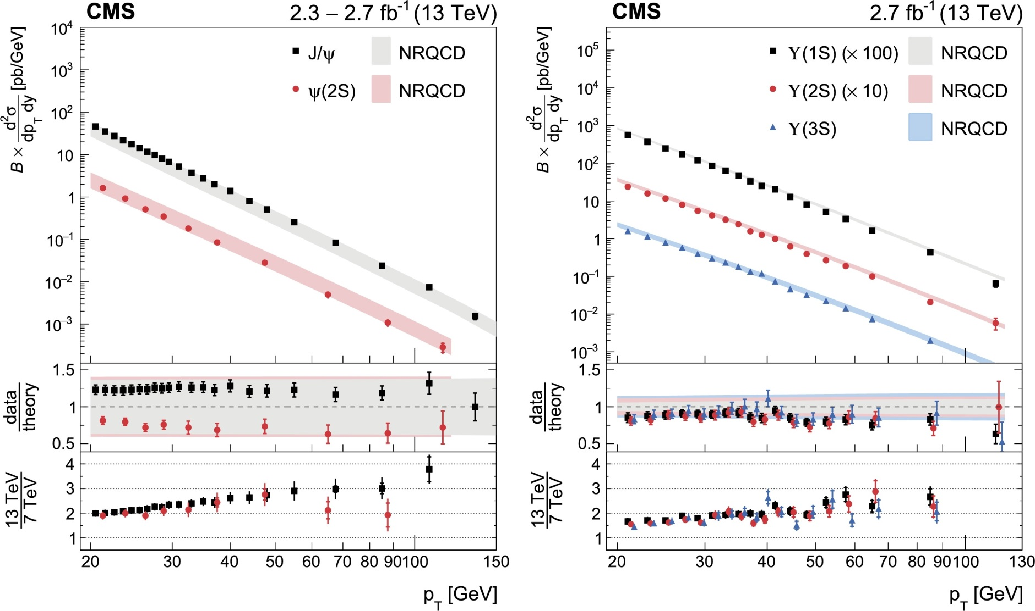
Comparison to NLO NRQCD and 7 TeV
(*) Y.-Q.Ma, K.Wang, K.-T.Chao, Rev. Lett. 106 (2011) 042002,
LDMEs from Tevatron yields.
(**) H.Han et al., Phys. Rev. D 94 014028,
LDMEs from Tevatron and LHC @7TeV yields.
(*)
(**)
NEW
Results in agreement with NLO NRQCD
As expected from evolution of PDFs, cross sections increase with energy.
These measurements should reduce theoretical uncertainties from the extraction of LDMEs.
PLB 780 (2018) 251
Notes:
FIG. The measured double-differential cross sections times branching fractions of the prompt J/ψ and ψ(2S) (left) and the ϒ(nS) (right) mesons (markers), assuming unpolarized dimuon decays, as a function of p_T, for |y| < 1.2, compared to NLO NRQCD predictions [43,44] (sha-ded bands). The inner vertical bars on the data represent the statistical uncertainty, while the outer bars show the statistical and systematic uncertainties, including the integrated luminosity uncertainty of 2.3%, added in quadrature.
The middle panels show the ratios of measurement to theory, where the vertical bars depict the total uncertainties in the measurement. The widths of the points represent the theoretical uncertainty, added in quadrature with the uncertainties in the dimuon branching fractions [36].
The lower panels show the ratios of cross sections measured at 13 TeV.
Results : cross sections at 13 Tev are a factor 2-3 larger than the correspo-nding values @7TeV and slowly increasing as a function of the dimuon p_T
As expected from evolution of PDFs, cross sections increase with energy (factor 2-3 with respect to 7TeV)
NLO NRQCD describes well the cross section - NLO NRQCD predictions in agreement with data.
These results show similar scaling for bottomonium and charmonium S-wave states and contribute to consolidate the underlying hypothesis of NRQCD and provide further input to constrain the theory parameters.
These measurements should reduce theoretical uncertainties from the extraction of LDMEs

Slide 13
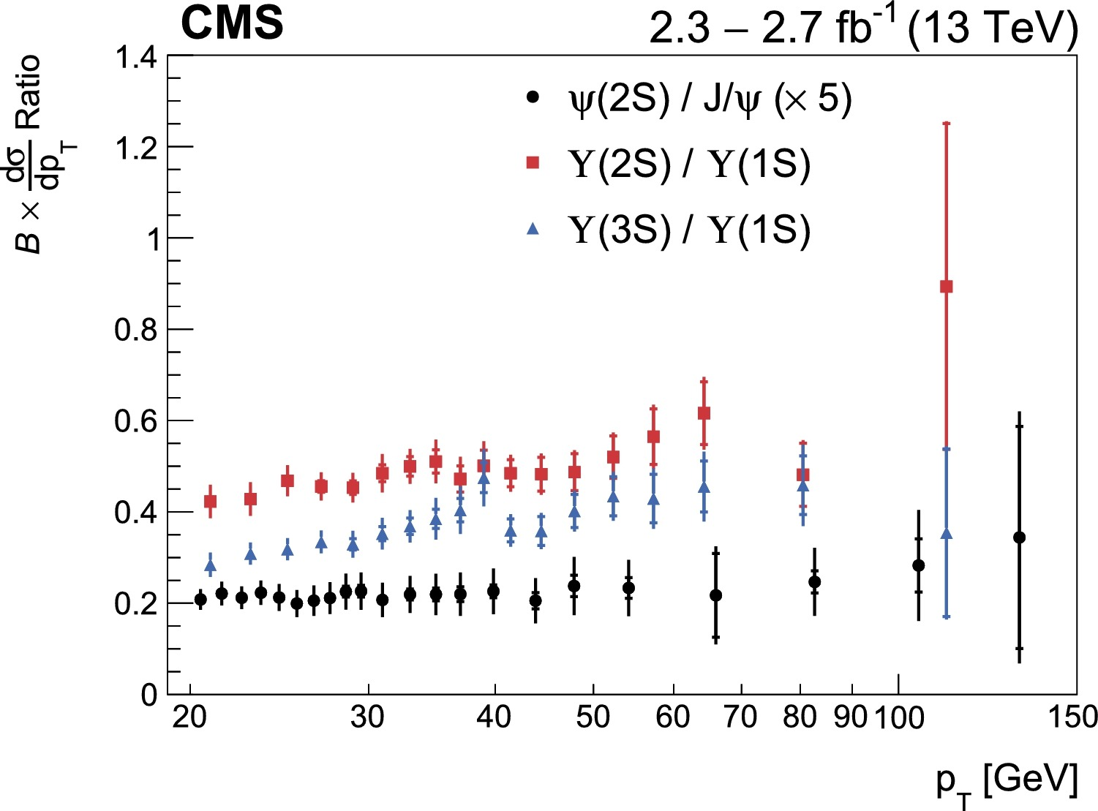
Production Ratios (to 1S) @13 TeV
NEW
Ratio:
σ^{ψ(2S)}/σ^{J/ψ(1S)}
σ^{ϒ(2S)}/σ^{ϒ(1S)}
and
σ^{ϒ(3S)}/σ^{ϒ(1S)}
→ cancelation of experimental systematics and
theoretical uncertainties.
The vertical bars account for correlations between measurements
Flat for Charmonium
Increasing slowly for Bottomonium
PLB 780 (2018) 251
Notes:
FIG. Ratios of the p T differential cross sections times dimuon branching
tions of the prompt ψ(2S) to J/ψ, ϒ(2S) to ϒ(1S), and ϒ(3S) to ϒ(1S) for |y|< 1.2. The inner vertical bars represent the statistical uncertainty, while outer bars show the statistical and systematic uncertainties added in quadrature. The ratio of the ψ(2S) to J/ψ meson cross sections is multiplied by a factor for better visibility.
Ratio→ cancel out of exper. systematics and theor. uncertainties. The error bars take into account correlations between measurements.
Ratio of cross sections can be considered to cancel out systematic experimental as well as theoretical
uncertainties. The error bars in this plot take into account correlations between the measurements.

Slide 14
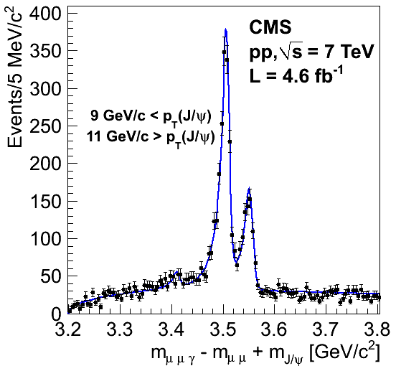

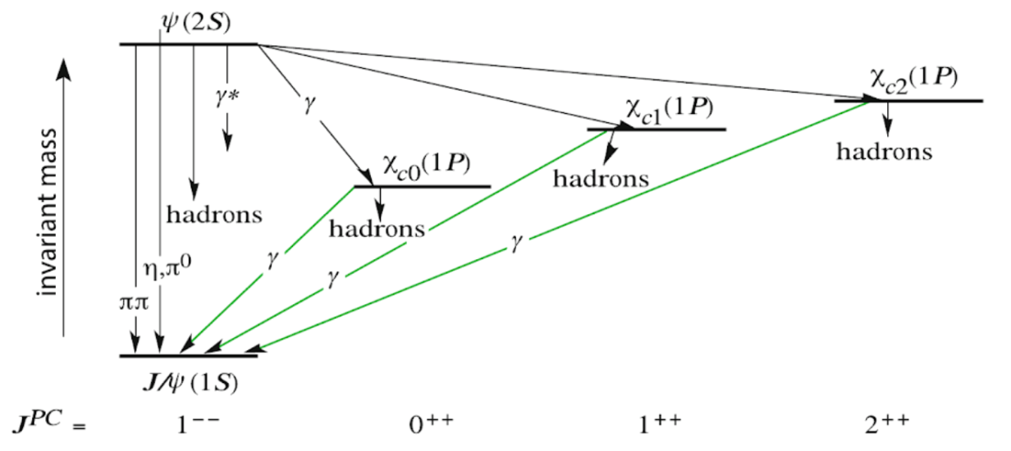

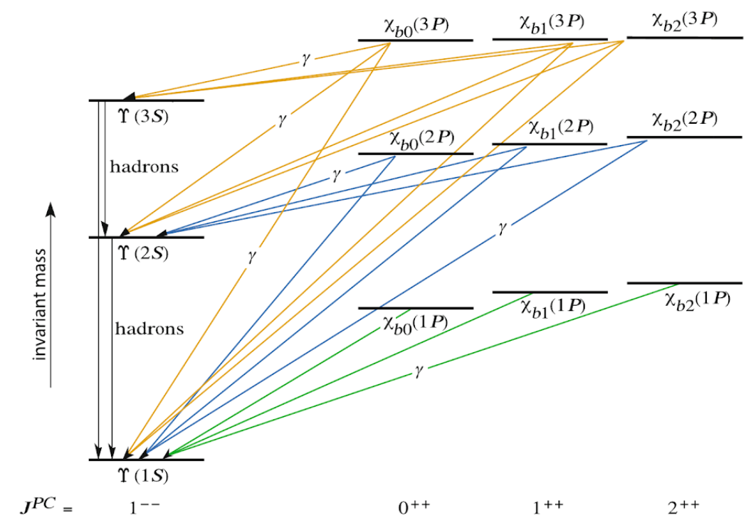
Quarkonium: the P States
χ_{c1}
χ_{c2}
EPJC 72 (2012) 2251
Pictures of Charmonium and Bottomonium energy levels,
showing only CP even and below open-c and open-b threshold
from V.Knünz, DOI: 10.1007/978-3-319-49935-2_2
The bottomonium family (bb) plays a special role
In understanding how the strong force binds
quarks because the high quark mass allows important theoretical simplifications.
The measurements of the masses of the χ_{b}(3P)
triplet states (J = 0, 1, 2) is especially interesting
to probe details of the bb interaction and test
theoretical treatments of the influence of open
beauty states on the bottomonium spectrum.
Notes:
With its high lumi yields at LHC one can explore new observables, detailed effects …. Experiment at LHC have excellent dimuon mass resolution which allow to study P-wave quarkonium states through radiative decays.
Picture…Quarkonium energy levels: only CP even and below open charm threshold.
The bottomonium family….
In parentheses it is sufficient to give the radial quantum number and the orbital angular momentum to specify the states with all their quantum numbers
With its high lumi the production xsection and possibly polariz of states as Chi_c and Chi_b might become available at LHC.
Quarkonia are probes of hadron formation, but production is not yet understood:
Historically physicist tried to understand the quarkonium production mechanism and polarization. Even after decades of theoretical and experimental research → No theory has simultaneously explained experimental measurements of both production xsection and polarization.
Some popular models in the market are: *Color singlet model (CSM), - color octet mechanism (COM /NRQCD) *color evaporation model (CEM) *K_T factorization….
A combination of COM and CSM seems to describe the p_T spectrum and xsection measured at Tevatron. However a satisfactory description of polarization remains elusive.
Complex system, requires careful investigation of many nuanced effects.
Ideal Testing ground for QCD calculations at the perturbative and non-perturbative boundary.
**Ideal Testing ground for QCD described by NRQCD: *Perturbative short distance process *Non-perturbative longdistance process *Color octet and color singlet B mesons, searches…. **Other production models include CE **Role of double parton scattering (DPS)
Other observable (double charm production…) have been proposed to solve the puzzle.
With its high lumi the production xsection and possibly polariz of states as Chi_c and Chi_b might become available at LHC.
Quarkonium Polarization is sensitive to the production mechanism.
No theory has simultaneously explained experimental measurements of both production xsection and polarization. More data is needed.
Also excellent test of pQCD and nonpQCD, +tune of MC generators at new energies, HF background to many searches, calibration and understanding of the detector.
Most models are for direct production only but experiments cannot separate all, at all, or all the time the direct production.

Slide 15
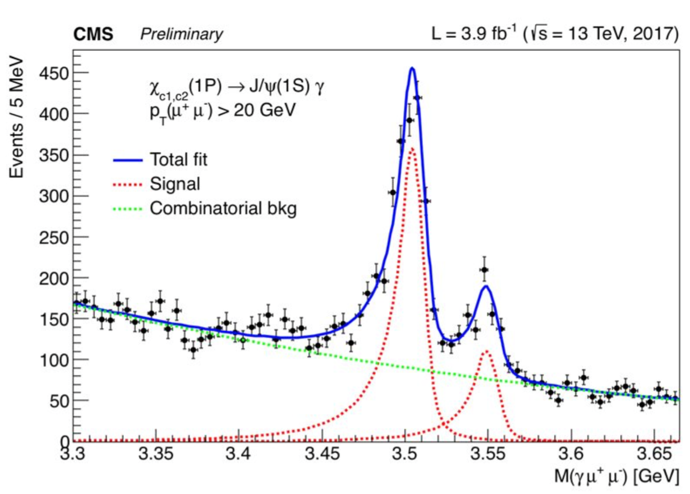
The χ_{c}(1P) States @ 13 TeV
χ_{c1} → γ J/ψ (→ μ⁺μ⁻)
● Trigger conditions:
opposite-sign muon pair with
invariant mass in range 2.9-3.3 GeV,
p_{T} > 20 GeV, |y| < 1.25 and
vertex-fit probability > 0.5%
● The J/ψ has p_{T} > 20 GeV
● The γ is a converted photon
● The distance between the J/ψ and the vertices along the beam direction is < 1 mm
● The J/ψ γ system has a vertex-fit probability > 1%
● Fit method: unbinned extended likelihood
  ○ Signal: double side Crystal Ball for each peak
  ○ Background: 2nd order Chebyshev polynomial
CMS-DP-2017-029
Notes:
Controllare le masse!!!!
Mass χ_{c1}(1P) = 3.504 ± 0.001 (stat) GeV
Mass χ_{c2}(1P) = 3.548 ± 0.001 (stat) GeV
le masse nel DP sono quelle del fit, senza correzioni di scala, e quindi non hanno senso. La massa della chi2 e' 3556 MeV.

Slide 16
The χ_{b1}(3P) & χ_{b2}(3P) States – ϒ Candidates
χ_{b}(3P) state first discovered by ATLAS (PRL102 (2012) 1528001).
New result from the first observation of resolved χ_{b1}(3P) and χ_{b2}(3P) states and their mass measurement through the decay channel:
χ_{b}(3P)→γ ϒ(3S)
ϒ(3S)→ μ+μ- decay triggering (@HLT) the event with a μ+μ-
pair with two opposite sign μ coming from a common vertex:
• p_{T} (μμ) >7.9 GeV |y| < 1.25 (2015-2016)
• p_{T} (μμ) >11.9 GeV |y| < 1.5 (2017)
• 8.5 GeV <M(μμ) <11.5 GeV
Reduced background level in the ϒ(3S) γ mass
distribution by selecting a high purity ϒ(3S) sample:
• M(μμ) < M(ϒ(3S)) + 2.5 σ_{m}(y) [assures S/B ratio > 0.5]
• M(μμ) > M(ϒ(3S)) – n_{σ} σ_{m}(y) [reduces ϒ(2S) contamination]
n_{σ} = 2 |y| < 0.9
n_{σ} = 1.5 0.9 < |y| < 1.2
CMS-BPH-17-008 and arXiv: 1805.11192 [hep-ex]
Based on 13 TeV pp data, corresponding to integrated luminosities of 2.7 /fb in 2015, 35.2 /fb in 2016, and 42.1/fb in 2017
Notes:
Although quantum chromodynamics (QCD) is well established as the theory of the strong in- teraction, a complete understanding of the (nonperturbative) processes that lead to the binding of quarks and gluons into hadrons is still lacking [1–3]. The bottomonium family, comprised of beauty quark-antiquark bound states, bb, plays a special role in understanding how the strong force binds quarks into hadrons because the large quark mass allows two important theoretical simplifications. First, the hard-scattering production of a proto-quarkonium quark-antiquark pair can be described in perturbation theory [4–6]. Second, the binding of the quark-antiquark pair can be described in terms of lattice-calculable nonrelativistic potentials [7–9]. Particularly stringent tests of current theories of quarkonium production can be achieved by examining the individual spin states of the quarkonium multiplets
χ_{b}(3P) state first discovered by ATLAS (PRL102 (2012) 1528001).
New result from the first observation of resolved χ_{b1}(3P) and χ_{b2}(3P) states and their masses measurement through the decay channel:
χ_{b}(3P)→ϒ (3S) γ
The chi_b(3P), observed at a mass of 10.5 GeV by the ATLAS, D0, and LHCb Collaborations [15–18], is especially interesting given that its properties could be affected by the proximity of the open-beauty (BB) threshold. Measurements of the masses of the cbJ(3P) triplet states, with total angular momentum J = 0, 1, and 2, probe details of the bb interaction and test theoretical treatments of the influence of open-beauty states on the bottomonium spectrum. These measurements may also help clarify the nature of several unexpected charmonium-like states, including the enigmatic X(3872) [19]. Contending interpretations include the possibility that it is a mixture of a cc1(2P) state and a DD_ molecule or a compact tetraquark [20–22] or that it is the cc1(2P), modified by strong-interaction effects associated with the coincident DD_ threshold [23]. The bottomonium analogues of the cc1(2P) and X(3872) states would be the (bb) Chi_b1(3P) state and a possible Xb state at the BB_ threshold. Confirming that the cb1(3P) is well below the open-beauty threshold would suggest differences with the charmonium system, where the Chi_c1(2P) state is expected approximately 100MeV above the DD threshold [24]. Among various possibilities, the 10.5 GeV peak could be the Xb or a mixture of the cb1(3P) and the Xb [25]; it could also simply be the conventional (unresolved) Chi_b(3P), in which case an hypothetical Xb might exist with a mass close to the BB_ threshold. The observation of a doublet structure in the 10.5 GeV peak and a precise measurement of the mass splitting should confirm the nature of the state and clarify the existence or absence of effects induced by the nearby open-beauty threshold.
Figure 1: The dimuon invariant mass distribution, in two equidistant jyj ranges. The midrapidity dimuons have a significantly better mass resolution.
Figure 1 shows the invariant mass distributions of the selected dimuons, in two halves of the covered rapidity range.
Fitting such distributions in fine |y| bins reveals that the dimuon mass resolution sm varies quadratically from 60MeV at y = 0 to 120MeV at |y| = 1.2. The background in the mass distribution of the Chi_b(3P) candidates is reduced by selecting dimuons with invariant mass between M(Upsilon(3S)) 􀀀 ns sm(y) and M(U(3S)) + 2.5 sm(y), where M(U(3S)) is the world-average U(3S)
mass [33]. The low-mass edge of the U(3S) signal window is defined by ns = 2 for jyj < 0.9
and ns = 1.5 for 0.9 < jyj < 1.2, to minimize the contamination from the U(2S) resonance
The mass of the dimuon is fixed to the U(3S) world-average mass, 10.3552 GeV [33]; the electron-positron pair is constrained to have a common vertex and zero mass; and the two muons and the photon are constrained to have a common vertex. The cb(3P) candidate is kept if the c2 probability of the kinematic fit exceeds 1%. Two or more candidates are found in about 1% of the events; only the one with the best fit is retained.

Slide 17
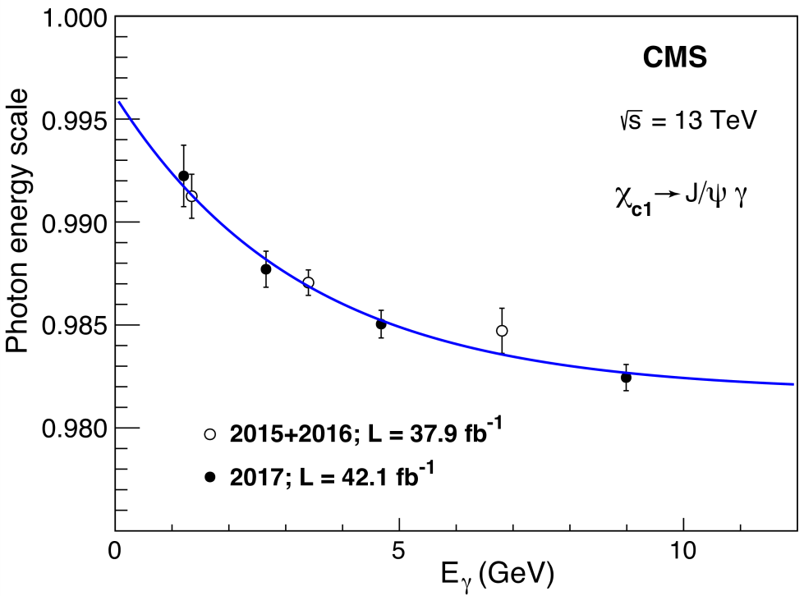
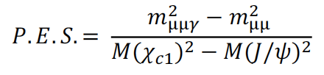
Photon Energy Scale Correction
The photons produced in the χ_{b}(3P) → ϒ(3S) γ
radiative decays are identified through their
conversions to electron-positron pairs inside the
CMS tracker.
For higher energy resolution we consider
only identified conversions to e⁺ e⁻ pairs
The selected photons have |η^{γ}| < 1.2 and p_{T}^{γ}> 500MeV
The measurement of the energy scale in the relevant
energy range is calibrated thanks to a large sample of
decays χ_{c1}→ J/ψ γ → μ⁺μ⁻ γ similarly reconstructed
CMS-BPH-17-008 and arXiv: 1805.11192 [hep-ex]
Photon energy scale (PES) as a function of photon energy, calibrated using χ_{c1}→ J/ψ γ → μ⁺μ⁻ γ events.
The fitted result is then used for the event-by-event correction of the photon energy entering in the computation of the ϒγ invariant mass.
Notes:
To accurately measure the invariant mass of the Chi_b(3P) candidate, the photon energy scale
(PES) must be calibrated. The PES, defined as the ratio between the reconstructed and true
energy, is measured using a sample of Chi_c1 → J/psi gamma → mu+mu- gamma events, through the ratio …where invariant masses, and M(cc1) and M(J/y) are the world-average masses [33] of the Chi_c1 and J/psi states. The valuesare obtained in several bins of photon energy, profiting from a large J/psi→ mu mu data sample collected in the same running periods as the Yupsilon → mm data. The energy spectrum of the cc1 ! J/y g photons covers the range relevant for the U g analysis. The PES values, shown in Fig. 2 as a function of the measured photon energy, Eg, are parametrized with the function p0 + p1 exp(-Eg/p2), where p0, p1, and p2 are free parameters in the fit. The resulting function is then used for the event-by-event correction of the photon energy in the computation of the U g invariant mass.
Figure 2: The PES as a function of the measured photon energy, obtained using cc1 ! J/y g
decays from the 2015–2016 (open circles) and 2017 (filled circles) data samples. The points are drawn at the average Eg in each bin. The curve represents the parametrization mentioned in the text.
Photon energy scale (PES) as a function of photon energy, measured using χ_{c1}→ J/ψ γ → μ⁺μ⁻ γ events, for the 2016 (open circles) and 2017 (closed circles) samples.
The energy spectrum of the chi_c1 → J/y gamma photons covers the range relevant for the Upsilon gamma analysis.
The results are fitted, with the function p0 + p1 exp(-E_{γ}/p2), then used for the event-by-event correction of the photon energy entering in the computation of the ϒγ invariant mass.

Slide 18
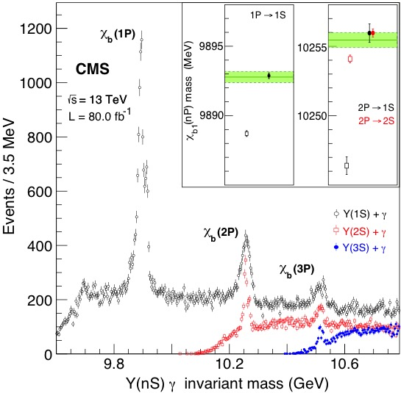
χ_{b}(nP) Candidates and Calibration Check
CMS-BPH-17-008 and arXiv: 1805.11192 [hep-ex]
The graph shows all candidates of
chi_b states reconstructed as Y(nS)γ
in 80/fb of 13-TeV collisions
The calibration of the PES brings
the measured masses to agree with
one another and with the WA
The graph also shows that the
mass resolution of Yγ pairs worsens
as the photon energy increases
(e.g. 2 MeV → 7 MeV → 15 MeV
in χb(nP) decays to 3S,2S,1S)
only the Y(3S)γ decay is used in
the measurement of the mass splitting
The world-average values are represented by the horizontal bands, widths equal to their total uncertainties.
Notes:
la riflessione e' Y2S -> chib(1P) + gamma -> Y1S + gamma, e tu associ con il fotone sbagliato
This is the first time that the two states are individually observed.
This measurement fills a gap in the spin-dependent bottomonium spectrum below the openbeauty threshold and should significantly contribute to an improved understanding of the nonperturbative spin-orbit interactions affecting quarkonium spectroscopy
This is the first time that the J = 1 and 2 states are well resolved and their masses individually measured:
10 513.42 _ 0.41 (stat) _ 0.18 (syst)MeV and 10 524.02 _ 0.57 (stat) _ 0.18 (syst)MeV;
they are determined with respect to the world-average value of the U(3S) mass, which has an uncertainty of 0.5MeV.
The mass splitting is measured to be 10.60 _ 0.64 (stat) _ 0.17 (syst)MeV.
*Figure 3: The invariant mass distributions of the cbJ ! U(nS) g candidates (n = 1, 2, 3), after the PES correction. The inset shows the cb1(1P) and cb1(2P) masses fitted before (open squares) and after (filled circles) the PES correction, with vertical bars representing the statistical uncertainties.
The world-average values [33] are shown by the horizontal bands, with dashed lines representing their total uncertainties.
*THE Figure shows the PES-corrected U(nS)-photon invariant mass distributions, with n = 1, 2, 3.
The U(1S) g and U(2S) g events are selected with the same criteria as used for the U(3S) gamma events, except that the dimuon invariant mass is required to be between M(U(1S)) 􀀀 2.5 sm(y) and M(U(1S)) + 2 sm(y) and within M(U(2S)) _ 2 sm(y), respectively.
The prominent cb(1P) and cb(2P) peaks seen in the U(1S) g and U(2S) g distributions in Fig. 3 are fit using a procedure analogous to the one described in the next paragraph. The resulting Chi_b1(1P) and Chi_b1(2P) masses are in agreement with the world-average values [33], as shown in the inset, confirming the validity of the PES correction function.
*Fig. Invariant mass distribution of the cbJ ! U(nS) g candidates (n = 1, 2, 3), after PES correction. The inset shows the cb1(1P) and cb1(2P) masses fitted before (open squares) and after (closed circles) the PES correction, with error bars representing statistical uncertainties.
The world-average values [8] are represented by the horizontal bands, of widths equal to their total uncertainties.

Slide 19
The χ_{b1}(3P) & χ_{b2}(3P) Mass Splitting
CMS-BPH-17-008 and arXiv: 1805.11192 [hep-ex]
χ_{b}(3P)→γ ϒ(3S)
First observation (>>5σ) of the doublet structure of the χ_{b}(3P) resonance
The ΔM between the J = 1 and 2 states is significantly larger than 2 MeV → this supports the standard mass hierarchy
NEW
Mass resolution
around 2.2MeV
Significantly constrains theor. predictions, which give mass splits in the range [-2, 18] MeV
ΔM=M(χ_{b2}(3P)) - M(χ_{b1}(3P)) = 10.60 ± 0.64 (stat) ± 0.17 (syst) MeV
M(χ_{b1}(3P) = 10,513.42 ± 0.41 (stat) ± 0.18 (syst) ± 0.5 (ϒ(3S)) MeV
M(χ_{b2}(3P) = 10,524.02 ± 0.57 (stat) ± 0.18 (syst) ± 0.5 (ϒ(3S)) MeV
Notes:
Figure 4: Invariant mass distribution of the cbJ(3P) ! U(3S) g candidates. The vertical bars are the statistical uncertainties. The curves represent the contributions from the two signal peaks, the continuum background, and their sum.
In summary, data samples collected by CMS in pp collisions at 13 TeV, in the years 2015, 2016, and 2017, were used to measure the invariant mass distribution of the cb(3P) ! U(3S) g candidates, with the U(3S) detected in the dimuon decay channel and the photon reconstructed through conversions to e+e􀀀 pairs. The measured distribution is well reproduced by the super position of the cb1(3P) and cb2(3P) quarkonium states, on the top of a smooth underlying continuum caused by uncorrelated dimuon-photon combinations.
The mass difference between the J = 1 and 2 states is measured to be:…
The DM between the J = 1 and 2 states is significantly larger than 2 MeV: this supports the standard mass hierarchy.
This measurement fills a gap in the spin-dependent bottomonium spectrum below the open beauty threshold and should significantly contribute to an improved understanding of the nonperturbative spin-orbit interactions affecting quarkonium spectroscopy.
The J = 1 and J = 2 states are well resolved thanks to a mass resolution around 2.2MeV.
Figure 4 compares the measured U(3S) g invariant mass distribution with the result of an unbinned extended maximum-likelihood fit to the superposition of the cb1(3P) and cb2(3P) signal peaks plus a smooth underlying background resulting from uncorrelated dimuon-photon pairs. The background contribution is described by the function (m 􀀀 q0)l exp [n(m 􀀀 q0)],
previously used in Refs. [6, 7], where m is the cb(3P) candidate invariant mass, l and n are free parameters, and q0 is fixed to 10.4GeV. Each of the two signal peaks is described by a double sided Crystal Ball function [9], which complements a Gaussian core with low- and high-masspower-law tails, defined by the transition points (aL,H) and the power-law exponents (nL,H). The tails of the signal functions, identical for both cbJ peaks, are defined by the parame93

Slide 20
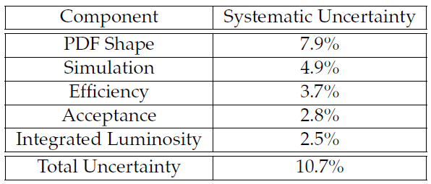
Search for Double Y Production
Exciting new spectroscopy of exotic hadrons – possible tetraquark states included - leads to interest in double quarkonium production
  So far, J/psi pair production seen by NA3, LHCb, CMS; J/psi Y production claimed by D0
Production of pairs should be contributed by SPS and DPS mechanisms
  SPS described by NRQCD
    For J/Psi pair production, CS prevalent for low pT and CO dominant at higher pT
    Less clear for Y →observation can provide input to theoretical models of production
CMS search is based on 20.3/fb of 8 TeV pp collisions, from trigger requiring one dimuon pair in [8.5-11] GeV window
  four muon events selected with Qtot=0 from same vertex
Likelihood fit is performed to 2D distribution of mass-ordered pairs of Y candidates, with 5 components:
  Y(1S)Y(1S) signal
  Y(2S)Y(1S) signal
  Y(1S) + combinatorial
  Y(2S) + combinatorial
  pure combinatorial
38+-7 Y(1S)Y(1S) candidates extracted from fit
>>5σ significance incl. systematics

Slide 21
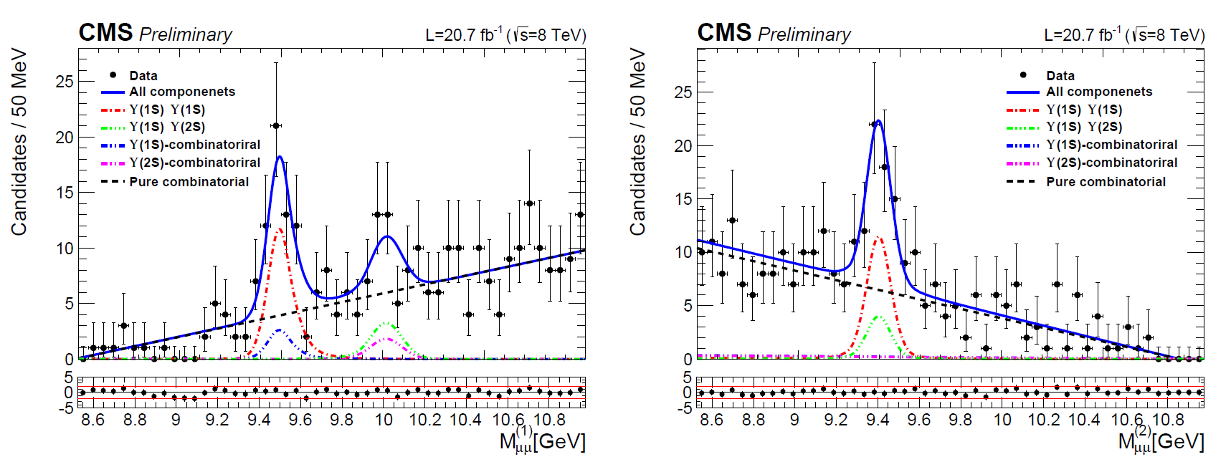
Fit Projections
The 2D fit evidences the presence of a strong Y(1S)Y(1S) signal as well as a possible smaller Y(1S)Y(2S) component (not claimed)
Mass distribution of higher-mass pair Mass distribution of lower-mass pair

Slide 22
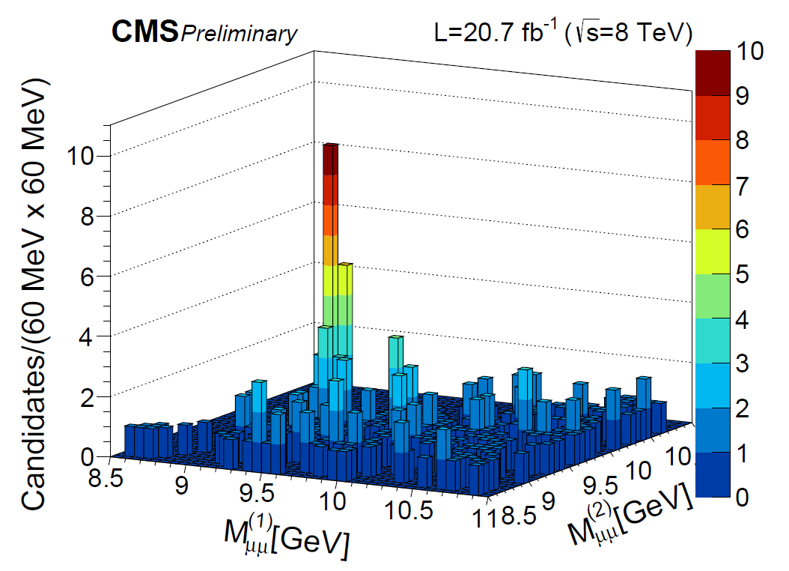
Double ϒ Production Signal and Cross Section
Taking into account selection efficiency, luminosity, and acceptance of fiducial cuts the
signal is converted into an estimate of the cross section for p_{T}<50 GeV, |y|<2.0:
σ = 68.8 +- 12.7 +- 7.4 +- 2.8 pb, in agreement with SPS calculation with 10-30% contribution
from DPS. Published in JHEP 05 (2017)013, arXiv:1610.07095

Slide 23
Summary
Data samples collected by CMS in pp collisions at 13 TeV, in the years 2015, 2016 and 2017, have been used to produce several competitive results on quarkonium production, properties and spectroscopy
Double-differential production cross section measurements of J/ψ, ψ(2S) and ϒ(1,2,3S) have been produced at √s= 13 TeV in a single analysis
The mass difference of χ_{b1,2}(3P) has been measured for the first time, ruling out most models and favoring those predicting a direct mass hierarchy i.e. M(χ_{b1}(3P)) < M(χ_{b2}(3P)). These results will contribute to consolidate the underlying hypotheses of NRQCD and provide further input to constrain the theory.
Double Y(1S) production has been conclusively observed by CMS, and the cross section measured in agreement with NRQCD
For more published or preliminary results see:
http://cms-results.web.cern.ch/cms-results/public-results/publications/BPH/index.html
http://cms-results.web.cern.ch/cms-results/public-results/preliminary-results/BPH/index.html
Notes:
A dimuon mass resolution of 18-40 MeV (depending on rapidity), a secondary vertex resolution of 25 μm, and high muon detection and identification capabilities made this possible. Over 15 onia-related publications.
In summary, data samples collected by CMS in pp collisions at 13 TeV, in the years 2015, 2016,
and 2017, were used to produce several competitive results on quarkonium properties.
measure the invariant mass distribution of the cb(3P) ! U(3S) g can152
didates, with the U(3S) detected in the dimuon decay channel and the photon reconstructed
153 through conversions to e+e􀀀 pairs.This measure158
ment fills a gap in the spin-dependent bottomonium spectrum below the open beauty thresh159
old and should significantly contribute to an improved understanding of the nonperturbative
160 spin-orbit interactions affecting quarkonium spectroscopy.
Cross section measurements show good consistency with NLO NRQCD
for prompt and FONLL non-prompt productions
The measurements of quarkonium production by LHCb, CMS, and ATLAS show that current NRQCD models well describe cross sections, (but fail to account for the null polarization)

Slide 24
SPARES

Slide 25
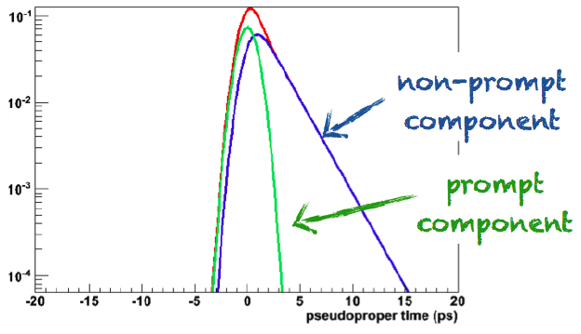
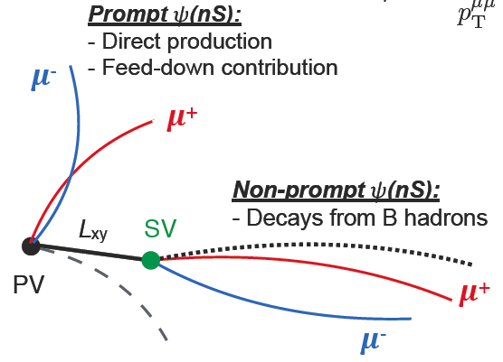
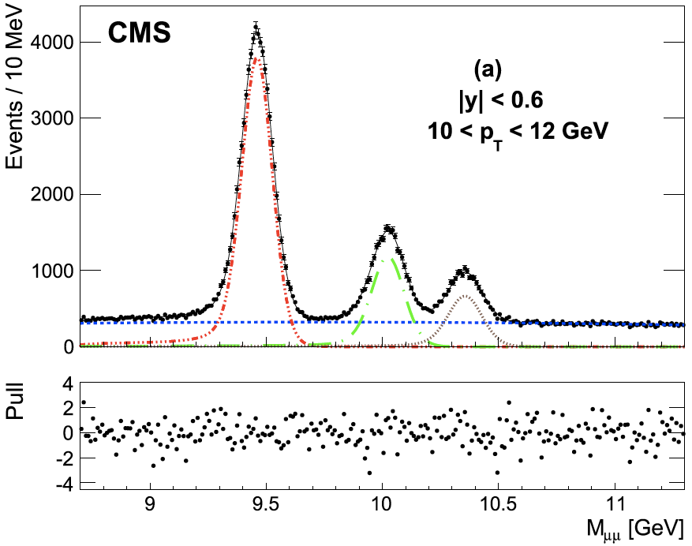
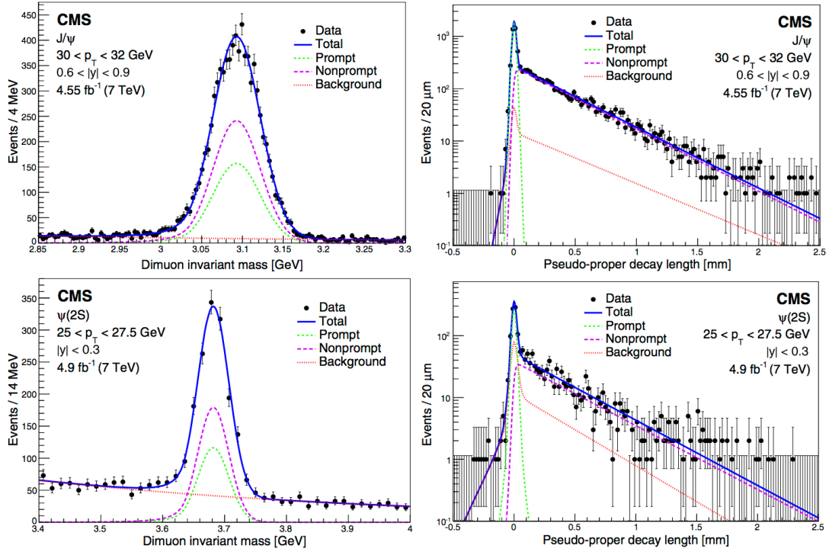
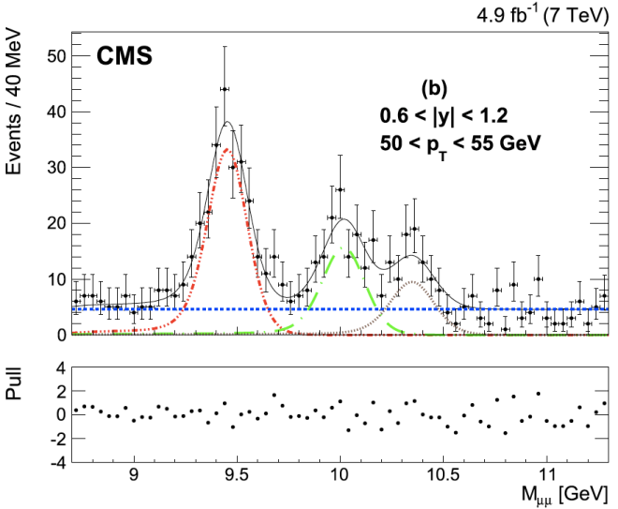
Mass fits and yields @7 TeV
Pseudo-proper time measured with precision tracking
To measure prompt and non-prompt yields simultaneously and disentangle the two contributions CMS exploits a fit on dimuon invariant mass and pseudo-proper time.
ϒ(1S)
ϒ(2S)
ϒ(3S)
7 TeV
PRL 114 (2015) 191802
J/ψ
7 TeV
ϒ(1S,2S,3S):
ψ(2S)
PLB 749 (2015) 14
Notes:
Prompt: direct production or feed-down from heavier quarkonium states, no long pseudo-proper-time tail - NonPrompt: i.e. from decays of B hadrons, long pseudo-proper-time tail , fitted to produce fractions
To measure prompt and non-prompt yields simultaneously and disentangle the two contributions CMS exploits an unbinned fit to 2D dimuon mass and pseudo-proper time.
FIG. L Projections on the dimuon invariant mass (left) and pseudo-proper-decay-length (right) axes, for the J/ψ (top) and ψ(2S) (bottom) events in the kinematic bins given in the plots. The right panels show dimuons of invariant mass within +-3σ_CB of the pole masses. The curves, identified in the legends, represent the result of the fits described in the text. The vertical bars on the data points show the statistical uncertainties.
Fig.R. Results of the fits to the dimuon invariant mass distribution for events in two bins: (a): |y| <0.6, 10 <pT<12 GeV and (b): 0.6 <|y| <1.2, 50 <pT<55 GeV. The solid line is the result of the full fit. The dash-dotted line is the ϒ(1S)signal fit, the long-dashed line is the ϒ(2S)signal fit, and the dotted line is the ϒ(3S)signal fit. The short-dashed line is the background contribution. The lower plots show the pull for each mass bin.
Prompt produced in primary vertex or from feed down. Non prompt J/psi and psi(2S) from B hadrons.
Υ(nS)→μ⁺μ⁻ decays
Fiducial cross section → correcting only for reconstruction and trigger ε in a restricted phase-space
Corrected cross section, correct also ϒ kinematic acceptance, full phase space
The ct signal is the sum of a delta (P) and decay (NP) function, convolved with a gaussian resolution function.
The ct background also has P and NP components

Slide 26
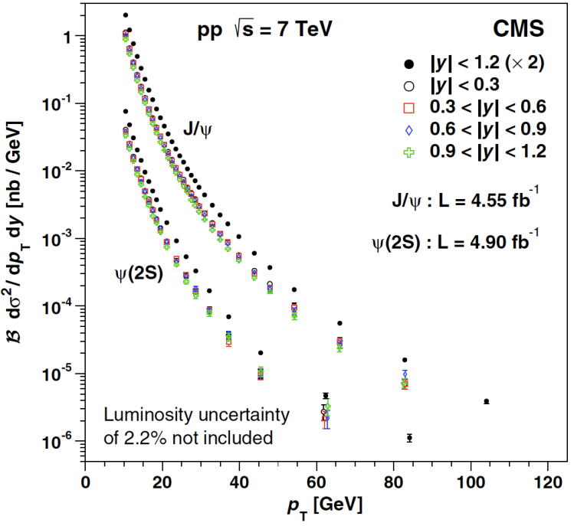
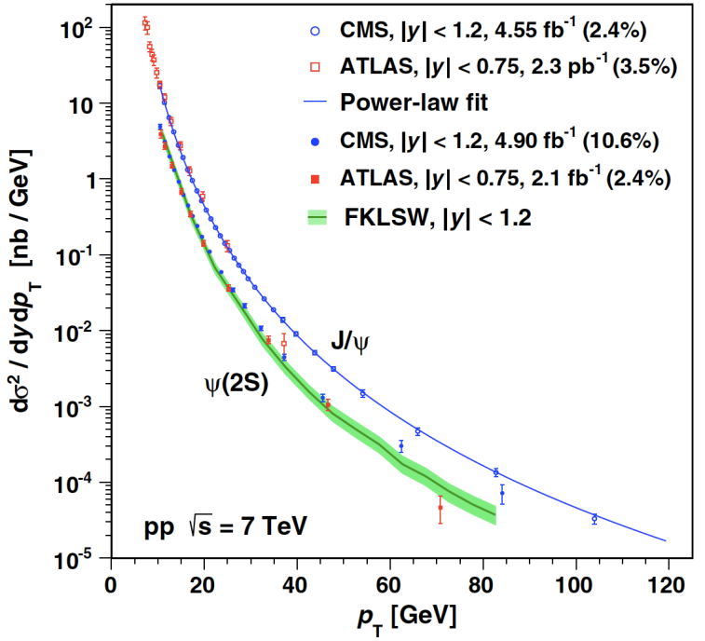
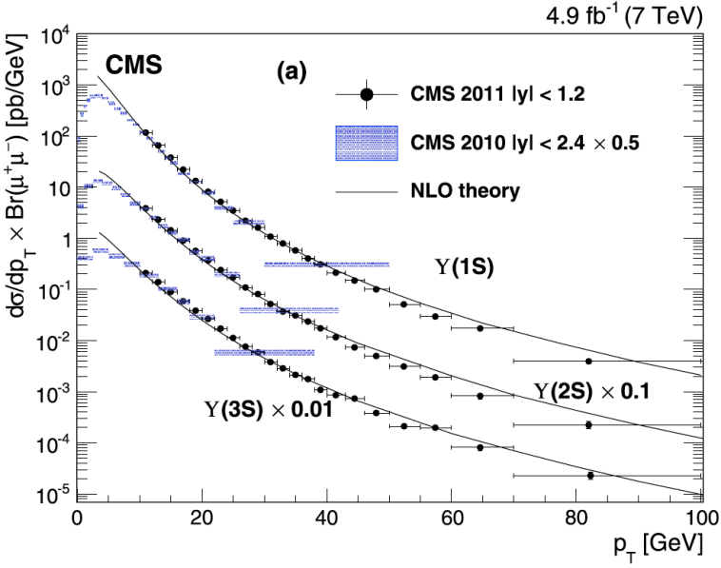
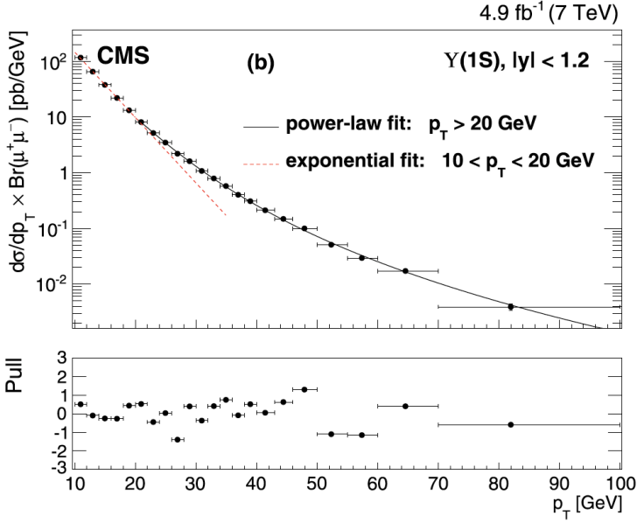
Prompt Production @7 TeV
[uncertainties from int. luminosity and branching fractions not included ]
Charmonium S-wave states production
Blue curve shows a power-law fit to J/ψ cross sections.
The green band labeled FKLSW re-presents a calculation of the ψ(2S) cross section using LDMEs determi-ned with lower p_{T} LHC data.
assuming unpolarized scenario
PRL 114 (2015) 191802
Bottomonium S-wave states production
All three Y(nS) states show similar trends.
Transition from exponential to power law behaviour at
p_{T} ~ 20 GeV/c
(fit holds for all three states)
[uncertainties from lumi int. not included ]
PLB 749 (2015) 14
Notes:
FIG. TOP L. The J/ψ and ψ(2S) differential pT cross sections times the dimuon branching fractions for four rapidity bins and integrated over the range |y| < 1.2 (scaled up by a factor of 2 for presentation purposes), assuming the unpolarized scenario. The vertical bars show the statistical and systematic uncertainties added in quadrature.
FIG. TOP R. The J/ψ (open symbols) and ψ(2S). (closed symbols) differential (unpolarized) cross sections from this analysis (circles) and from ATLAS (squares) [14,15]. The vertical bars show the statistical and systematic uncertainties added in quadrature, not including the uncertainties from integrated luminosities and branching fractions, which are indicated by the percentages given in the legend. The curve shows a fit of the J=ψ cross section measured in this analysis to a power-law function, while the band labeled FKLSW represents a calculation of the ψ.2S. cross section using LDMEs determined with lower pT LHC data [6].
In summary, the double-differential cross sections of the J/ψ and ψ(2S) mesons promptly produced in pp collisions at 7 TeV have been measured as a function of pT in four |y| bins, as well as integrated over the |y| < 1.2 range, extending up to or beyond p_T=100 GeV. New global fits of cross sections and polarizations, including these high-p_T measurements, will probe the theoretical calculations in a kinematical region where NRQCD factorization is believed to be most reliable. The new data should also provide input to stringent tests of recent theory developments, such as those described [32-34]
Blue curve shows a power-law fit to 4 y bins |y| < 1.2 J/ψ cross sections - FKLSW: calculation of the ψ(2S) cross sec. using LDMEs determined in a global fit of cross secs. And polarizations : ψ(2S) predominantly unpolarized
Fig.Bot
(a) The ϒ(nS) differential pT cross sections times dimuon branching fractions for |y|<1.2. The ϒ(2S)and ϒ(3S)measurements are scaled by 0.1 and 0.01, respectively, for display purposes. The vertical bars show the total uncertainty, excluding the systematic uncertainty in the integrated luminosity. The horizontal bars show the bin widths. Previous CMS measurements for |y|<2.4 are shown as violet cross-hatched areas[2]. These results have been scaled by 0.5 to account for the smaller |y|range in the latest measurement, where the scaling assumes that the rapidity distribution is flat. The solid lines are the NLO calculations from Ref.[13] extended by the authors to cover the range pT<100 GeV.
(b) Details of the parametrized cross section fit described in the text for ϒ(1S)with |y| <1.2. In this plot the solid line is the result of the power-law fit (see Eq.(6)) for pT>20 GeV. The dashed line shows an exponential fit to the data for 10 <pT<20 GeV. The lower plot shows the pulls of the fit as defined in the text.
- ℬ dsigma^2/(dy dp_T) Significant improvement in terms of precision and pT reach ( pT ≈ 100GeV ) w.r.t. previous CMS results CMS ,e.g. [1]
- ℬ dsigma/dp_T All 3 Y(nS) states show similar trends
Transition from exponential to powerlaw behaviour at pT ~ 20 GeV (fit holds for all the 3 states) NLO calculations from [PRL 112,
032001] have been extended to cover the range pT < 100 GeV and describe data trend for all 3 Y(nS) states
The measurements show a transition from an exponential to a power-law behavior at pT≈20 GeVfor the three ϒ states. Above that transition, the ϒ(3S) spectrum is significantly harder than that of the ϒ(1S). The ratios of the ϒ(3S)and ϒ(2S)differential cross sections to the ϒ(1S)cross section show a rise as pT increases at low pT, then become flatter at higher pT.

Slide 27
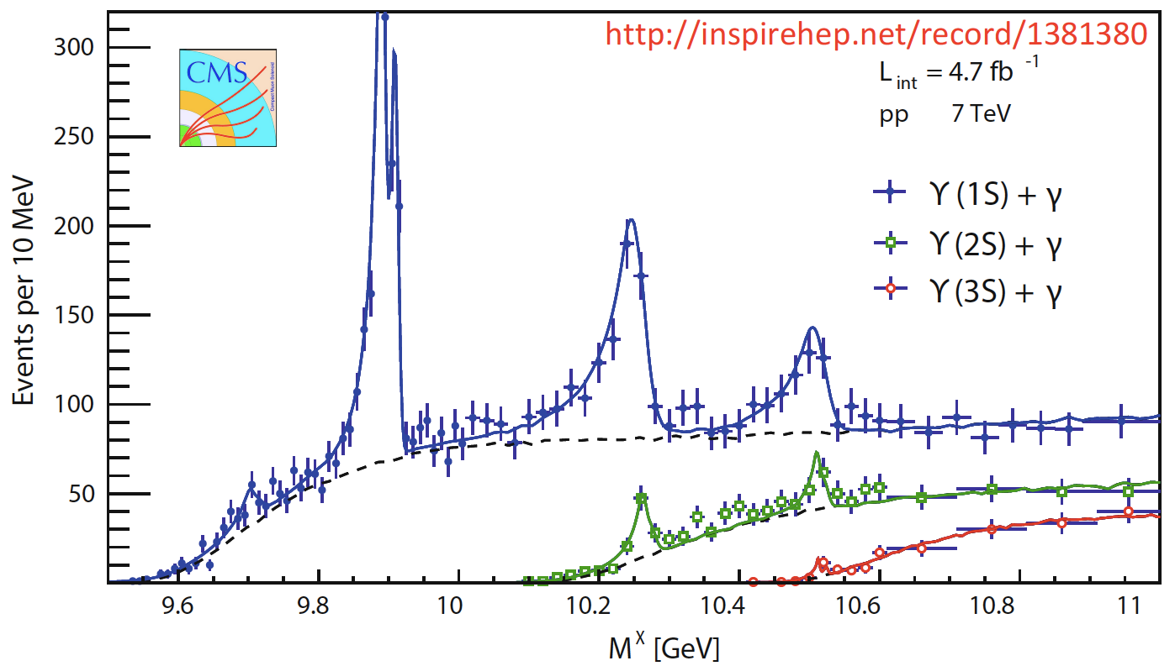
The χ_{b}(3P) States
CMS saw the χ_{b}(3P) in the Y(1S), Y(2S), and Y(3S) radiative decays (7 TeV data).

Slide 28
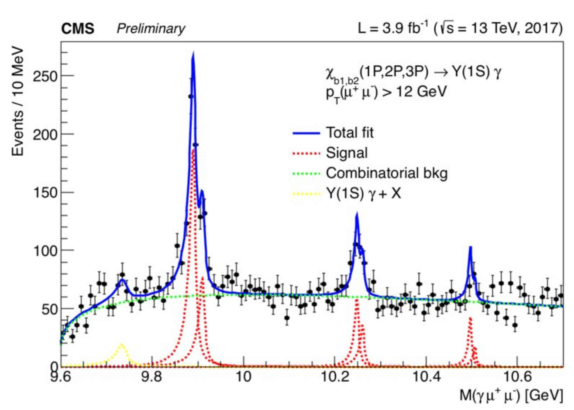
The χ_{b1}(3P) and χ_{b2}(3P) states
χ_{b} → γ ϒ(→ μ⁺ μ⁻)
● Trigger conditions: opposite-sign muon pair with invariant mass in range 8.5-11.5 GeV, p_{T} > 12 GeV, single muons |η| < 1.5 and vertex-fit probability > 0.5%
● The ϒ has p_{T} > 12 GeV
● The γ is a converted photon
● The distance between the ϒ and the γ vertices along the beam direction is < 1 mm
● The system has a vertex-fit probability > 1%
● Fit method: unbinned extended maximum likelihood
○ Signal: double side Crystal Ball for each peak with common n, α
  - m(χ_{b2}) – m(χ_{b1}) fixed to
  previous CMS results
  - first peak corresponds to the misreconstructed decay
  χ_{b}(2P) → γ ϒ(2S) (→ ϒ(1S) π⁺π⁻)
○ Background: exponential times power law
CMS-DP-2017-029
Mass χ_{b1}(1P) =9.890 0.001 (stat) GeV; Mass χ_{b2}(1P) =9.910 0.001 (stat) GeV
Mass χ_{b1}(2P) =10.248 0.001 (stat) GeV; Mass χ_{b2}(2P) =10.260 0.001 (stat) GeV
Mass χ_{b1}31P) =10.497 0.001 (stat) GeV; Mass χ_{b2}(3P) =10.507 0.001 (stat) GeV

Slide 29
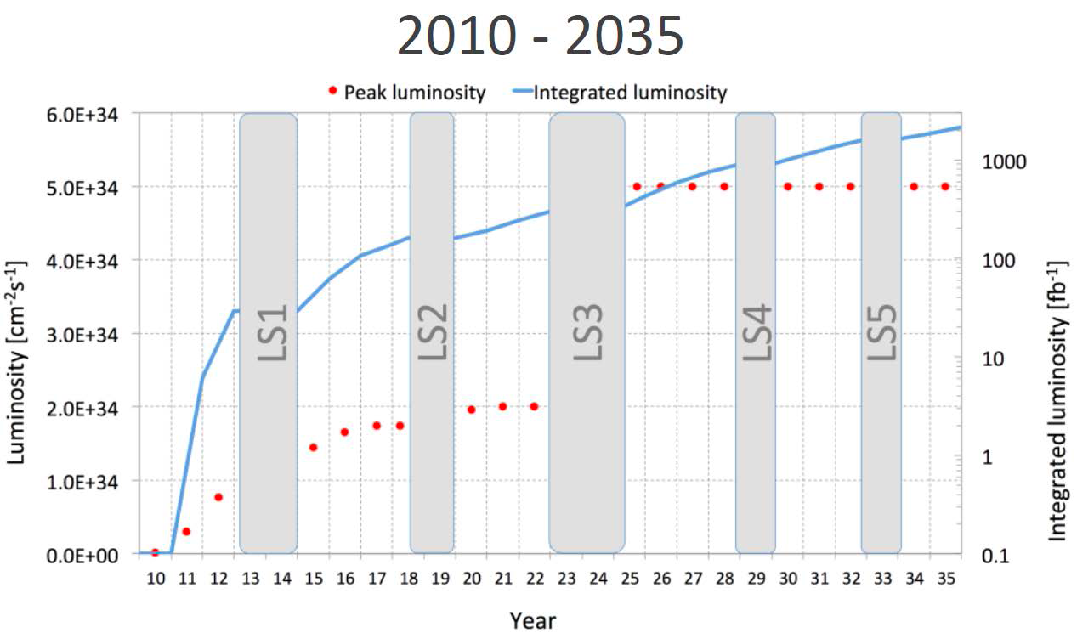
LHC – 2010-2035
~3000 fb⁻¹
~300 fb⁻¹
7-8 TeV
13 TeV
~30 fb⁻¹
Run 1
Run 2
Run 3
Higgs
Phase II
Major Achievement: Higgs discovery and characterization → Mass, spin, coupling, …
Top Quark: LHC is a top quark factory → High precision measurements: mass, decays, spin…
Searches for SUSY and other exotic particles BSM → Many limits for masses and couplings
Notes:
Run 2 start on 23 June 2015.

