Slide 1
Preliminary integration studies for 3rd TCDS block
C. Wiesner, C. Bracco
WP14 Meeting
June 27, 2017

Slide 2
Outline
Introduction: TCDS
Aperture for circulating beam
Shielding for MSD
Aperture for extracted beam – nominal case
Aperture for extracted beam – failure cases
Summary

Slide 3
Introduction: TCDS
Protection element for Extraction Septum (MSD).
Design Report, Chap. 17

Slide 4
Composition
TCDS Design V3
[EDMS 458836 v.2.0, EDMS 716298, EDMS 393973 v.2.0]
Final Solution:
    - 0.5m Graphite (density 1.77 g/cm³)
    - 0.5m C-C composite (density 1.9 g/cm³)
    - 2.0m C-C composite (density 1.4 g/cm³)
    - 1.5m C-C composite (density 1.9 g/cm³)
    - 1.0m Graphite (density 1.77 g/cm³)
    - 0.5m Titanium (density 4.5 g/cm³)
high density CfC >1.75g/cm³
was the best
we could find
Move 1st module upstream?
W. Weterings, TCDS material selection and qualification, 20-01-2015

Slide 5
TCDS
To be checked:
1) Aperture for circulating beam
2) Shielding for MSD
3) Aperture for extracted beam – nominal case
4) Aperture for extracted beam – failure cases
[B.Goddard, M.Gyr, LHC Project Note 320, 2003-08-13]
New TCDS with 3rd module

Slide 6
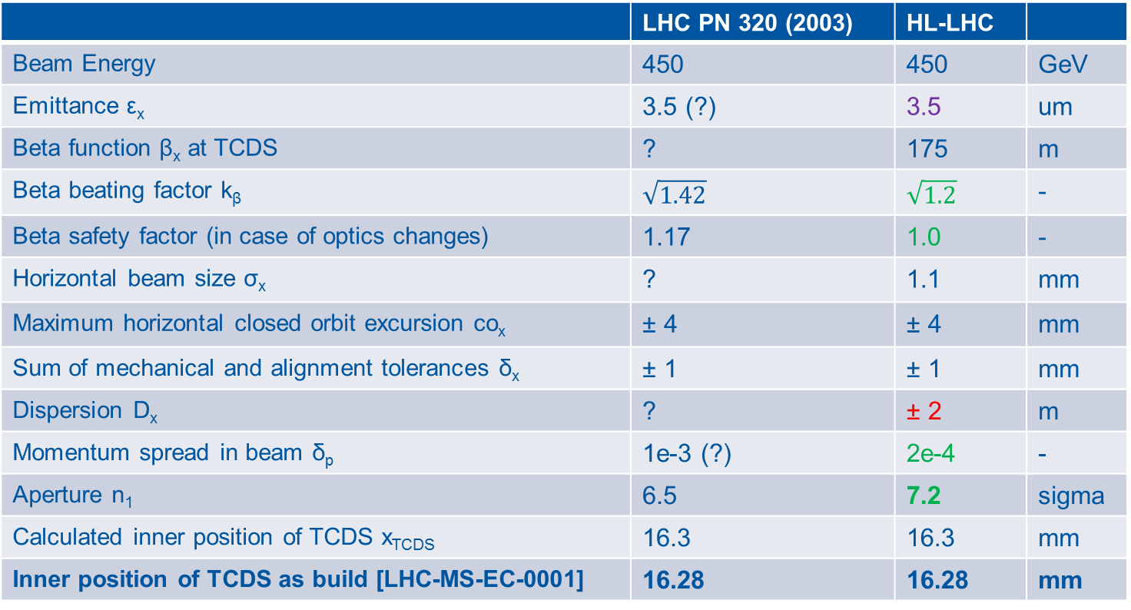
Assumed Parameters
 | LHC PN 320 (2003) | HL-LHC
Beam Energy | 450 | 450 | GeV
Emittance ε_{x} | 3.5 (?) | 3.5 | um
Beta function β_{x} at TCDS | ? | 175 | m
Beta beating factor k_{β} | $$\sqrt{1.42}$$ | $$\sqrt{1.2}$$ | -
Beta safety factor (in case of optics changes) | 1.17 | 1.0 | -
Horizontal beam size σ_{x} | ? | 1.1 | mm
Maximum horizontal closed orbit excursion co_{x} | ± 4 | ± 4 | mm
Sum of mechanical and alignment tolerances δ_{x} | ± 1 | ± 1 | mm
Dispersion D_{x} | ? | ± 2 | m
Momentum spread in beam δ_{p} | 1e-3 (?) | 2e-4 | -
Aperture n₁ | 6.5 | 7.2 | sigma
Calculated inner position of TCDS x_{TCDS} | 16.3 | 16.3 | mm
Inner position of TCDS as build [LHC-MS-EC-0001] | 16.28 | 16.28 | mm
[B.Goddard, M.Gyr, LHC Project Note 320, 2003-08-13]

Slide 7
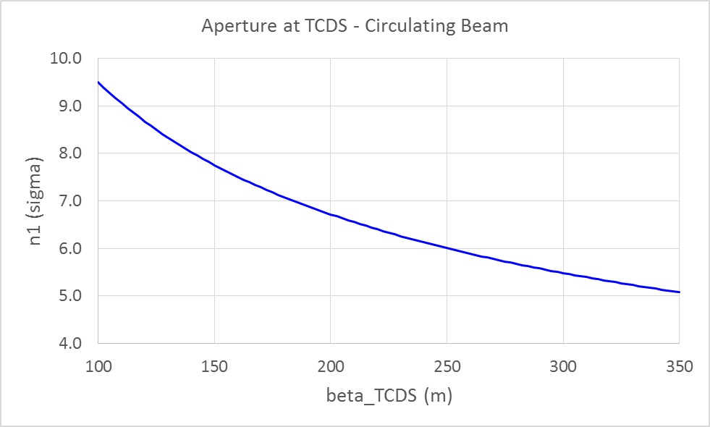
Aperture – Circulating Beam
450 GeV
7.2σ
6.5σ
175 m
213 m
For present constraint of max. β_{x} at TCDS = 175 m, the aperture is: n1 = 7.2σ.
Requirement of n1>6.5σ is fulfilled for β_{x} at TCDS < 213 m.

Slide 8
Shielding of MSD
Outside edge of TCDS is given by :
[B.Goddard, M.Gyr, LHC Project Note 320, 2003-08-13]
Current position is x = 39.84 mm [LHC-MS-EC-0001].
Moving TCDS upstream → MSD still protected by the TCDS against primary p+.
Energy deposition of secondary particles to be checked for HL-LHC parameters.
Are mitigations for sudden pressure rise and shockwaves in MSD required?

Slide 9
Aperture – Extracted Beam (Nominal Case)
Assuming that all bunches are on the nominal trajectory that is defined by the nominal kicks of the MKD (15 x 19.0553 urad) and the Q4 (to be discussed).
Using HL-LHC parameters (450 GeV):
  Free aperture for extracted beam with β_{x}=175 m:
  n1 = 5.04σ (old TCDS position)
Moving 1st TCDS module 3.3 m upstream leads to…
geometric aperture reduction for the extracted beam by
3.3 m*373 urad = 1.24 mm
i.e. geometric aperture at TCDS.START is reduced:
  from 13.05 mm to 11.8 mm.
  Free aperture reduced to n1 = 4.2σ (new TCDS position)
Requirements for clean extraction: 4σ at 450 GeV?
Is assumption of 4 mm orbit excursion too pessimistic?

Slide 10
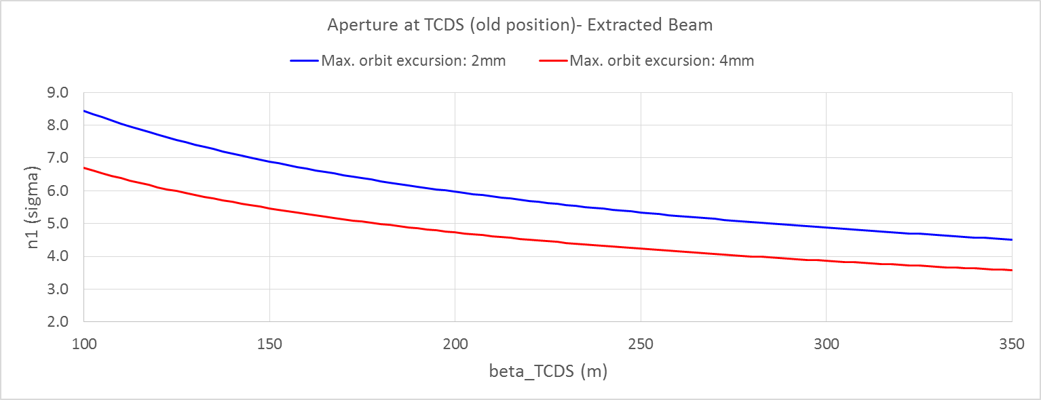
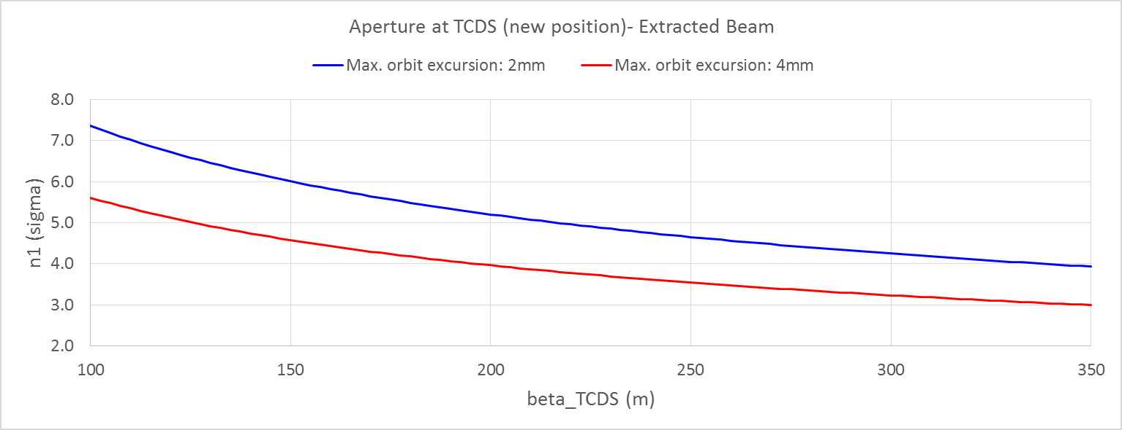
Aperture – Extracted Beam (Nominal Case)
450 GeV
175 m
175 m
Assuming nominal dump trajectory

Slide 11
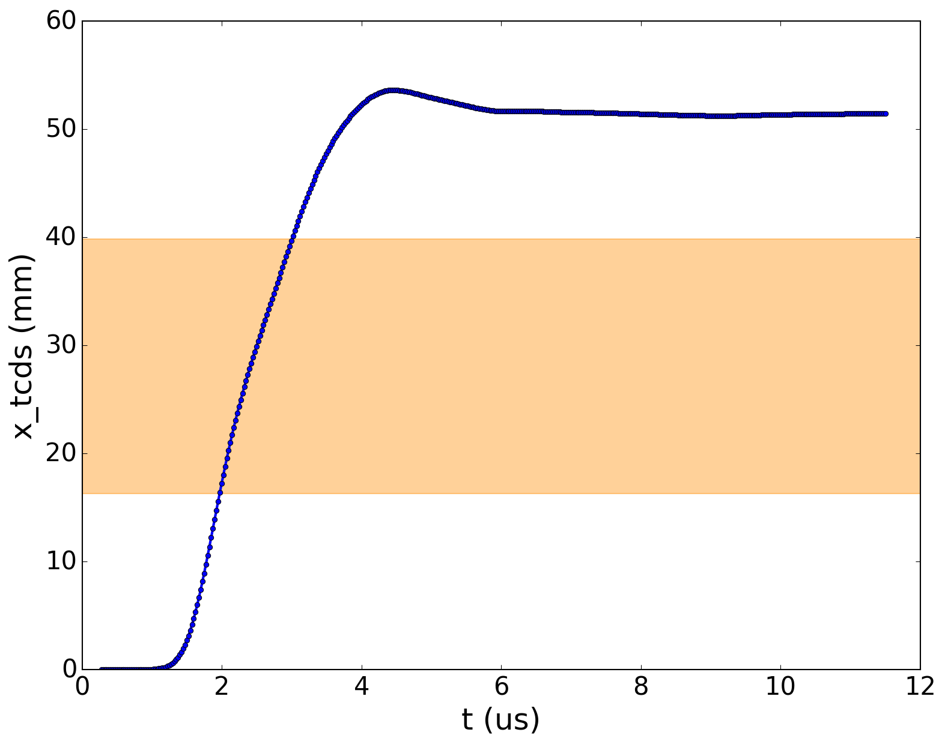
Kick at TCDS
Nominal kick with 15/15 MKD
Simulated using nominal, measured waveform from 2016-07-22, 17h01 dump event
Bucket 1
+
aperture margin
TCDS

Slide 12
Aperture – Extracted Beam (Failure Cases)
Accepted failure case is 14/15 MKD firing.
For worst case of missing MKD.O: deflection of extracted beam is reduced to ≈92%.
Free aperture (incl. 4mm orbit excursion) reduced to
  2.2σ (old TCDS position) and 1.4σ (new TCDS position)
Conclusion 2003: “it is clear that, for even moderate orbit excursions, the TCDS will receive some beam in the event of an MKD missing, with the attendant risk of quenches in downstream superconducting magnets or of damage to the TCDS” [LHC Project Note 320]
→ To be checked with energy-deposition studies for
HL-LHC parameters.

Slide 13
Aperture Measurements
Aperture measurement for extracted beam were performed in May 2017 during LHC recommissioning at 450 GeV.
Aperture margin of more than ±1 MKD confirmed for nominal beam parameters.
Beam | Losses
Beam 1 | Start seeing losses on TCDS at 13 MKD and no losses for 16 MKD
Beam 2 | Start seeing losses on TCDS at 12 MKD and 17 MKD

Slide 14
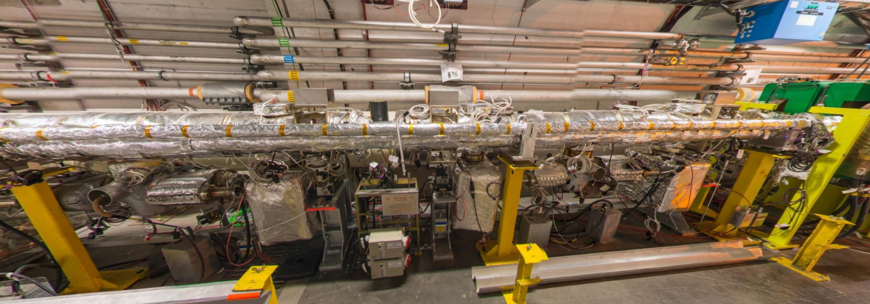
Integration: Tunnel View
MSD
TCDS
Beam 1

Slide 15
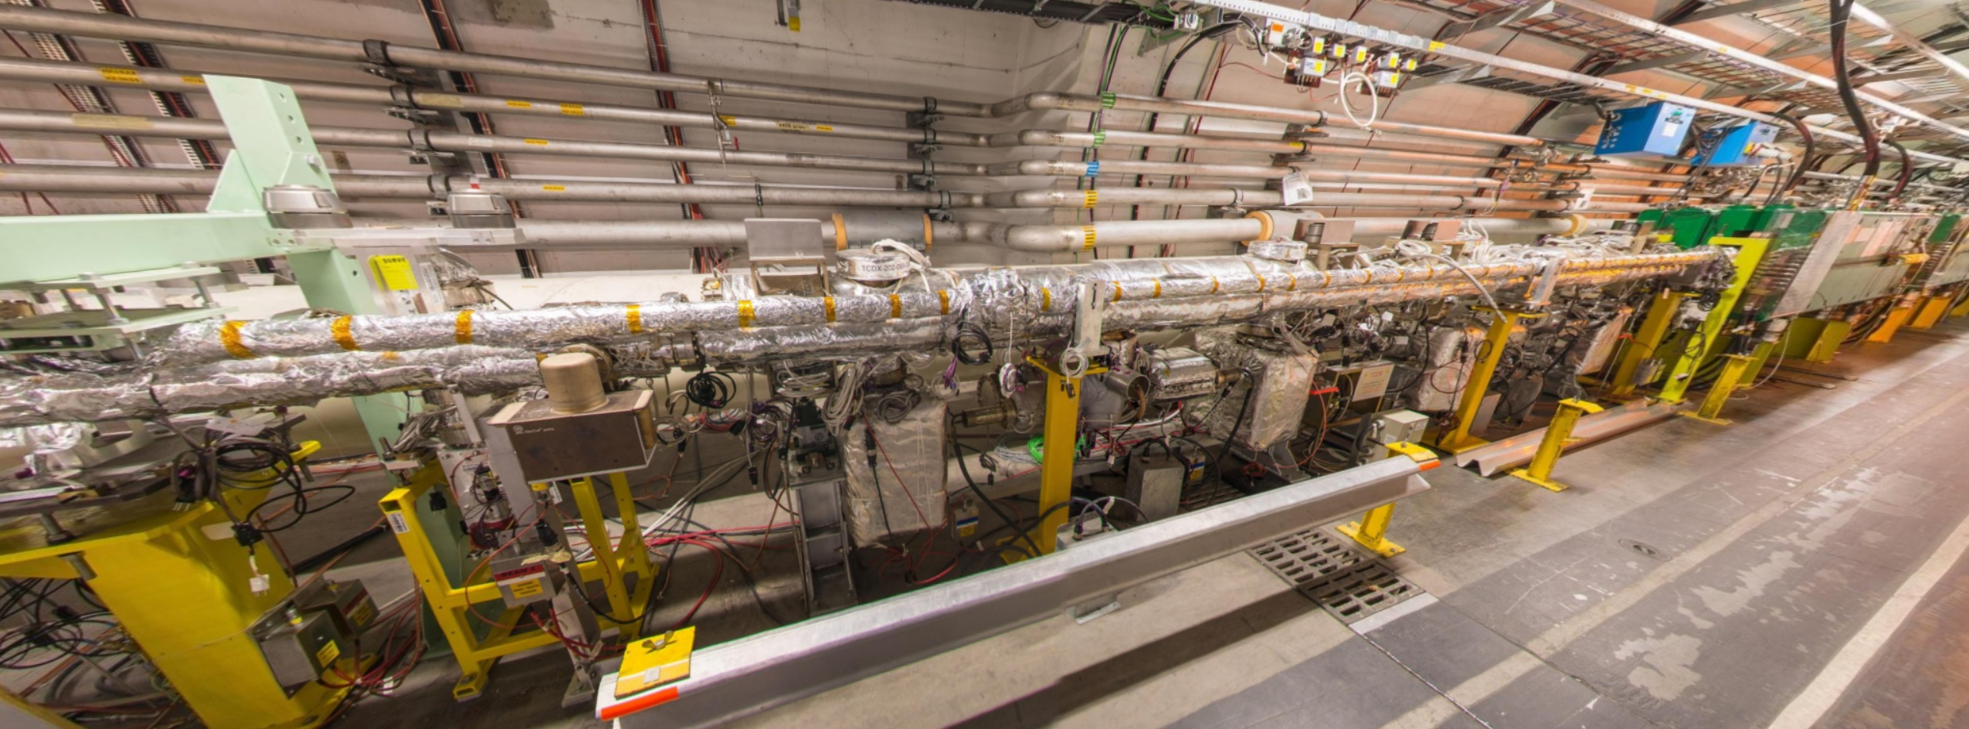
Integration: Tunnel View
TCDS
MSD
Beam 1
Upstream elements:
BTVSE.A4L6.B1, BPMSE.4L6.B1, BPMSA.A4L6.B1, BPMSA.B4L6.B1
and vacuum components.
Distance to MKBH.B2 > 60 m.

Slide 16
(Preliminary) Conclusions
Aperture for circulating beam: n1>6.5σ ☺
Shielding for MSD: OK for primary p+. To be checked for secondaries. 😐
Aperture for extracted beam – nominal case: n1>4σ 😐
Aperture for extracted beam – failure cases:
For worst-case assumptions: losses at TCDS expected for 14/15 MKDs ☹
Energy-deposition studies required for the HL-LHC parameters.
Physical integration of 3rd module seems possible (to be confirmed).

Slide 17
Thank you for your attention!

Slide 18
Aperture Measurements
Aperture measurement for circulating beam performed in May 2017 during LHC recommissioning.
Free aperture confirmed.
Plane | Beam | Aperture
Horizontal | Beam 1 | +15 mm (TCDS)/ -20 mm (TCSP)
 | Beam 2 | +15 mm (TCSP)/ -16 mm (TCDS)
Vertical | Beam 1 | +16 mm (TCSP)/ -19 mm (TCSP)
 | Beam 2 | +17 mm (Q5)/ -18 mm (Q5)

Slide 19
Shielding of MSD
[B.Goddard, M.Gyr, LHC Project Note 320, 2003-08-13]

