Slide 1
Status of the B-train
for the PSB Upgrade
Anthony Beaumont, Marco Buzio, Regis Chritin, Martino Colciago, Lucio Fiscarelli,
David Giloteaux, Christian Grech, Anthony Newborough, Marco Roda
TE/MSC
B-train consolidation project status
(including recent PS tests)
PSB test system (b. 361)
PSB Upgrade system (b. 245)
Notes:
Hi Marco,
I guess we would like to get a clear overview of the commissioning status and the outstanding points with planning…
Would that be OK for you?
Can be indeed short...
Cheers,
Bettina

Slide 2
B-train consolidation
project Status

Slide 3
Status of FIRESTORM B-train consolidation project
ELENA - new system being commissioned, White Rabbit provided to new LLRF for H⁻ injection at ~500 G
- repeatability of NMR marker about 0.15 G at both low and high field
- issues being worked on: cross-calibration of the two chains (consistency of high-field markers for gain calibration), drift control on minute-long plateaux, stability when reversing the polarity
PS - tests started in 2014, currently B_{UP}/B_{DOWN} distributed via White Rabbit
- four new CERN/EPFL FMR resonators/oscillators being tested at 497 G,
(OP/SPARE in F, D); up to ~2100 G possible
- first tests with simultaneous feedback of new measurement to RF + POPS (newly implemented PPM)
carried out successfully, more planned next months
- operation with new measurement by default in 2018
- gradual upgrade to production hardware, new coils in LS2
PSB - new sensors + prototype B-train chain installed in b. 361, tests ongoing
- fully new system (incl. reference magnet) to be installed in 245 during LS2
LEIR - electronics and new sensors installed
- major decision (opening of a dipole to install new coils) pending, according to upcoming test results
SPS - survey of available sensors done, 5 NMR probes found still alive, coil signals usable
- electronic racks assembled in the lab, preparations for installation ongoing
AD - only synthetic B-train needed
- prototype hardware ready to be tested, missing general FESA class go get cycles from LSA
Notes:
Marco: can we get final hardware in YETS 2017/8

Slide 4
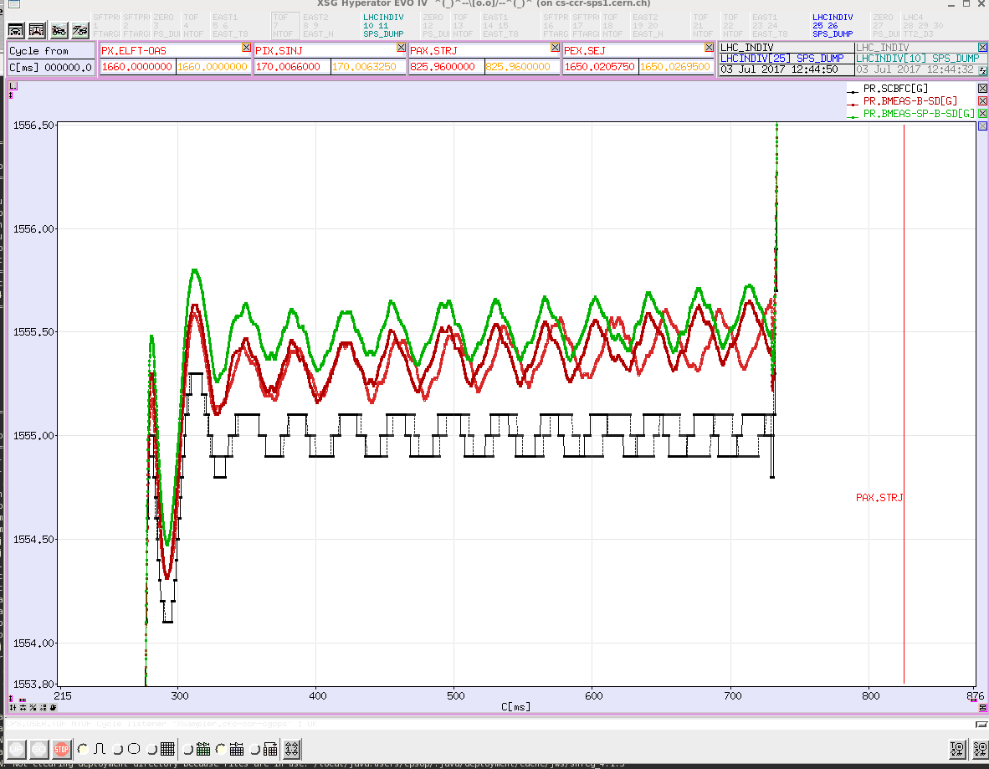
PS system tests (1/5) – Normal operation
oscillation ±0.2 G @ 27 Hz
source not clear, appears when regulating on B_{up}/B_{down}
(irrespective of distribution mode)
observed drift ~1 G/s could be ascribed
to either measurement (or both)
B(t) measured by FIRESTORM B-train
SPARE chain
OP chain
B(t) measured by old B-train (B_{up}/B_{down} pulses), distributed via White Rabbit (WROLDB_BTRAIN)
POPS keeps it ≡ reference within its original resolution 0.1 G
|Bup/Bdown − FIRESTORM| ≤ 0.5 G, FIRESTORM |OP−SPARE| ≤ 0.2 G

Slide 5
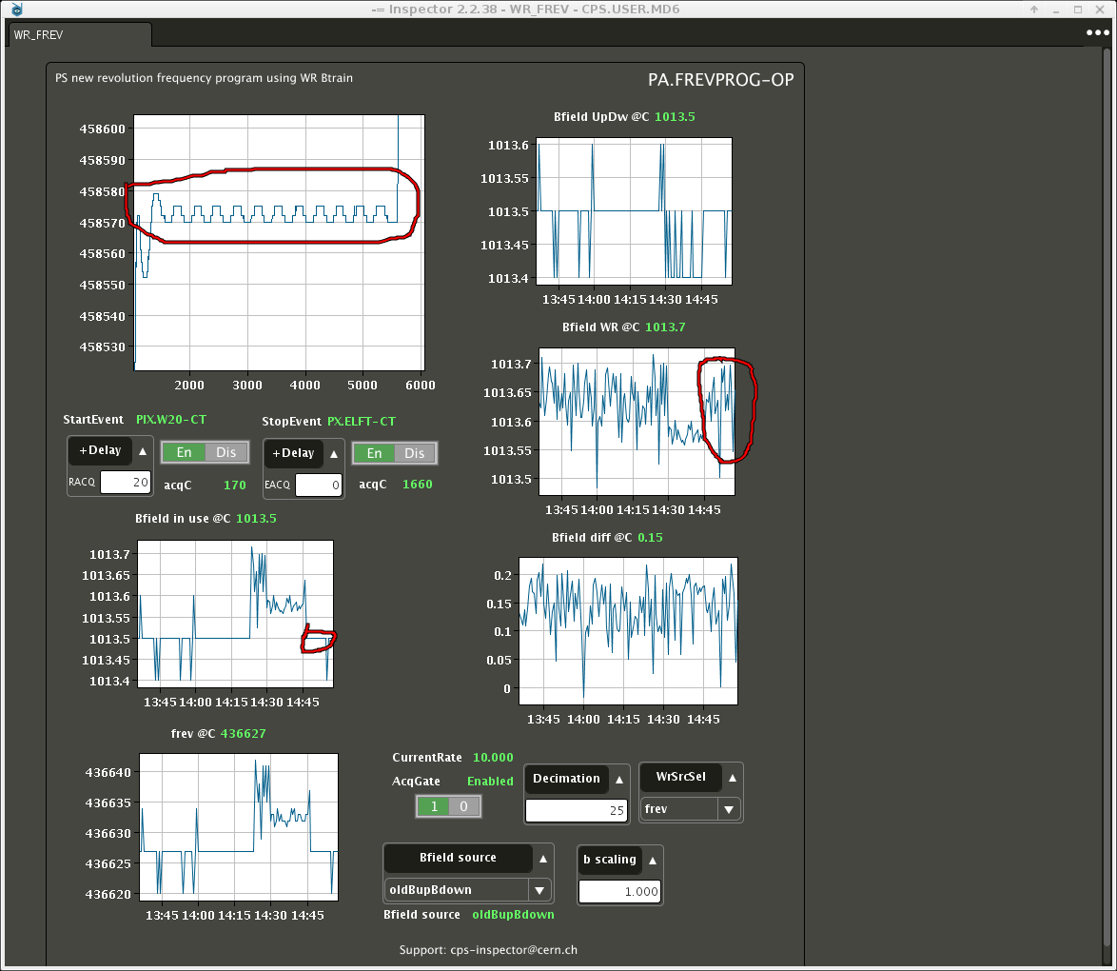

PS system test (2/5): clone of LHC_INDIV
MD2290: 31 May tests w/o beam, 14 June tests with beam on LHC_INDIV
POPS PPM works as intended, no impact on following cycle (for the tested S.C.)
B(t) measured by FIRESTORM B-train feedback to both RF and POPS in PPM
with FIRESTORM: 27 Hz ripple disappears, field resolution from 0.1 to < 0.02 G, frequency resolution from 8 to 1 Hz
feedback from B_{up}/B_{down}
feedback from FIRESTORM B(t)
http://elogbook.cern.ch/eLogbook/event_viewer.jsp?eventId=2371101, http://elogbook.cern.ch/eLogbook/event_viewer.jsp?eventId=2371081

Slide 6
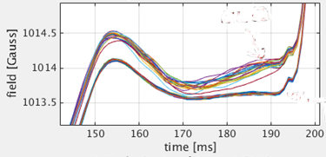
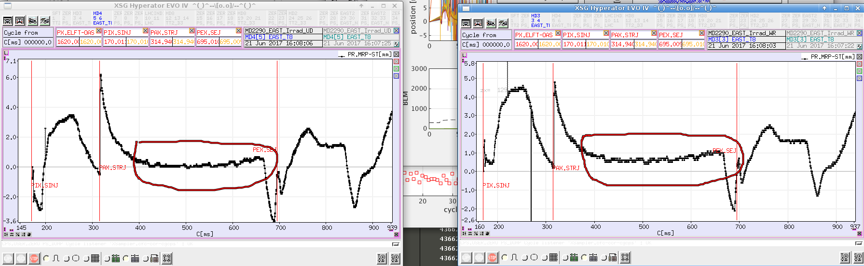
PS system tests (3/5) – EAST
MD2290 June 21: tests with beam on EAST
(w/o nTOF bunch)
B(t) measured by FIRESTORM B-train feedback to both RF and POPS in PPM
FIRESTORM measurement stable within 0.1 G at injection, no apparent oscillations
measurements differ by ≤ 0.5 G
MRP differs by < 1 mm, no BCT/BLM difference
B_{up}/B_{down}
FIRESTORM B(t)
beam MRP [mm]
feedback from B_{up}/B_{down}
beam MRP [mm]
feedback from FIRESTORM B(t)
http://elogbook.cern.ch/eLogbook/event_viewer.jsp?eventId=2378979

Slide 7
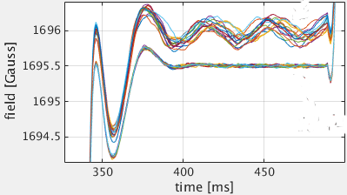
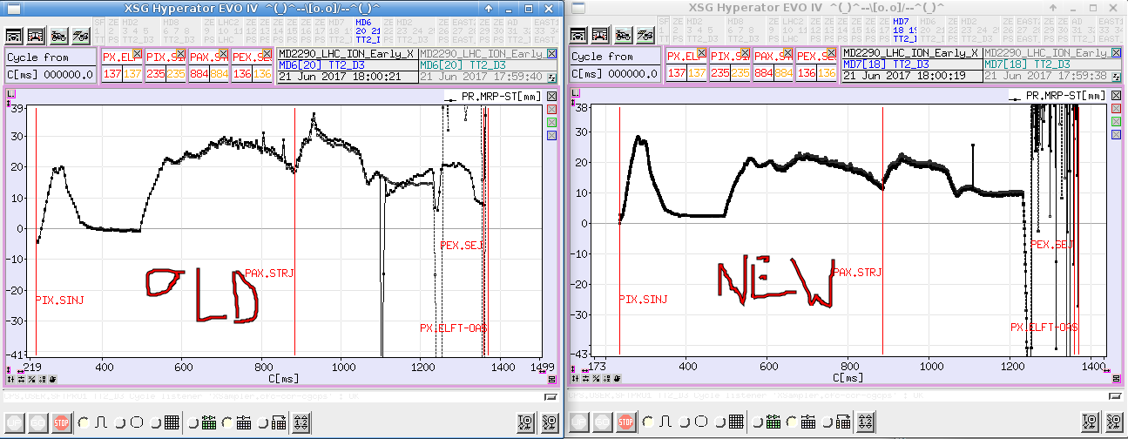
PS system tests (4/5) – ION Xe
MD2290 June 21: tests with beam on ION Xenon
B(t) measured by FIRESTORM B-train feedback to both RF and POPS in PPM
FIRESTORM measurement stable within 0.02 G on intermediate flat-top; 27 Hz oscillations appear on B_{UP}/B_{DOWN}
measurements differ by ≤ 0.8 G
RMS MRP with FIRESTORM smaller by several mm
B_{up}/B_{down}
FIRESTORM B(t)
beam MRP [mm]
feedback from B_{up}/B_{down}
beam MRP [mm]
feedback from FIRESTORM B(t)
http://elogbook.cern.ch/eLogbook/event_viewer.jsp?eventId=2379039

Slide 8
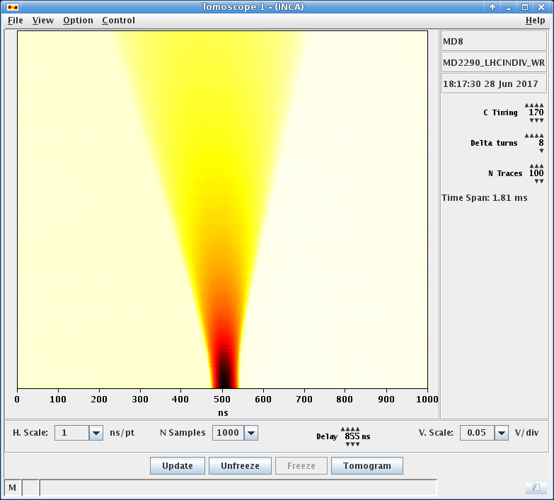
PS system tests (5/5) – Energy matching at injection
MD2290 LHCINDIV_WR 28 June (courtesy of Heiko Damerau)
both radial and longitudinal RF loops switched off immediately after injection at constant and known energy from the PSB
Comparing results between the two measurements → absolute |ΔB| ≤ 0.2 G
B_{up}/B_{down} via WR
FIRESTORM B(t) via WR
http://elogbook.cern.ch/eLogbook/event_viewer.jsp?eventId=2383271

Slide 9
PSB test system
(b. 361)

Slide 10
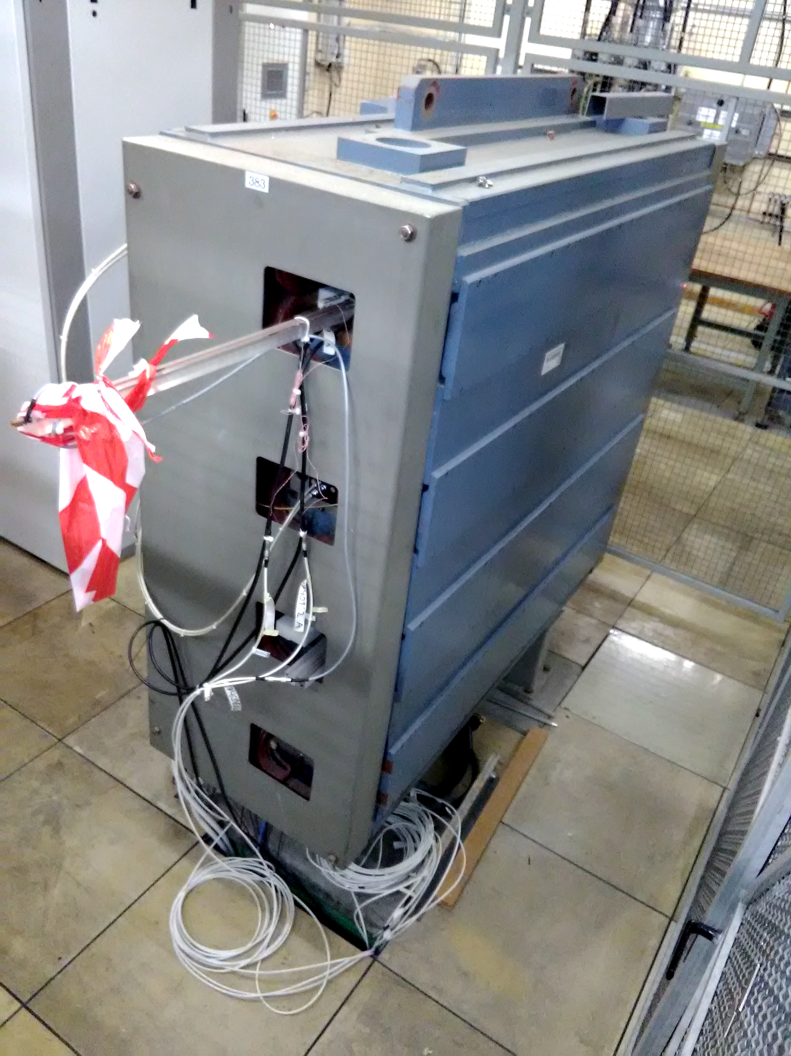
New sensors in the Reference Magnet
Low- and high-field NMR probes
(supports and cabling for
FMR resonators also foreseen)
New holes opened in the
rear plastic cover
End and central coils
(100 mm long, 0.3 m²)
Central coil and NMRs
in current use
Integral coil (2.75 m long, 1.6 m²)
left-right symmetric (not shown)
Old coil set removed during EYETS
Supports for new integral coils, NMR and FMR ready (YETS 17/18)
Old disconnected coil
(removal not planned)
Aim:
feed independent signals to the new FIRESTORM prototype B-train chain
get currently missing information (full integral including fringe field,
end and central eddy currents in both an inner and an outer ring)
Notes:
Philips PM6654 high resolution timer/counter – removed, wher is t now ?

Slide 11
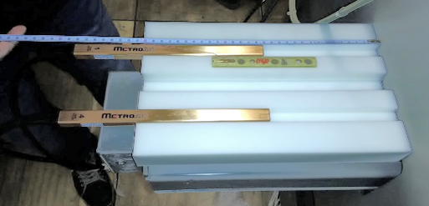
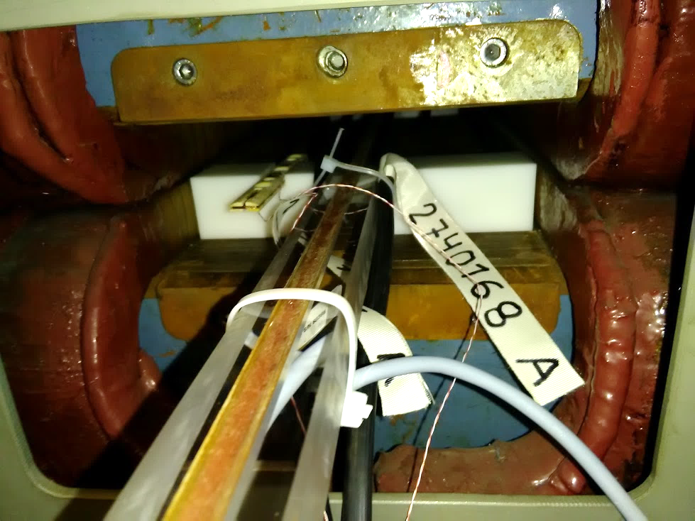
New sensors in the Reference Magnet
central induction coil
(measurement of the magnetic length )
end induction coil
(measurement of local eddy current effects)
High- and low-field NMR probes
(field marker)
integral induction coil
(measurement of the entire magnetic field swing)
Notes:
Philips PM6654 high resolution timer/counter – removed, wher is t now ?

Slide 12
Signal verification (1/2)
Random spikes on the DCCT
output at high field
(saturation above 10 V ?)
eliminated numerically
output signals found adequate for magnetic measurements and
B-train commissioning
minor issues (noise on small coils, abnormally low level of integral coil) → replacement when possible
are OASIS channels wanted to monitor raw signals in the CCC ?
MPS DCCT
Notes:
Thanks for the cabling facility

Slide 13
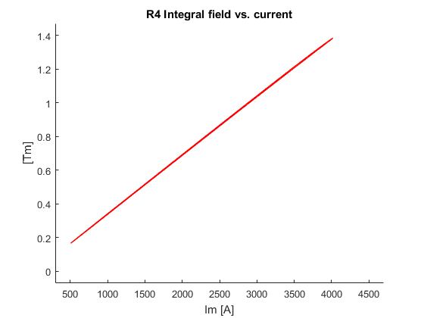
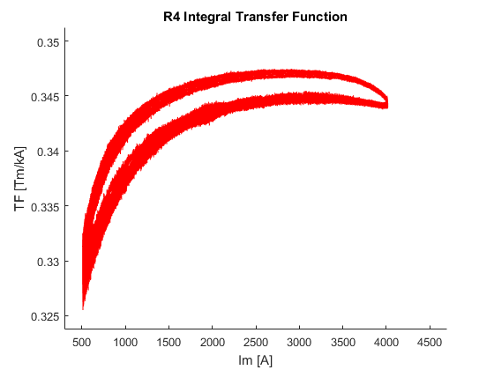
Signal verification (2/2)
Preliminary magnetic measurements in line with test bench results
Acquisition of raw NMR output to correct integrator drift (ongoing)
Online measurement of hysteresis- dependent and eddy current effects
(advantage wrt existing system: high-field NMR marker, inner and outer ring, central and fringe field coil)
Notes:
Thanks for the cabling facility

Slide 14
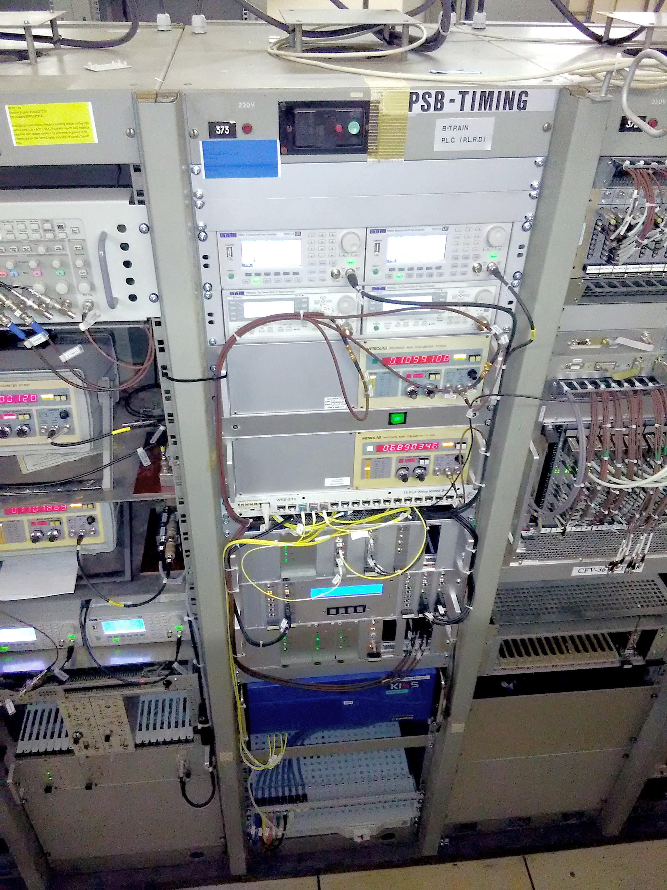
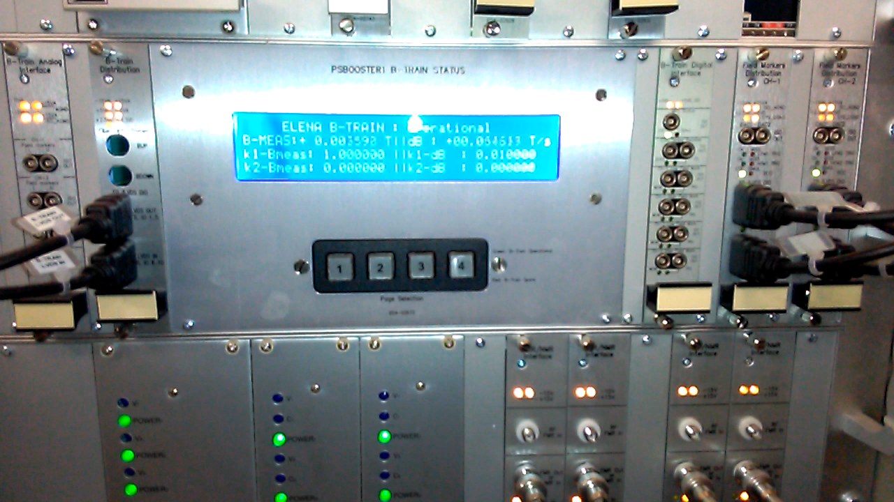
FIRESTORM B-train test rack in bldg. 361
Calibration (setting gains and offsets as FESA properties) still pending
4x signal generators for
low- and high- field NMR
2× Metrolab NMR teslameters
for Ring 4 (expensive ! Ring 2 will be equipped with 2 further units only if necessary)
White Rabbit switch
Power supplies
signal interfaces
B-train chassis with status display
FMR/NMR signal conditioning
Linux FEC
Fiber optic patch panel
Notes:
Philips PM6654 high resolution timer/counter – removed, wher is t now ?

Slide 15
Planned actions
2017 - Commissioning of new FIRESTORM B-train chain
- Feedback to new LLRF in PPM possible to test with beam (non need for dedicated MDs)
- Tests as done in the PS: a) distributing B_{up}/B_{down} wia WR and b) new measurement using R3 and R4 sensors as input
YETS 17/18 - Replacement of coils in Ring3 + new sensors in Ring2
- replacement of temporary WR fibre to RF (BOR R708 in 261-1-009) with a permanent one + new fibre to building 30 (demand discussed with EN/EL)
2018 - systematic beam tests using old sensors in R3 or new ones in R2/4
- Main goal: validate the new B-train to drive PSB
After LS2 The system remains in place as a fallback in case of return to MPS (FEC in the old B-train will not work anymore)

Slide 16
PSB Upgrade
system (b. 245)

Slide 17
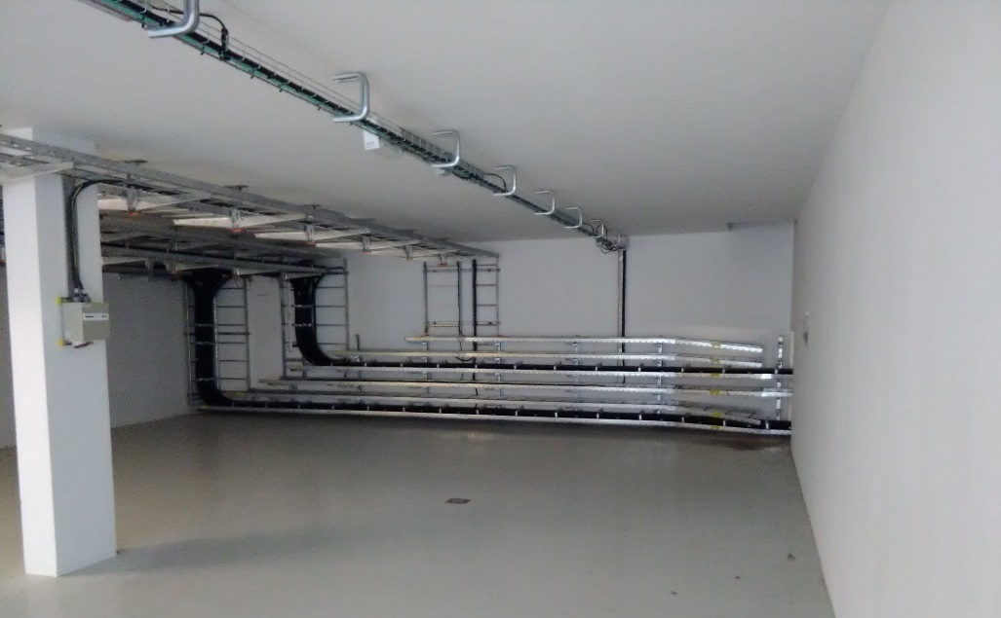
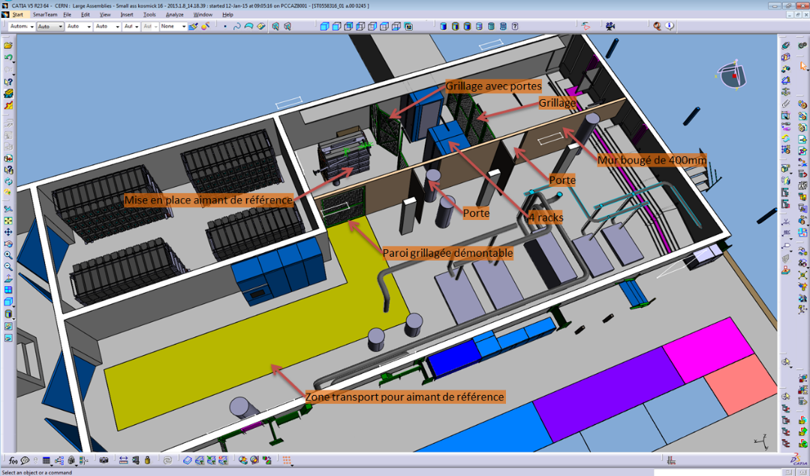
B-train installation in 245-S-402
“New” reference magnet currently in our test hall in b. 867.
Refurbishment to the final configuration (thicker outer ring side plates) foreseen by September 2017, detailed test campaign to follow Pre-DIC for LS2 transmitted to EN/EL
All B-train electronics on stock or procured (except for marker frequency generators)
Safety access procedure to the magnet enclosure involving a bypassable interlock being written with BE/ASR
Notes:
A second reference magnet will be recovered (currently with a tapered coil for injection) and kept for future reference

Slide 18
Planned actions
2017 - Finalization of DIC with missing details
- launch procurement of PCB fluxmeters with CERN PCB Service
- tests on finalized reference magnet in b. 867 ((harmonic field quality, calibration of new PCB coils when available, cross-talk effects between the two coupled powering circuits, choice of NMR vs FMR marker)
2018/19 - measure ambient field perturbations esp. from nearby 6kA cabling as soon as power available
- install electronics as soon as racks available
- install sensors in magnet as soon as available
- test and commission new system w/o beam as soon as POPS-B connected
Open points - do we want to feedback RF from all rings in parallel ?
- NMR vs FMR markers for high-Bdot cycles
`

Slide 19
BT.BHZ10
switching dipole on the extraction line to ISOLDE/PS
first unit expected at CERN around 03/2018 (vacuum chamber before then)
to be tested in new bldg. 311 for reproducibility choose between open/ closed loop
closed loop solution: basic design in preparation, prototype development to start in September (also motivated by other applications)
spare unit will remain available for tests indefinitely (degree of sameness will be measured)

Slide 20
Conclusions

Slide 21
Summary
PS tests show that the beam can be correctly injected, accelerated and extracted with the new measurement
Measurement resolution far exceeds the old system
Systematic differences well below 1 G (calibration still being worked on)
Stability and reproducibility need to be assessed statistically
(tests in parallel on multiple machines are foreseen before LS2)
The system (electronics + sensors) installed in b. 261 will be used to validate the new measurement for the PSB before LS2
Notes:
How many MD slots ? None in PPM mode, norma MDs

Slide 22
Additional
slides

Slide 23
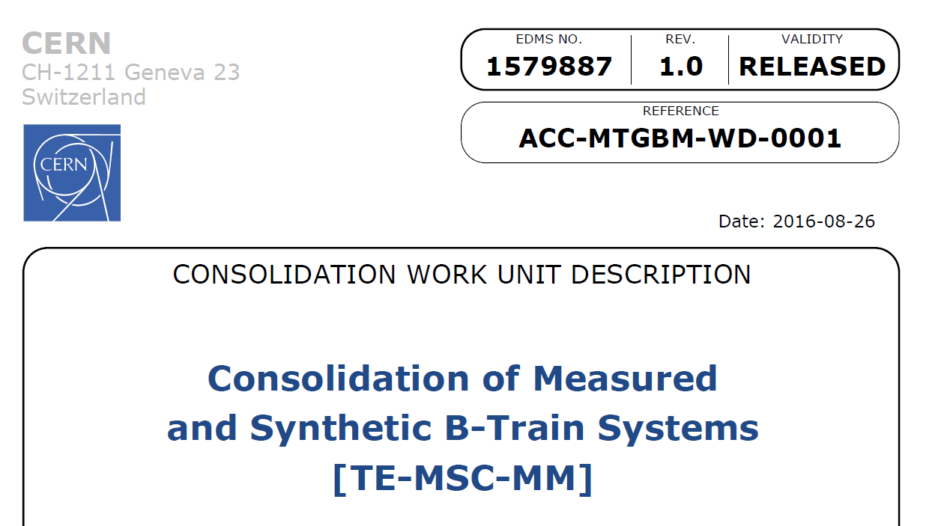
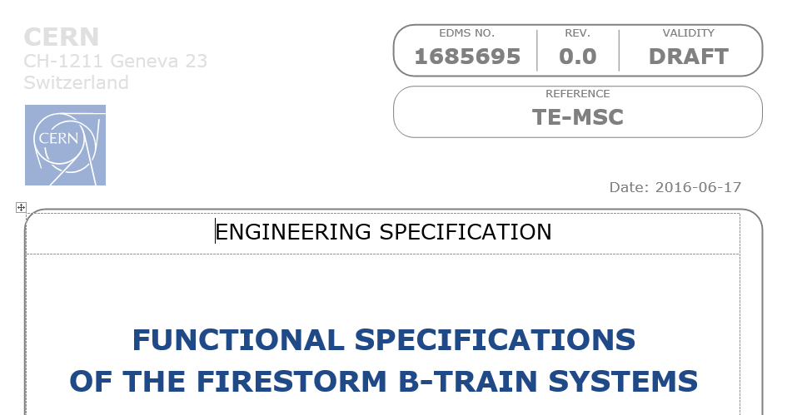

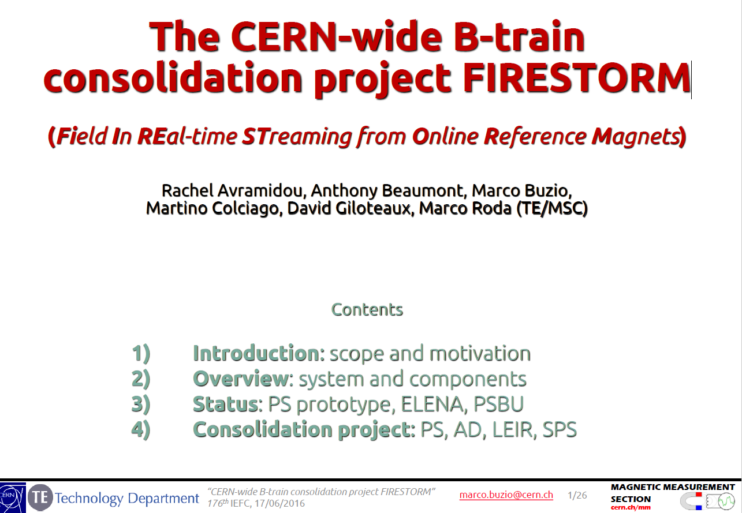
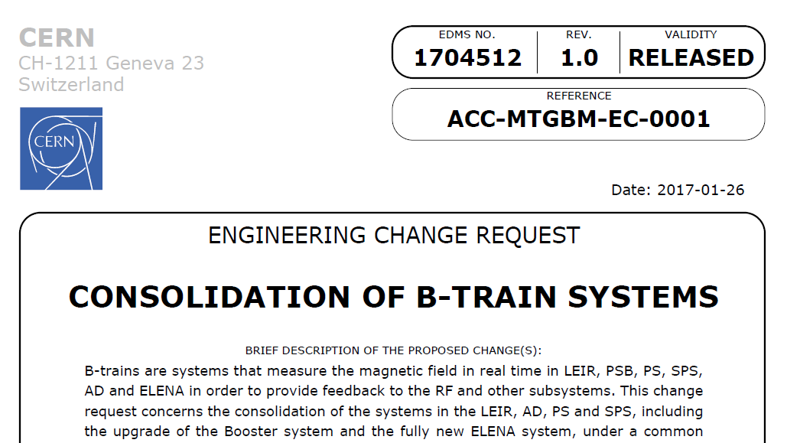
Project documents
B-train renovation first discussed at the LEIR coordination meeting on 12.10.2015 (see attached *.ppt)
Renovation of PS, SPS, LEIR and AD B-trains approved in 07.2016 as a CONS Work Unit (~1.5 MCHF)
ELENA, PSBU budgeted separately
ECR formally approved at the 192th IEFC (20.01.2017)
Activities declared in PLAN (no impact on tunnel activities)
EDMS 1704494

Slide 24
Acquisition and processing system
All essential hardware components procured or in stock at CERN
The production version requires additional hardware plug-ins (FPGA mezzanine cards)
Current work mainly focused on software (FESA) and firmware (FPGA) finalization
 | FIRESTORM prototype (2014-2017) | FIRESTORM production (2018-2020)
Hardware | Linux FEC
 | SPEC PCIe carrier board | SPEXI carrier on multi-slot PXIe chassis
 | Ancillary components (interfaces, diagnostics, patch panels)
 | FMC integrator
 | FMC marker trigger generator
 |  | FMC White Rabbit interface (developed with BE/CO, under test)
 |  | FMC synthetic (prototype ready to be tested)
 |  | FMC simulated (yet to be developed)
Software firmware | VHDL basic drift correction, integrator includes WR interface | - fully modular design - adaptive drift and gain correction - field-based marker gating - DC-mode field markers (NMR, Hall probes)
 | FESA (PS,ELENA in operation; PSB,LEIR deployed and under test) | - compatible with production VHDL - high-level diagnostics, alarms, logging - synthetic and simulated facilities
 | Inspector tool (PS, ELENA in operation) | extend to all machines
standard
BE/CO
frozen &
already installed
or procured
new plug-in
hardware
work
ongoing
SPEC, SPEXI = Simple PCIe/PXIe FMC carrier, FMC = FPGA Mezzanine Card (daughter board with custom analog front end, ADCs etc)

