Slide 1

HEL design, magnet system, e-beam generation and disposal
International Review on the e-lens concept readiness for integration into the HL-LHC baseline.
Diego Perini
19.10.2017

Slide 2
Acknowledgements
Samuel Riekki, Jakko Harjuniemi, Ville Nikkarinen, J. Uurasmaa, J. Markkanen, E. Jussila, J. Puska – Lapland University of Applied Sciences.
David Buglass, George Bowers Anderson - Oxford University
Pascal Simon – University of Darmstadt.
Federico Meneghetti – University of Padua
Contributions of:
Giulio Stancari (FNAL)
Stefano Redaelli, Adriana Rossi, Glyn Kyrby, Giorgia Gobbi, Carlo Zanoni, Antti Kolehmainen (CERN).

Slide 3
Outlines
Introduction
Main parameters
Design of the main components
  Solenoids , cryostats
  Gun and collector regions
Conclusions
More details in the presentations of Glyn Kirby and Giorgia Gobbi in the afternoon

Slide 4
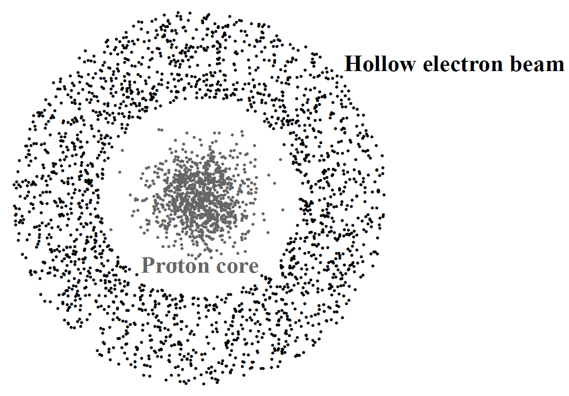
What do we want to do?
Reasonable precision of a middle size single component: + 0.05 mm.
Reasonable precision of an assembly of many components: + 0.2-0.5 mm.
Ø ~ 1.8 mm
Off-centre of the ring + 0.15 mm
Beam-beam overlapping: ~3m , e current intensity: 5 A.
Use at injection and at collision level.

Slide 5
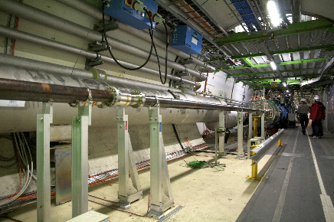
Where?
Candidate locations for the electron lenses are RB-44 and RB-46 at Point 4, on each side of the interaction region IR4
.
The beam to beam distance is 420 mm.
The longitudinal available space is limited.
Compact design

Slide 6
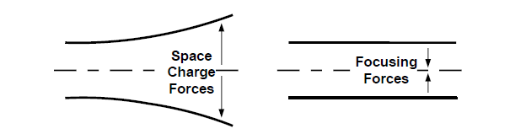
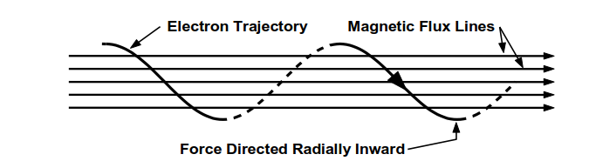
Confinement of an electron beam

Slide 7
Elements of an Hollow Electron lens
LHC beam
Electron gun solenoid and electron gun
Bending solenoid(s)
Main solenoid
Correctors
Bending solenoid(s)
Collector
Instrumentation, vacuum chamber, cryostats, supports etc.

Slide 8
Cathode
B₀
B₁ > B₀
The field level determines the radius of the e-beam.
The dimensions of the electron beam in two points along its path follow the equation:
Where r₀ and r₁ are the radii of the electron beam in point 0 (cathode) and 1 (main solenoid) and B₀ and B₁ are the magnetic field in points 0 and 1 respectively.

Slide 9
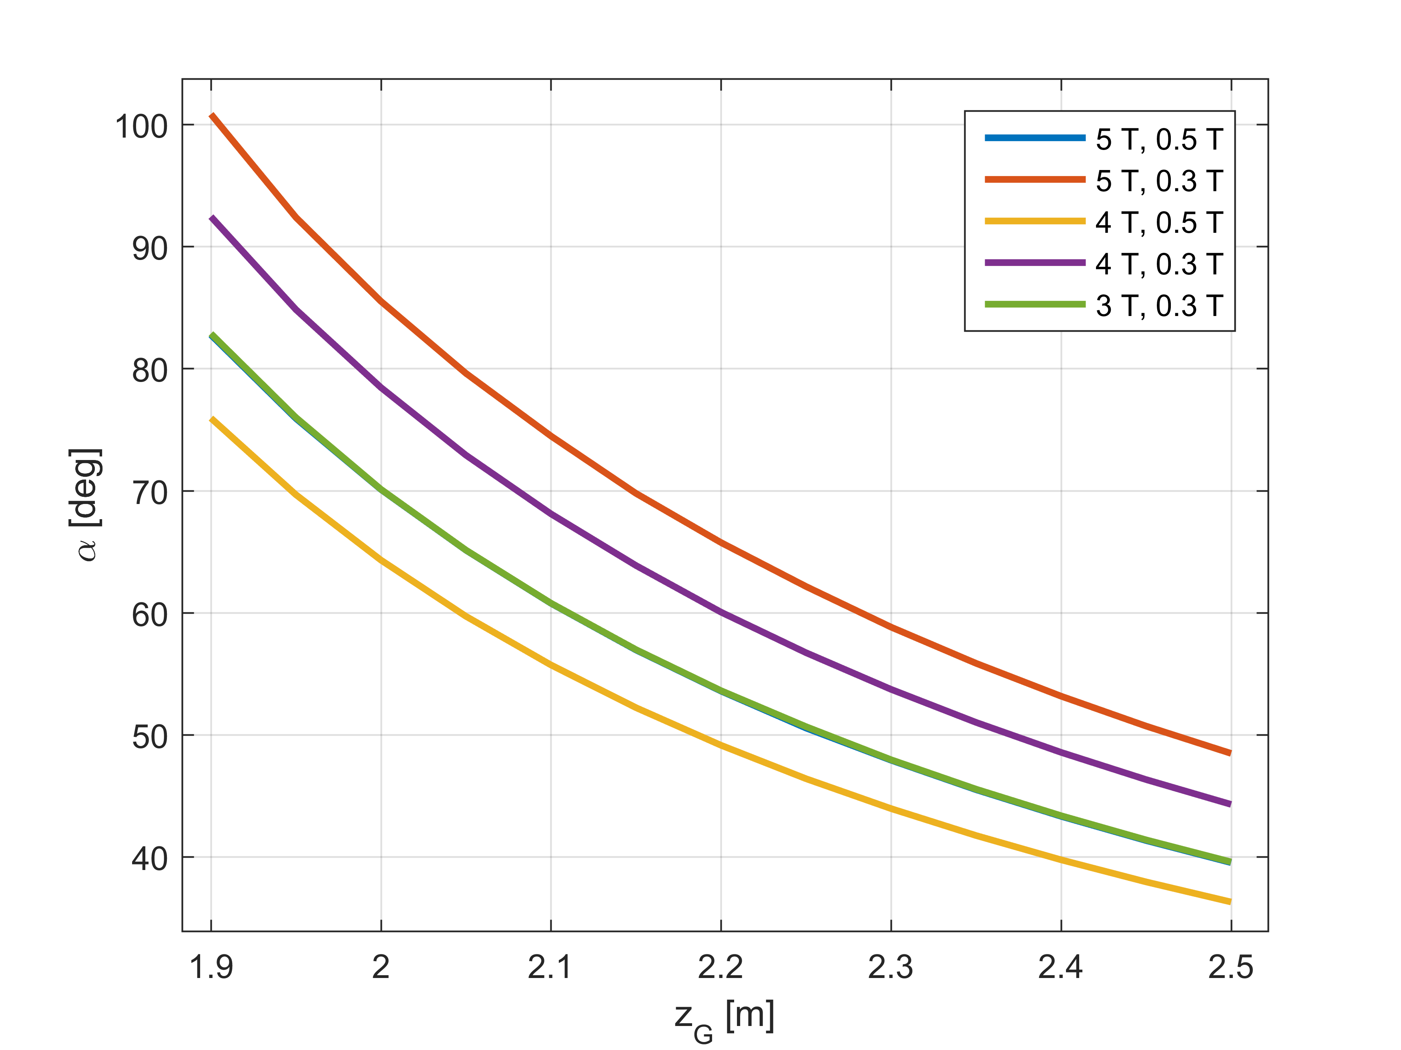
Why two solenoids are not enough?
B₁
B₂
α
Z_{G}
Z_{G}, α, B₁ and B₂ are not independent parameters.
A change of the ratio B₁/B₂ calls for different Z_{G} and α
C. Zanoni

Slide 10
Critical regions
Lower field and bends
Cryostats
Valve
Instrumentation
‘Y’ shaped vacuum chamber
It is necessary to iterate between mechanical design and simulations of e-beam dynamics.

Slide 11
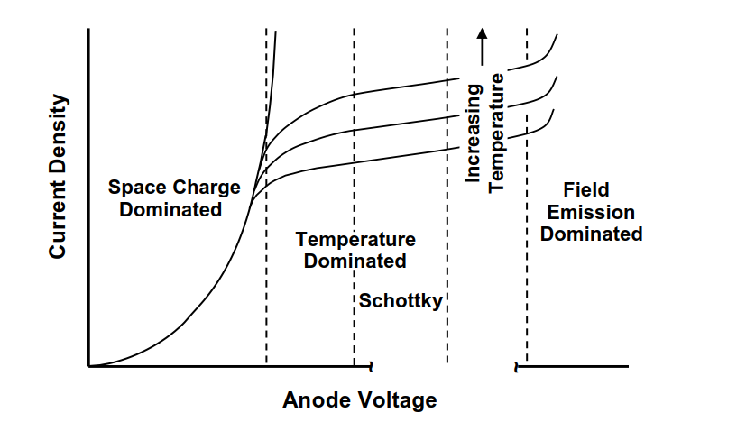
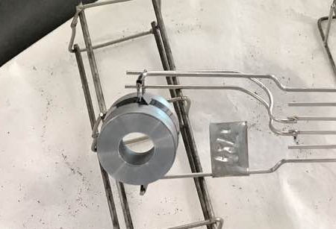
Cathode design
Free parameters:
Cathode Surface: R_{i} , R_{o}
Cathode – Anode distance
I = P V^{3/2} I = J A
P = K A/d²

Slide 12
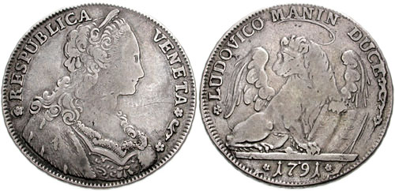
Summary of the requirements
The HEL must be compact.
Magnetic fields in the solenoids must be reasonable.
Magnetic fields in the transition regions must be smooth and high enough.
Dimensions and current density of the cathode must be technically feasible.
The HEL will be used at injection and at collision (very different e-beam size).

Slide 13
Important!
The today design is based on computations:
  - of magnetic field flux lines
  of trajectories of single electrons.
This is a first good approximation but not perfect (in particular for high currents).
The computations of the displacement and stability of a ring of electrons under all the internal and external forces are going on.
Therefore there could be small changes of size and relative position of the main components and some adjustments of the level of magnetic fields.
The field of the main solenoid is the lowest possible under these approximations.

Slide 14
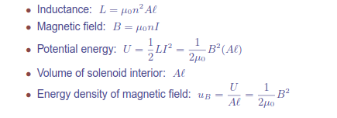
4T solenoid or more?
L is in Henries
μ_{ο} is the Permeability of Free Space (4.π.10⁻⁷)
n is the Number of turns
A is the Inner Core Area (π.r ²) in m²
I is the current in Amperes
ℓ is the length of the Coil in metres
To increase the field one has either to increase the current or the number of turns or both.
Consequences on:
quench protection (stored energy, inductance)
wire (cable) size, current lead size, heat load
power supplies (including ramp time of the system).

Slide 15
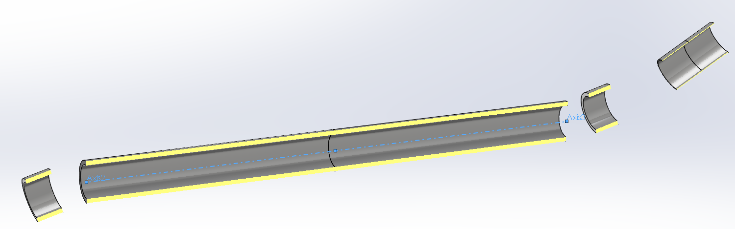
Design of the main components
E-gun solenoid (tuneable field)
Fixed field part
Nominal magnetic field of the main solenoid | 4 T
Nominal magnetic field in the e-gun cathode | 0.2 T
Inner radius of the hollow electron beam @ nominal fields | 0.9 mm (3 σ)
Outer radius of the hollow electron beam @ nominal fields | 1.8 mm (6 σ)
Inner diameter of the cathode | 8.05 mm
Outer diameter of the cathode | 16.10 mm
Inner radius of the hollow electron beam @ 4 T with 2 T @ cathode | 5.67 mm
Outer radius of the hollow electron beam @ 4 T with 2 T @ cathode | 11.34 mm
Nominal current at the cathode | 5 A

Slide 16
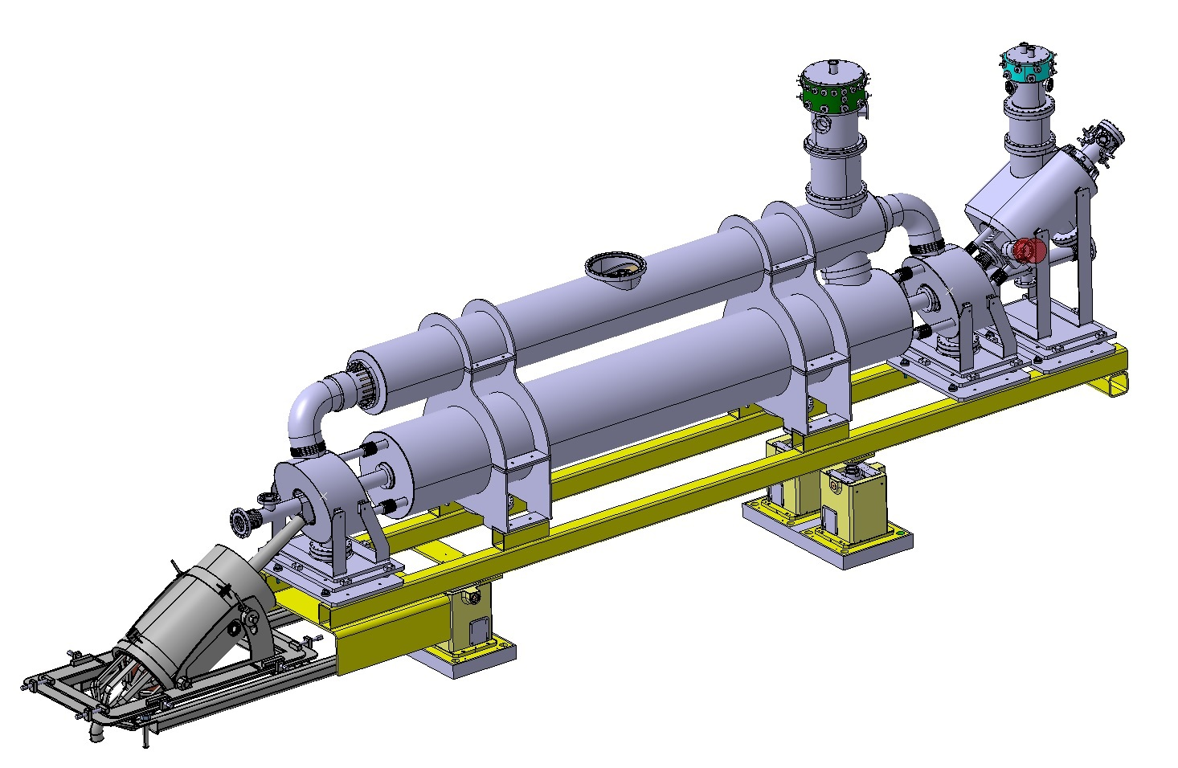
Current leads
Cryogenic jumper
e-gun
Bending s.
Main solenoid
Bending s.
Collector
Support structure + positioning tables
Discussions with the survey to define the position of their targets.

Slide 17
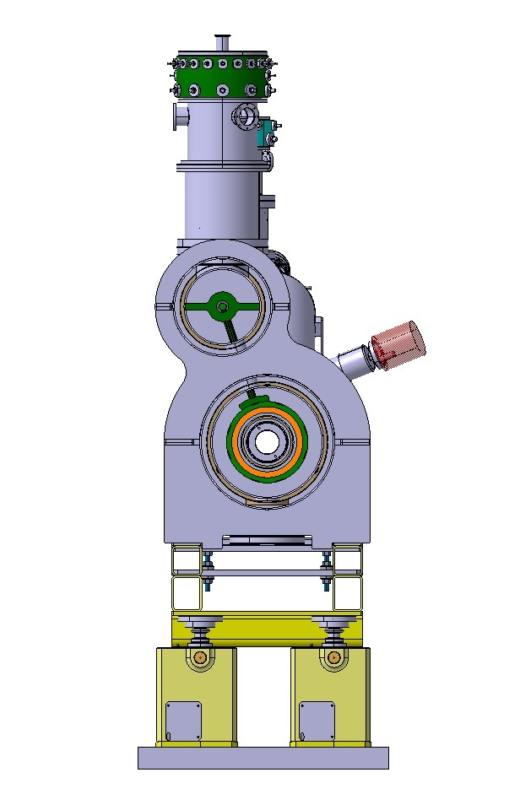
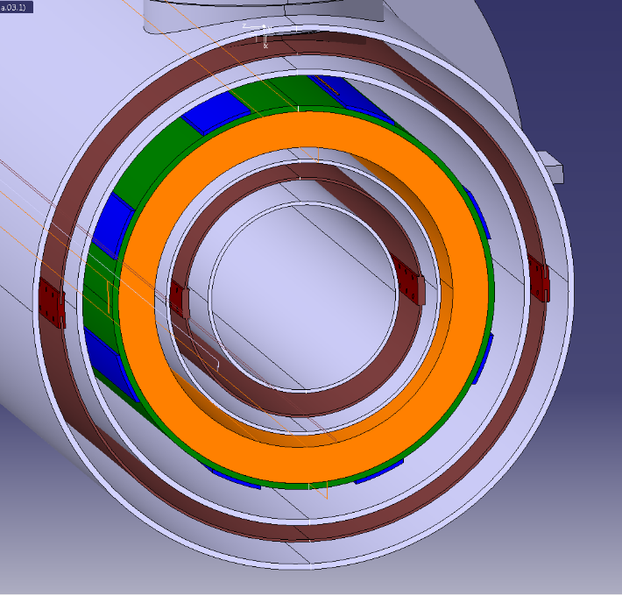
Ø 154 mm
Survey space
More details in the presentation of Maria Anparo Gonzalez de la Aleja Cabana.
Ø 454 mm

Slide 18
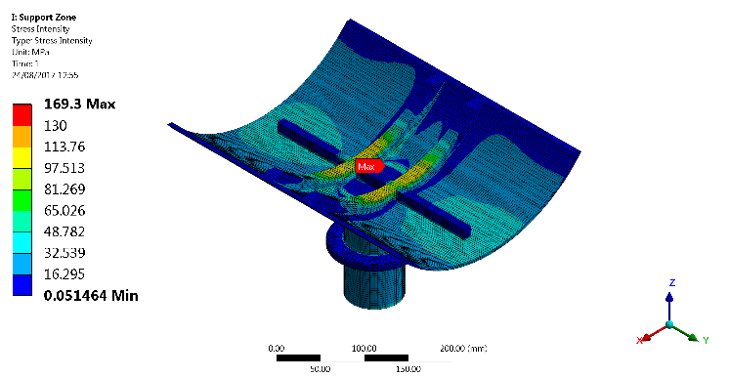
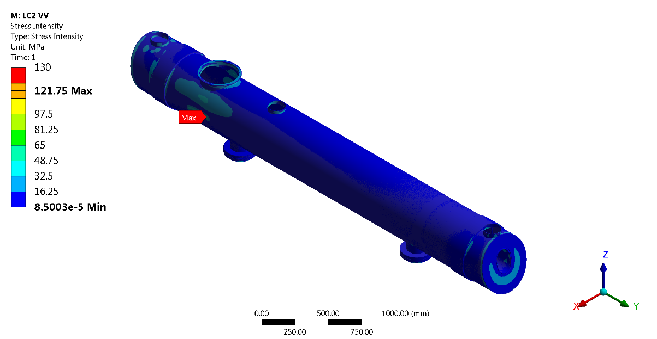
Verification of the structure according to:
EN 13445 Pressure vessels
EN 13458 Cryogenic vessels
F. Meneghetti, G. Gobbi, L. Dassa, C. Zanoni

Slide 19
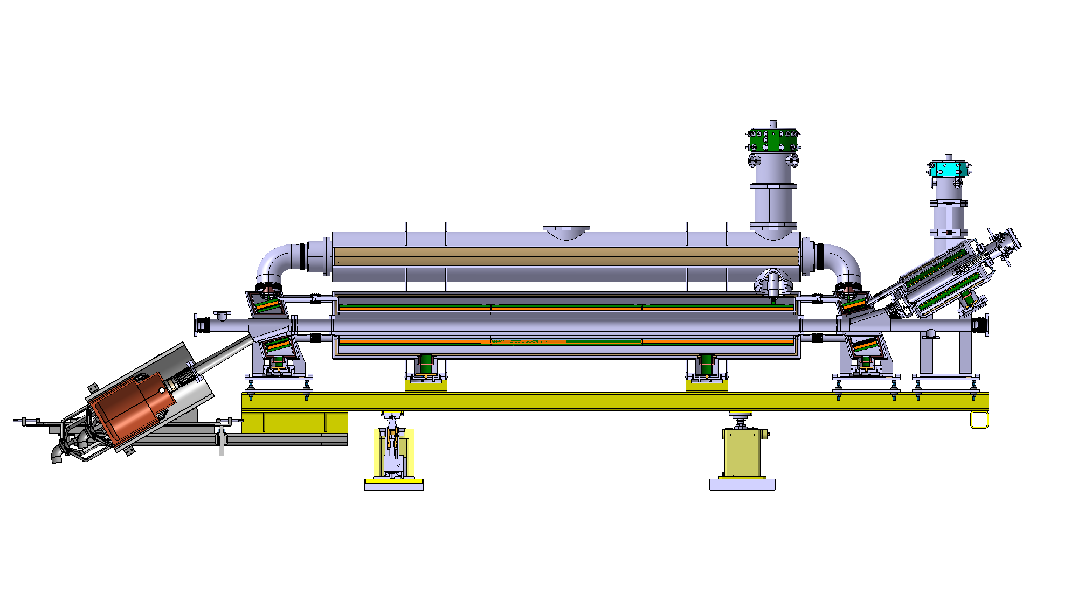
Bending solenoids
e-gun solenoids
Space for instrumentation
Main solenoid

Slide 20
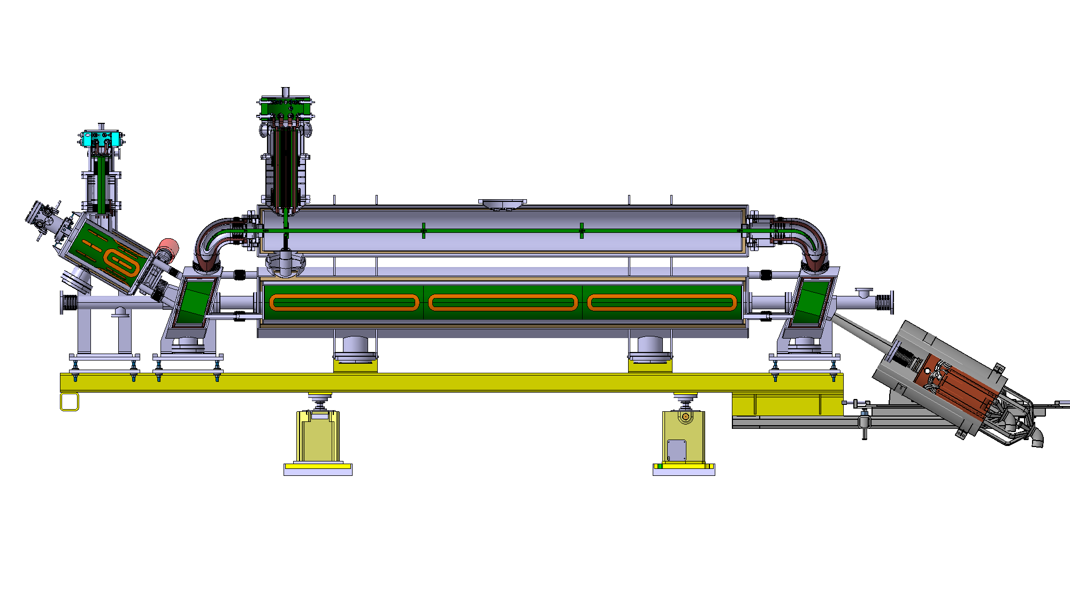
Cryostat
Corrector coils

Slide 21
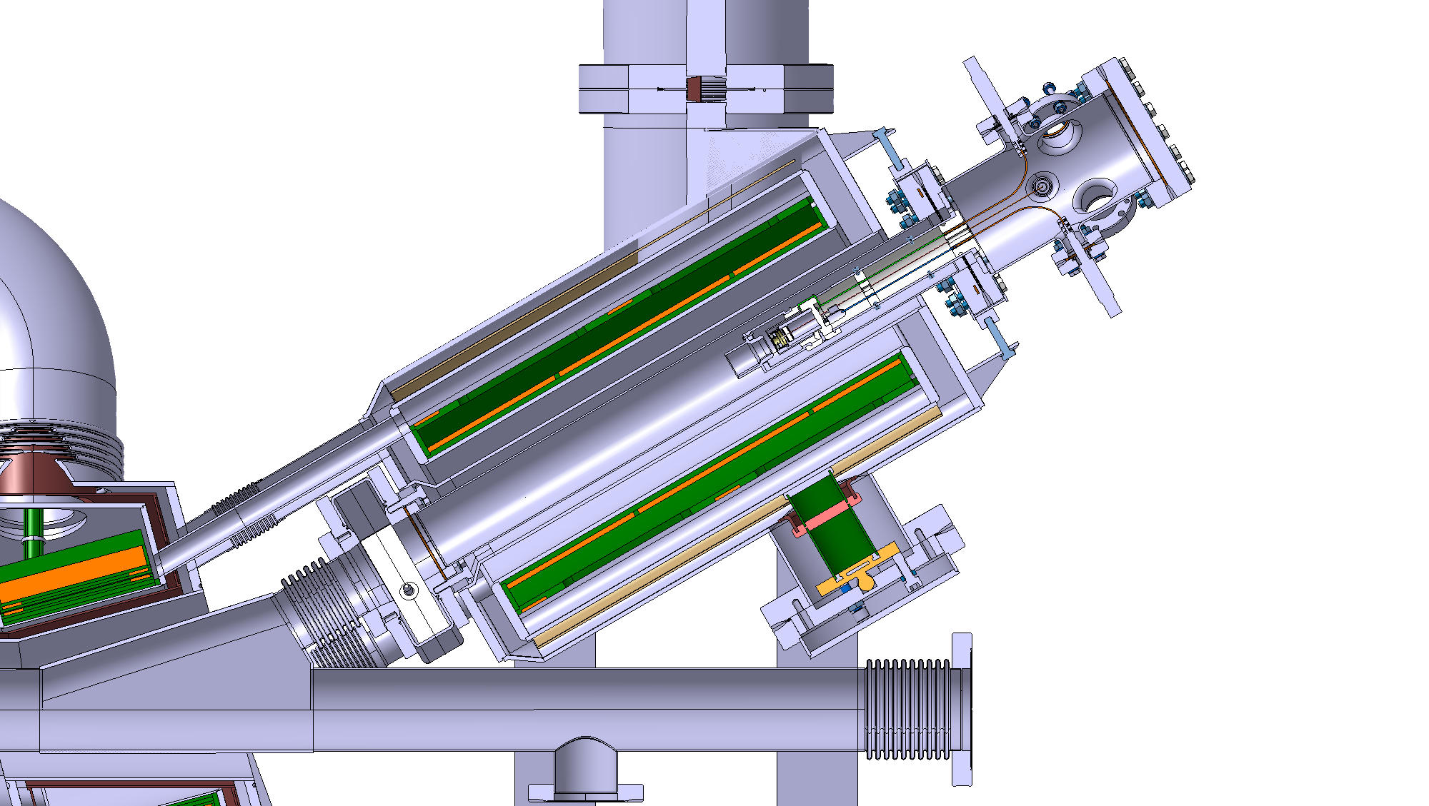
e-gun solenoids
Insertion region.
Impedance has been checked. It is ok
Final optimization going on.
e-gun
Vacuum chamber.
Discussions with vacuum group going on.

Slide 22
Collector
Collector in ETP copper
Maximum power absorbed | 50 kW
Maximum temperature | 85ºC
Maximum speed of the cooling water | 1 m/s
Water flux | 8 l/s
Inner diameter | 145 mm
External diameter | 175 mm
Height | 400 mm

Slide 23
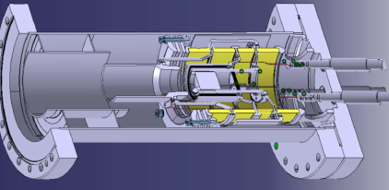
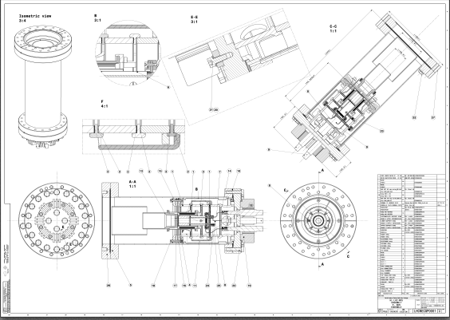

Slide 24
Conclusions
The Hollow Electron Lenses for HL-LHC are a complicate object with demanding performances (5 A current over a 3 m path, large range of e-ring sizes).
We have a well advanced design and we are not far from the final configuration. We have a solid base to start discussions with the possible manufacturers.
The HEL configuration will be frozen once the physic simulations will be completed and once the instrumentation will be defined.

Slide 25
Thank you for your attention

Slide 26
Existing electron lenses and HL-LHC hollow electron lenses
 | RHIC EL | Tevatron EL | HL-LHC HEL
Effective length [m] | 2.1 | 2 | 2.9
Current from cathode [A] | 1 | 0.6-3 | 5
Main solenoid field [T] | 6 | 3 | 4(*)
Solenoid inner bore [mm] | 200 | 160 | 200
E-gun field [T] | 0.2-0.8 | 0.3 | 0.2-2 (*)
Cathode radius [mm] Cathode surface* [cm²] Current density [A/cm²] | 4.1 @250GeV 7.5 @100GeV 0.53 @250GeV 1.77 @100GeV 1.89 @250GeV 0.53 @100GeV | 7.5 1.77 1.69 | 4 – 8.05 Hollow 1.53 3.27
E-beam compression | 1.6-5.5 | 3.26 | 1.41-4.47
(*) to be confirmed, could change

