Slide 1
FCC hh dump kicker - switch topologies and impact on beam
Pieter Van Trappen, Elisabeth Renner
Acknowledgments: Mike Barnes, Wolfgang Bartmann, Florian Burkart, Brennan Goddard, Thomas Kramer

Slide 2
Outline
Alternative topologies motivation
Electrical simulations
Impact on beam: comparison series connected switch to conventional switch design.
Open questions - Discussion

Slide 3
Alternative topologies motivation
Assuming that the switch (can be a stack of multiple devices) will self-trigger (a.k.a. erratic) because of R2E SEE or electrostatic discharges
What can be done to reduce the effect (i.e. magnet current) by using alternative topologies?
→ Switch series connection vs. crowbar connection

Slide 4
Electrical simulations
New dump layout yield the below ‘relaxed’ requirements.
Lumped inductance magnet with a small HV capacitor for fast magnet current rise-time and bigger (slower) capacitor discharge for flat-top.
Focus on most constraining part: fast rising-edge (1 us) capacitor discharge
Cable and stray inductances ignored
COTS Mitsubishi CM1000HA-24H has a complete PSpice model with parasitic components; max I_{C}=2kA; max V_{CES}=1.2kV
Parameters (per module) | Value
Number of modules | 300
B.dl [T.m] | 0.025
k [µrad] | 0.150
Length [mm] | 300
Inductance [µH] | 0.38
Current [kA] | 2.1
Magnet current rise-time | 1 µs

Slide 5
Electrical simulations cont’d
Series connection
2500A
250A
Nominal kick (0-100% 1.1us, 2.1kA, Vcapa=1400V)
bottom-side IGBT blocking full capacitor voltage; Vpfn vs. magnet leakage current
High dV/dt at bottom IGBT can trigger bottom-side IGBT (capacitive divider over Miller capacitance and C_{GE})

Slide 6
Electrical simulations cont’d
Crowbar connection
4000A
Is the
U2 collector current vs. 100ns -500ns delay
magnet current
No nominal kick cause single IGBT cannot block 1400V
Detection and triggering circuit delay!

Slide 7
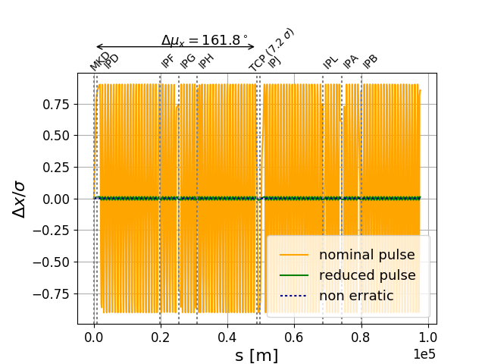

Impact on the beam: oscillation introduced by 1 erratic MKD
  Oscillation amplitude*:
  1 sw.: 0.9 sigma
  2 sw. in series: 0.01 sigma
*Values for MKD 1, as worst case scenario
(MKD entrance: $β_{x}=1498$m, MKD exit: $β_{x}=1009$ )

Slide 8

Impact on the beam: load on TCP for x erratic MKDs
Assumptions
beam profile: gaussian
different numbers of erratic segments considered → worst case scenarios chosen for further analysis:
  first x MKDs erratic
  simultaneous erratics
  phase advance between MKD1 and observation point 90° (full amplitude), although in current design $Δμ \left(MKD1, TCP\right) \sim 160°$
  If x segments fail, how many bunches can be tolerated to make an additional turn? How many abort gaps are necessary? …

Slide 9
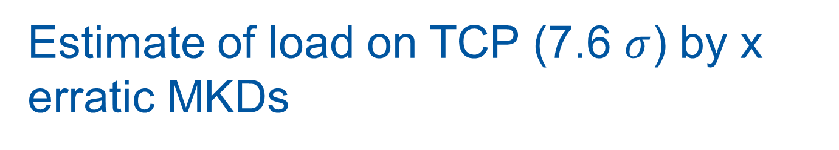
Estimate of load on TCP (7.6 $σ$) by x erratic MKDs
Assumptions
beam profile: gaussian
different numbers of erratic segments considered → worst case scenarios chosen for further analysis:
  first x MKDs erratic
  simultaneous erratics
  phase advance between MKD1 and observation point 90° (full amplitude), although in current design $Δμ \left(MKD1, TCP\right) \sim 160°$
  If x segments fail, how many bunches can be tolerated to make an additional turn? How many abort gaps are necessary? …

Slide 10
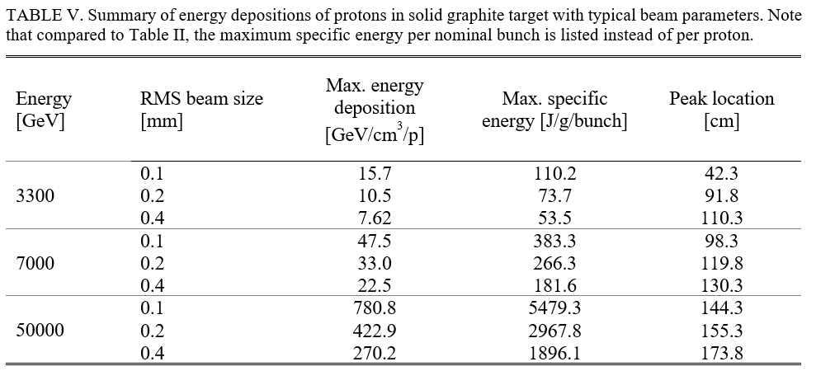

Estimate of load on TCP (7.6 $σ$) by x erratic MKDs
Energy/power thresholds for load comparison:
~ 500 kW: LHC: TCP load limit to avoid quenches of DS magnets [1]
~ 17 kJ/g: melting heat of graphite [3,4] with a max. energy deposition of $270 GeV/(cm^{3}p)$ and $ρ=2.28 g/cm^{3}$
But: Very rough estimate! (TCP not graphite etc.) Only for order of magnitude
[2]
[1] S. Radaelli et al, Quench tests at the large hardron collider with collimation losses at 3.5 Z TeV, Proceedings of HB2012
[2] Y. Nie, R. Schmidt, Interaction of 50 MeV - 50 TeV protons with solid copper and graphite targets in hadron accelerator complex at CERN, 2017
[3] A. Lechner, Design studies for the FCC-hh beam dump. FCC Week 2017; based on [4]
[4] Jan M. Zazula, LHC Project Note 78 / 97, 19

Slide 11
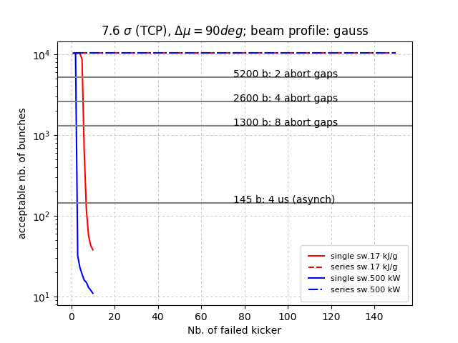
Acceptable number of bunches to stay below chosen load at 7.6 sigma for x erratic segments

Slide 12
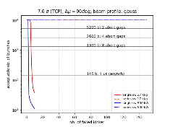
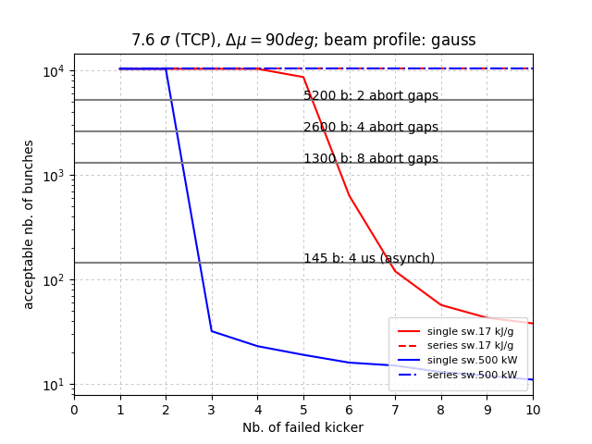
Acceptable number of bunches to stay below chosen load at 7.6 sigma for x erratic segments

Slide 13
Beam impact: Conclusion and open questions
series switch architecture is favorable for ‘1 sigma oscillation’, as load on is TCP negligible
potential to reduce number of segments should be considered

Slide 14
Beam impact: Conclusion and open questions
series switch architecture is favorable for ‘1 sigma oscillation’, as load on is TCP negligible
potential to reduce number of segments should be considered
But, careful:
600 instead of 300 switches → higher failure rate
series connected switches: erratic elements are missing for extraction after 1 turn.
  how many erratic MKDs can be tolerated to still extract the beam/partial beam safely after 1 turn (all previous erratic MKDs now missing)?
→Studies ongoing, discussion appreciated

