Slide 1
Advanced Beam Dump for FCC-ee
Armen Apyan ANSL, Yerevan, Armenia Brennan Goddard CERN, Geneva, Switzerland
Katsunobu Oide KEK, Tsukuba, Japan
Frank Zimmermann CERN, Geneva, Switzerland

Slide 2
Outline
__________________
Motivation
Distorted Beam Dumps
Mosaic Beam Dumps
FCC-ee Beam Dump
Summary

Slide 3
Motivation
__________________
The energy stored in the modern and future colliders beams ranges from several hundreds Mega to Gigajoules.
The design of beam dumps becomes difficult challenges with the increasing of the energy and intensity of the particles beams.
Construction of such beam dumps demands innovation for escaping the damage of the beam dump.

Slide 4
FCC-ee beam parameters used in simulation
__________________
FCC-ee | Units | Z
Beam Energy | GeV | 45.6
Beam current | mA | 1450
N_{b}/beam |  | 70600
Bunch Popul. | 10¹¹ | 0.4
σ_{x} | mm | 0.51
σ_{x’} | μrad | 0.51
σ_{y} | μm | 32
σ_{y’} | μrad | 0.032
σ_{p} | % | 0.1
The proposed FCC-ee beam dump system must have the capability to absorb an energy ranging from 0.4 MJ/beam (tt_{bar}) to 20 MJ/beam (for Z factory).

Slide 5
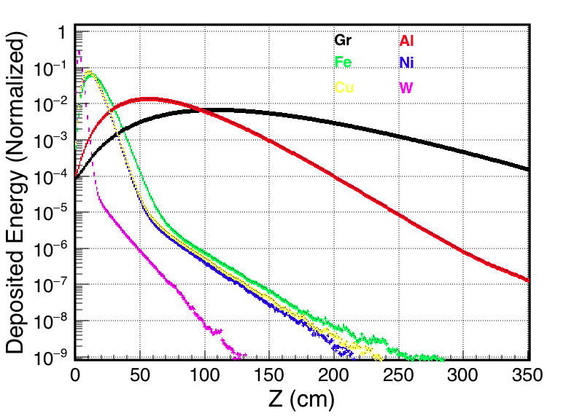
Candidate Materials for Beam Dump
__________________
Longitudinal distribution of the deposited energy in various absorbers.
* Sublimation point
The depth at maximum energy deposition is 4 cm for Tungsten and increases to 110 cm for graphite. The energy penetration depth is decreasing for higher Z materials.

Slide 6
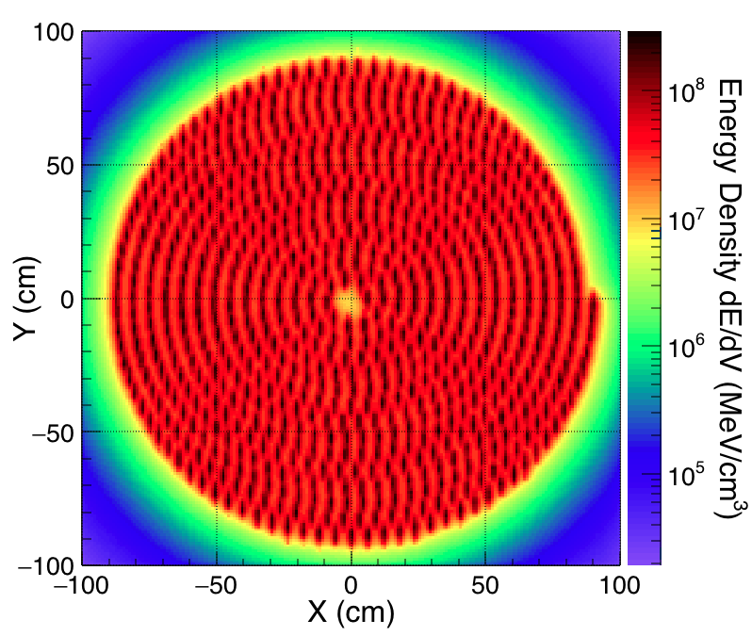
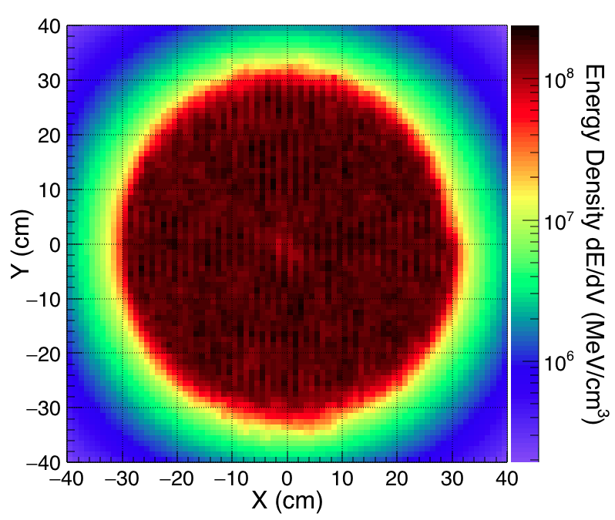
MC Simulations for Beam Transverse Distribution on the Face of BD
__________________
Number of bunches: 704. BD radius: 100cm. Distance between bunches ~6cm.
Number of bunches: 704. BD radius: 40cm. Distance between bunches ~2cm.

Slide 7
Temperature Distribution in the Graphite Absorber
__________________
The maximum energy deposition density from 70600 bunches of electrons distributed like a spiral on the graphite is found to be 63 J/cm³, which is equivalent to 37 J/g. The associated peak temperature rise in the unit volume of graphite due to the impact of FCC-ee beam is
ΔT = 52 °C.
Temperature distribution in the longitudinal-vertical plane considering a 1 cm wide horizontal slice of graphite from the center of the regular dump block.

Slide 8
1. Geometrically Distorted Beam Dump
__________________
The distribution of the electron bunches on the surface of the beam dump solves the problem partially. The energy deposition in the longitudinal direction is concentrated at a distance of 110 cm from the beam dump front surface.
The main idea for an improved beam dump design is to smear the energy deposition over the whole volume of the absorber. This would allow to better distribute the deposited energy over the whole volume and, thereby to decrease the temperature gradient inside the absorber.

Slide 9
Possible Solutions
__________________
One of the possible solutions is to use distorted geometrical shapes instead of the regular cylinders or blocks of materials.
The change in the geometrical shapes should break the symmetry in the distribution of the beam particles hitting the beam dump and redistribute them spatially wider inside the absorber in Z direction as well.
For example, one could use a trapezoidal shape for the beam dump.

Slide 10
Energy Deposition in Trapezoidal Absorber
__________________
The energy density deposited inside the graphite for regular (left plot) and distorted beam dump (right plot), in the vertical-longitudinal (y -z ) plane.
For the distorted beam dump the energy deposition is more widely distributed, which was exactly the purpose of the added pyramidal front part.

Slide 11
Energy Deposition in Longitudinal Direction
__________________
Gaussian fits of the longitudinal extents of the energy deposition yield the standard deviations σ_{z} = 53 cm for the regular and σ_{z} = 90 cm for the distorted beam dump, respectively.
The longitudinal energy deposition is 1.7 times wider in case of the distorted beam dump. This will decrease the temperature gradient inside the absorber.
Comparison of the longitudinal distributions of the deposited energy for the regular and distorted beam dumps.

Slide 12
Possible Solutions (2)
__________________
As another mitigation method, we considered mosaic beam dumps, e.g. composite dump blocks made from by sets of different materials.
Such a mosaic beam dump can redistribute the deposited energy since the penetration depth of the energy deposition varies for different materials.
We used blocks made from graphite and iron with dimensions of 10x10x600 cm, transversely in alternation, instead of a
larger monolithic block from a single material with dimensions
80x80x100 cm.

Slide 13
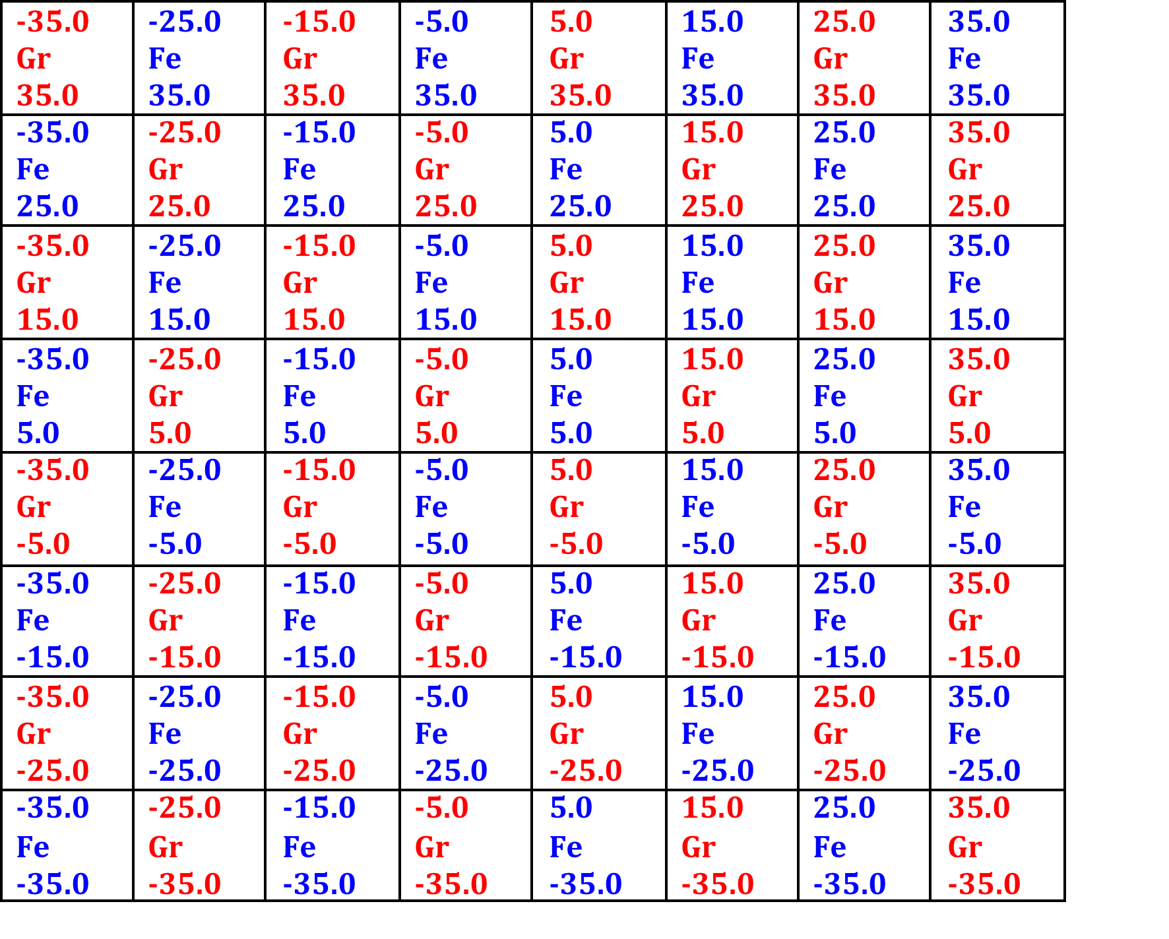
Mosaic Beam Dump
__________________
The peak of the deposited energy is situated around 110 cm depth for pure graphite and at a depth of 14 cm in case of pure iron. During the shower formation, beam and secondary particles may traverse several subblocks and deposit their energy at different depths inside the beam dump. As a result the energy deposition of the particles can be more evenly spread over the entire volume of the mosaic beam dump.
Front surface of the beam dump consisting of 64 cells 10x10x600cm each, made by Gr and Fe.

Slide 14
Energy Deposition in Mosaic Beam Dump
__________________
One can see that, compared with pure graphite, the energy deposition peak is shifted towards a shorter distance from the surface, since the interleaved iron subblocks have less penetration depth.
The energy density deposited on the mosaic beam dump in the vertical-longitudinal (y - z) plane.

Slide 15
Longitudinal Distribution of Energy Deposition in Mosaic Beam Dump
__________________
One can see that, Comparison with pure graphite shows that the energy deposition peak is shifted towards a shorter distance from the surface, since the interleaved iron subblocks have less penetration depth.
The energy density deposited on the mosaic beam dump in the vertical-longitudinal (y - z) plane.

Slide 16
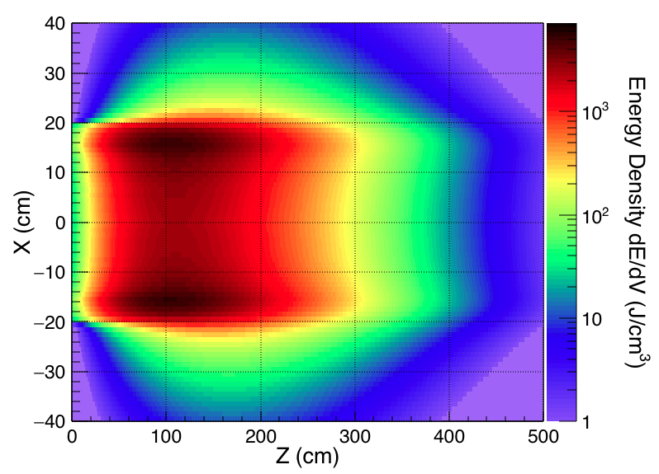
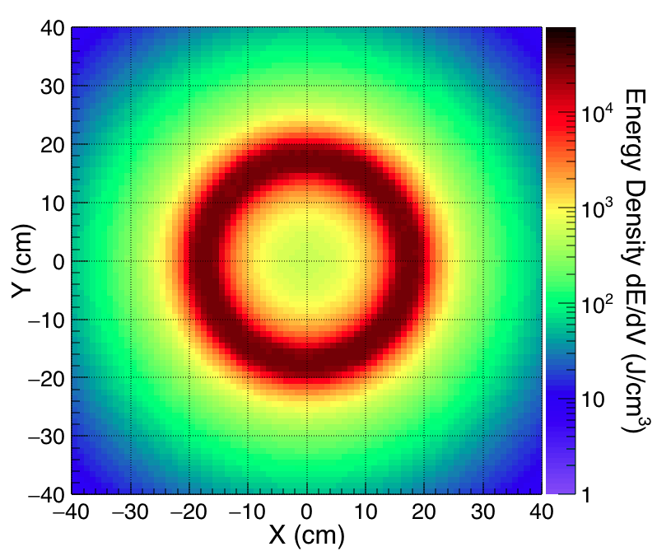
FCC-ee Beam Dump Consideration
__________________
The cylinder with 40 cm radius and 500 cm long was chosen as an absorber.
In case of 57 turns of the spiral, which keeps the dilution sweep frequency below 200 kHz, the maximum energy deposition density by the beam of electrons in the graphite is found to be 130 J/cm³, which is equivalent to 76 J/g. The associated peak temperature rise in the graphite due to the impact of a beam of electrons is 106 C.
Number of turns in spiral is 57, distance between the center of the bunches is 890 μm.

Slide 17
Summary
__________________
Monte-Carlo simulations illustrate that both distorted and multi-material mosaic beam dumps are promising devices for the future high energy and intensity colliders.
Most effective would be a combination of the two concepts, namely a distorted mosaic beam dump, which might achieve an almost perfectly uniform distribution of the deposited energy inside the beam dump.
For the FCC-ee collider the expected temperature rise of the graphite is not dramatic, and the rate of beam dumps low; at the very most one dump could occur every 30 minutes. For this specific application, also a conventional regular graphite block might suffice.

Slide 18
Summary(2)
__________________
The concepts presented here may be of great interest for other future colliders, e.g. the FCC-hh hadron collider.
Thank you for your attention

