Slide 1
CT-PPS & AFP experiments in the
(HL)-LHC optics landscape
S. Fartoukh (BE/ABP)
The conceptual “fragility” (optics-wise) of the CT-PPS and AFP experiments
Is there any room or un-known yet dimensions for improvement?
  More or less “symbolic” actions: “Orbit bump” in 2016, “Optics bump” in 2017
  Telescopic optics based on the ATS scheme, as optics baseline for HL-LHC
  Flat optics with V crossing in CMS (.. but H crossing in ATLAS) under study for Run III
Summary and outlook

Slide 2
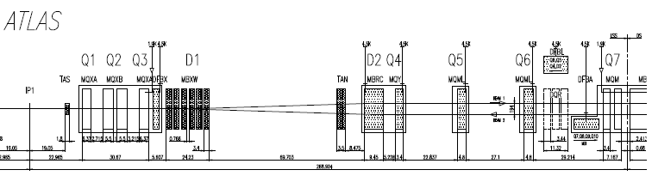
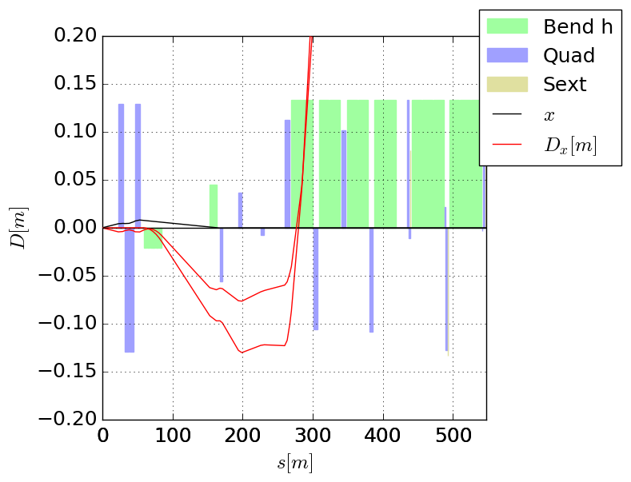
The conceptual “fragility” of the CT-PPS & AFP experiments
Both experiments rely on the small and rigid
dispersion generated by the D1/D2 separation-
recombination dipoles.
At the D2 exit w/o crossing angle
D_{x}  194 mm /2  97 mm & D_{Px}  0 (angular dispersion).
This dispersion is fixed by the main dipole geometry !!
At the RP’s between Q5 & Q6:
It can hardly increase by more than 2 cm, because (i) the
Q4/RP distance is short, and (ii) Q4 (H-defocusing) has a
low gradient for (standard, i.e. non-ATS) squeezed optics.
Additional impact of an horizontal crossing angle
  An H crossing angle can only be positive for beam1 (otherwise leading to a “second IP” in D1)
  It induces a dispersion fighting against the D1/2 dispersion by about 2.5 cm per 100 μrad half X-angle
Triplet
Separation dipoles D1/2
Matching section Q4/5/6
L*=23 m
L_{FFS}=268m
Courtesy of R. de Maria
RP’s
Dx ~ 7 cm with 185 μrad half X-angle
Dx ~ 12 cm without X-angle

Slide 3
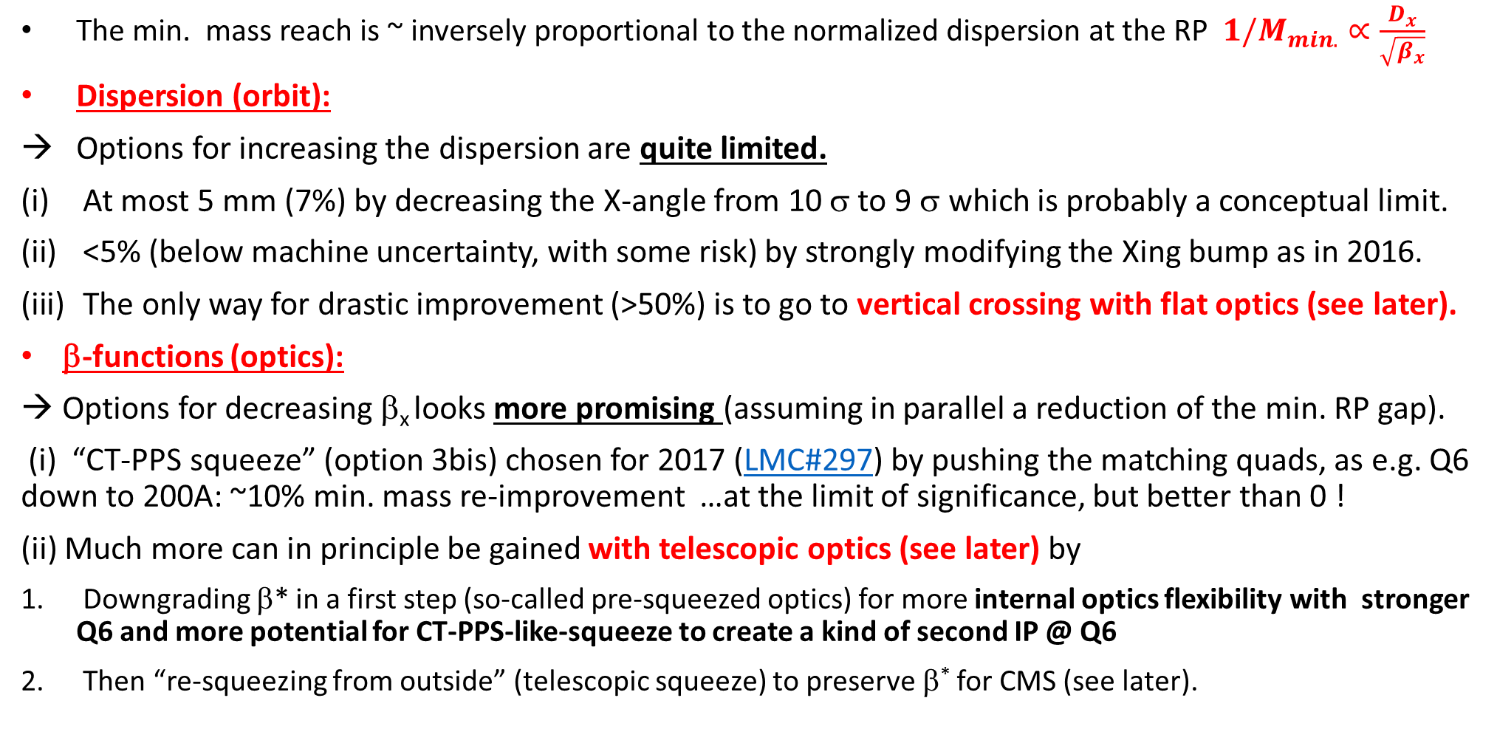
How to improve?
The min. mass reach is ~ inversely proportional to the normalized dispersion at the RP ${1/M}_{min.}∝\frac{D_{x}}{\sqrt{β_{x}}}$
Dispersion (orbit):
Options for increasing the dispersion are quite limited.
At most 5 mm (7%) by decreasing the X-angle from 10 σ to 9 σ which is probably a conceptual limit.
<5% (below machine uncertainty, with some risk) by strongly modifying the Xing bump as in 2016.
The only way for drastic improvement (>50%) is to go to vertical crossing with flat optics (see later).
β-functions (optics):
Options for decreasing β_{x} looks more promising (assuming in parallel a reduction of the min. RP gap).
(i) “CT-PPS squeeze” (option 3bis) chosen for 2017 (LMC#297) by pushing the matching quads, as e.g. Q6 down to 200A: ~10% min. mass re-improvement …at the limit of significance, but better than 0 !
(ii) Much more can in principle be gained with telescopic optics (see later) by
Downgrading β* in a first step (so-called pre-squeezed optics) for more internal optics flexibility with stronger Q6 and more potential for CT-PPS-like-squeeze to create a kind of second IP @ Q6
Then “re-squeezing from outside” (telescopic squeeze) to preserve β* for CMS (see later).

Slide 4
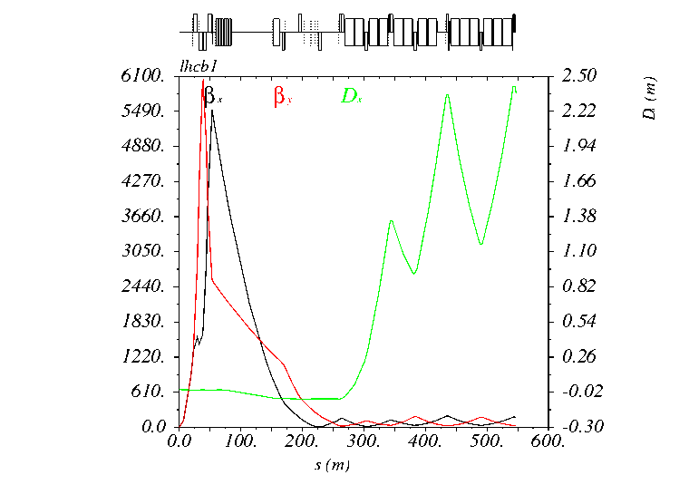
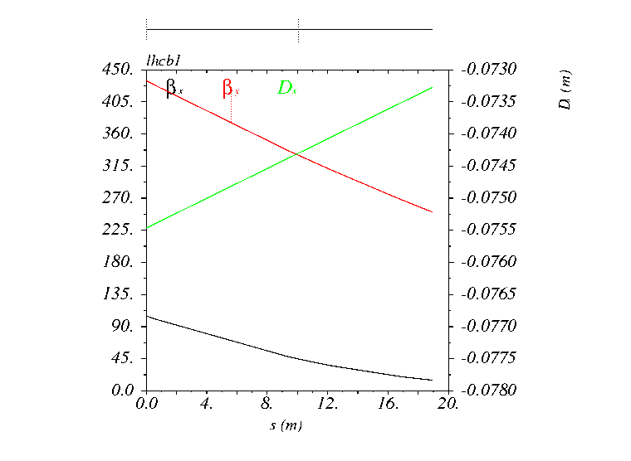
Beginnings of a CT-PPS squeeze in 2017 (animation) …
Beta’s and Single-pass dispersion for beam1
on the right side (β* is cst at the IP)
Zoom in the zone of the CT-PPS RP’s
(200-220 m w.r.t. the IP)
.. Not very impressive for a squeeze (only 15-20% β_{x}-reduction at the RPs, 200 μm dispersion increase). We should be able to do better.

Slide 5
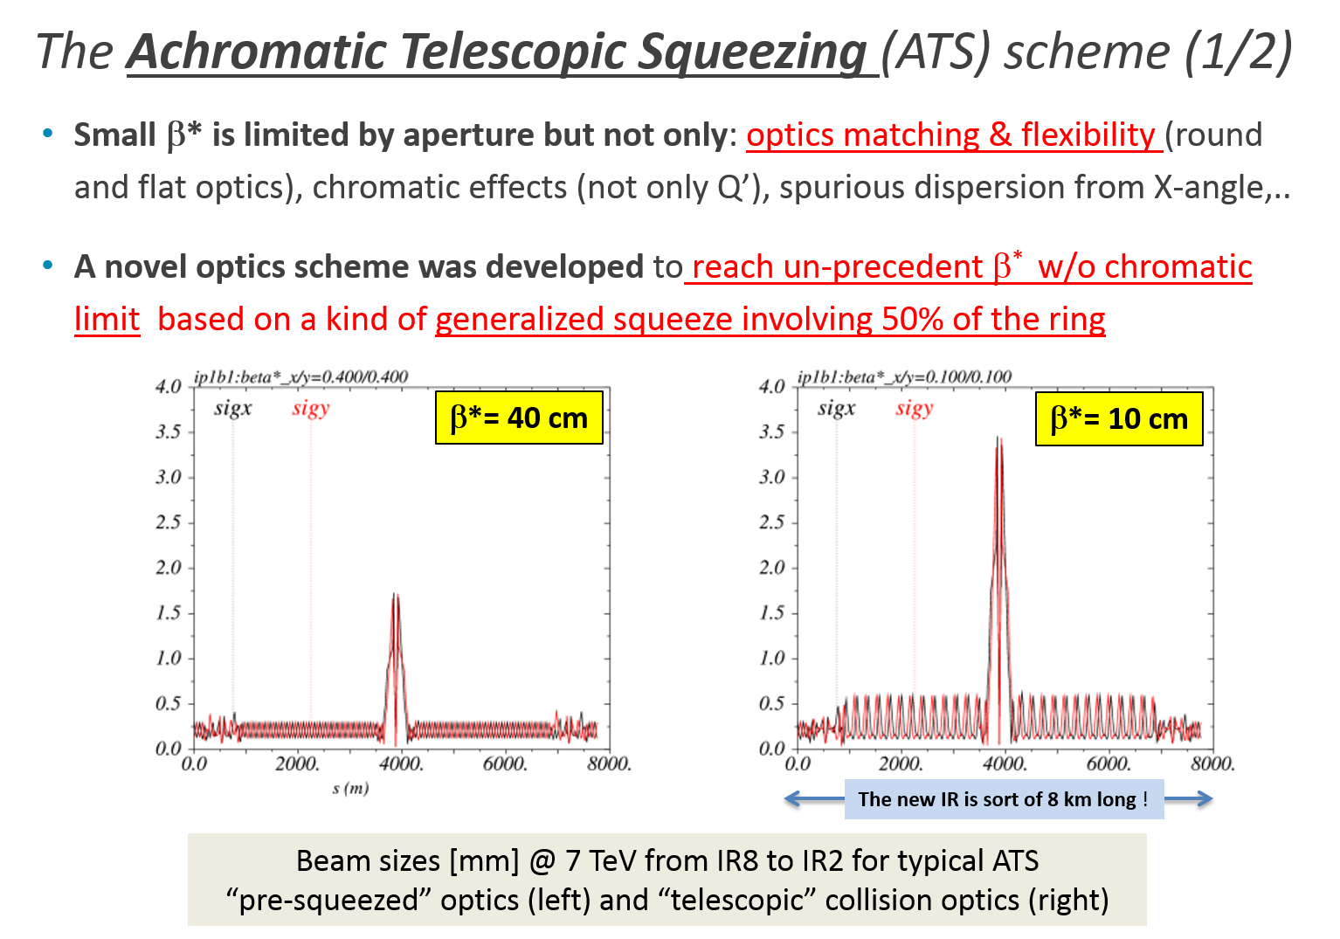
Telescopic optics (1/3)
Recap on ATS optics (in principle) for very small β* (HL-LHC Baseline optics)
Phys. Rev. ST Accel. Beams 16, 111002 – 2013

Slide 6
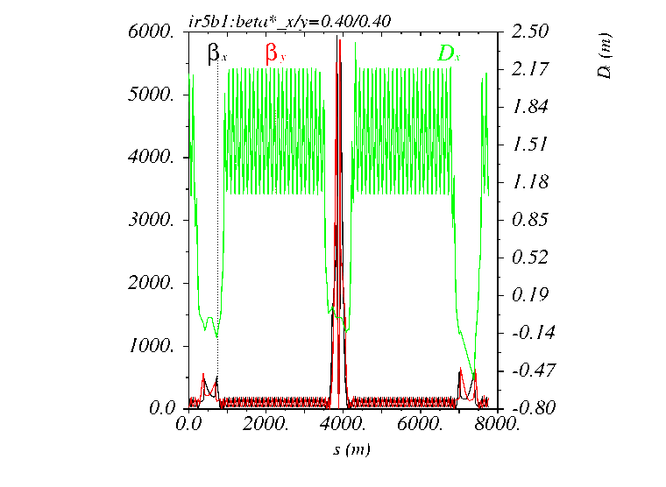
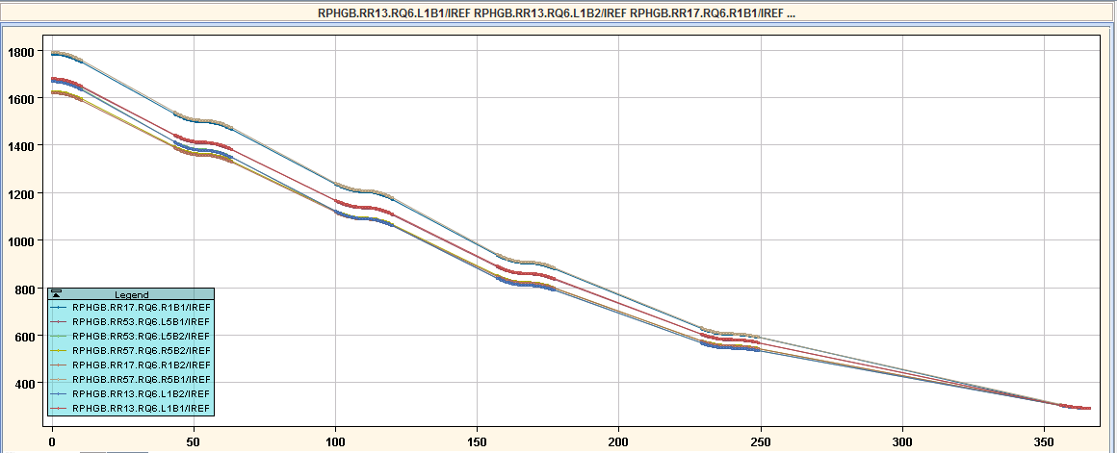
Telescopic optics (2/3)
Viewed differently, the ATS can be used to preserve “standard” LHC β* (e.g. β* =40-30 cm) in a telescopic manner:
To relax the demand on the IR1/5 matching quadrupoles themselves,
Then to better optimize internal IR1/5 constraints other than β*, e.g. much smaller β_{x} at the pots !
Q6> 1.5 KA @ 1m, offering quite some flexibility
For an aggressive “CT-PPS squeeze” at cst β*=1 m
Followed by a telescopic squeeze to reach back 40 cm
IR4
IR5
IR6
Q6@300A (quite low)
at 40 cm (w/o telescope)
“Natural” Q6 current for a standard ATS pre-squeeze
(w/o telescope) from 1 m to 40 cm
Un-squeezing IR5, and re-squeezing from outside
to relax the demand on matching quad.’s at cst β*=40 cm

Slide 7
Final considerations on Telescopic optics (3/3)
Even if not for β* proper, telescopic optics will need to be implemented soon in the LHC for HL-LHC optics validation, and with a large telescopic index (3→4).
At that moment CT-PPS (& AFP) will be able to profit from a much more performing “2017-like CT-PPS squeeze”
→ ..provided that roman pots equipped with new HW (as e.g. 220F), and the machine protection are ready to go beyond the 1.5 mm minimum gap.
Flat optics are also in the pipeline (for Run III) and are planned anyway to be done in a telescopic manner because of the aggressive (15-20 cm) β* in one of the two planes
→ CT-PPS will certainly “double gain” with Telescopic flat optics ( & V crossing)
→ AFP will gain less (due to H crossing for flat optics in ATLAS).
Some non-negligible R&D + MD time is still ahead to develop & validate all these idea, then precisely quantify the benefits for CT-PPS, but certainly in the 50%-100% range

Slide 8
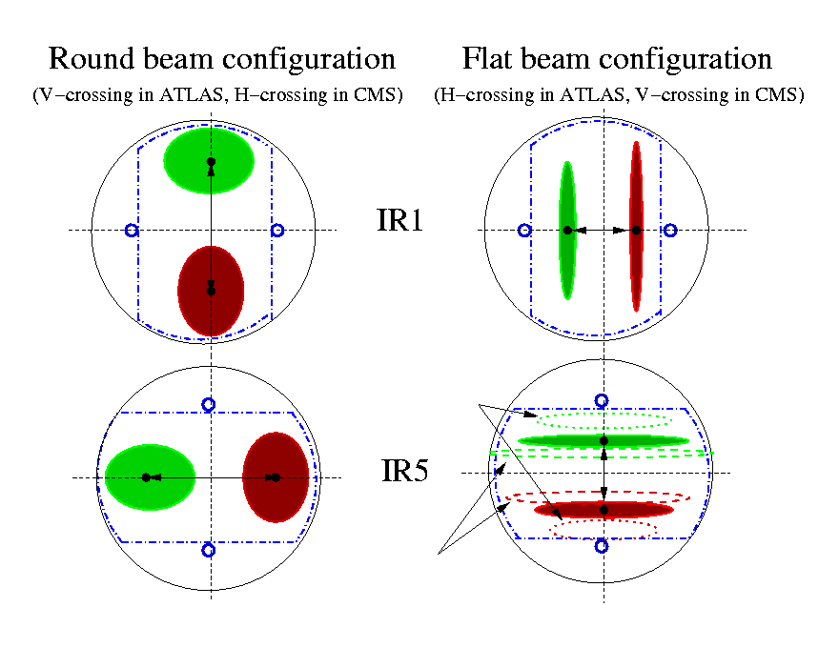
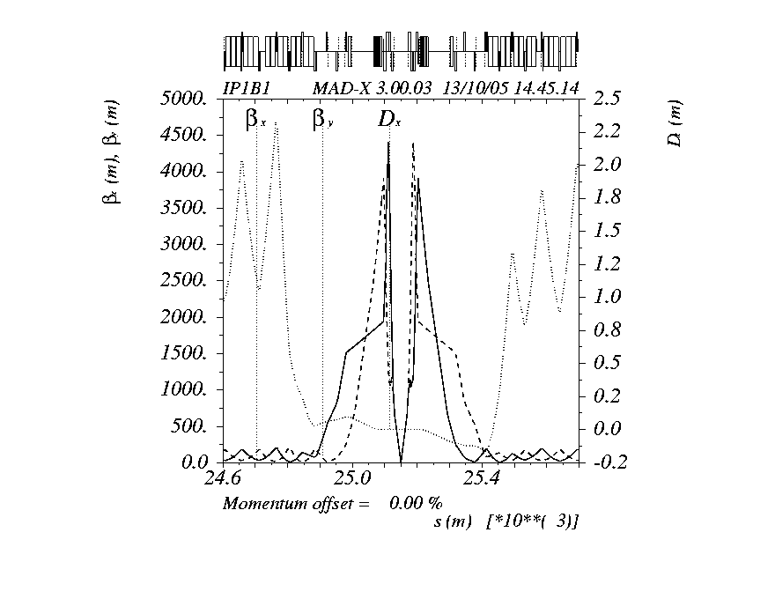
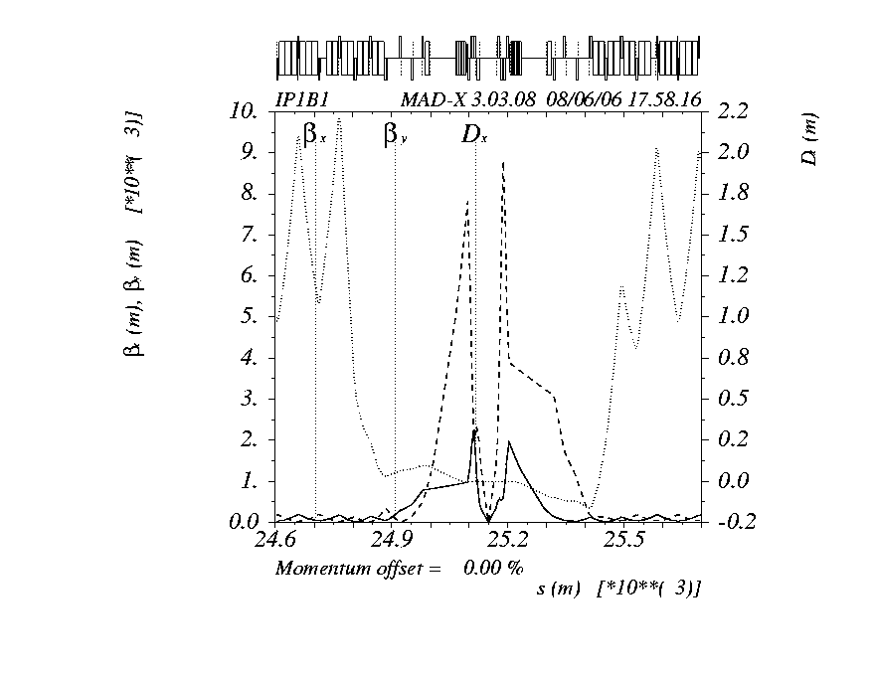
Flat optics (1/3) .. CT-PPS will gain, AFP might loose !
Competitive flat optics in LHC (typically $β_{x/y}^{∗}$= 100/25 cm instead of 50/50, down to 60/15 instead of 30/30) requires to change the crossing plane orientation (for triplet aperture)
Round 50/50
β_{x,max}~ 4.4 km
β_{y,max}~ 4.4 km
Effect of decreasing the
beam aspect ratio at the IP
(and increasing the vert. X-angle)
Flat 100/25
β_{x,max}~ 2.2 km
β_{y,max}~ 8.8 km
Effect of increasing the
beam aspect ratio at the IP
(and decreasing the vert. X-angle)
Very old idea (CERN MAC, 2006) recently revived

Slide 9
Flat optics (2/3)
Most promising and competitive flat optics for LHC
60/15 cm with 150 μrad Half X-angle H/V in ATLAS/CMS
2.4E34 peak lumi @ 6.5 TeV with BCMS beam (2592 collisions, 1.2E11, γε=2.5 μm, σ_{z}=7.5 cm) and up to 3.5E34 with 8b4e !...
Can be realized with a tele index
of ~ (1,4) for ATLAS and (4,1) for CMS
(still to be optimized for beam-beam)
β _{max} ~ 16 km in the separation plane !
→ IT multipole correction is vital !
Aperture is at the limit @6.5TeV
8.5 σ in the IT and 15 σ in the MS
(@Q5 for the worst case of CMS)

Slide 10
Flat optics (3/3)
Footprint with 2 IP’s, 154 μrad half X-angle (12.5 σ @ 6.5TeV and γε=2.5 μm)
New features showing up with LR only
→ LR tune shift of - 0.0035/IR
Reduced cross-anharmonicity (LR spread> 0 along the diagonal)
B6-like spread showing up (ΔQ α J²)
With HO and LR

Slide 11
With very good LR Correctability with MO (even with badly optimized telescope)
MO=0 @ 154 μrad
MO= -200A @ 154 μrad
MO= -400A @ 154 μrad
MO= -600A @ 154 μrad
MO= -700A @ 154 μrad
MO= -530A @ 165 μrad

Slide 12
Other “telescopic by-products” (one example amongst others)
From huge β∗ optics and/or faster de-squeeze using the telescopic techniques, to more luminous 90 m-like optics !
“Standard” 90 m-optics
with prescribed R12 and R34 from the IP to the RP
..4 times more luminous by telescopically re-squeezing to 25 m
.. therefore at constant R12 and R34 !!
.. and reopening 25 ns possibilities (at least for beam-beam effects)
Still preliminary (many details to be looked at), but it might be a good idea to re-start to brainstorm on a possible 25 ns upgrade of the electronics .. If so up to a factor ~10 in lumi !!

Slide 13
Summary & Outlook
The first step has been achieved this year by implementing the ATS in the LHC, with some immediate inconvenience for CT-PPS but also much more potential for future improvements.
The ATS is a wonderful tool for small β* but not only. A lot of imaginative work is indeed ahead to extract the best of it, in particular to serve the entire FP community.
The CT-PPS and AFP needs and limitations are now well-understood, together with clear directions for net improvement. Entering in the “telescopic era of the LHC”, both experiments can only profit from this move in the near future: not talking at the 5-10% level, but more at the 50-100% level !

