Slide 1
QPDB monthly update
June 28, 2017
Tiina Salmi and Timo Tarhasaari, TUT

Slide 2
Topics
Magnet parameters filled for 11 T and MQXFS03
  A few specific questions (attached Questions_080617.docx)
Jc fitting: The attempt to fit using only C0 did not work
  Alpha can be fixed but C0, Bc20 and Tc0 should be free to fit all cases (attached interactive matlab figure)
Data analysis: We are automizing the signal analysis in matlab
  Went trough manually ~10 quenches (1 quench / hour….)
  Wrote matlab routines to extract the results and save figures for manual check (1 quench / 30 min…)
  The analysis will be well documented
Work in progress: MQXFS03a hh-quench signals analysis (50% done)
  Some uncertainty in test settings related to detection and heater circuits
  Don’t have other signals
NEXT month:
  Some adjustments in DB, save test results for other magnets, simulations for measured cases

Slide 3
Signal analysis
Saved parameter | Channels | Criterion
Imag | IDCCT_HF | Check signal, but keep Imag as recorded by test operator
Time trigger QH | Trigger_QH1, Trigger_QH2 | Voltage level change time
Time QH ON | I_Heater1..8, U_Heater1..8 | Middle of the heater current rise
Time quench onset t1 | VT signals | t1 = ”activity”: When 95% of signal above noise level for 3 ms
Time quench onset t2 | VT signals | T2 = ”clear Q onset”: When signal above noise level for 10 ms, and increases.
Location on quench onset | VT signals
Current decay fit | IDCCT_HF, Trigger_QH1, Trigger_QH2, Trigger_Thy, Trigger_Mec | Piecewise polynomial fit, trigger times used to automatically define pieces end points

Slide 4
Quench onset definition
”Noise-level” defined before QH trigger: 95% of signal below that level
”t1 = activity”: 95% of signal above noise level for 3 ms
”t2 = Quench onset”: Signal above the noise level, and increases for 10 ms
Automatic routine cathces t2 quite well, but it needs manual checking
  False positives when signal later starts to decerease, or due to disturbance for QH fire
  Some cases t1 in not found and t2 is a bit earlier than automatically defined
To QPDB recorded t2 as quench onset
  Uncertainty range is (t1, t2). If clear propagation does not start from t2, in uncertainty range we put the time instant when clear propagation starts.
Matlab figs and jpg pictures saved for references and future analysis

Slide 5
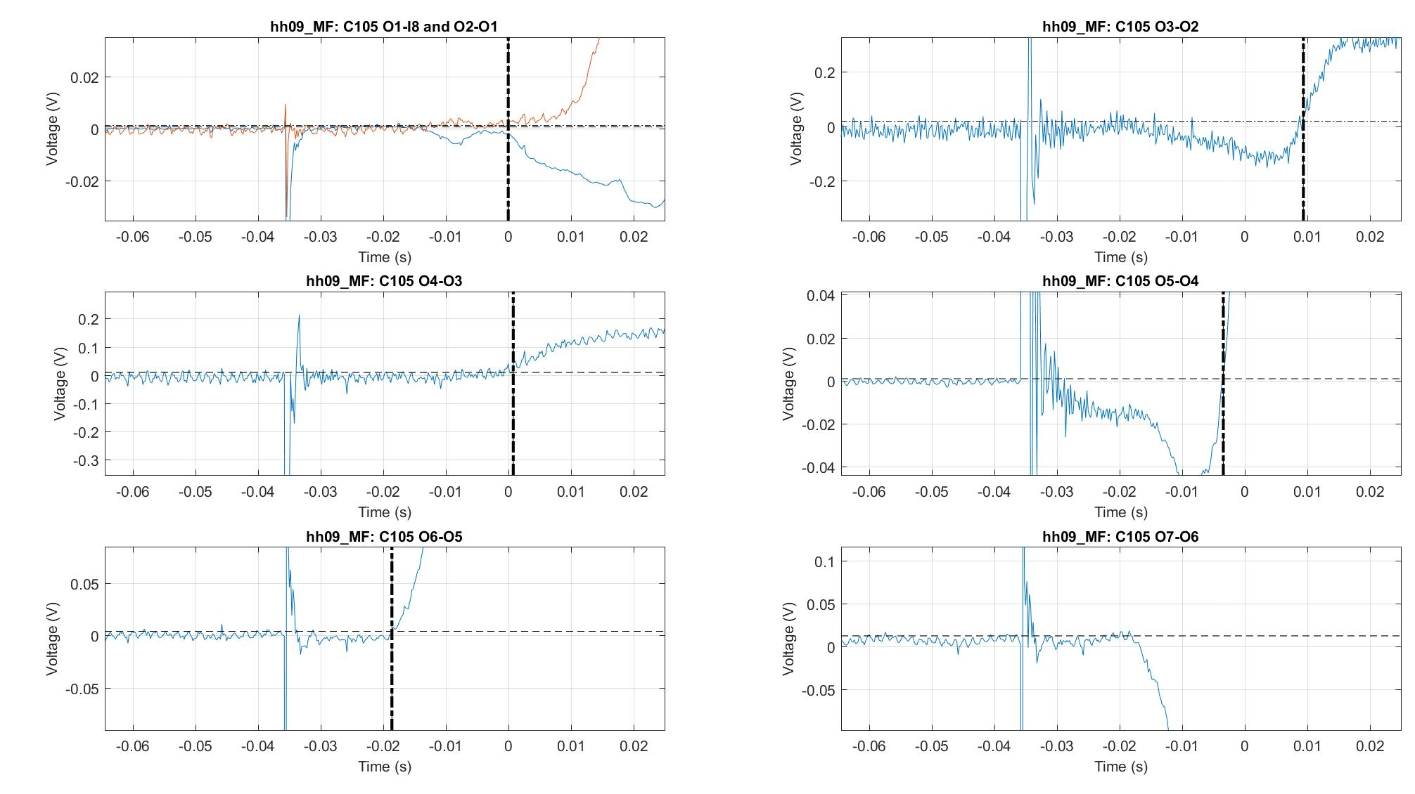
Example:
MQXFS03a, quench hh09
OL VT’s

Slide 6
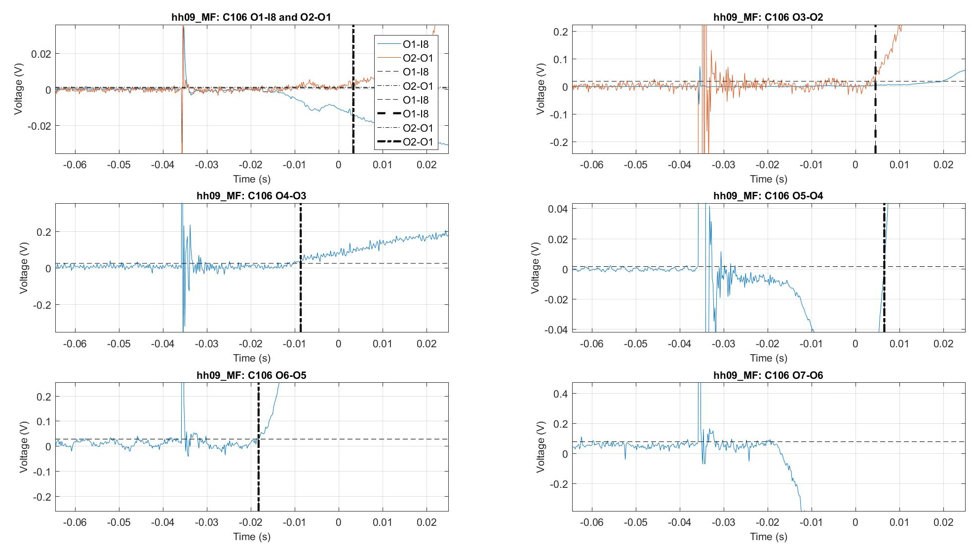
Example:
MQXFS03a, quench hh09
OL VT’s

Slide 7
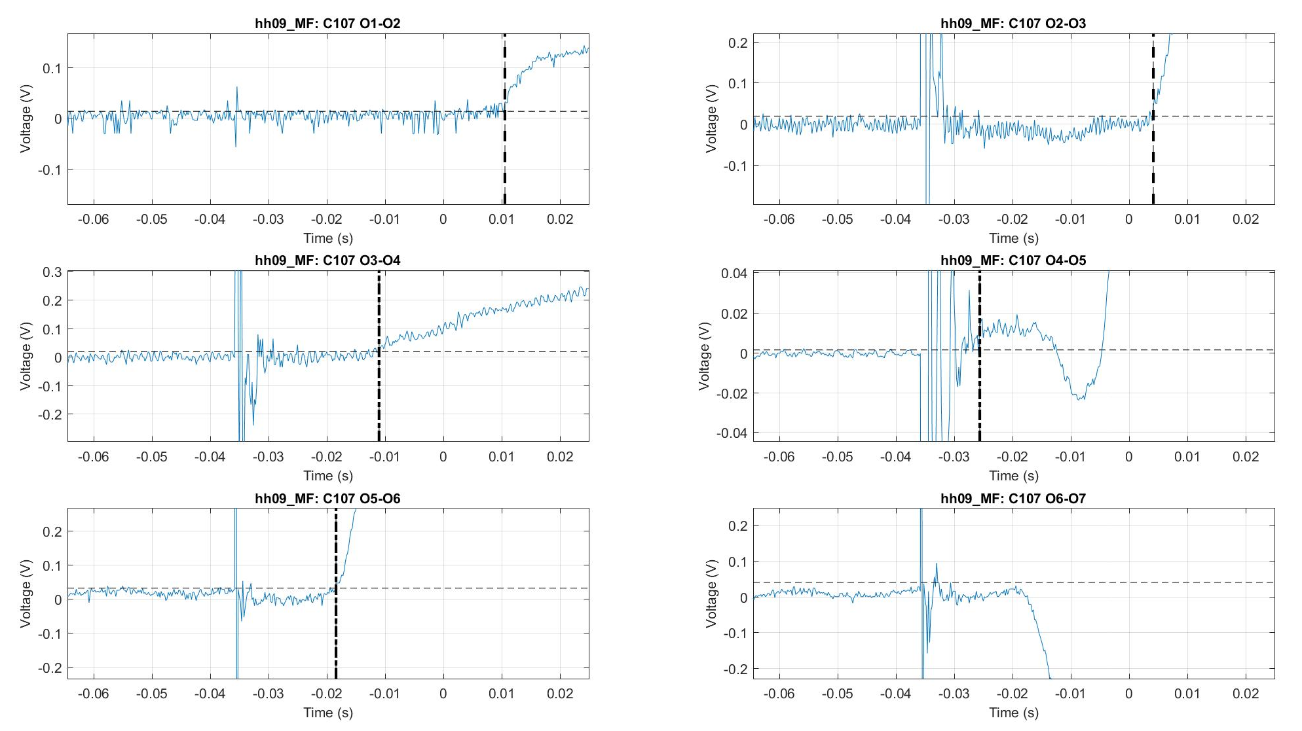
Example:
MQXFS03a, quench hh09
OL VT’s

Slide 8
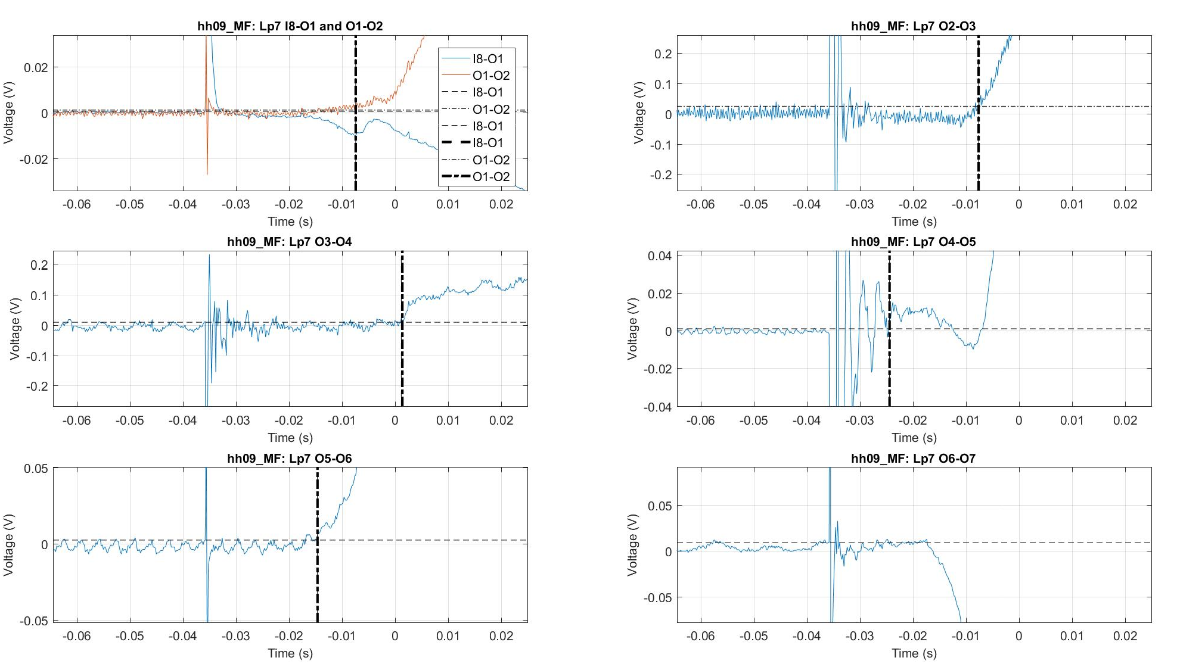
Example:
MQXFS03a, quench hh09
OL VT’s

Slide 9
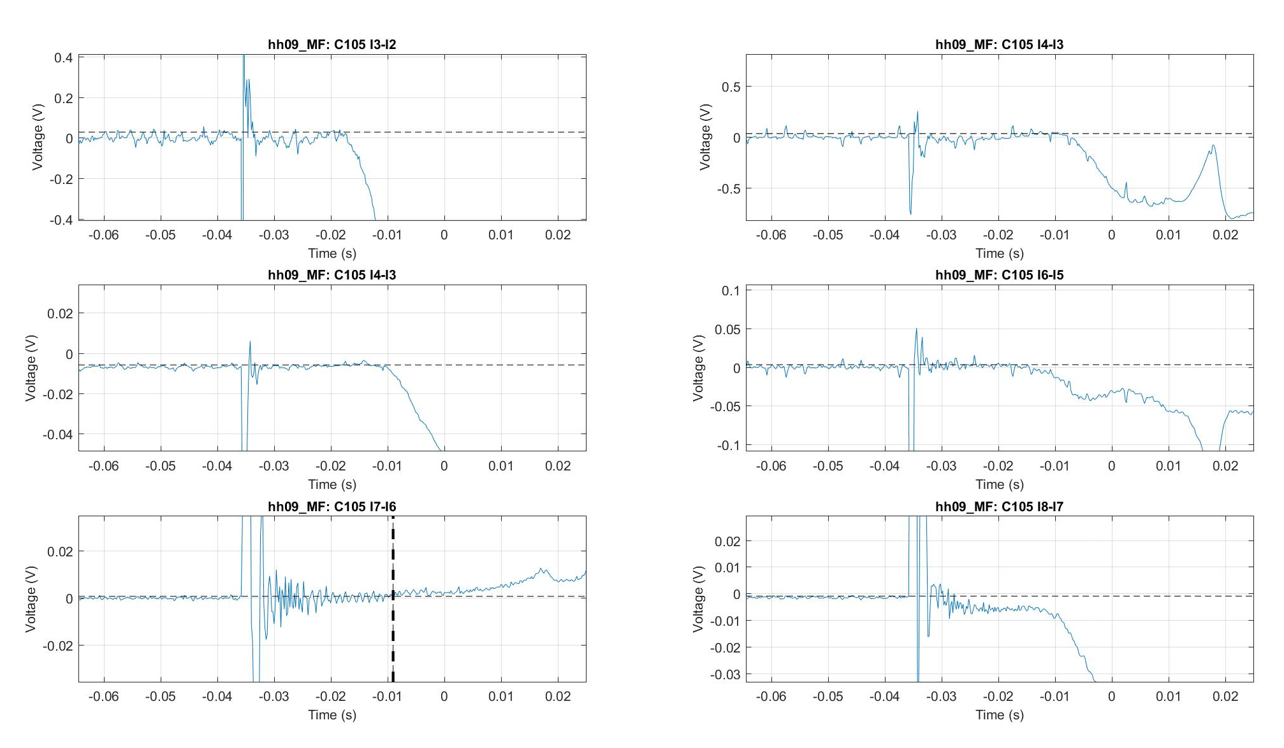
Example:
MQXFS03a, quench hh09
IL VT’s

Slide 10
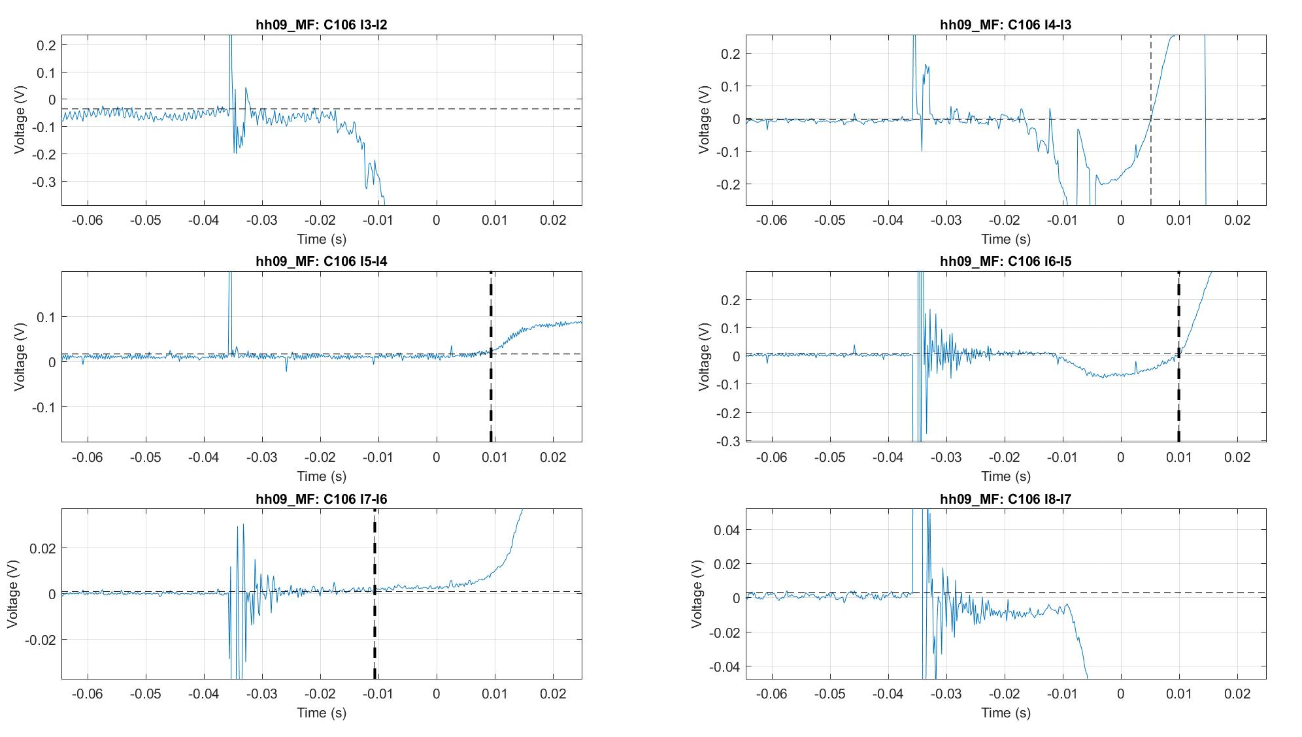
Example:
MQXFS03a, quench hh09
IL VT’s

Slide 11
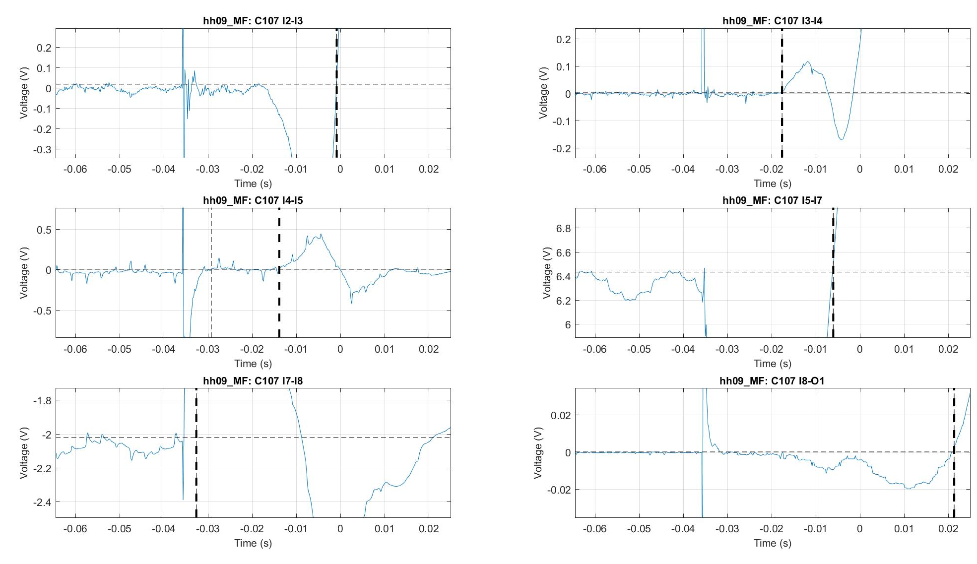
Example:
MQXFS03a, quench hh09
IL VT’s

Slide 12
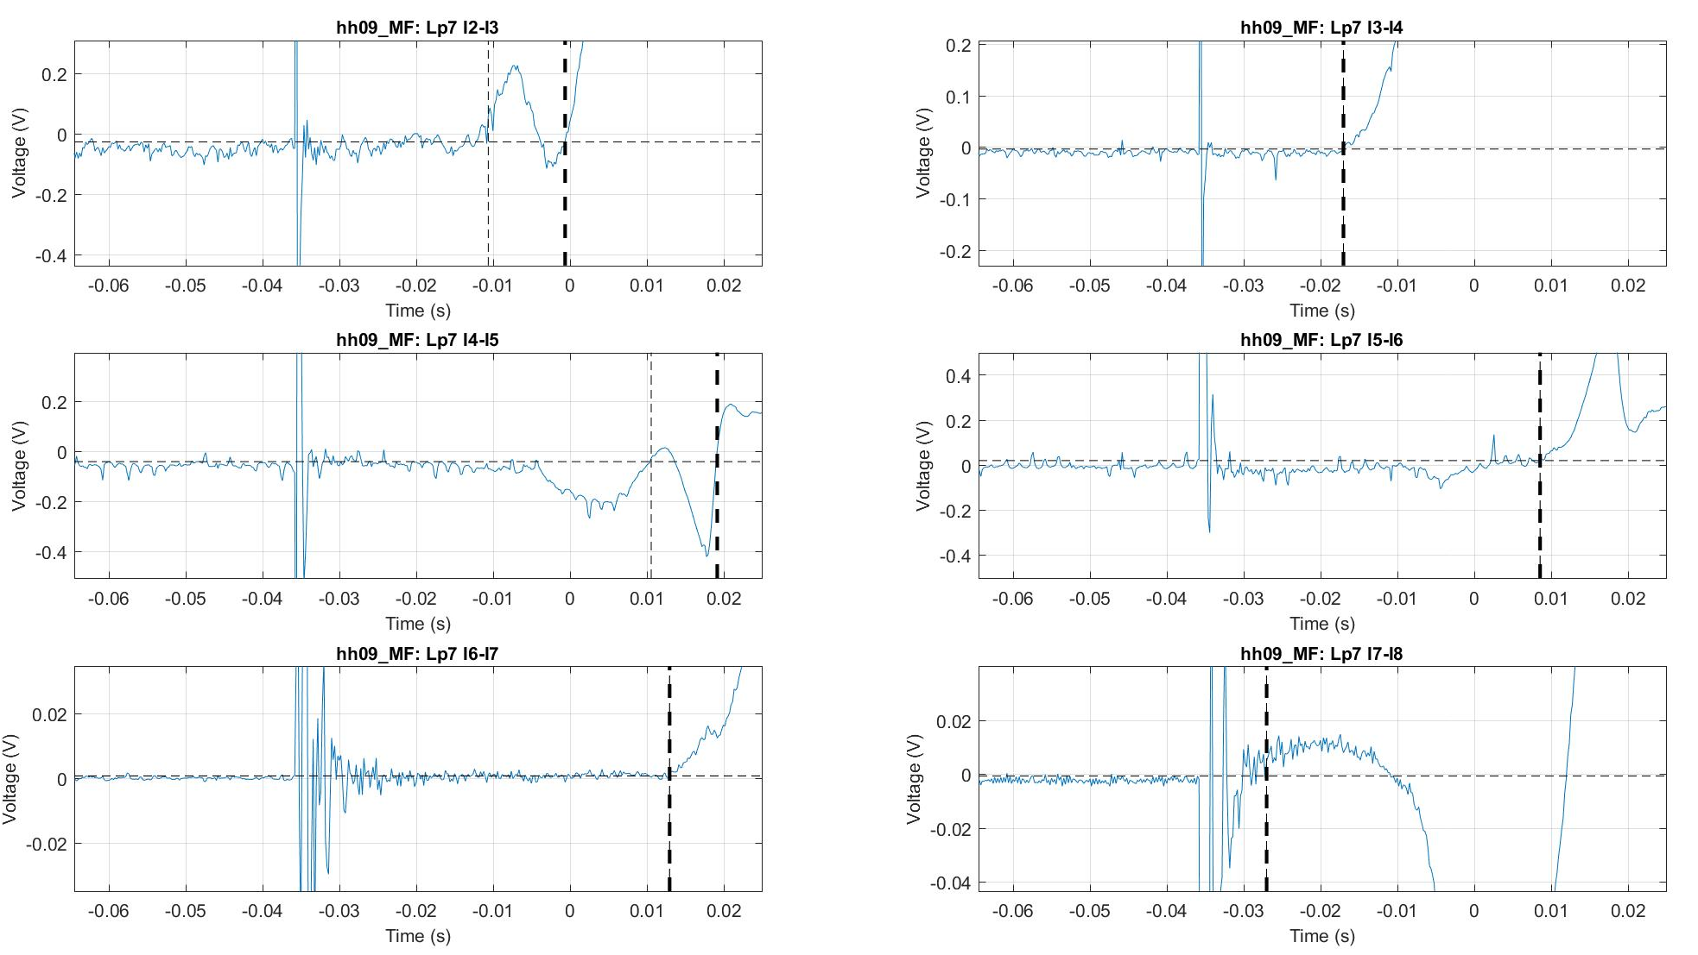
Example:
MQXFS03a, quench hh09
IL VT’s

Slide 13
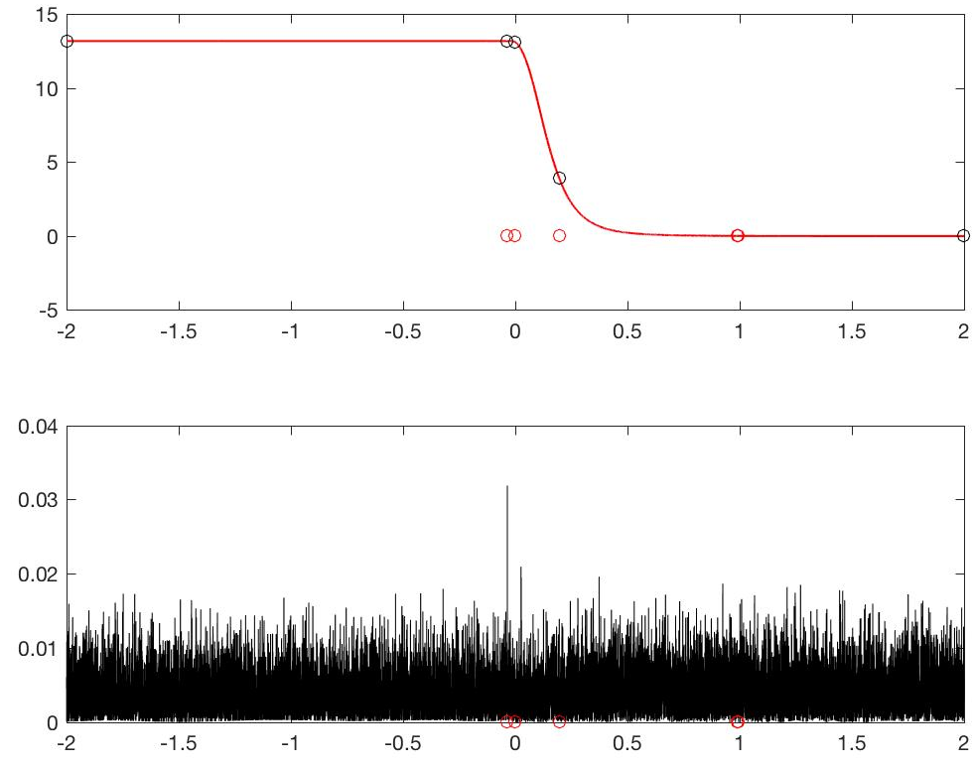
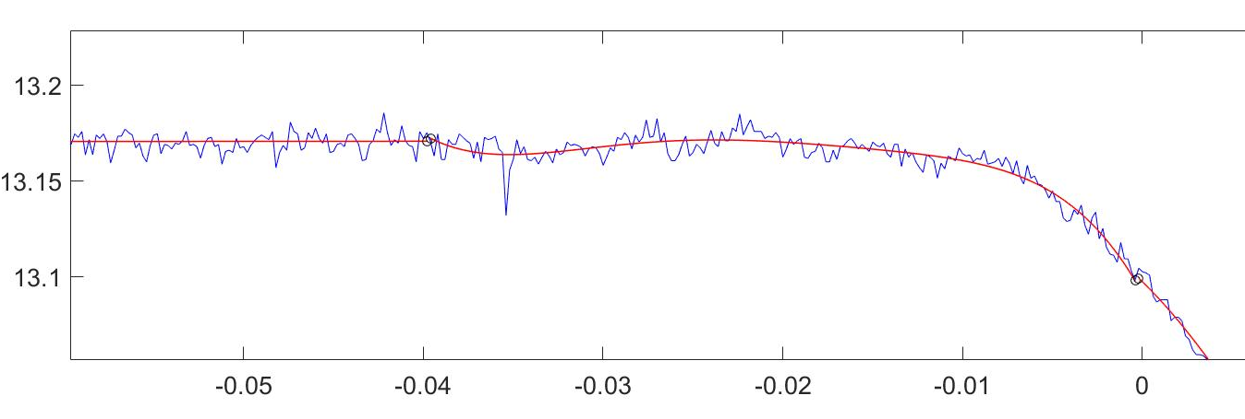
Fitting current decay automatized
Piecewise polynomial fit
  6 pieces, each with max order of 9
Matlab routine
  Goes trough a series of quench data files
  Prints results in format easy to copy to DB
  Prints figures for manual check
  Error mostly < 1%, for worst single points < 2%
  We will cut the tail below 100 A, ok?
MQXFS03a, quench hh09
Imag (kA)
Fit error (kA)
Time (s)

