Slide 1

40 m$L^{∗}$ Alternative Triplet
Leon van Riesen-Haupt

Slide 2
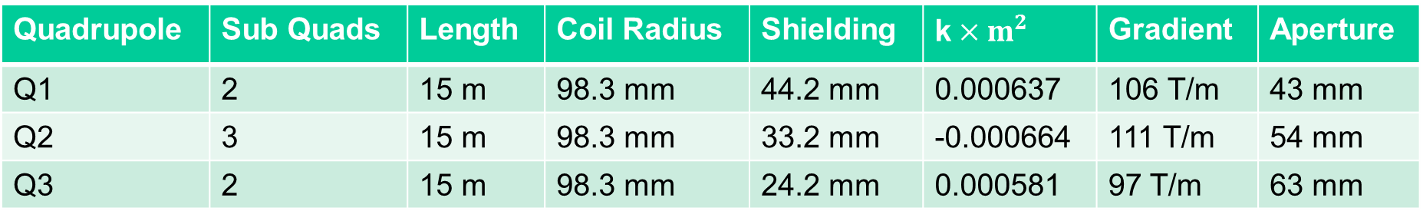
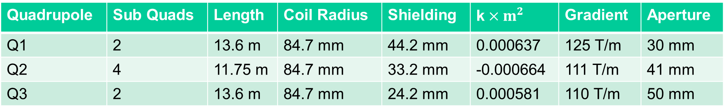
Quads
Before: Triplet made of 2-3-2 pattern of identical magnets
New Triplet
Quadrupole | Sub Quads | Length | Coil Radius | Shielding | k$×m^{2}$ | Gradient | Aperture
Q1 | 2 | 15 m | 98.3 mm | 44.2 mm | 0.000637 | 106 T/m | 43 mm
Q2 | 3 | 15 m | 98.3 mm | 33.2 mm | -0.000664 | 111 T/m | 54 mm
Q3 | 2 | 15 m | 98.3 mm | 24.2 mm | 0.000581 | 97 T/m | 63 mm
Quadrupole | Sub Quads | Length | Coil Radius | Shielding | k$×m^{2}$ | Gradient | Aperture
Q1 | 2 | 13.6 m | 84.7 mm | 44.2 mm | 0.000637 | 125 T/m | 30 mm
Q2 | 4 | 11.75 m | 84.7 mm | 33.2 mm | -0.000664 | 111 T/m | 41 mm
Q3 | 2 | 13.6 m | 84.7 mm | 24.2 mm | 0.000581 | 110 T/m | 50 mm

Slide 3
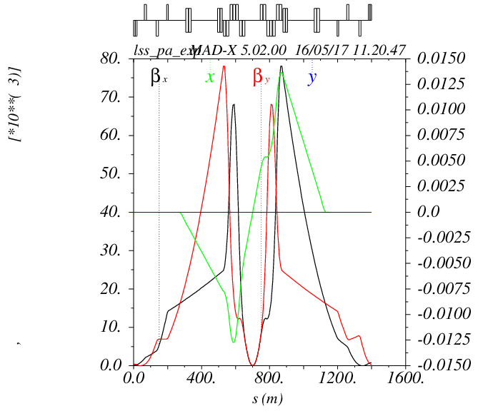
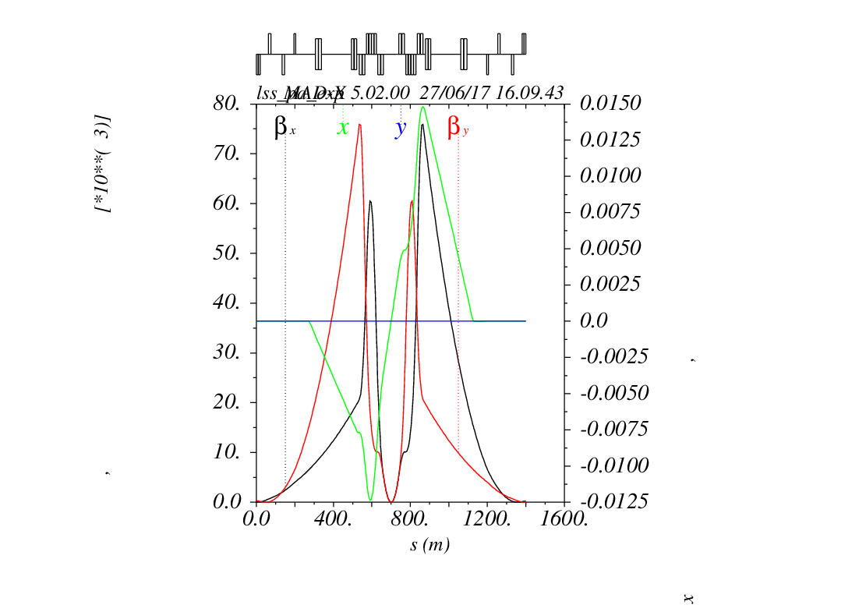


Optics
Old Round$β^{∗}=0.3 m$
New Round$β^{∗}=0.3 m$

Slide 4
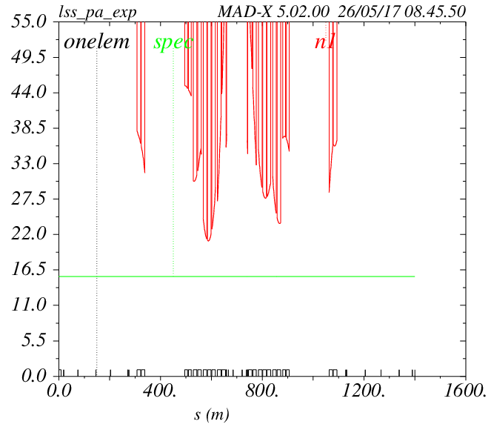
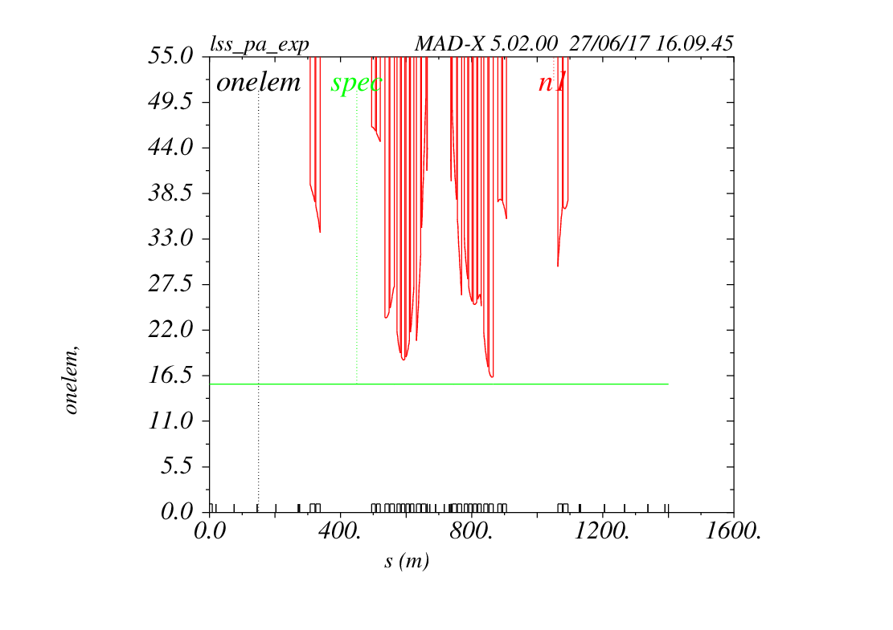


Beam Stay Clear
Old Round$β^{∗}=0.3 m$
New Round$β^{∗}=0.3 m$
$$21σ$$
$$19.6σ$$

Slide 5
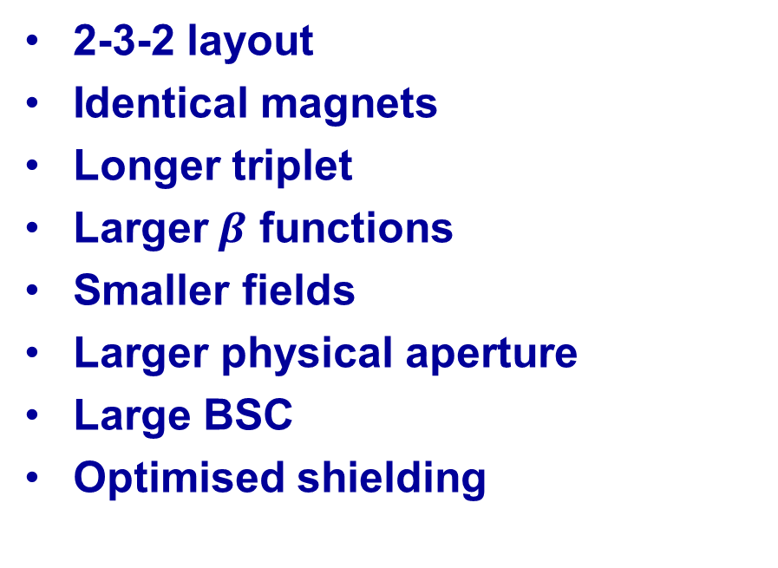
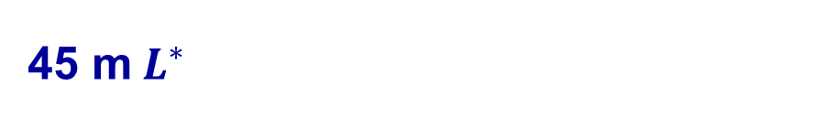
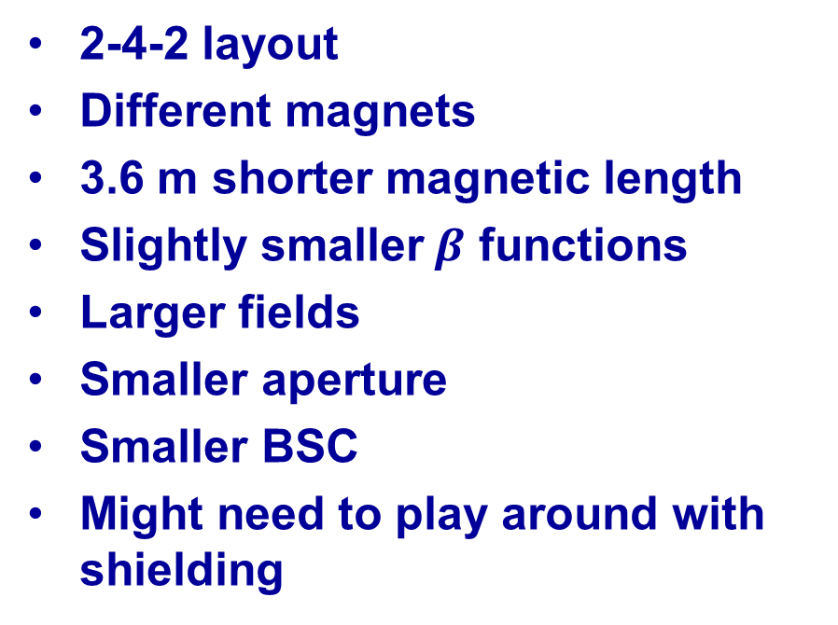
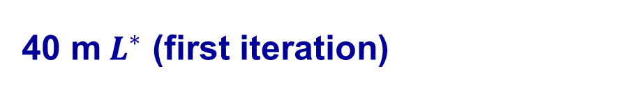
Comparison
45 m$L^{∗}$
40 m$L^{∗}$ (first iteration)
2-3-2 layout
Identical magnets
Longer triplet
Larger$β$ functions
Smaller fields
Larger physical aperture
Large BSC
Optimised shielding
2-4-2 layout
Different magnets
3.6 m shorter magnetic length
Slightly smaller$β$ functions
Larger fields
Smaller aperture
Smaller BSC
Might need to play around with shielding

Slide 6
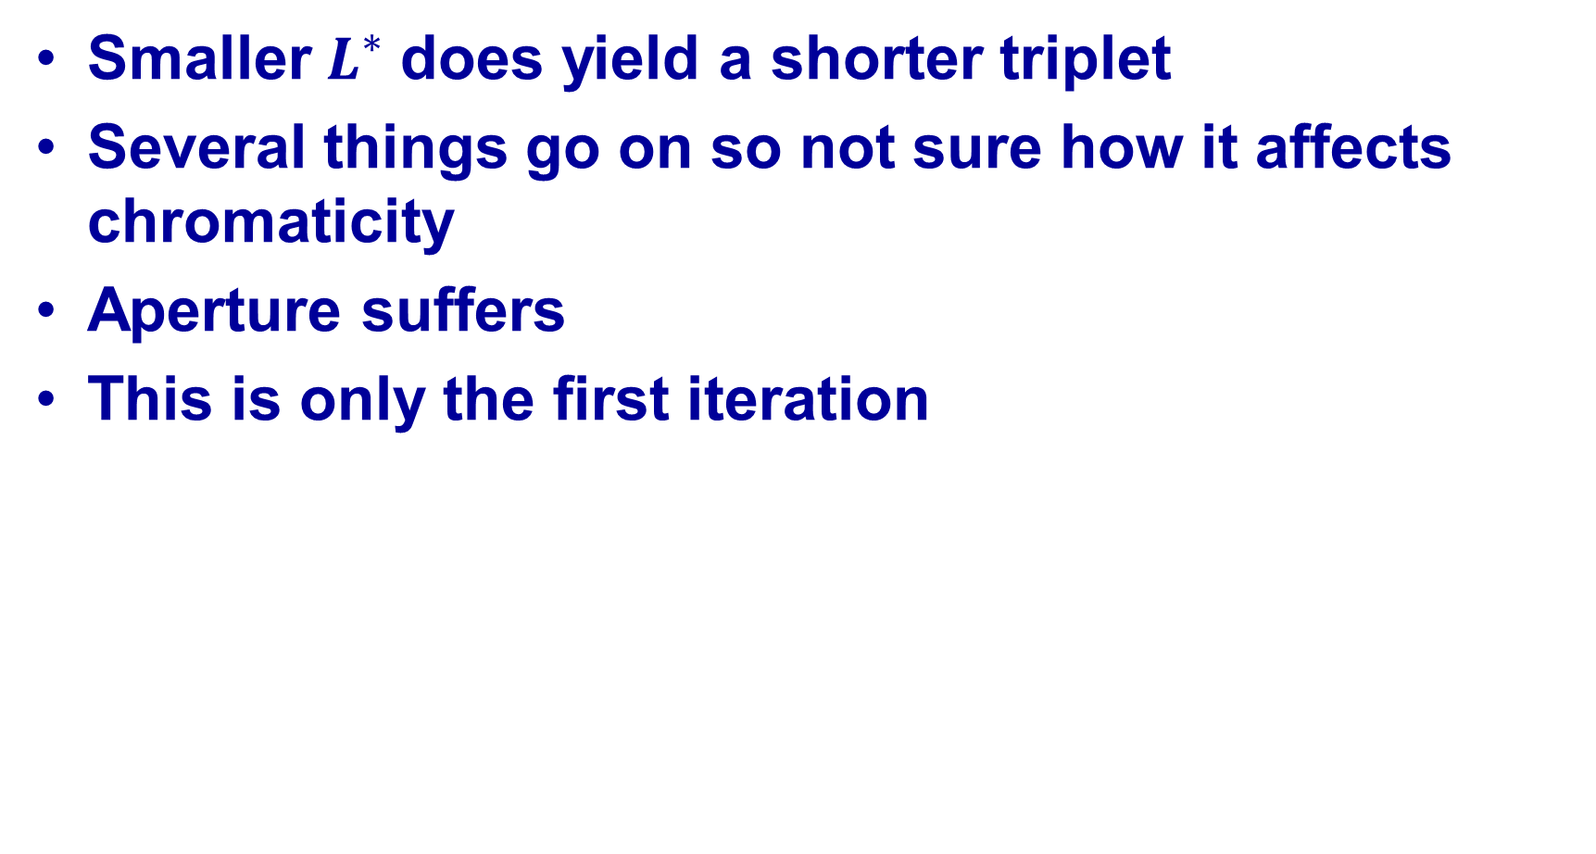
Summary
Smaller$L^{∗}$ does yield a shorter triplet
Several things go on so not sure how it affects chromaticity
Aperture suffers
This is only the first iteration

