Slide 1
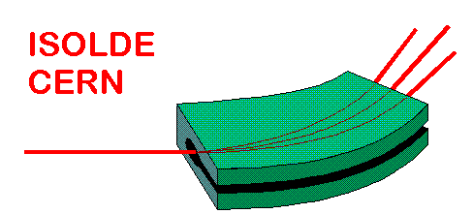

SOLID STATE PHYSICS @ ISOLDE
Karl Johnston
ISOLDE/CERN
40èmes Journées des Actinides
Sunday 28 Match 2010
cern.ch/isolde-ssp

Slide 2
Outline of talk
Introduction to SSP @ ISOLDE
Experiments running
Infrastructure
Techniques used
Case studies using PAC and Mossbauer Spectroscopy
Future directions

Slide 3
Radioactive isotopes for solid state physics? Why & How??
Nothing is more easy to detect with high sensitivity than nuclear radiation, i.e. very low concentrations of radioactive impurity atoms in a material can be detected.
The radioactive isotopes (“probes”) act as “spies” transmitting information with atomic resolution via their decay.
Crucial point: what information do you get?????
Adds extra dimension to “normal spectroscopies” e.g. optical / electrical characterisation of semiconductors
Provides extremely local probe which is applied to variety of systems
A facility providing a large variety of radioactive isotope (if possible, isotopically clean)
You need
You have to introduce the isotopes into the semiconductor
by ion implantation
by diffusion
during crystal growth
by nuclear reaction with one of the constituents of the solid

Slide 4
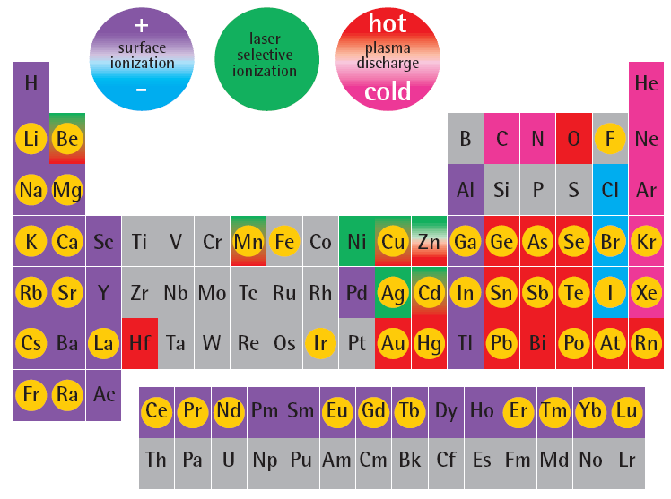
ISOLDE table of elements
isotopes of this element
used for solid state physics
or life science

Slide 5
SSP @ ISOLDE: Diverse community
Solid State physics: Semiconductors, Metals
Materials scientists: High Tc Superconductors, Multiferroic materials
Surface physics/Quantum Transport
Biophysics: structural properties & role of heavy metals in proteins, DNA.
SSP investment: money & people
Participating Countries | 21
Participating Institutes | 41
Postdocs/professors/researchers | 50
Graduate Students (estimate) | 50

Slide 6
Expt No. | Title of proposal | Spokesperson/ Affiliation | Experiment Category
IS501 | Emission Mössbauer spectroscopy of advanced materials for opto- and nano- electronics | Gunnlaugsson, H. (Aarhus), Sveinn Olafsson (Reykjavik) | Semiconductors (magnetism)
LOI88 | BetaNMR as a novel technique for biological applications | Lars Hemmingsen/Monika Stachura (Copenhagen) | Biophysics
LOI84 | ASPIC2 | Kay Potzger (FZ, Rossendorf, Germany) | Surface physics (magnetism/Quantum Transport)
LOI81 | Radioactive probe studies of coordination mechanisms of heavy metal ions from natural waters to functionalized magnetic nanoparticles | Vitor Amaral CICECO, Aveiro, Portugal | (BIO)PHYSICS (cleaning water)
IS492 | Defects in ZnO, CdTe, and Si: Optical, structural, and electrical characterization | Manfred Deicher TPUS, Saarbrücken, Germany | SEMICONDUCTORS(defects characterization)
IS489 | Radiotracer diffusion in semiconductors and metallic compounds using short-lived isotopes | Manfred Deicher TPUS, Saarbrücken, Germany | SEMICONDUCTORS(diffusion)
IS488 | Ag(I), Pb(II) and Hg(II) binding to biomolecules studied by Perturbed Angular Correlation of γ-rays (PAC) spectroscopy: Function and toxicity of metal ions in biological systems | Lars Hemmingsen RVAUDNS, Frederiksberg, Denmark | BIOPHYSICS(detoxification)
IS487 | Study of Local Correlations of Magnetic and Multiferroic Compounds | Vitor Amaral CICECO, Aveiro, Portugal | MULTIFERROICS(magnetism, dielectric…
IS486 | Crystal field investigations of rare earth doped wide band gap semiconductors | Ulrich Vetter PIUG, Göttingen, Germany | SEMICONDUCTORS(wide band gap)
IS481 | The role of In in III-nitride ternary semiconductors | Katharina Lorenz ITN, Sacavém, Portugal | SEMICONDUCTORS(ternary)
IS472 | High Resolution optical spectroscopy in isotopically-pure Si | Karl Johnston TPUS, Saarbrücken, Germany | SEMICONDUCTORS(fundamental)
IS464 | (n,p) emission channeling measurements on ion-implanted beryllium | Uli Köster ILL, Grenoble, France | METALS / R&D
IS453 | Emission channelling lattice location experiments with short-lived isotopes | Ulrich Wahl ITN, Sacavém, Portugal | SEMICONDUCTORS & OXIDES (lattice location dopants)
IS450 | Diffusion of ⁵⁶Co in GaAs, ZnO and Si_{1-x}Ge_{x} systems | Räisänen, J. Helsinki | SEMICONDUCTORS (diffusion)
IS448 | Pb(II) and Hg(II) binding to de novo designed proteins studied by ^{204m}Pb- and ^{199m}Hg-Perturbed Angular Correlation of g-rays (PAC) spectroscopy: clues to heavy metal toxicity | Hemmingsen, L. Frederiksberg | Biophysics
IS443 | Mössbauer studies of dilute magnetic semiconductors | Marco Fanciulli INFN, Milano, Italy | SEMICONDUCTORS(magnetism)
IS432 | Diffusion of ⁵²Mn in GaAs | Räisänen, J. Helsinki | SEMICONDUCTORS(diffusion)
IS425 | Radioactive probes on ferromagnetic surfaces | Wolf-Dietrich Zeitz HMI, Berlin, Germany | (INTER)SURFACES(fundamental)

Slide 7
RIB solid state physics as applied nuclear physics
Nuclear probes
Interactions
Methods
Radioactive
Nuclei
➔ γ, α, β
Hyperfine
Interaction
Mößbauer effect
γγ angular correlation
Nuclear Magnetic resonance
Nuclear orientation
Radioactive
decay
DLTS
Photoluminescence
Tracer Diffusion
Muons
➔ ß⁺
Coulomb
Interaction
Nuclear
Physics
Emission Channeling
Ion Channeling
Backscattering
Elastic Recoil
Resonant Scattering
Neutron Scattering
Solid state physics
applications
Ions
Scattering,
Diffraction
Neutrons
Nuclear
Reaction
Nuclear Reaction Analysis
Positrons
ß⁺-e⁻
Interaction
Positron Annihilation
Positron Angular Distribution
Positron Energy Distribution

Slide 8
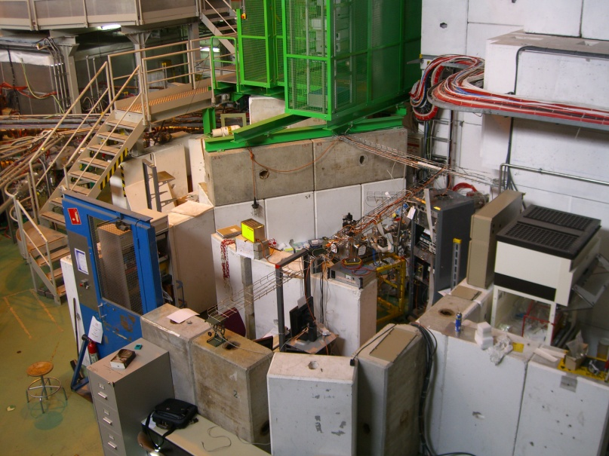
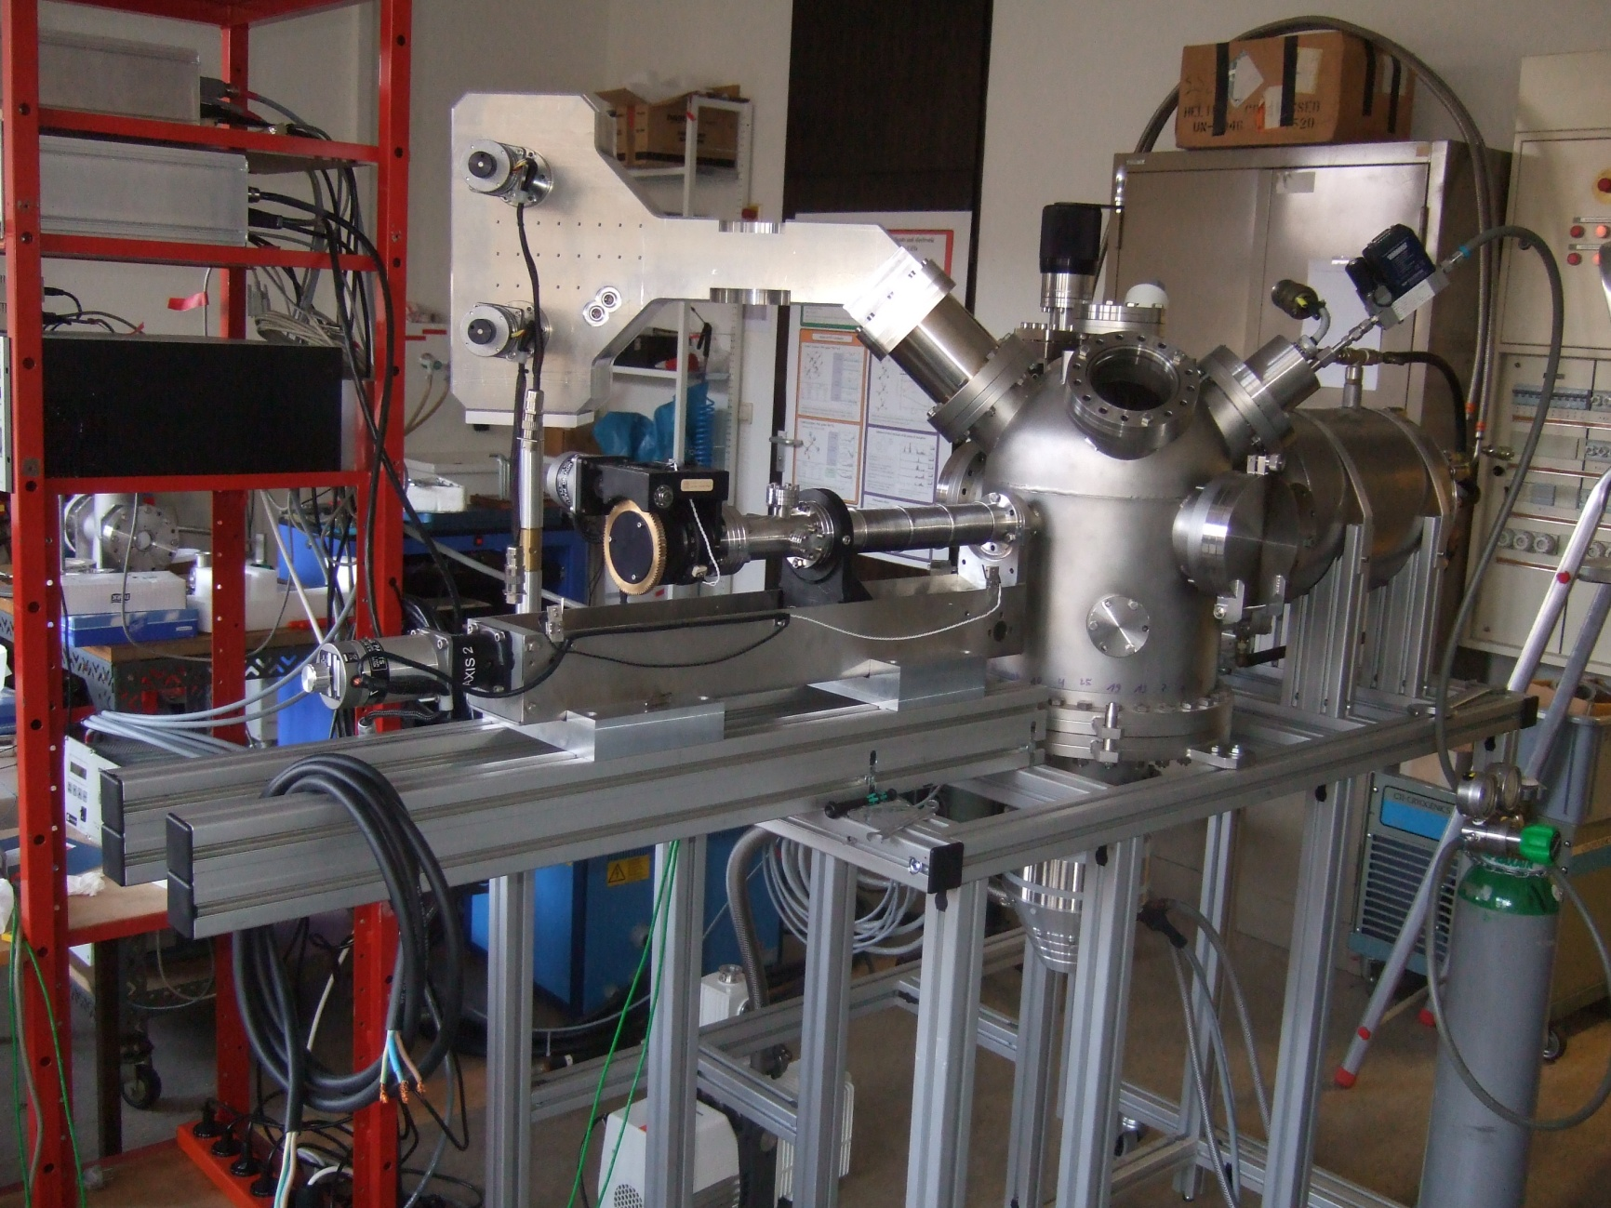
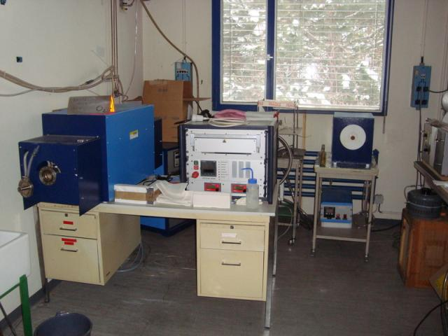
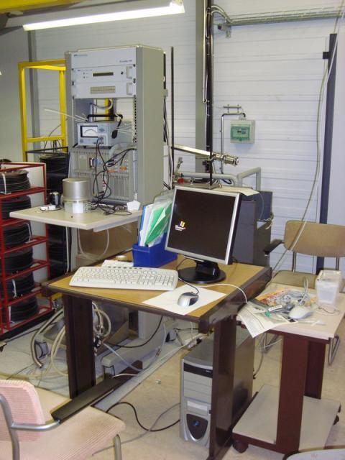
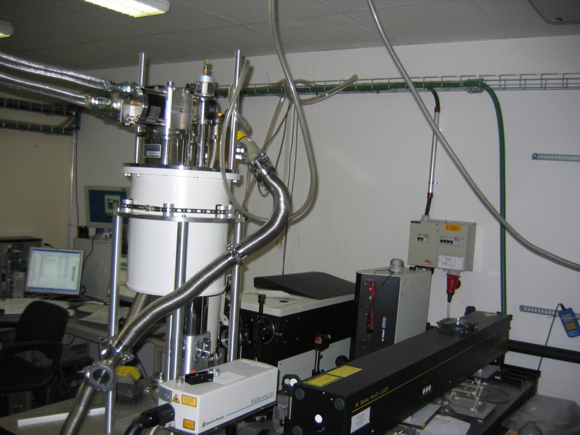

Slide 9
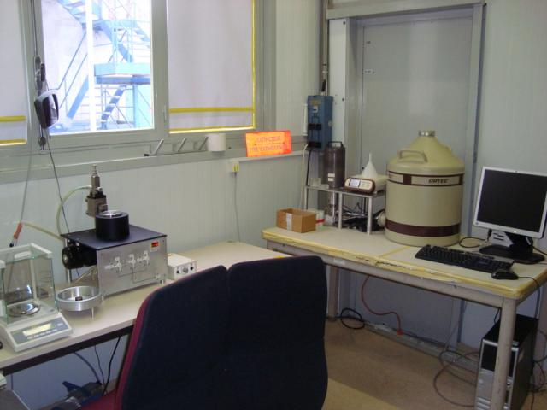
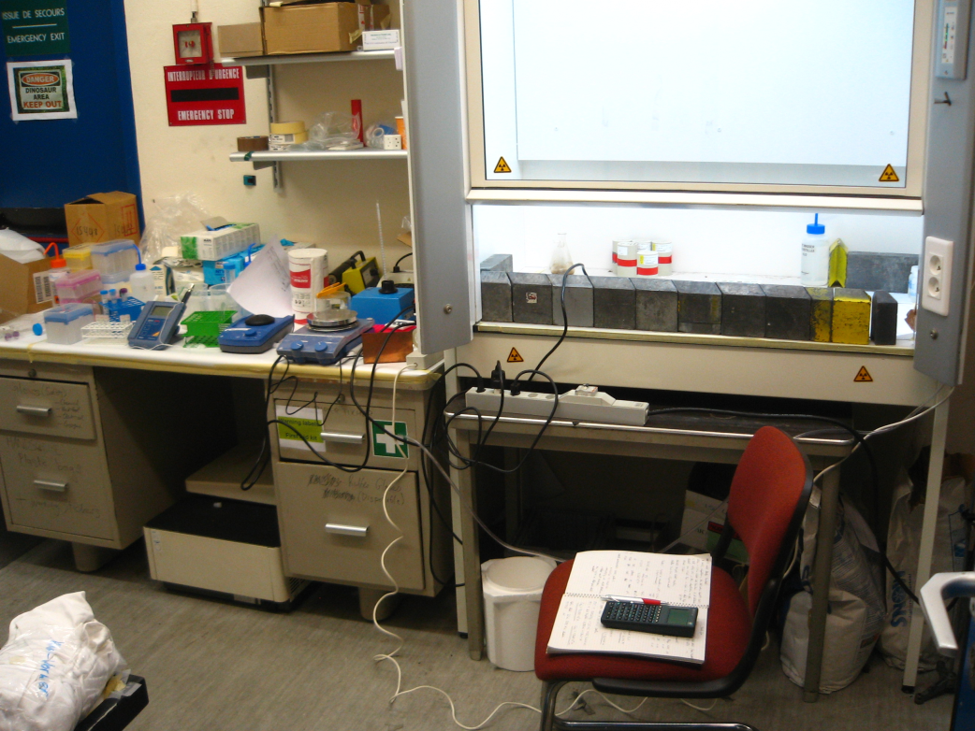
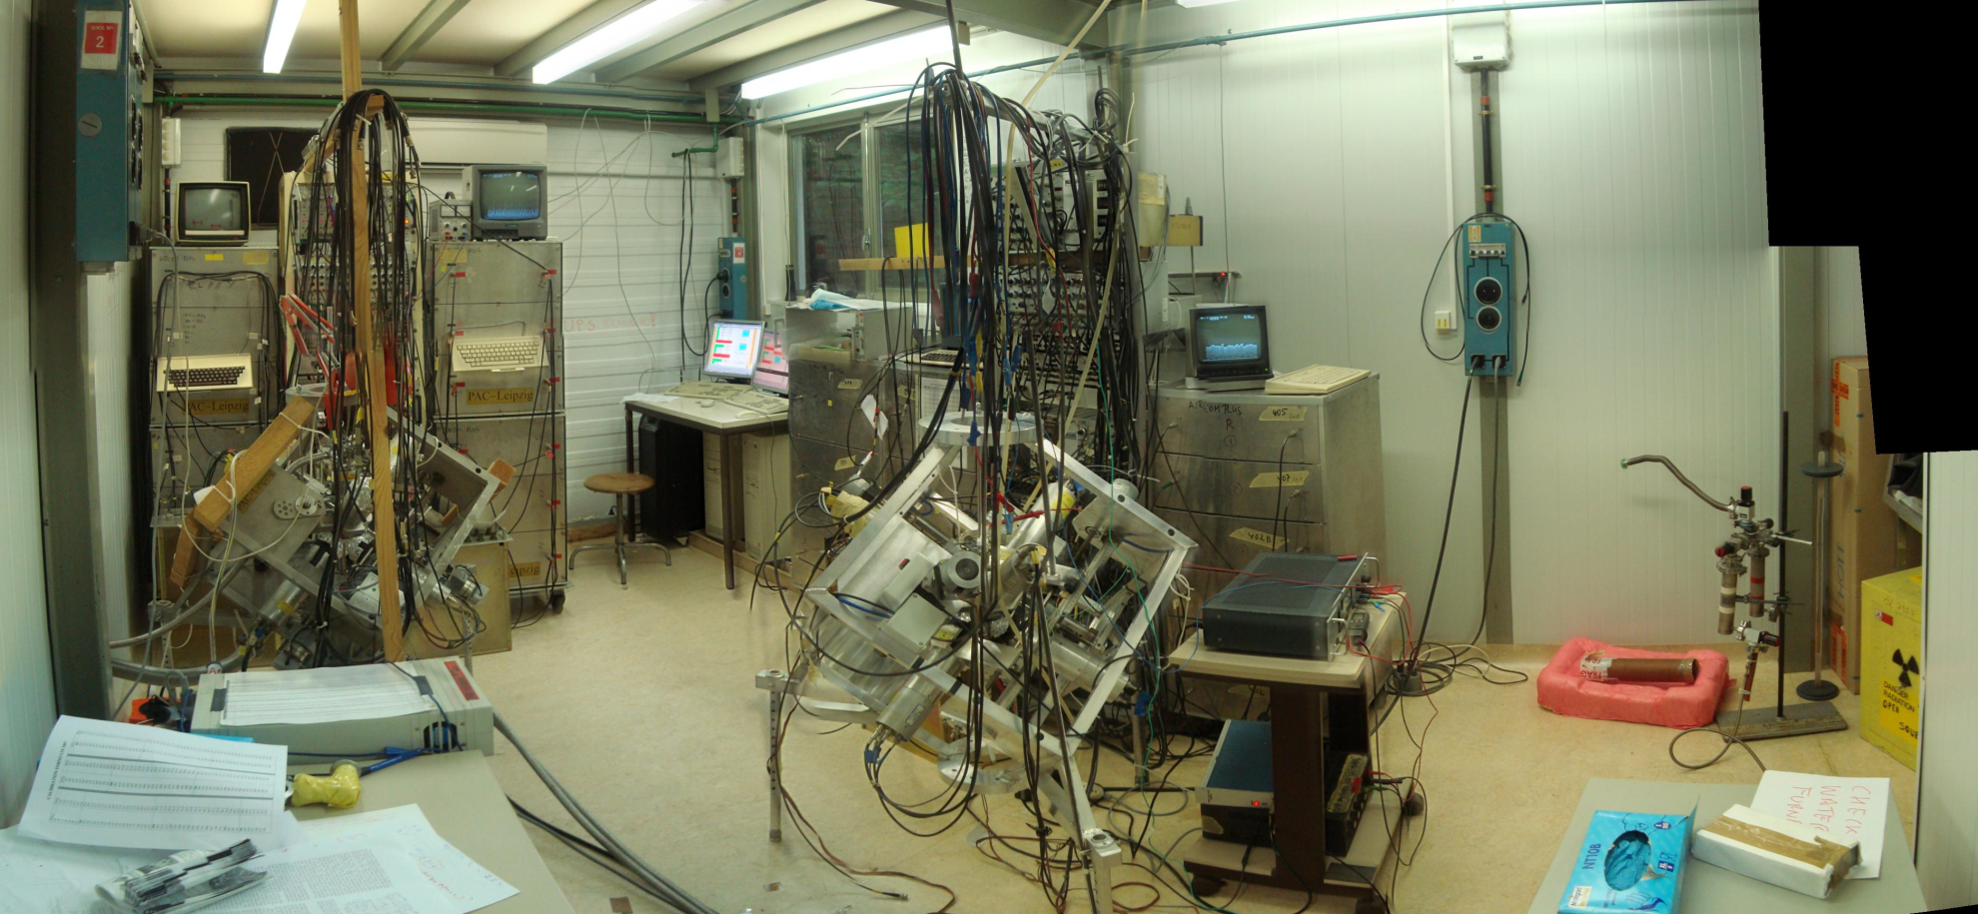

Slide 10
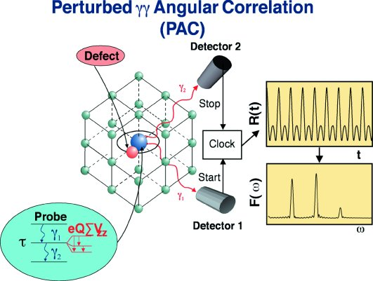
Two-Photon PERTURBED ANGULAR CORRELATION
Hyperfine splitting → Electric field gradient / Magnetic hyperfine field
Probe nucleus:
Q – quadrupolar moment
μ - magnetic moment
V_{zz} - EFG principal component
η - Asymmetry parameter
B_{hf} - Magnetic hyperfine field
E_{i}
γ₁
L₁
|I_{i}, m_{i} 〉
τ
μ , Q
E
γ₂
|I, m 〉
ΔE
L₂
|I_{f}, m_{f} 〉
E_{f}
Time dependence gives access to splitting of hyperfine levels
Most versatile of techniques at ISOLDE: Metals to proteins

Slide 11
PAC Elements produced at ISOLDE
low energies & high multipolarities → highly converted cascades → e-g PAC
e-g
RED → g-g PAC BLUE g-e PAC
e-e

Slide 12
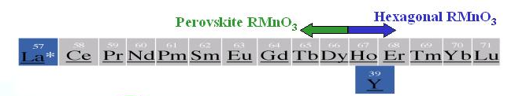
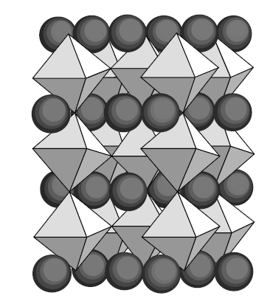
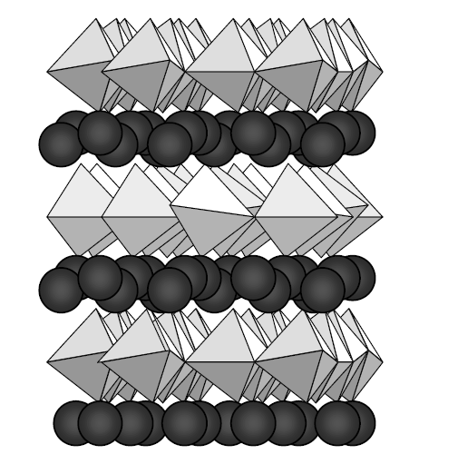
Multiferroic manganites
AMnO₃
Perovskite phases
octahedra
Hexagonal phase
Trigonal bipyramid
Van Aken , thesis univ. Groningen

Slide 13
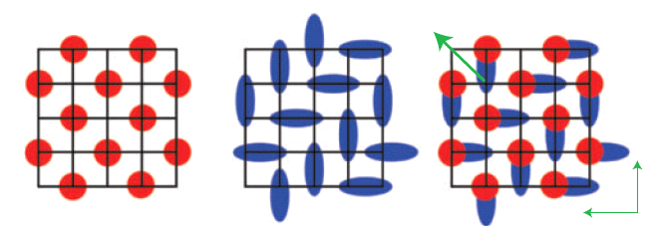
Charge ordered manganites
New scenario for the Charge Ordered State
Theoretical work predicts the possibility of local electric dipole moments in CO manganites
Inversion
symmetry
is broken
+
=
Site centred CO
Bond centred CO
Ferroelectricity
D.Efremov et al, Nature Materials, 3,853 (2004)
J. Van den Brink, D.I. Khomskii, J. Phys. Cond. Matt 20, 434217 (2008)
Ferroelectricity due to Charge Ordering in Pr_{1-x}Ca_{x}MnO₃
New paradigm for ferroelectrics, but it has been hard to prove experimentally that electric polarization exists in CO Pr_{1-x}Ca_{x}MnO₃ (due to finite conductivity)

Slide 14
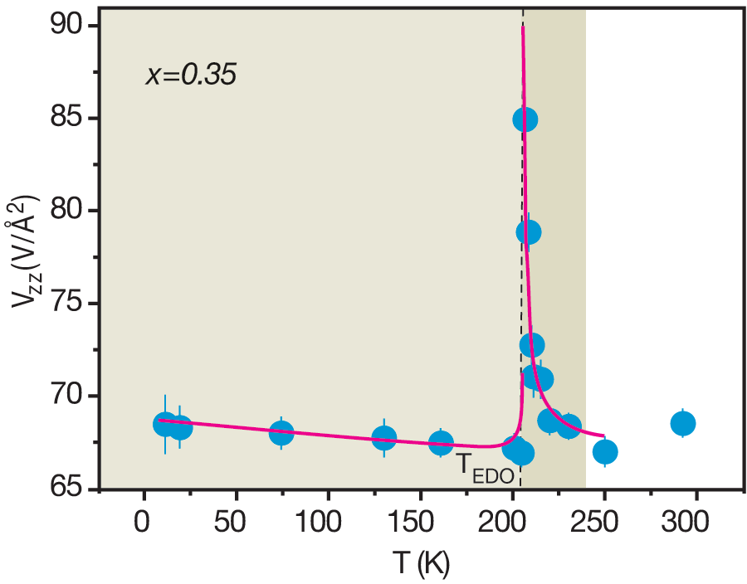
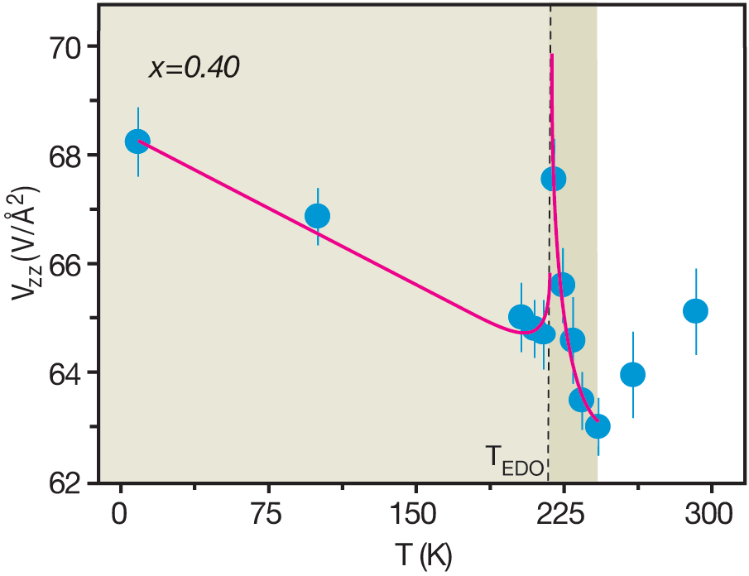
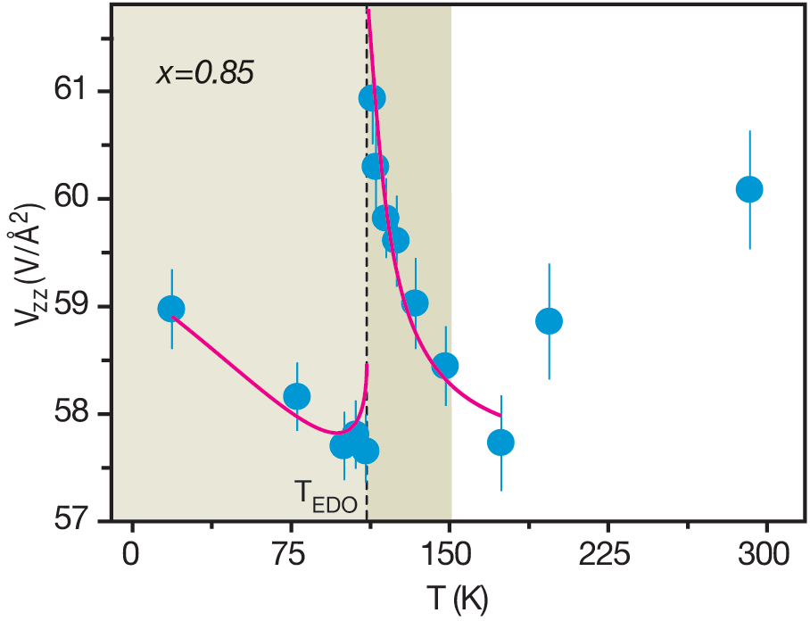
Local Probe Studies / Pr_{1-x}Ca_{x}MnO₃ system
Results: Electric susceptibility / spontaneous polarization below T_{C}
x=0.35 ->T_{EDO}=206 K, x=0.4 ->T_{EDO}=218 K,
x=0.85 -> T_{EDO}=112 K
Described as first-order dielectric phase transition below T_{co}
A.M.L. Lopes et al., Phys. Rev. Lett. 100, 155702 (2008)

Slide 15
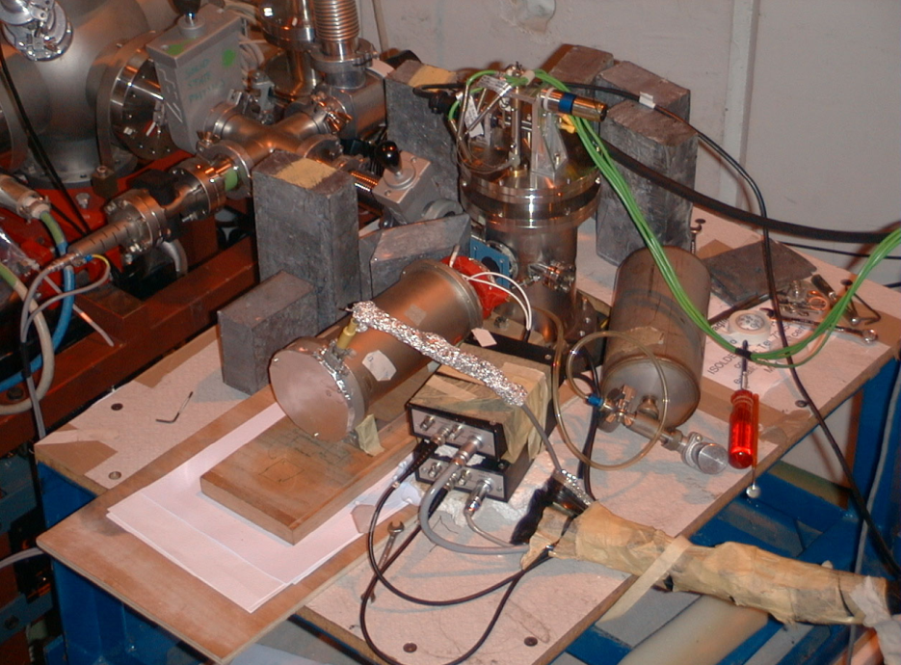
Mössbauer spectrsocopy at ISOLDE: ⁵⁷Mn

Slide 16
Radioactive Mössbauer spectroscopy: other possibilities
Work with dilutions (< 10⁻⁴ at.%) not possible with conventional MS
Site selective doping with different parents:
PAC
Use in home
laboratories
^{119m}Sn (290 d)
⁵⁷Mn (1.5 m)
⁵⁷Co (271 d)
¹¹⁹In (2.1 m)
¹¹⁹Sb (38 h)
⁵⁷Fe
¹¹⁹Sn
Off-line at
ISOLDE
Make use of special properties
- Recoil to create interstitials (⁵⁷Mn, ¹¹⁹In)
- Observe meta-stable electronic states (⁵⁷Co)

Slide 17
Studies of “Magnetic semiconductors”
Doping ZnO semiconductors with few percentages of 3d metals make the material magnetic at room temperature (Dietl et al., Science, 287 (2000) 1019)
Potential multifunction material or Dilute Magnetic Semiconductor (DMS) with applications in spintronics

Slide 18
Hyperfine interactions at the ⁵⁷Fe nuclear sites
δ
Δ
δ
0
      chemical bond local symmetry local magnetic field
      oxidation state (valence electrons, lattice)

Slide 19

Hyperfine interactions at the ⁵⁷Fe nuclear sites
δ
Δ
δ
0
  Mössbauer sextet means magnetism at the Fe site
→
μ
→
H

Slide 20
Mössbauer spectrum of ⁵⁷Fe in ZnO
Ferromagnetism
vs.
slow
paramagnetism
Defects
vs.
Fermi level effect
[Weyer et al., 2007]

Slide 21
Some recent results
Don’t have to worry about precipitation, implantations are low concentration
Can distinguish between paramagnetism and ferromagnetism
Can measure spin-lattice relaxation rates
Submitted to APL (2010)

Slide 22
Future Directions
Online emission channelling: lattice location in Semiconductors
Online diffusion
Beta – NMR as applied to biophysics

Slide 23
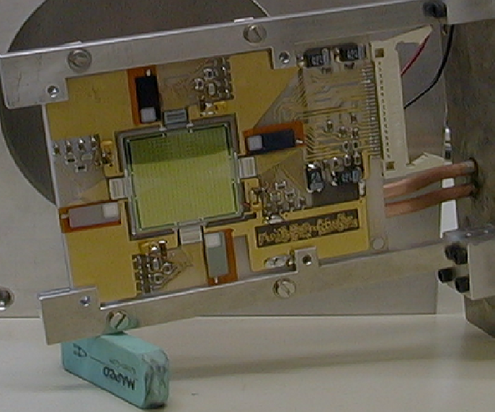
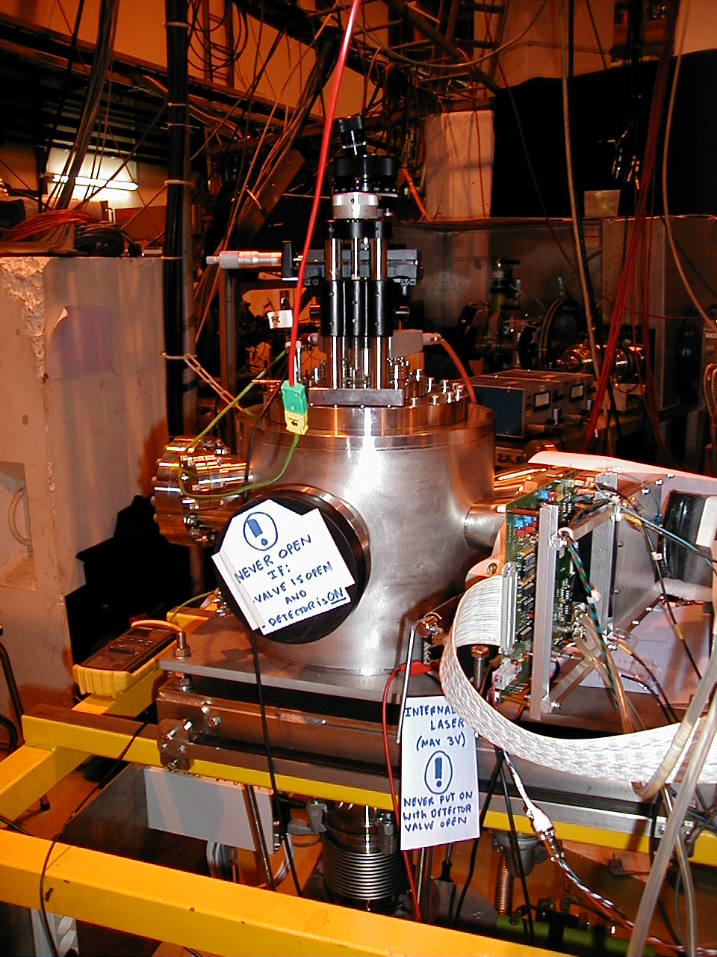
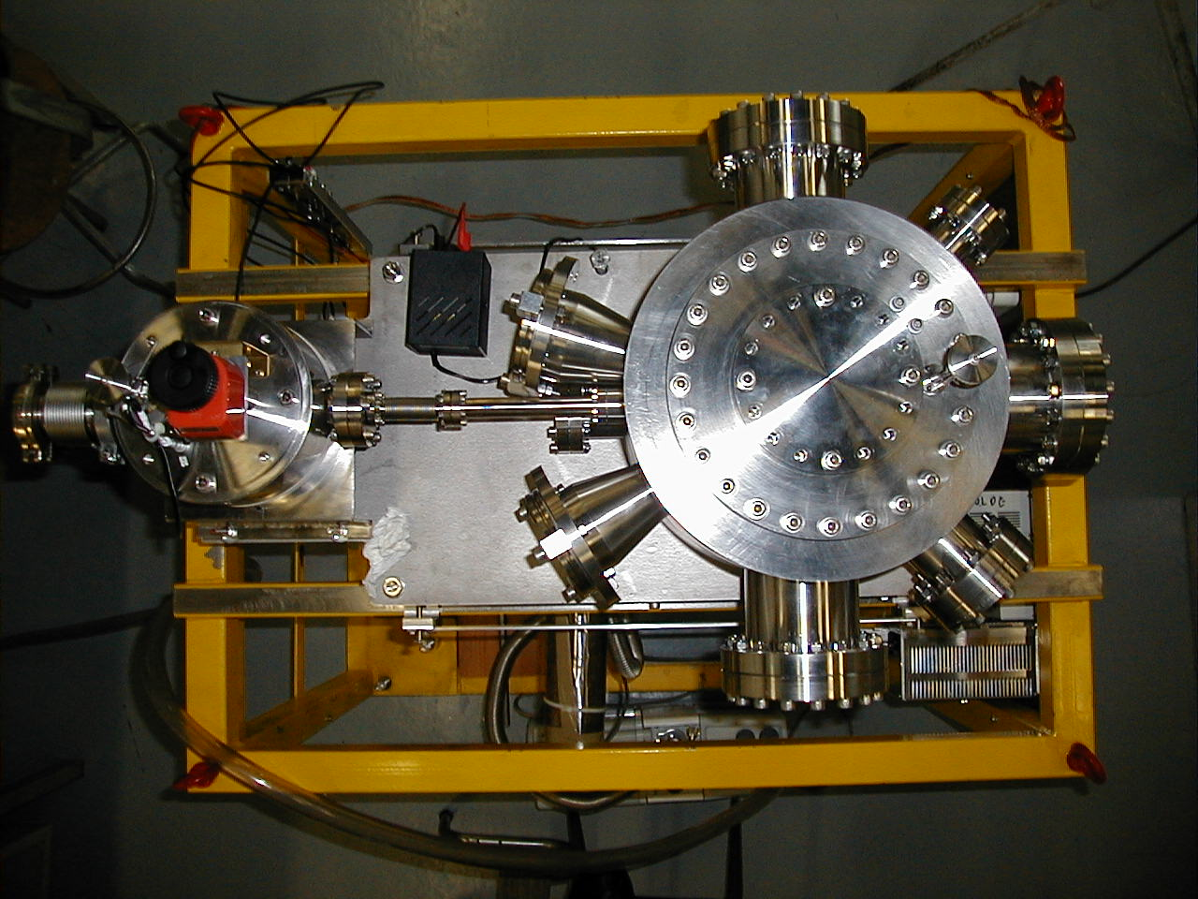
Online Lattice location studies

Slide 24
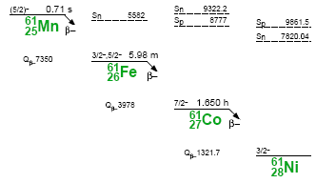
Can probe isotopes with short half-lives: e.g. ²⁷Mg ⁶¹Co
Can address some important questions, e.g. role of Mg in GaN
Properties of Co in materials such as ZnO and GaN
β⁻ emission channeling patterns
from ⁶¹Co in GaN
⁶¹Co on substitutional Ga sites

Slide 25
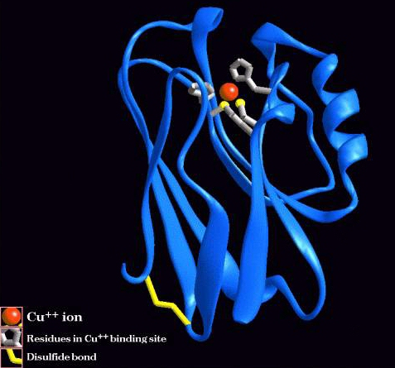
Beta-NMR applied to biophysics
Beta-NMR
Cu, Zn, Mg, Mn, Fe, Ni
Measurement of electric field gradient
  Cu(I) is “invisible” in most (except X-ray and nuclear) spectroscopic techniques because it is a closed shell ion
  Cu(I)/Cu(II) are essential in many redox processes and electron transport in biology

Slide 26
Radioactive Tracers
600 isotopes, 68 elements
600 isotopes, 68 elements
Plasma ion source
Surface ionization (+/-)
Laser ionization
t_{1/2} > 2 d
1 h < t_{1/2} < 2 d
current
t_{1/2} < 1 h
future/current

Slide 27
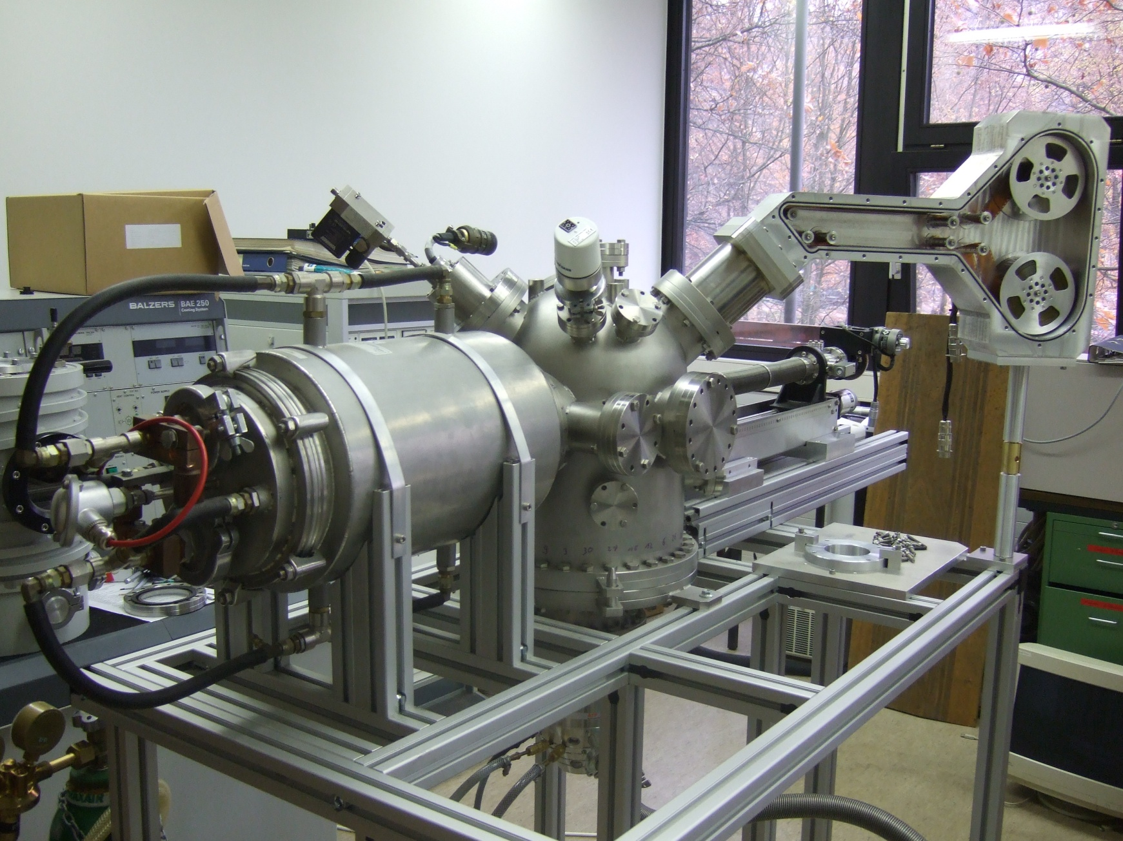
Tape station
Detector
Sputter-source
Detector
Furnace
Manipulator
Beamport

Slide 28
Summary:
Solid state physics at ISOLDE
covers a wide range of materials and areas:
Semiconductors:
  Si, Ge, SiGe, diamond,
  III-V, nitrides, II-VI, ZnO…
  Electrical doping, transition metals, rare earths, H,
  Diluted magnetic semiconductors
High-T_{c} superconductors and perovskites
Magnetism (manganites, CMR)
Biophysics… proteins, DNA, in vivo experiments
Low dimensional systems:
Surfaces, interfaces, multilayers
Opportunities for Actinide Materials?

Slide 29
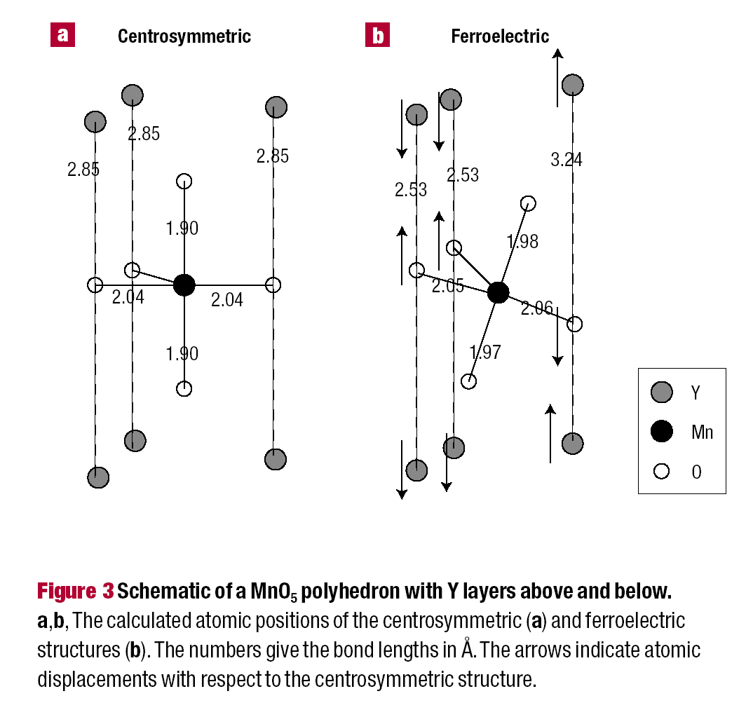
Multiferroic materials
Inversion symmetry breaking (charge-orbital related)
Dislocated spin density waves
Magneto-electric coupling
Tb/YMn₂O₅ Nature, 429, 392 (2004)
Magnetic field induces a sign reversal
of the electric polarization
Nature Materials 3, 164, (2004)

