Slide 1
HL-LHC project alignment baseline in IP1 and IP5: results of coherency checks leading to scope modification
Paolo Fessia, Helene Mainaud

Slide 2

Talks

Slide 3
List of initial questions to answer in that meeting
Which is the window of realignment that we have for an on-line modification using the remote alignment system?
Which conditions shall be fulfilled to apply larger movement and which are the limits of this enlarged window. How much time could take this operation?
Will we need to re-align the machine after initial installation? Can we have online re-alignment online and then intervene later (YETS) to recover the best situation ?
Do we have remote alignment everywhere? In particular:
  do we need it on
    Masks ?
    Collimators?
  Do we have it in places where we do not need
Having remote alignment installed does it translate
  Reduced aperture tolerance requests?
  Reduce requirements on the orbit correction system ?

Slide 4
Early key points discussed
Ground motion values shall be understood as drift values to be managed between 2 realignments (possibly YETS) and managed during the year by means of orbit correction or by the remote alignment. For the moment the table from J. Jeanneret, LHC rep 1007 is still used as reference and it is necessary to critically re-evaluate it. Need to verify and understand which part of the table of errors (ground motion) is taken care by the remote alignment possibilities
Possibility to compensate for +/- 2.5 mm IP shift provides a very efficient operational handle:
  Target the possibility to offset each element respect to the nearby of +/- 2.5 mm
  Rigid movement of the whole LSS of +/- 2.5 mm
  TAXS cannot be remotely re-aligned
If this is achieved (and presently it is the HL baseline for which we are investing) this could translate into
  Larger available aperture and increase beta reach
  Reduce loads on the orbit correction system

Slide 5
To make possible the +/-2.5 mm re - alignment with machine in operation conditions: what do we need ?

Slide 6
Vacuum components.
V. Baglin
Newly designed RF deformable bridge would allow +/- 10 mm radial offset (deformation to be controlled for beam impedance)
The advantage is partially counterbalanced by the requirement to better control the longitudinal relative positon of the interconnection flanges to avoid destructive extension of the bridge
In the warm sections the baseline is to have, when possible, beam tube allege enough to avoid smoothing or offset re - alignment. This avoids stressing the components and field work.
Presently the limiting elements would be
  Cold to warm transitions
  Standard room temperature vacuum sector modules
  It would be worth to have these last 2 elements designed with acceptable offsets that should be in the order of magnitude of the other ones
  It is necessary to monitor the cumulative offset between adjacent elements in order to know where we are vs the nominal
  For WP12 it is very important also to identify positions where importance offset should be allowed and to clarify the desire value before embarking in a design of new components therefore specifications are needed
  Possible impedance penalty of the deformable bellows to be accounted for. If too important then we shall be coherent and simplify the alignment system and revising the scope

Slide 7
Cryogenic system.
S. Claudet
Present QRL to magnet interfaces are designed in order to allow the movements listed here below but NOT IN OPERATING CONDITIONS
  Tolerance X-Y (horizontal): +/- 25mm
  Tolerance Z (vertical): +/- 50mm
It is possible to allow relative movement in operation conditions in the order of few mm (+/-2.5 mm)
The relative position vs. nominal shall be traced
Larger movement can be performed with empty magnets

Slide 8
What can be accepted by RF and intervention time in case of disconnection of wave guides. E. Montesinos
Deformable RF guide could allow horizontal movement without in situ intervention in the order of +/-2.5 mm
This shall be validated
Vertical solution still to be identified
Integration issues to be analysed
The intervention to disconnect and reconnect the RF guides to recover the nominal conditions can take place in a TS

Slide 9
Considerations on Q4-Q5 mask aperture enlarging and misalignment.
A. Tsinganis
The enlargement of the masks aperture of the Q4 Q5 and Q6 of 2 mm radially was studied to avoid their re - alignment .
The dose to the 1st corrector of the Q4 would increase from 7 MGy to 35 MGy for 3000 Fb⁻¹
No worrying effect on Q5 (TCL provides sufficient protection)
Q4 mask shall be remotely aligned. For Q5 to be decided. For coherency better

Slide 10
Considerations on BPMs.
(offline discussions with BE-BI team, R. De Maria and J. Wenninger )
Their position vs the related optic element shall be known
For the cold BPM this is fixed at construction and then position shall be repeatable (offset known, maximum acceptable one to be specified for BPM functionality)
For the warm BPM near elements that are remotely aligned (namely after D1 and in front of D2) we need to know where they are connecting them to a stable reference

Slide 11
Considerations on Collimator.
(offline discussions with collimation team)
Collimators between TAXN and D2 shall follow the remote alignment of the other elements
Such flexibility cannot be achieved simply acting on the jaws
Two options
  Integrate system in the present used collimation supporting system
  Add another hardware layer probably inspired to the system developed for CLIC by SU team

Slide 12
Summary of possible strategies
 | Scheme 1 Remote online alignment | Scheme 2 YETS alignment | Scheme 3 LS alignment
Machine conditions | Machine operating conditions | Magnet cold but empty | warm
Max stroke | +/- 2.5 mm | +/- 10 mm | more
Time required per IP side only Q1 to D1 | 30 min No access | 30 min No access
Time required per IP side only Q1 to Q4 | 2 days Access for intermediary components. No de-interconnection | 2 days Access for intermediary components. De-interconnection of the RF guides (from time point of view this fits into a TS)
Time required per IP side Q1 to Q6 | Not possible | 2 TS TS1: measure Between TS1 and TS2 compute TS2 realign
After LS3 at start of the machine
Case 1: the misalignment machine experiment is less then 2.5 mm apply 1 and then run till YETS where we redo full alignment
Case 2: error larger we wait the TS and we apply where necessary Scheme 2. it will be easier because no activation yet

Slide 13
Summary of the addition to the HL baseline leading to change of scope and therefore cost increase
Warm BPM after Q1 and before Q2: need to link them to a stable reference system in order to monitor their position. No remote alignment (WP13 and WP 15.4)
Motorized alignment for the TCL in front of Q4 and Q5 (WP5 and WP15.4)
TCTPXH TCTPV and TCLX: need to add remote alignment possibility (WP5 and WP15.4)
Need to develop approach to trace positon of bellows through life of the machine
As it will be shown in the next talk ALARA optimisation provide also a strong incentive to make available remote or semi remote alignment

Slide 14
Still many points to be verified, i.e.:
Are the forces in the interconnects acceptable in case of +/-2.5 mm misalignment ?
Need to state repartition of single interconnect bellow misalignment among different sources as it was done for the LHV
  Cold mass and Cryostating assembly tolerances +
  Alignment tolerances +
  +/-2.5 mm of the alignment=
  -------------------------------------------
  Total window in which the bellows shall operate

Slide 15
Spare slides

Slide 16
IP and CC alignment in HLLHCV1.3
The HL-LHC orbit correctors have the budget to provide ±2 mm offset of the beam in IP1/5 in both planes.
Crab cavities needs to realigned for any change of the average crossing angle and IP position to keep beam loading power below the allowed power. No other re-alignment needed.
If triplets can be realigned following the IP position, there is a gain in β* reach and in the required alignment stroke of the bellows.
Offset
D2
Q4
Specification | Offset [mm] | Shear [mm]
Crossing angle | 0.32 | 1.65
IP offset | 2.2 | 2.4
Total | 2.52 | 4.05
D2
Shear
Q4

Slide 17
Beam alignment at the CC in HLLHCV1.3
The HL-LHC orbit correctors have the budget to provide a shift of the orbit at crab cavities, independently from the IP, in both planes for :
± 0.5 mm average position of Beam 1 and Beam2
± 0.5 mm change of Beam 1 - Beam2 separation
± 0.25 mm change of slope of Beam 1 and Beam 2, independently, useful for 4 cavities per beam, side, point scenarios
This is needed to absorb alignment imperfections in between two realignment campaigns.
Avg. Position
Slope* Beam 1
D2
D2
Q4
Q4
Separation
Slope* Beam 2
D2
Q4
D2
Q4
*needed only in case of 4CC not in the baseline

Slide 18
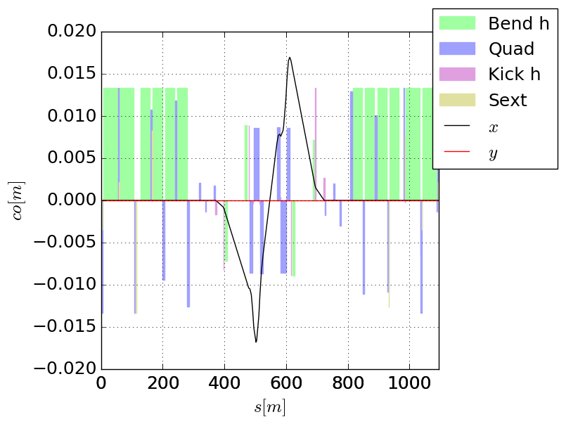
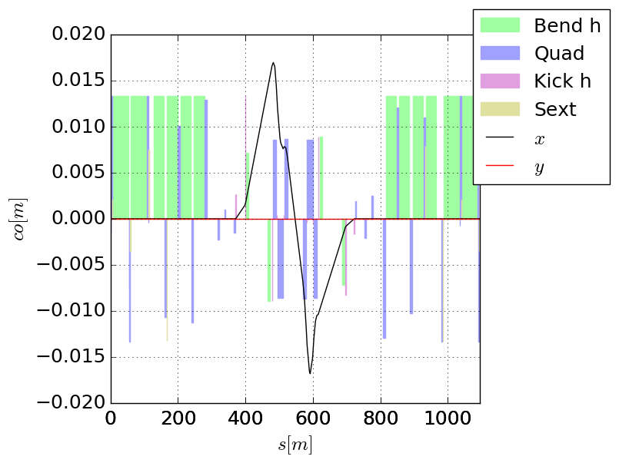
Nominal crossing bump
Baseline closed in MCBY.4 (acby.4=0.2 acbrd)
Beam 1
Beam 2
Impact on crab cavity alignment
Crossing angle:
  x,y: ±1.15 mm (Beam 1, AB)
  x,y: ±(-0.5) mm (Beam 2, AB)
  For cryomodules:
  average offset 0.325 mm
  shear 1.65 mm
D2
Q4

Slide 19
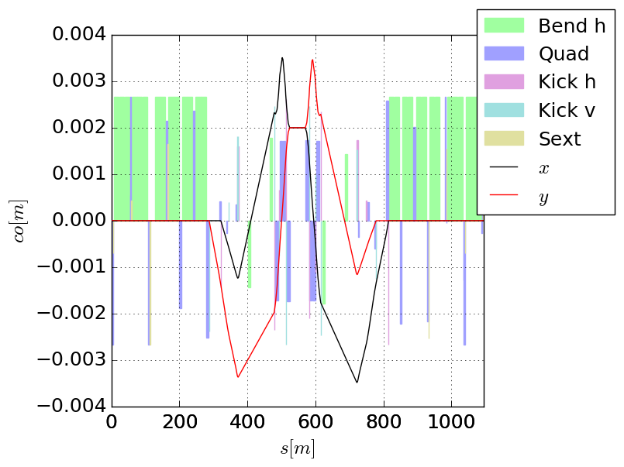
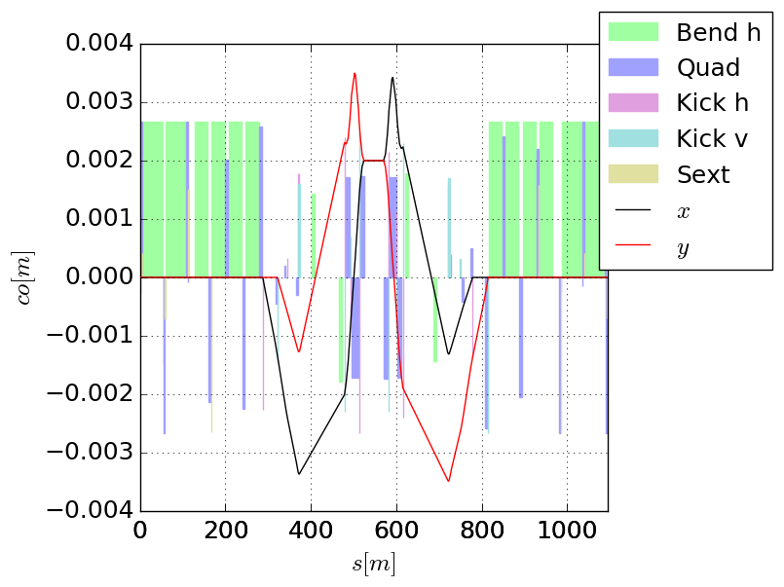
Orbit knobs - offset
Beam 1
Beam 2
IP Offset knob: x,y= ±2 mm same for the two beams to accommodate alignment needs of the experiments with machine realignment, besides crab cavities.
IP offset:
  x,y: ±3.4 mm (Beam 1, CD),
  x,y: ±1mm (Beam 2, CD),
  For cryomodules:
  avg. offset 2.2 mm
  shear 2.4 mm
D2
Q4

Slide 20
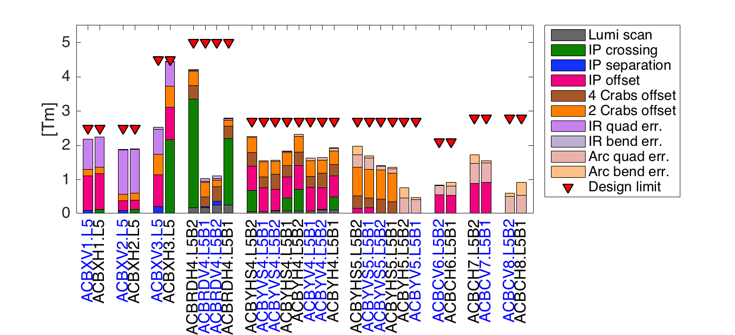
Correctors Budget requirements
For the Right and Point 1 symmetries apply:
Left B1 -> Right B2,
Left B2 -> Right B1
H Point 5 -> V Point 1
Correct quadrupole misalignments and dipole tilt and transfer function errors:
  uniformly distributed, uncorrelated error distribution (2 σ cut in the strengths):
    quadrupoles triplets and arc: 0.5 mm max transverse displacement, 1 mrad max roll
    dipoles D1, D2 and arcs: 10 mm max longitudinal displacement, 0.5 mrad max roll, 0.2% max field error
  Reduced estimates compared with LHC design (worst case) based on LHC experience
Adjust the IP position limiting the realignment of HW components (crab cavities only):
  offset in H/V planes: ±2.0 mm
Align beam in the crab cavities in both planes:
  Adjust for average offset and separation (±0.5 mm) between cavities in Beam 1 and Beam 2.
  Adjust for average offset between cavities of the same beam but in different cryomodules (±0.25 mm, relevant for 4 cavities per beam per plane per side).

