Slide 1

32nd HL-LHC TCC
WP8 Final layout of Q1-TAX (VAX) area
F. Sanchez Galan on behalf of WP8
CERN, 29 June 2017

Slide 2
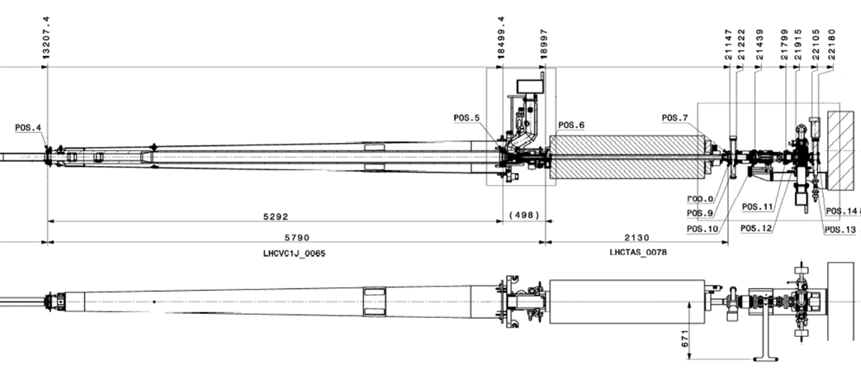
From today’s VAX to HL-LHC

Slide 3
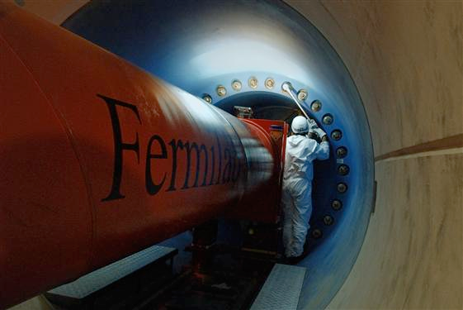
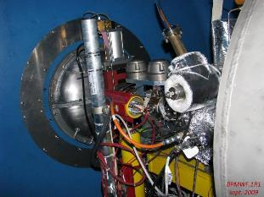
From today’s VAX to HL-LHC
Cabling
VAX
BPM
2 sector valves
Bellows
Piping
Integrate the BPM in Q1 and relocate the VAX equipment from the tunnel to the experiment side in order to improve access & minimize operations.

Slide 4
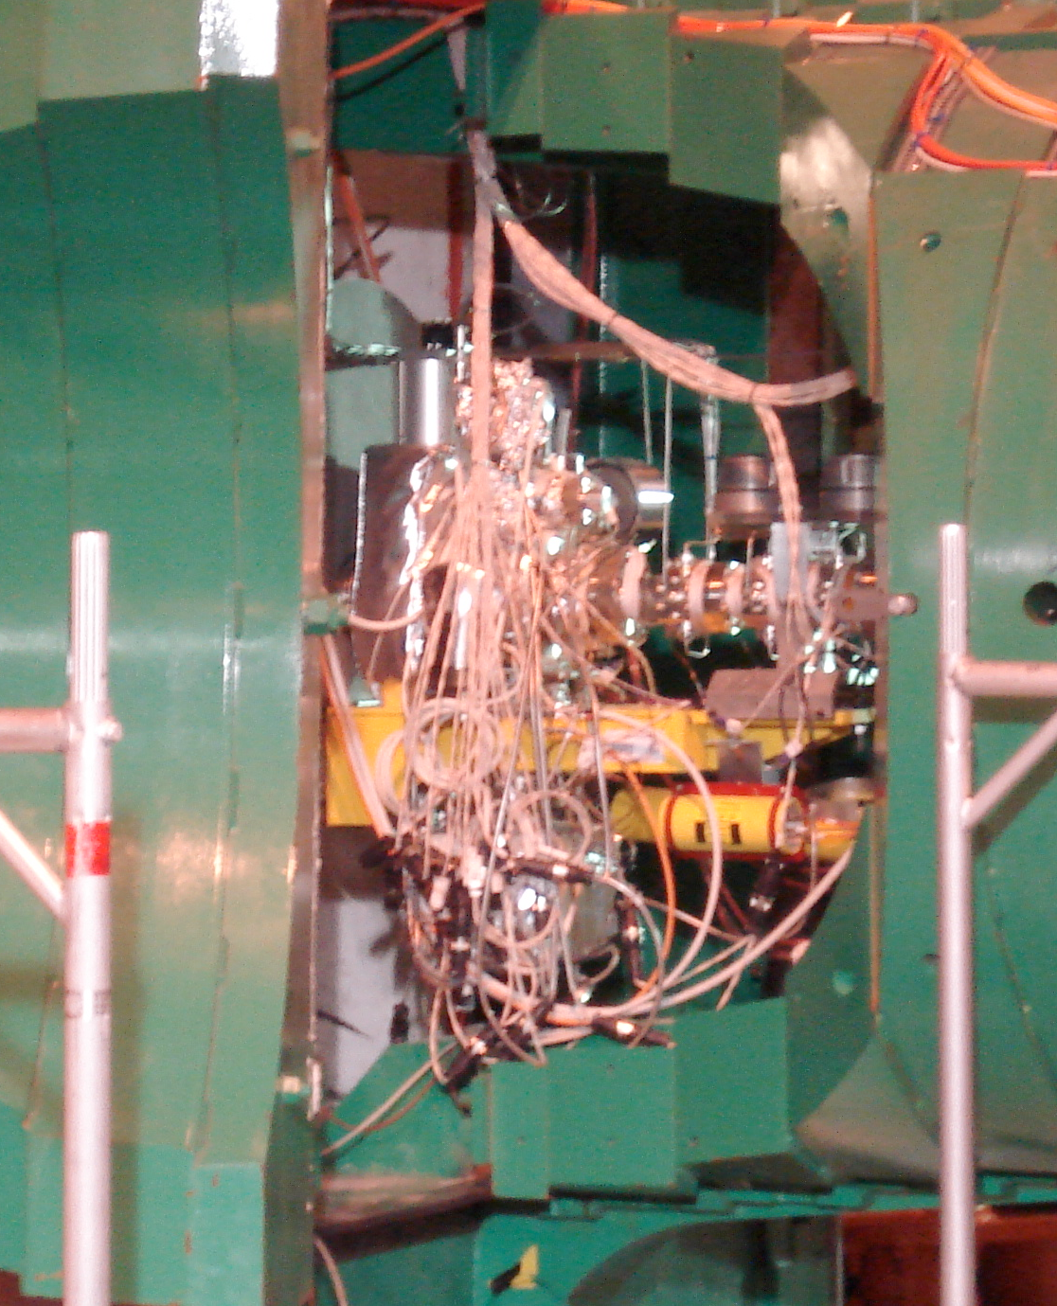
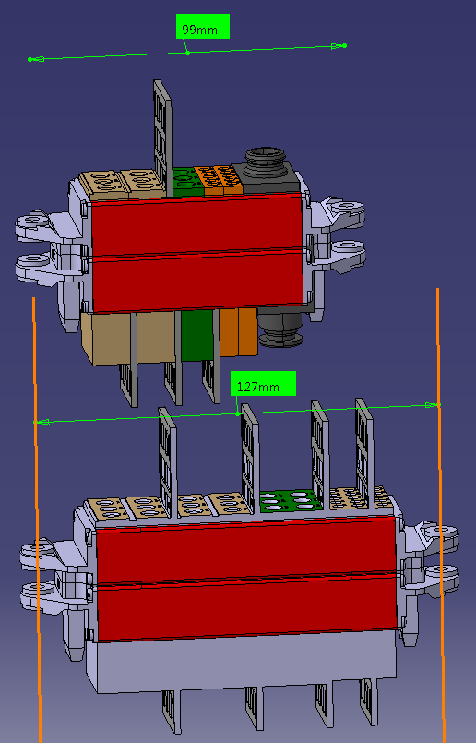
Cabling layout (P1 & P5)
Cabling needs already defined with the collaboration of WP12, TE-VSC, operation.
Routing discussed/adapted with experiments.
Quick connectors requirements defined.
Market survey being launched, prototyping ahead.
https://edms.cern.ch/document/1788841/1

Slide 5
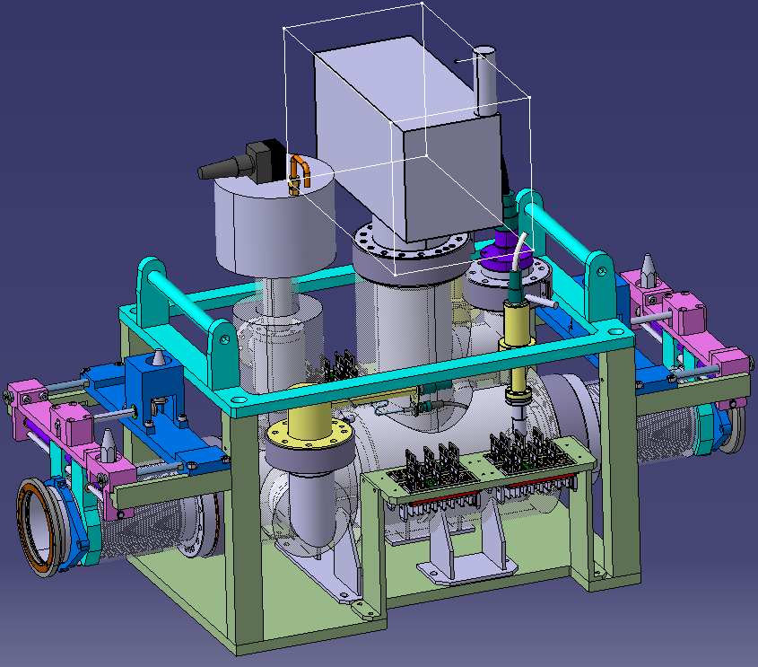
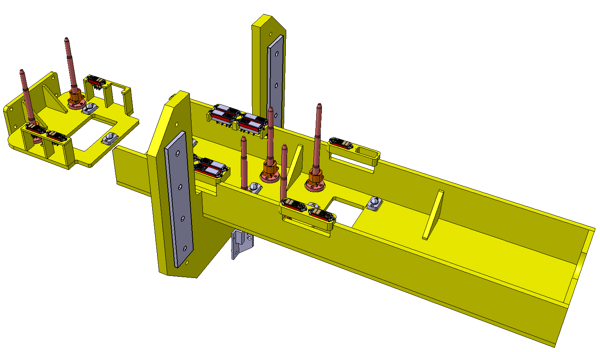
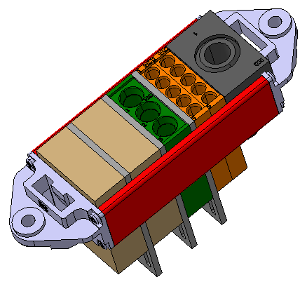
Layout. VAX
New support structure to host VAX, sector valves and bellows. Remote handling based on quick connector plugins.
Quick connectors
Radiation hard and include connection for:
  Pneumatic lines
  Thermocouples
  Vacuum valves actuators.
Aluminium support
Dimensions: Length 2570mm, Width (max.) 1030mm, Height (max.) 955mm
Prototype ongoing (DR connectors market survey, modules WP12)

Slide 6
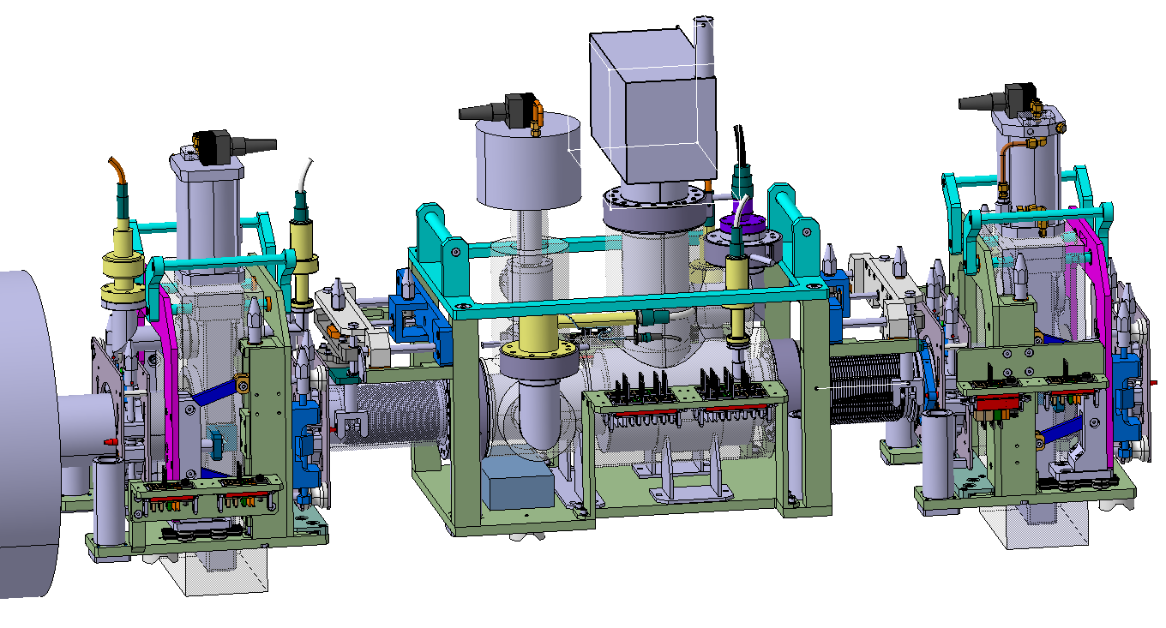
Layout VAX
Common layout for both sides of ATLAS & CMS based on standard vacuum elements, automatic connectors and vertical installation. Baking compatible. 3 structures to be removed independently
Courtesy of L, Krzkempek, J. Perez Espinos

Slide 7
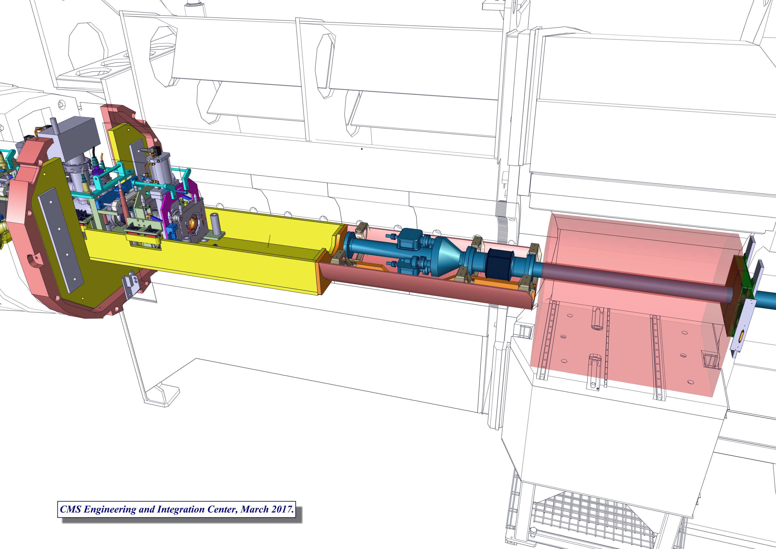
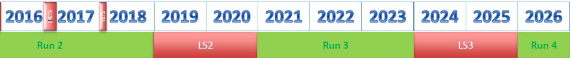
VAX integration- CMS
Forward Region after LS3

Slide 8
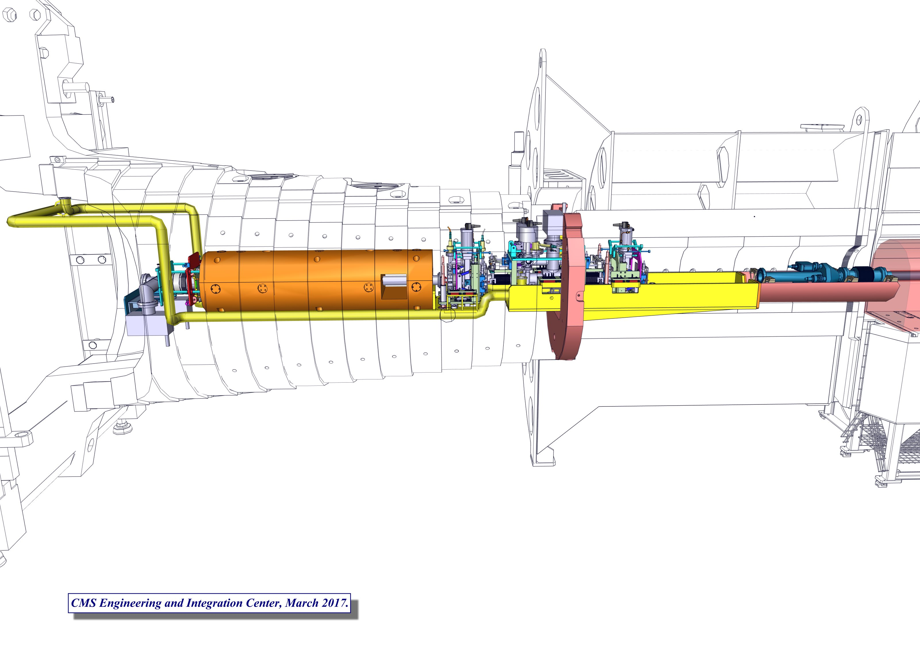
VAX integration- CMS
TAS Region after LS3

Slide 9
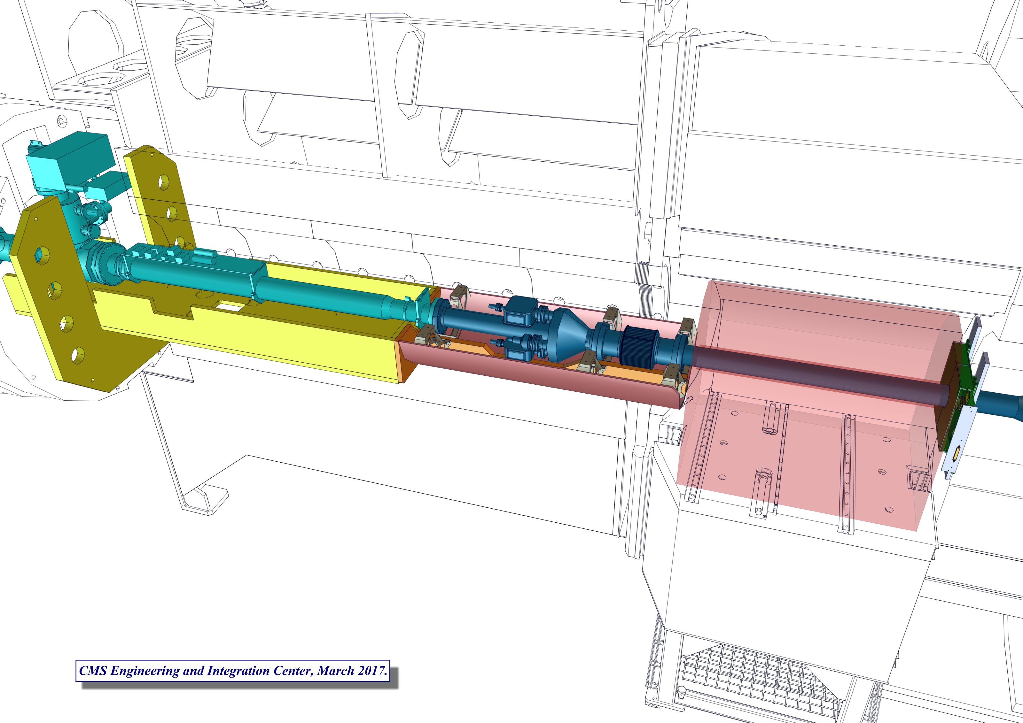
VAX integration- CMS
Solution accepted by CMS, takes into account vacuum modifications in LS2. (New support will host VAX modules)
Current forward pipe and VAX

Slide 10
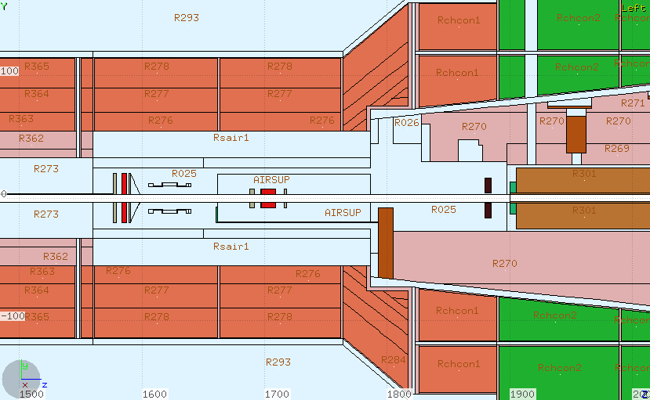
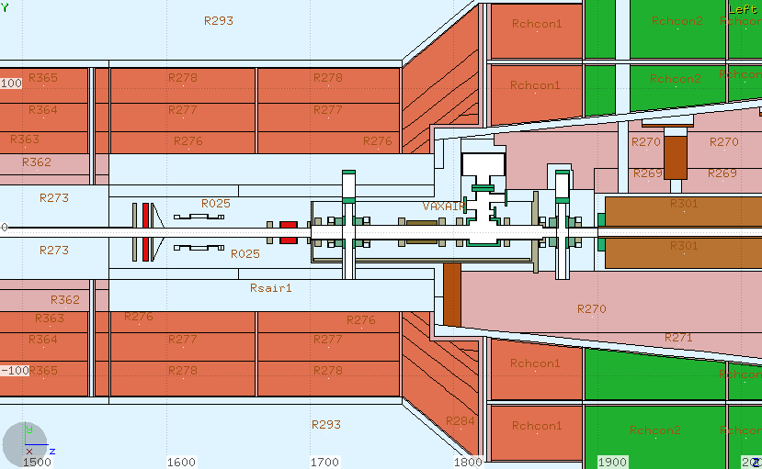
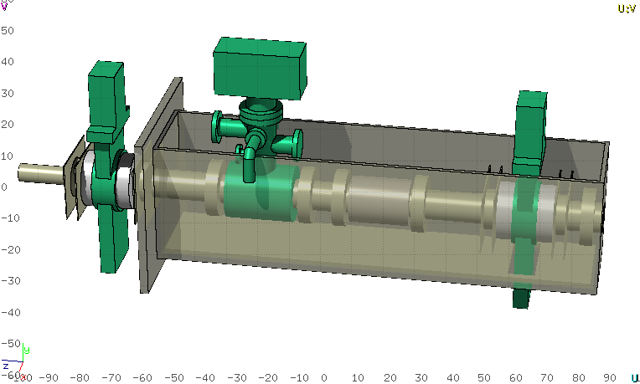
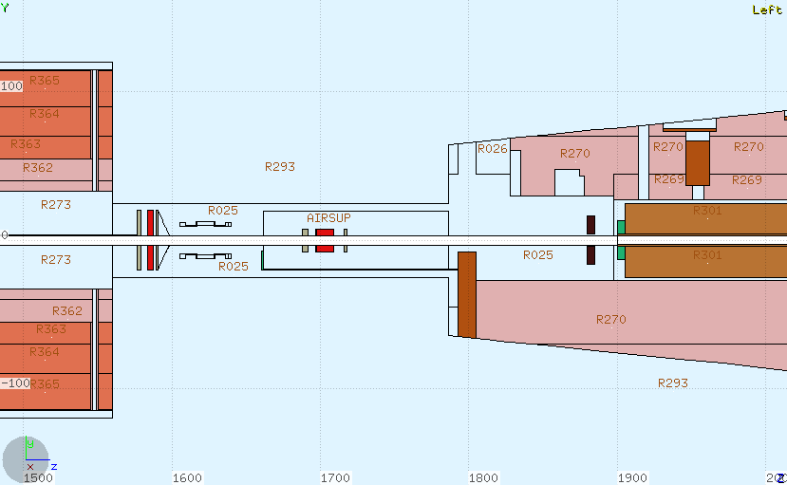
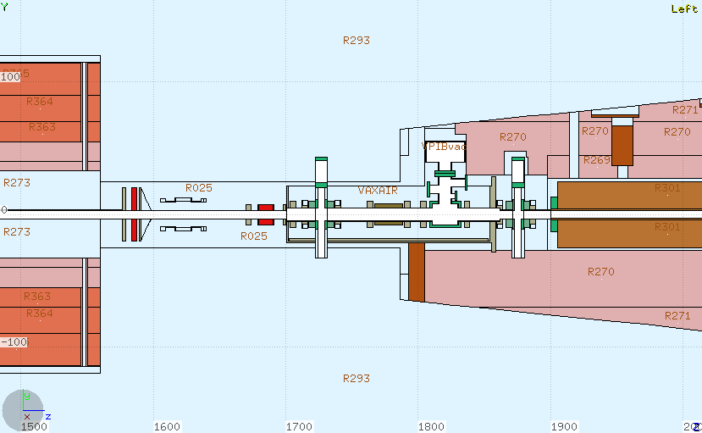
VAX implementation in CMS
←18 cm
Geometry: S.Chitra (CMS BRIL Rad Sim)
Included gaps in support tube and FIN
Ida Bergstrom, Heinz Vincke (HSE/RP)

Slide 11
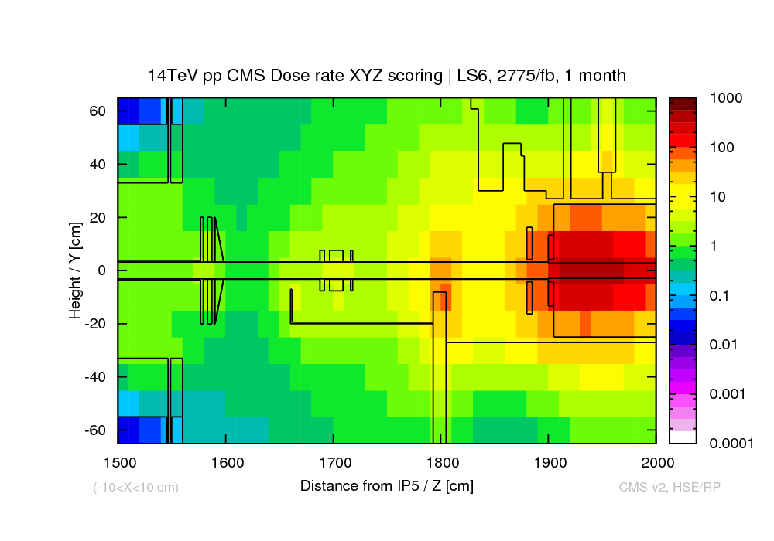
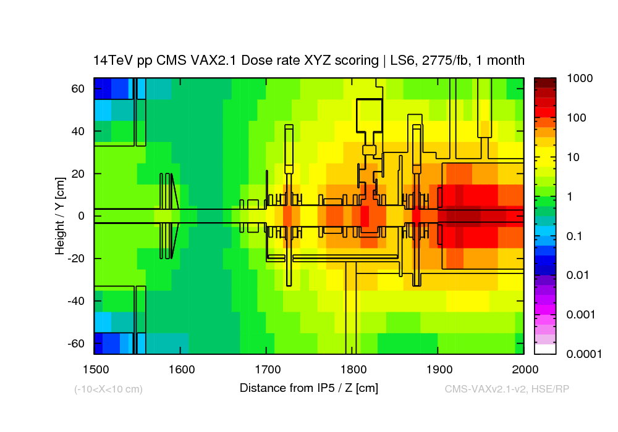
CMS, H*(10) in mSv/h, LS6 1 months cooling
CMS
Ambient residual dose rate [mSv/h]
Ambient residual dose rate [mSv/h]
Ida Bergstrom, Heinz Vincke (HSE/RP)
Status update of FLUKA radiation study of new VAX installation in CMS & ATLAS – 38th HL-LHC WP8 meeting (2016-08)
Radiological assessment of the proposed installation of vacuum equipment upstream of TAXS at Points 1 and 5, EDMS 1713941, CERN-RP-2016-146-REPORTS-TN IDA BERGSTROM

Slide 12
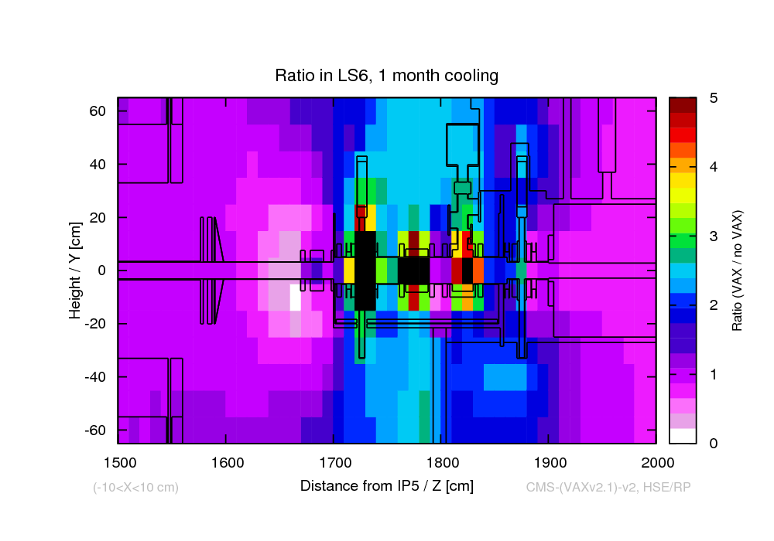
CMS H*(10) in mSv/h, LS6 1 months cooling
CMS
Ida Bergstrom, Heinz Vincke (HSE/RP)

Slide 13
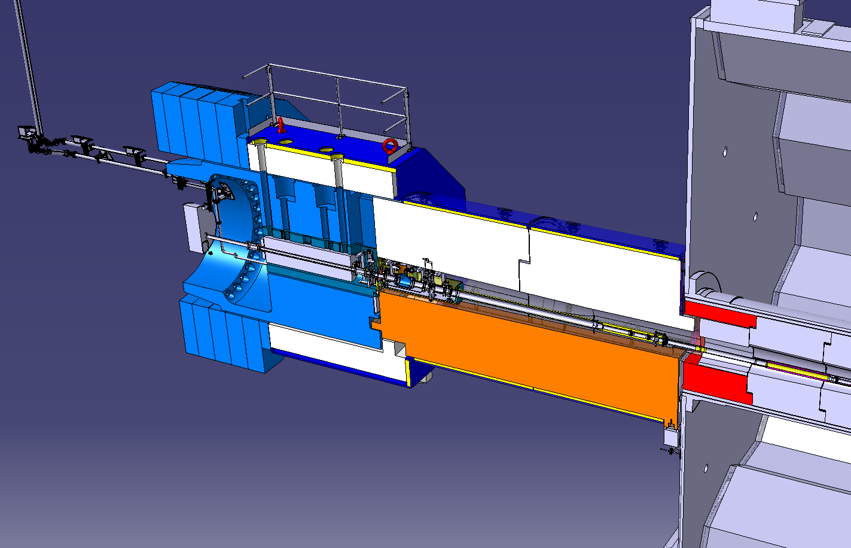
ATLAS Layout
Design close to completion: VAX modules, services re-routed. Shielding modifications analyzed, ongoing integration with TE-VSC LS2 modifications.

Slide 14
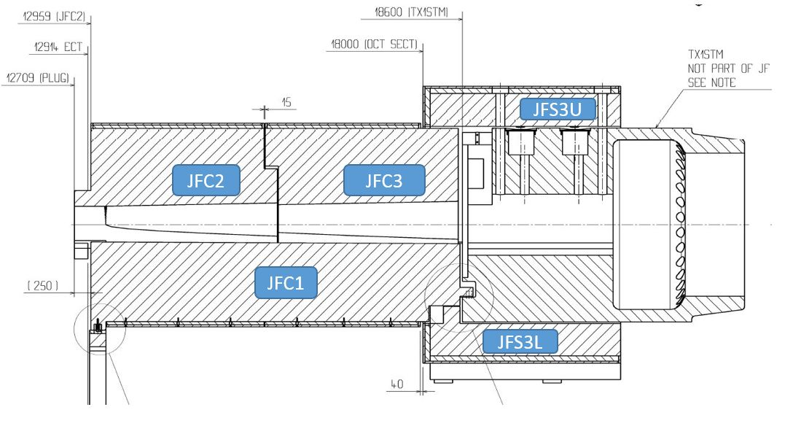
Shielding modifications- ATLAS
New rectangular support structure
Machining: TX1S (vertical slot)
JFS3U
JFC3
JFC1
JTT
Modification: JFC2
Component | Approximate weigth (kg) | To be removed (kg)
JFC1 | 84000 | 500
JFC2 | 93000 | 69
JFC3 | 97000 | 150
JFSU | 77000 | 400
JFSL | 66000 | 450
JTT1 | 13000 | 1300
JFC3
JTT

Slide 15
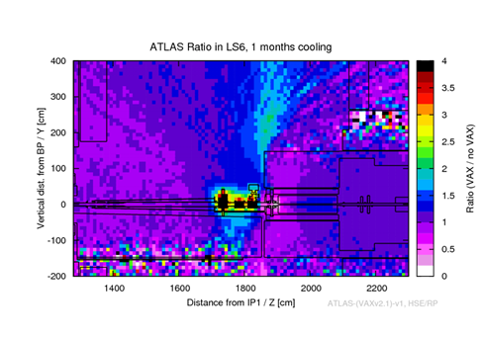
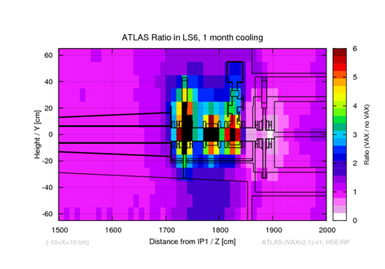
ATLAS H*(10) in mSv/h, LS6 1 months cooling
Ida Bergstrom, Heinz Vincke (HSE/RP)
Radiological assessment of the proposed installation of vacuum equipment upstream of TAXS at Points 1 and 5, EDMS 1713941, CERN-RP-2016-146-REPORTS-TN. IDA BERGSTROM, J.C ARMENTEROS CARMONA

Slide 16
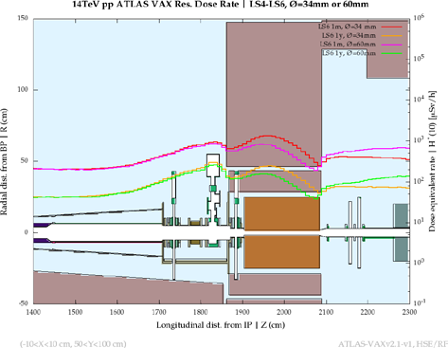
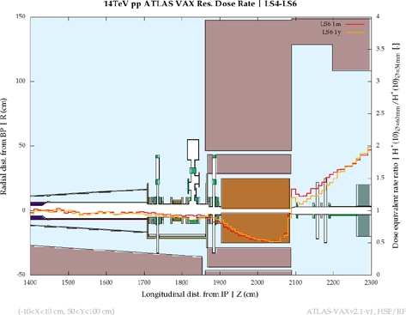
TAS Vs TAXS (34 vs 60 mm)
Dose rates and their ratio in ATLAS after installing the vacuum equipment with two different TAXS apertures, 60 mm/34 mm

Slide 17
Shielding modifications- ATLAS
New rectangular support structure
Machining: TX1S (vertical slot)
JFS3U
JFC3
JFC1
JTT
Modification: JFC2
Component | Approximate weigth (kg) | To be removed (kg)
JFC1 | 84000 | 500
JFC2 | 93000 | 69
JFC3 | 97000 | 150
JFSU | 77000 | 400
JFSL | 66000 | 450
JTT1 | 13000 | 1300
JFC3
JTT

Slide 18
Removal/Installation scenarios
TAS removal
ATLAS https://edms.cern.ch/document/1764384/2
CMShttps://indico.cern.ch/event/647382/contributions/2630663/attachments/1479507/2293645/INDC_WP8_pres_2_20170620.pdf
JTT Removal https://edms.cern.ch/document/1817010/1

Slide 19
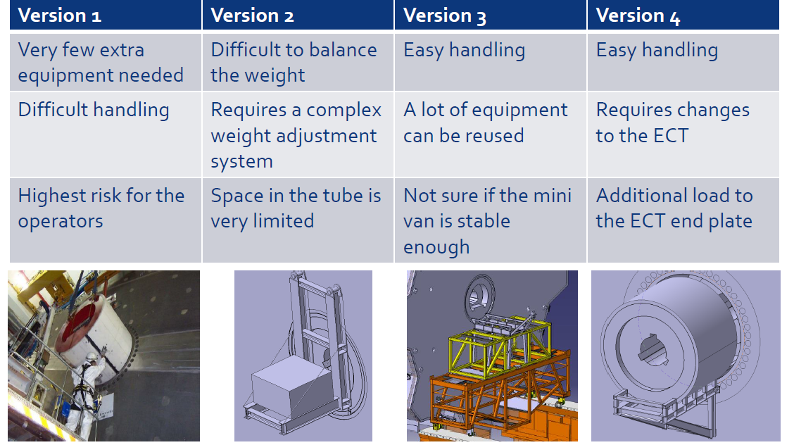
Work progress Installation/removal
Courtesy of P Strahle,, JL Grenard

Slide 20
Summary
VAX layout proposed.
CMS approved the VAX and the advance of some installation activities to LS2
ATLAS approval pending on agreement of JTT modifications (activity to be advanced to LS2)
Radiation impact assessed (ATLAS & CMS)
Background calculations (neutron/photon flux) ongoing (BRIL-CMS)

Slide 21
Next steps
JTT modifications, (→ATLAS approval)
TAXS Alignment
EDMS Documents about required shielding modifications.
Q1-TAXS
Prototype, test handling & plug-in principle.
Coordinate installation/deinstallation schedules (machine-experiments)

Slide 22
Thanks to all members of WP8& collaborators!

