Slide 1
Status of crab cavity test in SPS
G.Vandoni on behalf of WP4
32nd HL-LHC TCC, 29th June 2017

Slide 2
Outline
Overview of the SPS program scopes
Master Schedule
Status: cavities, cryomodule, SPS
YETS in SPS
SM18 tests, plan and rationale
Conclusions

Slide 3
Scope of the SPS CC programme
Assemble 2 prototype cryomodules, DQW and RFD
Fully qualify in SM18 for safety and performance
Prove feasibility in SPS proton beam
Qualification; SM18 and SPS
Prepare industrialization
SPS prototype beam tests
Preparation
SPS Test (CM1)
SPS Test (CM2)
2015
2016
2017
2018
2019
2020
2021
2022
2023
2024
2025
2026
EYETS
YETS
Run 2
LS2
Run 3
LS3
Run 4
LHC pre-series
(2 Industrial Dressed Cavities)
LHC series production & Installation (8 CMs)
Notes:
The test of the DQW cryo-module with beam in the SPS is planned before LS2, the test of the RFD cryomodule after LS2.

Slide 4
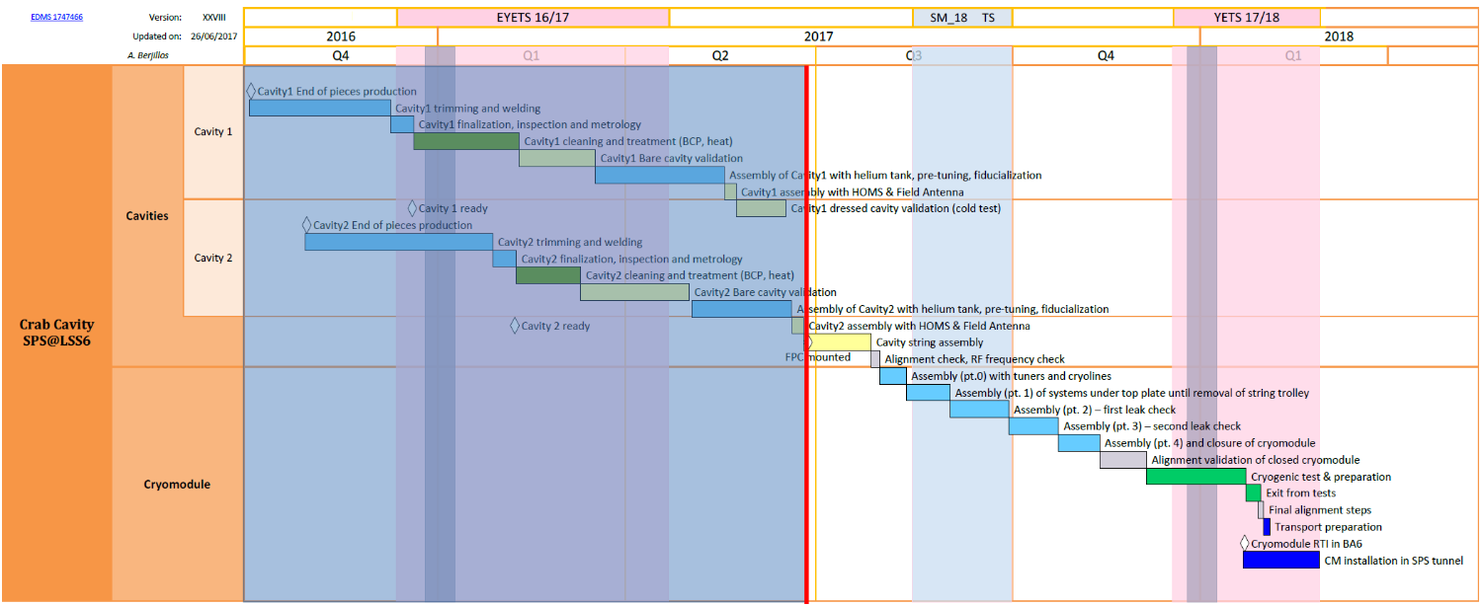
Master schedule, DQW cryomodule
[Master Schedule rev_XXVII]
String assembly start: 23/06
CM assembled in SM18: 4/12
String assembled: 25/07
String assembly started
CM ready for installation BA6: 31/01
CM ready for SM18 cooldown 15/12
Notes:
DQW#1 next week, but DQW#2 is already assembled with ancillaries. String assembled, is the milestone which will tell us if and how much we are late.

Slide 5
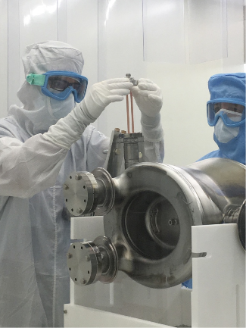
Status Cryomodule
[CAVITY #1]
Bare cavity successfully tested, beyond specification
Dressed cavity tests affected by a superfluid He leak (disappearing at T>T_{λ} )
Superleak review Friday 30th June with experts
RF Test ongoing at 2.5K
Next step: warmup, FPC installation in clean room
[CAVITY #2]
Bare cavity successfully tested, beyond specification
Cavity dressed in He tank + HOM couplers and pick-up
No dressed cavity test foreseen in Master schedule
[CRYOMODULE]
Pieces arriving, “portique” assembled in SM18
Vacuum vessel leak check today
String chariot assembled, valves installed on it
Notes:
Oral remark by Rama here on double wall tube

Slide 6
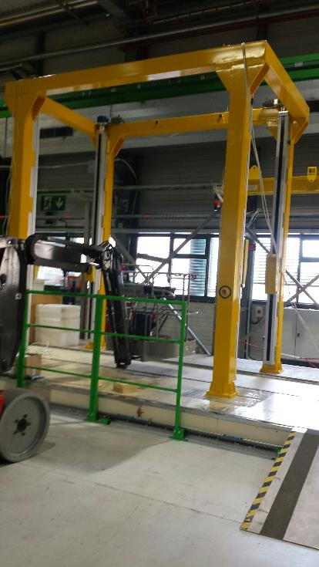
SM18 assembly area
Assembly area ready for assembly of cryomodule, dedicated « portique » erected in front of the ISO5 clean room

Slide 7
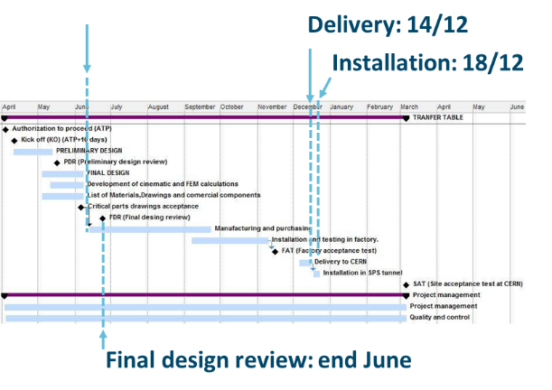
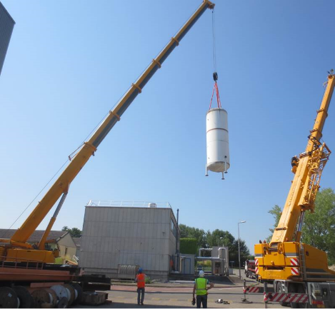
Status SPS
[TRANSFER TABLE]
Underground visit by contractor in TS#2
Installation sequence being worked out
[RF POWER]
IOTs installed in BA6
Test charge installed in TS#2 for commissioning
[LLRF]
Faraday cage supplier identified
[CRYOGENICS]
Helium buffer tanks transported to BA6, waiting for the new concrete slab
Underground visit by refrigeration contractor in TS#2
[INFRASTRUCTURE]
Connectors and cable routing continues in TS#2
Water manifold removal for intermediate storage in BA6

Slide 8
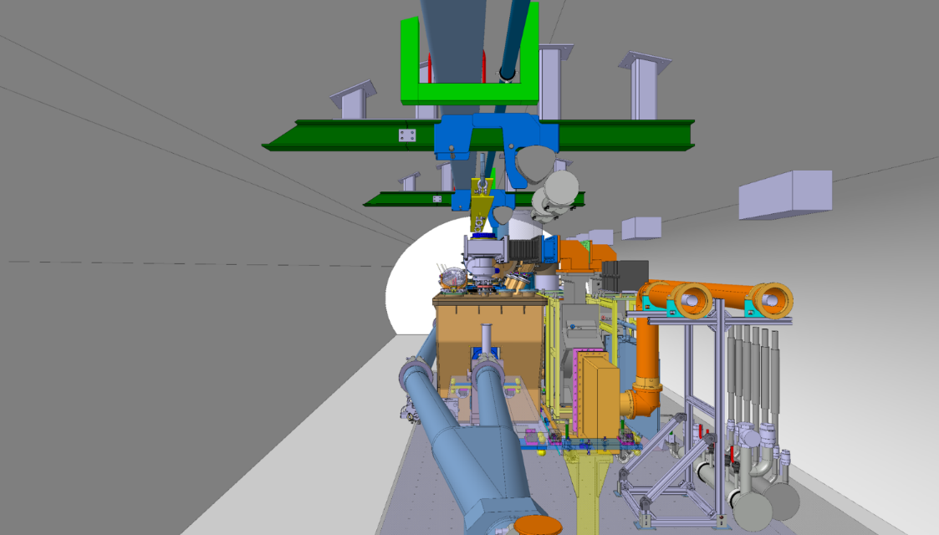
SPS Crab-cavity test stand
Cryogenic distribution line
Handling rails
RF power waveguides
Crab-cavity cryomodule
Y-chamber
Moving Transfer table

Slide 9
YETS Scheme
COLD CHECK-OUT
CRITICAL PATH: Refrigeration, Cryomodule
Earliest cooldown of the cryomodule in SPS : 21st Feb (after cryo commissioning)

Slide 10
SM18 Cryomodule Tests
[SAFETY]
mandatory for cooldown clearance
Pressure test at ambient temperature (at max allowable pressure)
Cryogenic design validation
Failure of vacuum components at cold
RF safety: no need for tests (EIS in SPS)
[OPERATIONABILITY]
Instrumentation check & commissioning
Static heat load: can we cool down the cryomodule to 2K?
Beam and Insulation vacuum validation at cold
FSI monitoring system (check with BCAMs) and suspension system functionality
Check pre-adjusted cavity position after contraction, readjust position at warm if needed
Do we need SM18 cooldown before going in SPS?
Not for safety.
Not if we can clear the tunnel in 6 days (warmup, disconnection, removal)
However, big logistical constraints in SPS versus dedicated assembly infrastructure in SM18

Slide 11
SM18 (RF) Cryomodule Tests
[RF VALIDATION]
Coupling measurement at warm (low RF power, check no coupling)
Frequency shift tracking during cooldown (low RF power)
Check of RF instrumentation
Tuner validation, mechanical
Tuner validation, with frequency response (low RF power)
HOM spectrum between the two cavities at warm, cooldown and cold (low RF power)
Initial RF conditioning is foreseen to be done in SM18 with 1 kW amplifier
Do we need SM18 RF tests before going in SPS?
Desirable but not mandatory
Proper RF qualification usually requires more time than available in planning
Notes:
Low RF power= network analyzer

Slide 12
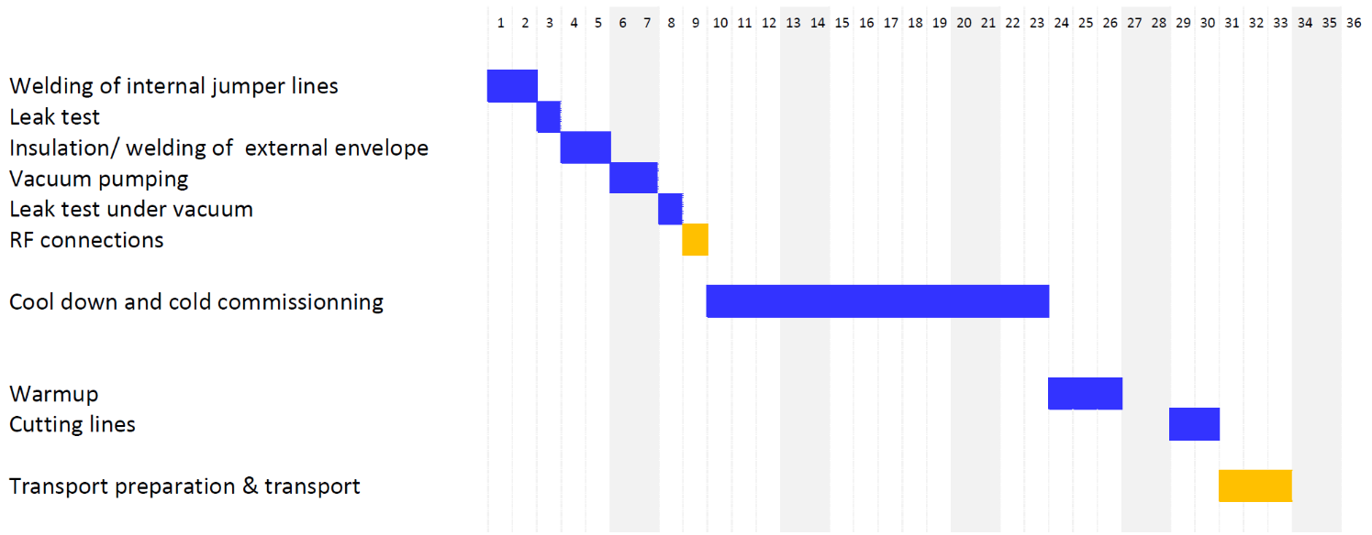
SM18 M7 Bunker tests
(RF tests)
Connect
Validate
9d
Cooldown/ Commissioning
14d
Warmup/ disconnect5d
Xmas break

Slide 13
Conclusion
No request for YETS extension
Dressed cavity#1 test results are critical for the overall planning of the project
September milestone to re-evaluate baseline schedule
Alternative scenarios being prepared to ensure proton beam test of the cryomodule in SPS in 2018.
[YETS]
[SM18 TESTS]
Essential validation tests of a complex object
Safety tests at warm required for cooldown clearance in SPS
SM18 is the assembly premise: dedicated infrastructure and tools are here
Easier fixing of small issues
Only location for larger repairs
Need 6 days to get the CM out of the SPS

Slide 14

Thank you
Acknowledgement, credits: R.Calaga, O.Capatina, F.Gerigk, M.Garlasche, C.Zanoni, K.Artoos, A.Macpherson, K.Schirm, M.Therasse, E.Montesinos, P.Baudrenghien, S.Claudet, K.Brodzinski, F.Galleazzi, A.Berjillos, M.Bernardini, D.Mcfarlane, and all the WP4 team

