Slide 1

Implications of civil engineering works next year on cabling in Point 1
Beniamino Di Girolamo
CERN
TCC Meeting – 29 June 2017

Slide 2
Outline
Archeology of cables at Point 1
LS2 Committee request to state about possible requests to ask for YETS2017-18 extension
  Comments given in EDMS about YETS length
Status of findings
Strategy

Slide 3
Archeology of cables at Point 1
Being Point 1 an old SPS point (house of BA6) there are always possible surprises when excavating
Three unknown cables surfaced during the work done in December 2016 for the rerouting of known network of cables in view of HL-LHC Civil Engineering work

Slide 4
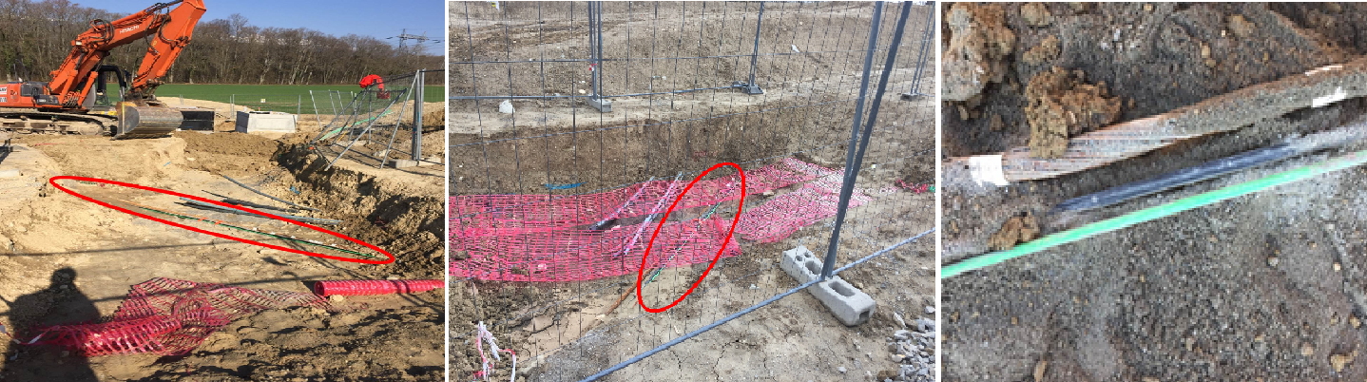
The unknown cables
In a location clashing with future CE works

Slide 5
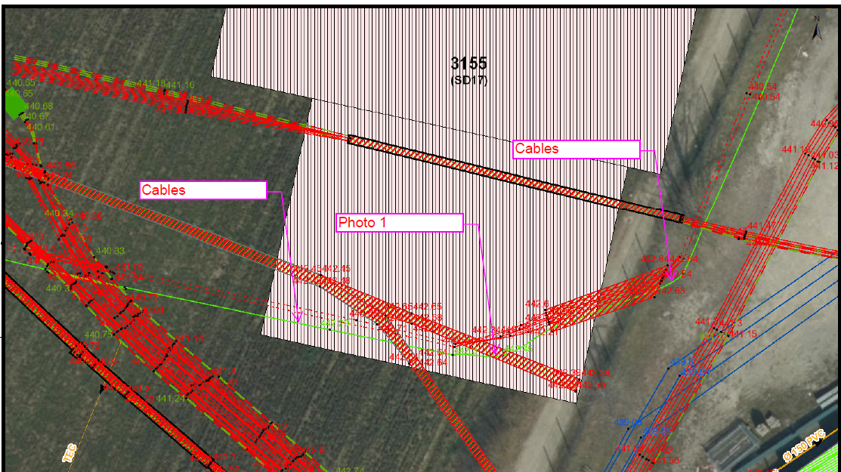
Identification in CERN maps and databases

Slide 6
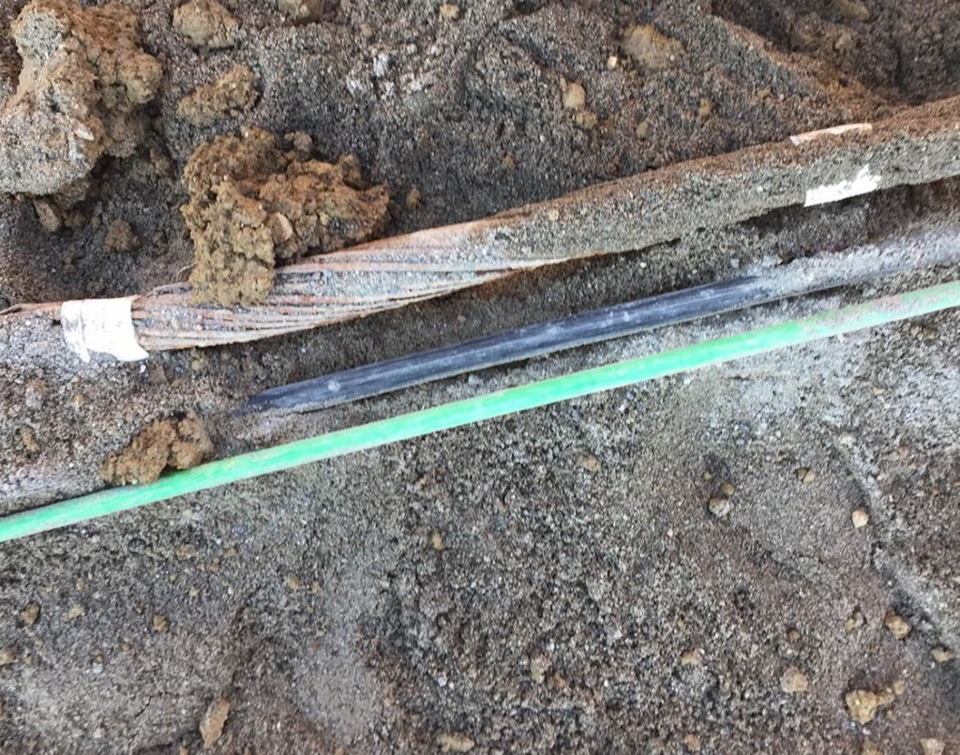
Partial identification of the cables
The cable with mechanical shielding is a phone cable unused
The green cable is an ancient coaxial for Ethernet not used anymore
The black cable is of the type NEU48 used for Alarm Level 3 transmission between SPS Points

Slide 7
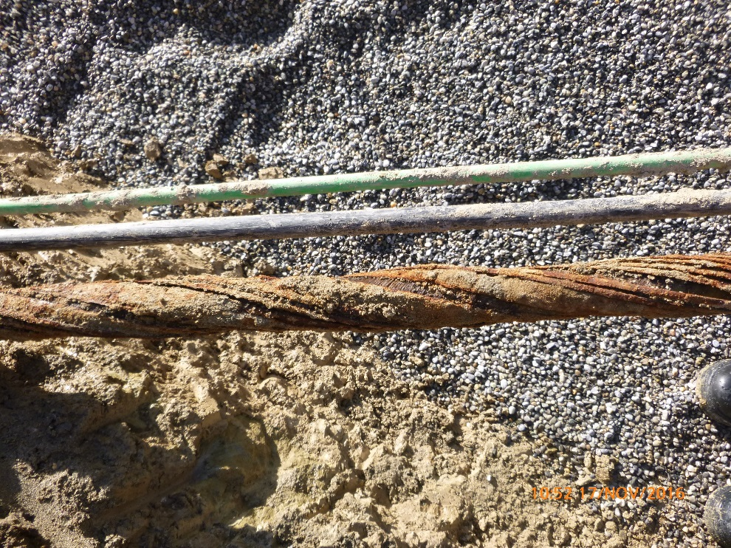
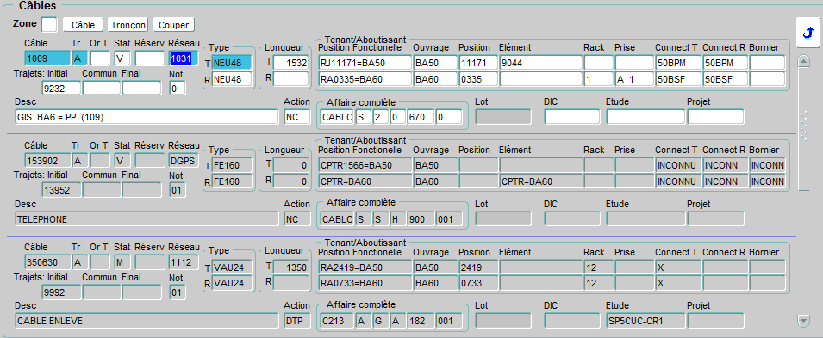
Cable identification so far
Photo prise au niveau de la fouille pt1
Or, selon la câblo entre BA5 et BA6:
3 câbles: 1 câble noir de type NEU48
1 câble blindé (téléphone)
1 câble vert de type VAU24
Courtesy J-C. Guillaume

Slide 8
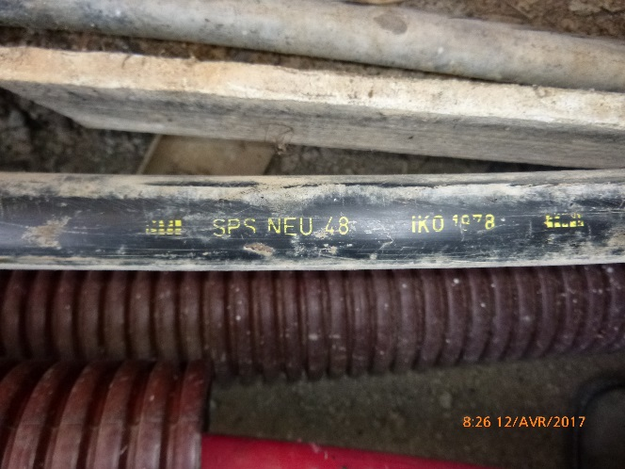
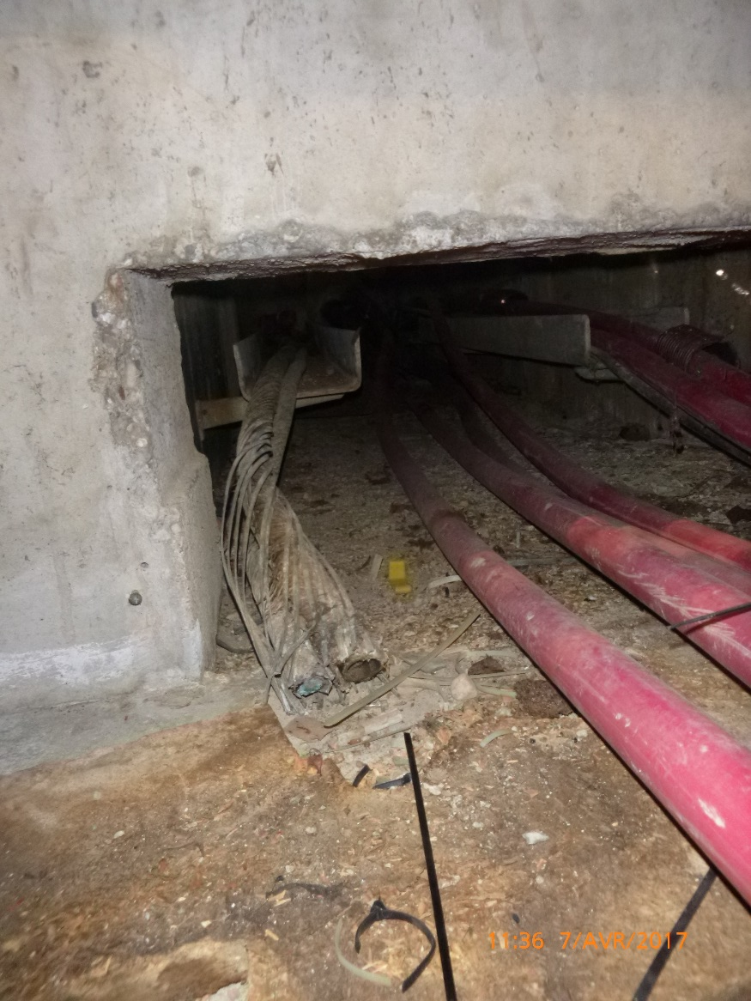
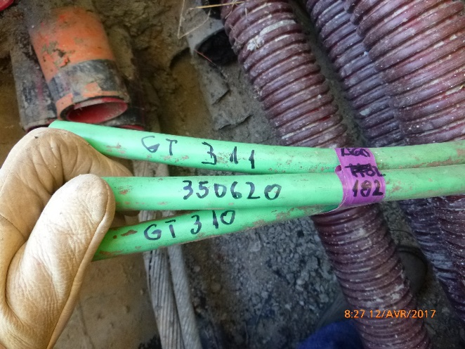
Cable identification so far
Entrée BA5
Câbles NEU48
Câble
multiconducteur
Téléphone
- câble coupé.
Câbles VAU24
effectivement coupé
et enlevé dans le BA5
lors la campagne de
retrait des câbles.
Par déduction, la seule possibilité restante est le NEU48.
A noter que ces câbles sont ensemble au niveau de la fouille
et rentrent ensemble dans le BA5.
Courtesy J-C. Guillaume

Slide 9
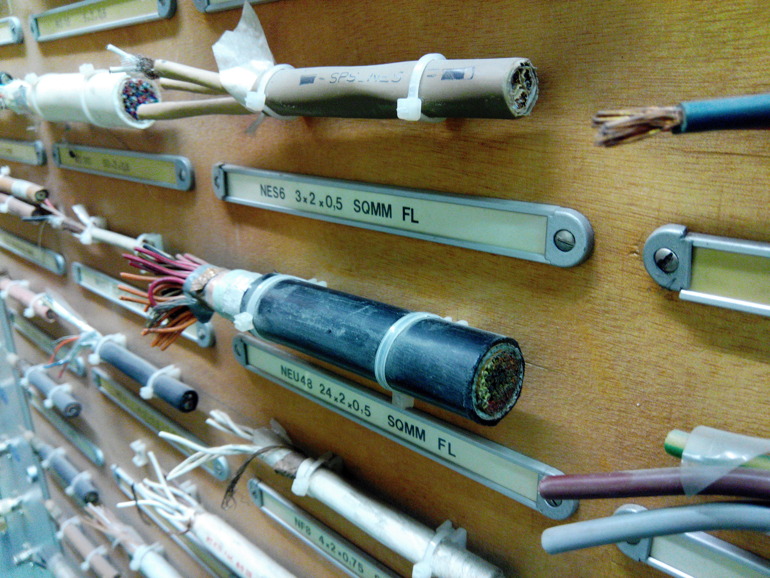
NEU48 multiconductors cable

Slide 10
YETS extension?
The complete identification of the remaining unknown cable is ongoing
In the meanwhile the document about the proposed length of YETS2017-18 circulated and the HL project raised a warning concerning the cable issue
Let’s see the latest findings and then answer this question
The urgency is given by the fact that in Spring 2018 the CE works are due to start

Slide 11
Findings
Investigations to identify cables between BA6 and BA5
1 cable identified at the exit of BA6 identified arriving to BA5 during the past TS
Distance between BA5 and BA6 ~ 1 km

Slide 12
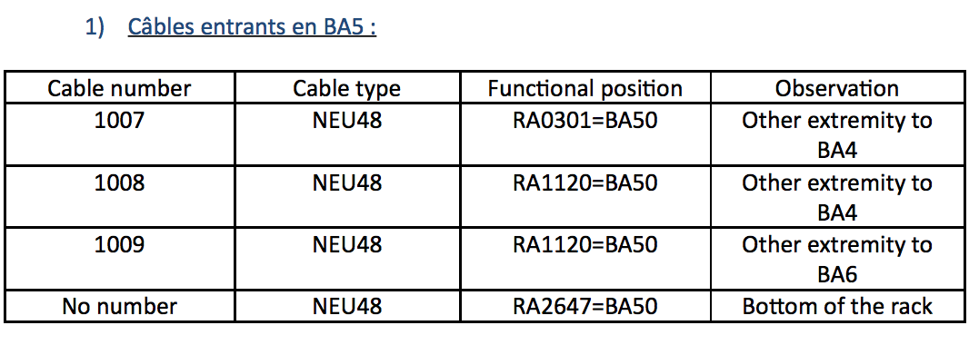
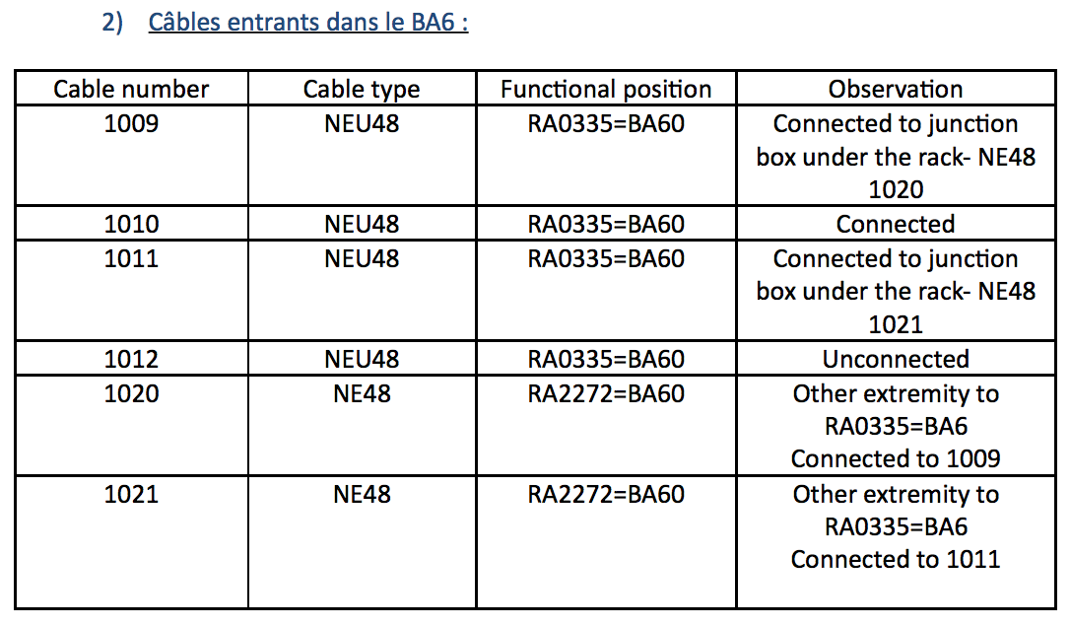
Findings

Slide 13
Strategy
Identified 1009 as candidate
The uncovered part has no identifier
If 1009 is the unknown cable the problem is solved:
  The cable is a backup cable for Alarm Level 3 transmission and we can easily reroute it without interfering
During the next TS (July 2017):
  Check of continuity of 1009 cable
  Injection of current in cable 1009 shielding and measurement with a current clamp (pince ampèremétrique)

Slide 14
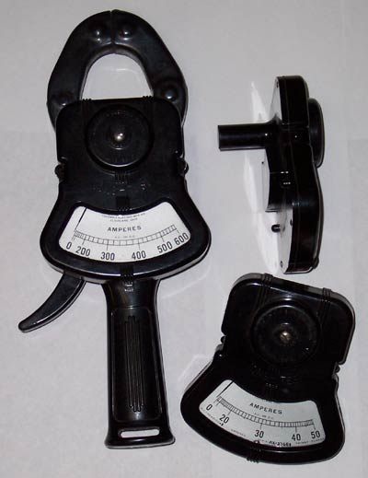
Our weapon

Slide 15
If the cable is not the 1009?
In that case we are back to square zero
We would need more investigation during next TSs:
  Further investigations on the cable
  Uncovering it over longer length?
  Trying to find where it goes: BA6? Elsewhere?
Will it affect YETS2017-18?
  We don’t know, it looks unlikely
  We should be able to solve earlier or well within the YETS

