Slide 1
Geant4 in a Nutshell
LCD group seminar
Peter Speckmayer
4. August 2009

Slide 2
How does Geant4 work?
What is simulated in there?

Slide 3
Outline / elements of GEANT4
Geometry
Events
Tracking
  Step length
  electromagnetic fields
  range cut
Physics processes
  Electromagnetic processes
    Multiple scattering
    Energy loss
  Hadronic Processes
    Modeling of final states
Physics lists

Slide 4
What is Geant4?
Simulation of interactions of particles with matter
A toolkit → (user has to wrap code around)
  Geometry
  Digitization
Aim of G4 design:
  Flexibility
  Customizable
  extendable

Slide 5
Geometry
Description of the detector
  efficient navigation of particles
Volumes defined by user with code
  typically experiments wrap interface around (e.g. compact.xml)
sensitive “logical volumes” for readout → linked with user defined class for detector response (digitization)

Slide 6
Geometry (detector description)
Readout structure can
be different from detector
structure
Logical volumes become “physical” when placed into a mother volume
Logical volume
Readout structure
Mother volume

Slide 7
Events
Event → main unit of simulation
Before being processed:
  Primary particles
  Vertices
Afterwards:
  Hits
  Digitizations (response of parts of the detector)
  (simulation truth)

Slide 8
Tracking
Event → consists of many tracks
Track → “a transported particle”
  consists of many steps
Step → smallest unit
Particles → not “self moving”
  Particles are “transported”
  transportation is a (physics)process like decay, pair production, …

Slide 9
Tracking
when one track is finished,
next particle is taken from
the stack
Track:
many subsequent steps
Secondaries:
put into a stack
(three stacks: → prioritize tracks
uninteresting tracks can be suppressed → performance)

Slide 10
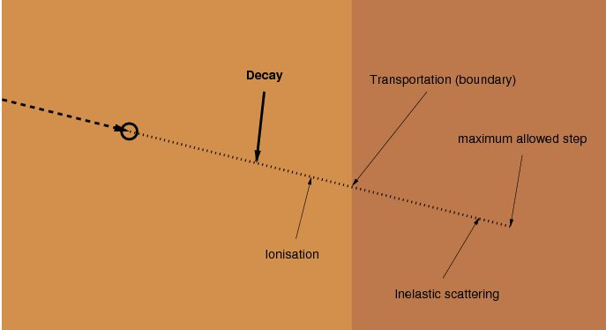
Tracking / Step
all processes propose step length
shortest one is taken (e.g. decay)
“post step action” of the limiting
step is called
for particles at rest → a time is proposed
for processes where energy is lost continuously → preservation of precision is the limiting factor
tracking decides which processes are invoked → process can demand to be invoked always (e.g. transportation, multiple scattering)

Slide 11
Tracking/ calculating the step length
Physics processes are associated to every particle
Each process proposes a step length
probability of not interacting within L
λ .. mean free path
interaction with material:
(composed of isotopes)
ρ .. density of the material
m_{i} .. mass of the isotope
x_{i} .. the mass fraction
σ_{i} .. cross-section of process for
this isotope
decay:
τ .. mean lifetime
ν .. velocity
γ .. Lorentz factor
random number [0,1] is thrown → η
length until decay or interaction L is computed
“transportation”-process → L = length to next boundary
step as well limited by user defined “maximum allowed step”

Slide 12
Tracking / electromagnetic fields / range-cut
electromagnetic fields
  non-linear propagation of charged particles
  trajectories are computed numerically
  method used (e.g. Runge-Kutta, helix) depends on smoothness of field
  intersection with boundaries → chord-approximation
range-cut
  particles with short range (less than user defined) are not generated → energy deposited
  avoids generating many soft photons and e-
  ranges → in tables (calculated once at G4 startup)

Slide 13
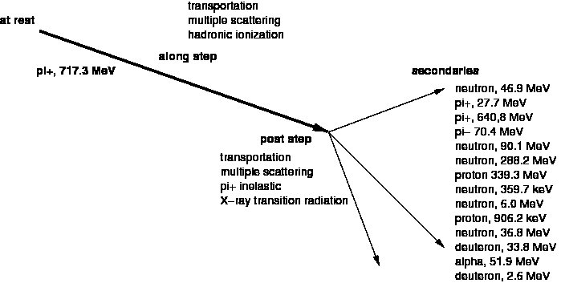
A real MC life example for one step
moves the particle
changes path of hadron slightly
produces energy deposit along path
three “actions” which can be
implemented by a process
process which limited the step

Slide 14
Visible and invisible energy
(not part of Geant4)
“visible” energy E_{vis}
energy of secondaries E_{sec}
Pre-step
Post-step
-m_{e-} : electron
+m_{e-} : positron
corr_{Mass}=
-m_{p} : p
+m_{p} : anti-p
-m_{n} : n
+m_{n} : anti-n
E_{meas}=E_{tot}+corr_{Mass}
E_{meas,nucleon}=E_{kin,nucleon}
E_{invisible}=E_{kin,pre-step}-E_{vis}-E_{meas,prim}-Σ_{i,sec}E_{meas,i}

Slide 15
Physics processes and models
Process → specific physical interaction of a particle
→ initial state, final state, cross-section/mean lifetime
detailed interaction → controlled by a model
  secondaries, kinematics
  model can be changed easily
several processes assigned to particle type (energy range)
Types of processes
  Decay
  Electromagnetic processes
  Hadronic processes
  Optical processes

Slide 16
Particle decays ...
decay tables in GEANT4 from PDG
complex decays (e.g. B mesons) are not modeled
  interface to external event generators provided
    Geant4 talks to external program, external program calculates decay
  pre-assigned decay mode
    event generator simulates decays
    G4 uses these data when needed
  what we do?
    ... is slightly different → we provide G4 only with particles which it can handle

Slide 17
Electromagnetic processes
for interactions of: e-, e+, photons, charged hadrons
effects of shell structure of atoms are averaged
  loss of precision (when shell effects are important)
photons:
  Compton scattering
  conversion into electron and muon pairs
  photo-electric effect
e- and e+:
  bremsstrahlung
  ionization
  δ-ray production
  e+ annihilation
  synchrotron radiation

Slide 18
Electromagnetic processes (2)
additions in the low energy region (examples)
  photoelectric effect
  Compton scattering
  Rayleigh scattering
  flourescence emission from excited atoms
  Auger effect
  corrections due to the molecular structure of materials
  corrections due to the effect of the nuclear stopping power
  Barkas effect
electromagnetic processes producing hadrons
  photonuclear and electronuclear reactions
    → can convert electromagnetical energy flow (e-, e+, photons) to energy flow of mesons, baryons and nuclear fracments
  hadron production by nuclear interaction of muons

Slide 19
Multiple scattering
calculated for one step
  → angular deflection
  → mean path length correction
  → mean lateral displacement
simulated for all charged particles

Slide 20
Energy loss
e+ and e- → contributions are summed up
  continuous → ionization, bremstrahlung
  discrete → Moeller & Bhabha scattering, δ-ray production, hard bremsstrahlung
muons
  ionization, bremsstrahlung, pair production
charged hadrons
  ionization (including hard δ-ray production)
mean energy loss is computed, fluctuations are added
ionization of ions and hadrons:
  model depends on energy range:
    >2MeV → Bethe-Bloch formula
    <1keV → free electron gas model
    intermediate range → parameterizations based on experimental data

Slide 21
Hadronic processes
thermal neutrons (0.025eV) → 7TeV → cosmic ray physics
total cross-sections → parameterized as a function of atomic weight and energy
  elastic scattering
  inelastic scattering
  capture of neutral particles
  induced fission
cross-sections: data-driven + theory based approaches for extension to high E and interpolation in regions without data

Slide 22
Modeling of final states
three possibilities
  data
  parameterizations and extrapolations of data
  theory-driven models
data
  preferred
  but not always available → high energies, short life-times, strange baryons, various target materials
  used mainly for
    isotope production (induced by n, p), transport of n (low E), photon evaporation (low E), radioactive decay, absorption of particles coming to rest

Slide 23
Modeling of final states
parameterized models
  mostly rewritten from Geant3 (GEISHA)
  parameterized:
    momentum distributions
    angular distributions
    extrapolations of cross-sections
  exist for many reactions and the full range of energies
  possibility to tune
  examples:
    induced fission for n, capture of n, elastic scattering, inelastic final state production, ...

Slide 24
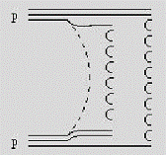
Modeling of final states
theory-based models
  allow for better extrapolation to energies not assessed in testbeams
  interactions of hadrons with a nucleus at high E final states (E_{CMS}>O(5GeV) )
    diffractive string excitation model (Fritiof like):
      the particles which are scattered only exchange momenta. For each of the scattered particles a string is formed where the quark content of the original hadron is randomly assigned to the string ends.
    quark gluon string model:
      the quark gluon string model splits a nucleon into a quark and a di-quark. Between those, strings are formed and hadroniyed (by adding a qqbar-pair). The color flow between partons from the interacting particles and the hadron-nucleon interactions are mediated by the exchange of Pomerons.

Slide 25
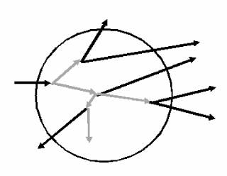
Modeling of final states
theory-based models
  intra-nuclear cascade models (E_{CMS}<O(5GeV) )
    Binary cascade model
    Bertini cascade model
      step-like concentric nuclear potential
      projectile transported along straight lines
      cross sections from data
  for E_{CMS}<O(100 MeV)
    exciton based pre-compound models available
    soften the steep quasi-elastic peaks
  evaporation phase
    models describe behaviour of excited, thermalised nuclei
      Weisskopf-Ewing model, Fermi breakup model, multifragmentation, fission
  atomic relaxation
  (alternative: CHIPS → thermodynamic approach for fragmentation of excited hadronic systems into hadrons)

Slide 26
Optical processes
in Geant4 → photons with wavelength >> atomic spacing are called “optical”
optical properties of a medium can be given as a function of photon wavelength
implemented processes:
  Cerenkov process
  Scintillation: user can define light yield, photon emission spectrum, ...
  Absorption and Rayleigh scattering
  Reflection and Refraction → optical boundaries can be defined by the user
  Transition radiation

Slide 27
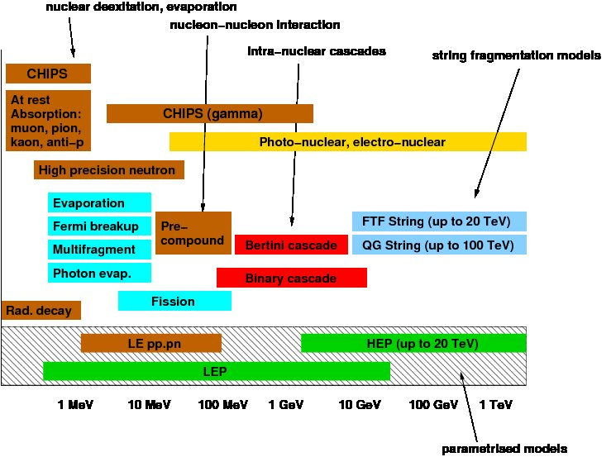
Physics processes, overview

Slide 28
Physics lists
G4 collaboration provides compilations of consistent sets of models → physics lists
electromagnetic simulations well known → accurate simulations
modeling of hadrons worse
LEP and HEP used as fallback solutions and for particles and regions where no other models are defined
High energy → QGS, FTF
Transitions between models in different E-regions → smoothed out → continuous transition between models (e.g. QGS to Bertini cascade)
Physics lists to be mentioned:
  LHEP
    old G3 (GEISHA) parametrizations → problematic (energy in processes not conserved, etc.)
    low energies: LEP, high energies: HEP
  LCPhys
    QGS (with precompound) above 12 GeV, LEP between 9.5 to 25 GeV, 0-9.9 GeV Bertini cascade
  QGSP_BERT
    QGS (with precompound) above 25 GeV, LEP between 25 and 10 GeV, below that: Bertini cascade
  FTF_BIC
    Fritiof with precompound above 5 GeV, below that: Binary cascade → no LEP, no HEP for pi and p

Slide 29
Summary
GEANT4 is very modular and flexible
  changes of models for physics processes possible
    → but: should be done together with GEANT4 collaboration, since set of chosen models should be consistent
GEANT4 performs good for electromagnetic processes
GEANT4 gives you results for hadronic processes
  certainly less accurate than for the electromag. processes
  has to be validated for the material which is used
  physics list? → no clear favourite, ... again: validation necessary
Which physics list to choose?
  QGSP_BERT is used the LHC-experiments
  LCPhys is used in ILC community (seems to be rather similar to QGSP_BERT)
  FTF_BIC is complementary to QGSP_BERT → good crosscheck

