Slide 1
Tile Dual Readout and Beyond
David R Winn, Fairfield/CMS
Yasar Onel, Iowa/CMS
(Achtung! Disclaimer: Not a CMS Presentation!)

Slide 2
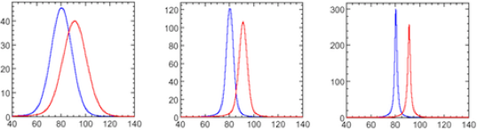
One Physics Example: Precision jets
- Jet-Jet masses: Goal for future experiments: SM Z->jetjet; W->jetjet
Ratio W,Z->jj to W,Z->leptons ~ 6-7
Reconstruct AND Separate(+SM, E_{Tmiss}, jet tags, V-V scattering, BSM, W’, Z’…)
Separation of W from Z: σ_{Ejet}/E_{jet} ~3% necessary at 100 GeV, with typical single particle energies ~10 GeV [ASIDE: during collision crossing times which may be a small as ~10’s of ns, pileup events ~200/crossing and raddam exceeding 50-100MRad.] A 3%-4% jet energy resolution from 50-500 GeV gives 2.6-2.3σ W/Z separation. J-J mass resolution is very important In searches for heavy W’/Z’, vector boson scattering, triple VVV….
W/Z->jet-jet separation: Left - calorimeter σ_{E}/E=60%/√E; Middle σ_{E}/E 22%/√E (3% @ 50 GeV) ~2.6σ separation; Right -perfect resolution: ~4.5σ separation.

Slide 3
Dual Readout: Cerenkov Compensation
1st Quantitative MC Study:
  GEANT MC in 1988 [Compensating Hadron Calorimeters with Cerenkov Light, D.R. Winn, W.Worstell, IEEE Trans. Nuc. Sci.,V1 NS-36, 334(1989)]
    Idea: Use differences in response to e-m fluctuations between - Cerenkov Medium(transparent – LAr, H₂O, SiO₂ ….) vs
    - Ionization Medium (scintillator, LAr ion collection,..)
    to reduce hadron shower fluctuations and make e/h-> 1
DREAM Collaboration/Richard Wigmans et al.
  Excellent progress in real tests!
  Thorough Analysis of Dual Parallel Fiber Calorimeters!
MC: 18%/√E seems possible.
DREAM: 30%/√E:Parallel Scintillating+Q Fibers

Slide 4
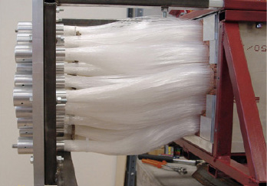
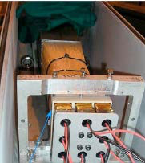
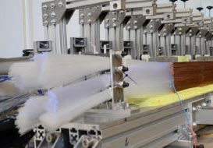
Parallel Fiber Dual Deficits - 1
1. Constant Term – unavoidable issue – scintillator light attenuation ~2+ m of fiber.
2. Pointing/Projective Geometry problematic in a practical parallel fiber calorimeter over a substantial solid angle. The mechanics + fiber packing of fully projective (θ,φ) very difficult for (pitch,yaw) more than ~5°. Streaming down fiber holes lowered the resolution in DREAM, even at a 2° pitch. Packing extra fibers from the back or conical fibers: ->Constant term, ->Calibration Issues
3. Scintillator Fiber & Photodetector Raddam: At present, there are no good examples of scintillator fibers which have proven sufficient raddam resistance or speed to be useful for hadron calorimetry at most future colliders.
4. Fiber Bundle & Photodetector Punchthrough: Huge fiber bundles, >33% of the back of the fiber dual calorimeter area, are directly behind the calorimeter. Large punchthrough backgrounds are generated by these fibers, photodetectors (~1/800 incident π/K quasi-elastic scatter through a 10 Lint calorimeter).

Slide 5
Parallel Fiber Dual Deficits - 2
4. E-M and Hadronic Components of Incident Jets: Parallel fibers ~no ability to detect + separate incident direct e-m component inside of a jet, since there is no longitudinal segmentation.
5. High Resolution EM Front End. The parallel fiber dual readout jet calo ~no ability to make a compensated high-Z high sampling EM front end.
6. Calibration: Parallel fiber geometry difficult to calibrate, as radiation damage & attenuation varies w/ length. (Contrast w/ longitudinally segmented calorimeters)
7. Timing & Pileup: Longitudinal fibers store the information of jet/em showers: the signal is over the time for the light to traverse the fibers. The light generated at the back of the calorimeter arrives at the photodetector first. Fiber calorimeters measure the falling edge of the shower, a less precise measurement
8. Longitudinal Segmentation: Fiber dual readout is incompatible with true longitudinal segmentation even with waveform electronics, and cannot be easily rebuilt for front raddam or implement 4,5 above.

Slide 6
Parallel Fiber Dual Deficits - 3
19. Cerenkov (Fiber)Index of Refraction: High Radiation Resistant Cerenkov fibers limited to quartz, with n=1.46 – h/e_{C} ~0.25-0.20 – limiting resolution. Low n tiles: even lower h/e_{C} ratio (aerogels, Teflon AF, Siloxanes, Fluoride glasses,….)
10. Particle Flow/Energy Flow Calorimetry: improving jet δθ/θ, core ID of jets, isolation/ID of leptons/photons in jets and pileup, and neutral particle (K^{O}, n) ID, all especially under pileup. Tile dual readout is fully compatible, and can be easily added to particle flow calorimeters
11. Other Sensors/Dual, Triple: Parallel fibers especially cannot readily use other hadronic or n-enhanced sensors, and e-m energy sensors. Examples: ionization detectors (solid – Si, Diamond, GaAs; liquid- LArgon; gasses – micromegas..); β->1 sensitive detectors such TRD, or ultra-low-index materials(aerogels, MgF₂, water, perfluoros, silicones,..); secondary emission sensors with higher response to slow particles β->0 and minimal response to minimum ionizing energy (new large MCP); inorganic non-hydrogenous scintillators (LYSO, PbWO₄ et al.), and ⁶Li, ¹⁰B or ³He containing materials.
12. Cost: the cost of tiles is significantly less per mass or volume of sensitive material than that of fibers, and the cost of a fabricated tile absorber matrix is considerably less than the parallel fiber Swiss cheese.

Slide 7
MC Study: Tile Dual Readout
GEANT4 MC on a simple tile calorimeter: 0.5 cm thick each of quartz, plastic scintillator, and Cu absorber tiles.
Two energies (50, 100 GeV) each of 1000 electrons (red dots) and of ~800-1000 pions (blue dots)] were sent into the 50x50 cm calorimeter, 12 Lint deep.
Nphotons 325-650nm generated in the Cerenkov and in the scintillator tiles were counted. 0.5% at random were assigned as converted to p.e.
Scintillator photons ~120x Cerenkov photons; photostatistics not limiting factors.
Means of histograms of the electron shower p.e. in quartz and in scintillator were used to convert/normalize the number of collected p.e. in Cerenkov light and in Scintillator light to normaized energies E_{Cerenkov} and E_{Scintillator}, and then plotted as a scatter plot of E_{C} vs E_{S} for each electron.
Pions of 50, 100 GeV were then simulated, converted to E_{C} vs E_{S}

Slide 8
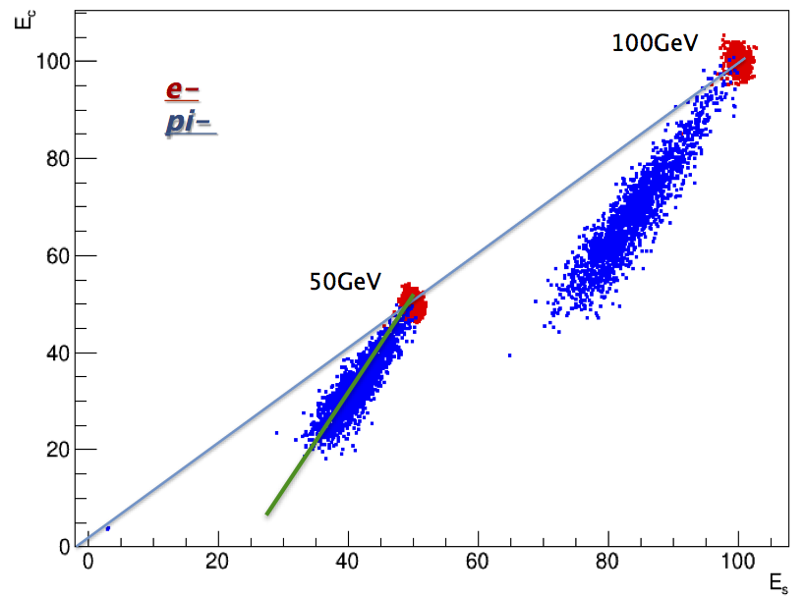
E_{c} GeV
Scatter plots: E_{S} GeV
Electrons: E_{c} vs E_{s} (red) lie along line shown schematically as E_{c} = E_{s}.
Pions: E_{c} vs E_{s} scatter-plotted (blue) lie mainly below the E_{c} = E_{s} electron line with correlation between E_{c} vs E_{s} fitted as a line (green, shown only 50 GeV points).
- As the shower fluctuates more to hadrons, E_{c} falls faster than E_{s}.
- A Simple analysis: Linear fit to hadron scatter points (Green line), with slope R, corrects the energy: Project the scatter points as a histogram perpendicular to the linear correlation, the energy distribution becomes Gaussian & narrower.

Slide 9
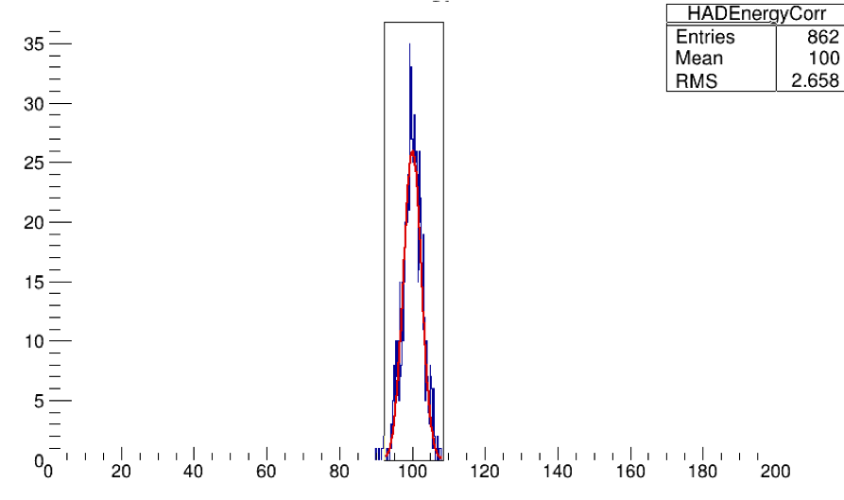
Dual Correction
• Pion Energy E (first order):E= E_{s} + [a correction term proportional to the difference (E_{s}-E_{c})]
E = E_{s} + α(E_{s}-E_{c}) with α given by slope R as R=(1+ α)/α or  =1/(1-R).
- The angle between the line E_{C}=E_{S} and fitted π scatter plot line: θ= arctan(R)–π/4.
• (E_{s}-E_{c}) grows as shower fluctuates into nuclear/hadronic energies.
• As slope R gets steeper, the correction term α(E_{s}-E_{c}) becomes more important. When Cerenkov E_{c} is the same as scintillation E_{s} (e’s or π’s exchange to πº’s), then (E_{s}-E_{c})~0, E=E_{s}.
(mean, rms) = (100, 2.66) GeV energy resolution that could enable W -> jet-jet; Z -> jet-jet
• Higher order terms- α₂(E_{s}-E_{c})² + α₃(E_{s}-E_{c})³ +.. and energy dependent α_{n} – there is a continuous mapping(vector field) of the points in E_{c} vs E_{s} space to the line E_{c}=E_{s} = E.

Slide 10
Tile Dual Summary/Discussion
  Rules of Thumb:
(0) An intrinsic limit of normal hadron calorimetry: σ_{E}/E > 11-13%/√E, given by the ratio of detectable neutron energy to the fluctuations in lost nuclear binding energy.
(1) Contrast between h_{i}/e_{i} (i=ionization) and h_{c}/e_{C} (C=Cerenkov) for hadrons h and e-m energy: the ratio of ratios [h_{i}/e_{i}]/[h_{c}/e_{C}] ≥ 4 in order to reach incident hadron energy resolutions below 30%/√E, with 18%/√E being a reasonable target to achieve using plastic scintillator and low index materials;
(2) h_{i}/e_{i}: as large as possible -> hydrogenous or n-sensitized ionization detection media.
(3) e-m energy resolution in Cerenkov light < 70%/√E to achieve <20%/√E;
(4 ) Resolution scales ~√(f_{sample}/f_{frequency}).
(5) Compensation can be achieved by enhancing neutron(hydrogenous or n-absorbing) or ion fragment sensitivity and/or by suppression electromagnetic component by tuning the absorber thickness relative to sampling media (f_{sample} typically ~1/10 but at a loss of potential ultimate resolution).

Slide 11
FUTURE
Adding sensor tiles relatively insensitive to MIPs, OR more sensitive to γβ->0 increases the contrast between e-m and hadronic energy (enhancing the low energy hadronic signal) – one such sensor is Secondary Emission; its signal scales as dE/dx, with a MIP SE signal ~100x less than that of the energy of the peak signal (peak signal for protons occurs at ~200KeV - n+p->p+n knock-on protons).
Homogeneous non-hydrogenous dense inorganic scintillators (LYSO, PbWO₄,CeF₃)
- h_{i}/e_{i} ~ 0.4 and h_{c}/e_{C} ~ 0.25, or [h_{i}/e_{i}]/[h_{c}/e_{C}] ~1.6:
-> Homogeneous calorimeters cannot achieve dual readout compensation better than ~50-60%/√E on hadrons, even with perfect separation between scintillator & Cerenkov light in the homogeneous detector. [Note: LAr/Ch4]
Theoretical ~15%-18%/√E on jets: scintillator sensors with h_{i}/e_{i} ~ 0.6-0.8 (likely hydrogenous & n-sensitive), and Cerenkov sensors with h_{C}/e_{C} ≤ 0.2 are needed. To achieve h_{C}/e_{C} < 0.2, lower n(index of refraction) Cerenkov radiators are required(i.e. β_{thresh} ->1), but require enough photons to achieve an e-m resolution < 70%/√E(GeV) or N_{pe}> 2 pe/GeV.

Slide 12
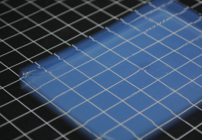
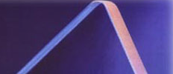
Beyond/Extended Dual Readout -1
Extend E-M Response by higher sensitivity to β->1
Results in high contrast ratio with h_{C}/e_{C} >0.15 (i.e. e_{C}/ h_{C} > 6-7)
( Lessens low energy Hadron, n,and nuclear fragment Sensitivity)
(A) TRD
    Straw tubes,…… Low mass issue for calorimetry)
(B) Low index Tiles
(1.1<n<1.35) tiles :
silica aerogels (n=1.05-1.3)
TeflonAF (n=1.29, 12 Mrad) (amorphous form; water-clear)
polysiloxanes (n=1.35, 100 Mrad)
MgF₂ (1.37);

Slide 13
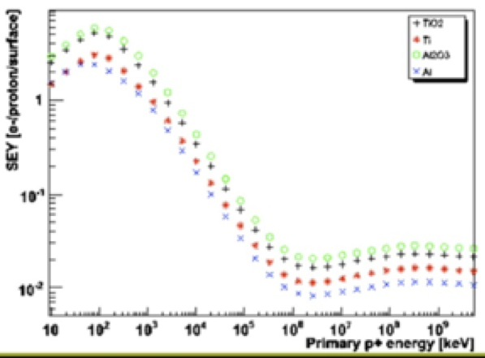
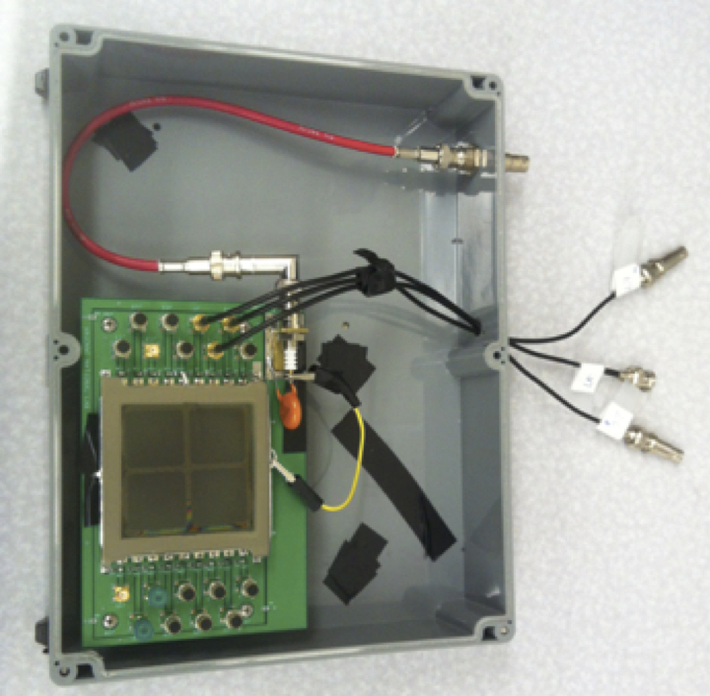
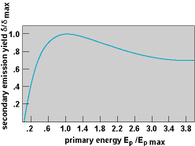
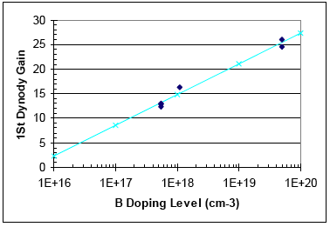
Beyond/Extended Dual Readout -2
Secondary Emission (SE). Secondary Emission(SE) tiles are more sensitive to γβ->0 particles than to MIPs - scales as dE/dx. MIP SE signal~100-200x less than at peak γβ SE signal – the opposite of Cerenkov light. SE tiles for correction for heavy fragments, lost neutron energies, slow hadrons. (triple/quadruple readout.) 1-2 MeV alpha particle: secondary yield ~at max.
LHC SE Monitors:
SE Yield vs
Ep (KeV)
10²⁰ p/cm² !
12x12 MCP
FNAL Test Beam
B-doped
Nanoxtal
Diamond
1µm thick
On dynode

Slide 14
N-Readout & Beyond
Triple Readout and beyond: 3 tiles to improve dual readout: non-hydrogenous scintillator, hydrogenous/neutron-sensitive scintillator, 2 indices of Cerenkov tile(s), SE tiles…. Compare less-sensitive neutron scintillators [non-hydrogenous scintillators; inorganic and perfluorcompounds] to more neutron-sensitive H or n-absorbing/converting scintillator tiles.
Combined Dual/Triple Readout with Particle Flow: Add Cerenkov tiles, TRD tiles, SE tiles, or others to existing Particle/Energy flow calorimeter prototypes.
Neutron-enhanced detecting scintillator tiles thin film coatings - ¹⁰B, ⁶Li, hydrogenous materials [⁶LiH] – thin clear film, buffered w/ alumina films; interesting: Li⁶B¹⁰H₄ which would be transparent if deposited as thin films between clear buffers. ¹⁰B SE yield dynodes.
Liquids: very large homogeneous detectors: LB, cosmic neutrinos or prot-rot.
1) water “tiles”(n=1.29-1.31 TeflonAF light pipe) + LS tiles – no absorber
2) LArgon drifted ions + Cerenkov light detection. The index n good e/h contrast; scintillation light at 128nm will not penetrate PMT windows.
-

