Slide 1
MiniDAQ2 Workshop
01.08.2017
Control System

Slide 2
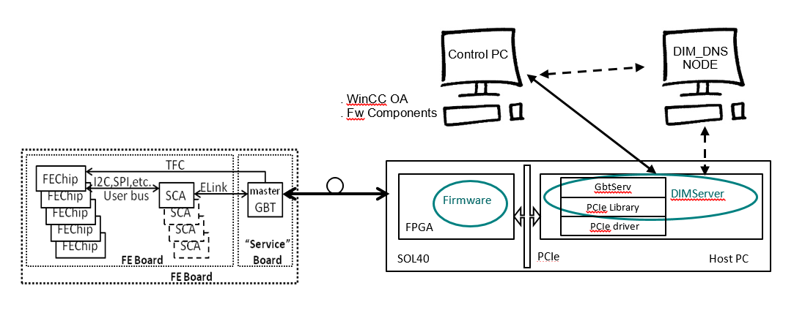
Control system
Requirements:
  SCADA (WinCC OA)
  DIM
  JCOP Core Components:
    FwCore
    FwDim
    FwConfigurationDB (for usage of recipes)
  Gbt Server
  Gbt Client (FwGbt)
  Hardware Tool (FwHw)
  MiniDAQ Component (FwMiniDAQ)

Slide 3
Control Node configuration
First steps:
  Have a CC7 machine
  Configure the daq40 repository (http://lbyum.cern.ch/daq40/)
  Install WinCC OA 3.15 (https://readthedocs.web.cern.ch/display/ICKB/PVSS+Service+Download)
  Install required RPMs
    dim
    dim-programs
  Start the DNS server
    Note: it might be a good idea to set it to start on boot (“sudo systemctl enable dnsd”)
  Install the GBT Server
  (https://gitlab.cern.ch/lhcb-amc40firmware-mng/lhcb-amc40software)

Slide 4
WinCC OA Project Configuration
  Create a new project
  Get the fwInstallation Tool to be able to install the components
  (http://jcop.web.cern.ch/jcop-framework-component-installation-tool)
  Install the core JCOP components
  (https://jcop.web.cern.ch/jcop-framework-0) → JCOP Framework
  (https://cernbox.cern.ch/index.php/s/UlbgqHTFE0wOZiU/download) → (LbHwFw v2r0) JCOP Framework + LHCb components
    fwCore
    fwDIM
  Install the LHCb Hw components
  (https://gitlab.cern.ch/lhcb-amc40firmware-mng/lhcb-amc40software)
  Install the fwMiniDAQ component
  (https://gitlab.cern.ch/lhcb-amc40firmware-mng/lhcb-amc40software)
    Note: due to the amount of datapoint data to import, this installation takes quite a bit (~15min), please be patient

Slide 5
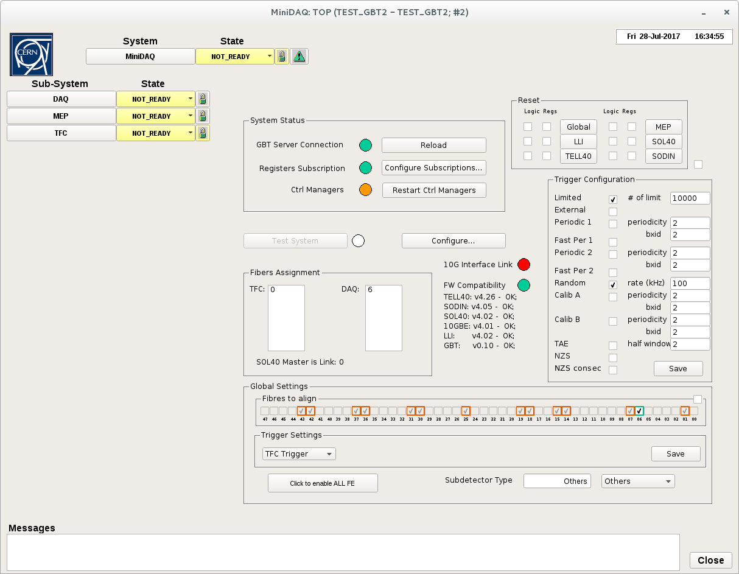
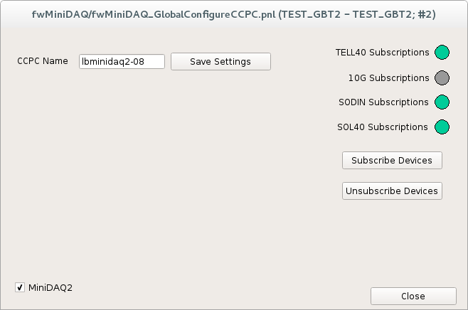
Configure the system
4
  Once the project is installed, you’ll need to configure it and subscribe your devices.
    Note: Make sure the checkbox is ticked if you’re subscribing for MiniDAQ2
  The subscription will configure all the registers for the TELL40, SOL40 and SODIN, as well as configure the correct Writer subscriptions
  The Reload button is very useful as it performs the following actions:
    Reloads the pcie driver
    Recalibrates the fPLLs
    Relaunches the Gbt Server
    Restarts the ctrl managers
  In the development phase, when trying out new firmwares it should come in handy
1
2
3

Slide 6
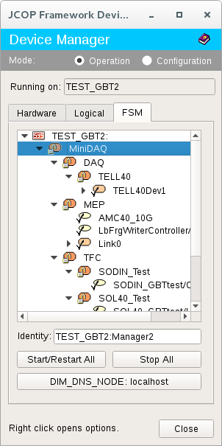

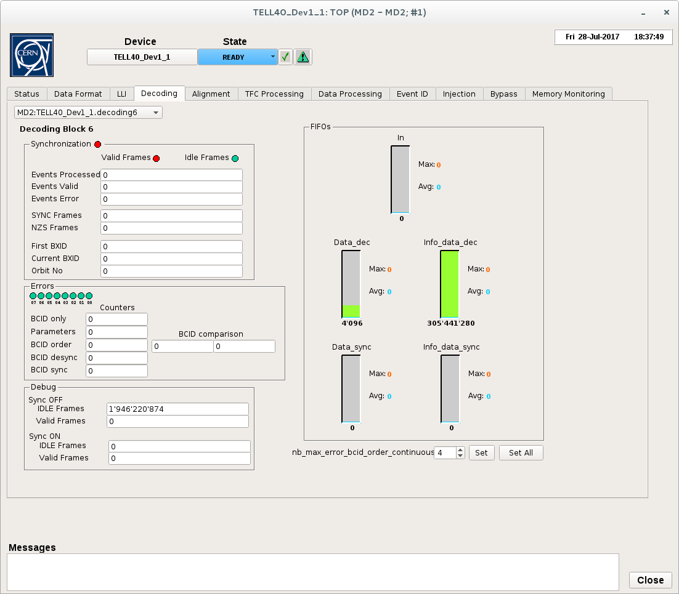
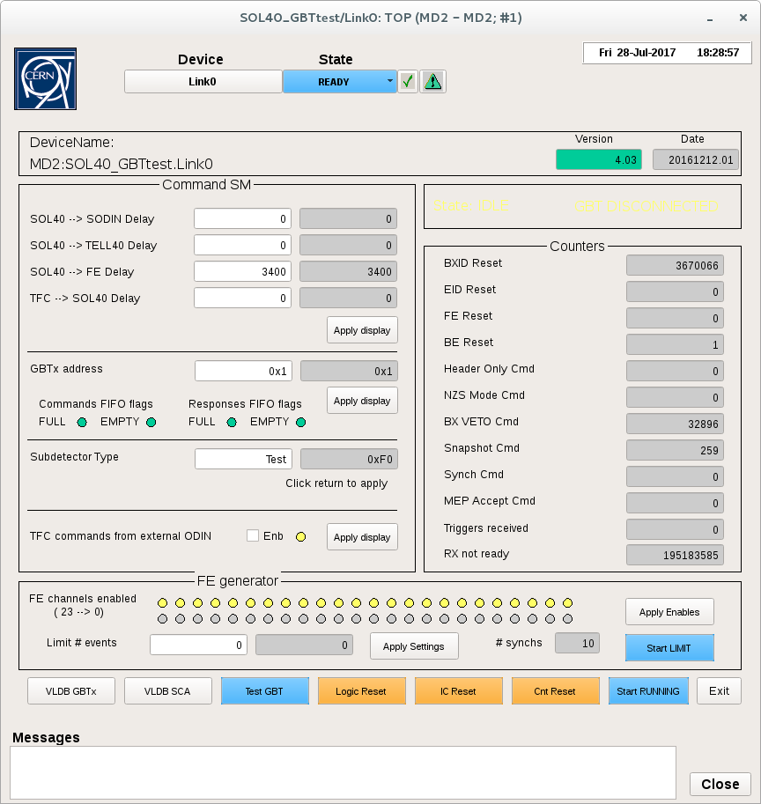
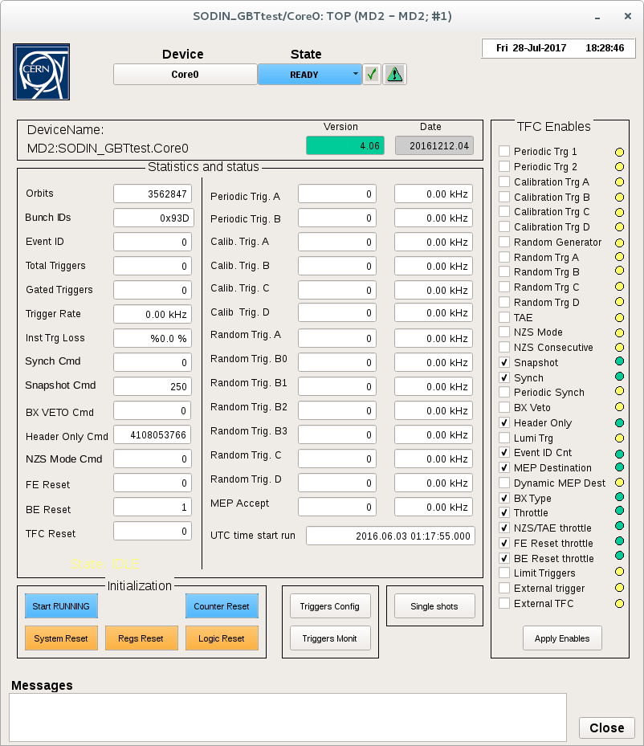
FSM
  The FSM can be opened from the Device Editor Navigator
  Expanding the Tree you can see all of the nodes of the FSM
    Some of the nodes do not appear on the FSM panels as they are only visible/not visible depending on the MiniDAQ configured (e.g. no 10G device on MiniDAQ2)
    This will change in the future and MiniDAQ1 related devices will be removed

Slide 7
FSM tree
Commands
States
MiniDAQ
TFC
MEP
DAQ
SODIN
Writer Controller
TELL40
SODIN Core0
10G Device
TELL40 Device1
10G Links
SOL40
TELL40 Device1
Block 1
SOL40 Link0
TELL40 Device1
Block 2
SOL40 Link5
SOL40 Link5
SOL40 Link5
SOL40 Link5
SOL40 Link5
  Control Units – Logical structure that groups devices and other Control/Logical Units - Can be partitioned
  Logical Units – Logical structure that groups devices and other Control/Logical Units - Can not be partitioned
  Device Unit – Corresponds to a real device (hw or software) that performs a given action
Control Unit
Logical Unit
Device Unit

Slide 8
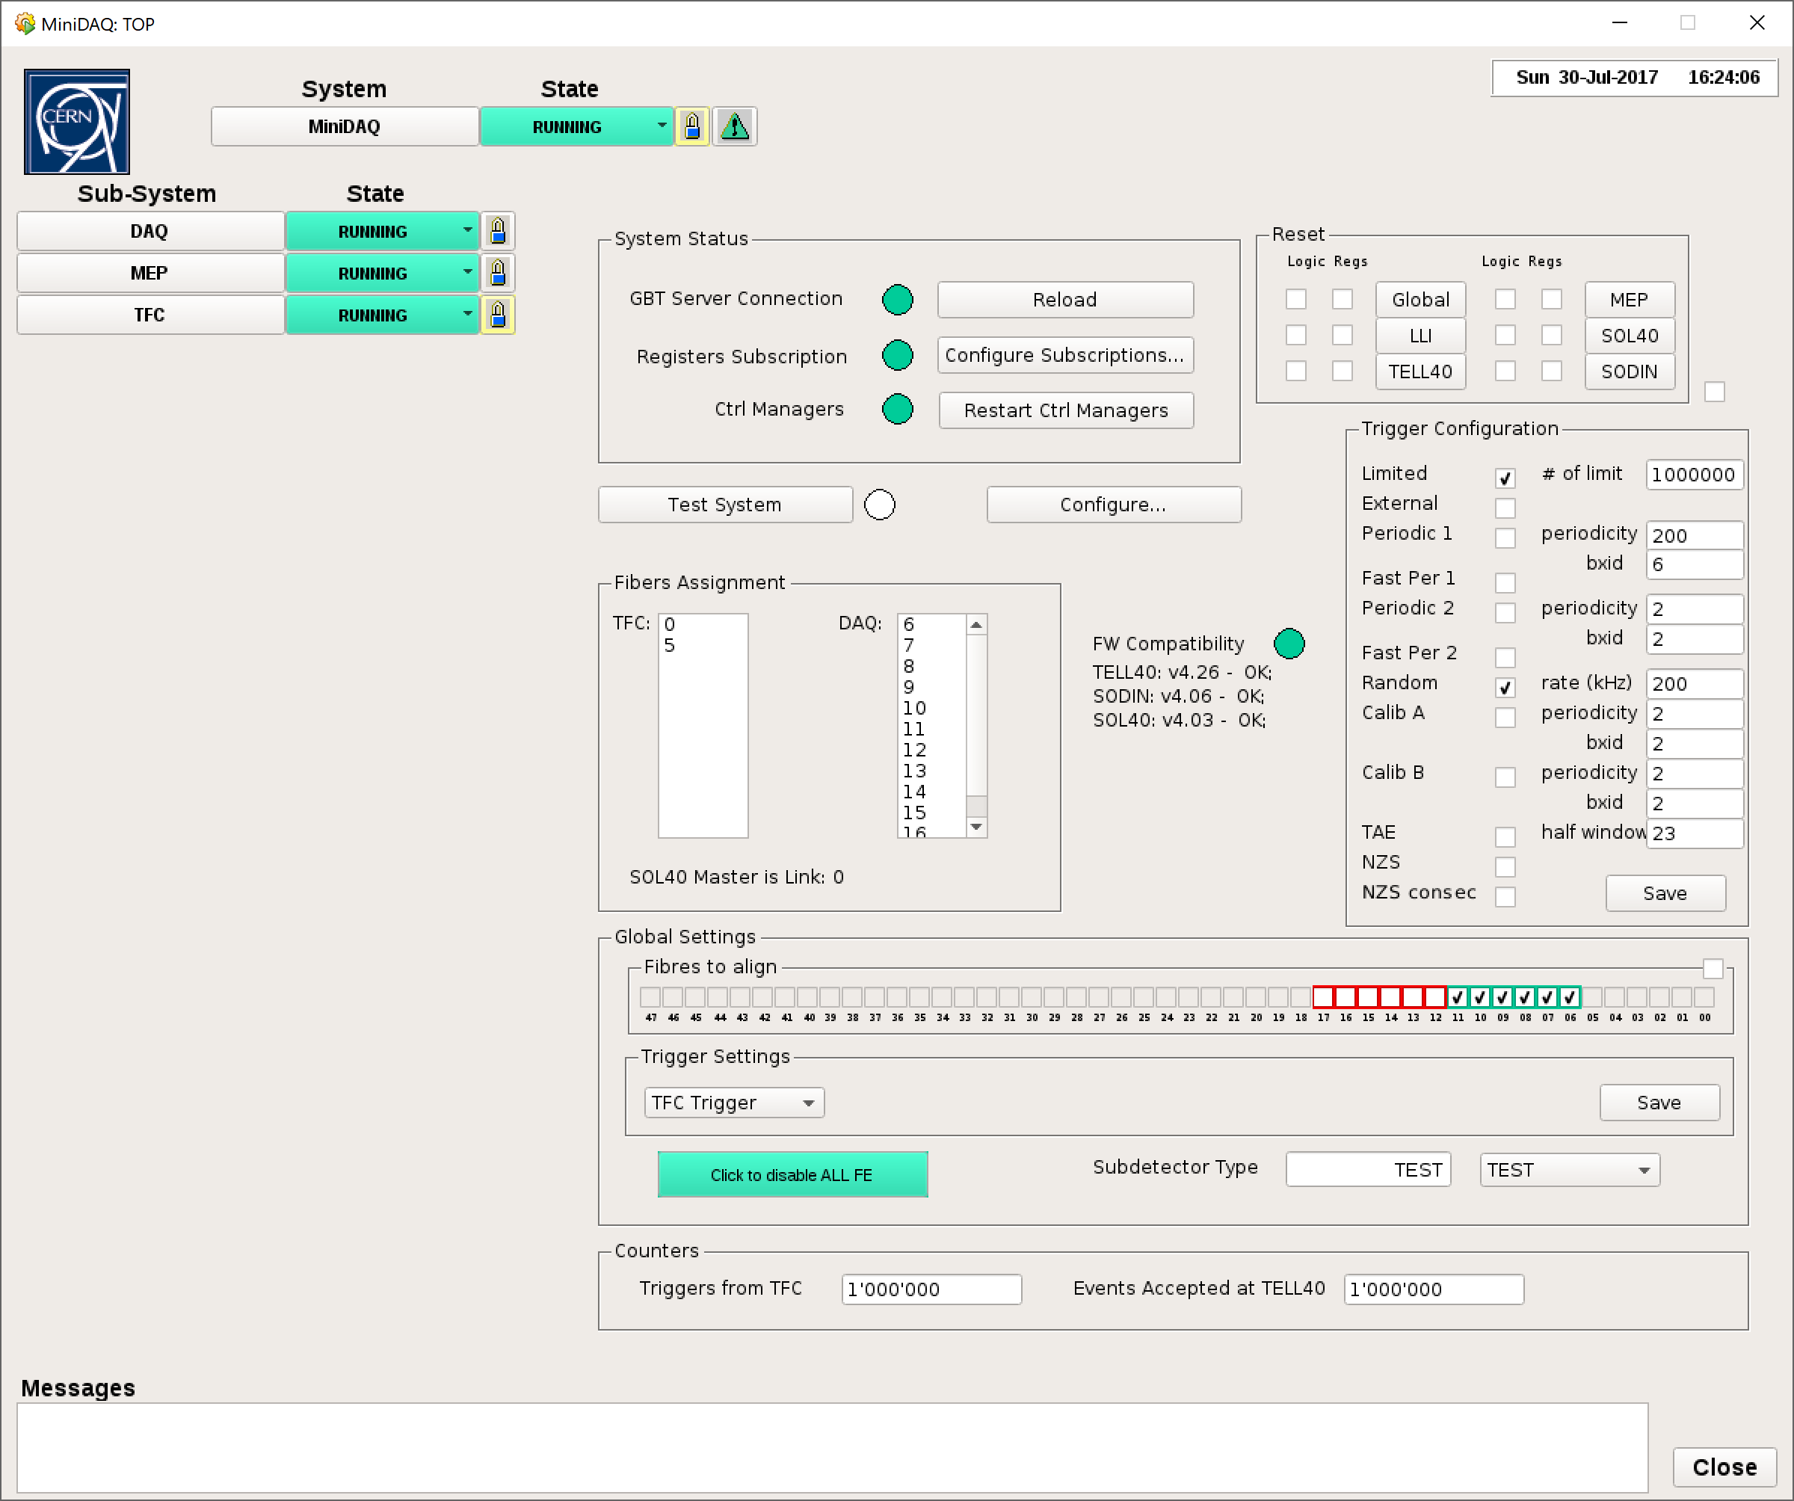
FSM Top panel
  Main face of the whole system
  Allows for the quick configuration of the most relevant run parameters
  Selection of DAQ Fibers
    MiniDAQ2 has up to 48 links of Data Acquisition
      This means 2 blocks of the TELL40, each with 24 links
    Green means fiber active and enabled
    Red means fiber active and not enabled
    Orange means fiber not active but selected on the current configuration → If you try to configure the TELL40 like this it will go to ERROR, you’ll have to disable the non active fibers
  Trigger Configuration
  FE Generator switch
    When the system is in the correct state it will be yellow when FEs generator not enabled and green when enabled
    If you don’t have any FE connected it might be useful to test the system
  Sub-detector type setting
    Should no longer be reset when resetting from the FSM

Slide 9
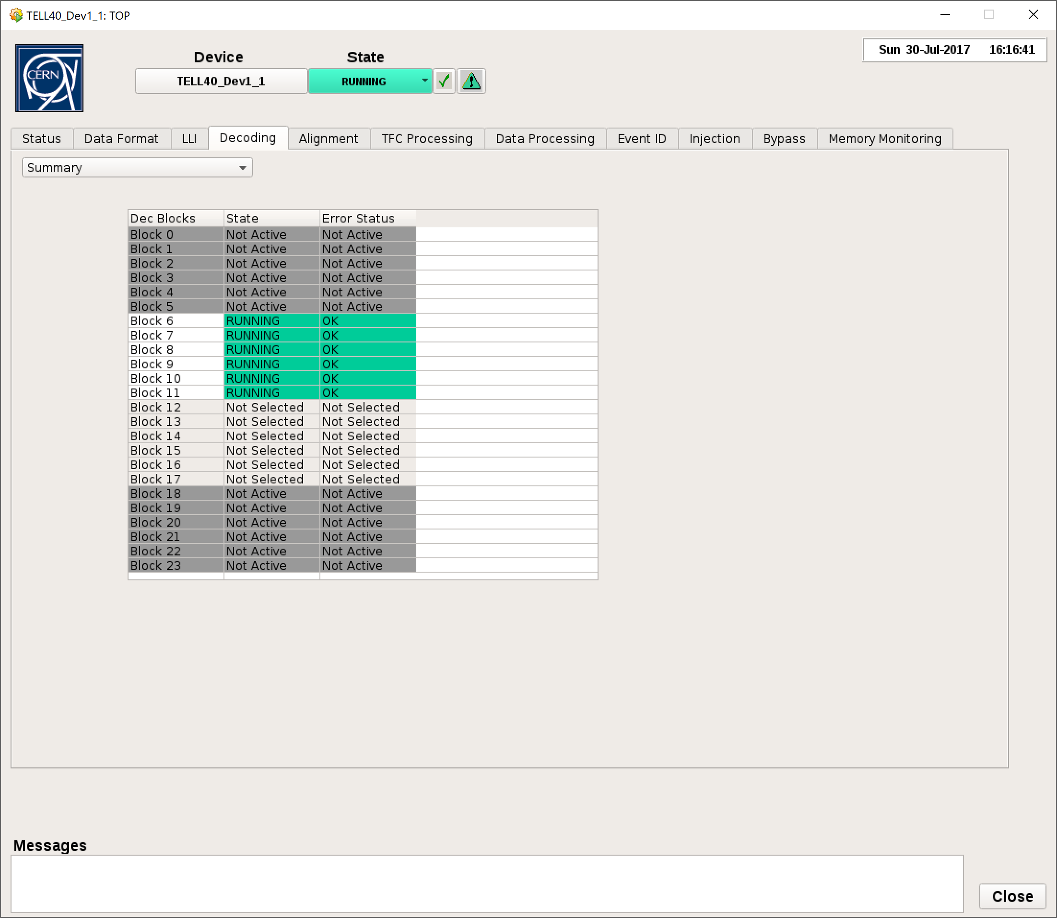
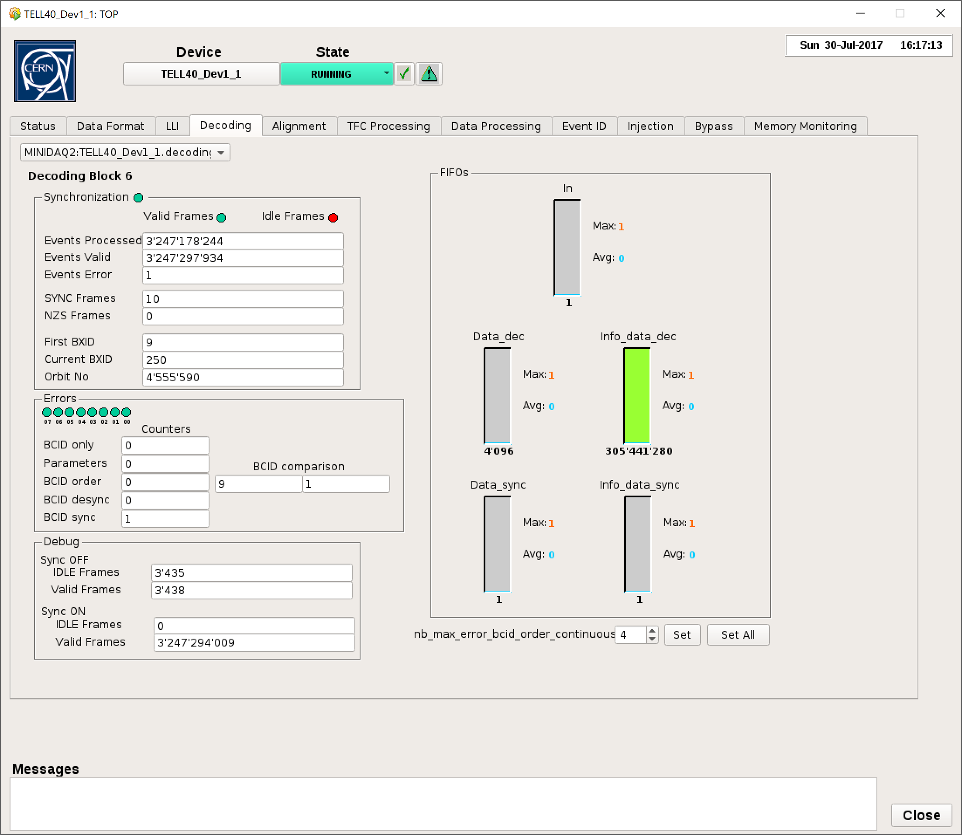
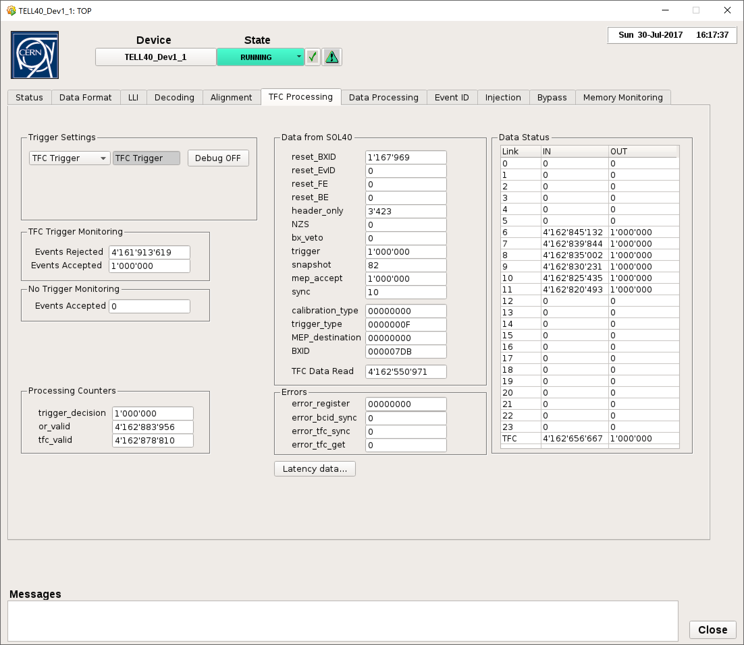
Trying things out
  To make sure everything is working as expected
    Push the “Test System” button
      This will read the current value from a test register, increase it by 1, write it and read it back again
      If everything went OK, the LED should go green
    Send the commands from the top MiniDAQ node and see if you can get it to running
      You can use the fibers in loopback and FE generators to help you
      All the selected fibers should go to state RUNNING
      On each of the decoding blocks
        You should see the “Synchronization” and “Valid Frames” green
        The “Sync ON” Valid Frames counter should be going up
      On the “TFC processing” tab, you should see the same number of TFC events accepted going up to same number of triggers set as limit on the top panel (if set) and after this you should see the events rejected going up

Slide 10
Troubleshooting
  The values on the panels are not updating
    Check if the Gbt Server is running (LED on Top panel)
    Restart the Ctrl Managers (to restart the monitoring of the registers)
  The “Test system” comes back red
    Try again (sometimes it takes a little while for the system to become stable)
    Restart the Gbt Server, wait a couple of seconds and restart the ctrl managers
    Sometimes, the firmwares are not ok and the control system becomes confused
      Try to read some register from the terminal (‘pcie40_ecs -b 0 -a 0x700004 -r’)
      Try a known good firmware to check if the control system reacts appropriately.
  Lots of “Unknown Service ID” errors on the log viewer
    Probably the Gbt Server was just started
    The Ctrl Managers issued a start monitoring to registers that the Gbt Server still doesn’t know
    Wait a bit and try restart Ctrl managers again
  Check the log viewer often
    Some times, errors happen which have not visible on the panels, but the log message can provide useful information
  We are always glad to check things out as sometimes things happen that we haven’t seen before
    The possibility to connect remotely to your system is really helpful
    A vidyo connection can be setup so we can debug together

