Slide 1

LHC beam screens: cryogenic observations and analysis
Benjamin Bradu,
Krzysztof Brodzinski and Serge Claudet
TE-CRG
E-cloud meeting
14th July 2017

Slide 2
Contents
Heat load observations in ARCS
Evolution of Feed-Forward parameters
Heat load observations in instrumented cells
Notes:
2

Slide 3
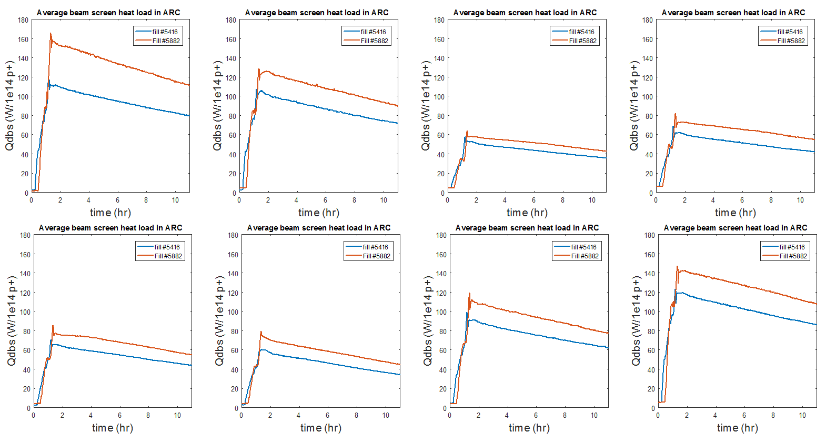
ARC Heat loads 2016 Vs 2017
Fill #5416 = 14th October 2016: 25ns_2220b_2208_1940_2036_96bpi_24inj
Fill #5882 = 28th June 2017: 25ns_2556b_2544_2215_2332_144bpi_20inj
S12
S23
S34
S45
S56
S67
S78
S81

Slide 4
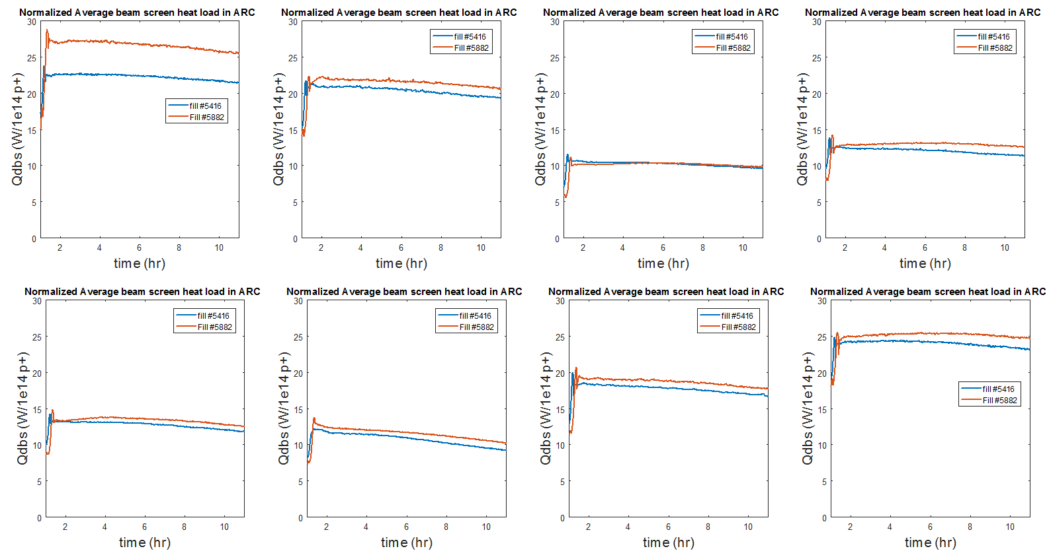
ARC Normalized Heat loads 2016 Vs 2017
Fill #5416 = 14th October 2016: 25ns_2220b_2208_1940_2036_96bpi_24inj
Fill #5882 = 28th June 2017: 25ns_2556b_2544_2215_2332_144bpi_20inj
S12
S23
S34
S45
S56
S67
S78
S81

Slide 5


Feed-Forward: Reminder
Feed-forward action on cryo valves + heaters to anticipate heat loads
Beam induced heat load calculated from online beam parameters
3 tuning parameters are used to compute the e-cloud contribution :
  Qeci: heat load per half-cell per bunch at injection (450 GeV)
  Qecr: heat load per half-cell per bunch after ramp (6.5 TeV)
  Nb0: proton per bunch threshold to activate e-cloud process

Slide 6
Heat Load observations in ARC
Evolution of FF parameters
  Qeci: heat load per half-cell per bunch at injection (450 GeV)
Conditioning finished at 450 GeV
Fill #5416 = 14th October 2016: 25ns_2220b_2208_1940_2036_96bpi_24inj
Fill #5882 = 28th June 2017: 25ns_2556b_2544_2215_2332_144bpi_20inj

Slide 7
Heat Load observations in ARC
Evolution of FF parameters
  Qecr: heat load per half-cell per bunch after ramp (6.5 TeV)
Conditioning not yet finished at 6.5 TeV
Fill #5416 = 14th October 2016: 25ns_2220b_2208_1940_2036_96bpi_24inj
Fill #5882 = 28th June 2017: 25ns_2556b_2544_2215_2332_144bpi_20inj

Slide 8
Heat Load observations in ARC
Evolution of FF parameters
  Nb0: proton per bunch threshold to activate e-cloud process
E-cloud threshold slightly lower after EYETS in high load sectors (12,23,78,81)
Fill #5416 = 14th October 2016: 25ns_2220b_2208_1940_2036_96bpi_24inj
Fill #5882 = 28th June 2017: 25ns_2556b_2544_2215_2332_144bpi_20inj

Slide 9
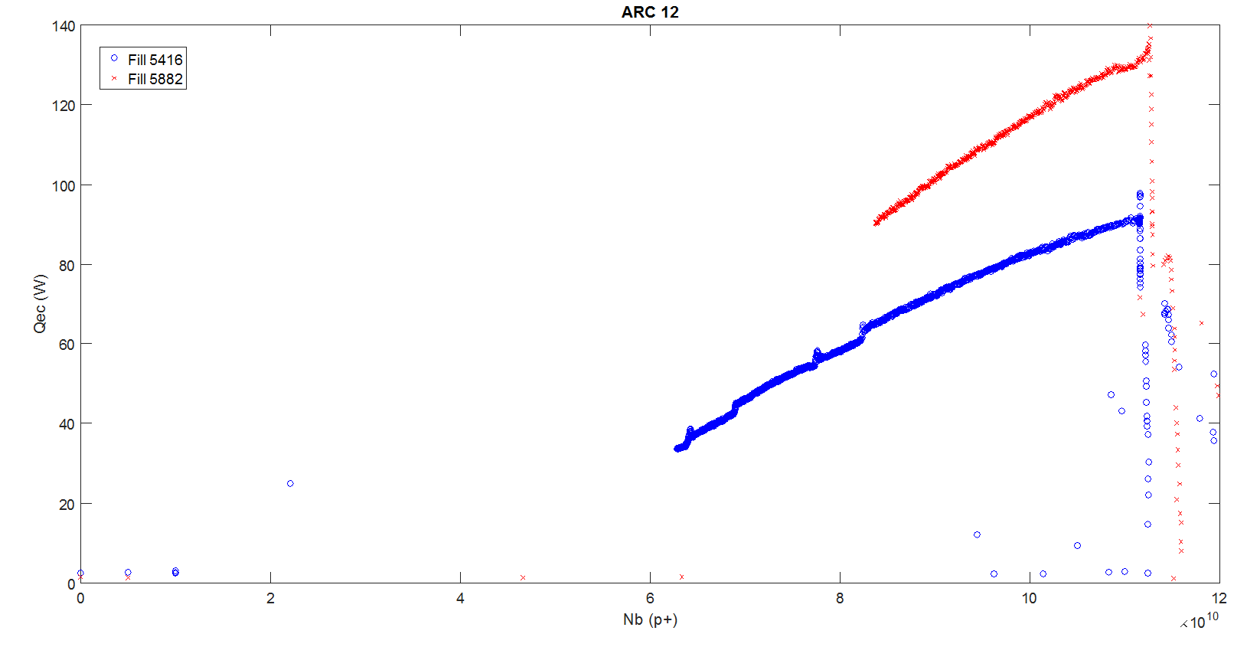
E-cloud threshold in ARC12
Qec = Qdbs (meas) - Qsr (theo) – Qic (theo)
Nb0 =
2.43e10
Nb0 =
3.69e10

Slide 10
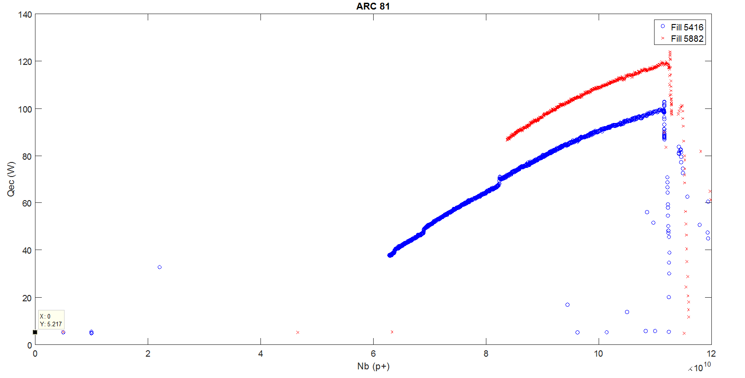
E-cloud threshold in ARC81
Qec = Qdbs (meas) - Qsr (theo) – Qic (theo)
Nb0 =
1.68e10
Nb0 =
3.63e10

Slide 11
Instrumented cells
3 cells in S45 since LS1
1 cell in S12 since EYETS 2016
Total = 4 quadrupoles and 12 dipoles
Before EYETS 2016:
  34R4: one sensor not working (QBBI_A34L5_TT826)
  34R4: suspicious sensor (QBBI_A34L5_TT824) ➔ Error on 2 dipoles
  13L5: sensor calibration issues ➔ Errors on 1 quadrupole
After EYETS 2016
  All sensors have been re-calibrated
  34R4: Previous issues solved except QBBI_A34L5_TT824 still suspicious
  13L5: One sensor not working (QBBI_B13L5_TT824)
  ➔ all magnet heat loads can be correctly calculated in 2017

Slide 12
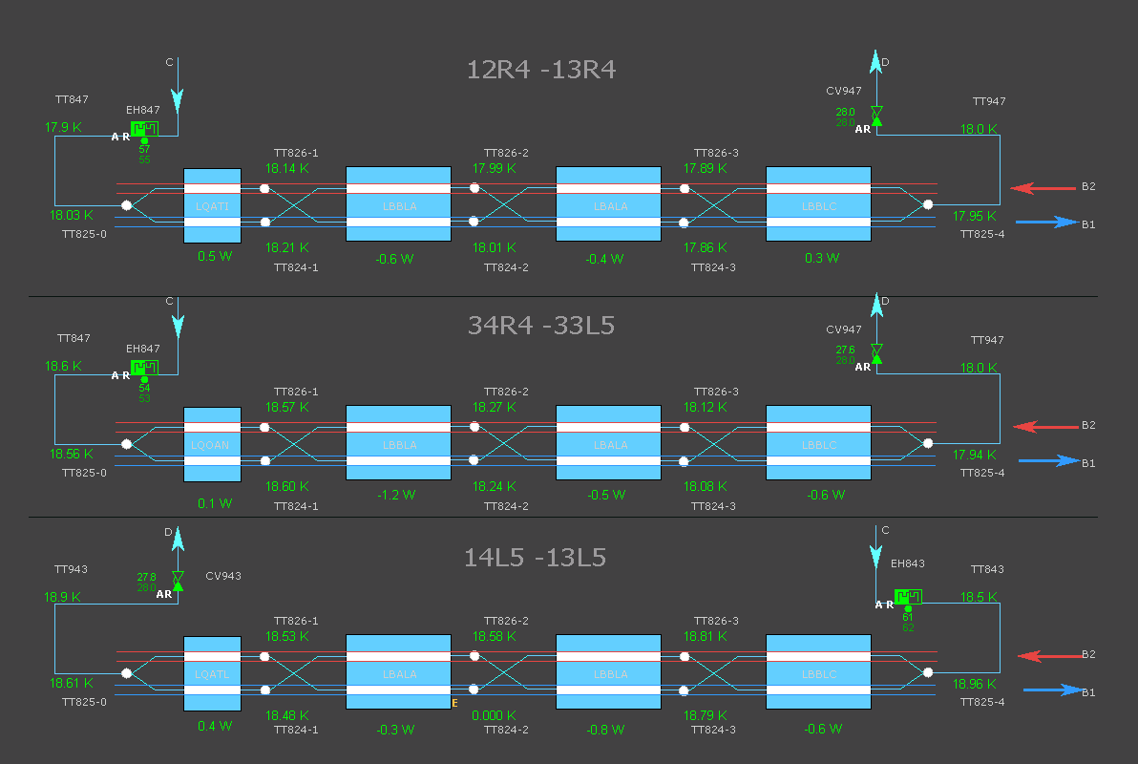
Instrumented cells in S45
Not working
(2016)
Suspicious
(2016-2017)
Suspicious (2016)
Not working (2017)
➔ very good temperature matching between B1/B2 between 6 K/30 K : no sensor deviation

Slide 13
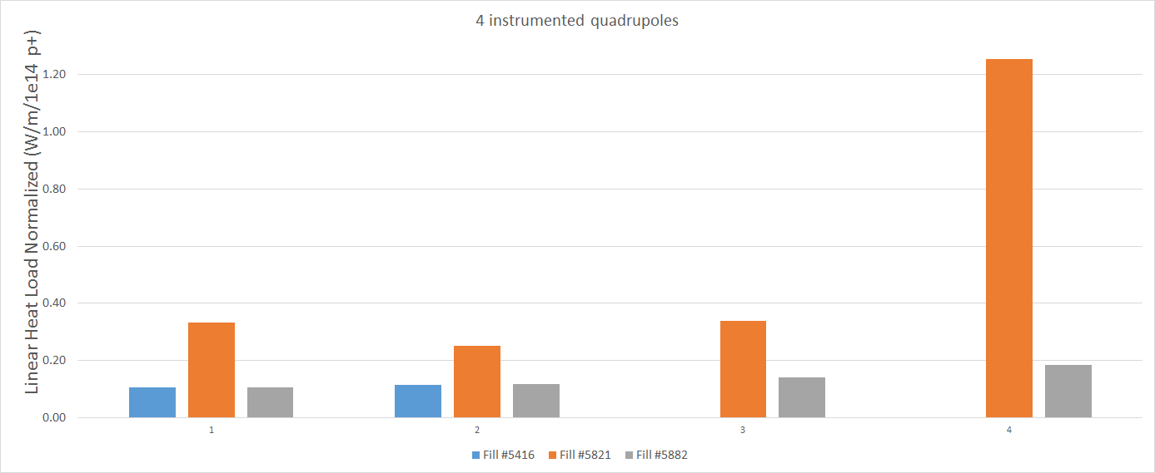
Instrumented Quadrupoles
No instrumentation
in 2016
31L2
ARC12
Average
Fill #5882
Instrumentation
issue in 2016
13L5
ARC45
Average
Fill #5882
12R4
34R4
Fill #5416 @ 6.5 TeV (14th October 2016) 25ns_2220b_2208_1940_2036_96bpi_24inj
Fill #5821 @ 450 GeV (12th June 2017) 25ns_2820b_288bpi_scrub2017
Fill #5882 @ 6.5 TeV (28th June 2017) 25ns_2556b_2544_2215_2332_144bpi_20inj

Slide 14
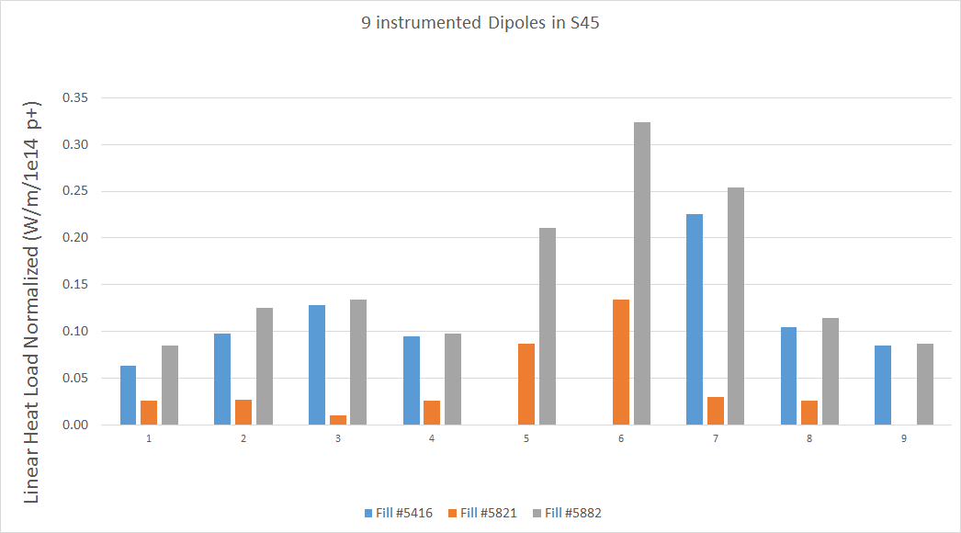
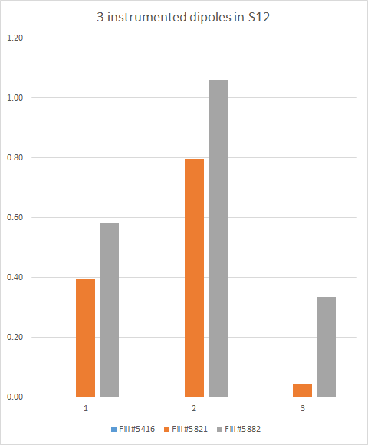
Instrumented Dipoles
12R4
34R4
13L5
31L2
ARC45
Average
Fill #5882
No instrumentation
in 2016
ARC12
Average
Fill #5882
Instrumentation issue
in 2016 for 2 dipoles
Fill #5416 @ 6.5 TeV (14th October 2016) 25ns_2220b_2208_1940_2036_96bpi_24inj
Fill #5821 @ 450 GeV (12th June 2017) 25ns_2820b_288bpi_scrub2017
Fill #5882 @ 6.5 TeV (28th June 2017) 25ns_2556b_2544_2215_2332_144bpi_20inj
Replaced dipole
during EYETS

Slide 15
Conclusion
Heat loads in ARC
  2017 similar to 2016
  S12 conditioning done @ 450 GeV, not yet @ 6.5 TeV
FF parameters
  2017 similar to 2016 except for e-cloud threshold (small impact)
Instrumented cells
  Quadrupoles
    “heating” at injection (450 GeV)
    Small dispersion of quadrupole heat loads at 6.5 TeV (but only 4 quad)
  Dipoles
    “heating” after the ramp (6.5 TeV)
    Important dispersion of dipoles at 6.5 TeV (on 12 dipoles)
  Replaced Dipole in 31L2 shows lower heat loads than the rest of S12

Slide 16
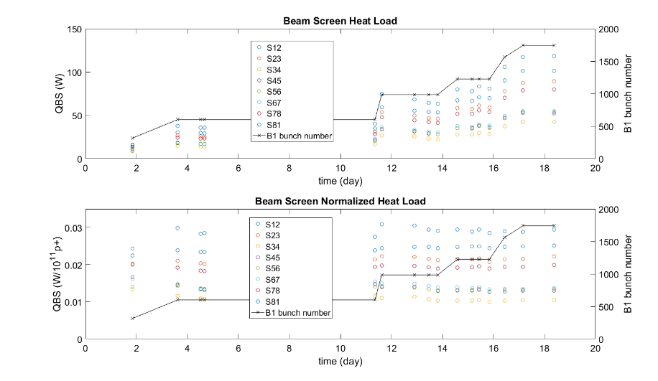
Beam screen heating – 2017
From K.Brodzinski_TETM_2017.06.22: https://indico.cern.ch/event/633648/

