Slide 1
Update on Tune Shifts at Injection
Electron Cloud Meeting
14th July 2017
S. Antipov, L. R. Carver, G. Iadarola, D. Valuch

Slide 2
Introduction
Can we obtain the tune shift along the batch from the injection oscillations to get a measure of local electron density?
Challenging due to ~50-60 turns worth of usable data. Combination of strong ADT and high chromaticity means it is not possible to obtain more usable turns.
Have been saving all injection oscillations (bunch-by-bunch turn-by-turn) since mid-2016 (with small gaps when script fails).
If we make the assumption that the gap between SPS trains in the LHC is enough to reset the local electron cloud, (seen in synchronous phase shift) then life becomes easier.
Can make a fill overview plot for each plane, whereby the tunes are averaged over all the injections for each bunch slot.
Some good data acquired for injections during the scrubbing. Can also shown some from just before TS1 in 2017.
Note: This is not a complete study, and what is being shown is the result of cherry picking the data that looks how it should. Work is still underway to provide adequate filtering of the data to consider, and then a complete statistical analysis can be performed. More later.

Slide 3
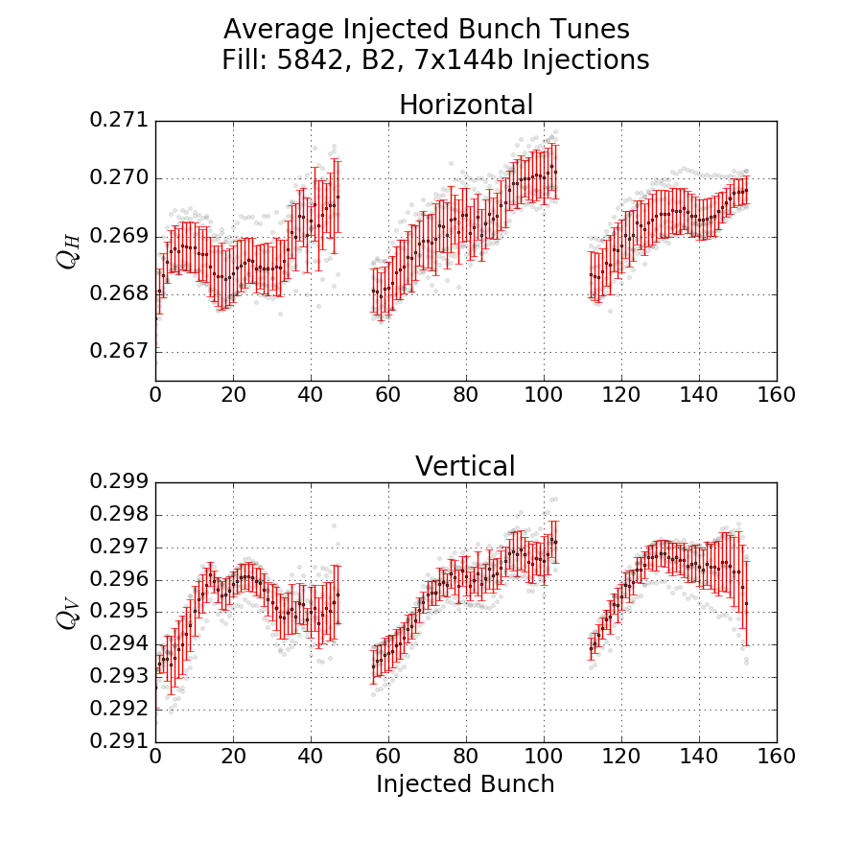
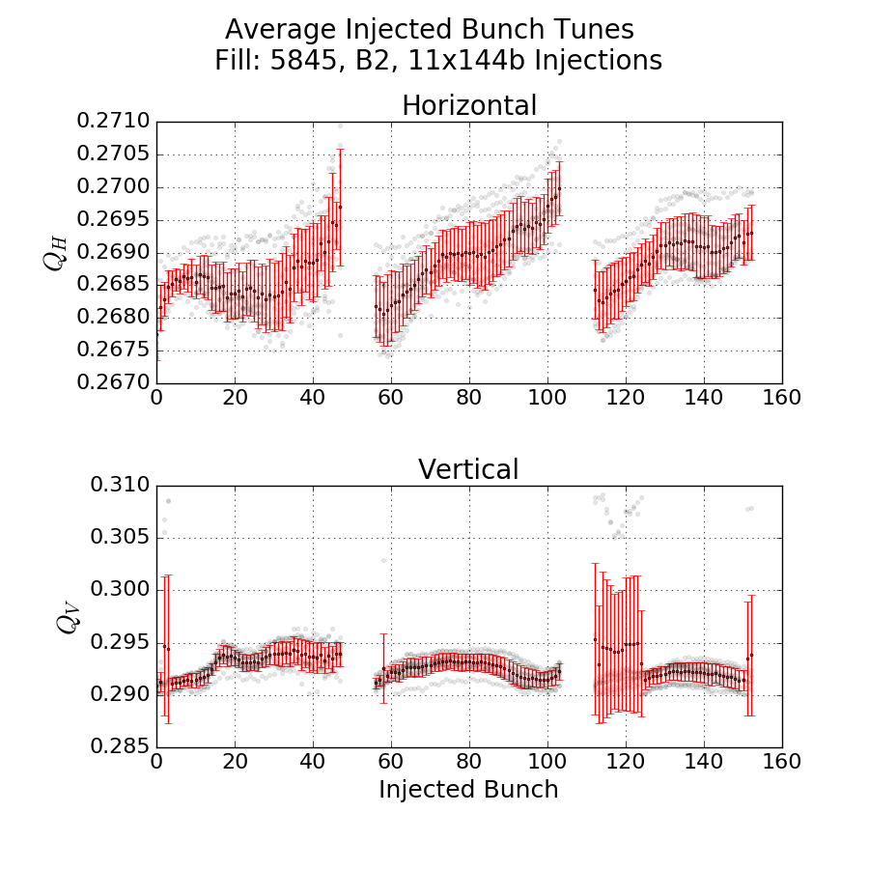
An example
Adjacent fills show different tune shifts (here in vertical)
Small std deviation from 11 injections, can not be neglected

Slide 4
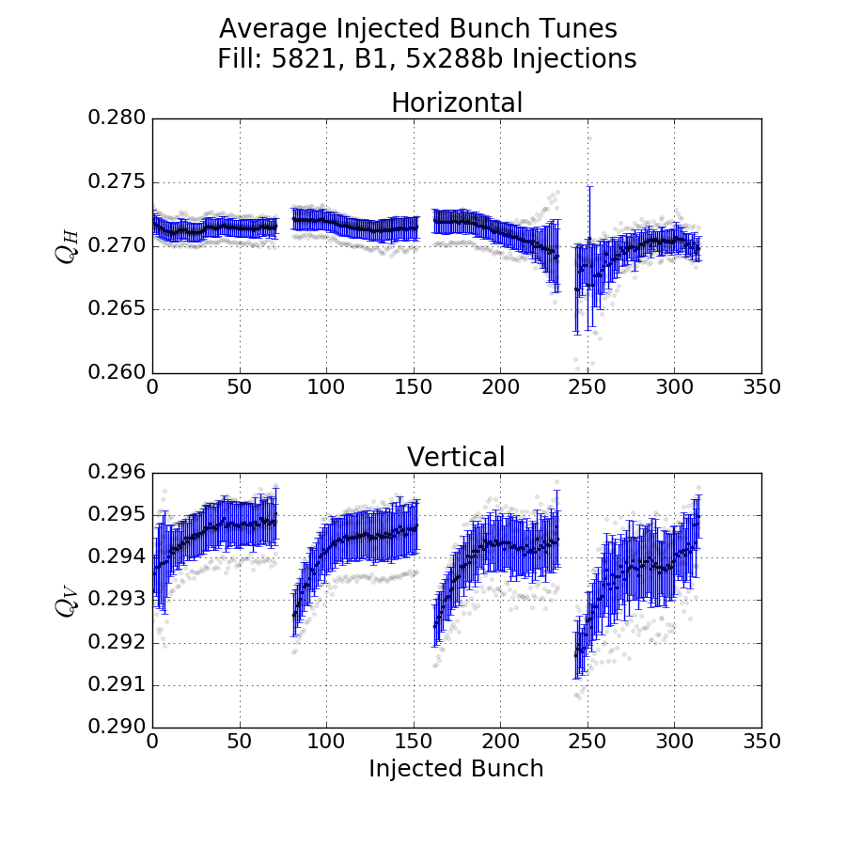
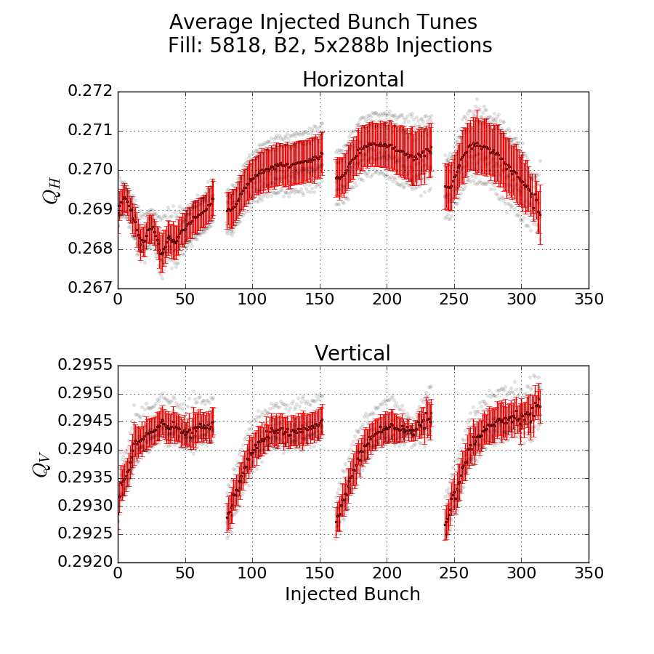
2017 – Scrubbing
Fills occurred at the end of the scrubbing run in 2017 (around 12/06/17).
For these fills with 288b injections, for shifts over 72b
ΔB1H ~ 0 ΔB2H ~ ?
ΔB1V~2e-3 ΔB2V ~ 1.5e-3

Slide 5
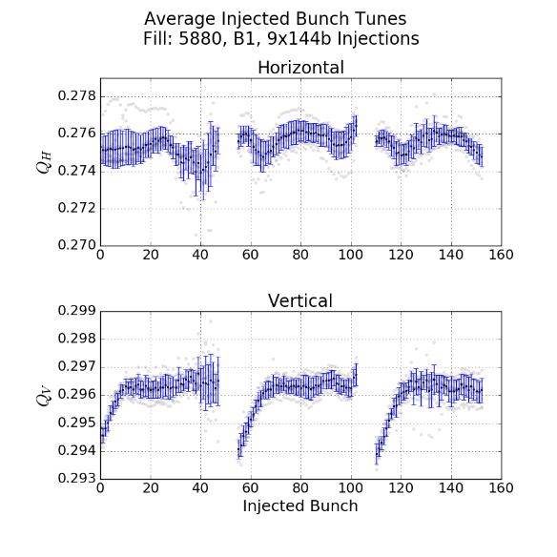
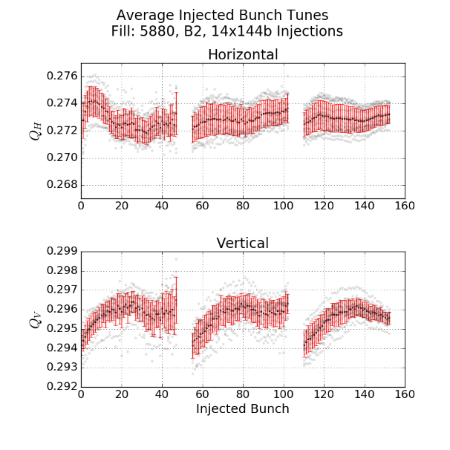
2017 – Before TS1
Fill 5871, 28/06/17
For these fills with 144b injections (from 3 BCMS batches), for shifts across 48b
ΔB1H ~ ? ΔB2H ~ 0
ΔB1V~2.5e-3 ΔB2V ~ 2e-3

Slide 6
Thoughts & Next Steps
Data shown here is horrendously cherry picked, clearly a more scientific and statistical approach is needed.
Define a rigid set of criteria for data quality and stick to it.
  Minimum of 5 injections
  Set a threshold on the spread of standard deviations for the first and last bunches.
  If it does not pass this test, do not include it.
My feeling from looking at individual plots, is that probably the full dataset of all injections in all fills will be reduced to about 10 meaningful points.
Also working on a way of accounting for the Laslett shift. Currently done automatically in steps of 2e-4 once the accumulated trim from Laslett shift exceeds this value.
Could possibly remove the automatic trim and apply one that is more adiabatic and based on past measurements.

