Slide 1

Scrubbing run summary
G. Iadarola, L. Mether and G. Rumolo for the e-cloud team
Many thanks to: LHC-MC, LHC-OP, LHC-MP, BE-ABP, EN-STI, TE-ABT, TE-CRG, TE-VSC,
S. Antipov, G. Arduini, T. Argyropoulos, M. Barnes, H. Bartosik, C. Bracco, E.Belli, G. Bragliozzi, B. Bradu,
Y. Brischetto, L. Carver, P. Chiggiato, P. Dijkstal, A. Lechner, I. Lamas Garcia, A. Lechner, K. Li, E. Metral,
D. Mirarchi, M. Pascale, A. Romano, S. Redaelli, B. Salvant, M. Schenk, G. Skripka, H. Timko, C. Yin Vallgren,
D. Valuch, F. Velotti, J. Wenninger, D. Wollmann, C. Zamantzas
Electron Cloud Meeting – July 14th 2017

Slide 2
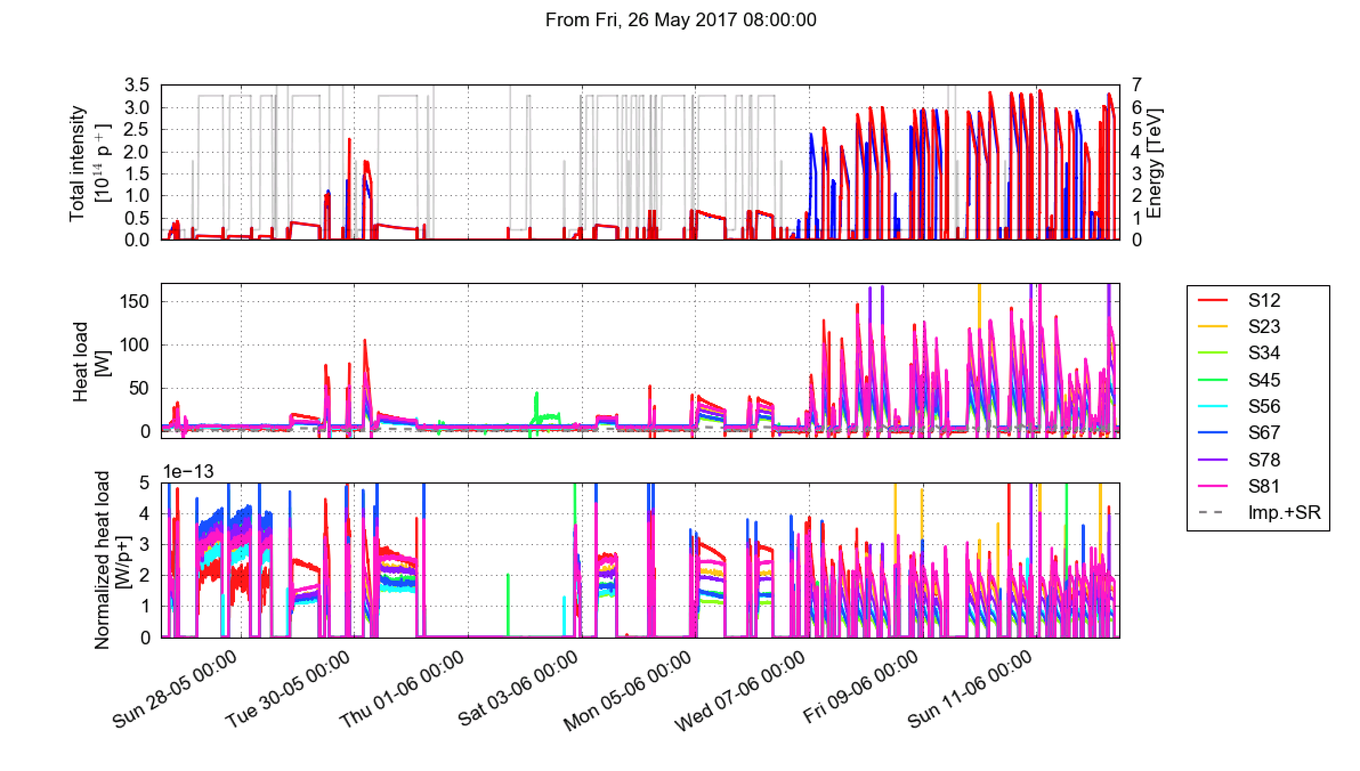
Overview
Physics:
trains of 12b
Physics:
trains of 48b
First tests with trains of 72b
Scrubbing with trains of 72b
Scrubbing run with longer trains (up to 288b)

Slide 3
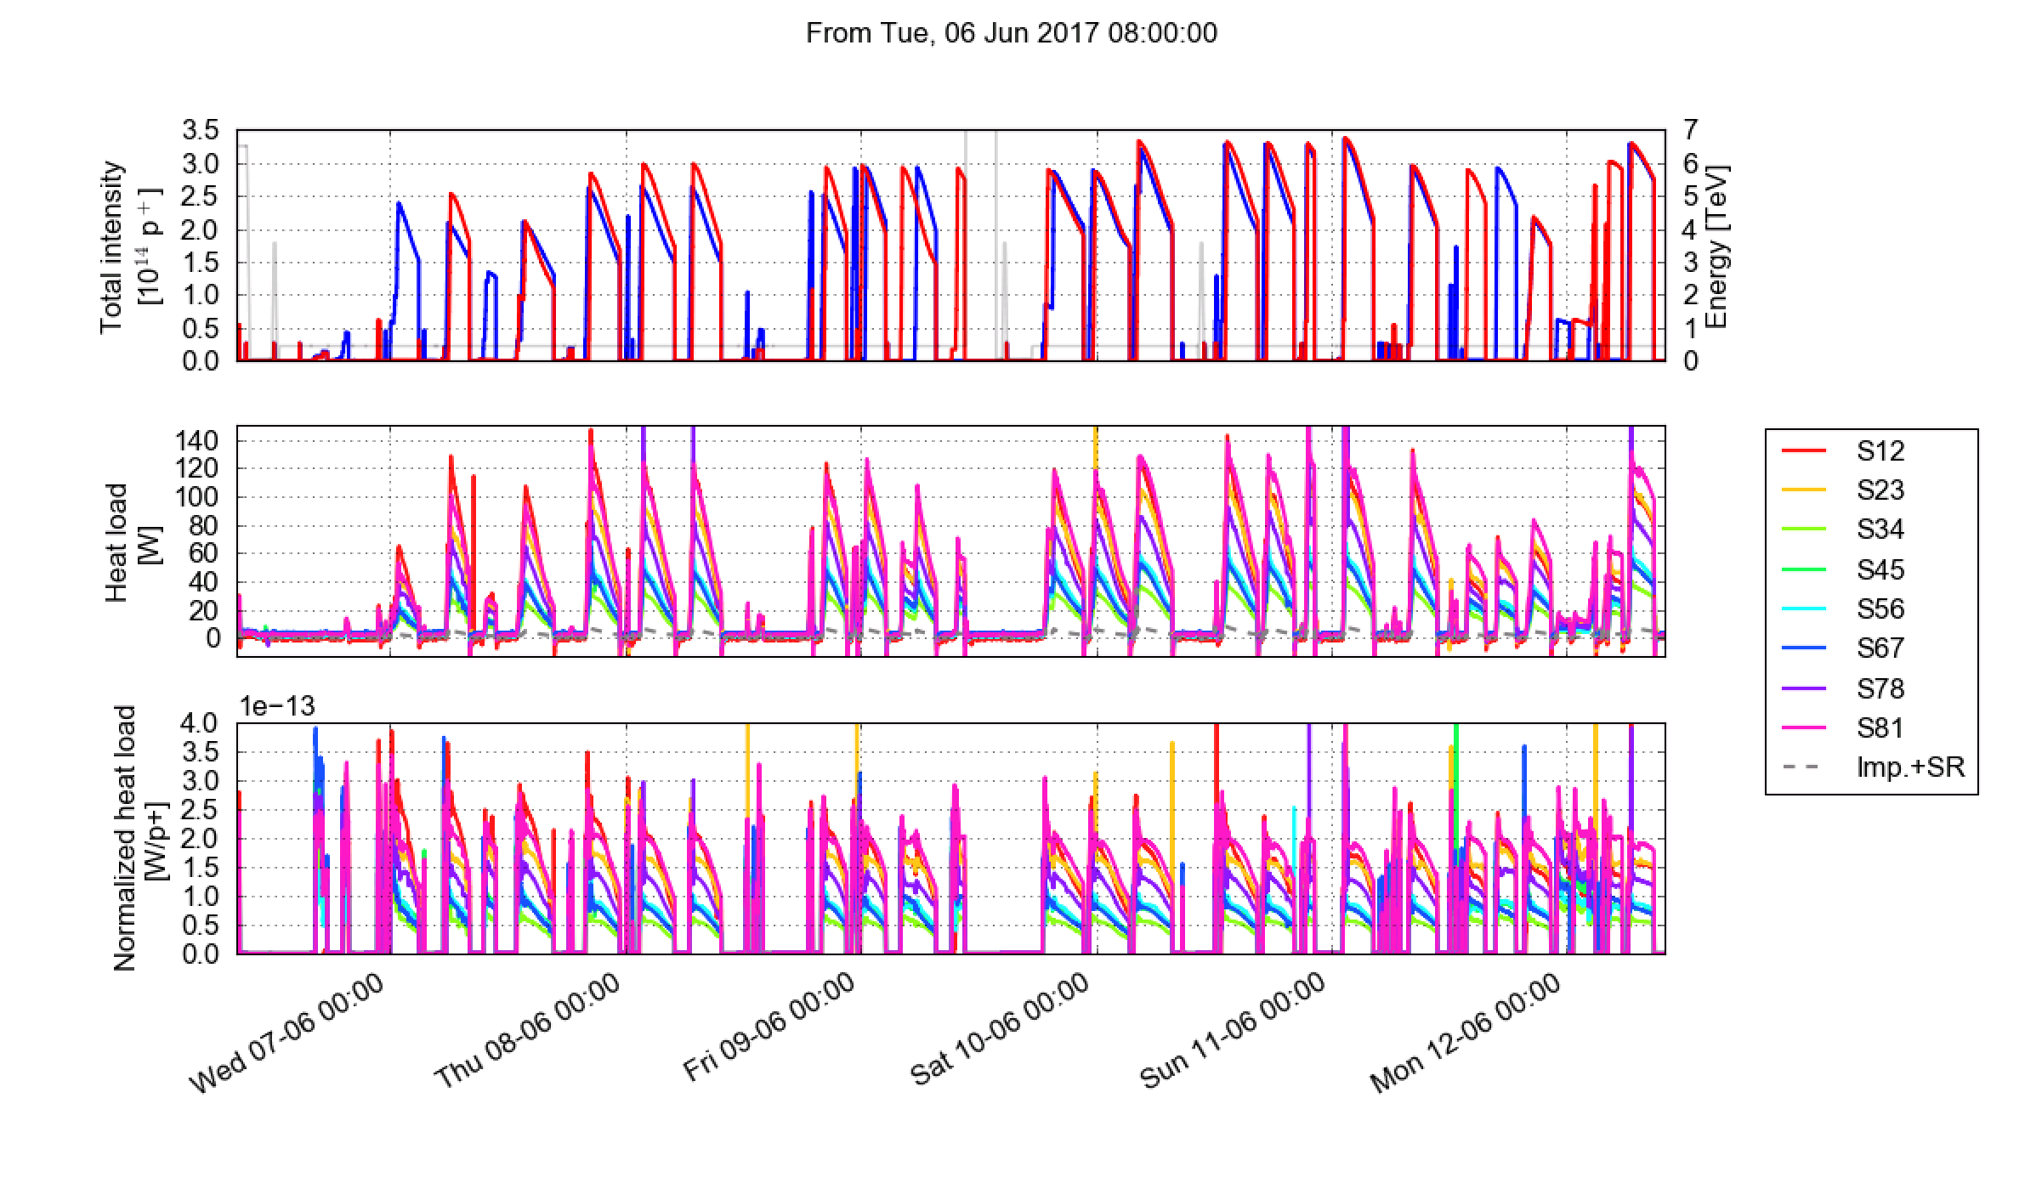
Overview
Injection setup for long trains
No problem with Beam 2 up to 288 b/injection
Strong losses at the first turn for Beam 1
  In spite of several hours devoted to investigating the issue,
  the cause could not be fully identified
Thanks to C. Bracco and the injection team for the extensive support!

Slide 4
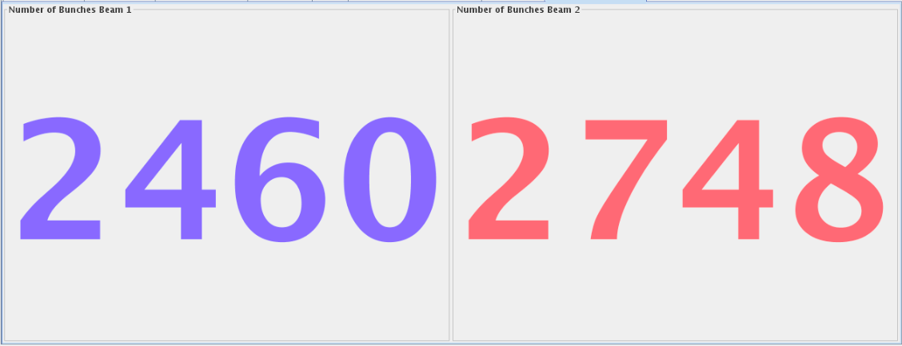

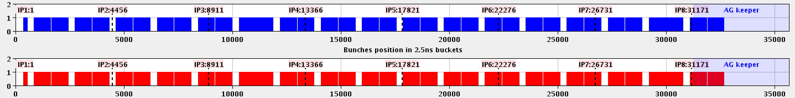
Overview
Scrubbing fills with trains of 144 bunches
Up to 2460 bunches per beam
Bunch intensity: ~1.05e11 p/bunch (limited by SPS longitudinal stability)

Slide 5
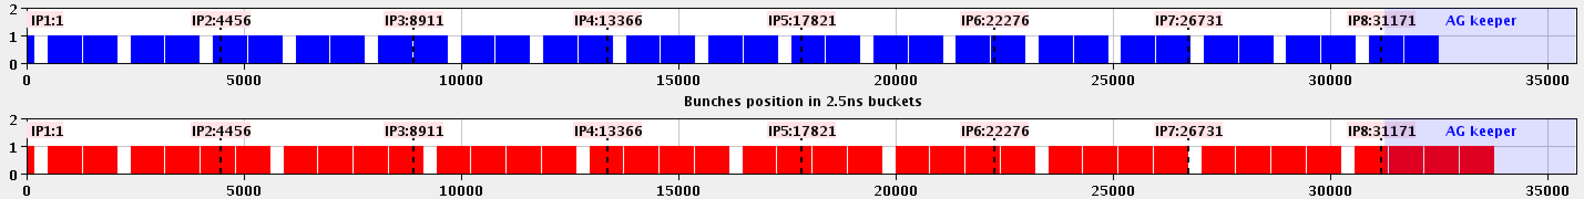
Overview
Trains of 288b per injection for B2
Trains of 288b still not possible for B1
Filling asymmetrically with 2460b in B1 and 2748b in B2

Slide 6
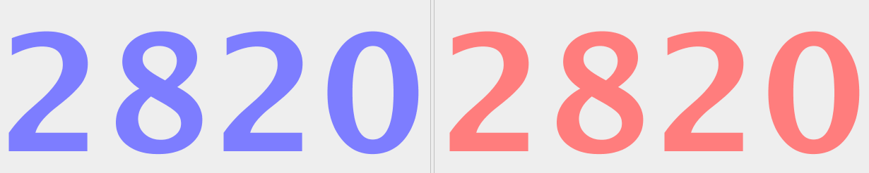
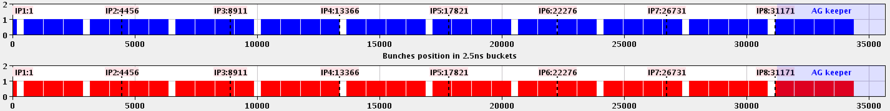
Overview
Trains of 288b per injection for both beams
Possible to inject 288 bpi also in Beam 1 only after:
  Increasing selected BLM thresholds in the injection region and at TCPs in IR7
  Improved stability at SPS flat-top
  Increasing scraping before SPS extraction
Losses stayed close to the increased dump threshold (occasionally exceeding it)
Filling with up to 2820b in both beams (maximum reached in the LHC)

Slide 7
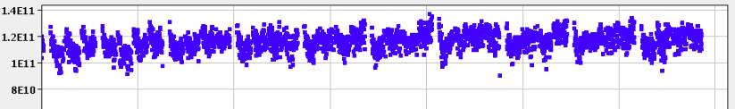

Overview
    Increased bunch intensity
    Average bunch intensity from the SPS ~1.2e11 p/bunch (possible only after relaxing beam quality requirements at SPS extraction)
    Intensity for both beams reached 3.3e14 p (largest achieved in the LHC)

Slide 8
Overview
Reference heat load measurements and other tests (with further scrubbing):
B1 and B2 separately for comparison against fills 5783, 5785 (from Thursday)
Trains of 72b for comparison against end-2016 and beginning-2017
Single beam (144 bpi) comparison against data collected on Tuesday
Identification of stability margins w.r.t. Q’, octupoles and ADT gain
Fill with full beam with optimized settings

Slide 9
Overview
The experience from 2015-16 and actions taken during EYETS were clearly beneficial:
  Excellent cryogenics performance: not a single loss of CryoMaintain during Scrubbing Run and no need to wait between injections (injected 2820b/beam in 15’)
  Instabilities well under control, thanks to scrubbing accumulated in the previous years and to the stabilization recipe defined in 2015-16 (ADT configuration, Q’, octupoles, tunes)
  The pressure rise in the MKI8D-Q5 interconnect, which was limiting the intensity in 2016, is largely reduced by the pumping module installed during EYETS

Slide 10
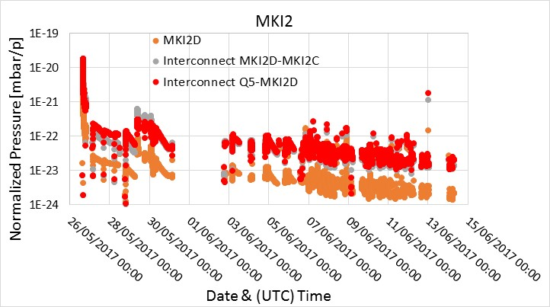
Pressure rise in the injection kicker regions
The newly installed MKI2D limited the stored intensity only in the first days but then it conditioned rather quickly:
  → it should not be a limitation for physics operation
Thanks to C. Belver Aguilar and M. Barnes

Slide 11
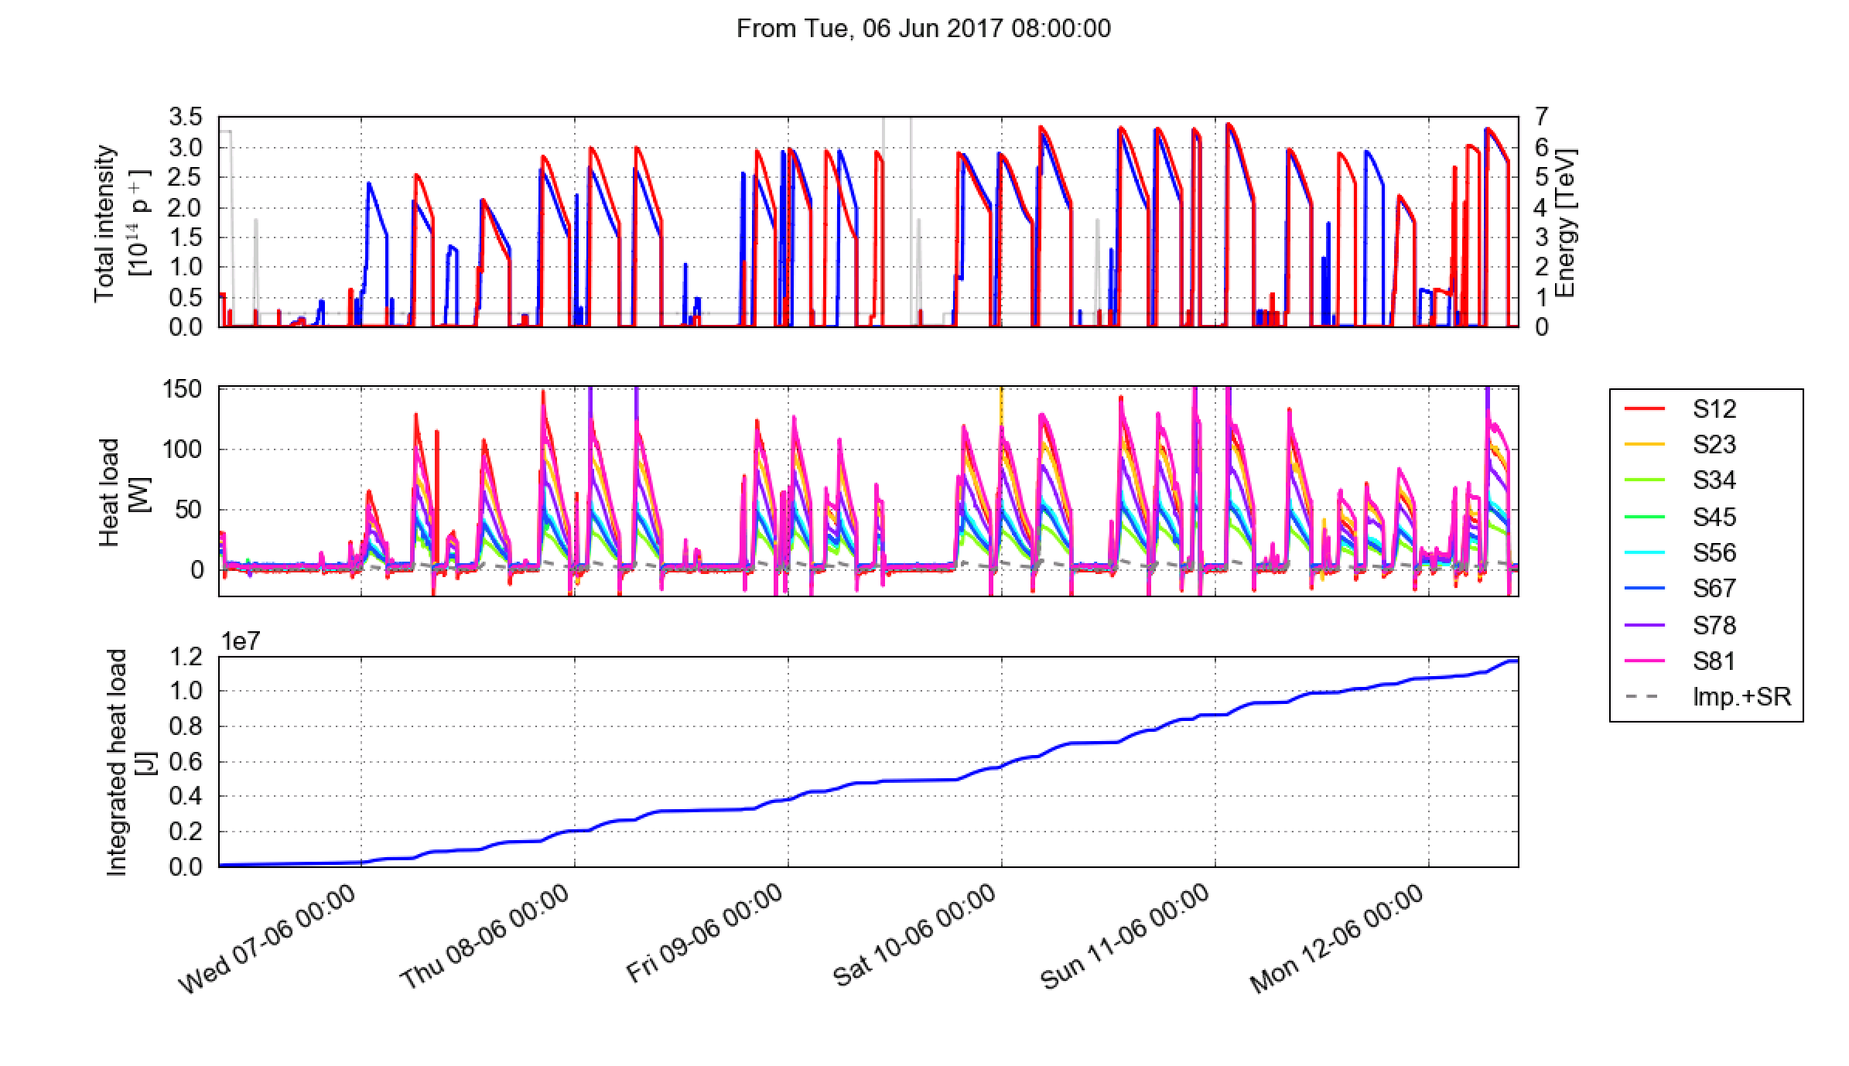
Heat load overview
We did not reach heat load limit (160 W/hcell) for any sector
Maximum heat load ~140 W/half-cell (S12, S81)
Integrated heat load over 6 days comparable to the amount accumulated in 14 days of scrubbing in 2015
Avg. per half-cell

Slide 12
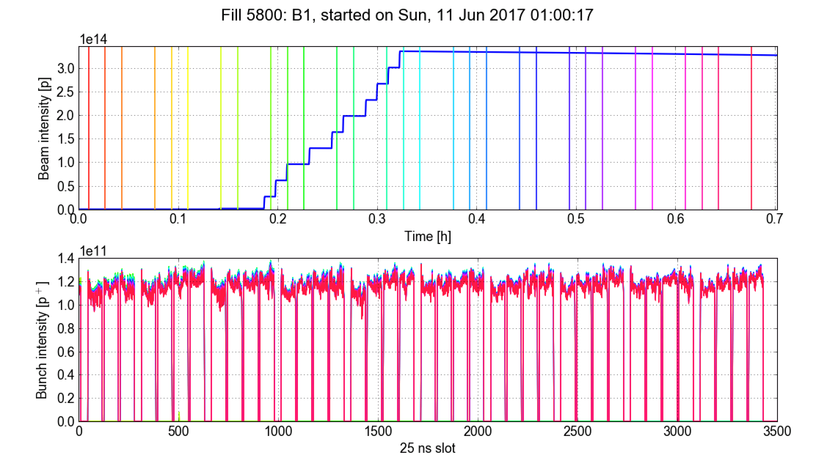
Beam quality observations
Stability well under control, thanks to scrubbing accumulated in the previous years and to the recipe defined in 2015-16 (ADT configuration, Q’, octupoles, tunes)
No fast blow-up nor losses are observed after injection
Beam quality is well preserved over the length of a typical physics injection period (even with 2800b)

Slide 13
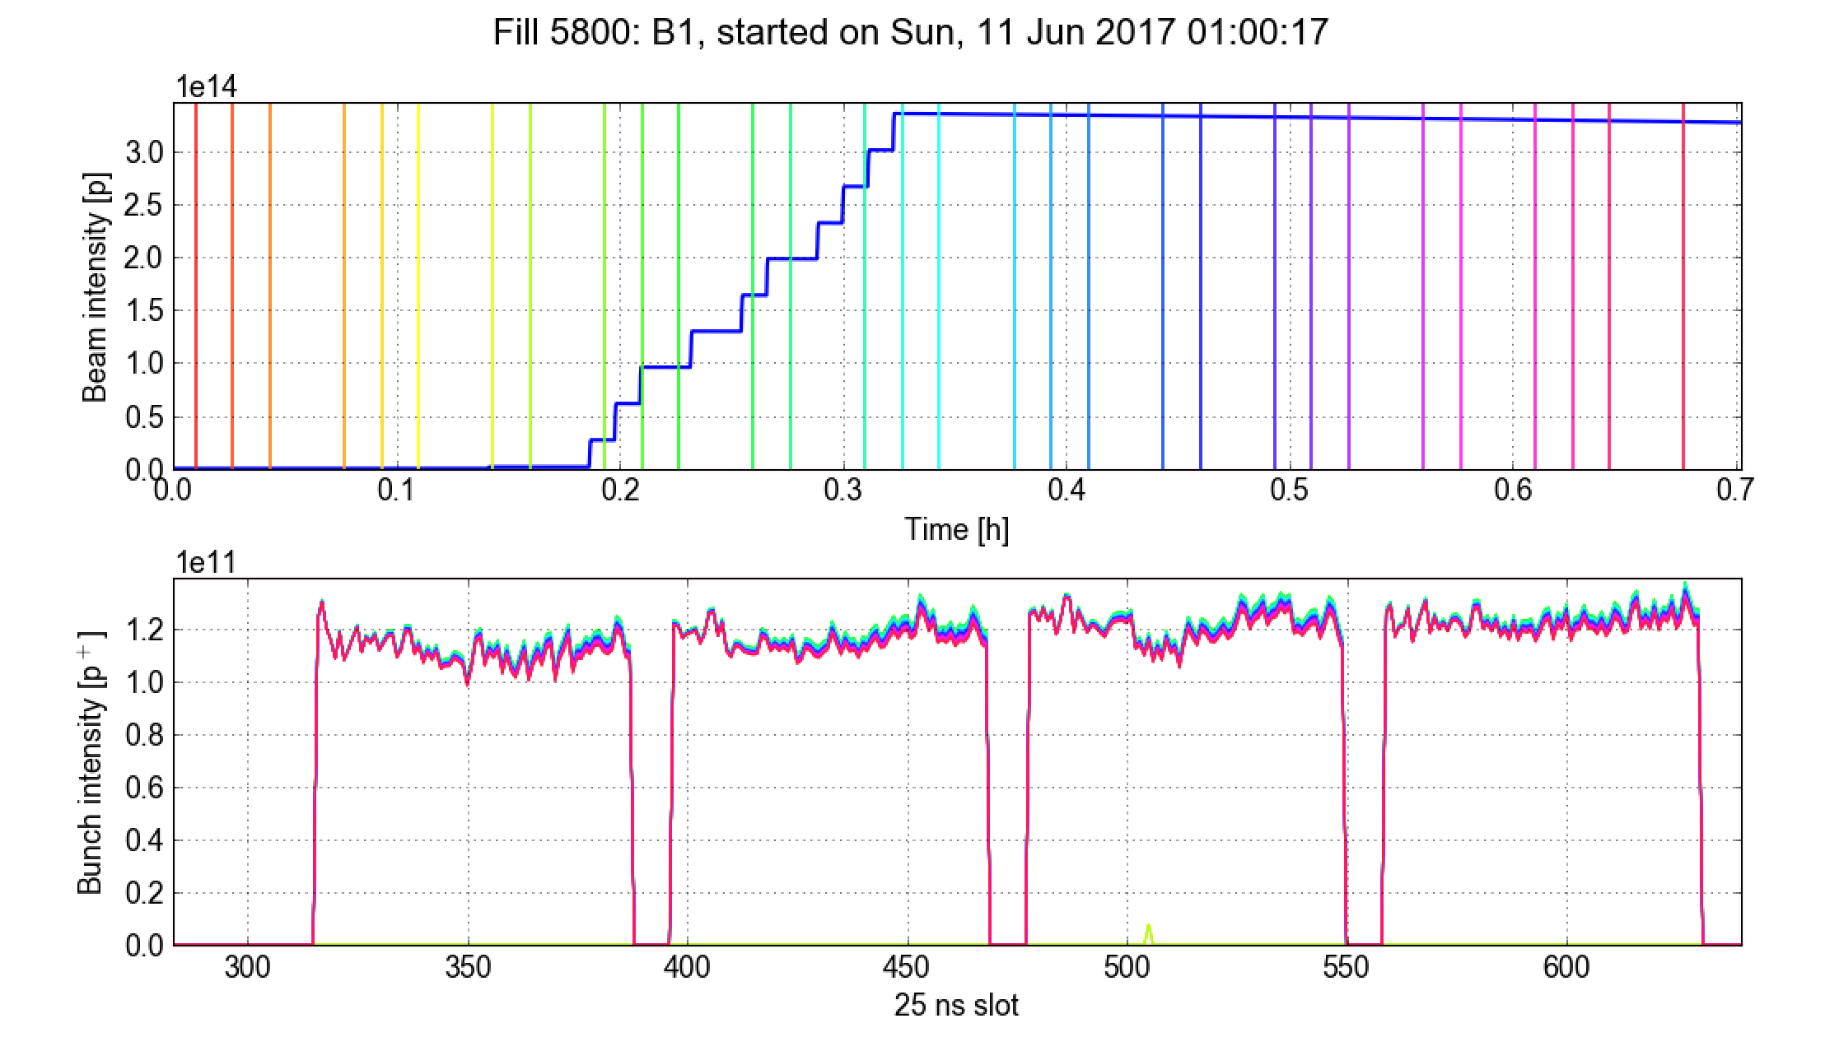
Beam quality observations
Stability well under control, thanks to scrubbing accumulated in the previous years and to the recipe defined in 2015-16 (ADT configuration, Q’, octupoles, tunes)
No fast blow-up nor losses are observed after injection
Beam quality is well preserved over the length of a typical physics injection period (even with 2800b)

Slide 14
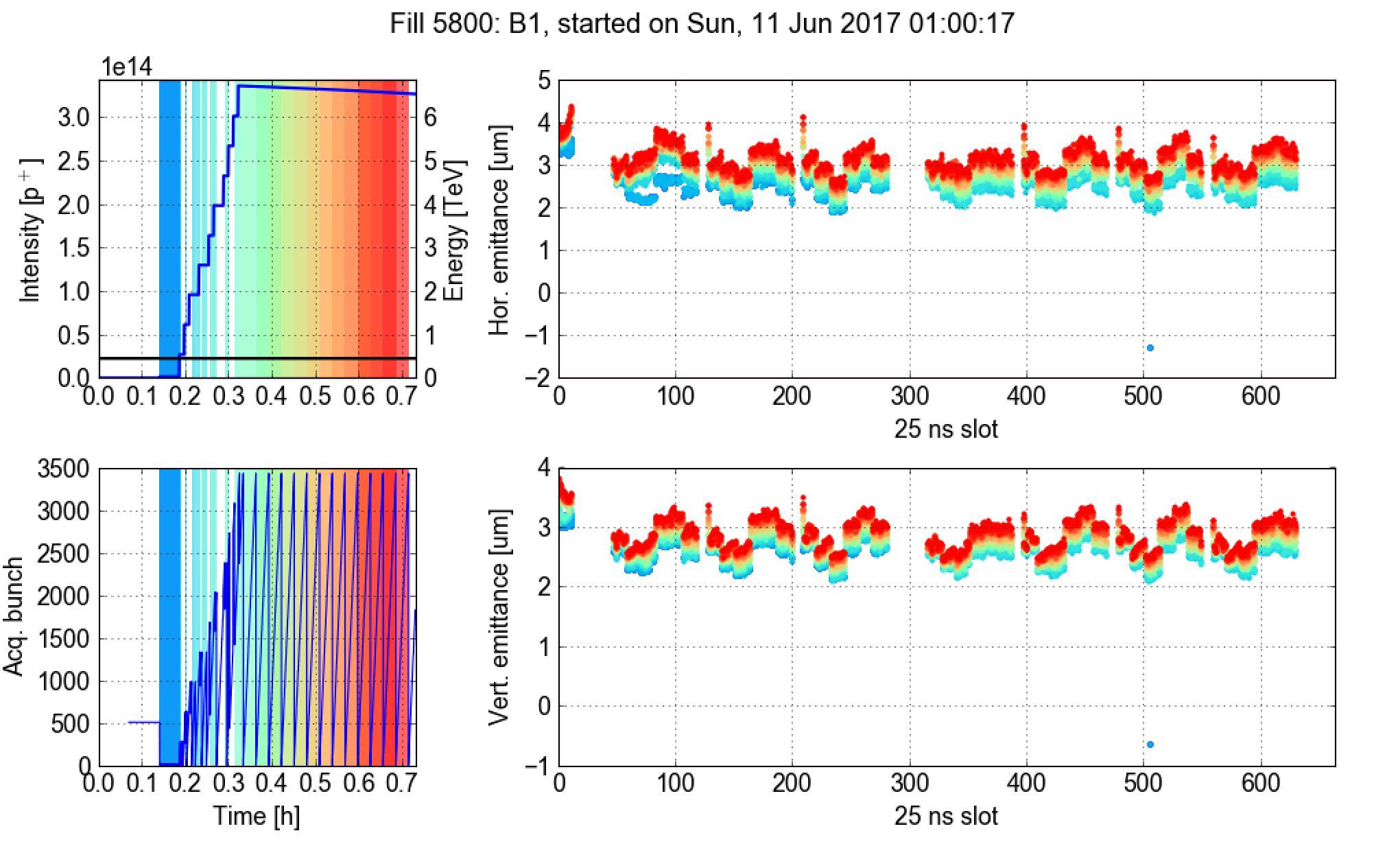
Beam quality observations
Stability well under control, thanks to scrubbing accumulated in the previous years and to the recipe defined in 2015-16 (ADT configuration, Q’, octupoles, tunes)
No fast blow-up nor losses are observed after injection
Beam quality is well preserved over the length of a typical physics injection period (even with 2800b)

Slide 15
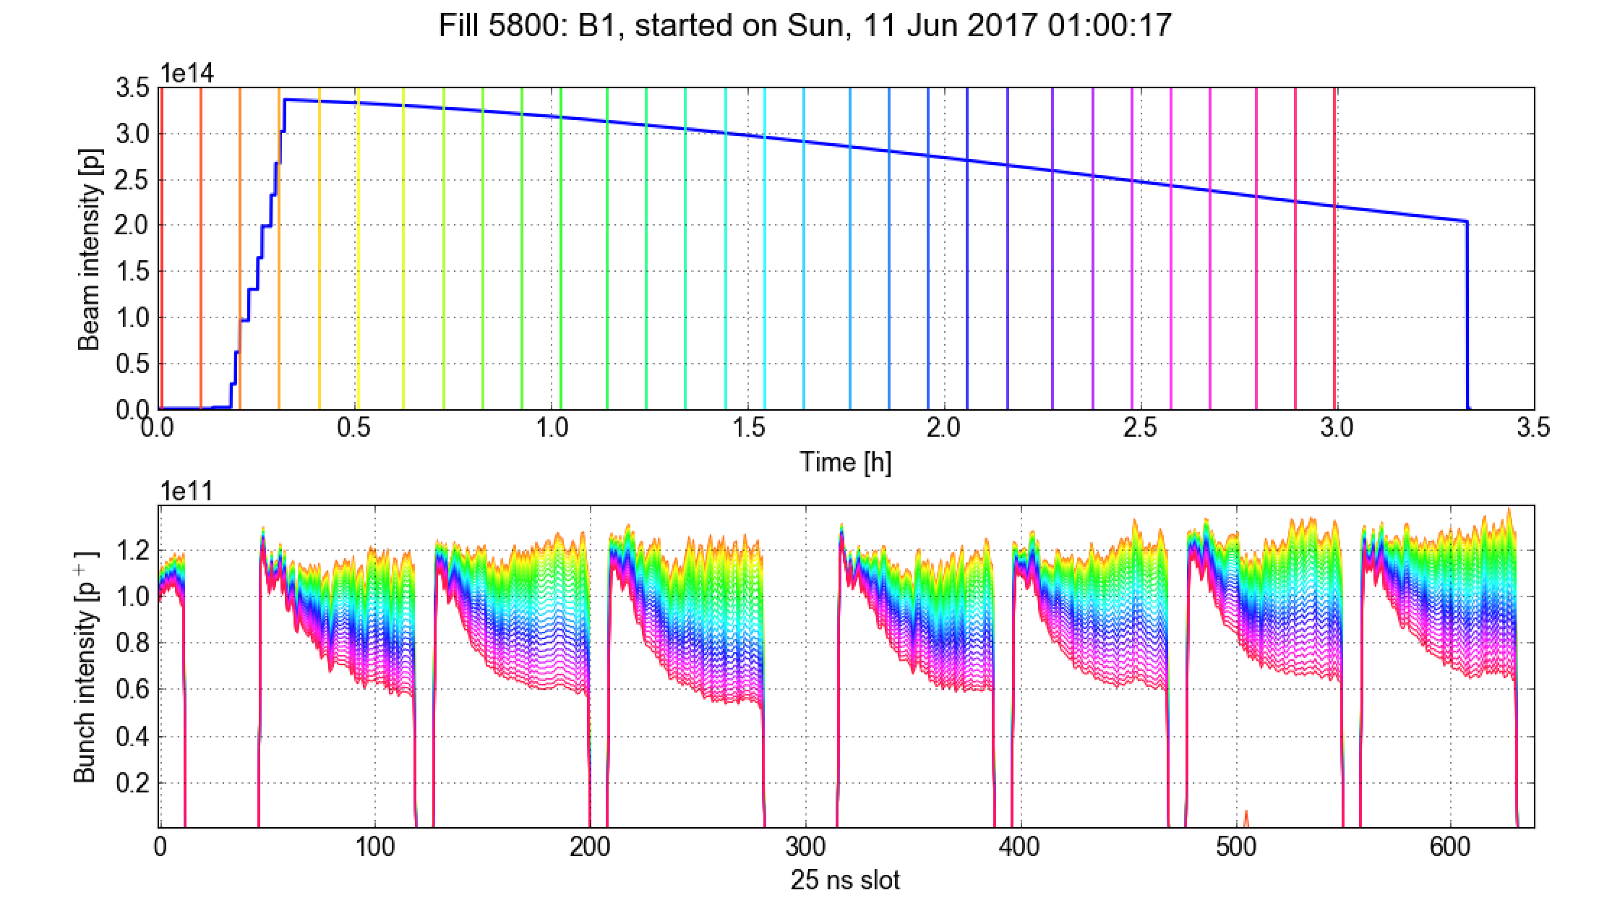
Beam quality observations
Losses driven by e-cloud are clearly observed when storing the beam long time at injection energy

Slide 16
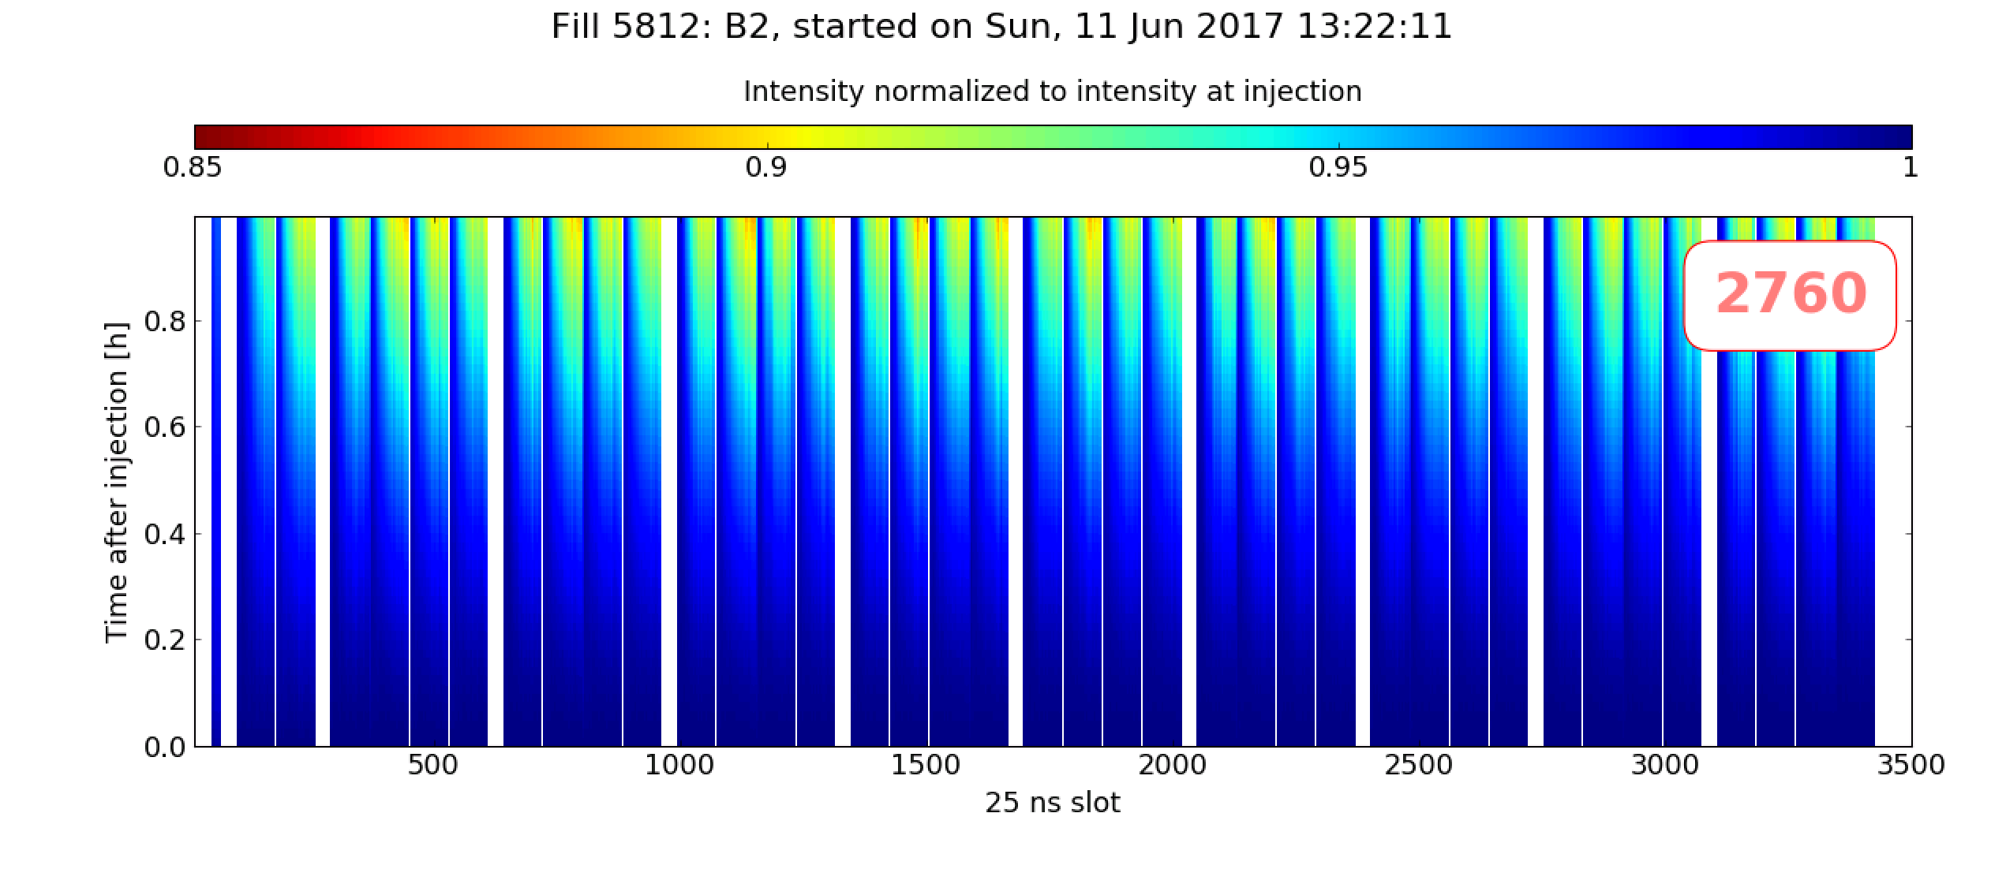
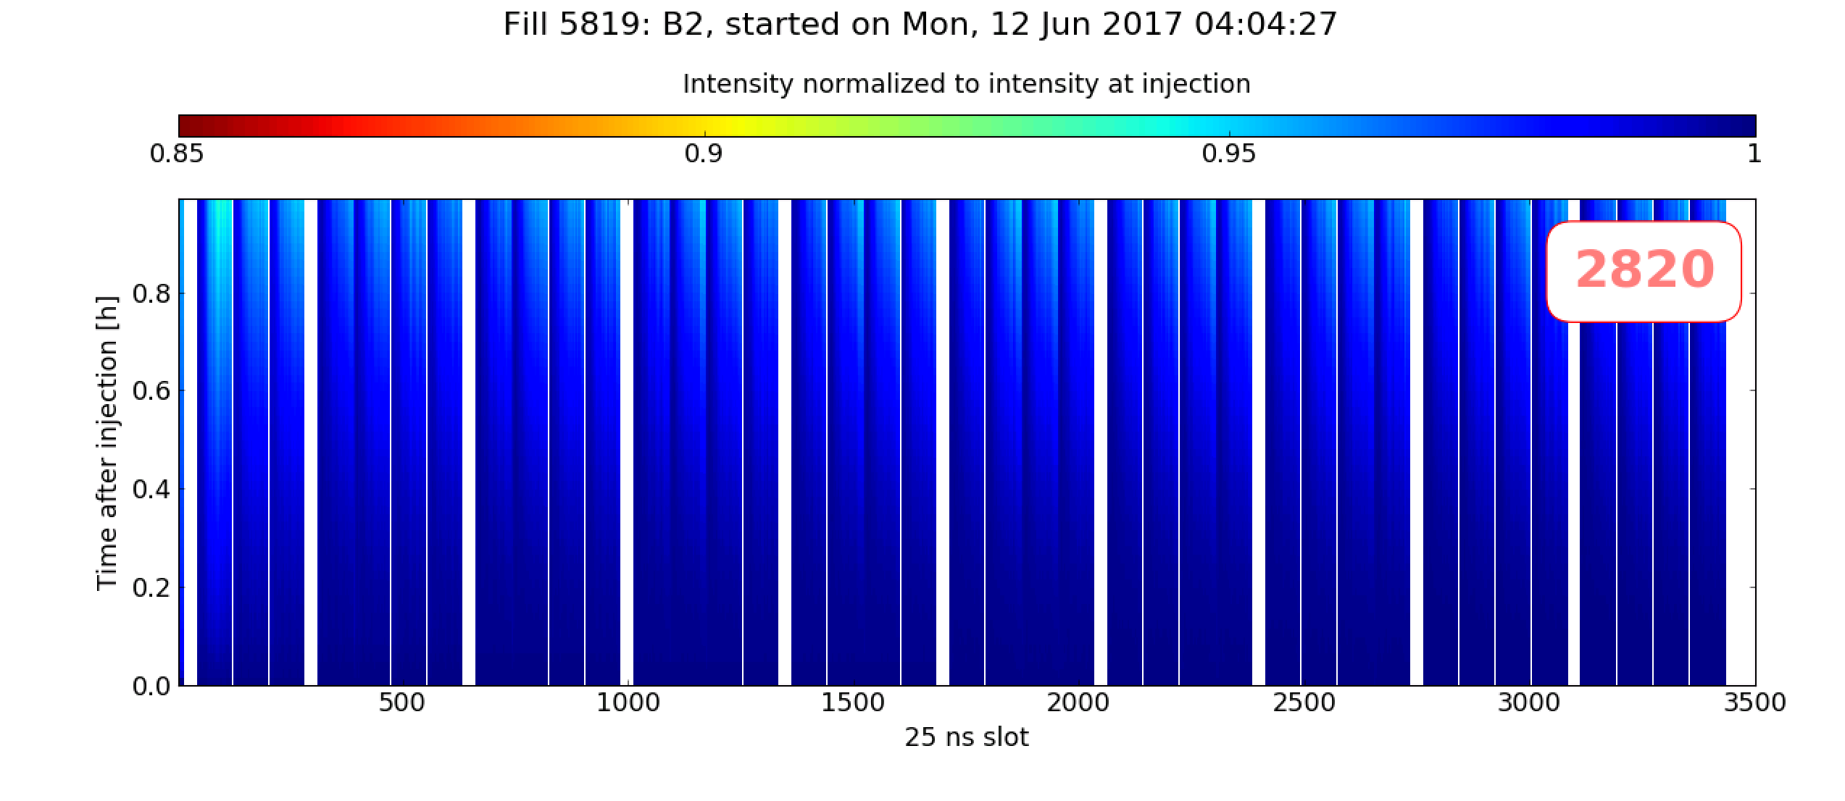
Stability margins
At the end of the scrubbing run stability margins were explored:
Q’=7/7, Oct=-1.0, ADT Gain= 0.1 found to be sufficient to ensure stability
A beneficial effect on beam lifetime is clearly observed
Q’=20/20, Oct=-1.5
ADT Gain 0.2
Q’=7/7, Oct=-1.0
ADT Gain 0.1

Slide 17
Summary and first conclusions
Overall quite efficient period: the intensity in the LHC could be rapidly increased up to ~3.4e14 p/beam in 2820b (present records at 450 GeV)
The experience from 2015-16 and actions taken during EYETS clearly beneficial:
  No difficulty from the cryogenics side, instabilities well under control, improved pumping in MKI areas
The newly installed MKI2D conditioned quickly → should not limit physics in 2017
The beam quality over the length of an operational injection period looks good even with 2800b:
  Degradation driven by e-cloud is observed only over longer time scales
  Some margin is available w.r.t. chromaticity and octupole settings → situation seems to be different with BCMS beams

Slide 18
Thanks for your attention!

