Slide 1
Summarization :
Optimising A Read Out PCB for A Possible FCC-hh ECAL
-Revathy Alagaraisamy:Supervised by Martin Aleksa,Jana Faltova
Summer Student Programm
CERN 2017

Slide 2
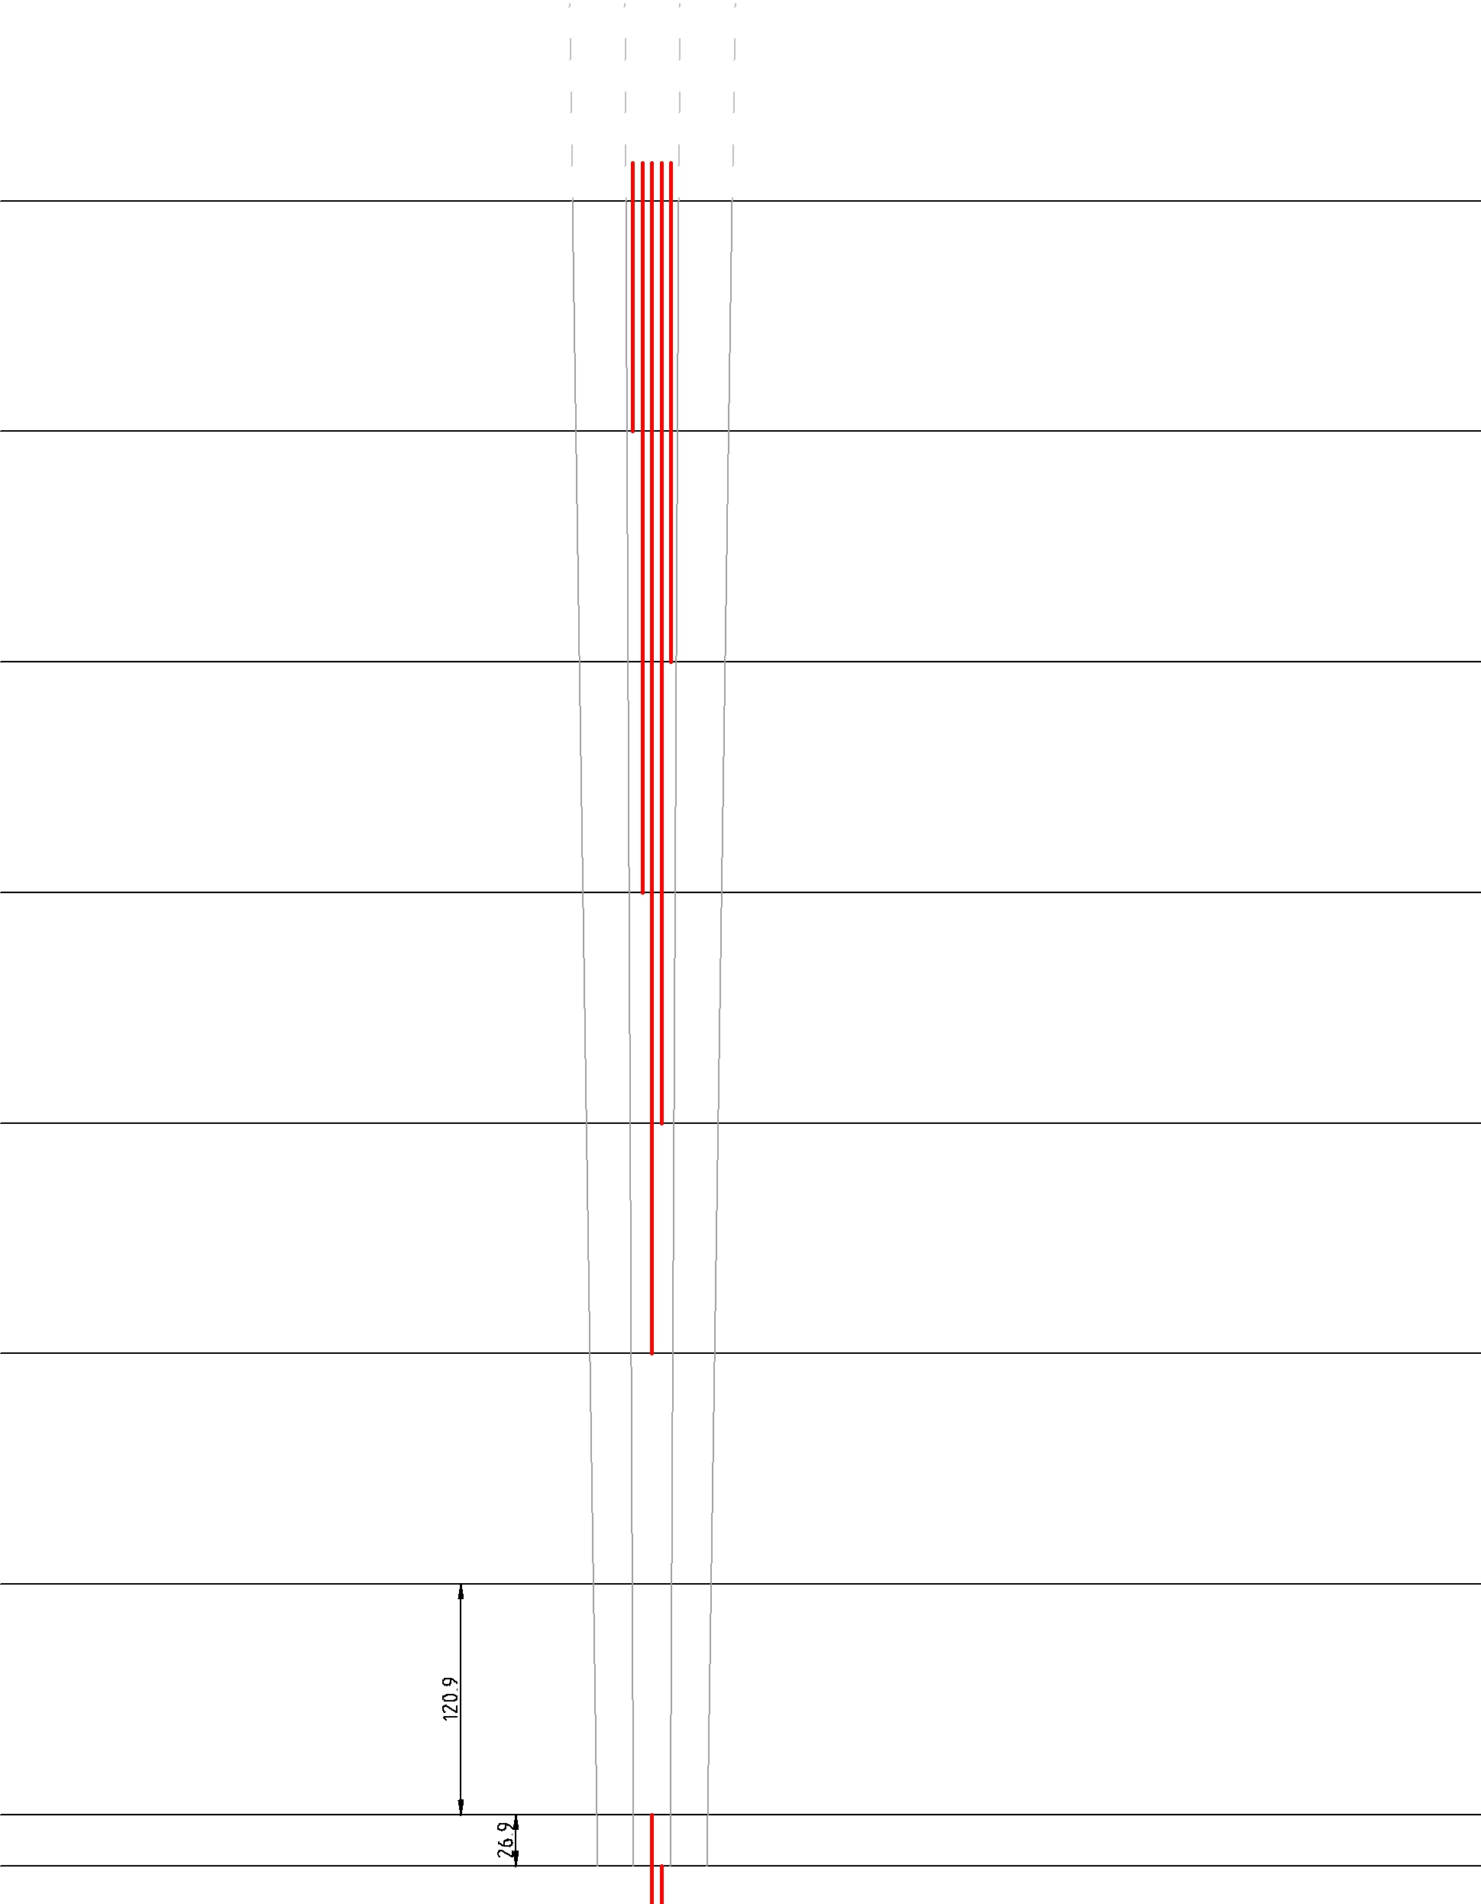
Signal Traces in PCB
> Length of Signal Trace multiplied by factor of 2 as it is symmetrical along Eta axis
> At the most sensitive part of detector, No Traces ( MInimize Electronics Noise)

Slide 3
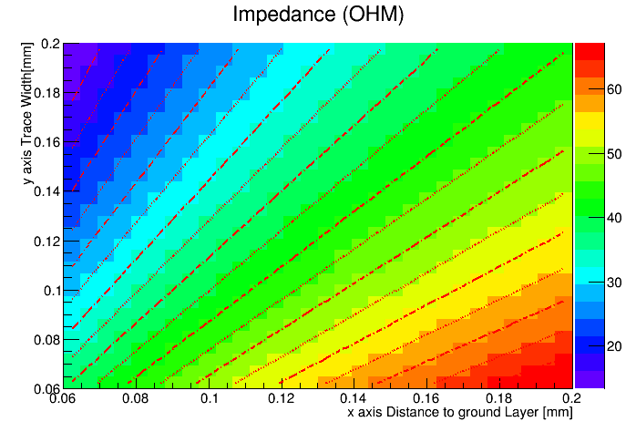
Impedance of Signal Traces
> Impedance is fixed at 50 Ohm (based on Atlas)
> Other components:
Width (min)=0.127mm
Thickness =0.035mm
> From the plot,obtained value= 0.17mm
( distance to ground layer)

Slide 4
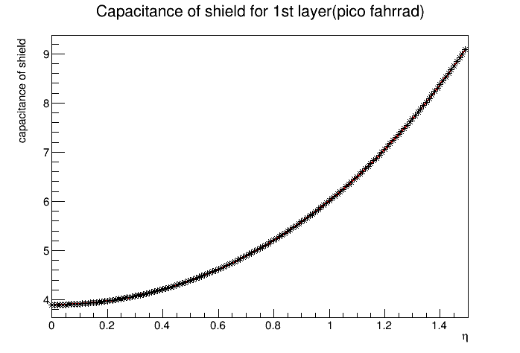

Capacitance of Shield
>Towards the edge,more shields to prevent Crosstalk of different Signals

Slide 5
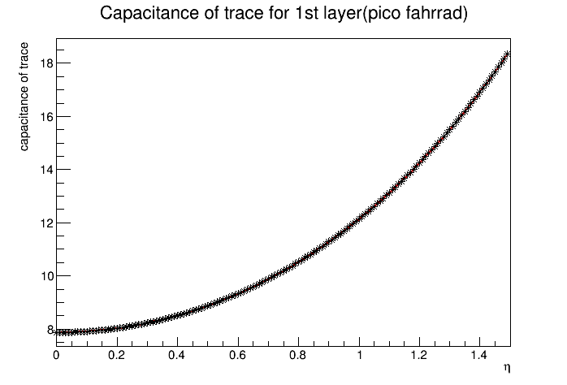

Capacitance of Trace
>Overall,capacitances of traces lower than capacitances of shields

Slide 6
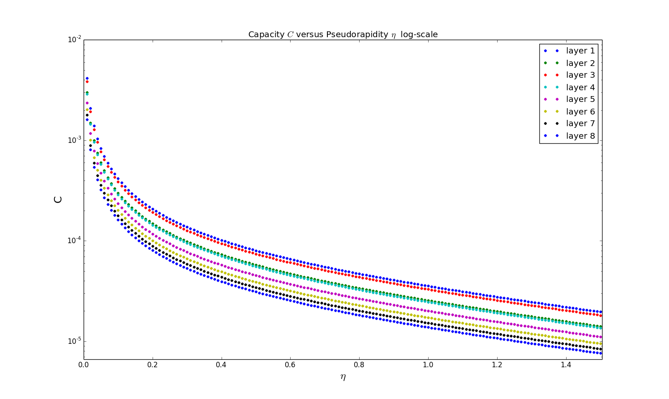
Capacitance of LAr
>Detector capacitance is small
>Capacitance of 8th layer is lower than 1st

