Slide 1

This work is supported by projects Research infrastructure CERN (CERN-CZ, LM2015058) and OP RDE CERN Computing (CZ.02.1.01/0.0/0.0/1 6013/0001404) from EU funds and MEYS.

Slide 2
ATLAS Computing at Czech HPC Center IT4I
Jiří Chudoba, Michal Svatoš
2. 2. 2018
Institute of Physics (FZU) of the Czech Academy of Sciences

Slide 3
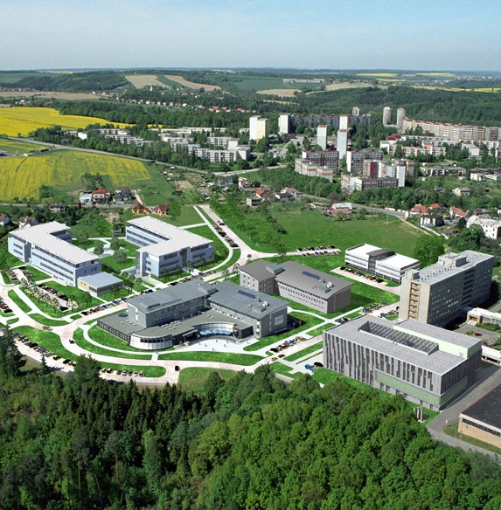
IT4I
IT4I – IT4Innovations
  Czech National Supercomputing Center located in Ostrava (300 km from Prague)
  Founded in 2011, first cluster in 2013
  Initial funds mostly from EU Operational Programme Research and Development for Innovations, 1.8 billion CZK (80 MCHF)
  Mission: to deliver scientifically excellent and industry relevant research in the fields of high performance computing and embedded systems

Slide 4
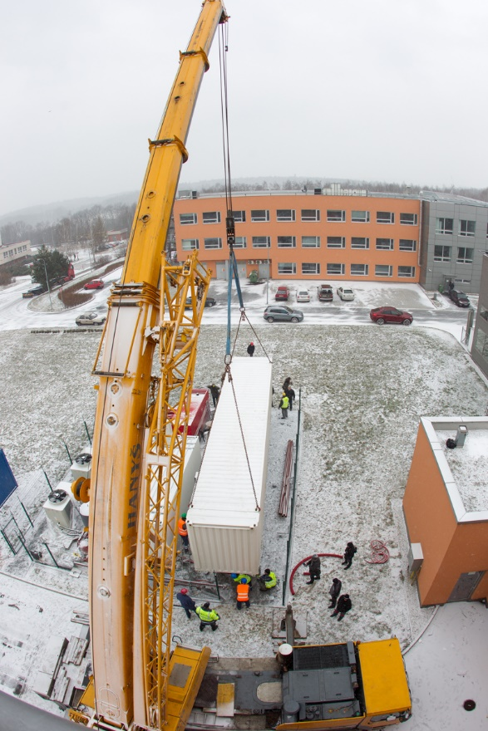
Cluster Anselm
Delivered in 2013
94 TFLOPs
209 compute nodes
  180 nodes without acc.
  16 cores per node (2x Intel Xeon E5-2665)
  64 GB RAM
bullx Linux Server release 6.3
PBSPro
Lustre FS for shared HOME and SCRATCH
Infiniband QDR and Gigabit Ethernet
Access via login nodes

Slide 5
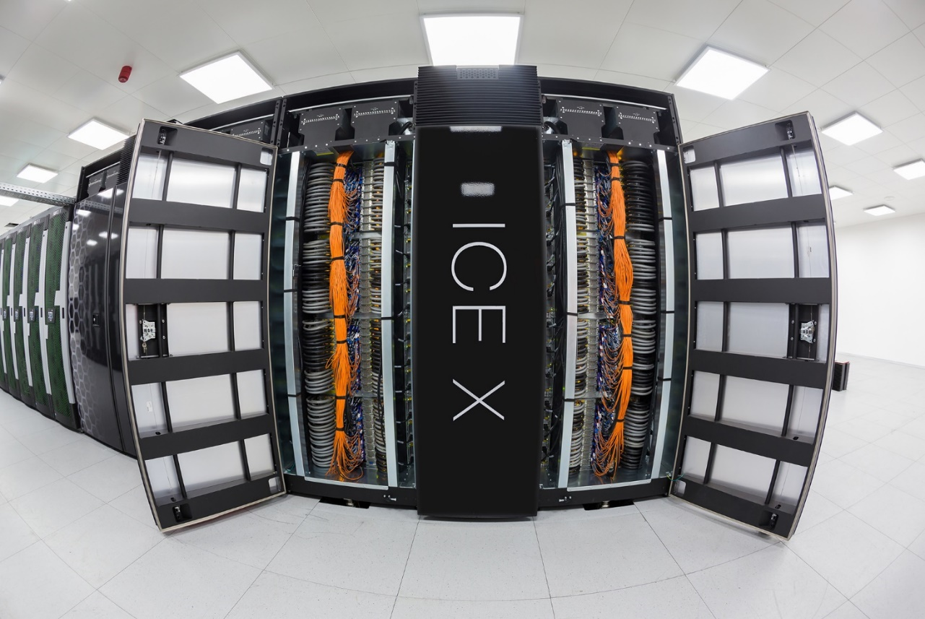
Cluster Salomon - 2015
  2 PFLOPs peak perf – nr. 87 in 2017/11
1008 compute nodes
  576 no accelerators
  432 with Intel Xeon Phi MIC
  24 cores per node (2x Intel Xeon E5-2680v3 )
  128 GB RAM (or more)
CentOS 6.9
PBSPro 13
Lustre FS for shared HOME and SCRATCH
Infiniband (56 Gbps)
Access via login nodes, port forwarding allowed

Slide 6
ATLAS jobs on Anselm
Solution similar to TITAN
  Needs some changes for a different environment
  Work in progress

Slide 7
ATLAS jobs on Salomon
Sw installed by rsync with the site CVMFS
A special Panda queue on praguelcg2 (CZ Tier2 site)
ARC CE (arc-it4i)
  accepts jobs from Panda
  downloads input files to sshfs mounted SCRATCH on Salamon
  submits jobs via login node
  uploads log and output files from SCRATCH
Solution based on ARC CE was introduced to ATLAS first for SuperMUC and CSC. Many thanks to Rod Walker, Gianfranco Sciacca, Jaroslava Schovancova (test jobs), David Cameron, Petr Vokac, Emmanoile Vamvakopoulos

Slide 8
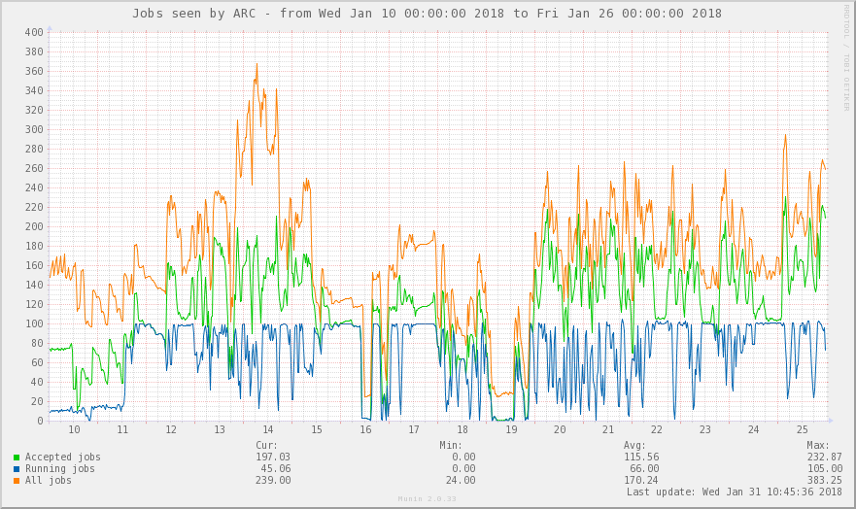
Jobs at Salomon
Limit 100 from qfree

Slide 9
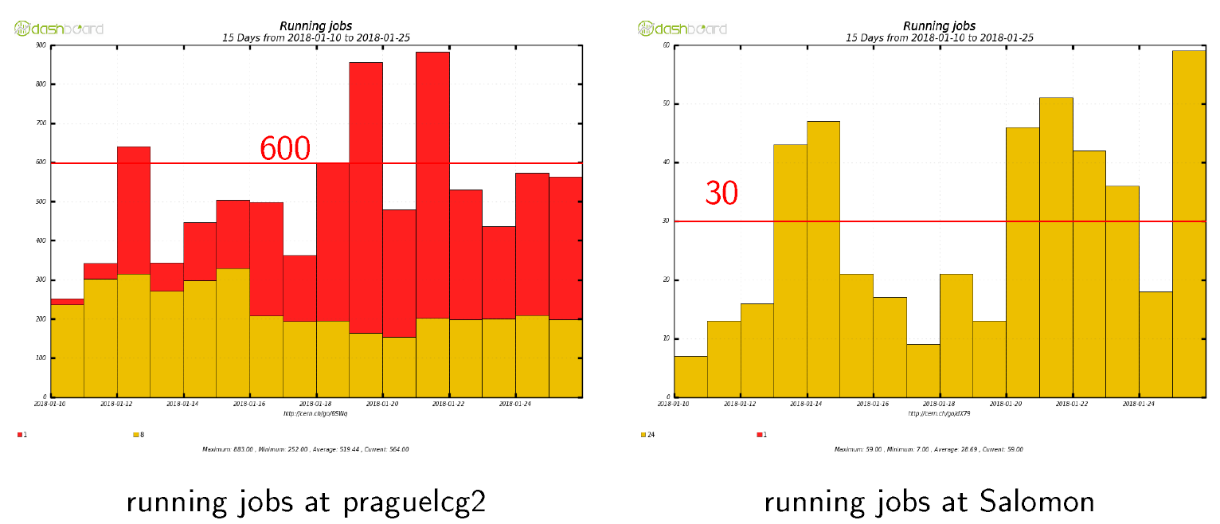
CZ-Tier2 vs Salomon: Running jobs

Slide 10
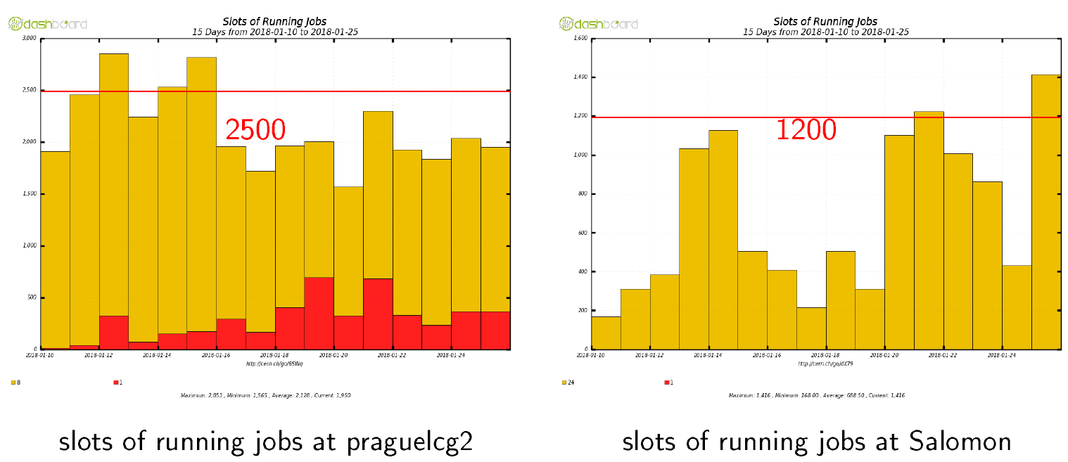
CZ-Tier2 vs Salomon: Running job slots

Slide 11
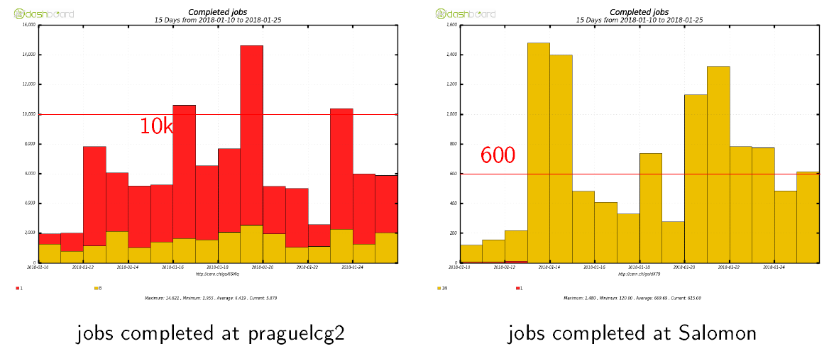
CZ-Tier2 vs Salomon: Completed jobs
Completed = successful + failed

Slide 12
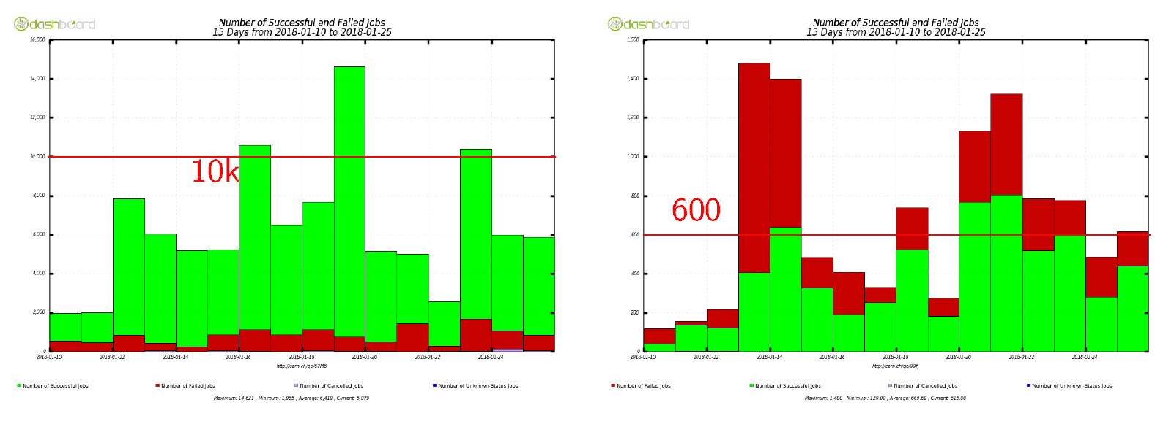
CZ-Tier2 vs Salomon: Njobs
Job failures at Salomon on 12.1.-14.1. caused by jobs from release which was incomplete at the scratchdisk
Other failures: boost::filesystem::status: Permission denied:"/var/spool/PBS/mom_priv/hooks/resourcedef"
  reason why some jobs need it is under investigation

Slide 13
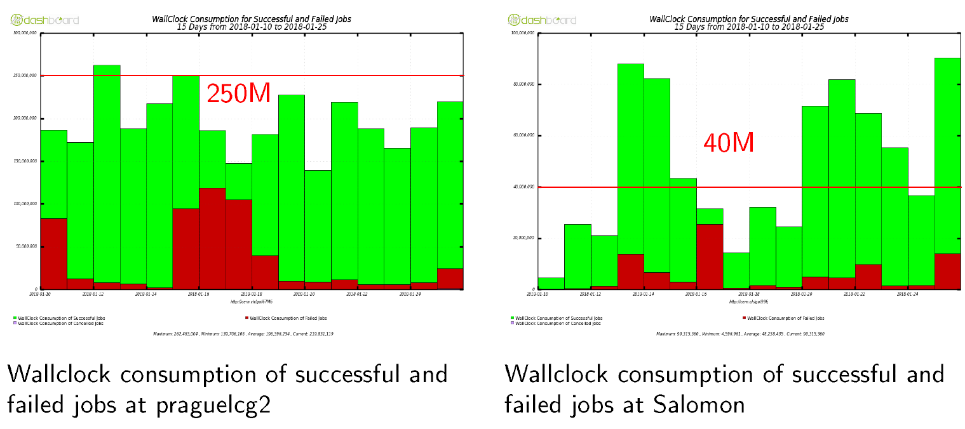
CZ-Tier2 vs Salomon: Wallclock usage

Slide 14
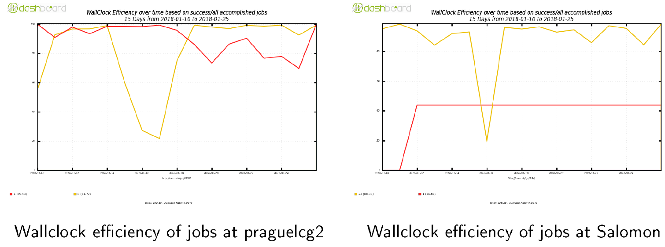
CZ-Tier2 vs Salomon: Efficiency

Slide 15
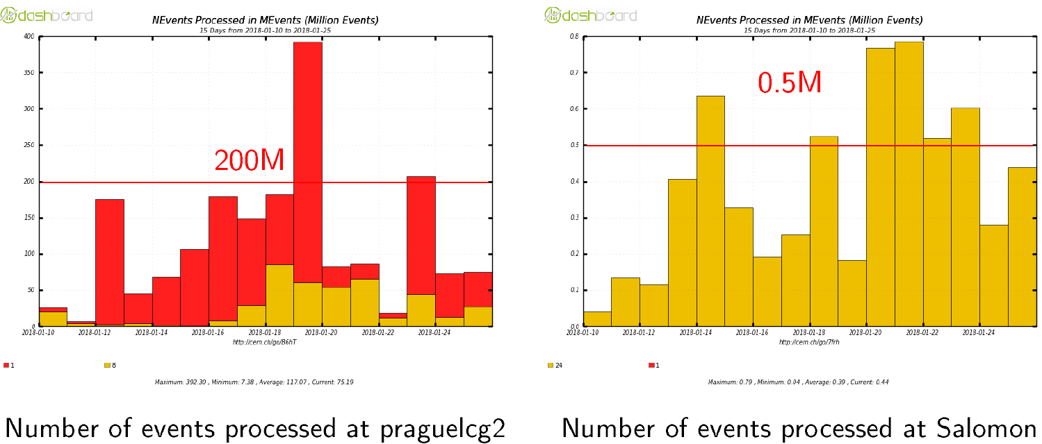
CZ-Tier2 vs Salomon: Processed events

Slide 16
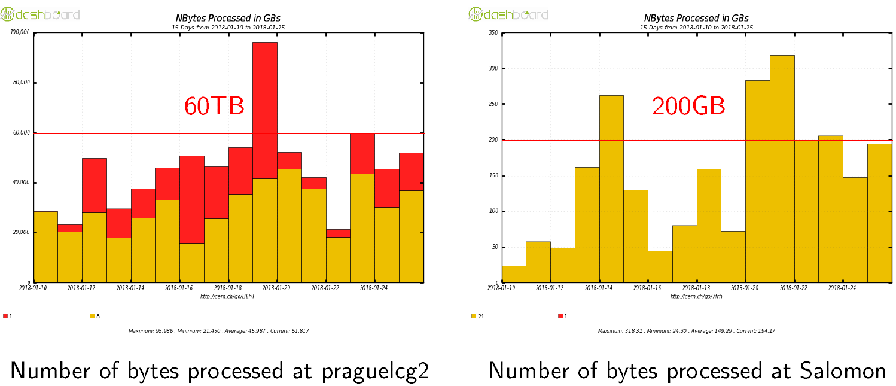
CZ-Tier2 vs Salomon: Input Size

Slide 17
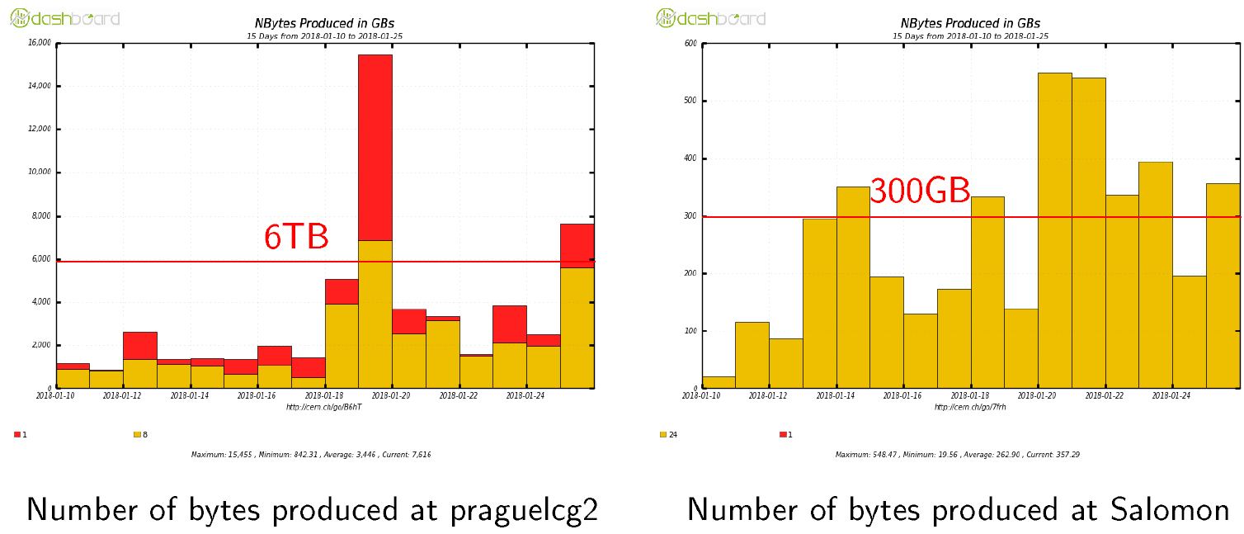
CZ-Tier2 vs Salomon: Output Size

Slide 18
Conclusion
HPC resources can significantly contribute to the CZ Tier-2 computing capacity
We greatly appreciate the possibility to use IT4I resources and very good support from IT4I team.

