Slide 1
GDB Introduction
Ian Collier
ian.collier@stfc.ac.uk
STFC Rutherford Appleton Laboratory
GDB, February 14th 2018

Slide 2
Meeting details
Summaries prepared by team of volunteers
  Today: …
  Will be available at https://twiki.cern.ch/twiki/bin/view/LCG/WLCGGDBDocs
Vidyo & mailing list monitoring
  I am unlikely to check email during the day– please use the list.
  Can someone in the room monitor that and Vidyo chat?

Slide 3
Today: Main topics
HNSciCloud update
System Performance Modelling WG update
GPU exploitation pre-GDB report
CNAF data centre update
CernVM Workshop report
HPC exploitation pre-GDB report
CSCS HPC experience
EOS Workshop report
Spectre/Meltdown update
Benchmarking impact of spectre/meltdown

Slide 4
Upcoming GDBs
March 2018 GDB will be co-located with ISGC in Taipei
  shifted to March 21st
April – pre-GDB - Benchmarking F2F
July – moving to 19th
October – moving to 17th
Let me know if you have topics to bring to the GDB

Slide 5
Upcoming Meetings
Inverted CSC, March 5th-8th at CERN - http://indico.cern.ch/e/iCSC-2018
LHCOPN/LHCONE workshop March 6th-7th, RAL, UK
  https://indico.cern.ch/event/681168/ - registration still open
ISGC 2018, March 16th – 23rd, Taipei, Taiwan
  http://indico4.twgrid.org/indico/event/4/
2018 WLCG Workshop & HSF Workshop, March 26th– 29th Naples, Italy
  https://indico.cern.ch/event/658060/overview - early bird registration extended
HEPiX Spring 2018, May 14th – 18th, Madison, WI, USA
  https://indico.cern.ch/event/676324/
HTCondor Week 2018, May 21st – 24th, Madison, WI, USA
  https://indico.fnal.gov/event/15680/
8th DIRAC Users’ Workshop, May 22nd-25th May, Lyon, France
  http://cern.ch/go/sG8d
Thematic CSC, June 3rd -9th, Split, Croatia - http://indico.cern.ch/e/tCSC-2018
CHEP 2018, July 9th – 13th, Sofia, Bulgaria
  http://chep2018.org
European HTCondor week, September 5th-7th, RAL, UK
HEPiX Fall 2018, October 8th – 12th, Barcelona, Spain
Anything I’ve missed, let me know & I’ll add it to the slides.

Slide 7
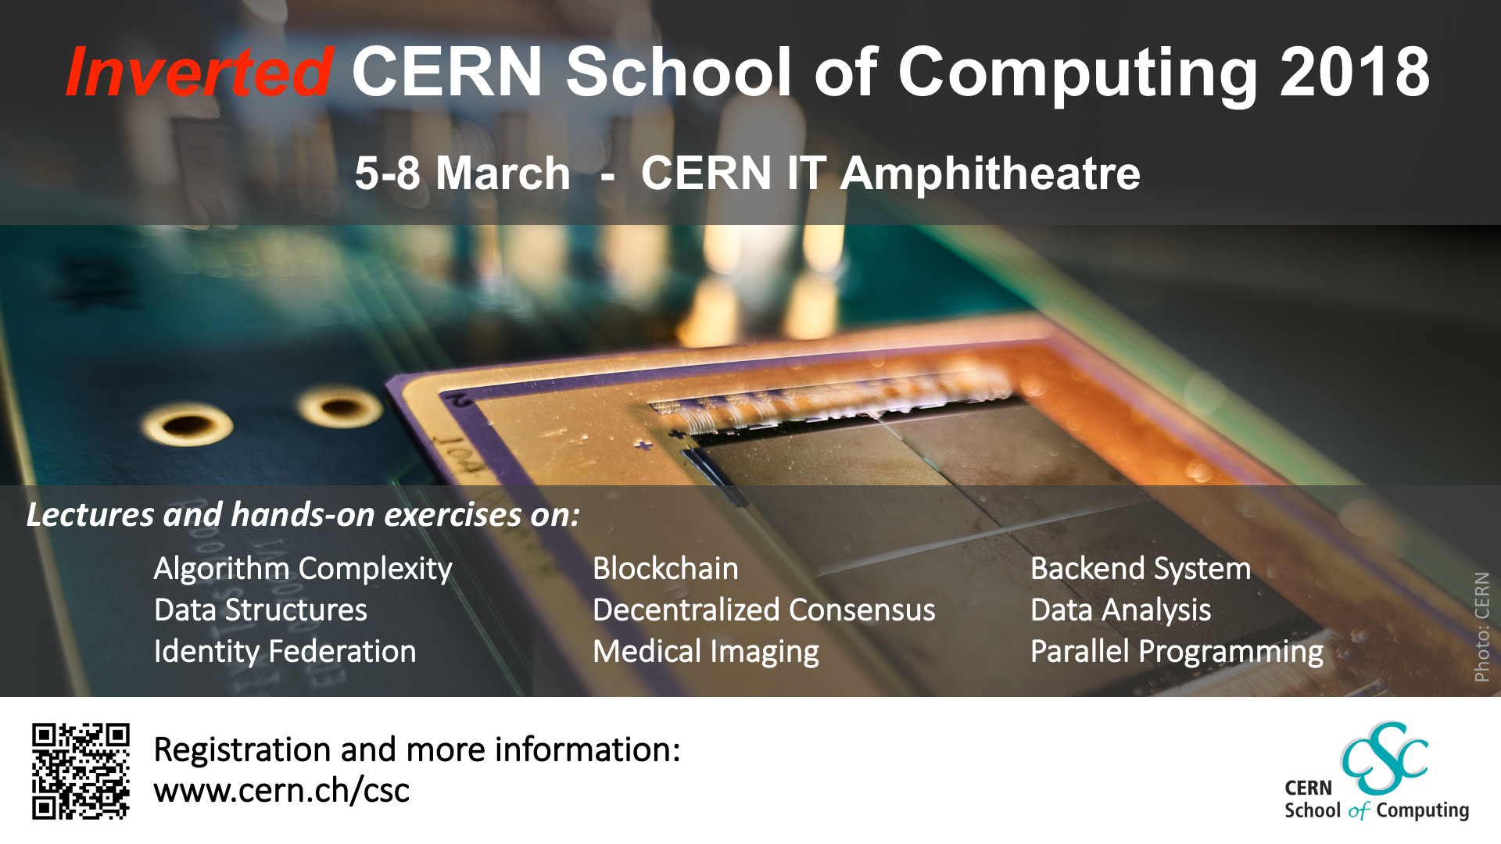
CERN School of Computing 1

Slide 8

CERN School of Computing 2

Slide 9
Questions?

