Slide 1
Analysis Facilities and Use Cases Next steps after Naples
Oliver Gutsche, Eduardo Rodrigues
Fermilab University of Cincinnati
WLCG GDB Meeting, CERN, 11 April 2018

Slide 2
Summary-ish of session @ Naples Workshop

Slide 3
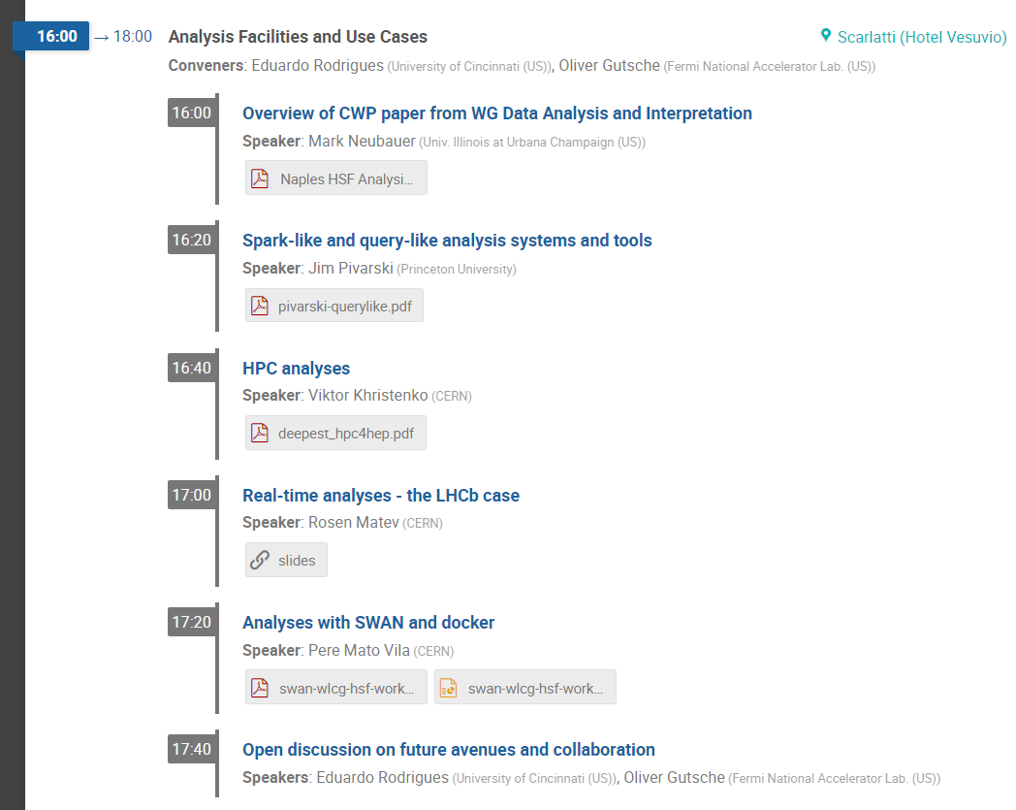
Session overview
Workshop = environment for examples of new and/or innovative analysis flows techniques and facilities
being used/investigated

Slide 4
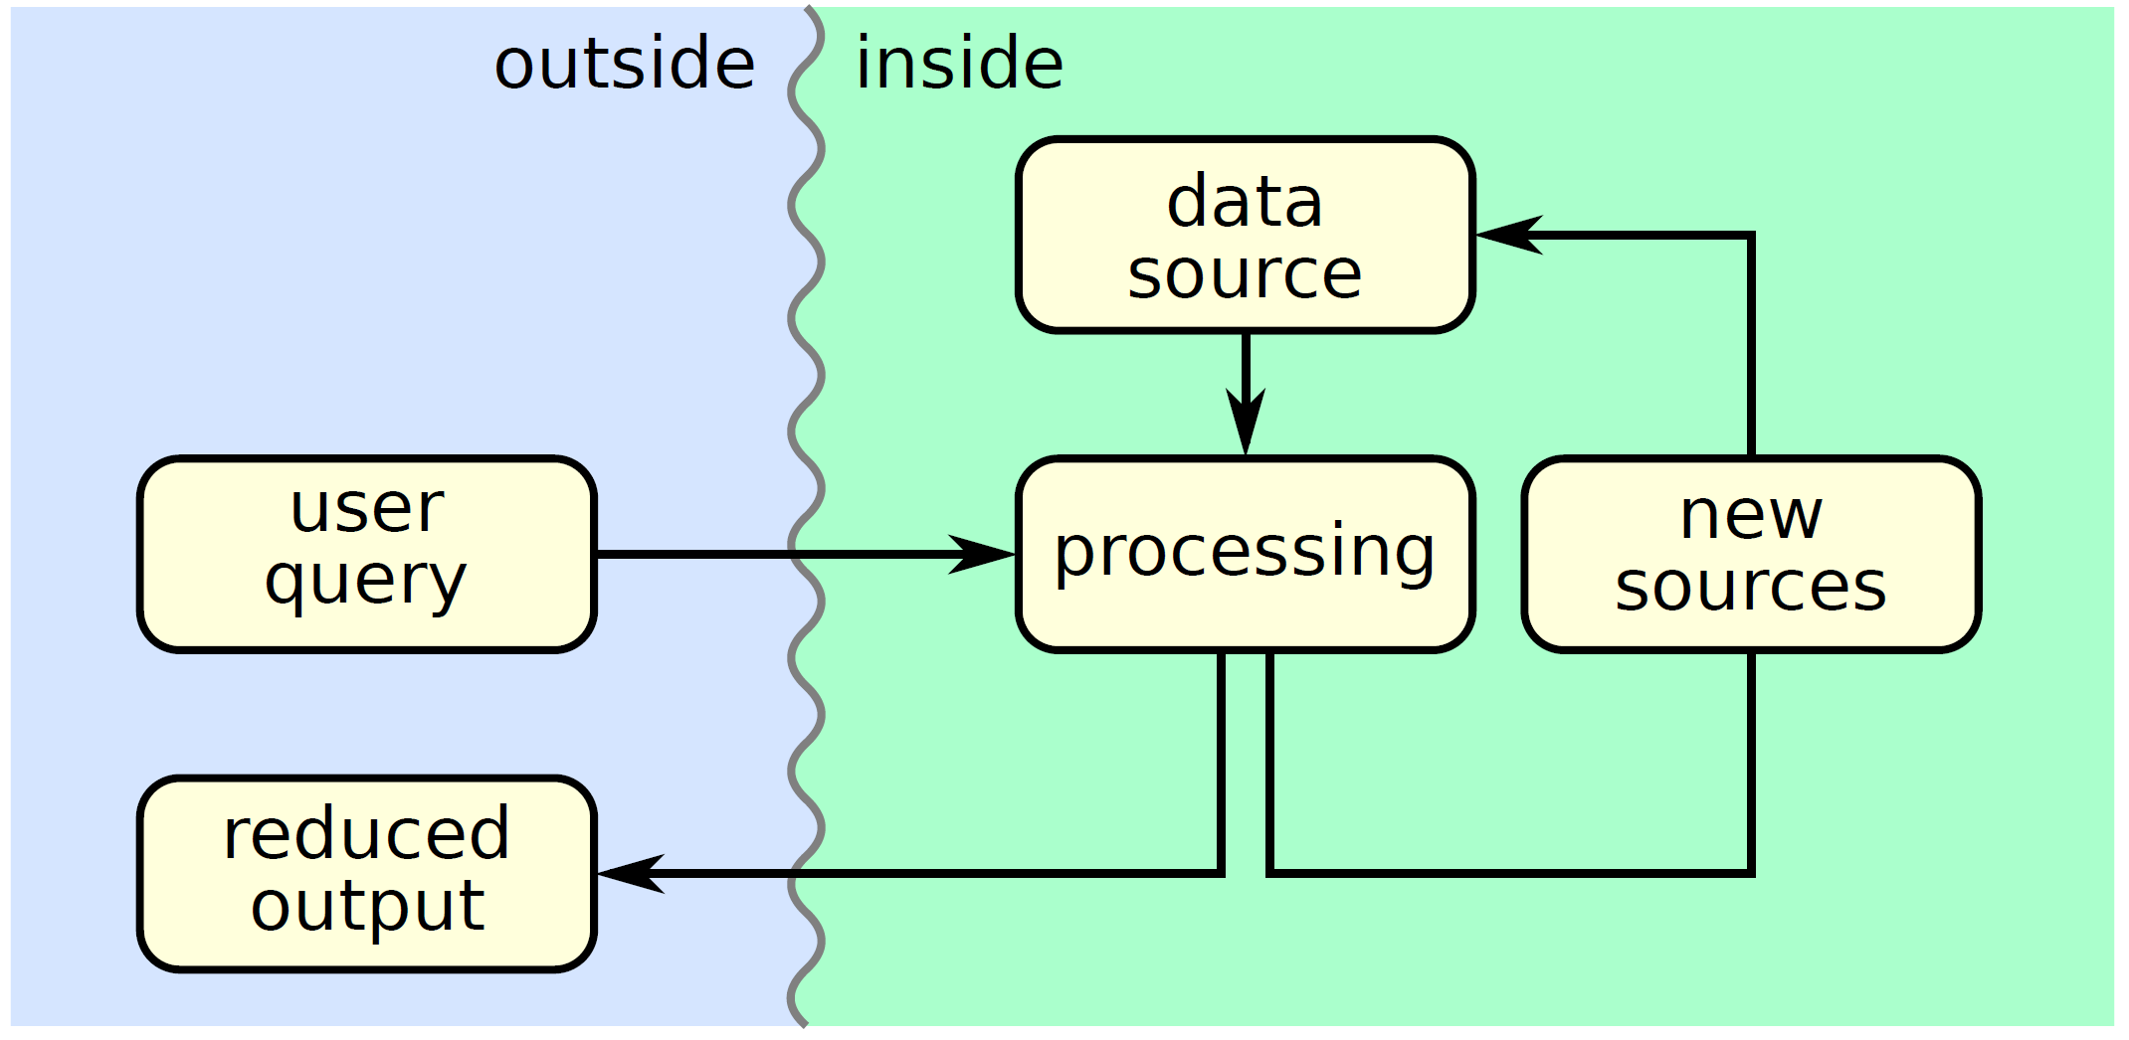
Explorations around data querying in analysis flows
Jim Pivarski
Or: what works, what doesn’t, what’s needed, what we’re building
Exploratory work around
the following grand picture:
  All boxes deserve dedicated focus
  Ex.: functional programming style,
  Dask for distributed processing
Several proof-of-concept Python packages developed along the way

Slide 5
HEP analysis pipelines on HPC facilities
Viktor Khristenko
DEEP-EST^{(*)} :
  EU R&D project for Exascale HPC, in design phase
  Explore conventional HEP analysis workflows on HPC infrastructure
  Explore usability of Apache Spark for HEP data analysis
Some R&D activities:
  Optimising analysis workflows for novel compute/memory/storage capabilities
  Utilising industry tools like Apache Spark: enabled to read ROOT files natively
  Benchmarking with TBs of CMS Open Data
  In some sense: are general purpose solutions viable for HEP data analysis?
^{(*)} Dynamical Exascale Entry Platform - Extreme Scale Technologies

Slide 6

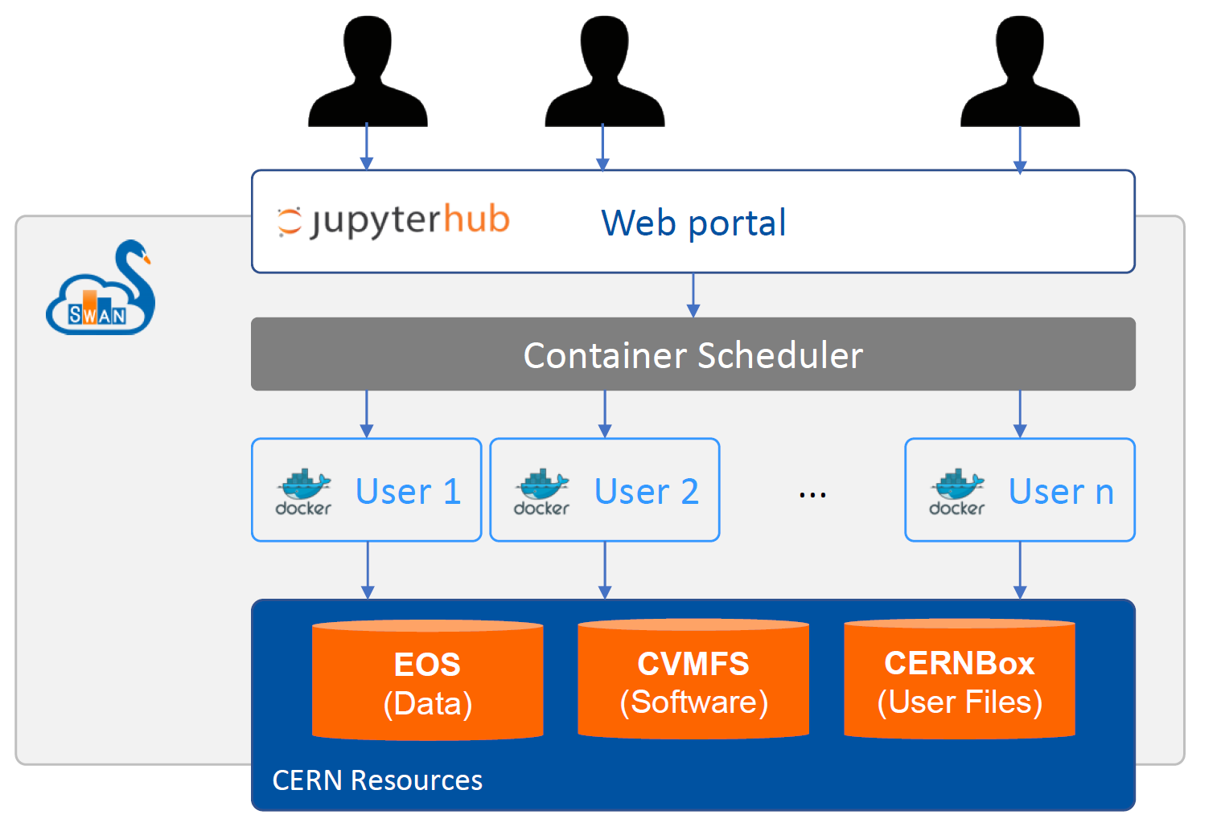
SWAN - service for web-based analysis
Pere Mato
Service integrates experiments/user data and software, and computing resources
Users can do analysis only with their browser
  Anywhere, anytime, with no local installation
  Cloud-based analysis model
Interface: Jupyter Notebooks on demand
  Combine code, equations, text and visualisations
  Most useful for final steps of analysis, teaching, documentation
  Use personalised docker container instance
  System can scale to larger resources like Spark clusters
Developments guided by (heterogeneous) community
SWAN is first step towards a truly scalable
and interactive distributed data analysis environment

Slide 7
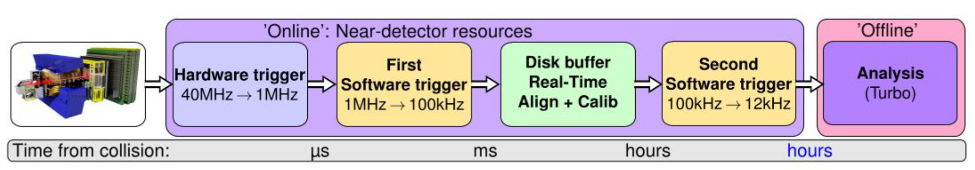
LHCb online & high-throughput analysis (flow)
Rosen Matev
A reality, in production !
Boosts up physics reach and allows for otherwise non-doable analyses
Only saving reconstructed objects (no raw event) in the trigger demands much on online calibration and alignment, hence on a robust and efficient online monitoring of the data quality as well

Slide 8
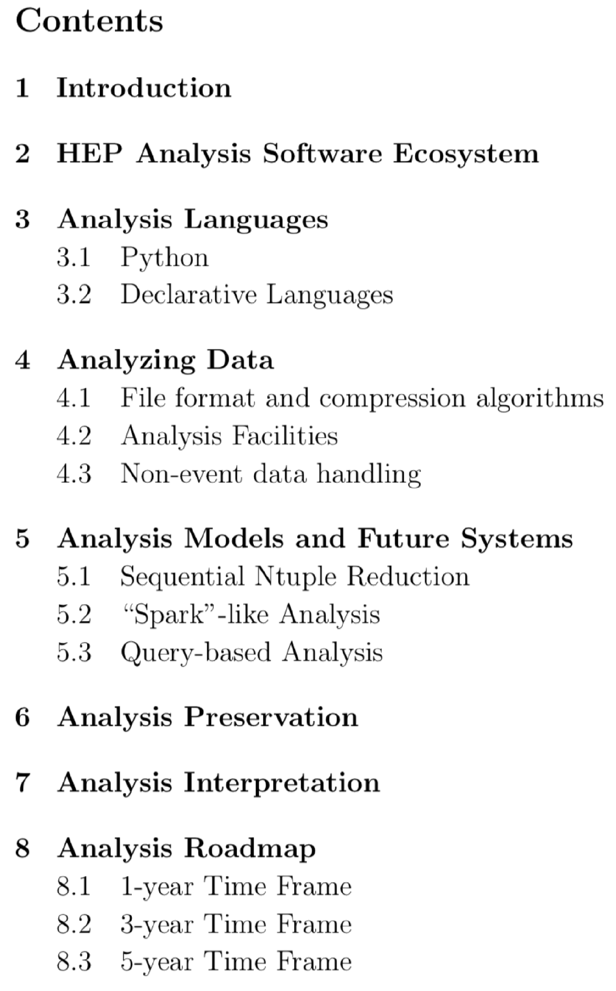
Data Analysis & Interpretation WG Paper
Mark Neubauer
In support of Community White Paper
Cuts across many other WG areas
  Data preservation, Machine Learning, ...
Submitted to the arXiv yesterday!
Time-to-insight (data) is a crucial metric
Think towards a “smart” data analysis system
Scope for new ideas of analysis pipelines,
collaborating with non-HEP communities

Slide 9
Outlook
We want, and need(!), to foster collaboration and common projects
on analysis-related topics
  Examples of funded efforts exist (e.g., NSF-funded DIANA/HEP project) ,
  but need more to make a difference !
Lots of activities post-CWP but no organisational structure / specific timelines to tackle proposed roadmap …
… can the HSF facilitate information exchange in the analysis area,
Maybe with a dedicated WG ?
  Let us know about funded (and non-funded) efforts
Links with communities outside HEP are emerging through the tools
explored and used - great !

Slide 10
Next steps beyond Naples

Slide 11
“Random” questions from Naples, to keep in mind ...
Is more contact information needed for projects already discussed
to start more collaboration?
How do we keep the discussion and exchange of information alive?
What common projects are identified for this area that will advance?
  Are the right stakeholders already involved? Should other experiments or organisations be contacted?
  Are any resource needs covered?
Are there projects that are not currently advancing?
  What would allow them to do so?
Links with communities outside HEP
  Are any established? Are any links needed that we don’t have?
Are we making best use of community expertise in this area?
  How best do we advance collaborations that will be of benefit more widely and improve our software and maximise the effectiveness of effort

Slide 12
Further engage with the open-source community ?
For what concerns data analysis, there is much to be learned/used
from the non-HEP community
  Software - huge (Python) scientific software ecosystem
  Training - lots of conferences/workshops with tutorials and hands-on (see next slides for examples)
  Exchanges - effectively done via open-source events and contributions to OS software
Many non-HEP open-source conferences / workshops we should try to have a more “active” presence in (again, see next slide for a few examples)
  HEP community presence is not overwhelming
  We do have our own dedicated conferences/workshops, which work very well
    Ex.: ACAT, CHEP, DS@HEP, ROOT Users
  But much to be gained with a stronger exchange, building relations & contacts:
  attend a broader range of events, further invite non-HEP speakers to our events
    The HSF may help as a “visiting card”
    Obvious challenge for event participation: financial support ...

Slide 13
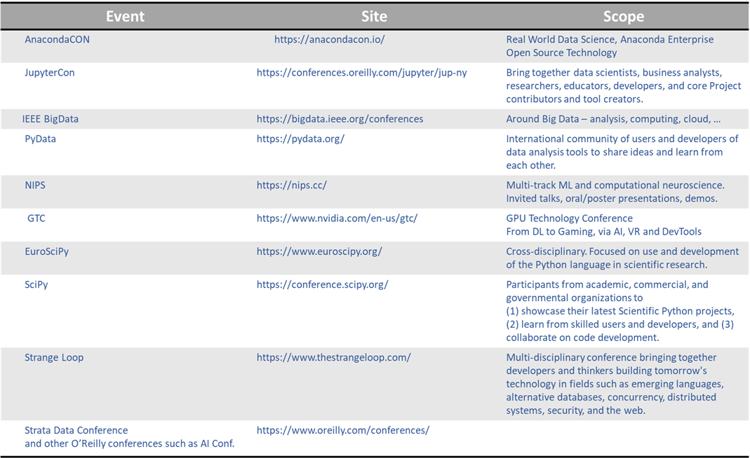

Further engage with the open-source community ?
Non-HEP open-source SW&C / Statistics / Data Science / Machine Learning Events

Slide 14
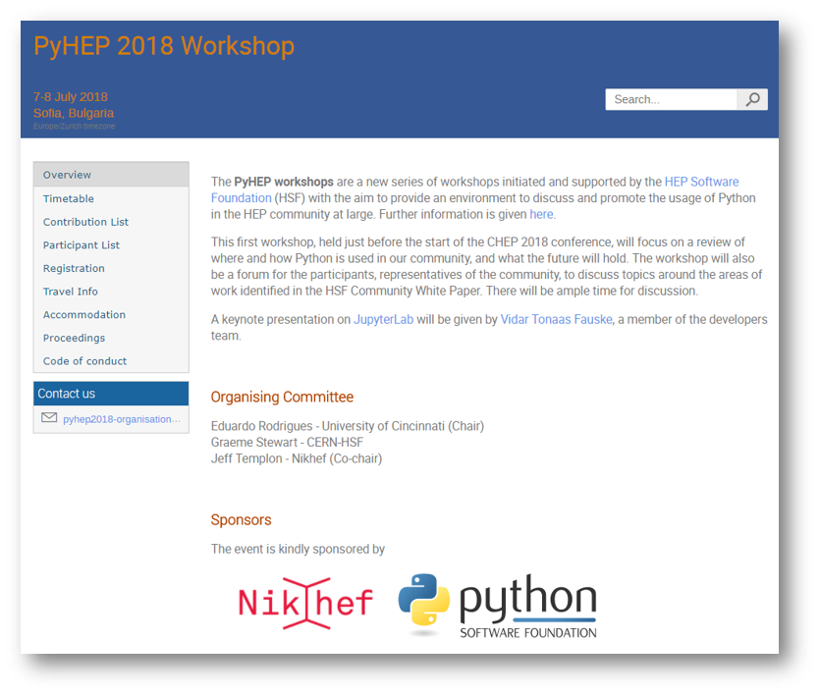
Promoting Python as a 1st-class analysis language
PyHEP “Python in HEP” workshops
  Initiative strongly welcomed by HSF
In longer term will hopefully enable stronger bridges with the Data Science, Machine Learning,
SW&C communities
  E.g. inviting speakers from interesting projects, tools, etc.
  Hopefully that may result in more of those projects/companies becoming aware and interested in our use cases … they may then invite us too!

Slide 15
CWP roadmap - 1-year time frame (1/2)
Enable new open-source tools to be plugged in dynamically in the existing ecosystem and mechanisms to dynamically exchange parts of the ecosystem
with new components
  Ongoing projects: e.g. the Scikit-HEP project
  Work by Giulio Eulisse on initial Apache Arrow TDataSource for ROOT,
  as starting point to deliver Arrow interoperability to ROOT
Develop requirements and design a next generation analysis facility concept, incorporating fast caching technologies to explore a query-based analysis approach and open-source cluster management tools
  See e.g. Jim’s and Viktor’s work presented @ Naples

Slide 16
CWP roadmap - 1-year time frame (2/2)
Finalise full support of Python in our ecosystem including long-term maintenance
  Need strong commitment and effort from ROOT team
  Would profit from more community engagement
  See initiative of PyHEP workshop series
Evolve policies to minimise this effort by retiring less used components from the integration and validation efforts
Establish a schema for the “analysis database”
  Obvious link to groups on Data Preservation & Interpretation
Interpretation Gateway: conceptualisation integrating the analysis facility, analysis preservation infrastructure, data repositories, and recasting tools
Note: the WG paper contains R&D items on the 3- and 5-year time frame, but not so important to list then here at this stage (many are follow-ups and finalisations of the above)

Slide 17
In short
Lots of activities post-CWP and many people involved
across the various experiments
  We need to keep these activities alive, “connected” and, hopefully, focused,
  with an effective communication across experiments in particular
Challenging to keep a broad overview of what’s happening
  No organisational structure so far
  This may be a role for the HSF
  Post-CWP WLCG/HSF workshops might be a good thing, say once a year
Links with communities outside HEP are emerging through the tools
explored and used - great !
  Trend is established and we should encourage it further

