Slide 1
LHCb handling of CNAF incident
Stefan Roiser
GDB
9 May ‘18

Slide 2
Overall Status
CNAF site is the second biggest T1 resource of LHCb
Non-redundant LHCb resources
  Tape
    Reconstruction output files
    Archive data
  Disk
    Intermediate files of monte carlo and data processing workflows
    Potentially user analysis output data
 | % of T1s | % of WLCG
CPU | 19 % | 10 %
Disk | 23 % | 13 %
Tape | 25 % | 14 %
2018 WLCG LHCb pledges provided by CNAF

Slide 3
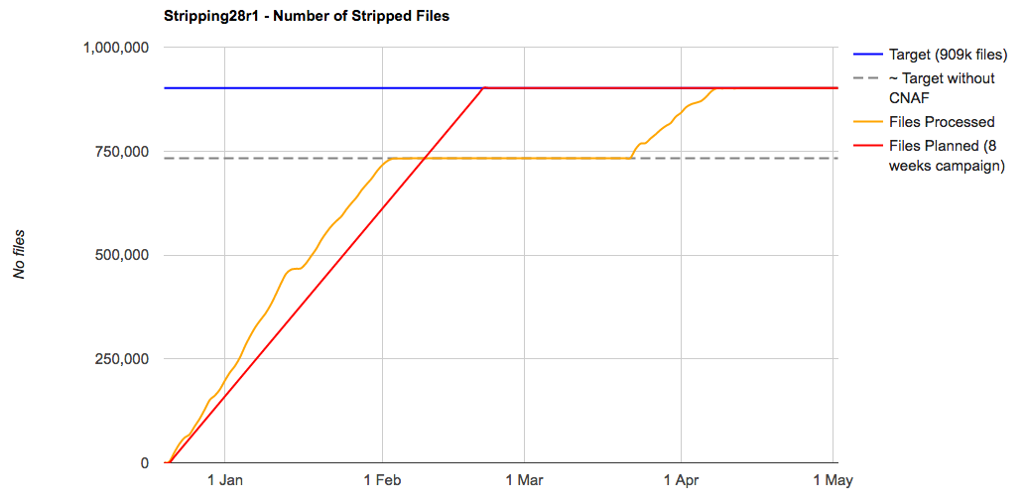
Effect on productions
Data re-stripping of Run 2 data
  ~ 20 % of data could not be processed until site was recovered
Monte carlo simulation
  Intermediate files could not be accessed
→ Many productions need to be kept open until site came back
→ Production system had to deal with multiple of jobs than usual
  Production archiving was pending
  Now closing of productions has started → system recovering
Stats of one of the data processing campaigns
Job entries in the production system database

Slide 4
Data management handling
Tape
  27 “wet” cartridges
    12 cartridges with archive data: all recovered
    10 cartridges with raw data: second replica created on other site
    5 cartridges with reco output data: all recovered but
      Lost 877 files from 2012 and 47 files from 2017
Disk
  Vertical RAID system avoided data loss
  Access after site became operational was slightly delayed because of (planned) migration to new disk infrastructure

Slide 5
Person power cost
Difficult to calculate
  Meetings with CNAF representatives and technical personnel to judge the impact the prepare a plan for the duration of the outage
  Additional load on the production and data management teams to handle operations during the outage
  Additional load on the grid operations teams and site contacts during the period of the outage

Slide 6
Lessons learnt
Gathering files via “tape families” on tape cartridges saved a lot of operational effort
  Only one “wet cartridge” affected for the re-stripping campaign
Communication is crucial and was very well done by CNAF!!!!
  Several meetings and personal interaction on technical levels
    Suggestion to streamline the discussions, e.g. via a “taskforce”
LHCb computing infrastructure mostly resilient to outage of a big site
  Delay in data processing campaigns by 2 – 3 months due to computing model and resource constraints

Slide 7
Lessons learnt
Gathering files via “tape families” on tape cartridges saved a lot of operational effort
  Only one “wet cartridge” affected for the re-stripping campaign
Communication is crucial and was very well done by CNAF!!!!
  Several meetings and personal interaction on technical levels
    Suggestion to streamline the discussions, e.g. via a “taskforce”
LHCb computing infrastructure mostly resilient to outage of a big site
  Delay in data processing campaigns by 2 – 3 months due to computing model and resource constraints
Congratulations to the CNAF team for the professional handling of the incident which kept the impact and data loss at the possible minimum.

