Slide 1
WLCG DOMA report
Maria Girone, Simone Campana
CERN

Slide 2
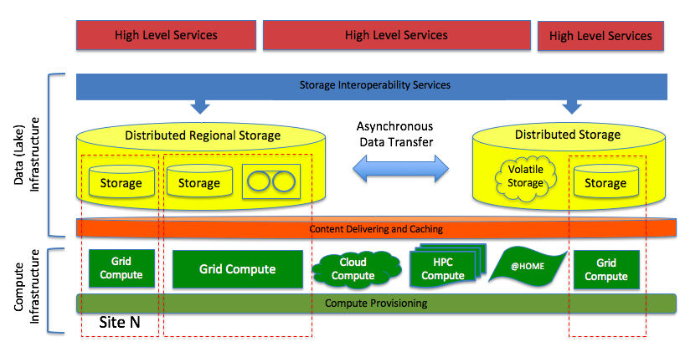
The WLCG Data Organization Management Access
evolution project (DOMA)
  keep track of developments and advancements in all DOMA areas
  provide a forum to discuss ideas and foster interoperability of solutions
  an umbrella for experiments, middleware developers and storage providers, facilities

Slide 3
Introduction
Meeting every 4th Wednesday of each month, from 16:00 (finishing before 17:30)
One topical discussion at every meeting + short report for each working group
DOMA general Mailing List: wlcg-doma (at) cern.ch
Three active working groups:
  Third Party Copy (TPC) protocols: wlcg-doma-tpc (at) cern.ch
  Data Access, Content Delivery and Caching (ACCESS): wlcg-doma-access (at) cern.ch
  Storage Quality of Service (QoS): wlcg-doma-qos (at) cern.ch
DOMA twiki: https://twiki.cern.ch/twiki/bin/view/LCG/DomaActivities
  The twikis of the working groups are all linked from here

Slide 4
TPC
Chairs: Alessandra Forti and Brian Bockelman
https://twiki.cern.ch/twiki/bin/view/LCG/ThirdPartyCopy
Short term goal: investigate, commission and deploy alternative TPC protocols to gridFTP
  Three phases (milestones) finishing in Dec 2019 with all sites providing storage to WLCG offering a non-gridFTP endpoint
Medium term goal: prototype token-based auth in TPC
  Focus on bearer tokens (capability based): Macaroons and SciTokens
  In line with the WLCG AAI task force (see later)
Xrootd and HTTP/Dav are the candidate protocols

Slide 5
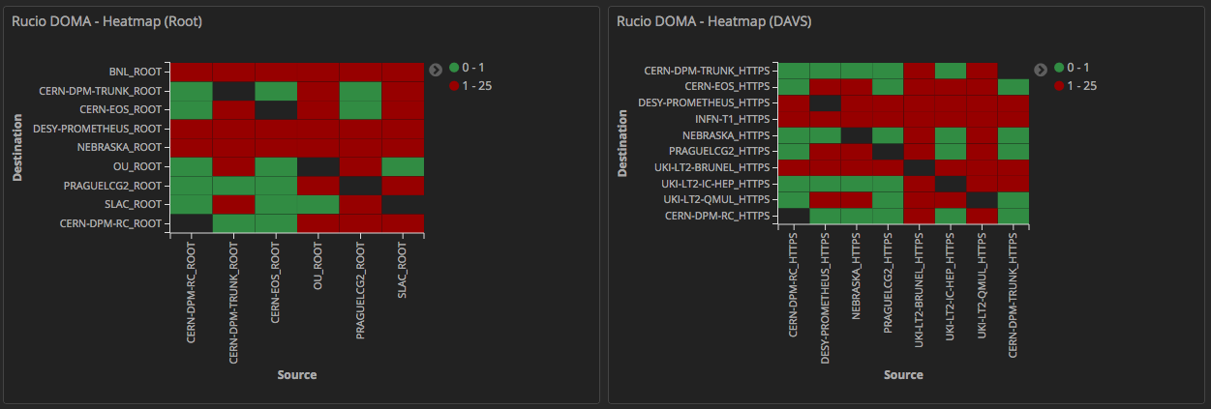
Initially focusing on functionality. Performance will follow.
Need to test the full matrix of storage technologies for each protocol
  Through Rucio+FTS: an instance of Rucio was deployed for this by the Rucio team on Kubernetes
Current status: many caveats being addressed. Documentation is an important one.

Slide 6
ACCESS
A broad scope WG: data access performance, content delivery and caching
Chairing team: S. Jezequel, I. Vukotic, F. Wuerthwein, X. Espinal, M. Schulz
https://twiki.cern.ch/twiki/bin/view/LCG/ContentDeliveryCaching
Started by looking at existing activities in this broad domain and organize the information by topic
  https://docs.google.com/document/d/1Sk5wtFLdHDCjyc_VmTwJY4qzk_ErKidBs7GLhTnN4xo/edit
Two main topics:
  Data access patterns and access performance studies
  Organizing and deploying caching solutions

Slide 7
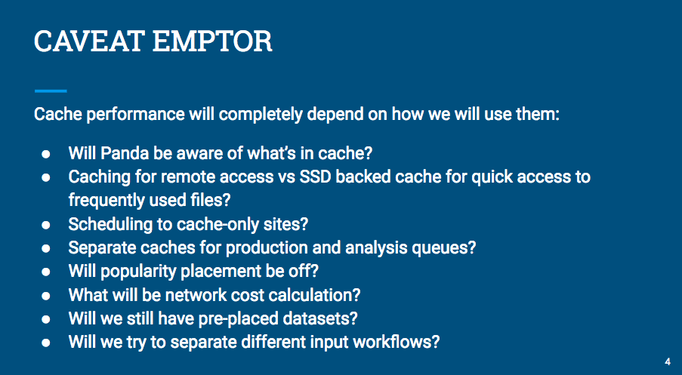
A lot of activity around caching, including latency hiding and bandwidth levelling
“Cache performance will completely depend on how we will use them”
Two very interesting studies
  Caching simulation based on access records in MWT2. Study of the cache effectiveness based on workflows/file type
  Concluding that caching has to be “content and workflow”-aware
Xcache configuration and deployment options, with pros and cons
  Local node -> In parallel to managed storage -> Replacing managed storage -> multi-level cache (node, site, region)
https://indico.cern.ch/event/763847/

Slide 8
QoS
performance
Chaired by Paul Millar
Recently started, mandate under construction
However, the high level goals are:
  At the storage level, define, implement and expose different classes based on performance/reliability need and what you can afford
  Integrate the notion of storage classes in the higher levels, such as experiment DDM systems. Leveraging on XDC
reliability
cost
Not a new concept: What we call “Disk” and “Tape” are in fact QoS.
A potential source of large hardware saving for HL-LHC and favors the integration of new storage technologies
Trade off performance, reliability and cost based on the use case

Slide 9
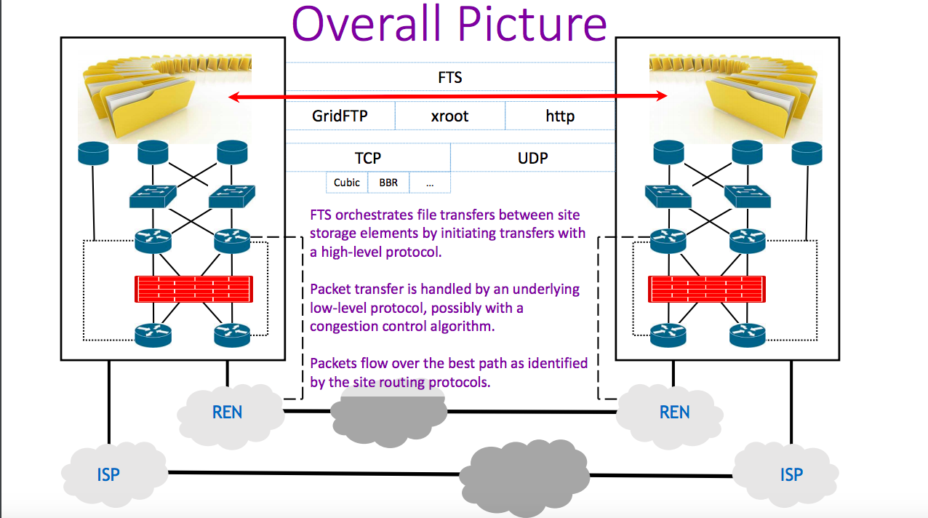
DOMA related network activities
Network R&D activities, focusing on data transfer
  DTNs, low level transfer protocols, bandwidth on demand, P2P channels, SDNs, …
Collaboration with the SKA AENEAS project and HEPIX
Leveraging information from FTS as file transfer manager
http://cern.ch/go/7qxT

Slide 10
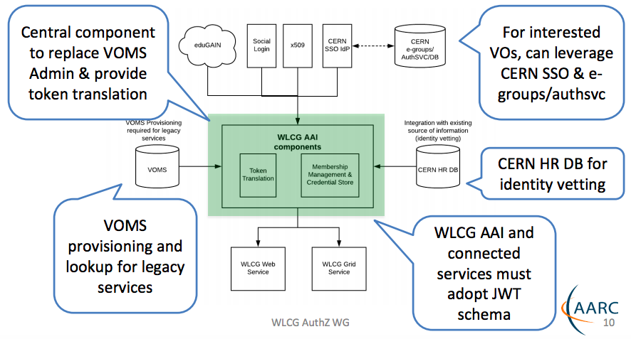
DOMA and AAI
AAI evolution in WLCG is driven by the WLCG AuthZ WG
  Prototyping an architecture of which DOMA activities are one aspect
  X509 free, based on Jason Web Tokens
The WG collected requirements and is evaluating existing solutions for the WLCG MB
All inline with the DOMA needs and strategy
http://cern.ch/go/9fXq

Slide 11
Dude, where is the
Data Lake WG?
???

Slide 12
DOMA works bottom-up: does not defines an architecture at this stage
We have indications of how facilities and services will look like and we define an R&D program to prototype various aspects
The current DOMA working groups will enable the technology for a Data Lake
We have no WG dedicated to distributed storage, but the challenges are being addressed in ACCESS, Network, QoS, TPC
We had no real discussion on interoperability services: Rucio being used by ATLAS and CMS (with interest of other communities) opens a big opportunity
QoS
TPC,
Network
ACCESS,
Network

Slide 13
Conclusions
There is a lot of work going on, inline with the WLCG Strategy document
We also have a list of topics we have not yet discussed (tape carousels, interoperability services)
The first milestone is the preparation for the LHCC review of the strategy, where we intend to present our findings
We will finalize such preparation at the HSF/WLCG/OSG workshop in JLAB
We work in synergy with existing projects/initiatives. E.g. XDC and in the future ESCAPE
DOMA WGs are led by experiments, facilities and middleware providers. Working very effectively

