Slide 1
WLCG AuthZ WG
WLCG AuthZ WG
GDB Update
GDB, October 17th 2018

Slide 2
Agenda
WG Background
Status
Next Steps
All information is available on the Twiki:
https://twiki.cern.ch/twiki/bin/view/LCG/WLCGAuthorizationWG
WLCG AuthZ WG

Slide 3
WG Background
12/07/17
WLCG AuthZ WG

Slide 4
Motivation
Evolving Identity Landscape
  User-owned x.509 certificates -> federated identities
  Current grid middleware does not support federated identities
  How can we shield users from the complexities of X.509 certificate management ?
  Token-based (JWT) authorization widely adopted in commercial services and increasingly by R&E Infrastructures
Data Protection
  Tightening of data protection (GDPR) requires fine-grained user level access control, certain provisioning practices may need to be adjusted
  Objective: Understand & meet the requirements of a
  future-looking AuthZ service for WLCG experiments
WLCG AuthZ WG

Slide 5
WG Objectives
Design and pilot a Token Based Authentication and Authorisation Infrastructure (AAI) for WLCG
Produce a v1 schema for these tokens
Principle throughout is to maximise use of common standards and shared software.

Slide 6
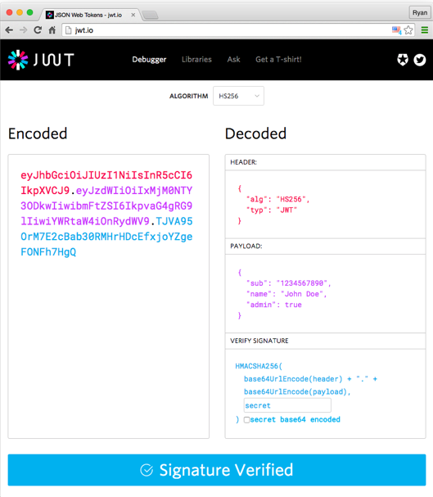
What is a JSON Web Token?
What are they? “JSON Web Tokens are an open, industry standard RFC 7519 method for representing claims securely between two parties.”
Computing services are increasingly turning to token based authentication & authorization
  particularly used by the OIDC and OAuth2 protocols
Multiple infrastructure projects already using/supporting token based authorization but with diverging schemas or technologies
  INDIGO IAM
  EGI Check-in
  SciTokens
  dCache
  ALICE tokens
https://jwt.io/introduction/
WLCG AuthZ WG

Slide 7
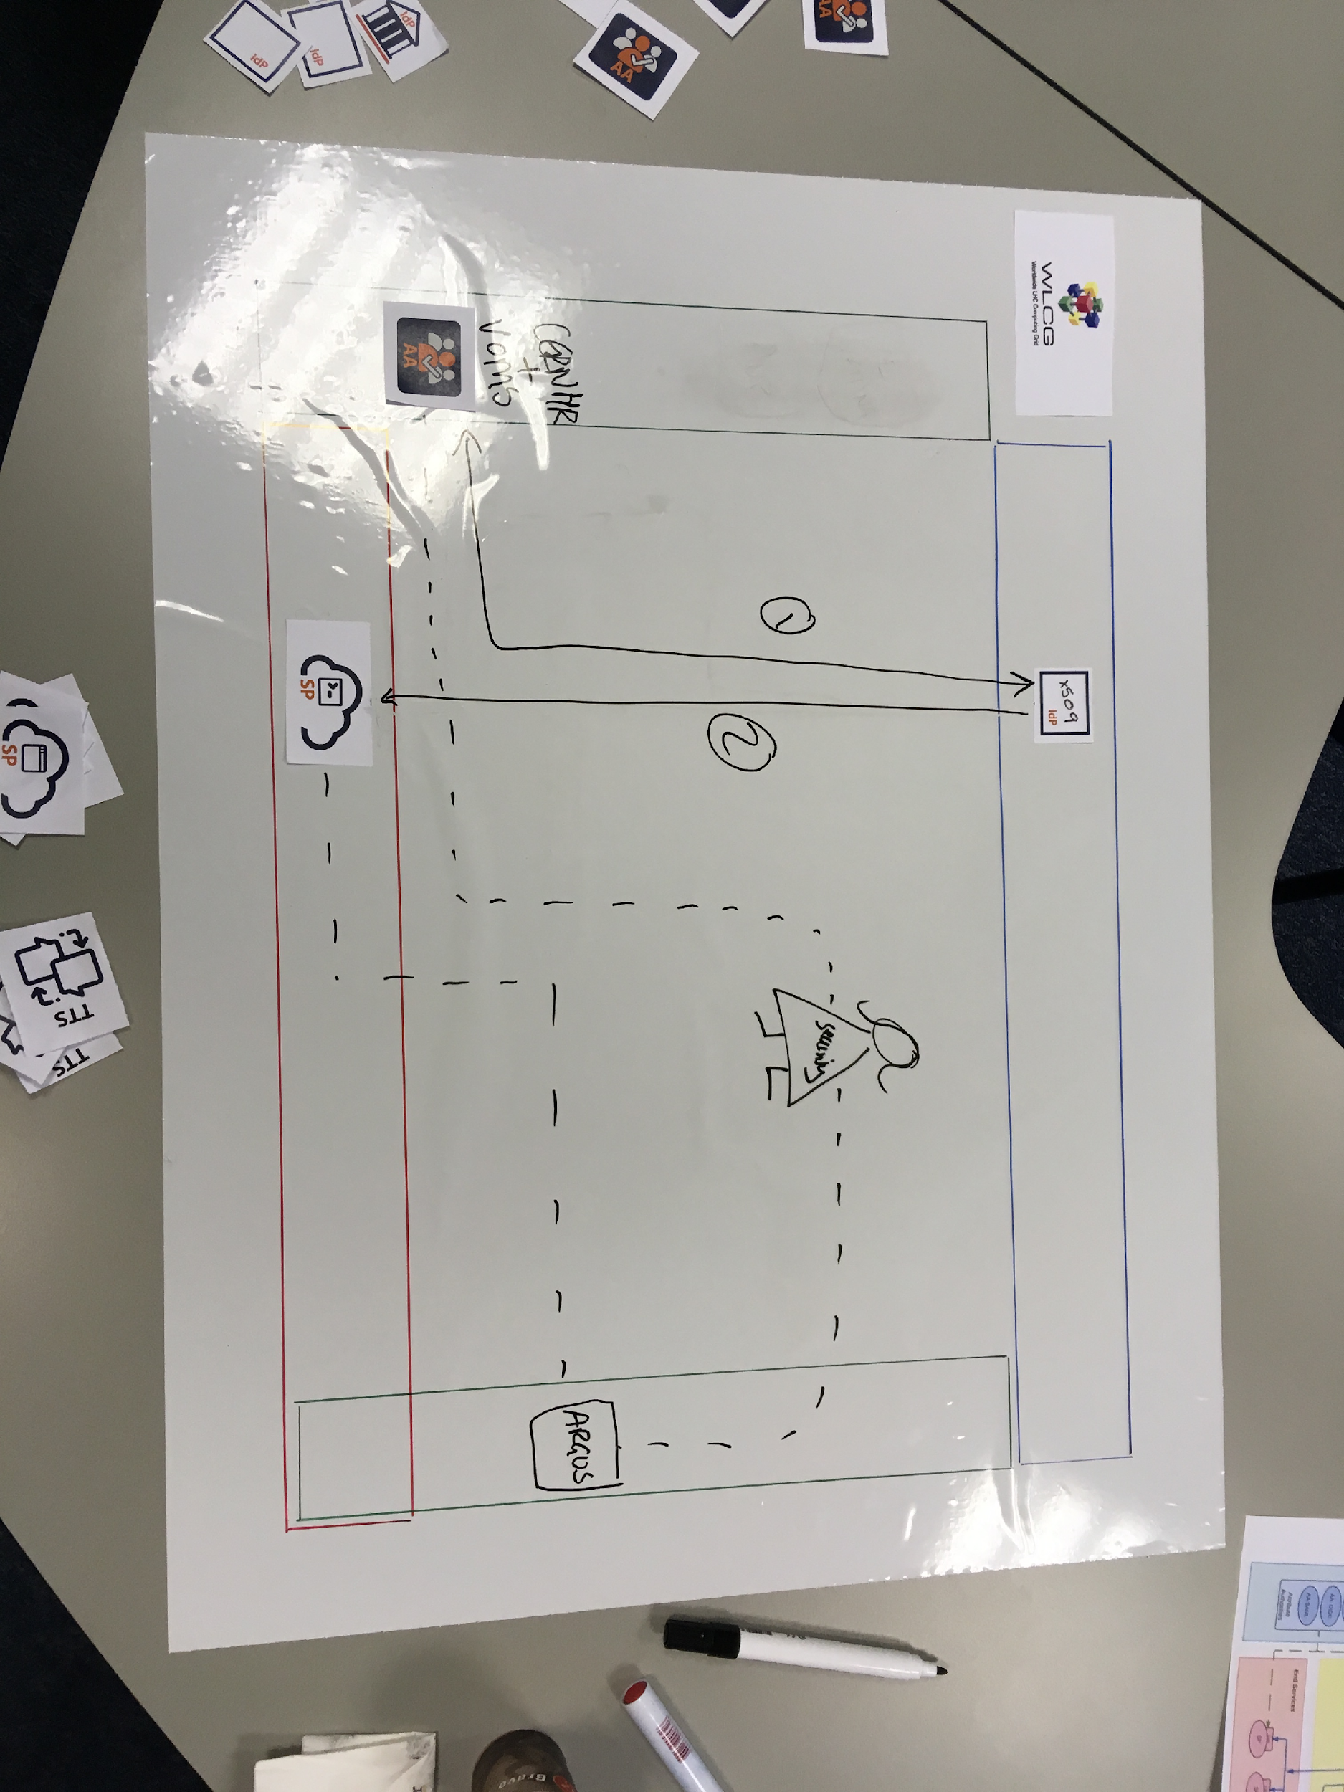
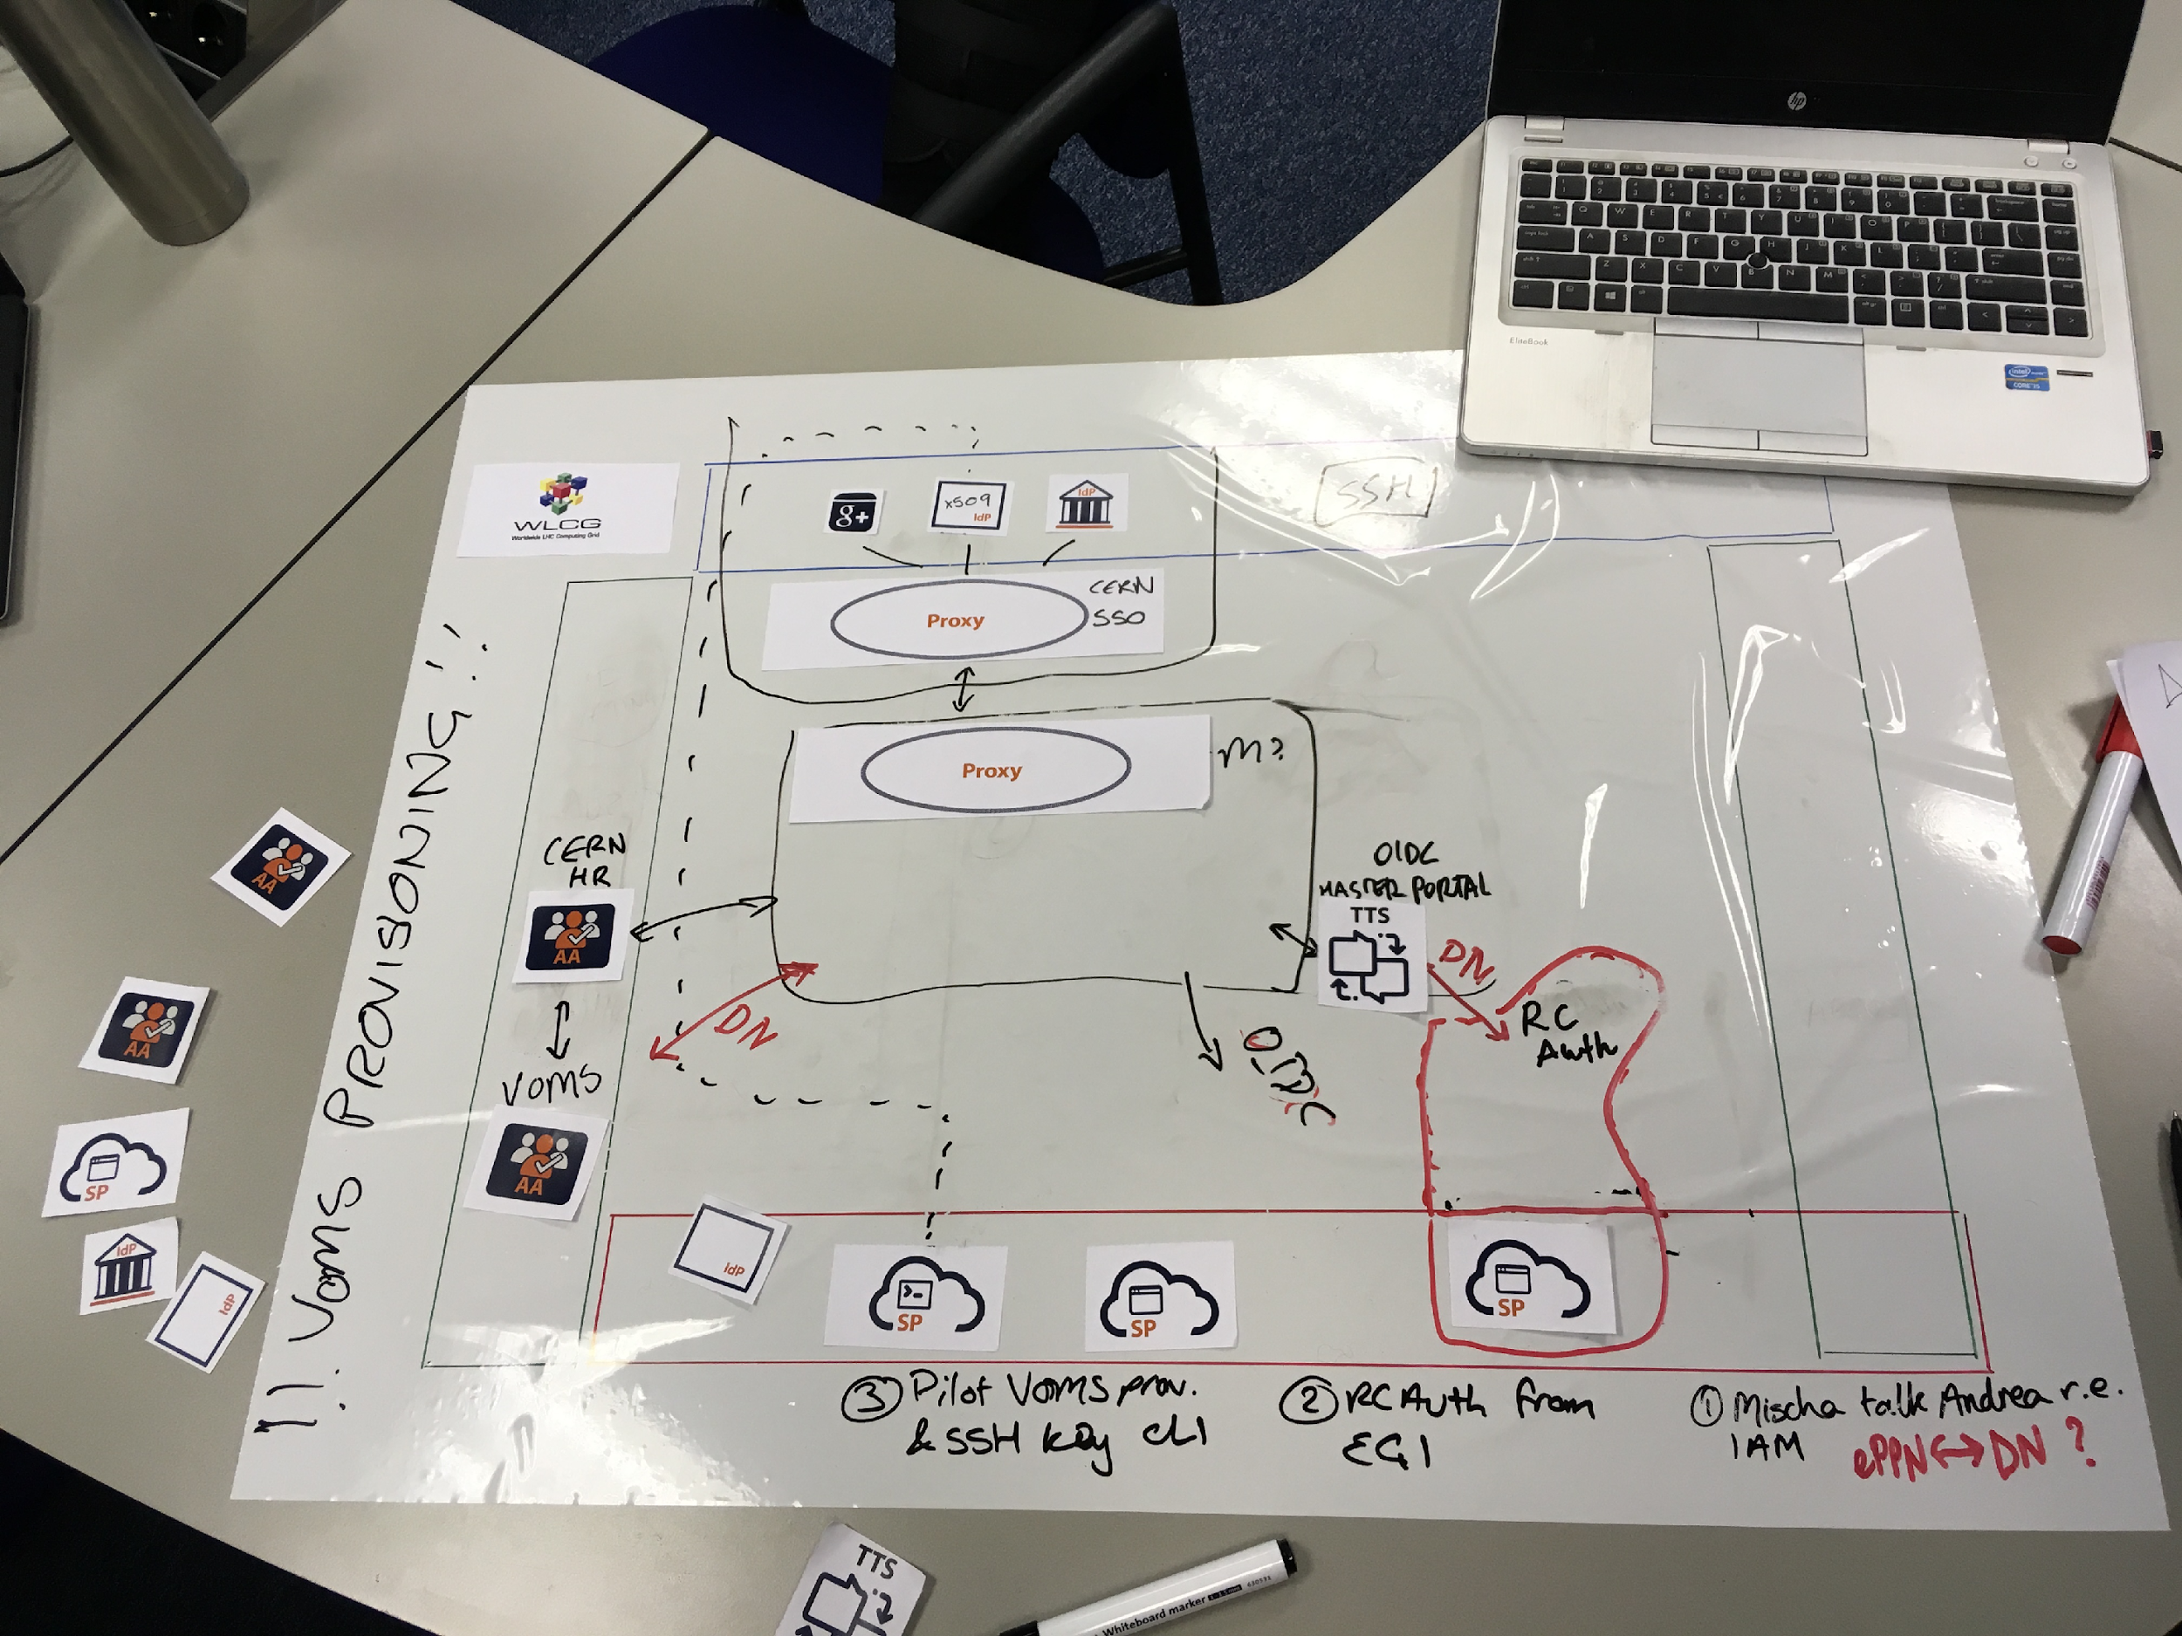

What does the future look like?
Future infrastructure will support a range of credential types for users and services and provide a user friendly experience
Current infrastructure allows access based on X509, including VOMS, CERN HR DB and Argus
Supporting information available at: https://hackmd.web.cern.ch/s/rkyic3vtm
WLCG AuthZ WG

Slide 8
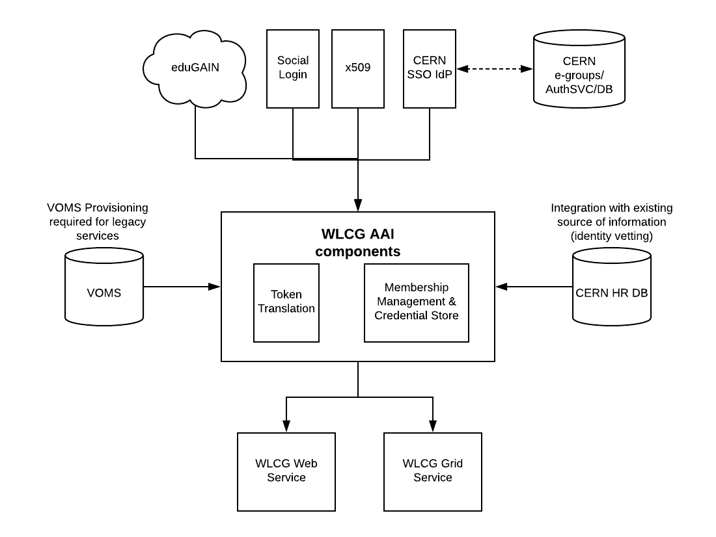
Overlap with CERN?
2 modes for the AAI solution
  CERN Mode = integration with CERN SSO, CERN HR DB
  Standalone Mode = configurable authentication and identity vetting source
In parallel CERN will be moving to a token based infrastructure
  Likely on a longer timeline
  Opportunity for convergence
  see HEPiX Talk by Paolo Tedesco https://indico.cern.ch/event/730908

Slide 9
Status
12/07/17
WLCG AuthZ WG

Slide 10
Status
Item | Status | Date
Document Current Token Usage | Final Draft | October 2018
Publish Requirements Document | Done | September 2018
Identify Pilot AAI Implementations | Done | November 2017
Enhance Pilot AAIs to meet requirements | Ongoing | December 2018
Define Token Schema | Ongoing | January 2019
Align with VO workflows (VO Interviews) | Ongoing | November 2018
HR approval of privacy policies for HR DB data release (name, experiment affiliation etc) | Ongoing | December 2018
Assess Pilots in pre-GDB |  | December 2018
Provide feedback to WLCG Management Board |  | February 2019

Slide 11
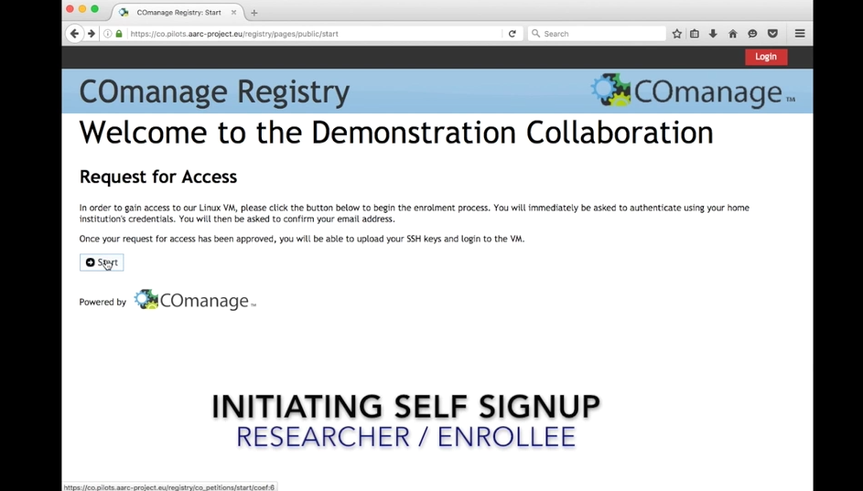
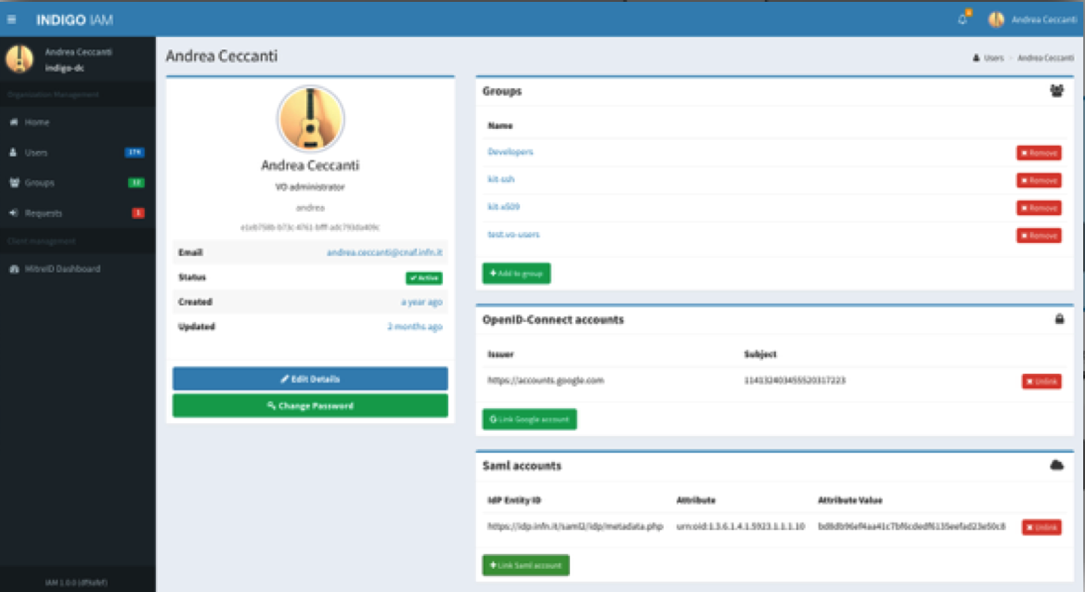
AAI Pilot Projects
Two solutions appear to meet the majority of requirements
  EGI Check-in & COmanage
  INDIGO IAM
Additional integration required for
  VOMS provisioning & lookup
  CERN HR DB integration (postponed until autumn)
  AUP re-signing
RCAuth.eu for x509 generation
  High availability setup in progress
This software exists. We do not want to re-invent the wheel!
WLCG AuthZ WG

Slide 12
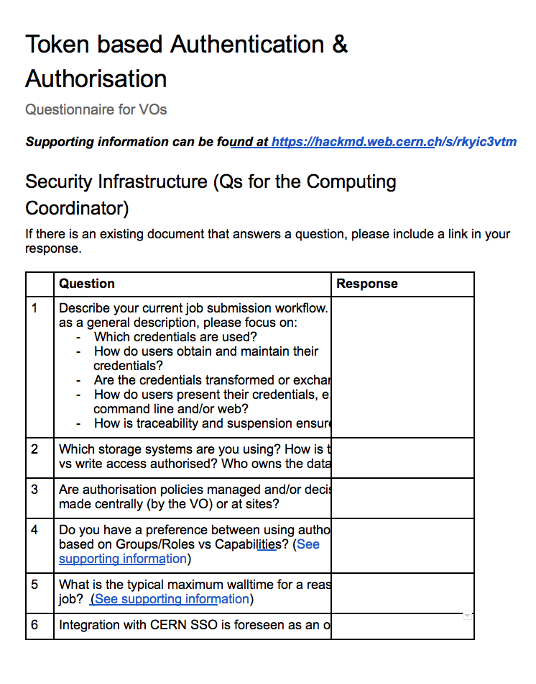
VO Interviews
Questionnaire compiled by WG aimed at VO Computing Coordinators and VO Managers
Supporting material produced to provide an overview of the technology https://hackmd.web.cern.ch/s/rkyic3vtm
Offer to go through in face-to-face interview if needed
Sent to first VO last week
Many thanks in advance for filling the questionnaire!

Slide 13
Next Steps
12/07/17
WLCG AuthZ WG

Slide 14
Next Steps
Gather input from LHC VOs
Much work needed to confirm token schemas, e.g.
  Input from VOs will be essential, e.g. for token lifetimes
  Clarification on level of assurance, difference between attribute vs authorisation tokens
Deploy Pilot AAIs at CERN (required for data transfer)

Slide 15
Questions?
12/07/17
WLCG AuthZ WG

