Slide 1
The eXtreme Data Cloud (XDC) project
GDB Update
Oliver Keeble
On behalf of the project

Slide 2
XDC Overview
The eXtreme DataCloud’s aim: Develop scalable technologies for federating storage resources and managing data in highly distributed scientific computing environments
XDC is a 2 year, 3M€, EU-funded software development and integration project
  Started active work 1st Feb 2018
The targeted platforms are the current and next generation e-Infrastructures deployed in Europe
  European Open Science Cloud (EOSC)
  The e-infrastructures used by the represented communities
  WLCG

Slide 3
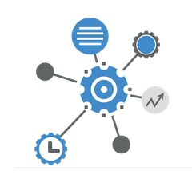




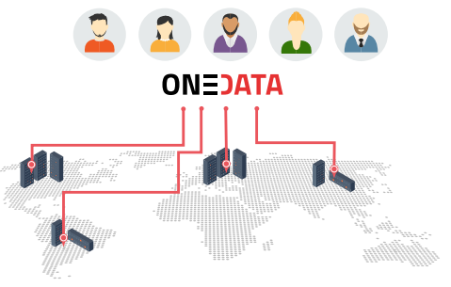
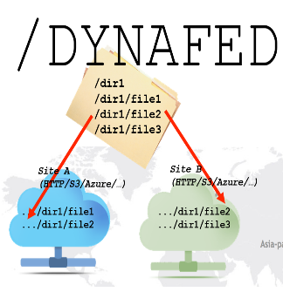





The Approach
Improve already existing, production quality Data Management services
  By adding missing functionalities requested by research communities
  Based mainly on technologies provided by the partners and by the INDIGO-Datacloud project
  Must be coherently harmonised in the European e-Infrastructures
Status
  10 months into the active work of the project
  This update is WLCG focused and does not represent all the work going on in the project!
INDIGO PaaS Orchestrator
INDIGO CDMI Server

Slide 4

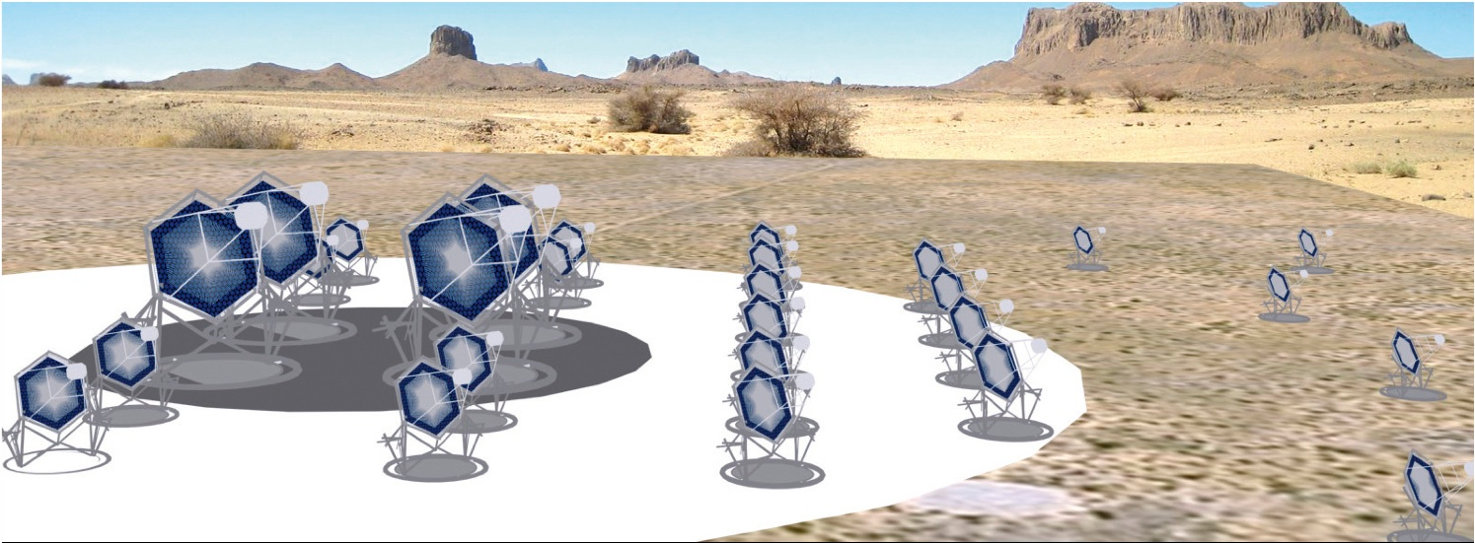










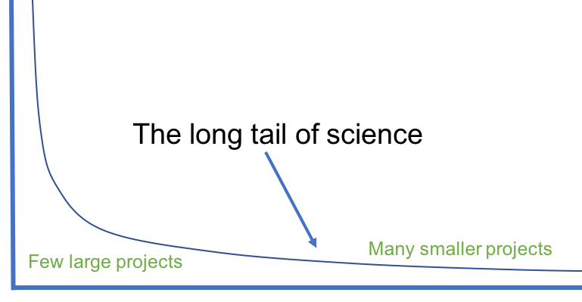
Represented research communities

Slide 5
A usecase driven project
New functionalities added on top of existing production quality services
Integration of different services to address the requirements

Slide 6
A usecase driven project
New functionalities added on top of existing production quality services
Integration of different services to address the requirements

Slide 7
Data Orchestration
Indigo PaaS Orchestrator
  FTS
  Dynafed
  Rucio
INFN National cache federation
QoS

Slide 8

Extending the INDIGO Orchestrator

Slide 9
XDC & OpenID Connect (OIDC)
This is a standardised part of the “token based auth” landscape
  Tracking WLCG policy direction
XDC uses the Indigo IAM as the IdP
  Others should work too – it’s standardised
User “logs in” with a browser, using a login service somewhere else.
  Can work without web-browser subsequently
Primary an “access-token” – a bearer token that lets whoever holds it obtain identity information. Usually short-lived.
  The access token may be passed around, but has a finite lifetime.
Also a “refresh token” – allows an agent to fetch a fresh access-token once it runs out.
  The refresh token is bound to the client’s identity, it cannot be passed around.
A process called “delegation” allows an agent that receives an “access token” to obtain a fresh access token and refresh token
  Typical use-case: a long-running job that is acting on behalf of a user.

Slide 10
FTS – OAuth2/OIDC
FTS has demonstrated a transfer authorised with an access token
  CLI client arrives with access token
  FTS validates token and authorises the client
  FTS uses the access token to acquire a refresh token
  FTS’s internal concept of a credential has been generalised
    No longer assumes X509
  Token used to authorise a transfer
    gfal2 has been adapted appropriately
  If the token has expired, the refresh token is used to request a new access token
Avoids all the X509 management and delegation overhead

Slide 11
Dynafed
XDC’s HTTP federator
Integration of OIDC authentication
  Apache-level integration
  Allows browser based access to the Dynafed namespace.
    Browser is redirected to the identity provider in the usual way
  Testbed currently configured to authorise all IAM identities
Integration of authorisation based on OAuth2 access tokens
  Access to namespace authorised by presenting an appropriate token
  No browsers required, just an HTTP header
Auth schemes partitioned in the namespace
  /x509, /oidc, /oauth
  Dynafed still contacts endpoints with an X509 credential

Slide 12
Quality of Service
Goal – use the cheapest possible solution that supports a particular use case
  This may change over time -> “data lifecycle management” (DLM).
  XDC includes an Orchestrator which will drive DLM and QoS transitions
Exploit differing QoS / Cost ratios
  Diversity on your infrastructure
  “Software Defined Storage”
    Adjust QoS levels
“Bring online” is our most familiar QoS action
  Other possibilities
    Increase/Reduce replica count
    Other media (SSD, Shingled drives, …)
    Erasure encodings
    Transfer data to other locations / systems
XDC (Paul Millar) is chairing the WLCG DOMA QoS WG

Slide 13
FTS - QoS
The Indigo project produced a CDMI interface for managing QoS
  Created by the “Storage Service Definitions” WG in the RDA
  Available in dCache
Use case – increase capacity at a storage system by a bulk transition of data to cheaper storage (e.g. lower replication)
gfal2 has been updated as a basic CDMI client
  Including python bindings
FTS can now accept a QoS job
  QoS parameters passed in job metadata
  FTS evaluates if the QoS criteria can be met with a simple transfer (i.e. QoS defaults are fine)
    If so, transfer as usual
    If not, check that the requested QoS is realisable with a transfer + transition
    If so, schedule a QoS job which will manage the QoS transition after the transfer has completed
Still some development steps left before this work is complete

Slide 14
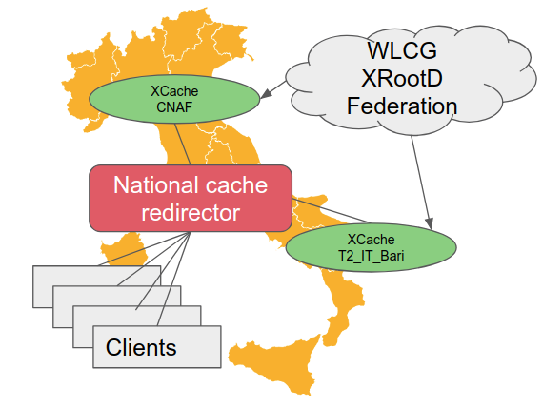
INFN : National XCache
National Cache Federation
  Distributed cache federation
    Currently 3 sites
  Used by sites without local data
    A national cache for a global dataset
  Integrated into CMS
    metrics being collected
  Next steps
    increase scale
    employ a predictive model
Automated Standalone Deployment
  Kubernetes and/or Mesos/Marathon orchestration
    Demonstrated with 2k CMS jobs on OpenTelekomCloud
    https://cloud-pg.github.io/CachingOnDemand/
Starting to model the cache infrastructure to evaluate optimisations

Slide 15
Distributed Storage
dCache
  Notifications
EOS
  Xcache
  Storage adoption
OneData

Slide 16
dCache Notifications
A way for a storage system to notify external systems about events
  “/dir/file1 was deleted”
dCache has implemented support based on 2 technologies:
  “inotify” over Server-Sent Events (SSE)
    automatic updates sent over HTTP, suitable for WAN
  dCache “billing” events over Kafka, suitable for LAN
Use cases
  Catalogue synchronisation
    Data loss notification and automated recovery
  Tape staging
  Triggered data processing
  Cache synchronisation
  Storage adoption

Slide 17




Storage events for catalogue synchronisation
Subscribe …
Upload a file
OK
OK
File uploaded
Delete a file
OK
File deleted
Rucio/Orchestrator/…
P.Millar - The eXtreme DataCloud Project
17

Slide 18
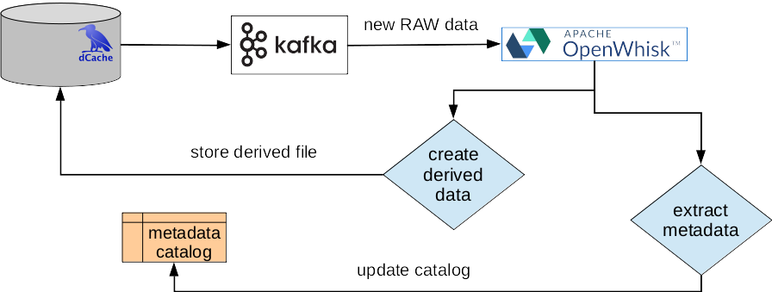
XFEL use-case
11/09/2018
P.Millar - The eXtreme DataCloud Project
18

Slide 19
EOS XCache
AIM: Integration of XCache as a caching solution for EOS
  Reference scenarios :
    XCache deployed at a remote centre (e.g. cloud procurement) to accelerate its local CPU.
    Managing a fast front-end, e.g. SSDs
  Front end is HTTP/xroot, backend communication is xroot.
  As EOS is based on XRootD, this offers a number of opportunities for closer integration of the two systems
Identity forwarding plugin created whereby the cache can identify on whose behalf it is acting
  Upstream storage can authorise appropriately
  Full system deployed on XDC testbed and integrated with VOMS
Next
  write support
    write-through at first
  notification integration

Slide 20
EOS Storage Adoption
EOS can now adopt
  External storage systems
    Through an S3 or a WebDAV interface
    Demonstrated with dCache/WebDAV
  External data
    Data already present on a system described above can be incorporated into EOS
    It can then be replicated, moved, managed in the usual way
      Can even be removed from the original storage while preserving access
Allows local centres to pledge capacity to a regional system
  S3 support integrates cloud resources
At present, EOS takes over management of the storage system
  Independent access is… possible but highly discouraged.
  This can be addressed through notifications

Slide 21
INFN : HTTP(S) nginx cache
HTTP(S) caching solution based on nginx
  VOMS auth provided by a plugin
  Upstream endpoint selection based on VO information
Client contacts nginx which either retrieves (miss) or serves (hit) the data
Cache operates with a service credential
  No delegation
Smarter caching algorithms may be contemplated
  nginx plugin mechanism

Slide 22
Future
First release before the end of the year
  Will allow preview deployments of the functionality described
  This will then emerge in the standard releases of participating projects
Review
  First review end of March
Rucio
  Moving towards a more formal involvement in the project
Keep up the work on scalable data solutions for WLCG and others
  In sync with the DOMA WGs

