Slide 1
EN-CV Progress
EHN1 Extension Project
Jérôme Rodary EN-CV-PJ 2017/07/13

Slide 2
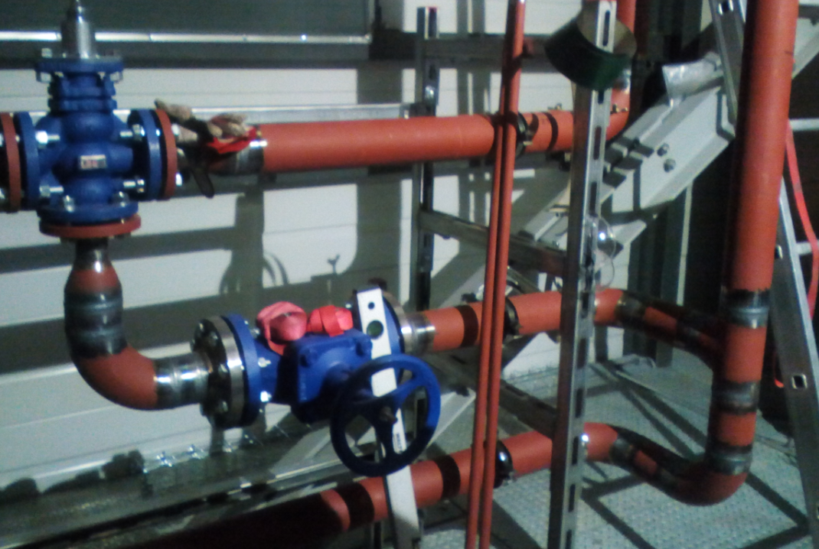
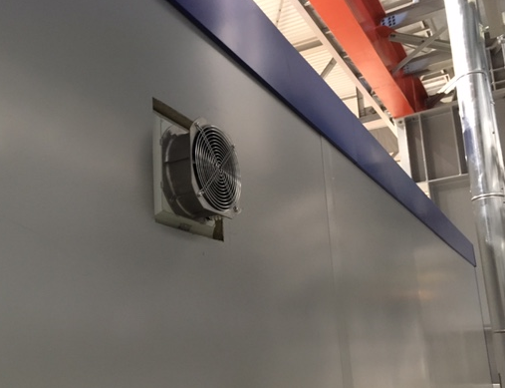
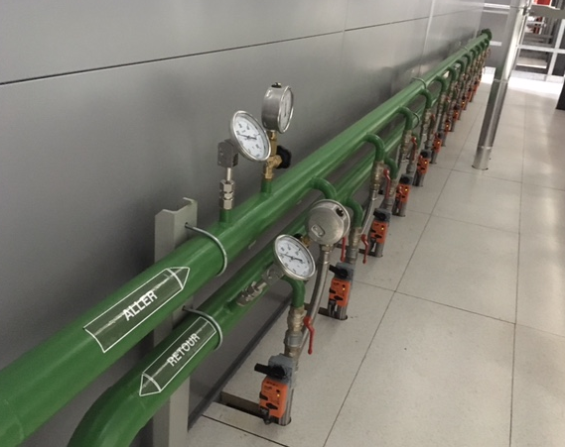
Progress
  HVAC (Ferrostaal GmbH)
    WL2 (SW pipework)
      X-rays controls & pressure tests OK
      Insulation works timeslot TBD (September ?)
    WL1 & WL2 (Tests / Commissioning phase)
      Loop tests / I-O tests OK
      Commissioning report pending !
    WL3 (Air-conditioning for the barracks)
      Fan-coils & fan units installed
      Temporary electrical supply for air-conditioning
    WL1 (Argon extraction system)
      Extension of the argon ducts in the pits (September ?)
      Completion of the pulsion duct under beam line structure (September ?)
  COOLING (Rampower)
    All WL : pipework works are completed
    Cooling system (Raw water) for CENF racks is operational
    WL1 (Demi water) : all welds are now conforme (no more X-rays)!
      DW piping pressure test foreseen end of August

Slide 3
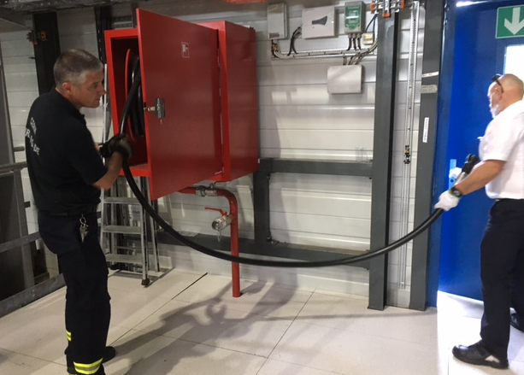
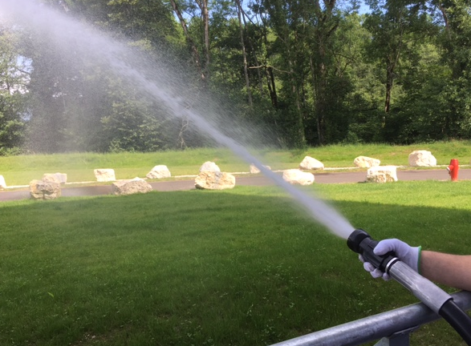
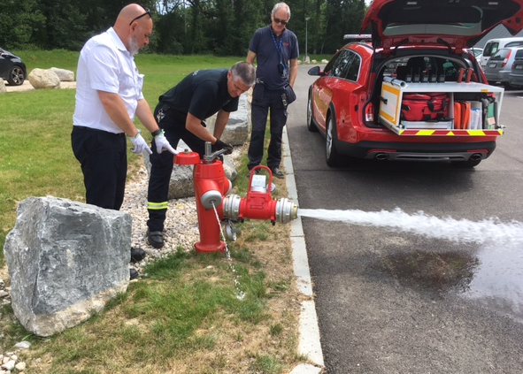
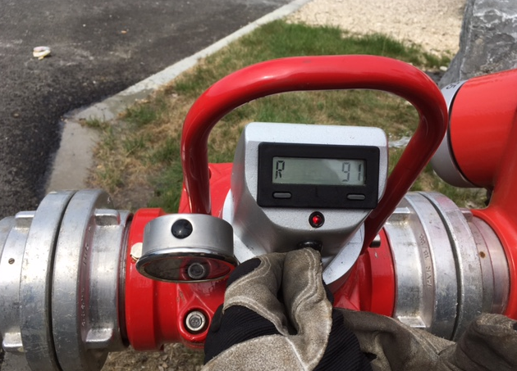
Firefighting systems
  Tests and reception with HSE/FB done on 14 June 2017
    RIAs network inside EHN1 extension area
    Hydrants network outdoor EHN1 extension area
    Conclusion : all firefighting systems are operational. Some minor snags must be treated
    A formal reception report is being prepared : will be included in the installation safety file

Slide 4
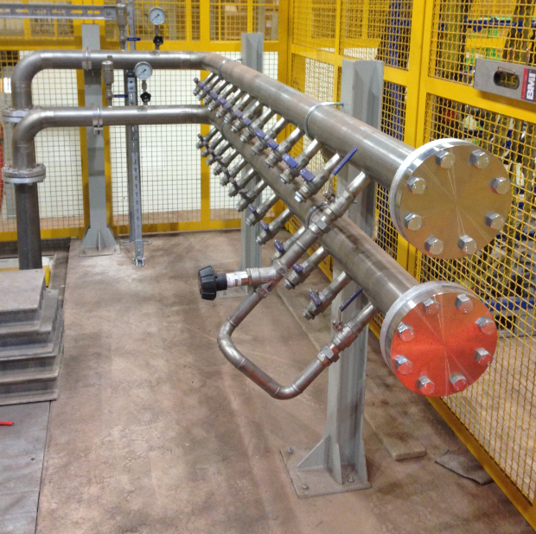
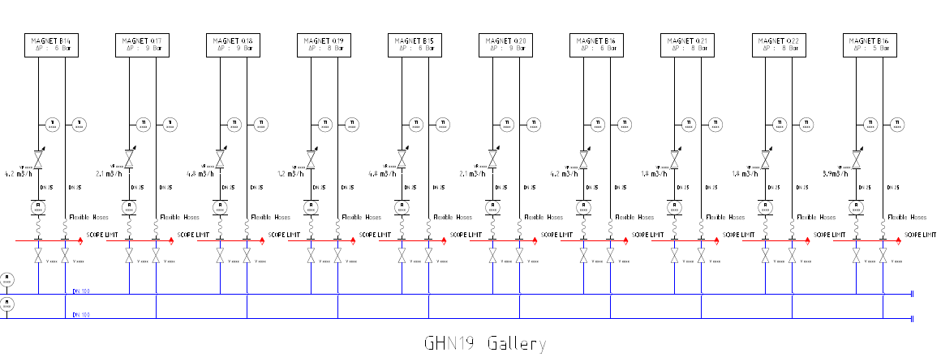
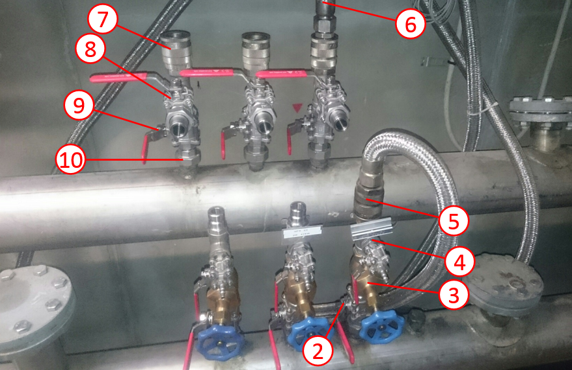
Cooling for new magnets
  Scope limit and contribution for TE/MSC and EN/CV
    The demineralized water distribution ‘clarinette’ is built : shut-off valves installed (EN/CV scope)
    TE/MSC asks EN/CV to supply/install the hydraulic manifold for each magnet
      Water flexible hoses remain in TE/MSC scope
      Manual balancing valves, fittings and ‘Walther’ connectors will be in EN/CV scope
    Reference for the material will be provided by TE/MSC
    Calendar for the installation to be agreed, to comply with the magnets tests

Slide 5
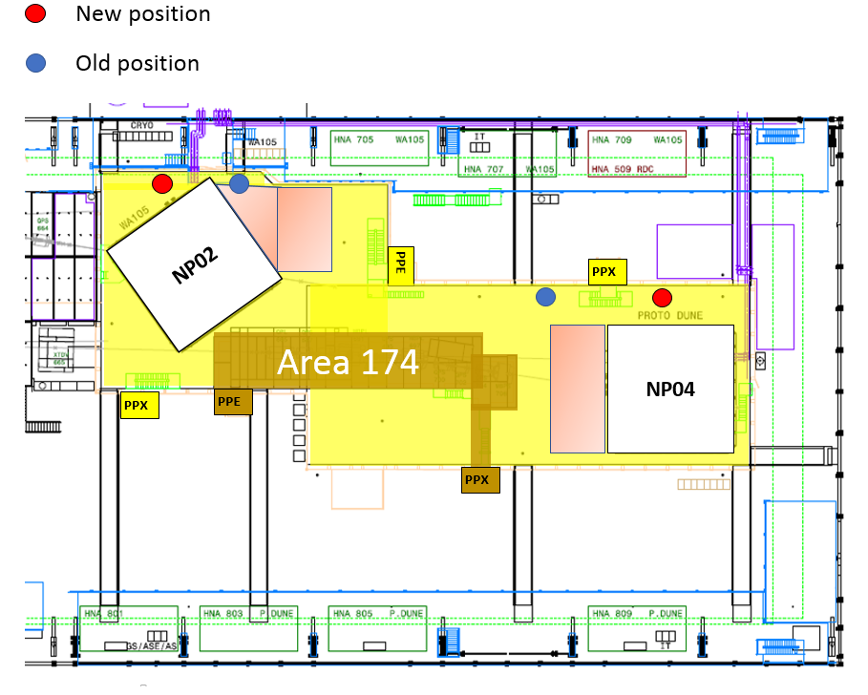
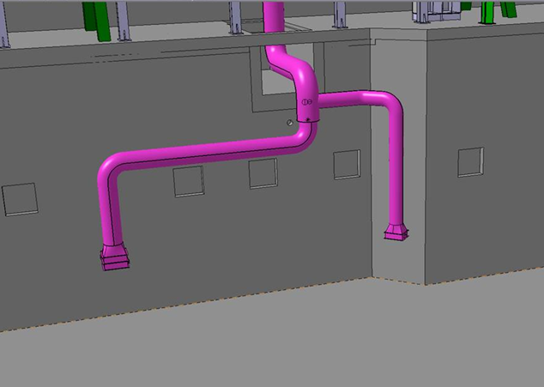
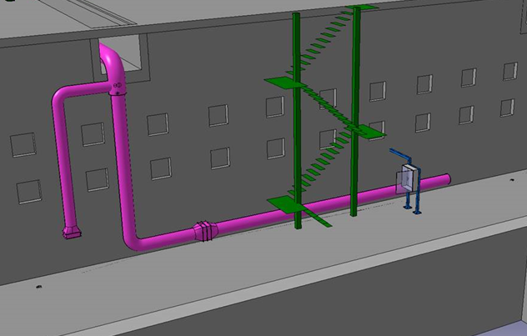
Integration of new argon ducts
    Integration of the new argon ducts was done (see EN-CV 3D mock-up)
    Extra-pressure drop should decrease the extraction flowrate in emergency mode : to be discussed with HSE and EP !
    If OK with HSE: works could be performed in September with other tasks related to WL1
    Note: Regarding the extraction flowrate requirement given in the ODH risk assessment, EN-CV had foreseen safety margin for the WL1 system design (15.000 m3/h versus 13.000 m3/h required)
~ 4 m
~ 13 m

