Slide 1
EHN1 extension
72th EAs integration meeting
V. Clerc – S. Girod
https://indico.cern.ch/event/651507/

Slide 2
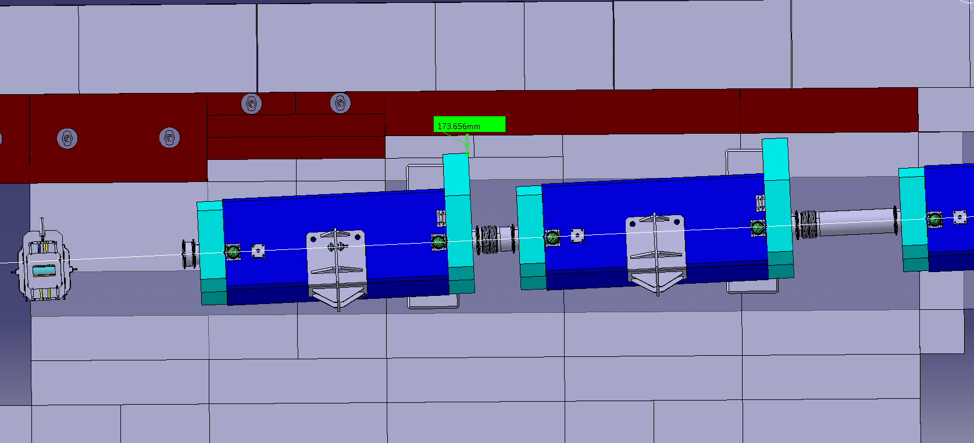
H2 PPE182 shielding change
Interference 70 mm
QPL.021.636 / shielding
Beam

Slide 3
H2 PPE182 shielding change
200 mm steel removed
Beam

Slide 4
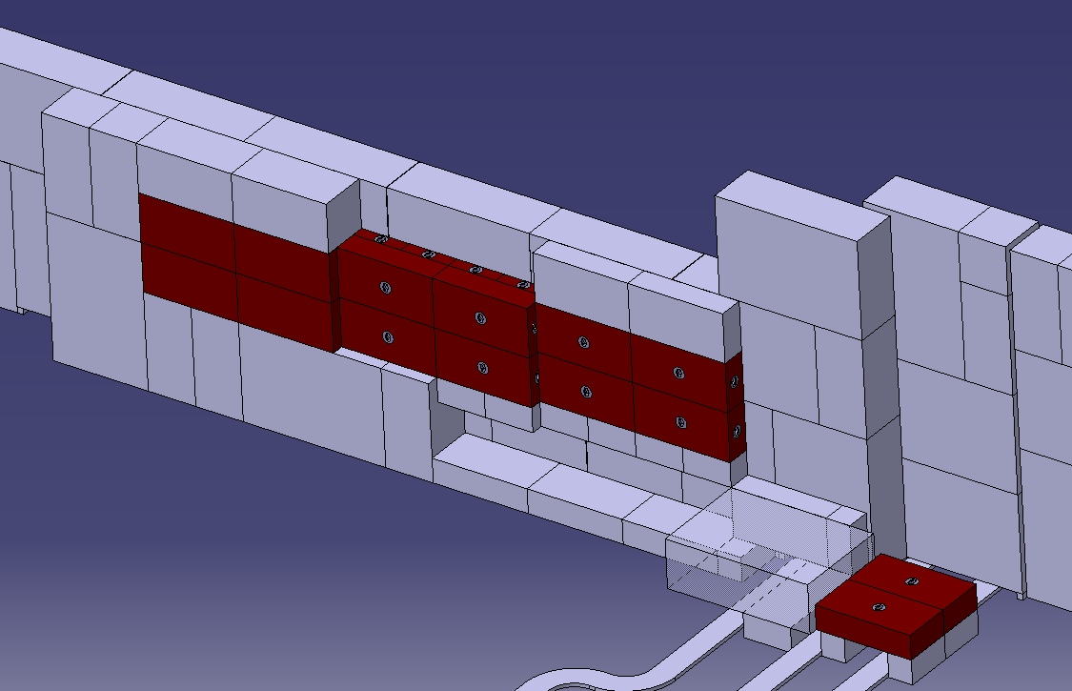
H2 PPE182 shielding change
200 mm steel removed

Slide 5
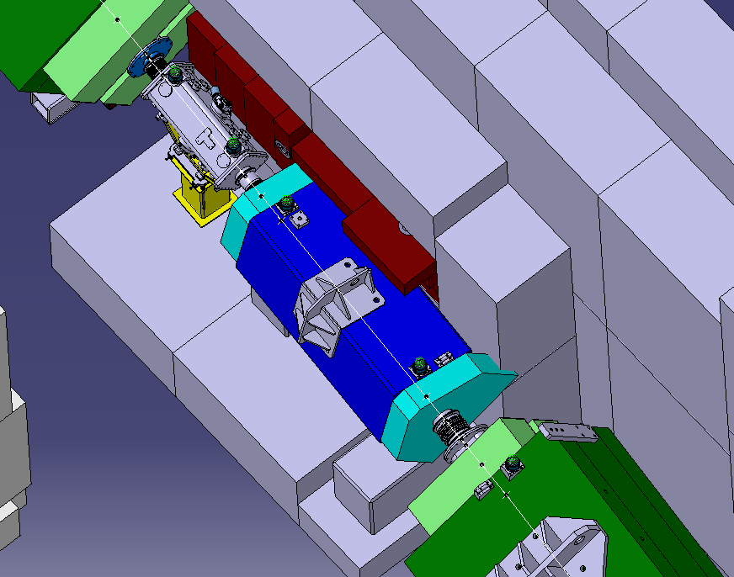
H2 PPE182 shielding change
Interference
QPL.021.651 / shielding

Slide 6
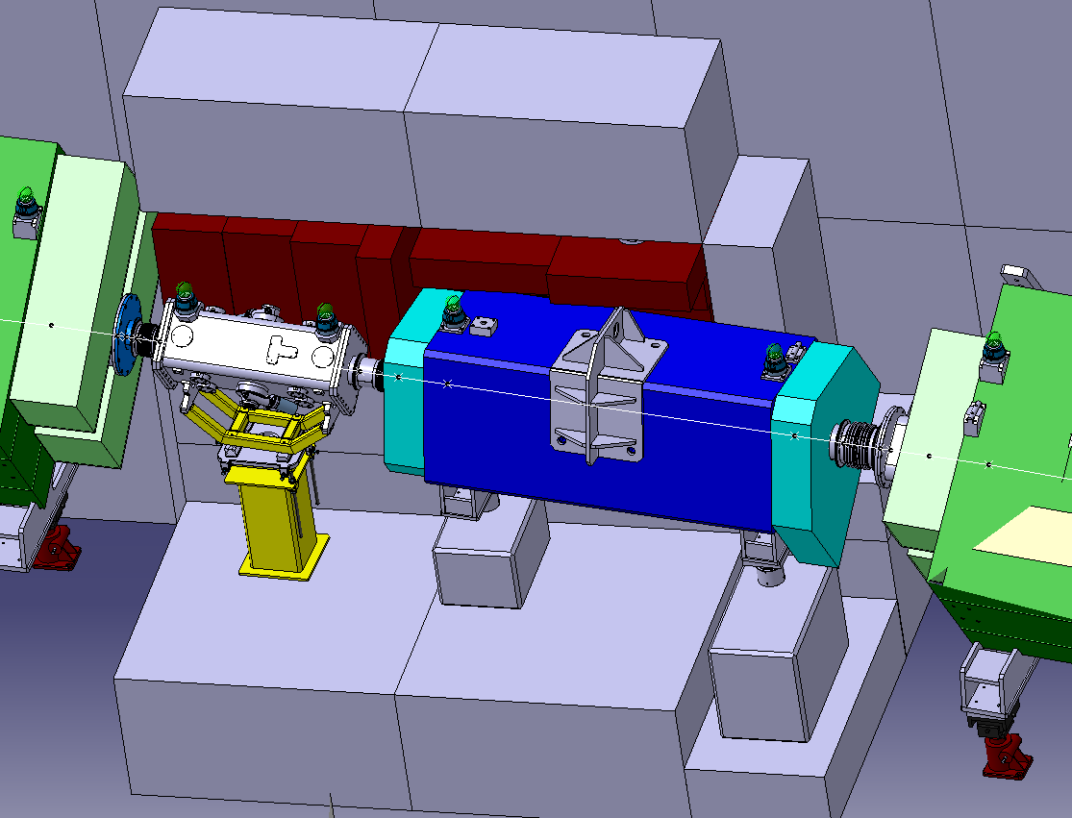
H2 PPE182 shielding change
Concrete bloc 1688 replaced by 1684

Slide 7
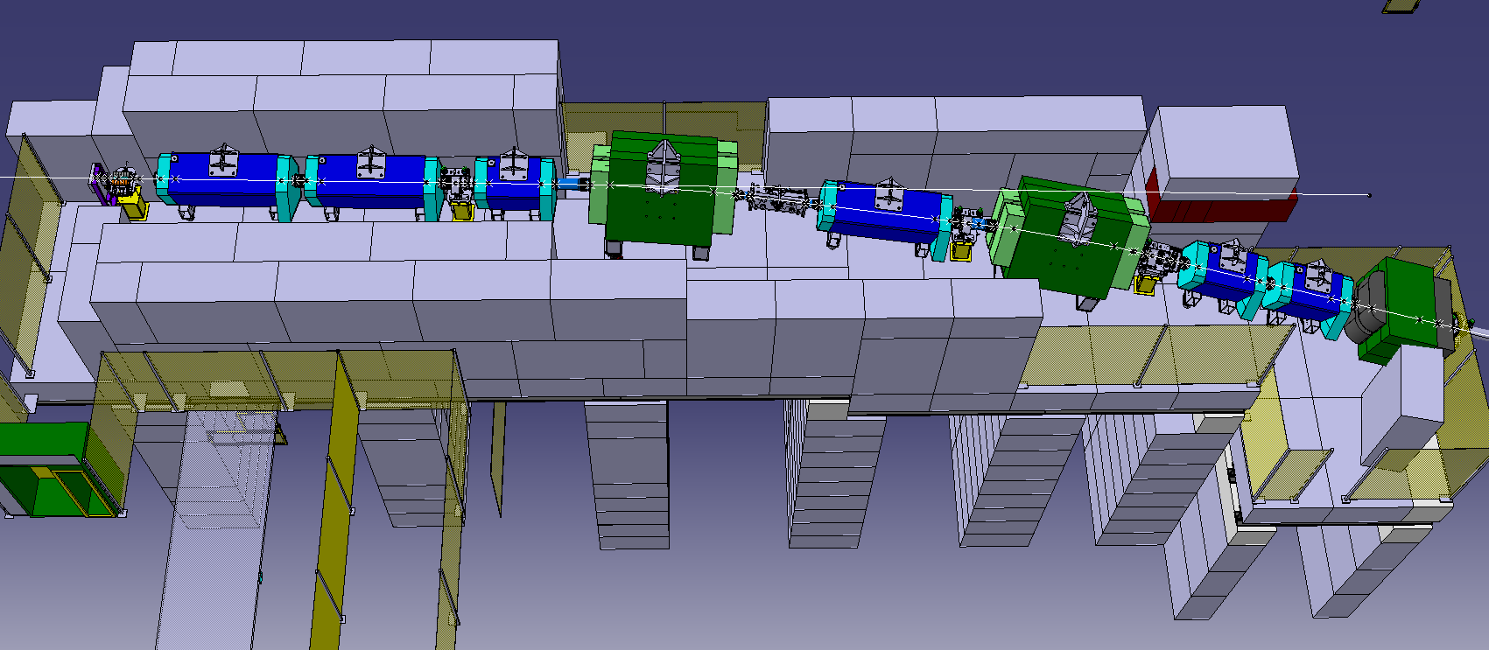
H4 PPE174 shielding change
VLE Target
New dump position
Old dump position

Slide 8
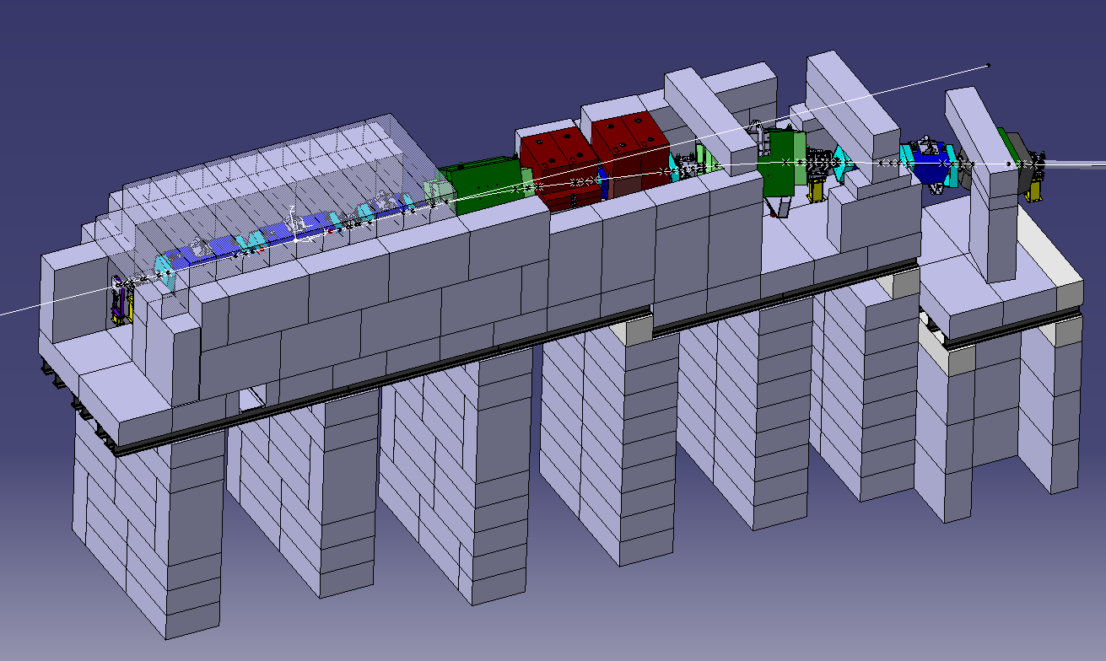
H4 PPE174 shielding change
New shielding for NP04 background
New dump

Slide 9
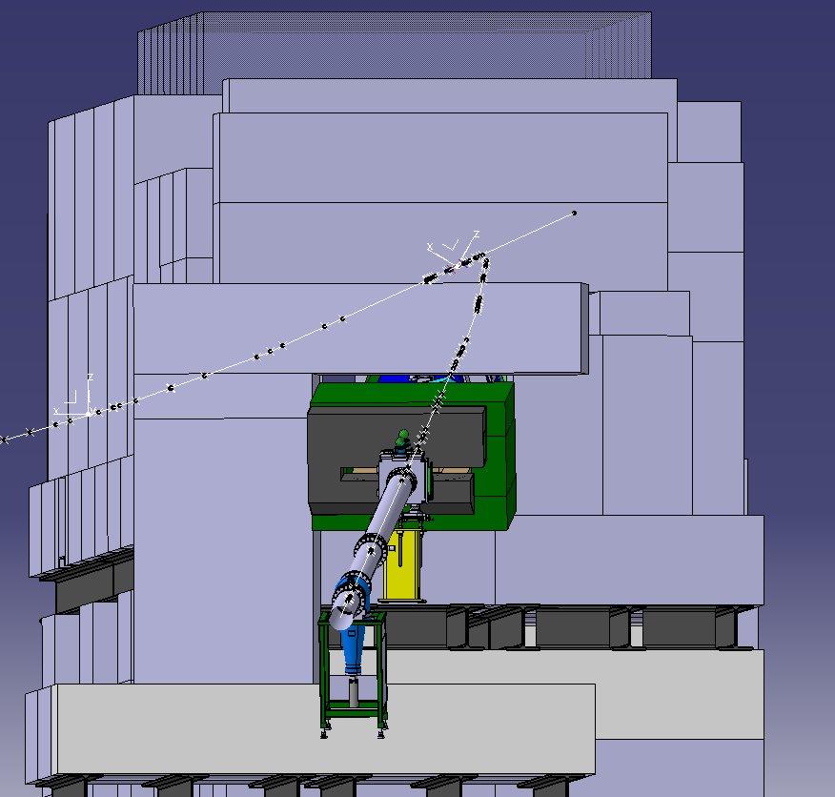
Upstream view from NP04

Slide 10
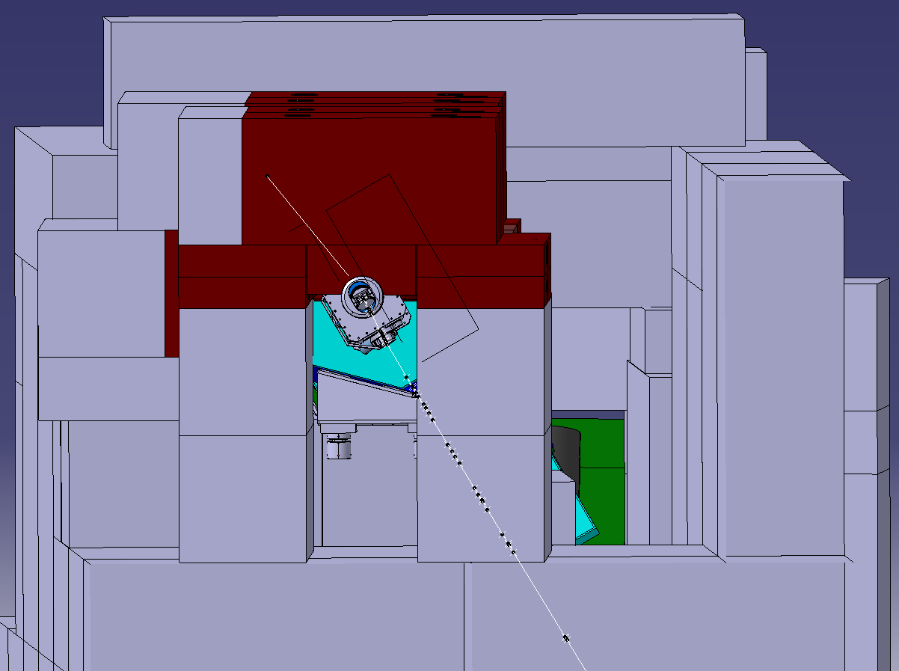
H4 PPE174 shielding change

Slide 11
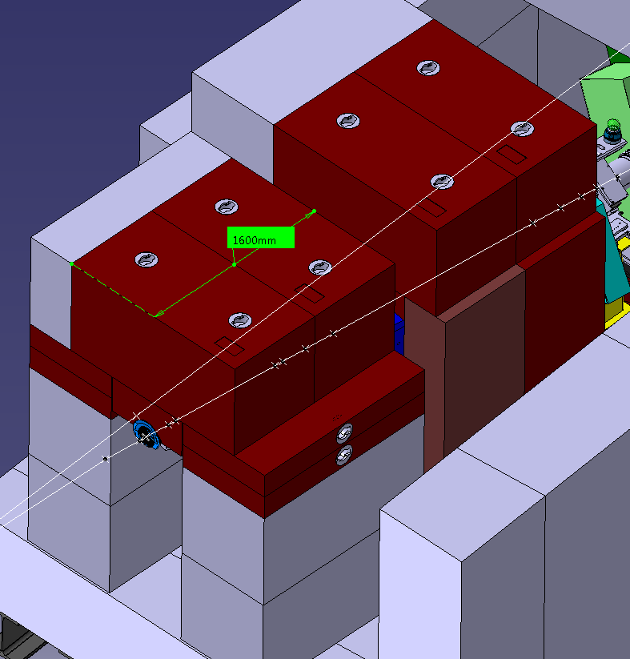
Dump around collimator

Slide 12
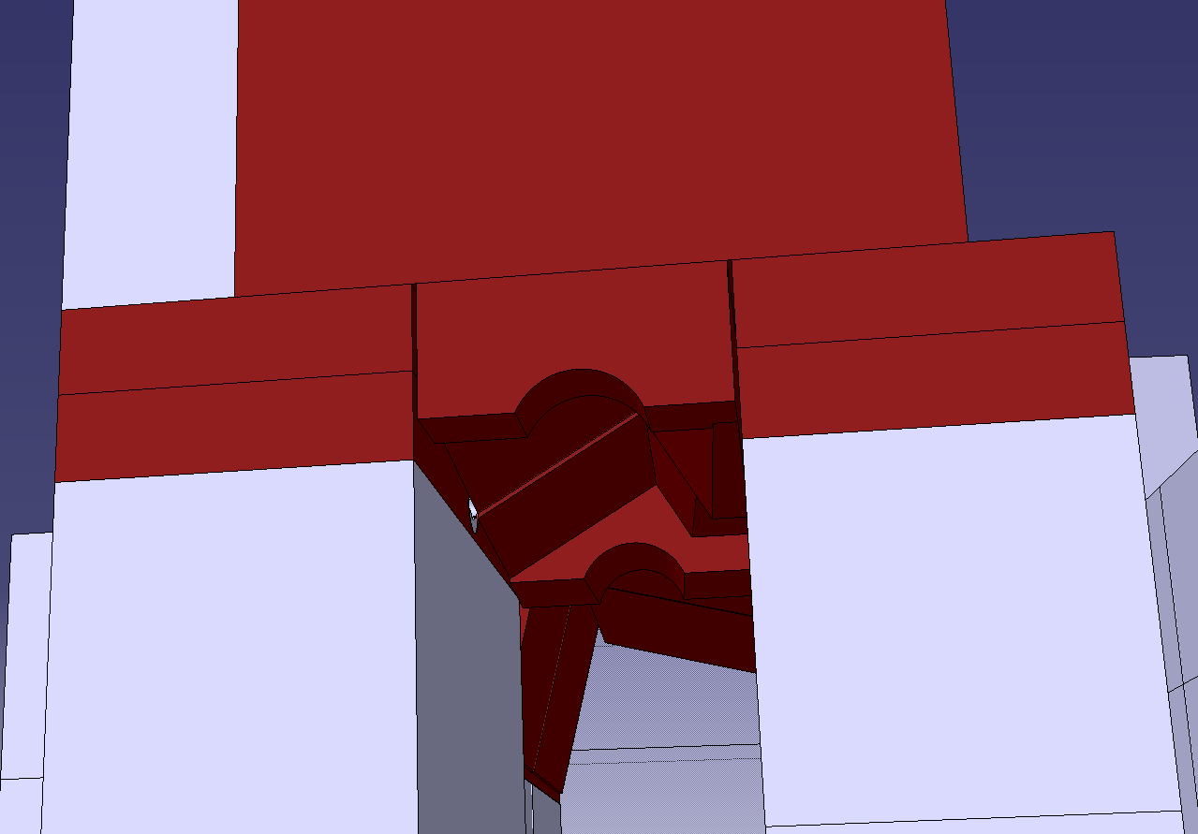
Dump around collimator

Slide 13
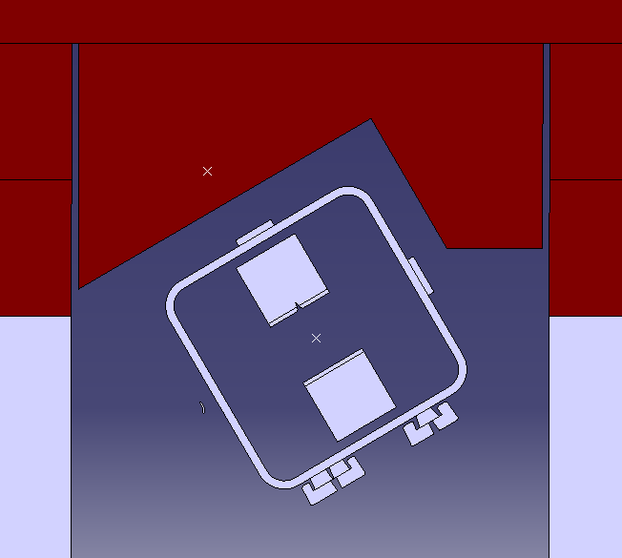
Dump around collimator - section
Beam plane
59.7°

Slide 14
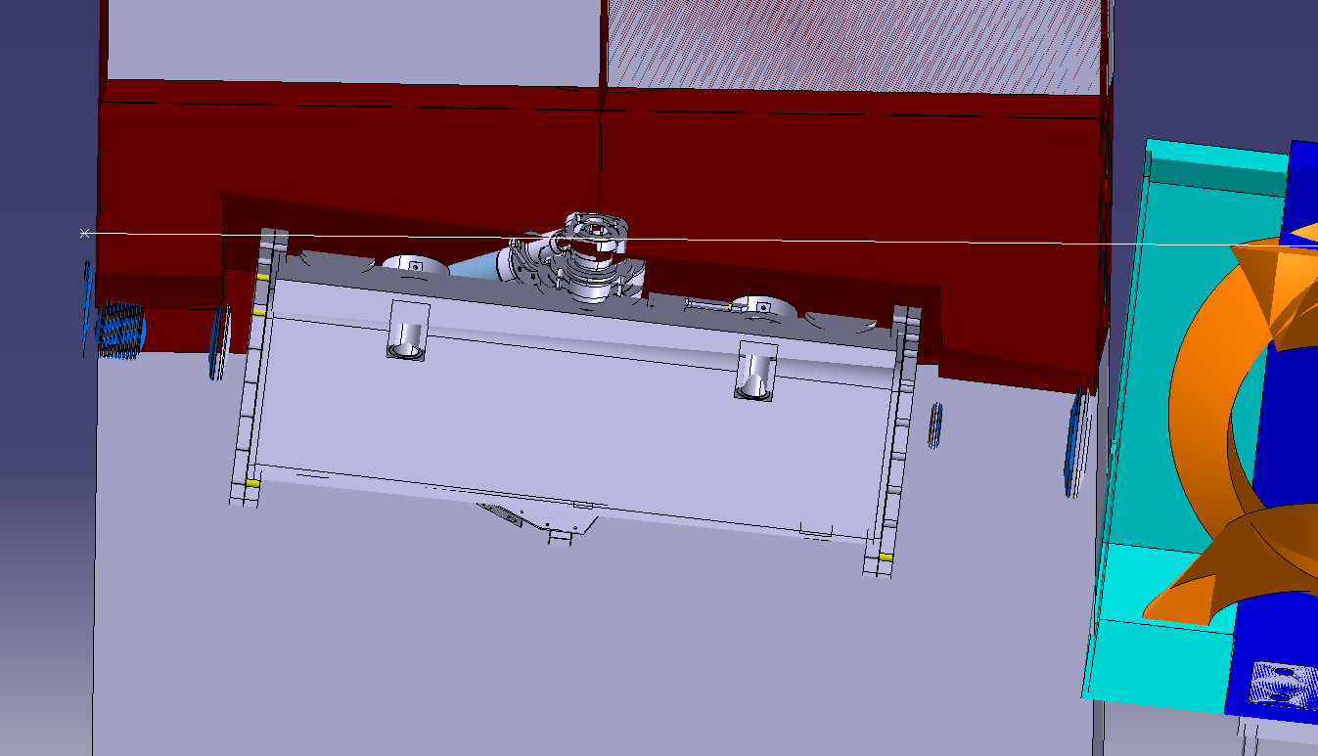
Dump around collimator – side view
Gap mini to collimator: 50mm

Slide 15
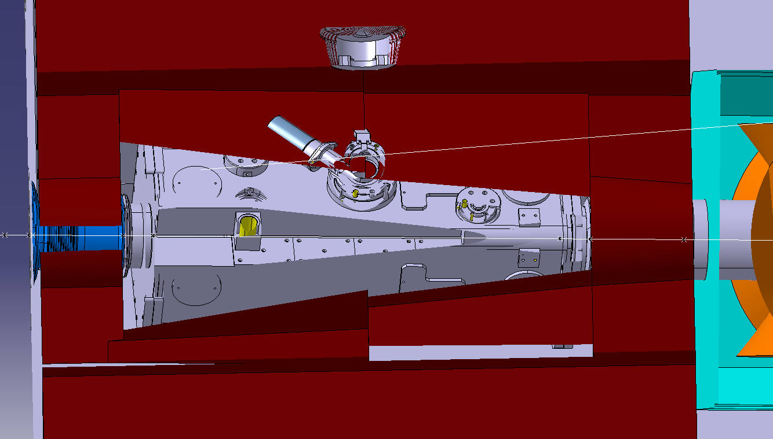
Dump around collimator – top view
Gap mini to collimator: 50mm

Slide 16
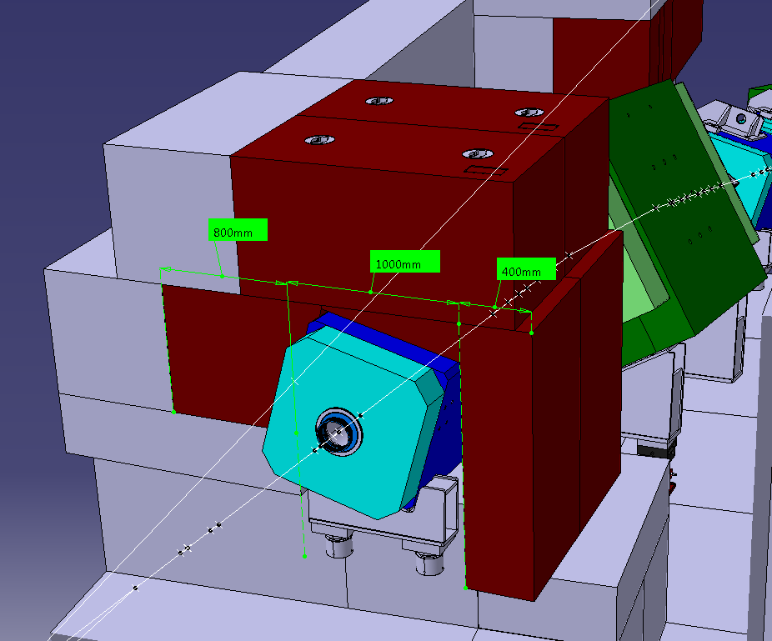
Dump around QPL

Slide 17
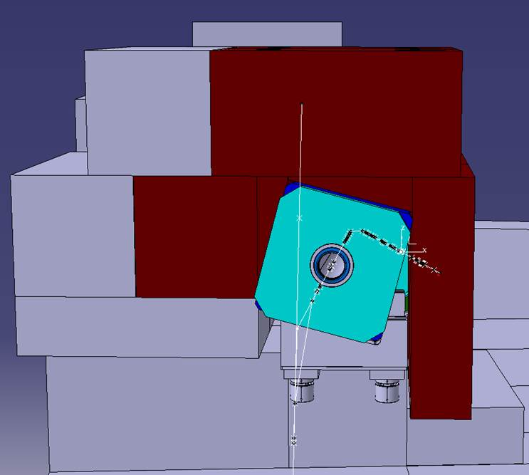
Dump around QPL

Slide 18
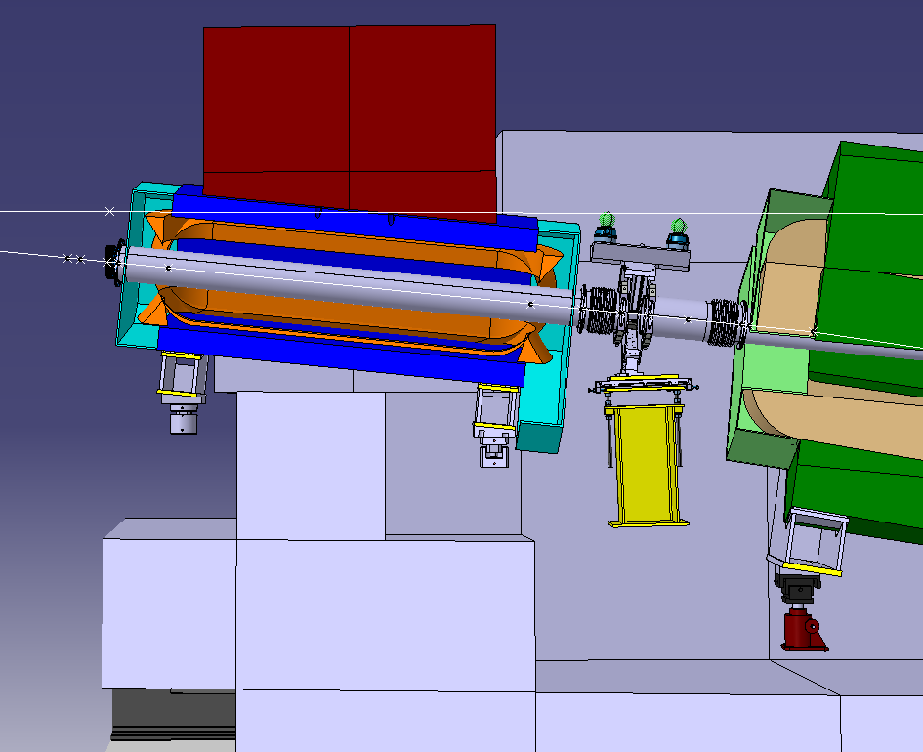
Dump around QPL - side view

Slide 19
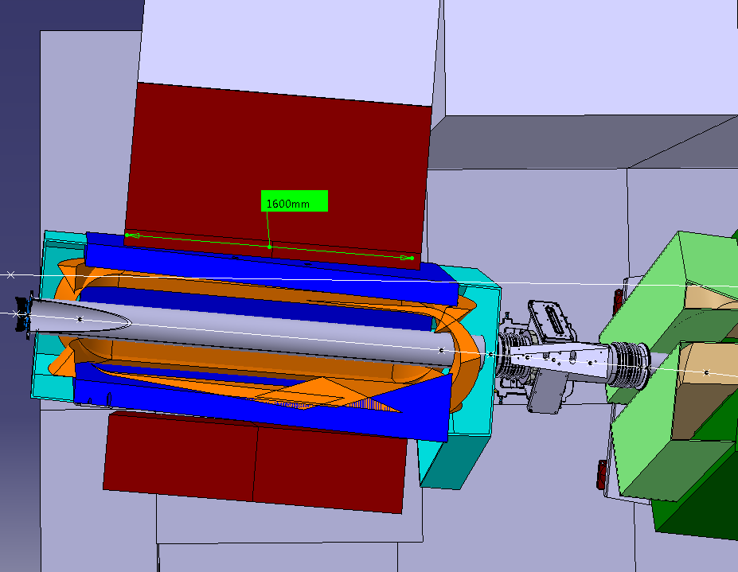
Dump around QPL - top view

Slide 20
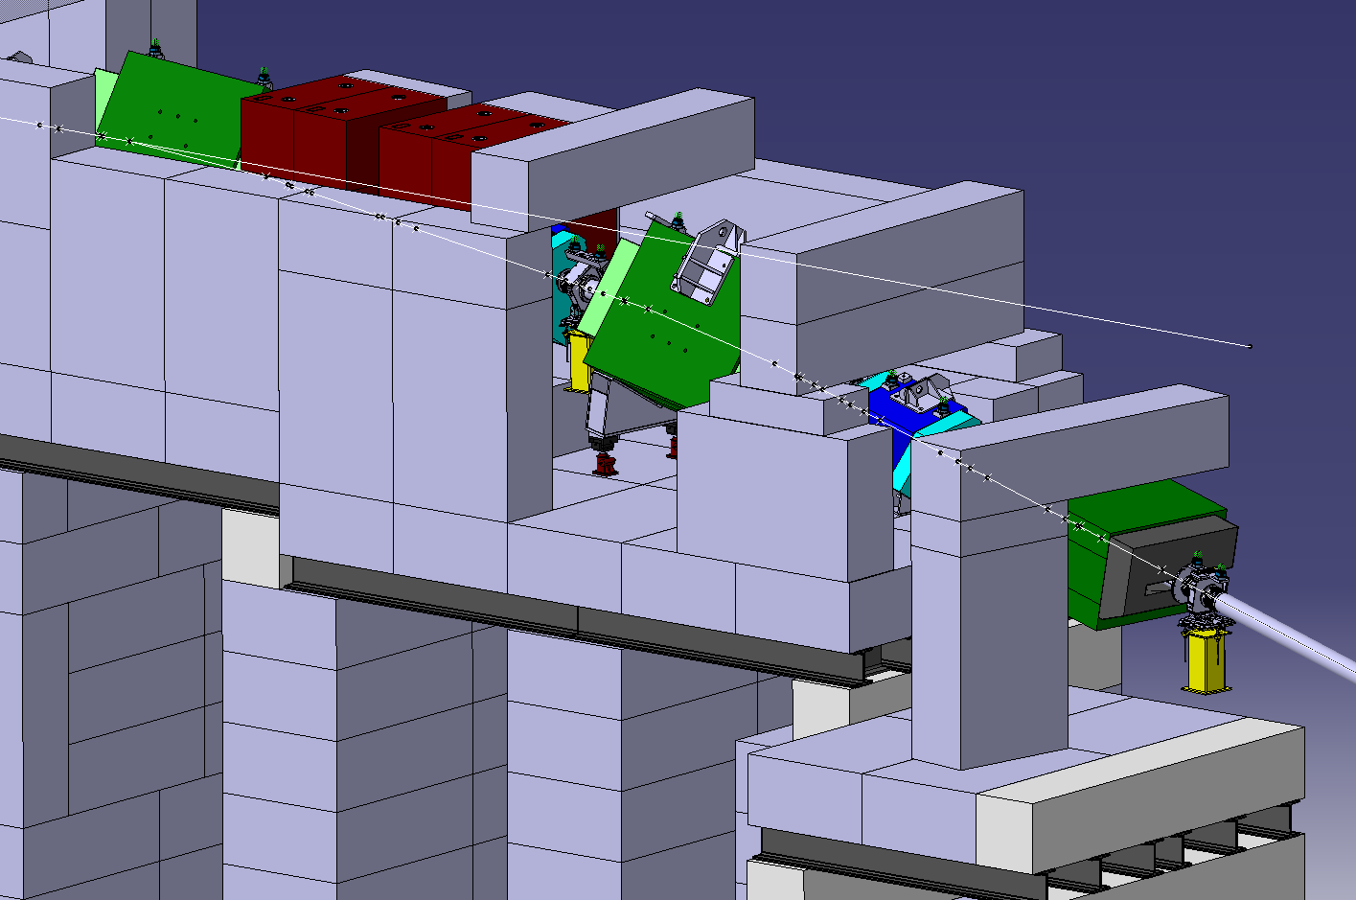
Concrete shielding
Be 4888
Steel pillar
Stair access

Slide 21
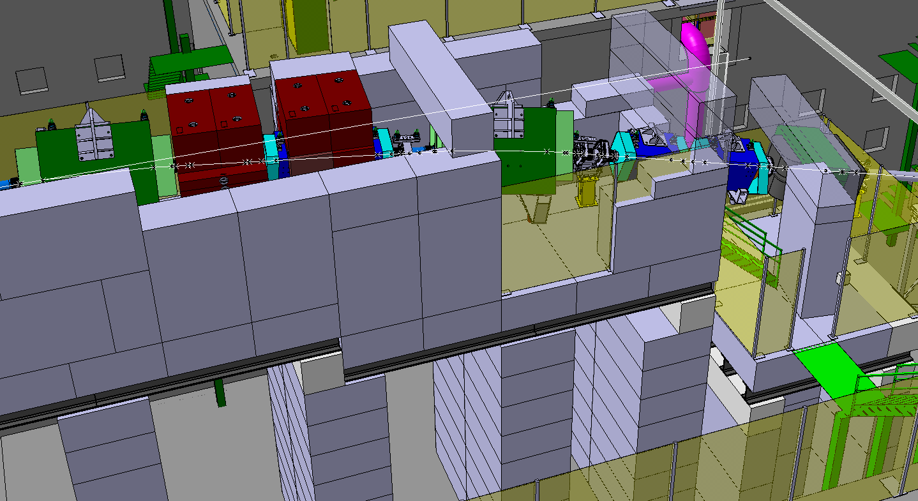

Slide 22
