Slide 2
ARW history
2002 ARW Grenoble
2009 Vancouver
2011 Cape town
2013 Melbourne
2015 Knoxville
2017 Soleil (Paris)
2019 Asia
2021 America

Slide 3
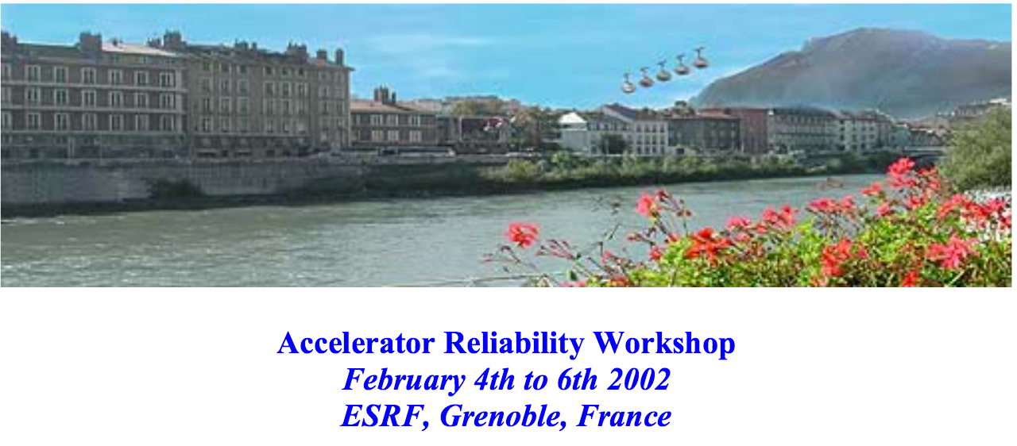
ARW History
2001 ARW Grenoble
  L.Hardy chairman and the main motivator to start the reliability Accelerator workshop.
  He felt we need a community to share reliability aspects of our facilities.

Slide 4
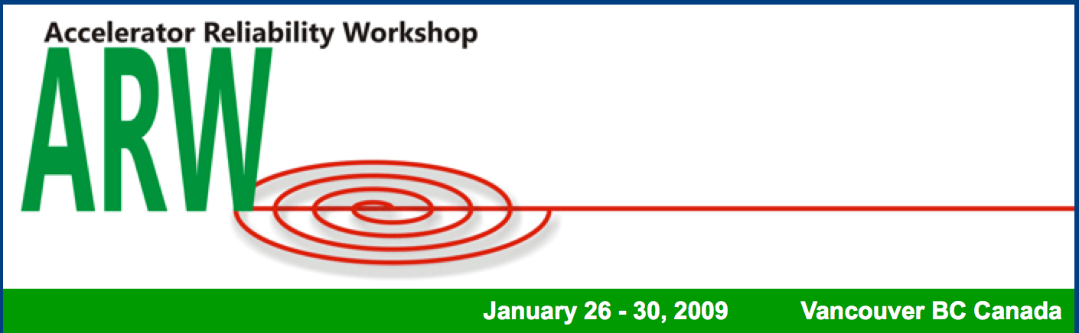
ARW history
2009 Vancouver
Only 7 year later the second workshop thanks to Triumph Operation
Cern Representative (machine protection)
ARW still very fragile continuity no host in view only a possibility with South Africa?

Slide 5

ARW history
2011 Cape Town iThemba Lab
This workshop is marking the first change, ARW community express the interest to have a workshop every 2 years!
Paris, Melbourne and Shanghai show interest to host next ARW, Melbourne was chosen.
Cern Representative (S.Claudet,K.Foraz,M.Pojer,B.Puccio,P.Sollander, R.Giachino)

Slide 6

ARW history
2013 Melbourne Australian synchrotron
This workshop was a big success despite the difficult world financial situation, more than 100 delegates.
Cern Representative (M.Brugger, A.Masi, K.Foraz, B.Todd, P.Sollander, R.Giachino)
Paris, Knoxville and Shanghai show interest to host next ARW, Knoxville was chosen.
The workshop is now growing the IOC wish more organization, a mid/long term plan for futures ARW’s are needed. A IOC chairman is voted to take this commitment.
The objective is to be more and more visible and enlarge the community to new labs and equipment's specialist and reliability experts worldwide.

Slide 7

ARW history
2013 Knoxville SNS
This workshop is marking again another step forward with the level of organization and the quality of the scientific program.
The participation is very wide new labs (Iter, Myrrha, Ifmif, etc,) and more and more equipment's specialist and reliability experts are part of the audience.
Cern Representative (B.Todd, A.Apollonio, M.Solfaroli, K.Foraz, V.Baglin,S.Cettour, R.Giachino)
Soleil (Paris), show interest to host next ARW.

Slide 8
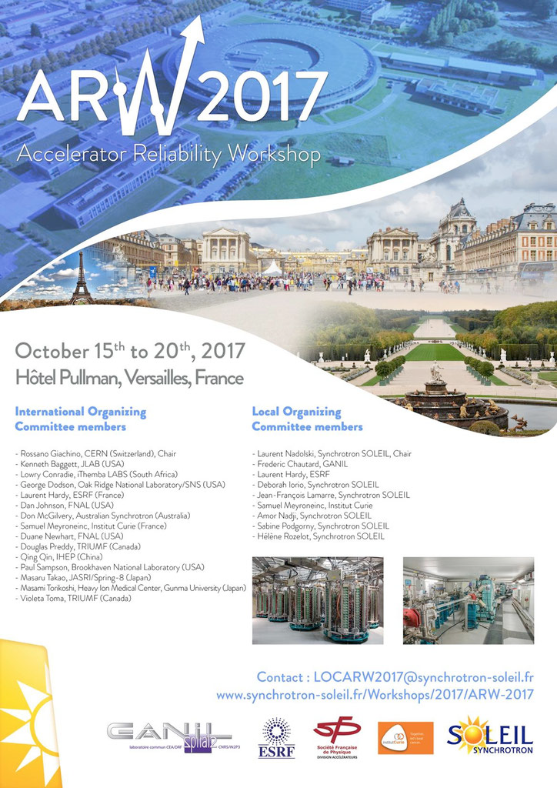
ARW history
2017 Soleil France
Cern Representative so far..
(B.Todd, A.Apollonio, S.Uznanski , L.Delprat F.Ferrand, V.Schramm, R.Giachino).

Slide 9
