Slide 1
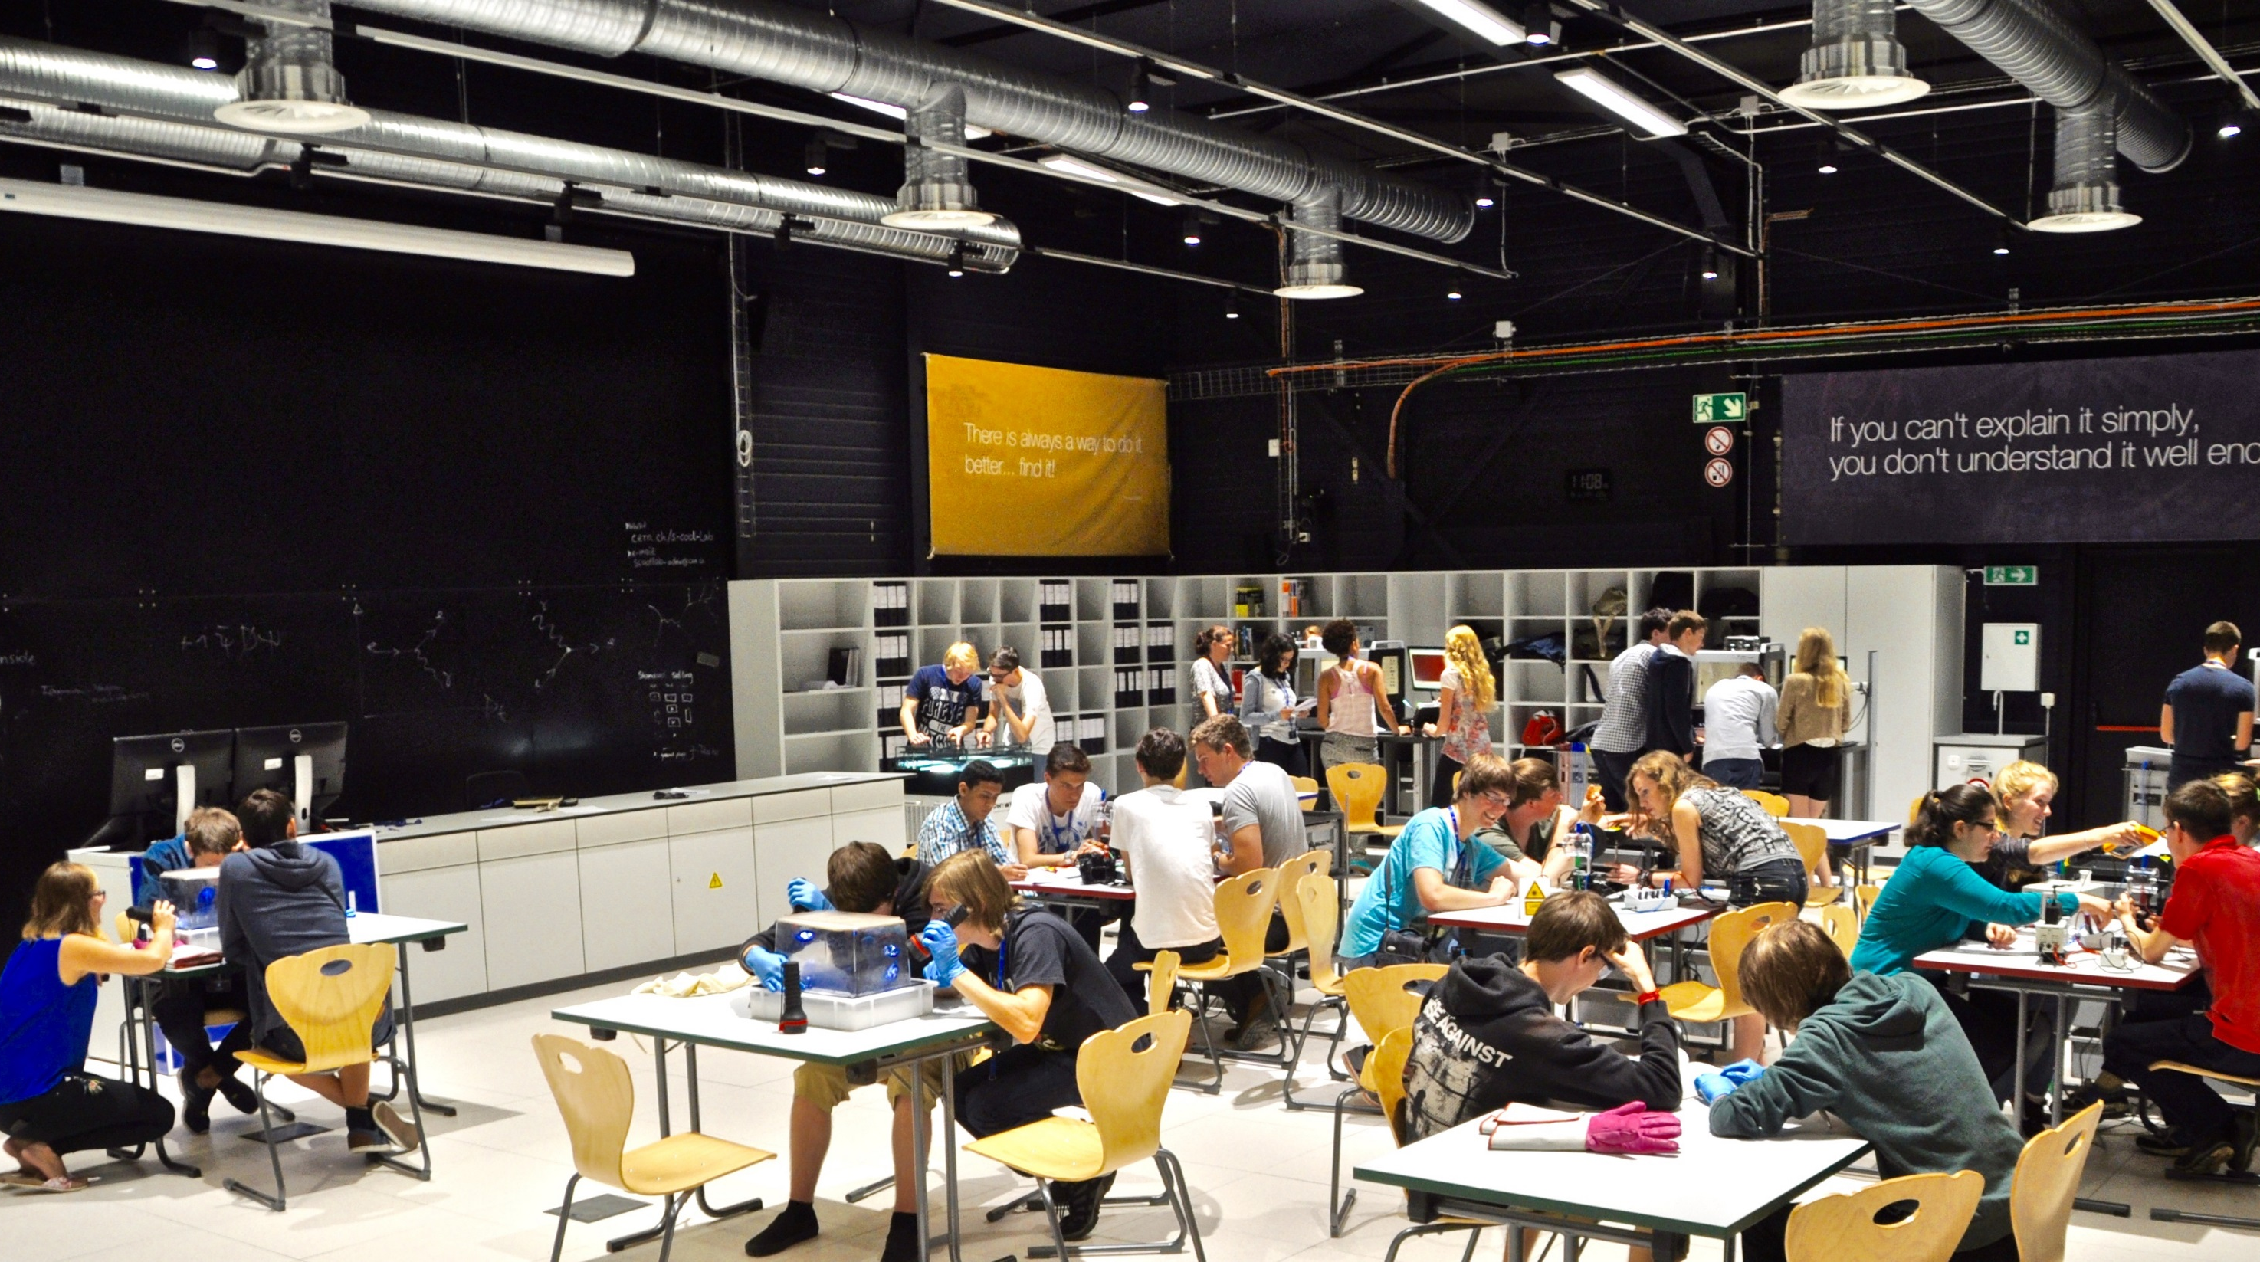

WG1 & WG2

Slide 2
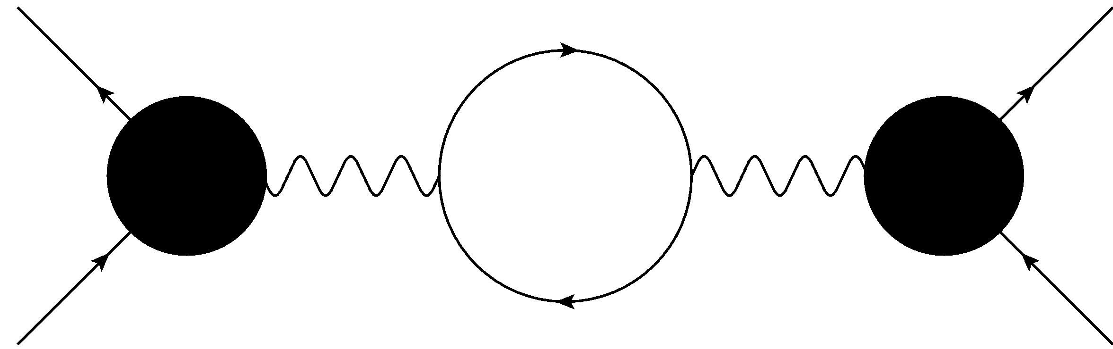
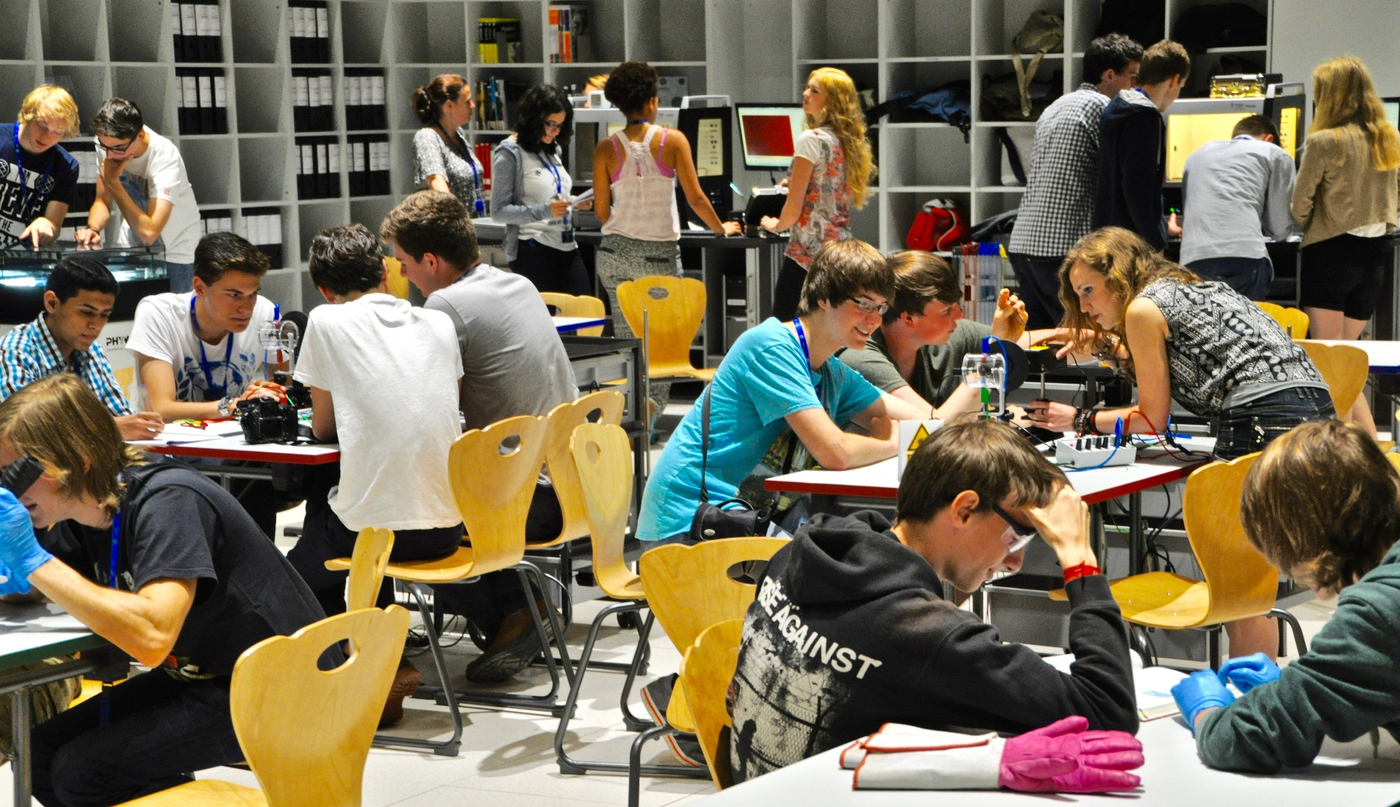
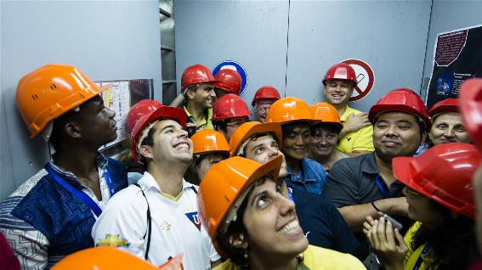
What is S’Cool LAB?
particle physics experiments
► hands-on & minds-on
Physics Education Research
high school students
high school teachers

Slide 3
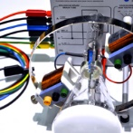

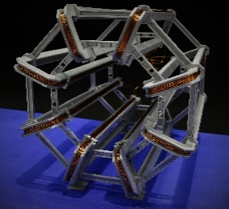
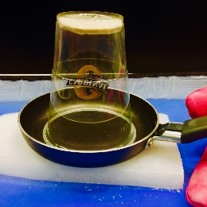
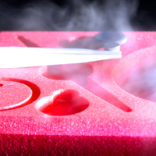
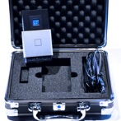
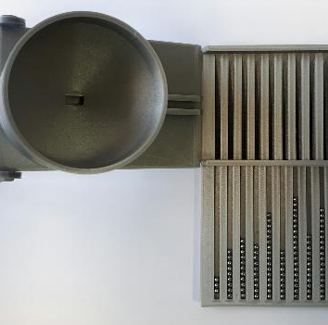
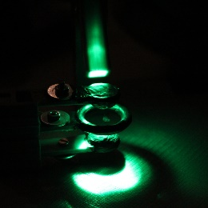
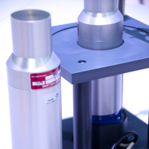
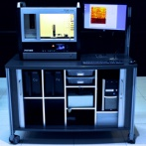
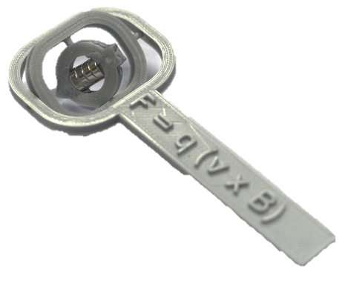
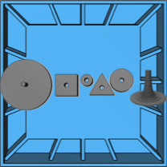
Experiments: high-tech vs. low-cost
In S’Cool LAB: high-tech
For the classroom: low-cost
electrons in magnetic fields
cloud chambers
3D printable magnet models
DIY
cloud
chambers
super-conductivity
pixel detectors
Bragg peak model
3D printable particle traps
PET
X-ray
machines
3D compass
Rutherford scattering model
… and many more to come

Slide 4
Experiments: high-tech vs. low-cost
For the classroom: low-cost
3D printable magnet models
DIY
cloud
chambers
Bragg peak model
3D printable particle traps
3D compass
Rutherford scattering model
… and many more to come

Slide 5
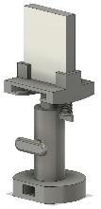
HST working Group – Low Cost 3D Printable Experiments
Fabian Bernstein and Lachlan McGinness
3D printable magnet models
DIY
cloud
chambers
Bragg peak model
3D printable particle traps
Beam optics
Rutherford scattering model

Slide 6
HST working Group – Low Cost 3D Printable Experiments
Fabian Bernstein and Lachlan McGinness
3D printable magnet models
DIY
cloud
chambers
Bragg peak model
3D printable particle traps
Beam optics
Rutherford scattering model
Quadrupole Ion Trap

Slide 7
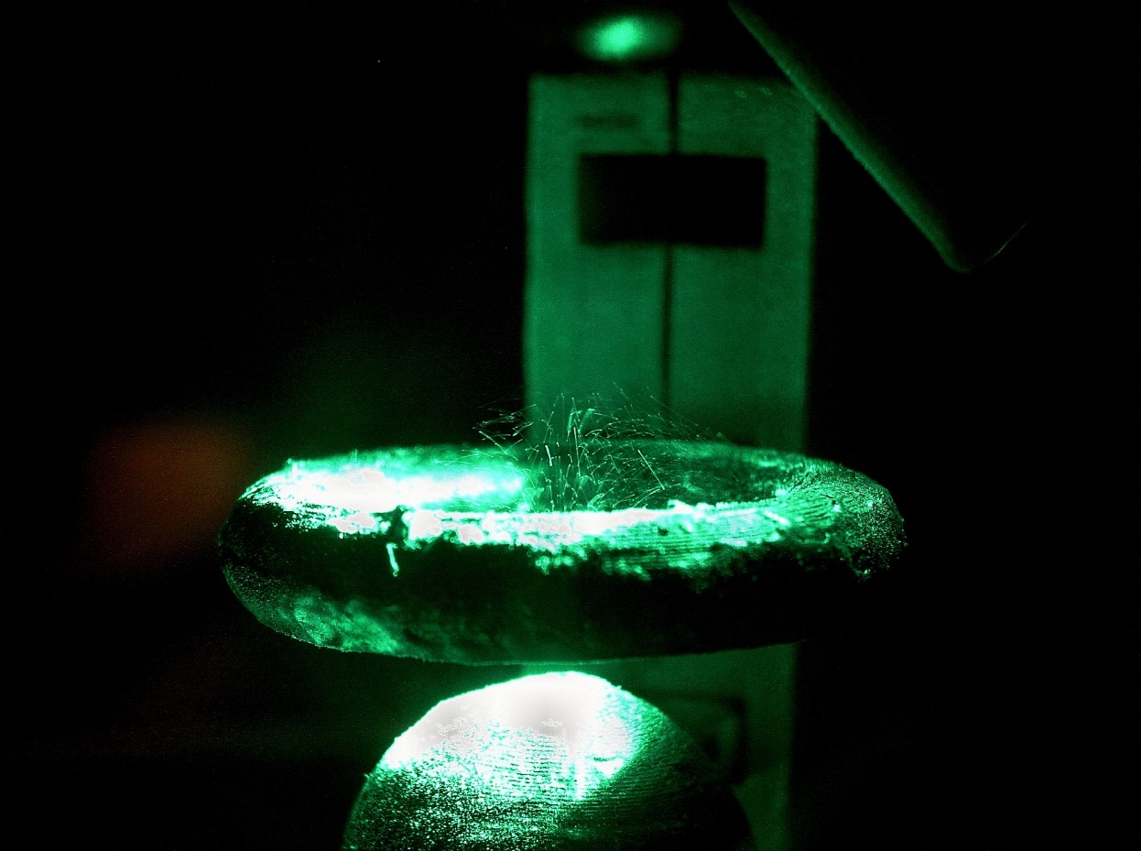
HST working Group – Low Cost 3D Printable Experiments
Fabian Bernstein and Lachlan McGinness
3D printable magnet models
DIY
cloud
chambers
Bragg peak model
3D printable particle traps
Beam optics
Rutherford scattering model
Quadrupole Ion Trap

Slide 8
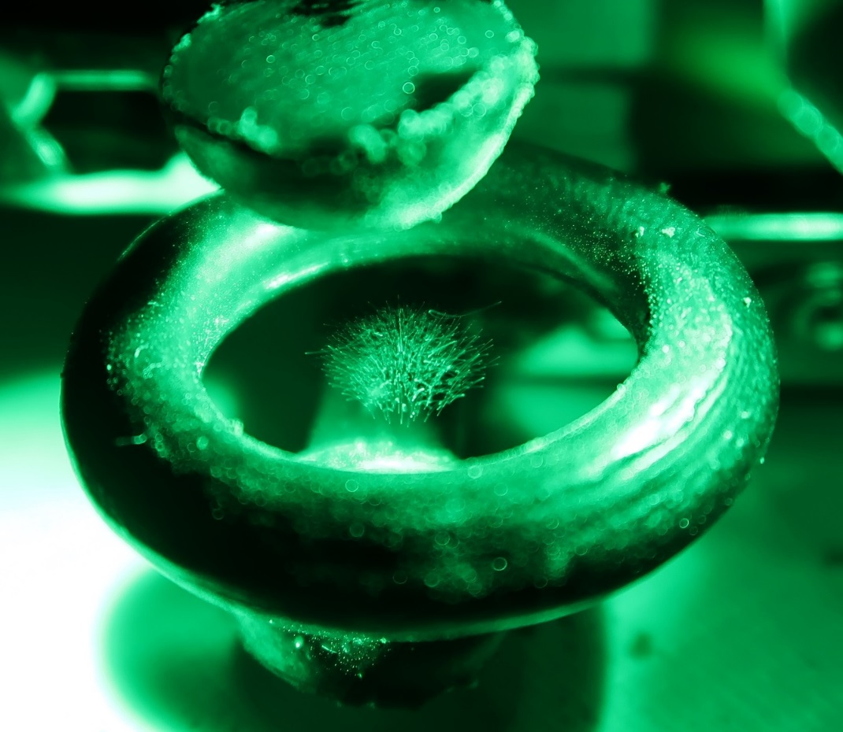
HST working Group – Low Cost 3D Printable Experiments
Fabian Bernstein and Lachlan McGinness
1.) Build a quadrupole ion trap
2.) Perform an experiment with the trap and figure out how it works
Quadrupole Ion Trap

Slide 9
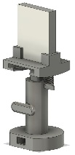
HST working Group – Low Cost 3D Printable Experiments
Fabian Bernstein and Lachlan McGinness
3D printable magnet models
DIY
cloud
chambers
Bragg peak model
3D printable particle traps
Beam optics
Rutherford scattering model
Beam Optics

Slide 10
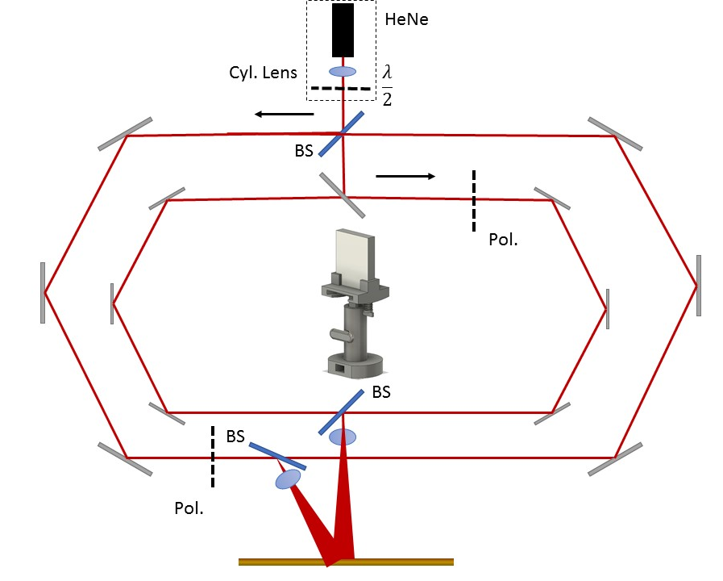
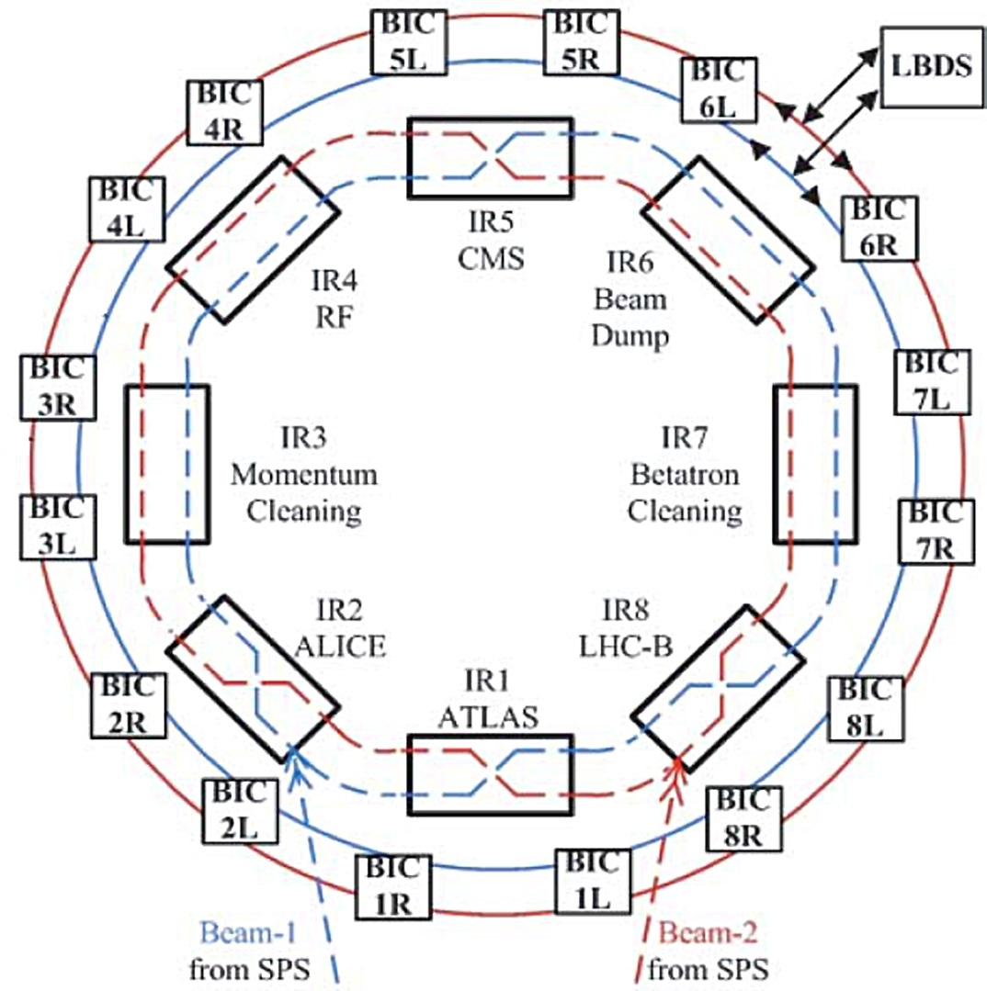
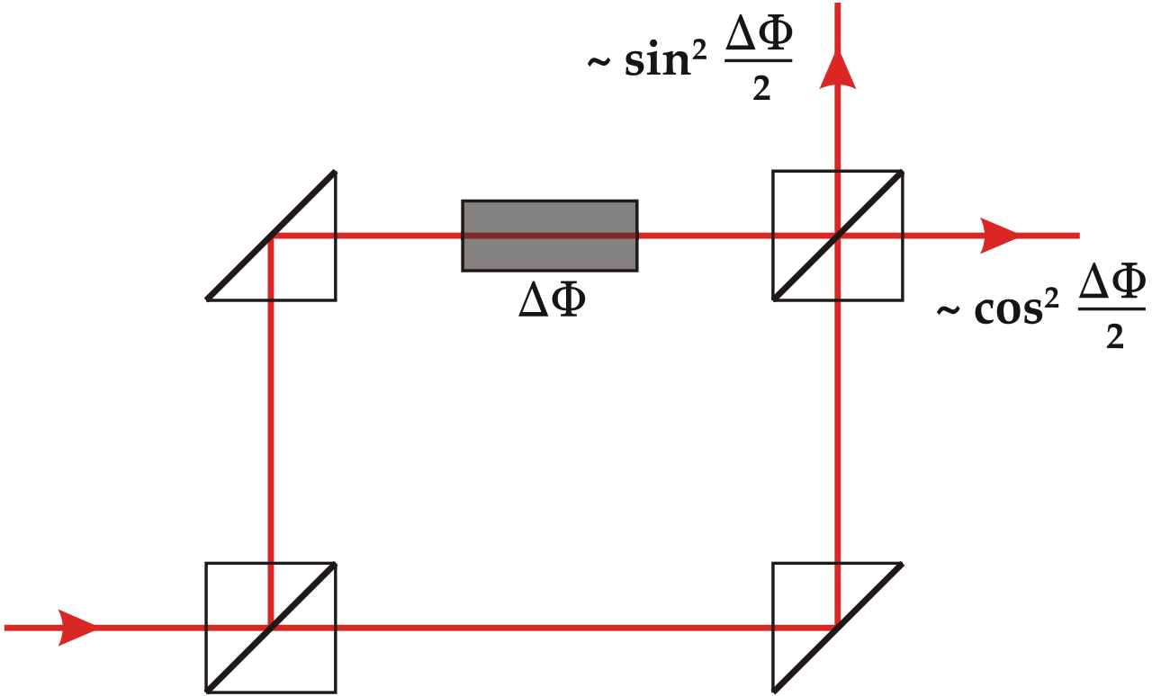
HST working Group – Low Cost 3D Printable Experiments
Fabian Bernstein and Lachlan McGinness

Slide 11
HST working Group – Low Cost 3D Printable Experiments
Fabian Bernstein and Lachlan McGinness
We are looking to represent the LHC
proton beam using geometric optics.
Mirrors and lenses can bend and focus optical beams. In the LHC different types of magnets bend and focus particle beams.
This is a more open ended project and we are excited to see where you take it.

Slide 12
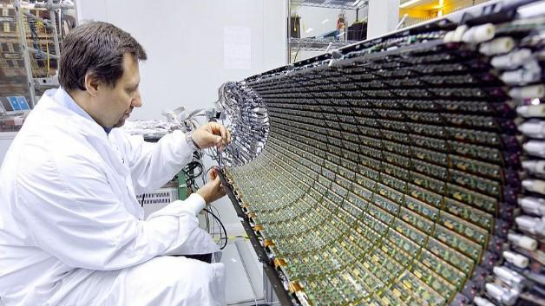
HST S`Cool LAB Working Group 2
Semiconductors at CERN
https://www.elektroniknet.de/markt-technik/halbleiter/ohne-halbleiter-kein-higgs-teilchen-105672.html

Slide 13
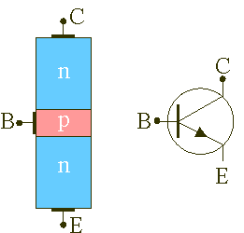
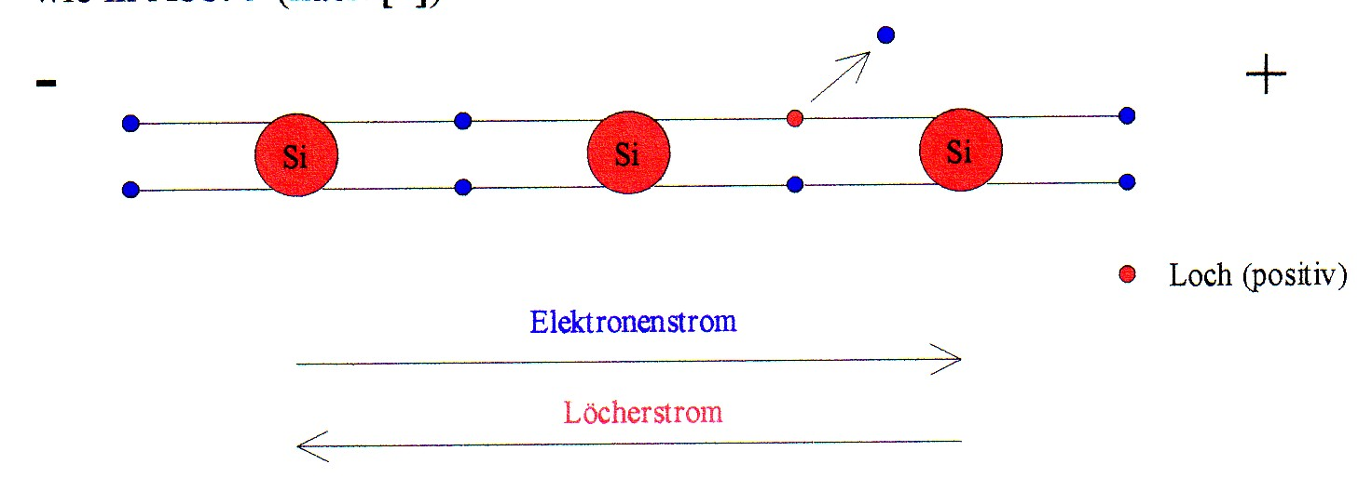
HST S`Cool LAB Working Group 2
Semiconductors at CERN
Experience how Semiconductors can be introduced at school
npn-transistor

Slide 14
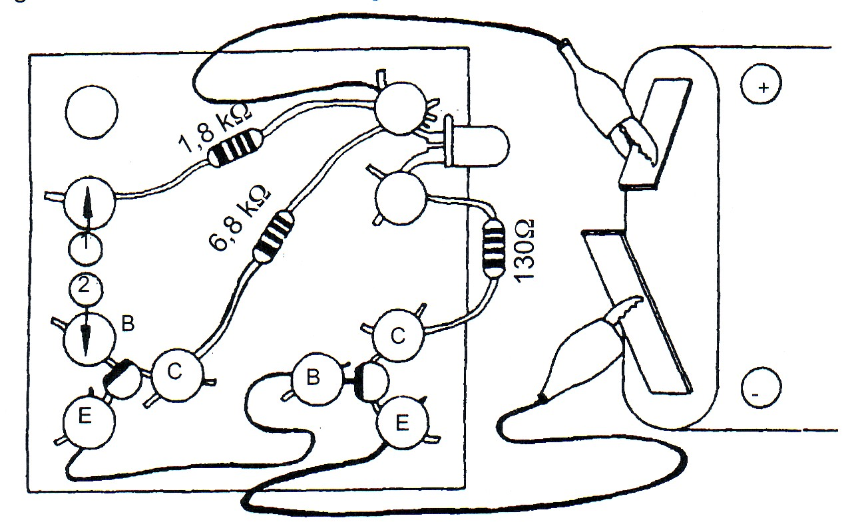
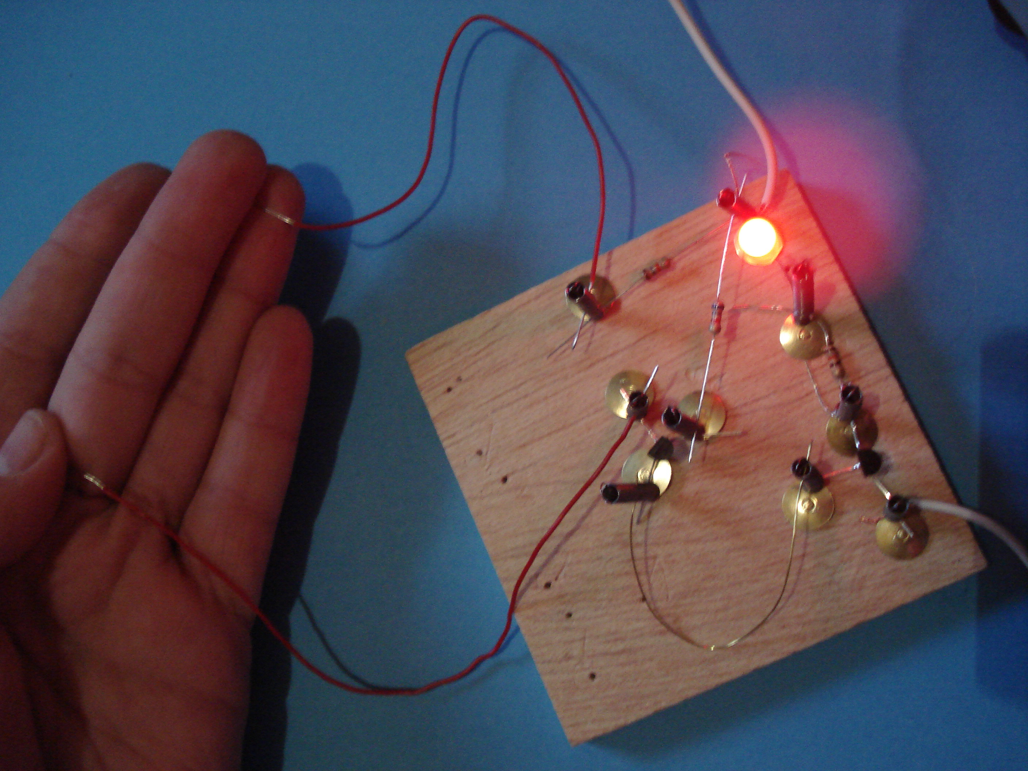
HST S`Cool LAB Working Group 2
Semiconductors at CERN
Experience how Semiconductors can be introduced at school
Use hands-on low cost experiments to discover different functional circuits
Sensor switch

Slide 15
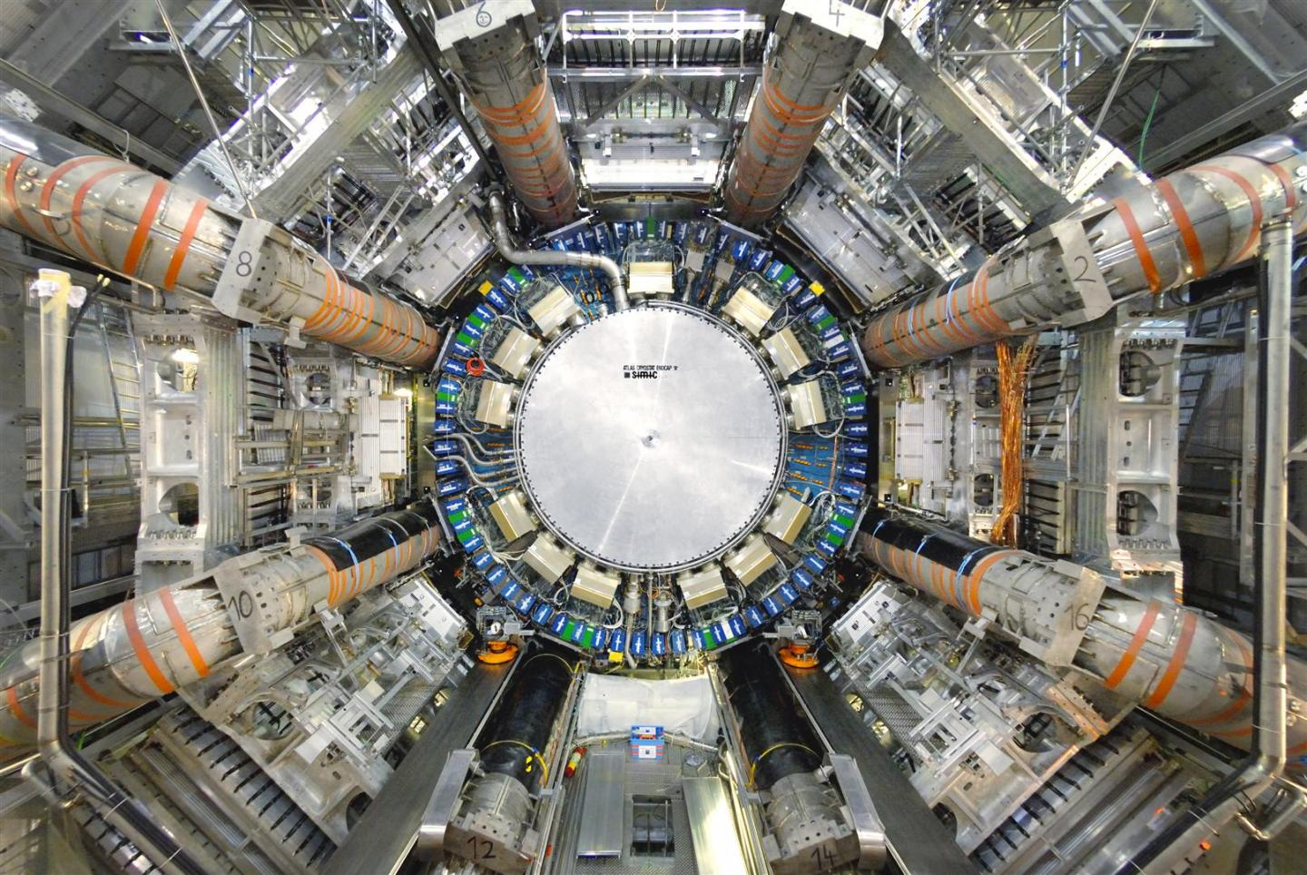
HST S`Cool LAB Working Group 2
Semiconductors at CERN
Experience how Semiconductors can be introduced at school
Use hands-on low cost experiments to discover different functional circuits
Discover where and how semiconductors are used at CERN
https://home.cern/sites/home.web.cern.ch/files/image/experiment/2013/01/atlas.jpeg

Slide 16
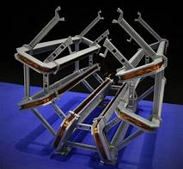
HST S`Cool LAB Working Group 2
Semiconductors at CERN
Experience how Semiconductors can be introduced at school
Use hands-on low cost experiments to discover different functional circuits
Discover where and how semiconductors are used at CERN
Create your own model for school, explaining the use of semiconductors at CERN

