Slide 1
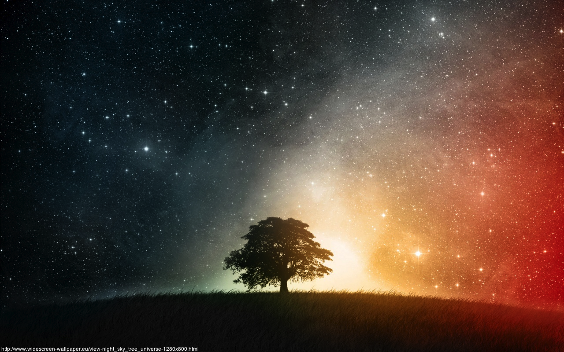
Cosmology
A short introduction
Sarah Aretz
CERN

Slide 2
What is cosmology all about?
Κοσμολογία = study of the world
description of the origin, evolution and eventual fate of the universe by physical laws

Slide 3
Cosmological Questions
What is the universe made of?
How does its structure look like?
What is its origin?
Can we reconstruct the history of the universe?
Where is the journey taking us?

Slide 4
Outline
Dimensions of our universe
Dynamics of the universe
A journey through time
Mysteries of the universe

Slide 5
Dimensions of our Universe

Slide 6
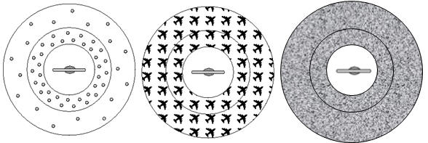
The Cosmological Principle
“On large scales the Universe is
homogeneous and isotropic”
We don’t find ourselves in a special place.
Credit: http://www.astronomynotes.com
isotropic, but not homogeneous
homogeneous, but not isotropic
homogeneous and isotropic

Slide 7
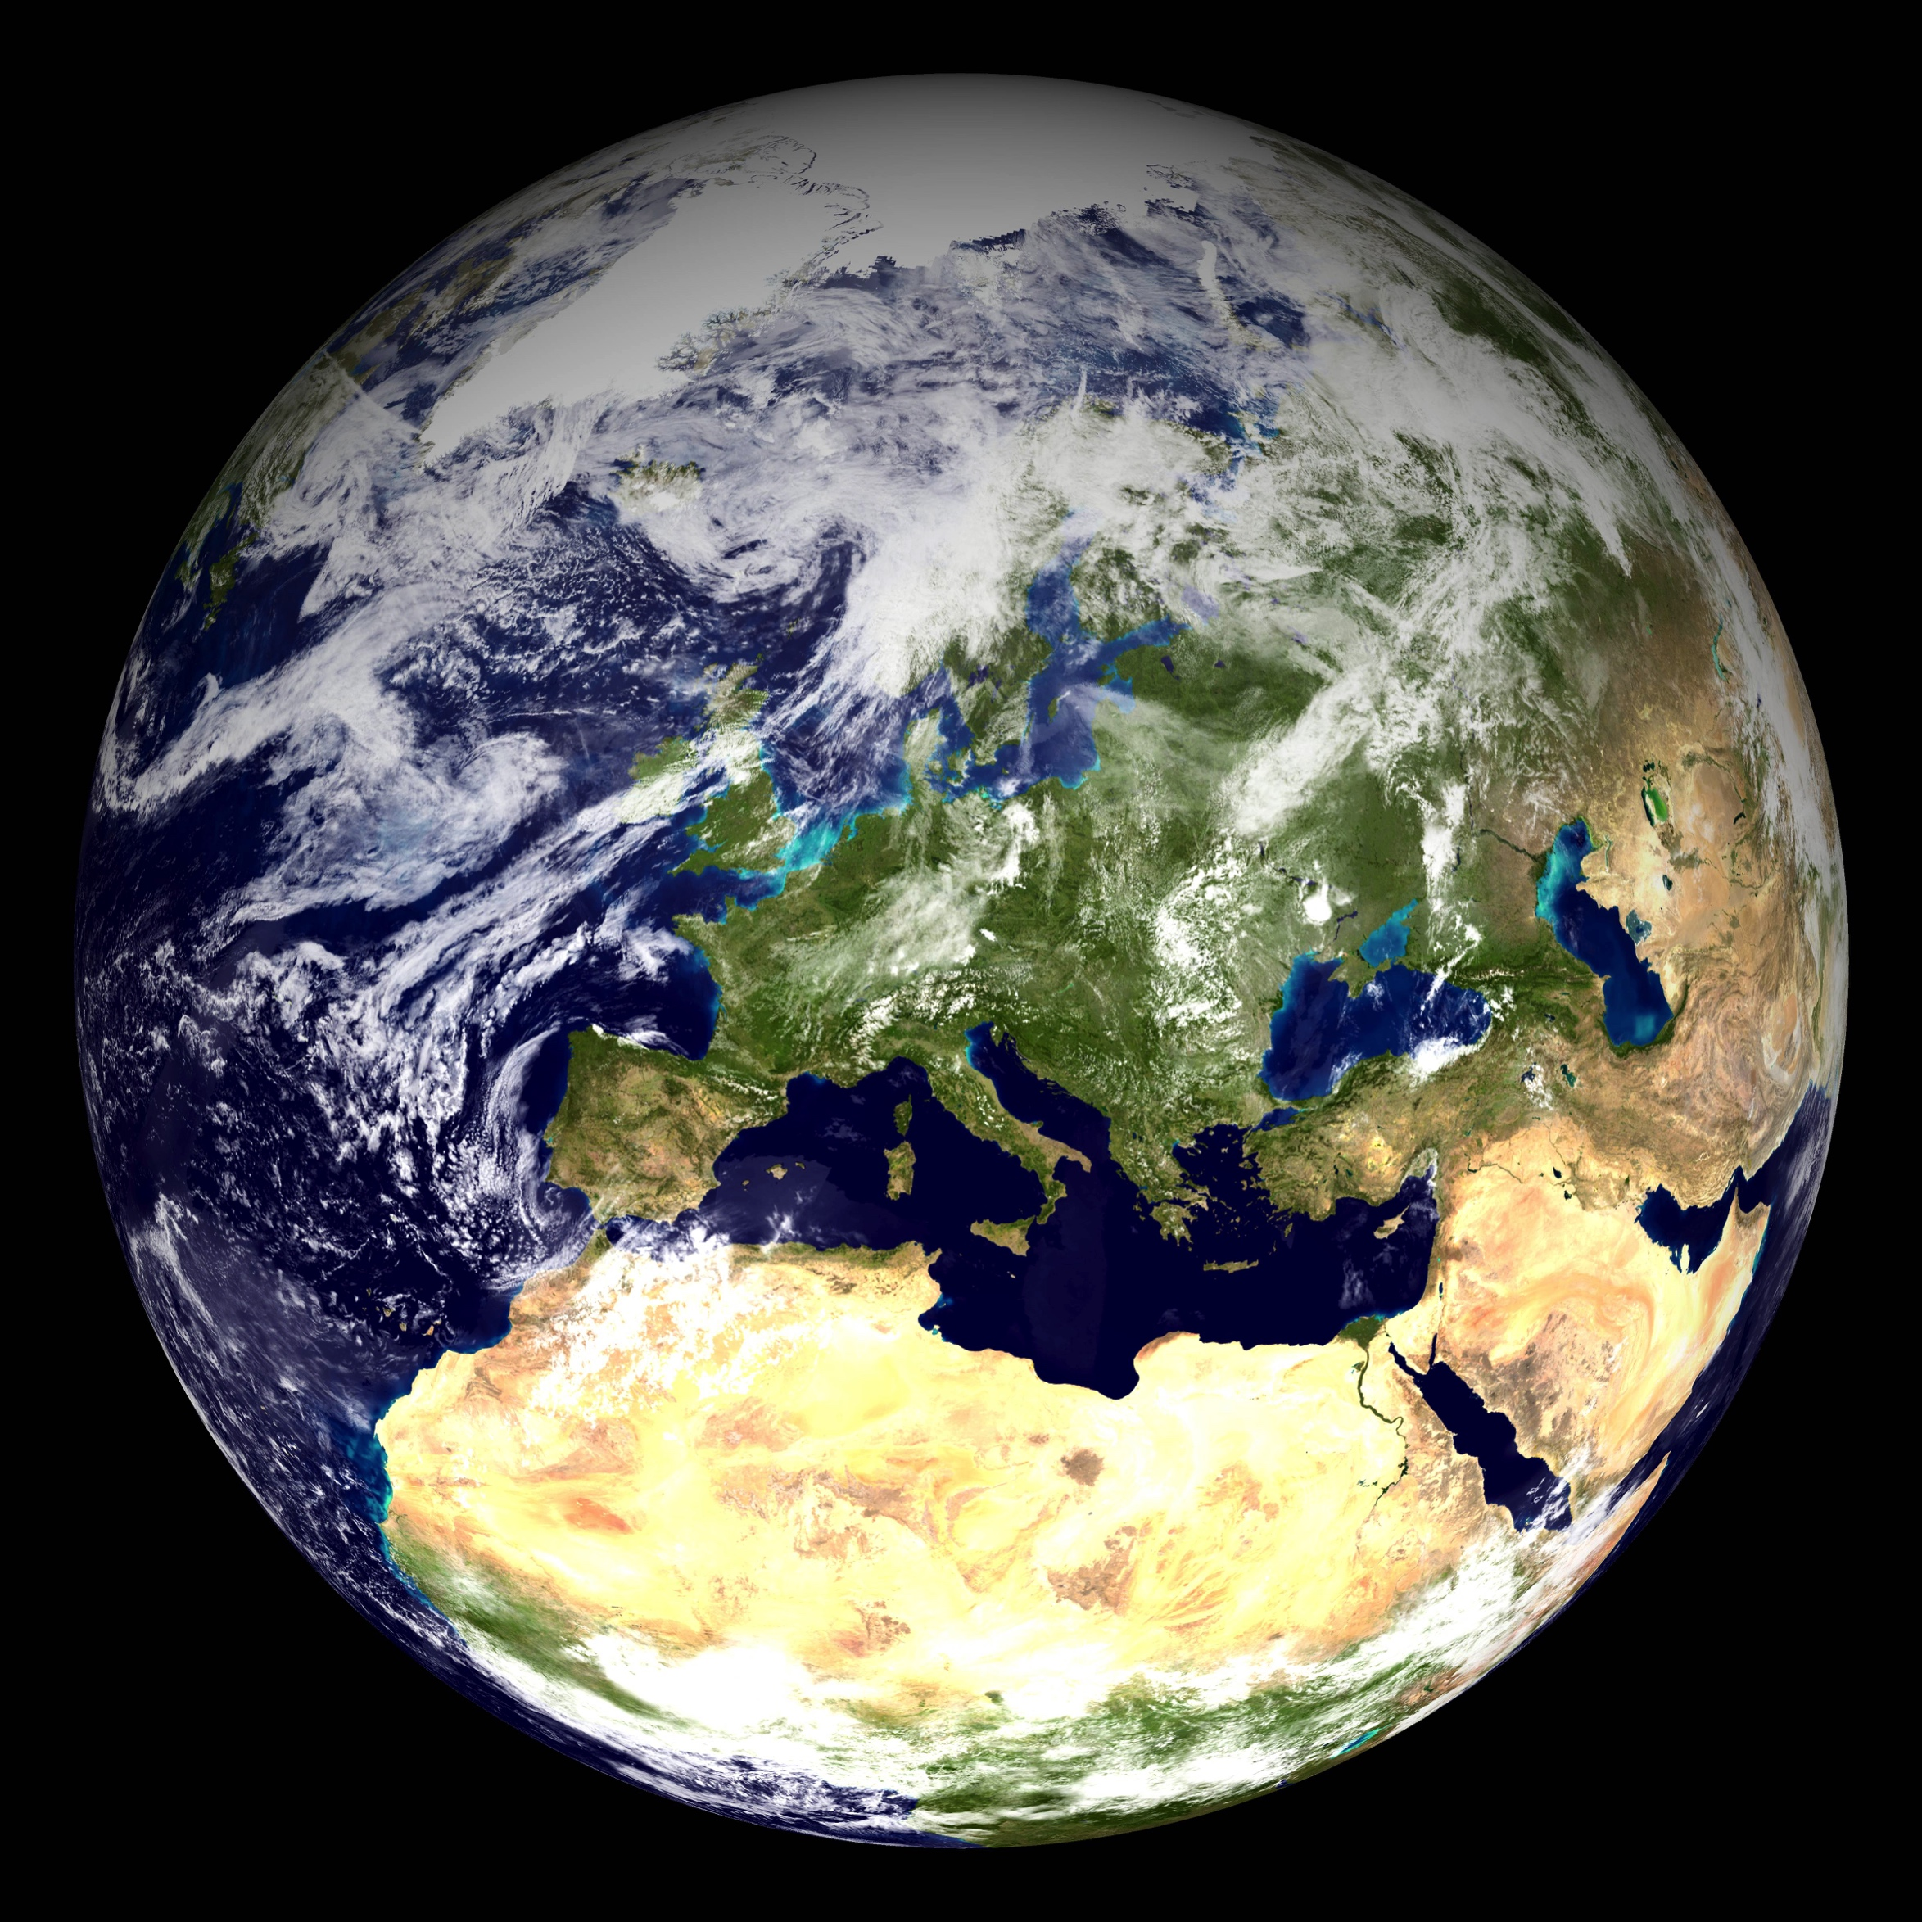
The Earth: ≈13000 km in diameter

Slide 8
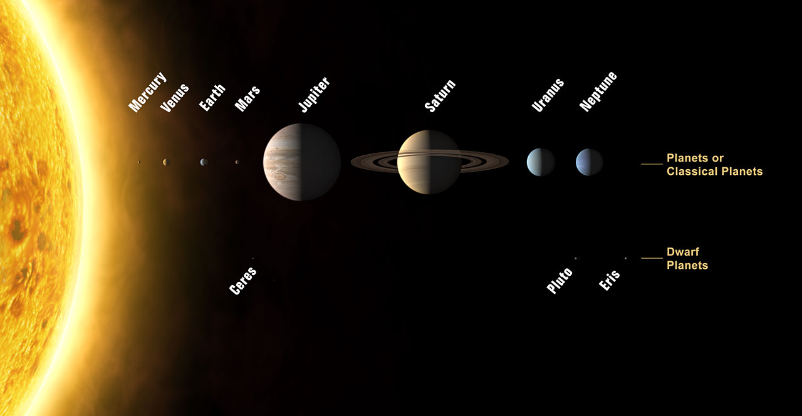
The Solar System:
≈10 billion km in diameter
Credit: The International Astronomical Union/Martin Kornmesser

Slide 9
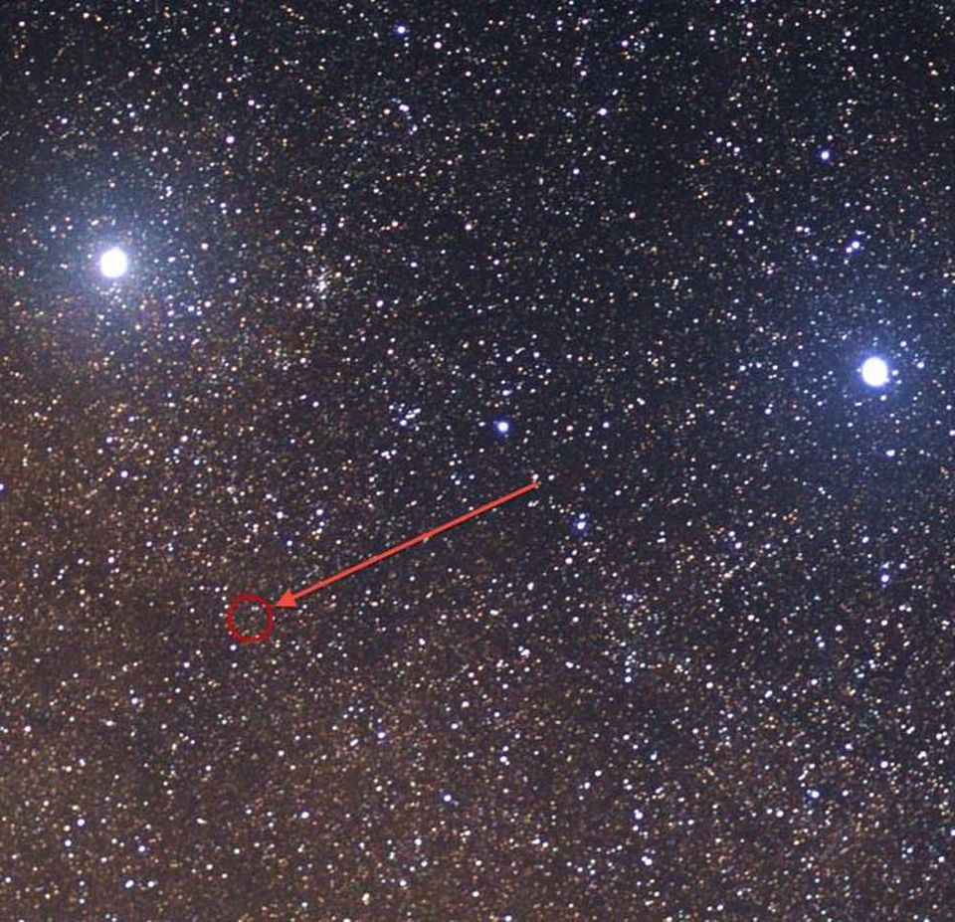
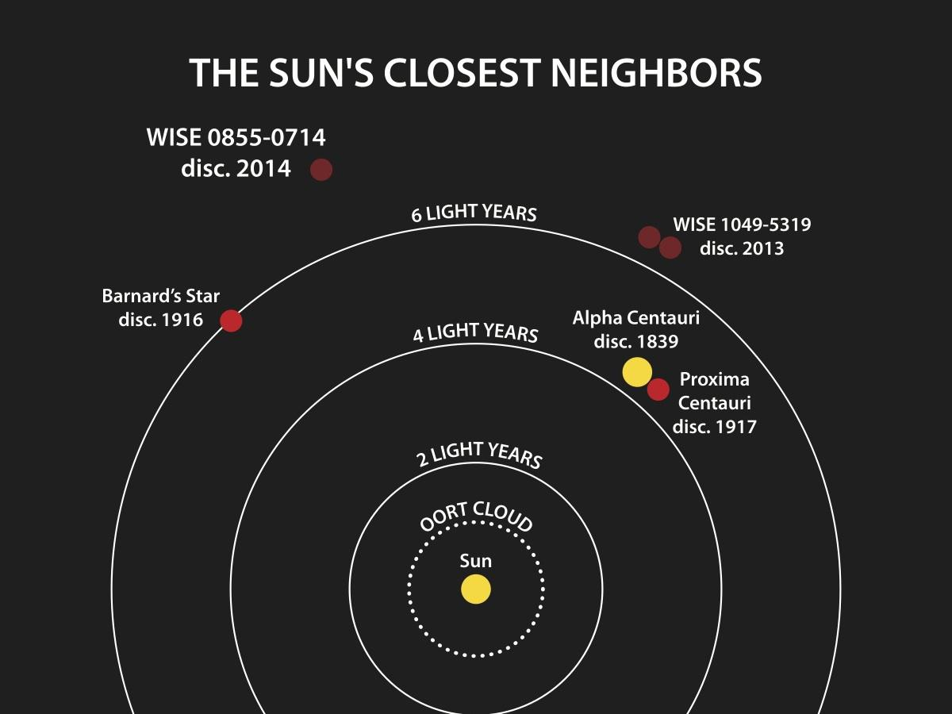
Proxima Centauri:
40×10¹² km = 4,24 light years distance
Credit: NASA/Penn State University
Credit: Wikimedia Commons user Skatebiker

Slide 10
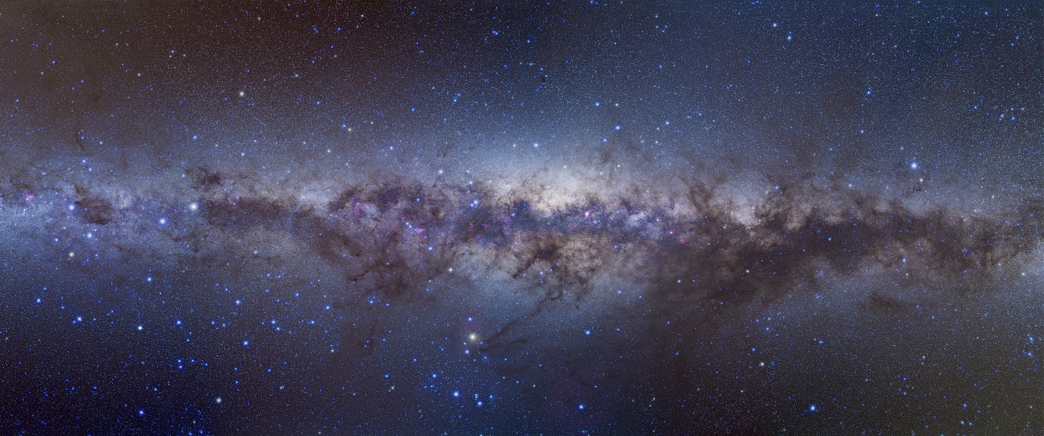
Our Milky Way:
9.5×10¹⁷ km = 100000 light years in diameter
Credit: Alan Dyer/Stocktrek Imagesr

Slide 11
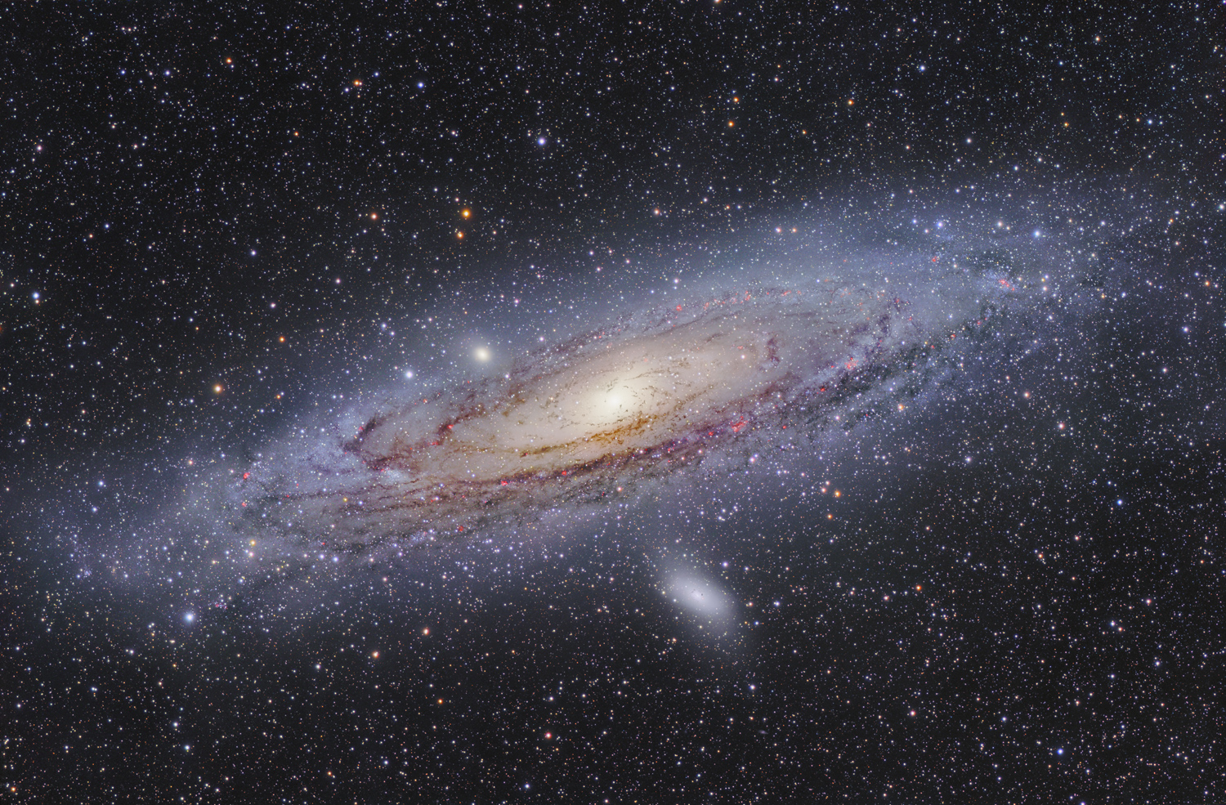
Andromeda Galaxy:
2.5 million light years distance
Credit: Fabian Neyer

Slide 12
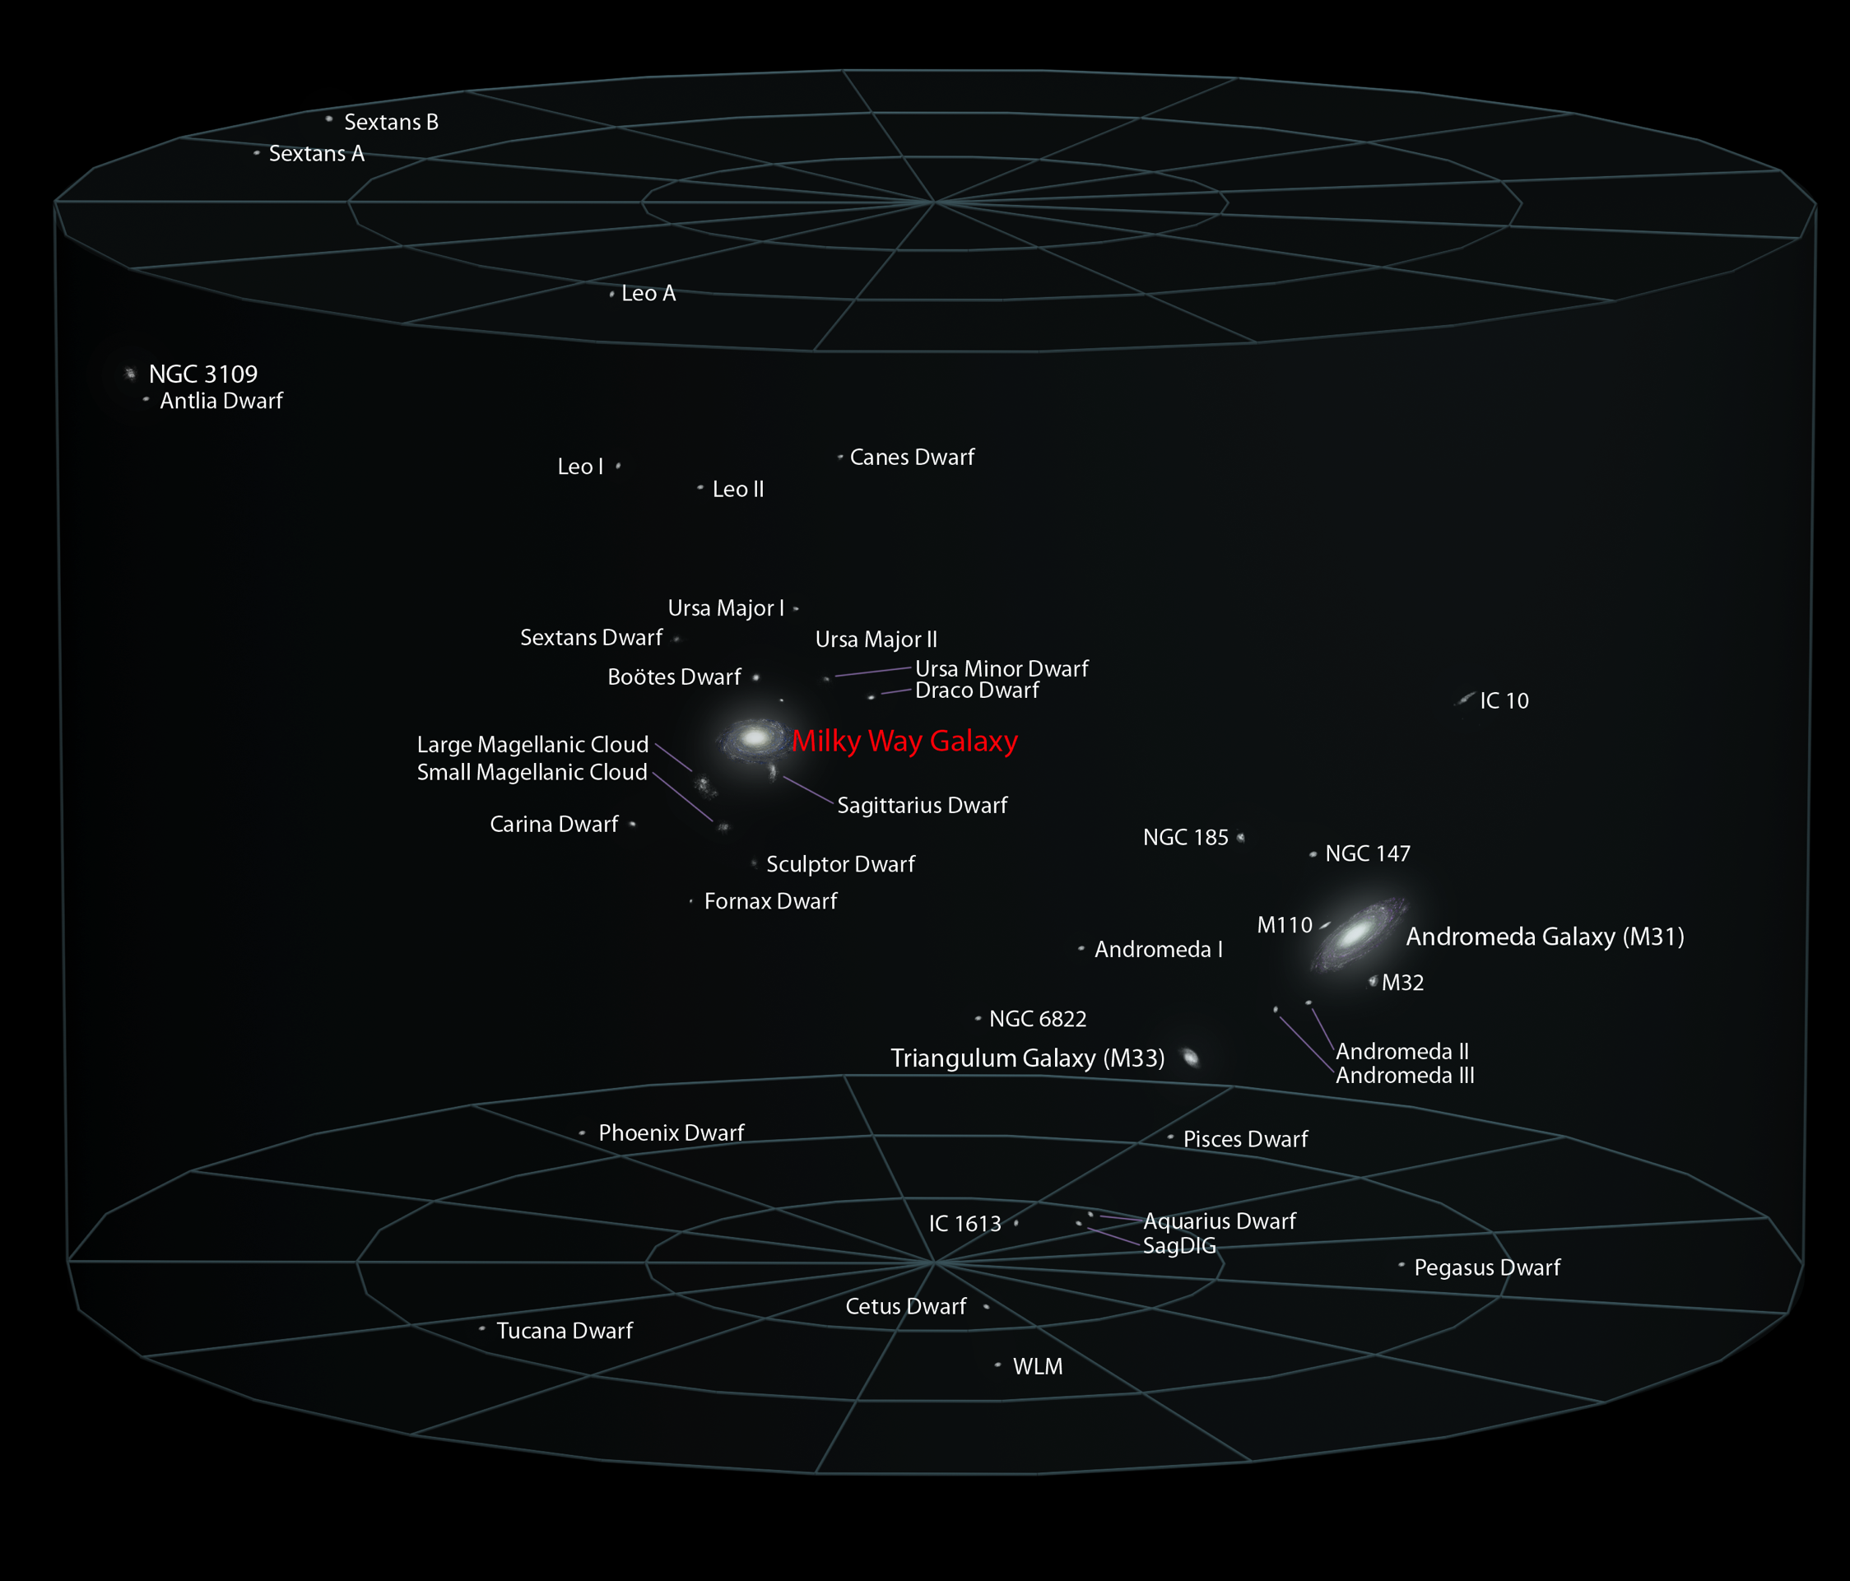
Local Group:
8 million light years in diameter
Credit: Andrew Z. Colvin

Slide 13
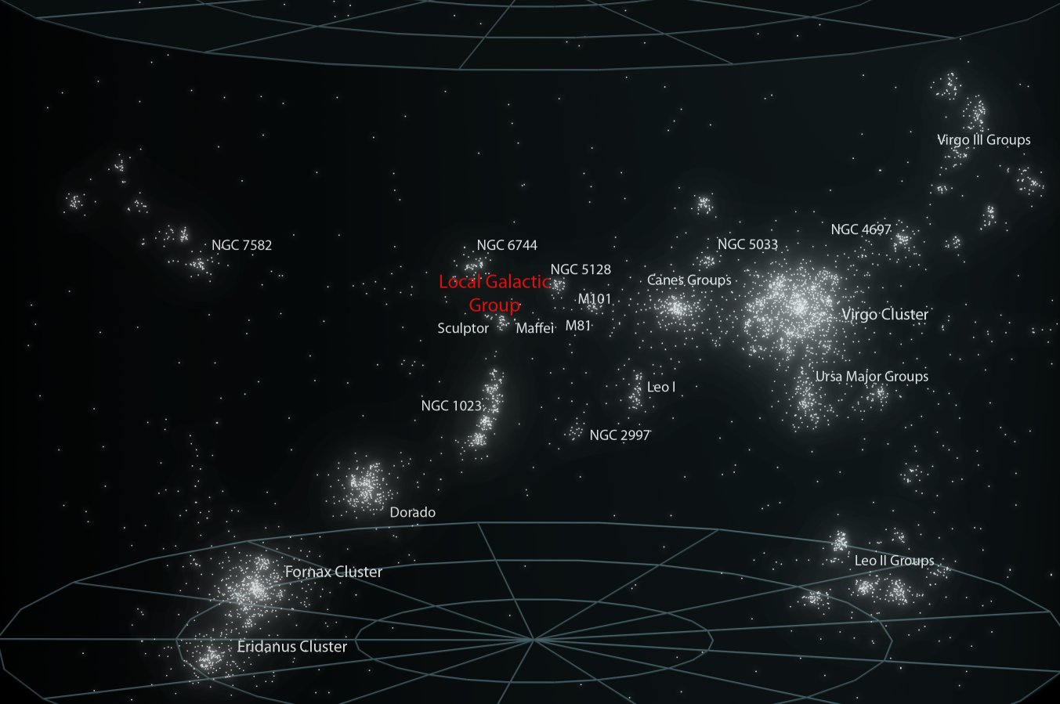
Virgo Supercluster: ≈130 million light years in diameter
Credit: Andrew Z. Colvin

Slide 14
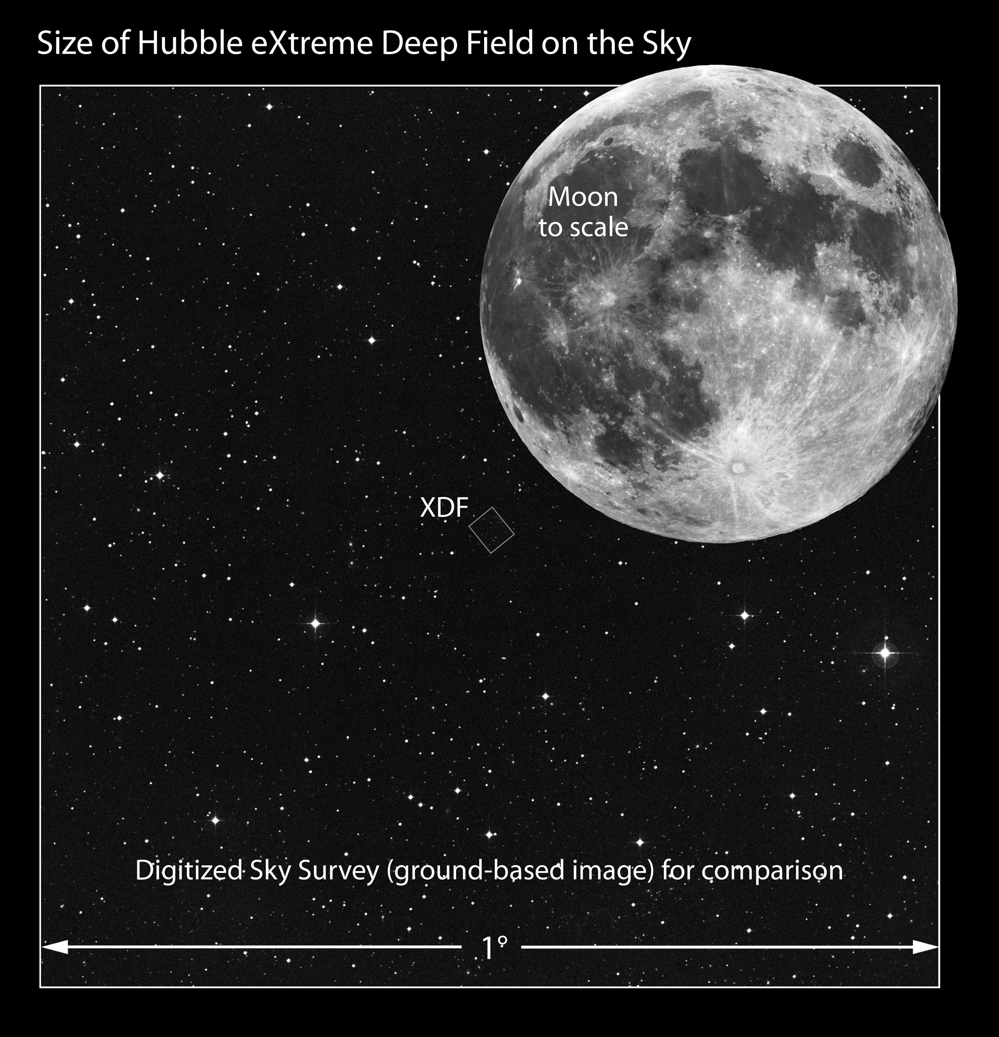
Credit: Illustration: NASA, ESA, and Z. Levay (STScI); Image: T. Rector, I. Dell'Antonio/NOAO/AURA/NSF, Digitized Sky Survey (DSS), STScI/AURA, Palomar/Caltech, and UKSTU/AAO
Notes:
2

Slide 15
Hubble Extreme Deep Field
Credit: NASA; ESA; G. Illingworth, D. Magee, and P. Oesch, University of California, Santa Cruz; R. Bouwens, Leiden University; and the HUDF09 Team

Slide 16

Notes:
https://www.youtube.com/watch?v=1Eh5BpSnBBw

Slide 17
Dynamics of the Universe

Slide 18
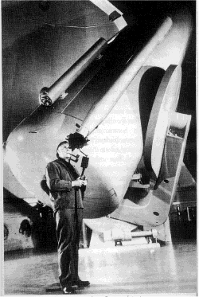
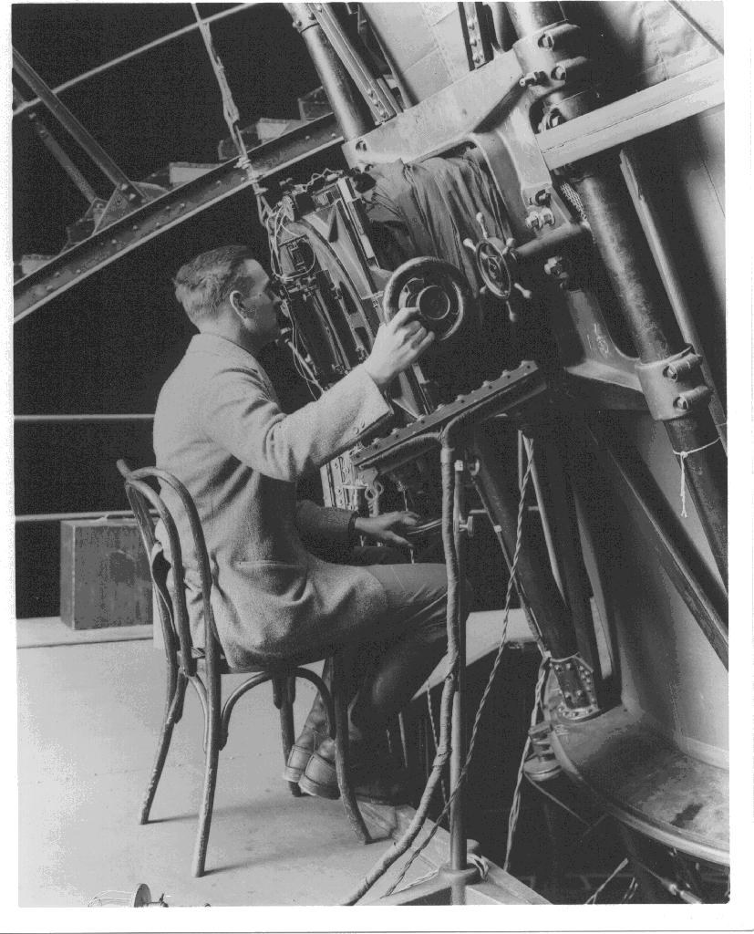
The Universe is bigger than we thought!
Credit: Bettmann / Contributor
Edwin Hubble (1924)
Mt. Palomar telescope
Observation of „nebulas“
Proof of the existence of galaxies outside the
Milky Way

Slide 19
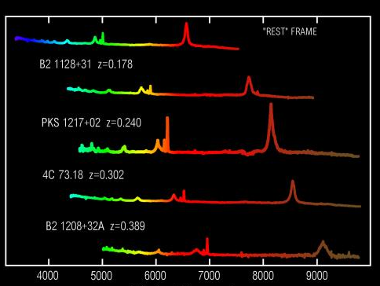
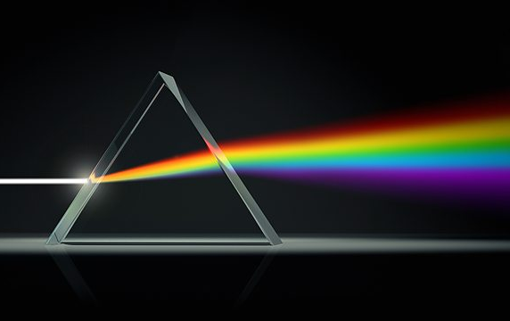
Measuring the Redshift
Emission lines
Spectroscopy
in the lab
Wavelength [Å]

Slide 20
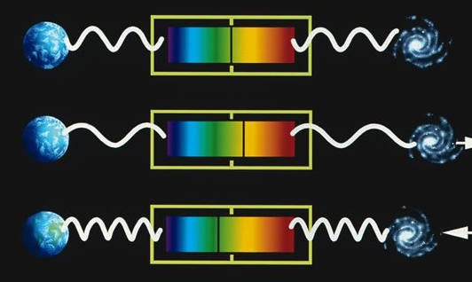
Cosmological Redshift vs.
Doppler Effect
https://briankoberlein.com/2013/11/18/color-in-the-lines/
The cosmological redshift is comparable with a redshift caused by a relative movement of source and observer

Slide 21
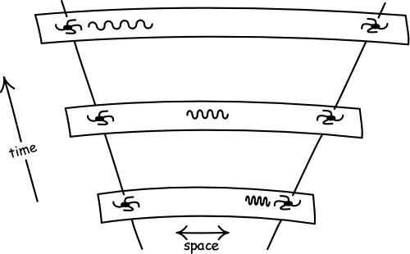
Cosmological Redshift
http://www.pitt.edu/~jdnorton/teaching/HPS_0410/chapters/big_bang_FRW_spacetimes/
Space itself expands and “stretches” the wavelength of the photons.

Slide 22
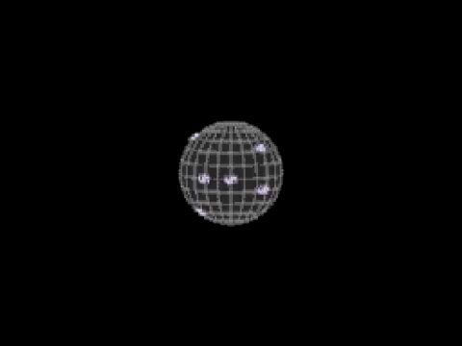
Cosmological Redshift
Notes:
https://www.youtube.com/watch?v=e6G2Z6iD-9M

Slide 23
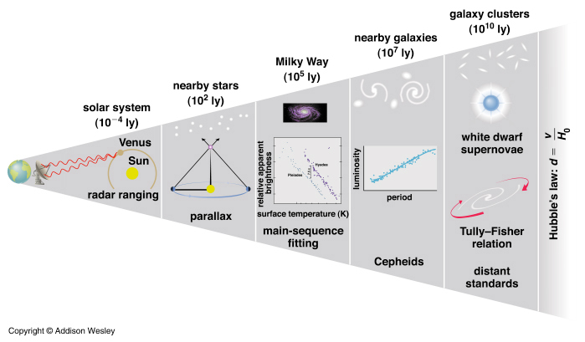
Distance Ladder

Slide 24
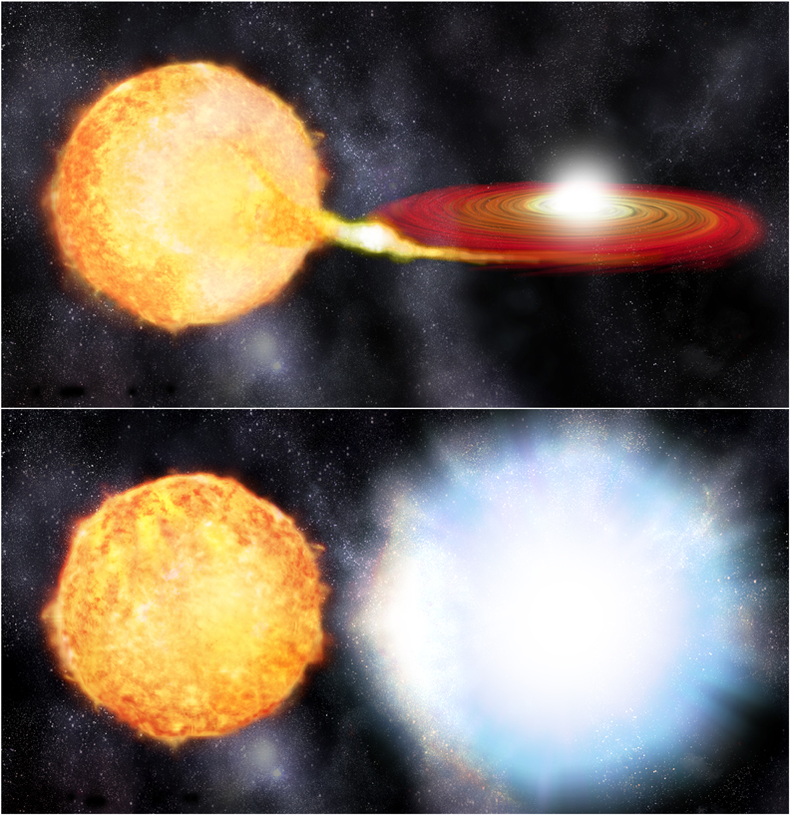

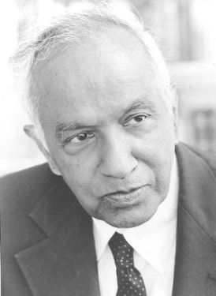
Type Ia Supernova
white dwarf
Chandrasekhar limit:
M ≈ 1.4 M_{sun}
Notes:
https://www.youtube.com/watch?v=Ua-fx1xe_FE

Slide 25
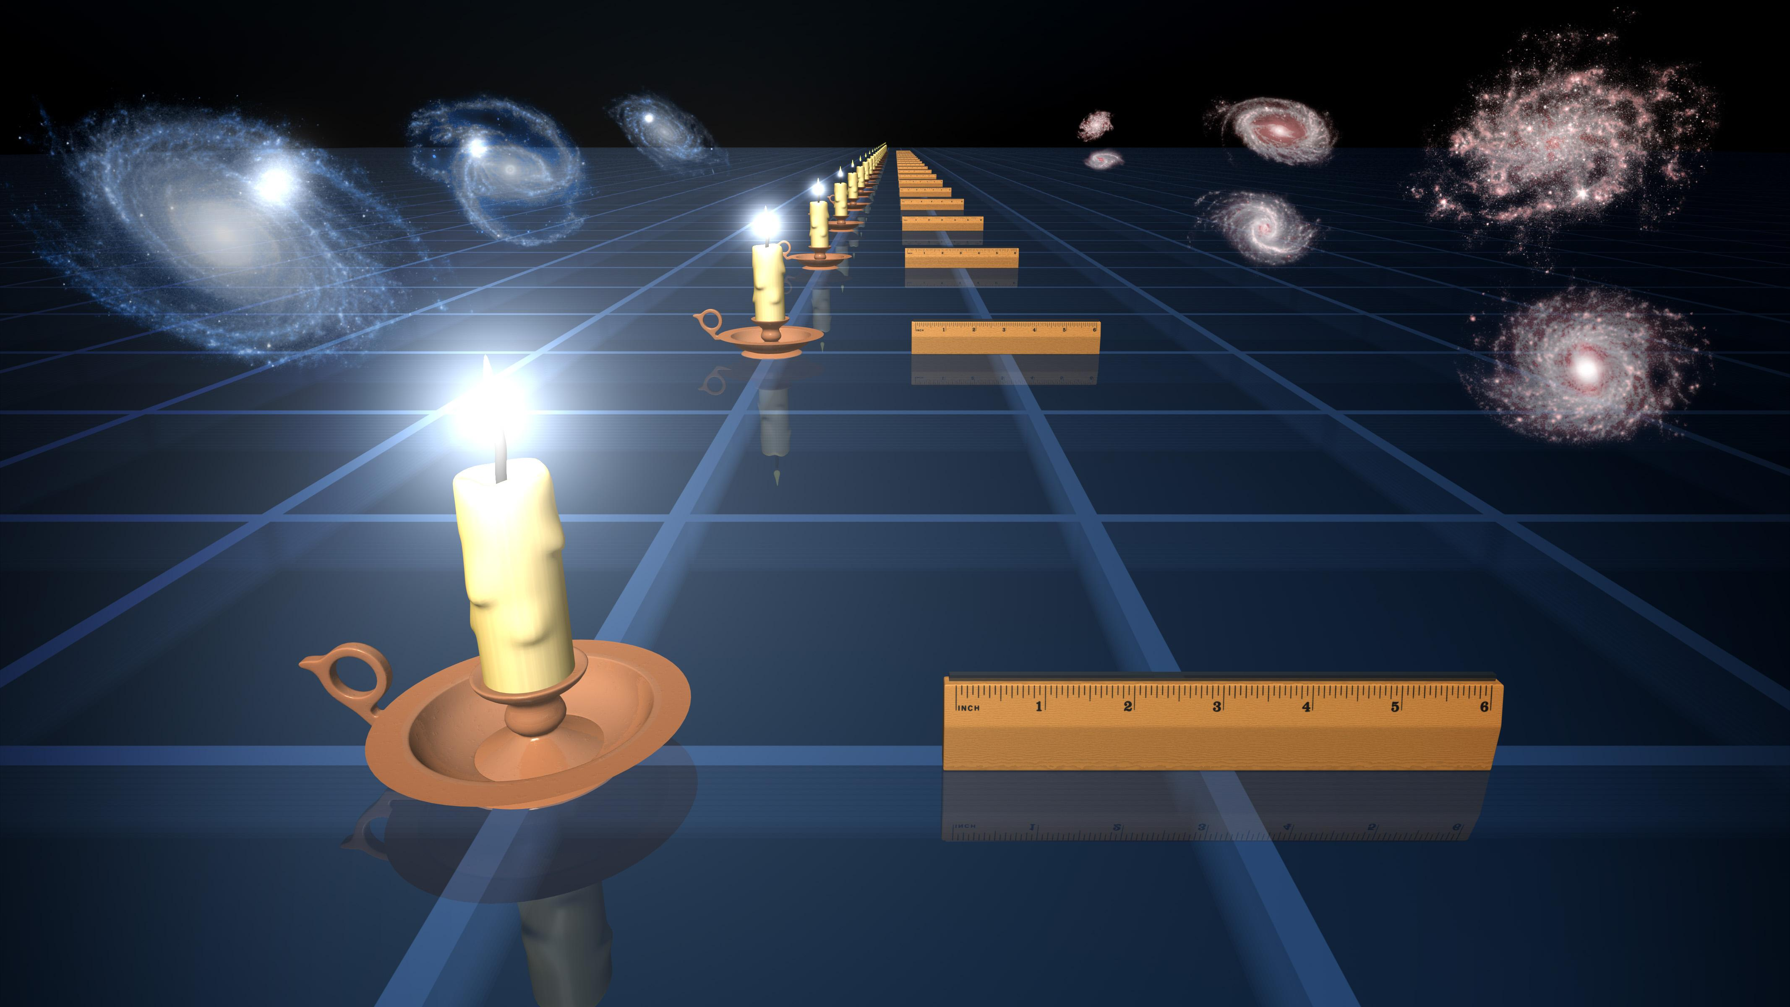
Standard Candles and Brightness
Credit: NASA/JPL-Caltech

Slide 26
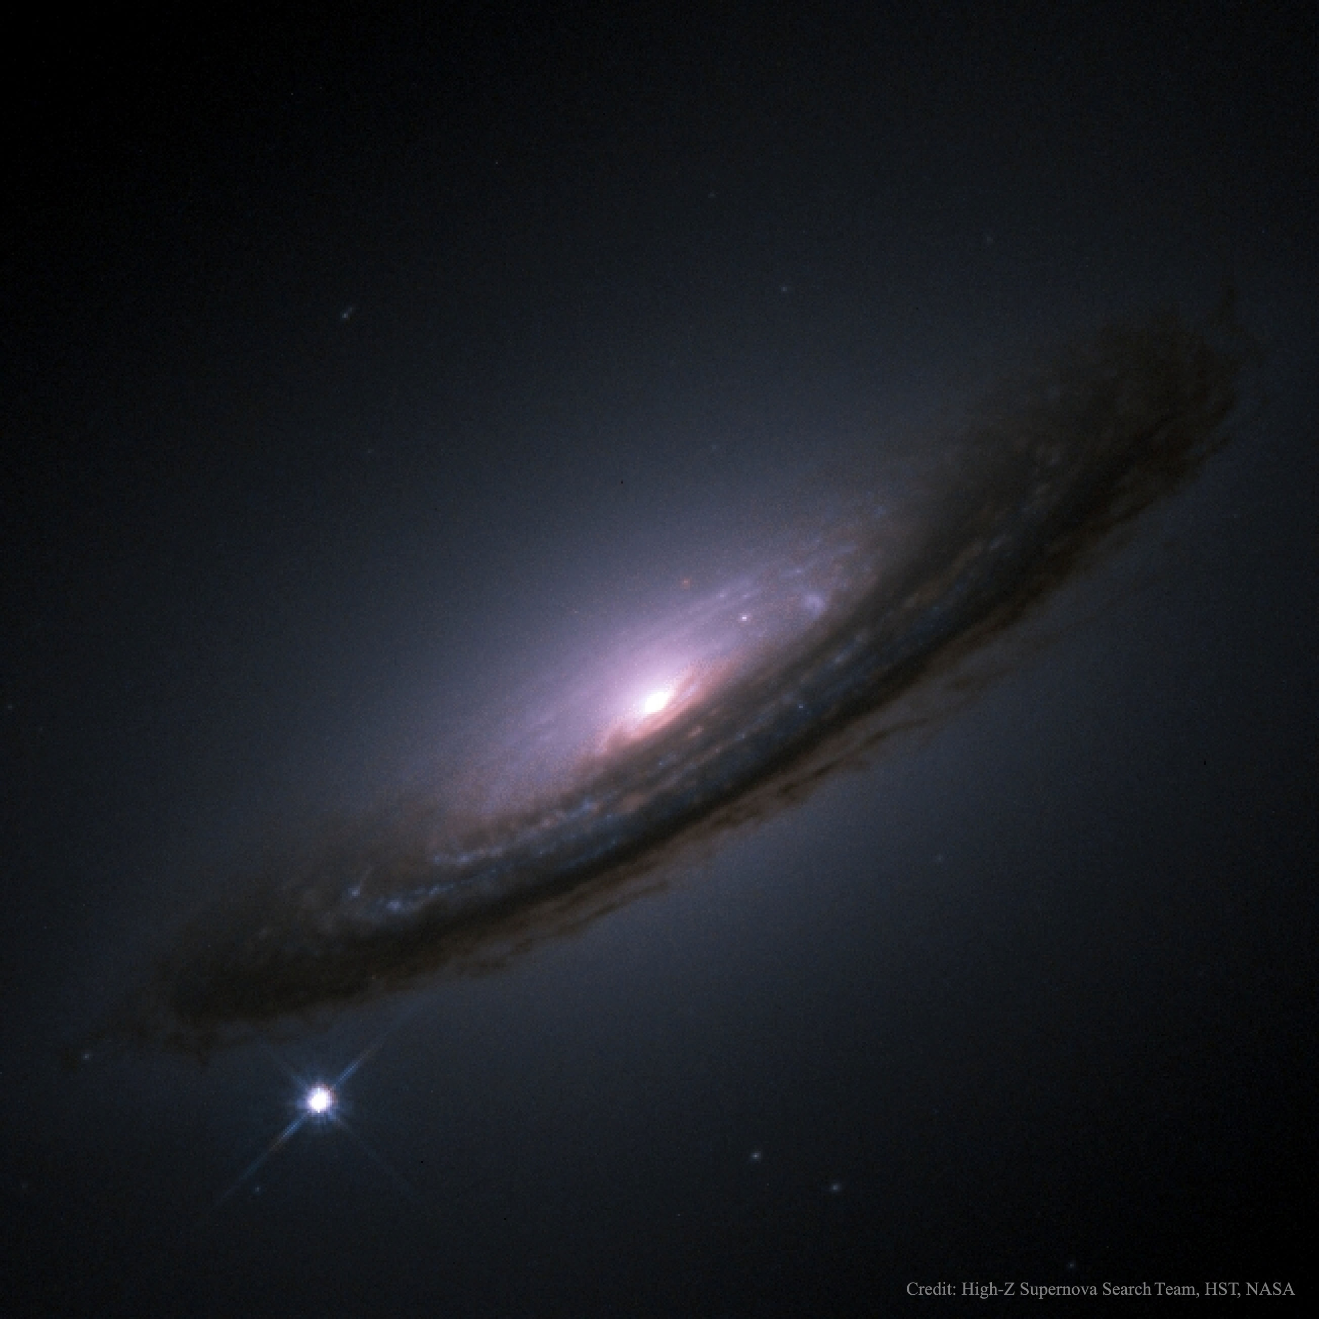
Example of a Supernova from 1994
Supernovae can temporarily release as much energy
as a whole galaxy!

Slide 27
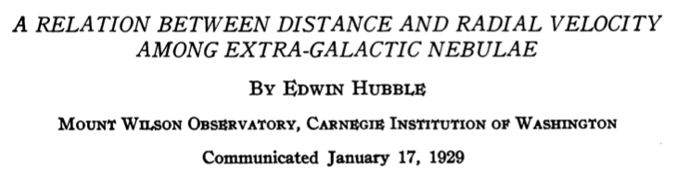
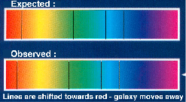
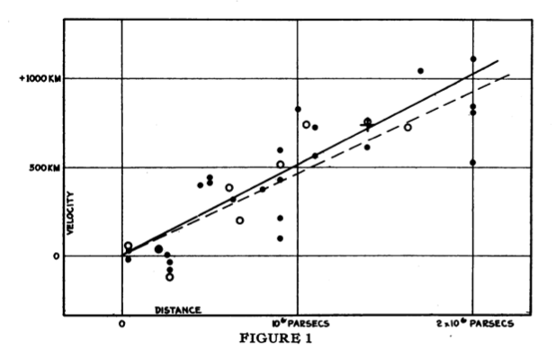
The Universe is expanding
redshift is proportional to the distance of the galaxies
(galaxy escape)
Hubble‘s law: v = Ho d
Ho = 530 km/s / Mpc !!

Slide 28
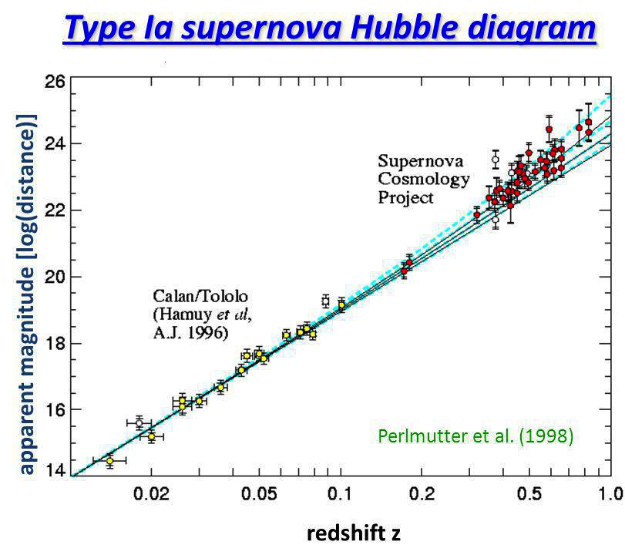
The present value of the Hubble ”constant”
proportional to distance
proportional to apparent velocity
Today: H = 67,3±1,2 km s⁻¹ Mpc ⁻¹

Slide 29
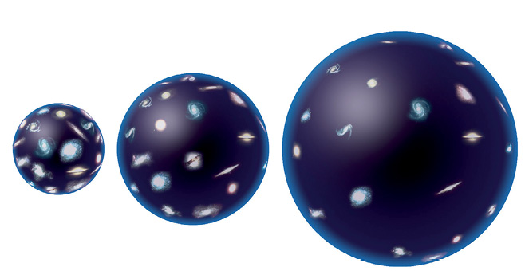
The further we look back into the past, the smaller was the Universe. conclusion about the Big Bang
Consequences of the Cosmological Expansion

Slide 30
A Journey through Time

Slide 31
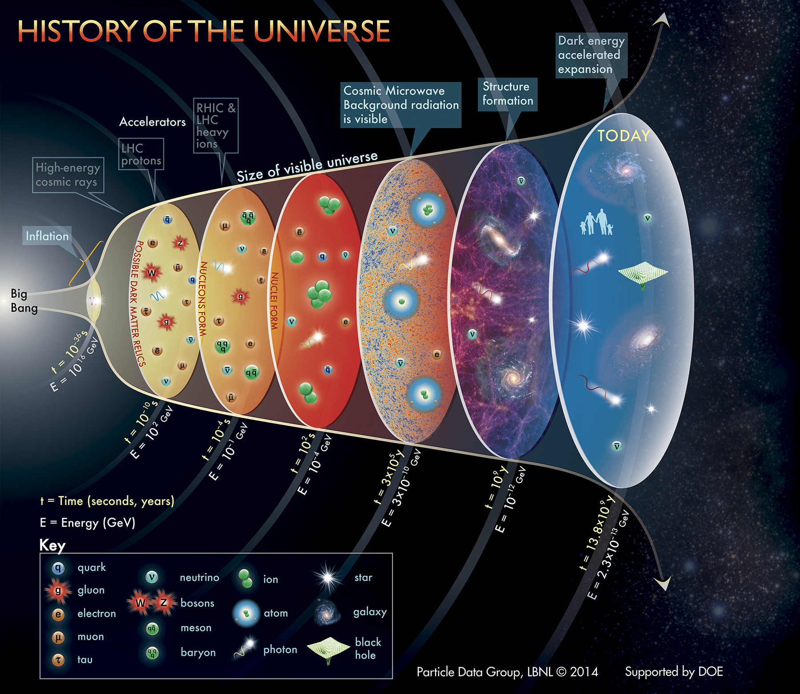

Slide 32
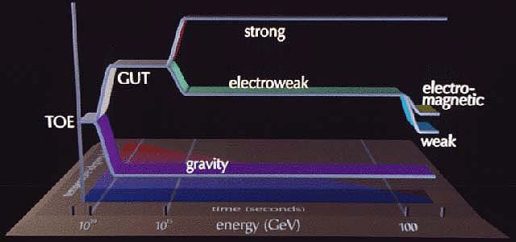
Unification of the Forces
age 10⁻³⁶ s: strong and electroweak force get separated
http://crestroyertheory.com/2013/11/09/grand-unification/

Slide 33
inflation

Slide 34
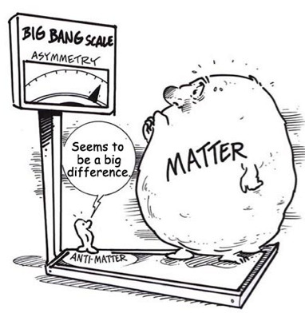
destruction battle

Slide 35
nucleosynthesis

Slide 36
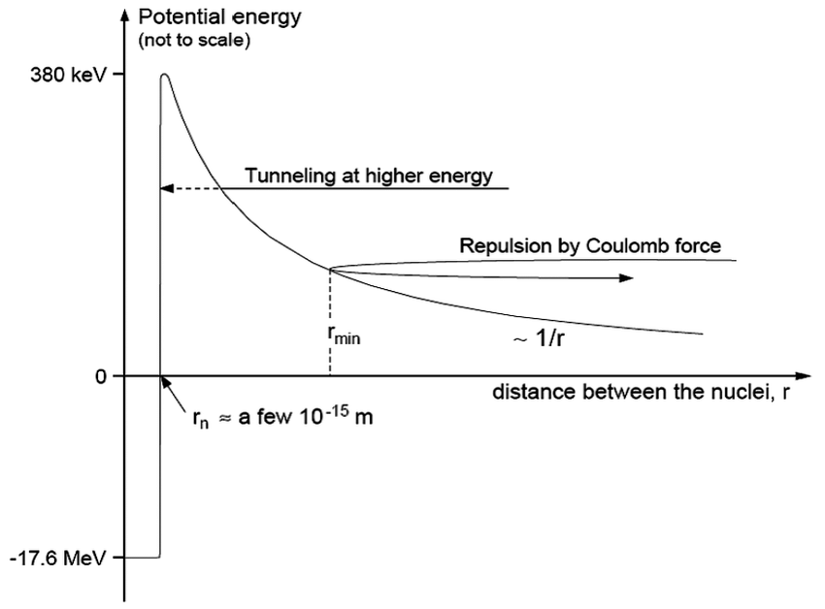
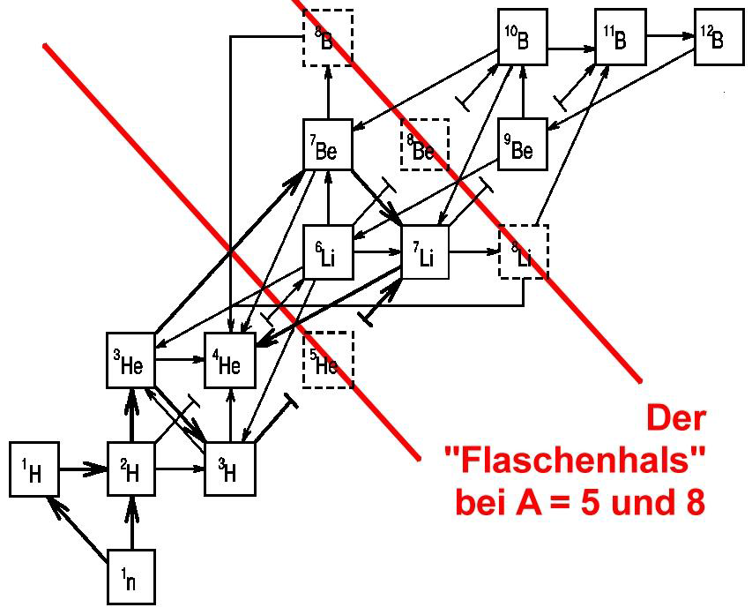
Nuclear Fusion
fusion in particle collisions
fusion needs high temperatures
and high particle densities
Bottleneck at A = 5 and 8
Ongena, J. (2015). Fusion: A true challenge for an enormous reward. EPJ Web of Conferences 98, 05004
Credit: Ohio State University

Slide 37
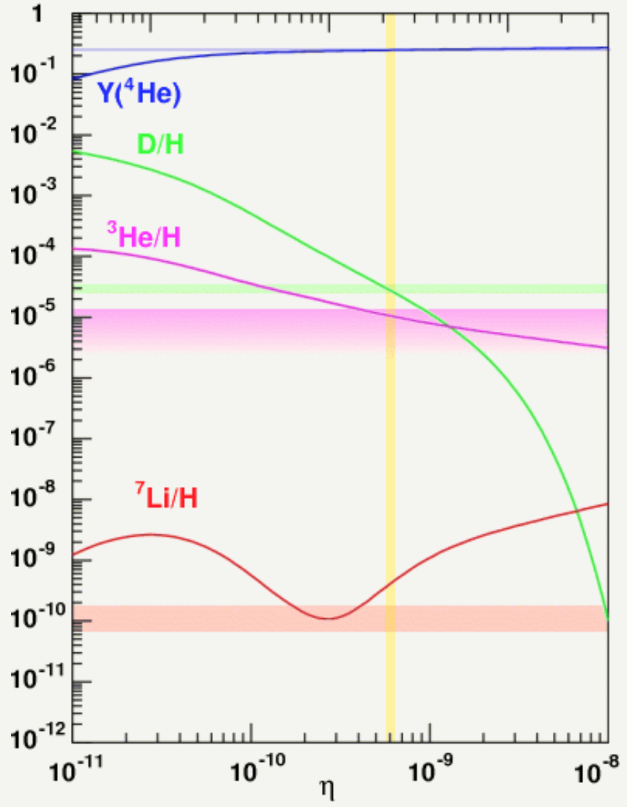
Primordial Nucleosynthesis
Comparison of theory (curves) and observation (horizontal lines)
abundances
of light elements:
74 % hydrogen
25 % helium
1 % rest
Heffernan, M. J. and Walker-Loud, A. (2016). Quantifying the sensitivity of Big Bang Nucleosynthesis to isospin breaking

Slide 38
recombination

Slide 39
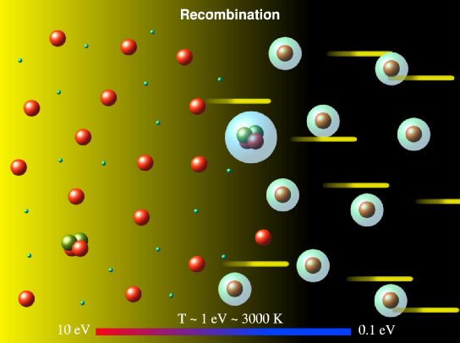
Recombination
Credit: W. H. Kinney, arXiv:astro-ph/0301448v2
below T = 3000 K (t = 380000 a) neutral atoms can form
afterwards photons don’t scatter any more on free electrons
The Universe becomes transparent!

Slide 40
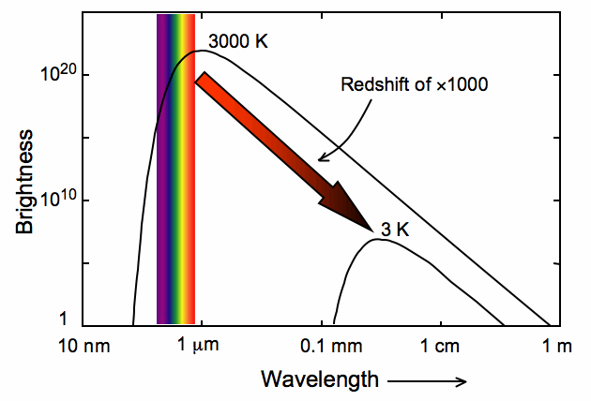
The Cosmic Microwave Background (CMB)
During recombination the photons are in thermic equilibrium with the electrons and atomic nuclei.
Their energy spectrum is the one of a black body (“Planck spectrum”)

Slide 41
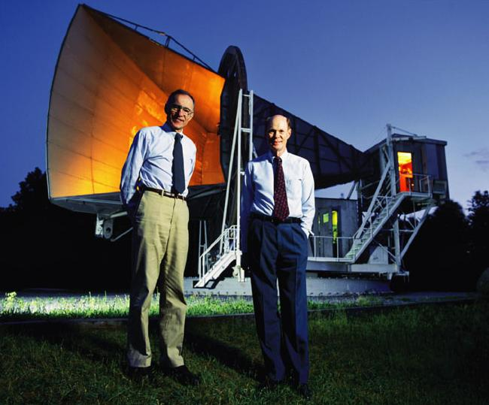
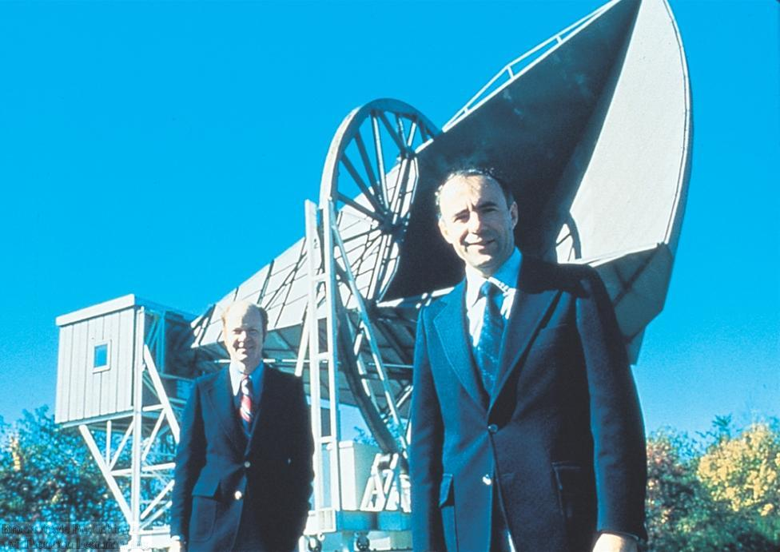
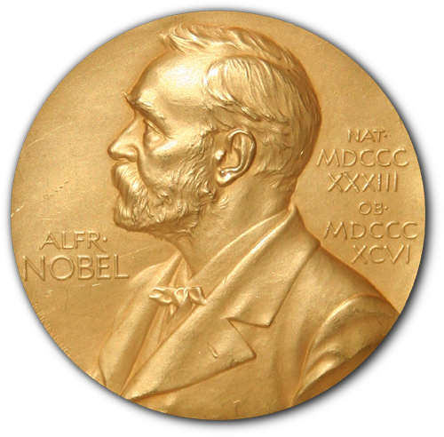
Discovery of the CMB
1964 Penzias und Wilson discovered a noise, which they couldn’t explain
(1978)

Slide 42
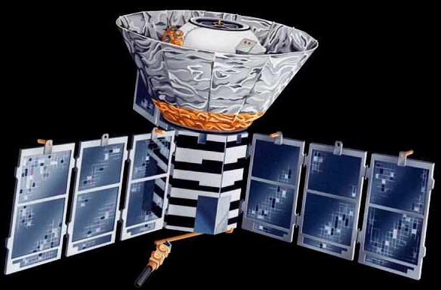
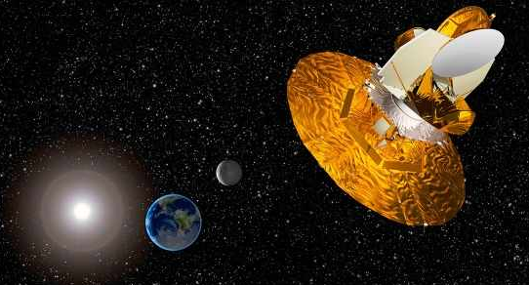
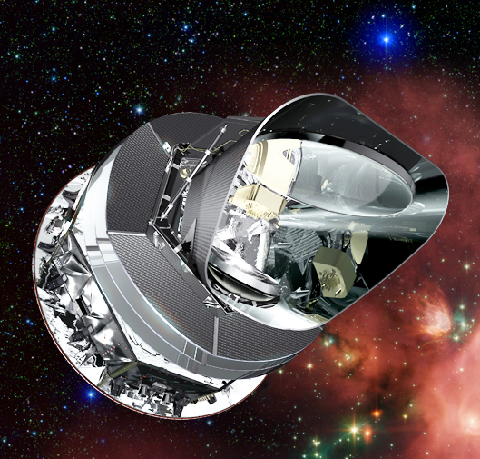
Satellites for the investigation of the CMB
COBE
Cosmic Background Explorer
1989-1993
Nobel Prize 2006
(Smoot & Mather)
WMAP
Wilkinson Microwave Anisotropy Probe
2001-2010
Planck
2009-2013

Slide 43
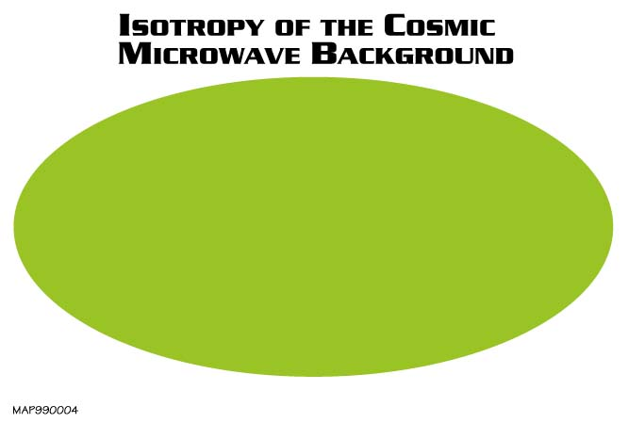
Next problem for the Big Bang theory
The second analysis revealed no sign of any variation at a level of 1 part in 10.000!
Where are the galaxies coming from, if not from density fluctuations?

Slide 44
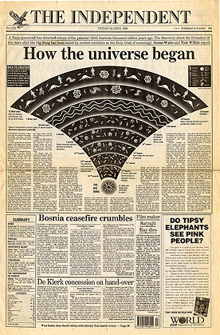
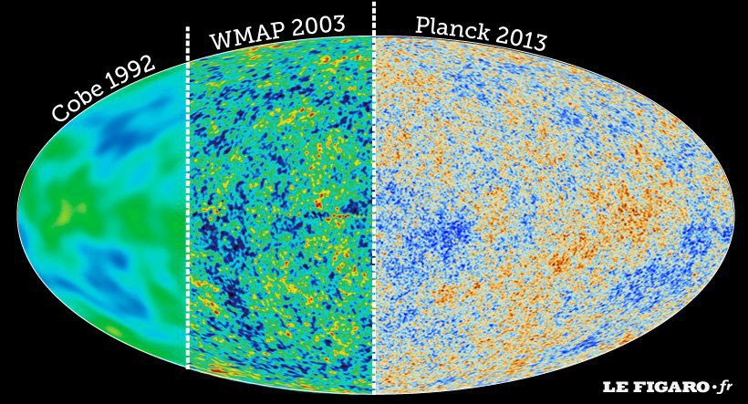
The Echo of the Big Bang

Slide 45
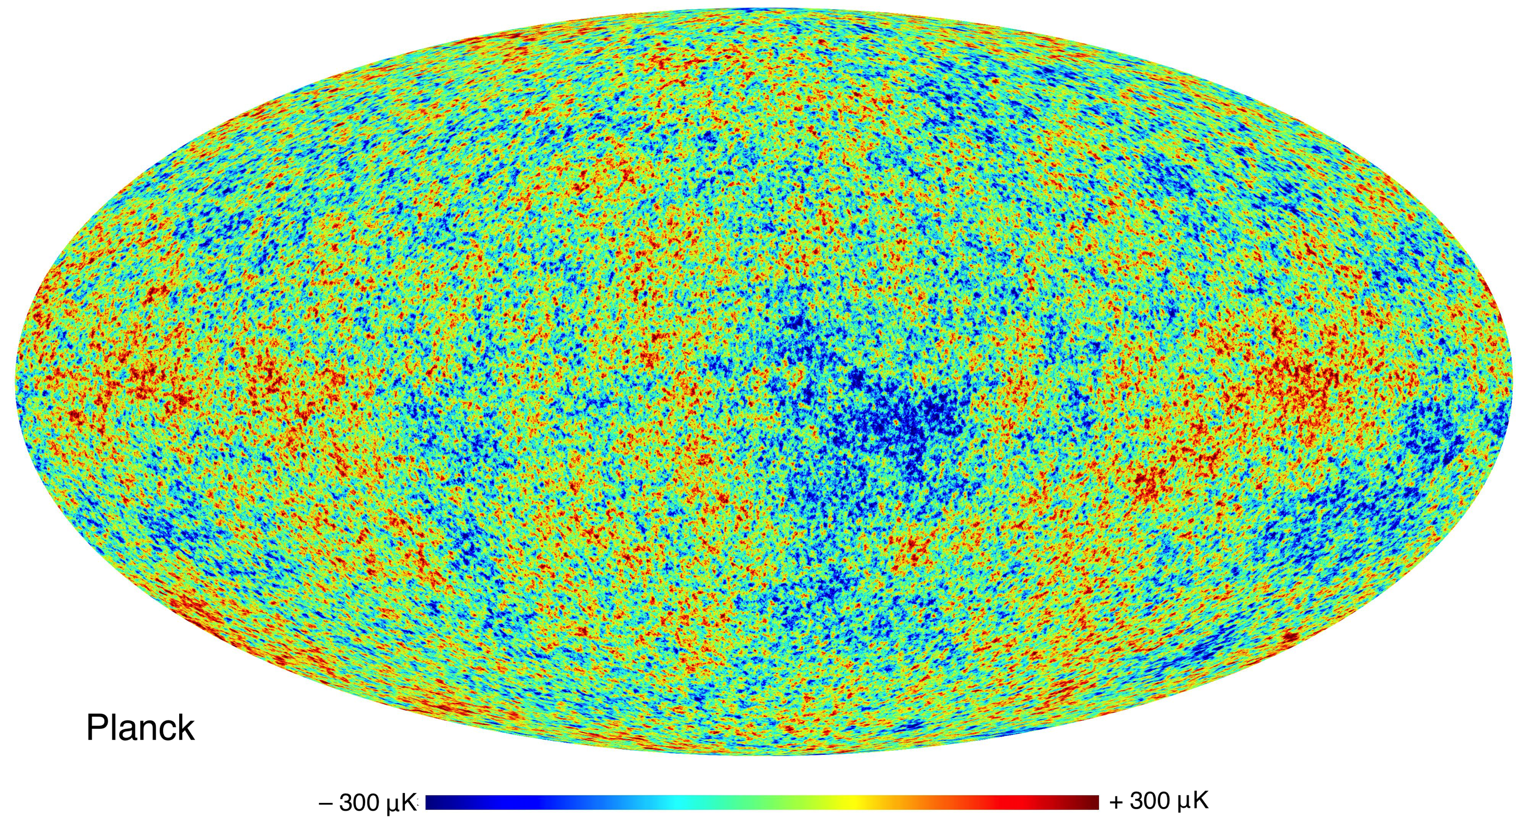
The Echo of the Big Bang
The CMB is extremely isotropic with a temperature of T_{CMB} = 2,725 K.
The temperature differences are in the range of microkelvin!

Slide 46
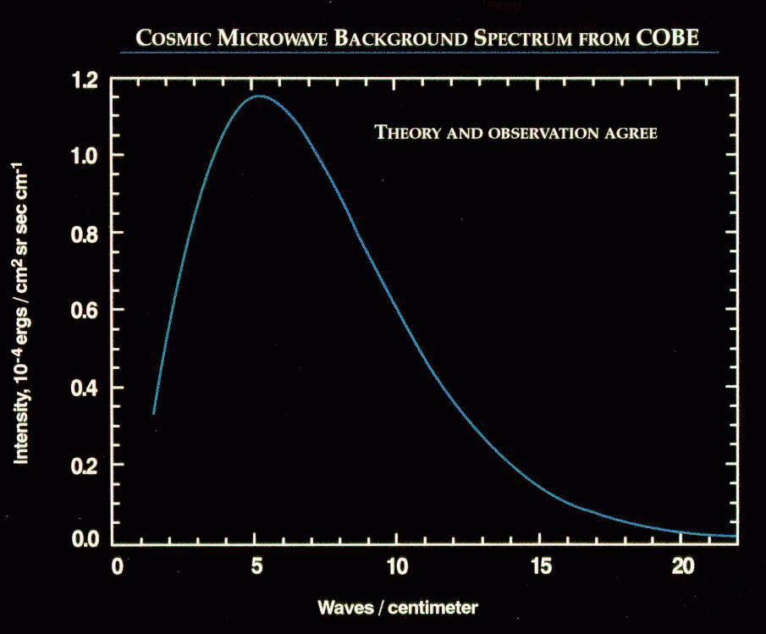
The spectrum of the CMB

Slide 47
structure building

Slide 48
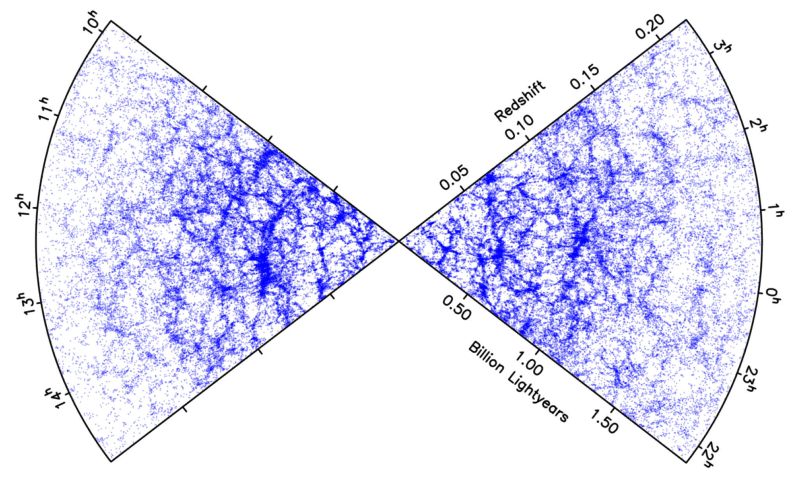

Galaxy Distribution
In the past the universe was much more homogeneous than today
Each single point is a galaxy!

Slide 49
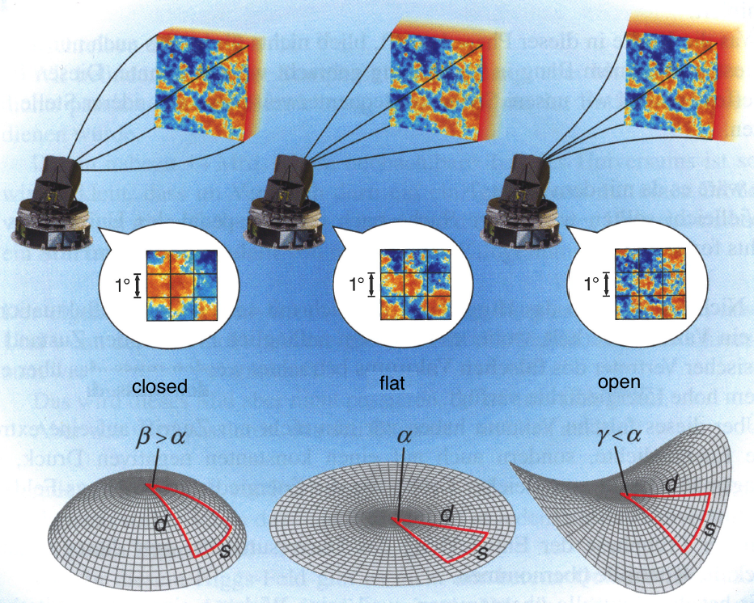
Geometry of the universe

Slide 50
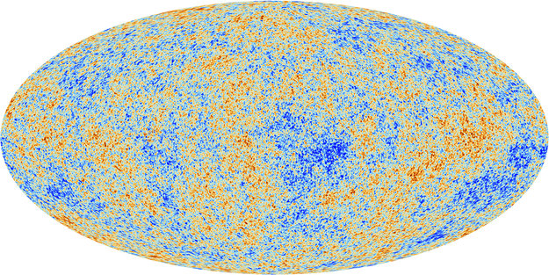

From the map to the spectrum…
theory is not able to predict the exact position of individual hot or cool spots
instead: prediction of statistical properties of the temperature map (for example mean value, variance, correlations,…)

Slide 51

The Angular Power Spectrum of the CMB
typical size of the hot
and cool spots
Temperature deviations

Slide 52

Theoretical Predictions of the
CMB Spectrum
spatial
curvature
vacuum energy density
The theoretical CMB spectrum is depending on values of certain cosmological parameters
Comparison with the measured spectrum allows to distinguish between the models and to determine the values of the unknown parameters
baryon density
matter energy density

Slide 53

The Standard Cosmological Model
The simplest model, with which the data can be explained (Ockham’s Razor!)
dark matter?!
dark energy?!?!
(vacuum energy)
About 95% of the Universe is still unknown…
“normal” matter

Slide 54
Mysteries of the Universe
What is dark matter?

Slide 55


Rotation Curves of Galaxies
Notes:
https://www.youtube.com/watch?v=kwFxXmOAUp0

Slide 56

Galaxy Cluster CL0024+17

Slide 57


Gravitational Lenses
Massive objects curve space-time and therefore distort the light of the objects behind.

Slide 58
Gravitational Lenses
galaxy cluster Abell 2218
Thereby light arcs of the objects behind are visible.

Slide 59


Structure building in the early universe

Slide 60
era of dark energy

Slide 61


Slide 62
Cosmology of the 21st century
Dark Matter
What is it made of, what are its properties?
Or another model (e.g. MOND)?
Dark Energy
What kind of energy is it? How does it influence the expansion of the Universe?
Inflation
Can we find experimental confirmation? If yes, what caused it?
Matter-Antimatter Asymmetry
Where is the tiny surplus of matter coming from, from which everything around us is made of?
The Moment of the Big Bang
Will we find a unified theory, which describes the beginning of the Universe?
The Fate of the Universe...

Slide 63


cosmology.web.cern.ch

Slide 64

Students’ conceptions about cosmology –
The questionnaire

Slide 65

Many thanks for your attention!

Slide 66

Are there any questions?

