Slide 1

S’Cool LAB group 1
Quadrupole Ion Trap &
Beam Optics
Group Leaders: Lachlan, Fabian & Hector
1. Quadratic Ion Trap: Ayyaz, Thana, Susanna
2. Beam Optics: Bahareh, Kazuoki, Lidwina

Slide 2
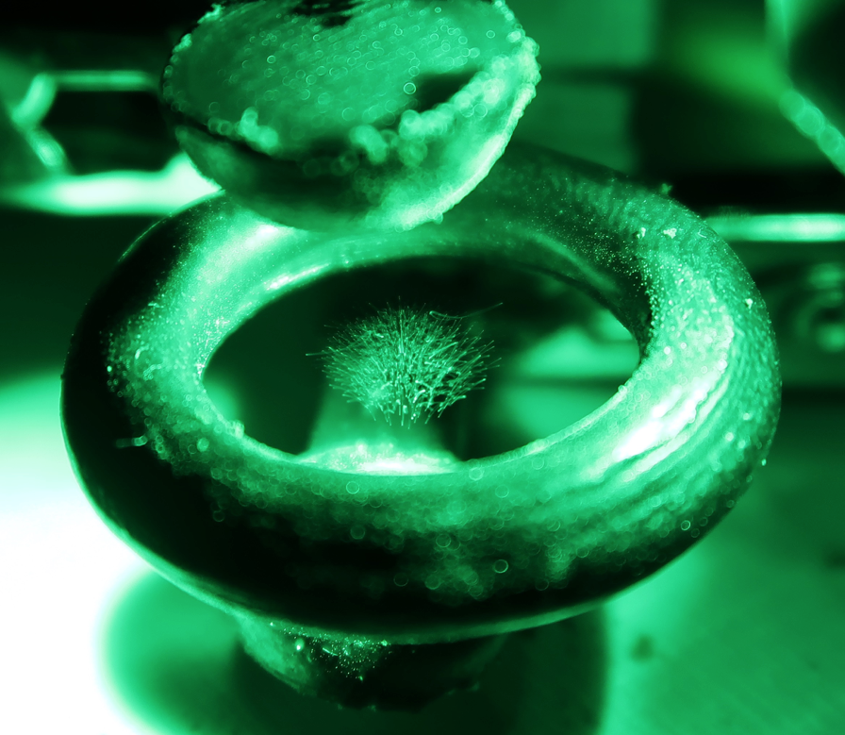
Quadrupole Ion Trap
Theory
Setup
Problems
Equipments and Setup:

Slide 3
Theory of Quadruple ion trap
•Observation of particle when isolated or without material walls
Types of traps
1.Penning traps, developed by Dehmelt and Penning, use static electric and magnetic fields,
2.Paul traps, developed by Wolfgang Paul, are operated with alternating electric fields

Slide 4
Difference between ion trap and group work
1. Uses spores instead of ions
2. Three poles are used instead of four

Slide 5
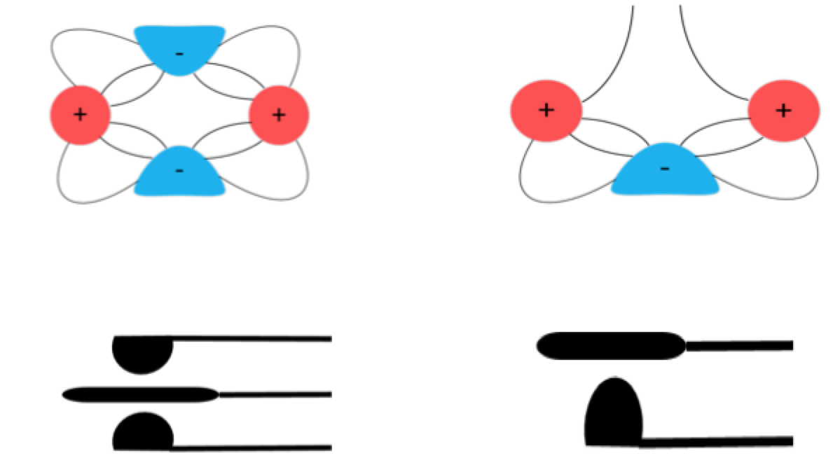

Slide 6
Equipment and Setup:
Equipments and Setup:

Slide 7
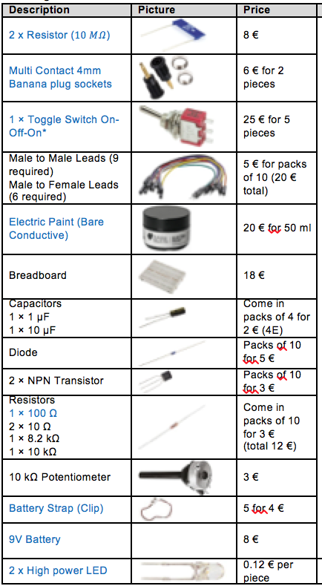
Materials:

Slide 8
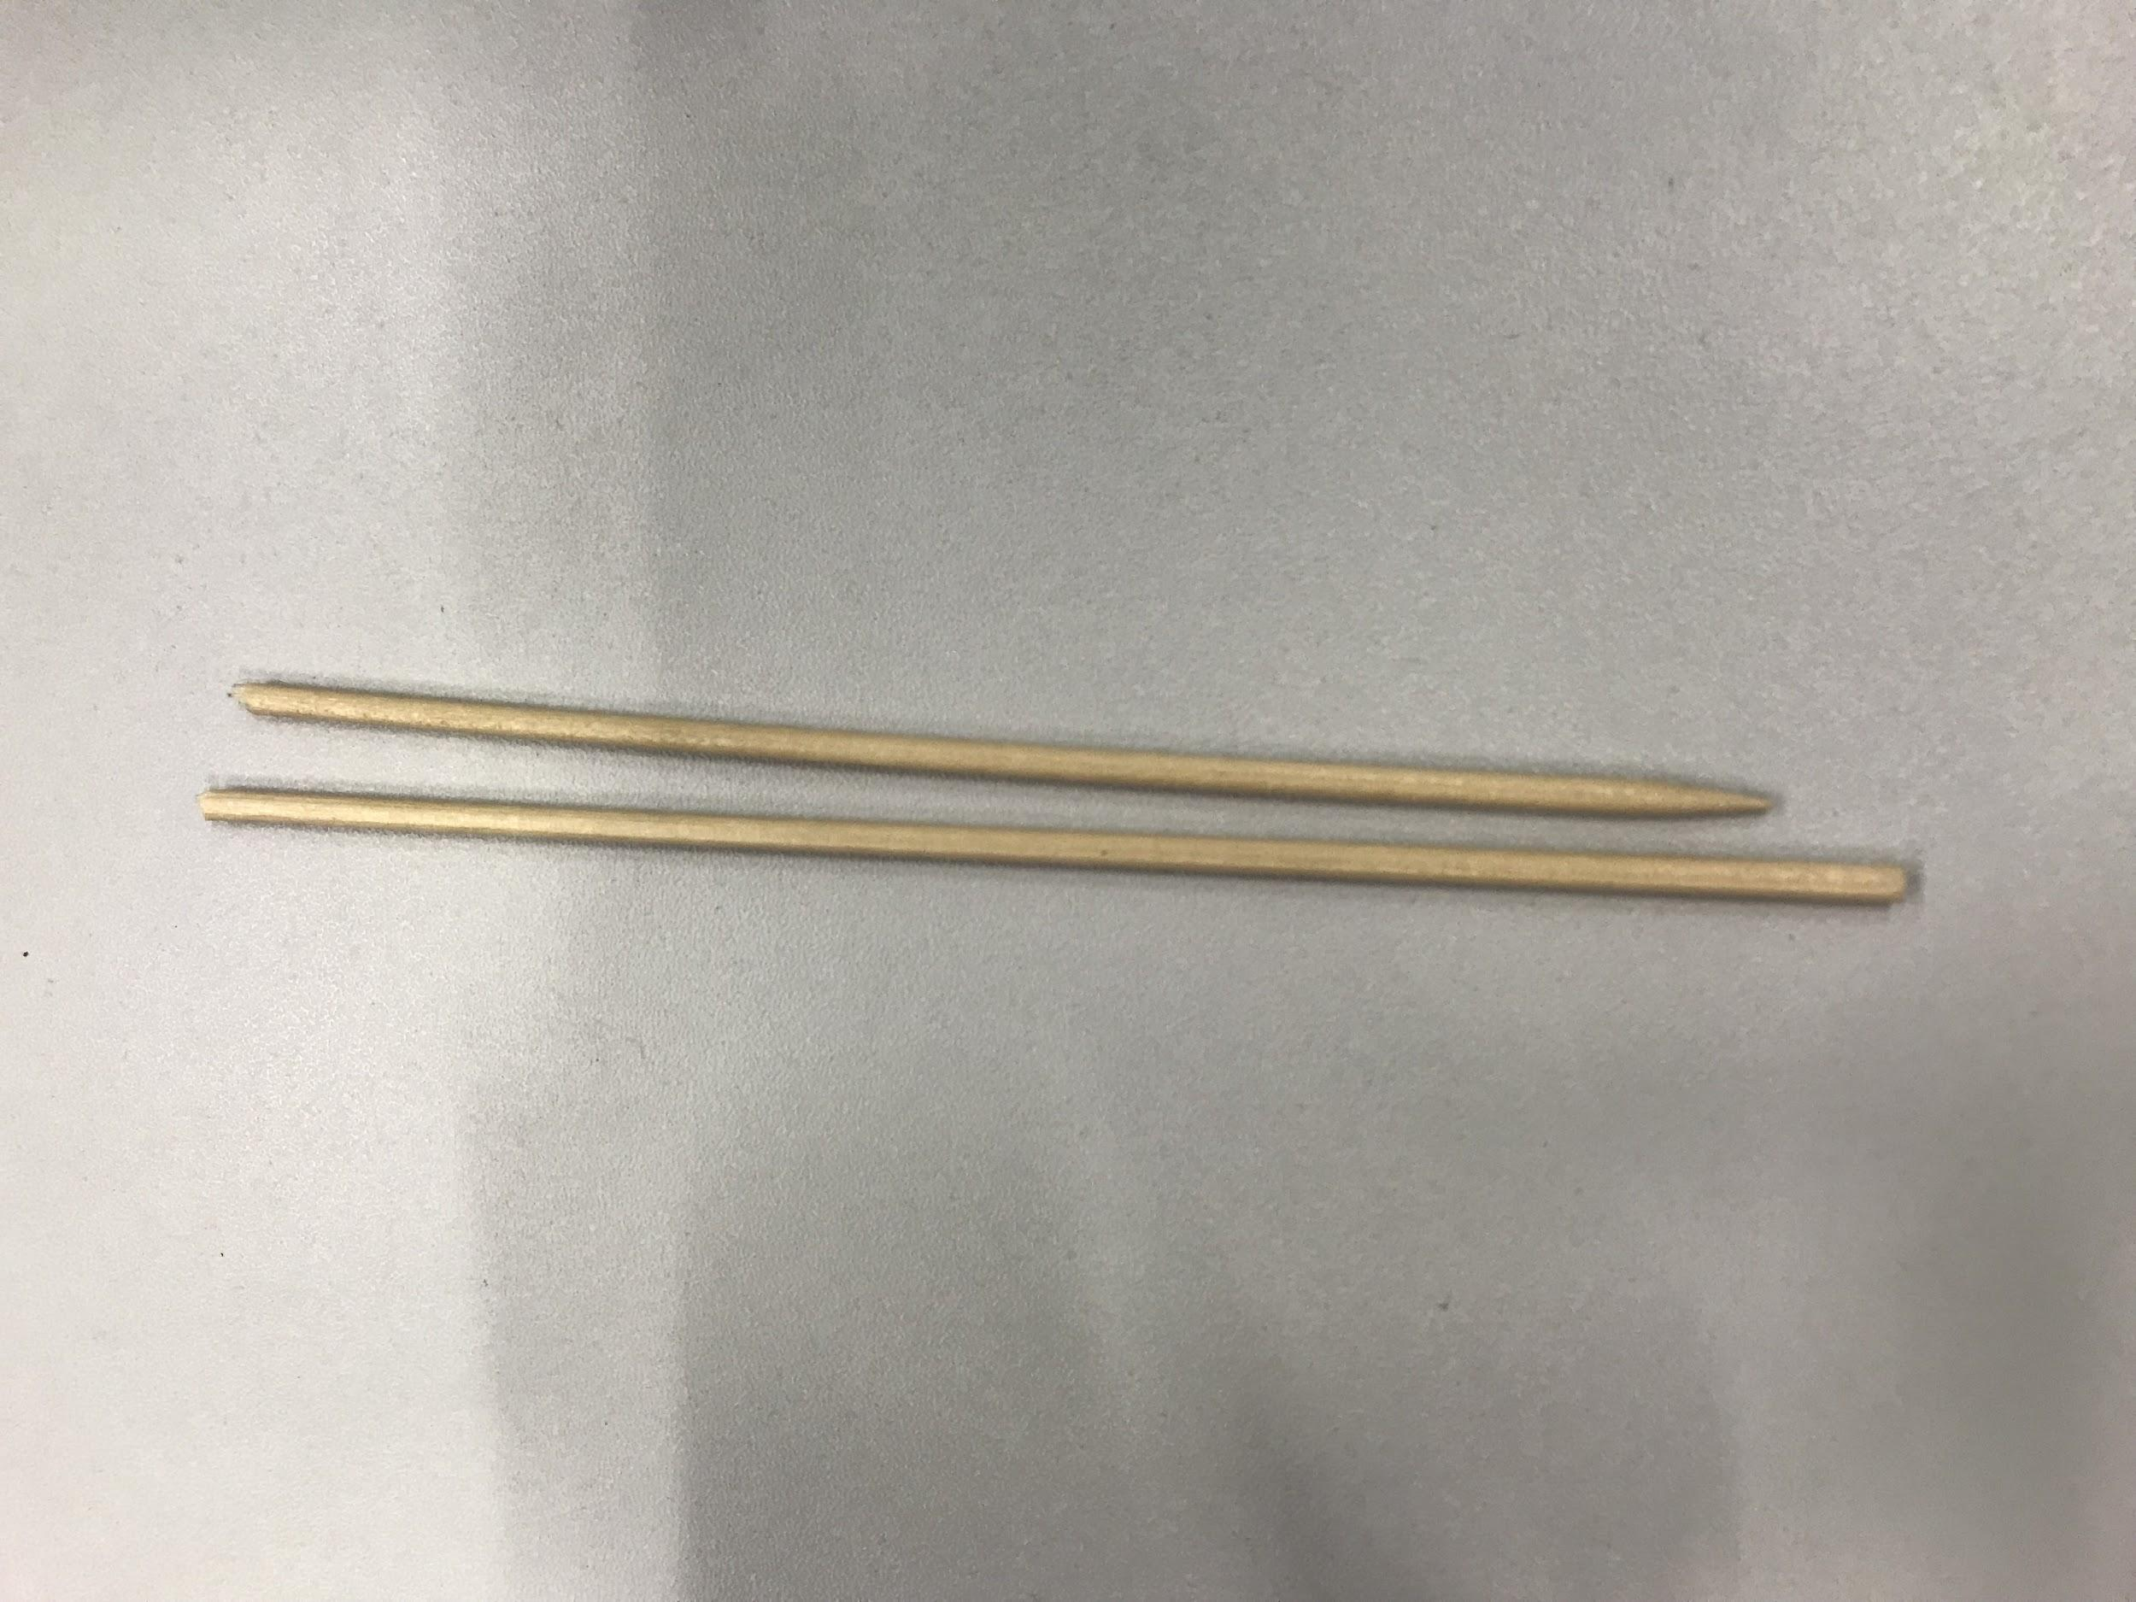
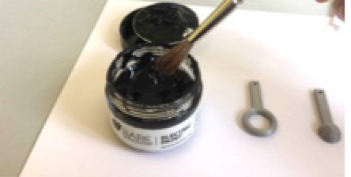
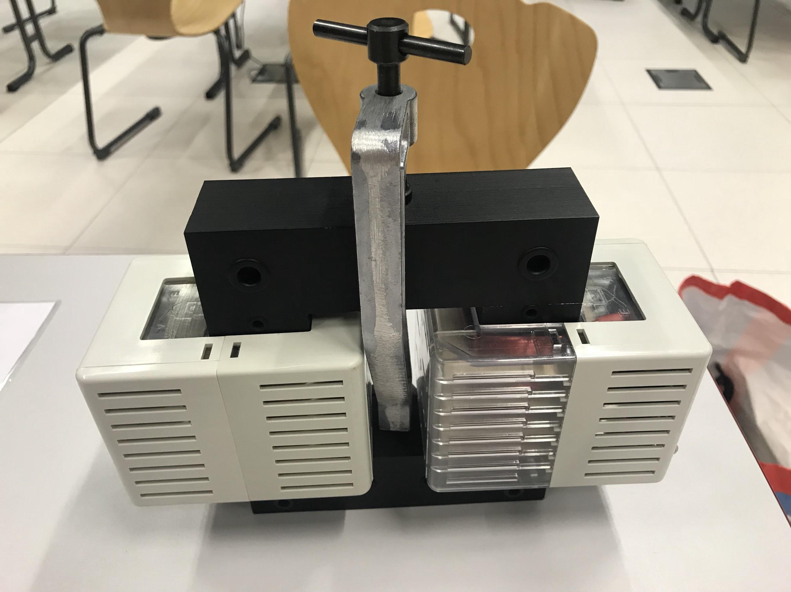
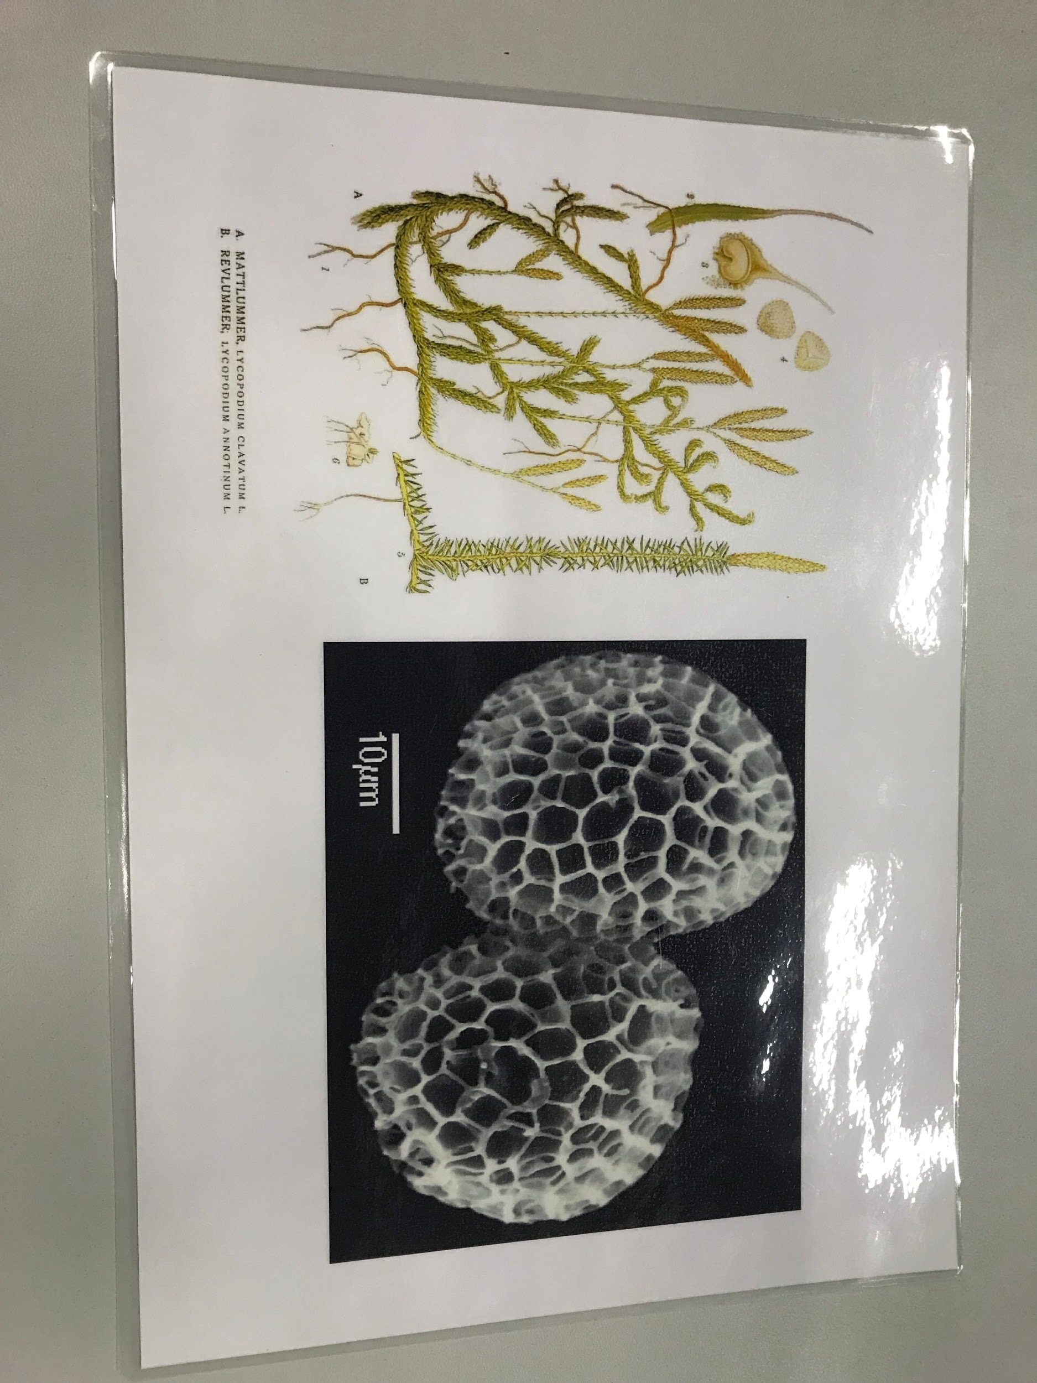
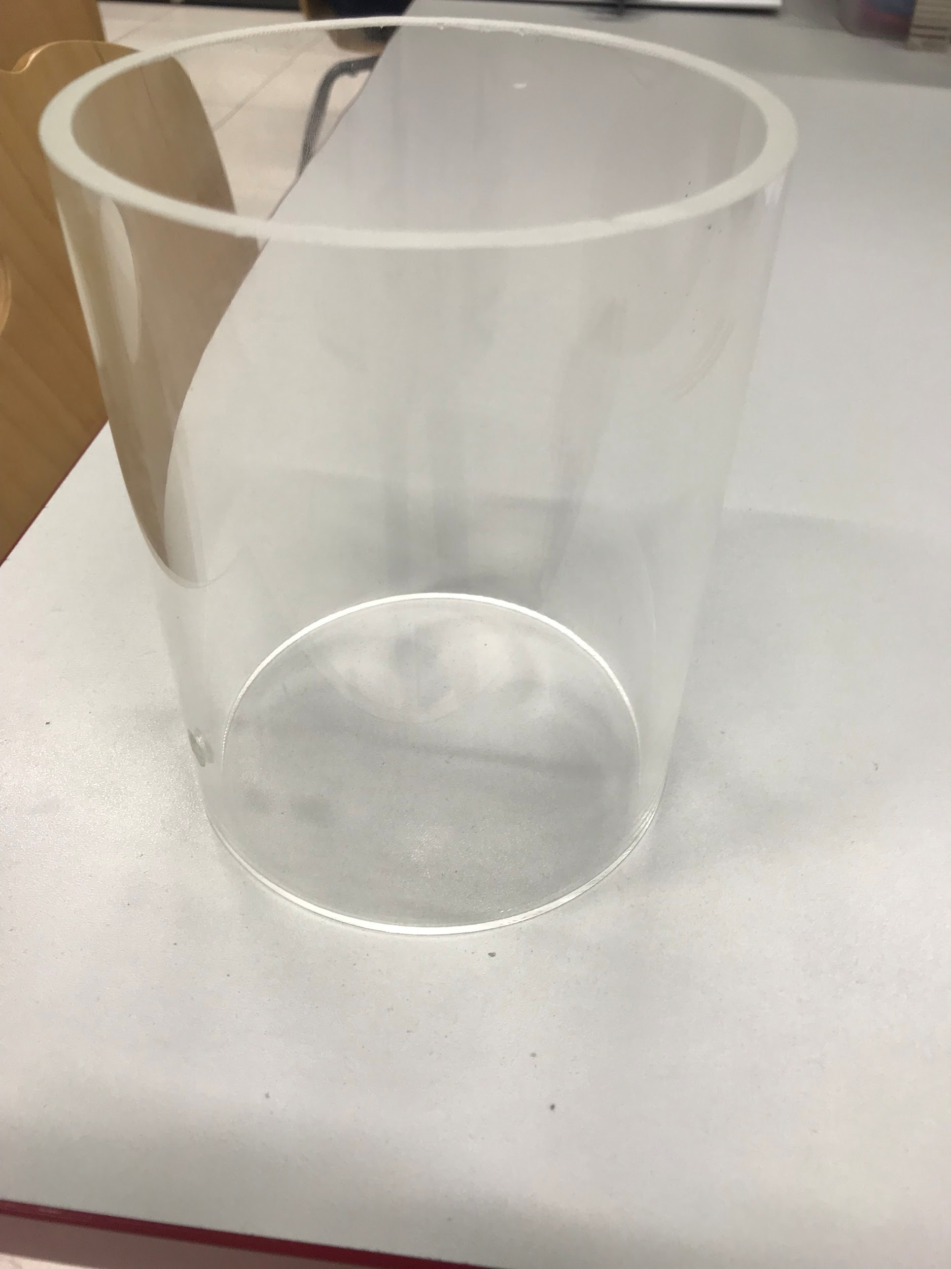
Other materials required to perform experiment:
Wooden Skewers –
Electric Paint
Perspex tube
Power Source/Transformer
Spores (Lycopodium Powder)
Notes:
Power Source/Transformer – 2-3 kV power source of frequency 50 Hz using a standard variable 20 V AC power source and a transformer with voltage transformation ratio of 200 (coils with N₁ = 50, N₂ = 10000).
Perspex tube– The spores can be blown out of the trap by the airflow in the room or by breathing students, thus, placing a clear plastic barrier around the electrodes. It is possible to use a Perspex tube of diameter approximately 120 mm or a clear sheet of plastic (for example the slides used on overhead projectors).

Slide 9
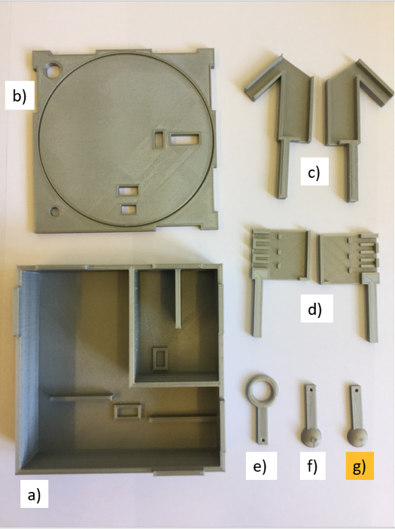
Building Instructions: 3D printing:
Lid
LED Holder
Electrode Stand
Spherical Electrode
Base
Ring Electrode
Notes:
a) Base – approximate mass 110 g
b) Lid – approximate mass 55 g
c) LED holder – approximate mass 15 g
d) Electrode Stand – approximate mass 12 g
e) Ring Electrode – approximate mass 2 g
f) Spherical Electrode – approximate mass 2 g
g) Second Spherical Electrode (optional) – approximate mass 2 g
We recommend printing the spherical and ring electrodes in the highest possible resolution as these have small holes designed for screws.

Slide 10
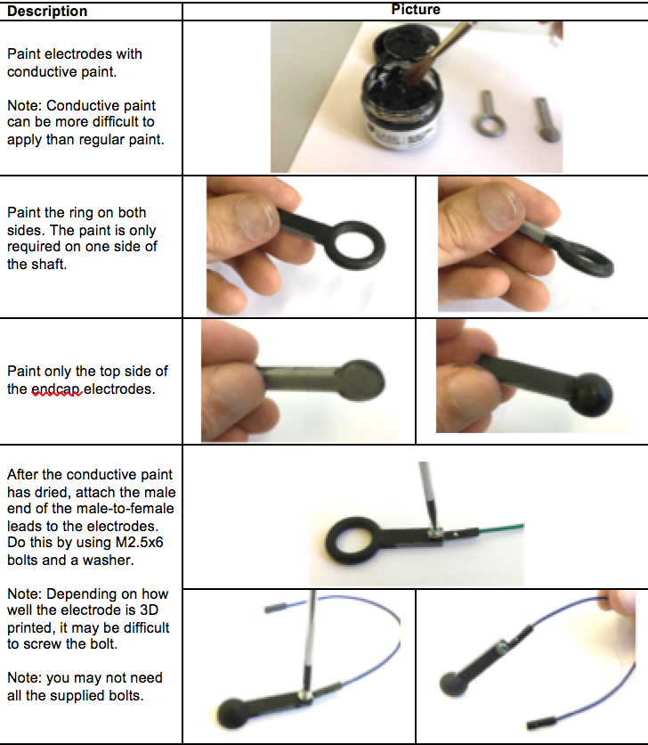
Building Instructions Cont’d
Notes:
Conductive electric paint, two 4mm banana plug sockets, two 10 MΩ resistors, the 3D printed electrodes and two male to female leads.

Slide 11
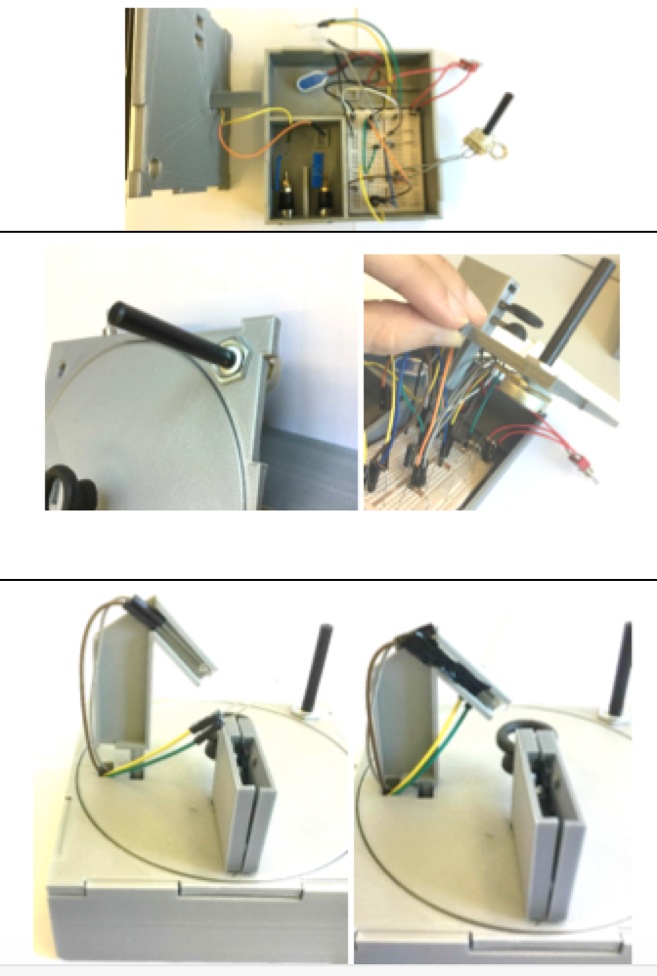
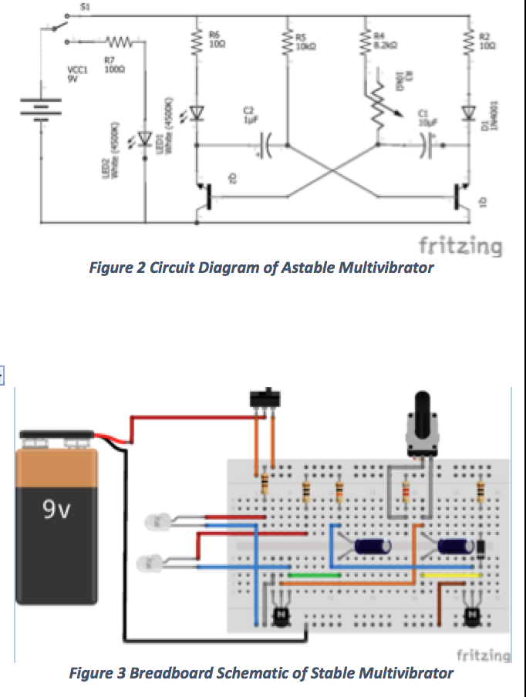
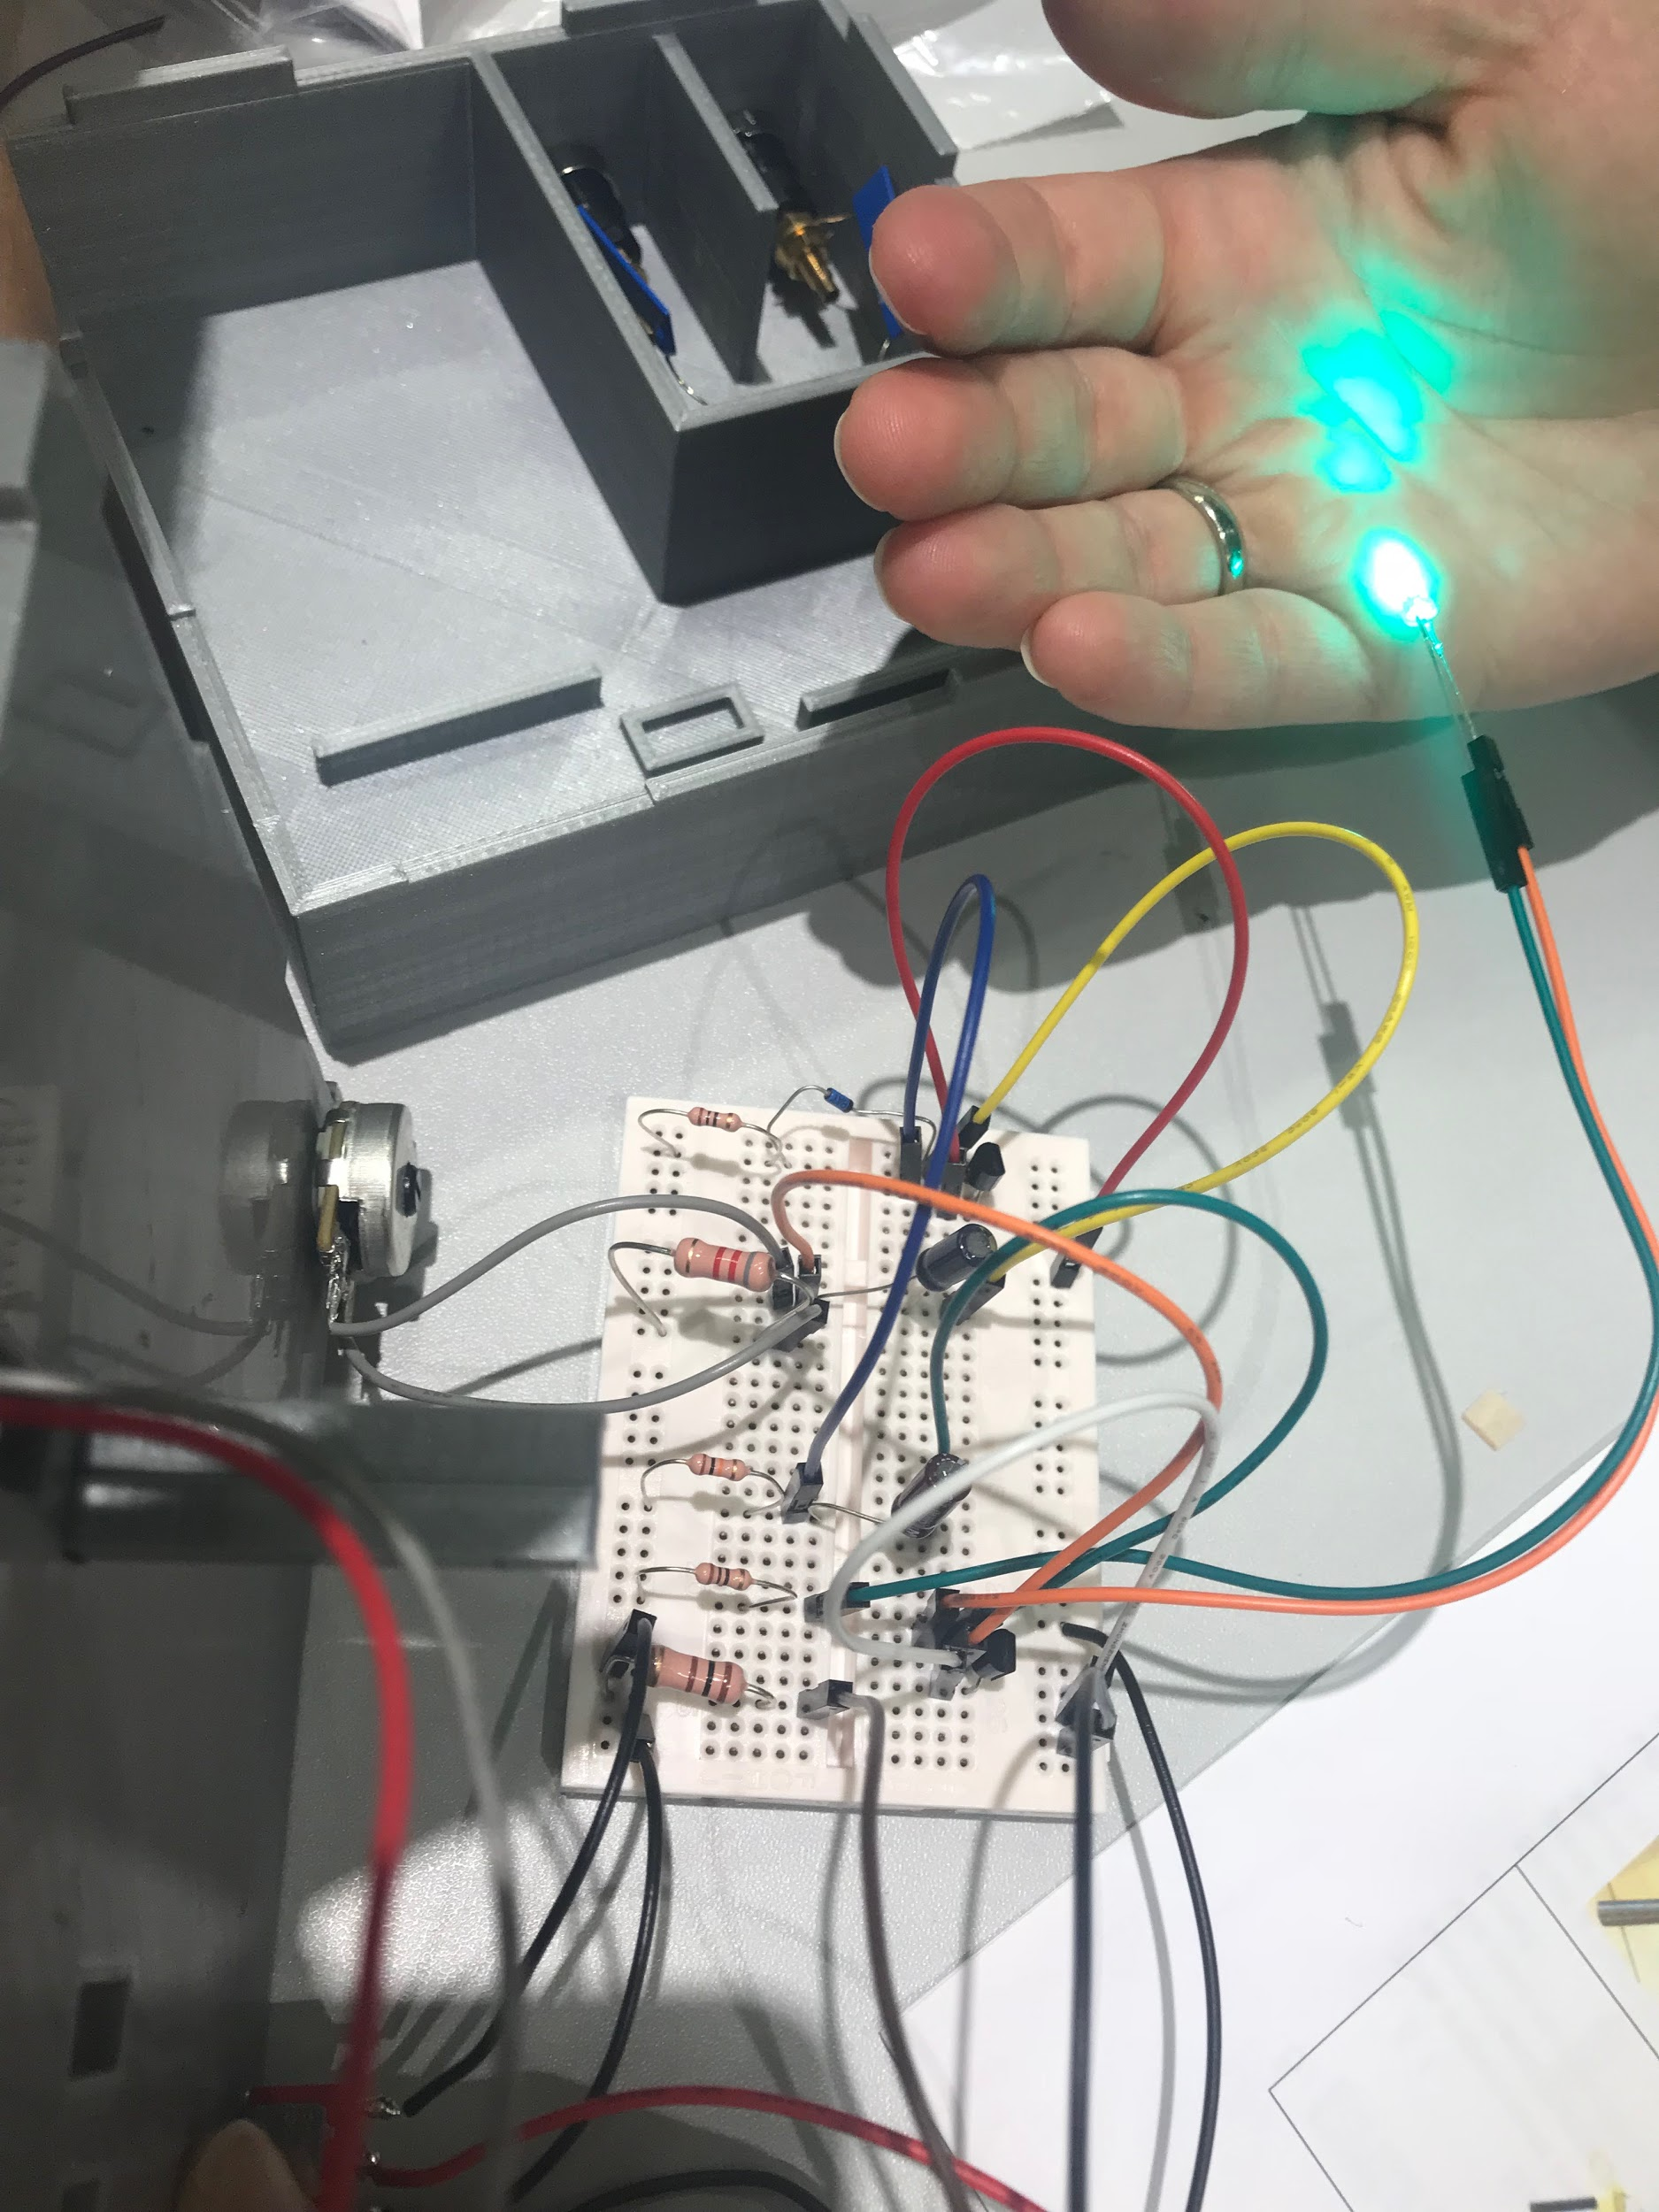

Slide 12
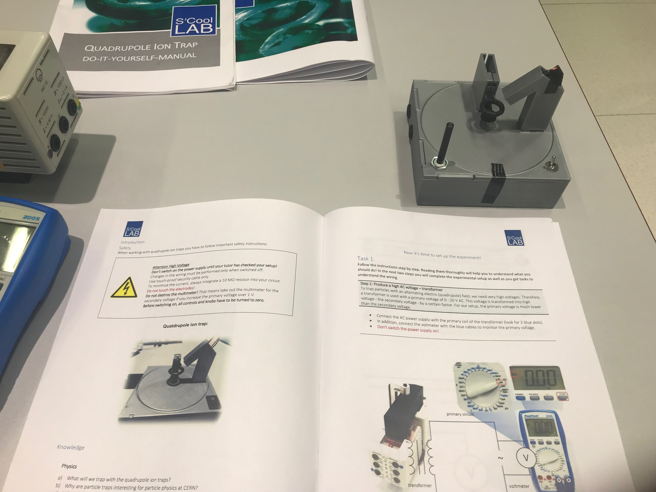
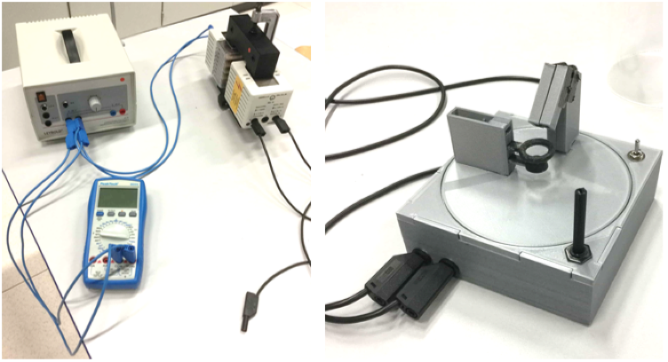
Operation Instructions
Safety Notes
Trapping Spores
Notes:
Safety Notes
This experiment involves using a high voltage power source (at least V_{rms}=2000 V), teacher supervision is required, also it is recommended that teachers check the student’s circuit before they switch on their circuit.
Trapping Spores
Once the quadrupole trap is complete it can be used to trap lycopodium powder. The first step is to set up the high voltage power source that will be connected to the electrodes. An AC power source that is capable of reaching at least V_{rms}= 2000V AC. This can be done by connecting a 20V AC power source to a transformer with voltage transformation ratio of 1:200. See image below:

Slide 13
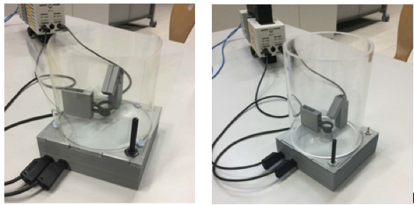
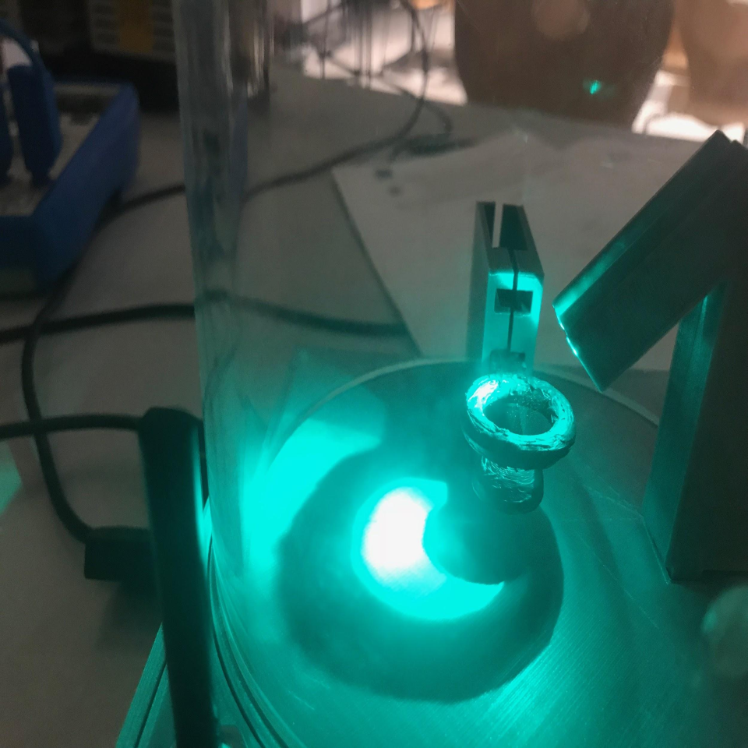
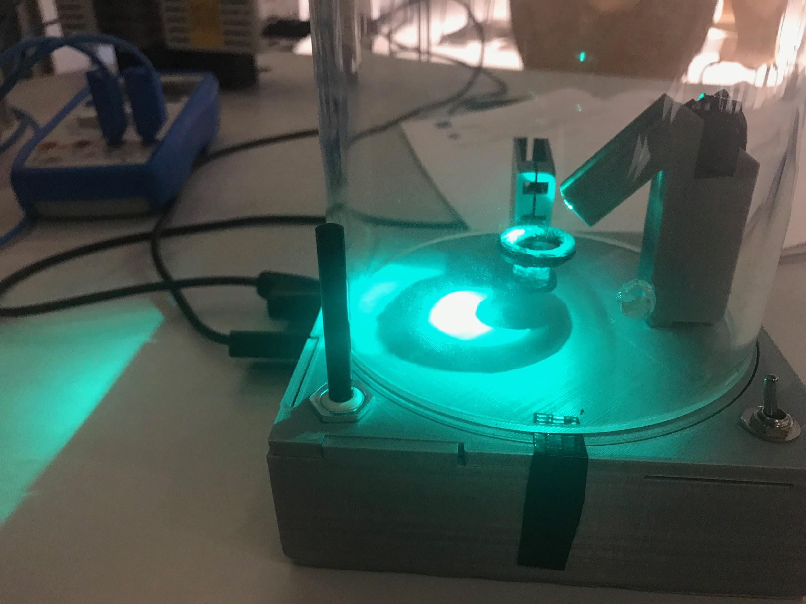
Operation Instructions Cont’

Slide 14
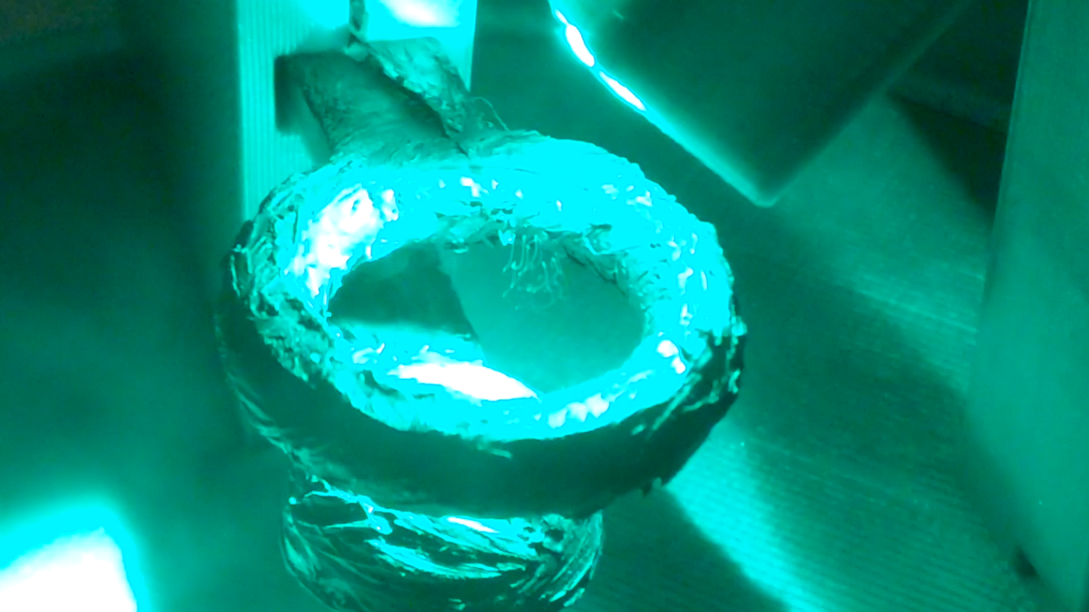

Slide 15

SOURCEheyitscaspian.tumblr.com

Slide 16
Problems and Tipps:
Equipments and Setup:

Slide 17
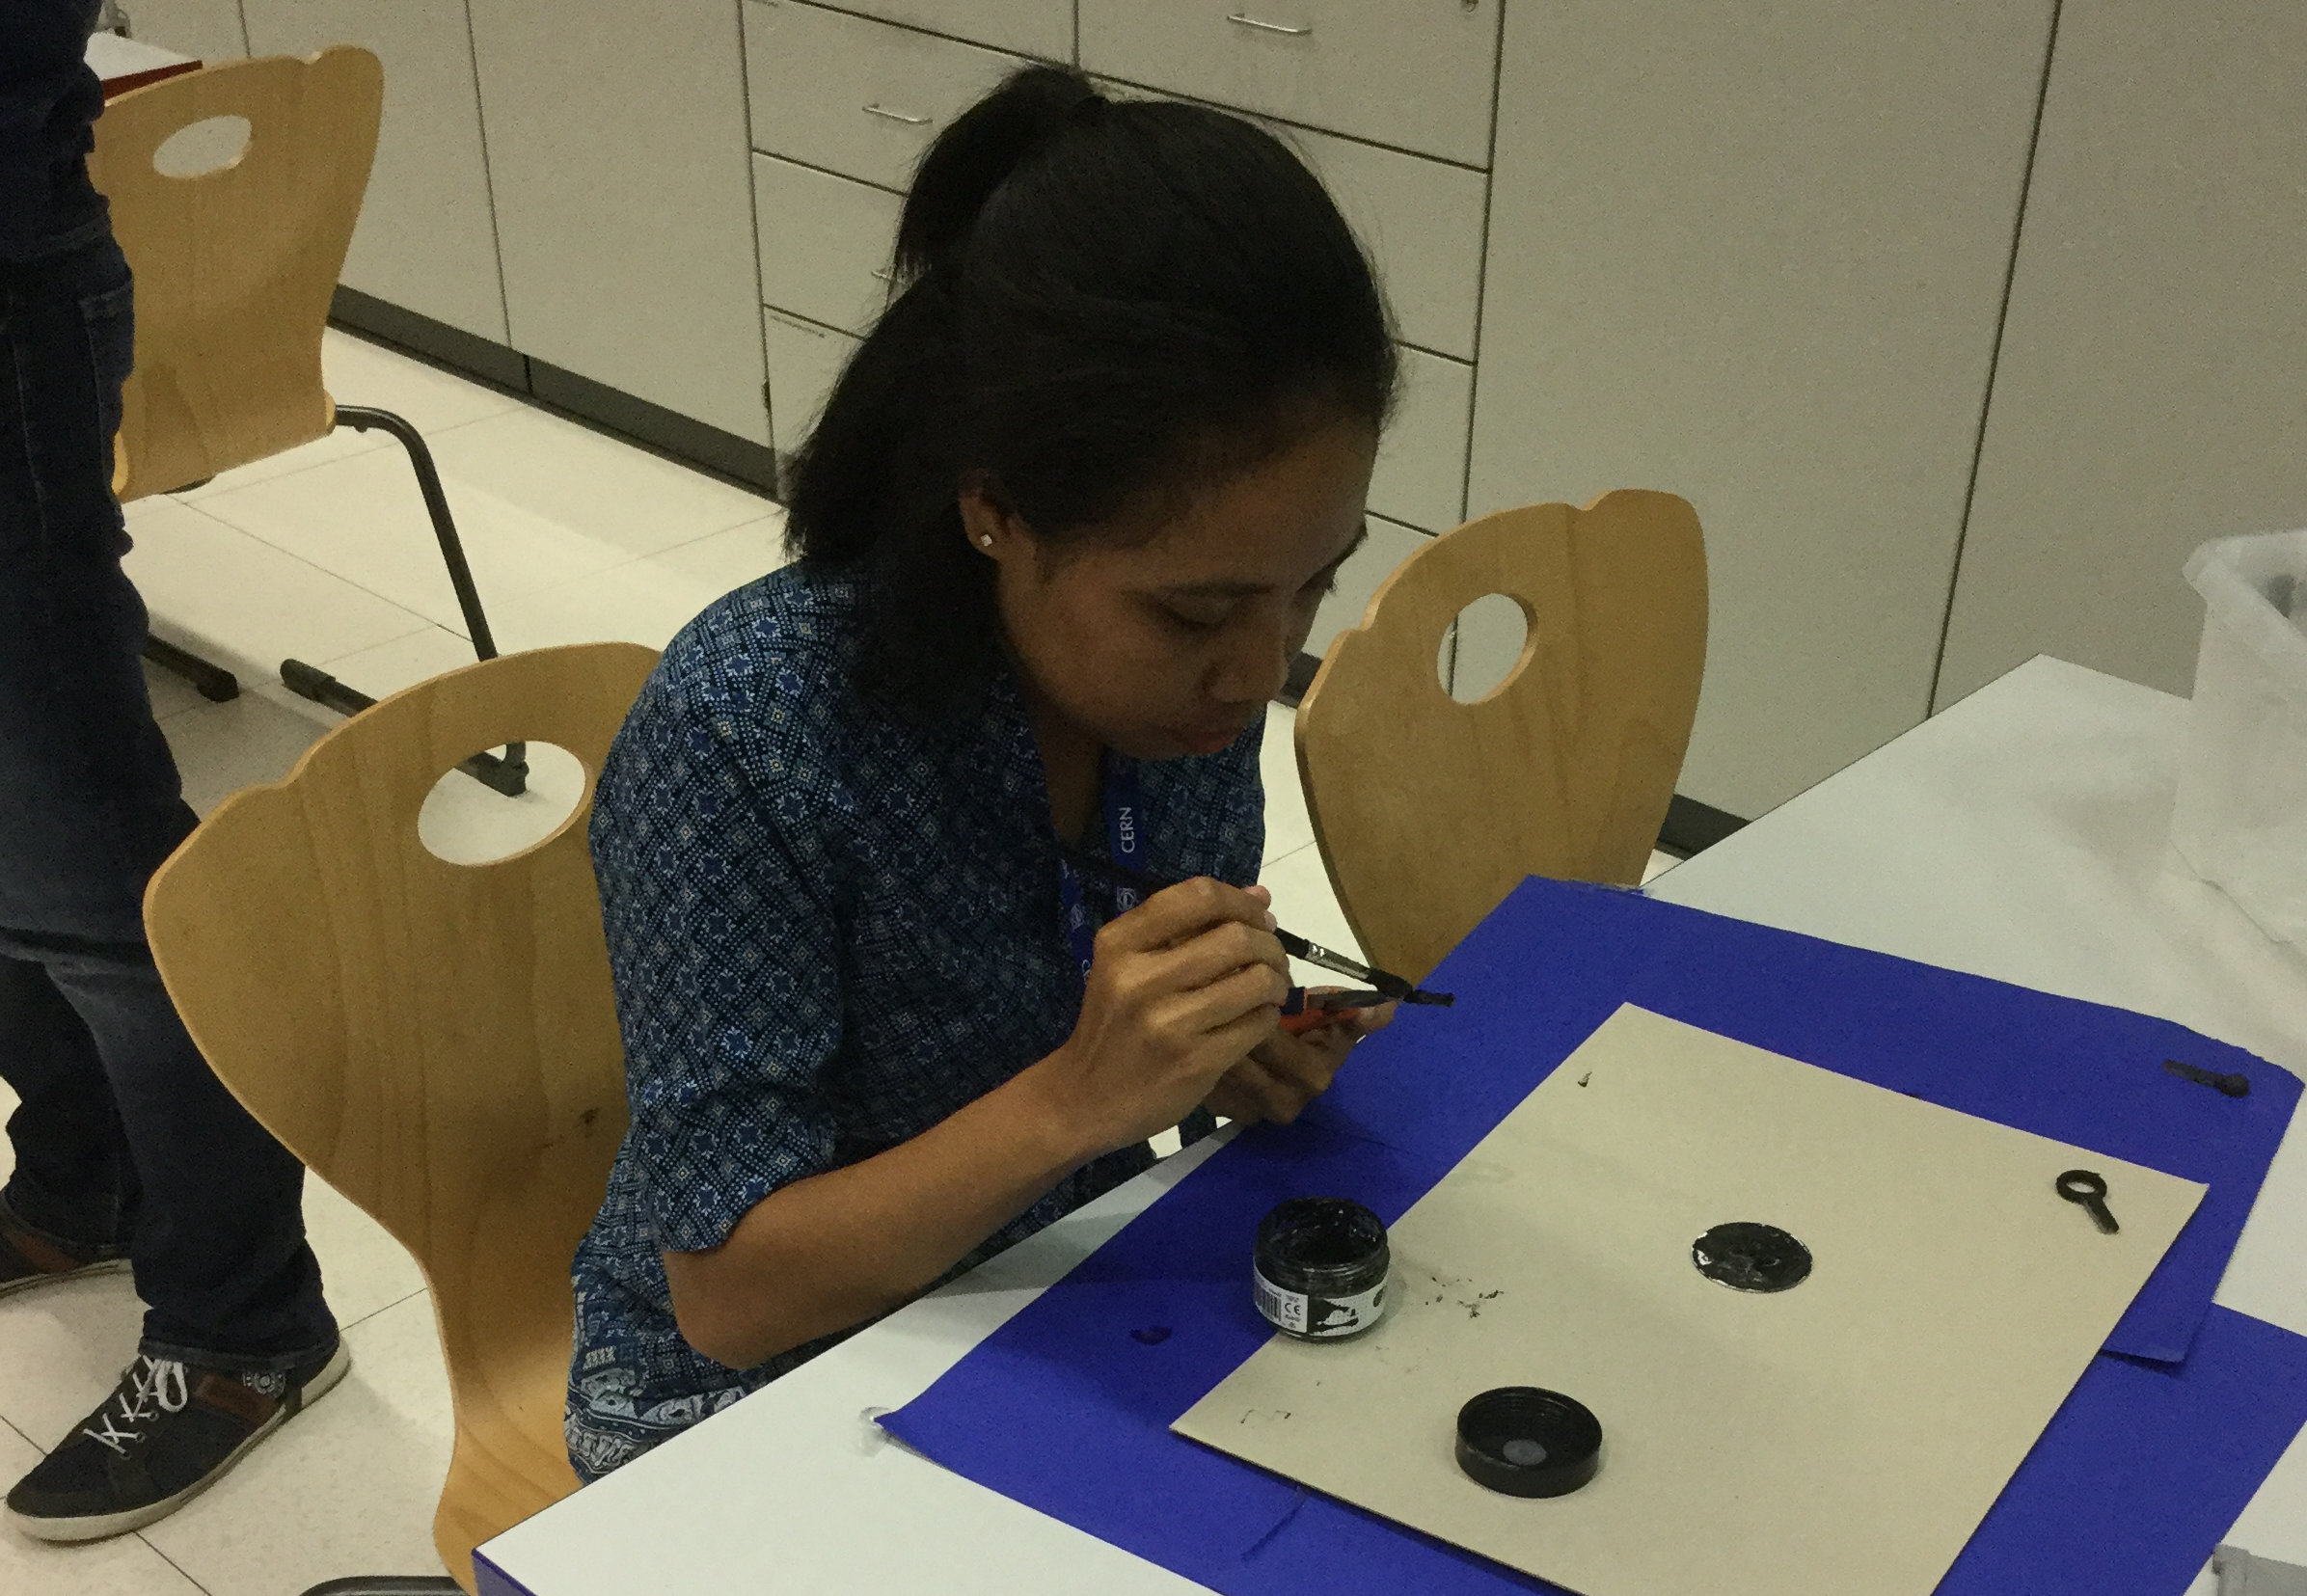



Painting
Have you ever painted with glue? We did.
TIP: Use a brush with stiff hair.

Slide 18
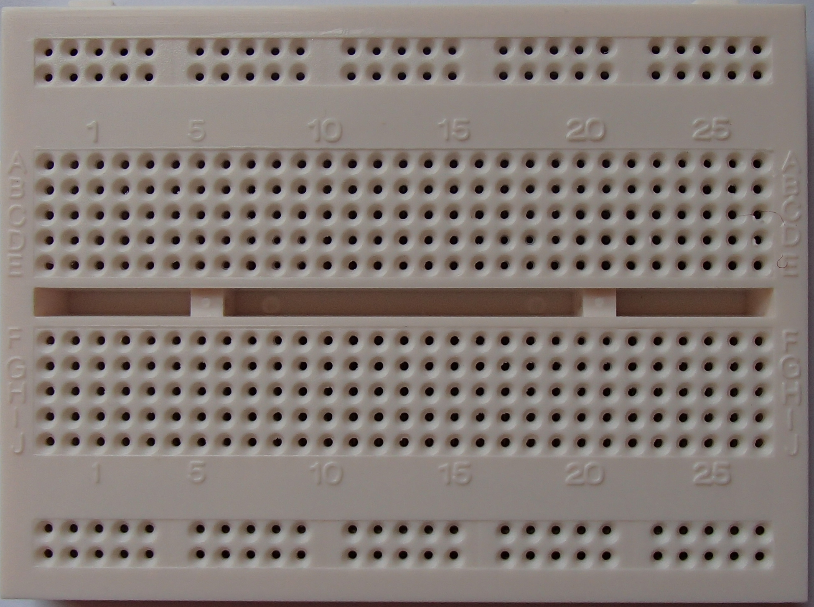
Project Board
The dots on the outer side connect horizontally.
The dots in the middle connect vertically.
TIP: Stick the electric components deep into the board. Otherwise they are not connected properly.

Slide 19

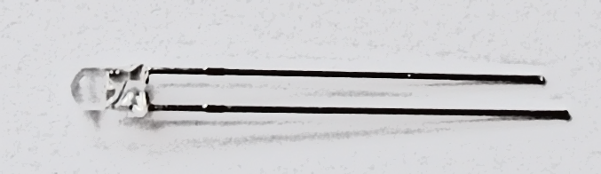
Don´t kill the LED!
9 Volt will kill the LED – always use the resistor!!
Tip:
The short end of most electronic devices must be connected with the negative pole of the battery.
How can you remember this:
You want the negative experiences in life to last a short time!

Slide 20
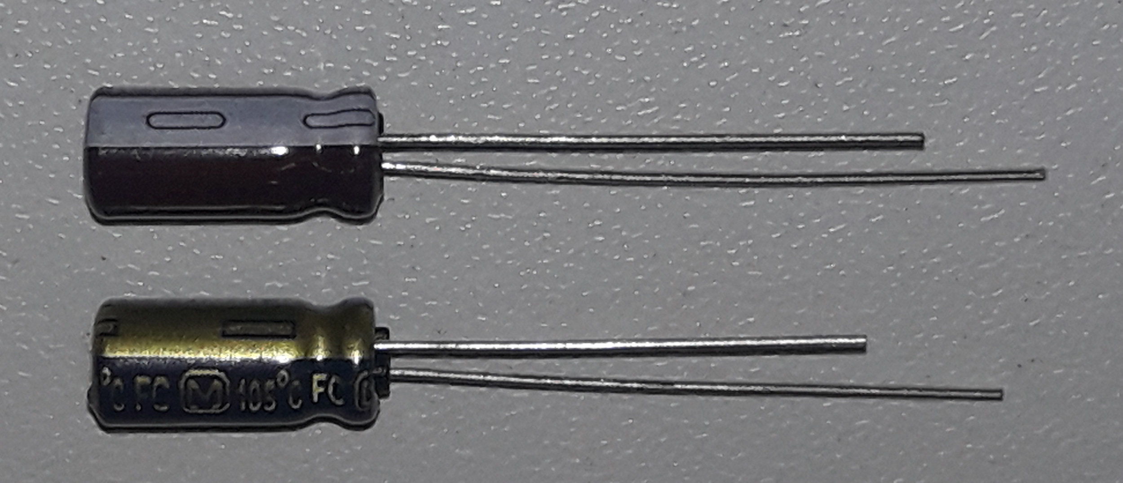

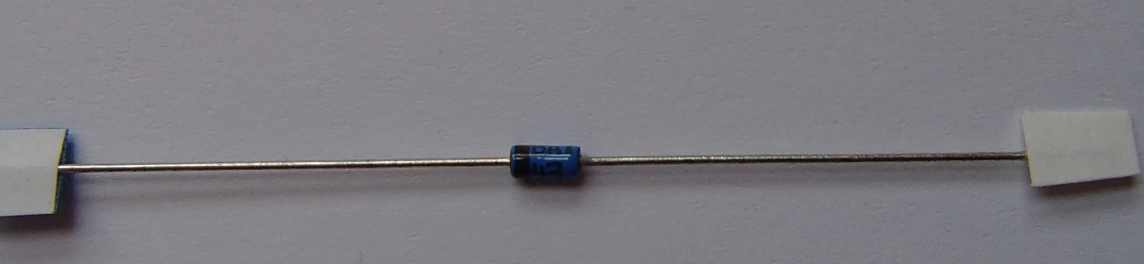
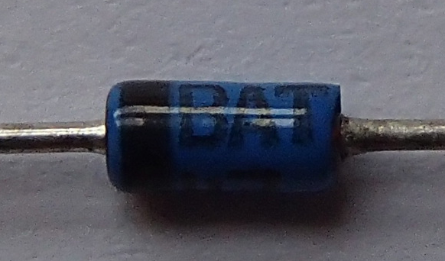
Connect the capacitors and the diode correctly!
Capacitors:
Diode:
The black ring is the negative connection.

Slide 21
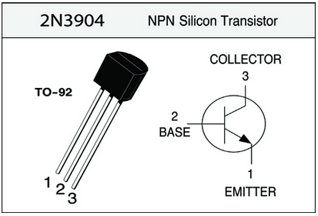
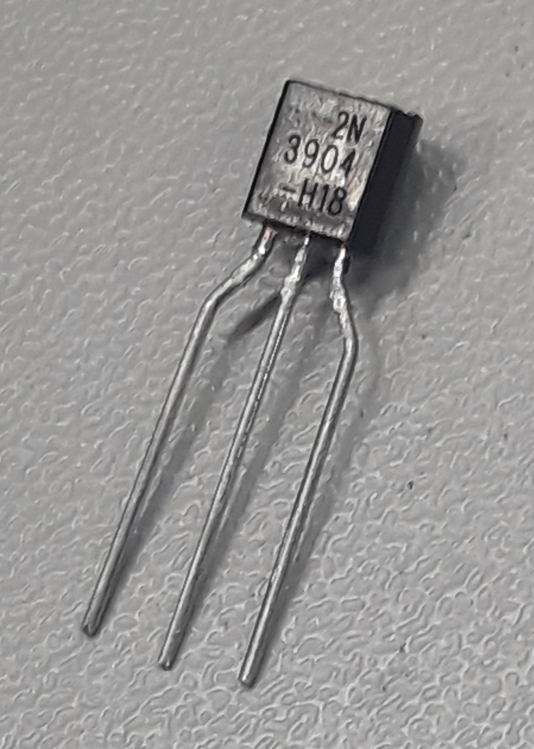
Put the 2 transistors the right way!
This goes to the negative pole.
These go to the positive pole.

Slide 22
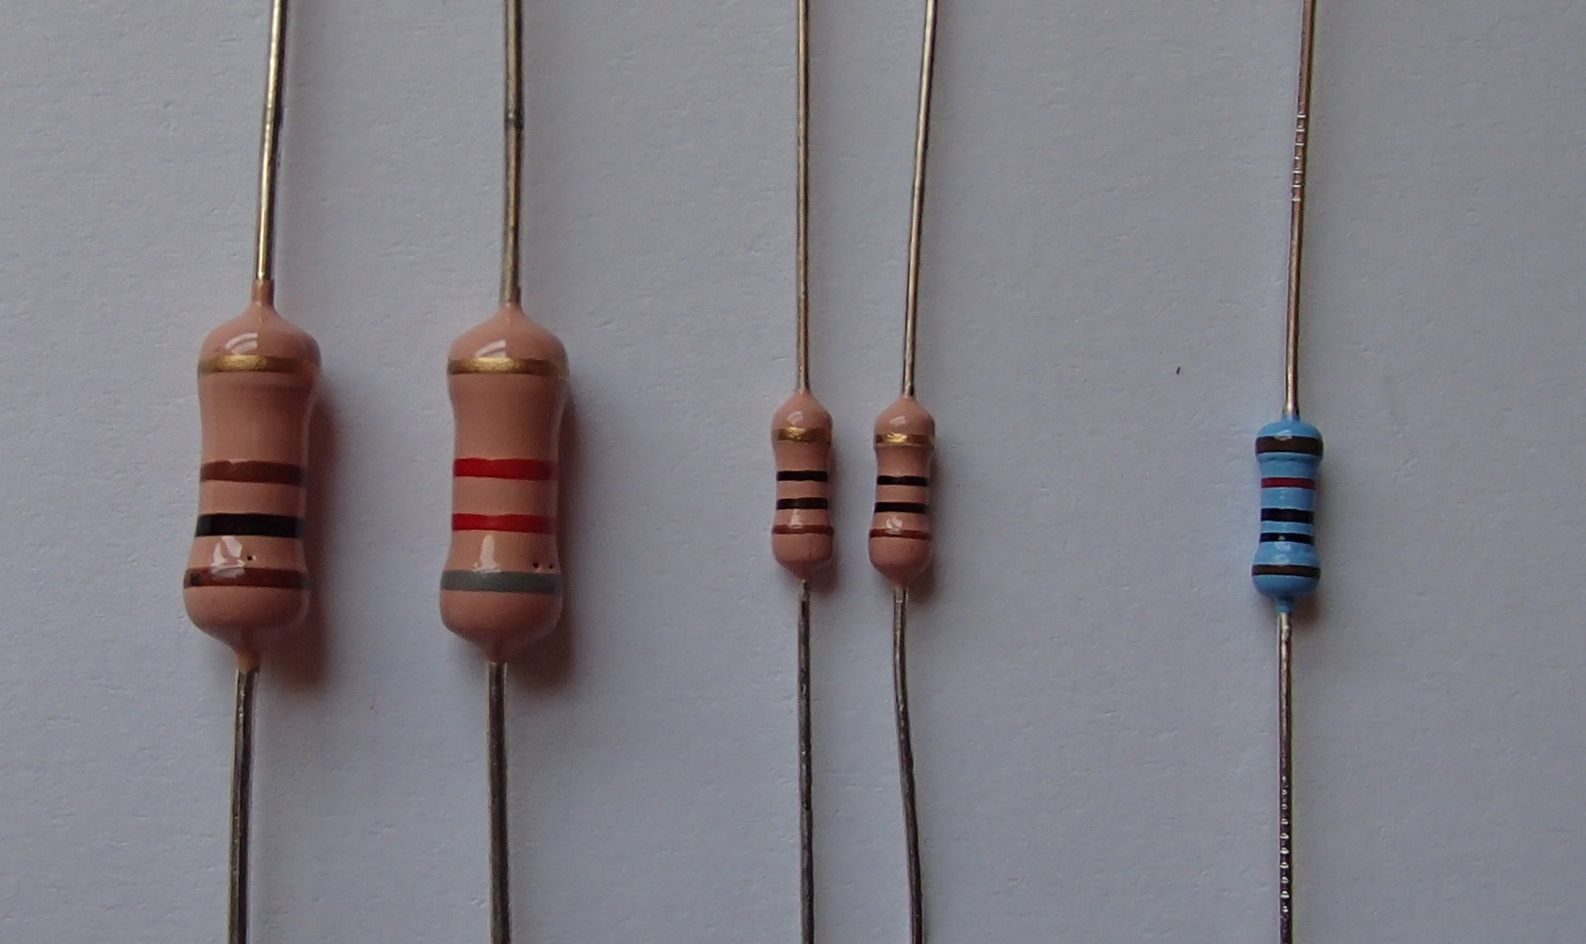
Don´t mix up the resistors!
100Ω
8.2kΩ
10Ω
10Ω
10kΩ

Slide 23
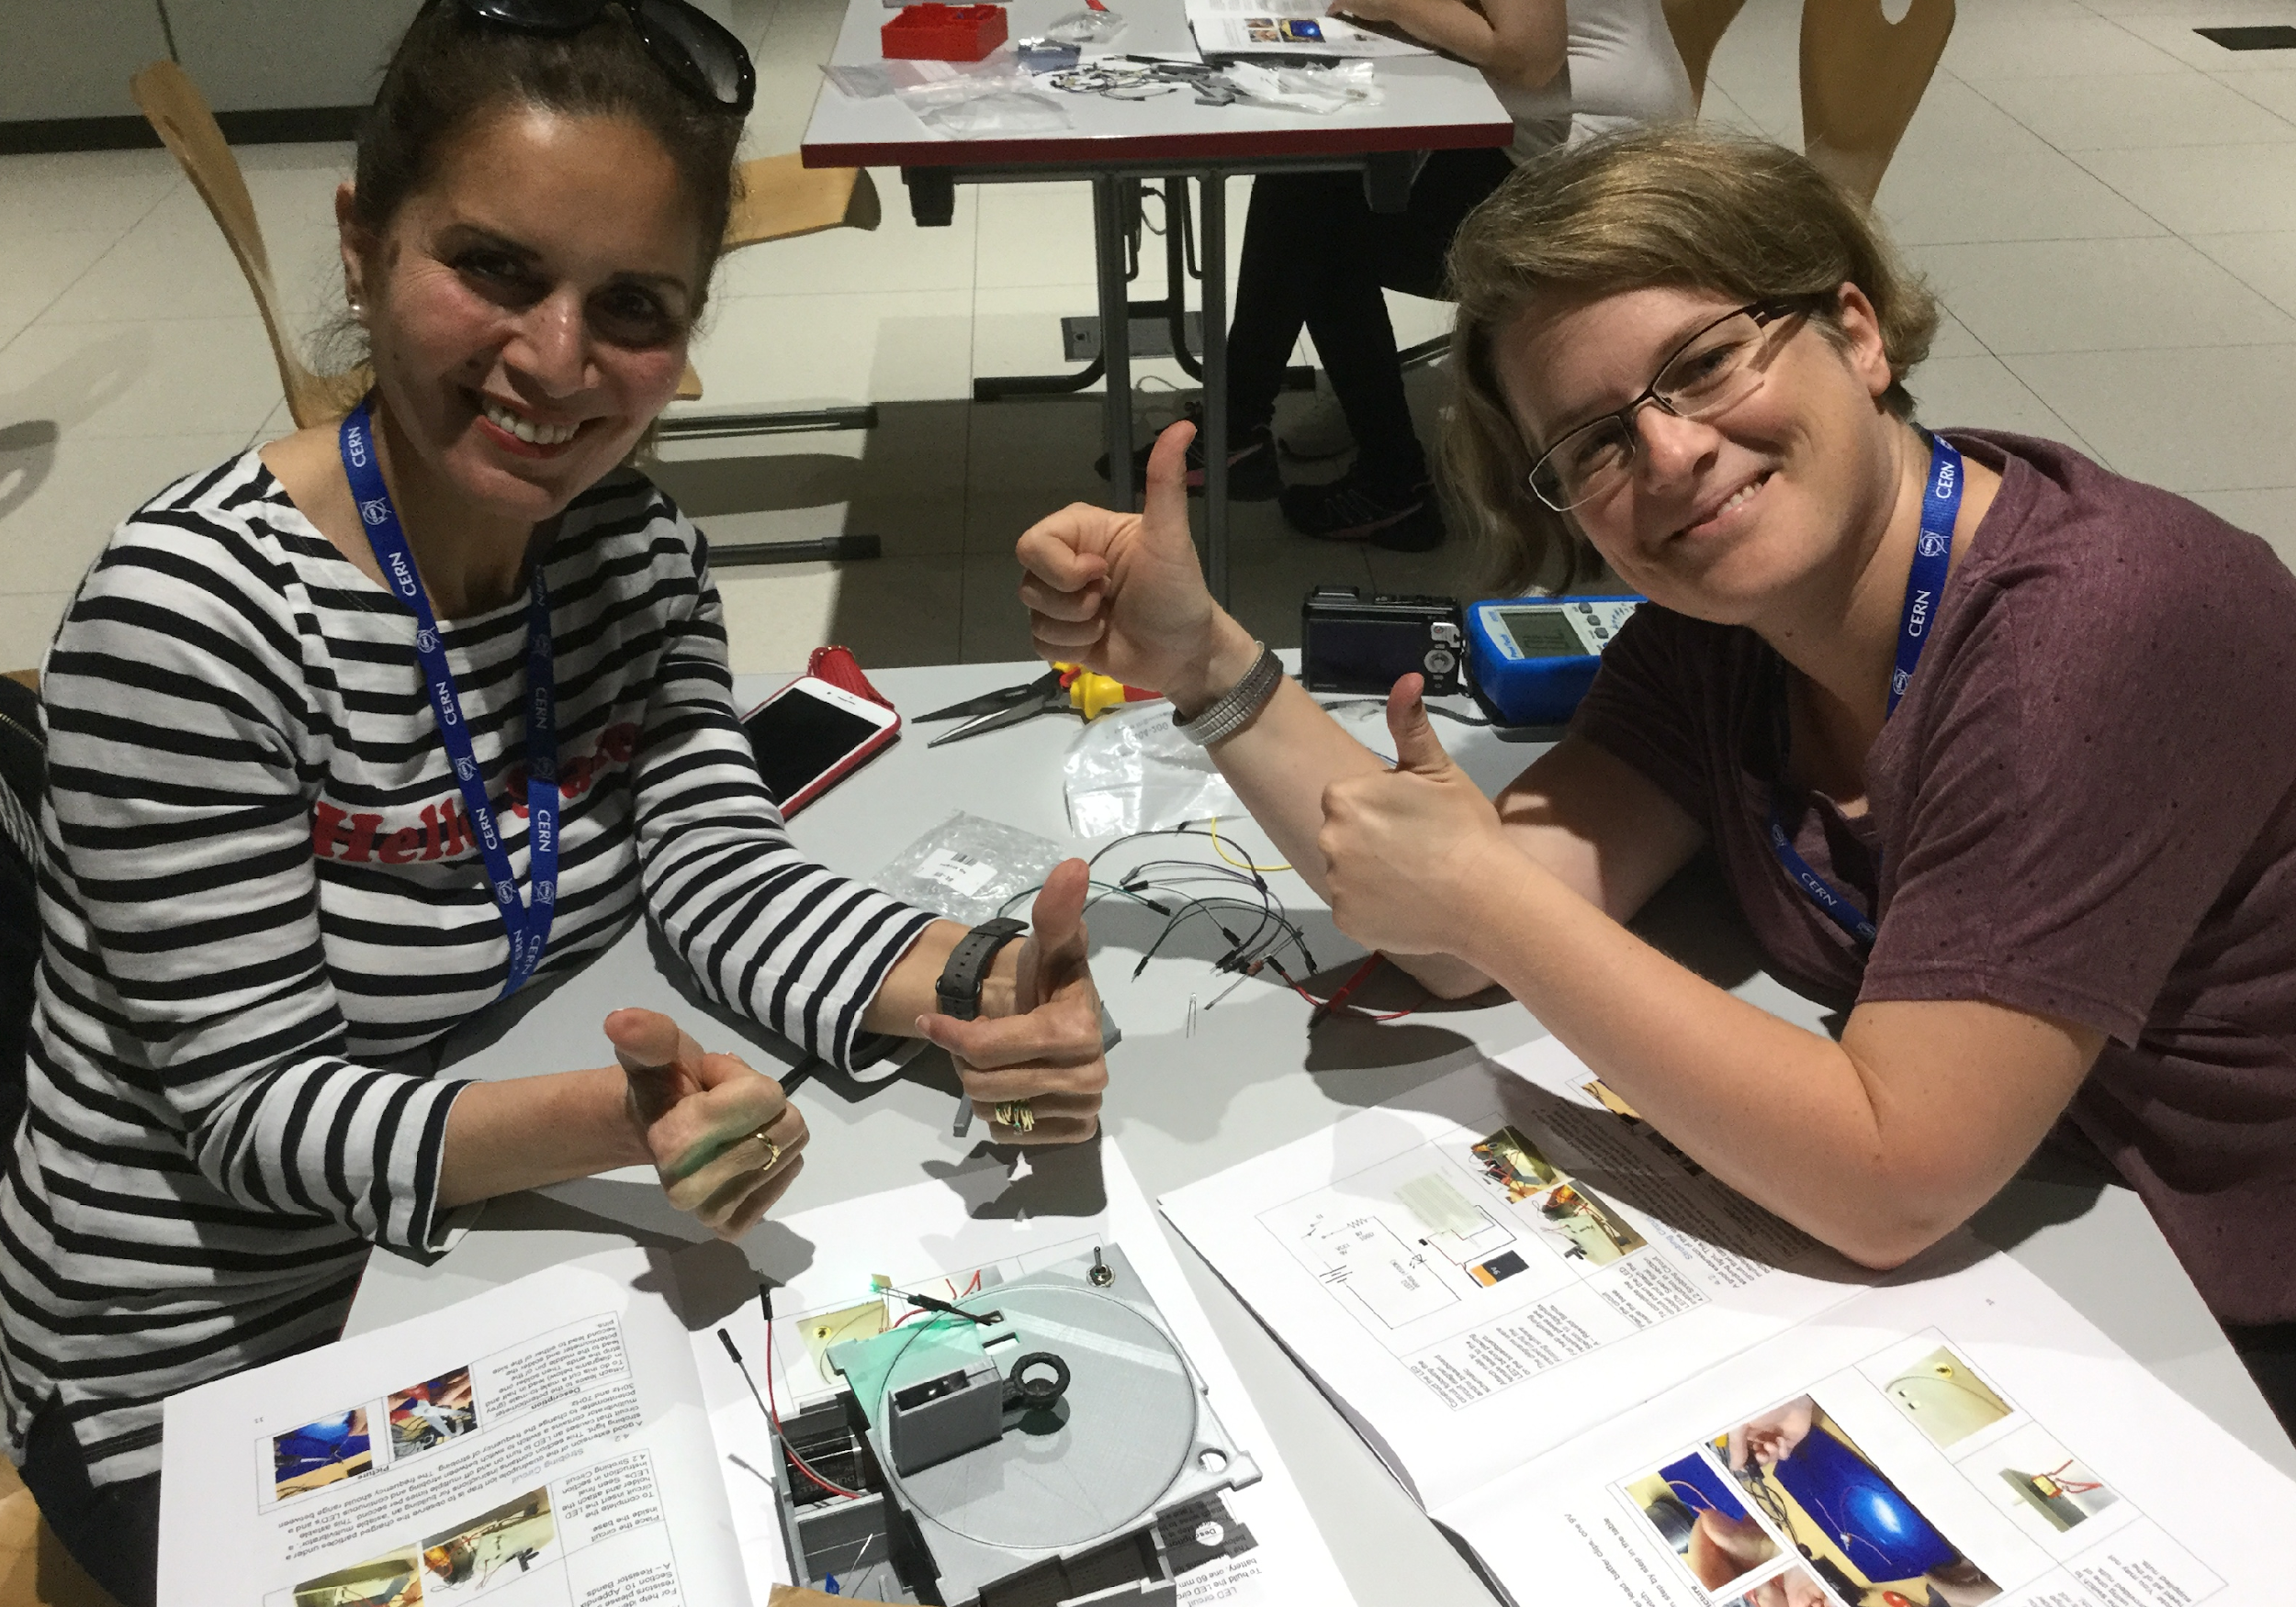
GOOD LUCK!!

Slide 24
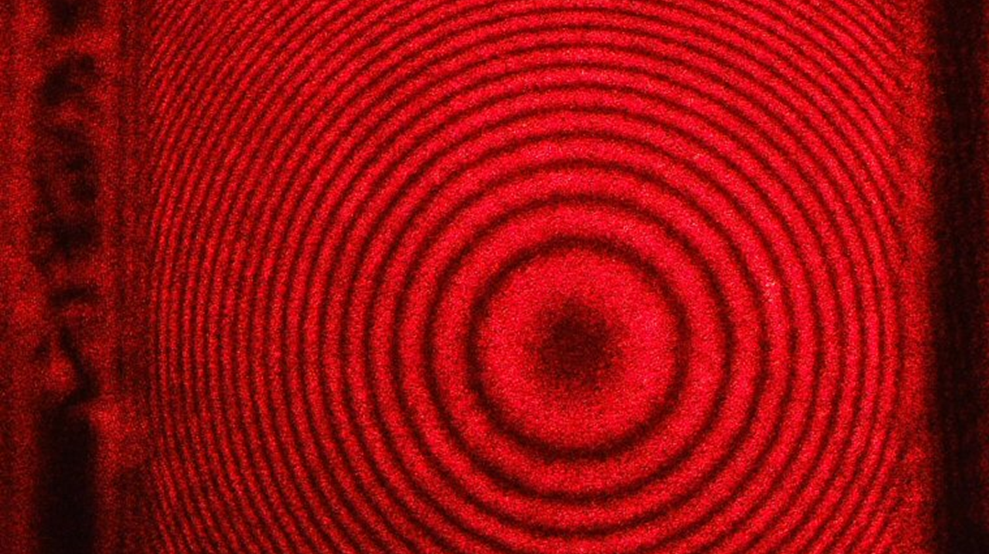
OPTICAL INTERFEROMETRY
Theory
Setup
Analogy
Notes:
Optical Interferometry is a technique where 2 or more light waves are combined to produce an interference pattern, this interference can be measured to extract information of light.

Slide 25

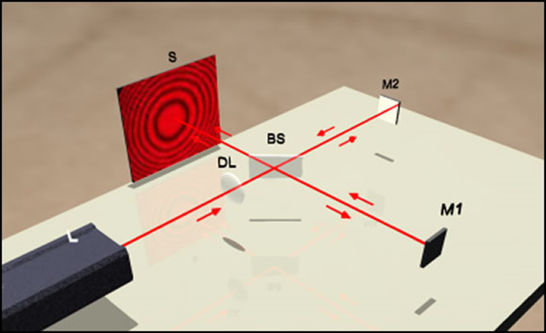
Notes:
A Michelson Interferometer is a tool used to produce interference between 2 beams of light.
It is the most common design for optical interferometry and the first interferometer invented by Albert Abraham Michelson.

Slide 26
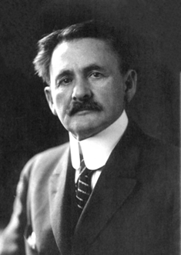
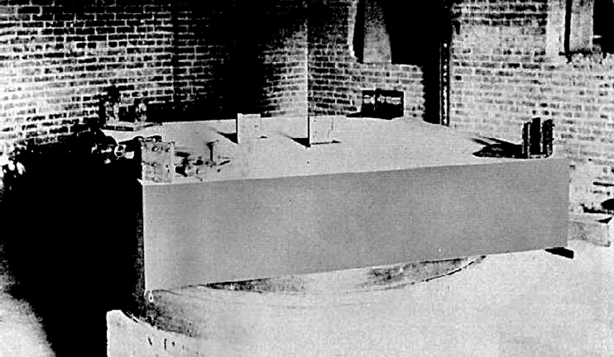
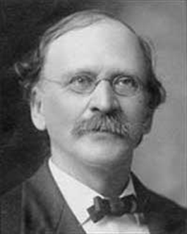
Notes:
The Michelson Morely experiment was for compared the speed of light in perpendicular directions, in an attempt to detect the relative motion of matter through the stationary luminiferous aether.
The result was negative and they found that there is no difference betwen the speed of light in this 2 directions.

Slide 27
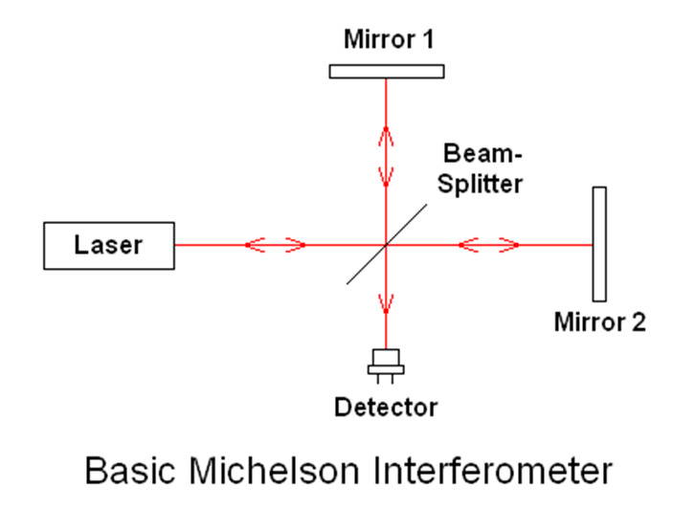
Notes:
The Michelson interferometer works by splitting a beam of monochromatic light into 2 equal beams.
One beam hits

Slide 28
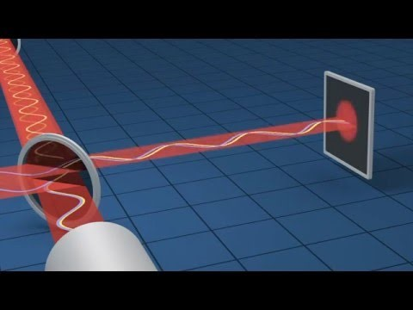
https://www.youtube.com/watch?v=UA1qG7Fjc2A
Notes:
There is a kind of laser light and hear is a beam splitter that takes half the light in reflex on way, while leading the other half pass.
Then we have 2 mirrors on either arm of the interferometer reflecting the light right back.
Depending on the difrent distance make destructive or constructive interfierence.

Slide 29

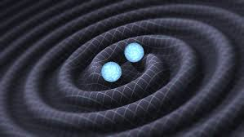

Slide 30
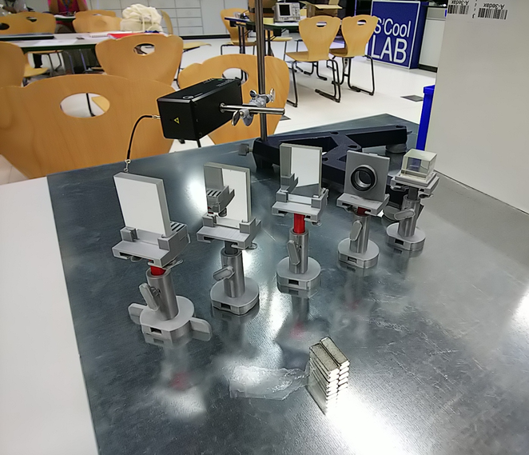
Set up (Equipments)
Iron plate : 1
He-Ne laser source : 1
(λ= 632.8nm)
Iron stand : 1
Screen : 1
Mirrors* : 3
Lens* : 1
Beam splitter* : 1
(45% Reflection/45% Passing through)
Neodymium magnet : 5
* = Mount them on a stands
made with a 3D printers

Slide 31
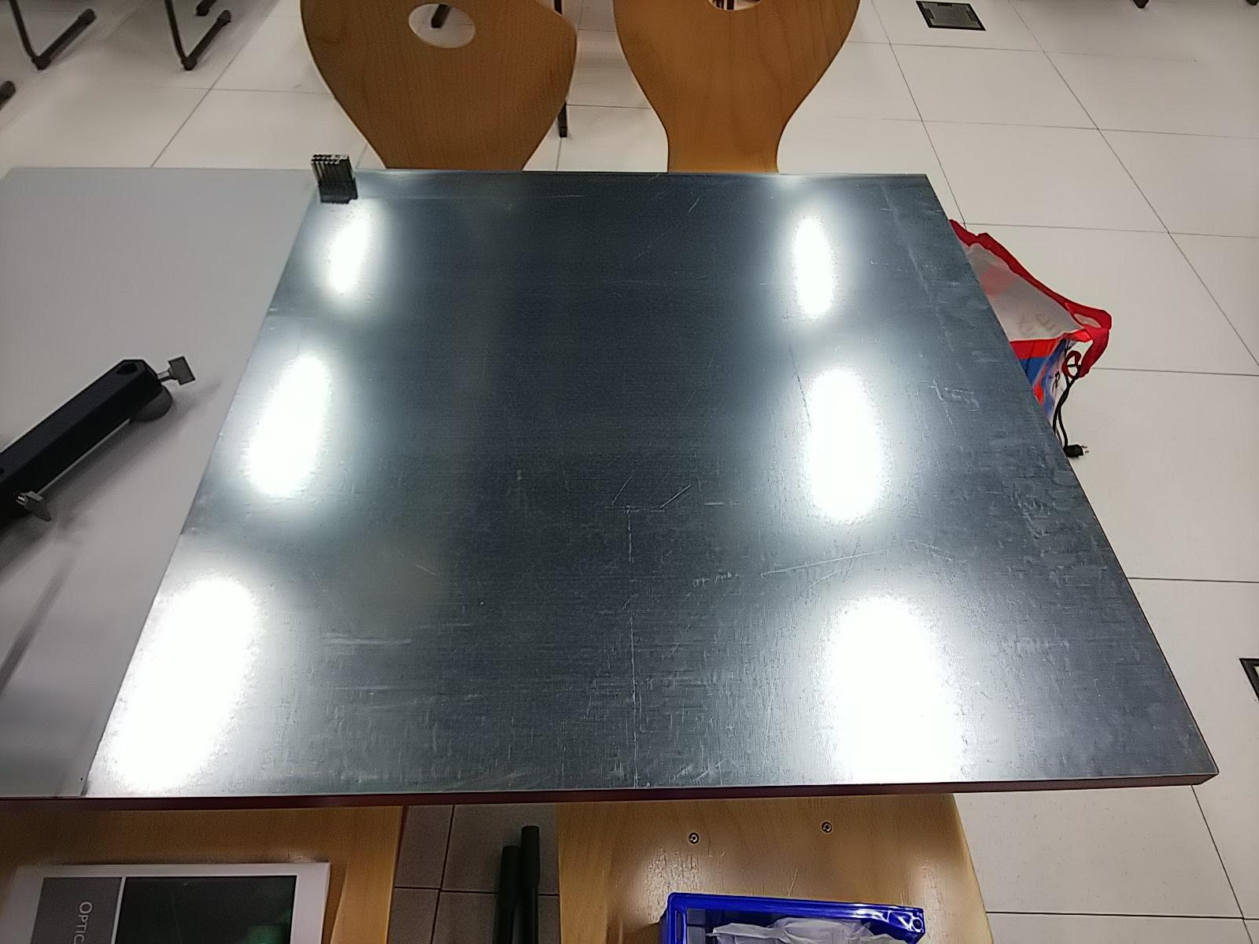
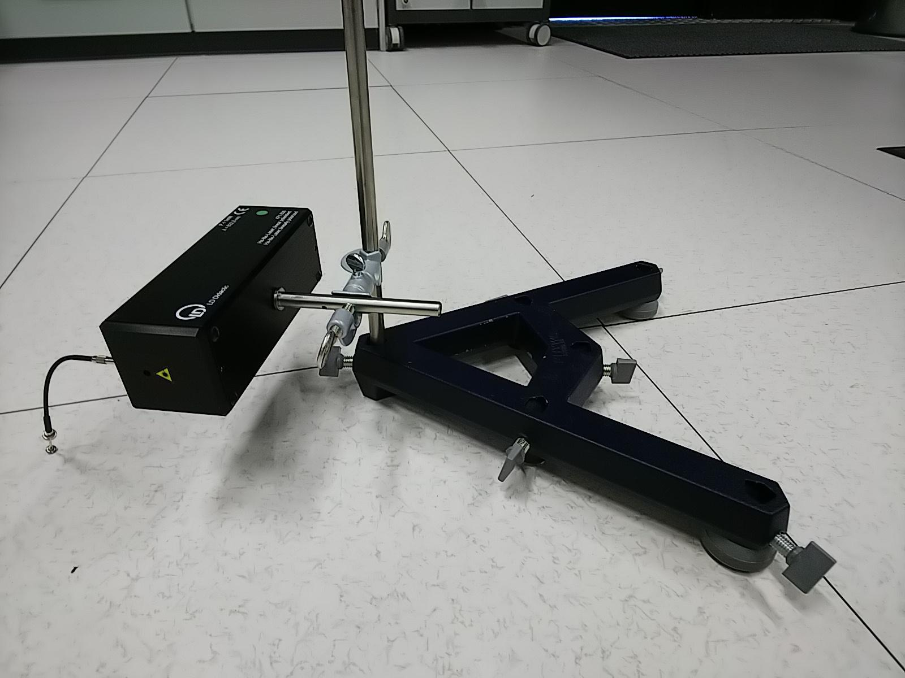
Set up

Slide 32
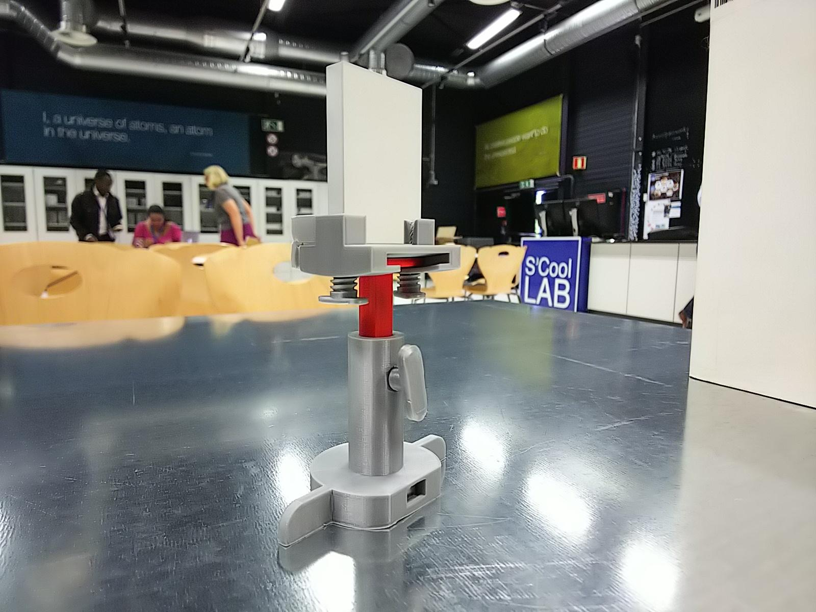
Set up
Nd Magnet

Slide 33
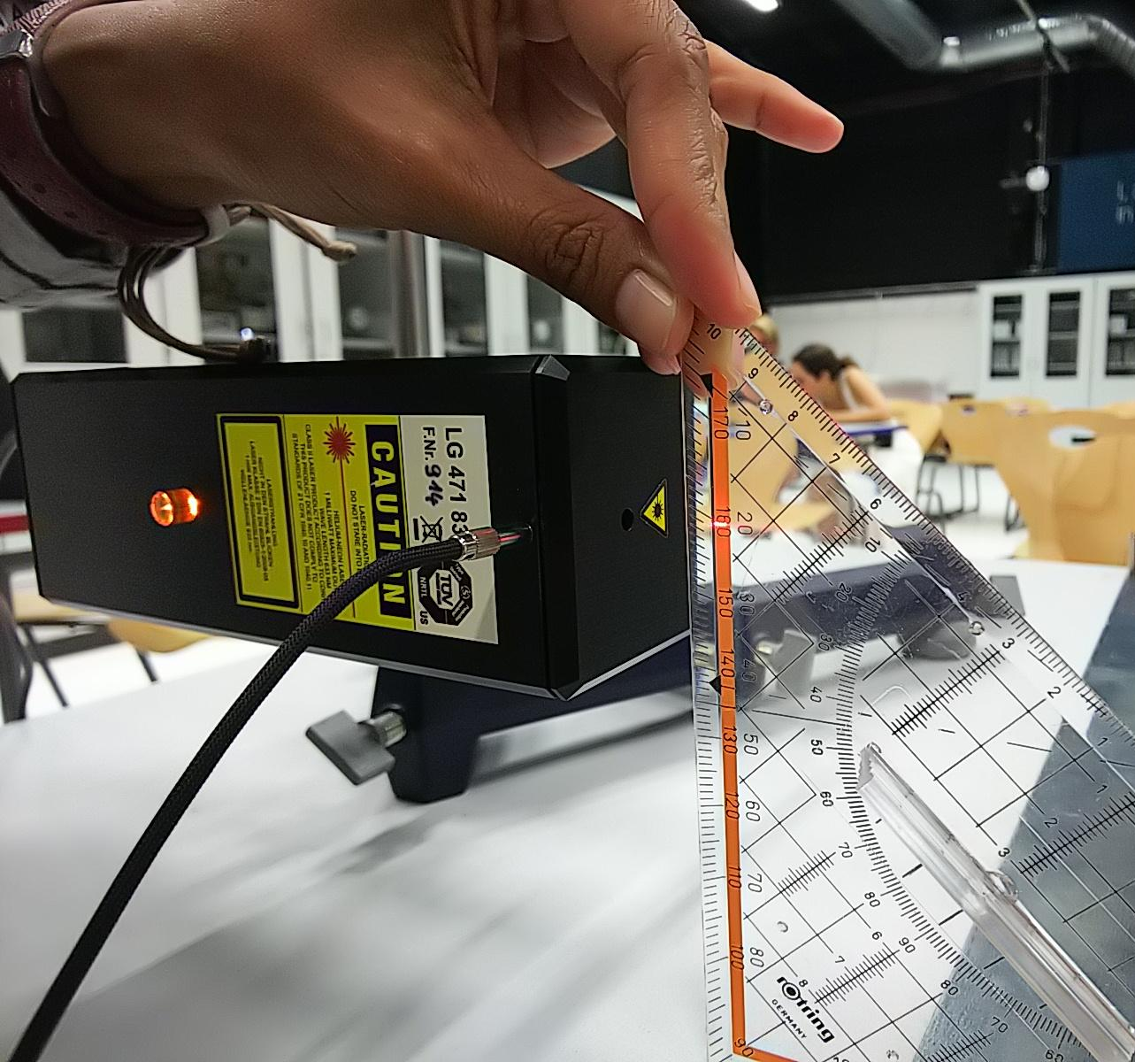
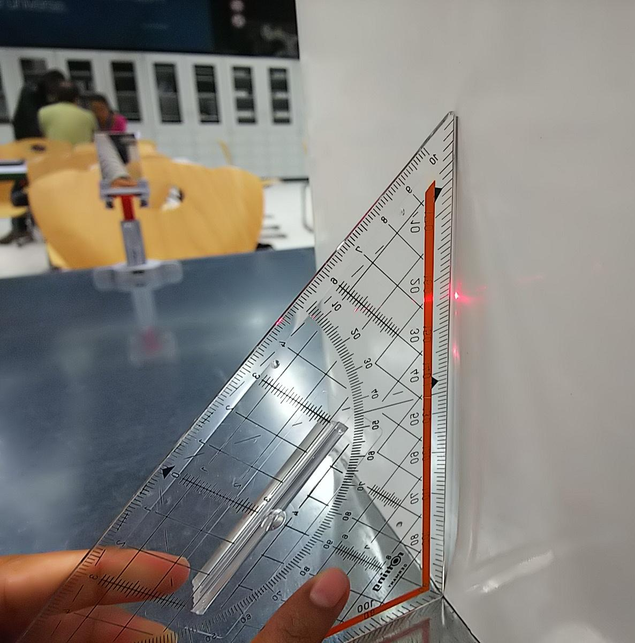
Set up (Alignment)

Slide 34
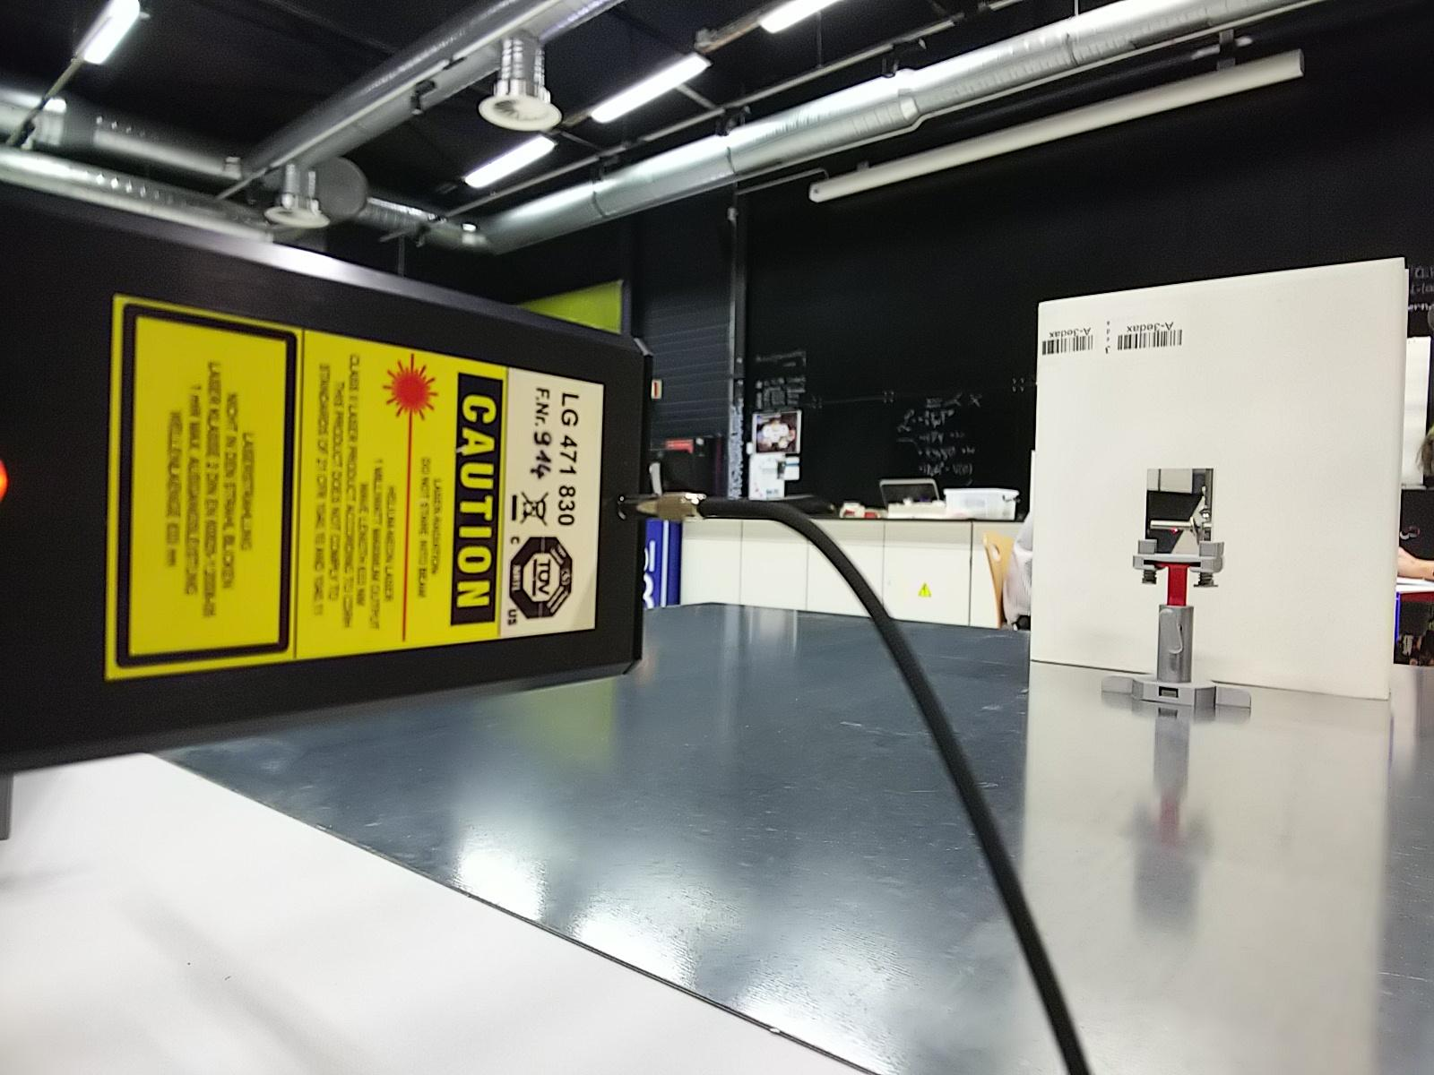
Set up (Alignment)

Slide 35
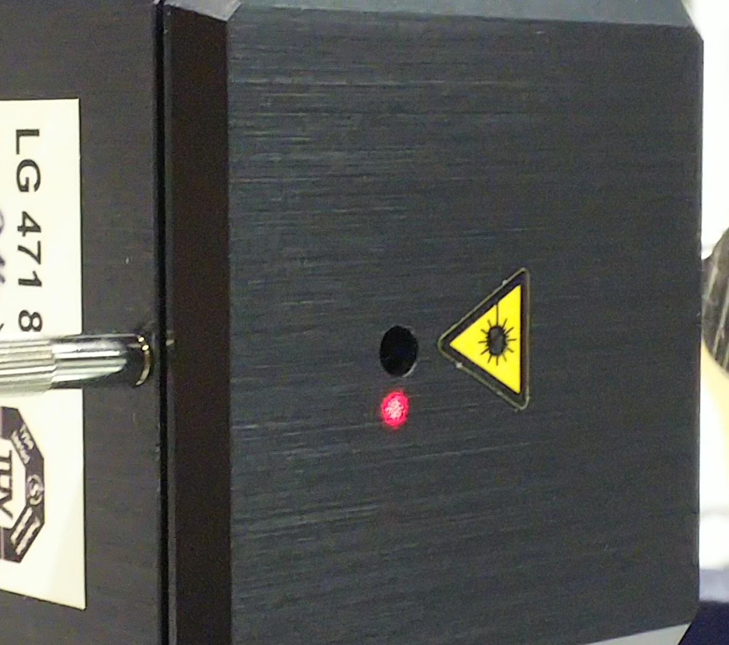
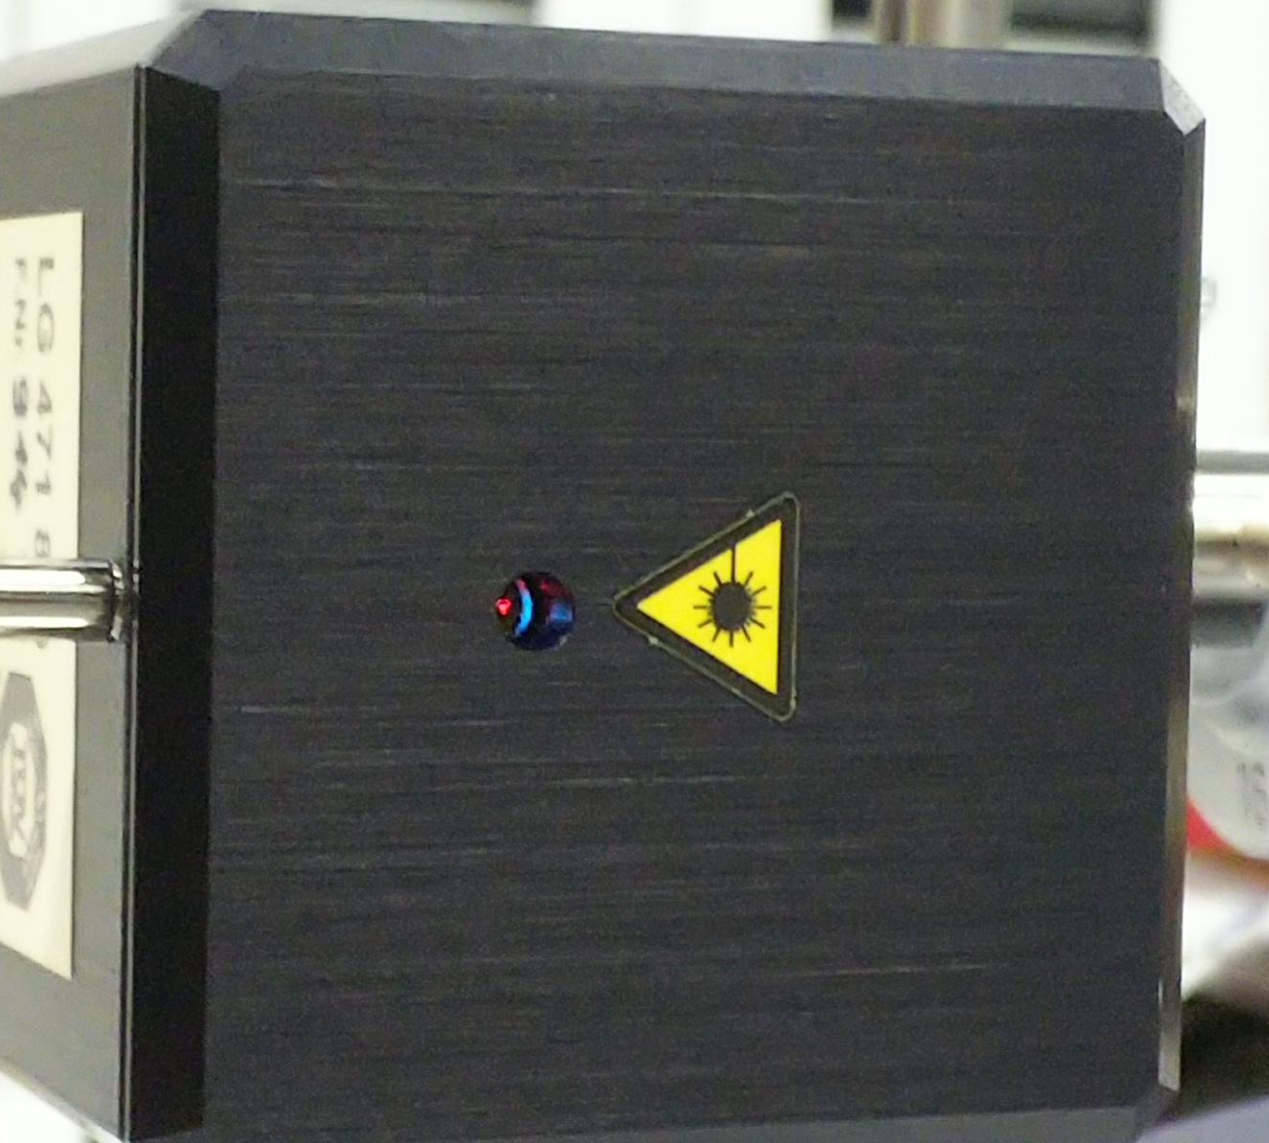
Set up (Alignment)
✖
✔

Slide 36
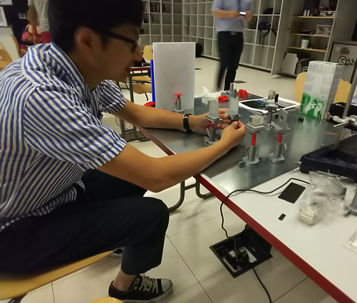
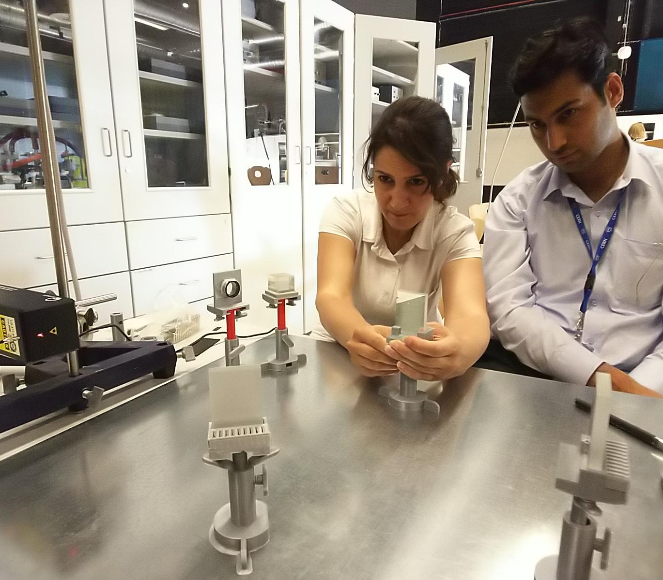
Set up (Alignment)

Slide 37
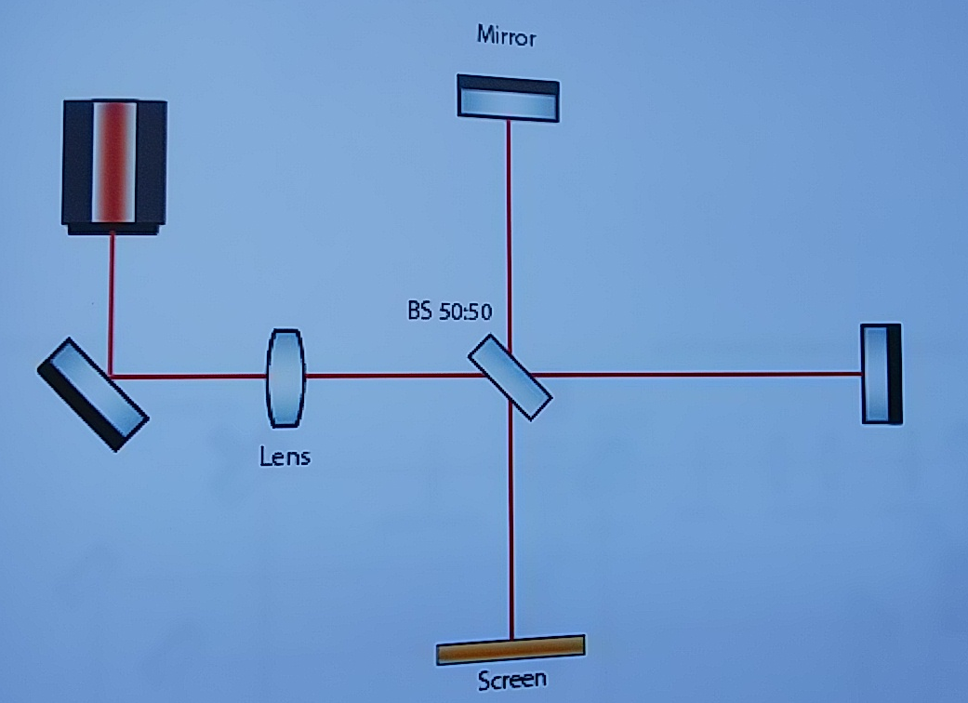
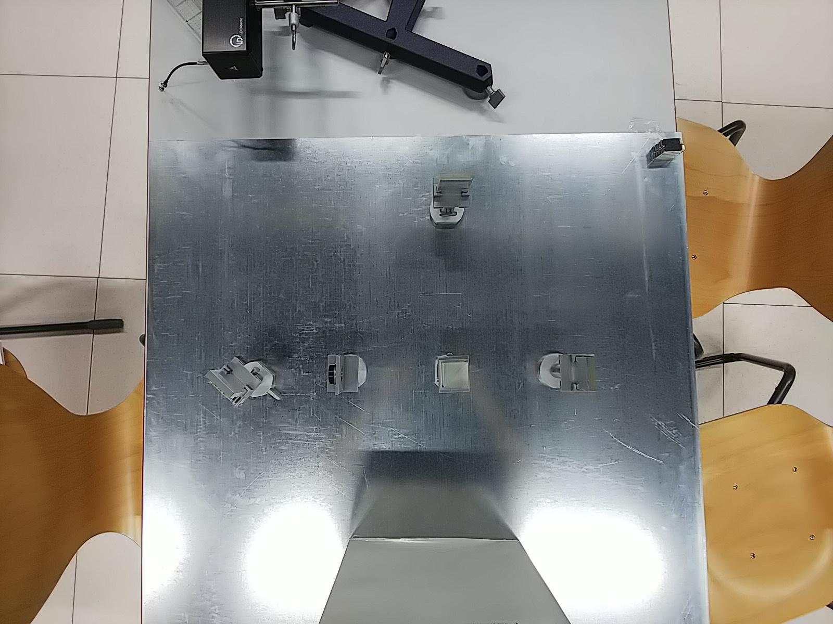
Set up

Slide 38






Analogy
Optical Interferometry = LHC
Red Laser (photon) = Proton
Mirrors = Dipoles
Lenses = Quadrapoles
Screen = Detector
Interference = Collision

Slide 39
Difficulties
To make sure that all beams are
in a line (need time)
The interference effect might
hard to produce or not to clear
to see

Slide 40
Limitations
Great amount of time (preparation and execution)
Big size class is not recommended
Need teacher’s supervision

Slide 41
Recommendation
It might be done at school, but...
Teachers should do some preparations of the experiments before handing it out to students (for example, set up the magnets and the holders).
For the base plate, it is better to use the grid one.
Make it clear to students that LHC is a complicated tool, thus what they get here is a simple analogy.

Slide 42

Thank you :)

