Slide 1

HL-LHC Cryogenics,
SPS-BA6 Cryogenic cooling capacities, and limits!
S. Claudet, K. Brodzinski (TE-CRG)
On behalf of WP9 team
TCC#33, 13 July 2017

Slide 2
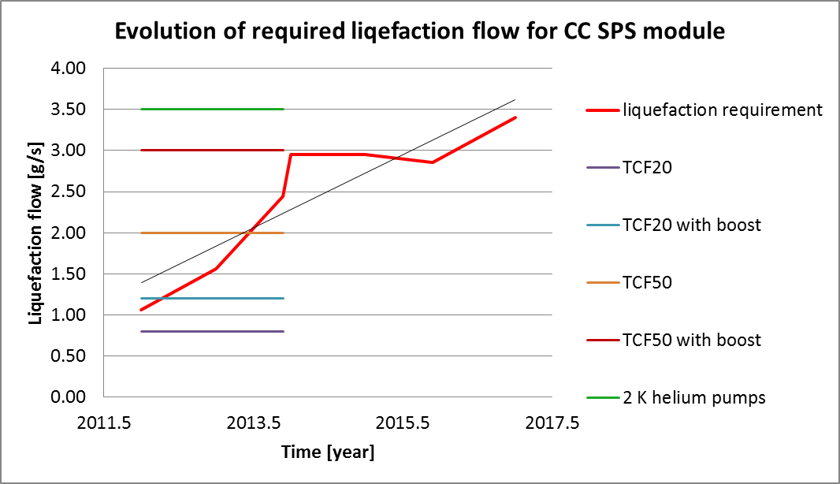
Heat load evolution
CC review 2017.04.04
Warning !
Factor 1.5 applied for contingency on needed flow
New 4.5 K cold box will have liquefaction capacity of ~7 g/s and will allow for using of full capacity of 2 K pumping units (~3.5 g/s @30 mbar) as well as to cover client and distribution heat load with safety factor of ~1.5.
Warning! No additional helium pumps can be added to the infrastructure respecting present planning and integration constraints.

Slide 3
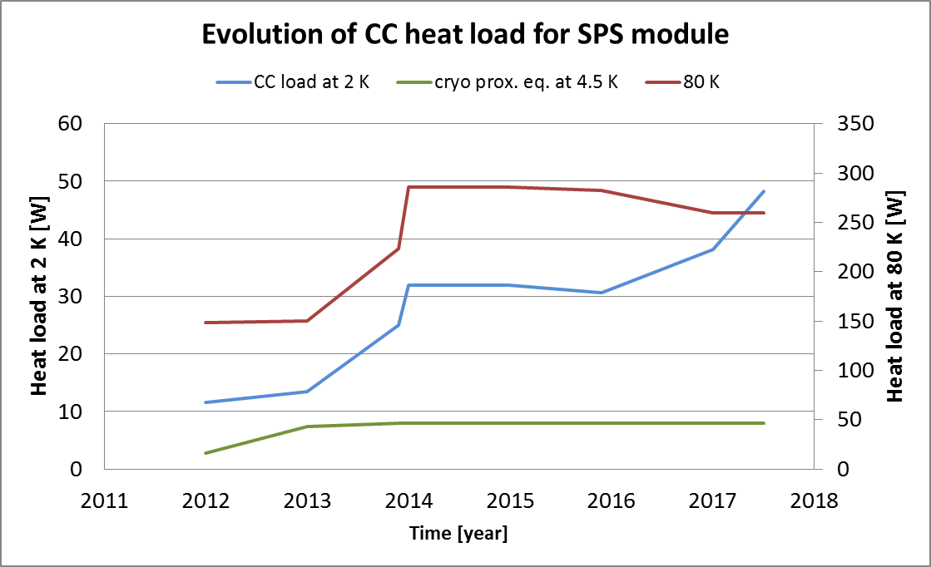
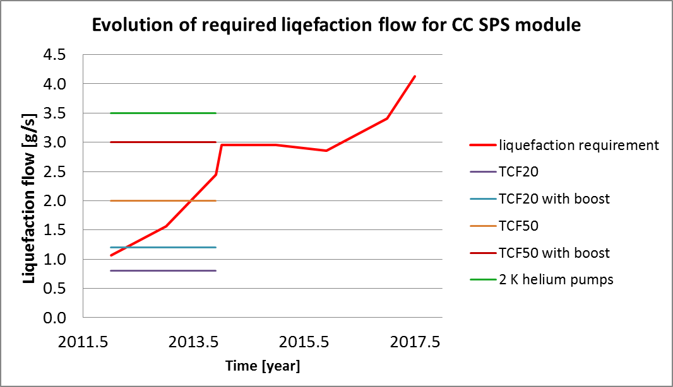
CC Heat load evolution
Limit for design
Factor 1.5 applied for contingency on needed flow
New 4.5 K cold box will have liquefaction capacity of ~7 g/s and will allow for using of full capacity of 2 K pumping units (~3.5 g/s @30 mbar) as well as to cover client and distribution heat load with safety factor of ~1.5.
No additional helium pumps can be added to the infrastructure respecting present planning and integration constraints.
Last increase of heat load by 5 W/cavity make an increase of total required 2 K flow above the design limits of the helium pumps. Operation above the limit of 3.5 g/s is not guaranteed and could be possible only if assumed theoretical heat load reflects precisely the reality or/and operation will be done at the higher temperature still keeping superfluid helium in the bath e.g. at 2.05 K. These solutions shall not be assumed now as standard approach to design and operation the system but should be kept as last security margin.

Slide 4
Target or design point would be appreciated (not only MV)
At least the maximum heat load considering all the other contributors “nominal” would help

