Slide 1
ECR for wire installation in IR1
A. Rossi on behalf of the whole team
TCC 13 July 2017

Slide 2
Motivation
Wire-in-jaw collimators for LRBB compensation
  First stage installation in IR5 during EYETS 2016-17
  First demonstration test 1 July 2017 (see G. Sterbini’s talk)
  Now complete the compensation scheme with installation in IR1 during YETS 2017-18

Slide 3
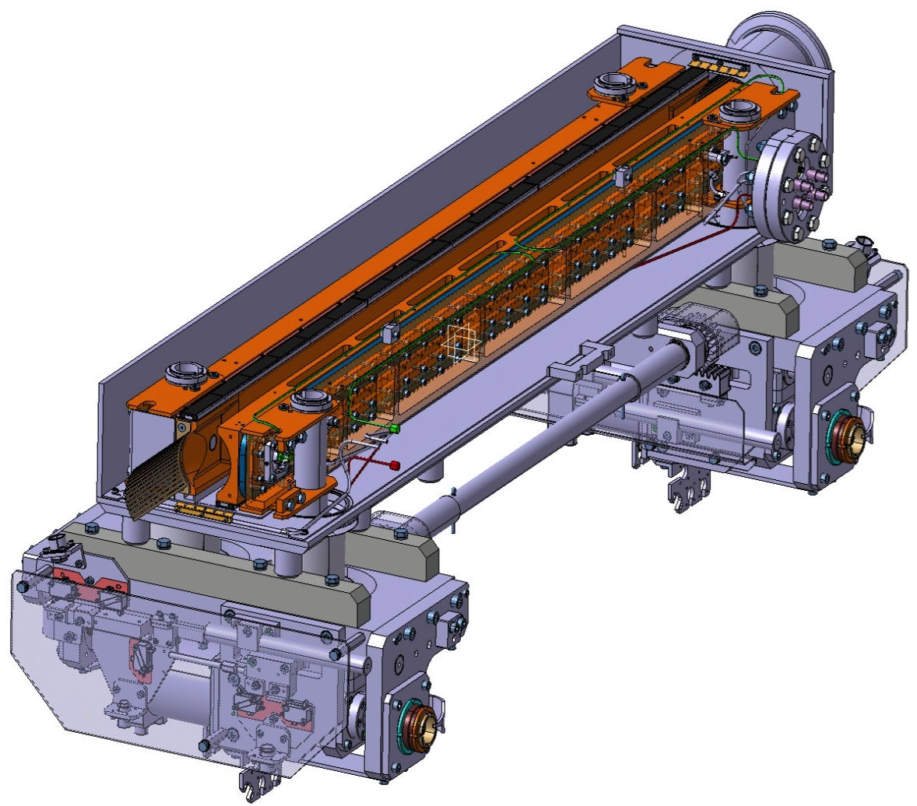
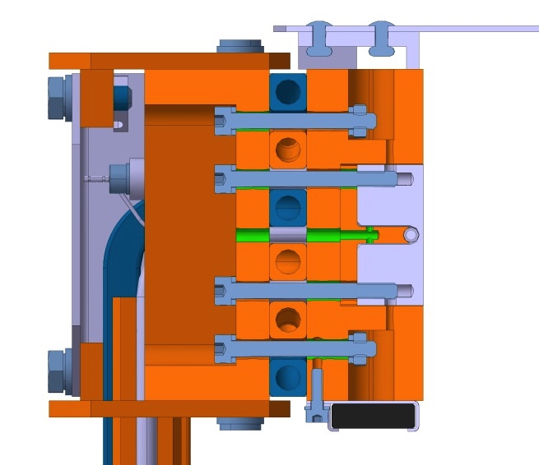
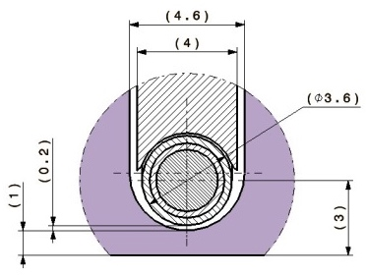
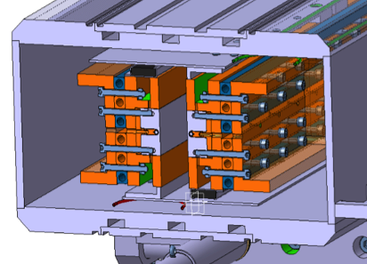
Recall of design of wire in-jaw collimator
Cooling pipes CuNi10
Vacuum tank
Tungsten inserts
(Inermet® IT180)
Jaws
Design:
Thin wire (Ø_{CU}≤ 2.5 mm)
In-jaw wire (depth ≤ 3 mm with positioning accuracy of ~0.1mm)
High DC current (up to 350 A)
Maintain TCTP complete functionality!
BBLRC wire
Glidcop “T” support
Glidcop Al-15 housing and back stiffener
L= 1000 mm
3mm
O. Aberle EN-STI
L. Gentini – CERN (EN-MME)

Slide 4
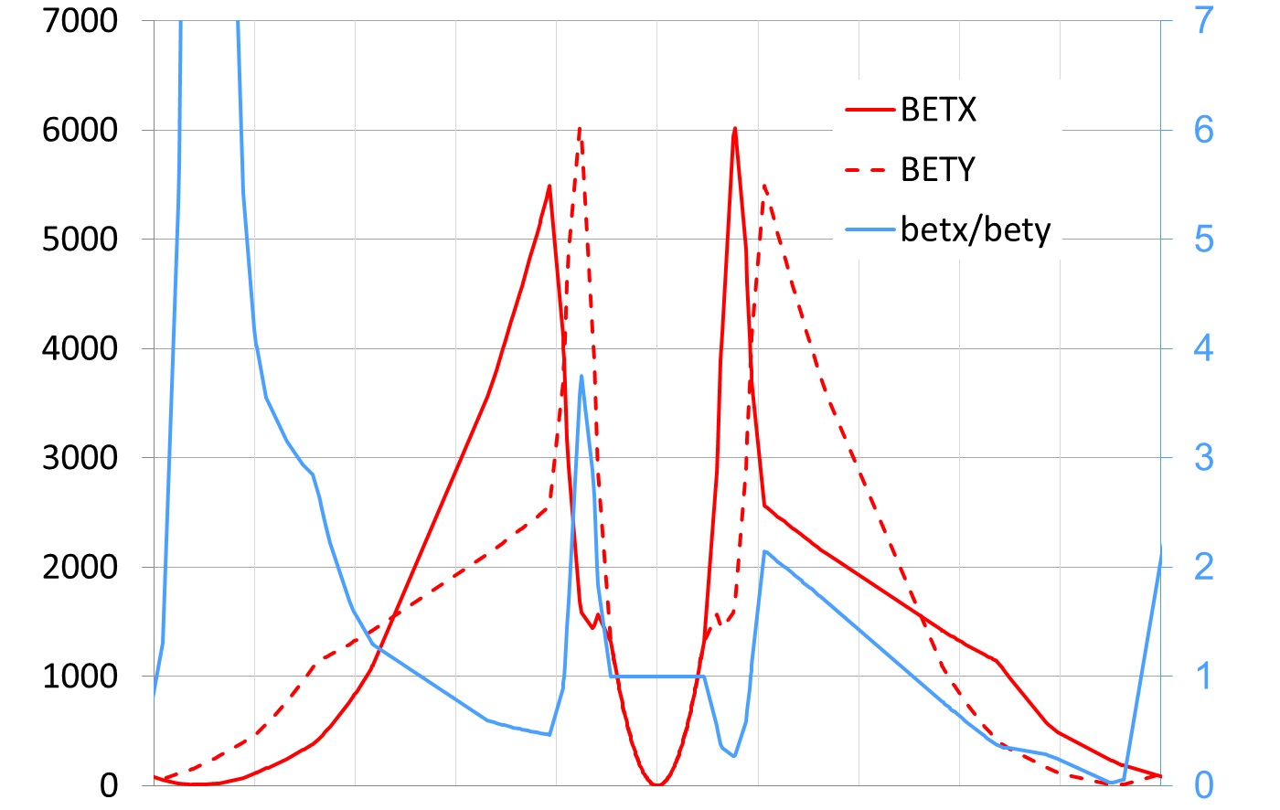
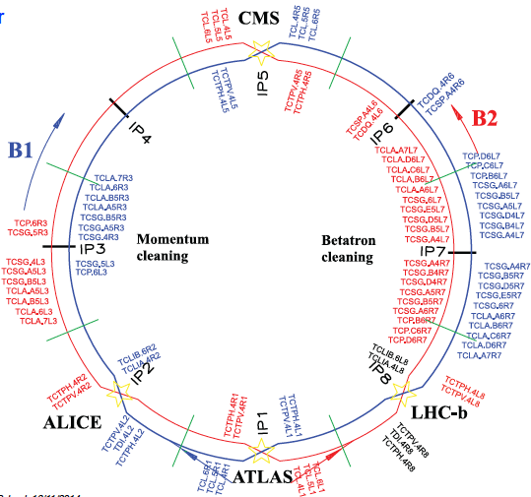
LHC – optics RunII 2017 – collision round 40cm
Vertical collimator require for compensation in Xing plane of IR1
TCL (outgoing beam) only horizontal, need of new slot loss in symmetry
Optimal wire position for LHC at beta ratio β_{𝒙}/β_{𝒚}~1.8 (or 1/1.8)
[S. Fartoukh, 10.1103/PhysRevSTAB.18.121001]
B2
beta (m)
ratio
-250 -200 -150 -100 -50 0 50 100 150 200 250
distance from IP1/5 (m)

Slide 5
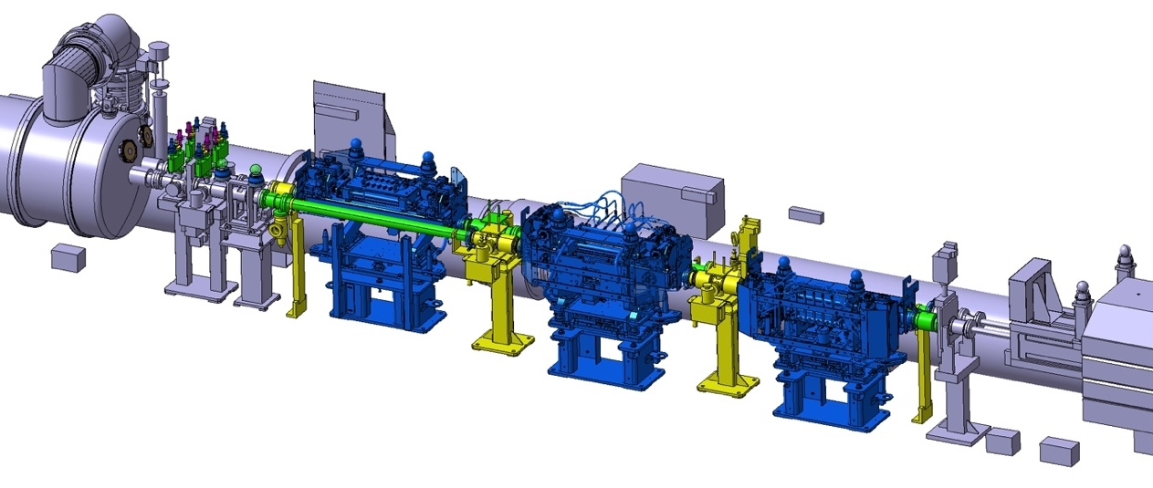
Replacement of TCTPV.4R1.B2
Installation requires replacement of the existing vertical collimator
Wire connections (junction box to 400mm² cables + wire voltage)
D1
TCL
TAN
TCTPH
TCTPV.4R1.B2

Slide 6
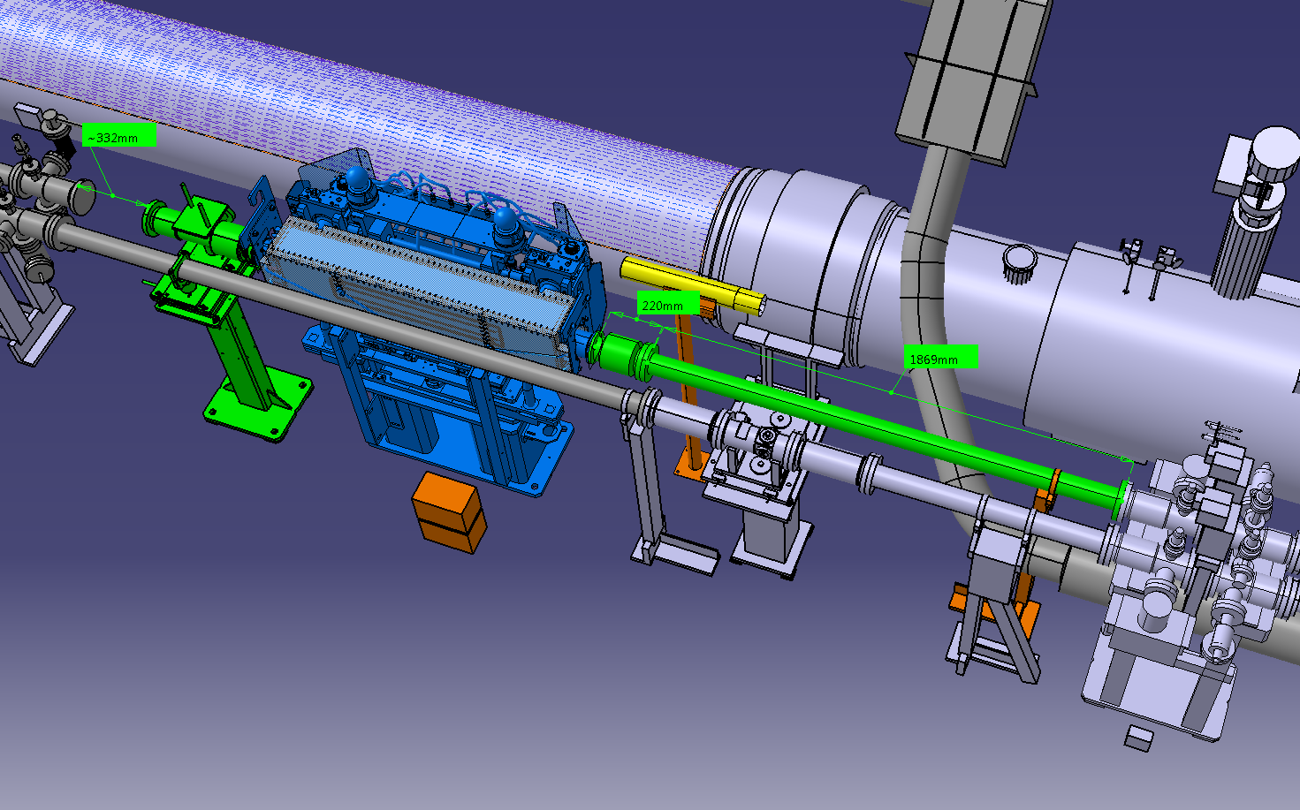
5L1 with new vertical collimator
- 176.17 m
Q4
E. Page

Slide 7
5L1 with new vertical collimator
The installation requires :
1 new vertical collimator including 2 pick-ups (+ cabling and rack space), already built and tested.
2 new NEG cambers VCDAN and VCD__ to be fabricated.
1 new VAMTB (= 1 new ion pump + cabling and rack space) – spare available, to be replaced
1 new bellow module VMTBA allowing for the 5th axis movement – spare available, to be replaced.
Necessary supports.
1 new BLM (cabling and rack space), to be confirmed
New water cooling tapping.

Slide 8
Thank you

Slide 9
LHC – optics RunII 2016 – collision round 40cm
Optimal wire position for LHC at beta ratio β_{𝒙}/β_{𝒚}~1.8 (or 1/1.8)
[S. Fartoukh, 10.1103/PhysRevSTAB.18.121001]
B2
beta (m)
ratio
distance from IP1/5 (m)

